Slide 1
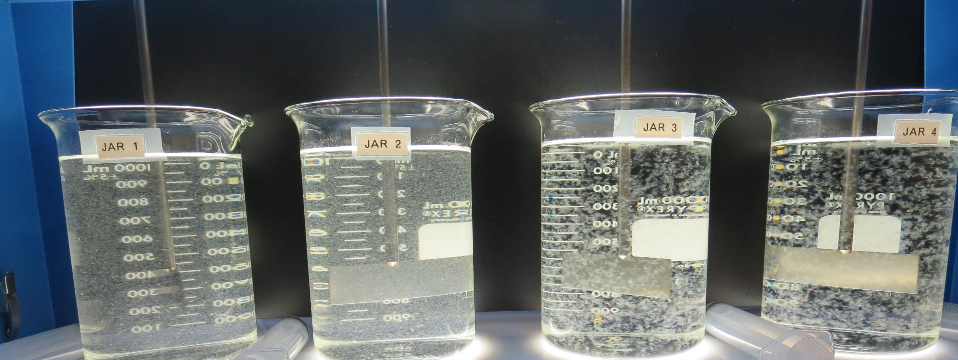
Lucerne Water Co., CA Water Service CA1710005 Lake County Jar Test
by Guy Schott, P.E.
March 5, 2020

Slide 2
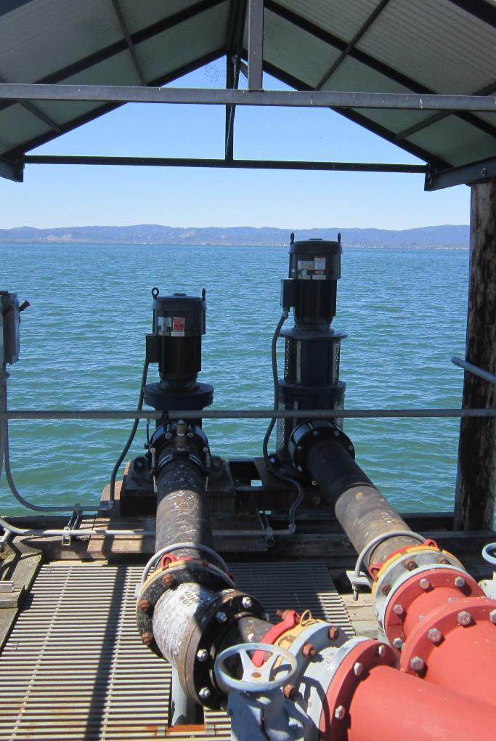
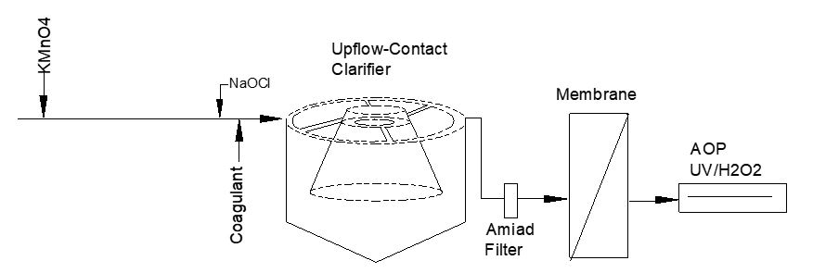
Lucerne Water Co. Source Water: Clear Lake Conventional Treatment

Slide 3
Lucerne Water Co. Characteristics March 4, 2020
Source
Turbidity: 5.17 NTU
pH: 8.15
UVT: 84.8%, UVA: 0.071/cm
0.4 um Filtered
Turbidity: 0.24 NTU
UVT: 88.4%, UVA: 0.053/cm
Post Membrane, Pre-Chlorine: 0.05 NTU
UVT: 94.1%, UVA: 0.026/cm
UVA Reduction: 50.9%
Post Membrane, Post-Chlorine: 0.05 NTU
UVT: 95.8%, UVA: 0.018/cm
UVA Reduction: 66%

Slide 4
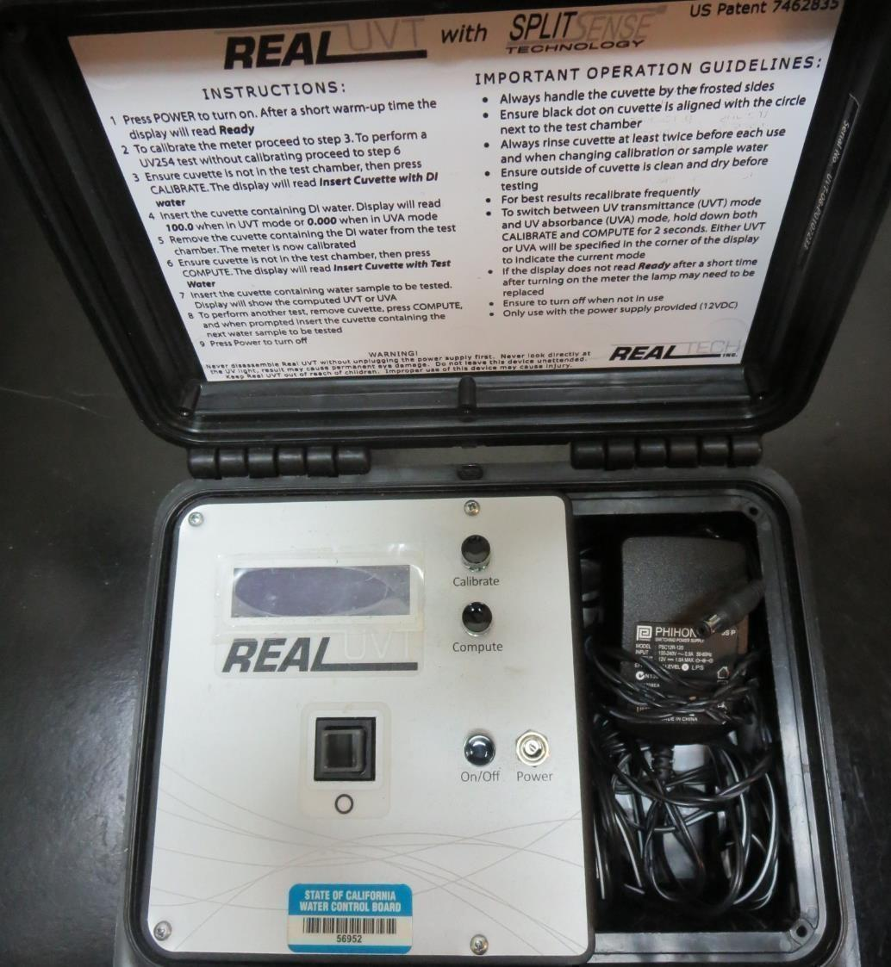
UVT/UVA, pathlength 10 mm
UV transmittance (UVT) is a measurement of the amount of ultraviolet light (commonly at 254 nm due to its germicidal effect) that passes through a water sample compared to the amount of light that passes through a pure water sample. The measurement is expressed as a percentage, % UVT.
%UVT = 10^{(-UVA)} x 100%
UV absorbance (UVA) is calculated as a relative measure of the amount of light absorbed by a water sample compared with the amount of light absorbed by a pure water sample.
UVA = -log(%UVT/100)

Slide 5
Applied Coagulants for Jar Testing
Pro Pac 9800 (NTU Technologies)
50% Aluminum Chlorohydrate (ACH)
50% Water
SG = 1.34
7066 (Garratt Callahan)
10 – 30% Poly Aluminum Hydroxychloride Sulfate
50% Basicity
SG = 1.2

Slide 6
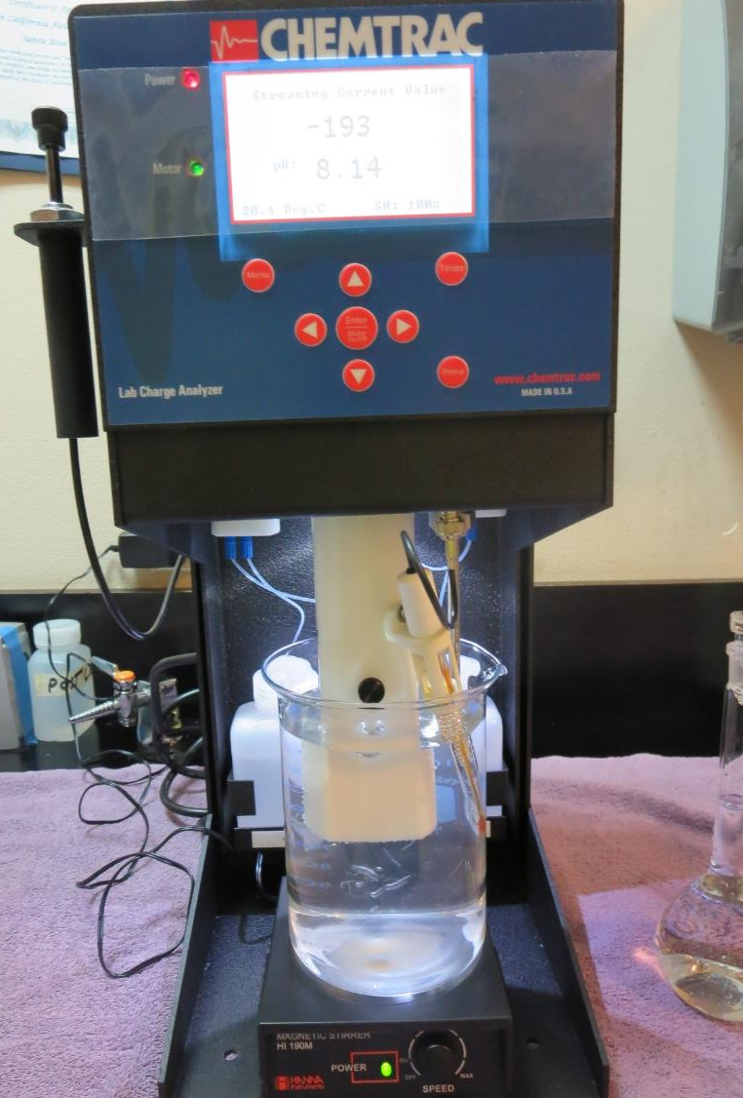
Laboratory Charge Analyzer
LCA: Used to determine coagulant demand of a source water entering the treatment plant.
Source pH: 8.15
LCA #1:
9800: 20 mg/L as product
pH adjusted to 7.50 with acetic acid
LCA #2:
7066: 116 mg/L
pH adjusted to 7.50 with acetic acid

Slide 7
Coagulant Information
Unless stated otherwise, all coagulant doses are reported as Product (100% strength).
Preparation of coagulant stock solutions are generally 1.0 and/or 0.1 percent strength using 100 and/or 200 mL volumetric flasks.
Finnpipette F2 variable volume pipette, capacity 100-1000 micro liters is used for stock solution preparation and coagulant aid jar test dosing.
Finnpipette F2 variable volume pipette, capacity 0.5-5 mL is used for primary coagulant jar test dosing.

Slide 8
Lucerne Water Co., Jar Test 1 - 8 Results Flash Mix 200 RPM for 30 Seconds
Jar# | 30 RPM Floc Mix min | 9800 mg/L | Filtrate NTU | Filtrate %UVT | Filtrate UVA/cm | %UVA Reduction | Settle NTU 10 min | Settle NTU 25 min
J1 | 5 | 18 | 0.11 | 91.9 | 0.036 | 32.1 | 0.57 | 0.48
J2 | 5 | 20 | 0.08 | 91.9 | 0.036 | 32.1 | 0.63 | 0.50
J3 | 5 | 22 | 0.07 | 92.0 | 0.036 | 32.1 | 0.50 | 0.44
J4 | 5 | 24 | 0.08 | 92.3 | 0.034 | 35.8 | 0.59 | 0.38
J5 | 5 | 26 | 0.08 | 92.8 | 0.032 | 39.6 | 0.76 | 0.40
J6 | 5 | 28 | 0.07 | 92.9 | 0.031 | 41.5 | 0.51 | 0.34
J7 | 5 | 30 | 0.08 | 92.8 | 0.032 | 39.6 | 0.55 | 0.47
J8 | 5 | 32 | 0.07 | 92.9 | 0.031 | 41.5 | 0.70 | 0.34

Slide 9
Lucerne Water Co., Jar Test 9 - 16 Results Flash Mix 200 RPM for 30 Seconds
Jar# | 30 RPM Floc Mix min | 7066 mg/L | Filtrate NTU | Filtrate %UVT | Filtrate UVA/cm | %UVA Reduction | Settle NTU 10 min | Settle NTU 25 min
J9 | 5 | 100 | 0.09 | 92.2 | 0.035 | 34.0 | 0.29 | 0.29
J10 | 5 | 110 | 0.09 | 92.4 | 0.034 | 35.8 | 0.28 | 0.30
J11 | 5 | 120 | 0.08 | 92.7 | 0.032 | 39.6 | 0.30 | 0.29
J12 | 5 | 130 | 0.07 | 92.8 | 0.032 | 39.6 | 0.28 | 0.23
J13 | 5 | 140 | 0.07 | 93.3 | 0.030 | 43.4 | 0.22 | 0.21
J14 | 5 | 150 | 0.07 | 93.4 | 0.029 | 45.3 | 0.30 | 0.28
J15 | 5 | 160 | 0.07 | 93.6 | 0.028 | 47.2 | 0.28 | 0.28
J16 | 5 | 170 | 0.06 | 93.8 | 0.027 | 49.1 | 0.25 | 0.21

Slide 10
Lucerne Water Co., Jar Test 17 - 20 Results Flash Mix 200 RPM (30 sec), Floc 30 RPM (5 min)
Jar # | 9800 mg/L | 7066 mg/L | Filtrate NTU | Filtrate %UVT | Filtrate UVA/cm | %UVA Reduction | Settle NTU 10 min | Settle NTU 25 min
J17 | 75 | 0 | 0.07 | 93.5 | 0.029 | 45.3 | 0.59 | 0.33
J18 | 80 | 0 | 0.09 | 93.3 | 0.030 | 43.4 | 0.41 | 0.34
J19 | 0 | 180 | 0.07 | 92.7 | 0.032 | 39.6 | 0.28 | 0.31
J20 | 0 | 190 | 0.06 | 92.9 | 0.031 | 41.5 | 0.19 | 0.19

Slide 11
Lucerne Water Co., Jar Test 21 - 22 Results Flash Mix 200 RPM (30 sec), Floc 30 RPM (5 min)
Jar # | KMnO₄ mg/L | 9800 mg/L | Filtrate NTU | Filtrate %UVT | Filtrate UVA/cm | %UVA Reduction | Settle NTU 10 min | Settle NTU 25 min
J21 | 0 | 80 | 0.06 | 93.3 | 0.030 | 43.4 | 0.54 | 0.44
J22 | 0.4 | 80 | 0.09 | 93.5 | 0.029 | 45.3 | 0.64 | 0.51

Slide 12
Lucerne Water Co., Jar Test 23 - 24 Results Flash Mix 200 RPM (30 sec), Floc 30 RPM (5 min)
Jar # | KMnO₄ mg/L | 7066 mg/L | Filtrate NTU | Filtrate %UVT | Filtrate UVA/cm | %UVA Reduction | Settle NTU 10 min | Settle NTU 25 min
J23 | 0 | 200 | 0.06 | 93.1 | 0.030 | 43.4 | 0.22 | 0.21
J24 | 0.4 | 200 | 0.06 | 93.3 | 0.029 | 45.3 | 0.22 | 0.18

Slide 13
Lucerne Water Co., Jar Test 25 - 28 Results Flash Mix 200 RPM for 30 Seconds
Jar# | 30 RPM Floc Mix min | 7066 mg/L | Filtrate NTU | Filtrate %UVT | Filtrate UVA/cm | %UVA Reduction | Settle NTU 10 min | Settle NTU 25 min
J25 | 5 | 220 | 0.06 | 93.3 | 0.030 | 43.4 | 0.16 | 0.16
J26 | 5 | 240 | 0.06 | 93.3 | 0.030 | 45.3 | 0.17 | 0.17
J27 | 5 | 260 | 0.06 | 93.5 | 0.029 | 43.4 | 0.27 | 0.21
J28 | 5 | 280 | 0.06 | 93.7 | 0.028 | 45.3 | 0.16 | 0.17

Slide 14
Jars 1-4 Test Flash Mix 30 Sec (200 RPM) Floc Mix 5 min (30 RPM) Applied Coagulant 9800

Slide 15
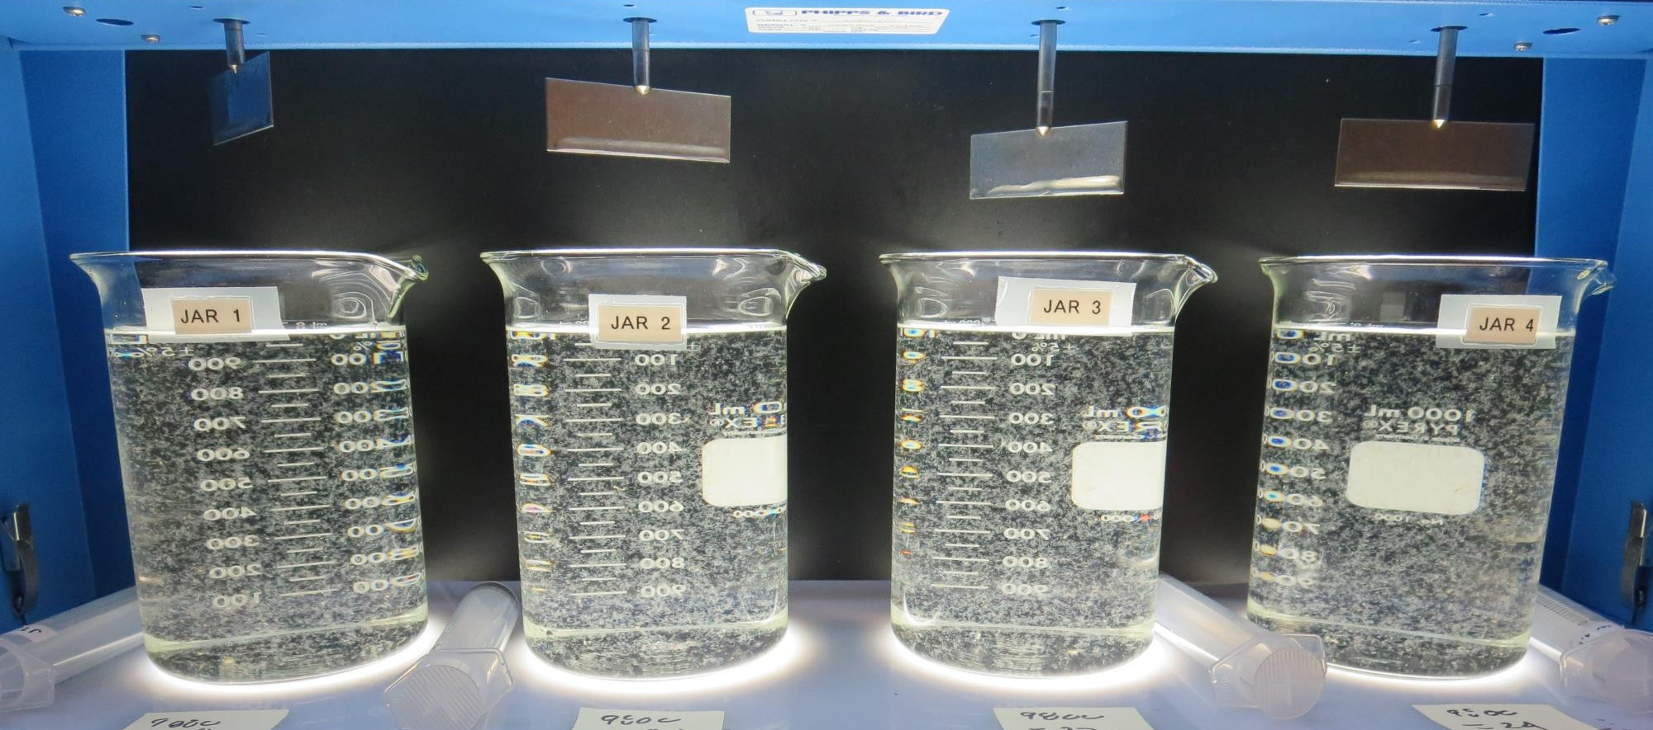
Jars 1-4: End of 5-minute flocculation (30 RPM) duration.
18 mg/L 9800
Filtrate 0.11 NTU
UVT: 91.9%
UVA: 0.036/cm
UVA Reduction 32.1%
Settled: 0.48 NTU
20 mg/L 9800
Filtrate 0.08 NTU
UVT: 91.9%
UVA: 0.036/cm
UVA Reduction 32.1%
Settled: 0.50 NTU
22 mg/L 9800
Filtrate 0.07 NTU
UVT: 92.0%
UVA: 0.036/cm
UVA Reduction 32.1%
Settled: 0.44 NTU
24 mg/L 9800
Filtrate 0.08 NTU
UVT: 92.3%
UVA: 0.034/cm
UVA Reduction 35.8%
Settled: 0.38 NTU

Slide 16
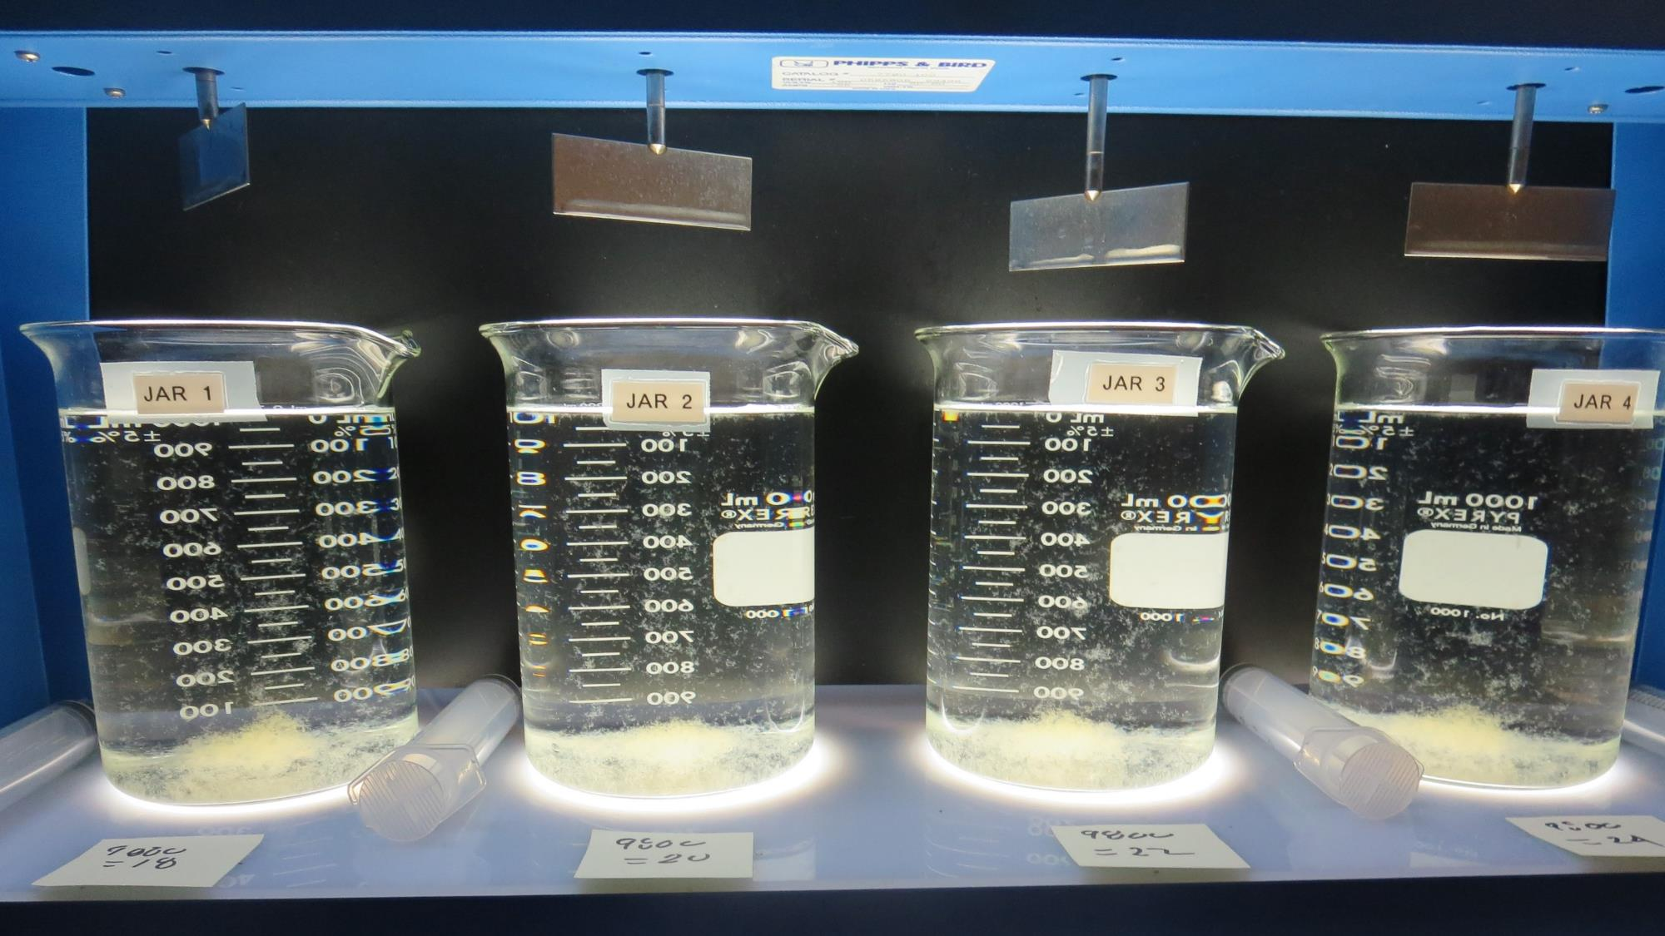
Jars 1-4: After 5 min of settling, 25 mL is syringed for filterability and %UVT/UVA.

Slide 17
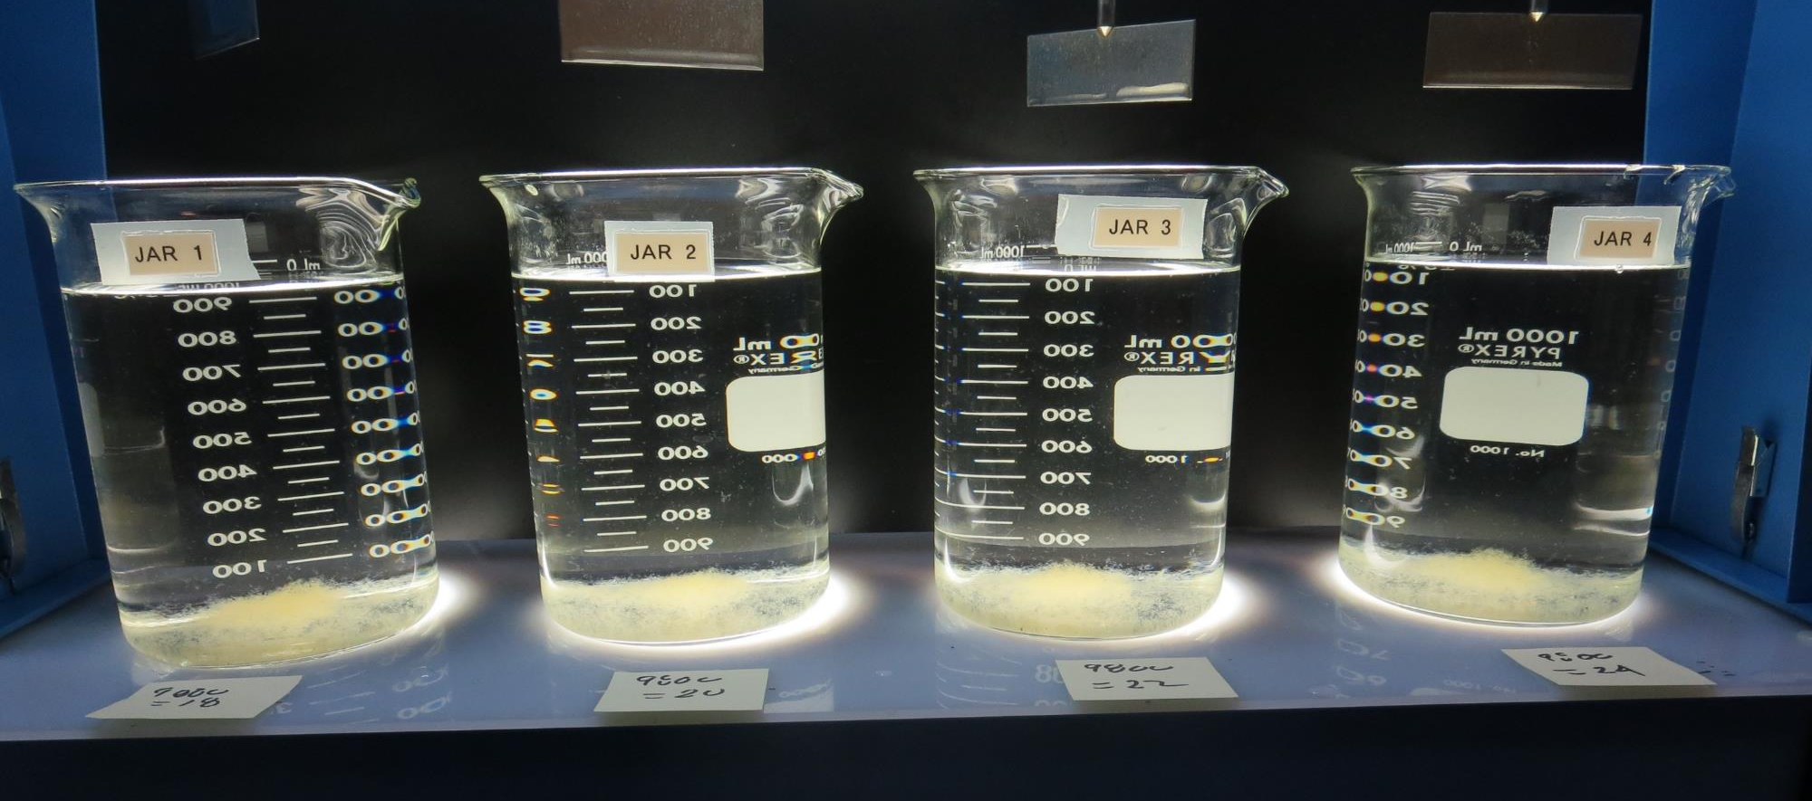
Jars 1-4: After 25-minutes of settling, settled water turbidity is taken.
18 mg/L 9800
Filtrate 0.11 NTU
UVT: 91.9%
UVA: 0.036/cm
UVA Reduction 32.1%
Settled: 0.48 NTU
20 mg/L 9800
Filtrate 0.08 NTU
UVT: 91.9%
UVA: 0.036/cm
UVA Reduction 32.1%
Settled: 0.50 NTU
22 mg/L 9800
Filtrate 0.07 NTU
UVT: 92.0%
UVA: 0.036/cm
UVA Reduction 32.1%
Settled: 0.44 NTU
24 mg/L 9800
Filtrate 0.08 NTU
UVT: 92.3%
UVA: 0.034/cm
UVA Reduction 35.8%
Settled: 0.38 NTU

Slide 18
Jars 5-8 Test Flash Mix 30 Sec (200 RPM) Floc Mix 5 min (30 RPM) Applied Coagulant 9800

Slide 19
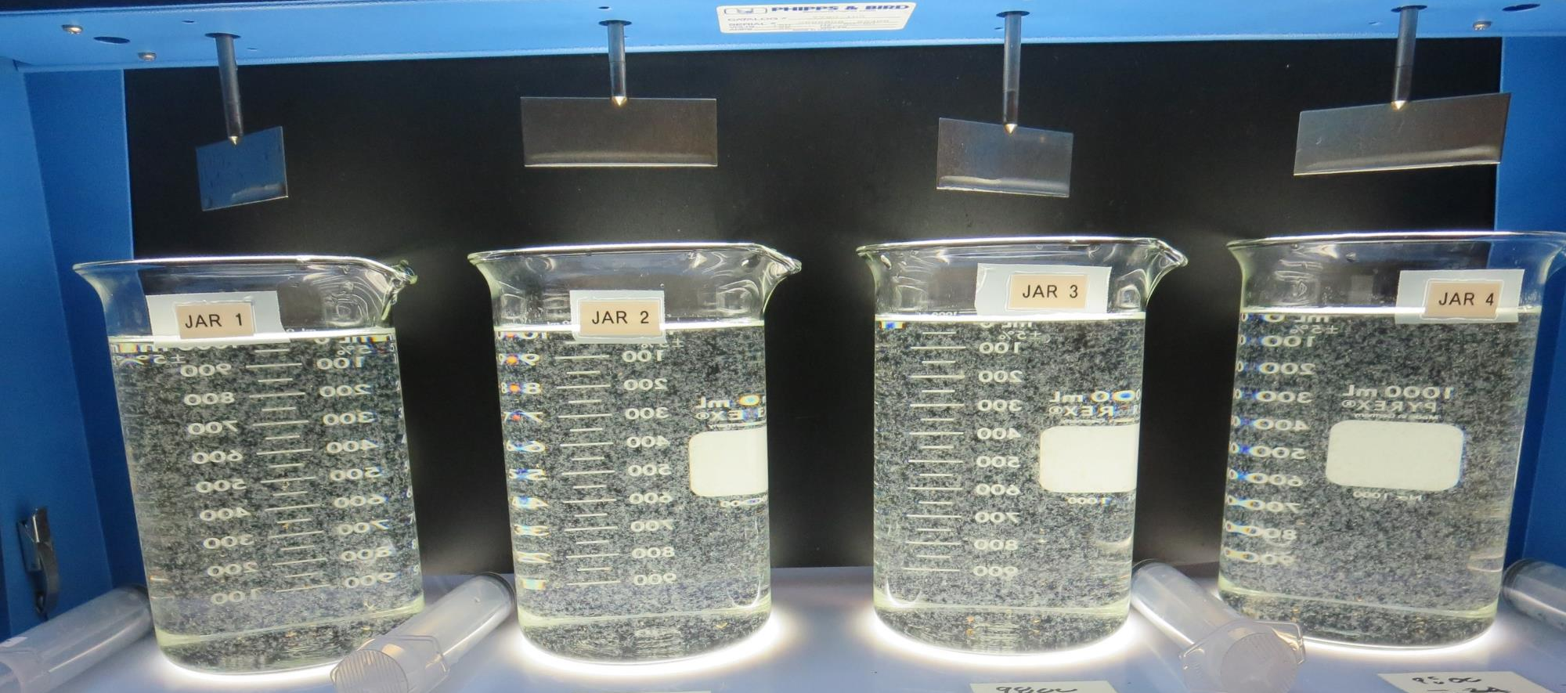
Jars 5-8: End of 5-minute flocculation (30 RPM) duration.

Slide 20
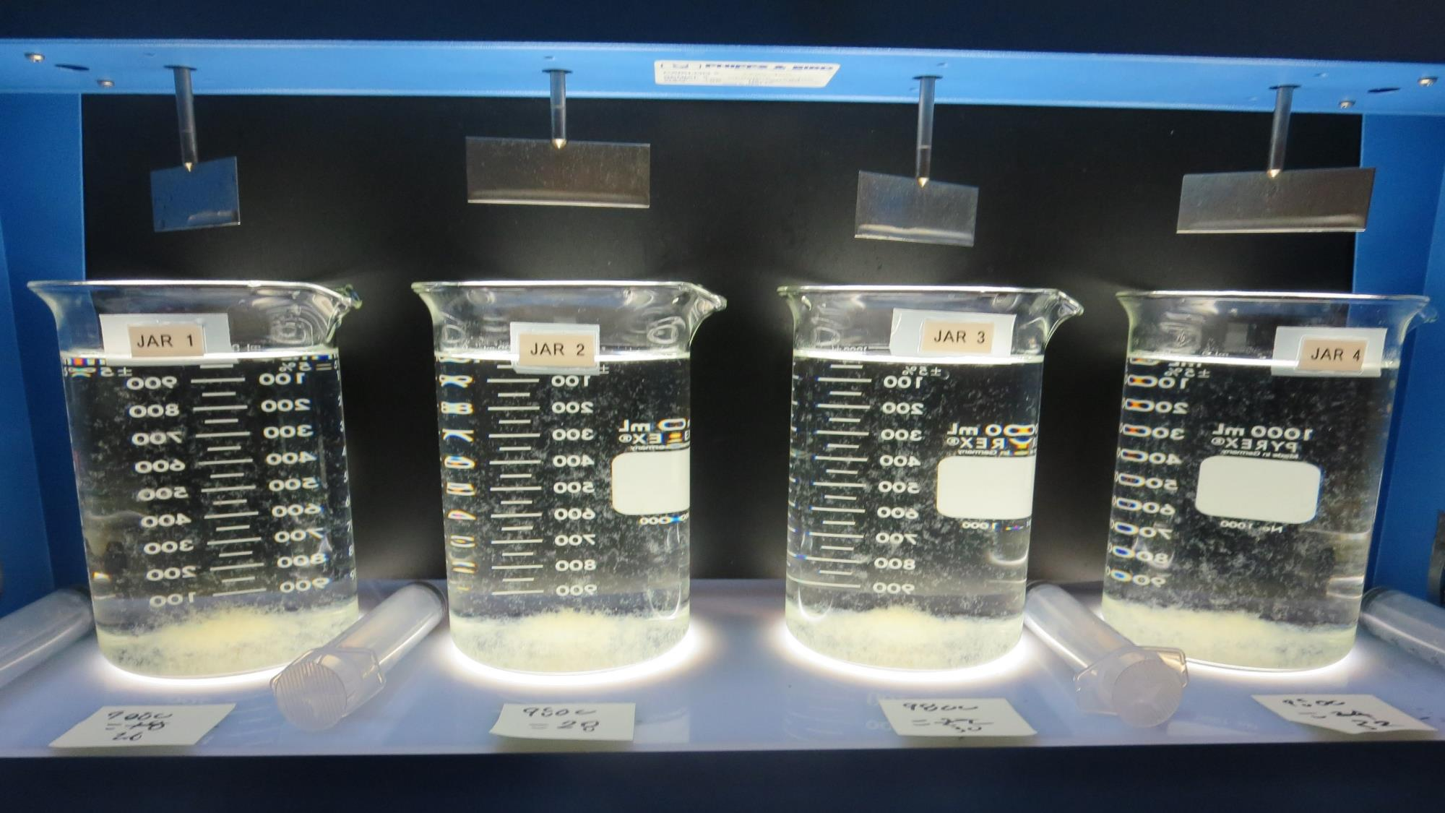
Jars 5-8: After 5 min of settling, 25 mL is syringed for filterability and %UVT/UVA.

Slide 21
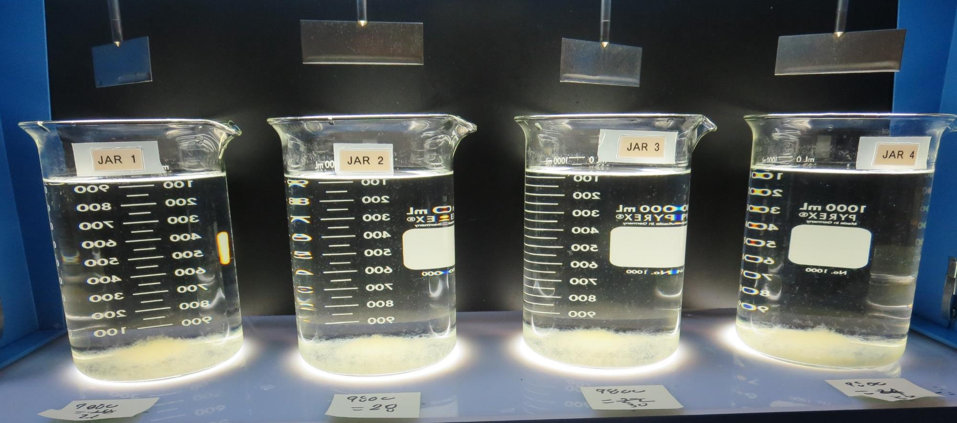
Jars 5-8: After 25-minutes of settling, settled water turbidity is taken.
26 mg/L 9800
Filtrate 0.08 NTU
UVT: 92.8%
UVA: 0.032/cm
UVA Reduction 39.6%
Settled: 0.40 NTU
28 mg/L 9800
Filtrate 0.07 NTU
UVT: 92.9%
UVA: 0.031/cm
UVA Reduction 41.5%
Settled: 0.34 NTU
30 mg/L 9800
Filtrate 0.08 NTU
UVT: 92.8%
UVA: 0.032/cm
UVA Reduction 39.6%
Settled: 0.47 NTU
32 mg/L 9800
Filtrate 0.07 NTU
UVT: 92.9%
UVA: 0.031/cm
UVA Reduction 41.5%
Settled: 0.34 NTU

Slide 22
Jars 9-12 Test Flash Mix 30 Sec (200 RPM) Floc Mix 5 min (30 RPM) Applied Coagulant 7066

Slide 23
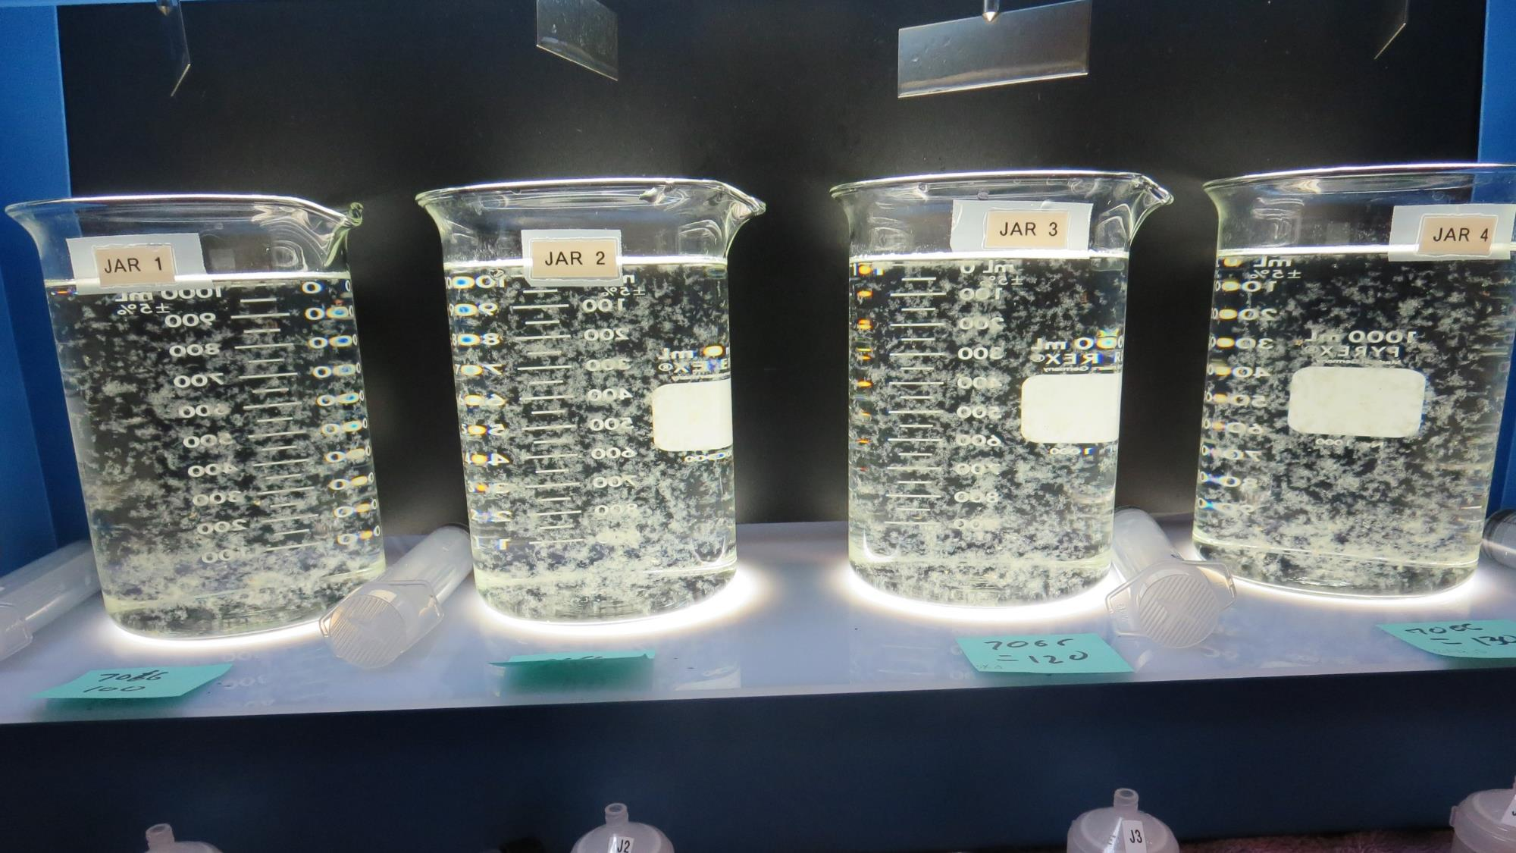
Jars 9-12: End of 5-minute flocculation (30 RPM) duration.
100 mg/L 7066
Filtrate 0.09 NTU
UVT: 92.2%
UVA: 0.035/cm
UVA Reduction 34%
Settled: 0.29 NTU
110 mg/L 7066
Filtrate 0.09 NTU
UVT: 92.4%
UVA: 0.034/cm
UVA Reduction 35.8%
Settled: 0.30 NTU
120 mg/L 7066
Filtrate 0.08 NTU
UVT: 92.7%
UVA: 0.032/cm
UVA Reduction 39.6%
Settled: 0.29 NTU
130 mg/L 7066
Filtrate 0.07 NTU
UVT: 92.8%
UVA: 0.032/cm
UVA Reduction 39.6%
Settled: 0.23 NTU

Slide 24
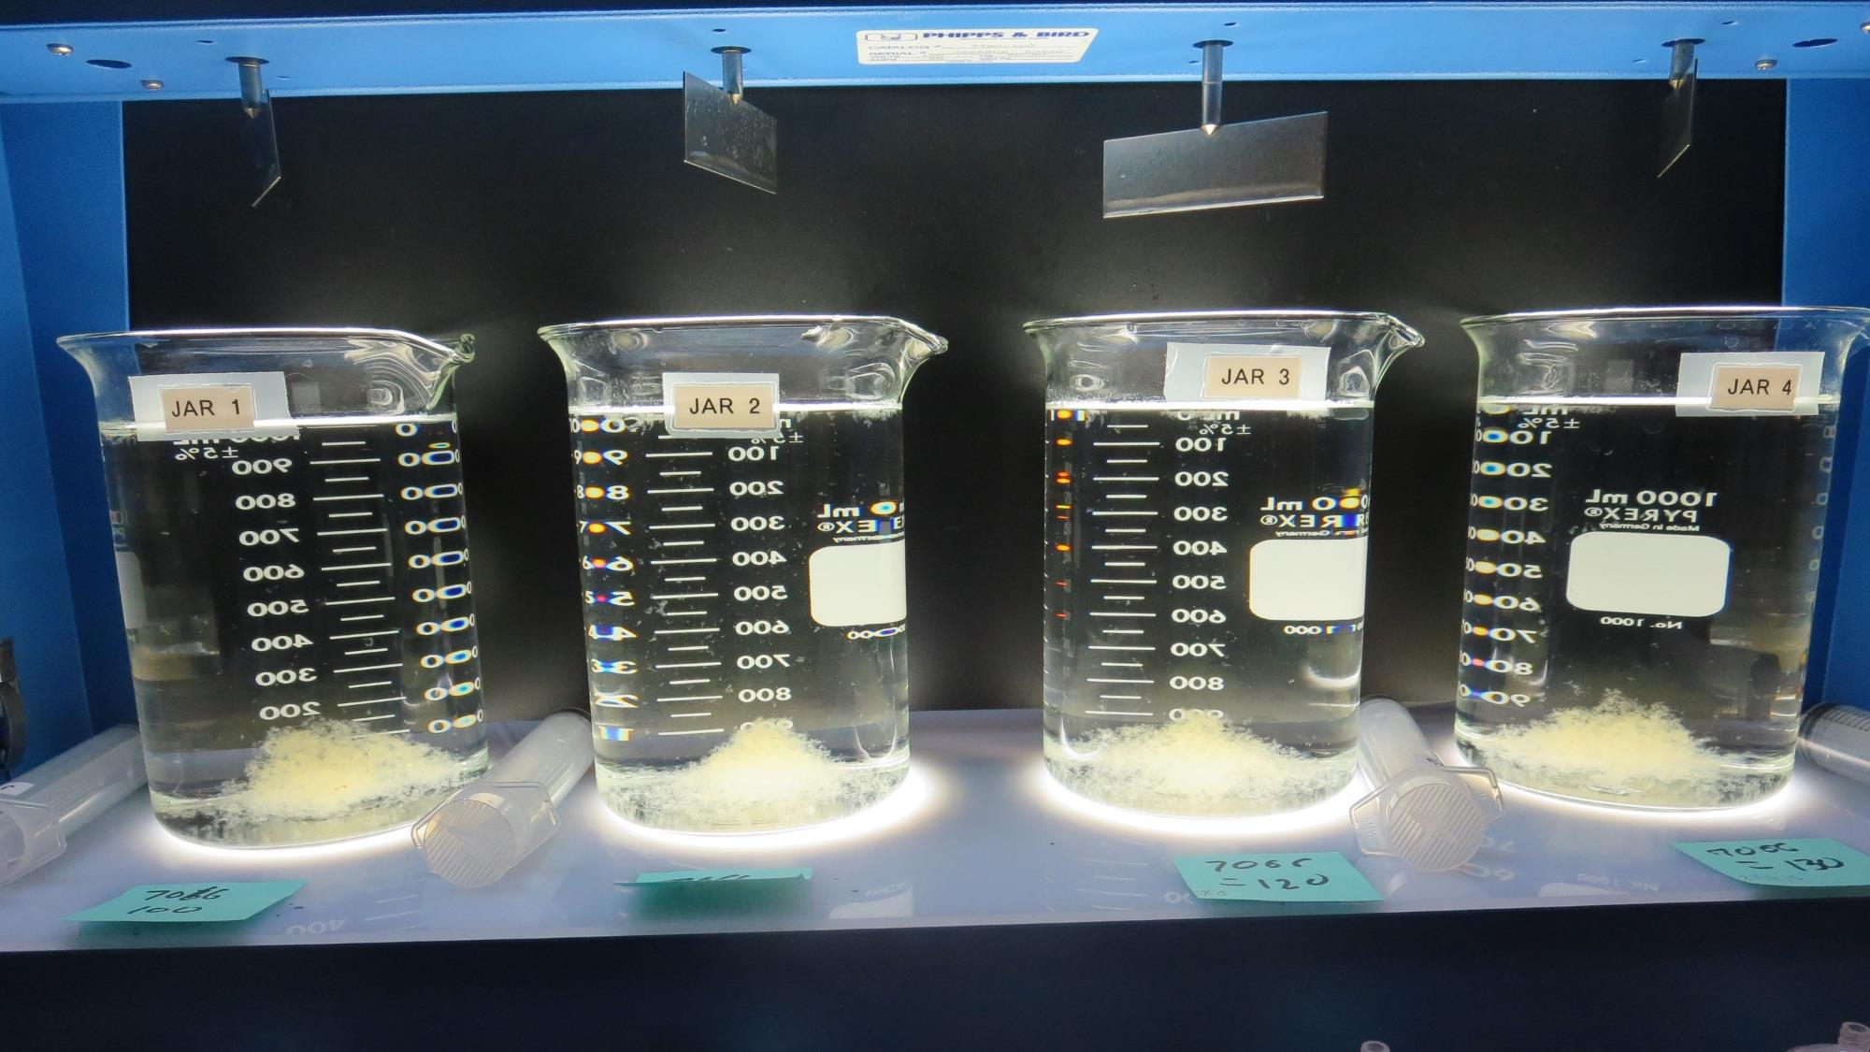
Jars 9-12: After 5 min of settling, 25 mL is syringed for filterability and %UVT/UVA.

Slide 25
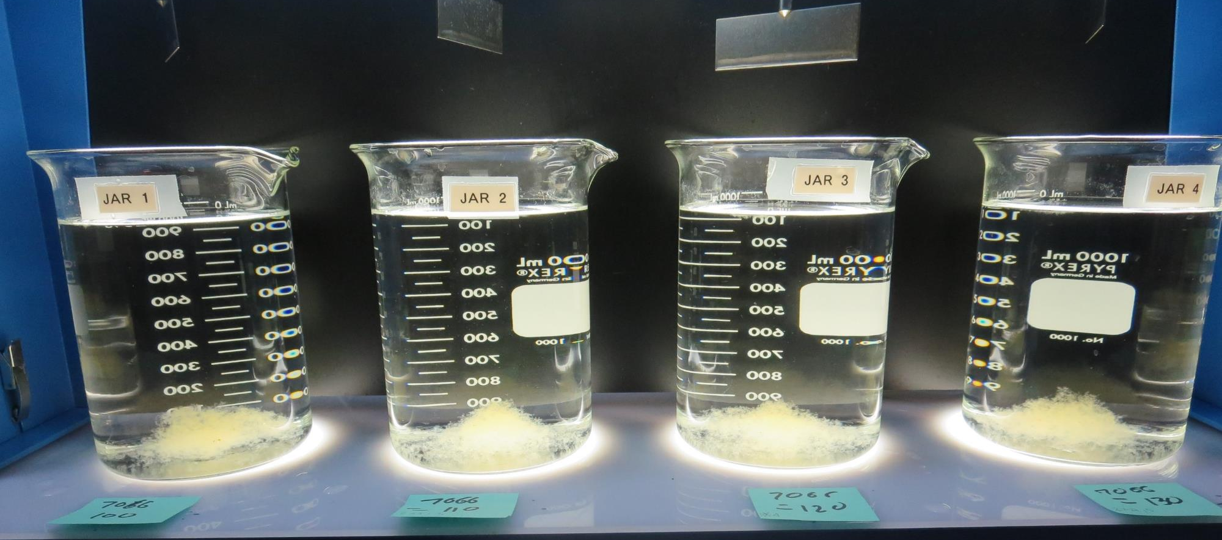
Jars 9-12: After 25-minutes of settling, settled water turbidity is taken.
100 mg/L 7066
Filtrate 0.09 NTU
UVT: 92.2%
UVA: 0.035/cm
UVA Reduction 34%
Settled: 0.29 NTU
110 mg/L 7066
Filtrate 0.09 NTU
UVT: 92.4%
UVA: 0.034/cm
UVA Reduction 35.8%
Settled: 0.30 NTU
120 mg/L 7066
Filtrate 0.08 NTU
UVT: 92.7%
UVA: 0.032/cm
UVA Reduction 39.6%
Settled: 0.29 NTU
130 mg/L 7066
Filtrate 0.07 NTU
UVT: 92.8%
UVA: 0.032/cm
UVA Reduction 39.6%
Settled: 0.23 NTU

Slide 26
Jars 13-16 Test Flash Mix 30 Sec (200 RPM) Floc Mix 5 min (30 RPM) Applied Coagulant 7066

Slide 27
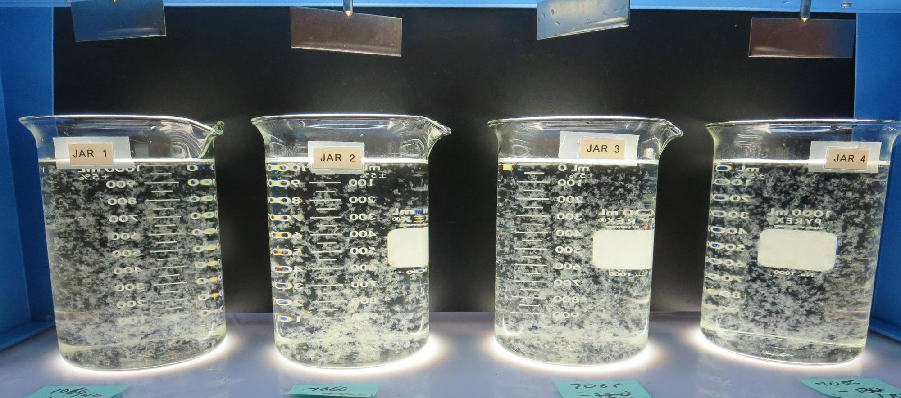
Jars 13-16: End of 5-minute flocculation (30 RPM) duration.
140 mg/L 7066
Filtrate 0.07 NTU
UVT: 93.3%
UVA: 0.030/cm
UVA Reduction 32.1%
Settled: 0.21 NTU
150 mg/L 7066
Filtrate 0.07 NTU
UVT: 93.4%
UVA: 0.029/cm
UVA Reduction 32.1%
Settled: 0.28 NTU
160 mg/L 7066
Filtrate 0.07 NTU
UVT: 93.6%
UVA: 0.028/cm
UVA Reduction 32.1%
Settled: 0.28 NTU
170 mg/L 7066
Filtrate 0.06 NTU
UVT: 93.8%
UVA: 0.027/cm
UVA Reduction 32.1%
Settled: 0.21 NTU

Slide 28
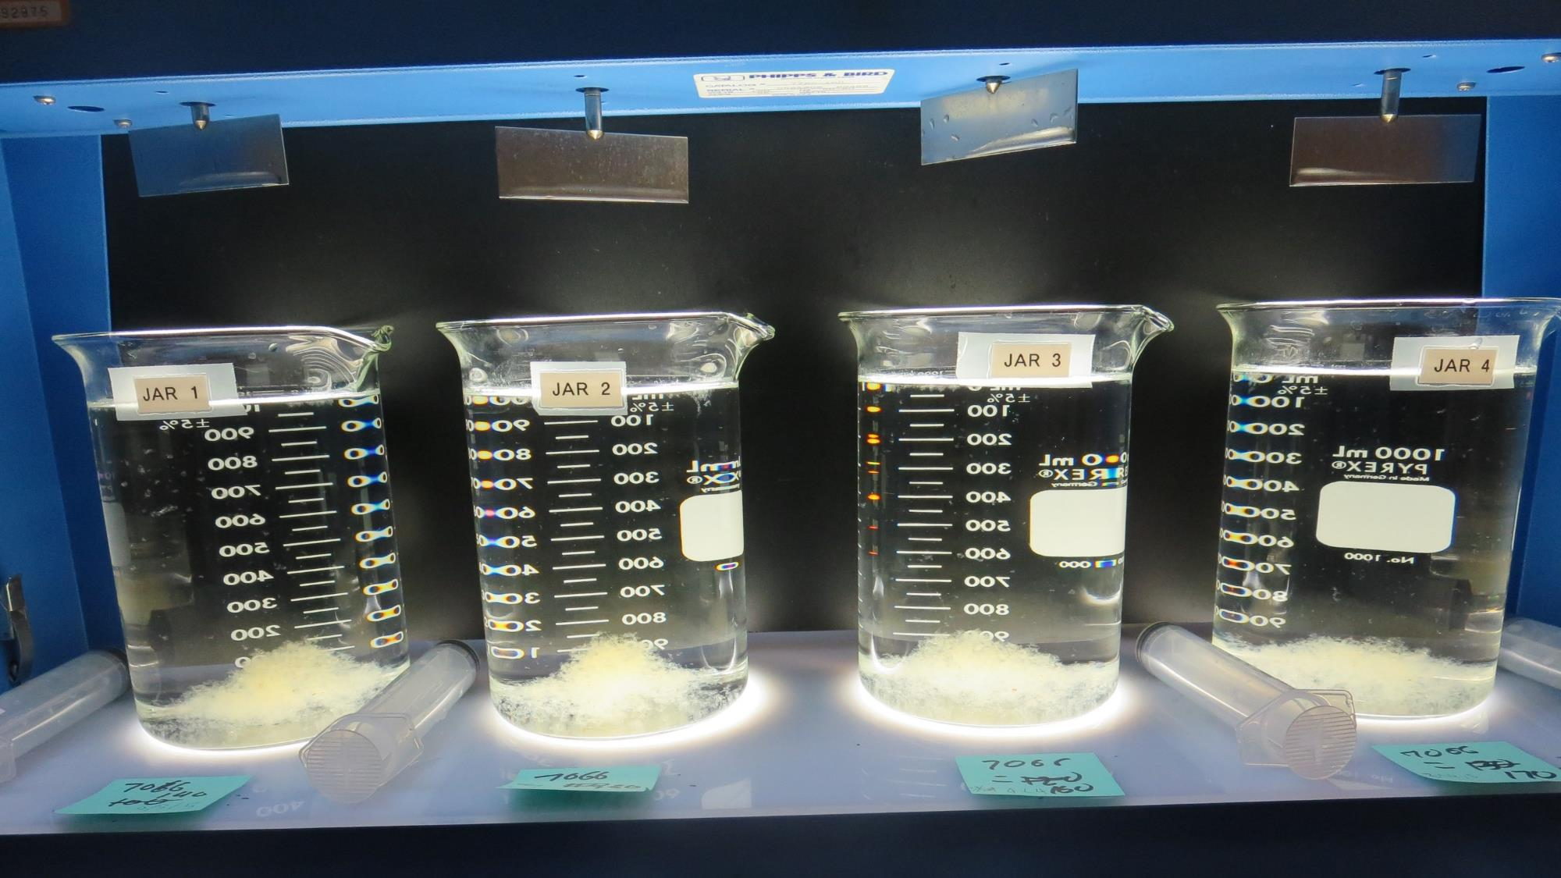
Jars 13-16: After 5 min of settling, 25 mL is syringed for filterability and %UVT/UVA.

Slide 29
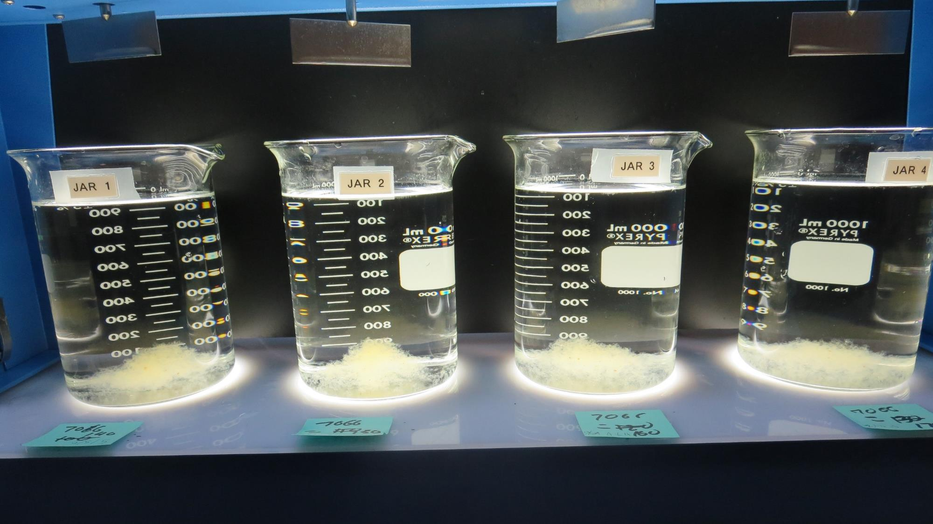
Jars 13-16: After 25-minutes of settling, settled water turbidity is taken.
140 mg/L 7066
Filtrate 0.07 NTU
UVT: 93.3%
UVA: 0.030/cm
UVA Reduction 32.1%
Settled: 0.21 NTU
150 mg/L 7066
Filtrate 0.07 NTU
UVT: 93.4%
UVA: 0.029/cm
UVA Reduction 32.1%
Settled: 0.28 NTU
160 mg/L 7066
Filtrate 0.07 NTU
UVT: 93.6%
UVA: 0.028/cm
UVA Reduction 32.1%
Settled: 0.28 NTU
170 mg/L 7066
Filtrate 0.06 NTU
UVT: 93.8%
UVA: 0.027/cm
UVA Reduction 32.1%
Settled: 0.21 NTU

Slide 30
Jars 17-20 Test Flash Mix 30 Sec (200 RPM) Floc Mix 5 min (30 RPM) Applied Coagulants 9800 7066

Slide 31
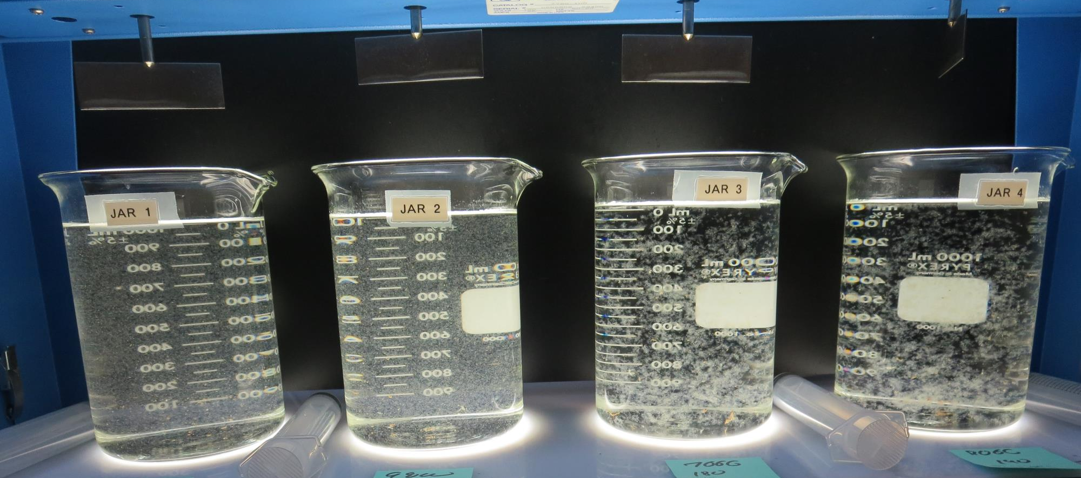
Jars 17-20: End of 5-minute flocculation (30 RPM) duration.
75 mg/L 9800
Filtrate 0.07 NTU
UVT: 93.5%
UVA: 0.029/cm
UVA Reduction 45.3%
Settled: 0.33 NTU
80 mg/L 9800
Filtrate 0.09 NTU
UVT: 93.3%
UVA: 0.030/cm
UVA Reduction 43.4%
Settled: 0.34 NTU
180 mg/L 7066
Filtrate 0.07 NTU
UVT: 92.7%
UVA: 0.032/cm
UVA Reduction 39.6%
Settled: 0.31 NTU
190 mg/L 7066
Filtrate 0.06 NTU
UVT: 92.9%
UVA: 0.031/cm
UVA Reduction 41.5%
Settled: 0.19 NTU

Slide 32
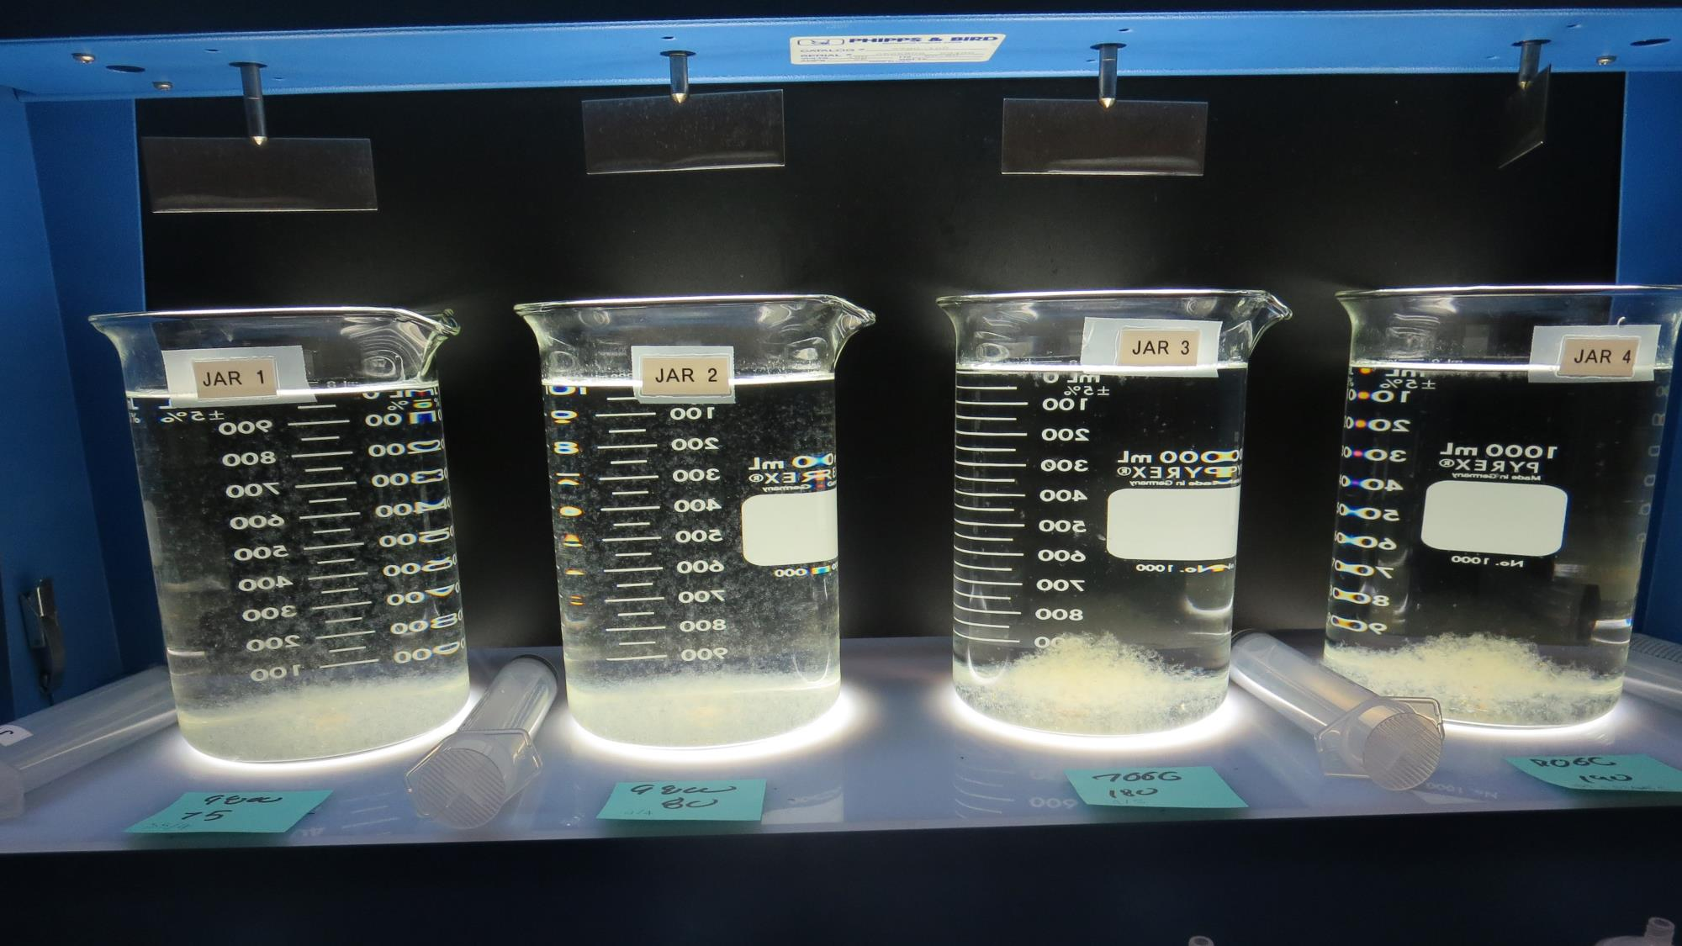
Jars 17-20: After 5 min of settling, 25 mL is syringed for filterability and %UVT/UVA.

Slide 33
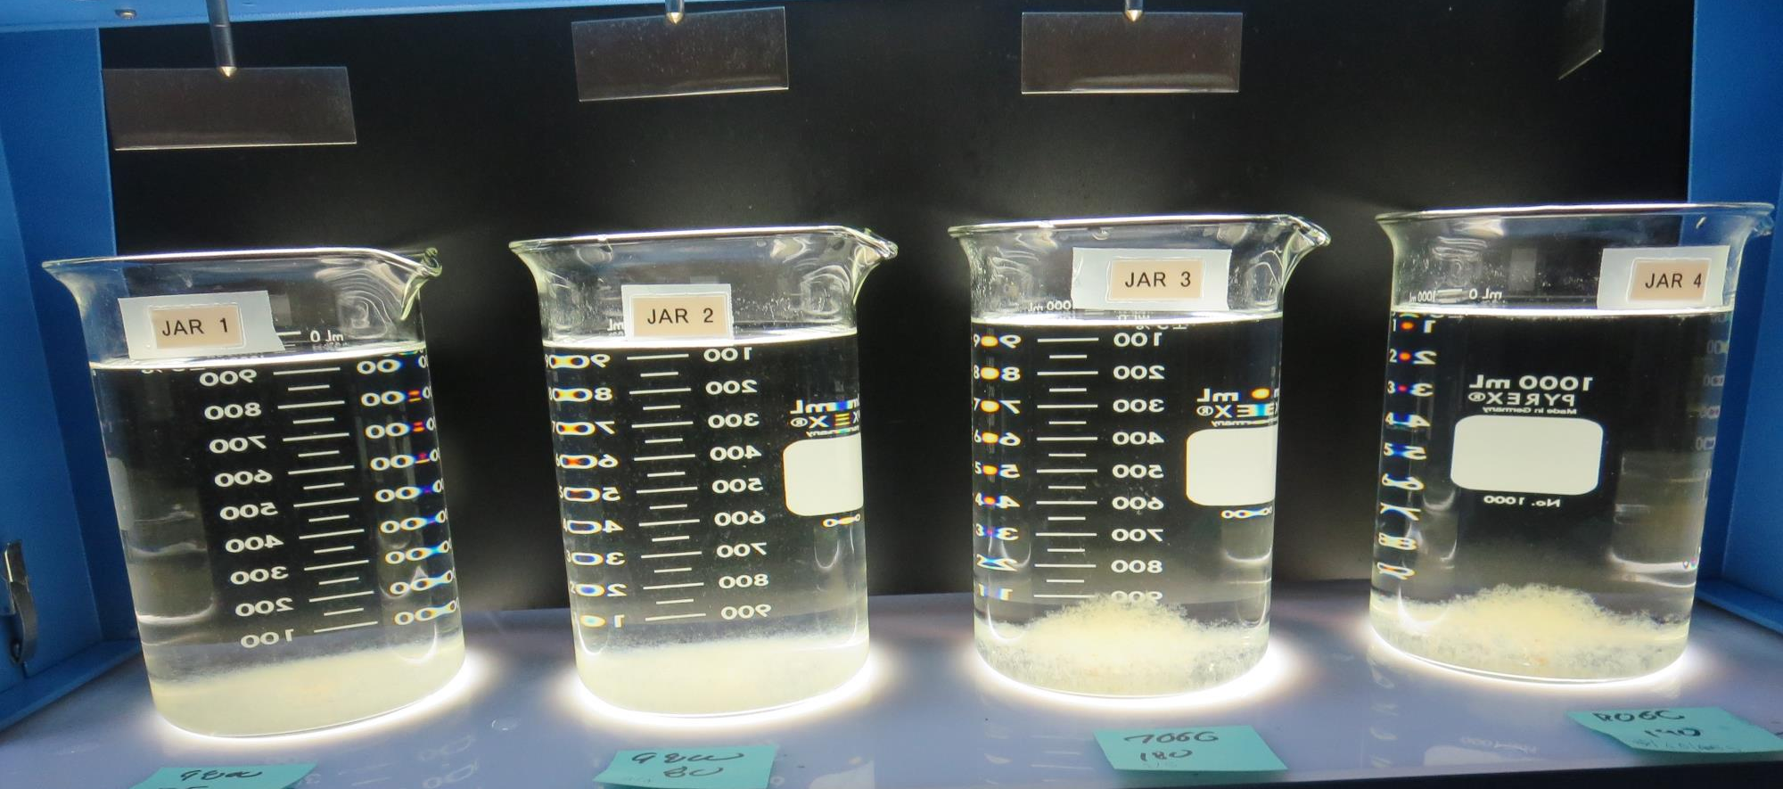
Jars 17-20: After 25-minutes of settling, settled water turbidity is taken.
75 mg/L 9800
Filtrate 0.07 NTU
UVT: 93.5%
UVA: 0.029/cm
UVA Reduction 45.3%
Settled: 0.33 NTU
80 mg/L 9800
Filtrate 0.09 NTU
UVT: 93.3%
UVA: 0.030/cm
UVA Reduction 43.4%
Settled: 0.34 NTU
180 mg/L 7066
Filtrate 0.07 NTU
UVT: 92.7%
UVA: 0.032/cm
UVA Reduction 39.6%
Settled: 0.31 NTU
190 mg/L 7066
Filtrate 0.06 NTU
UVT: 92.9%
UVA: 0.031/cm
UVA Reduction 41.5%
Settled: 0.19 NTU

Slide 34
Jars 21 -24 Test Added: KMNO₄ Mix for 5 minutes Flash Mix 30 Sec (200 RPM) Floc Mix 5 min (30 RPM) Applied Coagulants 9800 7066

Slide 35
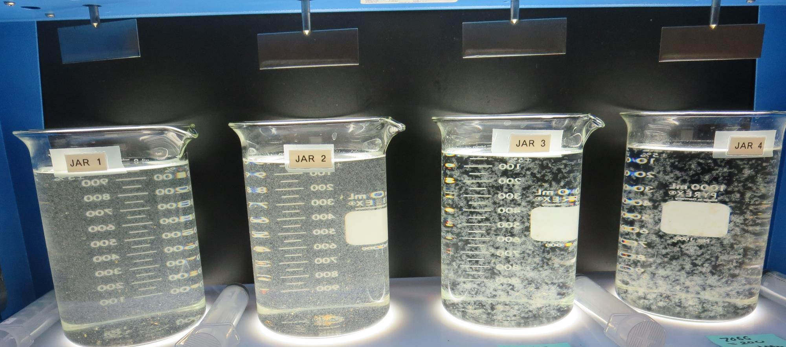
Jars 21-24 Test: End of 5-minute flocculation (30 RPM) duration.
0 mg/L KMnO₄
80 mg/L 9800
Filtrate 0.06 NTU
UVT: 93.3%
UVA: 0.030/cm
UVA Reduction 43.4%
Settled: 0.44 NTU
0.4 mg/L KMnO₄
80 mg/L 9800
Filtrate 0.09 NTU
UVT: 93.5%
UVA: 0.029/cm
UVA Reduction 45.3%
Settled: 0.51 NTU
0 mg/L KMnO₄
200 mg/L 7066
Filtrate 0.06 NTU
UVT: 93.1%
UVA: 0.030/cm
UVA Reduction 43.4%
Settled: 0.21 NTU
0.4 mg/L KMnO₄
200 mg/L 7066
Filtrate 0.06 NTU
UVT: 93.3%
UVA: 0.029/cm
UVA Reduction 45.3%
Settled: 0.18 NTU

Slide 36
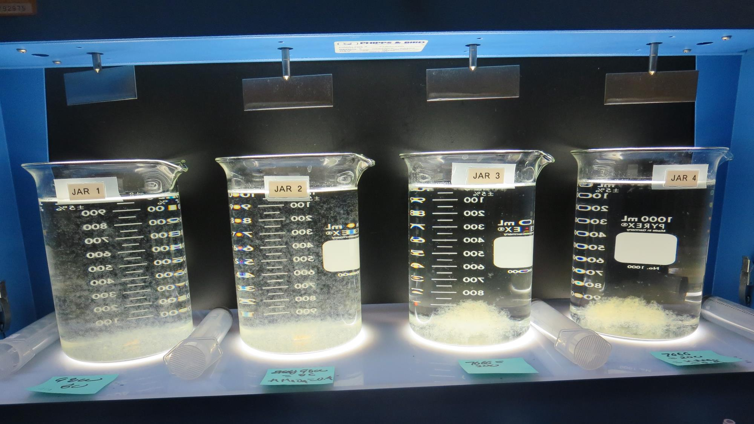
Jars 21-24: After 5 min of settling, 25 mL is syringed for filterability and %UVT/UVA.

Slide 37
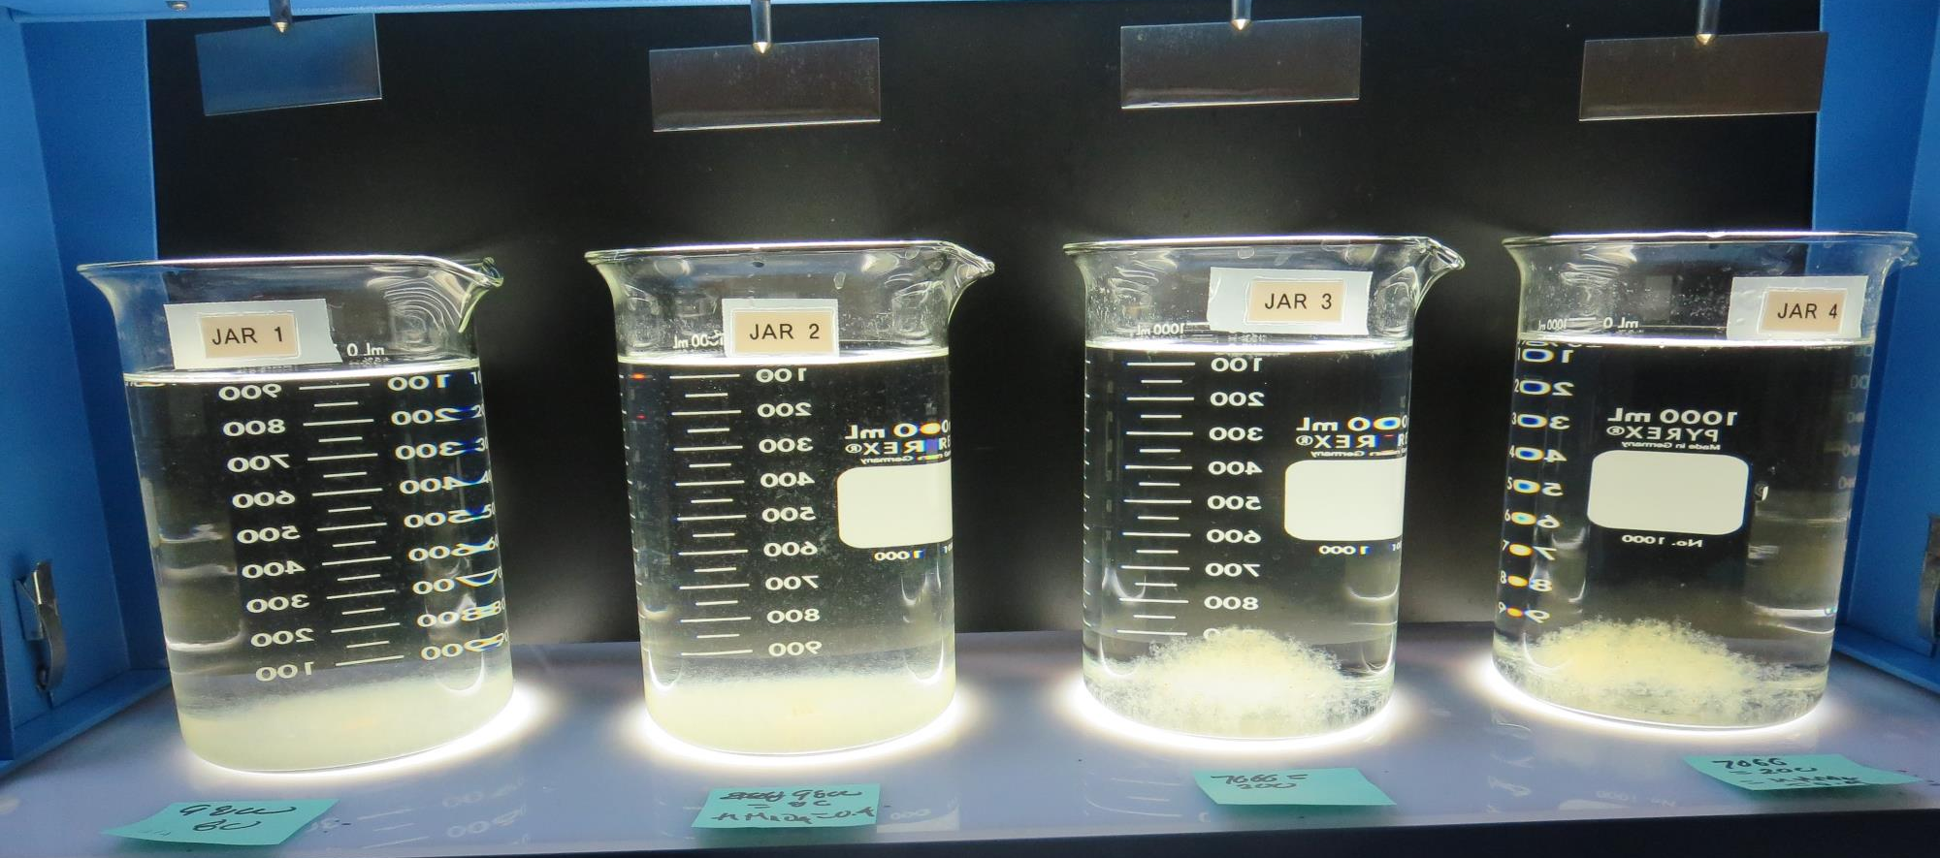
Jars 21-24: After 25-minutes of settling, settled water turbidity is taken.
0 mg/L KMnO₄
80 mg/L 9800
Filtrate 0.06 NTU
UVT: 93.3%
UVA: 0.030/cm
UVA Reduction 43.4%
Settled: 0.44 NTU
0.4 mg/L KMnO₄
80 mg/L 9800
Filtrate 0.09 NTU
UVT: 93.5%
UVA: 0.029/cm
UVA Reduction 45.3%
Settled: 0.51 NTU
0 mg/L KMnO₄
200 mg/L 7066
Filtrate 0.06 NTU
UVT: 93.1%
UVA: 0.030/cm
UVA Reduction 43.4%
Settled: 0.21 NTU
0.4 mg/L KMnO₄
200 mg/L 7066
Filtrate 0.06 NTU
UVT: 93.3%
UVA: 0.029/cm
UVA Reduction 45.3%
Settled: 0.18 NTU

Slide 38
Jars 25-28 Test Flash Mix 30 Sec (200 RPM) Floc Mix 5 min (30 RPM) Applied Coagulant 7066

Slide 39
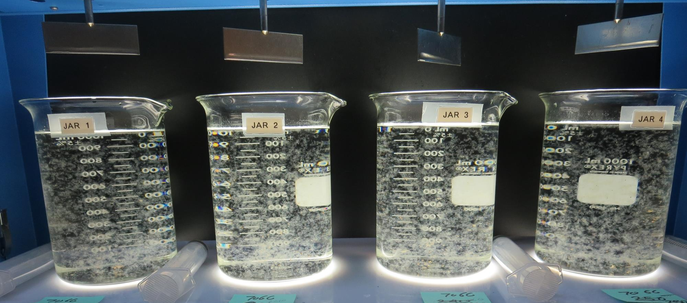
Jars 25-28: End of 5-minute flocculation (30 RPM) duration.
220 mg/L 7066
Filtrate 0.06 NTU
UVT: 93.3%
UVA: 0.030/cm
UVA Reduction 43.4%
Settled: 0.16 NTU
240 mg/L 7066
Filtrate 0.06 NTU
UVT: 93.3%
UVA: 0.030/cm
UVA Reduction 43.4%
Settled: 0.17 NTU
260 mg/L 7066
Filtrate 0.06 NTU
UVT: 93.5%
UVA: 0.029/cm
UVA Reduction 45.3%
Settled: 0.21 NTU
280 mg/L 7066
Filtrate 0.06 NTU
UVT: 93.7%
UVA: 0.028/cm
UVA Reduction 47.2%
Settled: 0.17 NTU

Slide 40
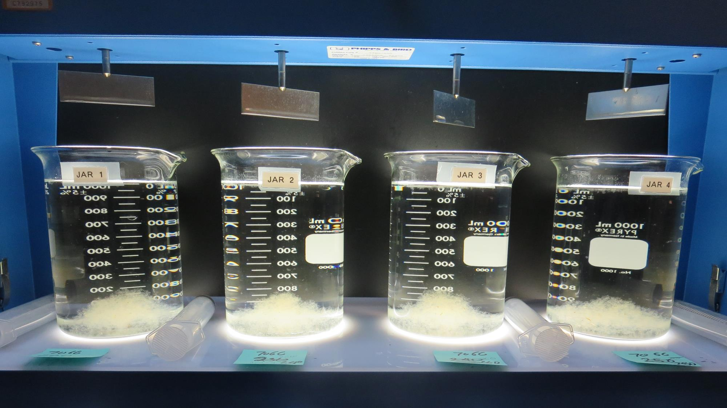
Jars 25-28: After 5 min of settling, 25 mL is syringed for filterability and %UVT/UVA.

Slide 41
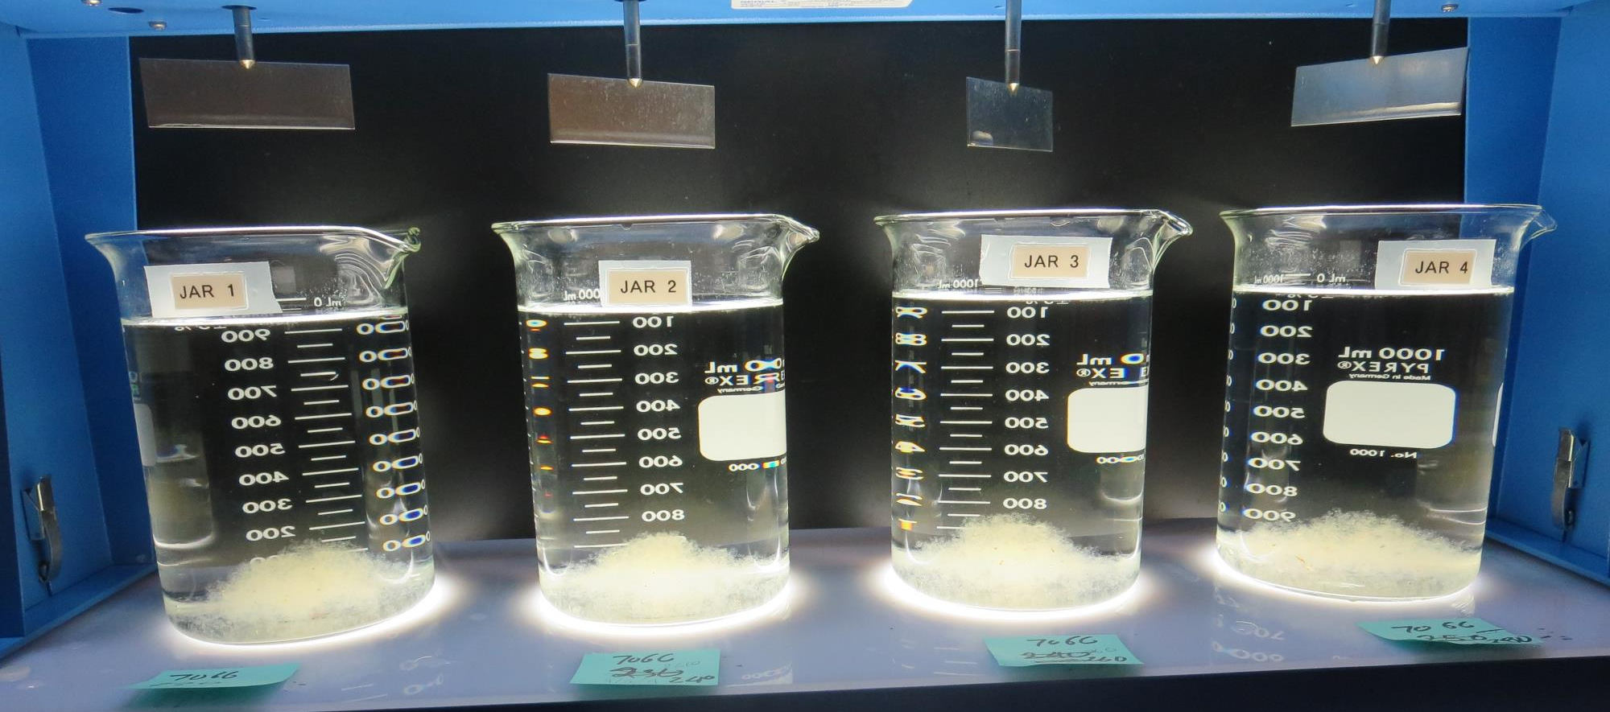
Jars 25-28: After 25-minutes of settling, settled water turbidity is taken.
220 mg/L 7066
Filtrate 0.06 NTU
UVT: 93.3%
UVA: 0.030/cm
UVA Reduction 43.4%
Settled: 0.16 NTU
240 mg/L 7066
Filtrate 0.06 NTU
UVT: 93.3%
UVA: 0.030/cm
UVA Reduction 43.4%
Settled: 0.17 NTU
260 mg/L 7066
Filtrate 0.06 NTU
UVT: 93.5%
UVA: 0.029/cm
UVA Reduction 45.3%
Settled: 0.21 NTU
280 mg/L 7066
Filtrate 0.06 NTU
UVT: 93.7%
UVA: 0.028/cm
UVA Reduction 47.2%
Settled: 0.17 NTU

Slide 42
Jar Testing for 1-Liter Jars: Procedures for Most Treatment Plants
Fill jars with source water prior to coagulant injection and set paddle speed at 30 rpm
Add chemicals (i.e., NaOCl, primary coagulant, coagulant aid) to each jar
Flash mix for 15-60 seconds (200 rpm)
Slow mix for 5 minutes (20-30 rpm)
Settled for 5 minutes. Syringe 25 mL from each jar taken 1-inch below surface (25 mL/12 sec rate)
Filtered through 1.2 um isopore membrane into cuvette drip rate, 15 mL/(50-90 sec)
Measure filtrate turbidity, chlorine residual and %UVT/UVA
Measure settled water turbidity after 25 minutes of total setting
Record all data

Slide 43
Jar Test Filterability Test Equipment
Turbidity Instrument
Syringe w/Luer-Lock Tip, 30 cc
(part#: 2225800, by Hach)
Swinnex Filter Holder, 25 mm (part#: SX0002500)
Isopore Membrane Filter, 1.2 um absolute
pore size,
Φ= 25 mm , thickness: 24 um,
hydrophilic polycarbonate membrane
(part #: RTTP02500)
Go to Sigma-Aldrich for laboratory supplies http://www.sigmaaldrich.com/united-states.html

Slide 44
Isopore Membrane Information
Categories | Information
trade name | Isopore
filter color | White
chemistry | Polycarbonate (PC)
water flow rate | Avg. 175 mL/min x cm² (typical results @ 10 psi)
media | Isopore®
wettability | Hydrophilic
porosity | 14.7%
pore size | 1.2 µm
bubble point at 23 °C | 1.0 bar, air with water
thickness | 24 µm
filter diameter (ø) | 25 mm
material size | polycarbonate, Hydrophilic, 1.2 µm, 25 mm, white, plain, 100

Slide 45
Isopore Membrane Background Information
The Isopore membrane is a polycarbonate, track-etched screen filter recommended for all analyses in which the sample is viewed on the surface of the membrane. The Isopore membrane is composed of polycarbonate film, which has a smooth, glass-like surface for clearer sample observation. The unique manufacturing process of the membrane ensures a precise pore diameter and a consistent pore size for accurate separation of samples by size. Matched-weight filters are not usually required because of low, constant tar and ash weights. Features & Benefits: Membrane structure retains particles on the surface, simplifying counting and analysis

Slide 46
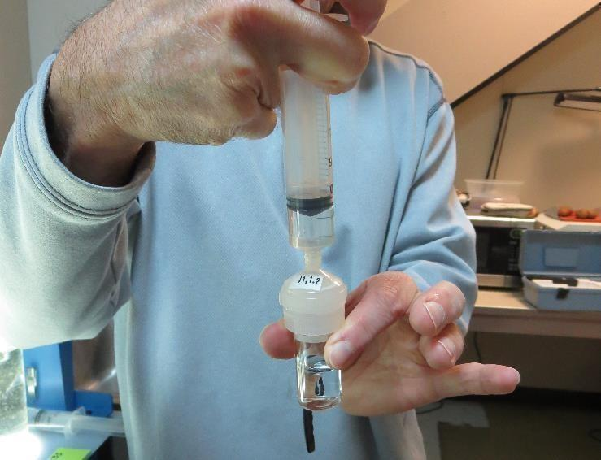
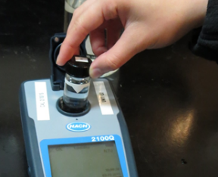
Jar Test - Filterability Test
Syringe ~ 25 mL from jar (after 5-minutes of settling)
Filter-to-waste 3-5 mL
Filter directly into clean cuvette
Measure turbidity
Note: Take several readings before recording final NTU results. Micro bubbles can adhere to glass causing false NTU readings. To remove bubbles, tilt cuvette up to 90 degrees.

Slide 47
Contact
Guy Schott, P.E.
State Water Resources Control Board
Division of Drinking Water
Santa Rosa, CA
Go to Stock Solution/Dose calculations/Jar Test Results for tools to download
www.waterboards.ca.gov/drinking_water/programs/districts/mendocino_district.html
Email: Guy Schott - Guy.Schott@waterboards.ca.gov
Office Number: 707-576-2732

