Slide 1
Willits, City of CA2310004 Mendocino County Jar Test
by Guy Schott, P.E.
June 25, 2020

Slide 2
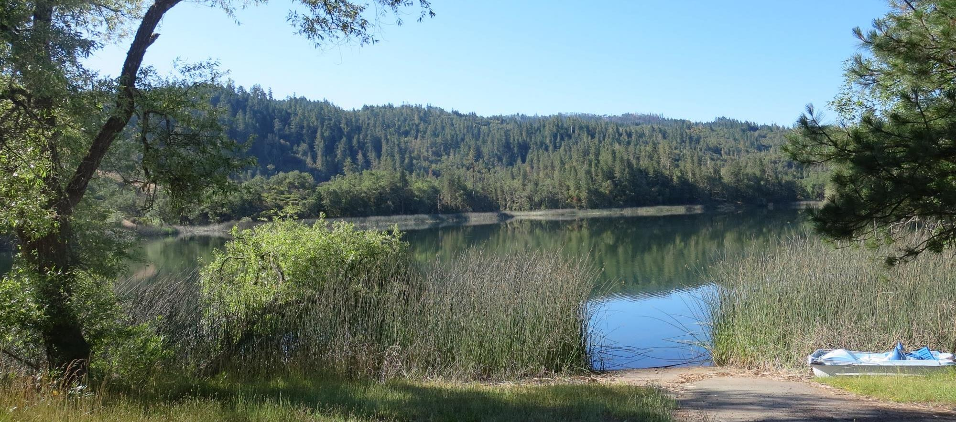
Morris Reservoir

Slide 3
Treatment Processes
Pre-Treatment: KMnO₄
Upflow solids-contact clarifier
Trident Filtration (adsorption contact clarifier/Multi-media filtration)
Chlorine disinfection

Slide 4
Willits, City of, June 25, 2020 Source Water Characteristics
Source
Post KMnO₄ Sample
pH: 7.79
Turbidity: 3.79 NTU
UVT: 72.8%
UVA: 0.137/cm
0.6 um Filtered
Turbidity: 0.36 NTU
UVT: 85.2%
UVA: 0.069/cm
Plant Filtrate
Coagulant Dose:
103 mg/L 42.4% FeCl₃
Turbidity: 0.07 NTU
UVT: 95.4%
UVA: 0.020/cm
UVA Reduction: 71%

Slide 5
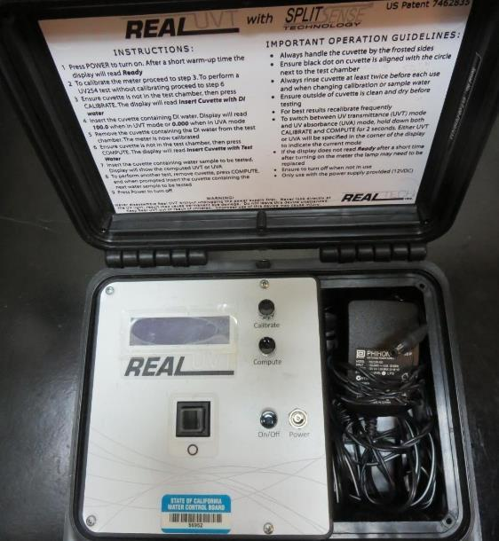
UVT/UVA, pathlength 10 mm
UV transmittance (UVT) is a measurement of the amount of ultraviolet light (commonly at 254 nm due to its germicidal effect) that passes through a water sample compared to the amount of light that passes through a pure water sample. The measurement is expressed as a percentage, % UVT.
%UVT = 10^{(-UVA)} x 100%
UV absorbance (UVA) is calculated as a relative measure of the amount of light absorbed by a water sample compared with the amount of light absorbed by a pure water sample.
UVA = -log(%UVT/100)

Slide 6
Applied Coagulants for Jar Testing
42.4% FeCl₃
SG = 1.44
Pro Pac 9800 (NTU Technologies)
50% Aluminum Chlorohydrate
50% Water
83% Basicity
SG = 1.34
7066 (Garratt Callahan)
10 – 30% Poly Aluminum Hydroxychloride Sulfate
50% Basicity
SG = 1.2
Advanced Coagulant
12.55% Al₂O₃
64.9% Basicity
SG = 1.299

Slide 7
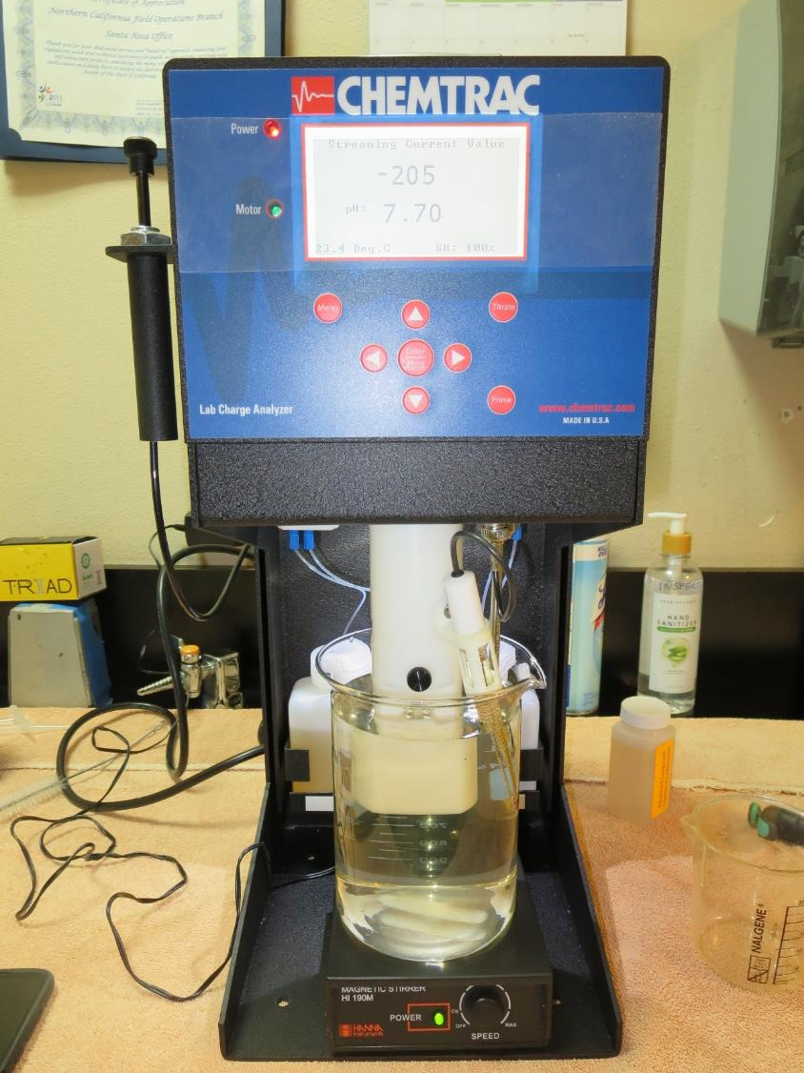
Laboratory Charge Analyzer
LCA: Used to determine coagulant demand of a source water entering the treatment plant.
Source pH: 7.70
LCA #1:
9800: 15.08 mg/L as product
pH adjusted to 7.5 w/acetic acid solution
LCA #2:
Advance Coagulant: 51 mg/L as product
pH adjusted to 7.5 w/acetic acid solution
LCA #3:
7066: 68.4 mg/L as product
pH adjusted to 7.5 w/acetic acid solution

Slide 8
Laboratory Charge Analyzer Results for FeCl₃
Source pH: 7.70
LCA #1: No pH adjustment
42.4% FeCl₃: 161 mg/L
pH_{final}: 6.22
LCA #2: pH adjusted to 7.0 w/acetic acid solution
42.4% FeCl₃: 110 mg/L
pH_{final}: 6.20
LCA #3: pH adjusted to 6.3 w/acetic acid solution
42.4% FeCl₃: 58 mg/L
pH_{final}: 5.93
LCA #3: pH adjusted to 6.0 w/acetic acid solution
42.4% FeCl₃: 52.2 mg/L
pH_{final}: 5.66

Slide 9
Coagulant Information
Unless stated otherwise, all coagulant doses are reported as Product (100% strength).
Preparation of coagulant stock solutions are generally 1.0 and/or 0.1 percent strength using 100 and/or 200 mL volumetric flasks.
Finnpipette F2 variable volume pipette, capacity 100-1000 micro liters is used for stock solution preparation and coagulant aid jar test dosing.
Finnpipette F2 variable volume pipette, capacity 0.5-5 mL is used for primary coagulant jar test dosing.

Slide 10
Willits, City of: Jar Test 1-8 Results Post-KMnO4 Source Water, Flash Mix 200 RPM (10 sec)
Jar # | 30 RPM Floc Duration minutes | 42.4% FeCl₃ mg/L | Filtrate NTU | Filtrate %UVT | Filtrate UVA/cm | %UVA Reduction | Settle NTU 25 min
J1 | 5 | 55 | 0.16 | 90.9 | 0.041 | 40.6 | 1.25
J2 | 5 | 60 | 0.16 | 90.6 | 0.042 | 39.1 | 1.46
J3 | 5 | 65 | 0.14 | 90.9 | 0.041 | 40.6 | 1.06
J4 | 5 | 70 | 0.14 | 91.0 | 0.040 | 42.0 | 1.03
J5 | 5 | 75 | 0.09 | 92.9 | 0.031 | 55.1 | 1.06
J6 | 5 | 80 | 0.12 | 92.2 | 0.034 | 50.7 | 1.02
J7 | 5 | 85 | 0.11 | 92.5 | 0.033 | 52.2 | 0.98
J8 | 5 | 105 | 0.10 | 93.2 | 0.030 | 56.5 | 1.01

Slide 11
Willits, City of: Jar Test 9-12 Results Post-KMnO₄ Source Water Flash Mix 200 RPM (10 sec), Floc Mix 30 RPM (5 min)
Jar # | 42.4% FeCl₃ mg/L | 926 mg/L | Filtrate NTU | Filtrate %UVT | Filtrate UVA/cm | %UVA Reduction | Settle NTU 25 min
J9 | 75 | 3.36 | 0.10 | 93.3 | 0.030 | 56.5 | 1.04
J10 | 80 | 3.58 | 0.12 | 92.7 | 0.032 | 53.6 | 1.21
J11 | 85 | 3.81 | 0.12 | 93.1 | 0.031 | 55.1 | 1.02
J12 | 105 | 4.70 | 0.11 | 93.5 | 0.029 | 58.0 | 1.02

Slide 12
Willits, City of: Jar Test 13-20 Results Post-KMnO₄ Source Water, Flash Mix 200 RPM (30 sec)
Jar # | 30 RPM Floc Duration minutes | Adv Coag mg/L | Filtrate NTU | Filtrate %UVT | Filtrate UVA/cm | %UVA Reduction | Settle NTU 25 min
J13 | 5 | 50 | 0.09 | 92.2 | 0.035 | 49.3 | 0.42
J14 | 5 | 54 | 0.08 | 92.4 | 0.034 | 50.7 | 0.36
J15 | 5 | 58 | 0.09 | 92.5 | 0.033 | 52.2 | 0.34
J16 | 5 | 62 | 0.10 | 92.6 | 0.033 | 52.2 | 0.31
J17 | 5 | 66 | 0.09 | 93.2 | 0.030 | 56.5 | 0.30
J18 | 5 | 70 | 0.07 | 93.4 | 0.029 | 58.0 | 0.30
J19 | 5 | 74 | 0.08 | 93.4 | 0.029 | 58.0 | 0.31
J20 | 5 | 78 | 0.07 | 93.3 | 0.030 | 56.5 | 0.23

Slide 13
Willits, City of: Jar Test 21-28 Results Post-KMnO₄ Source Water, Flash 200 RPM (30 sec)
Jar # | 30 RPM Floc Duration minutes | 9800 mg/L | Filtrate NTU | Filtrate %UVT | Filtrate UVA/cm | %UVA Reduction | Settle NTU 25 min
J21 | 5 | 15 | 0.16 | 91.4 | 0.038 | 44.9 | 1.80
J22 | 5 | 17 | 0.08 | 92.2 | 0.035 | 49.3 | 1.62
J23 | 5 | 19 | 0.07 | 92.5 | 0.033 | 52.2 | 1.78
J24 | 5 | 21 | 0.07 | 92.8 | 0.032 | 53.6 | 1.29
J25 | 5 | 23 | 0.11 | 92.8 | 0.032 | 53.6 | 1.28
J26 | 5 | 25 | 0.07 | 93.2 | 0.030 | 56.5 | 1.22
J27 | 5 | 27 | 0.15 | 92.9 | 0.031 | 55.1 | 1.17
J28 | 5 | 29 | 0.13 | 93.2 | 0.030 | 56.5 | 1.44

Slide 14
Willits, City of: Jar Test 29-32 Results Post-KMnO₄ Source Water, Flash Mix 200 RPM (30 sec)
Jar # | 30 RPM Floc Duration minutes | 7066 mg/L | Filtrate NTU | Filtrate %UVT | Filtrate UVA/cm | %UVA Reduction | Settle NTU 25 min
J29 | 5 | 70 | 0.08 | 93.0 | 0.031 | 55.1 | 0.30
J30 | 5 | 80 | 0.08 | 93.3 | 0.030 | 56.5 | 0.32
J31 | 5 | 90 | 0.08 | 93.5 | 0.028 | 59.4 | 0.27
J32 | 5 | 100 | 0.07 | 93.8 | 0.027 | 60.9 | 0.23

Slide 15
Willits, City of: Jar Test 33-36 Results Post-KMnO₄ Source Water, Flash Mix 200 RPM (30 sec)
Jar # | 30 RPM Floc Duration minutes | pH adj to 6.5 w/CO₂ | 42.4% FeCl₃ mg/L | Filtrate NTU | Filtrate %UVT | Filtrate UVA/cm | %UVA Reduction | Settle NTU 25 min
J33 | 5 | No | 75 | 0.12 | 92.4 | 0.034 | 50.7 | 0.67
J34 | 5 | Yes | 75 | 0.10 | 92.0 | 0.036 | 47.8 | 0.69
J35 | 5 | No | 105 | 0.08 | 93.8 | 0.027 | 60.9 | 0.74
J36 | 5 | Yes | 105 | 0.11 | 92.6 | 0.033 | 52.2 | 1.00

Slide 16
Willits, City of: Jar Test 37-40 Results Post-KMnO₄ Source Water, Flash Mix 200 RPM (30 sec)
Jar # | 30 RPM Floc Duration minutes | 42.4% FeCl₃ mg/L | Filtrate NTU | Filtrate %UVT | Filtrate UVA/cm | %UVA Reduction | Settle NTU 25 min
J37 | 5 | 105 | 0.11 | 93.0 | 0.031 | 55.1 | 0.48
J38 | 5 | 110 | 0.09 | 93.4 | 0.029 | 58.0 | 0.62
J39 | 5 | 120 | 0.07 | 94.6 | 0.023 | 66.7 | 0.55
J40 | 5 | 130 | 0.09 | 93.8 | 0.027 | 60.9 | 0.66

Slide 17
Willits, City of: Jar Test 41-44 Results Post-KMnO₄ Source Water, Flash Mix 200 (30 sec)
Jar # | 30 RPM Floc Duration minutes | 7066 mg/L | Filtrate NTU | Filtrate %UVT | Filtrate UVA/cm | %UVA Reduction | Settle NTU 25 min
J41 | 5 | 100 | 0.08 | 92.4 | 0.034 | 50.7 | 0.34
J42 | 5 | 110 | 0.12 | 92.6 | 0.033 | 52.2 | 0.42
J43 | 5 | 120 | 0.11 | 92.7 | 0.032 | 53.6 | 0.33
J44 | 5 | 130 | 0.14 | 93.0 | 0.031 | 55.1 | 0.33

Slide 18
Willits, City of: Jar Test 45-48 Results Post-KMnO₄ Source Water, Floc Mix 30 RPM (5 min)
Jar # | 200 RPM Flash Mix sec | 7066 mg/L | 42.4% FeCl₃ mg/L | Filtrate NTU | Filtrate %UVT | Filtrate UVA/cm | %UVA Reduction | Settle NTU 25 min
J45 | 0 | 100 | 0 | 0.14 | 92.5 | 0.033 | 52.2 | 0.56
J46 | 30 | 100 | 0 | 0.13 | 92.4 | 0.034 | 50.7 | 0.34
J47 | 0 | 0 | 120 | 0.19 | 93.6 | 0.028 | 59.4 | 0.84
J48 | 30 | 0 | 120 | 0.14 | 93.6 | 0.028 | 59.4 | 0.71

Slide 19
Willits, City of: Jar Test 49-56 Results Post-KMnO₄ Source Water, Flash 200 RPM (30 sec)
Jar # | 30 RPM Floc Duration minutes | Adv Coag. mg/L | Filtrate NTU | Filtrate %UVT | Filtrate UVA/cm | %UVA Reduction | Settle NTU 25 min
J49 | 5 | 70 | 0.08 | 93.3 | 0.029 | 58.0 | 0.20
J50 | 5 | 75 | 0.07 | 93.3 | 0.030 | 56.5 | 0.25
J51 | 5 | 80 | 0.08 | 93.5 | 0.029 | 58.0 | 0.24
J52 | 5 | 85 | 0.07 | 93.5 | 0.028 | 59.4 | 0.21
J53 | 5 | 85 | 0.09 | 93.6 | 0.028 | 59.4 | 0.24
J54 | 5 | 90 | 0.08 | 93.7 | 0.027 | 60.9 | 0.26
J55 | 5 | 95 | 0.08 | 93.9 | 0.027 | 60.9 | 0.22
J56 | 5 | 100 | 0.08 | 94.0 | 0.026 | 62.3 | 0.23

Slide 20
Jars 1-4 Test Flash Mix 10 Sec (200 RPM) Floc Mix 5 min (30 RPM) Post KMnO₄ Applied Coagulant 42.4% FeCl₃

Slide 21
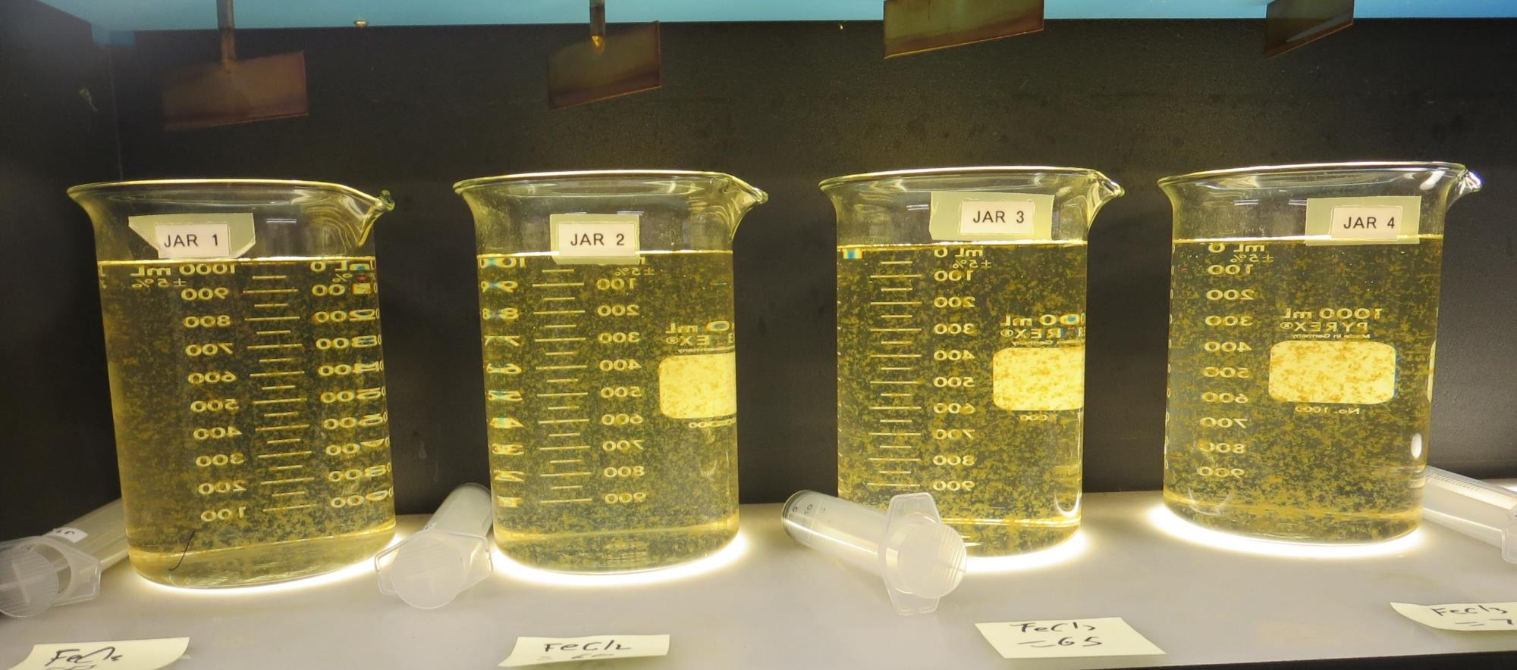
Jars 1-4: End of 5-minute flocculation (30 RPM) duration.
55 mg/L 42.4% FeCl₃
Filtrate 0.16 NTU
UVT: 90.9%
UVA: 0.041/cm
Settled: 1.25 NTU
60 mg/L 42.4% FeCl₃
Filtrate 0.16 NTU
UVT: 90.6%
UVA: 0.042/cm
Settled: 1.46 NTU
65 mg/L 42.4% FeCl₃
Filtrate 0.14 NTU
UVT: 90.9%
UVA: 0.041/cm
Settled: 1.06 NTU
70 mg/L 42.4% FeCl₃
Filtrate 0.14 NTU
UVT: 91.0%
UVA: 0.040/cm
Settled: 1.03 NTU

Slide 22
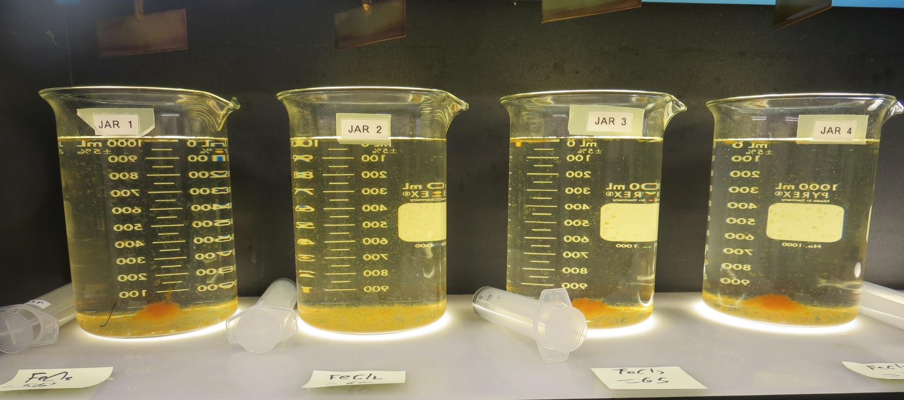
Jars 1-4: After 5 min of settling, 25 mL is syringed for filterability and %UVT/UVA.

Slide 23
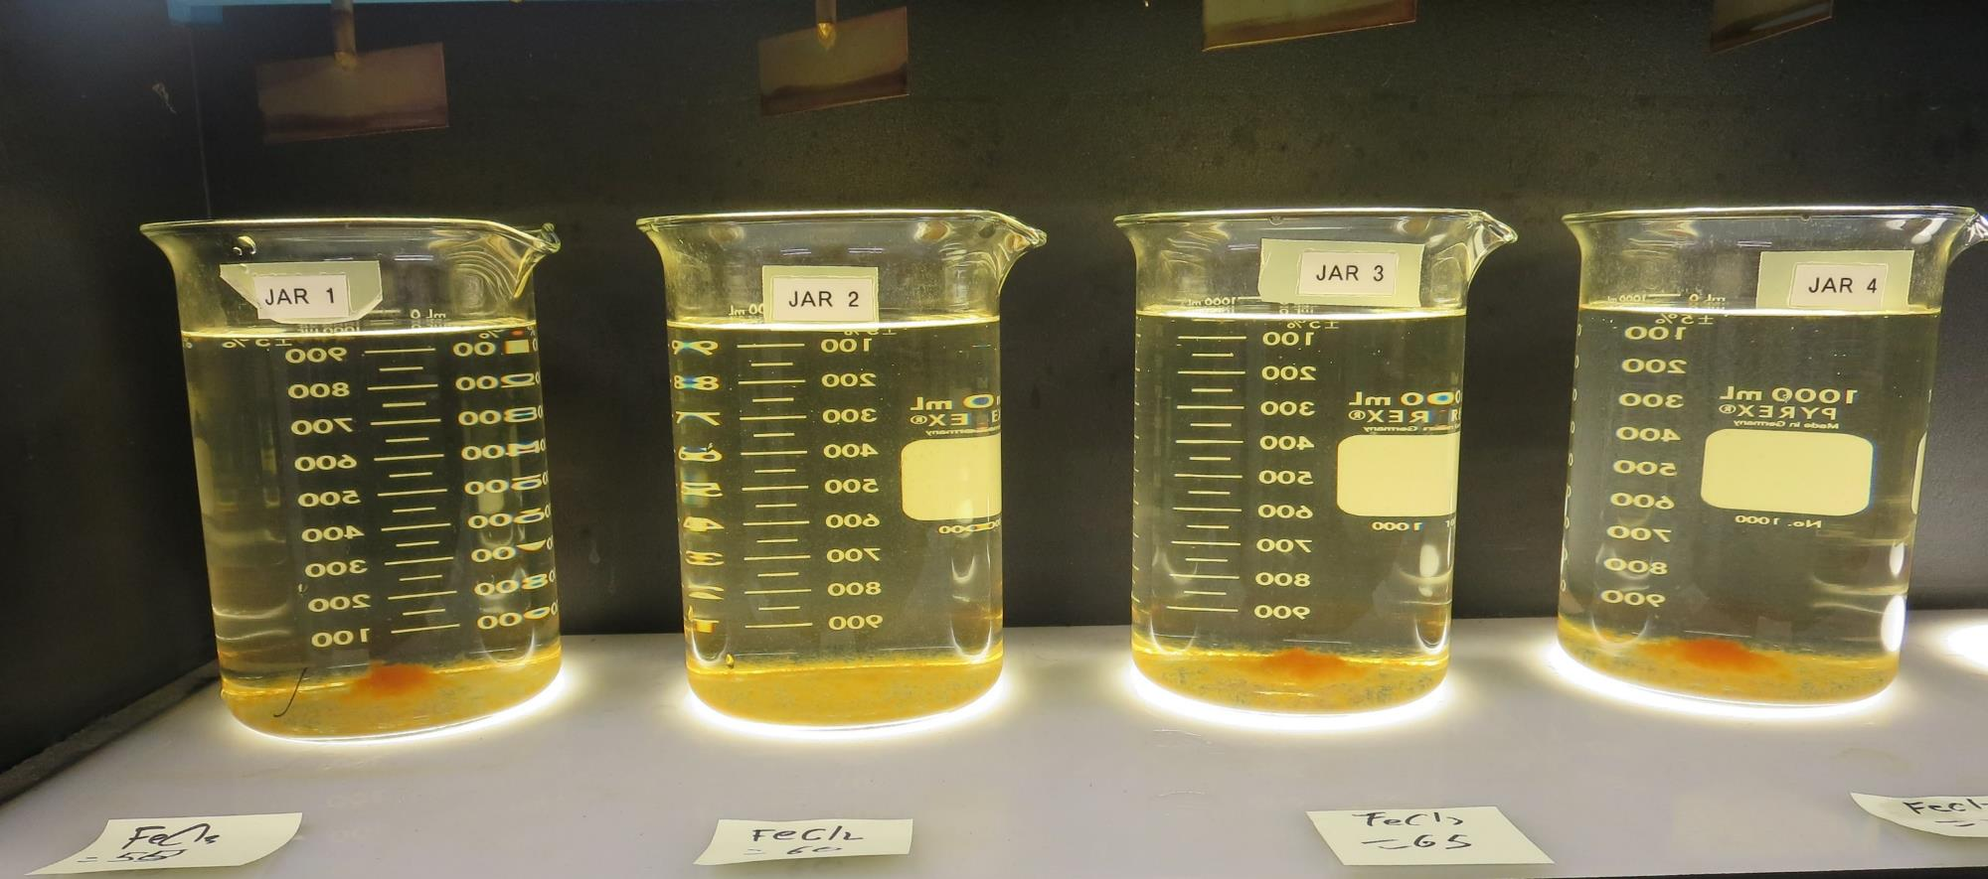
Jars 1-4: After 25-minutes of settling, settled water turbidity is taken.
55 mg/L 42.4% FeCl₃
Filtrate 0.16 NTU
UVT: 90.9%
UVA: 0.041/cm
Settled: 1.25 NTU
60 mg/L 42.4% FeCl₃
Filtrate 0.16 NTU
UVT: 90.6%
UVA: 0.042/cm
Settled: 1.46 NTU
65 mg/L 42.4% FeCl₃
Filtrate 0.14 NTU
UVT: 90.9%
UVA: 0.041/cm
Settled: 1.06 NTU
70 mg/L 42.4% FeCl₃
Filtrate 0.14 NTU
UVT: 91.0%
UVA: 0.040/cm
Settled: 1.03 NTU

Slide 24
Jars 5-8 Test Flash Mix 10 Sec (200 RPM) Floc Mix 5 min (30 RPM) Post KMnO₄ Applied Coagulant 42.4% FeCl₃

Slide 25
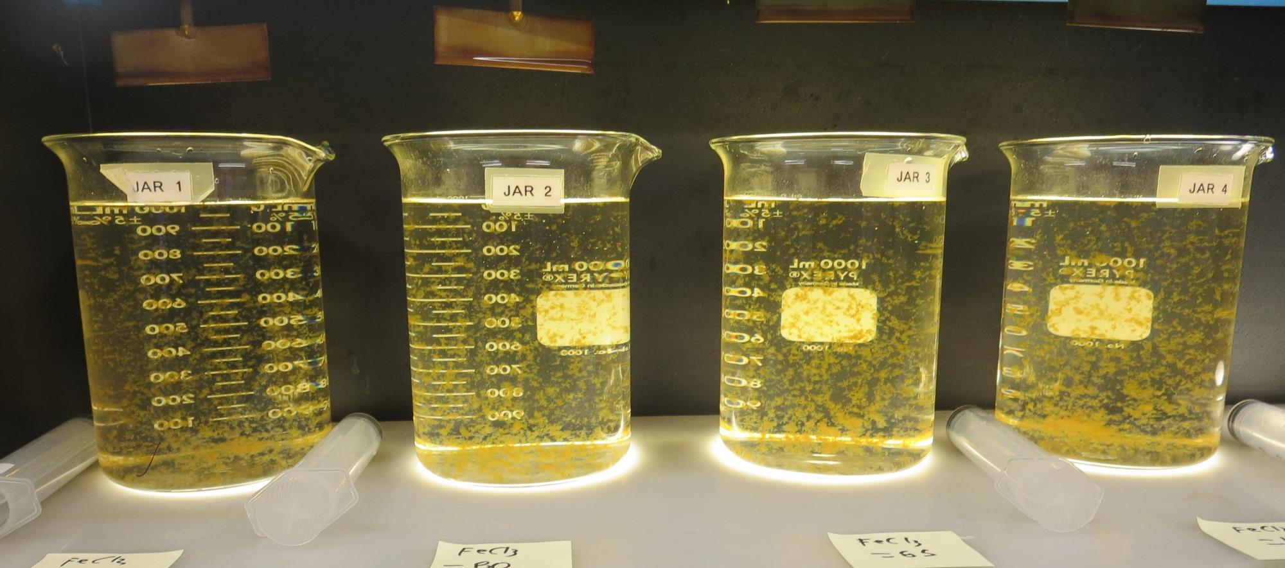
Jars 5-8: End of 5-minute flocculation (30 RPM) duration.
75 mg/L 42.4% FeCl₃
Filtrate 0.09 NTU
UVT: 92.9%
UVA: 0.031/cm
Settled: 1.06 NTU
80 mg/L 42.4% FeCl₃
Filtrate 0.12 NTU
UVT: 92.2%
UVA: 0.034/cm
Settled: 1.02 NTU
85 mg/L 42.4% FeCl₃
Filtrate 0.11 NTU
UVT: 92.5%
UVA: 0.033/cm
Settled: 0.98 NTU
105 mg/L 42.4% FeCl₃
Filtrate 0.10 NTU
UVT: 93.2%
UVA: 0.030/cm
Settled: 1.01 NTU

Slide 26
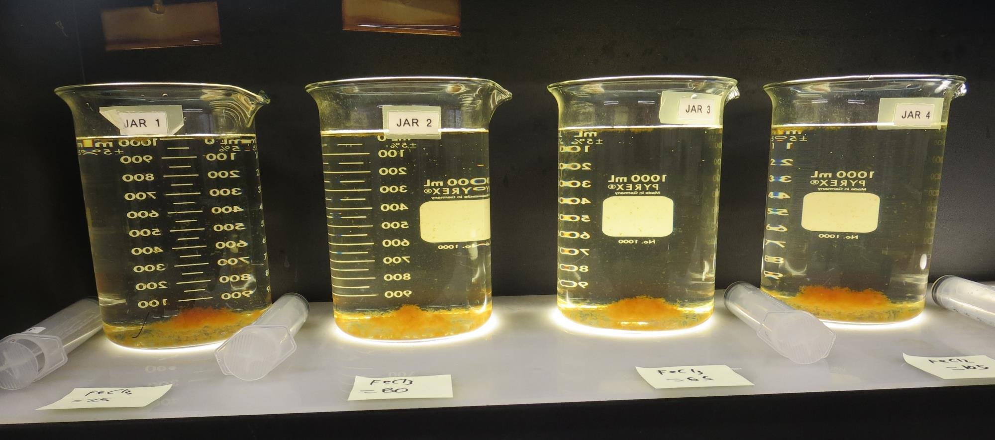
Jars 5-8: After 5 min of settling, 25 mL is syringed for filterability and %UVT/UVA.

Slide 27
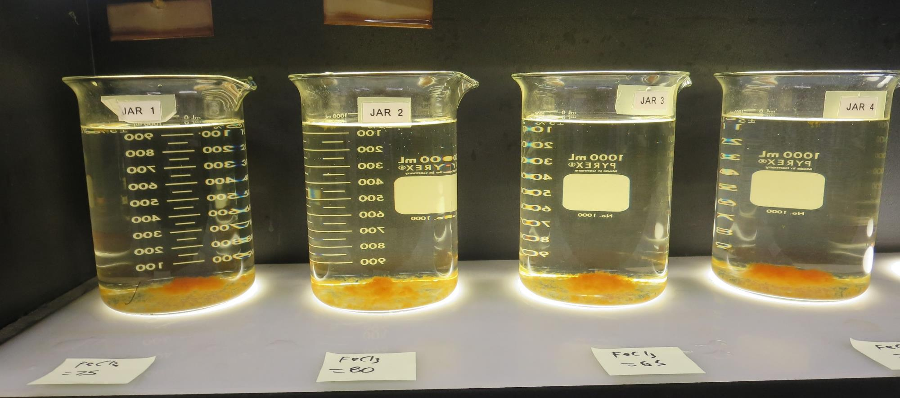
Jars 5-8: After 25-minutes of settling, settled water turbidity is taken.
75 mg/L 42.4% FeCl₃
Filtrate 0.09 NTU
UVT: 92.9%
UVA: 0.031/cm
Settled: 1.06 NTU
80 mg/L 42.4% FeCl₃
Filtrate 0.12 NTU
UVT: 92.2%
UVA: 0.034/cm
Settled: 1.02 NTU
85 mg/L 42.4% FeCl₃
Filtrate 0.11 NTU
UVT: 92.5%
UVA: 0.033/cm
Settled: 0.98 NTU
105 mg/L 42.4% FeCl₃
Filtrate 0.10 NTU
UVT: 93.2%
UVA: 0.030/cm
Settled: 1.01 NTU

Slide 28
Jars 9-12 Test Flash Mix 30 Sec (200 RPM) Floc Mix 5 min (30 RPM) Post KMnO₄ Applied Coagulants 42.4% FeCl₃/926

Slide 29
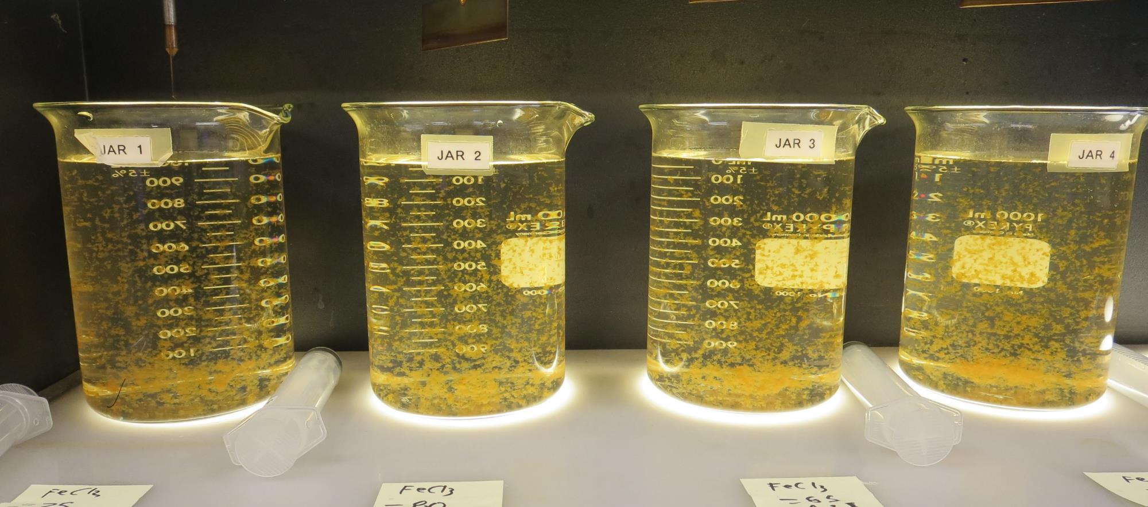
Jars 9-12: End of 5-minute flocculation (30 RPM) duration.
75 mg/L 42.4% FeCl₃
3.75 mg/L 926
Filtrate 0.10 NTU
UVT: 93.3%
UVA: 0.030/cm
Settled: 1.04 NTU
80 mg/L 42.4% FeCl₃
3.58 mg/L 926
Filtrate 0.12 NTU
UVT: 92.7%
UVA: 0.032/cm
Settled: 1.21 NTU
85 mg/L 42.4% FeCl₃
3.81 mg/L 926
Filtrate 0.12 NTU
UVT: 93.1%
UVA: 0.031/cm
Settled: 1.02 NTU
105 mg/L 42.4% FeCl₃
4.70 mg/L 926
Filtrate 0.11 NTU
UVT: 93.5%
UVA: 0.029/cm
Settled: 1.02 NTU

Slide 30
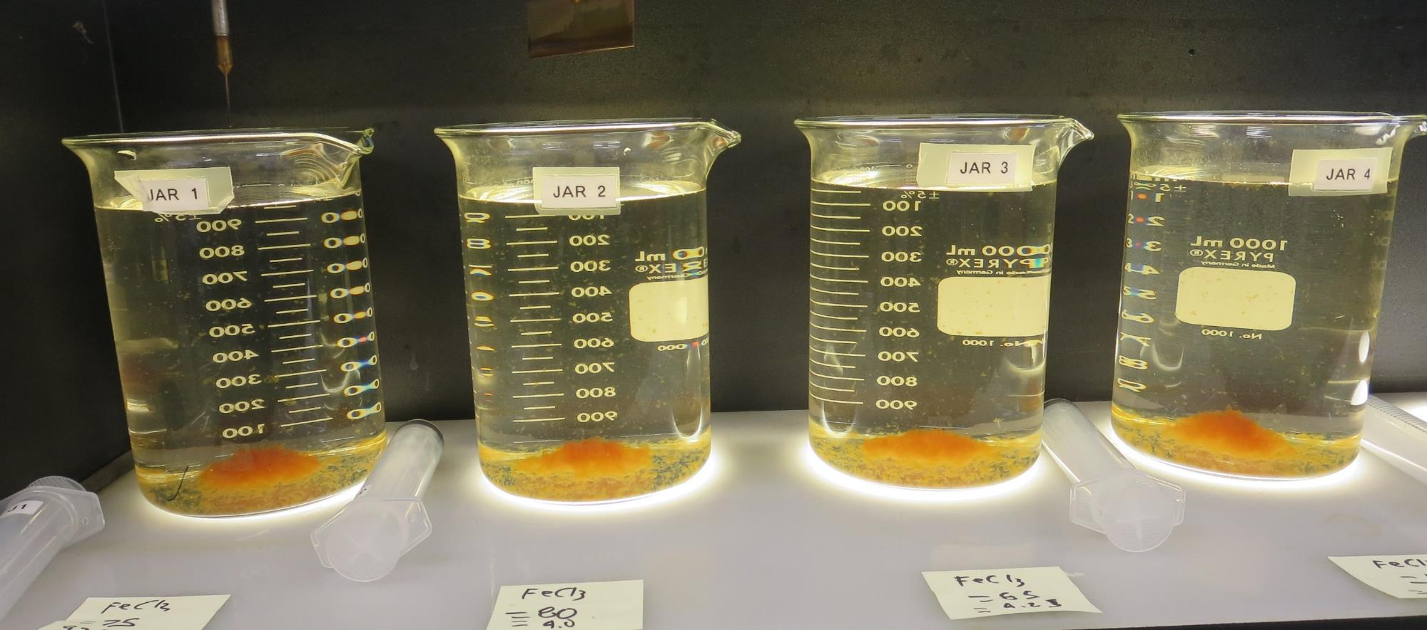
Jars 9-12: After 5 min of settling, 25 mL is syringed for filterability and %UVT/UVA.

Slide 31
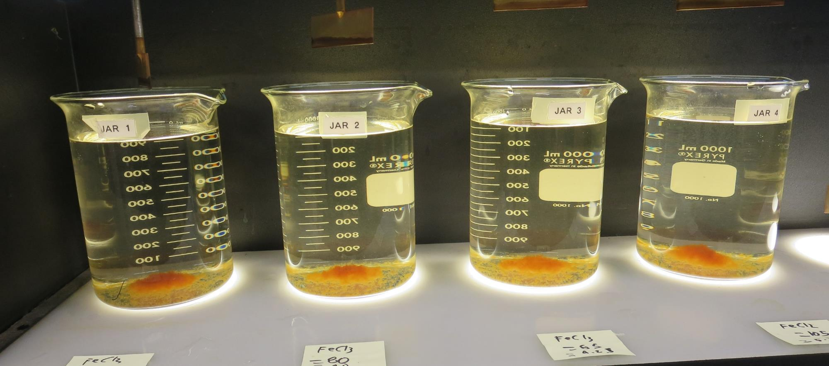
Jars 9-12: After 25-minutes of settling, settled water turbidity is taken.
75 mg/L 42.4% FeCl₃
3.75 mg/L 926
Filtrate 0.10 NTU
UVT: 93.3%
UVA: 0.030/cm
Settled: 1.04 NTU
80 mg/L 42.4% FeCl₃
3.58 mg/L 926
Filtrate 0.12 NTU
UVT: 92.7%
UVA: 0.032/cm
Settled: 1.21 NTU
85 mg/L 42.4% FeCl₃
3.81 mg/L 926
Filtrate 0.12 NTU
UVT: 93.1%
UVA: 0.031/cm
Settled: 1.02 NTU
105 mg/L 42.4% FeCl₃
4.70 mg/L 926
Filtrate 0.11 NTU
UVT: 93.5%
UVA: 0.029/cm
Settled: 1.02 NTU

Slide 32
Jars 13-16 Test Flash Mix 30 Sec (200 RPM) Floc Mix 5 min (30 RPM) Post KMnO₄ Applied Coagulant Advanced Coagulant

Slide 33
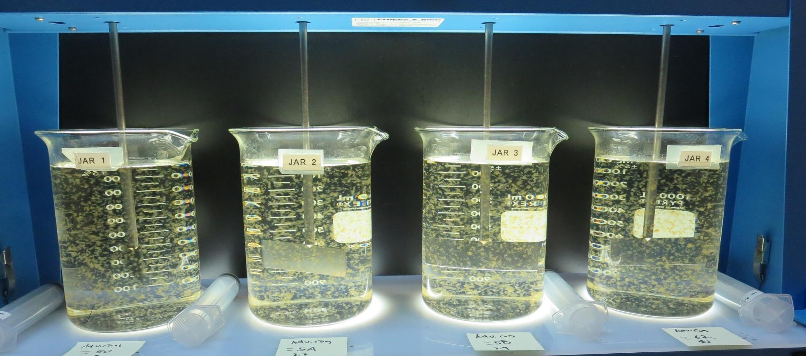
Jars 13-16: End of 5-minute flocculation (30 RPM) duration.
50 mg/L Adv Coag
Filtrate 0.09 NTU
UVT: 92.2%
UVA: 0.035/cm
Settled: 0.42 NTU
54 mg/L Adv Coag
Filtrate 0.08 NTU
UVT: 92.4%
UVA: 0.034/cm
Settled: 0.36 NTU
58 mg/L Adv Coag
Filtrate 0.09 NTU
UVT: 92.5%
UVA: 0.033/cm
Settled: 0.34 NTU
62 mg/L Adv Coag
Filtrate 0.10 NTU
UVT: 92.6%
UVA: 0.033/cm
Settled: 0.31 NTU

Slide 34
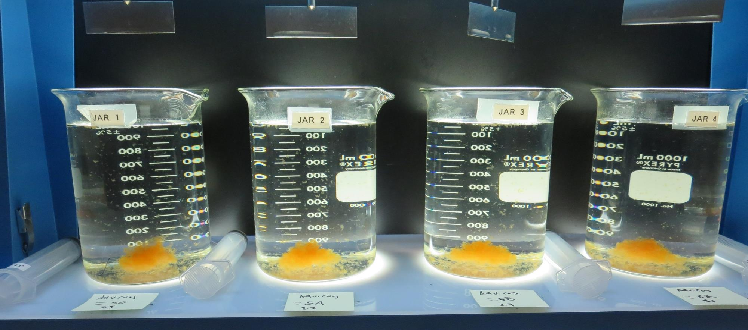
Jars 13-16: After 5 min of settling, 25 mL is syringed for filterability and %UVT/UVA.

Slide 35
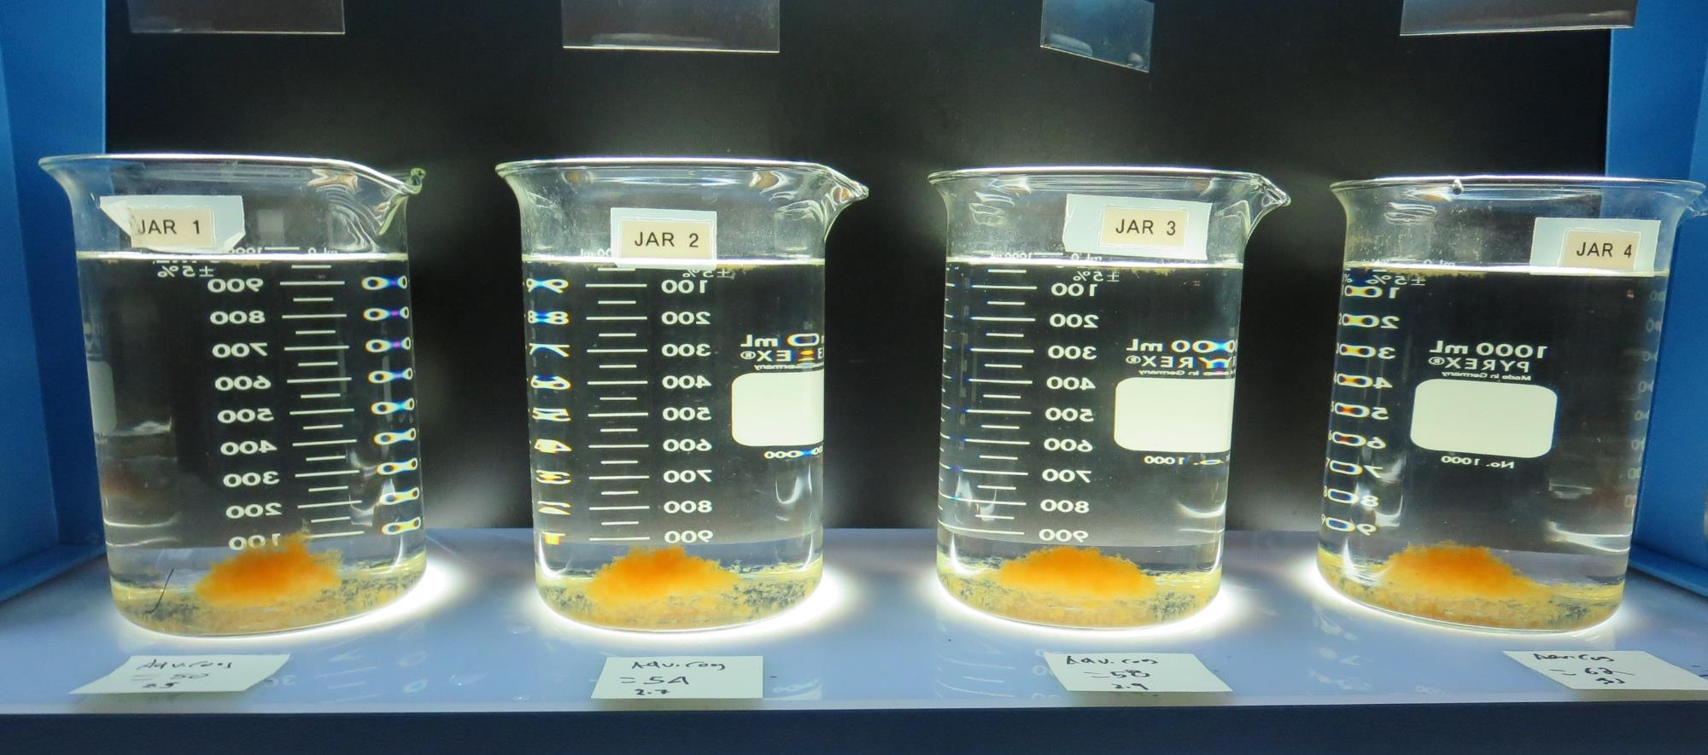
Jars 13-16: After 25-minutes of settling, settled water turbidity is taken.
50 mg/L Adv Coag
Filtrate 0.09 NTU
UVT: 92.2%
UVA: 0.035/cm
Settled: 0.42 NTU
54 mg/L Adv Coag
Filtrate 0.08 NTU
UVT: 92.4%
UVA: 0.034/cm
Settled: 0.36 NTU
58 mg/L Adv Coag
Filtrate 0.09 NTU
UVT: 92.5%
UVA: 0.033/cm
Settled: 0.34 NTU
62 mg/L Adv Coag
Filtrate 0.10 NTU
UVT: 92.6%
UVA: 0.033/cm
Settled: 0.31 NTU

Slide 36
Jars 17-20 Test Flash Mix 30 Sec (200 RPM) Floc Mix 5 min (30 RPM) Post KMnO₄ Applied Coagulant Advanced Coagulant

Slide 37
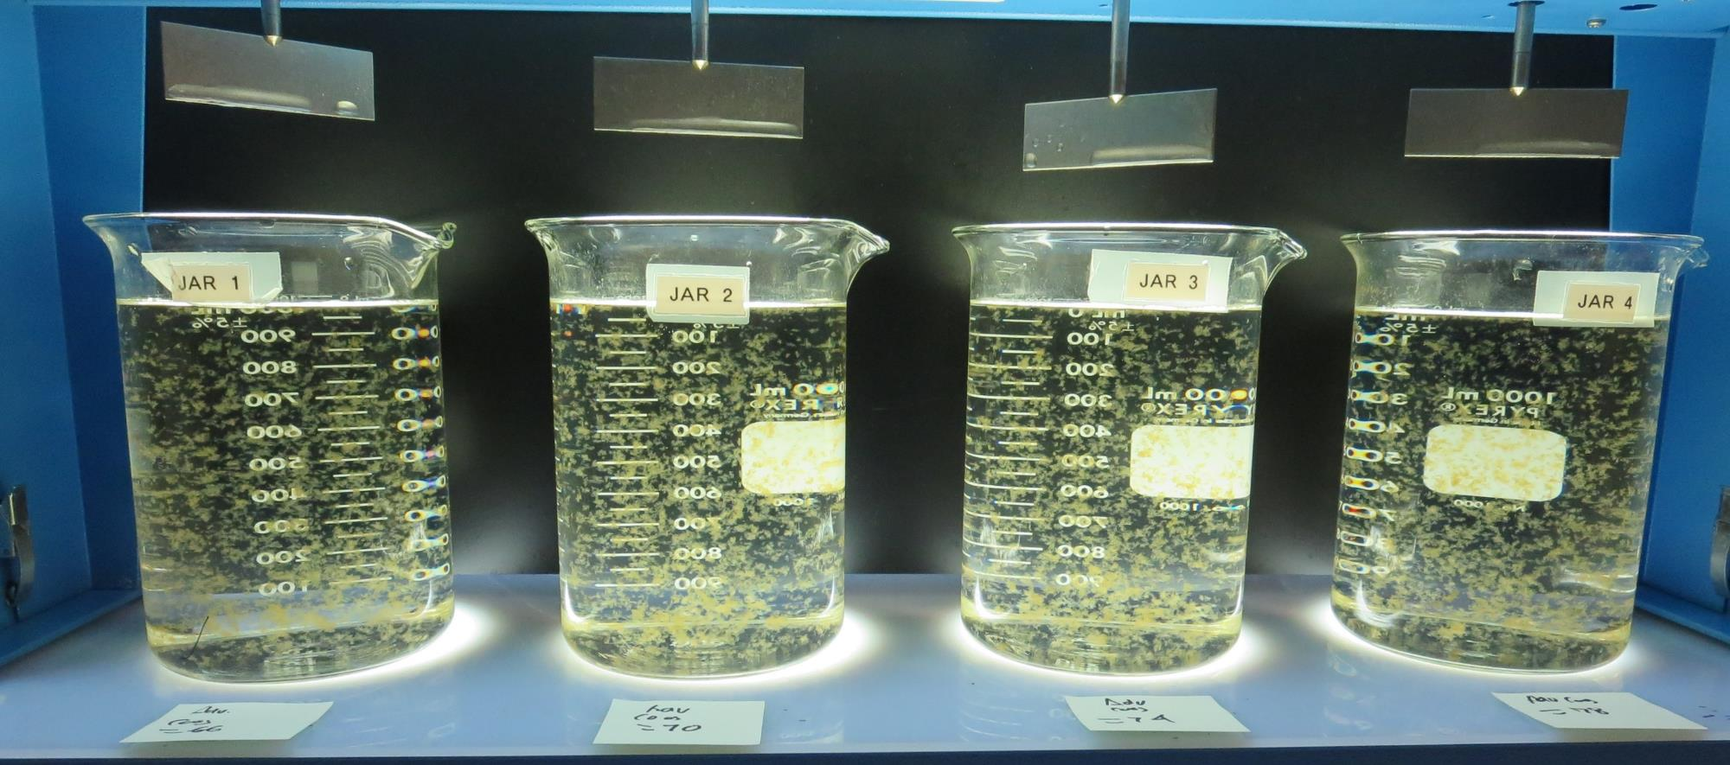
Jars 17-20: End of 5-minute flocculation (30 RPM) duration.
66 mg/L Adv Coag
Filtrate 0.09 NTU
UVT: 93.2%
UVA: 0.030/cm
Settled: 0.30 NTU
70 mg/L Adv Coag
Filtrate 0.07 NTU
UVT: 93.4%
UVA: 0.029/cm
Settled: 0.30 NTU
74 mg/L Adv Coag
Filtrate 0.08 NTU
UVT: 93.4%
UVA: 0.029/cm
Settled: 0.31 NTU
78 mg/L Adv Coag
Filtrate 0.07 NTU
UVT: 93.3%
UVA: 0.030/cm
Settled: 0.23 NTU

Slide 38
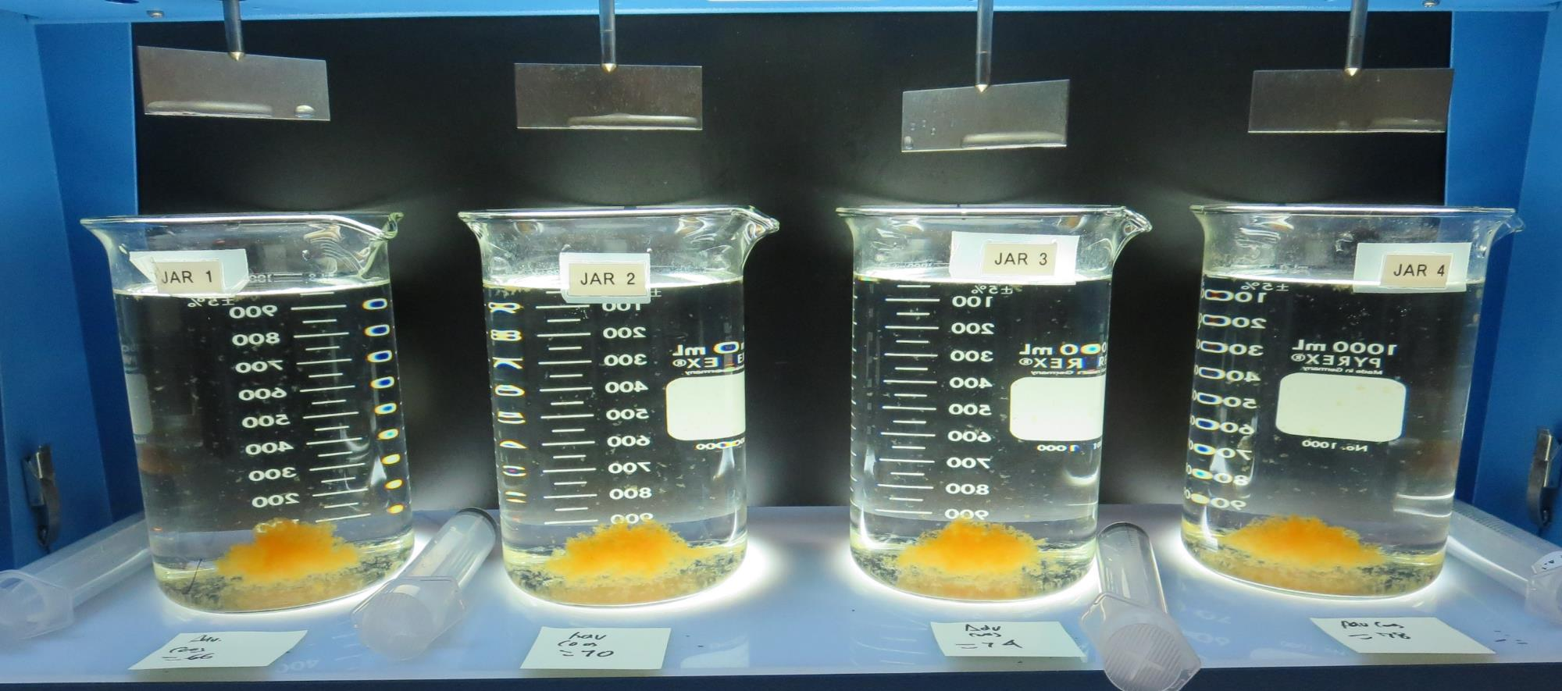
Jars 17-20: After 5 min of settling, 25 mL is syringed for filterability and %UVT/UVA.

Slide 39
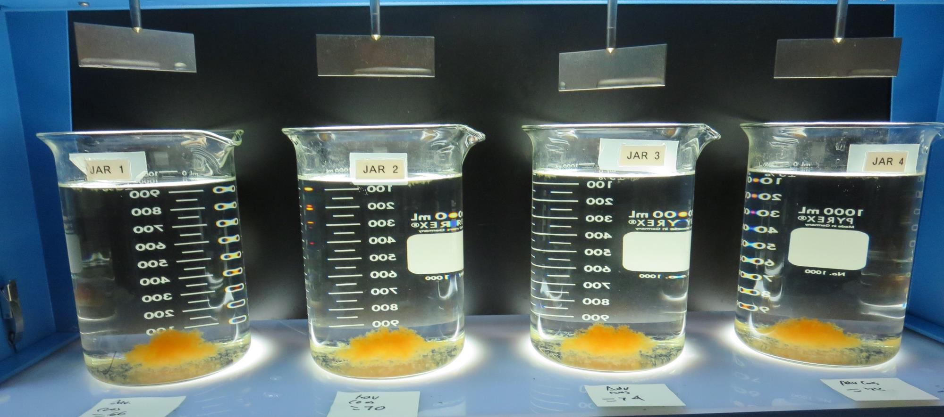
Jars 17-20: After 25-minutes of settling, settled water turbidity is taken.
66 mg/L Adv Coag
Filtrate 0.09 NTU
UVT: 93.2%
UVA: 0.030/cm
Settled: 0.30 NTU
70 mg/L Adv Coag
Filtrate 0.07 NTU
UVT: 93.4%
UVA: 0.029/cm
Settled: 0.30 NTU
74 mg/L Adv Coag
Filtrate 0.08 NTU
UVT: 93.4%
UVA: 0.029/cm
Settled: 0.31 NTU
78 mg/L Adv Coag
Filtrate 0.07 NTU
UVT: 93.3%
UVA: 0.030/cm
Settled: 0.23 NTU

Slide 40
Jars 21-24 Test Flash Mix 30 Sec (200 RPM) Floc Mix 5 min (30 RPM) Post KMnO₄ Applied Coagulant 9800

Slide 41
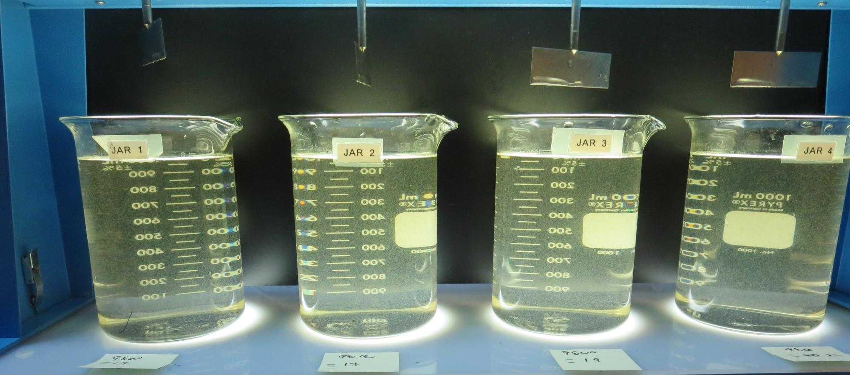
Jars 21-24: End of 5-minute flocculation (30 RPM) duration.
15 mg/L 9800
Filtrate 0.16 NTU
UVT: 91.4%
UVA: 0.038/cm
Settled: 1.80 NTU
17 mg/L 9800
Filtrate 0.08 NTU
UVT: 92.2%
UVA: 0.035/cm
Settled: 1.62 NTU
19 mg/L 9800
Filtrate 0.07 NTU
UVT: 92.5%
UVA: 0.033/cm
Settled: 1.78 NTU
21 mg/L 9800
Filtrate 0.07 NTU
UVT: 92.8%
UVA: 0.032/cm
Settled: 1.29 NTU

Slide 42
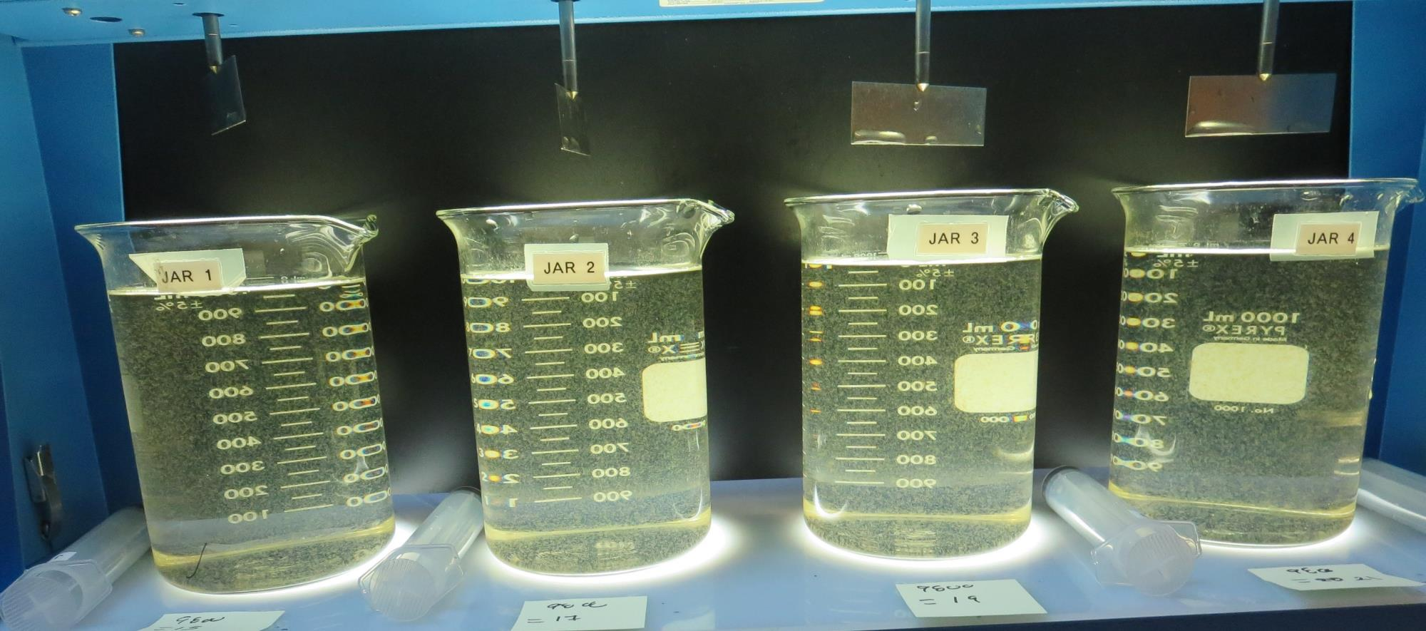
Jars 21-24: After 5 min of settling, 25 mL is syringed for filterability and %UVT/UVA.

Slide 43
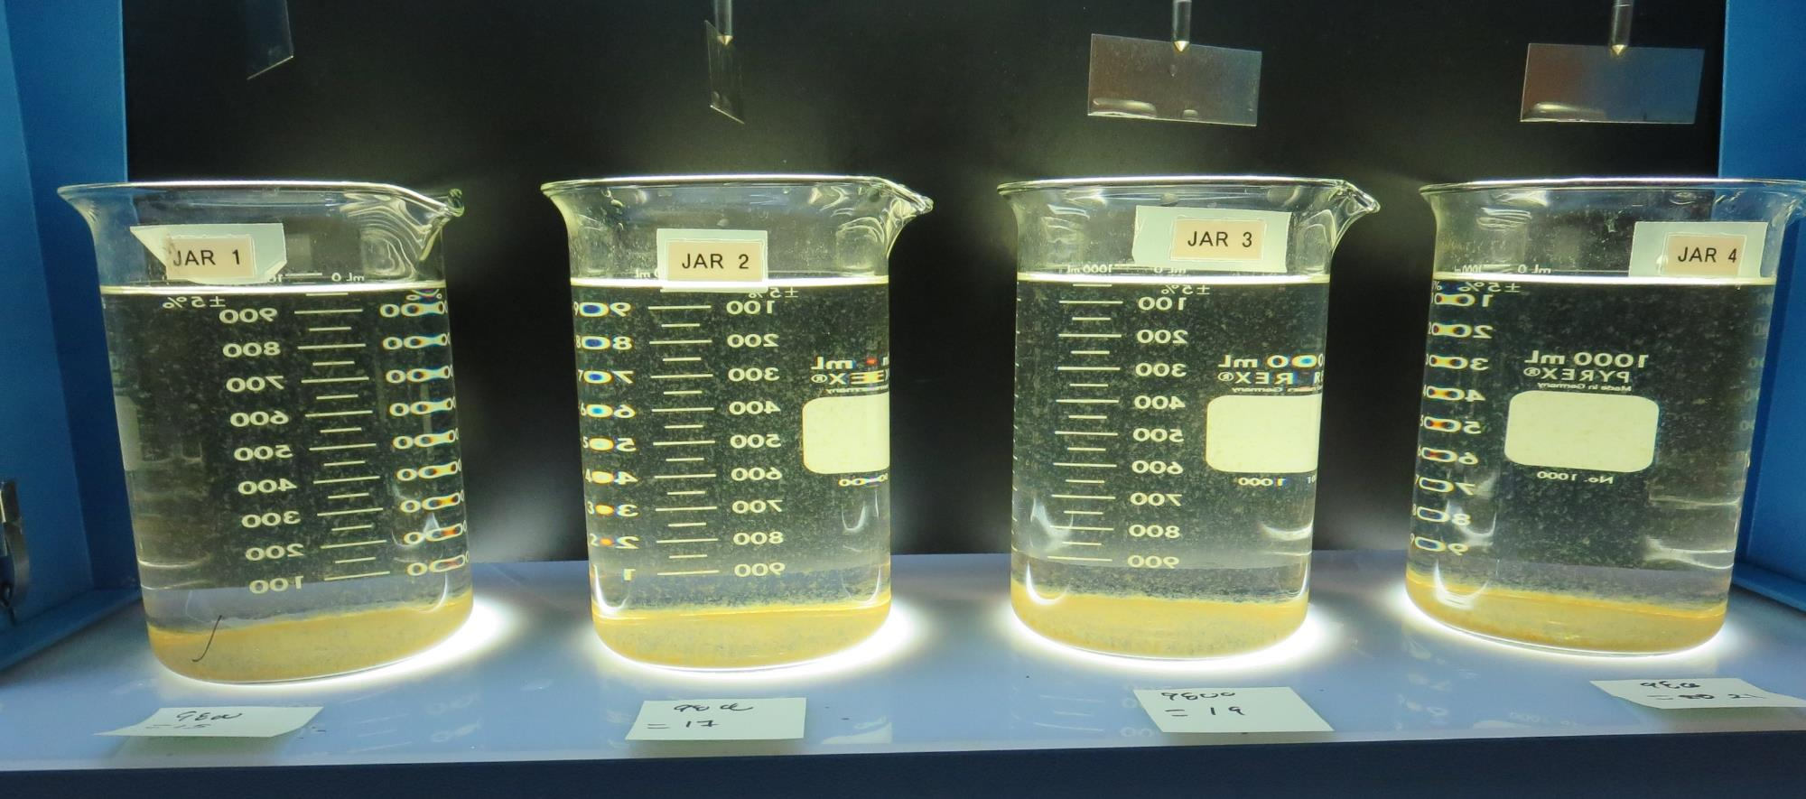
Jars 21-24: After 25-minutes of settling, settled water turbidity is taken.
15 mg/L 9800
Filtrate 0.16 NTU
UVT: 91.4%
UVA: 0.038/cm
Settled: 1.80 NTU
17 mg/L 9800
Filtrate 0.08 NTU
UVT: 92.2%
UVA: 0.035/cm
Settled: 1.62 NTU
19 mg/L 9800
Filtrate 0.07 NTU
UVT: 92.5%
UVA: 0.033/cm
Settled: 1.78 NTU
21 mg/L 9800
Filtrate 0.07 NTU
UVT: 92.8%
UVA: 0.032/cm
Settled: 1.29 NTU

Slide 44
Jars 25-28 Test Flash Mix 30 Sec (200 RPM) Floc Mix 5 min (30 RPM) Post KMnO₄ Applied Coagulant 9800

Slide 45
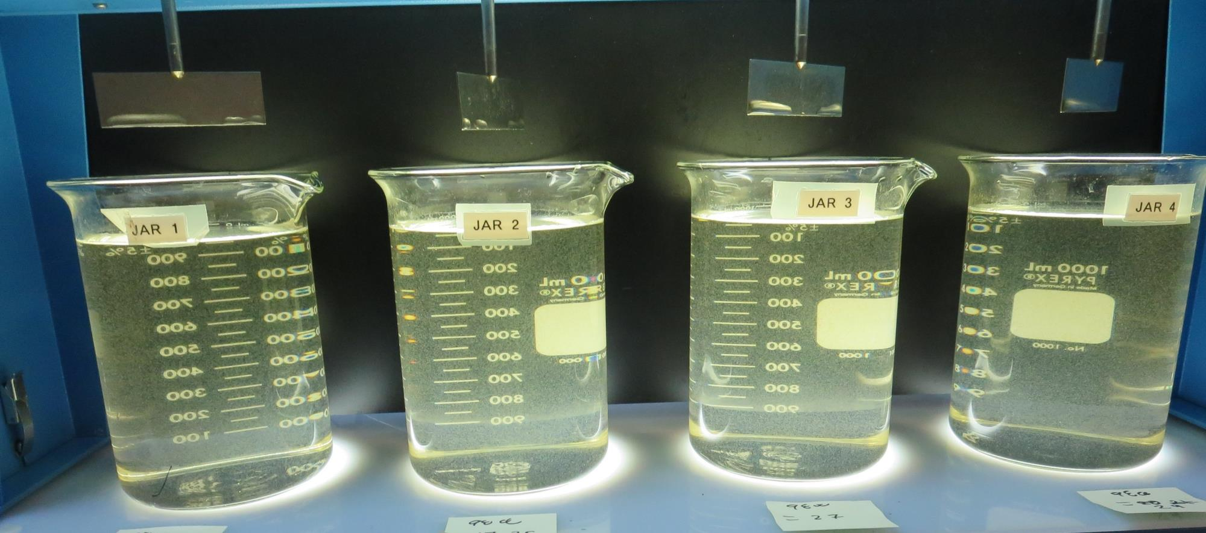
Jars 25-28: End of 5-minute flocculation (30 RPM) duration.
23 mg/L 9800
Filtrate 0.11 NTU
UVT: 92.8%
UVA: 0.032/cm
Settled: 1.28 NTU
25 mg/L 9800
Filtrate 0.07 NTU
UVT: 93.2%
UVA: 0.030/cm
Settled: 1.22 NTU
27 mg/L 9800
Filtrate 0.15 NTU
UVT: 92.9%
UVA: 0.031/cm
Settled: 1.17 NTU
29 mg/L 9800
Filtrate 0.13 NTU
UVT: 93.2%
UVA: 0.030/cm
Settled: 1.44 NTU

Slide 46
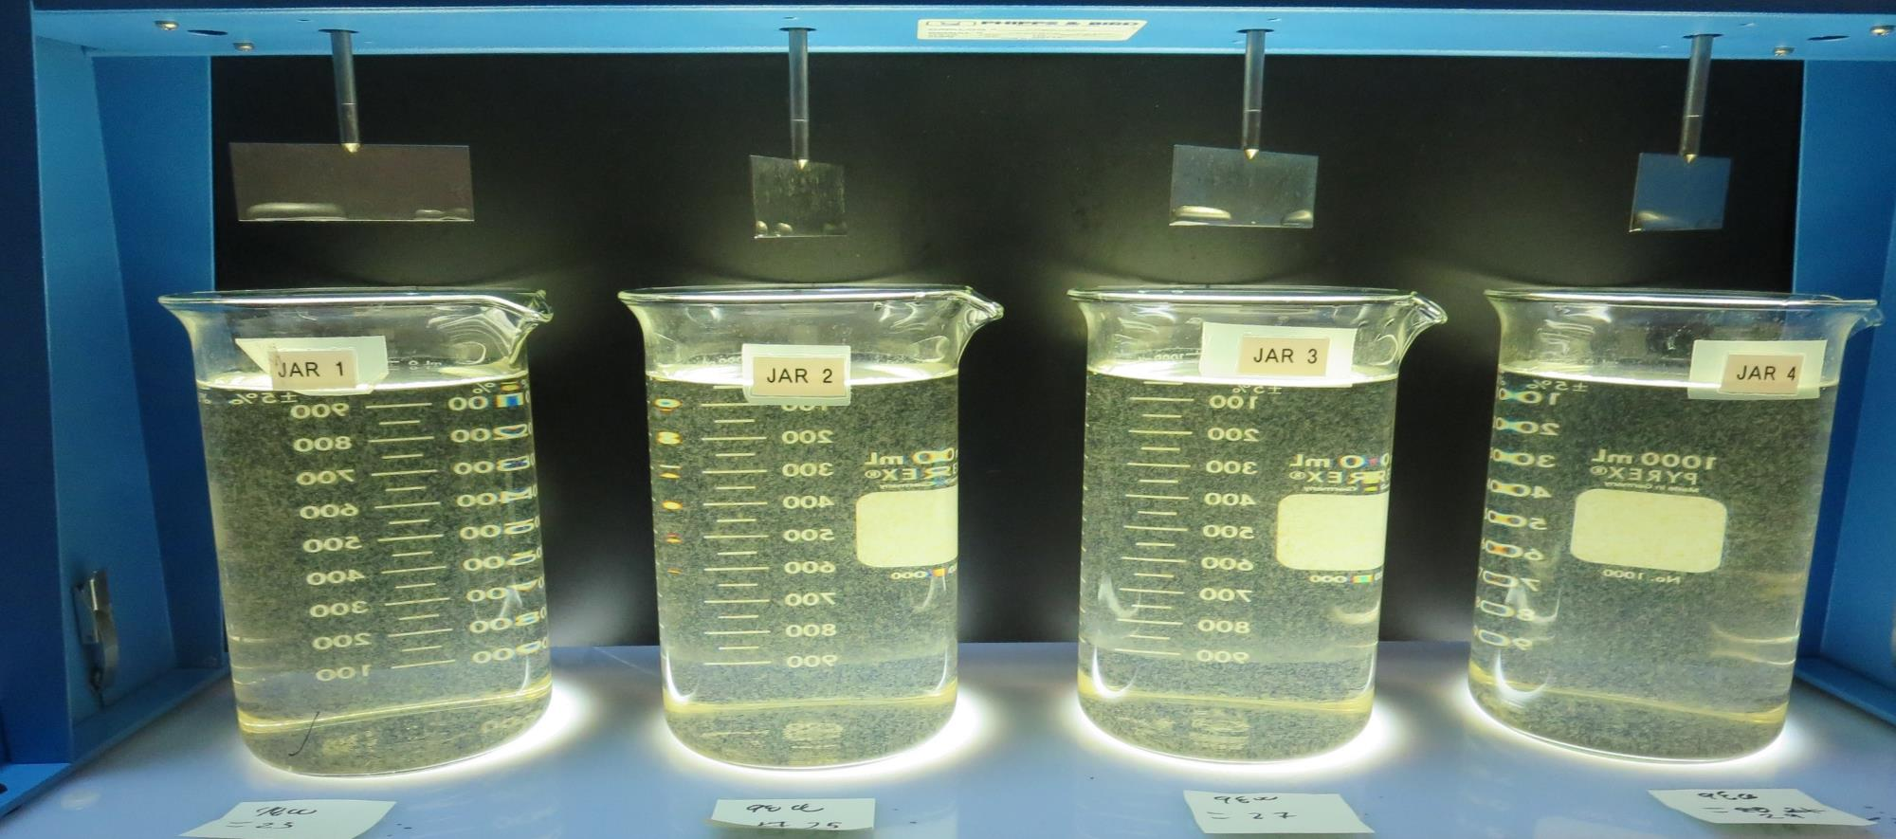
Jars 25-28: After 5 min of settling, 25 mL is syringed for filterability and %UVT/UVA.

Slide 47
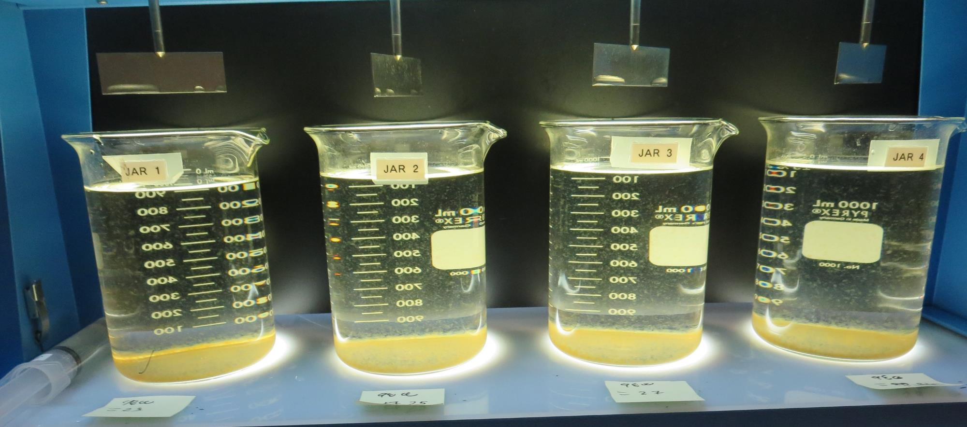
Jars 25-28: After 25-minutes of settling, settled water turbidity is taken.
23 mg/L 9800
Filtrate 0.11 NTU
UVT: 92.8%
UVA: 0.032/cm
Settled: 1.28 NTU
25 mg/L 9800
Filtrate 0.07 NTU
UVT: 93.2%
UVA: 0.030/cm
Settled: 1.22 NTU
27 mg/L 9800
Filtrate 0.15 NTU
UVT: 92.9%
UVA: 0.031/cm
Settled: 1.17 NTU
29 mg/L 9800
Filtrate 0.13 NTU
UVT: 93.2%
UVA: 0.030/cm
Settled: 1.44 NTU

Slide 48
Jars 29-32 Test Flash Mix 30 Sec (200 RPM) Floc Mix 5 min (30 RPM) Post KMnO₄ Applied Coagulant 7066

Slide 49
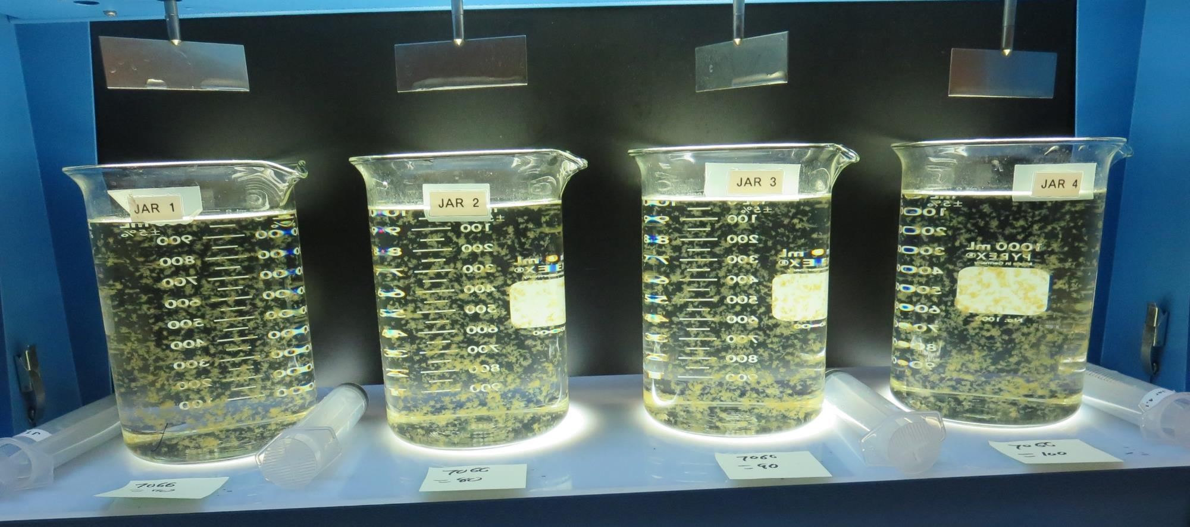
Jars 29-32: End of 5-minute flocculation (30 RPM) duration.
70 mg/L 7066
Filtrate 0.08 NTU
UVT: 93.0%
UVA: 0.031/cm
Settled: 0.30 NTU
80 mg/L 7066
Filtrate 0.08 NTU
UVT: 93.3%
UVA: 0.030/cm
Settled: 0.32 NTU
90 mg/L 7066
Filtrate 0.08 NTU
UVT: 93.5%
UVA: 0.028/cm
Settled: 0.27 NTU
100 mg/L 7066
Filtrate 0.07 NTU
UVT: 93.8%
UVA: 0.027/cm
Settled: 0.23 NTU

Slide 50
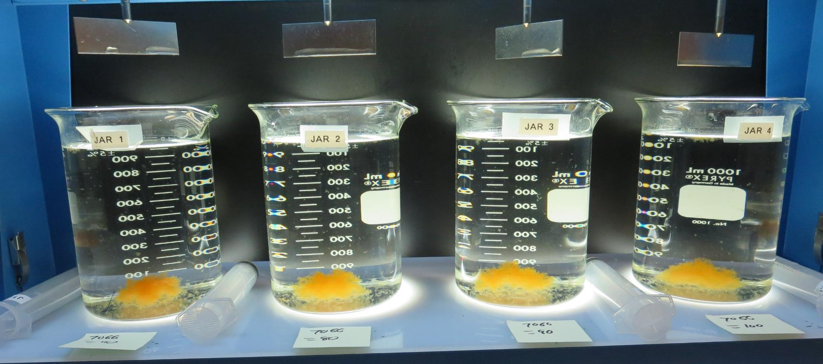
Jars 29-32: After 5 min of settling, 25 mL is syringed for filterability and %UVT/UVA.

Slide 51
Jars 29-32: After 25-minutes of settling, settled water turbidity is taken.
70 mg/L 7066
Filtrate 0.08 NTU
UVT: 93.0%
UVA: 0.031/cm
Settled: 0.30 NTU
80 mg/L 7066
Filtrate 0.08 NTU
UVT: 93.3%
UVA: 0.030/cm
Settled: 0.32 NTU
90 mg/L 7066
Filtrate 0.08 NTU
UVT: 93.5%
UVA: 0.028/cm
Settled: 0.27 NTU
100 mg/L 7066
Filtrate 0.07 NTU
UVT: 93.8%
UVA: 0.027/cm
Settled: 0.23 NTU

Slide 52
Jars 33-36 Test Flash Mix 30 Sec (200 RPM) Floc Mix 5 min (30 RPM) Post KMnO₄ Applied Coagulant 42.4% FeCl₃ w/pH adjustment

Slide 53
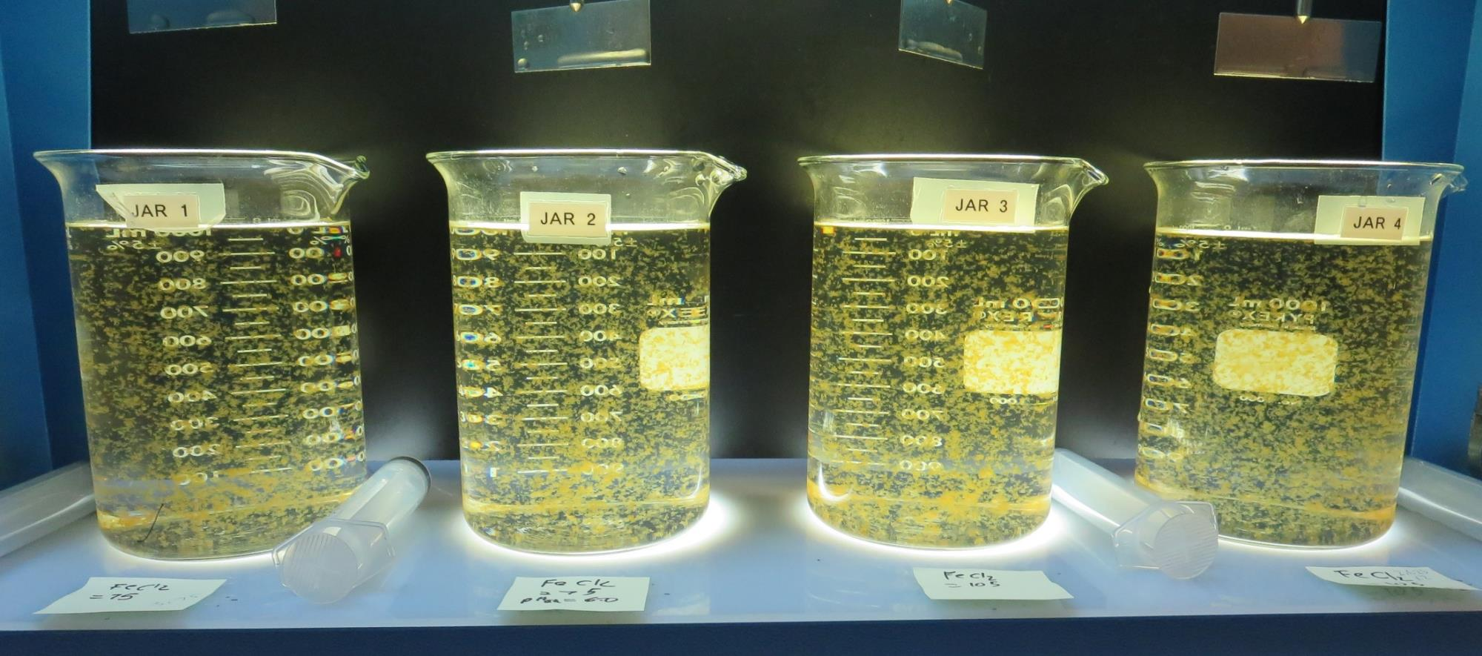
Jars 33-36: End of 5-minute flocculation (30 RPM) duration.
pH_{adj}: No
75 mg/L 42.4% FeCl₃
Filtrate 0.12 NTU
UVT: 92.4%
UVA: 0.034/cm
Settled: 0.67 NTU
pH_{adj}: 6.5
75 mg/L 42.4% FeCl₃
Filtrate 0.10 NTU
UVT: 92.0%
UVA: 0.036/cm
Settled: 0.67 NTU
pH_{adj}: No
105 mg/L 42.4% FeCl₃
Filtrate 0.08 NTU
UVT: 93.8%
UVA: 0.027/cm
Settled: 0.74 NTU
pH_{adj}: 6.5
105 mg/L 42.4% FeCl₃
Filtrate 0.11 NTU
UVT: 92.6%
UVA: 0.033/cm
Settled: 1.00 NTU

Slide 54
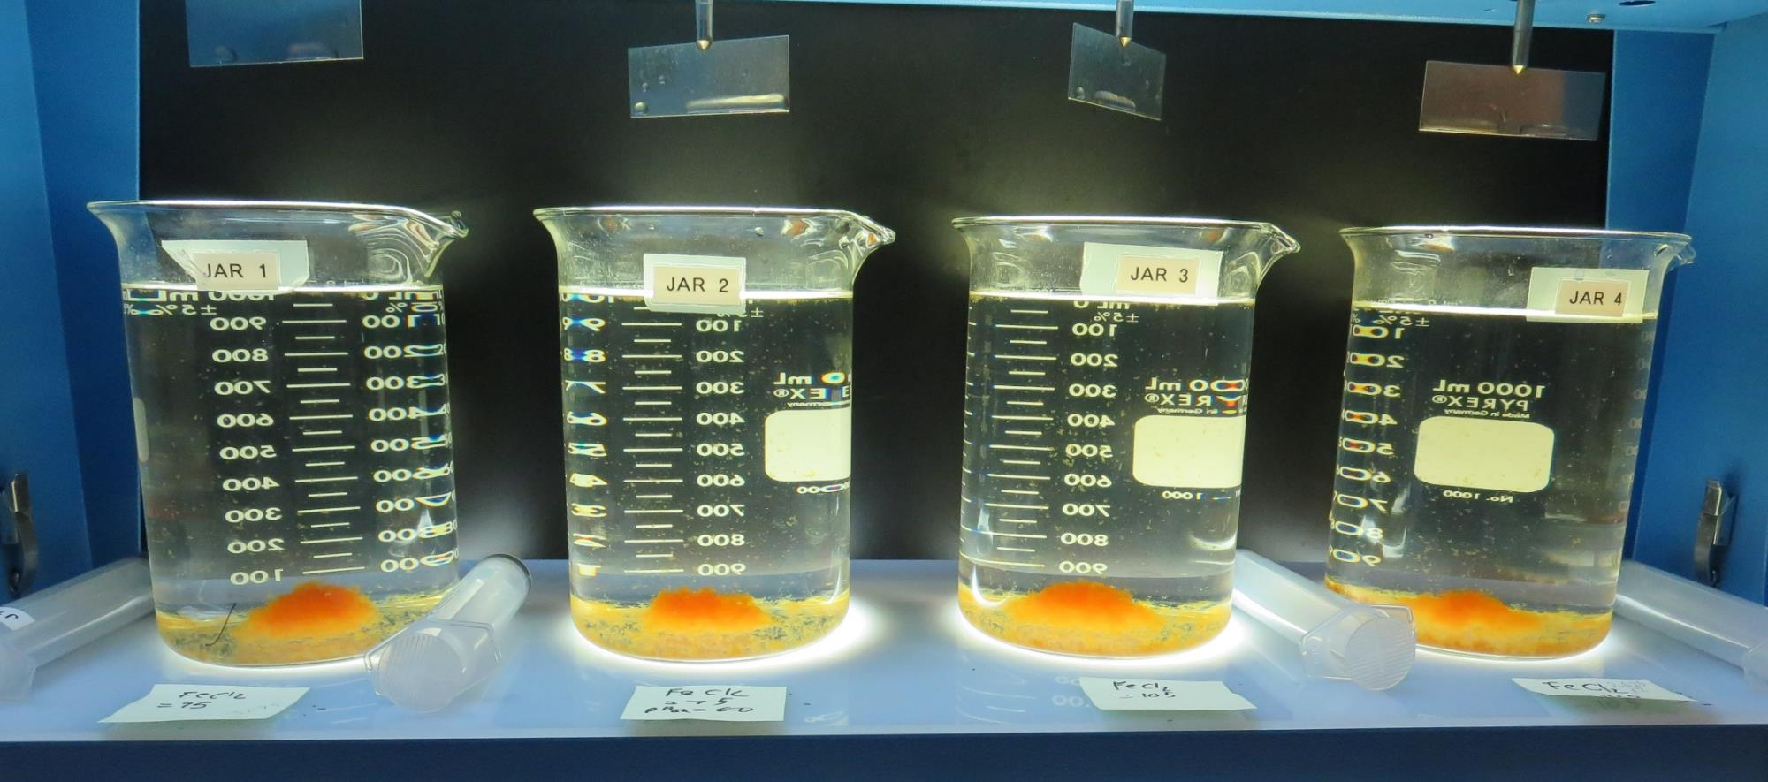
Jars 33-36: After 5 min of settling, 25 mL is syringed for filterability and %UVT/UVA.

Slide 55
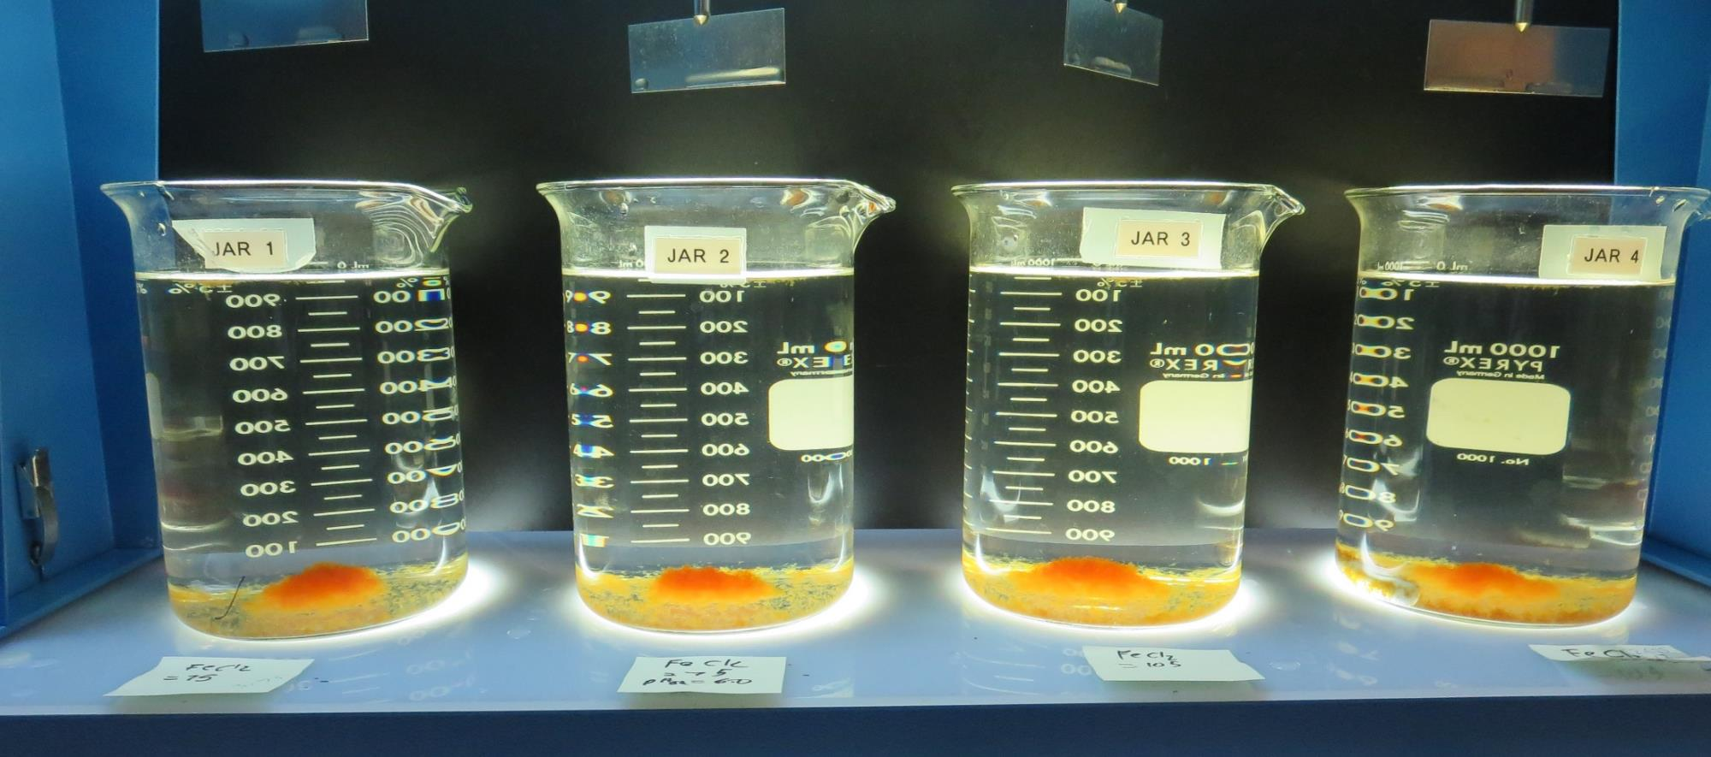
Jars 33-36: After 25-minutes of settling, settled water turbidity is taken.
pH_{adj}: No
75 mg/L 42.4% FeCl₃
Filtrate 0.12 NTU
UVT: 92.4%
UVA: 0.034/cm
Settled: 0.67 NTU
pH_{adj}: 6.5
75 mg/L 42.4% FeCl₃
Filtrate 0.10 NTU
UVT: 92.0%
UVA: 0.036/cm
Settled: 0.67 NTU
pH_{adj}: No
105 mg/L 42.4% FeCl₃
Filtrate 0.08 NTU
UVT: 93.8%
UVA: 0.027/cm
Settled: 0.74 NTU
pH_{adj}: 6.5
105 mg/L 42.4% FeCl₃
Filtrate 0.11 NTU
UVT: 92.6%
UVA: 0.033/cm
Settled: 1.00 NTU

Slide 56
Jars 37-40 Test Flash Mix 30 Sec (200 RPM) Floc Mix 5 min (30 RPM) Post KMnO₄ Applied Coagulant 42.4% FeCl₃

Slide 57
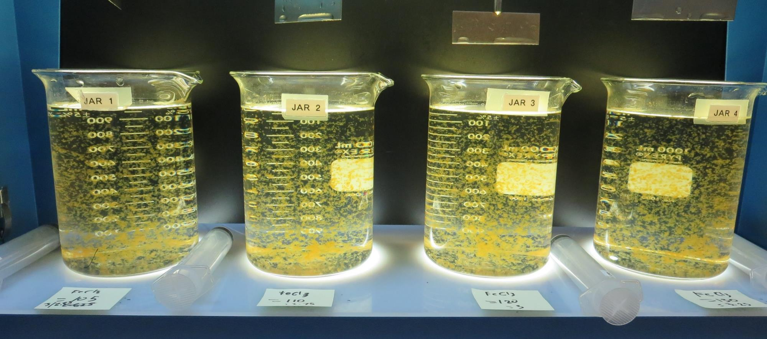
Jars 36-40: End of 5-minute flocculation (30 RPM) duration.
105 mg/L 42.4% FeCl₃
Filtrate 0.11 NTU
UVT: 93.0%
UVA: 0.031/cm
Settled: 0.48 NTU
110 mg/L 42.4% FeCl₃
Filtrate 0.09 NTU
UVT: 93.4%
UVA: 0.029/cm
Settled: 0.62 NTU
120 mg/L 42.4% FeCl₃
Filtrate 0.07 NTU
UVT: 94.6%
UVA: 0.023/cm
Settled: 0.55 NTU
130 mg/L 42.4% FeCl₃
Filtrate 0.09 NTU
UVT: 93.8%
UVA: 0.027/cm
Settled: 0.66 NTU

Slide 58
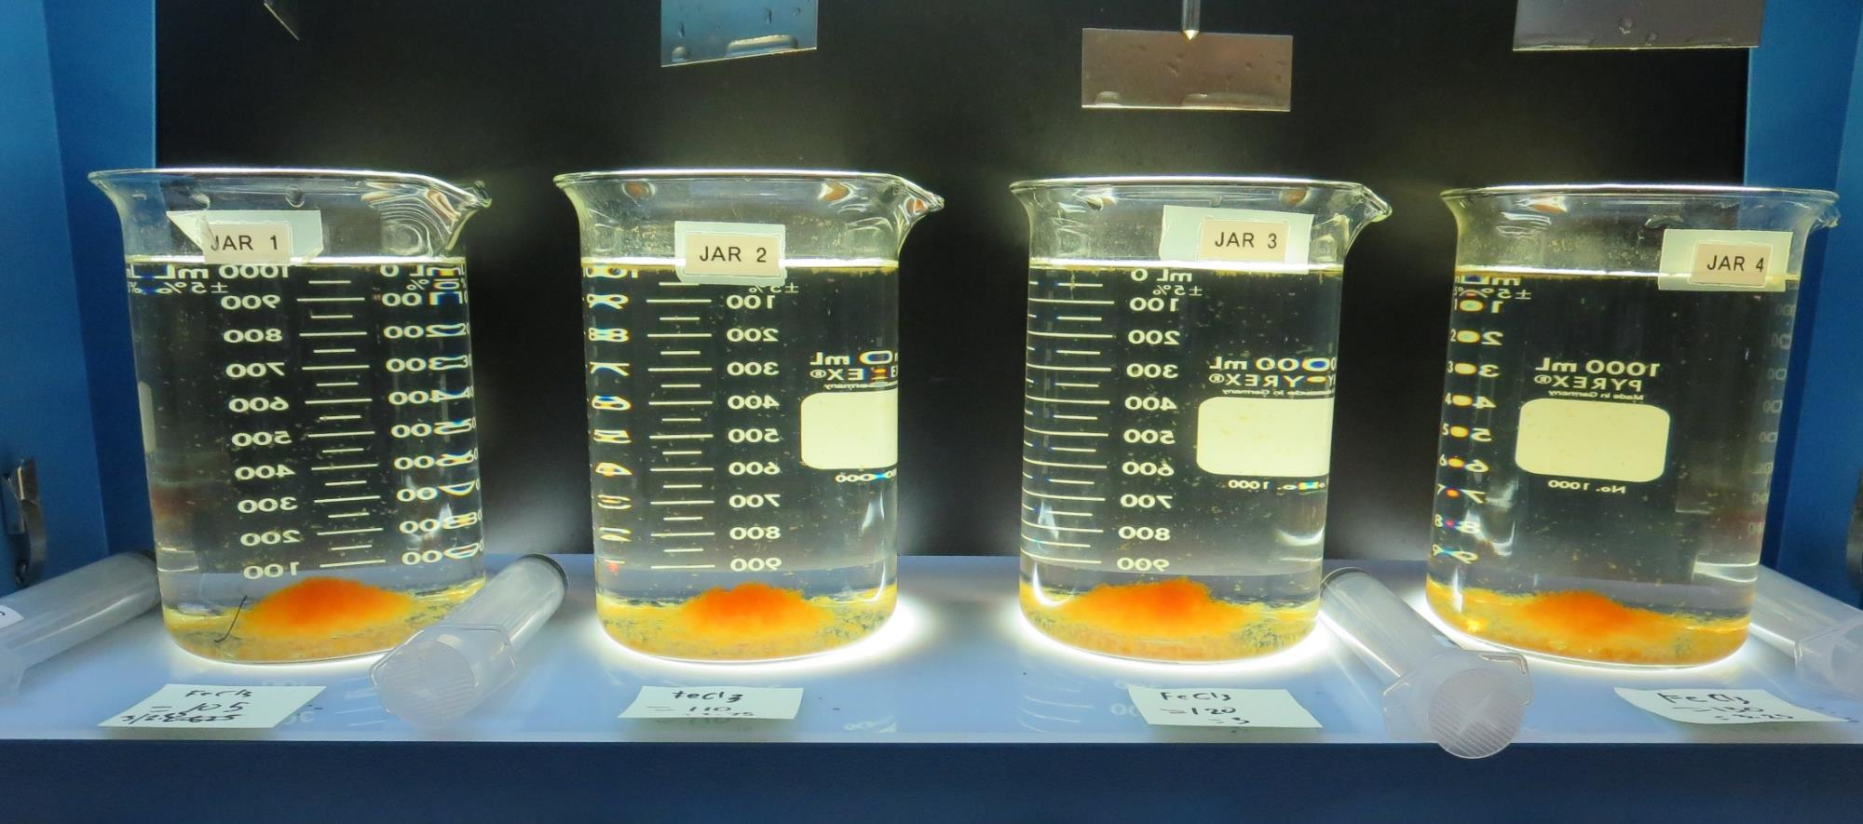
Jars 37-40: After 5 min of settling, 25 mL is syringed for filterability and %UVT/UVA.

Slide 59
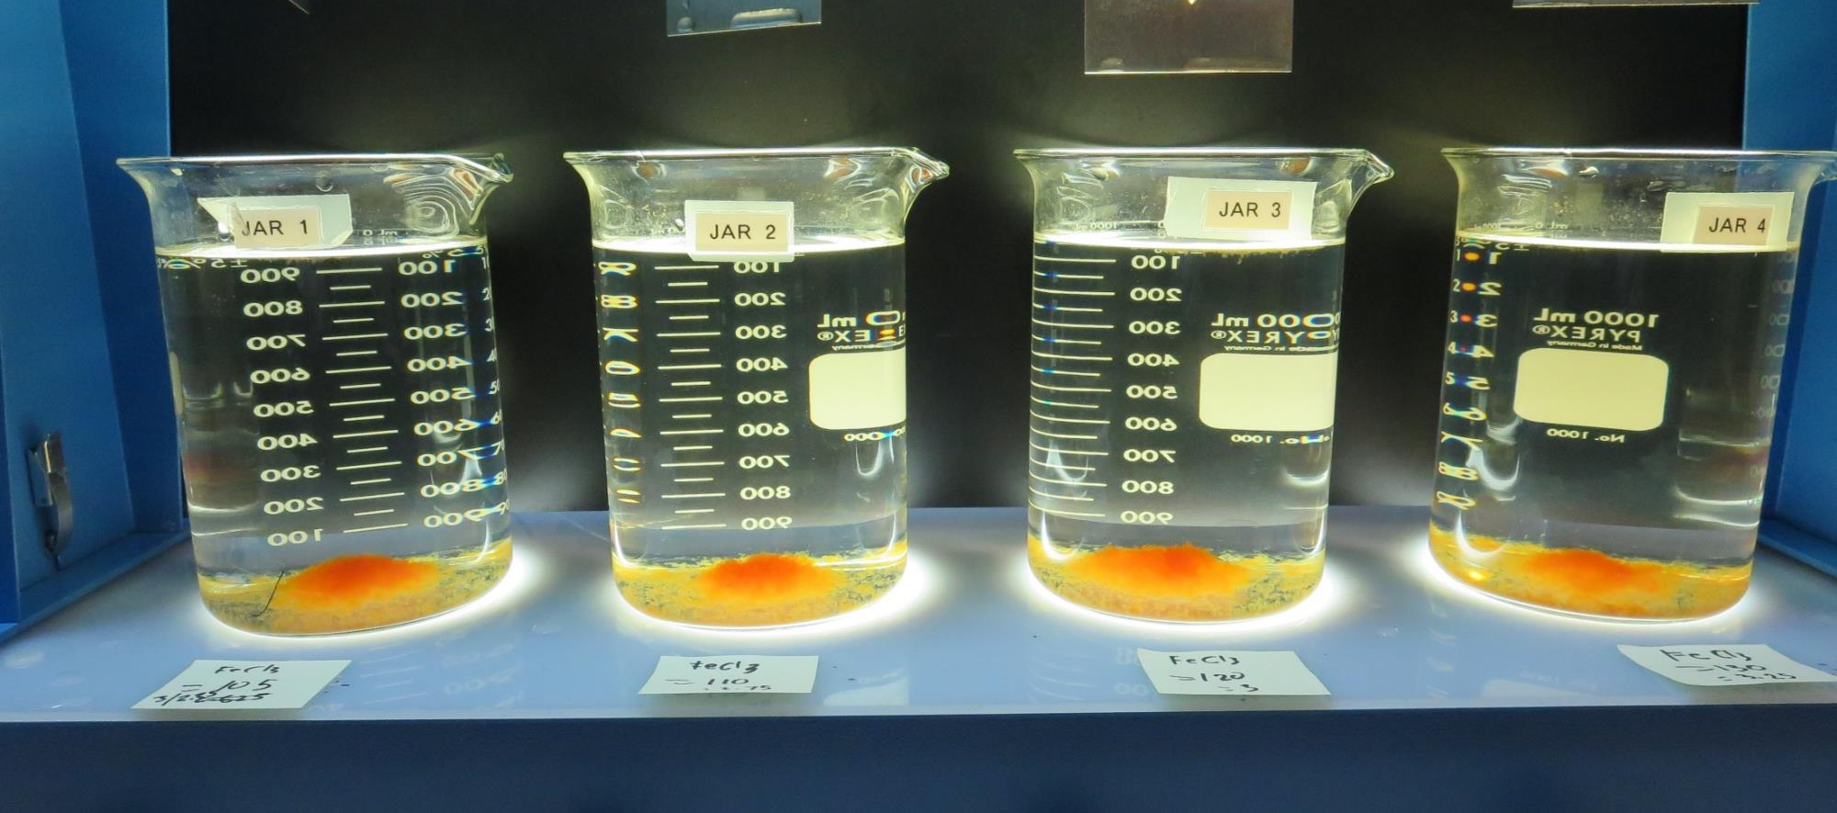
Jars 37-40: After 25-minutes of settling, settled water turbidity is taken.
105 mg/L 42.4% FeCl₃
Filtrate 0.11 NTU
UVT: 93.0%
UVA: 0.031/cm
Settled: 0.48 NTU
110 mg/L 42.4% FeCl₃
Filtrate 0.09 NTU
UVT: 93.4%
UVA: 0.029/cm
Settled: 0.62 NTU
120 mg/L 42.4% FeCl₃
Filtrate 0.07 NTU
UVT: 94.6%
UVA: 0.023/cm
Settled: 0.55 NTU
130 mg/L 42.4% FeCl₃
Filtrate 0.09 NTU
UVT: 93.8%
UVA: 0.027/cm
Settled: 0.66 NTU

Slide 60
Jars 41-44 Test Flash Mix 30 Sec (200 RPM) Floc Mix 5 min (30 RPM) Post KMnO₄ Applied Coagulant 7066

Slide 61
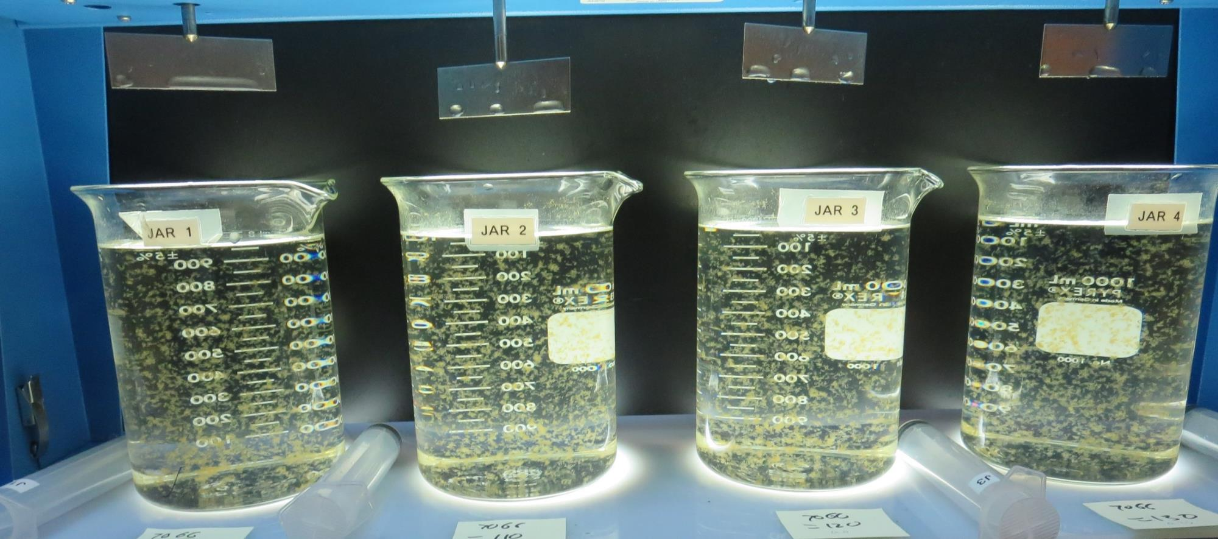
Jars 41-44: End of 5-minute flocculation (30 RPM) duration.
100 mg/L 7066
Filtrate 0.08 NTU
UVT: 92.4%
UVA: 0.034/cm
Settled: 0.34 NTU
110 mg/L 7066
Filtrate 0.12 NTU
UVT: 92.6%
UVA: 0.033/cm
Settled: 0.42 NTU
120 mg/L 7066
Filtrate 0.11 NTU
UVT: 92.7%
UVA: 0.032/cm
Settled: 0.33 NTU
130 mg/L 7066
Filtrate 0.14 NTU
UVT: 93.0%
UVA: 0.031/cm
Settled: 0.33 NTU

Slide 62
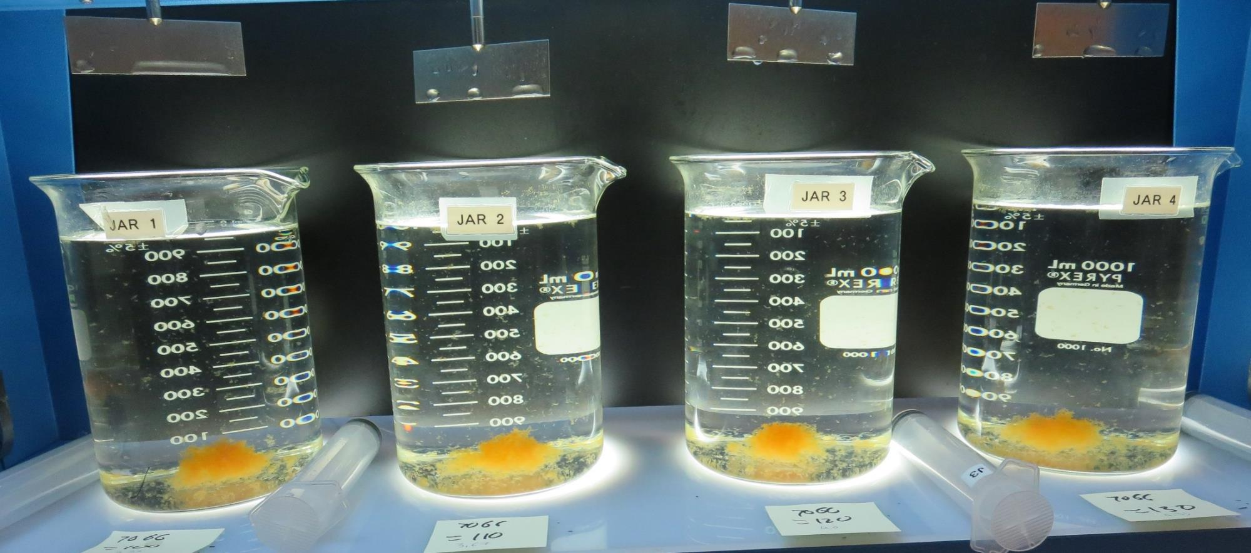
Jars 41-44: After 5 min of settling, 25 mL is syringed for filterability and %UVT/UVA.

Slide 63
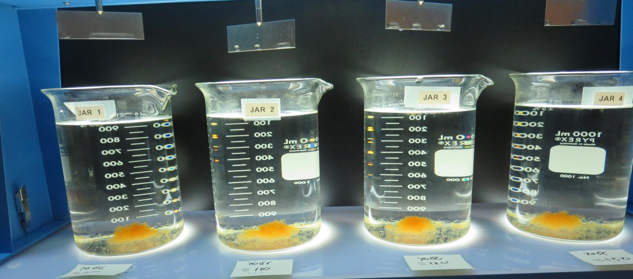
Jars 40-44: After 25-minutes of settling, settled water turbidity is taken.
100 mg/L 7066
Filtrate 0.08 NTU
UVT: 92.4%
UVA: 0.034/cm
Settled: 0.34 NTU
110 mg/L 7066
Filtrate 0.12 NTU
UVT: 92.6%
UVA: 0.033/cm
Settled: 0.42 NTU
120 mg/L 7066
Filtrate 0.11 NTU
UVT: 92.7%
UVA: 0.032/cm
Settled: 0.33 NTU
130 mg/L 7066
Filtrate 0.14 NTU
UVT: 93.0%
UVA: 0.031/cm
Settled: 0.33 NTU

Slide 64
Jars 45-48 Test Flash Mix 0 & 30 Sec (200 RPM) Floc Mix 5 min (30 RPM) Post KMnO₄ Applied Coagulants 7066/ 42.4% FeCl₃

Slide 65
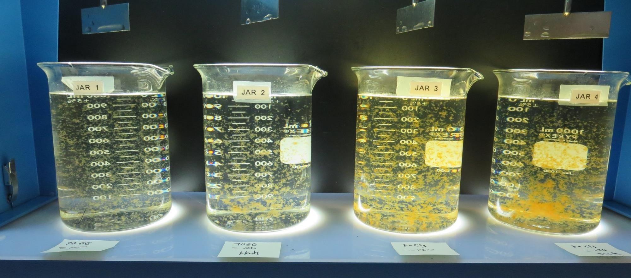
Jars 45-48: End of 5-minute flocculation (30 RPM) duration.
No Flash Mix
100 mg/L 7066
Filtrate 0.14 NTU
UVT: 92.5%
UVA: 0.033/cm
Settled: 0.56 NTU
Yes Flash Mix
100 mg/L 7066
Filtrate 0.13 NTU
UVT: 92.4%
UVA: 0.034/cm
Settled: 0.39 NTU
No Flash Mix
120 mg/L 42.4% FeCl₃
Filtrate 0.19 NTU
UVT: 93.6%
UVA: 0.028/cm
Settled: 0.84 NTU
Yes Flash Mix
120 mg/L 42.4% FeCl₃
Filtrate 0.14 NTU
UVT: 93.6%
UVA: 0.028/cm
Settled: 0.71 NTU

Slide 66
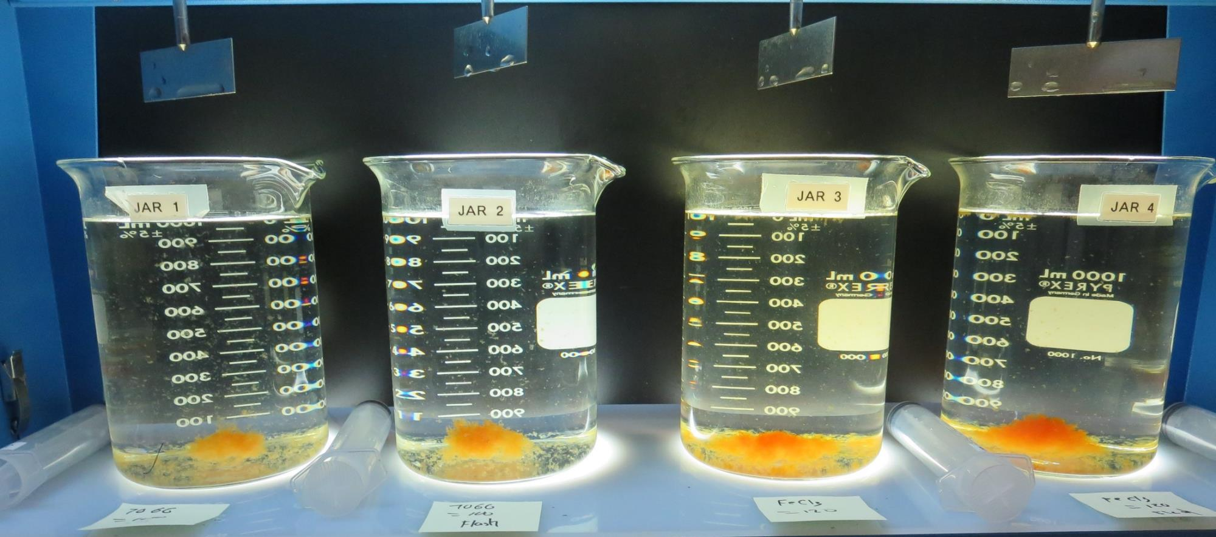
Jars 45-48: After 5 min of settling, 25 mL is syringed for filterability and %UVT/UVA.

Slide 67
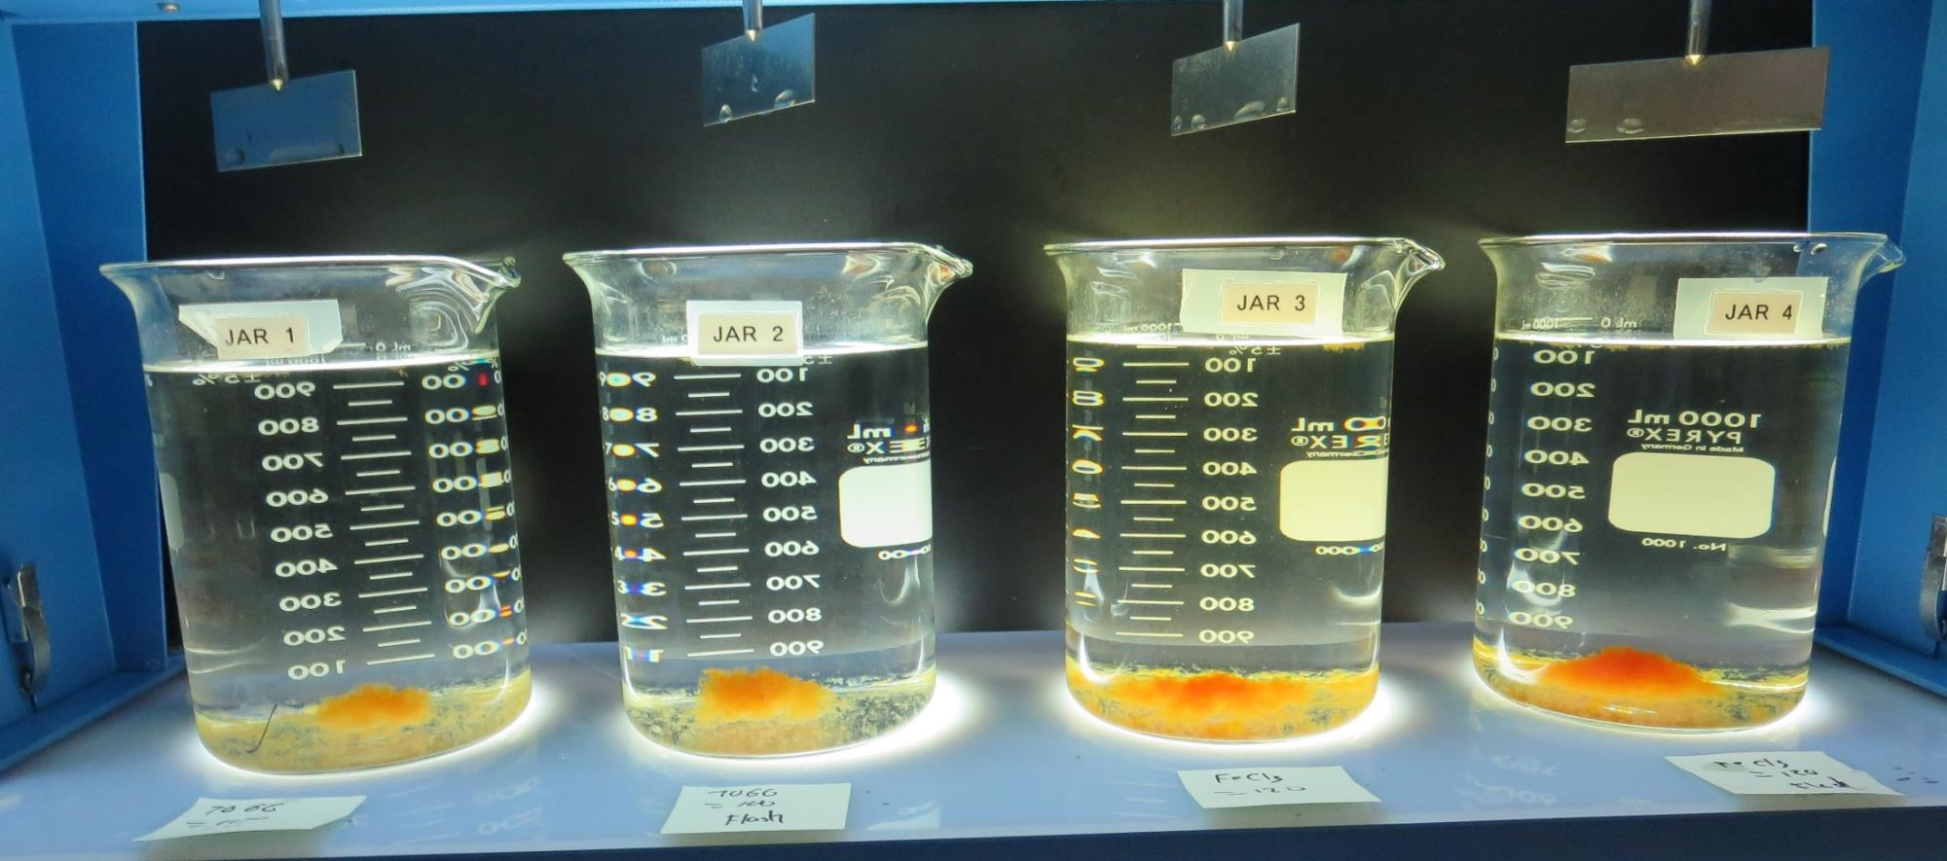
Jars 45-48: After 25-minutes of settling, settled water turbidity is taken.
No Flash Mix
100 mg/L 7066
Filtrate 0.14 NTU
UVT: 92.5%
UVA: 0.033/cm
Settled: 0.56 NTU
Yes Flash Mix
100 mg/L 7066
Filtrate 0.13 NTU
UVT: 92.4%
UVA: 0.034/cm
Settled: 0.39 NTU
No Flash Mix
120 mg/L 42.4% FeCl₃
Filtrate 0.19 NTU
UVT: 93.6%
UVA: 0.028/cm
Settled: 0.84 NTU
Yes Flash Mix
120 mg/L 42.4% FeCl₃
Filtrate 0.14 NTU
UVT: 93.6%
UVA: 0.028/cm
Settled: 0.71 NTU

Slide 68
Jars 49-52 Test Flash Mix 30 Sec (200 RPM) Floc Mix 5 min (30 RPM) Post KMnO₄ Applied Coagulant Advanced Coagulant

Slide 69
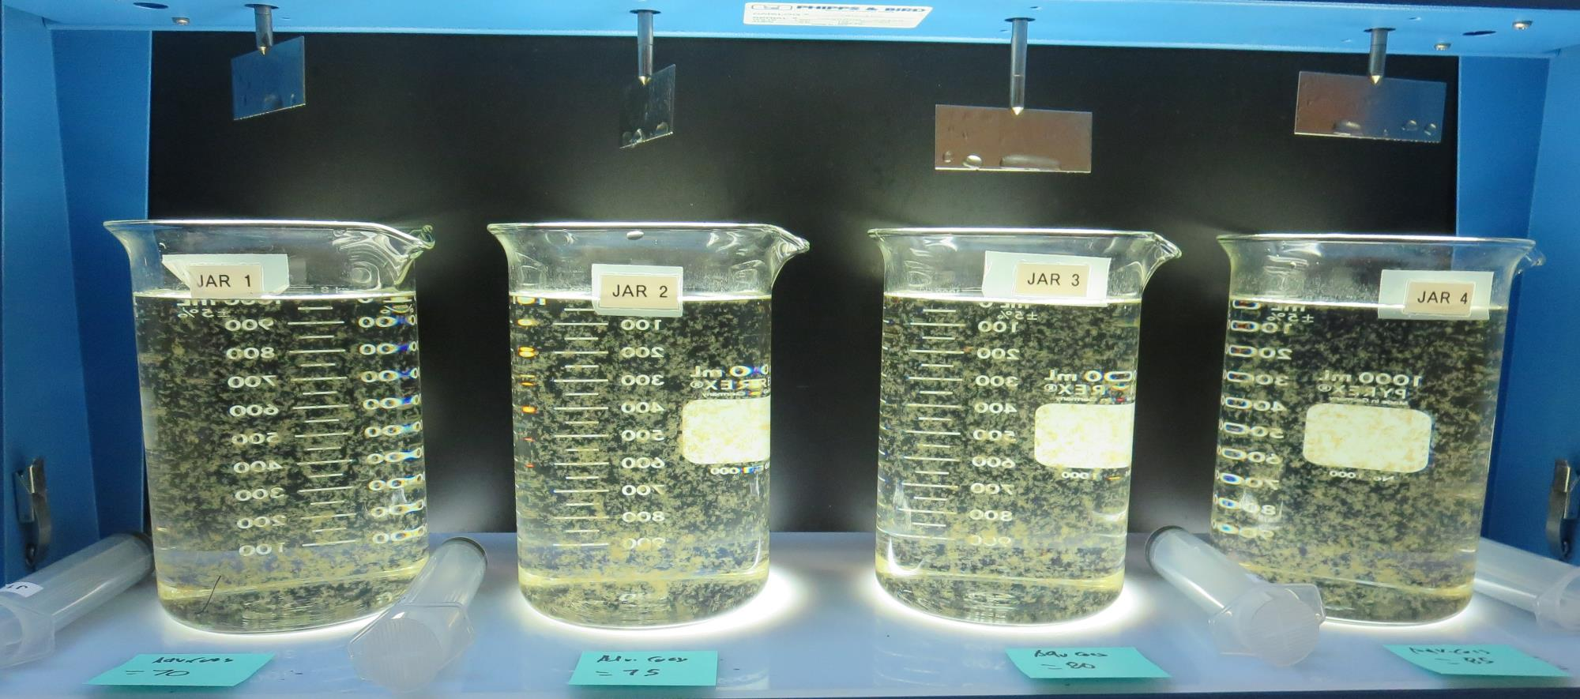
Jars 48-52: End of 5-minute flocculation (30 RPM) duration.
70 mg/L Adv Coag
Filtrate 0.08 NTU
UVT: 93.3%
UVA: 0.029/cm
Settled: 0.20 NTU
75 mg/L Adv Coag
Filtrate 0.07 NTU
UVT: 93.3%
UVA: 0.030/cm
Settled: 0.25 NTU
80 mg/L Adv Coag
Filtrate 0.08 NTU
UVT: 93.5%
UVA: 0.029/cm
Settled: 0.24 NTU
85 mg/L Adv Coag
Filtrate 0.07 NTU
UVT: 93.5%
UVA: 0.028/cm
Settled: 0.21 NTU

Slide 70
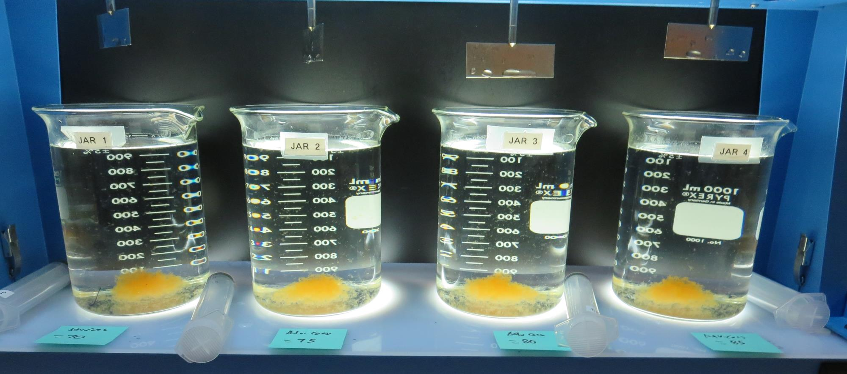
Jars 48-52: After 5 min of settling, 25 mL is syringed for filterability and %UVT/UVA.

Slide 71
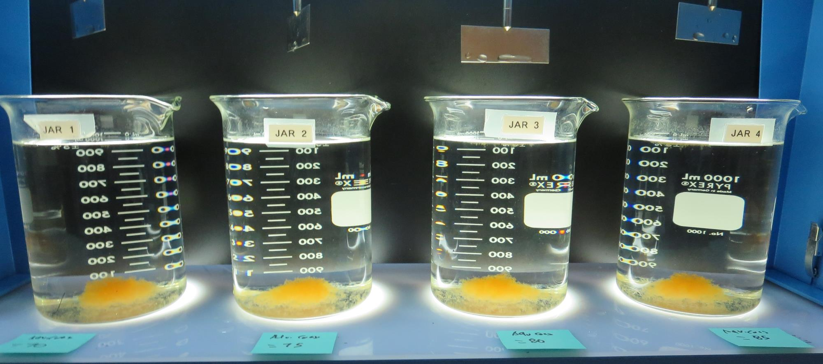
Jars 48-52: After 25-minutes of settling, settled water turbidity is taken.
70 mg/L Adv Coag
Filtrate 0.08 NTU
UVT: 93.3%
UVA: 0.029/cm
Settled: 0.20 NTU
75 mg/L Adv Coag
Filtrate 0.07 NTU
UVT: 93.3%
UVA: 0.030/cm
Settled: 0.25 NTU
80 mg/L Adv Coag
Filtrate 0.08 NTU
UVT: 93.5%
UVA: 0.029/cm
Settled: 0.24 NTU
85 mg/L Adv Coag
Filtrate 0.07 NTU
UVT: 93.5%
UVA: 0.028/cm
Settled: 0.21 NTU

Slide 72
Jars 53-56 Test Flash Mix 30 Sec (200 RPM) Floc Mix 5 min (30 RPM) Post KMnO₄ Applied Coagulant Advanced Coagulant

Slide 73
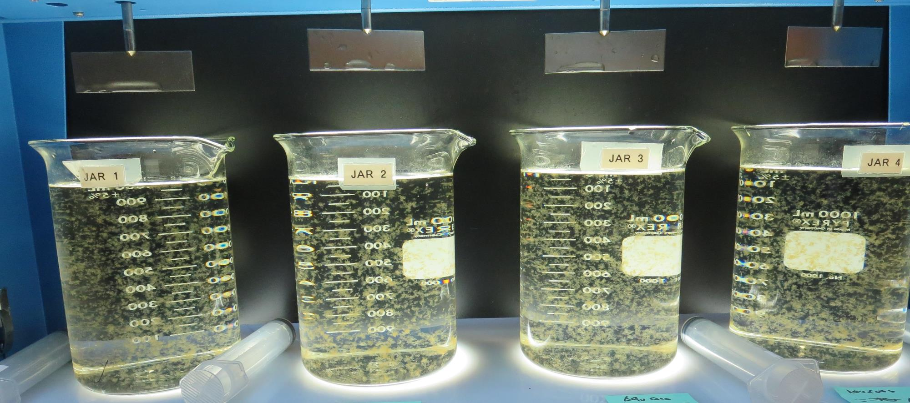
Jars 53-56: End of 5-minute flocculation (30 RPM) duration.
85 mg/L Adv Coag
Filtrate 0.09 NTU
UVT: 93.6%
UVA: 0.028/cm
Settled: 0.24 NTU
90 mg/L Adv Coag
Filtrate 0.08 NTU
UVT: 93.7%
UVA: 0.027/cm
Settled: 0.26 NTU
95 mg/L Adv Coag
Filtrate 0.08 NTU
UVT: 93.9%
UVA: 0.027/cm
Settled: 0.22 NTU
100 mg/L Adv Coag
Filtrate 0.08 NTU
UVT: 94.0%
UVA: 0.026/cm
Settled: 0.23 NTU

Slide 74
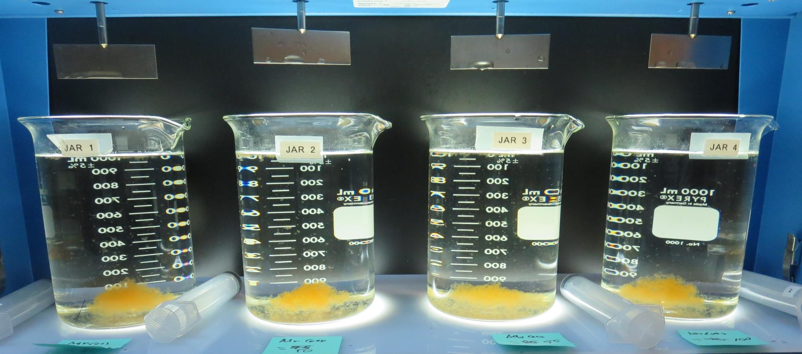
Jars 53-56: After 5 min of settling, 25 mL is syringed for filterability and %UVT/UVA.

Slide 75
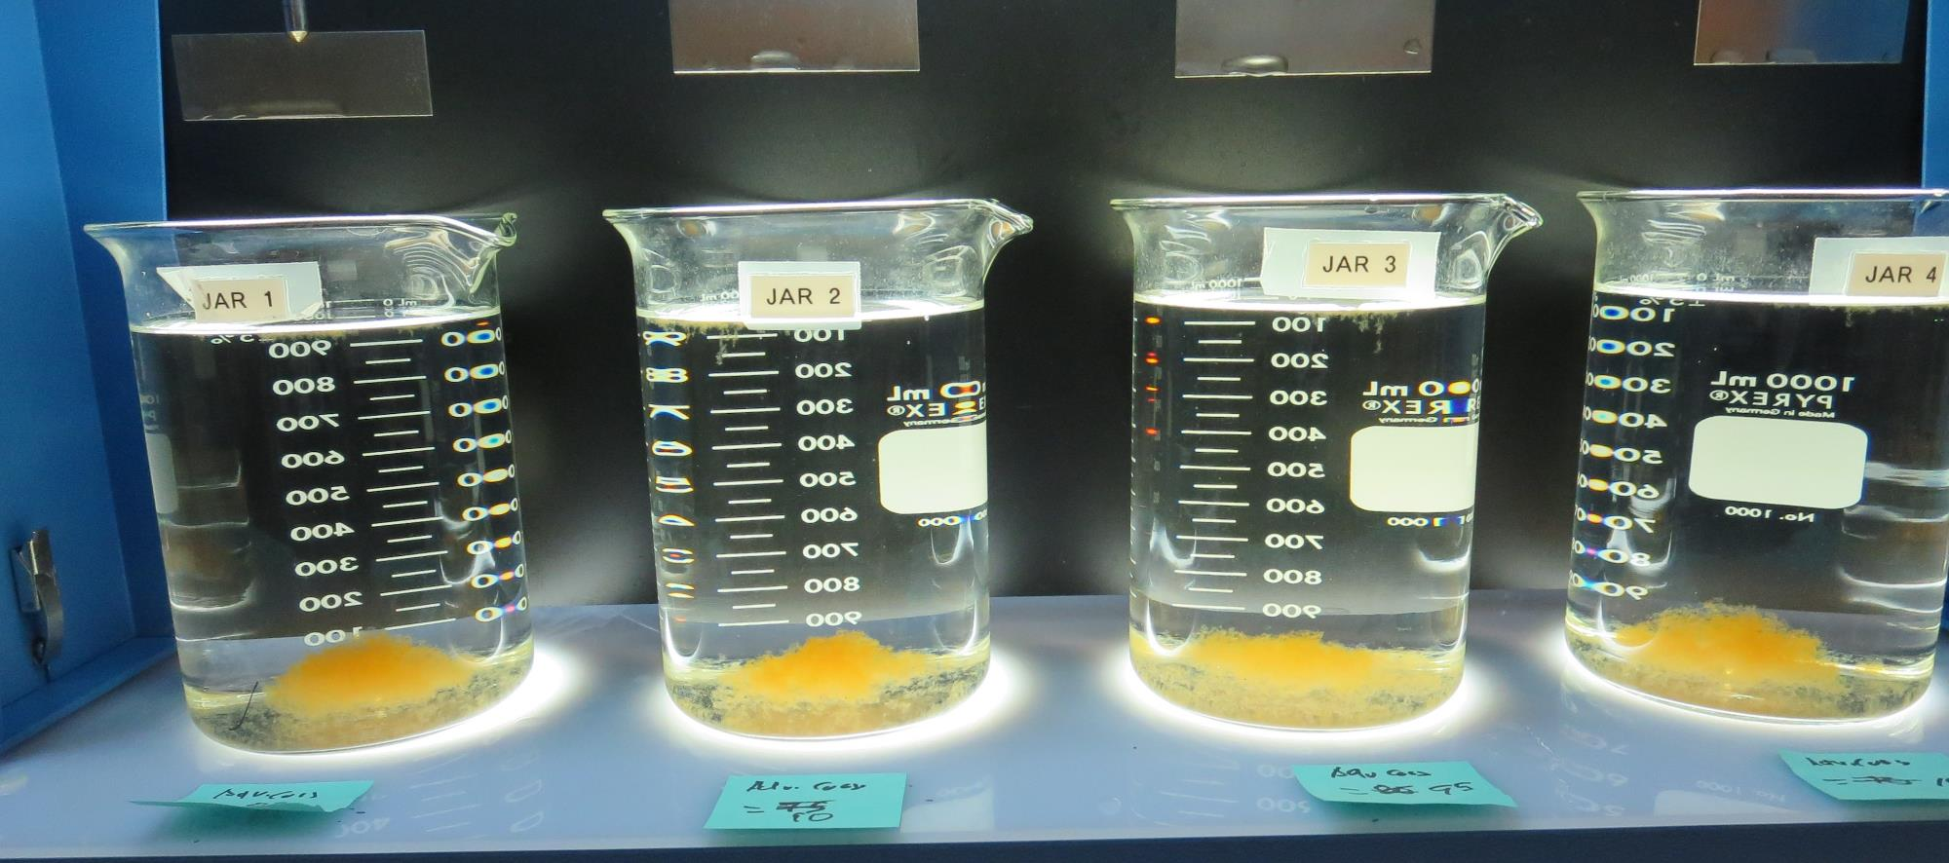
Jars 53-56: After 25-minutes of settling, settled water turbidity is taken.
85 mg/L Adv Coag
Filtrate 0.09 NTU
UVT: 93.6%
UVA: 0.028/cm
Settled: 0.24 NTU
90 mg/L Adv Coag
Filtrate 0.08 NTU
UVT: 93.7%
UVA: 0.027/cm
Settled: 0.26 NTU
95 mg/L Adv Coag
Filtrate 0.08 NTU
UVT: 93.9%
UVA: 0.027/cm
Settled: 0.22 NTU
100 mg/L Adv Coag
Filtrate 0.08 NTU
UVT: 94.0%
UVA: 0.026/cm
Settled: 0.23 NTU

Slide 76
Jar Testing for 1-Liter Jars: Procedures for Most Treatment Plants
Fill jars with source water prior to coagulant injection and set paddle speed at 30 rpm
Add chemicals (i.e., NaOCl, primary coagulant, coagulant aid) to each jar
Flash mix for 15-30 seconds (200 rpm)
Slow mix for 5 minutes (20-30 rpm)
Settled for 5 minutes. Syringe 25 mL from each jar taken 1-inch below surface (25 mL/12 sec rate)
Filtered through 1.2 um isopore membrane into cuvette drip rate, 15 mL/(50-90 sec)
Measure filtrate turbidity, chlorine residual and %UVT/UVA
Measure settled water turbidity after 25 minutes of total setting
Record all data

Slide 77
Jar Test Filterability Test Equipment
Turbidity Instrument
Syringe w/Luer-Lock Tip, 30 cc
(part#: 2225800, by Hach)
Swinnex Filter Holder, 25 mm (part#: SX0002500)
Isopore Membrane Filter, 1.2 um absolute
pore size,
Φ= 25 mm , thickness: 24 um,
hydrophilic polycarbonate membrane
(part #: RTTP02500)
Go to Sigma-Aldrich for laboratory supplies http://www.sigmaaldrich.com/united-states.html

Slide 78
Isopore Membrane Information
Categories | Information
trade name | Isopore
filter color | White
chemistry | Polycarbonate (PC)
water flow rate | Avg. 175 mL/min x cm² (typical results @ 10 psi)
media | Isopore®
wettability | Hydrophilic
porosity | 14.7%
pore size | 1.2 µm
bubble point at 23 °C | 1.0 bar, air with water
thickness | 24 µm
filter diameter (ø) | 25 mm
material size | polycarbonate, Hydrophilic, 1.2 µm, 25 mm, white, plain, 100

Slide 79
Isopore Membrane Background Information
The Isopore membrane is a polycarbonate, track-etched screen filter recommended for all analyses in which the sample is viewed on the surface of the membrane. The Isopore membrane is composed of polycarbonate film, which has a smooth, glass-like surface for clearer sample observation. The unique manufacturing process of the membrane ensures a precise pore diameter and a consistent pore size for accurate separation of samples by size. Matched-weight filters are not usually required because of low, constant tar and ash weights. Features & Benefits: Membrane structure retains particles on the surface, simplifying counting and analysis

Slide 80
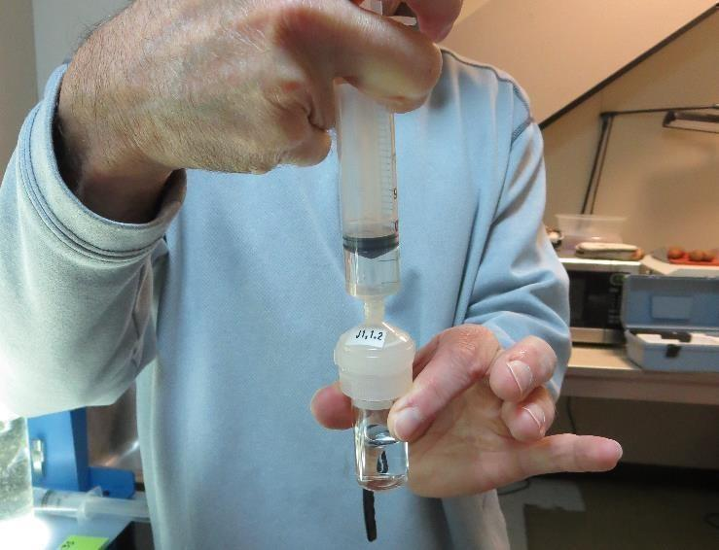
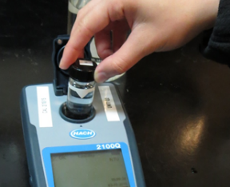
Jar Test - Filterability Test
Syringe ~ 25 mL from jar (after 5-minutes of settling)
Filter-to-waste 3-5 mL
Filter directly into clean cuvette
Measure turbidity
Note: Take several readings before recording final NTU results. Micro bubbles can adhere to glass causing false NTU readings. To remove bubbles, tilt cuvette up to 90 degrees.

Slide 81
Contact
Guy Schott, P.E.
State Water Resources Control Board
Division of Drinking Water
Santa Rosa, CA
Go to Stock Solution/Dose calculations/Jar Test Results for tools to download
www.waterboards.ca.gov/drinking_water/programs/districts/mendocino_district.html
Email: Guy Schott - Guy.Schott@waterboards.ca.gov
Office Number: 707-576-2732

