Slide 1
Cement Hill Water Plant CA4810005 Solano County Jar Test
by Guy Schott, P.E.
July 30, 2020

Slide 2
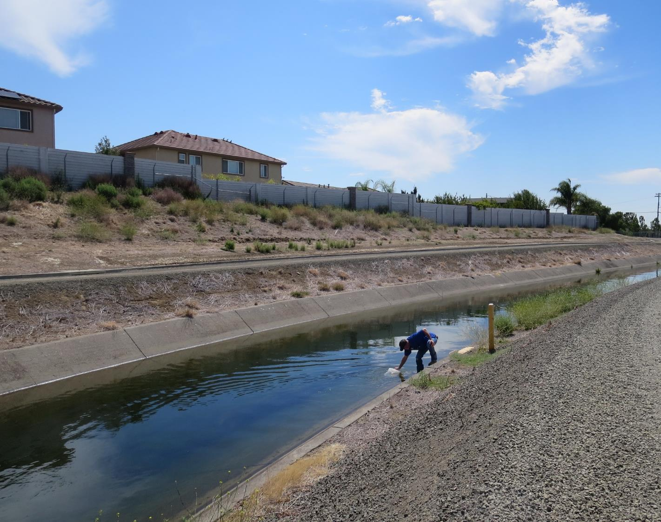
Cement Hill WTP Source Water: Putah South Canal Conventional Treatment

Slide 3
Cement Hill WTP, July 30, 2020 Source Water Characteristics
Source
pH: 8.74
Turbidity: 7.8 NTU
UVT: 85.7%
UVA: 0.066/cm
0.4 um Filtered
Turbidity: 0.14 NTU
UVT: 87.2%
UVA: 0.059/cm
Plant CFE (w/prechlorination)
Turbidity: 0.09 NTU
UVT: 91.5%
UVA: 0.038/cm
UVA Reduction: 35.6%
Clearwell (post)
Turbidity: 0.08 NTU
UVT: 94.4%
UVA: 0.024/cm
Plant Treatment Chemicals
Pre-chlorination: ?
Coagulant: 932 = 3.42 mg/L
Filter Aid: 9890 = 3.14 mg/L

Slide 4
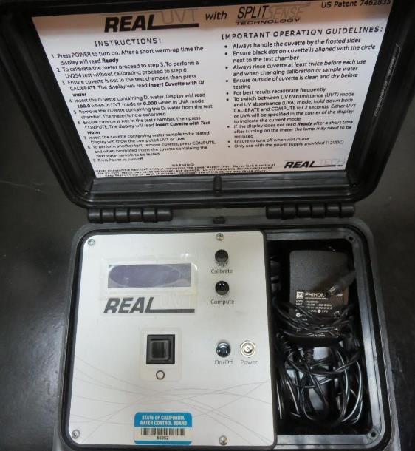
UVT/UVA, pathlength 10 mm
UV transmittance (UVT) is a measurement of the amount of ultraviolet light (commonly at 254 nm due to its germicidal effect) that passes through a water sample compared to the amount of light that passes through a pure water sample. The measurement is expressed as a percentage, % UVT.
%UVT = 10^{(-UVA)} x 100%
UV absorbance (UVA) is calculated as a relative measure of the amount of light absorbed by a water sample compared with the amount of light absorbed by a pure water sample.
UVA = -log(%UVT/100)

Slide 5
Applied Coagulants for Jar Testing
Pro Pac 9890 (NTU Technologies)
35-45% Aluminum Chlorohydrate
35-45% Water
SG = 1.25-1.34
Pro Pac 932 (NTU Technologies)
Contains water soluble Aluminum compound
SG = 1.3
Advanced Coagulant
12.55% Al₂O₃
6.64% Al
66.4% Basicity
SG = 1.3
Pro Pac 9810 (NTU Technologies)
45-50% Aluminum Chlorohydrate
45-50% Water
SG = 1.25-1.34

Slide 6
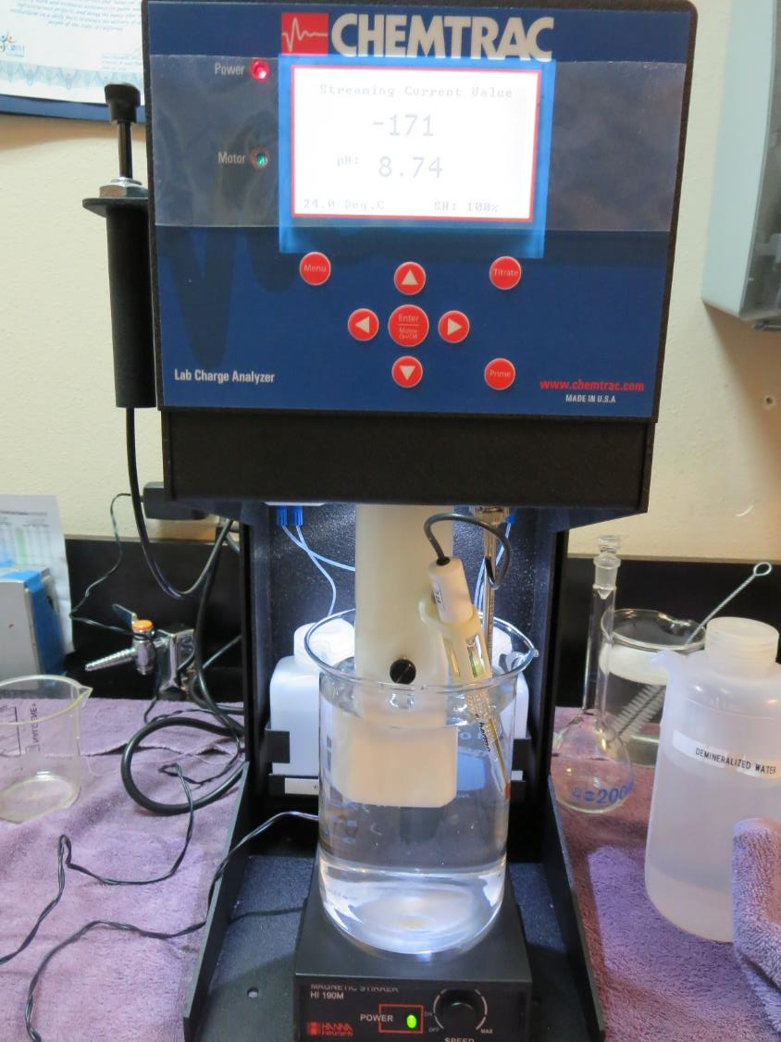
Laboratory Charge Analyzer
LCA: Used to determine coagulant demand of a source water entering the treatment plant.
Source pH: 8.74
LCA #1:
932: 22 mg/L as product
pH adjusted to 7.5 w/acetic acid solution
LCA #2:
9810: 15 mg/L as product
pH adjusted to 7.5 w/acetic acid solution
LCA #3:
Advanced Coagulant: 91 mg/L as product
pH adjusted to 7.5 w/acetic acid solution

Slide 7
Coagulant Information
Unless stated otherwise, all coagulant doses are reported as Product (100% strength).
Preparation of coagulant stock solutions are generally 1.0 and/or 0.1 percent strength using 100 and/or 200 mL volumetric flasks.
Finnpipette F2 variable volume pipette, capacity 100-1000 micro liters is used for stock solution preparation and coagulant aid jar test dosing.
Finnpipette F2 variable volume pipette, capacity 0.5-5 mL is used for primary coagulant jar test dosing.

Slide 8
Cement Hill WTP : Jar Test 1-8 Results Putah South Canal Source Water
Jar # | 200 RPM Flash Mix sec | 30 RPM Floc Duration min | 932 mg/L | Filtrate NTU | Filtrate %UVT | Filtrate UVA/cm | %UVA Reduction | Settle NTU 25 min
J1 | 30 | 5 | 20 | 0.14 | 90.9 | 0.041 | 30.5 | 0.91
J2 | 30 | 5 | 22 | 0.08 | 91.3 | 0.039 | 33.9 | 0.90
J3 | 30 | 5 | 24 | 0.08 | 91.6 | 0.036 | 39.0 | 0.66
J4 | 30 | 5 | 26 | 0.09 | 92.0 | 0.036 | 39.0 | 0.83
J5 | 30 | 5 | 28 | 0.16 | 92.1 | 0.035 | 40.7 | 0.58
J6 | 30 | 5 | 30 | 0.07 | 92.6 | 0.033 | 44.1 | 0.59
J7 | 30 | 5 | 32 | 0.07 | 92.7 | 0.032 | 45.8 | 0.46
J8 | 30 | 5 | 34 | 0.09 | 92.7 | 0.032 | 45.8 | 0.69

Slide 9
Cement Hill WTP : Jar Test 9-16 Results Putah South Canal Source Water
Jar # | 200 RPM Flash Mix sec | 30 RPM Floc Duration min | Adv Coag. mg/L | Filtrate NTU | Filtrate %UVT | Filtrate UVA/cm | %UVA Reduction | Settle NTU 25 min
J9 | 30 | 5 | 60 | 0.08 | 91.1 | 0.040 | 32.2 | 0.34
J10 | 30 | 5 | 70 | 0.09 | 91.5 | 0.038 | 35.6 | 0.25
J11 | 30 | 5 | 80 | 0.08 | 92.1 | 0.035 | 40.7 | 0.22
J12 | 30 | 5 | 90 | 0.07 | 92.5 | 0.033 | 44.1 | 0.27
J13 | 30 | 5 | 85 | 0.08 | 92.0 | 0.035 | 40.7 | 0.21
J14 | 30 | 5 | 90 | 0.08 | 92.1 | 0.035 | 40.7 | 0.21
J15 | 30 | 5 | 95 | 0.08 | 92.3 | 0.034 | 42.4 | 0.26
J16 | 30 | 5 | 100 | 0.07 | 92.7 | 0.032 | 45.8 | 0.20

Slide 10
Cement Hill WTP : Jar Test 17-20 Results Putah South Canal Source Water
Jar # | 200 RPM Flash Mix sec | 30 RPM Floc Duration min | 9810 mg/L | Filtrate NTU | Filtrate %UVT | Filtrate UVA/cm | %UVA Reduction | Settle NTU 25 min
J17 | 30 | 5 | 14 | 0.12 | 91.8 | 0.037 | 37.3 | 0.42
J18 | 30 | 5 | 16 | 0.08 | 92.1 | 0.035 | 40.7 | 0.53
J19 | 30 | 5 | 18 | 0.11 | 92.2 | 0.035 | 40.7 | 0.40
J20 | 30 | 5 | 20 | 0.12 | 92.3 | 0.034 | 42.4 | 0.48

Slide 11
Cement Hill WTP : Jar Test 21-24 Results; Putah South Canal Source; Flash Mix 200 RPM (30 sec)
Jar # | 30 RPM Floc Duration min | 932 mg/L | Adv. Coag. mg/L | Filtrate NTU | Filtrate %UVT | Filtrate UVA/cm | %UVA Reduction | Settle NTU 25 min
J21 | 5 | 24 | 0 | 0.11 | 92.4 | 0.033 | 44.1 | 0.28
J22 | 5 | 30 | 0 | 0.11 | 92.8 | 0.032 | 45.8 | 0.38
J23 | 5 | 0 | 90 | 0.07 | 92.6 | 0.033 | 44.1 | 0.24
J24 | 5 | 0 | 100 | 0.07 | 92.9 | 0.031 | 47.5 | 0.20

Slide 12
Cement Hill WTP : Jar Test 25-28 Results; Putah South Canal Source; Flash Mix 200 RPM (30 sec)
Jar # | 30 RPM Floc Duration min | 932 mg/L | 9890 mg/L | Filtrate NTU | Filtrate %UVT | Filtrate UVA/cm | %UVA Reduction | Settle NTU 25 min
J25 | 5 | 24 | 0 | 0.10 | 92.6 | 0.033 | 44.1 | 0.33
J26 | 5 | 23 | 1.0 | 0.10 | 92.6 | 0.033 | 44.1 | 0.31
J27 | 5 | 22 | 2.0 | 0.12 | 92.5 | 0.033 | 44.1 | 0.33
J28 | 5 | 21 | 3.0 | 0.07 | 92.8 | 0.032 | 45.8 | 0.33

Slide 13
Cement Hill WTP : Jar Test 25-28 Results; Putah South Canal Source; Flash Mix 200 RPM (30 sec) Flocculation 30 RPM (5 minutes)
Jar # | 932 mg/L | 9890 mg/L | Adv. Coag. mg/L | Filtrate NTU | Filtrate %UVT | Filtrate UVA/cm | %UVA Reduction | Settle NTU 25 min | Al mg/L
J29 | 21 | 3.0 | 0 | 0.12 | 92.4 | 0.034 | 42.4 | 0.37 | 0.004
J30 | 0 | 0 | 65 | 0.10 | 91.3 | 0.039 | 33.9 | 0.26 | 0.122
J31 | 0 | 0 | 75 | 0.10 | 91.8 | 0.037 | 37.3 | 0.24 | 0.239
J32 | 0 | 0 | 85 | 0.08 | 92.2 | 0.034 | 42.4 | 0.20 | 0.164

Slide 14
Jars 1-4 Test Flash Mix 30 Sec (200 RPM) Floc Mix 5 min (30 RPM) Applied Coagulant 932

Slide 15
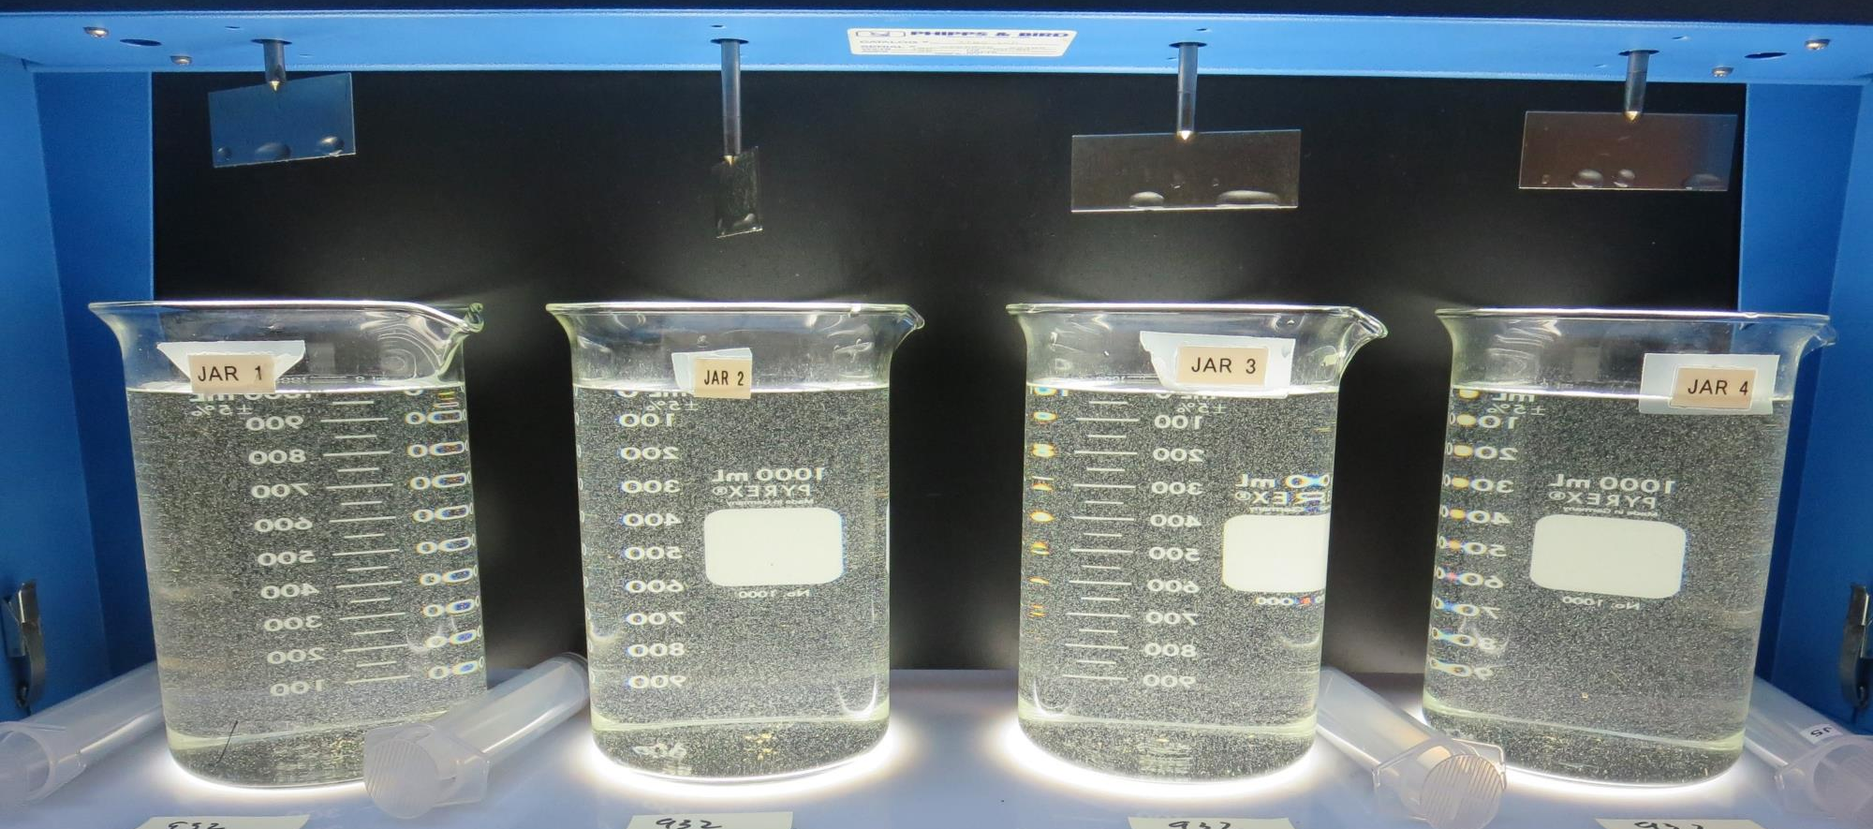
Jars 1-4: End of 5-minute flocculation (30 RPM) duration.
20 mg/L 932
Filtrate 0.14 NTU
UVT: 90.9%
UVA: 0.041/cm
UVA Reduction: 30.5%
Settled: 0.91 NTU
22 mg/L 932
Filtrate 0.08 NTU
UVT: 91.3%
UVA: 0.039/cm
UVA Reduction: 33.9%
Settled: 0.90 NTU
24 mg/L 932
Filtrate 0.08 NTU
UVT: 91.8%
UVA: 0.036/cm
UVA Reduction: 39.0%
Settled: 0.66 NTU
26 mg/L 932
Filtrate 0.09 NTU
UVT: 92.0%
UVA: 0.036/cm
UVA Reduction: 39.0%
Settled: 0.83 NTU

Slide 16
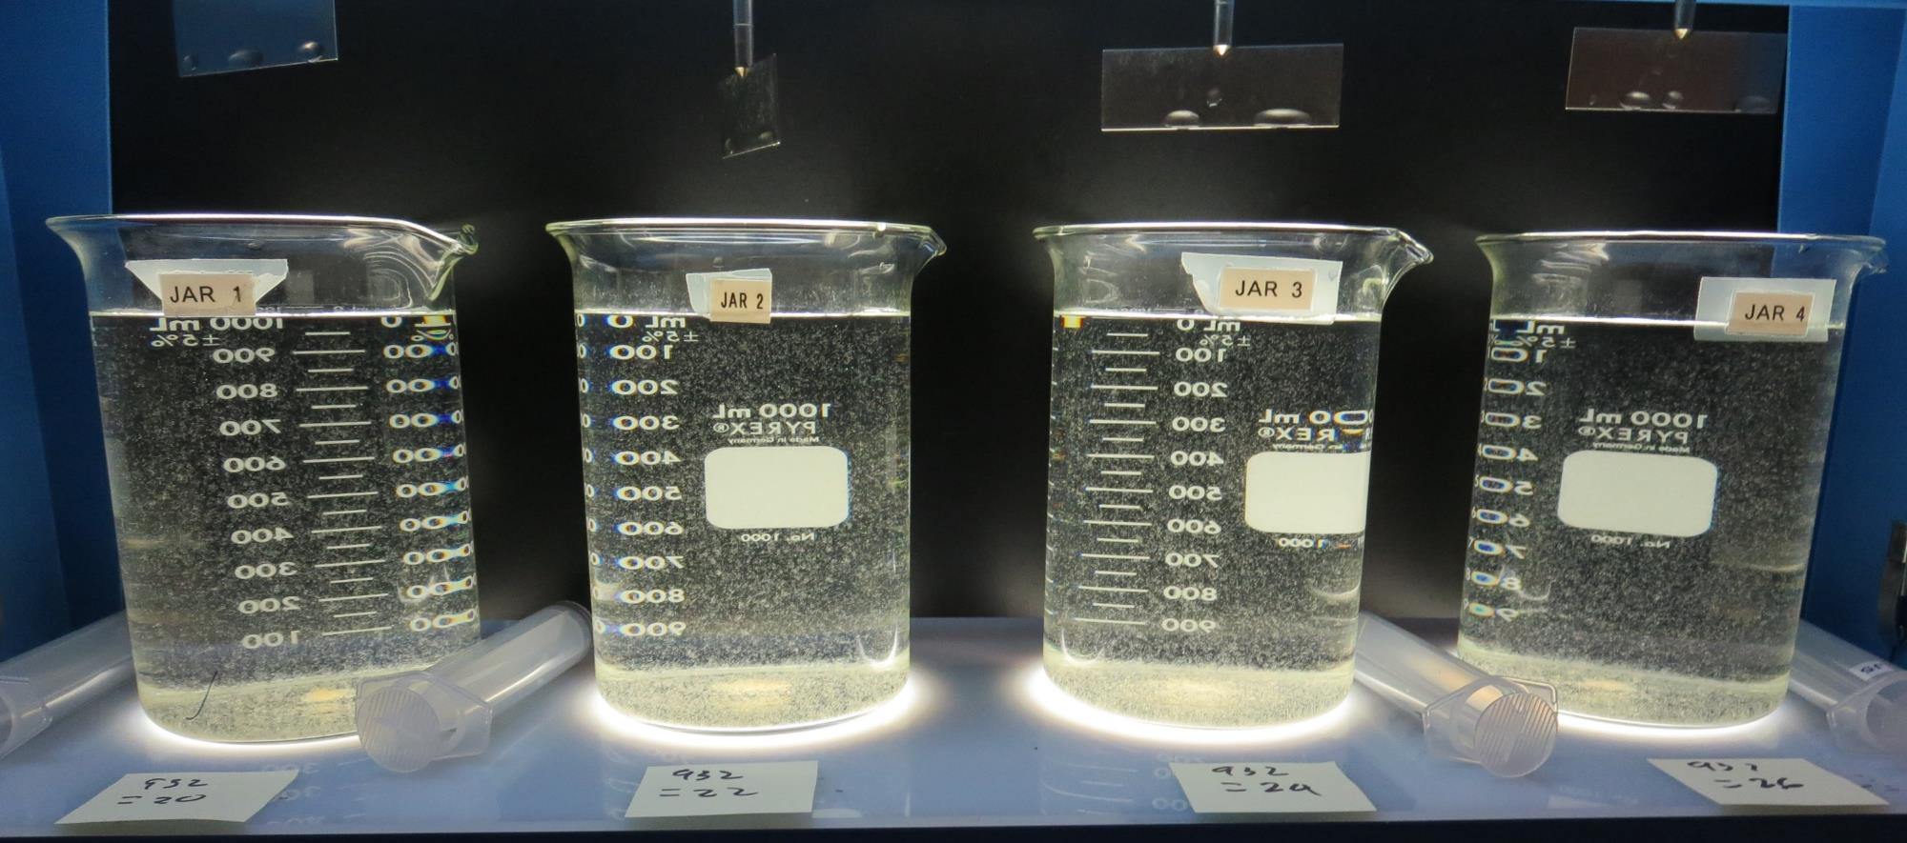
Jars 1-4: After 5 min of settling, 25 mL is syringed for filterability and %UVT/UVA.

Slide 17
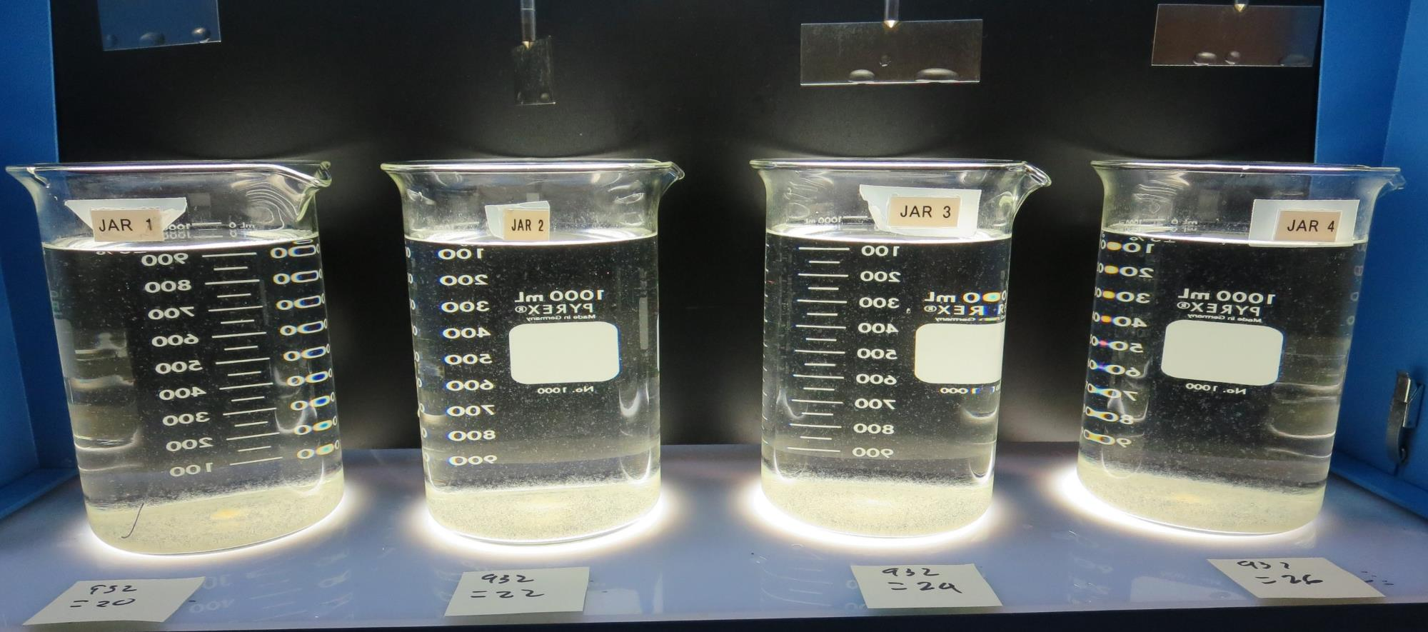
Jars 1-4: After 25-minutes of settling, settled water turbidity is taken.
20 mg/L 932
Filtrate 0.14 NTU
UVT: 90.9%
UVA: 0.041/cm
UVA Reduction: 30.5%
Settled: 0.91 NTU
22 mg/L 932
Filtrate 0.08 NTU
UVT: 91.3%
UVA: 0.039/cm
UVA Reduction: 33.9%
Settled: 0.90 NTU
24 mg/L 932
Filtrate 0.08 NTU
UVT: 91.8%
UVA: 0.036/cm
UVA Reduction: 39.0%
Settled: 0.66 NTU
26 mg/L 932
Filtrate 0.09 NTU
UVT: 92.0%
UVA: 0.036/cm
UVA Reduction: 39.0%
Settled: 0.83 NTU

Slide 18
Jars 5-8 Test Flash Mix 30 Sec (200 RPM) Floc Mix 5 min (30 RPM) Applied Coagulant 932

Slide 19
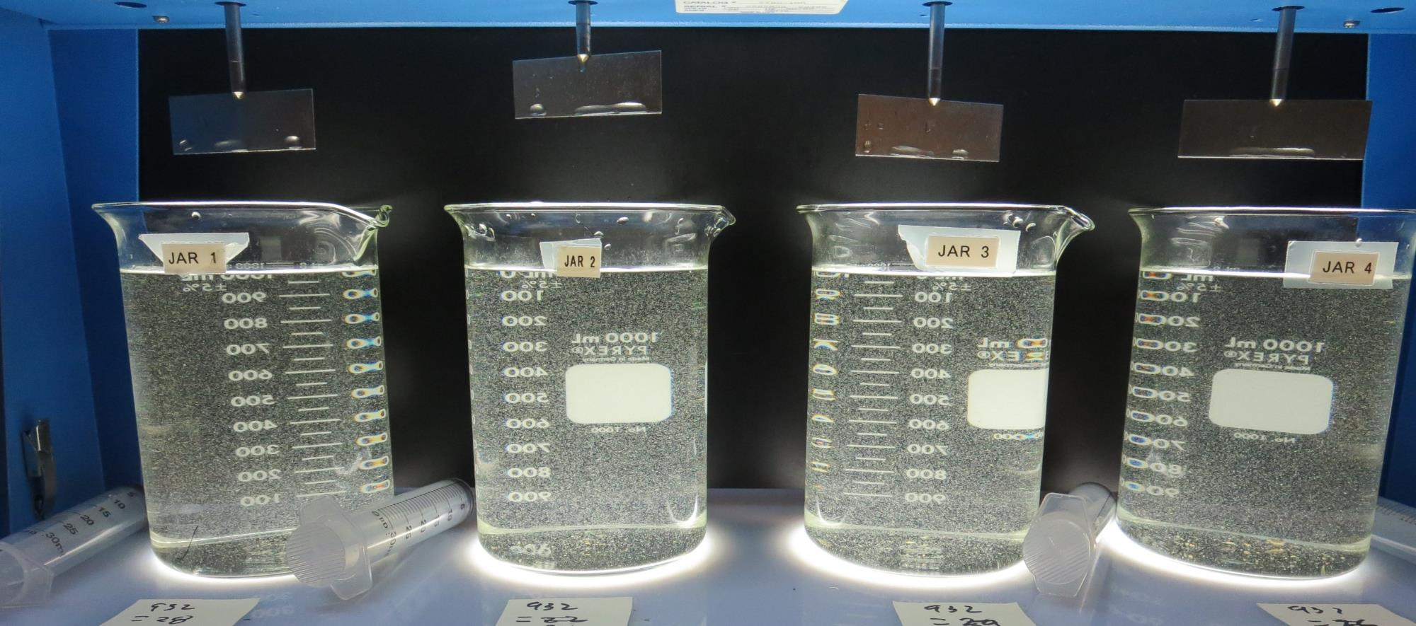
Jars 5-8: End of 5-minute flocculation (30 RPM) duration.
28 mg/L 932
Filtrate 0.16 NTU
UVT: 92.1%
UVA: 0.035/cm
UVA Reduction: 40.7%
Settled: 0.58 NTU
30 mg/L 932
Filtrate 0.07 NTU
UVT: 92.6%
UVA: 0.033/cm
UVA Reduction: 44.1%
Settled: 0.59 NTU
32 mg/L 932
Filtrate 0.07 NTU
UVT: 92.7%
UVA: 0.032/cm
UVA Reduction: 45.8%
Settled: 0.46 NTU
34 mg/L 932
Filtrate 0.09 NTU
UVT: 92.7%
UVA: 0.032/cm
UVA Reduction: 45.8%
Settled: 0.64 NTU

Slide 20
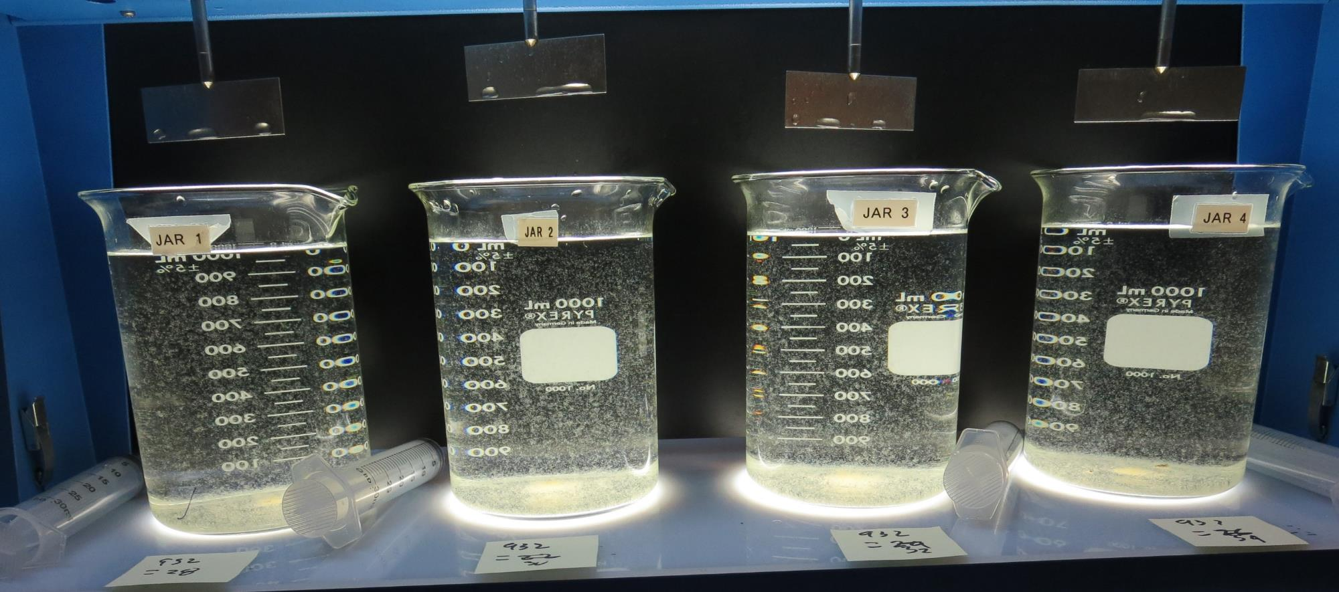
Jars 5-8: After 5 min of settling, 25 mL is syringed for filterability and %UVT/UVA.

Slide 21
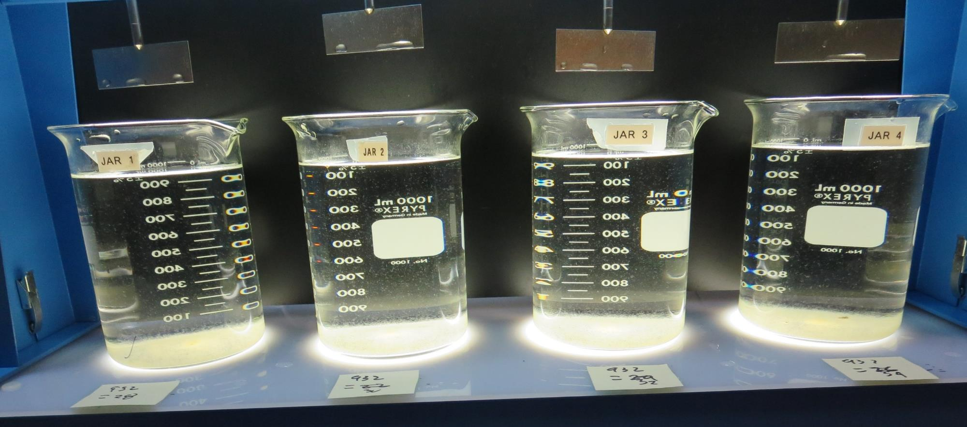
Jars 5-8: After 25-minutes of settling, settled water turbidity is taken.
28 mg/L 932
Filtrate 0.16 NTU
UVT: 92.1%
UVA: 0.035/cm
UVA Reduction: 40.7%
Settled: 0.58 NTU
30 mg/L 932
Filtrate 0.07 NTU
UVT: 92.6%
UVA: 0.033/cm
UVA Reduction: 44.1%
Settled: 0.59 NTU
32 mg/L 932
Filtrate 0.07 NTU
UVT: 92.7%
UVA: 0.032/cm
UVA Reduction: 45.8%
Settled: 0.46 NTU
34 mg/L 932
Filtrate 0.09 NTU
UVT: 92.7%
UVA: 0.032/cm
UVA Reduction: 45.8%
Settled: 0.64 NTU

Slide 22
Jars 9 -12 Test Flash Mix 30 Sec (200 RPM) Floc Mix 5 min (30 RPM) Applied Coagulant Advanced Coagulant

Slide 23
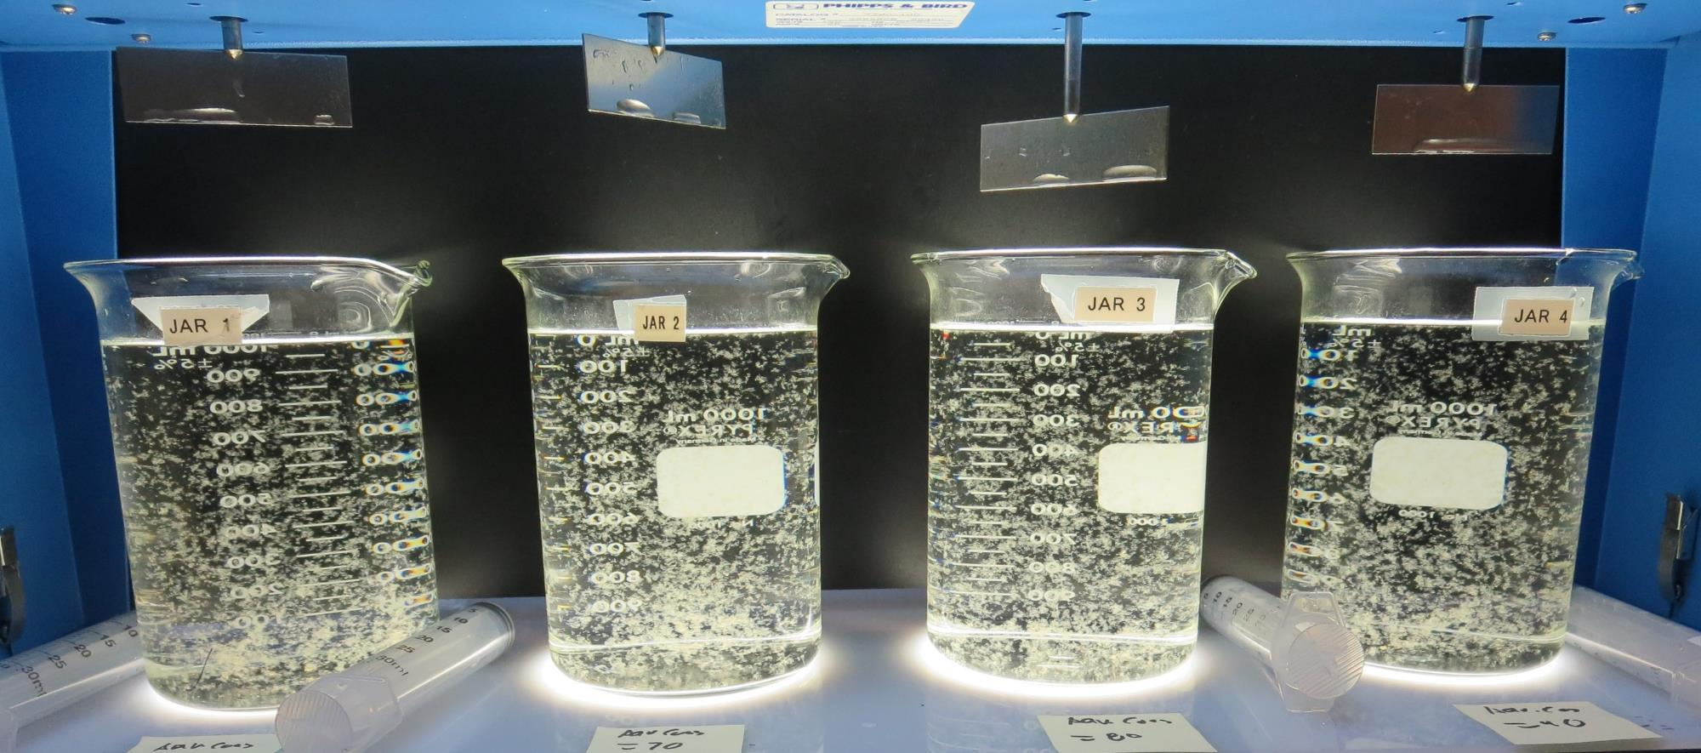
Jars 9-12: End of 5-minute flocculation (30 RPM) duration.
60 mg/L Adv Coag.
Filtrate 0.08 NTU
UVT: 91.1%
UVA: 0.040/cm
UVA Reduction: 32.2%
Settled: 0.34 NTU
70 mg/L Adv Coag.
Filtrate 0.09 NTU
UVT: 91.5%
UVA: 0.038/cm
UVA Reduction: 35.6%
Settled: 0.25 NTU
80 mg/L Adv Coag.
Filtrate 0.08 NTU
UVT: 92.1%
UVA: 0.035/cm
UVA Reduction: 40.7%
Settled: 0.22 NTU
90 mg/L Adv Coag.
Filtrate 0.07 NTU
UVT: 92.5%
UVA: 0.033/cm
UVA Reduction: 44.1%
Settled: 0.27 NTU

Slide 24
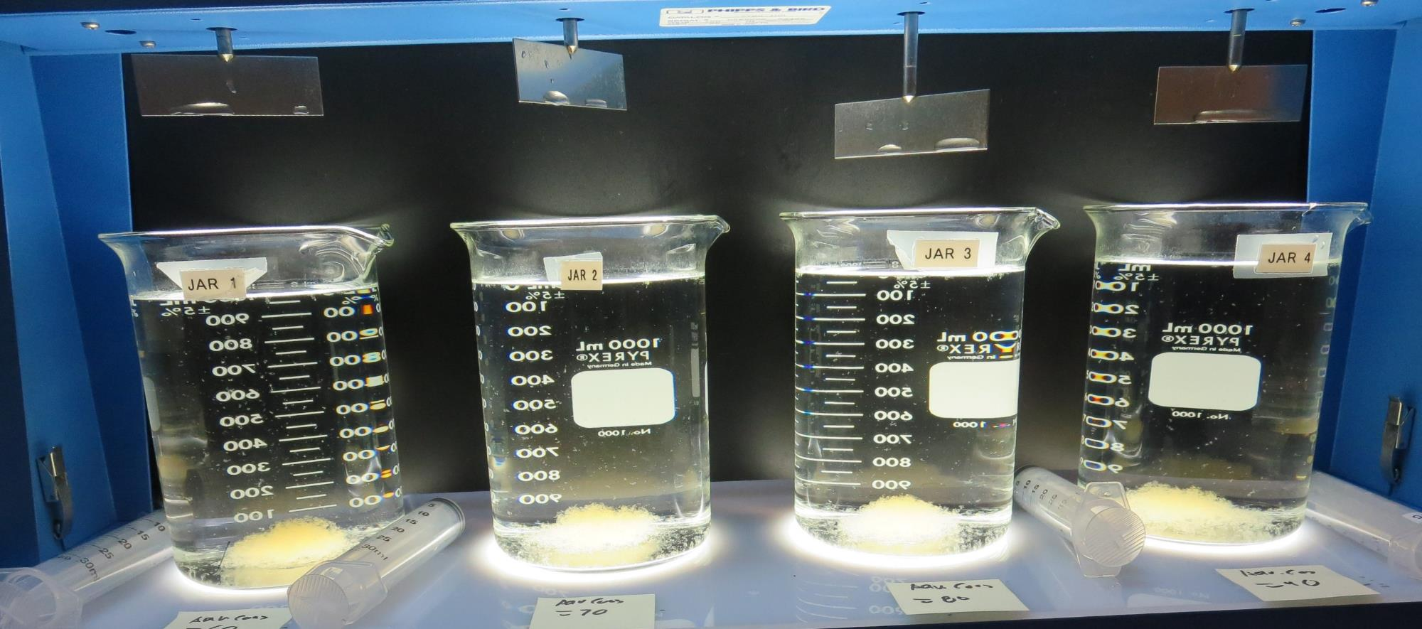
Jars 9-12: After 5 min of settling, 25 mL is syringed for filterability and %UVT/UVA.

Slide 25
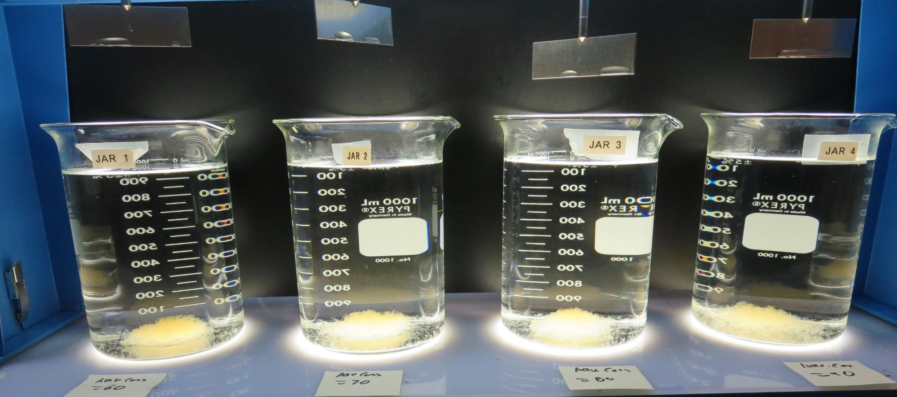
Jars 9-12: After 25-minutes of settling, settled water turbidity is taken.
60 mg/L Adv Coag.
Filtrate 0.08 NTU
UVT: 91.1%
UVA: 0.040/cm
UVA Reduction: 32.2%
Settled: 0.34 NTU
70 mg/L Adv Coag.
Filtrate 0.09 NTU
UVT: 91.5%
UVA: 0.038/cm
UVA Reduction: 35.6%
Settled: 0.25 NTU
80 mg/L Adv Coag.
Filtrate 0.08 NTU
UVT: 92.1%
UVA: 0.035/cm
UVA Reduction: 40.7%
Settled: 0.22 NTU
90 mg/L Adv Coag.
Filtrate 0.07 NTU
UVT: 92.5%
UVA: 0.033/cm
UVA Reduction: 44.1%
Settled: 0.27 NTU

Slide 26
Jars 13-16 Test Flash Mix 30 Sec (200 RPM) Floc Mix 5 min (30 RPM) Applied Coagulant Advanced Coagulant

Slide 27
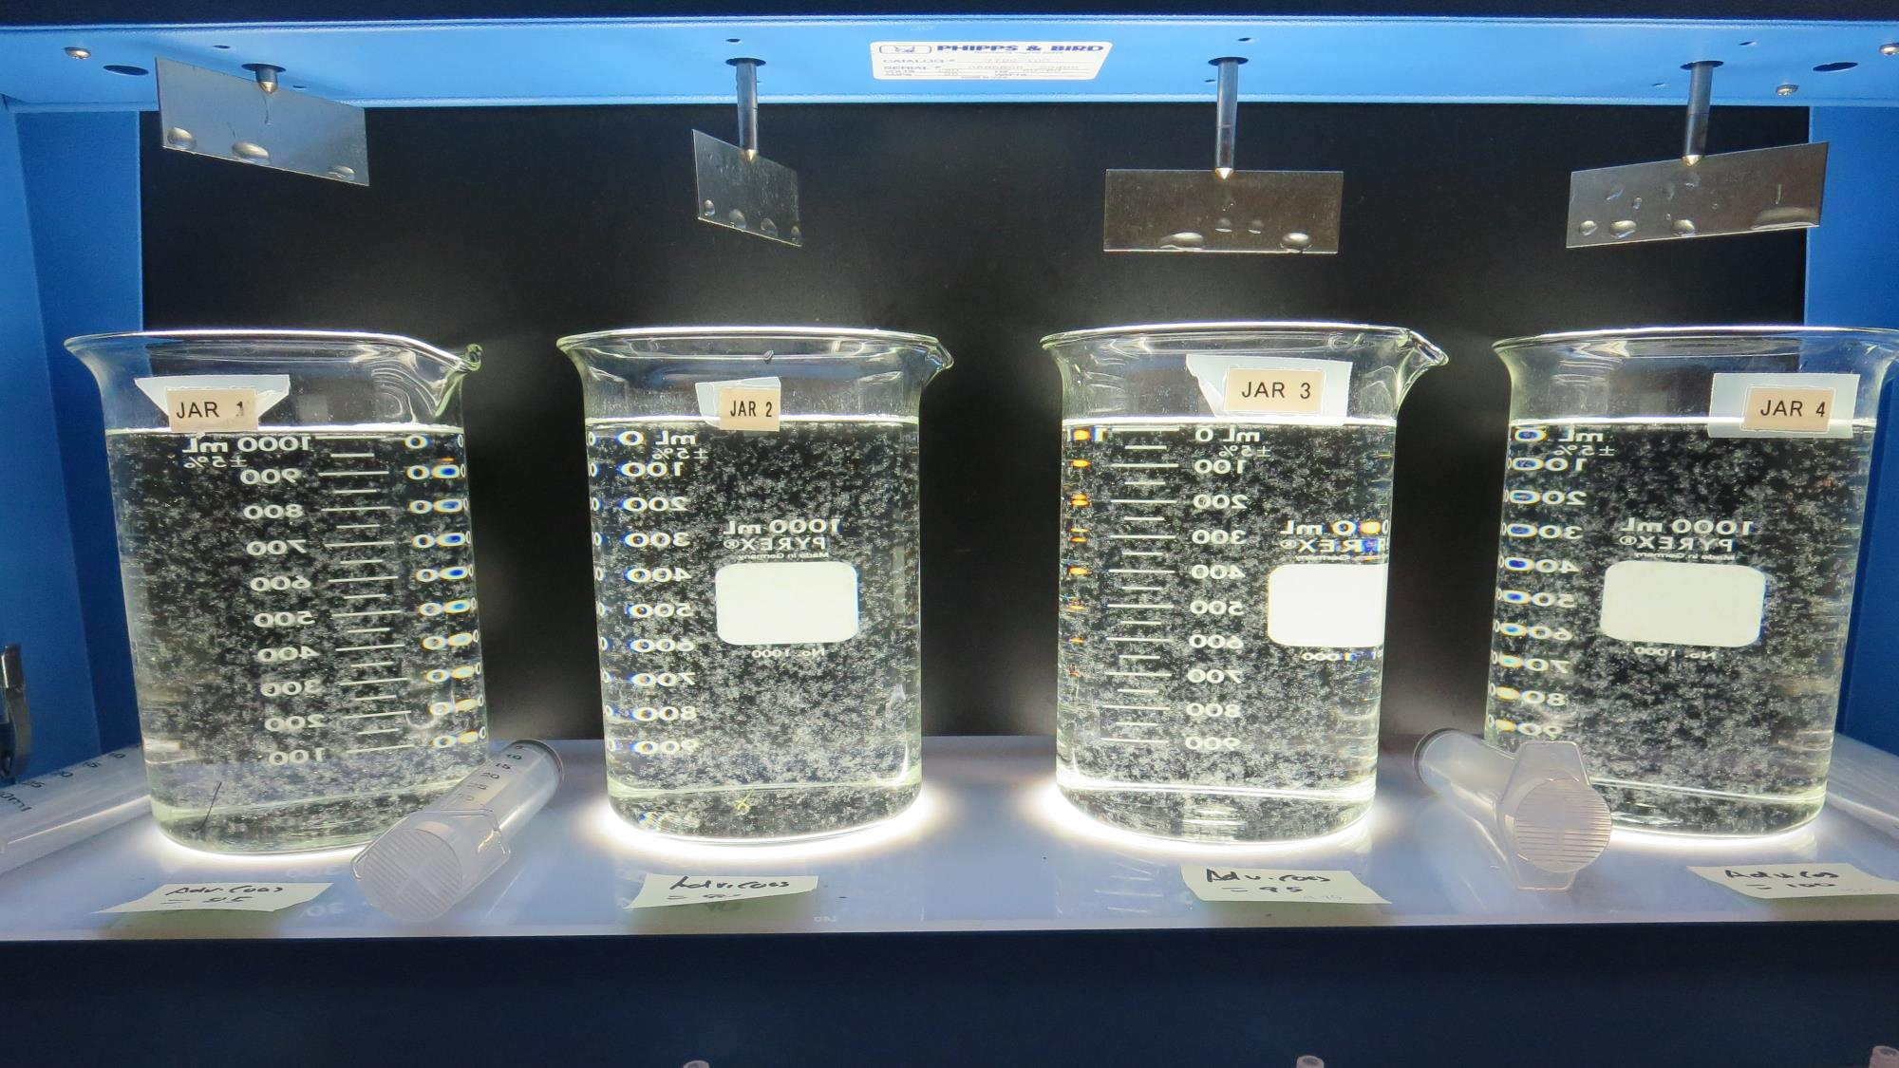
Jars 13-16: End of 5-minute flocculation (30 RPM) duration.
85 mg/L Adv Coag.
Filtrate 0.08 NTU
UVT: 92.0%
UVA: 0.035/cm
UVA Reduction: 40.7%
Settled: 0.21 NTU
90 mg/L Adv Coag.
Filtrate 0.08 NTU
UVT: 92.1%
UVA: 0.035/cm
UVA Reduction: 40.7%
Settled: 0.21 NTU
95 mg/L Adv Coag.
Filtrate 0.08 NTU
UVT: 92.3%
UVA: 0.034/cm
UVA Reduction: 42.4%
Settled: 0.26 NTU
100 mg/L Adv Coag.
Filtrate 0.07 NTU
UVT: 92.7%
UVA: 0.032/cm
UVA Reduction: 45.8%
Settled: 0.20 NTU

Slide 28
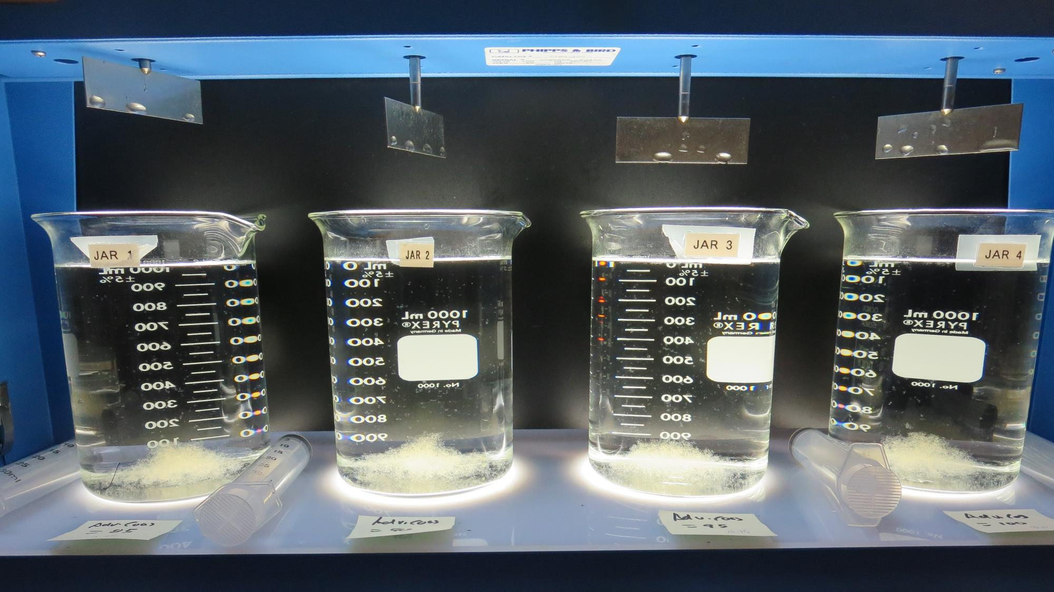
Jars 13-16: After 5 min of settling, 25 mL is syringed for filterability and %UVT/UVA.

Slide 29
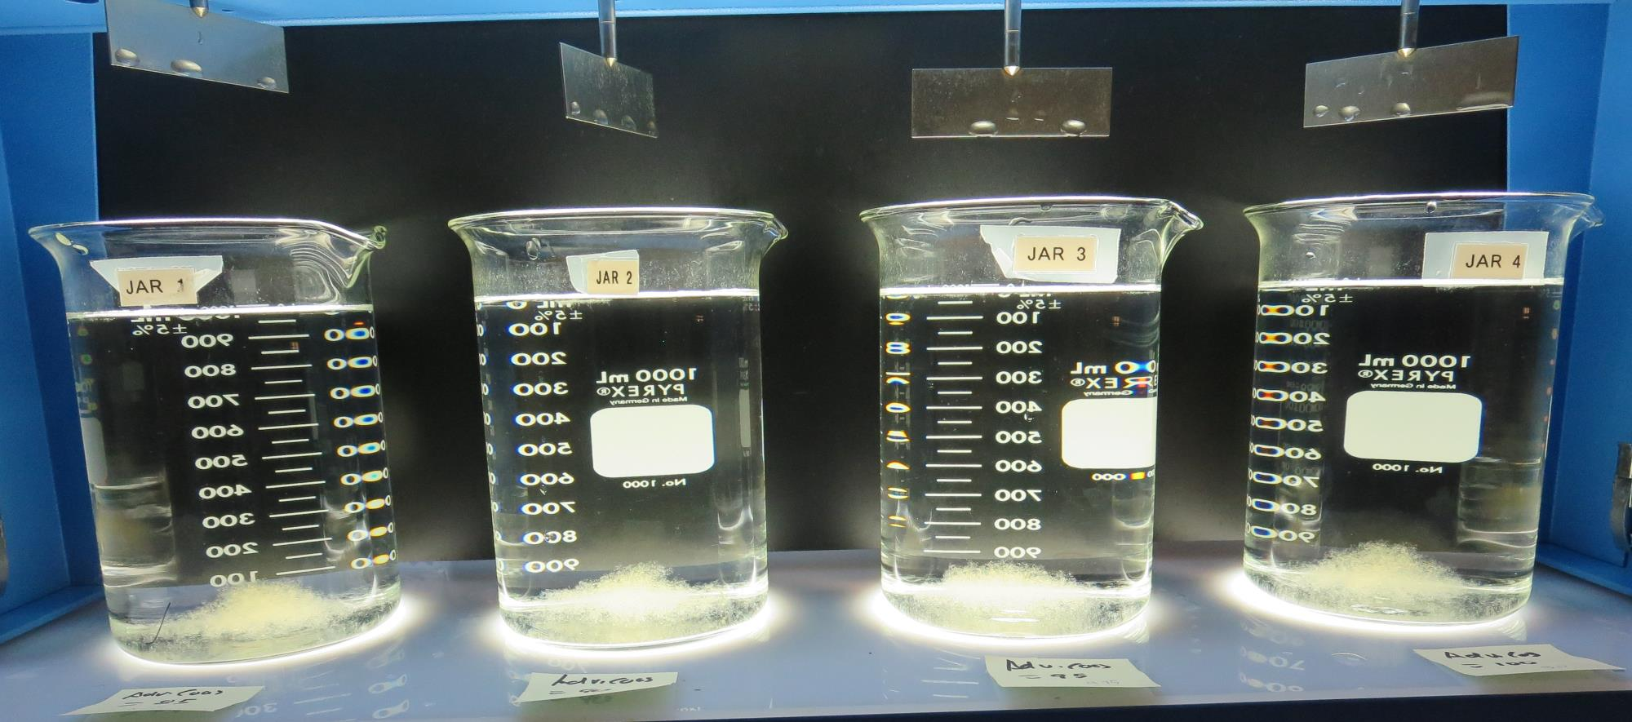
Jars 13-16: After 25-minutes of settling, settled water turbidity is taken.
85 mg/L Adv Coag.
Filtrate 0.08 NTU
UVT: 92.0%
UVA: 0.035/cm
UVA Reduction: 40.7%
Settled: 0.21 NTU
90 mg/L Adv Coag.
Filtrate 0.08 NTU
UVT: 92.1%
UVA: 0.035/cm
UVA Reduction: 40.7%
Settled: 0.21 NTU
95 mg/L Adv Coag.
Filtrate 0.08 NTU
UVT: 92.3%
UVA: 0.034/cm
UVA Reduction: 42.4%
Settled: 0.26 NTU
100 mg/L Adv Coag.
Filtrate 0.07 NTU
UVT: 92.7%
UVA: 0.032/cm
UVA Reduction: 45.8%
Settled: 0.20 NTU

Slide 30
Jars 17-20 Test Flash Mix 30 Sec (200 RPM) Floc Mix 5 min (30 RPM) Applied Coagulant 9810

Slide 31
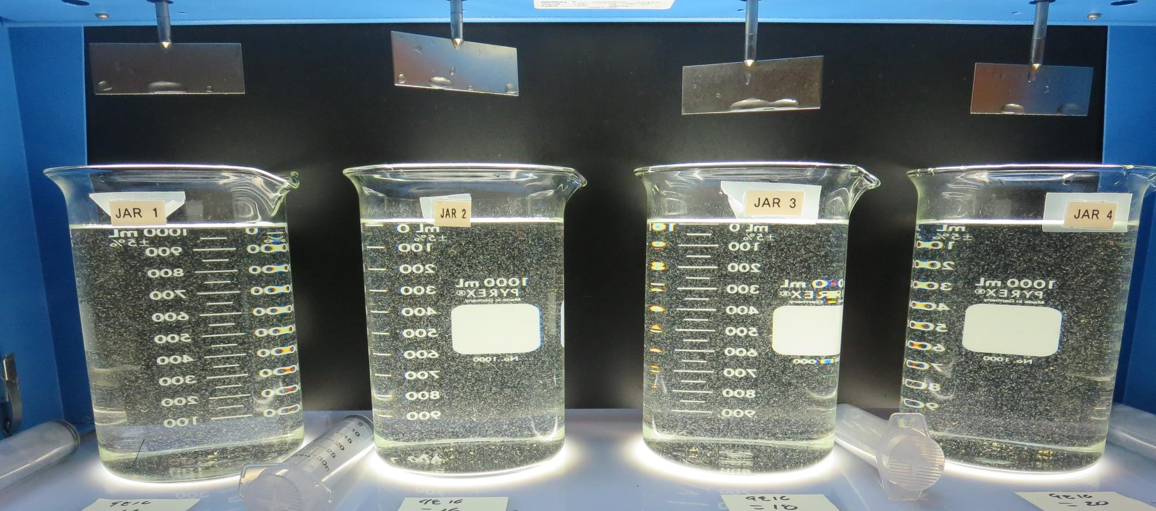
Jars 17-20: End of 5-minute flocculation (30 RPM) duration.
14 mg/L 9810
Filtrate 0.12 NTU
UVT: 91.8%
UVA: 0.037/cm
UVA Reduction: 37.3%
Settled: 0.42 NTU
16 mg/L 9810
Filtrate 0.08 NTU
UVT: 92.1%
UVA: 0.035/cm
UVA Reduction: 40.7%
Settled: 0.53 NTU
18 mg/L 9810
Filtrate 0.11 NTU
UVT: 92.2%
UVA: 0.035/cm
UVA Reduction: 40.7%
Settled: 0.40 NTU
20 mg/L 9810
Filtrate 0.12 NTU
UVT: 92.3%
UVA: 0.034/cm
UVA Reduction: 42.4%
Settled: 0.48 NTU

Slide 32
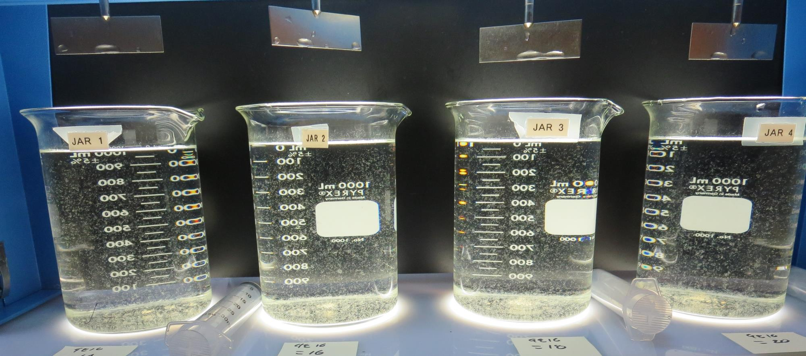
Jars 17-20: After 5 min of settling, 25 mL is syringed for filterability and %UVT/UVA.

Slide 33
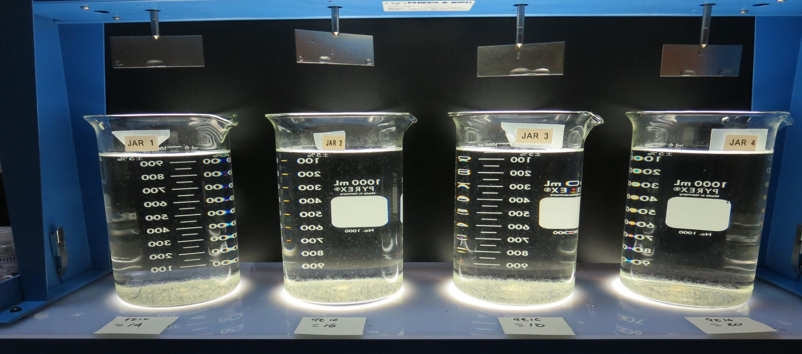
Jars 17-20: After 25-minutes of settling, settled water turbidity is taken.
14 mg/L 9810
Filtrate 0.12 NTU
UVT: 91.8%
UVA: 0.037/cm
UVA Reduction: 37.3%
Settled: 0.42 NTU
16 mg/L 9810
Filtrate 0.08 NTU
UVT: 92.1%
UVA: 0.035/cm
UVA Reduction: 40.7%
Settled: 0.53 NTU
18 mg/L 9810
Filtrate 0.11 NTU
UVT: 92.2%
UVA: 0.035/cm
UVA Reduction: 40.7%
Settled: 0.40 NTU
20 mg/L 9810
Filtrate 0.12 NTU
UVT: 92.3%
UVA: 0.034/cm
UVA Reduction: 42.4%
Settled: 0.48 NTU

Slide 34
Jars 21-24 Test Flash Mix 30 Sec (200 RPM) Floc Mix 5 min (30 RPM) Applied Coagulants 932/Advanced Coagulant

Slide 35
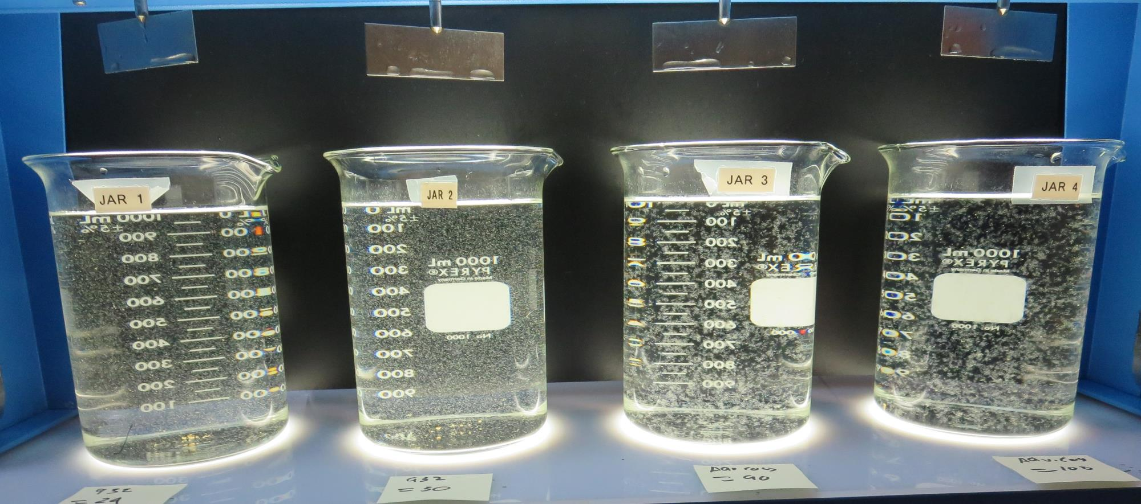
Jars 21-24: End of 5-minute flocculation (30 RPM) duration.
24 mg/L 932
Filtrate 0.11 NTU
UVT: 92.4%
UVA: 0.033/cm
UVA Reduction: 44.1%
Settled: 0.28 NTU
30 mg/L 932
Filtrate 0.11 NTU
UVT: 92.8%
UVA: 0.032/cm
UVA Reduction: 45.8%
Settled: 0.38 NTU
90 mg/L Adv. Coag.
Filtrate 0.07 NTU
UVT: 92.6%
UVA: 0.033/cm
UVA Reduction: 44.1%
Settled: 0.24 NTU
100 mg/L Adv. Coag.
Filtrate 0.07 NTU
UVT: 92.9%
UVA: 0.031/cm
UVA Reduction: 47.5%
Settled: 0.20 NTU

Slide 36
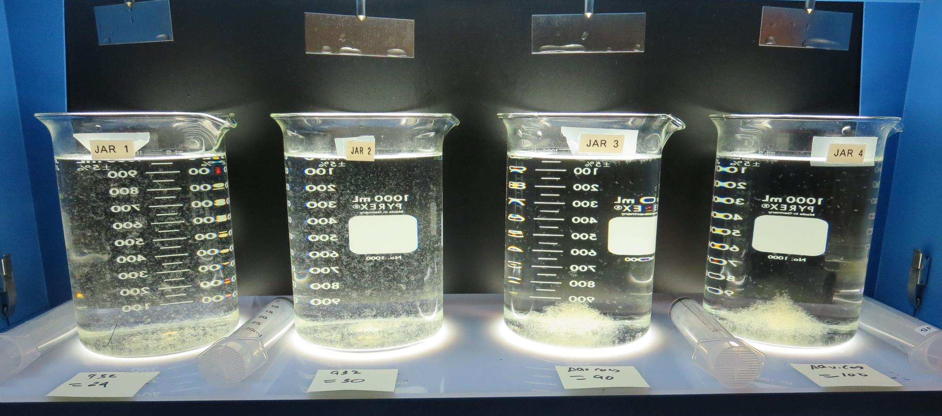
Jars 21-24: After 5 min of settling, 25 mL is syringed for filterability and %UVT/UVA.

Slide 37
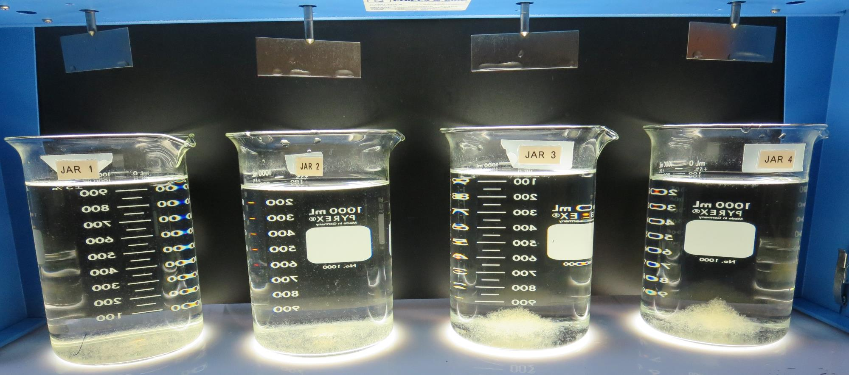
Jars 21-24: After 25-minutes of settling, settled water turbidity is taken.
24 mg/L 932
Filtrate 0.11 NTU
UVT: 92.4%
UVA: 0.033/cm
UVA Reduction: 44.1%
Settled: 0.28 NTU
30 mg/L 932
Filtrate 0.11 NTU
UVT: 92.8%
UVA: 0.032/cm
UVA Reduction: 45.8%
Settled: 0.38 NTU
90 mg/L Adv. Coag.
Filtrate 0.07 NTU
UVT: 92.6%
UVA: 0.033/cm
UVA Reduction: 44.1%
Settled: 0.24 NTU
100 mg/L Adv. Coag.
Filtrate 0.07 NTU
UVT: 92.9%
UVA: 0.031/cm
UVA Reduction: 47.5%
Settled: 0.20 NTU

Slide 38
Jars 25-28 Test Flash Mix 30 Sec (200 RPM) Floc Mix 5 min (30 RPM) Applied Coagulant 932

Slide 39
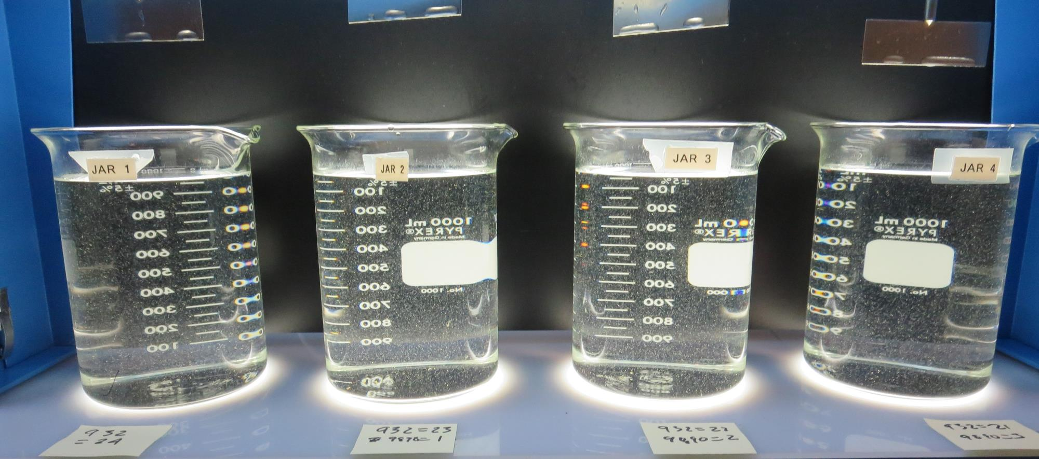
Jars 25-24: End of 5-minute flocculation (30 RPM) duration.
24 mg/L 932
Filtrate 0.10 NTU
UVT: 92.6%
UVA: 0.033/cm
UVA Reduction: 44.1%
Settled: 0.33 NTU
23 mg/L 932
1.0 mg/L 9890
Filtrate 0.10 NTU
UVT: 92.6%
UVA: 0.033/cm
UVA Reduction: 44.1%
Settled: 0.31 NTU
22 mg/L 932
2.0 mg/L 9890
Filtrate 0.12 NTU
UVT: 92.5%
UVA: 0.033/cm
UVA Reduction: 44.1%
Settled: 0.33 NTU
21 mg/L 932
3.0 mg/L 9890
Filtrate 0.07 NTU
UVT: 92.8%
UVA: 0.032/cm
UVA Reduction: 45.8%
Settled: 0.33 NTU

Slide 40
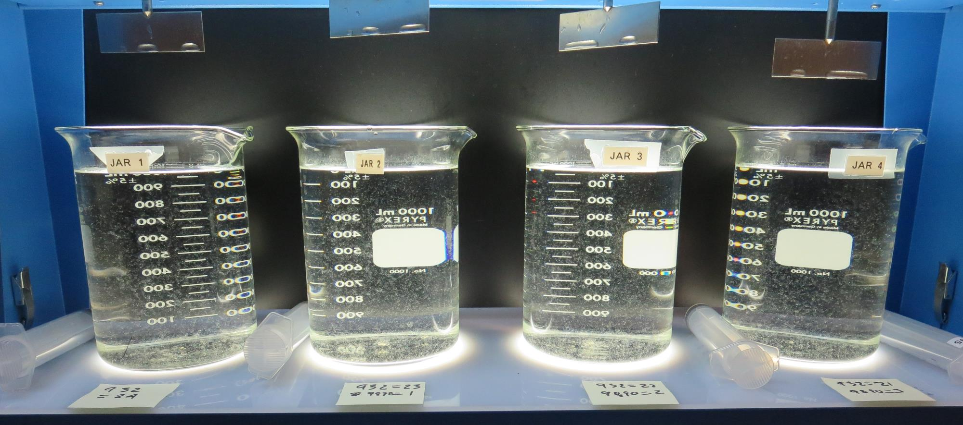
Jars 25-28: After 5 min of settling, 25 mL is syringed for filterability and %UVT/UVA.

Slide 41
Jars 25-28: After 25-minutes of settling, settled water turbidity is taken.
24 mg/L 932
Filtrate 0.10 NTU
UVT: 92.6%
UVA: 0.033/cm
UVA Reduction: 44.1%
Settled: 0.33 NTU
23 mg/L 932
1.0 mg/L 9890
Filtrate 0.10 NTU
UVT: 92.6%
UVA: 0.033/cm
UVA Reduction: 44.1%
Settled: 0.31 NTU
22 mg/L 932
2.0 mg/L 9890
Filtrate 0.12 NTU
UVT: 92.5%
UVA: 0.033/cm
UVA Reduction: 44.1%
Settled: 0.33 NTU
21 mg/L 932
3.0 mg/L 9890
Filtrate 0.07 NTU
UVT: 92.8%
UVA: 0.032/cm
UVA Reduction: 45.8%
Settled: 0.33 NTU

Slide 42
Jars 29-32 Test Flash Mix 30 Sec (200 RPM) Floc Mix 5 min (30 RPM) Applied Coagulants 932/9890/Adv. Coag.

Slide 43
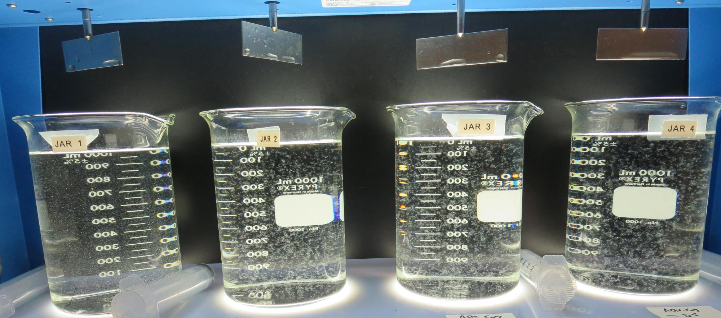
Jars 29-32: End of 5-minute flocculation (30 RPM) duration.
21 mg/L 932
3.0 mg/L 9890
Filtrate 0.12 NTU
UVT: 92.4%
UVA: 0.034/cm
UVA Reduction: 42.4%
Settled: 0.37 NTU
65 mg/L Adv. Coag.
Filtrate 0.10 NTU
UVT: 91.3%
UVA: 0.039/cm
UVA Reduction: 33.9%
Settled: 0.26 NTU
75 mg/L Adv. Coag.
Filtrate 0.10 NTU
UVT: 91.8%
UVA: 0.037/cm
UVA Reduction: 37.3%
Settled: 0.24 NTU
85 mg/L Adv. Coag.
Filtrate 0.08 NTU
UVT: 92.2%
UVA: 0.034/cm
UVA Reduction: 42.4%
Settled: 0.20 NTU

Slide 44
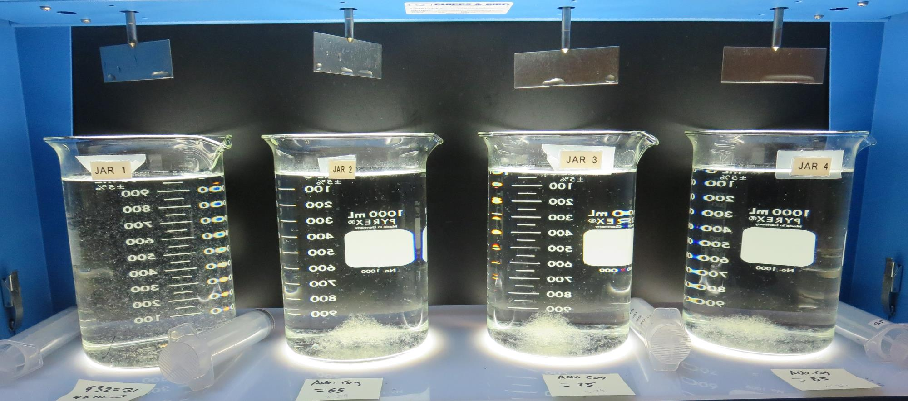
Jars 29-32: After 5 min of settling, 25 mL is syringed for filterability and %UVT/UVA.

Slide 45
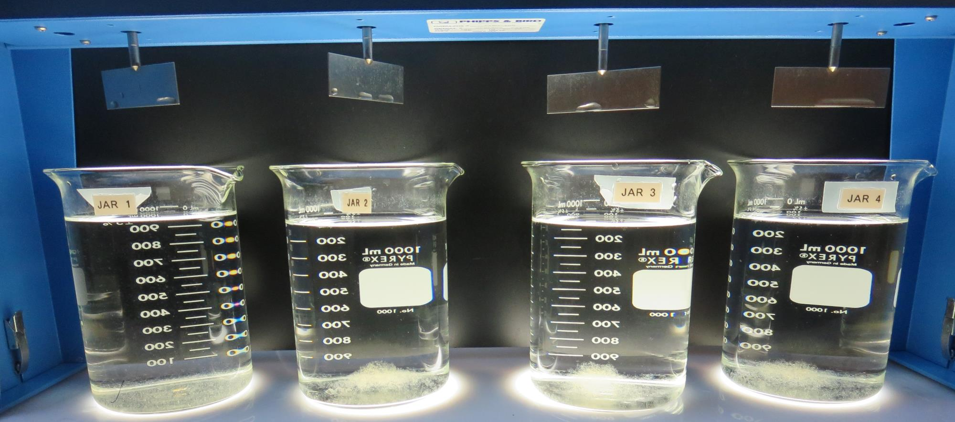
Jars 29-32: After 25-minutes of settling, settled water turbidity is taken.
21 mg/L 932
3.0 mg/L 9890
Filtrate 0.12 NTU
UVT: 92.4%
UVA: 0.034/cm
UVA Reduction: 42.4%
Settled: 0.37 NTU
65 mg/L Adv. Coag.
Filtrate 0.10 NTU
UVT: 91.3%
UVA: 0.039/cm
UVA Reduction: 33.9%
Settled: 0.26 NTU
75 mg/L Adv. Coag.
Filtrate 0.10 NTU
UVT: 91.8%
UVA: 0.037/cm
UVA Reduction: 37.3%
Settled: 0.24 NTU
85 mg/L Adv. Coag.
Filtrate 0.08 NTU
UVT: 92.2%
UVA: 0.034/cm
UVA Reduction: 42.4%
Settled: 0.20 NTU

Slide 46
Jar Testing for 1-Liter Jars: Procedures for Most Treatment Plants
Fill jars with source water prior to coagulant injection and set paddle speed at 30 rpm
Add chemicals (i.e., NaOCl, primary coagulant, coagulant aid) to each jar
Flash mix for 15-30 seconds (200 rpm)
Slow mix for 5 minutes (20-30 rpm)
Settled for 5 minutes. Syringe 25 mL from each jar taken 1-inch below surface (25 mL/12 sec rate).
Filtered through 1.2 um isopore membrane into cuvette drip rate, 15 mL/(50-90 sec)
Measure filtrate turbidity, chlorine residual and %UVT/UVA
Measure settled water turbidity after 25 minutes of total setting
Record all data

Slide 47
Jar Test Filterability Test Equipment
Turbidity Instrument
Syringe w/Luer-Lock Tip, 30 cc
(part#: 2225800, by Hach)
Swinnex Filter Holder, 25 mm (part#: SX0002500)
Isopore Membrane Filter, 1.2 um absolute
pore size,
Φ= 25 mm , thickness: 24 um,
hydrophilic polycarbonate membrane
(part #: RTTP02500)
Go to Sigma-Aldrich for laboratory supplies http://www.sigmaaldrich.com/united-states.html

Slide 48
Isopore Membrane Information
Categories | Information
trade name | Isopore
filter color | White
chemistry | Polycarbonate (PC)
water flow rate | Avg. 175 mL/min x cm² (typical results @ 10 psi)
media | Isopore®
wettability | Hydrophilic
porosity | 14.7%
pore size | 1.2 µm
bubble point at 23 °C | 1.0 bar, air with water
thickness | 24 µm
filter diameter (ø) | 25 mm
material size | polycarbonate, Hydrophilic, 1.2 µm, 25 mm, white, plain, 100

Slide 49
Isopore Membrane Background Information
The Isopore membrane is a polycarbonate, track-etched screen filter recommended for all analyses in which the sample is viewed on the surface of the membrane. The Isopore membrane is composed of polycarbonate film, which has a smooth, glass-like surface for clearer sample observation. The unique manufacturing process of the membrane ensures a precise pore diameter and a consistent pore size for accurate separation of samples by size. Matched-weight filters are not usually required because of low, constant tar and ash weights. Features & Benefits: Membrane structure retains particles on the surface, simplifying counting and analysis

Slide 50
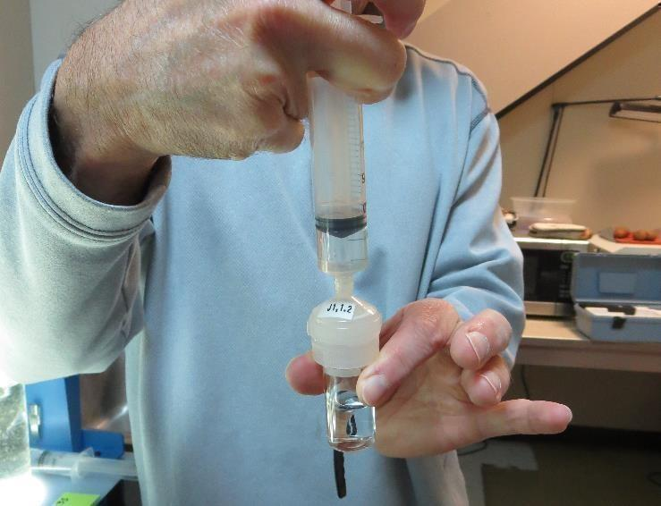
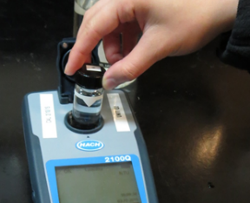
Jar Test - Filterability Test
Syringe ~ 25 mL from jar (after 5-minutes of settling)
Filter-to-waste 3-5 mL
Filter directly into clean cuvette
Measure turbidity
Note: Take several readings before recording final NTU results. Micro bubbles can adhere to glass causing false NTU readings. To remove bubbles, tilt cuvette up to 90 degrees.

Slide 51
Contact
Guy Schott, P.E.
State Water Resources Control Board
Division of Drinking Water
Santa Rosa, CA
Go to Stock Solution/Dose calculations/Jar Test Results for tools to download
www.waterboards.ca.gov/drinking_water/programs/districts/mendocino_district.html
Email: Guy Schott - Guy.Schott@waterboards.ca.gov
Office Number: 707-576-2732

