Slide 1
Agricultural Lands Discharge Program Update North Coast Regional Water Quality Control Board Rebecca Fitzgerald, Regional Water Board Ben Zabinsky, Regional Water Board Mike Hiatt, Oregon Dept. of Environmental Quality
Item 5
March 8, 2017
Fortuna, CA

Slide 2
Purpose
Update on the Agricultural Lands Discharge Program
Background
Current approach
Current initiatives
Focus on
Scott and Shasta River TMDL Waivers
Development of the vineyard and orchard Waste Discharge Requirements (WDRs)
Watershed stewardship in Upper Klamath and Tule Lake watersheds
Water quality monitoring in the Smith River Plain

Slide 3
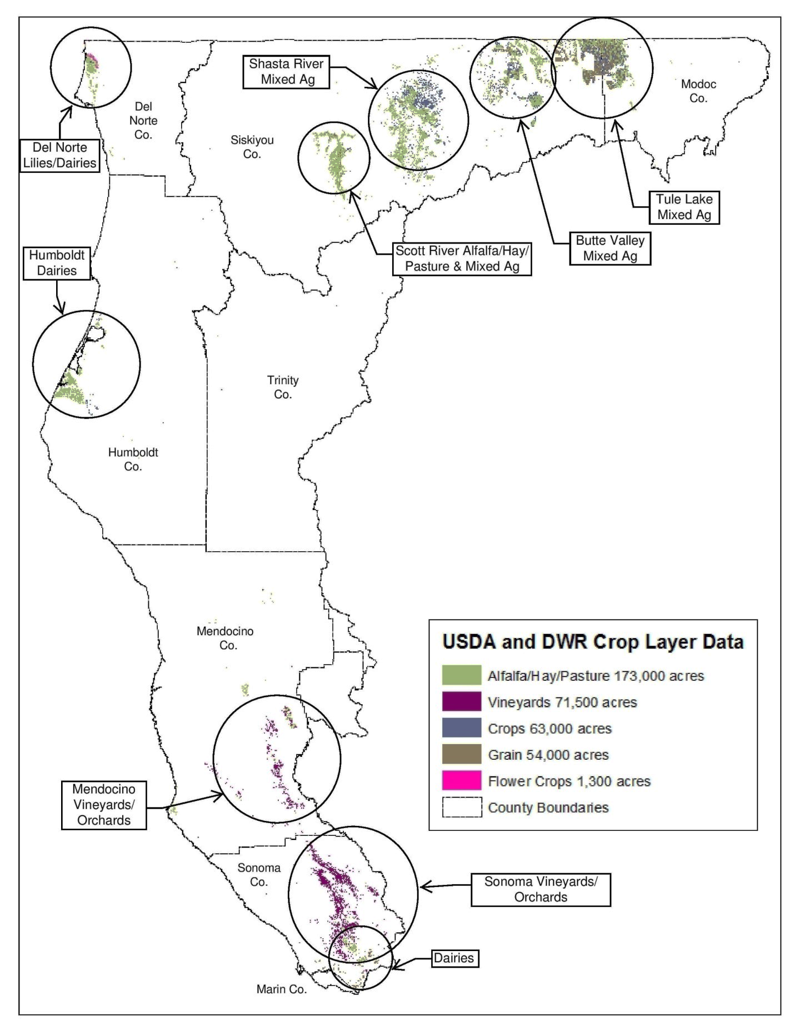
Agriculture in the North Coast Region

Slide 4
Basis for Agricultural Lands Discharge Program
Require controls on discharges of waste associated with agricultural activities
Meet state legislation and policies
California Water Code
2004 State Nonpoint Source Policy requirements
Implementation of TMDLs
Klamath River and Lost River
Scott River
Shasta River

Slide 5
Existing Permits
Scott and Shasta River TMDL conditional Waivers of WDRs
adopted in 2006, revised 2012
Cannabis and related activities Waiver of WDRs
adopted in 2015
Regionwide cow dairy permits
adopted in 2012, renewed in 2016
revisions planned for 2018
US Forest Service lands Waiver of WDRs
adopted in 2010, renewed in 2015
includes grazing allotments

Slide 6
Program Development to Date
Development of a regionwide Agricultural Lands Discharge Program began after adoption of Klamath TMDLs in 2010
In 2013, Regional Board directed staff to separate permits for commodities and geographic areas
Since 2013, staff have been working on developing three separate permits simultaneously
Vineyard and Orchard WDR
Lily Bulb Cultivation permit
Tule Lake Ag Lands permit

Slide 7
Staff Proposed Prioritization
Renew Scott and Shasta River Waivers
Develop Vineyard and Orchards WDRs
Implement Upper Klamath Lake and Tule Lake watershed stewardship
Monitor water quality associated with lily bulb cultivation in the Smith River Plain
Staff resources allocated: 1 Person Year (PY)

Slide 8
Agricultural Lands Discharge Program Lower Priority Tasks
Grazing on private lands regionwide
Butte Valley agricultural lands

Slide 9
Vineyard and Orchard WDRs
Reasons for prioritizing development of vineyard and orchard WDRs:
Need to address water quality risks
San Francisco Bay Region is developing WDRs for vineyards
Third-party certification programs already up and running in our region
WDRs will be integral in addressing 303(d) list impairments

Slide 10
Vineyard and Orchard WDRs Planned Permit Scope
Water quality issues to address
Erosion prevention and minimization
Riparian management
Pesticide management
Nutrient management
BMP-based approach
Farm water quality management plans
Monitoring and reporting
Third-party certification process
Enrollment into tiers based on risk

Slide 11
Vineyard and Orchard WDRs Development Schedule
Process/Milestone | Completion Date or Range
Administrative Draft of Permit | 2017
Advisory Group Meeting | 2017
Tribal Consultations | 2017-2018
CEQA Documentation | 2018
Advisory Group Meeting | 2018
Public Comment Period | 2019
Public Workshops | 2019
Adoption Hearing | 2019

Slide 12
Questions

Slide 13
Scott River Watershed & Shasta River Watershed TMDL Waivers of Waste Discharge Requirements

Slide 14
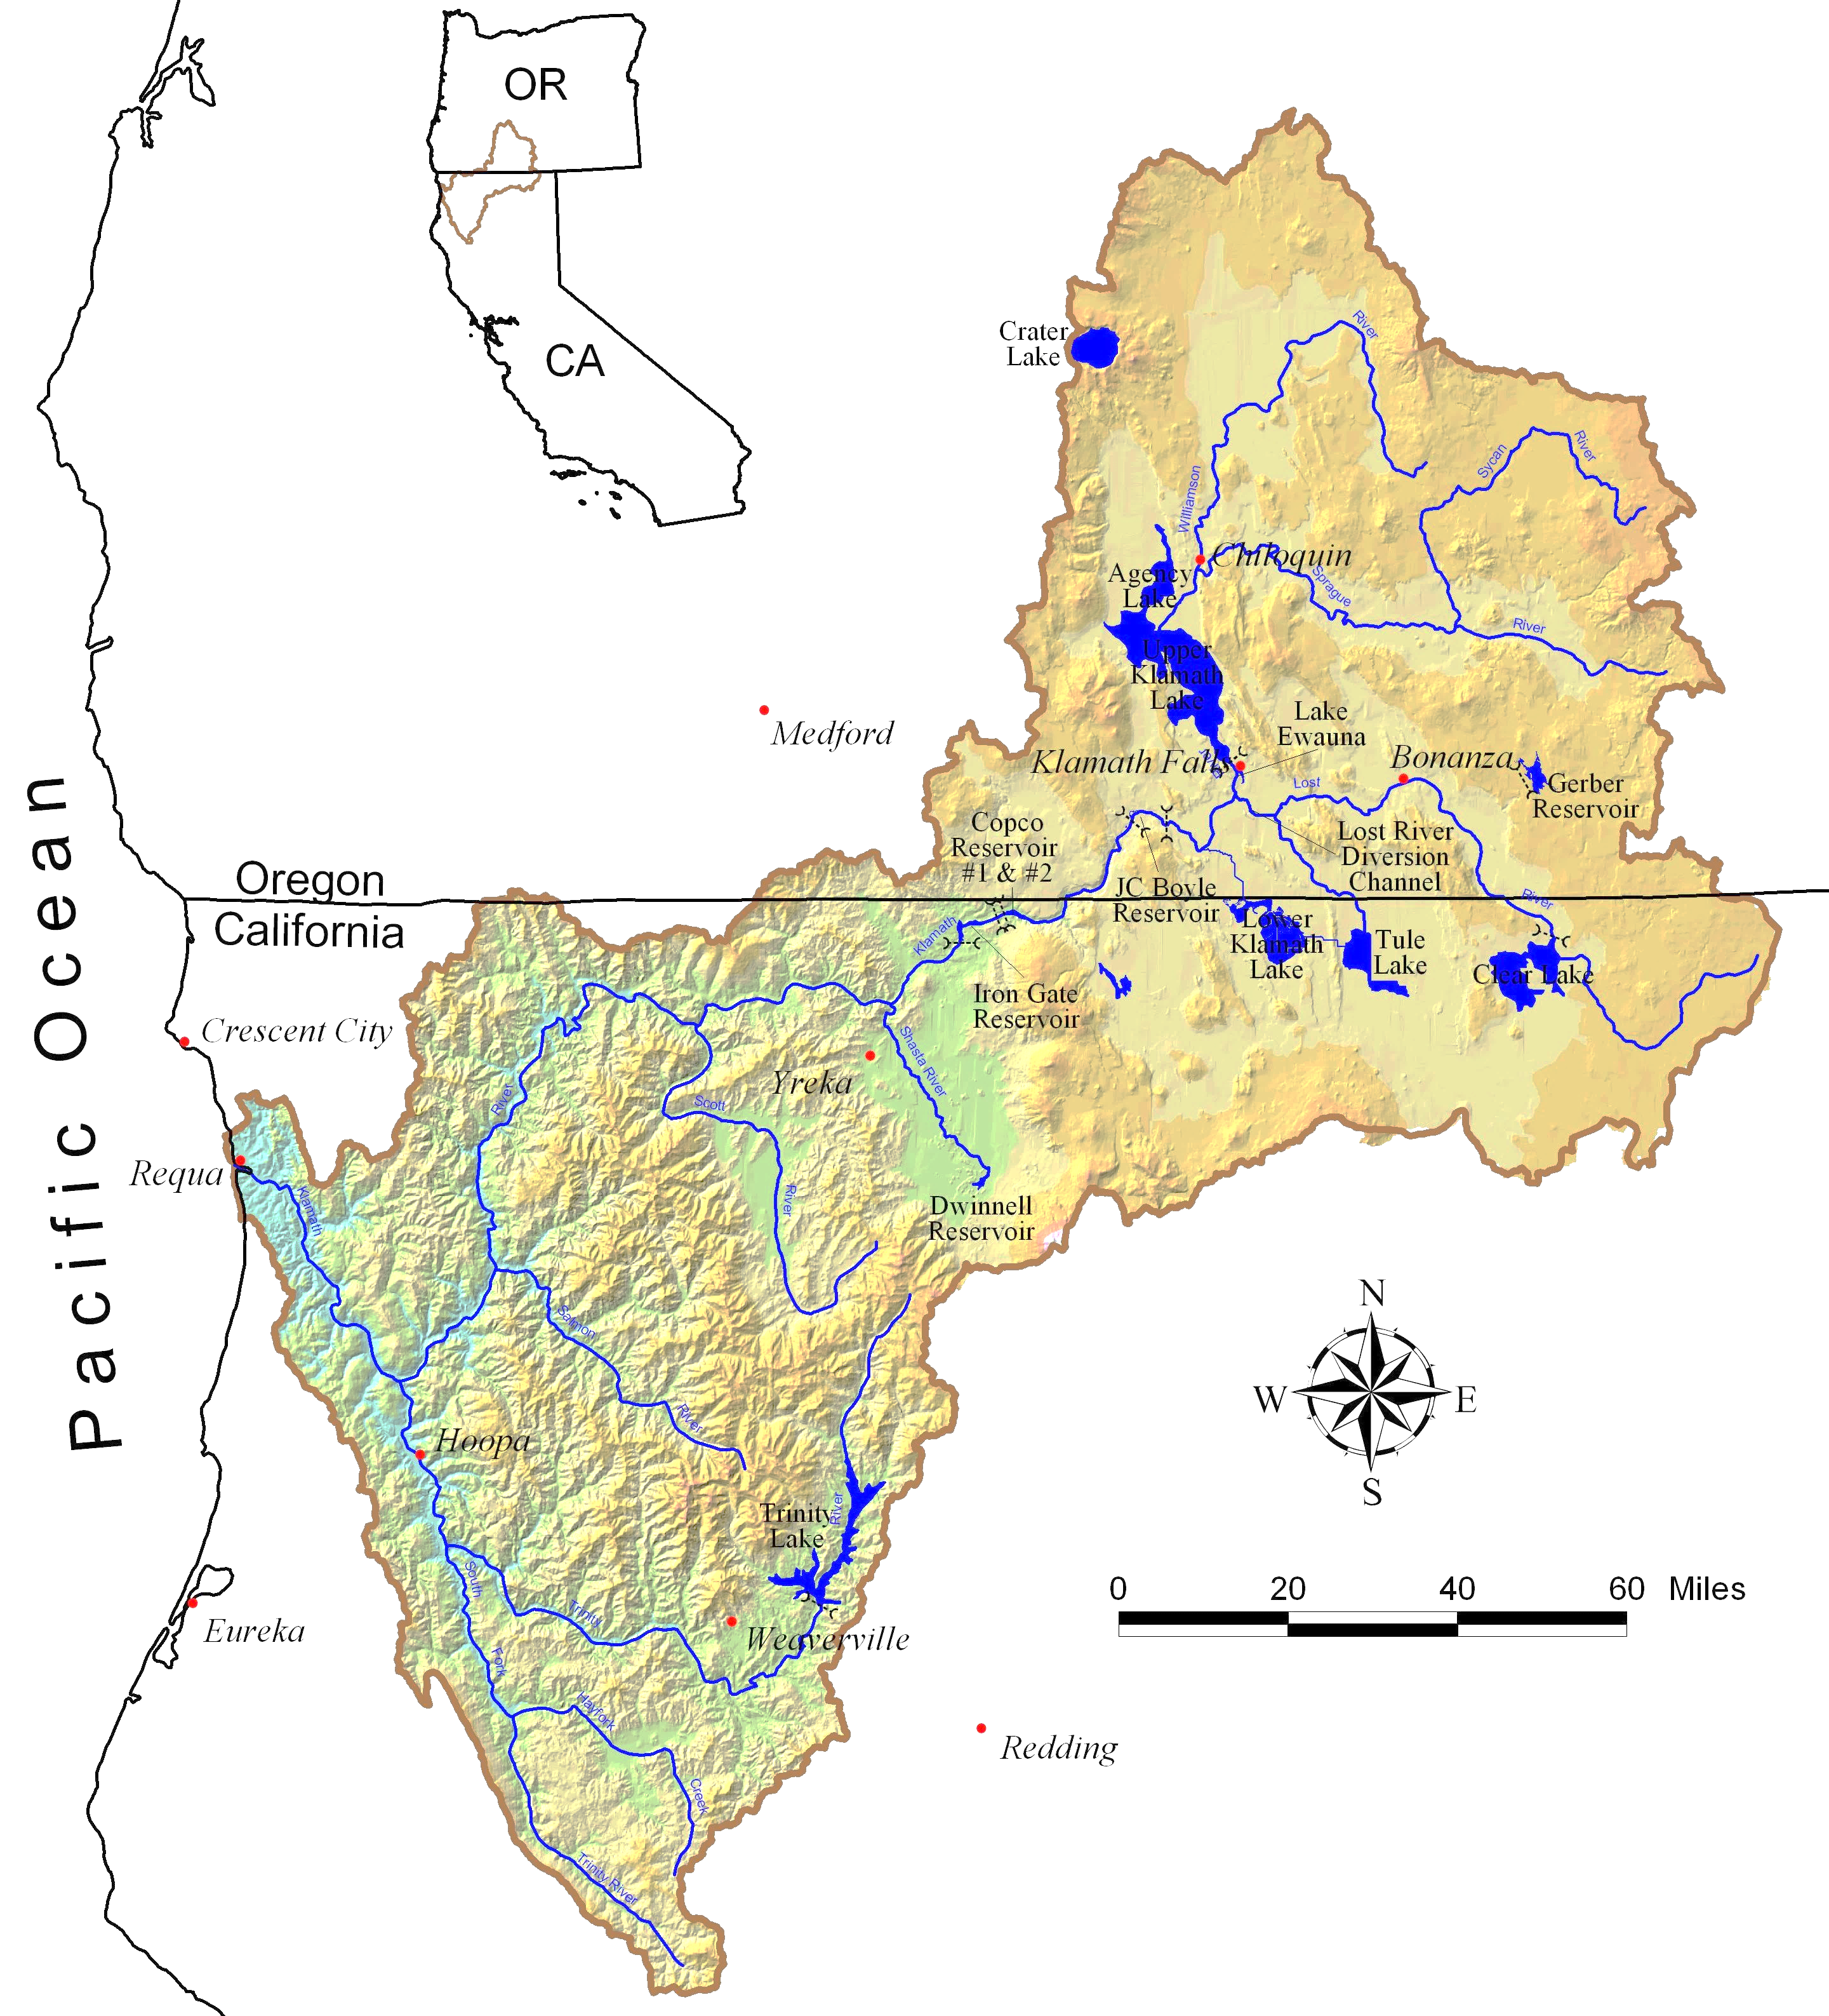
Klamath River
Watershed
Shasta River
Scott River
Notes:
As Ben mentioned, one of the permit program currently in place and being implemented is to address discharges from agriculture and other land uses in the Scott River and Shasta River watersheds – part of Klamath

Slide 15
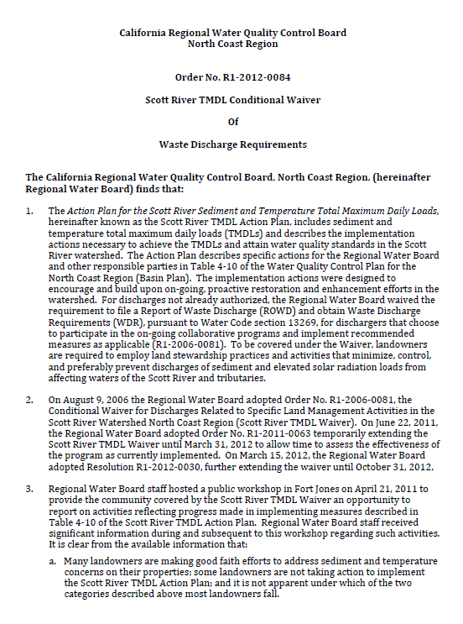
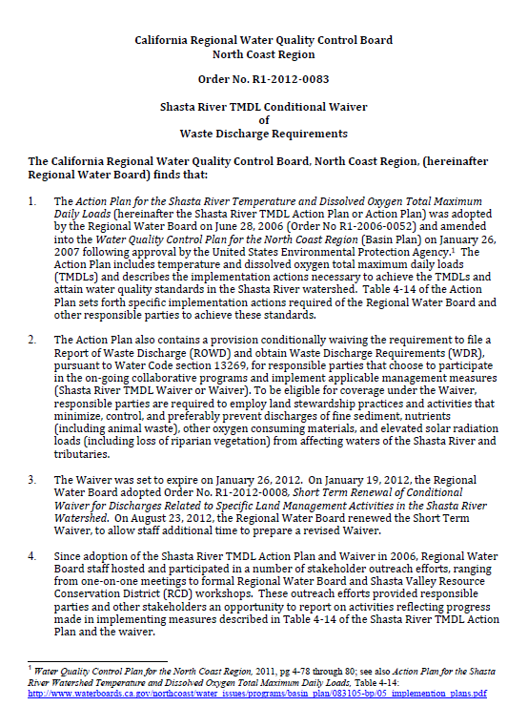
Scott & Shasta River TMDL Waivers
Scott River TMDL Waiver (R1-2012-0084)
Shasta River TMDL Waiver (R2-2012-0083)
Focus on high priority areas
No Notice of Intent; Rely on standard conditions
Rely upon farm/ranch assessments
Rely upon farm/ranch plans to identify Best Management Practices (BMPs)
Staff follow up to ensure implementation
Staff Resources: 1 person (Eli Scott)
Notes:
These watersheds are also a little unique in that we have a more regulatory mechanism in place in the form of a conditional waiver of waste discharge requirements for each watershed.
The waivers came out of the TMDLs and are one of the pieces of the puzzle identified in the TMDL action plans to prevent, minimize, or control discharges of sediment, nutrients, or elevated solar radiation loads.
The waivers are very similar to each other. Staff are focusing on responsible parties whose ranching or farming operations present higher risks to water quality based on type and intensity of the land use, proximity to high priority stream or river reaches, and the length of stream adjacent to the farm or ranch. In the Scott, this translates to the larger farms and ranches that border the mainstem and the major tributaries. In the Shasta, we are focused on ranches near the cold water spring complexes.
Currently, there is no enrollment requirement under the two waivers.
Staff work directly with landowners in the high priority areas to arrange ranch or farm field assessments. If discharges are found (such as places where tailwater is returning to the river) or site specific effective potential shade is being impacted (such as by cattle loafing in the riparian area), then we ask the landowner to develop, submit, and implement a plan to fix the problem in a specific period of time. These are BMP-based waivers.
We have one staff person’s time allocated to this effort in both watershed. That is Eli, who as you know was recently hired after 9 months without someone in the position. But we already have our next assessment scheduled and are moving forward again.
As with any waiver, these two have a five year life span and they will expire in October of this year. We are therefore in the process of renewing them.

Slide 16
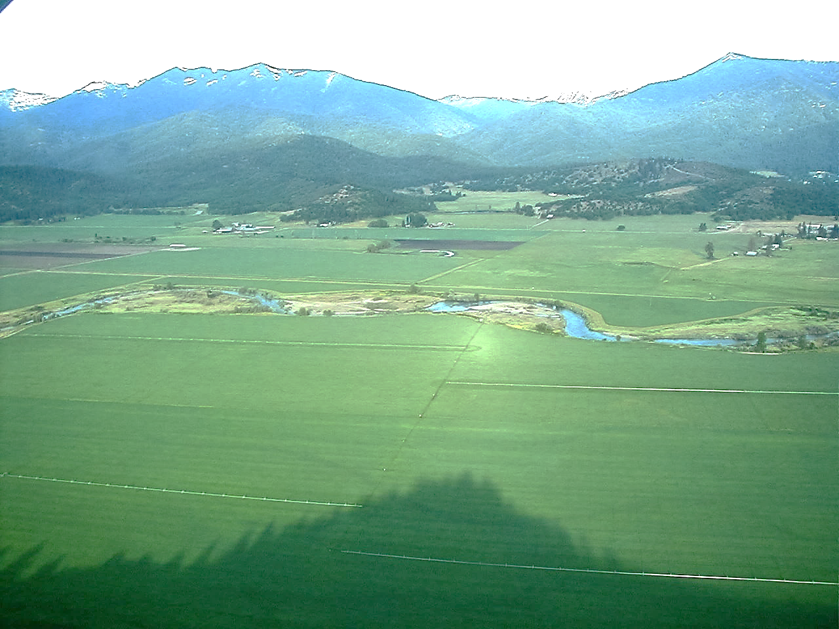
Scott & Shasta TMDL Waiver Renewals Proposed Content
Renew with minimal changes to the current requirements and process
Retain focus on high priority areas
Retain staff-driven outreach
Retain farm/ranch assessments
Retain farm/ranch plan development and implementation efforts
Improve tracking of performance measures
Provide status check of stewardship efforts
Scott Valley
Shasta Valley
Notes:
For now, my preview of coming attractions is to say that we are working on renewing both waivers with minimal changes to the current process and requirements. Still have a staff-driven process of working with high priority farms and ranches, using a farm/ranch plan as the mechanism to improve BMPs on the ground, following up, and responding to complaints and other high risk issues that we might see.
We also want to improve our tracking procedures and quantifiable performance measures.
You will hear more detail on how many assessments we have completed over the past five years, how close we are on attaining our goals from 5 years ago on assessing farms and ranches in the high priority areas, some assessment of temp and DO data for the Shasta, and the status of other TMDL implementation actions.

Slide 17
Scott & Shasta TMDL Waiver Renewals Development Schedule
Current Waivers expire in October 2017
Process/Milestone | Estimated Date
Public Comment Period | May-July 2017
Public Workshops | June 2017
Adoption Hearing | October 2017

Slide 18
Upper Klamath River and Tule Lake Watershed Stewardship
Working on restoration initiatives in the Upper Klamath watershed in Oregon and California that will improve water quality in the Lost and Klamath Rivers
Staff intend to develop a permit after investing effort in stewardship and the MOU effort
Mike Hiatt from Oregon Dept. of Environmental Quality will present on our joint efforts

Slide 19
Klamath River
Watershed
Upper Klamath Watershed
Notes:
As Ben mentioned, one of the permit program currently in place and being implemented is to address discharges from agriculture and other land uses in the Scott River and Shasta River watersheds – part of Klamath

Slide 20
Upper Klamath Lake Watershed with Bureau of Reclamation’s Klamath Irrigation Project Land

Slide 21
Upper Klamath River and Tule Lake Watershed Stewardship
Reducing loading in the Upper Klamath Lake watershed in Oregon will improve water quality in Oregon and California
Basinwide Coordination – planned MOU
North Coast Regional Water Quality Control Board
Oregon Department of Environmental Quality
US Bureau of Reclamation and US Fish and Wildlife Service
Klamath Basin Water Users
Klamath Basin Tribes

Slide 22
Upper Klamath River and Tule Lake Watershed Stewardship
Collaborative relationship between the states and EPA Regions 9 and 10
MOA established for TMDL development
MOU established for TMDL implementation and planning
TMDL development has come and passed and planning will be the primary focus moving forward
Currently in the process of developing the implementation framework
Implementation MOU will be renewed

Slide 23
Upper Klamath River and Tule Lake Watershed Stewardship
Currently completing revisions to Oregon Temperature TMDL
Final Oregon Temperature TMDL issuance expected in late June or early July 2017
TMDL implementation plans from BOR and Klamath Water Users Association (KWUA) have been drafted
Plans for an umbrella document that would cover two major irrigation districts in Oregon and California

Slide 24
Upper Klamath River and Tule Lake Watershed Stewardship
Current efforts include the following:
Large scale piping projects for conservation and efficiency minimizing tail water returns to the Lost River
Farmers Conservation Alliance – investigating opportunities with the Langell Valley and Horsefly Irrigation Districts to implement piping and irrigation infrastructure projects with a required environmental benefit
Installation of a demonstration wetland by the BOR to show efficiency of nutrient/sediment removal of tail water before discharging into Klamath Straits Drain
Watershed planning through the NRCS and the National Water Quality Initiative in the Lost River which will lead to on farm practices and irrigation modernization with a focus on water quality improvement

Slide 25
Upper Klamath River and Tule Lake Watershed Stewardship
Regional Water Board will coordinate with stakeholders in both Oregon and California to support restoration and water quality projects
Staff intends to develop a permit for discharges from agricultural lands in the Tule Lake watershed after investing effort in stewardship and the MOU effort

Slide 26
Easter Lily Bulb Cultivation in the Smith River Plain
Regional Water Board conducted sampling in 2013 and 2015
Surface water
Stream bed sediments
Groundwater
Preliminary results available on our website:
http://www.waterboards.ca.gov/northcoast/water_issues/programs/agricultural_lands/lily.shtml
Final Report available summer 2017

Slide 27
Summary
Staff proposed priorities
Scott and Shasta conditional waiver program implementation (1 PY – Eli Scott)
Develop vineyard and orchard WDRs (1 PY – Ben Zabinsky)
Upper Klamath and Tule Lake Watershed Stewardship
Smith River Plain and lily bulb monitoring
Limited staff resources to develop permits

Slide 28
Email List (Lyris)/Webpage
http://www.waterboards.ca.gov/northcoast/water_issues/programs/agricultural_lands/

Slide 29
Contacts
Ben Zabinsky – Agricultural Lands Discharge Program Staff
Ben.Zabinsky@waterboards.ca.gov
707-576-6750
Eli Scott – Scott and Shasta River TMDL Program Staff
Elias.Scott@waterboards.ca.gov
707-576-2610
Clayton Creager – Watershed Stewardship Coordinator
Clayton.Creager@waterboards.ca.gov
707-576-2666
Rich Fadness – Regional Monitoring Coordinator
Rich.Fadness@waterboards.ca.gov
707-576-6718
Rebecca Fitzgerald – Watershed Adaptive Management Unit Senior Rebecca.Fitzgerald@waterboards.ca.gov
707-576-2650

