Slide 1
California Statewide Mercury Control Program for Reservoirs
California Lake Management Society October 13, 2016
Patrick Morris
Lauren Smitherman

Slide 2
Outline
Project update
Program background
Reservoir pilot tests
Questionnaire for binning
Potential climate change impacts to reservoirs

Slide 3
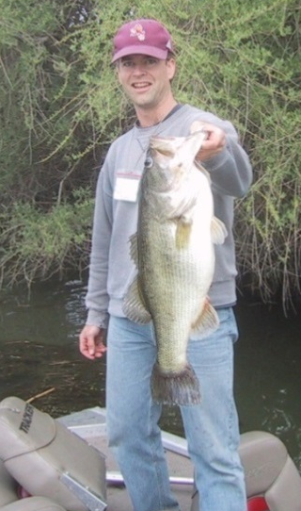
Background
Mercury is an issue for people and wildlife eating fish
State Water Board developing statewide mercury objectives
Statewide approach: 74 168 reservoirs
Total maximum daily load (TMDL)

Slide 4
Impaired Reservoirs
Mercury-Impaired Reservoirs
2012 303(d) List
Future Listing

Slide 5
Methylmercury Biomagnification
Dietary inputs = primary MeHg source
100,000x

Slide 6
Key Factors in Mercury Problem
Water Chemistry
Pollution
Fisheries

Slide 7
Water Boards
Water Chemistry
Pollution
Fisheries

Slide 8
Water Boards
Mines
Dredging and erosion from land disturbance
Wastewater (NPDES-permitted facilities)
Atmospheric deposition
Stormwater (urban runoff)
Pollution

Slide 9
Reservoirs
Water Chemistry
Pollution
Fisheries

Slide 10
Phase I - Pilot Tests
Conduct in representative, select reservoirs
Coordinated approach
Technical review committee
Scientific input
Reservoir and pilot test selection
Source control
Pilot tests

Slide 11
Pilot Tests How to Bin Reservoirs
Questionnaire:
Water chemistry
Fishing management
Pilot test and technical review committee

Slide 12
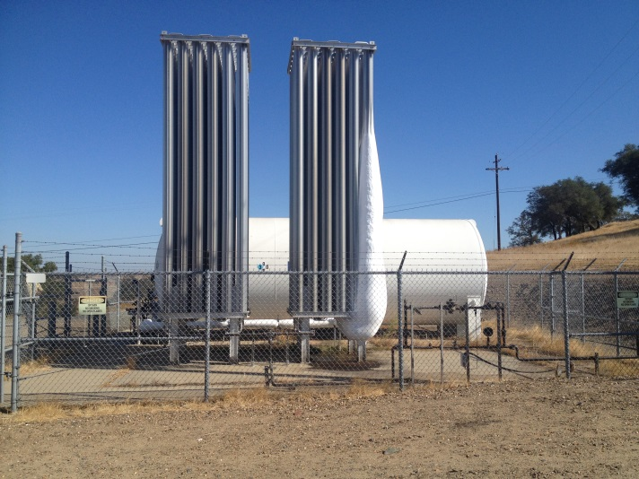
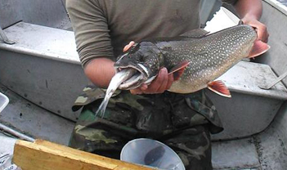
What to Pilot Test
Water Chemistry
Aim: Reduce production
Examples:
Oxidant addition
Remove/cap sediment
Fisheries Mgmt
Aim: Reduce accumulation
Examples:
Change fish stocking
Prey fish with lower MeHg

Slide 13
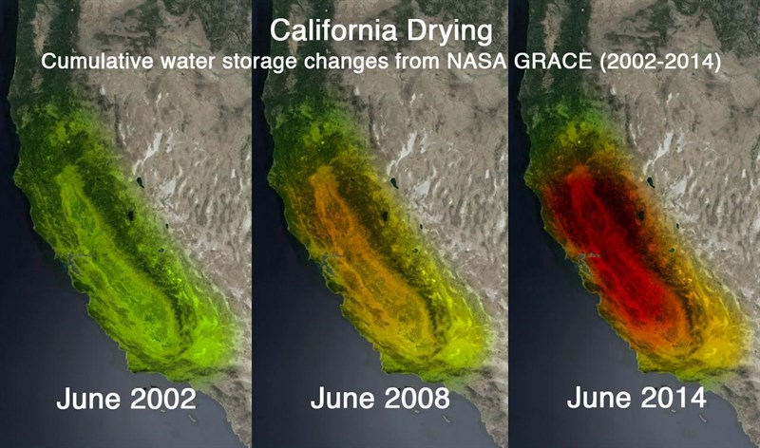
Climate Change Fish Hg Changes?
Can we continue to use current reservoir management strategies under changing conditions?

Slide 14
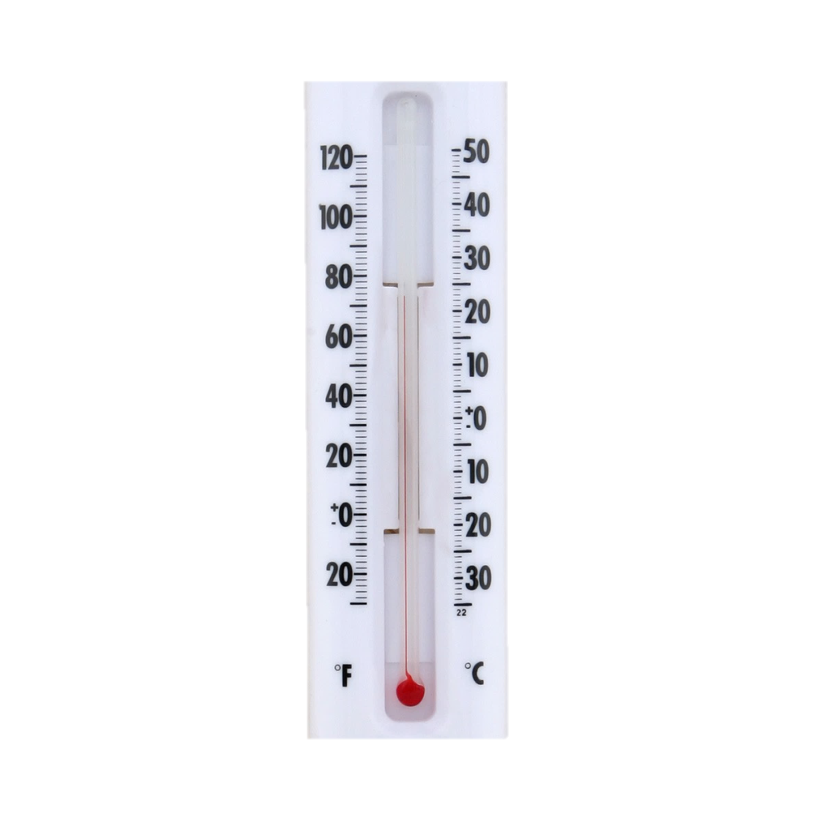
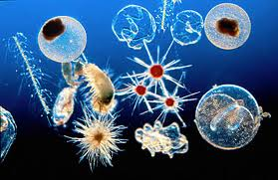
Climate Change General Effects on Water Quality
Increased
Water temps
Turbidity
Primary production

Slide 15
Climate Change Stratification
Reservoirs will stratify earlier in year and de-stratify later longer anoxia more MeHg production
Hypolimnion deep water will be warmer increased MeHg production rate

Slide 16
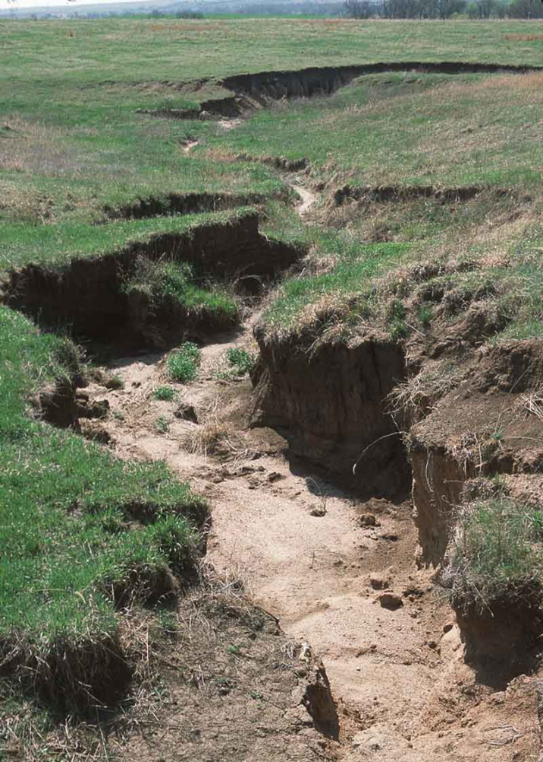
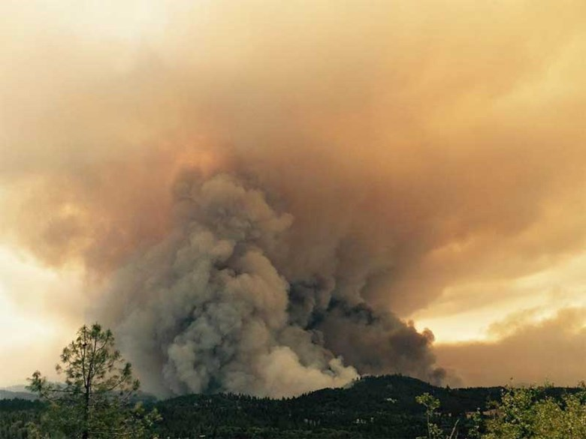
Climate Change Erosion
Increase of frequency, scale, and intensity of flooding and wildland fires

Slide 17
Competing Scenarios
Increased temperatures lead to increased primary production

Slide 18
Increased Primary Production
Decreased fish MeHg levels via algal bloom dilution and somatic growth dilution

Slide 19
Increased Primary Production
Decrease dissolved oxygen because decomposition of (more) algae requires (more) oxygen. Less dissolved oxygen could in turn lead to increases in in-reservoir MeHg production

Slide 20
Increased Primary Production
Increased organic matter can enhance MeHg production by providing a food source to sulfate-reducing bacteria.
However, organic matter also can reduce the potential for methylation and bioaccumulation by decreasing the bioavailability of Hg to biota due to complex binding

Slide 21
Adaptive Management

Slide 22
Questions?
For program information and updates:
www.waterboards.ca.gov/water_issues/programs/mercury/
Email:
MercuryProject@waterboards.ca.gov

