Slide 1
Comments on Proposed Methods to Develop Flow Criteria for Priority Tributaries to the Sacramento-San Joaquin Delta
Prepared for SWRCB
March 19, 2014
Valerie Kincaid
Doug Demko
San Joaquin Tributaries Authority

Slide 2
SWRCB Flow Criteria Development Goals
Scientifically defensible
Watershed scale
Cost-effective
Timely

Slide 3
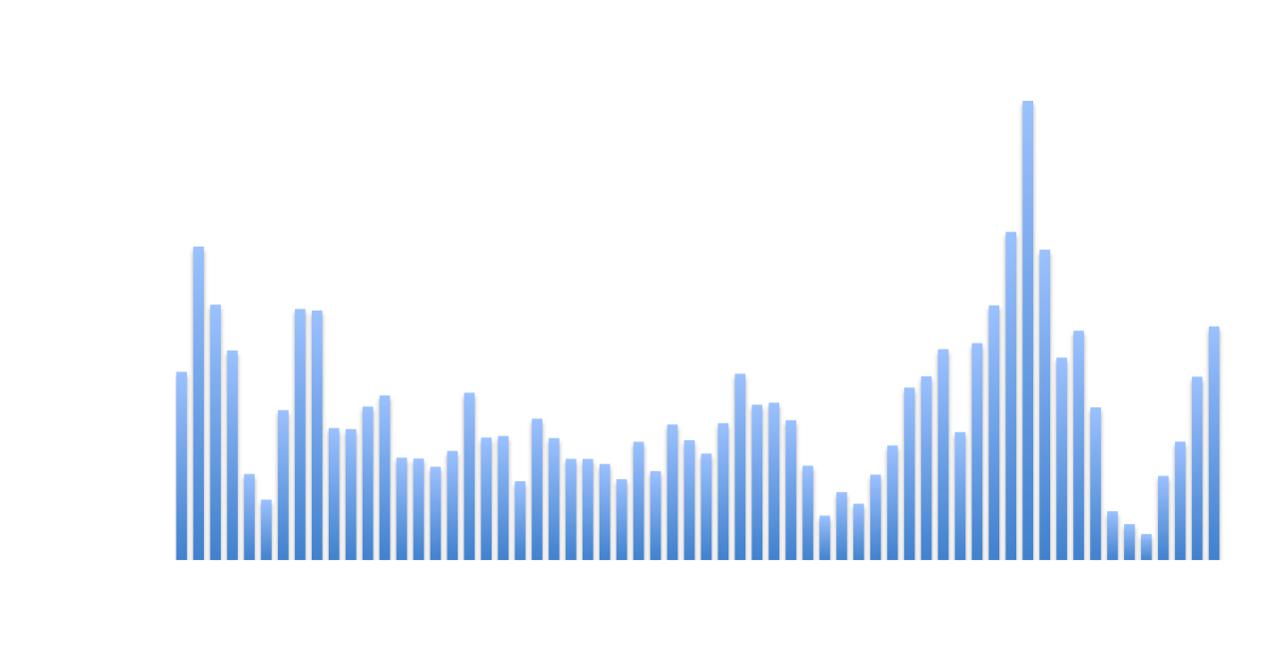
The Cost of Salmon Recovery
“It is estimated that the cost for implementing recovery actions will range from $1.04 to 1.26 billion over the next 5 years, and over $10 billion over the next 50 years."
National Marine Fisheries Service. 2009
Notes:
------------------------------------
source:
National Marine Fisheries Service. 2009. Public Draft Recovery Plan for the Evolutionarily Significant Units of Sacramento River Winter‐run Chinook Salmon and Central Valley Spring‐run Chinook Salmon and the Distinct Population Segment of Central Valley Steelhead. Sacramento Protected Resources Division. October 2009.
http://swr.nmfs.noaa.gov/recovery/cent_val/Public_Draft_Recovery_Plan.pdf

Slide 4
The Value of Fish, Hydropower, and Water in California
Salmon
$255 mil to 2 Billion
Hydropower
$34 Billion
Urban
$8 Billion
Water
Agriculture $35 Billion
CDFG 2009, Southwick Assoc. 2009, Cooley et al. 2008, 2010 U.S. Energy Information Administration

Slide 5
Key Component of ELOHA – Watershed Scale
“ELOHA framework rests on the premise that although every river is unique, many exhibit similar ecological responses to flow alteration. ELOHA assumes that this relationship holds for all rivers of that type.”
Nature Conservancy 2012

Slide 6
Is ELOHA Scalable to Multiple Watersheds?
Tributaries with dams could not be compared due to different hydrologic regime
Approach may not be applicable to all tributaries in the watershed even without dams
Flow – ecology relationships variable and many times weak
(Davies et al. 2013; Arthington et al. 2012; McManamay et al. 2013)

Slide 7
General Concerns with “Scientifically Defensible”
Justification for revising the thorough, collaborative, and more common IFIM method questionable
Is IFIM Broke? 38 FERC studies on 23 CV tributaries
Application of new ELOHA/hybrid method in West Coast regulated streams seems questionable
New, hybrid methodology contradictory to “scientifically defensible”?
More detailed plan needed for evaluation

Slide 8
Step 1: Identify Public Trust and Existing Beneficial Uses
Re-allocation of water to protect the public trust is a process that requires the collection of significant information to weigh and balance existing and proposed uses
Identify Public Trust Uses
Identify Existing Beneficial Uses
Recreation
Fish Species
Navigation
Terrestrial Species
Commerce
Scenic views
Irrigation
Domestic Use
Industrial Use
Hydropower generation
Existing fish and wildlife flows

Slide 9
Step 2: Identify Fish Species that Require Protection
Steelhead
Fall-Run Chinook Salmon
Spring-Run Chinook Salmon
Winter-Run Chinook Salmon
Sturgeon
Delta Smelt
Longfin Smelt

Slide 10
Step 3: Identify Method of Protection
Habitat Loss
Temperature
Predation
Climate Change
Sediment
Toxics
Ocean Conditions
Ocean Harvest
Hatchery Practices
Channel Modification
Migration Barriers
Entrainment
Flow

Slide 11
Flow is a Small Component
Development of Public Trust Flows
Public Trust Uses
Existing Beneficial Uses
Domestic Use
Irrigation
Industrial Use
Hydropower
Fish Refuge/Flow
Recreation
Commerce
Fish Species
Scenic Views
Terrestrial Species
Navigation
Fall-run Chinook
Spring-run Chinook
Winter-run Chinook
Delta Smelt
Sturgeon
Longfin Smelt
Steelhead
Habitat Loss
Temperature
Predation
Climate Change
Sediment
Toxics
Ocean Conditions
Harvest
Hatchery Practices
Channel Modification
Migration Barriers
Entrainment
Flow

Slide 12
Existing Challenges/Suggested Solutions
Existing Challenges
Current process focuses on a small piece of the puzzle
Flow is a difficult tool because of the indirect connection to survival and the process of re-allocation
Overwhelming amount of information
Suggested Solutions
1. Develop a plan from top down, not bottom up
2(a). Choose tools that re more directly related to fish survival (predation or ocean harvest
2(b). Choose tools more streamlined then re-allocation of existing water rights (predation and habitat projects)
3. Develop checklists with stakeholders and focus on public trust uses that need protection

Slide 13
Comments on Proposed Methods to Develop Flow Criteria for Priority Tributaries to the Sacramento-San Joaquin Delta
Prepared for SWRCB
March 19, 2014
Valerie Kincaid
Doug Demko
San Joaquin Tributaries Authority
Notes:
Remaining tributaries without IFIM include:
Antelope, Butte, Big Chico, Cow, Dry, McClure, Paynes, Putah, Stony, Thomes Creeks
Bear, Cosumnes, Lower Feather, Lower Mokelumne, Lower Yuba Rivers
Worth another slide to create a map of above? What do all these have in common? Not important for Chinook, other than Feather which is considerably different and strongly influenced by hatchery.
So, all major tribs (other than Feather) have undergone substantial effort and study to cooperatively evaluate and set flow criteria.
As per bullet 3, is it fair to say that IFIM is the single best accepted methodology in US, West Coast, California?

Slide 14
Flow is a Small Component
Development of Public Trust Flows
Public Trust Uses
Existing Beneficial Uses
Domestic Use
Irrigation
Industrial Use
Hydropower
Fish Refuge/Flow
Recreation
Commerce
Fish Species
Scenic Views
Terrestrial Species
Navigation
Salmon
Delta Smelt
Sturgeon
Longfin Smelt
Steelhead
Climate Change
Dams
Temperature
Sediment
Toxins
Flow
Habitat Loss

