Slide 1
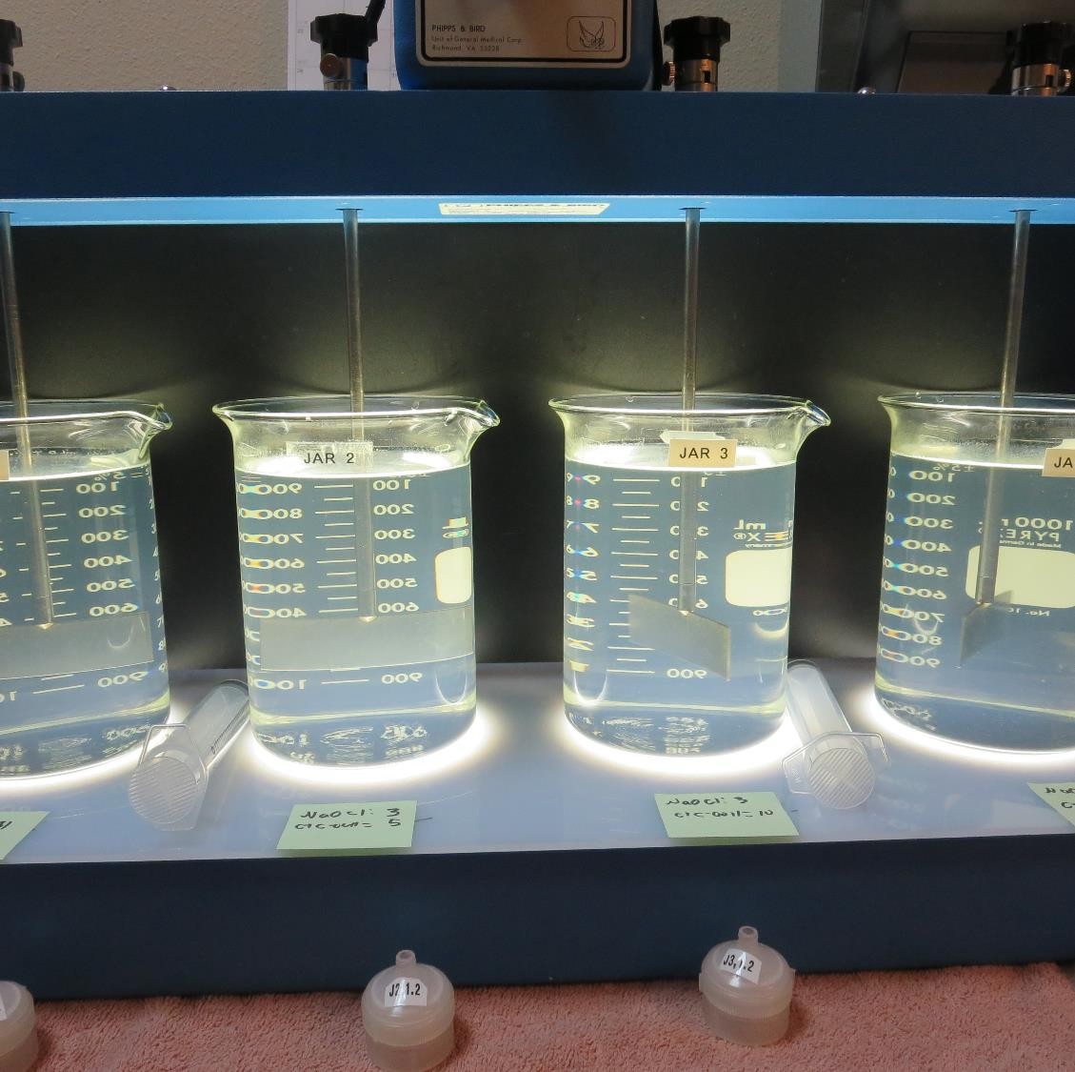
Baycliff Water CA1700606, Lake County, Jar Test, Fe Removal
by Guy Schott, P.E.
August 18, 2021

Slide 2
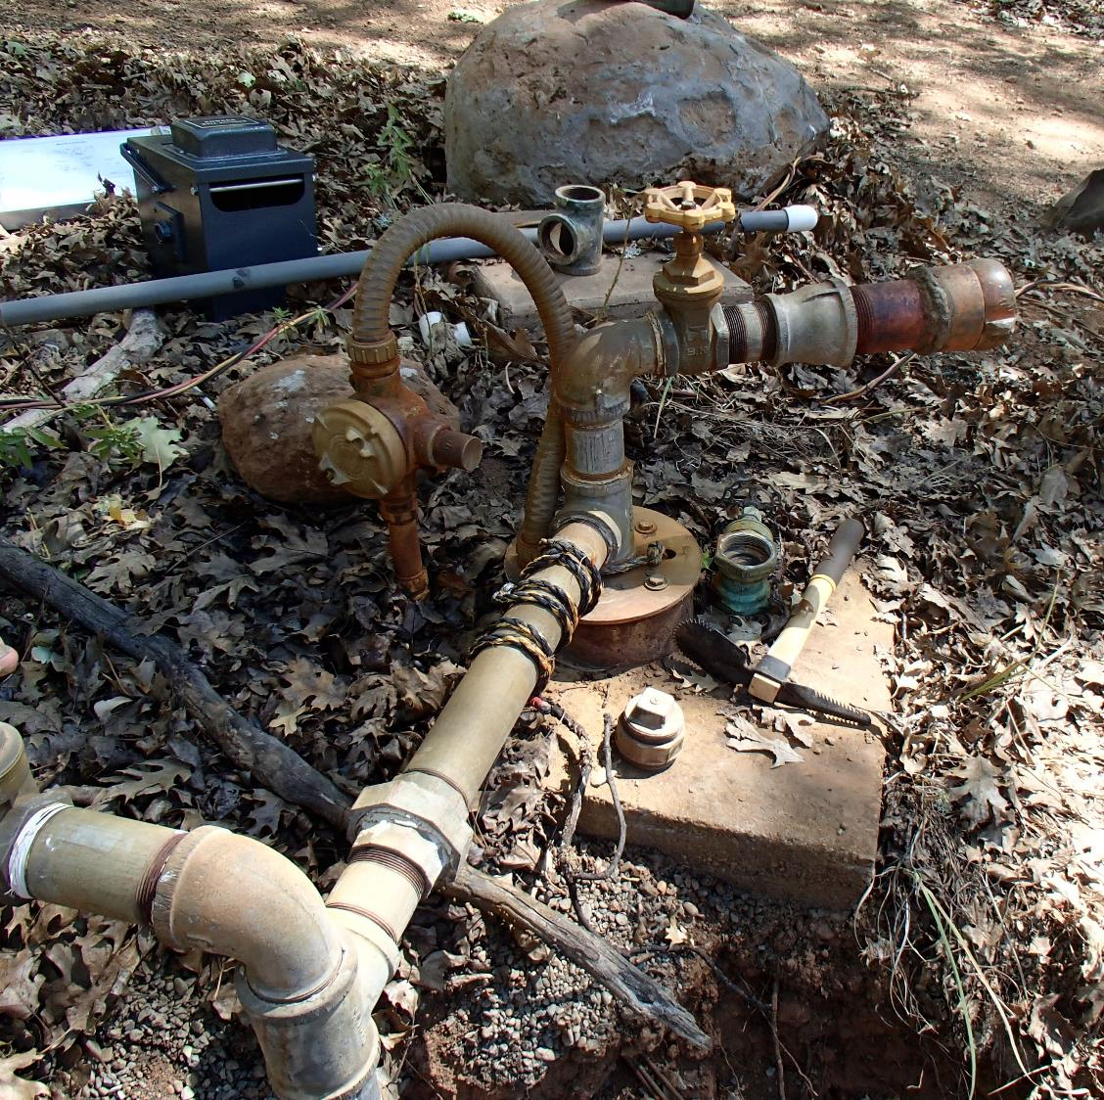
Baycliff Water Ag Well Source: Fe: 2.18 mg/L

Slide 3
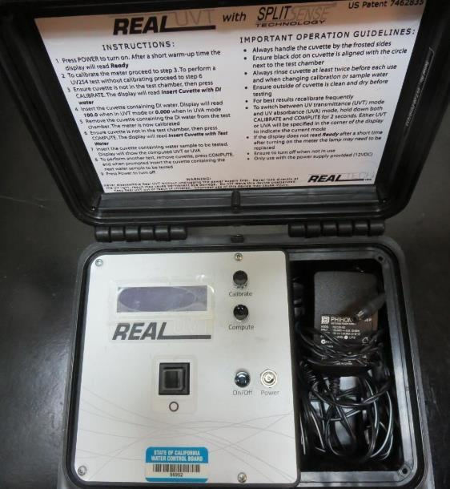
UVT/UVA, pathlength 10 mm
UV transmittance (UVT) is a measurement of the amount of ultraviolet light (commonly at 254 nm due to its germicidal effect) that passes through a water sample compared to the amount of light that passes through a pure water sample. The measurement is expressed as a percentage, % UVT.
%UVT = 10^{(-UVA)} x 100%
UV absorbance (UVA) is calculated as a relative measure of the amount of light absorbed by a water sample compared with the amount of light absorbed by a pure water sample.
UVA = -log(%UVT/100)

Slide 4
Applied Coagulants for Jar Testing (1)
BWS, Inc.
AdvFloc-CTC-00011
Polyaluminum Hydroxy Chlorosulfate
12.55% Al₂O₃
6.64% Al
64.9% Basicity
SG = 1.299
NSF limit: 250 mg/L as Product
BWS, Inc.
Greg Nieckarz, Ph.D.
Greg.niekarz@bws.works
541-953-5112

Slide 5
Baycliff Water: Jar Test 1-8 Results, Ag Well Flash Mix 200 RPM (20 sec); Floc Mix 20 RPM (2 minutes)
Jar # | NaOCl mg/L | CTC-00011 mg/L | Filtrate NTU | Filtrate %UVT | Filtrate UVA/cm | Fe mg/L | %Fe Reduction | Free Cl₂ Residual mg/L
J1 | 3.0 | 0 | 0.07 | 98.5 | 0.006 | 0.042 | 98.1 | 0.99
J2 | 3.0 | 5 | 0.30 | 96.3 | 0.016 | 0.146 | 93.3 | 0.97
J3 | 3.0 | 10 | 0.12 | 98.1 | 0.008 | 0.093 | 95.7 | 1.07
J4 | 3.0 | 15 | 0.09 | 98.6 | 0.006 | 0.008 | 99.6 | 1.01
J5 | 3.0 | 0 | 0.71 | 91.7 | 0.037 | 0.454 | 79.2 | 0.97
J6 | 3.0 | 0 | 0.80 | 90.6 | 0.042 | - | - | 0.79
J7 | 0 | 15 | 0.06 | 98.7 | 0.005 | >1.45 | - | 0
J8 | 3.0 | 15 | 0.06 | 97.9 | 0.009 | 0.102 | 95.3 | 0.70

Slide 6
Baycliff Water: Jar Test 9-12 Results, Ag Well Flash Mix 200 RPM (20 sec)
Jar # | Floc 20 RPM min | NaOCl mg/L | CTC-00011 mg/L | Filtrate NTU | Filtrate %UVT | Filtrate UVA/cm | Fe mg/L | %Fe Reduction | Free Cl₂ Residual mg/L
J9 | 2 | 3.5 | 15 | 0.06 | 98.6 | 0.006 | 0.144 | 93.4 | 1.51
J10 | 12 | 3.5 | 0 | 0.32 | 95.8 | 0.018 | 0.455 | 79.1 | 1.35
J11 | 22 | 3.5 | 0 | 0.36 | 95.0 | 0.022 | 0.250 | 88.5 | 1.39
J12 | 32 | 3.5 | 0 | 0.12 | 97.8 | 0.009 | 0.058 | 97.3 | 1.07

Slide 7
Jar Testing for 1-Liter Jars: Procedures for Iron Removal
Fill jars with source water prior to coagulant injection and set paddle speed at 30 rpm
Add chemicals (i.e., NaOCl, primary coagulant, coagulant aid) to each jar
Flash mix for 20 seconds (200 rpm)
Slow mix for 2 minutes (20 rpm).
Syringe 25 mL from each jar taken 1-inch below surface (25 mL/12 sec rate).
Filtered through 1.2 um isopore membrane into cuvette drip rate, 15 mL/(50-90 sec).
Measure filtrate turbidity, %UVT/UVA and Fe.
Dip cuvette into jar and measure chlorine residual.
Record all data.

Slide 8
Jar Test Filterability Test Equipment
Turbidity Instrument
Syringe w/Luer-Lock Tip, 30 cc
(part#: 2225800, by Hach)
Swinnex Filter Holder, 25 mm (part#: SX0002500)
Isopore Membrane Filter, 1.2 um absolute
pore size,
Φ= 25 mm , thickness: 24 um,
hydrophilic polycarbonate membrane
(part #: RTTP02500)
Go to Sigma-Aldrich for laboratory supplies http://www.sigmaaldrich.com/united-states.html

Slide 9
Isopore Membrane Information
Categories | Information
trade name | Isopore
filter color | White
chemistry | Polycarbonate (PC)
water flow rate | Avg. 175 mL/min x cm² (typical results @ 10 psi)
media | Isopore®
wettability | Hydrophilic
porosity | 14.7%
pore size | 1.2 µm
bubble point at 23 °C | 1.0 bar, air with water
thickness | 24 µm
filter diameter (ø) | 25 mm
material size | polycarbonate, Hydrophilic, 1.2 µm, 25 mm, white, plain, 100

Slide 10
Isopore Membrane Background Information
The Isopore membrane is a polycarbonate, track-etched screen filter recommended for all analyses in which the sample is viewed on the surface of the membrane. The Isopore membrane is composed of polycarbonate film, which has a smooth, glass-like surface for clearer sample observation. The unique manufacturing process of the membrane ensures a precise pore diameter and a consistent pore size for accurate separation of samples by size. Matched-weight filters are not usually required because of low, constant tar and ash weights. Features & Benefits: Membrane structure retains particles on the surface, simplifying counting and analysis

Slide 11
Jar Test - Filterability Test
Syringe ~ 25 mL from jar (after 5-minutes of settling)
Filter-to-waste 3-5 mL
Filter directly into clean cuvette
Measure turbidity
Note: Take several readings before recording final NTU results. Micro bubbles can adhere to glass causing false NTU readings. To remove bubbles, tilt cuvette up to 90 degrees.

Slide 12
Contact
Guy Schott, P.E.
State Water Resources Control Board
Division of Drinking Water
Santa Rosa, CA
Go to Stock Solution/Dose calculations/Jar Test Results for tools to download
www.waterboards.ca.gov/drinking_water/programs/districts/mendocino_district.html
Email: Guy Schott - Guy.Schott@waterboards.ca.gov
Office Number: 707-576-2732

