Slide 1
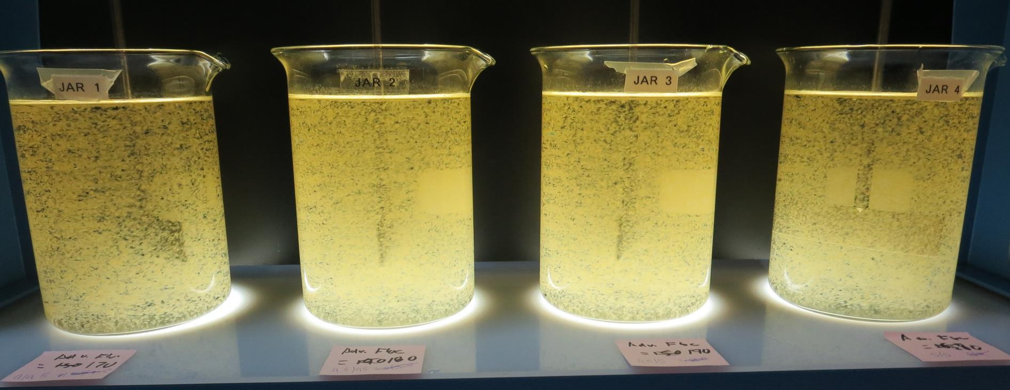
Heritage Ranch CSD CA4010012 San Luis Obispo County Jar Test
by Guy Schott, P.E.
February 22, 2021

Slide 2
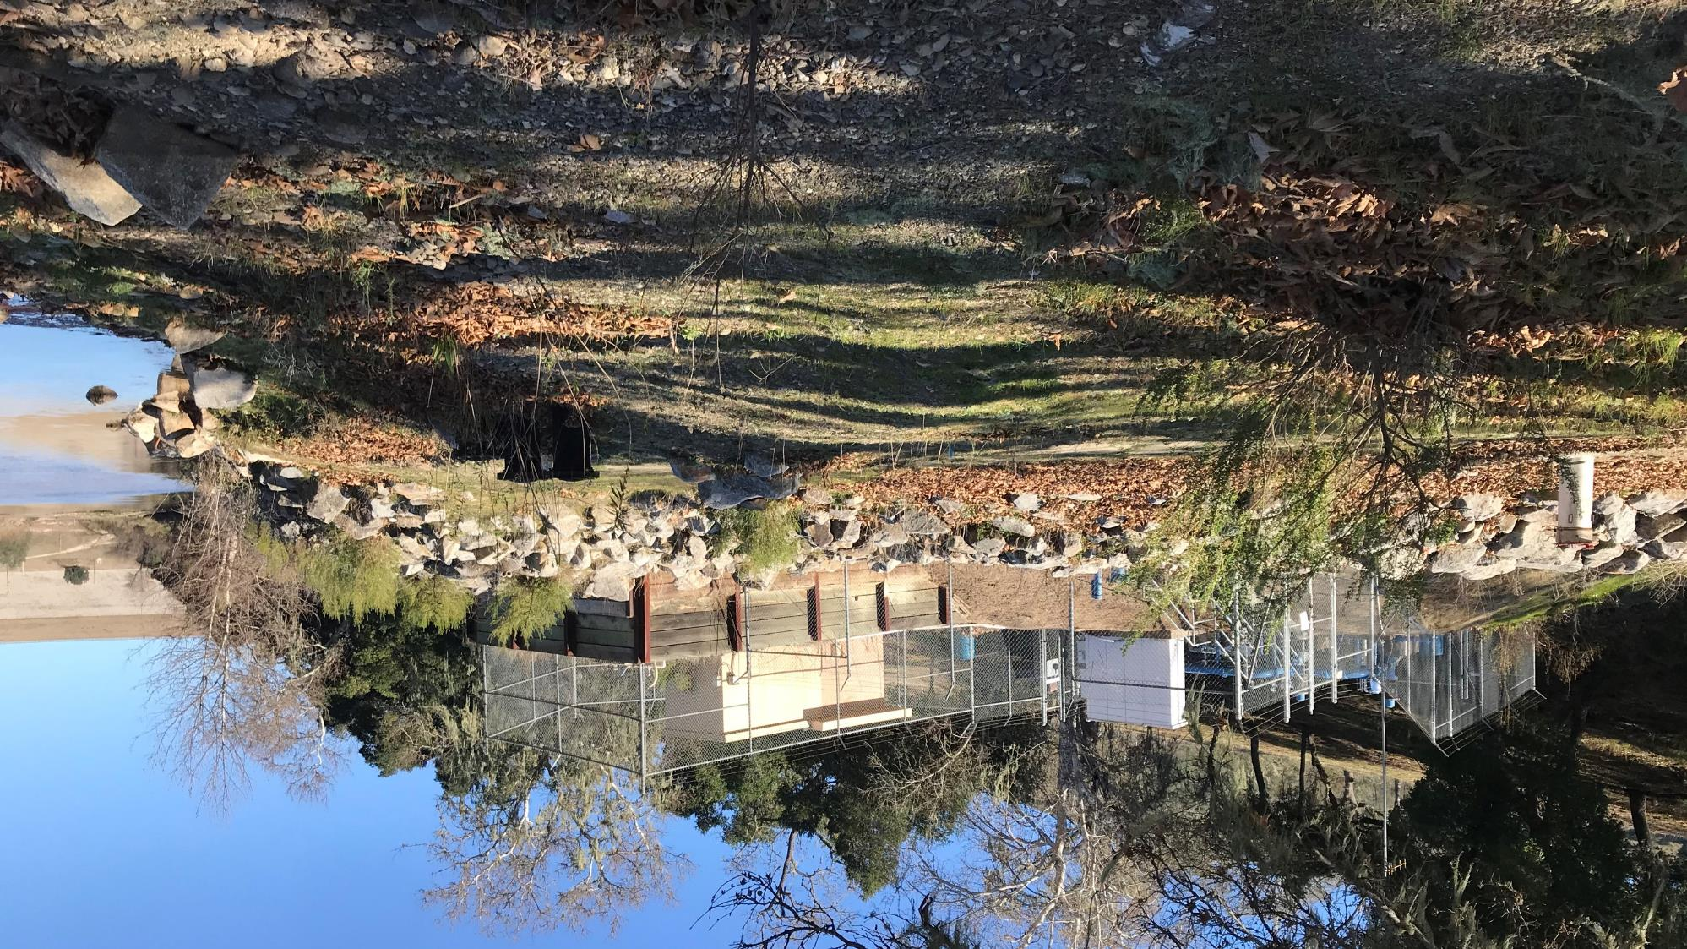
Source Water: Well 01 (Nacimiento River)

Slide 3
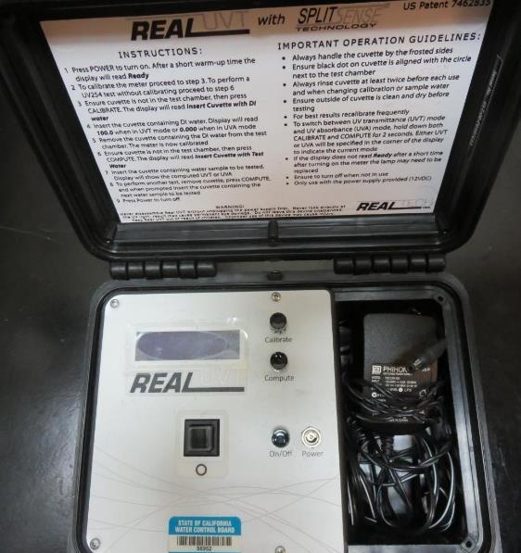
UVT/UVA, pathlength 10 mm
UV transmittance (UVT) is a measurement of the amount of ultraviolet light (254 nm) that passes through a water sample compared to the amount of light that passes through a pure water sample. The measurement is expressed as % UVT.
%UVT = 10^{(-UVA)} x 100%
UV absorbance (UVA) is calculated as a relative measure of the amount of light absorbed by a water sample compared with the amount of light absorbed by a pure water sample.
UVA = -log(%UVT/100)

Slide 4
Heritage Ranch CSD Source Water Characteristics, February 22, 2021
Source
pH: 7.82
Alkalinity: 70 mg/L as CaCO₃
Turbidity: 88 NTU
UVT: 30.9%,
UVA: 0.508/cm
0.4 um Filtered
Turbidity: 0.86 NTU
UVT: 63.1%,
UVA: 0.199/cm
Source (post-KMnO4/PAC)
pH: 7.88
Alkalinity: 73 mg/L as CaCO₃
Turbidity: 65 NTU
UVT: 41.3%,
UVA: 0.384/cm
0.4 um Filtered
Turbidity: 0.61 NTU
UVT: 68.0%,
UVA: 0.167/cm

Slide 5
Heritage Ranch CSD WTP Water Characteristics, February 22, 2021 Treatment Plant: Plate Settlers followed by Roberts Filtration
Plant Coagulant Dose:
Alum(dry): 34.5 mg/L
Clarifloc C-378: 7 mg/L (pDADMAC solution)
Plant Filtrate Water (pre-chlorination
pH: 7.42
Alkalinity: 60 mg/L as CaCO₃
Turbidity: 0.19 NTU
UVT: 86.5%,
UVA: 0.062/cm
Filtrate Water (post-chlorine)
Turbidity: 0.11 NTU
UVT: 90.9%,
UVA: 0.041/cm

Slide 6
Applied Coagulants for Jar Testing (1)
Aluminum Sulfate (Product)
Al₂(SO₄)₃*14.3H₂0 (Liquid)
48% Aluminum Sulfate
52% Water
8.2% Al₂O₃
4.3% Al
0% Basicity
SG = 1.32
NSF limit: 400 mg/L (product)
As hydrated Al₂(SO₄)₃*14.3H₂0
17% Al₂O₃
Polydyne Incorporated
Clarifloc C-378
SG = 1.0 – 1.2
pDADMAC (20% active, 80% H₂O)
NSF limit: 50 mg/L (product)
Product dose 5 mg/L = 1 mg/L pDADMAC active

Slide 7
Applied Coagulants for Jar Testing (2)
Pro Pac 9810 (NTU Technologies)
45-50% Aluminum Chlorohydrate
45-50% Water
~22.4% Al₂O₃
~11.9% Al
83% Basicity
5% polyamine (50% water, 50% active polyamines)
SG = 1.25-1.34
NSF limit: 200 mg/L as Product;
Product dose 40 mg/L = 1 mg/L polyamines active
BWS, Inc.
AdvFloc-CTC-00011
Polyaluminum Hydroxy Chlorosulfate
12.55% Al₂O₃
6.64% Al
64.9% Basicity
SG = 1.299
NSF limit: 250 mg/L as Product

Slide 8
Applied Coagulants for Jar Testing (3)
Pro Pac 9800 (NTU Technologies)
50% Aluminum Chlorohydrate
50% Water
23.62% Al₂O₃
12.5% Al
83% Basicity
SG = 1.25-1.34
NSF limit: 250 mg/L as Product;

Slide 9
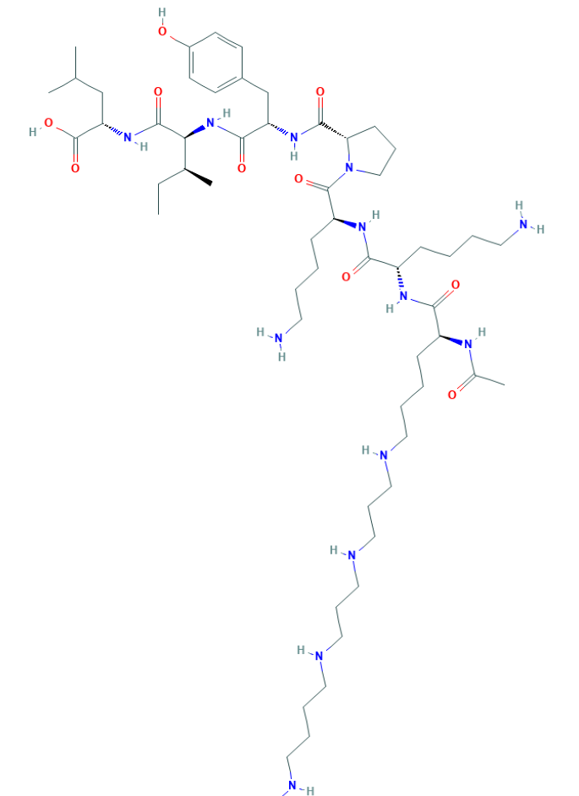
Polyamine C₅₉H₁₀₈N₁₄O₁₀ MW: 1,173.6 g/mol

Slide 10
Diallyldimethylammonium chloride or N-allyl-N,N-dimethylprop-2-en-1-aminium chloride pDADMAC C₈H₁₆ClN MW: 161.67 g/mol
CH₃
CH₂
CH₂
CH
N
+
CH
CH₂
CH₂
CH₃
Cl⁻

Slide 11
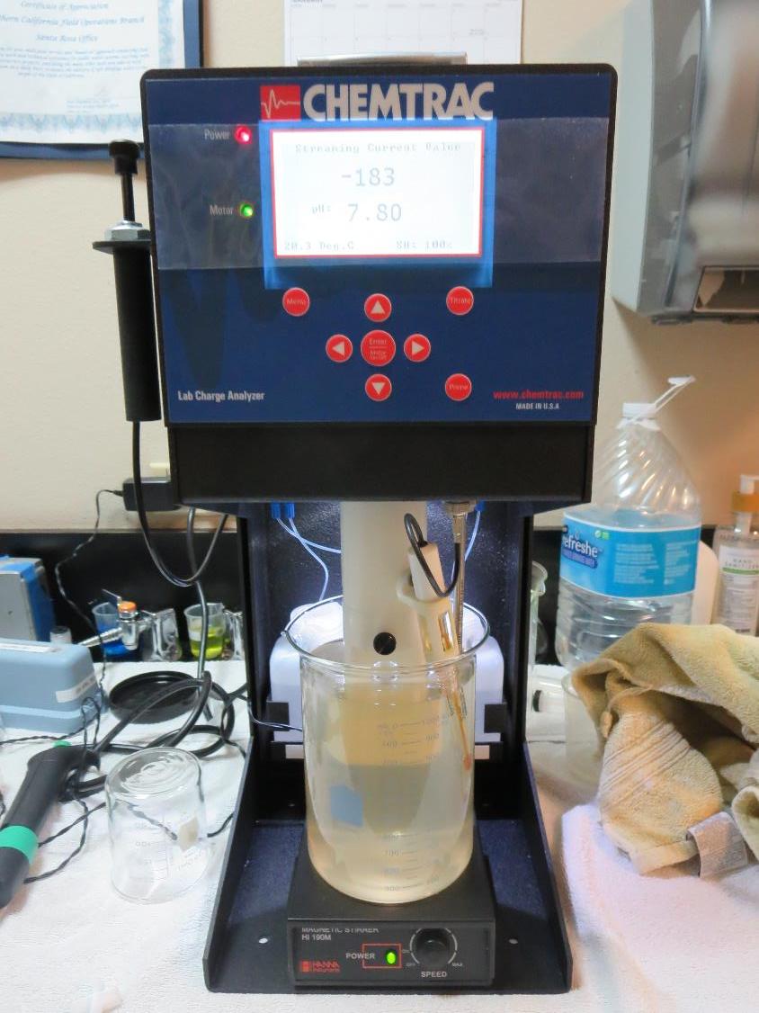
Laboratory Charge Analyzer
LCA: Used to determine coagulant demand of a source water entering the treatment plant.
Source pH: 7.8 (post KMnO₄ oxidation)
LCA #1: Alum: 45.8 mg/L as hydrated
pH adjusted to 6.7 with acetic acid
LCA #2: 9810: 40 mg/L
pH adjusted to 7.6 with acetic acid
LCA #3: AdvFloc CTC-00011: 136 mg/L
pH adjusted to 7.6 with acetic acid

Slide 12
Coagulant Information
Unless stated otherwise, all coagulant doses are reported as Product (100% strength).
Aluminum Sulfate doses are reported as hydrated Al₂(SO₄)₃*14.3H₂0.
Preparation of coagulant stock solutions are generally 1.0 and/or 0.1 percent strength using 100 and/or 200 mL volumetric flasks.
Finnpipette F2 variable volume pipette, capacity 100-1000 micro liters is used for stock solution preparation and coagulant aid jar test dosing.
Finnpipette F2 variable volume pipette, capacity 0.5-5 mL is used for primary coagulant jar test dosing.

Slide 13
Heritage Ranch CSD; Source Well 01 (Nacimiento River) Summary of Plant Coagulant/Dose Jar vs. Optimum Dose and Coagulants
Jar# | Alum mg/L | AdvFloc CTC-0011 mg/L | 9800 mg/L | CatFloc C-378 mg/L | Filtrate NTU | Filtrate %UVT | Filtrate UVA/cm | %UVA Reduction | Settle NTU 25 min
A | 35 | 0 | 0 | 6.0 | 0.10 | 87.0 | 0.061 | 69.3 | 3.22
vs.
B | 70 | 0 | 0 | 6.0 | 0.05 | 90.7 | 0.042 | 78.9 | 3.45
C | 0 | 160 | 0 | 6.0 | 0.05 | 92.0 | 0.036 | 81.9 | 1.16
D | 0 | 0 | 70 | 6.0 | 0.05 | 91.3 | 0.039 | 80.4 | 2.84

Slide 14
Jar Test – Filtrate Water Spiked with 2.2 mg/L NaOCl Plant Coagulant Dose vs. Optimum Dose and Coagulant

Slide 15
Source Water: (pH: 7.88, Alkalinity: 73 mg/L)
Coagulant | Chemical Dose, mg/L | Alkalinity Consumed mg/L as CaCO₃ | Treated Water Alkalinity mg/L as CaCO₃ | *Treated Water pH
Alum (dry) | 35 | 17.5 | 55.5 | 6.81
Alum (dry) | 70 | 35.1 | 37.9 | 6.36
AdvFloc | 160 | 20.8 | 52.2 | 6.71
9810 | 65 | 7.3 | 65.7 | 7.20
9800 | 70 | 8.3 | 64.7 | 7.15
*Note: Predicted treated water pH is based on a closed system (no CO₂ loss). In an open system (water exposed to atmosphere), lost of CO₂ can be up to 60% thereby raising pH. Alkalinity is not affected by CO₂ lost. The Heritage Ranch CSD treatment plant is considered an open system.

Slide 16
Heritage Ranch CSD; Source Well 01; Jar Test 1 - 8 Results Flash Mix 200 RPM (30 sec); Floc Mix 30 RPM (5 min)
Jar# | Alum mg/L | Filtrate NTU | Filtrate %UVT | Filtrate UVA/cm | %UVA Reduction | Settle NTU 25 min
J1 | 35 | 1.06 | 82.3 | 0.084 | 57.8 | 13.3
J2 | 40 | 1.00 | 82.5 | 0.083 | 58.3 | 11.4
J3 | 45 | 0.66 | 84.1 | 0.075 | 62.3 | 8.68
J4 | 50 | 0.28 | 87.1 | 0.059 | 70.4 | 3.79
J5 | 55 | 0.27 | 87.4 | 0.058 | 70.9 | 5.03
J6 | 60 | 0.26 | 88.3 | 0.053 | 73.4 | 4.29
J7 | 65 | 0.26 | 88.5 | 0.052 | 73.9 | 3.79
J8 | 70 | 0.16 | 89.8 | 0.046 | 76.9 | 2.79

Slide 17
Heritage Ranch CSD; Source Well 01; Jar Test 9 - 16 Results Flash Mix 200 RPM (30 sec); Floc Mix 30 RPM (5 min)
Jar# | AdvFloc CTC-0011 mg/L | Filtrate NTU | Filtrate %UVT | Filtrate UVA/cm | %UVA Reduction | Settle NTU 25 min
J9 | 130 | 0.09 | 90.3 | 0.044 | 77.9 | 0.71
J10 | 140 | 0.12 | 90.3 | 0.043 | 78.4 | 0.90
J11 | 150 | 0.09 | 91.0 | 0.040 | 79.9 | 0.73
J12 | 160 | 0.07 | 91.1 | 0.040 | 79.9 | 0.42
J13 | 170 | 0.08 | 91.6 | 0.037 | 81.4 | 0.53
J14 | 180 | 0.09 | 91.8 | 0.037 | 81.4 | 0.64
J15 | 190 | 0.07 | 91.6 | 0.037 | 81.4 | 0.61
J16 | 200 | 0.06 | 92.1 | 0.035 | 82.4 | 0.43

Slide 18
Heritage Ranch CSD; Source Well 01; Jar Test 17 - 24 Results Flash Mix 200 RPM (30 sec); Floc Mix 30 RPM (5 min)
Jar# | 9810 mg/L | Filtrate NTU | Filtrate %UVT | Filtrate UVA/cm | %UVA Reduction | Settle NTU 25 min
J17 | 35 | 0.25 | 87.1 | 0.059 | 70.4 | 4.08
J18 | 40 | 0.29 | 88.1 | 0.054 | 72.9 | 3.31
J19 | 45 | 0.28 | 89.9 | 0.046 | 76.9 | 3.18
J20 | 50 | 0.22 | 89.4 | 0.048 | 75.9 | 3.41
J21 | 55 | 0.26 | 89.5 | 0.048 | 75.9 | 3.18
J22 | 60 | 0.25 | 89.8 | 0.046 | 76.9 | 3.10
J23 | 65 | 0.06 | 90.8 | 0.041 | 79.4 | 3.38
J24 | 70 | 0.18 | 90.6 | 0.042 | 78.9 | 2.93

Slide 19
Heritage Ranch CSD; Source Well 01; Jar Test 25 - 28 Results Flash Mix 200 RPM (30 sec); Floc Mix 30 RPM (5 min)
Jar# | Alum mg/L | CatFloc C-378 mg/L | Filtrate NTU | Filtrate %UVT | Filtrate UVA/cm | %UVA Reduction | Settle NTU 25 min
J25 | 35 | 0 | 0.72 | 83.8 | 0.076 | 61.8 | 10.2
J26 | 35 | 2.0 | 0.12 | 85.7 | 0.066 | 66.8 | 4.93
J27 | 35 | 4.0 | 0.17 | 86.4 | 0.063 | 68.3 | 2.90
J28 | 35 | 6.0 | 0.10 | 87.5 | 0.057 | 71.4 | 3.74

Slide 20
Heritage Ranch CSD; Source Well 01; Jar Test 29 - 36 Results Flash Mix 200 RPM (30 sec); Floc Mix 30 RPM (5 min)
Jar# | Alum mg/L | CatFloc C-378 mg/L | Filtrate NTU | Filtrate %UVT | Filtrate UVA/cm | %UVA Reduction | Settle NTU 25 min
J29 | 35 | 6.0 | 0.08 | 87.9 | 0.056 | 71.9 | 3.15
J30 | 45 | 6.0 | 0.05 | 89.2 | 0.049 | 75.4 | 2.68
J31 | 50 | 6.0 | 0.05 | 89.8 | 0.046 | 76.9 | 2.84
J32 | 55 | 6.0 | 0.04 | 90.3 | 0.044 | 77.9 | 3.86
J33 | 35 | 6.0 | 0.11 | 87.5 | 0.057 | 71.4 | 3.38
J34 | 60 | 6.0 | 0.04 | 90.3 | 0.044 | 77.9 | 4.79
J35 | 65 | 6.0 | 0.05 | 90.9 | 0.041 | 79.4 | 3.64
J36 | 70 | 6.0 | 0.04 | 91.1 | 0.040 | 79.9 | 3.95

Slide 21
Heritage Ranch CSD; Source Well 01; Jar Test 37 - 40 Results Flash Mix 200 RPM (30 sec); Floc Mix 30 RPM (5 min)
Jar# | AdvFloc CTC-0011 mg/L | CatFloc C-378 mg/L | Filtrate NTU | Filtrate %UVT | Filtrate UVA/cm | %UVA Reduction | Settle NTU 25 min
J37 | 160 | 0 | 0.08 | 91.4 | 0.038 | 80.9 | 0.38
J38 | 160 | 6.0 | 0.06 | 92.3 | 0.034 | 82.9 | 1.0
J39 | 180 | 0 | 0.08 | 91.9 | 0.036 | 81.9 | 0.67
J40 | 180 | 6.0 | 0.05 | 92.6 | 0.033 | 83.4 | 0.86

Slide 22
Heritage Ranch CSD; Source Well 01; Jar Test 41 - 48 Results Flash Mix 200 RPM (30 sec); Floc Mix 30 RPM (5 min)
Jar# | 9800 mg/L | CatFloc C-378 mg/L | Filtrate NTU | Filtrate %UVT | Filtrate UVA/cm | %UVA Reduction | Settle NTU 25 min
J41 | 45 | 6.0 | 0.10 | 90.2 | 0.044 | 77.9 | 2.21
J42 | 50 | 6.0 | 0.07 | 90.7 | 0.042 | 78.9 | 2.57
J43 | 55 | 6.0 | 0.06 | 91.3 | 0.039 | 80.4 | 2.84
J44 | 60 | 6.0 | 0.07 | 91.4 | 0.038 | 80.9 | 2.67
J45 | 65 | 6.0 | 0.10 | 90.9 | 0.041 | 79.4 | 2.48
J46 | 70 | 6.0 | 0.08 | 91.5 | 0.038 | 80.9 | 2.54
J47 | 75 | 6.0 | 0.07 | 91.6 | 0.037 | 81.4 | 2.65
J48 | 80 | 6.0 | 0.08 | 91.6 | 0.037 | 81.4 | 2.07

Slide 23
Heritage Ranch CSD; Source Well 01; Jar Test 49 - 52 Results Flash Mix 200 RPM (30 sec); Floc Mix 30 RPM (5 min) Results compares plant dose (Jar 49) with optimum Alum dose and other coagulants (AdvFloc & 9800).
Jar # | Alum mg/L | AdvFloc CTC-0011 mg/L | 9800 mg/L | CatFloc C-378 mg/L | Filtrate NTU | Filtrate %UVT | Filtrate UVA/cm | %UVA Reduction | Settle NTU 25 min
J49 | 35 | 0 | 0 | 6.0 | 0.10 | 87.0 | 0.060 | 69.8 | 3.22
J50 | 70 | 0 | 0 | 6.0 | 0.05 | 90.7 | 0.042 | 78.9 | 3.45
J51 | 0 | 160 | 0 | 6.0 | 0.05 | 92.0 | 0.036 | 81.9 | 1.16
J52 | 0 | 0 | 70 | 6.0 | 0.05 | 91.3 | 0.039 | 80.4 | 2.84

Slide 24
Heritage Ranch CSD; Source Well 01; Jar Test 53 - 56 Results Flash Mix 200 RPM (30 sec); Floc Mix 30 RPM (5 min) Jars 53 & 55 (Source, without pre-oxidation); Jars 54 & 56 (Source, post-oxidation KMnO₄)
Jar # | Alum mg/L | AdvFloc CTC-0011 mg/L | CatFloc C-378 mg/L | Filtrate NTU | Filtrate %UVT | Filtrate UVA/cm | %UVA Reduction | Settle NTU 25 min
J53 | 70 | 0 | 6.0 | 0.08 | 89.2 | 0.049 | 75.4 | 6.45
J54 | 70 | 0 | 6.0 | 0.05 | 90.8 | 0.042 | 78.9 | 3.14
J55 | 0 | 160 | 6.0 | 0.10 | 90.8 | 0.041 | 79.4 | 3.69
J56 | 0 | 160 | 6.0 | 0.05 | 92.1 | 0.035 | 82.4 | 0.93

Slide 25
Jars 1-4 Test Flash Mix 30 Sec (200 RPM) Floc Mix 5 min (30 RPM) Post-KMnO₄ Oxidation Applied Coagulant Alum

Slide 26
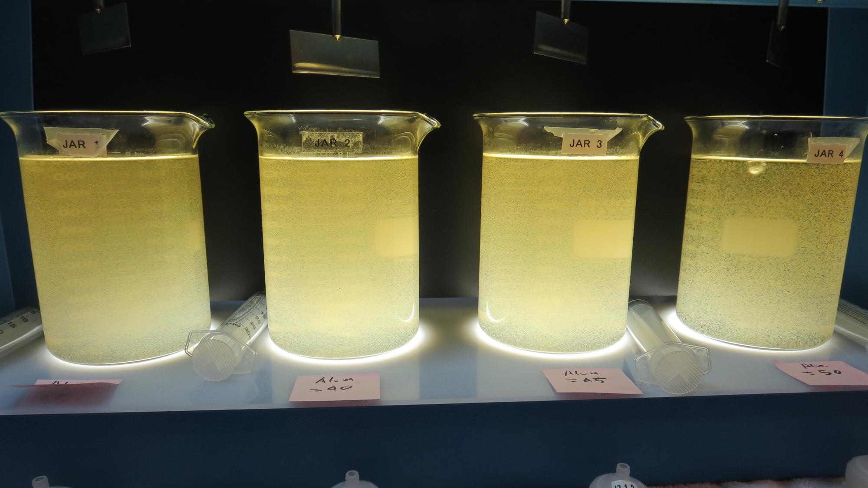
Jars 1-4: End of 5-minute flocculation (30 RPM) duration.
35 mg/L Alum
Filtrate 1.06 NTU
UVT: 82.3%
UVA: 0.084/cm
UVA Reduction 57.8%
Settled: 13.3 NTU
40 mg/L Alum
Filtrate 1.00 NTU
UVT: 82.5%
UVA: 0.083/cm
UVA Reduction 58.3%
Settled: 11.4 NTU
45 mg/L Alum
Filtrate 0.66 NTU
UVT: 84.1%
UVA: 0.075/cm
UVA Reduction 62.3%
Settled: 8.68 NTU
50 mg/L Alum
Filtrate 0.28 NTU
UVT: 87.1%
UVA: 0.059/cm
UVA Reduction 70.4%
Settled: 3.79 NTU

Slide 27
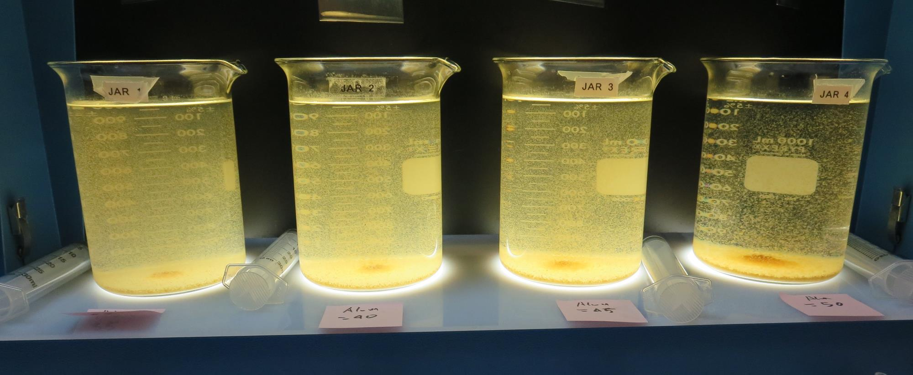
Jars 1-4: After 5 min of settling, 25 mL is syringed for filterability and %UVT/UVA.

Slide 28
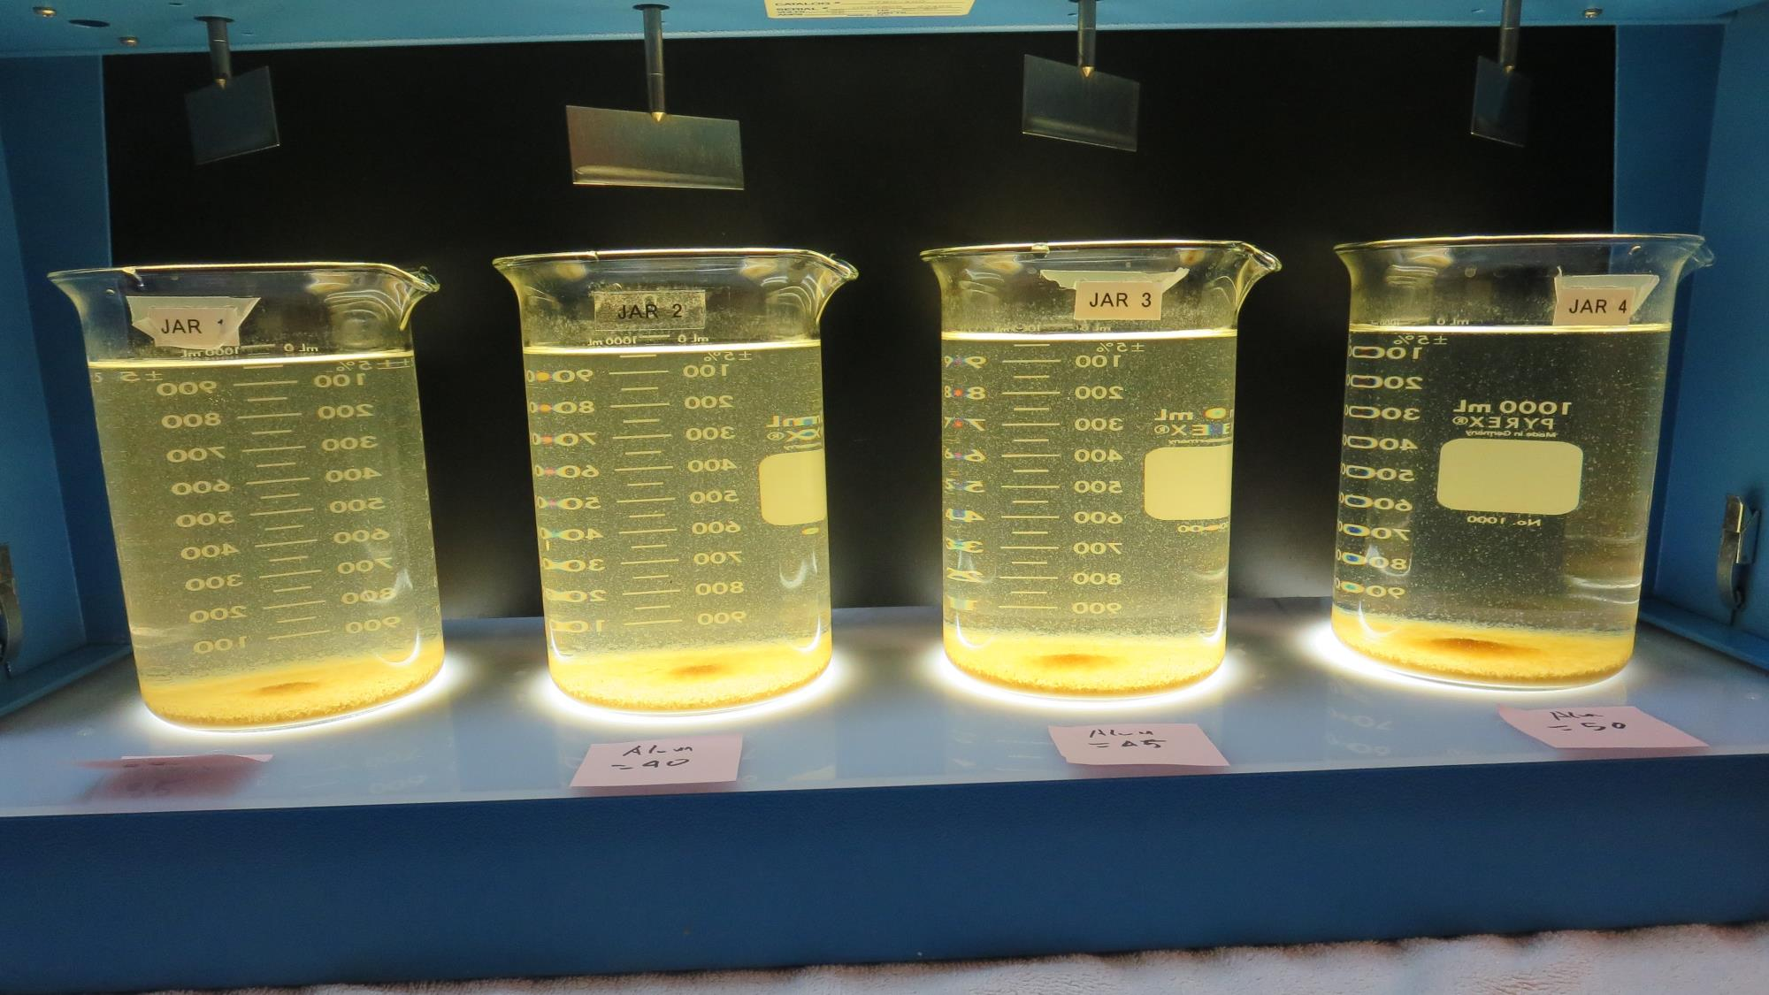
Jars 1-4: After 25-minutes of settling, settled water turbidity is taken.
35 mg/L Alum
Filtrate 1.06 NTU
UVT: 82.3%
UVA: 0.084/cm
UVA Reduction 57.8%
Settled: 13.3 NTU
40 mg/L Alum
Filtrate 1.00 NTU
UVT: 82.5%
UVA: 0.083/cm
UVA Reduction 58.3%
Settled: 11.4 NTU
45 mg/L Alum
Filtrate 0.66 NTU
UVT: 84.1%
UVA: 0.075/cm
UVA Reduction 62.3%
Settled: 8.68 NTU
50 mg/L Alum
Filtrate 0.28 NTU
UVT: 87.1%
UVA: 0.059/cm
UVA Reduction 70.4%
Settled: 3.79 NTU

Slide 29
Jars 5-8 Test Flash Mix 30 Sec (200 RPM) Floc Mix 5 min (30 RPM) Post-KMnO₄ Oxidation Applied Coagulant Alum

Slide 30
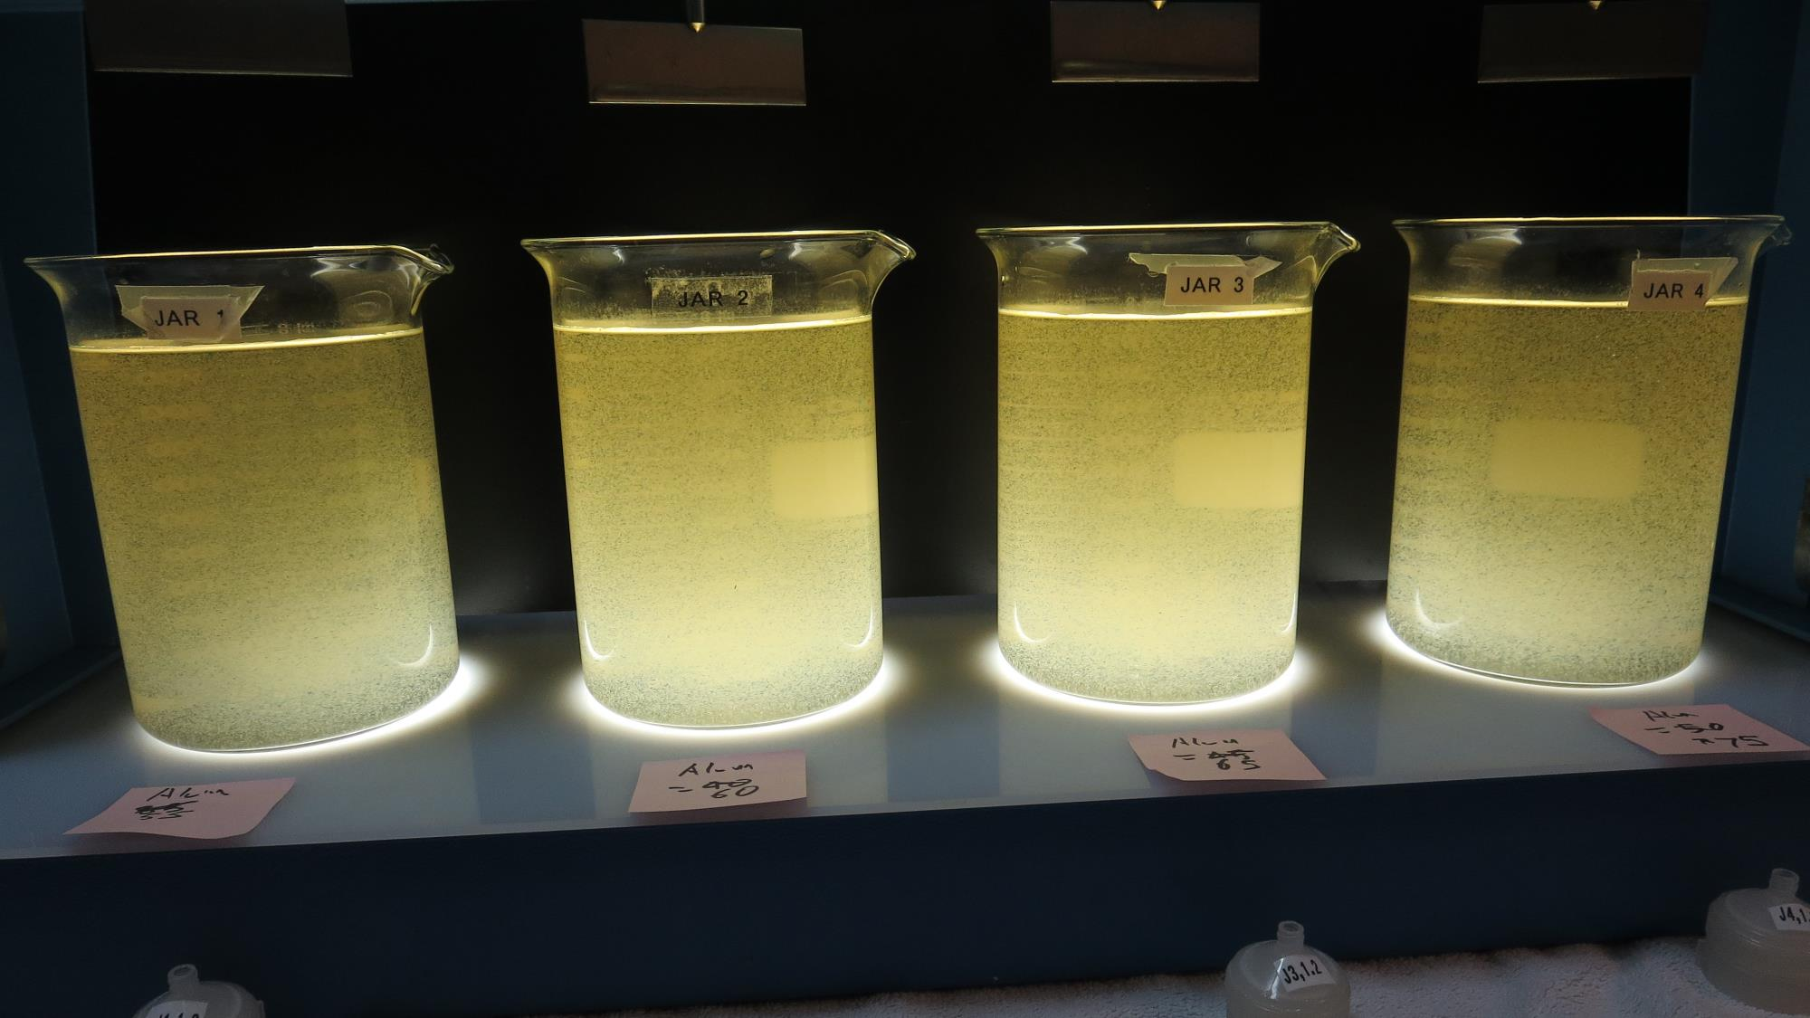
Jars 5-8: End of 5-minute flocculation (30 RPM) duration.
55 mg/L Alum
Filtrate 0.27 NTU
UVT: 87.4%
UVA: 0.058/cm
UVA Reduction 70.9%
Settled: 5.03 NTU
60 mg/L Alum
Filtrate 0.26 NTU
UVT: 88.3%
UVA: 0.053/cm
UVA Reduction 73.4%
Settled: 4.29 NTU
65 mg/L Alum
Filtrate 0.26 NTU
UVT: 88.5%
UVA: 0.052/cm
UVA Reduction 73.9%
Settled: 3.79 NTU
70 mg/L Alum
Filtrate 0.16 NTU
UVT: 89.8%
UVA: 0.046/cm
UVA Reduction 76.9%
Settled: 2.79 NTU

Slide 31
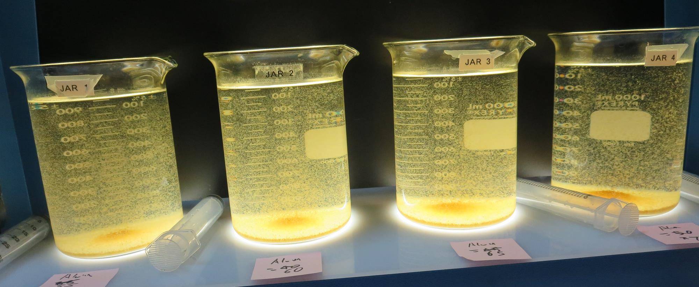
Jars 5-8: After 5 min of settling, 25 mL is syringed for filterability and %UVT/UVA.

Slide 32
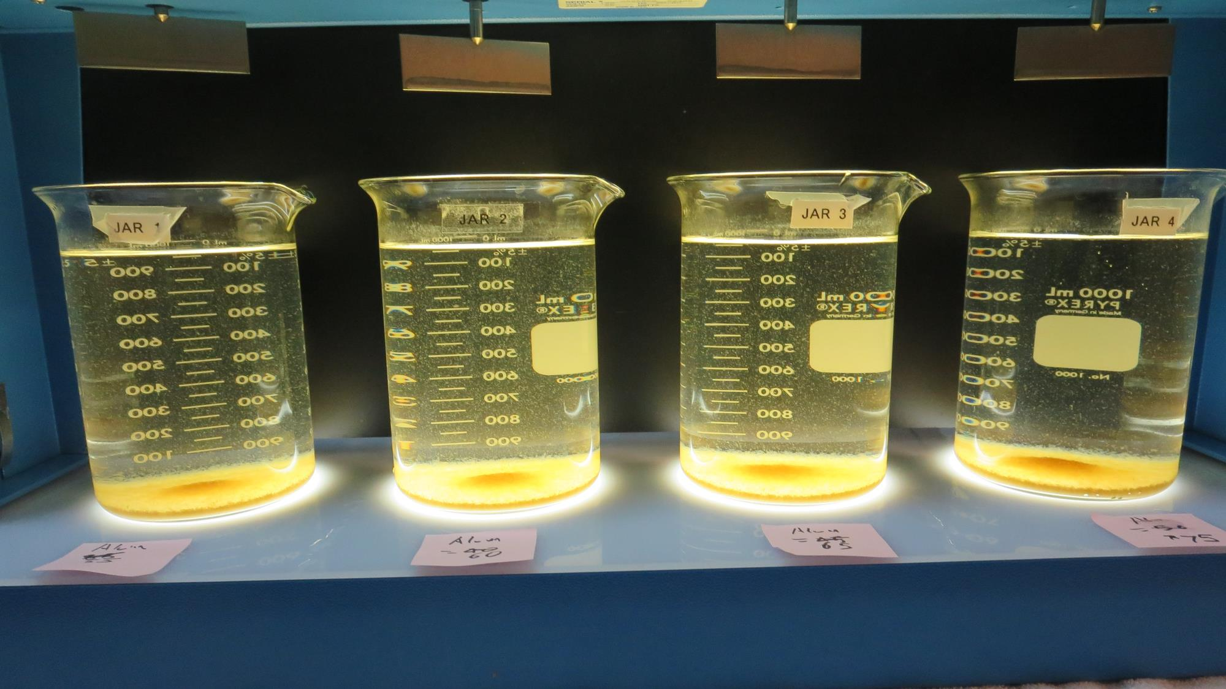
Jars 5-8: After 25-minutes of settling, settled water turbidity is taken.
55 mg/L Alum
Filtrate 0.27 NTU
UVT: 87.4%
UVA: 0.058/cm
UVA Reduction 70.9%
Settled: 5.03 NTU
60 mg/L Alum
Filtrate 0.26 NTU
UVT: 88.3%
UVA: 0.053/cm
UVA Reduction 73.4%
Settled: 4.29 NTU
65 mg/L Alum
Filtrate 0.26 NTU
UVT: 88.5%
UVA: 0.052/cm
UVA Reduction 73.9%
Settled: 3.79 NTU
70 mg/L Alum
Filtrate 0.16 NTU
UVT: 89.8%
UVA: 0.046/cm
UVA Reduction 76.9%
Settled: 2.79 NTU

Slide 33
Jars 9-12 Test Flash Mix 30 Sec (200 RPM) Floc Mix 5 min (30 RPM) Post-KMnO₄ Oxidation Applied Coagulant AdvFloc CTC-00011

Slide 34
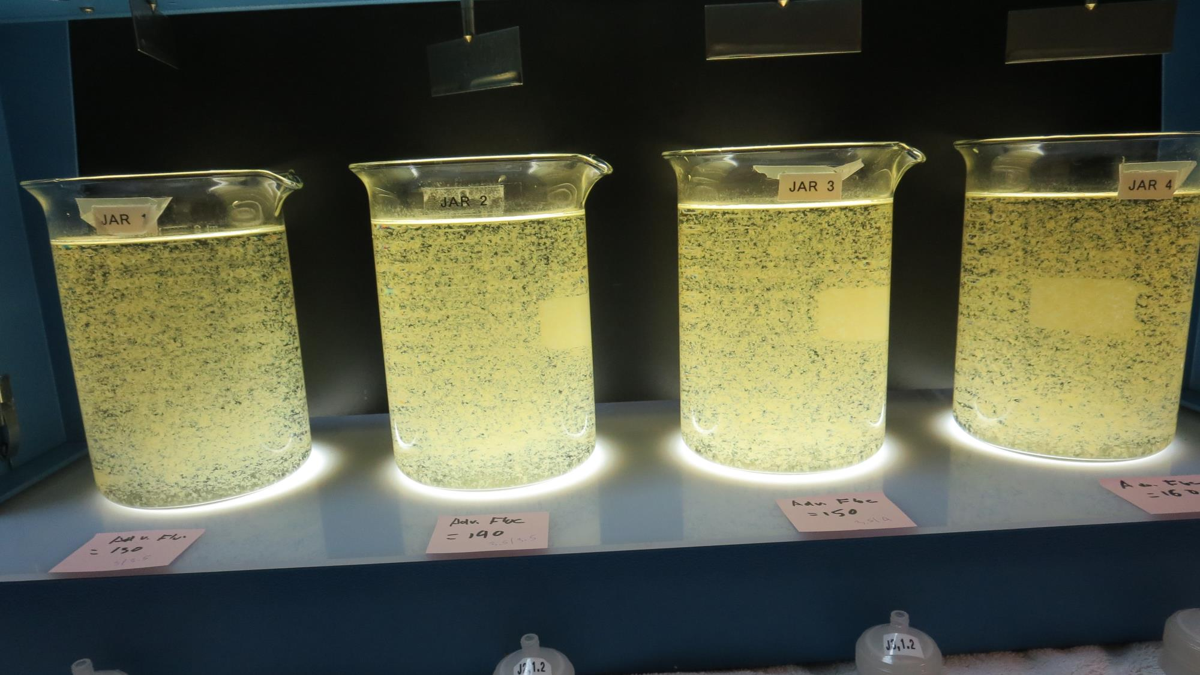
Jars 9-12: End of 5-minute flocculation (30 RPM) duration.
130 mg/L AdvFloc
Filtrate 0.09 NTU
UVT: 90.3%
UVA: 0.044/cm
UVA Reduction 77.9%
Settled: 0.71 NTU
140 mg/L AdvFloc
Filtrate 0.12 NTU
UVT: 90.3%
UVA: 0.043/cm
UVA Reduction 78.4%
Settled: 0.90 NTU
150 mg/L AdvFloc
Filtrate 0.09 NTU
UVT: 90.3%
UVA: 0.040/cm
UVA Reduction 79.9%
Settled: 0.73 NTU
160 mg/L AdvFloc
Filtrate 0.07 NTU
UVT: 90.3%
UVA: 0.040/cm
UVA Reduction 79.9%
Settled: 0.42 NTU

Slide 35
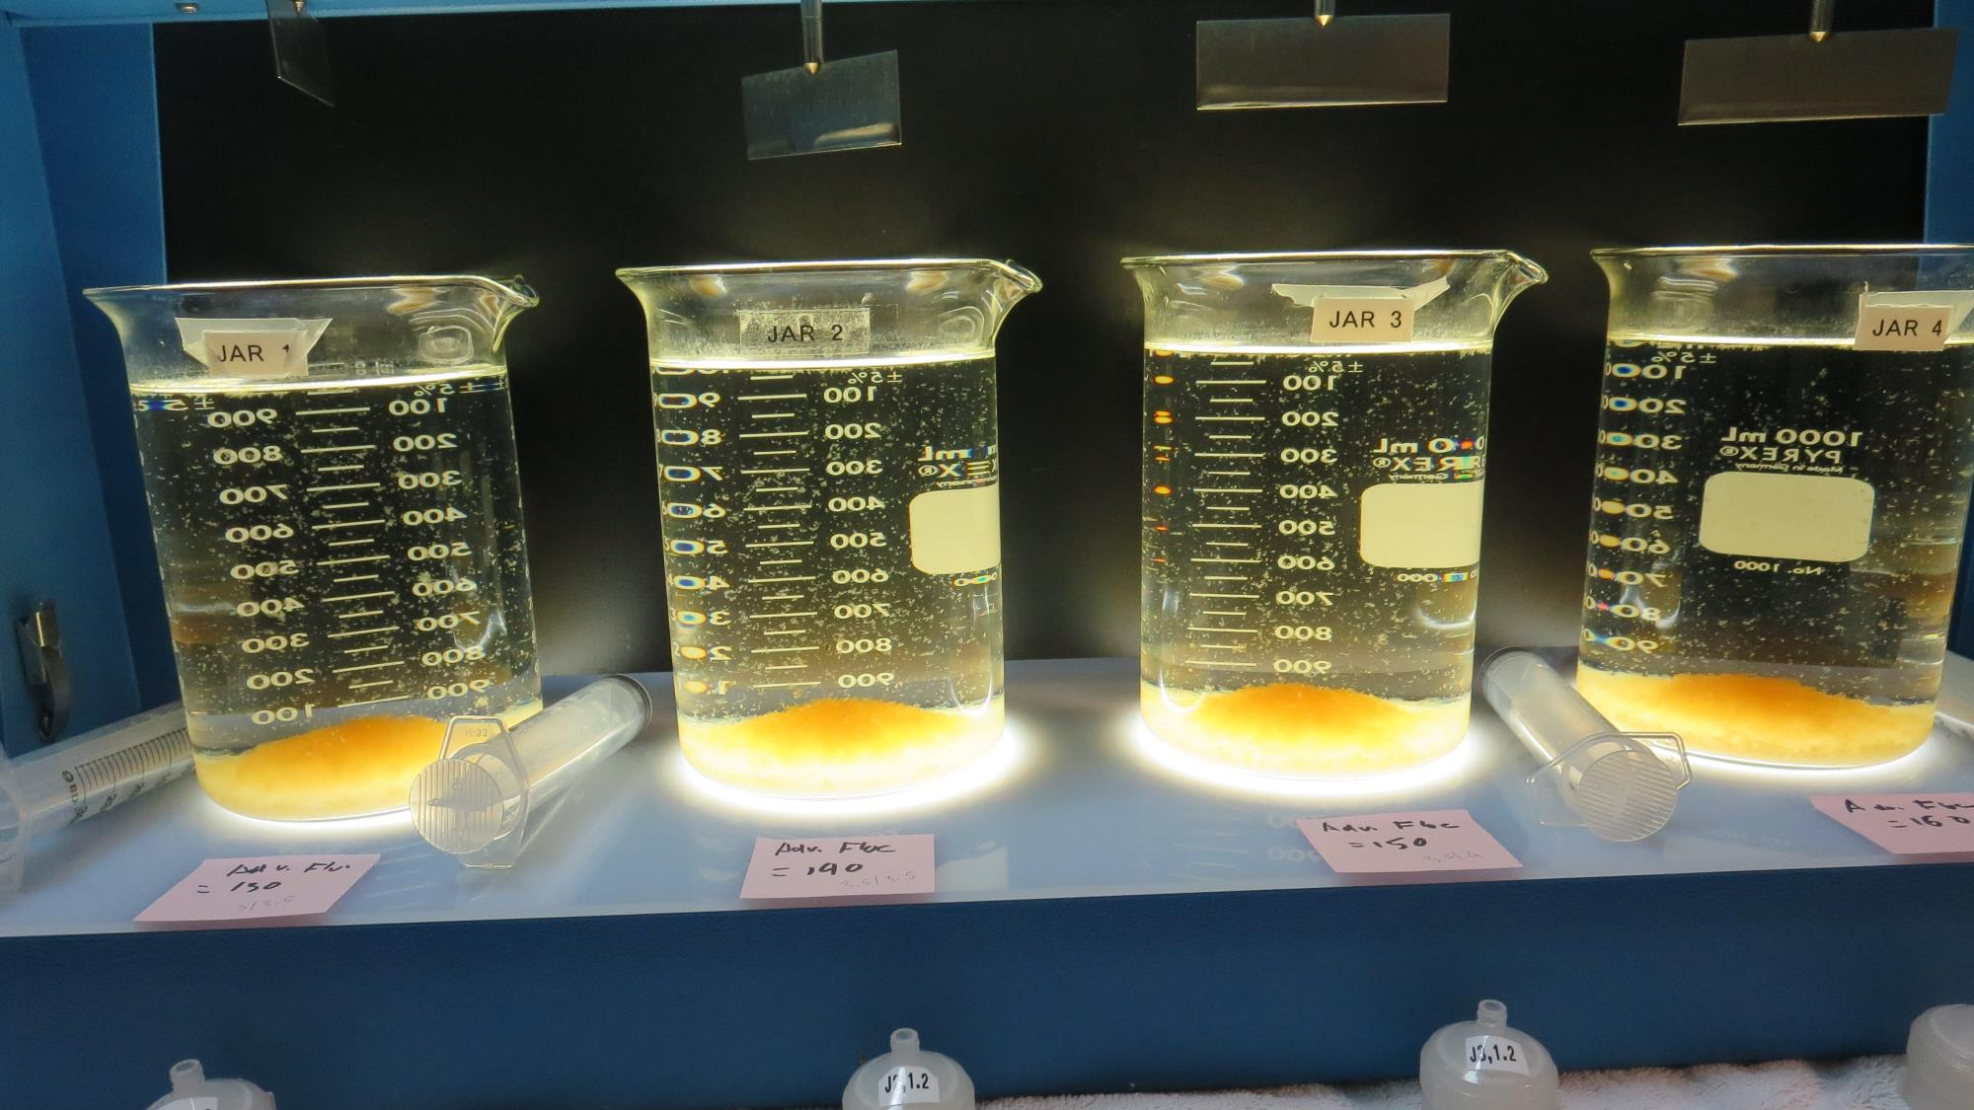
Jars 9-12: After 5 min of settling, 25 mL is syringed for filterability and %UVT/UVA.

Slide 36
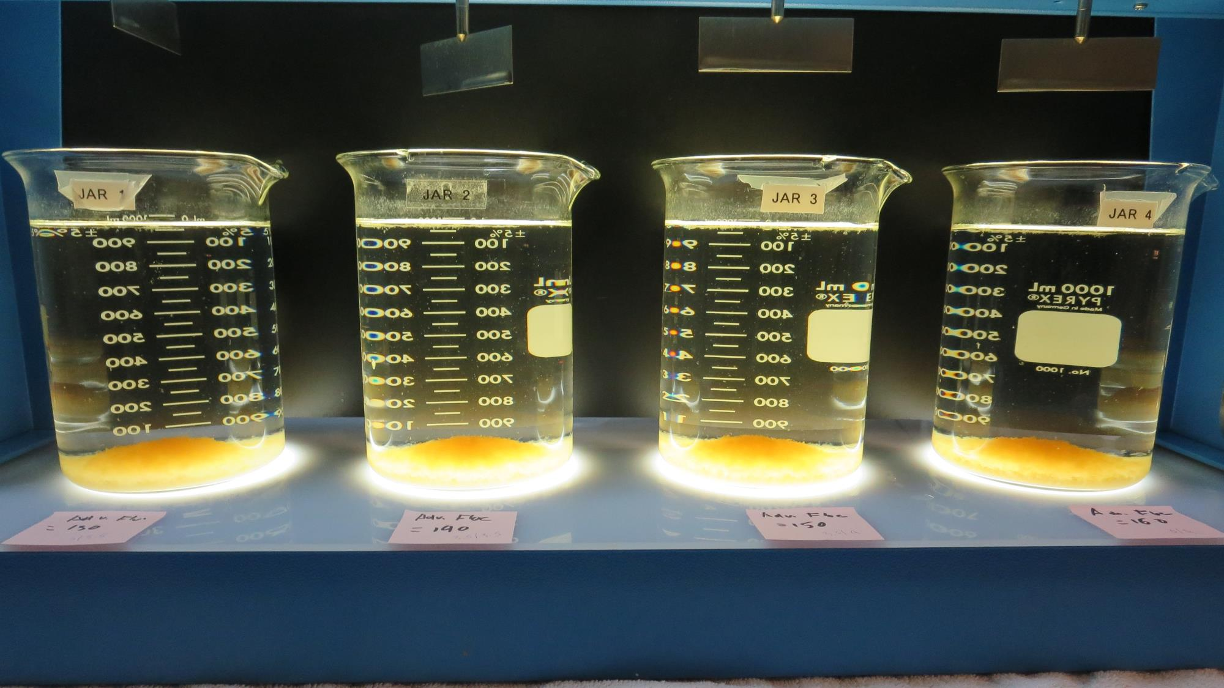
Jars 9-12: After 25-minutes of settling, settled water turbidity is taken.
130 mg/L AdvFloc
Filtrate 0.09 NTU
UVT: 90.3%
UVA: 0.044/cm
UVA Reduction 77.9%
Settled: 0.71 NTU
140 mg/L AdvFloc
Filtrate 0.12 NTU
UVT: 90.3%
UVA: 0.043/cm
UVA Reduction 78.4%
Settled: 0.90 NTU
150 mg/L AdvFloc
Filtrate 0.09 NTU
UVT: 90.3%
UVA: 0.040/cm
UVA Reduction 79.9%
Settled: 0.73 NTU
160 mg/L AdvFloc
Filtrate 0.07 NTU
UVT: 90.3%
UVA: 0.040/cm
UVA Reduction 79.9%
Settled: 0.42 NTU

Slide 37
Jars 13-16 Test Flash Mix 30 Sec (200 RPM) Floc Mix 5 min (30 RPM) Post-KMnO₄ Oxidation Applied Coagulant AdvFloc CTC-00011

Slide 38
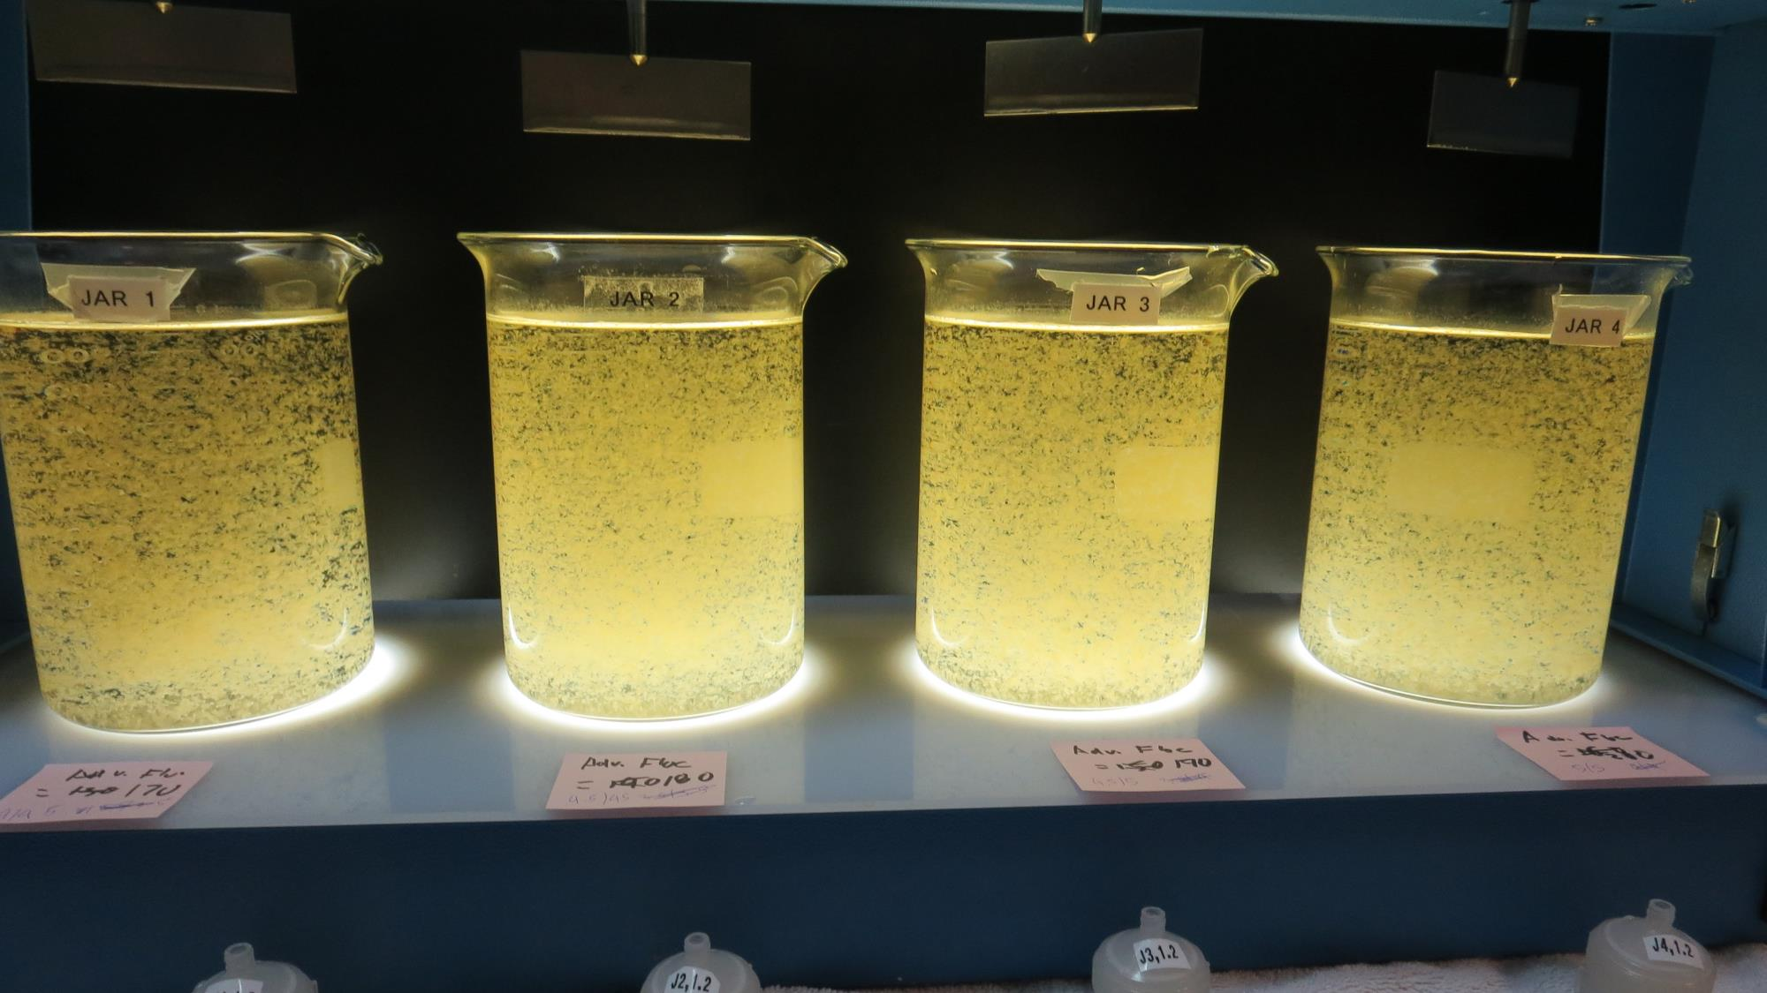
Jars 13-16: End of 5-minute flocculation (30 RPM) duration.
170 mg/L AdvFloc
Filtrate 0.08 NTU
UVT: 91.6%
UVA: 0.037/cm
UVA Reduction 81.4%
Settled: 0.53 NTU
180 mg/L AdvFloc
Filtrate 0.09 NTU
UVT: 91.8%
UVA: 0.037/cm
UVA Reduction 81.4%
Settled: 0.64 NTU
190 mg/L AdvFloc
Filtrate 0.07 NTU
UVT: 91.6%
UVA: 0.037/cm
UVA Reduction 81.4%
Settled: 0.61 NTU
200 mg/L AdvFloc
Filtrate 0.06 NTU
UVT: 92.1%
UVA: 0.035/cm
UVA Reduction 82.4%
Settled: 0.43 NTU

Slide 39
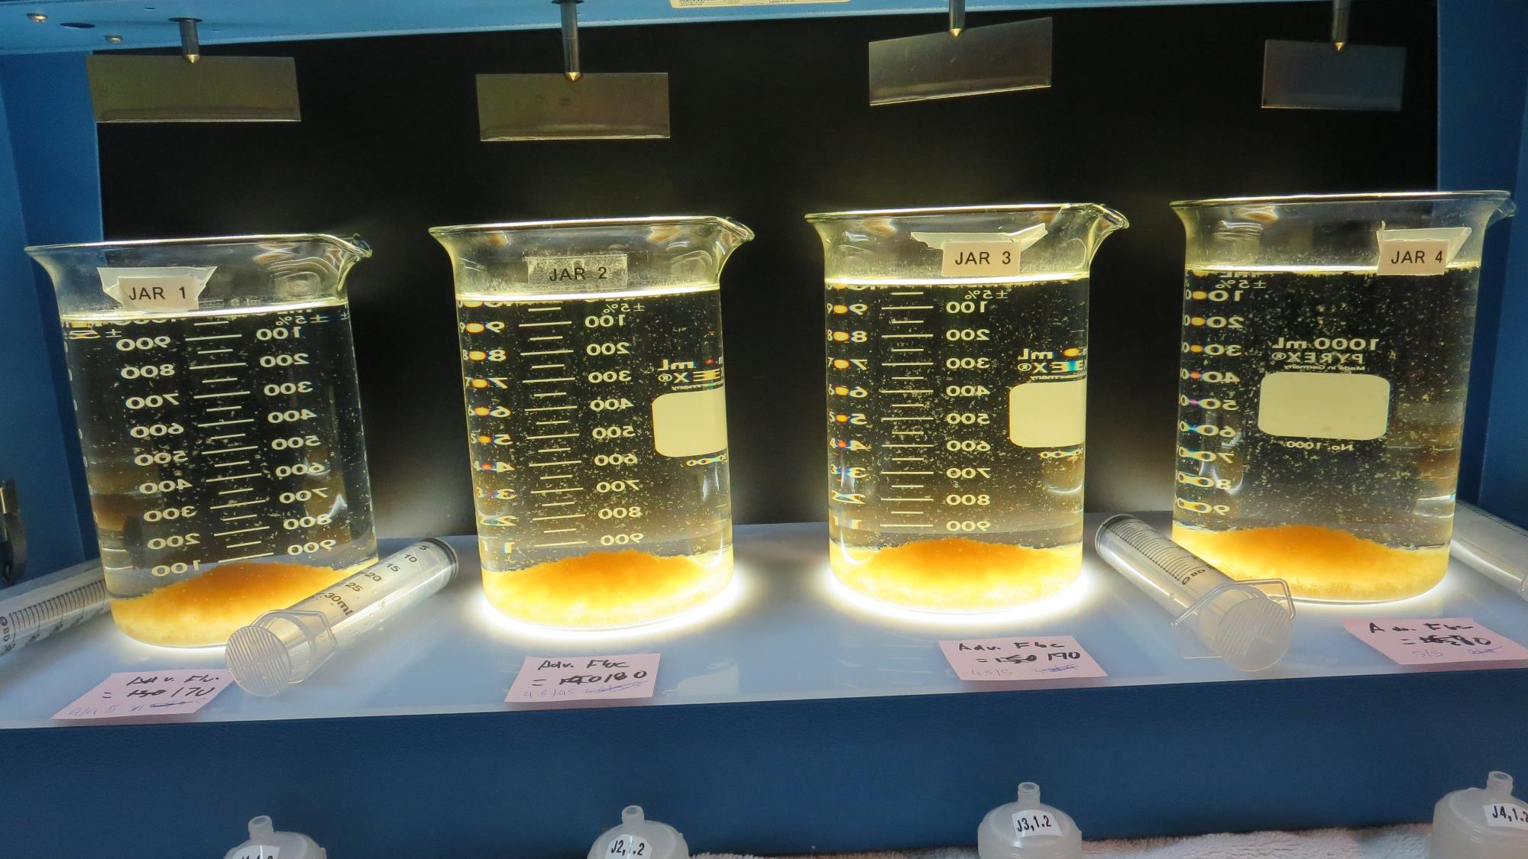
Jars 13-16: After 5 min of settling, 25 mL is syringed for filterability and %UVT/UVA.

Slide 40
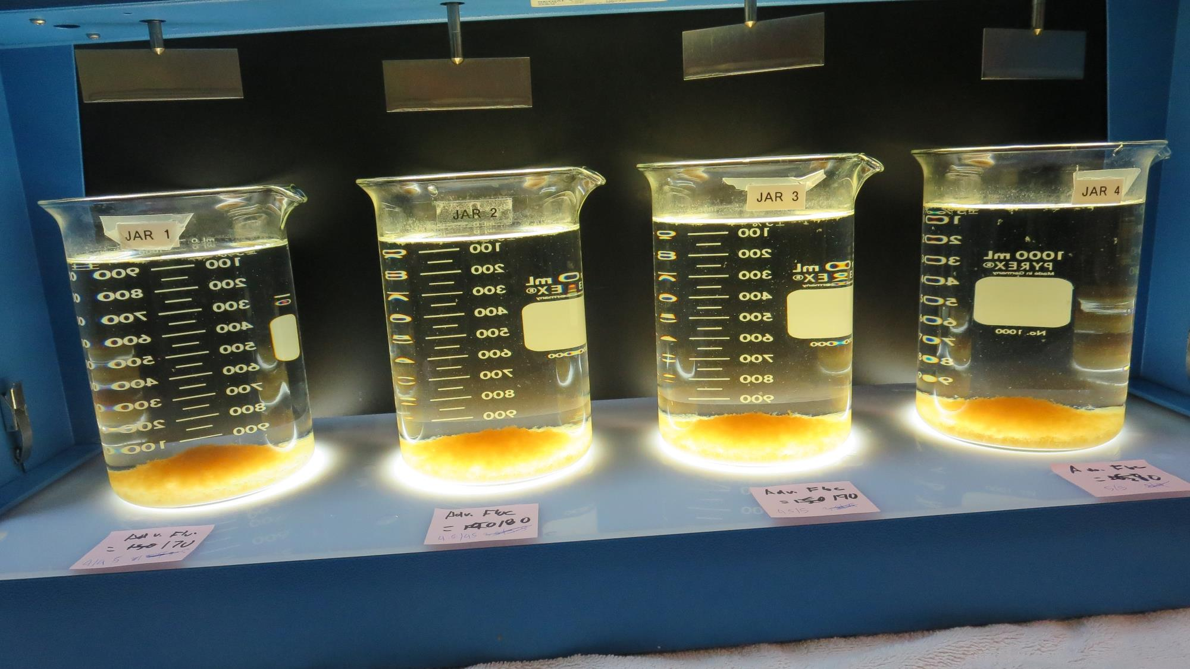
Jars 13-16: After 25-minutes of settling, settled water turbidity is taken.
170 mg/L AdvFloc
Filtrate 0.08 NTU
UVT: 91.6%
UVA: 0.037/cm
UVA Reduction 81.4%
Settled: 0.53 NTU
180 mg/L AdvFloc
Filtrate 0.09 NTU
UVT: 91.8%
UVA: 0.037/cm
UVA Reduction 81.4%
Settled: 0.64 NTU
190 mg/L AdvFloc
Filtrate 0.07 NTU
UVT: 91.6%
UVA: 0.037/cm
UVA Reduction 81.4%
Settled: 0.61 NTU
200 mg/L AdvFloc
Filtrate 0.06 NTU
UVT: 92.1%
UVA: 0.035/cm
UVA Reduction 82.4%
Settled: 0.43 NTU

Slide 41
Jars 17-20 Test Flash Mix 30 Sec (200 RPM) Floc Mix 5 min (30 RPM) Post-KMnO₄ Oxidation Applied Coagulant 9810

Slide 42
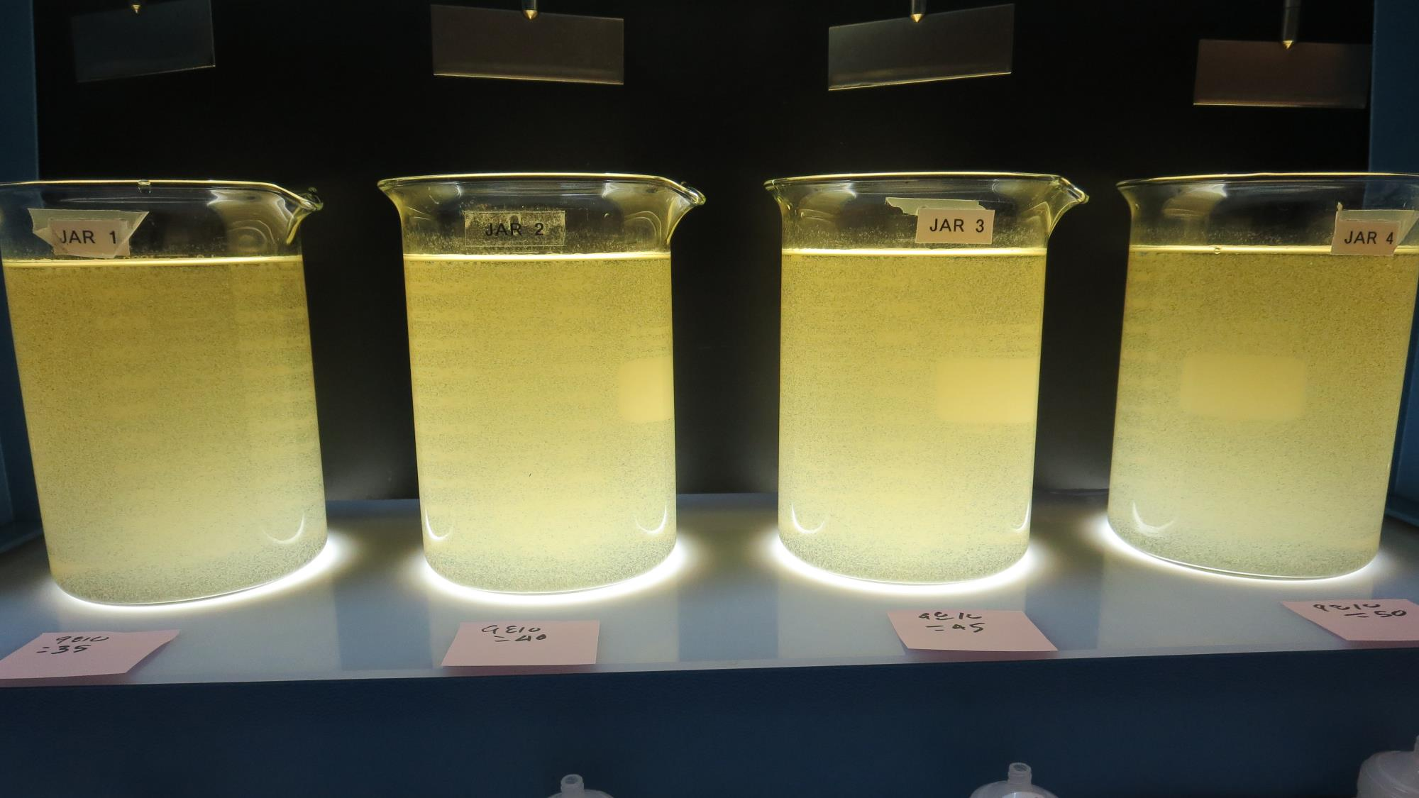
Jars 17-20: End of 5-minute flocculation (30 RPM) duration.
35 mg/L 9810
Filtrate 0.25 NTU
UVT: 87.1%
UVA: 0.059/cm
UVA Reduction 70.4%
Settled: 4.08 NTU
40 mg/L 9810
Filtrate 0.29 NTU
UVT: 88.1%
UVA: 0.054/cm
UVA Reduction 72.9%
Settled: 3.31 NTU
45 mg/L 9810
Filtrate 0.28 NTU
UVT: 89.9%
UVA: 0.046/cm
UVA Reduction 76.9%
Settled: 3.18 NTU
50 mg/L 9810
Filtrate 0.22 NTU
UVT: 89.4%
UVA: 0.048/cm
UVA Reduction 75.9%
Settled: 3.41 NTU

Slide 43
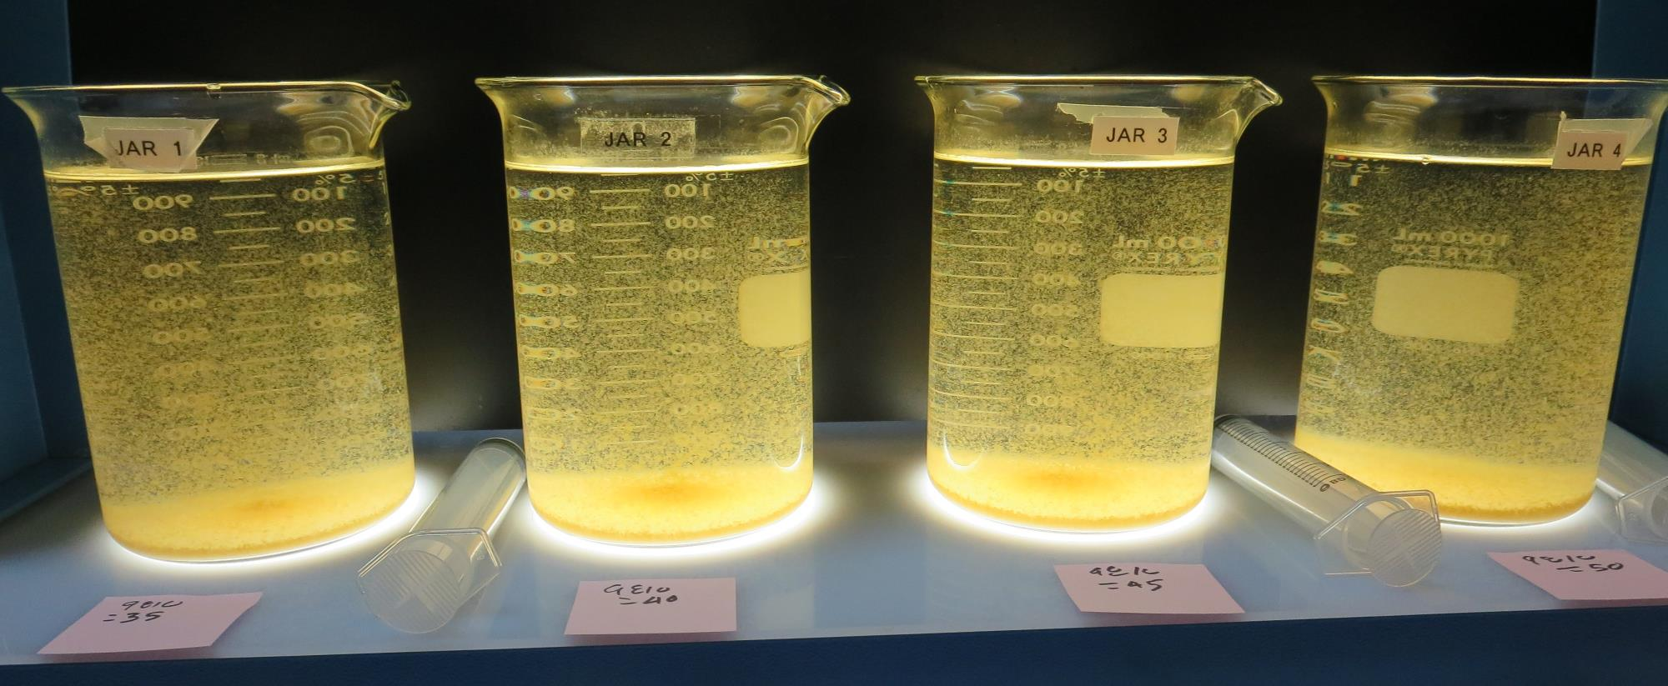
Jars 17-20: After 5 min of settling, 25 mL is syringed for filterability and %UVT/UVA.

Slide 44
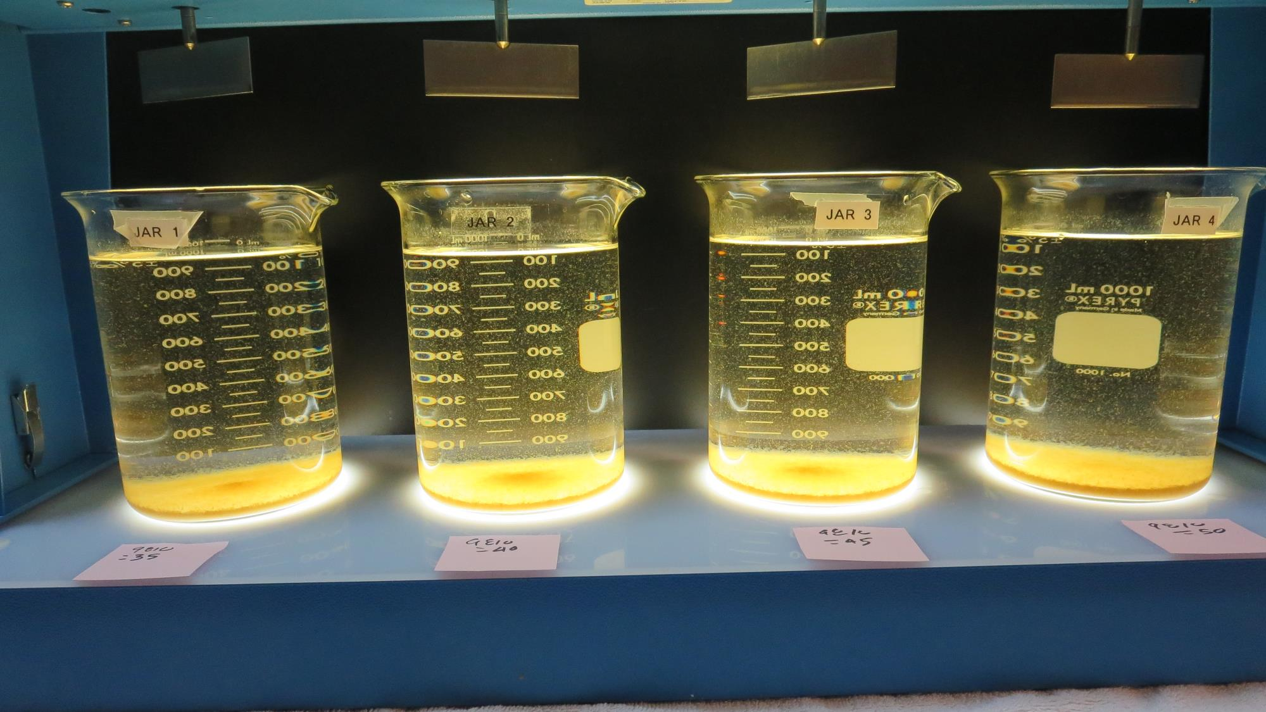
Jars 17-20: After 25-minutes of settling, settled water turbidity is taken.
35 mg/L 9810
Filtrate 0.25 NTU
UVT: 87.1%
UVA: 0.059/cm
UVA Reduction 70.4%
Settled: 4.08 NTU
40 mg/L 9810
Filtrate 0.29 NTU
UVT: 88.1%
UVA: 0.054/cm
UVA Reduction 72.9%
Settled: 3.31 NTU
45 mg/L 9810
Filtrate 0.28 NTU
UVT: 89.9%
UVA: 0.046/cm
UVA Reduction 76.9%
Settled: 3.18 NTU
50 mg/L 9810
Filtrate 0.22 NTU
UVT: 89.4%
UVA: 0.048/cm
UVA Reduction 75.9%
Settled: 3.41 NTU

Slide 45
Jars 21-24 Test Flash Mix 30 Sec (200 RPM) Floc Mix 5 min (30 RPM) Post-KMnO₄ Oxidation Applied Coagulant 9810

Slide 46
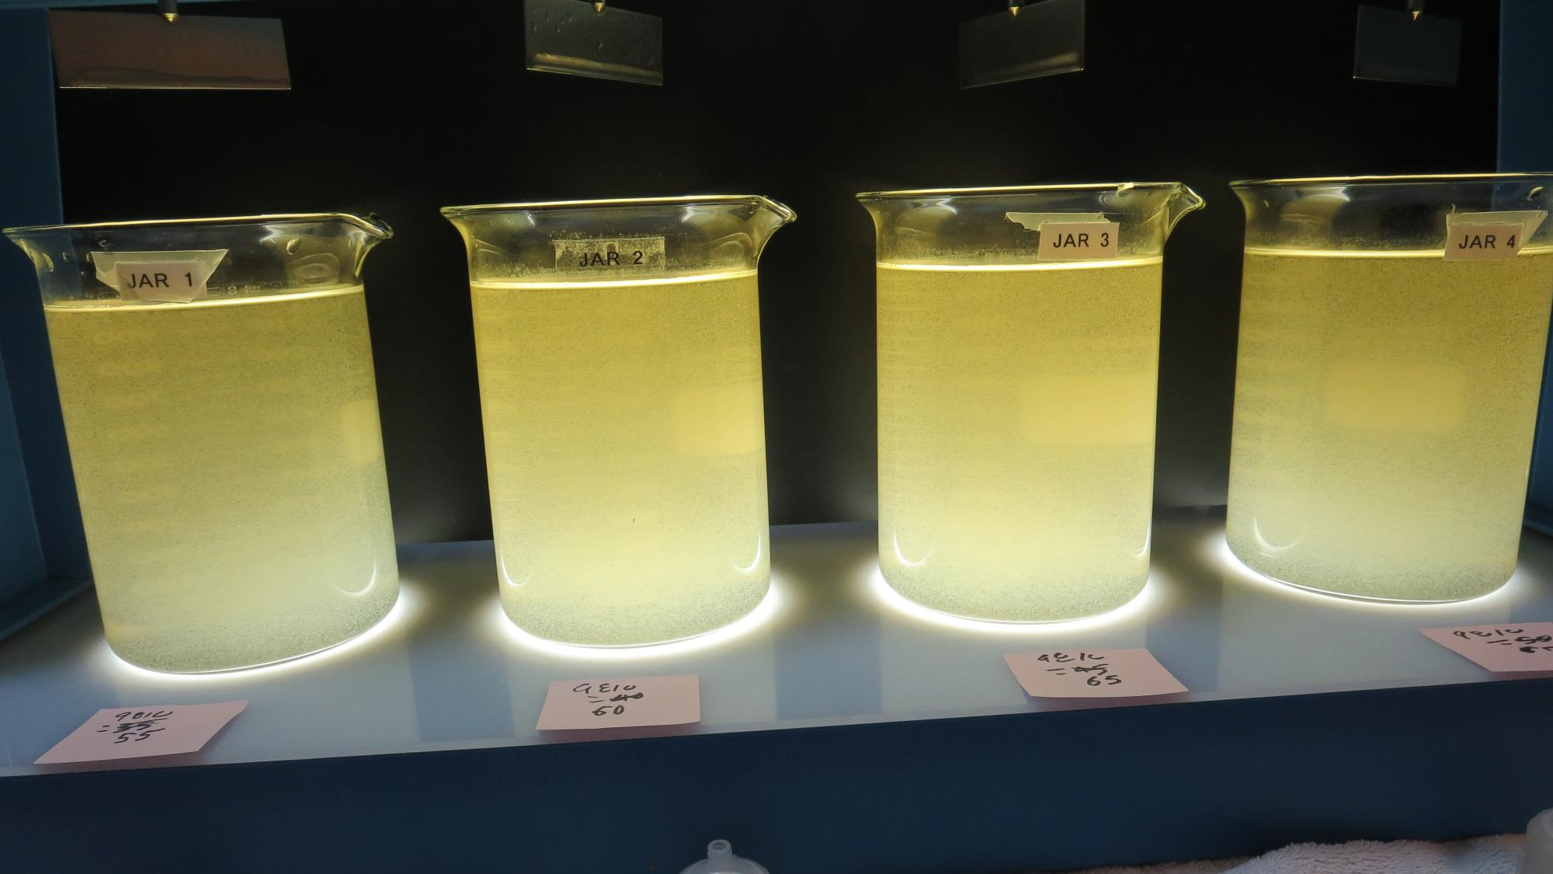
Jars 21-24: End of 5-minute flocculation (30 RPM) duration.
55 mg/L 9810
Filtrate 0.26 NTU
UVT: 89.5%
UVA: 0.048/cm
UVA Reduction 75.9%
Settled: 3.18 NTU
60 mg/L 9810
Filtrate 0.25 NTU
UVT: 89.8%
UVA: 0.046/cm
UVA Reduction 76.9%
Settled: 3.10 NTU
65 mg/L 9810
Filtrate 0.06 NTU
UVT: 90.8%
UVA: 0.041/cm
UVA Reduction 79.4%
Settled: 3.38 NTU
70 mg/L 9810
Filtrate 0.18 NTU
UVT: 90.6%
UVA: 0.042/cm
UVA Reduction 78.9%
Settled: 2.93 NTU

Slide 47
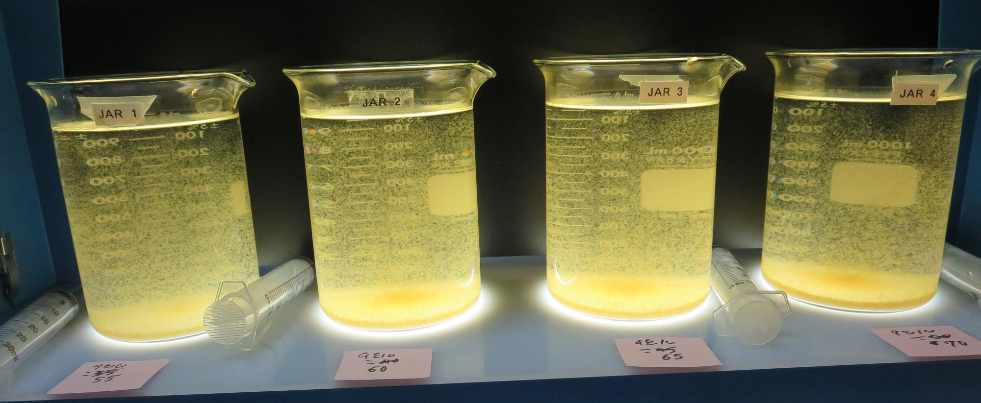
Jars 21-24: After 5 min of settling, 25 mL is syringed for filterability and %UVT/UVA.

Slide 48
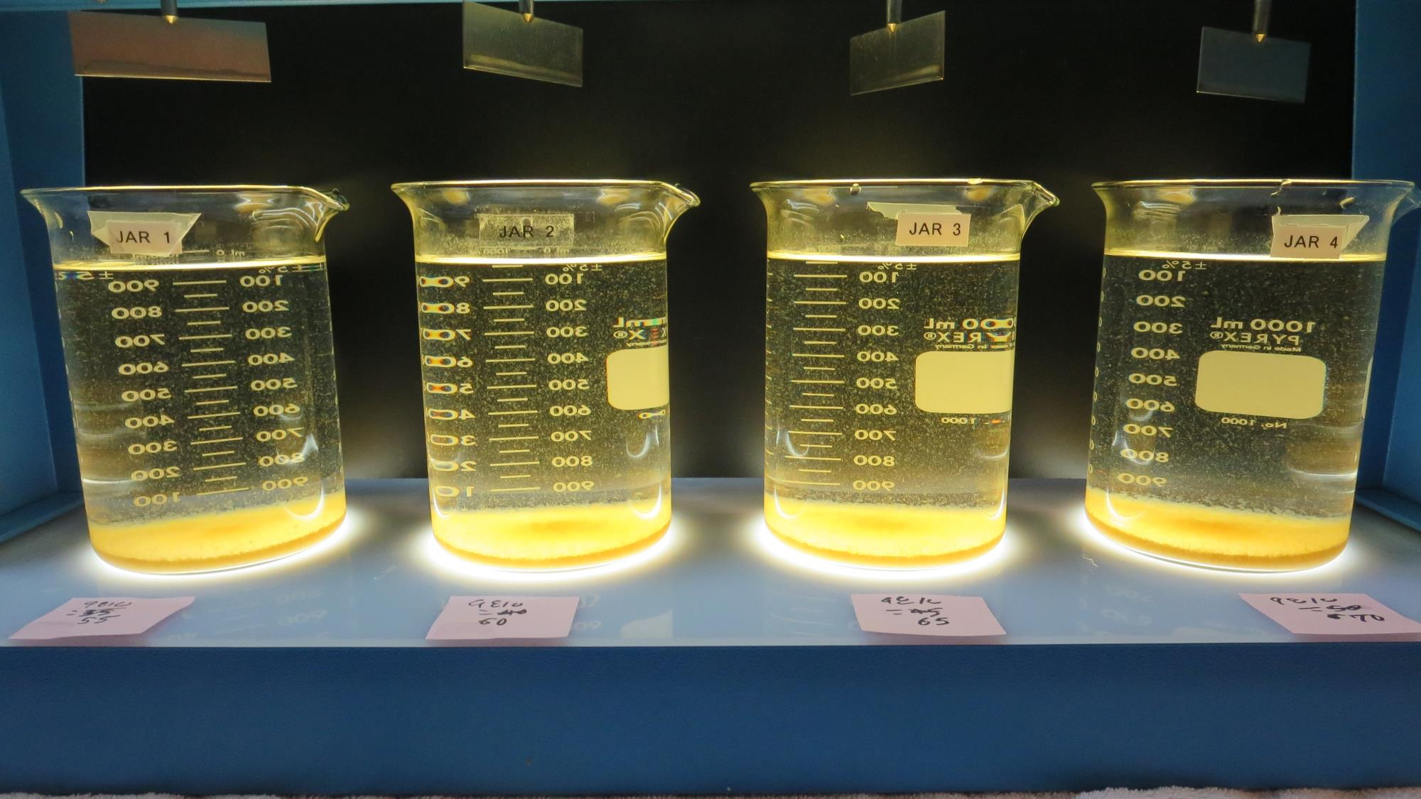
Jars 21-24: After 25-minutes of settling, settled water turbidity is taken.
55 mg/L 9810
Filtrate 0.26 NTU
UVT: 89.5%
UVA: 0.048/cm
UVA Reduction 75.9%
Settled: 3.18 NTU
60 mg/L 9810
Filtrate 0.25 NTU
UVT: 89.8%
UVA: 0.046/cm
UVA Reduction 76.9%
Settled: 3.10 NTU
65 mg/L 9810
Filtrate 0.06 NTU
UVT: 90.8%
UVA: 0.041/cm
UVA Reduction 79.4%
Settled: 3.38 NTU
70 mg/L 9810
Filtrate 0.18 NTU
UVT: 90.6%
UVA: 0.042/cm
UVA Reduction 78.9%
Settled: 2.93 NTU

Slide 49
Jars 25-28 Test Flash Mix 30 Sec (200 RPM) Floc Mix 5 min (30 RPM) Post-KMnO₄ Oxidation Applied Coagulants Alum/CatFloc C-378

Slide 50
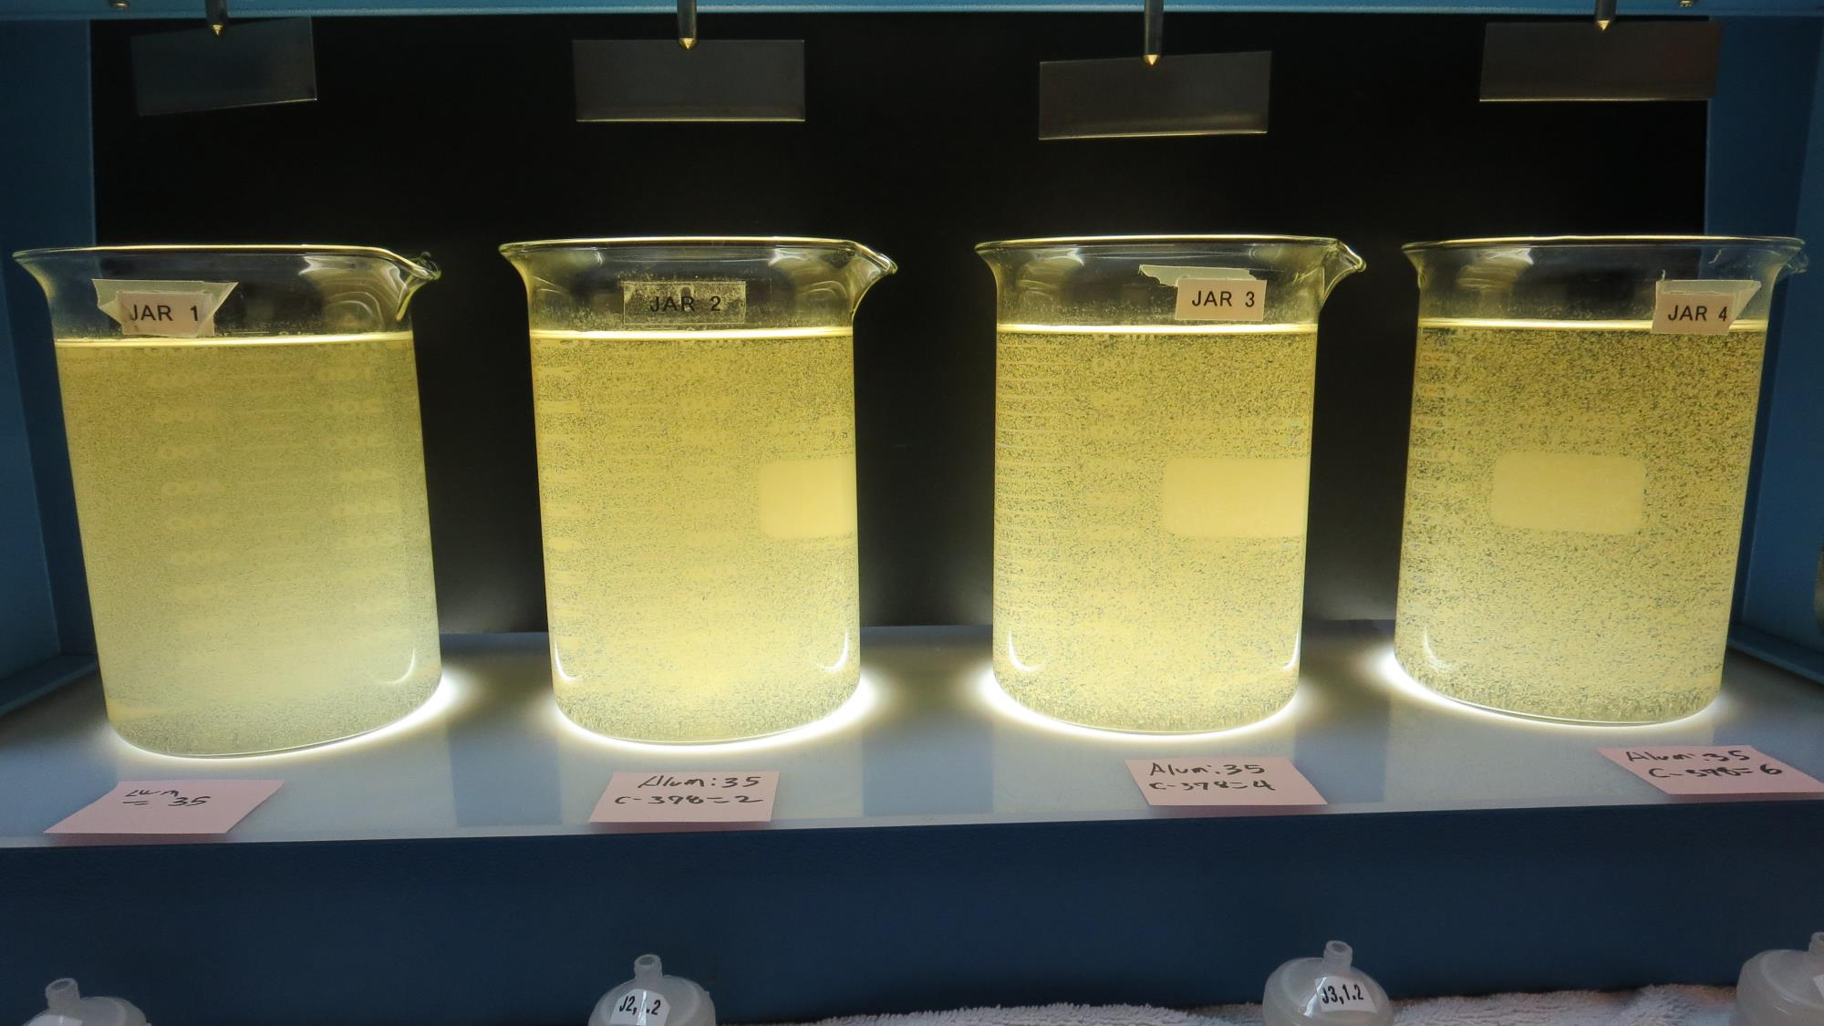
Jars 25-28: End of 5-minute flocculation (30 RPM) duration.
35 mg/L Alum
0.0 mg/L C-378
Filtrate 0.72 NTU
UVT: 83.8%
UVA: 0.076/cm
UVA Reduction 61.8%
Settled: 10.2 NTU
35 mg/L Alum
2.0 mg/L C-378
Filtrate 0.12 NTU
UVT: 85.7%
UVA: 0.066/cm
UVA Reduction 66.8%
Settled: 4.93 NTU
35 mg/L Alum
4.0 mg/L C-378
Filtrate 0.17 NTU
UVT: 86.4%
UVA: 0.063/cm
UVA Reduction 68.3%
Settled: 2.90 NTU
35 mg/L Alum
6.0 mg/L C-378
Filtrate 0.10 NTU
UVT: 87.5%
UVA: 0.057/cm
UVA Reduction 71.4%
Settled: 3.74 NTU

Slide 51
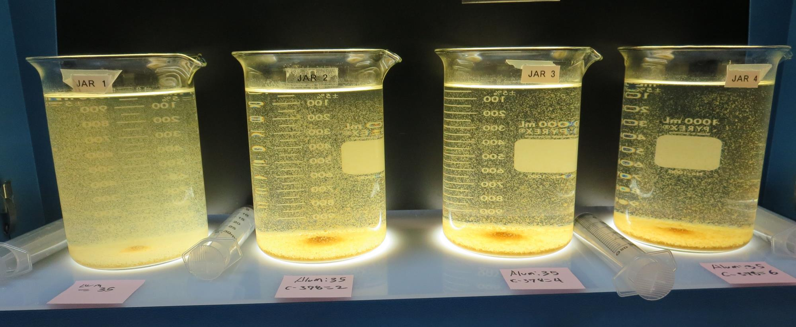
Jars 25-28: After 5 min of settling, 25 mL is syringed for filterability and %UVT/UVA.

Slide 52
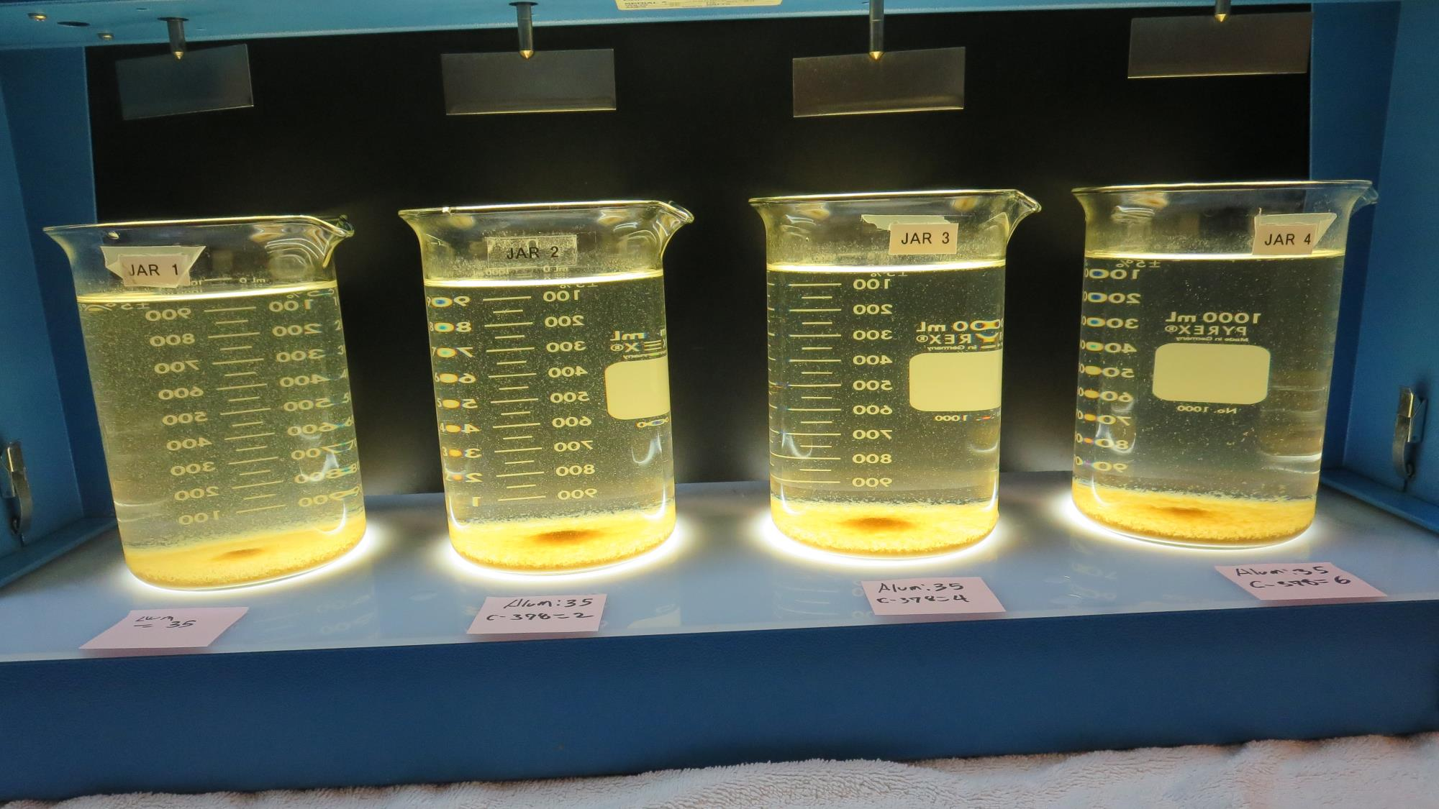
Jars 25-28: After 25-minutes of settling, settled water turbidity is taken.
35 mg/L Alum
0.0 mg/L C-378
Filtrate 0.72 NTU
UVT: 83.8%
UVA: 0.076/cm
UVA Reduction 61.8%
Settled: 10.2 NTU
35 mg/L Alum
2.0 mg/L C-378
Filtrate 0.12 NTU
UVT: 85.7%
UVA: 0.066/cm
UVA Reduction 66.8%
Settled: 4.93 NTU
35 mg/L Alum
4.0 mg/L C-378
Filtrate 0.17 NTU
UVT: 86.4%
UVA: 0.063/cm
UVA Reduction 68.3%
Settled: 2.90 NTU
35 mg/L Alum
6.0 mg/L C-378
Filtrate 0.10 NTU
UVT: 87.5%
UVA: 0.057/cm
UVA Reduction 71.4%
Settled: 3.74 NTU

Slide 53
Jars 29-32 Test Flash Mix 30 Sec (200 RPM) Floc Mix 5 min (30 RPM) Post-KMnO₄ Oxidation Applied Coagulants Alum/CatFloc C-378

Slide 54
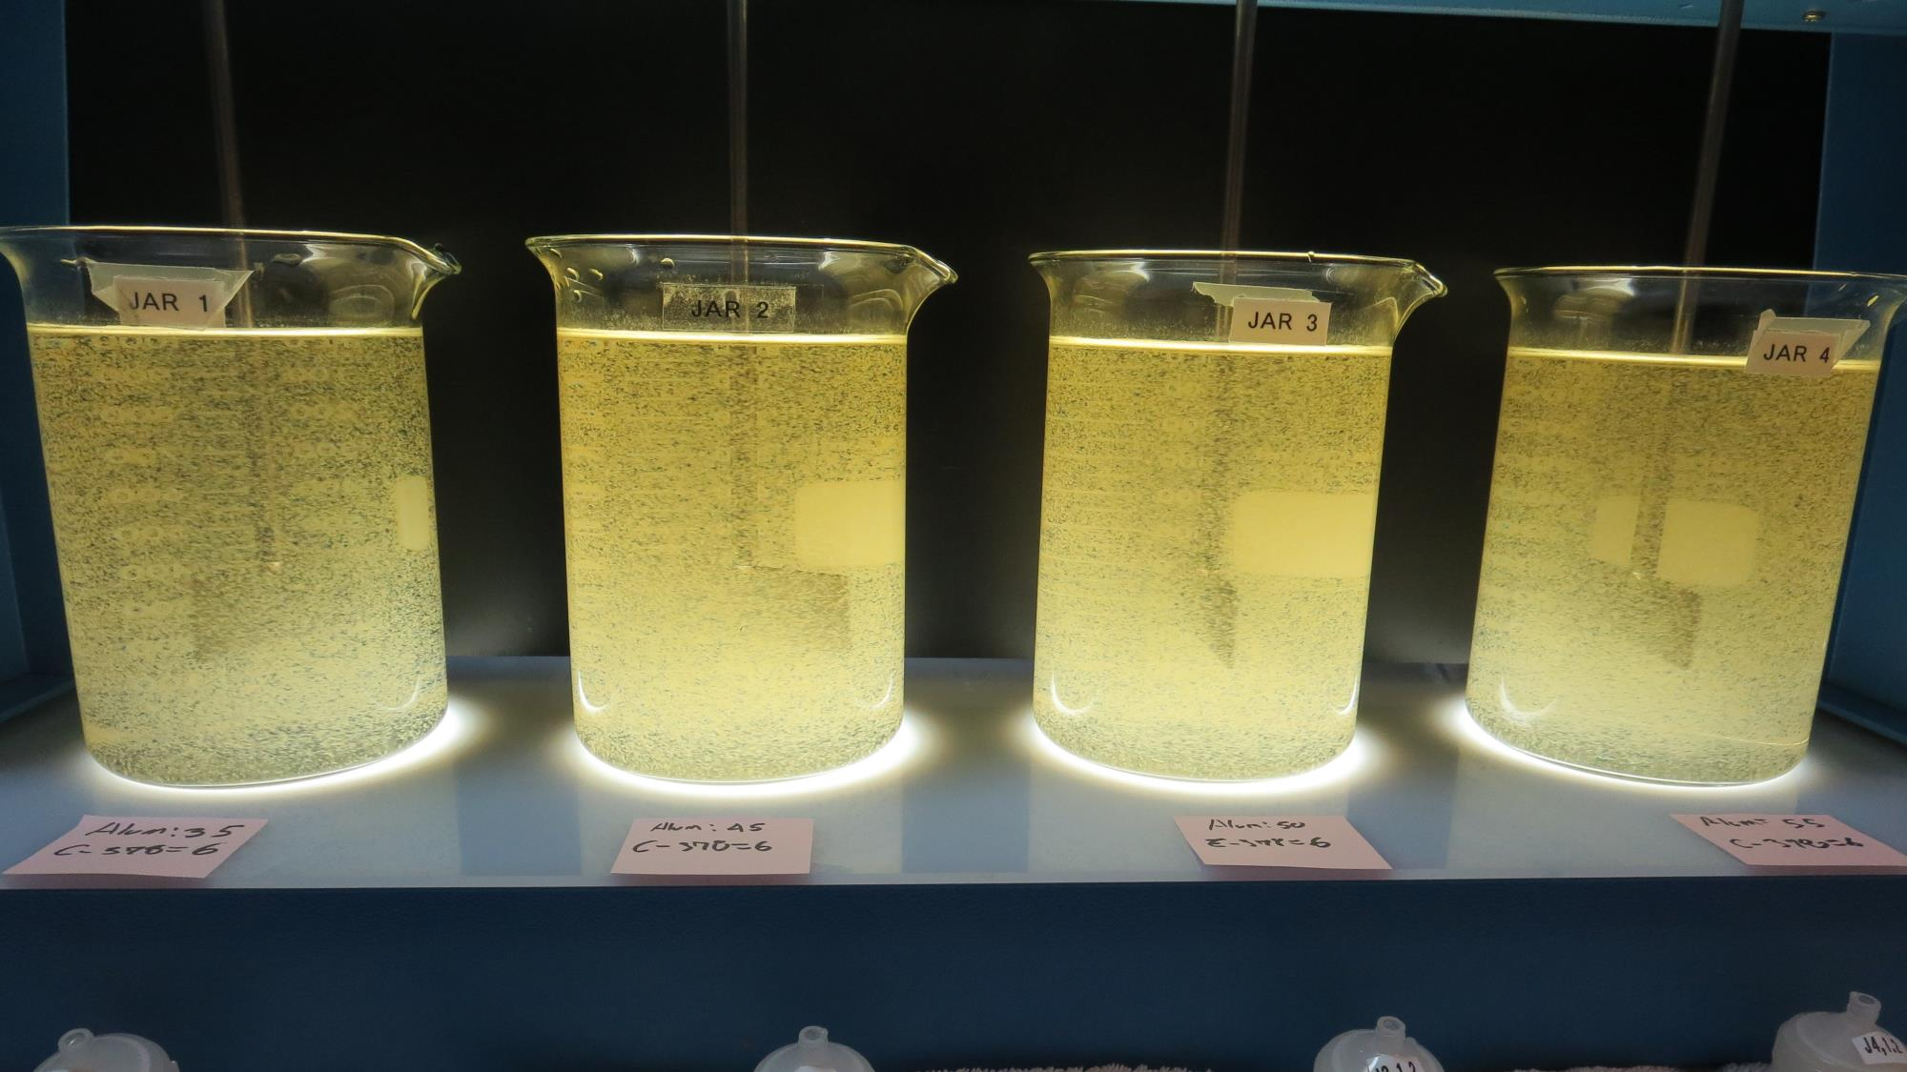
Jars 29-32: End of 5-minute flocculation (30 RPM) duration.
35 mg/L Alum
6.0 mg/L C-378
Filtrate 0.08 NTU
UVT: 87.9%
UVA: 0.056/cm
UVA Reduction 71.9%
Settled: 3.15 NTU
45 mg/L Alum
6.0 mg/L C-378
Filtrate 0.05 NTU
UVT: 89.2%
UVA: 0.049/cm
UVA Reduction 75.4%
Settled: 2.68 NTU
50 mg/L Alum
6.0 mg/L C-378
Filtrate 0.05 NTU
UVT: 89.8%
UVA: 0.046/cm
UVA Reduction 76.9%
Settled: 2.84 NTU
55 mg/L Alum
6.0 mg/L C-378
Filtrate 0.04 NTU
UVT: 90.3%
UVA: 0.044/cm
UVA Reduction 77.9%
Settled: 3.86 NTU

Slide 55
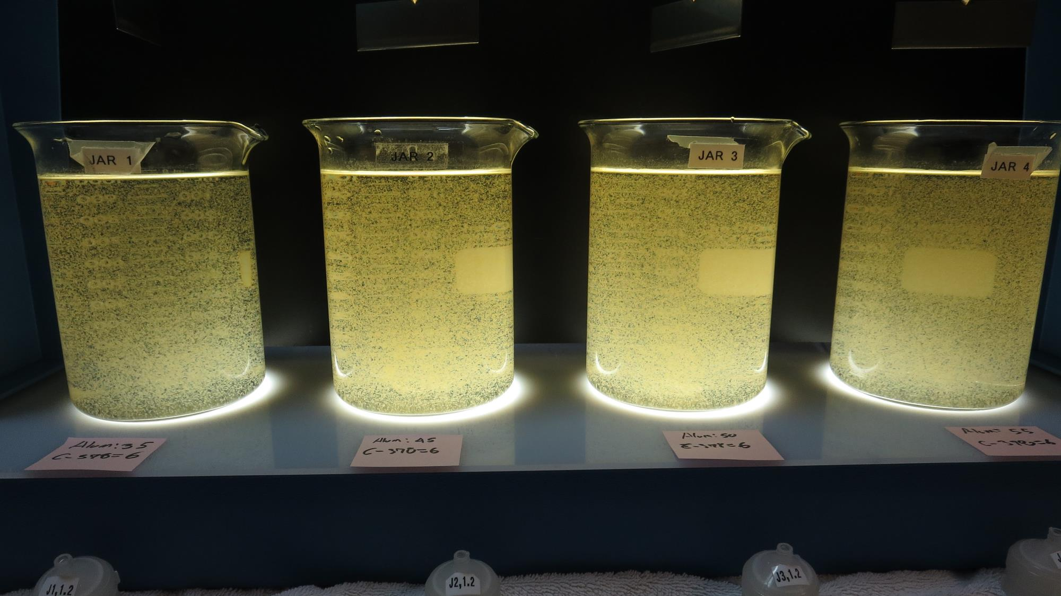
Jars 29-32: After 5 min of settling, 25 mL is syringed for filterability and %UVT/UVA.

Slide 56
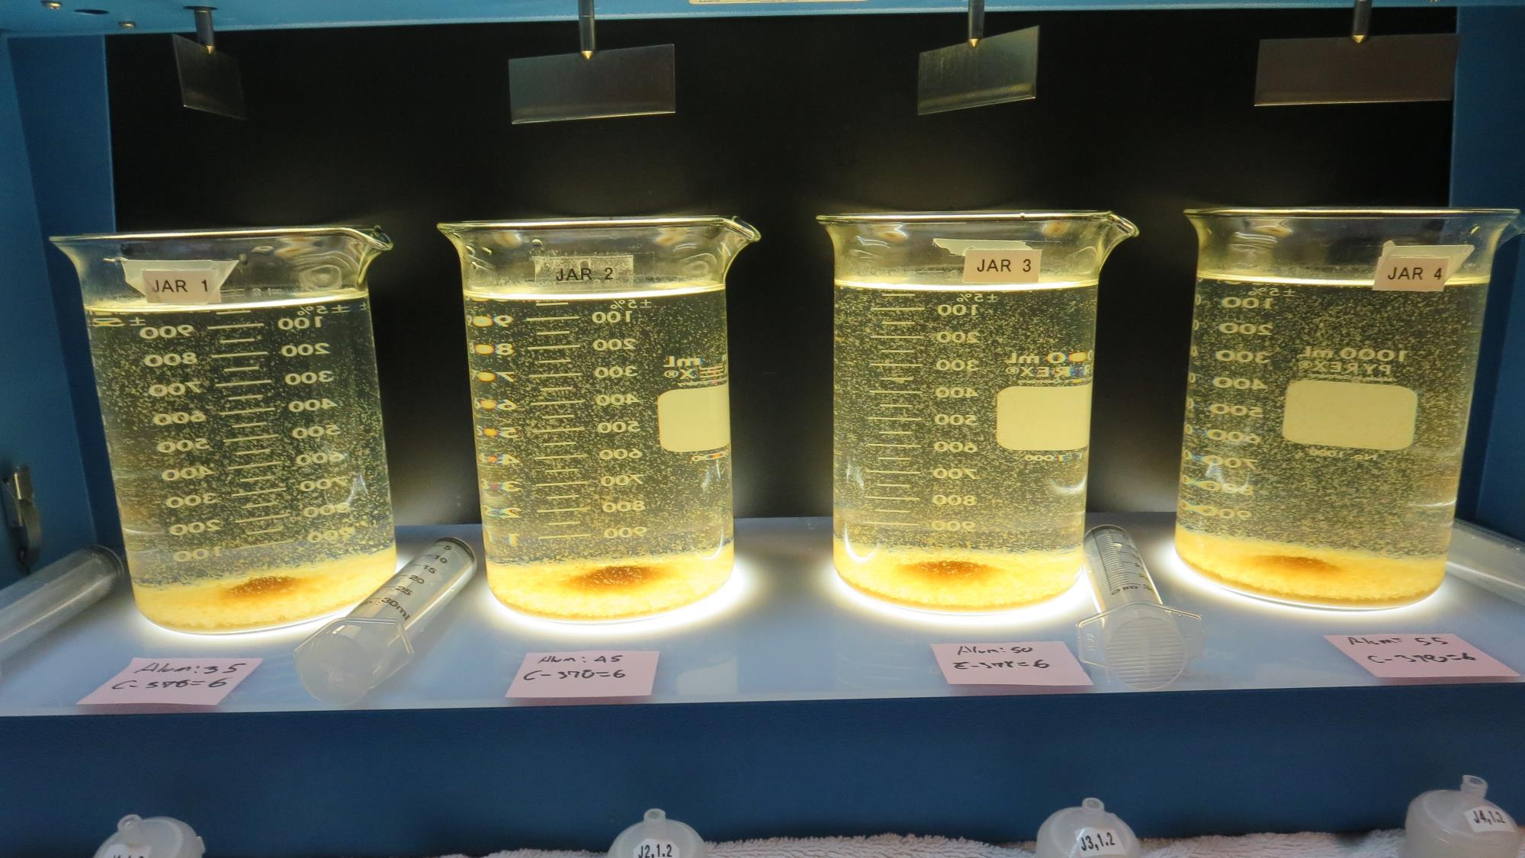
Jars 29-32: After 25-minutes of settling, settled water turbidity is taken.
35 mg/L Alum
6.0 mg/L C-378
Filtrate 0.08 NTU
UVT: 87.9%
UVA: 0.056/cm
UVA Reduction 71.9%
Settled: 3.15 NTU
45 mg/L Alum
6.0 mg/L C-378
Filtrate 0.05 NTU
UVT: 89.2%
UVA: 0.049/cm
UVA Reduction 75.4%
Settled: 2.68 NTU
50 mg/L Alum
6.0 mg/L C-378
Filtrate 0.05 NTU
UVT: 89.8%
UVA: 0.046/cm
UVA Reduction 76.9%
Settled: 2.84 NTU
55 mg/L Alum
6.0 mg/L C-378
Filtrate 0.04 NTU
UVT: 90.3%
UVA: 0.044/cm
UVA Reduction 77.9%
Settled: 3.86 NTU

Slide 57
Jars 33-36 Test Flash Mix 30 Sec (200 RPM) Floc Mix 5 min (30 RPM) Post-KMnO₄ Oxidation Applied Coagulants Alum/CatFloc C-378

Slide 58
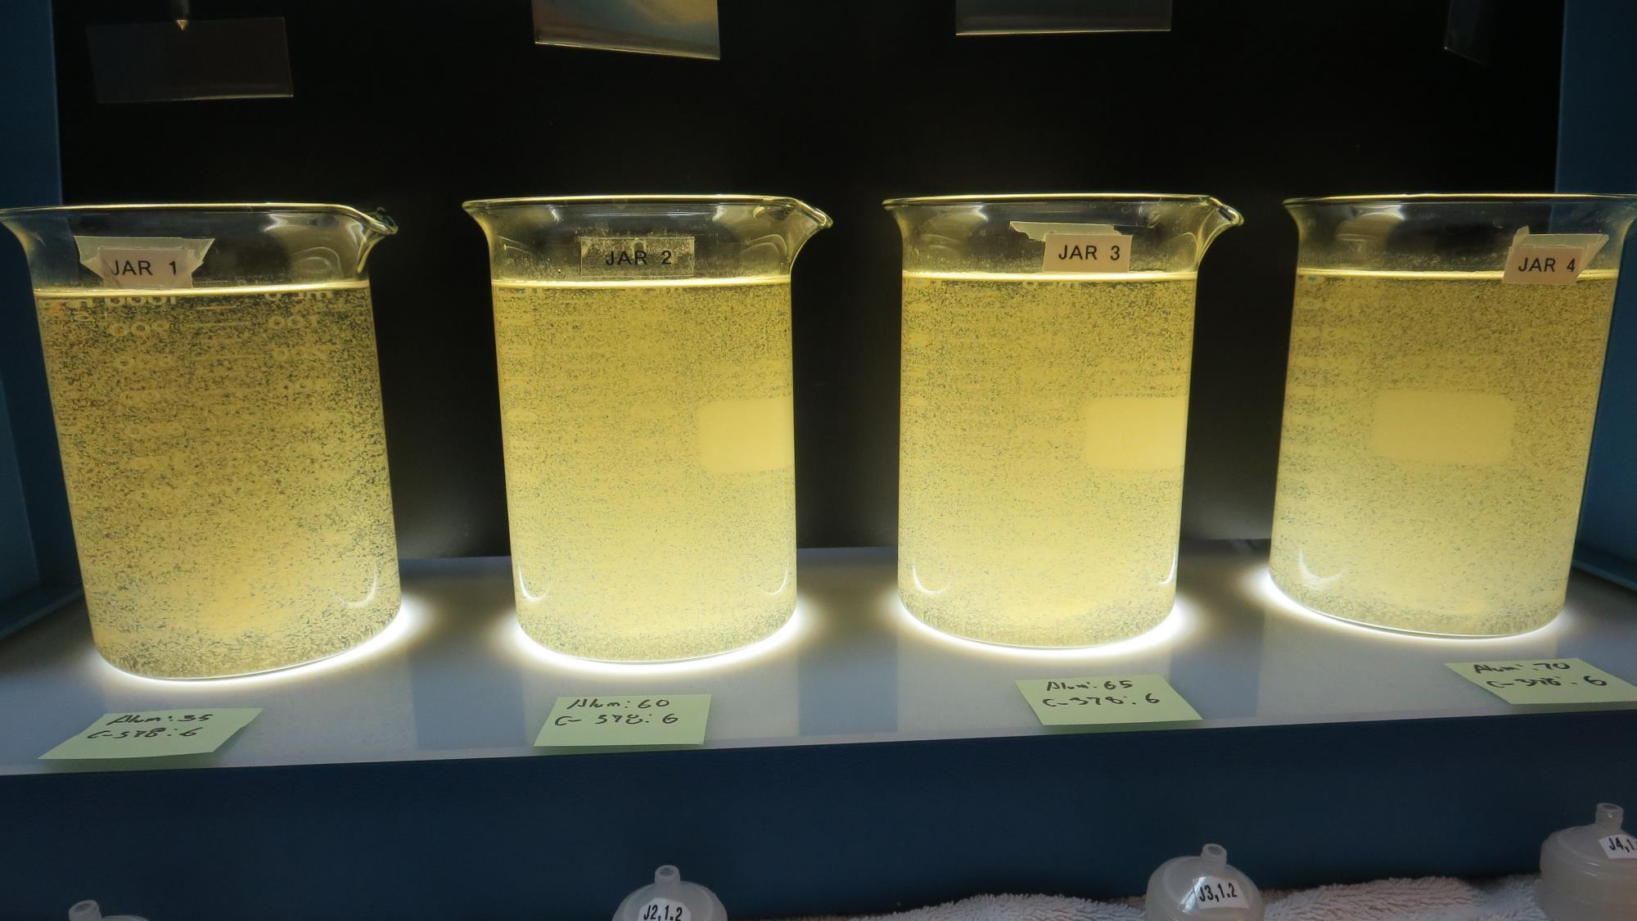
Jars 33-36: End of 5-minute flocculation (30 RPM) duration.
35 mg/L Alum
6.0 mg/L C-378
Filtrate 0.11 NTU
UVT: 87.5%
UVA: 0.057/cm
UVA Reduction 71.4%
Settled: 3.38 NTU
60 mg/L Alum
6.0 mg/L C-378
Filtrate 0.04 NTU
UVT: 90.3%
UVA: 0.044/cm
UVA Reduction 77.9%
Settled: 4.79 NTU
65 mg/L Alum
6.0 mg/L C-378
Filtrate 0.05 NTU
UVT: 90.9%
UVA: 0.041/cm
UVA Reduction 79.4%
Settled: 3.64 NTU
70 mg/L Alum
6.0 mg/L C-378
Filtrate 0.04 NTU
UVT: 91.1%
UVA: 0.040/cm
UVA Reduction 79.9%
Settled: 3.95 NTU

Slide 59
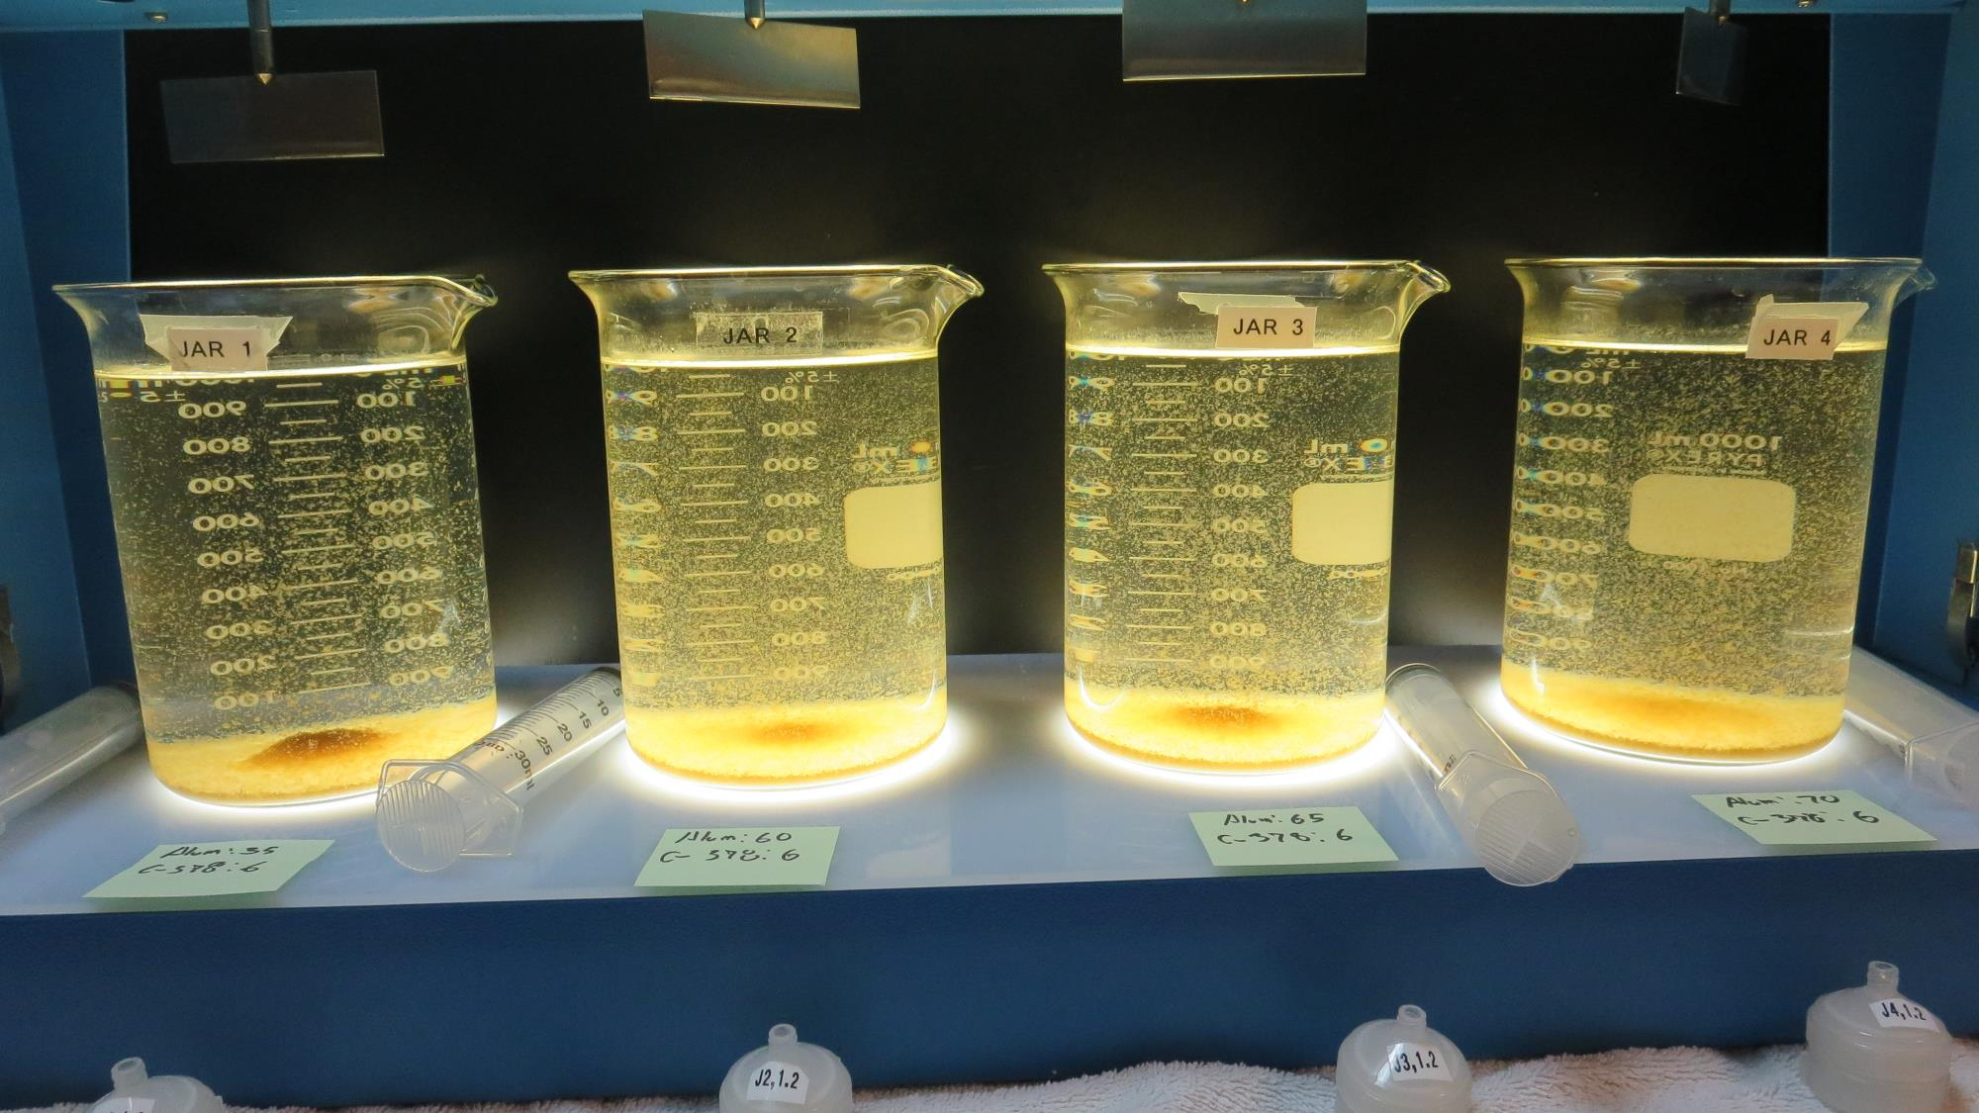
Jars 33-36: After 5 min of settling, 25 mL is syringed for filterability and %UVT/UVA.

Slide 60
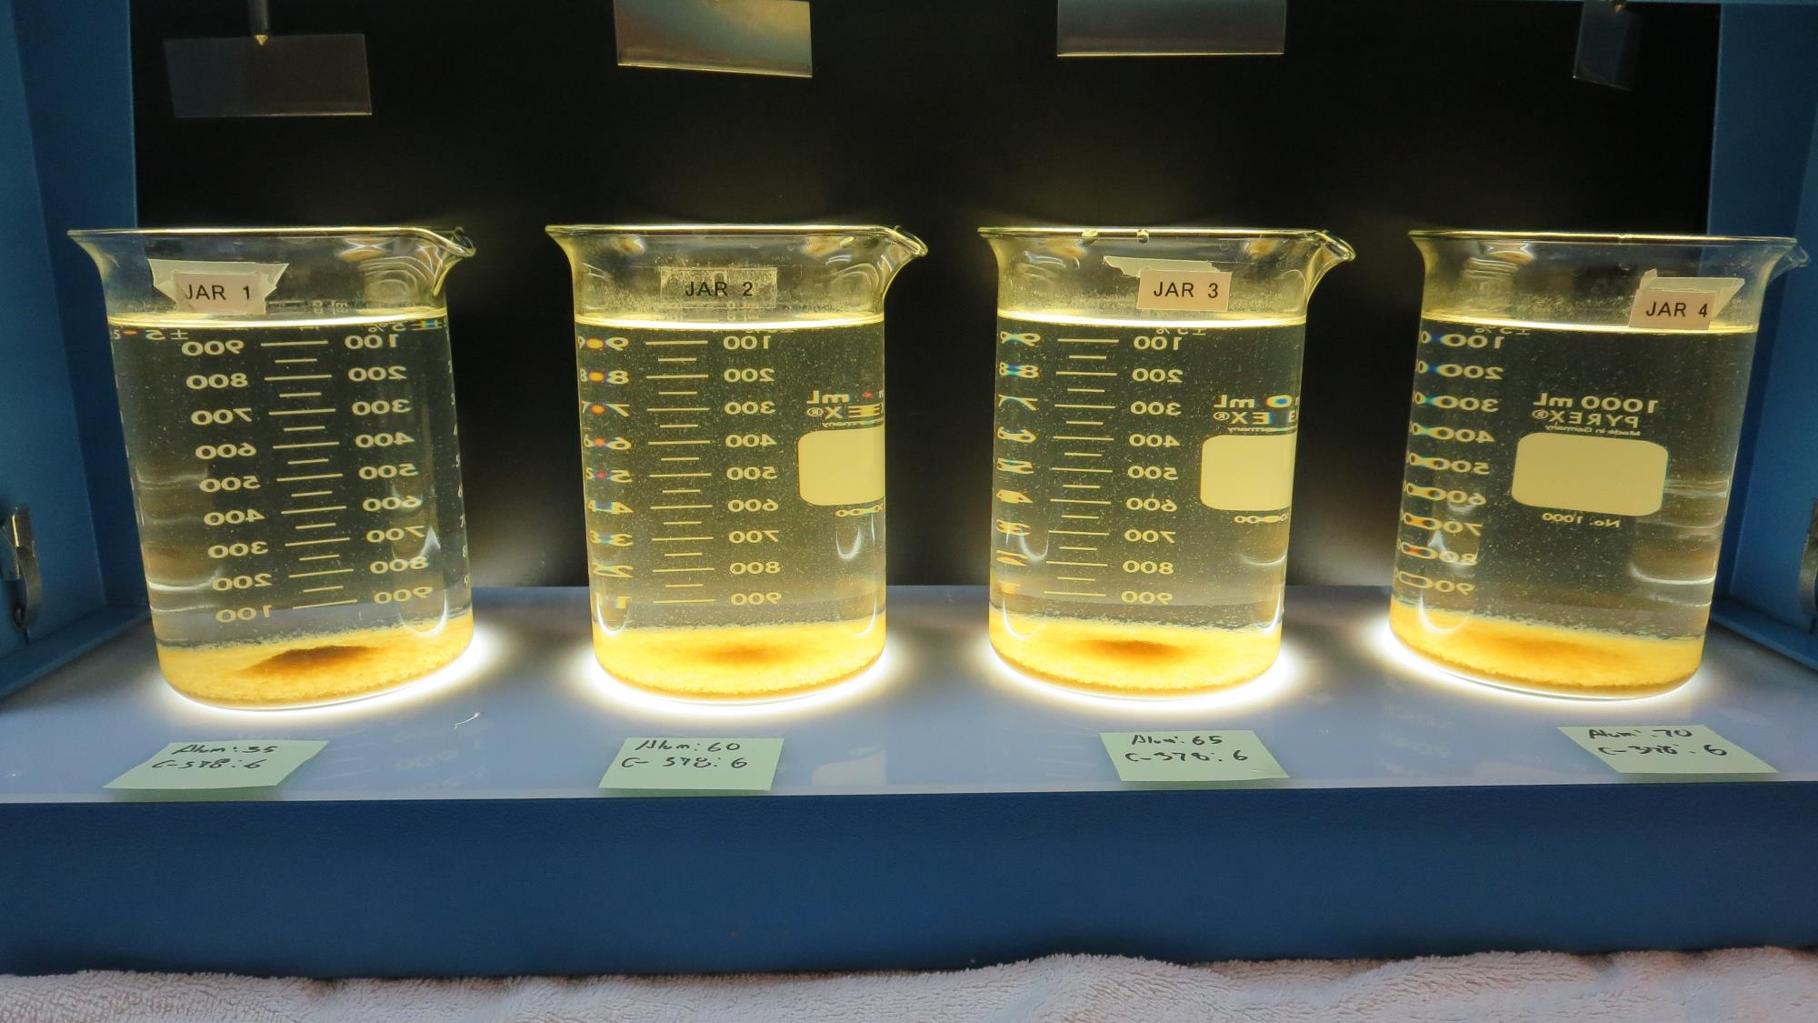
Jars 33-36: After 25-minutes of settling, settled water turbidity is taken.
35 mg/L Alum
6.0 mg/L C-378
Filtrate 0.11 NTU
UVT: 87.5%
UVA: 0.057/cm
UVA Reduction 71.4%
Settled: 3.38 NTU
60 mg/L Alum
6.0 mg/L C-378
Filtrate 0.04 NTU
UVT: 90.3%
UVA: 0.044/cm
UVA Reduction 77.9%
Settled: 4.79 NTU
65 mg/L Alum
6.0 mg/L C-378
Filtrate 0.05 NTU
UVT: 90.9%
UVA: 0.041/cm
UVA Reduction 79.4%
Settled: 3.64 NTU
70 mg/L Alum
6.0 mg/L C-378
Filtrate 0.04 NTU
UVT: 91.1%
UVA: 0.040/cm
UVA Reduction 79.9%
Settled: 3.95 NTU

Slide 61
Jars 37-40 Test Flash Mix 30 Sec (200 RPM) Floc Mix 5 min (30 RPM) Post-KMnO₄ Oxidation Applied Coagulants AdvFloc CTC-00011 /CatFloc C-378

Slide 62
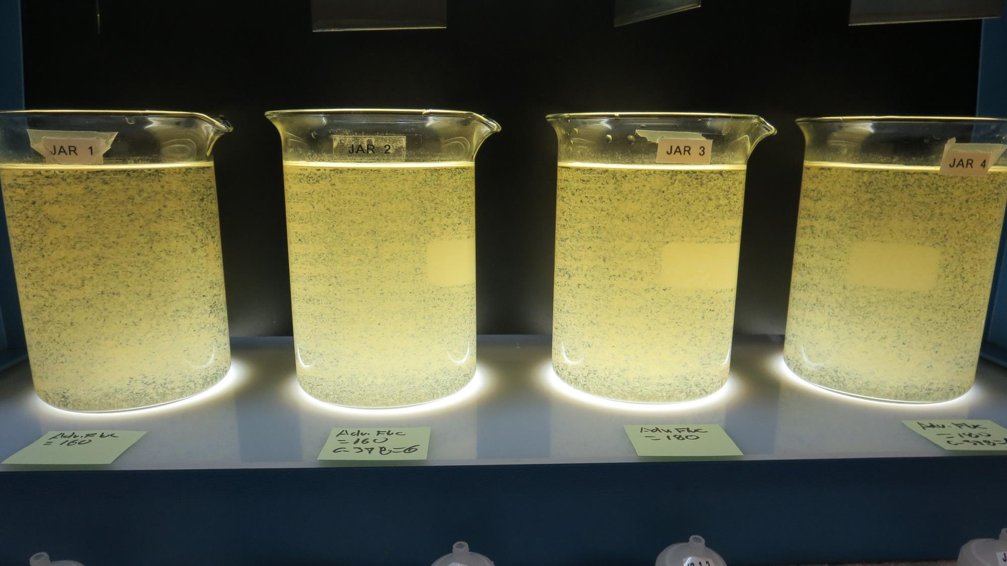
Jars 37-40: End of 5-minute flocculation (30 RPM) duration.
160 mg/L AdvFloc
0.0 mg/L C-378
Filtrate 0.08 NTU
UVT: 91.4%
UVA: 0.038/cm
UVA Reduction 80.9%
Settled: 0.38 NTU
160 mg/L AdvFloc
6.0 mg/L C-378
Filtrate 0.06 NTU
UVT: 92.3%
UVA: 0.034/cm
UVA Reduction 82.9%
Settled: 1.0 NTU
180 mg/L AdvFloc
0.0 mg/L C-378
Filtrate 0.08 NTU
UVT: 91.9%
UVA: 0.036/cm
UVA Reduction 81.9%
Settled: 0.67 NTU
180 mg/L AdvFloc
6.0 mg/L C-378
Filtrate 0.05 NTU
UVT: 92.6%
UVA: 0.033/cm
UVA Reduction 83.4%
Settled: 0.86 NTU

Slide 63
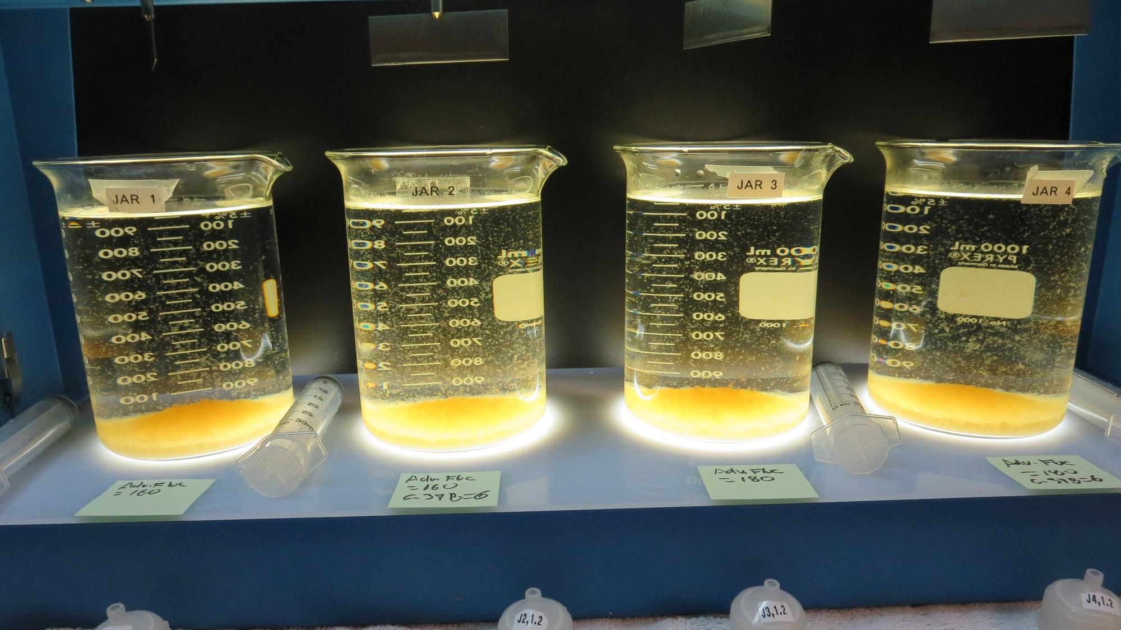
Jars 37-40: After 5 min of settling, 25 mL is syringed for filterability and %UVT/UVA.

Slide 64
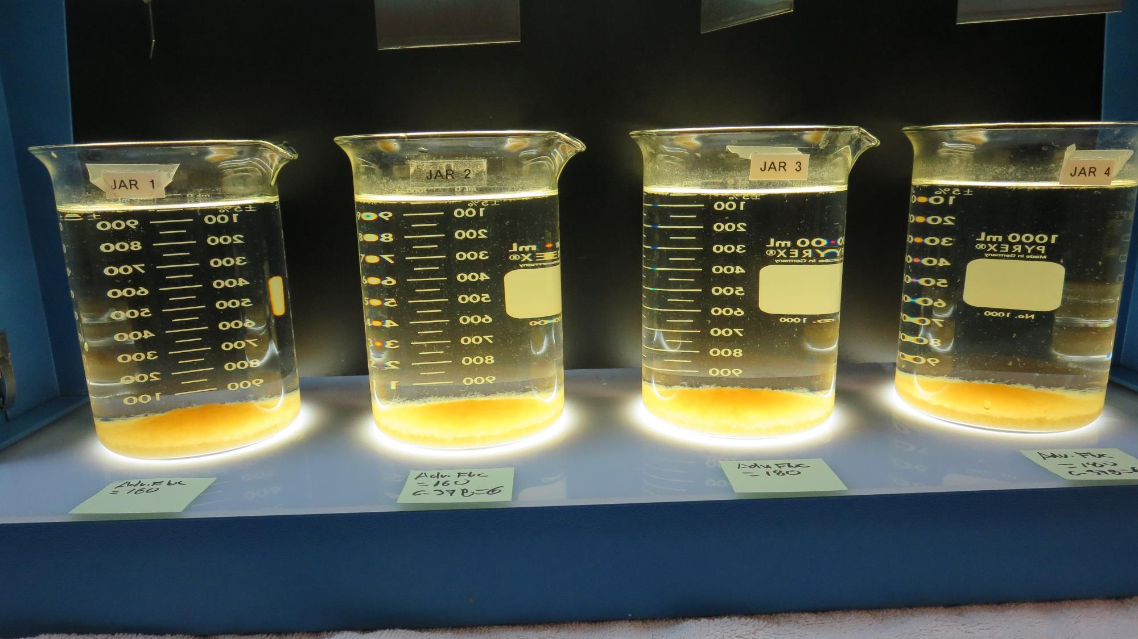
Jars 37-40: After 25-minutes of settling, settled water turbidity is taken.
160 mg/L AdvFloc
0.0 mg/L C-378
Filtrate 0.08 NTU
UVT: 91.4%
UVA: 0.038/cm
UVA Reduction 80.9%
Settled: 0.38 NTU
160 mg/L AdvFloc
6.0 mg/L C-378
Filtrate 0.06 NTU
UVT: 92.3%
UVA: 0.034/cm
UVA Reduction 82.9%
Settled: 1.0 NTU
180 mg/L AdvFloc
0.0 mg/L C-378
Filtrate 0.08 NTU
UVT: 91.9%
UVA: 0.036/cm
UVA Reduction 81.9%
Settled: 0.67 NTU
180 mg/L AdvFloc
6.0 mg/L C-378
Filtrate 0.05 NTU
UVT: 92.6%
UVA: 0.033/cm
UVA Reduction 83.4%
Settled: 0.86 NTU

Slide 65
Jars 41-44 Test Flash Mix 30 Sec (200 RPM) Floc Mix 5 min (30 RPM) Post-KMnO₄ Oxidation Applied Coagulants 9800/CatFloc C-378

Slide 66
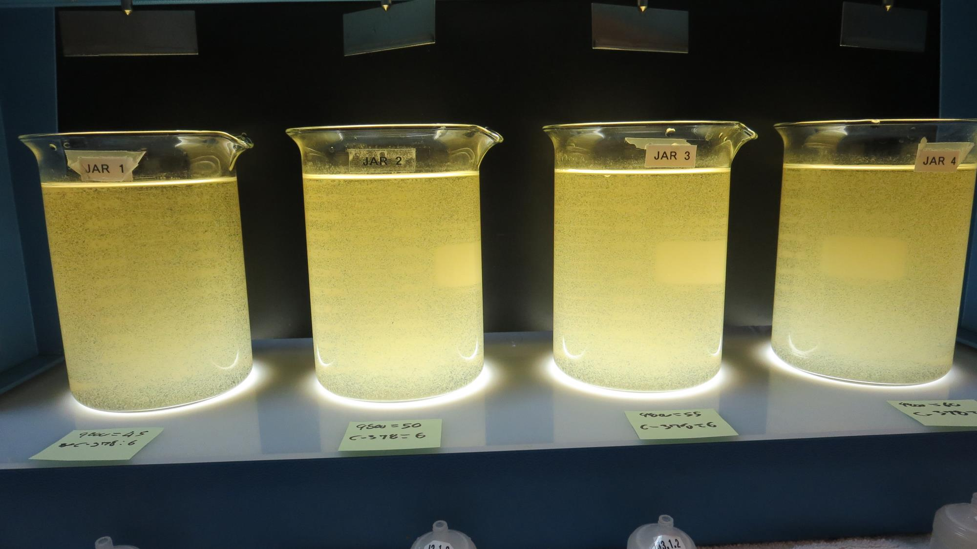
Jars 41-44: End of 5-minute flocculation (30 RPM) duration.
45 mg/L 9800
6.0 mg/L C-378
Filtrate 0.10 NTU
UVT: 90.2%
UVA: 0.044/cm
UVA Reduction 77.9%
Settled: 2.21 NTU
50 mg/L 9800
6.0 mg/L C-378
Filtrate 0.07 NTU
UVT: 90.7%
UVA: 0.042/cm
UVA Reduction 78.9%
Settled: 2.57 NTU
55 mg/L 9800
6.0 mg/L C-378
Filtrate 0.06 NTU
UVT: 91.3%
UVA: 0.039/cm
UVA Reduction 80.4%
Settled: 2.84 NTU
60 mg/L 9800
6.0 mg/L C-378
Filtrate 0.07 NTU
UVT: 91.4%
UVA: 0.038/cm
UVA Reduction 80.9%
Settled: 2.67 NTU

Slide 67
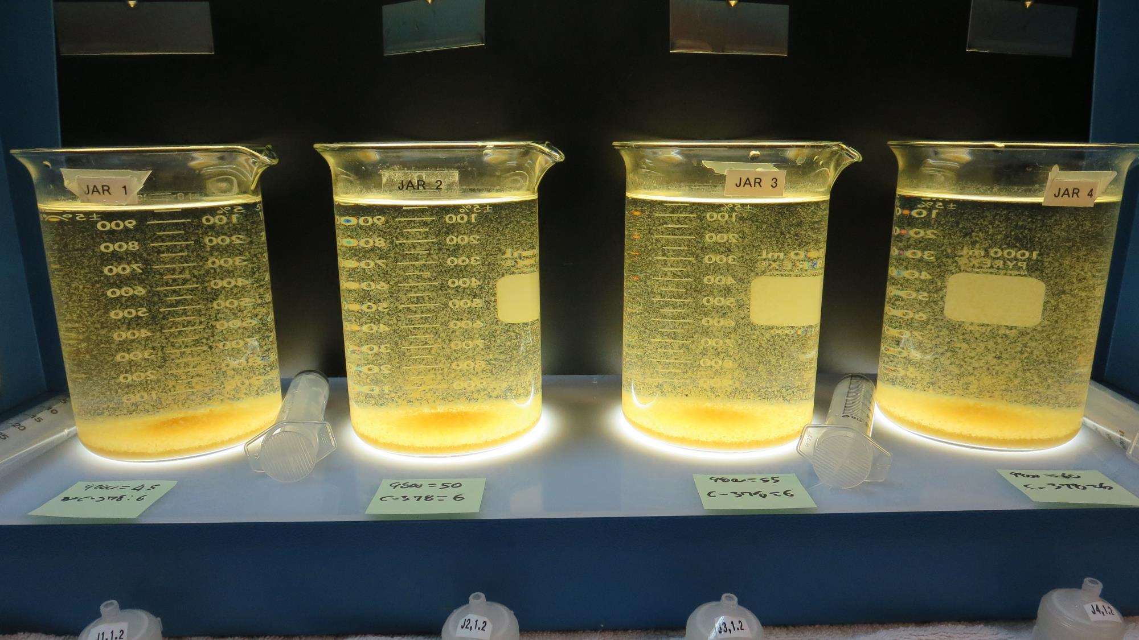
Jars 41-44: After 5 min of settling, 25 mL is syringed for filterability and %UVT/UVA.

Slide 68
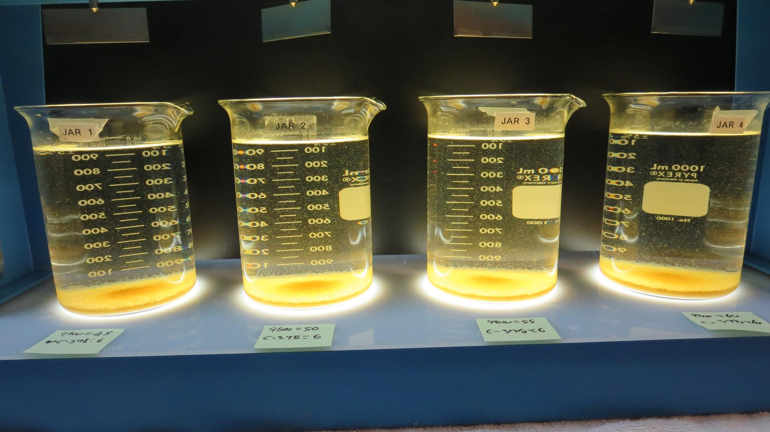
Jars 41-44: After 25-minutes of settling, settled water turbidity is taken.
45 mg/L 9800
6.0 mg/L C-378
Filtrate 0.10 NTU
UVT: 90.2%
UVA: 0.044/cm
UVA Reduction 77.9%
Settled: 2.21 NTU
50 mg/L 9800
6.0 mg/L C-378
Filtrate 0.07 NTU
UVT: 90.7%
UVA: 0.042/cm
UVA Reduction 78.9%
Settled: 2.57 NTU
55 mg/L 9800
6.0 mg/L C-378
Filtrate 0.06 NTU
UVT: 91.3%
UVA: 0.039/cm
UVA Reduction 80.4%
Settled: 2.84 NTU
60 mg/L 9800
6.0 mg/L C-378
Filtrate 0.07 NTU
UVT: 91.4%
UVA: 0.038/cm
UVA Reduction 80.9%
Settled: 2.67 NTU

Slide 69
Jars 45-48 Test Flash Mix 30 Sec (200 RPM) Floc Mix 5 min (30 RPM) Post-KMnO₄ Oxidation Applied Coagulants 9800/CatFloc C-378

Slide 70
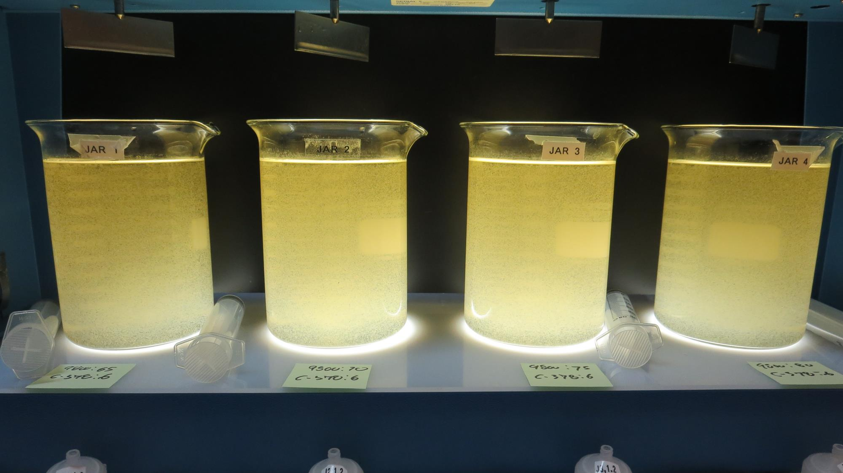
Jars 45-48: End of 5-minute flocculation (30 RPM) duration.
65 mg/L 9800
6.0 mg/L C-378
Filtrate 0.10 NTU
UVT: 90.9%
UVA: 0.041/cm
UVA Reduction 79.4%
Settled: 2.48 NTU
70 mg/L 9800
6.0 mg/L C-378
Filtrate 0.08 NTU
UVT: 91.5%
UVA: 0.038/cm
UVA Reduction 80.9%
Settled: 2.54 NTU
75 mg/L 9800
6.0 mg/L C-378
Filtrate 0.07 NTU
UVT: 91.6%
UVA: 0.037/cm
UVA Reduction 81.4%
Settled: 2.65 NTU
80 mg/L 9800
6.0 mg/L C-378
Filtrate 0.08 NTU
UVT: 91.6%
UVA: 0.037/cm
UVA Reduction 81.4%
Settled: 2.07 NTU

Slide 71
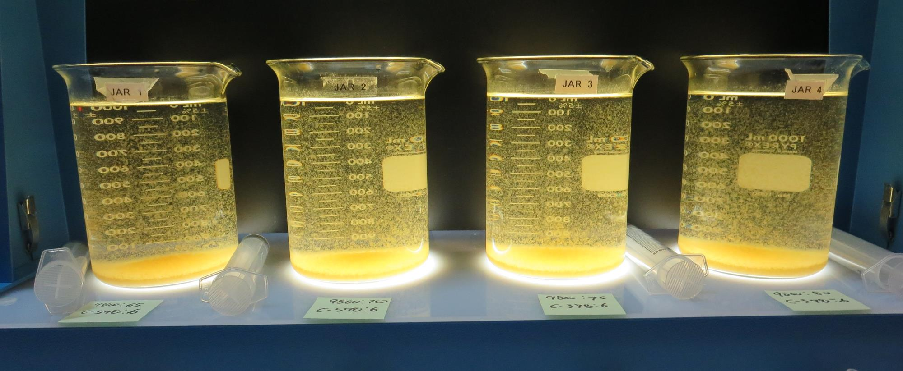
Jars 45-48: After 5 min of settling, 25 mL is syringed for filterability and %UVT/UVA.

Slide 72
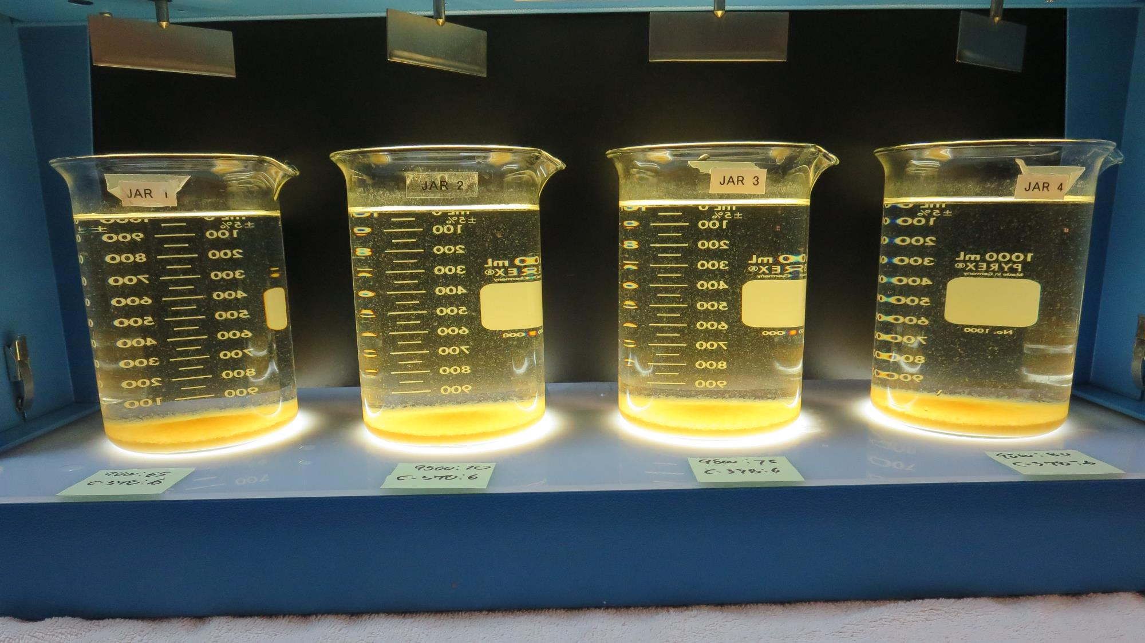
Jars 45-48: After 25-minutes of settling, settled water turbidity is taken.
65 mg/L 9800
6.0 mg/L C-378
Filtrate 0.10 NTU
UVT: 90.9%
UVA: 0.041/cm
UVA Reduction 79.4%
Settled: 2.48 NTU
70 mg/L 9800
6.0 mg/L C-378
Filtrate 0.08 NTU
UVT: 91.5%
UVA: 0.038/cm
UVA Reduction 80.9%
Settled: 2.54 NTU
75 mg/L 9800
6.0 mg/L C-378
Filtrate 0.07 NTU
UVT: 91.6%
UVA: 0.037/cm
UVA Reduction 81.4%
Settled: 2.65 NTU
80 mg/L 9800
6.0 mg/L C-378
Filtrate 0.08 NTU
UVT: 91.6%
UVA: 0.037/cm
UVA Reduction 81.4%
Settled: 2.07 NTU

Slide 73
Jars 49-52 Test Flash Mix 30 Sec (200 RPM) Floc Mix 5 min (30 RPM) Post-KMnO₄ Oxidation Applied Coagulants Alum/AdvFloc CTC-00011 9800/CatFloc C-378

Slide 74
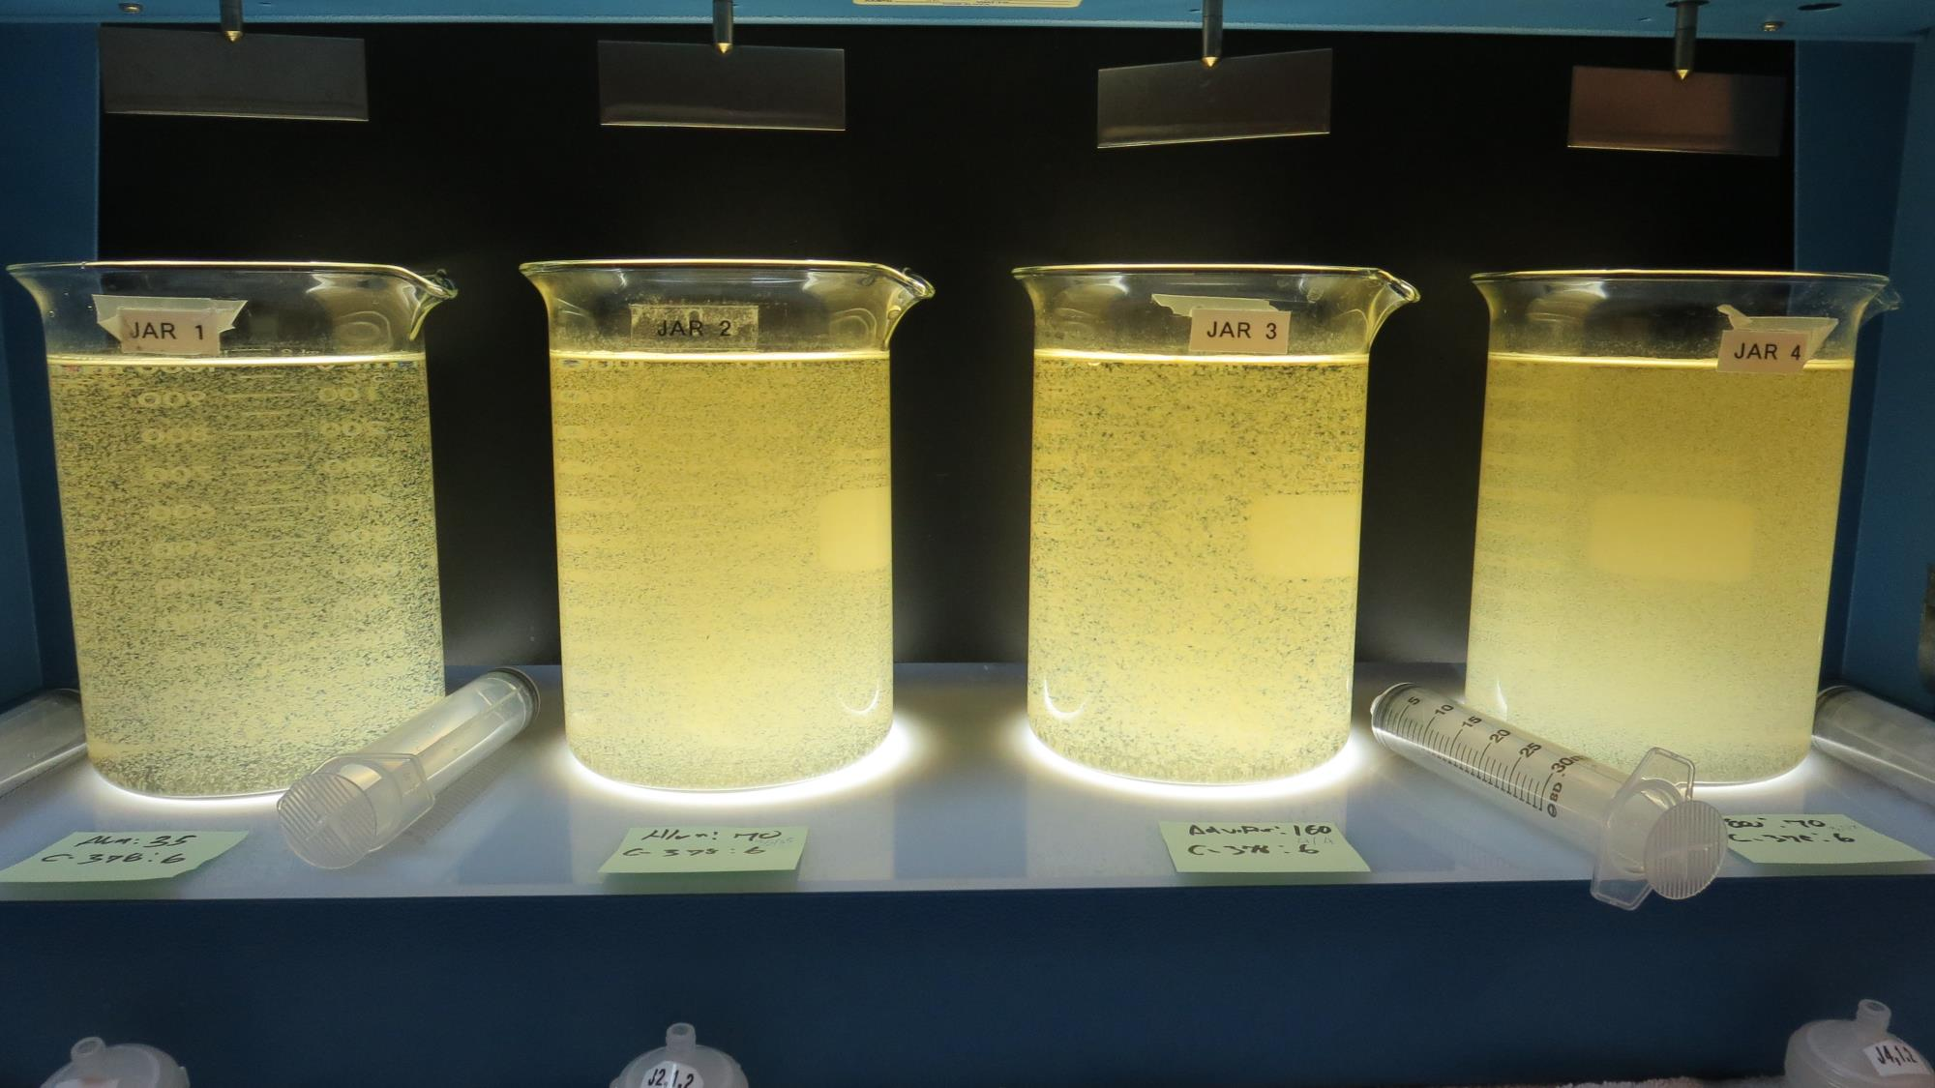
Jars 49-52: End of 5-minute flocculation (30 RPM) duration.
35 mg/L Alum
6.0 mg/L C-378
Filtrate 0.10 NTU
UVT: 87.0%
UVA: 0.060/cm
UVA Reduction 69.8%
Settled: 3.22 NTU
70 mg/L Alum
6.0 mg/L C-378
Filtrate 0.05 NTU
UVT: 90.7%
UVA: 0.042/cm
UVA Reduction 78.9%
Settled: 3.45 NTU
160 mg/L AdvFloc
6.0 mg/L C-378
Filtrate 0.05 NTU
UVT: 92.0%
UVA: 0.042/cm
UVA Reduction 81.9%
Settled: 1.16 NTU
70 mg/L 9800
6.0 mg/L C-378
Filtrate 0.05 NTU
UVT: 91.3%
UVA: 0.039/cm
UVA Reduction 80.4%
Settled: 2.84 NTU

Slide 75
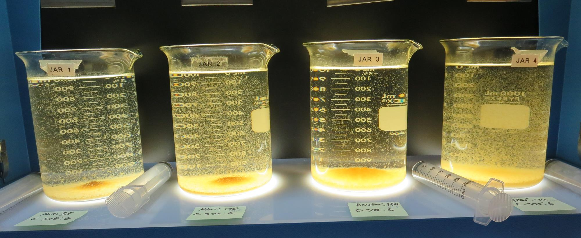
Jars 49-52: After 5 min of settling, 25 mL is syringed for filterability and %UVT/UVA.

Slide 76
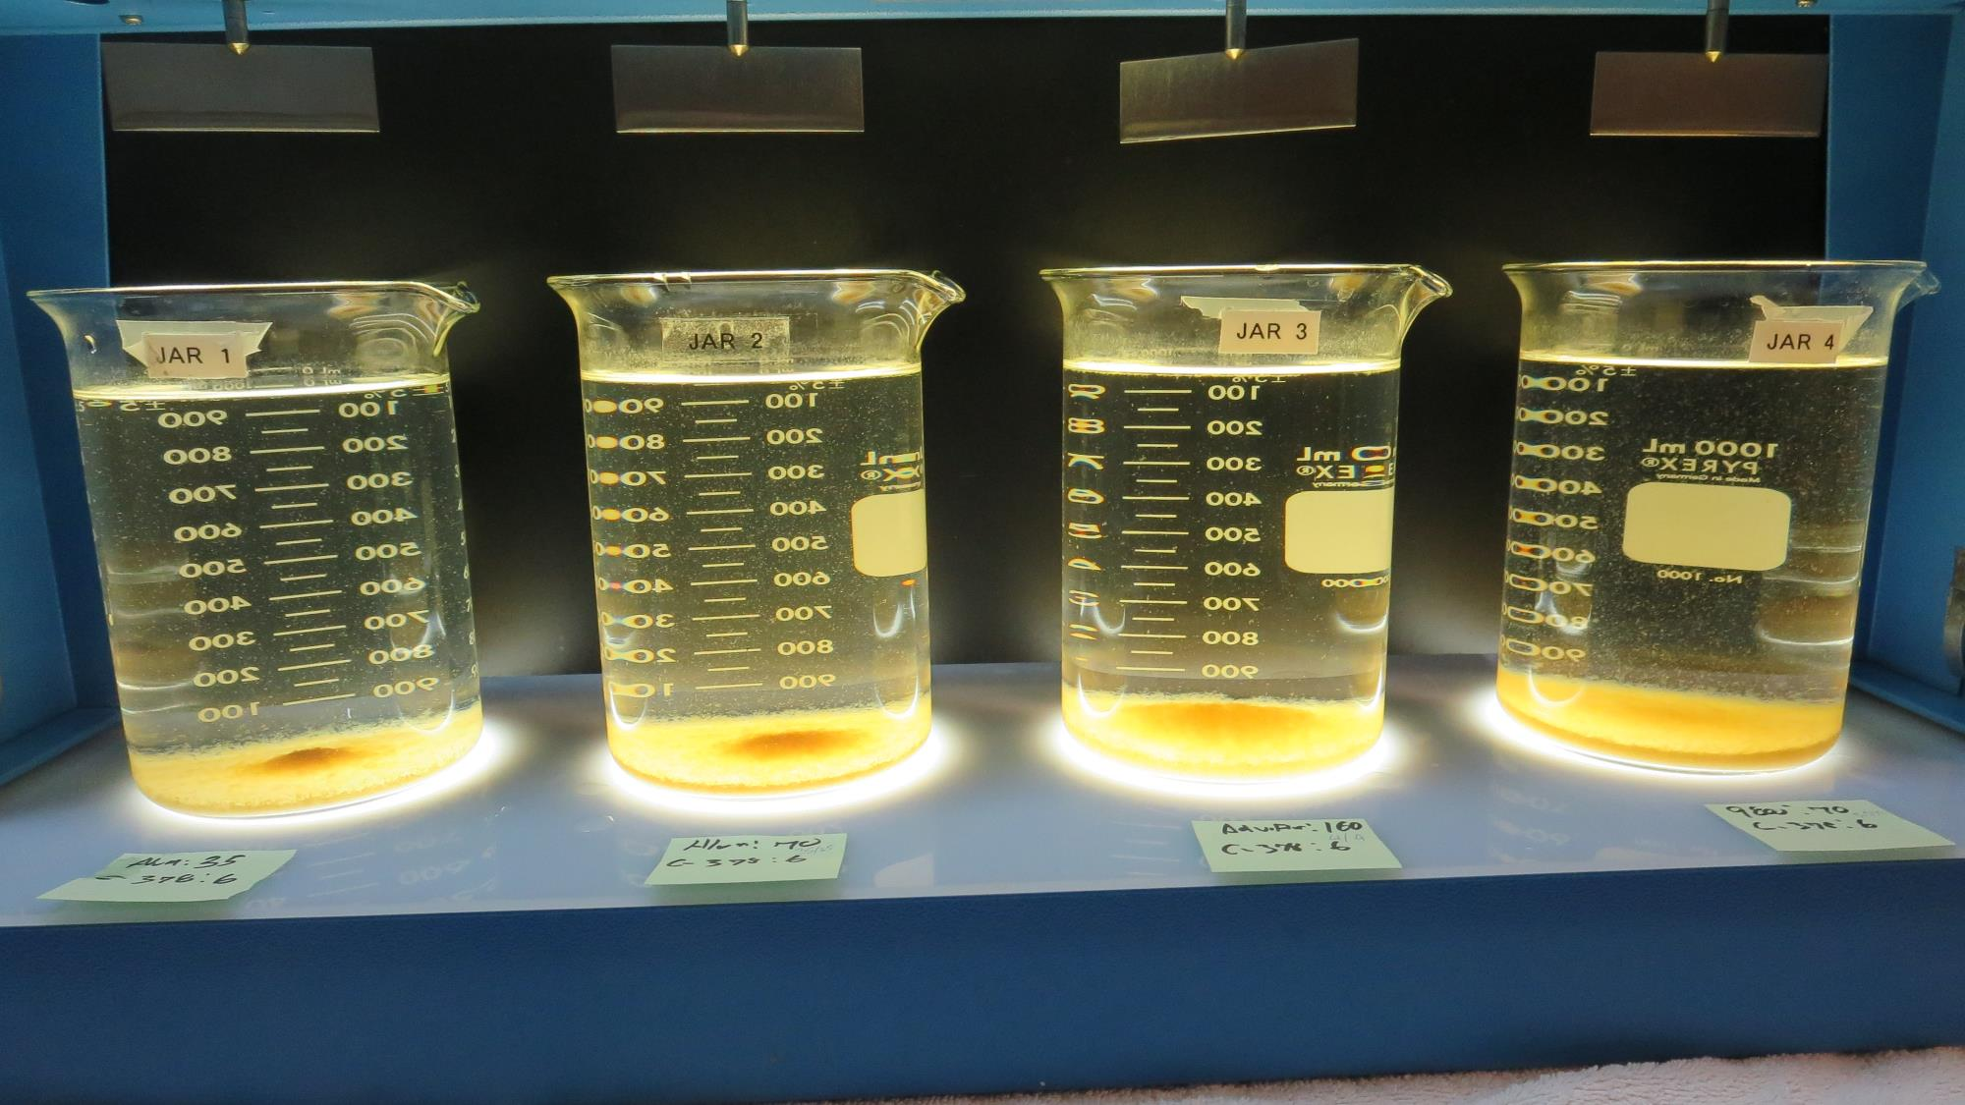
Jars 49-52: After 25-minutes of settling, settled water turbidity is taken.
35 mg/L Alum
6.0 mg/L C-378
Filtrate 0.10 NTU
UVT: 87.0%
UVA: 0.060/cm
UVA Reduction 69.8%
Settled: 3.22 NTU
70 mg/L Alum
6.0 mg/L C-378
Filtrate 0.05 NTU
UVT: 90.7%
UVA: 0.042/cm
UVA Reduction 78.9%
Settled: 3.45 NTU
160 mg/L AdvFloc
6.0 mg/L C-378
Filtrate 0.05 NTU
UVT: 92.0%
UVA: 0.042/cm
UVA Reduction 81.9%
Settled: 1.16 NTU
70 mg/L 9800
6.0 mg/L C-378
Filtrate 0.05 NTU
UVT: 91.3%
UVA: 0.039/cm
UVA Reduction 80.4%
Settled: 2.84 NTU

Slide 77
Jars 54-56 Test Flash Mix 30 Sec (200 RPM) Floc Mix 5 min (30 RPM) Pre & Post-KMnO₄ Oxidation Applied Coagulants Alum/AdvFloc CTC-00011 /CatFloc C-378

Slide 78
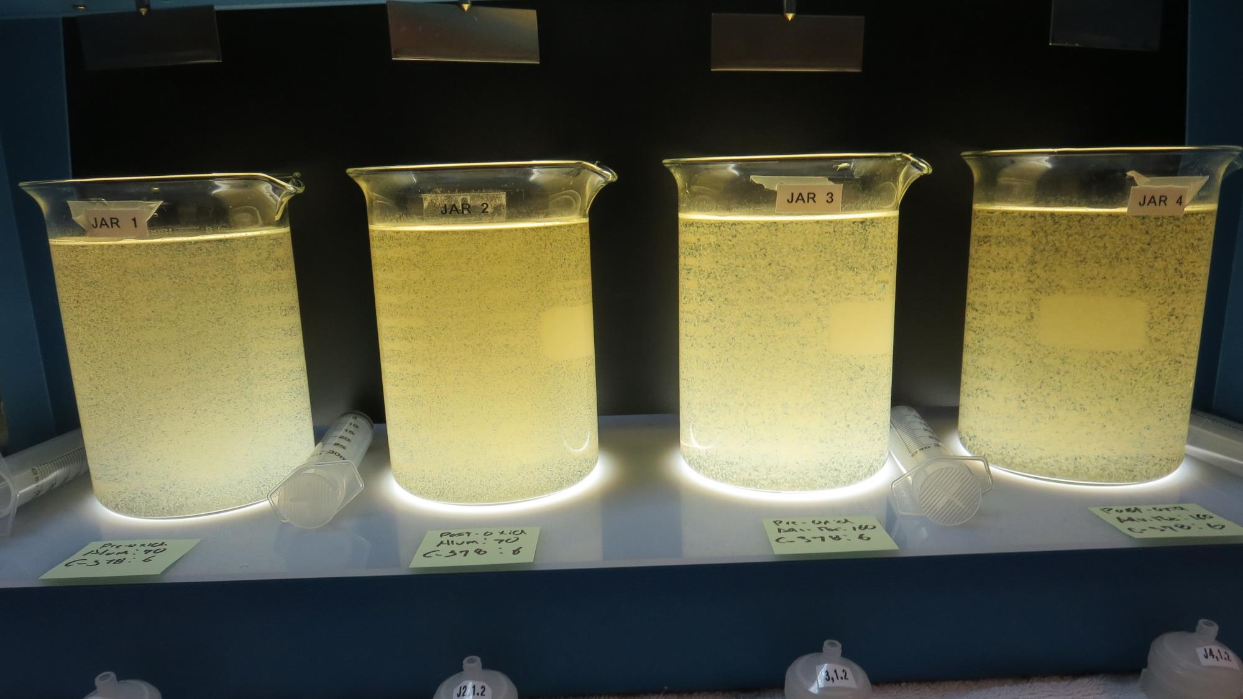
Jars 53-56: End of 5-minute flocculation (30 RPM) duration.
Pre-Oxidation Source
70 mg/L Alum
6.0 mg/L C-378
Filtrate 0.08 NTU
UVT: 89.2%
UVA: 0.049/cm
UVA Reduction 75.4%
Settled: 6.45 NTU
Post-Oxidation Source
70 mg/L Alum
6.0 mg/L C-378
Filtrate 0.05 NTU
UVT: 90.8%
UVA: 0.042/cm
UVA Reduction 78.9%
Settled: 3.14 NTU
Pre-Oxidation Source
160 mg/L AdvFloc
6.0 mg/L C-378
Filtrate 0.10 NTU
UVT: 90.8%
UVA: 0.041/cm
UVA Reduction 79.4%
Settled: 3.69 NTU
Post-Oxidation Source
160 mg/L AdvFloc
6.0 mg/L C-378
Filtrate 0.05 NTU
UVT: 92.1%
UVA: 0.035/cm
UVA Reduction 82.4%
Settled: 0.96 NTU

Slide 79
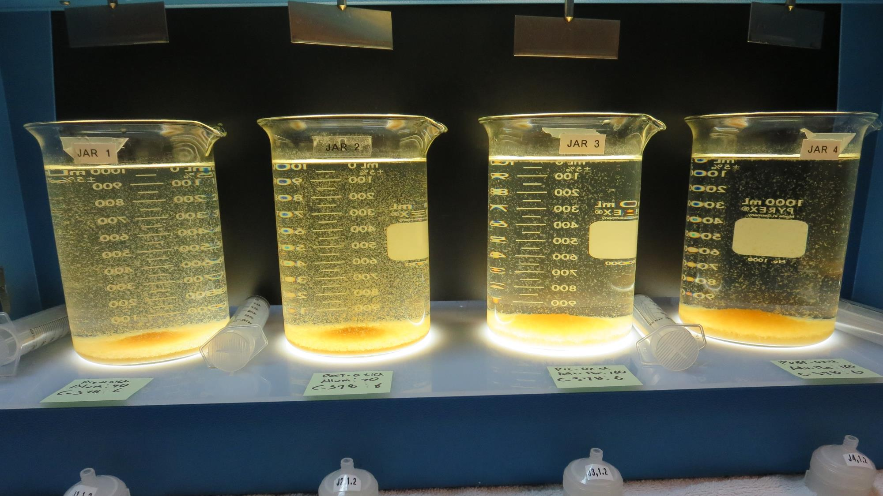
Jars 53-56: After 5 min of settling, 25 mL is syringed for filterability and %UVT/UVA.

Slide 80
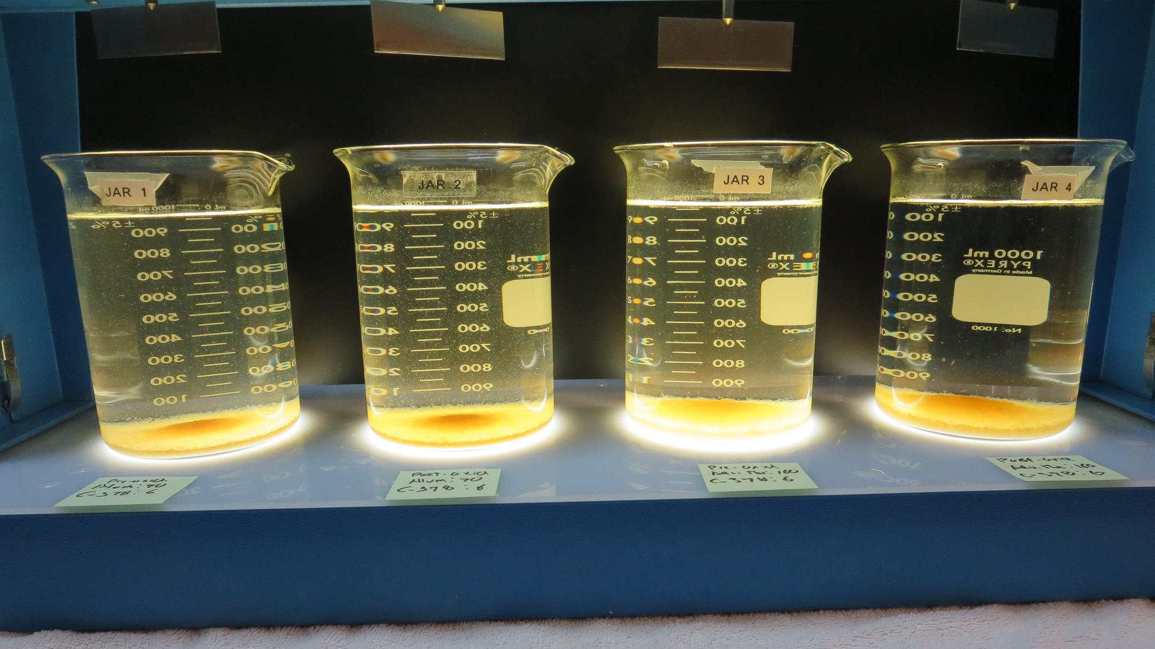
Jars 53-56: After 25-minutes of settling, settled water turbidity is taken.
Pre-Oxidation Source
70 mg/L Alum
6.0 mg/L C-378
Filtrate 0.08 NTU
UVT: 89.2%
UVA: 0.049/cm
UVA Reduction 75.4%
Settled: 6.45 NTU
Post-Oxidation Source
70 mg/L Alum
6.0 mg/L C-378
Filtrate 0.05 NTU
UVT: 90.8%
UVA: 0.042/cm
UVA Reduction 78.9%
Settled: 3.14 NTU
Pre-Oxidation Source
160 mg/L AdvFloc
6.0 mg/L C-378
Filtrate 0.10 NTU
UVT: 90.8%
UVA: 0.041/cm
UVA Reduction 79.4%
Settled: 3.69 NTU
Post-Oxidation Source
160 mg/L AdvFloc
6.0 mg/L C-378
Filtrate 0.05 NTU
UVT: 92.1%
UVA: 0.035/cm
UVA Reduction 82.4%
Settled: 0.96 NTU

Slide 81
Jar Testing for 1-Liter Jars: Procedures for Most Treatment Plants
Fill jars with source water prior to coagulant injection and set paddle speed at 30 rpm
Add chemicals (i.e., NaOCl, primary coagulant, coagulant aid) to each jar
Flash mix for 15-30 seconds (200 rpm)
Slow mix for 5 minutes (20-30 rpm)
Settled for 5 minutes. Syringe 25 mL from each jar taken 1-inch below surface (25 mL/12 sec rate)
Filtered through 1.2 um isopore membrane into cuvette drip rate, 15 mL/(50-90 sec)
Measure filtrate turbidity, chlorine residual and %UVT/UVA
Measure settled water turbidity after 25 minutes of total setting
Record all data

Slide 82
Jar Test Filterability Test Equipment
Turbidity Instrument
Syringe w/Luer-Lock Tip, 30 cc
(part#: 2225800, by Hach)
Swinnex Filter Holder, 25 mm (part#: SX0002500)
Isopore Membrane Filter, 1.2 um absolute
pore size,
Φ= 25 mm , thickness: 24 um,
hydrophilic polycarbonate membrane
(part #: RTTP02500)
Go to Sigma-Aldrich for laboratory supplies http://www.sigmaaldrich.com/united-states.html

Slide 83
Isopore Membrane Information
Categories | Information
trade name | Isopore
filter color | White
chemistry | Polycarbonate (PC)
water flow rate | Avg. 175 mL/min x cm² (typical results @ 10 psi)
media | Isopore®
wettability | Hydrophilic
porosity | 14.7%
pore size | 1.2 µm
bubble point at 23 °C | 1.0 bar, air with water
thickness | 24 µm
filter diameter (ø) | 25 mm
material size | polycarbonate, Hydrophilic, 1.2 µm, 25 mm, white, plain, 100

Slide 84
Isopore Membrane Background Information
The Isopore membrane is a polycarbonate, track-etched screen filter recommended for all analyses in which the sample is viewed on the surface of the membrane. The Isopore membrane is composed of polycarbonate film, which has a smooth, glass-like surface for clearer sample observation. The unique manufacturing process of the membrane ensures a precise pore diameter and a consistent pore size for accurate separation of samples by size. Matched-weight filters are not usually required because of low, constant tar and ash weights. Features & Benefits: Membrane structure retains particles on the surface, simplifying counting and analysis

Slide 85
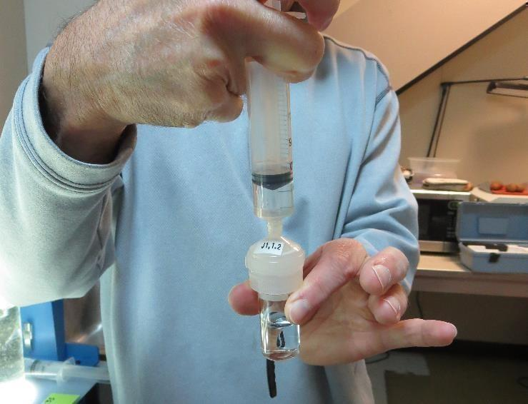
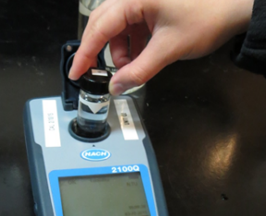
Jar Test - Filterability Test
Syringe ~ 25 mL from jar (after 5-minutes of settling)
Filter-to-waste 3-5 mL
Filter directly into clean cuvette
Measure turbidity
Note: Take several readings before recording final NTU results. Micro bubbles can adhere to glass causing false NTU readings. To remove bubbles, tilt cuvette up to 90 degrees.

Slide 86
Contact
Guy Schott, P.E.
State Water Resources Control Board
Division of Drinking Water
Santa Rosa, CA
Go to Stock Solution/Dose calculations/Jar Test Results for tools to download
www.waterboards.ca.gov/drinking_water/programs/districts/mendocino_district.html
Email: Guy Schott - Guy.Schott@waterboards.ca.gov
Office Number: 707-576-2732

