Slide 1

SAFER: 2021 Drinking Water Needs Assessment Results
April 13, 2021
9:00 am
Remote participation only
CALIFORNIA WATER BOARDS SAFER PROGRAM

Slide 2

Meeting Logistics
Kristyn Abhold
Needs Analysis Unit, SAFER Section
Division of Drinking Water
State Water Resources Control Board
CALIFORNIA WATER BOARDS SAFER PROGRAM
Notes:
Itze

Slide 3


Water Board’s Mission Statement
Preserve, enhance, and restore the quality of California’s water resources and drinking water for the protection of the environment, public health, and all beneficial uses, and to ensure proper water resource allocation and efficient use, for the benefit of present and future generations.
CALIFORNIA WATER BOARDS SAFER PROGRAM
Notes:
Itze
Explain: This is the mission statement for the Water Boards (collectively). We work to achieve our mission through an array of programs established within our major Divisions and Regions.

Slide 4
Ways to Participate-
Please wait for your name
to be called.
Public comments are
3 minutes each.
1. Watch ONLY: Visit video.calepa.ca.gov
2. Email: Submit a comment or ask a question that will be read aloud, send an email to: safer@waterboards.ca.gov
3. Q&A: Submit a question using the Q&A feature at the bottom of your Zoom Screen. You can UPVOTE any question you would like answered.
4. Raise Hand: Attendees will be given the opportunity to provide verbal comment or ask questions, if you’re interested in this option, please raise your virtual hand when the time is right.
CALIFORNIA WATER BOARDS SAFER PROGRAM
Notes:
Itze

Slide 5
Needs Assessment Overview
CALIFORNIA WATER BOARDS SAFER PROGRAM
Notes:
Itze introduces Kristyn

Slide 6
Presentation Outline
Overview of Needs Assessment
Failing Water Systems: HR2W List
Risk Assessment Methodology & Results
Cost Assessment Methodology & Results
Affordability Assessment Methodology & Results
Conclusions and Next Steps
CALIFORNIA WATER BOARDS SAFER PROGRAM
Notes:
Itze
Presentation Outline
Introduction of DDW Needs Analysis Unit
Overview of Needs Assessment
Risk Assessment 2.0 Development
Timeline

Slide 7
  Audience Poll Question 1
Have you participated in any of the last 2020-2021 webinar workshops on the Risk Assessment or Cost Assessment?
  Yes
  No
  View recordings and materials here: https://www.waterboards.ca.gov/drinking_water/certlic/drinkingwater/needs
  Respond to survey here: https://bit.ly/2OH58wm
CALIFORNIA WATER BOARDS SAFER PROGRAM

Slide 8
  Audience Poll Question 2
Have you read the report: “2021 Drinking Water Needs Assessment”?
  Yes, read the whole thing
  Yes, I skimmed it
  No, but I plan to
  No, I don’t intend to read it
  Access report here: https://bit.ly/3mAz2yK
  Respond to survey here: https://bit.ly/2OH58wm
CALIFORNIA WATER BOARDS SAFER PROGRAM

Slide 9
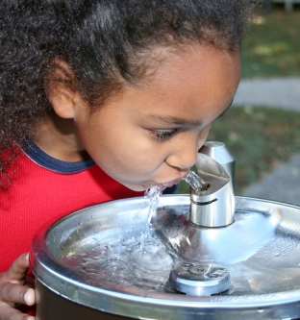
2012 - Human Right to Water (HR2W)
Water Code Section 106.3, the State statutorily recognizes that:
“every human being has the right to safe, clean, affordable, and accessible water adequate for human consumption, cooking, and sanitary purposes.”
CALIFORNIA WATER BOARDS SAFER PROGRAM
Notes:
Presentation Outline
Introduction of DDW Needs Analysis Unit
Overview of Needs Assessment
Risk Assessment 2.0 Development
Timeline

Slide 10
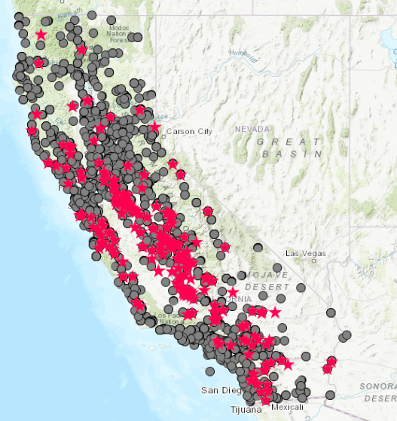
Failing Water Systems: HR2W List
7,800 Public Water Systems
HR2W list is updated quarterly on State Water Board website.
Currently there are 331 (as of today) failing water systems
On average, 90% of Violations Occur in Water Systems Serving Less than 500 connections
CALIFORNIA WATER BOARDS SAFER PROGRAM
Notes:
Presentation Outline
Introduction of DDW Needs Analysis Unit
Overview of Needs Assessment
Risk Assessment 2.0 Development
Timeline

Slide 11





SB 200 and the SAFER Program
In 2019, to advance the goals of the Human Right to Water “HR2W”, California passed Senate Bill 200, which enabled the State Water Board to establish the Safe and Affordable Funding for Equity and Resilience (SAFER) Program.
Safe and Affordable Drinking Water Fund
Data Collection
& Analysis
Consolidation & Regional Solutions
Administrators
Technical Assistance & Capacity Building
CALIFORNIA WATER BOARDS SAFER PROGRAM

Slide 12
SAFER Program
SAFER PROGRAM
Division of Financial Assistance
Division of Drinking Water
Division of Water Quality
Office of Public Participation
Fund Expenditure Plan & Executing Funding
Needs Assessment, Data Collection, & Engagement
State Smalls & Domestic Well Sourcewater Quality
Public Engagement & Meeting Facilitation
COLLABORATION PARTNERS
SAFER Advisory Group
Department of Water Resources
CA Public Utilities Commission
UCLA, Luskin Center for Innovation
UC Berkeley CEC-WESS
Office of Env. Health Hazard Assessment
Environmental Finance Centers:
UNC & Sac State
Pacific Institute
Corona Environmental
CA Conference of Directors of Env. Health
CALIFORNIA WATER BOARDS SAFER PROGRAM

Slide 13

Safe and Affordable Drinking Water Fund
Up to $130 million per year through 2030.
The annual Fund Expenditure Plan prioritizes projects for funding, documents past and planned expenditures, and is “based on data and analysis drawn from the drinking water Needs Assessment” (Health and Safety Code §116769).
CALIFORNIA WATER BOARDS SAFER PROGRAM
Notes:
SB 200 and the Needs Assessment
Senate Bill 200 (2019) enabled the establishment of the Safe and Affordable Funding for Equity and Resilience (SAFER) Program.
A set of tools, funding sources, and regulatory authorities to help struggling water systems sustainably and affordably provide safe drinking water.
Senate Bill 200 also created the Safe and Affordable Drinking Water Fund.
Up to $130 million per year through 2030
The annual Fund Expenditure Plan prioritizes projects for funding, documents past and planned expenditures, and is “based on data and analysis drawn from the drinking water Needs Assessment” (Health and Safety Code §116769).

Slide 14

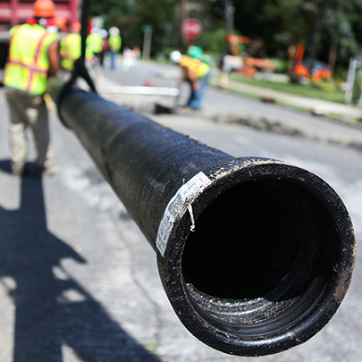
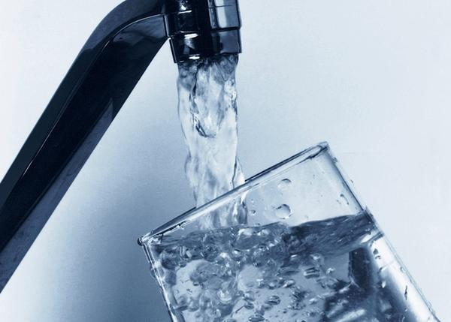



Needs Assessment Components
Risk
Assessment
Cost
Assessment
Affordability
Assessment
Systems ≤ 3,300 conn.; K-12 Schools; SSWS, & DWs
HR2W & At-Risk Systems
and Domestic Wells
DAC/SDAC Community Water Systems
https://www.waterboards.ca.gov/drinking_water/certlic/drinkingwater/needs.html
CALIFORNIA WATER BOARDS SAFER PROGRAM
Notes:
Needs Assessment for Public Water Systems
Affordability Assessment
Risk Assessment – evaluates risk indicators that reflect water quality, accessibility, affordability, and TMF (technical, managerial, and financial capacity).
Cost Estimate for Interim and Long-Term Solutions – for all At-Risk Public Water Systems and Human Right to Water (HR2W) Systems

Slide 15
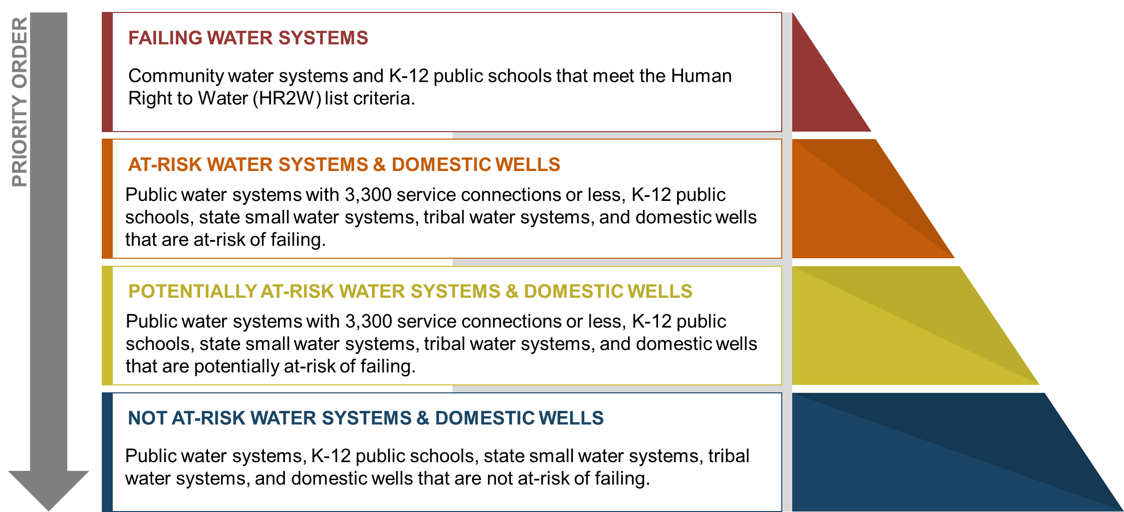
SAFER Program Priority Systems
CALIFORNIA WATER BOARDS SAFER PROGRAM
Notes:
The SAFER Program will utilize the results of the Risk Assessment to assist DDW and DFA in prioritizing systems for targeted technical and financial assistance. Priority from highest to lowest will be:
Human Right to Water Systems, those that are out of compliance for water quality contaminants
At-Risk public water systems, tribal water systems, state small water systems, and domestic wells
Potentially At-Risk public water systems, tribal water systems, state small water systems, and domestic wells
No At-Risk public water systems, tribal water systems, state small water systems, and domestic wells

Slide 16

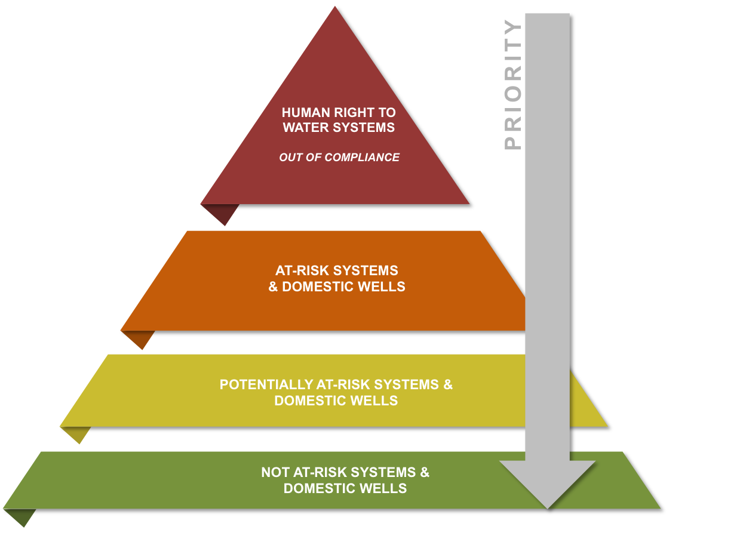




Needs Assessment Uses
NEEDS ASSESSMENT
Division of Financial Assistance (DFA)
Funding and TA Prioritization
Engagement Unit Services Rendered
Affordability Assessment
Annual Fund Expenditure Plan
Risk Assessment
Cost Assessment
CALIFORNIA WATER BOARDS SAFER PROGRAM
Notes:
Needs Assessment for Public Water Systems
Affordability Assessment
Risk Assessment – evaluates risk indicators that reflect water quality, accessibility, affordability, and TMF (technical, managerial, and financial capacity).
Cost Estimate for Interim and Long-Term Solutions – for all At-Risk Public Water Systems and Human Right to Water (HR2W) Systems

Slide 17
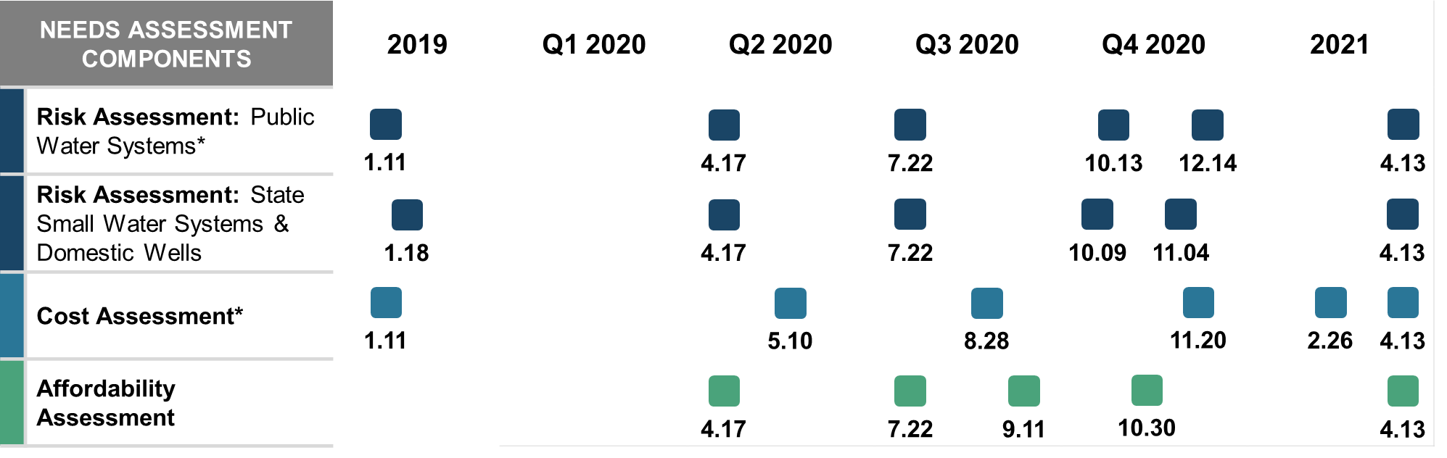
Needs Assessment Development
Access workshop recordings, white papers, and presentations here:
https://www.waterboards.ca.gov/drinking_water/certlic/drinkingwater/needs.html
CALIFORNIA WATER BOARDS SAFER PROGRAM
Notes:
Needs Assessment for Public Water Systems
Affordability Assessment
Risk Assessment – evaluates risk indicators that reflect water quality, accessibility, affordability, and TMF (technical, managerial, and financial capacity).
Cost Estimate for Interim and Long-Term Solutions – for all At-Risk Public Water Systems and Human Right to Water (HR2W) Systems

Slide 18
Needs Assessment Numbers and Dates
Different start dates, different data sets.
You will see a different numbers of systems that are on the HR2W list or At-Risk list within different components of the Needs Assessment.
This was due to the timing of the Needs Assessment in its inaugural year.
CALIFORNIA WATER BOARDS SAFER PROGRAM
Notes:
Needs Assessment for Public Water Systems
Affordability Assessment
Risk Assessment – evaluates risk indicators that reflect water quality, accessibility, affordability, and TMF (technical, managerial, and financial capacity).
Cost Estimate for Interim and Long-Term Solutions – for all At-Risk Public Water Systems and Human Right to Water (HR2W) Systems

Slide 19
Failing Water Systems:
HR2W List
CALIFORNIA WATER BOARDS SAFER PROGRAM

Slide 20
  Expanded Criteria for Failing Water Systems: HR2W List
Criteria | Before 3.2021 | After 4.2021
Primary MCL Violation with an open Enforcement Action | Yes | Yes
Secondary MCL Violation with an open Enforcement Action | Yes | Yes
E. Coli Violation with an open Enforcement Action | No | Yes
Treatment Technique Violations (in lieu of an MCL): One or more Treatment Technique violations (in lieu of an MCL), related to a primary contaminant, with an open enforcement action; and/or Three or more Treatment Technique violations (in lieu of an MCL), related to a primary contaminant, within the last three years. | Partially | Expanded
Monitoring and Reporting Violations (related to an MCL and TTs): 3 Monitoring and Reporting violations (related to an MCL) within the last three years where at least one violation has been open for 15 months or greater. | No | Yes
*Approximately 29 water systems have been added to the HR2W list with the expanded criteria.
CALIFORNIA WATER BOARDS SAFER PROGRAM
Notes:
Immediate Next Steps
Incorporate public feedback to refine List of Potential Risk Indicators and Evaluation Tool
Submit feedback to: SAFER@waterboards.ca.gov
Email Title: Public Water System Risk Assessment
Use Tool to evaluate risk indicators
Share results with the public - September/October webinar workshop
Determine final list of indicators for Risk Assessment 2.0 and begin exploring thresholds, weighting, and scoring approaches

Slide 21
  HR2W Map (4.12.2021)
331 water systems on the HR2W list.
29 of these systems meet the new expanded criteria.
The State Water Board maintains a SAFER Program map: https://www.waterboards.ca.gov/safer/safer_data.html
HR2W map: https://www.waterboards.ca.gov/water_issues/programs/hr2w/
CALIFORNIA WATER BOARDS SAFER PROGRAM
Notes:
Immediate Next Steps
Incorporate public feedback to refine List of Potential Risk Indicators and Evaluation Tool
Submit feedback to: SAFER@waterboards.ca.gov
Email Title: Public Water System Risk Assessment
Use Tool to evaluate risk indicators
Share results with the public - September/October webinar workshop
Determine final list of indicators for Risk Assessment 2.0 and begin exploring thresholds, weighting, and scoring approaches

Slide 22
  Providing Assistance to HR2W List Systems
Approximately 90% of the water systems on the HR2W list are progressing towards long-term solutions.
Reach out to the State Water Board if you’re looking for financial or technical assistance:
  Financial Assistance: https://bit.ly/3a6yFHj
  Technical Assistance: https://bit.ly/3uL3ole
CALIFORNIA WATER BOARDS SAFER PROGRAM
Notes:
Immediate Next Steps
Incorporate public feedback to refine List of Potential Risk Indicators and Evaluation Tool
Submit feedback to: SAFER@waterboards.ca.gov
Email Title: Public Water System Risk Assessment
Use Tool to evaluate risk indicators
Share results with the public - September/October webinar workshop
Determine final list of indicators for Risk Assessment 2.0 and begin exploring thresholds, weighting, and scoring approaches

Slide 23
  The Challenge
Approximately 47 unique water systems come on the HR2W list each year.
To be proactive, the State Water Board needed to develop an early warning approach to identify water systems that are at-risk of failing.
CALIFORNIA WATER BOARDS SAFER PROGRAM
Notes:
Immediate Next Steps
Incorporate public feedback to refine List of Potential Risk Indicators and Evaluation Tool
Submit feedback to: SAFER@waterboards.ca.gov
Email Title: Public Water System Risk Assessment
Use Tool to evaluate risk indicators
Share results with the public - September/October webinar workshop
Determine final list of indicators for Risk Assessment 2.0 and begin exploring thresholds, weighting, and scoring approaches

Slide 24
Risk Assessment Results:
Public Water Systems
Greg Pierce
Luskin Center for Innovation
University of California, Los Angles
CALIFORNIA WATER BOARDS SAFER PROGRAM

Slide 25
Public Water Systems Analyzed in the Risk Assessment
Water System Type | Number | Water Quality | Accessibility | Affordability | TMF Capacity
Public Water Systems* (≤ 3,300 connections) | 2,241 | Yes | Yes | Yes | Yes
K-12 Schools | 383 | Yes | Yes | No | Yes
Other Public Water Systems** | 155 | Yes | Yes | No | Yes
TOTAL ANALYZED: | 2,779
* Excluded Wholesalers.
** Included Transient Areas, Recreational Facilities, Hotels, Summer Camps, Prisons, Medical Facilities, Military Complexes
CALIFORNIA WATER BOARDS SAFER PROGRAM

Slide 26




Risk Assessment for Public Water Systems
RISK ASSESSMENT
METHODOLOGY
Public Water System
19 RISK INDICATORS
Quantifiable measurements of key data used to assess a water system’s risk of becoming non-compliant with water quality standards.
Affordability
Accessibility
RISK INDICATOR THRESHOLDS
Water Quality
Values associated with a risk indicator that designates when a water system is more at-risk of becoming non-compliant with water quality standards.
TMF
WEIGHTS / SCORES
Application of weight to each risk indicator and indicator category – some are more critical than others in contributing to overall risk.
CALIFORNIA WATER BOARDS SAFER PROGRAM
Notes:
Risk Assessment Methodology for Public Water Systems
RISK INDICATORS: Quantifiable measurements of key data used to assess risk of becoming non-compliant with water quality standards.
THRESHOLDS: Values associated with a risk indicator that designates when a water system is more at-risk of failing.
WEIGHTS / SCORES: Application of weight to each risk indicator – as some may be deemed more critical than others in contributing to overall risk.
Today’s webinar is focused on Risk Indicators. Future 2020 webinars will focus on Thresholds and Weights / Scores.

Slide 27
Risk Indicators
Final list of 19 risk indicators selected from 129 proposed risk indicators through a stakeholder driven process.
WATER QUALITY
ACCESSIBILITY
AFFORDABILITY
TMF CAPACITY
E. Coli Presence
Increasing Presence of Water Quality Trends Towards MCL
Treatment Technique Violations
Past Presence on the HR2W List
Maximum Duration of High Potential Exposure (HPE)
Percentage of Sources Exceeding an MCL
Number of Sources
Absence of Interties
Water Source Types
DWR – Drought & Water Shortage Risk Assessment Results
Critically Overdrafted Groundwater Basin
% Median Household Income
Extreme Water Bill
% Shut-Offs
# of Service Connections
Operator Certification Violations
Monitoring and Reporting Violations
Significant Deficiencies
Extensive Treatment Installed
CALIFORNIA WATER BOARDS SAFER PROGRAM
Notes:
Risk Assessment Methodology for Public Water Systems
RISK INDICATORS: Quantifiable measurements of key data used to assess risk of becoming non-compliant with water quality standards.
THRESHOLDS: Values associated with a risk indicator that designates when a water system is more at-risk of failing.
WEIGHTS / SCORES: Application of weight to each risk indicator – as some may be deemed more critical than others in contributing to overall risk.
Today’s webinar is focused on Risk Indicators. Future 2020 webinars will focus on Thresholds and Weights / Scores.

Slide 28
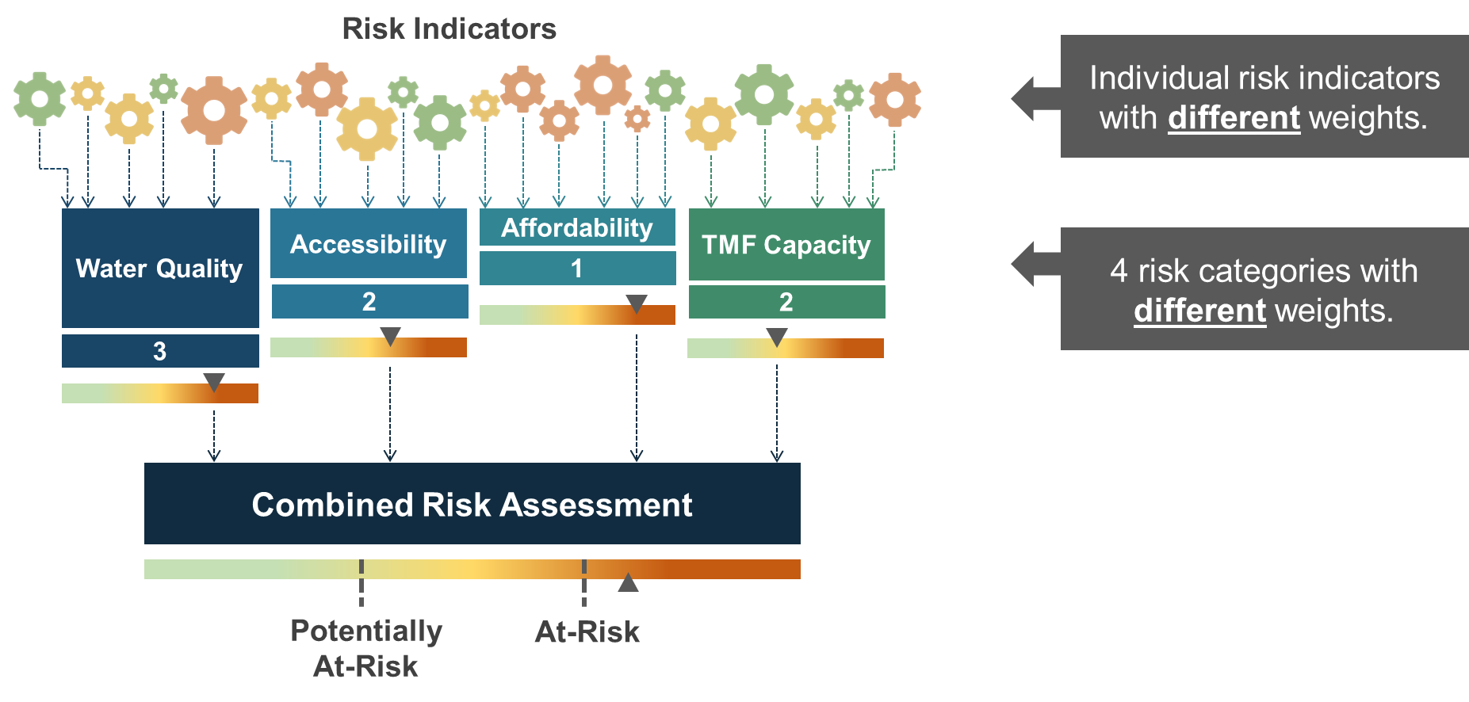
Aggregated Risk Assessment with Indicator & Category Weights
CALIFORNIA WATER BOARDS SAFER PROGRAM

Slide 29
  Risk Indicator Thresholds, Scores, and Weights (pg. 150)
To enable the evaluation and comparison of risk indicators, a standardized score range between 0 and 1 was applied to each risk indicator threshold.
Weights between 1 and 3 were applied to each risk indicator to indicate which risk indicators are comparatively more critical.
Example:
Risk Indicator | Thresholds | Raw Score | Weight | Total Risk Indicator Score
Maximum Duration of High Potential Exposure (HPE) | Threshold 0 = 0 years | 0 | N/A | 0
 | Threshold 1 = 1 year | 0.25 | 3 | 0.75
 | Threshold 2 = 2 years | 0.5 | 3 | 1.5
 | Threshold 3 = 3 or more years | 1 | 3 | 3
CALIFORNIA WATER BOARDS SAFER PROGRAM
Notes:
Immediate Next Steps
Incorporate public feedback to refine List of Potential Risk Indicators and Evaluation Tool
Submit feedback to: SAFER@waterboards.ca.gov
Email Title: Public Water System Risk Assessment
Use Tool to evaluate risk indicators
Share results with the public - September/October webinar workshop
Determine final list of indicators for Risk Assessment 2.0 and begin exploring thresholds, weighting, and scoring approaches

Slide 30
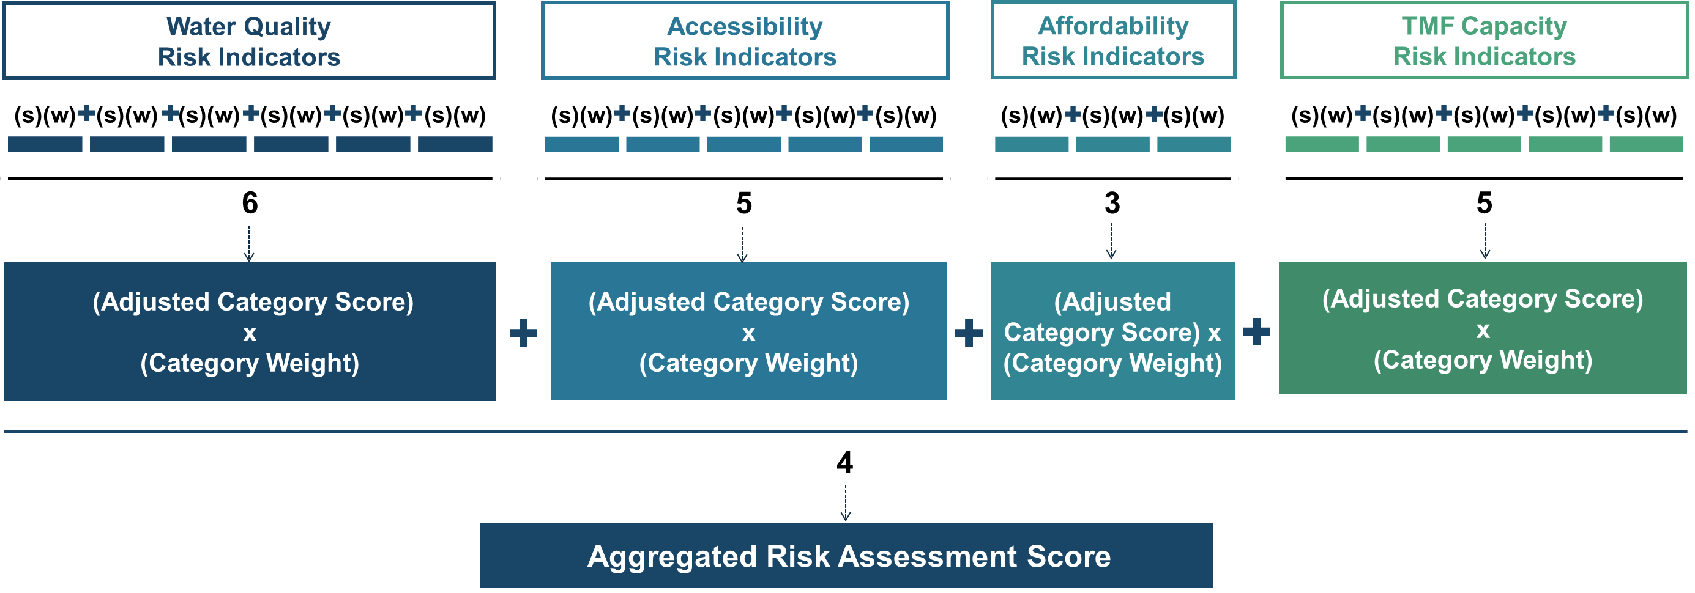
Aggregated Risk Assessment Calculation Methodology
CALIFORNIA WATER BOARDS SAFER PROGRAM

Slide 31
  Adjusting for Missing Risk Indicator Data
A system may have failed to report necessary data or the system may not have data to report.
The Risk Assessment removed any value for a missing risk indicator and re-distributed the scores/weights to risk indicators within the same category which did have valid values.
The same approach was used for risk indicator categories as well.
Risk Indicator Category
With No Missing Indicator
Risk Indicator Category
With Missing Indicator
1 | 1 | .5 | .25 | 0
5
1 | 1 | .5 | N/A | 0
4
CALIFORNIA WATER BOARDS SAFER PROGRAM

Slide 32
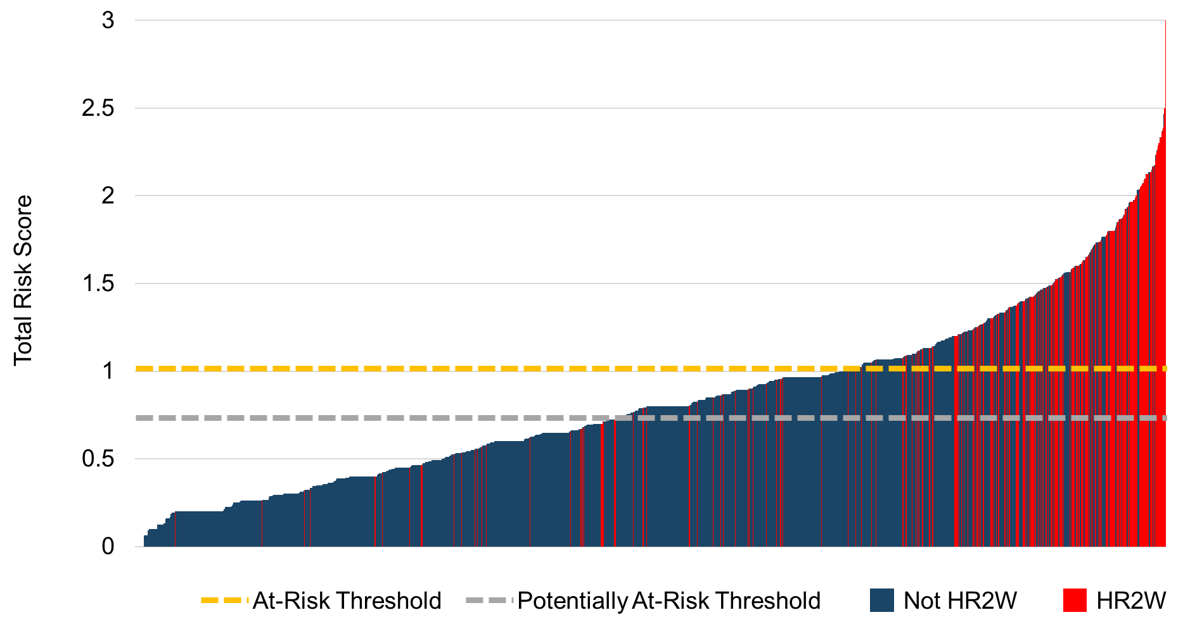
Risk Assessment: Aggregated Distribution of Weighted Scores
These thresholds were determined based on where the current and expanded HR2W systems started to cluster.
At-Risk (≥1)
Potentially At-Risk (0.75 ≤ x <1)
CALIFORNIA WATER BOARDS SAFER PROGRAM

Slide 33
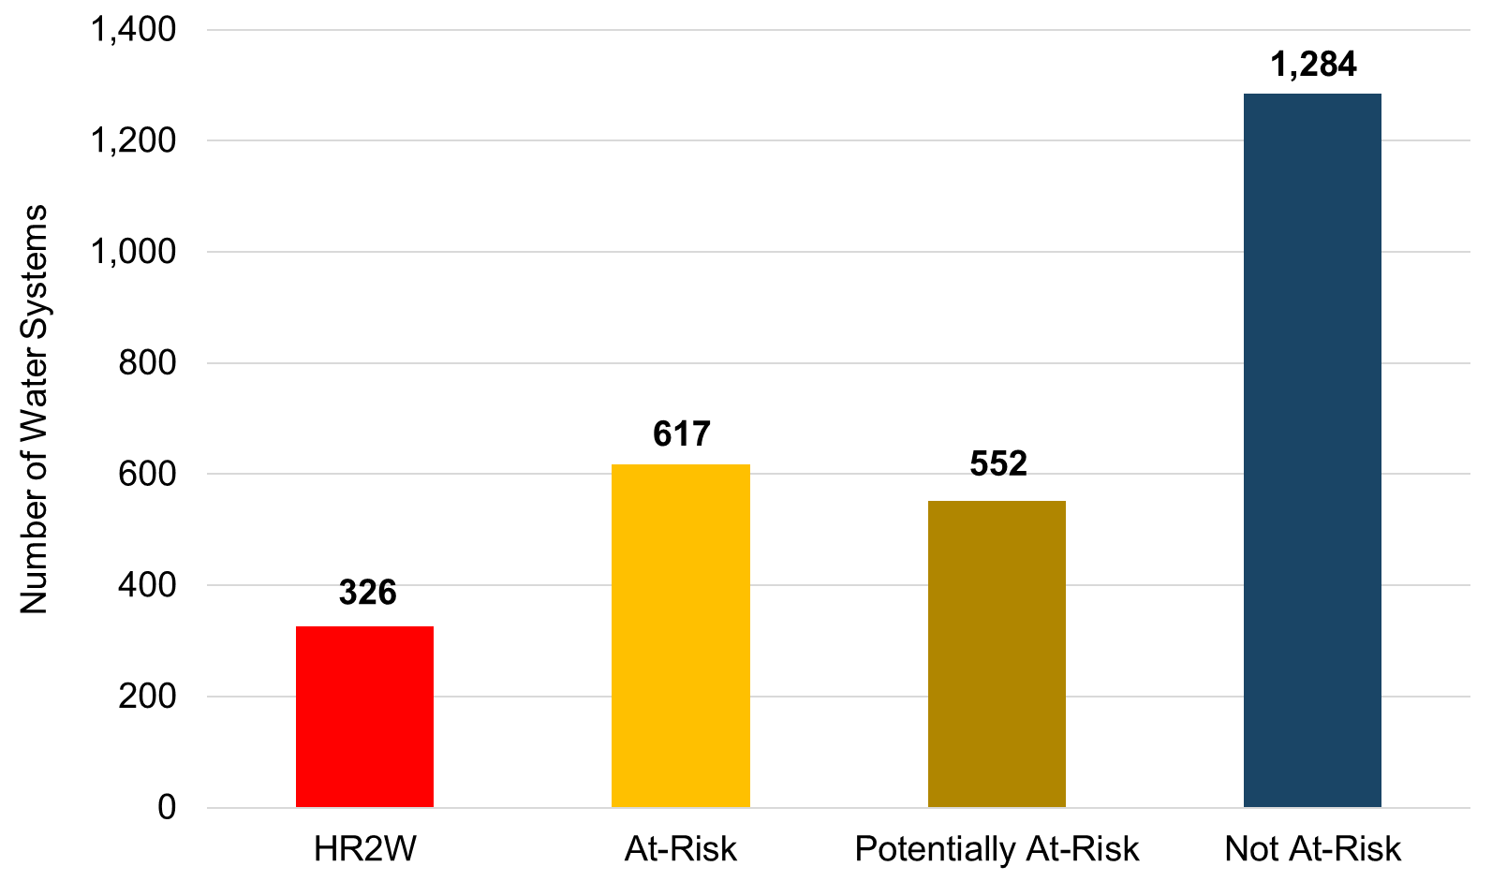
Risk Assessment Results (n=2,779)
CALIFORNIA WATER BOARDS SAFER PROGRAM

Slide 34
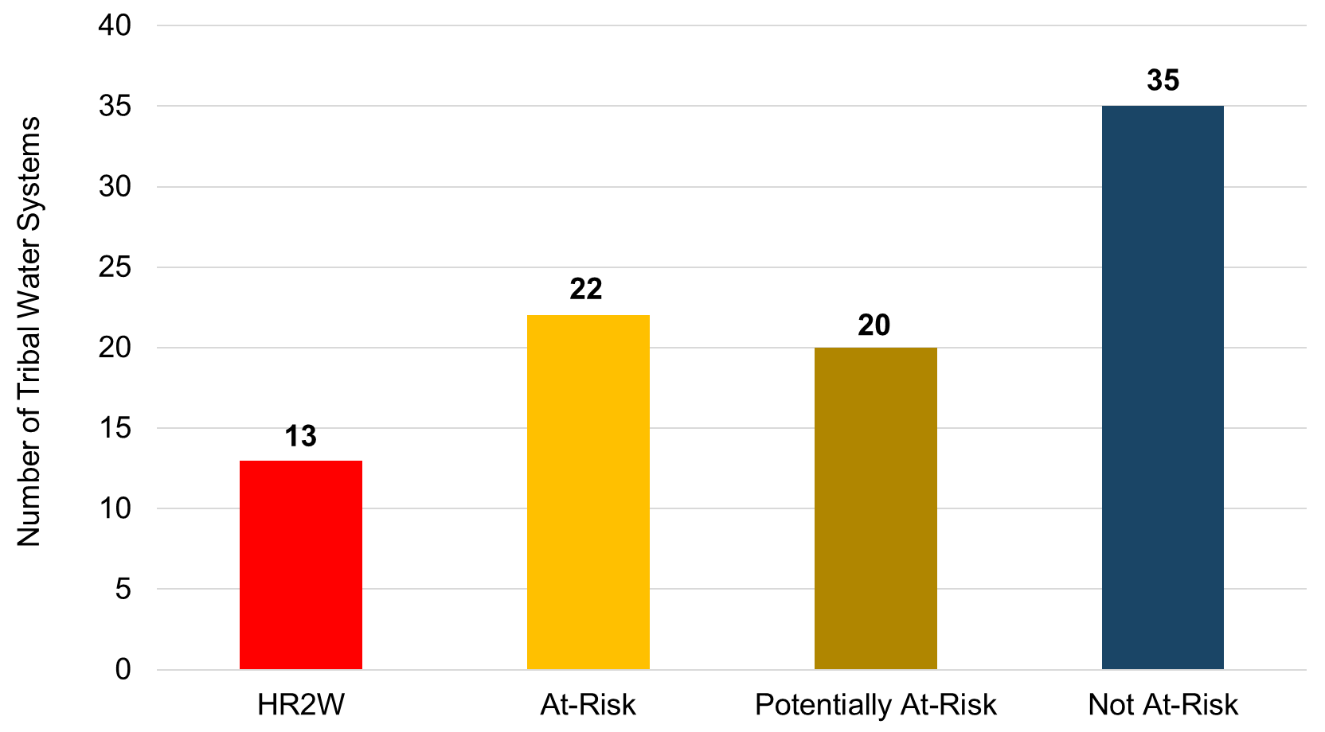
HR2W List & At-Risk Equivalent Tribal Water Systems
CALIFORNIA WATER BOARDS SAFER PROGRAM

Slide 35
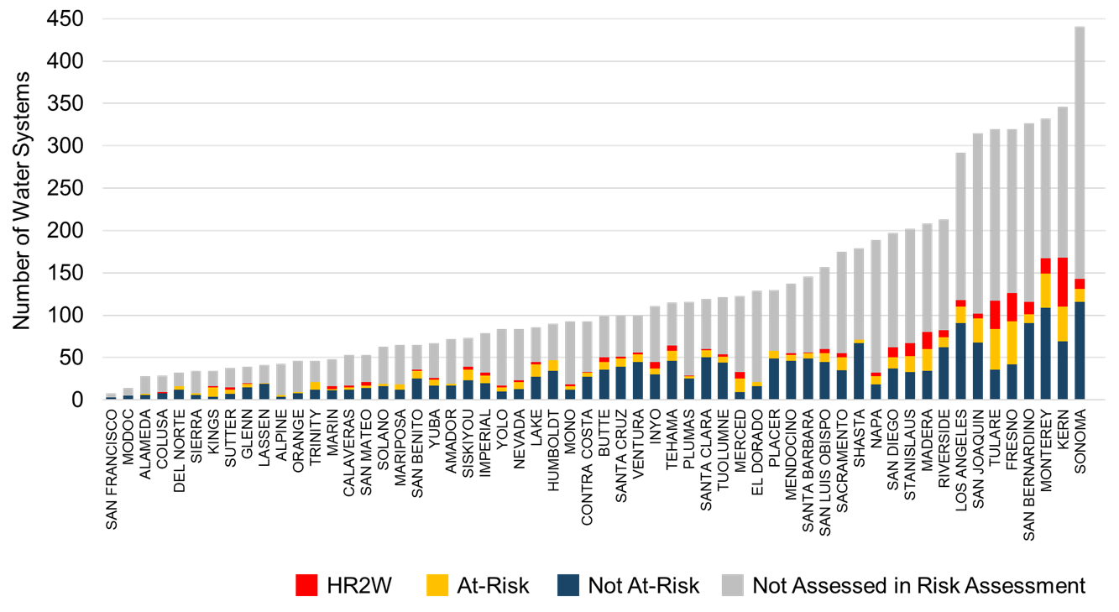
Risk Assessment Results by County, Proportional to All Systems
CALIFORNIA WATER BOARDS SAFER PROGRAM

Slide 36
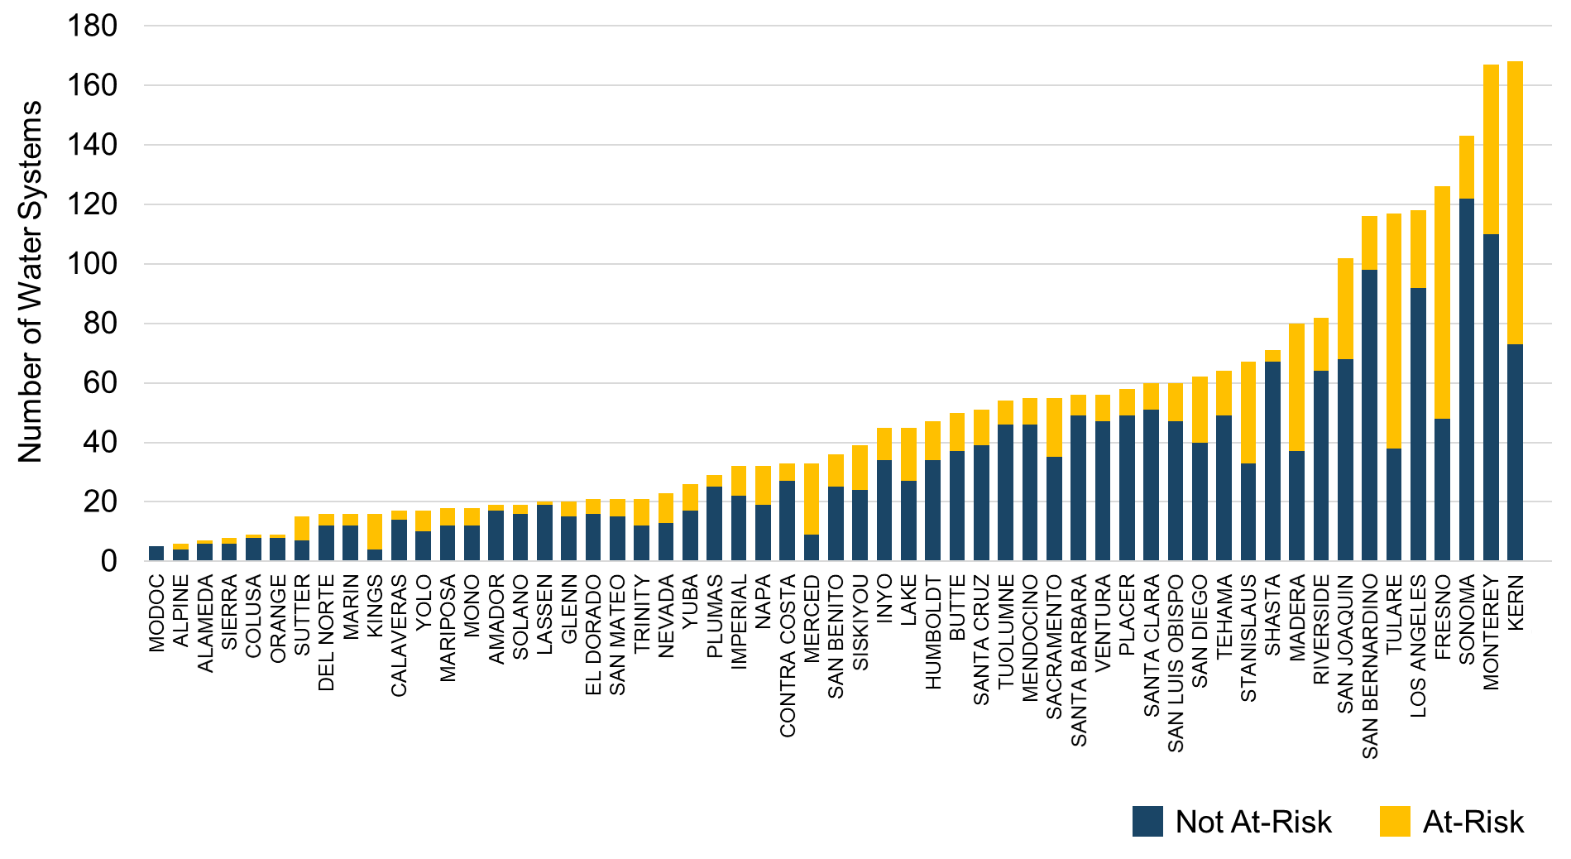
Risk Assessment Results by County
CALIFORNIA WATER BOARDS SAFER PROGRAM

Slide 37
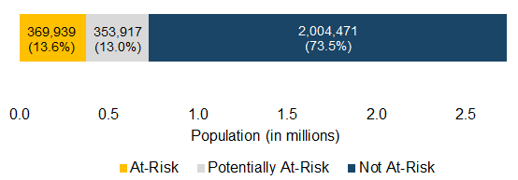
Population Served by At-Risk Water Systems
(3,300 service connections or less)*
* The Risk Assessment excluded large water systems that serve the majority of Californians.
CALIFORNIA WATER BOARDS SAFER PROGRAM

Slide 38
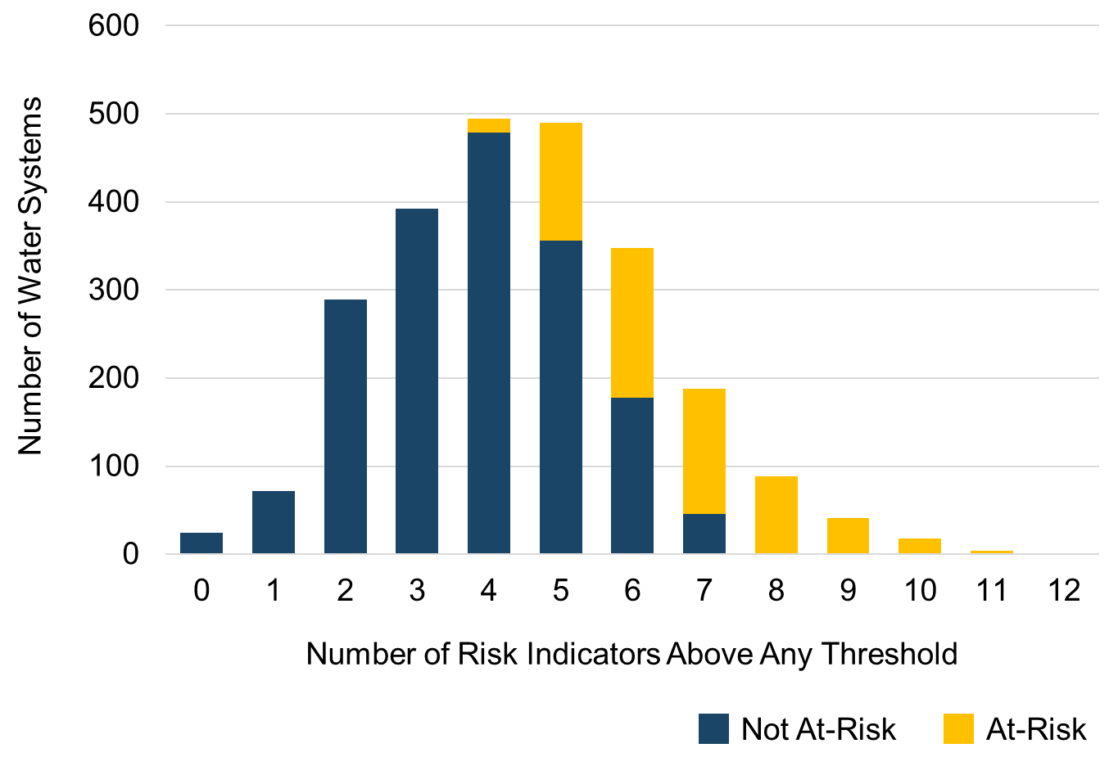
Distribution of the Number of Risk Indicator Thresholds Exceeded
All At-Risk systems exceed a threshold of concern for at least 4 risk indicators.
The average At-Risk system exceeded more than 6 risk indicator thresholds.
This means that systems were not designated as At-Risk based on a single or even a handful of risk indicators.
CALIFORNIA WATER BOARDS SAFER PROGRAM

Slide 39

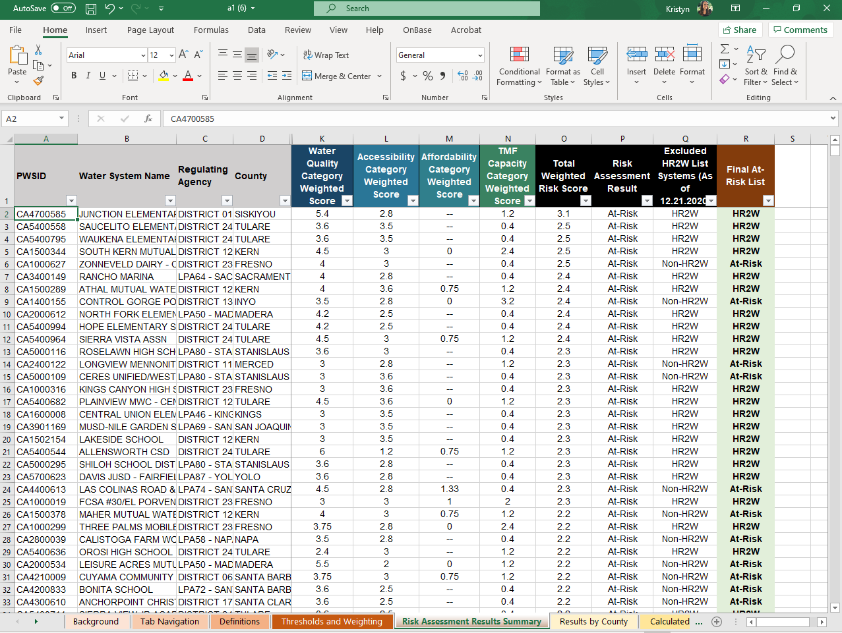
Access the At-Risk List and Raw Data
Download the Risk Assessment Results Spreadsheet to view the list of At-Risk public water systems:
https://bit.ly/3d0XxSF
This spreadsheet will be updated periodically with data refreshes.
CALIFORNIA WATER BOARDS SAFER PROGRAM

Slide 40
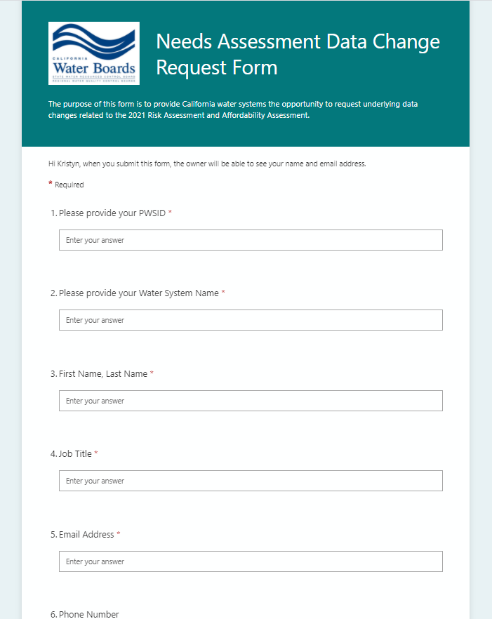
Water System Data Change Requests
See something that isn’t right? Water systems can submit a data change request here:
https://bit.ly/3t9XgTg
Requests will be reviewed by State Water Board staff.
CALIFORNIA WATER BOARDS SAFER PROGRAM

Slide 41
Risk Assessment Results:
State Small Water Systems & Domestic Wells
Emily Houlihan
GAMA Unit, Division of Water Quality
State Water Resources Control Board
CALIFORNIA WATER BOARDS SAFER PROGRAM

Slide 42
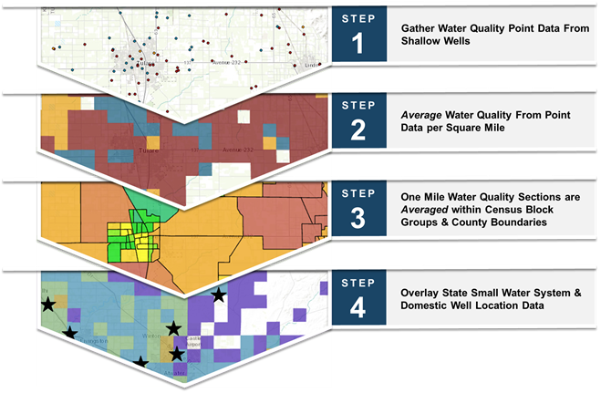
Summary of Risk Assessment Methodology for State Small Water Systems & Domestic Wells
CALIFORNIA WATER BOARDS SAFER PROGRAM

Slide 43
Data Processing
43
Water Quality Data
  Publicly-available data from both public and domestic wells
  Filter wells by depth
  Average results by year, well, and square mile section (de-clustering)
  Assess both long-term averages (20 year) and recent results
  Assess all constituents with an MCL, including Hexavalent Chromium
Domestic Well & State Small Water System Locations
  Domestic well density is from the Online System of Well Completion Records, excluding domestic wells drilled prior to 1970
  State small water system locations are from the Rural Community Assistance Corporation
CALIFORNIA WATER BOARDS SAFER PROGRAM
Notes:
Emily

Slide 44
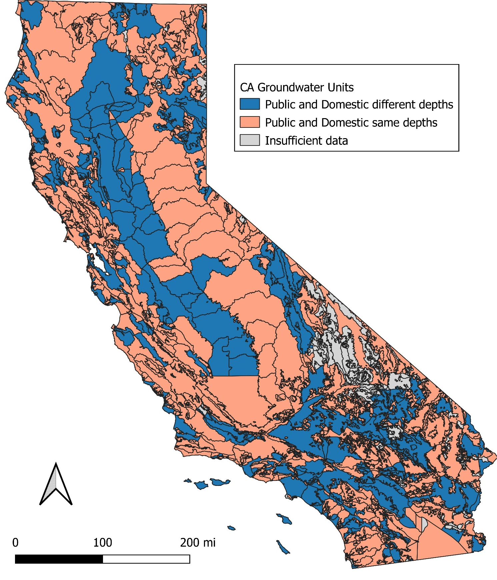
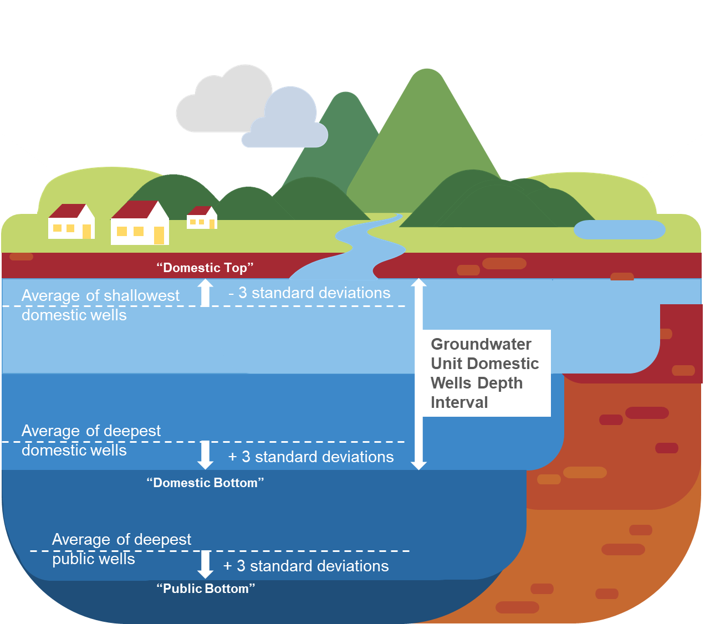
Depth Filter
CALIFORNIA WATER BOARDS SAFER PROGRAM
Notes:
Emily

Slide 45
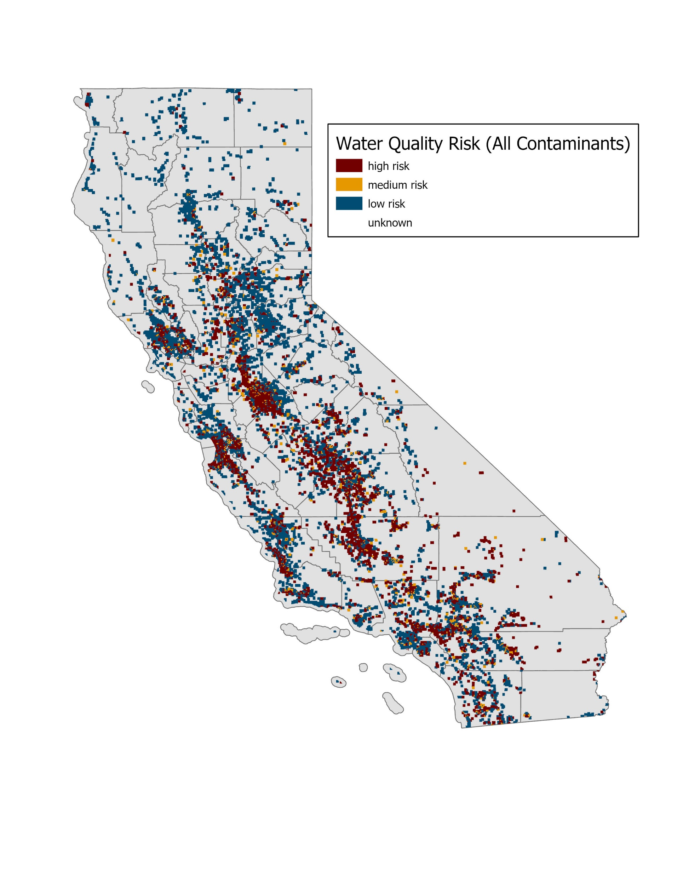
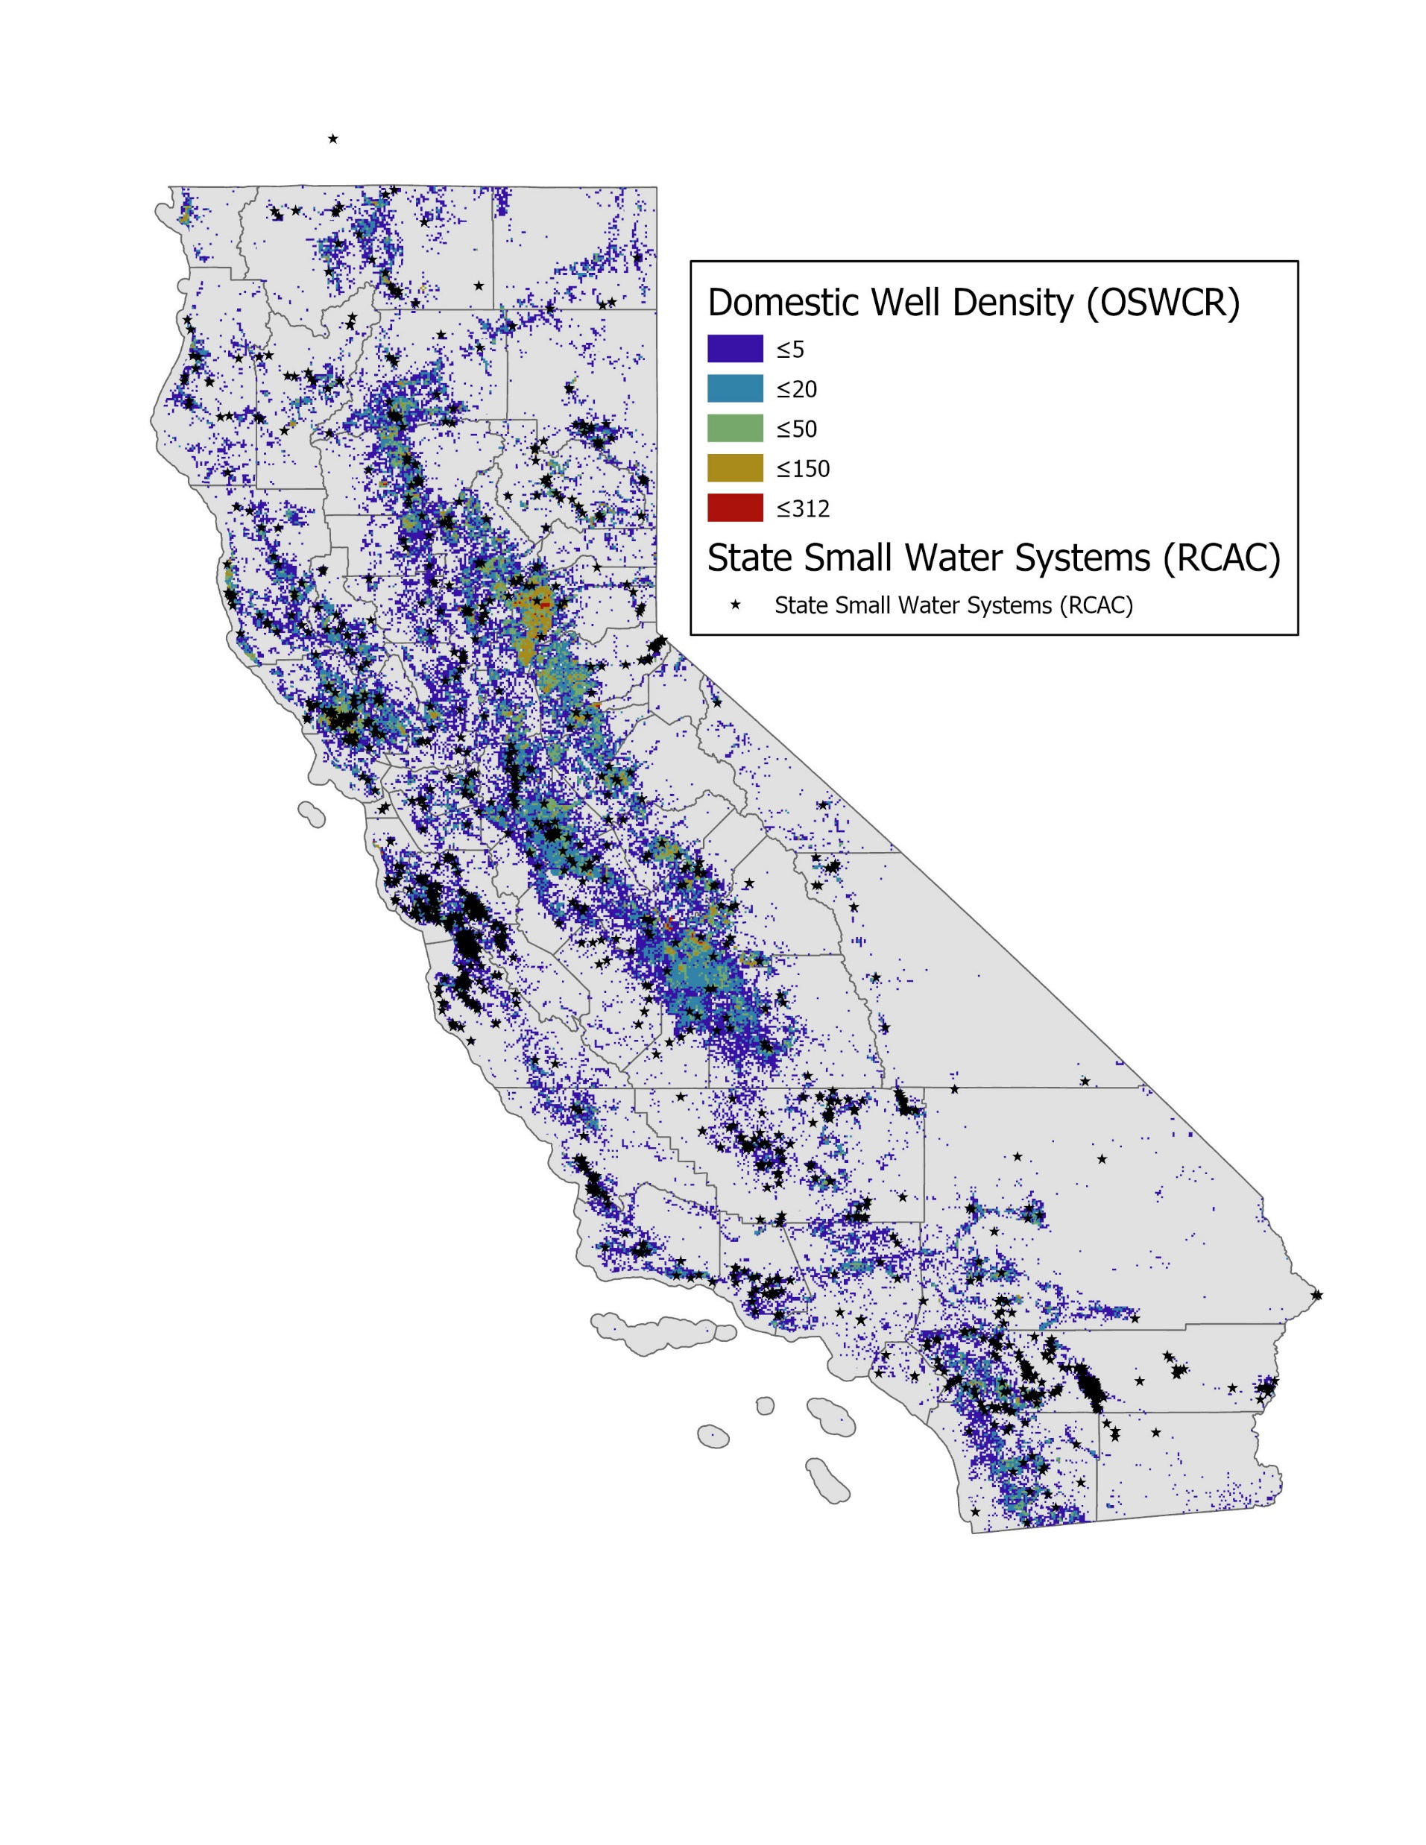
Risk Map Components – Water Quality and Domestic Well/State Small Water System Density
CALIFORNIA WATER BOARDS SAFER PROGRAM

Slide 46
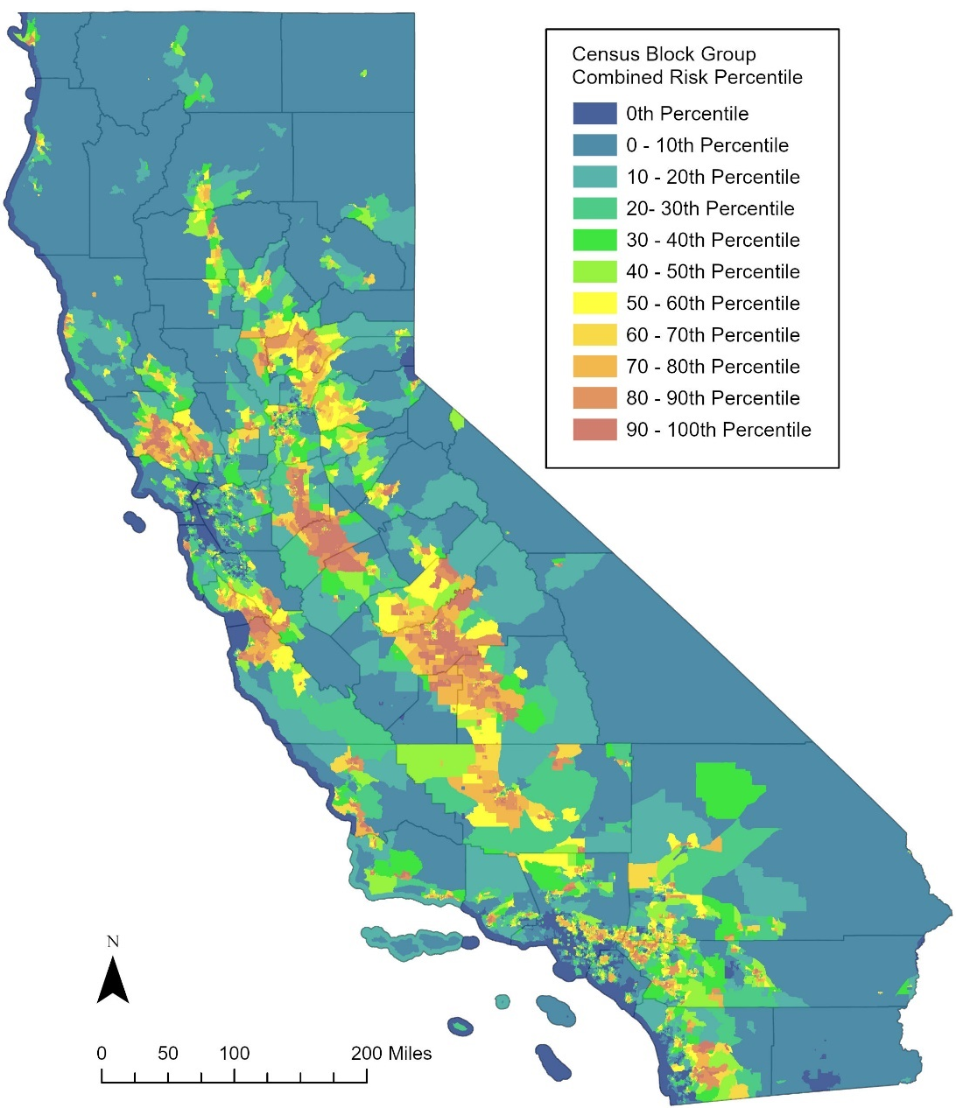
Risk Map for State Small Water Systems & Domestic Wells
Combines water quality results with density of state small water systems and domestic well users to estimate overall source water risk.
CALIFORNIA WATER BOARDS SAFER PROGRAM

Slide 47
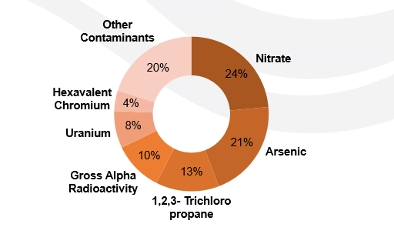
Top Contaminants
CALIFORNIA WATER BOARDS SAFER PROGRAM

Slide 48
Risk Assessment Results for State Small Water Systems & Domestic Wells
At-Risk = High Risk: Estimated water quality above Maximum Contaminant Level (MCL)
Medium Risk: Estimated water quality between 80 – 100% of MCL
Low Risk: Estimated water quality below 80% of MCL
Section Water Quality Risk Designation | Domestic Wells | State Small Water Systems
At-Risk = High Risk | 77,973 | 611
Medium Risk | 15,791 | 71
Low Risk | 147,185 | 554
No Data | 84,800 | 227
CALIFORNIA WATER BOARDS SAFER PROGRAM

Slide 49
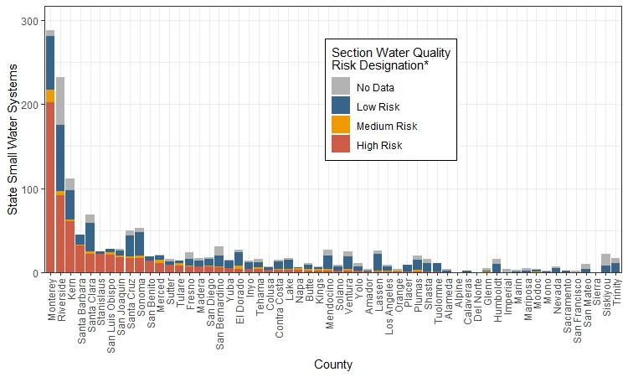
Results by County, State Small Water Systems
CALIFORNIA WATER BOARDS SAFER PROGRAM

Slide 50
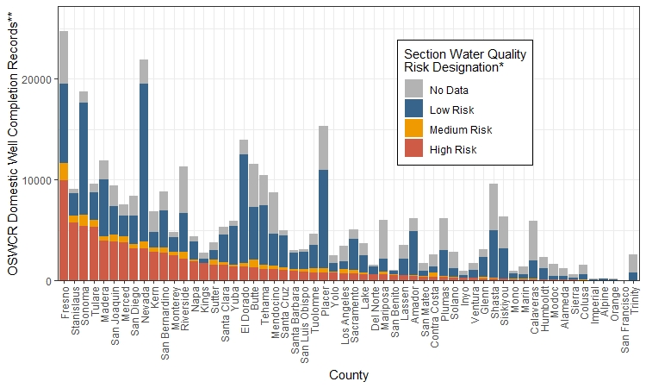
Results by County, Domestic Wells
CALIFORNIA WATER BOARDS SAFER PROGRAM

Slide 51
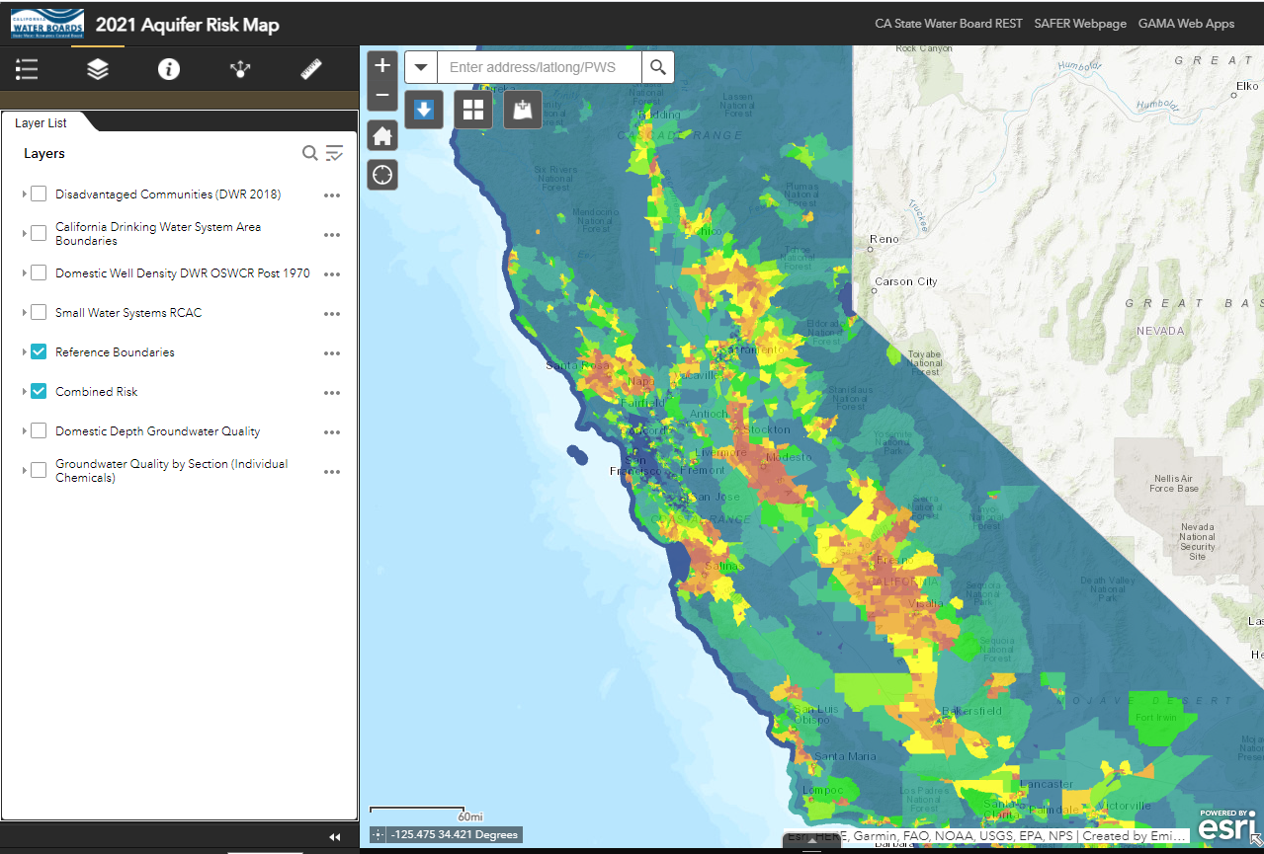
Check out the Aquifer Risk Map Tool
Explore the Aquifer Risk Map online and access the raw data:
https://bit.ly/323KFEZ
CALIFORNIA WATER BOARDS SAFER PROGRAM

Slide 52
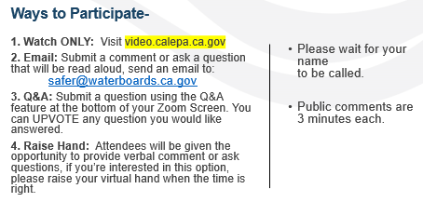
Discussion Topic: Risk Assessment
Do you have any questions or comments about the Risk Assessment Methodology and/or Results?

Slide 53
5 Minute Break
CALIFORNIA WATER BOARDS SAFER PROGRAM

Slide 54
Cost Assessment Model Results
Tarrah Henrie
Corona Environmental Consulting
CALIFORNIA WATER BOARDS SAFER PROGRAM

Slide 55
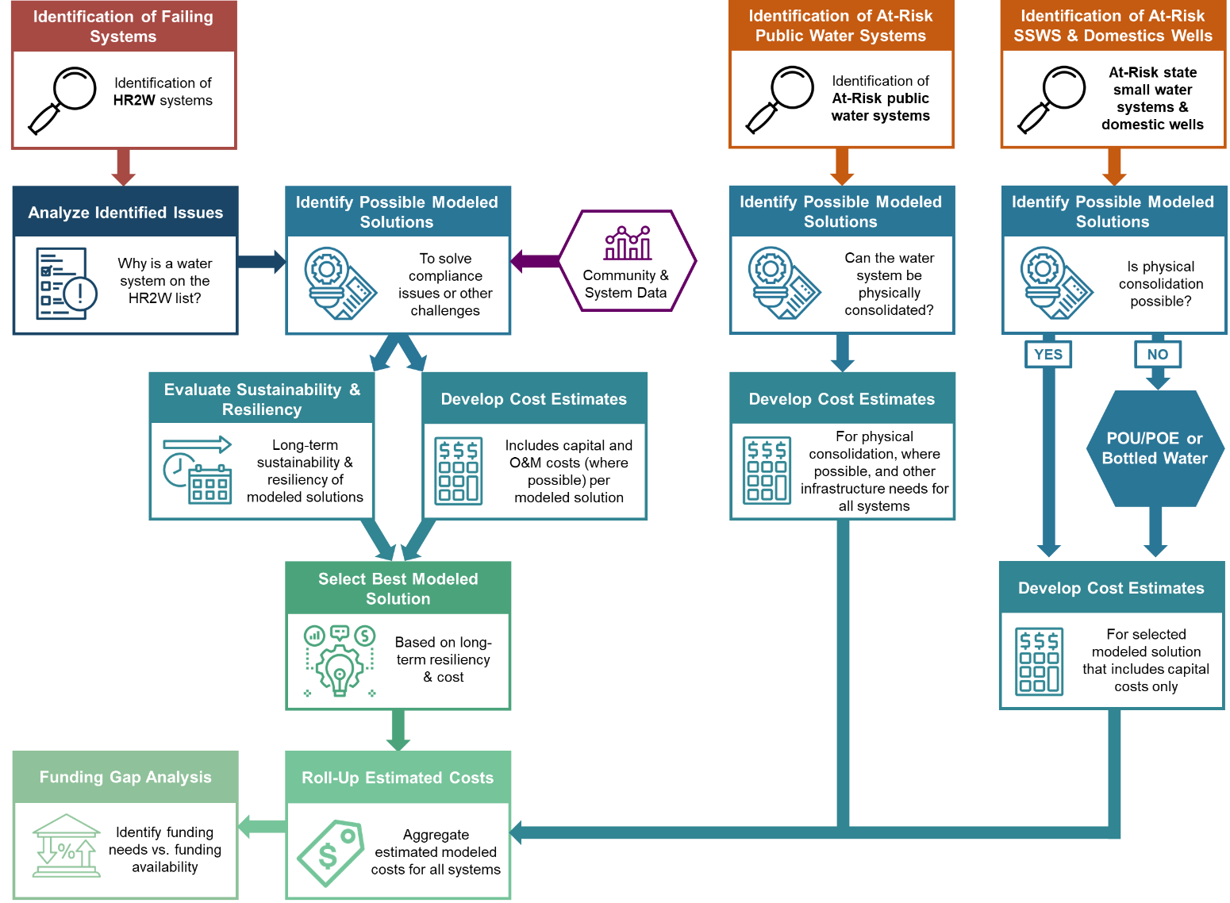
Cost Assessment Model Process Diagram (pg. 235)
CALIFORNIA WATER BOARDS SAFER PROGRAM

Slide 56





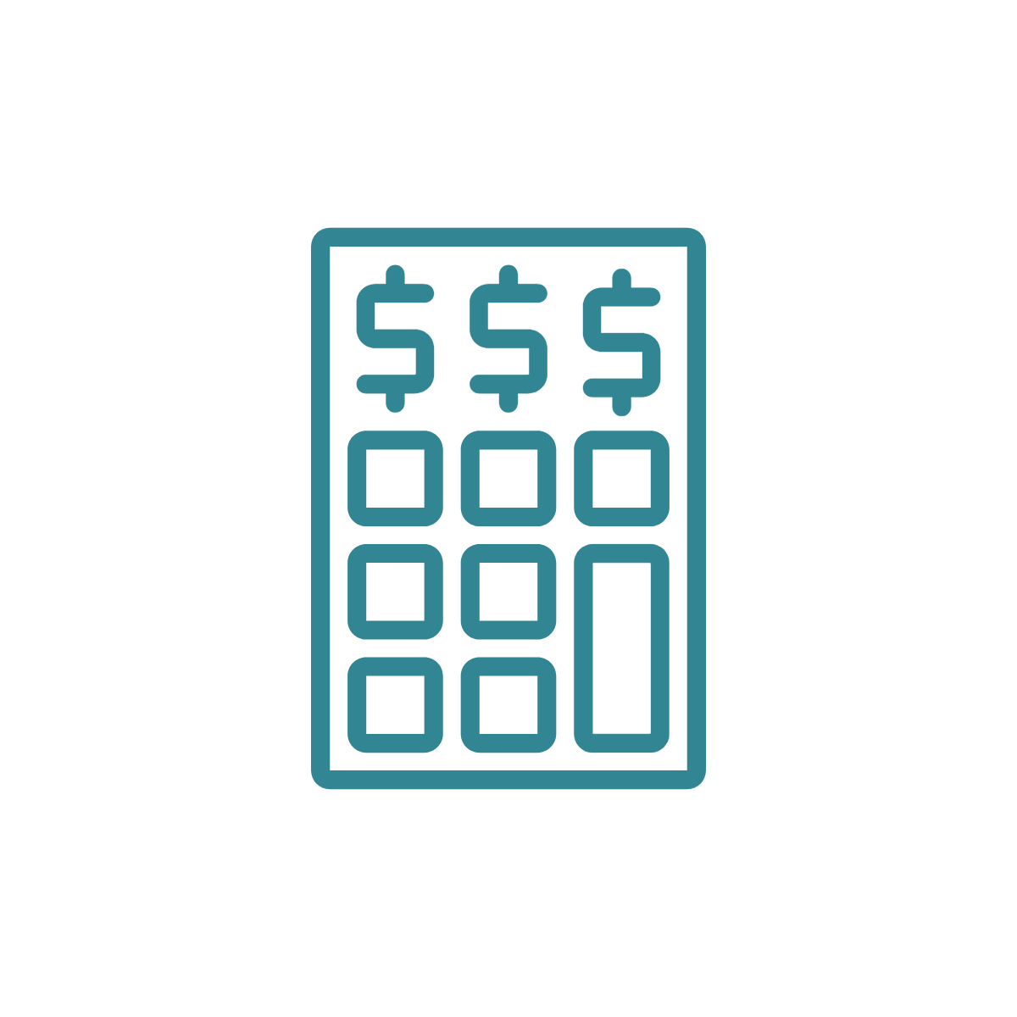



Cost Assessment Model Process for HR2W List Systems
STEP 1
Identification of HR2W Systems
STEP 2
Analyze Identified System Issues
STEP 3
Identify Possible Modeled Solutions
Community & System Data
STEP 4.a
Evaluate Long-Term Sustainability & Resiliency of Solutions
STEP 4.b
Develop Cost Estimates for Possible Solutions
STEP 7
Identify Funding Needs vs. Funding Gaps
STEP 6
Aggregate Estimated Modeled Costs for All Systems
STEP 5
Select Best Possible Solution for Each System
CALIFORNIA WATER BOARDS SAFER PROGRAM
Notes:
Needs Assessment for Public Water Systems
Affordability Assessment
Risk Assessment – evaluates risk indicators that reflect water quality, accessibility, affordability, and TMF (technical, managerial, and financial capacity).
Cost Estimate for Interim and Long-Term Solutions – for all At-Risk Public Water Systems and Human Right to Water (HR2W) Systems

Slide 57

Cost Assessment Model Process for At-Risk Public Water Systems
Identification of At-Risk Public Water Systems
Identify Possible Modeled Solutions
Develop Cost Estimates
Can the water system be physically consolidated?
For physical consolidation, where possible, and other infrastructure needs for all systems
Identification of At-Risk public water systems
Funding Gap Analysis
Roll-Up Estimated Costs
Identify funding needs vs. funding availability
Aggregate estimated modeled costs for all systems
CALIFORNIA WATER BOARDS SAFER PROGRAM
Notes:
Needs Assessment for Public Water Systems
Affordability Assessment
Risk Assessment – evaluates risk indicators that reflect water quality, accessibility, affordability, and TMF (technical, managerial, and financial capacity).
Cost Estimate for Interim and Long-Term Solutions – for all At-Risk Public Water Systems and Human Right to Water (HR2W) Systems

Slide 58
Cost Assessment Model Process for At-Risk State Small Water Systems (SSWS) and Domestic Wells
Identification of At-Risk SSWS & Domestic Wells
Identify Possible Modeled Solutions
POU/POE or Bottled Water
NO
Develop Cost Estimates
For physical consolidation, where possible, and other infrastructure needs for all systems
Identification of At-Risk SSWS & Domestic Wells
Is physical consolidation possible?
YES
Funding Gap Analysis
Roll-Up Estimated Costs
Identify funding needs vs. funding availability
Aggregate estimated modeled costs for all systems
CALIFORNIA WATER BOARDS SAFER PROGRAM
Notes:
Needs Assessment for Public Water Systems
Affordability Assessment
Risk Assessment – evaluates risk indicators that reflect water quality, accessibility, affordability, and TMF (technical, managerial, and financial capacity).
Cost Estimate for Interim and Long-Term Solutions – for all At-Risk Public Water Systems and Human Right to Water (HR2W) Systems

Slide 59
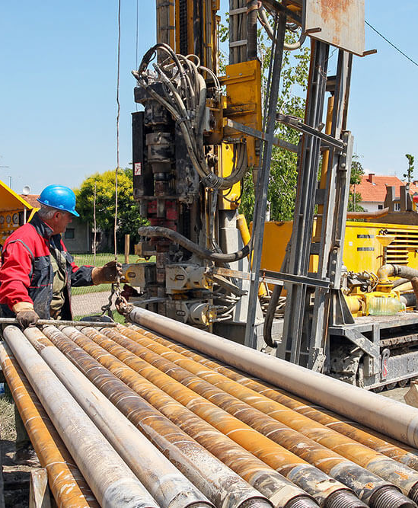
Potential Model Solutions Considered for HR2W List Systems
Physical Consolidation
Centralized Treatment
Point of Use / Point of Entry
Other Essential Infrastructure (i.e. storage tanks, new wells, upgraded electrical, distribution replacement, etc.)
Operations & Maintenance (O&M)
Interim or Emergency Solutions
Technical Assistance
CALIFORNIA WATER BOARDS SAFER PROGRAM

Slide 60
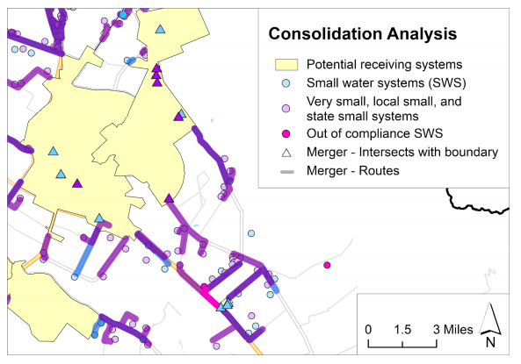
Physical Consolidation Modeling
Feasibility of one-to-one physical consolidation was based on connection to a nearby larger non-HR2W public water system within a maximum of a 3-mile area along public access roads.
SSWSs and domestic wells were analyzed for consolidation costs only if they were along the pipeline path of another HR2W list or an At-Risk consolidation.
CALIFORNIA WATER BOARDS SAFER PROGRAM

Slide 61
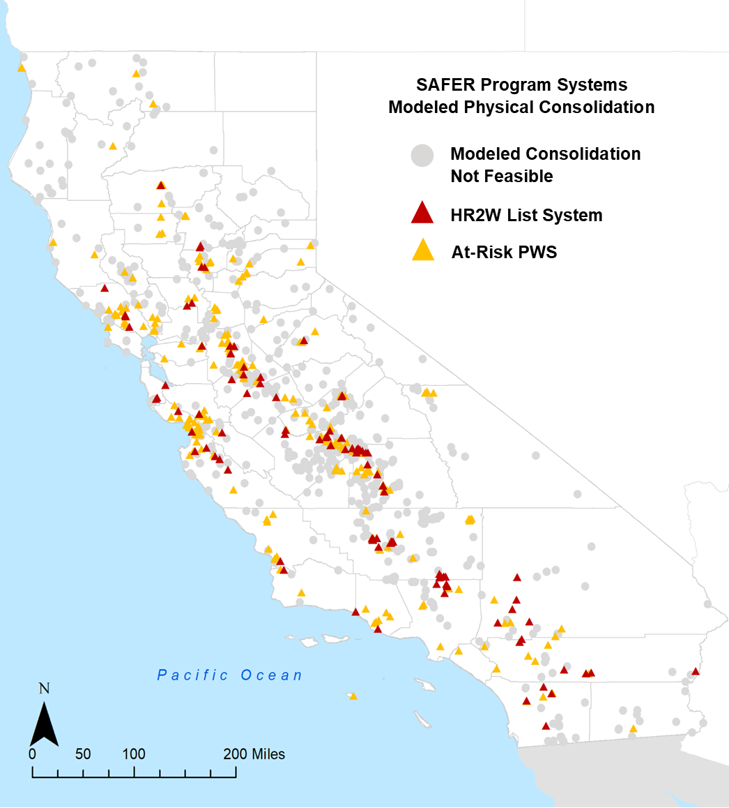
Potential Consolidation Map
Physical consolidation (one-to-one) was considered as a potential solution for 107 HR2W list systems and 234 At-Risk public water systems.
Significant potential cost savings can occur with regionalization as opposed to one-to-one consolidations. However, this analysis was not included in the aggregated cost estimate due to unknowns about boundary challenges and community acceptance.
CALIFORNIA WATER BOARDS SAFER PROGRAM

Slide 62
Number of Potential Solutions Considered by System Type
System Type | # of Systems | Treatment | Physical Consolidation | POU/POE | Other Essential Infrastructure & Technical Assistance
HR2W List | 305 | 305 (100%) | 107 (35%) | 194 (64%) | 305 (100%)
At-Risk PWS | 630 | N/A | 234 (37%) | N/A | 630 (100%)
At-Risk SSWS | 455 | N/A | 262 (58%) | 455 (100%) | N/A
At-Risk Domestic Wells | 62,607 | N/A | 25,696 (41%) | 62,607 (100%) | N/A
CALIFORNIA WATER BOARDS SAFER PROGRAM

Slide 63
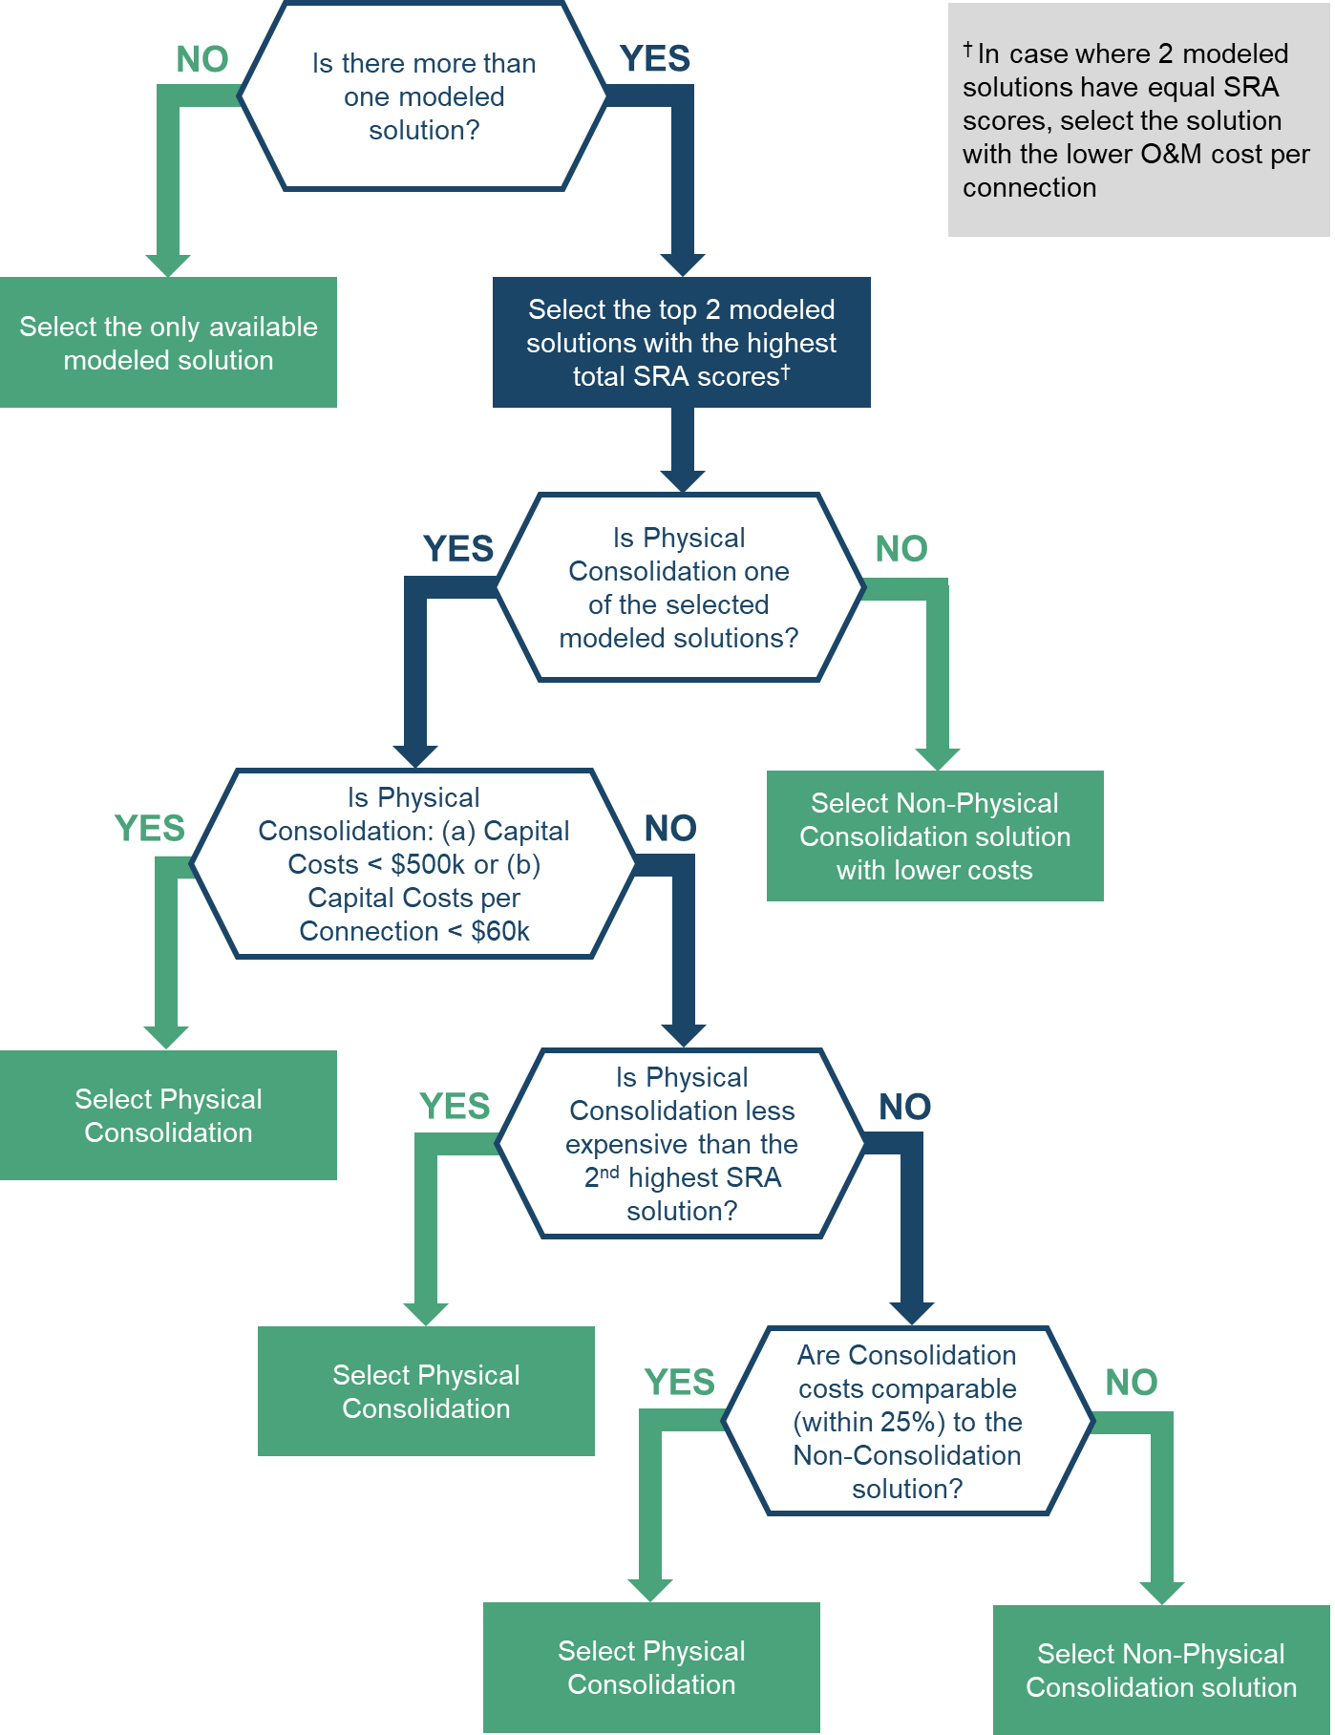
Selecting the Best Potential Model Solution for HR2W List Systems (pg. 270)
Model assessed BOTH the long-term sustainability and resiliency of each potential model solution per system and estimated cost.
Sustainability and Resiliency Assessment (SRA) analyzed:
  O&M Costs per Connection
  Relative Operational Difficulty
  Operator Training Requirements
  Waste Stream Generation
CALIFORNIA WATER BOARDS SAFER PROGRAM

Slide 64
Number of Selected Model Solutions by System Type
System Type | # of Systems | Treatment | Physical Consolidation | POU/POE | Other Essential Infrastructure & Technical Assistance | No Solution
HR2W List | 305 | 138 (45%) | 61 (20%) | 106 (35%) | 305 (100%) | 0
At-Risk PWS | 630 | N/A | 145 (23%) | N/A | 630 (100%) | 0
At-Risk SSWS | 455 | N/A | 142 (31%) | 303 (67%) | N/A | 10 (2%)
At-Risk Domestic Wells | 62,607 | N/A | 25,696 (41%) | 36,911 (59%) | N/A | 0
CALIFORNIA WATER BOARDS SAFER PROGRAM

Slide 65
Estimated Capital Costs by System Type
System Type | # of Systems | Total Capital Cost Range
HR2W List | 305 | $887 M - $3,550 M
At-Risk PWS | 630 | $819 M - $3,280 M
At-Risk SSWS | 445 | $27 M - $106 M
At-Risk Domestic Wells | 62,607 | $548 M - $2,190 M
TOTAL: |  | $2,280 M - $9,120 M
CALIFORNIA WATER BOARDS SAFER PROGRAM

Slide 66
Estimated HR2W Capital Costs by System Size (number of service connections)
System Type | 3,300+ | 3,300 – 1,001 | 1,000 – 501 | 500 – 101 | 100 or less
HR2W List | $4,900 | $6,800 | $11,700 | $18,200 | $86,900
HR2W List Annual O&M | $230 | $320 | $560 | $300 | $910
CALIFORNIA WATER BOARDS SAFER PROGRAM

Slide 67
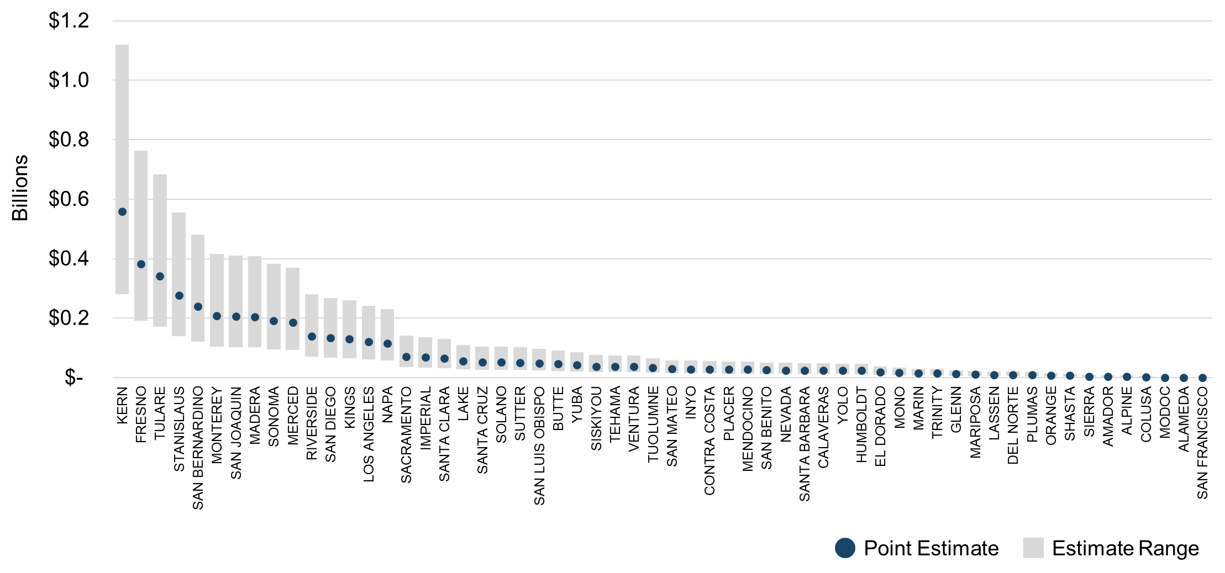
Total Long-Term Capital Costs by County
CALIFORNIA WATER BOARDS SAFER PROGRAM

Slide 68
Annual Long-Term O&M for HR2W List Systems
Cost Type | Treatment | POU/ POE | O&M Point Estimate Total | O&M Range Total
Total Cost | $52.4 M | $1.60 M | $54.1 M | $24.0 M - $108 M
Average Cost Per Connection | $780 | $1,500 | $2,280 | $1,140 - $4,560
CALIFORNIA WATER BOARDS SAFER PROGRAM

Slide 69
Estimated Interim Assistance Costs
System Type | Total Systems Analyzed | Total First Year Cost Estimate | NPW Cost of Duration* of Interim Solution
HR2W list | 343 | $216 M | $1,000 M
At-Risk SSWS | 496 | $18 M | $35 M
At-Risk Domestic Wells | 59,370 | $280 M | $547 M
TOTAL: |  | $514 M | $1,580 M
* 6 years for HR2W list systems and 9 years for At-Risk SSWS and domestic wells
CALIFORNIA WATER BOARDS SAFER PROGRAM

Slide 70
Tribal Water System Cost Estimate
The total estimated capital costs to address both the tribal equivalent HR2W list and At-Risk is $98.3 million.
The estimated O&M cost for the three tribal water systems associated with a treatment solution for equivalent HR2W list systems is $152,000 per year, or $10 million dollars for 20 years.
The total estimated 6-year tribal emergency/interim equivalent estimated costs were $6.7 million.
These cost estimates were NOT included in the Funding and Financing Gap Analysis.
CALIFORNIA WATER BOARDS SAFER PROGRAM

Slide 71
Funding & Financing Gap Analysis
Morgan Shimabuku
Pacific Institute
CALIFORNIA WATER BOARDS SAFER PROGRAM

Slide 72
Cost Assessment Model Process for HR2W Systems: Step 7
STEP 1
Identification of HR2W Systems
STEP 2
Analyze Identified System Issues
STEP 3
Identify Possible Modeled Solutions
Community & System Data
STEP 4.a
Evaluate Long-Term Sustainability & Resiliency of Solutions
STEP 4.b
Develop Cost Estimates for Possible Solutions
STEP 7
Identify Funding Needs vs. Funding Gaps
STEP 6
Aggregate Estimated Modeled Costs for All Systems
STEP 5
Select Best Possible Solution for Each System
CALIFORNIA WATER BOARDS SAFER PROGRAM
Notes:
Needs Assessment for Public Water Systems
Affordability Assessment
Risk Assessment – evaluates risk indicators that reflect water quality, accessibility, affordability, and TMF (technical, managerial, and financial capacity).
Cost Estimate for Interim and Long-Term Solutions – for all At-Risk Public Water Systems and Human Right to Water (HR2W) Systems

Slide 73


Funding Gap Analysis Objectives
Refine the estimated funding needed for modeled solutions for HR2W and At-Risk systems; and
Estimate the gap between the estimated needs and funding/financing availability.
These results help the State Water Board inform the broader demands of the SAFER Program as well as the annual funding needs for the Safe and Affordable Drinking Water Fund.
CALIFORNIA WATER BOARDS SAFER PROGRAM

Slide 74




Overview of the Funding Gap Analysis Methodology
STEP 1
STEP 2
STEP 3
Determine Estimated Funding Needs and Funding Availability
Match Estimated Funding Needs to Funding Programs
Determine Funding Gaps & Estimate Time to Meet Funding Needs
Physical Consolidation $
Tier 1 Priorities
Estimated Funding Needs
Treatment $
O&M $
Estimated Funding Availability
Interim & Emergency $
Tier 2 Priorities
Technical Assistance $
CALIFORNIA WATER BOARDS SAFER PROGRAM

Slide 75
Funding Gap Analysis Methodology: Step 1
STEP 1
Determine Estimated Funding Needs & Funding Availability
Cost Assessment modeled solution estimates for HR2W & At-Risk systems
Remove needs that have already been addressed & may be covered by local cost share
Estimate potential funding needs over 1 yr. & 5 yr. time periods
Estimated Funding Needs
Identify potential State & Federal funding programs
Determine potential funding program eligibilities to support modeled solutions
Estimate potential funding availability over 1 yr. & 5 yr. time periods
Estimated Funding Availability
CALIFORNIA WATER BOARDS SAFER PROGRAM

Slide 76
Cumulative Projected Number of Systems
5-Year Inventory of Projected Projects
System Type | 2021 | Projected* 5-Year Total
HR2W list | 326 | 540 (47 new/yr.)
At-Risk PWS | 617 | 1,200 (95 new/yr.)
At-Risk SSWSs | 611 | 611 (no change)
At-Risk domestic wells | 78,000 | 78,000 (no change)
* Projected “new” HR2W list and At-Risk systems are assigned the same proportion of modeled cost needs and community economic status.
CALIFORNIA WATER BOARDS SAFER PROGRAM

Slide 77


Developing Refined 5-Year Cost Estimates (1/4)
Grant eligibilities are based on established State Water Board policies that examine project needs, community size, and community economic status (DAC/SDAC).
GRANT ELIGIBLE
NOT GRANT ELIGIBLE
(Local Cost Share)
Total Long-Term Solution Cost
(Capital and O&M)
CALIFORNIA WATER BOARDS SAFER PROGRAM

Slide 78

Developing Refined 5-Year Cost Estimates (2/4)
Loan eligibilities are based on established State Water Board policies that examine project needs, community size, and community economic status (DAC/SDAC).
STATE WATER BOARD (SWB) LOAN ELIGIBLE
NOT SWB LOAN ELIGIBLE
Total Long-Term Solution Costs NOT GRANT ELIGIBLE
(Local Cost Share)
CALIFORNIA WATER BOARDS SAFER PROGRAM

Slide 79
Developing Refined 5-Year Cost Estimates (3/4)
Additional Solution Implementation Costs:
Capital costs met by a SWB or private loan will have interest payment costs.
O&M costs (not covered by grant)
+
Total Long-Term Solution Costs NOT GRANT ELIGIBLE
Local Cost Share
Additional Solution Implementation Costs
(Local Cost Share)
CALIFORNIA WATER BOARDS SAFER PROGRAM

Slide 80

Developing Refined 5-Year Cost Estimates (4/4)
Grant Eligible Costs: $3.25 Billion
Solutions implementation costs potentially covered by SWB.
$10.25 Billion
Local Cost Share = $7 Billion Solution implementation costs borne by water system customers or private well owners.
  $4.05 Billion Eligible for SWB Loans
  $2.95 Billion Not Eligible for SWB Loans (capital costs, includes O&M, interest payments)
+
Total 5-Year Unrefined Long-Term & Interim Solution Costs
Total 5-Year Refined Long-Term & Interim Solutions Costs
CALIFORNIA WATER BOARDS SAFER PROGRAM

Slide 81
5-Year Funding and Financing Availability ($ in Millions)
State Water Board Fund | Yr. 1 Est. Fund Size | Cumulative Est. 5-Yr. Fund Size
Safe and Affordable Drinking Water Fund (SADWF) (Grant) | $137 | $593
Drinking Water State Revolving Fund (DWSRF) (Grant) | $120 | $320
DWSRF Loan Capacity | $ 300 | $ 1,500
Small Community Drinking Water Funding Program (Grant) | $275 | $275
Emergency Drinking Water/Cleanup & Abatement Account Programs – Urgent Drinking Water Needs Projects (Grant) | $9 | $9
Water Board Household & Small Water System Drought Assistance Program; CAA – DW Well Replacement Program (Grant) | $0.861 | $0.861
Water System Administrator Program (Grant) | $8 | $8
TOTAL: | $850 M | $2,710 M
CALIFORNIA WATER BOARDS SAFER PROGRAM

Slide 82
Estimating Funding Availability: Non-SWRCB Funds
Non-SWRCB loan and grant programs that may be available to support SAFER projects have been identified (pg. 293)
A rough estimate of the aggregate, non-SWRCB funds potentially available to leverage with SWRCB funding in the future is provided.
Non-SWRCB funds were not incorporated into the Gap Analysis.
U.S. EPA
U.S. USDA
DWR
USBR
CALIFORNIA WATER BOARDS SAFER PROGRAM

Slide 83
Funding Gap Analysis Methodology: Step 2
STEP 2
Match Estimated Funding Needs to Funding Programs
HR2W & At-Risk
HR2W & At-Risk
Physical Consolidation $
Physical Consolidation $
Treatment $
Treatment $
DWSRF
O&M $
DAC/SDAC: HR2W
Interim & Emergency $
SADWF
DAC/SDAC: At-Risk
Technical Assistance $
Interim & Emergency $
Emergency DW Account
CALIFORNIA WATER BOARDS SAFER PROGRAM

Slide 84

Funding Gap Analysis Methodology: Step 3
STEP 3
Determine Funding Gaps & Estimate Time to Meet Funding Needs
Funding Gap Based on SAFER Program Priorities
Time
Time
Tier 1 Priorities
Tier 2 Priorities
HR2W: Primary Violations $
HR2W: Secondary Violations $
HR2W & At-Risk: Consolidation $
At-Risk Non-Consolidation $
Interim & Emergency $
All Eligible
Funding Programs
Technical Assistance & O&M $
All Eligible
Funding Programs
CALIFORNIA WATER BOARDS SAFER PROGRAM

Slide 85
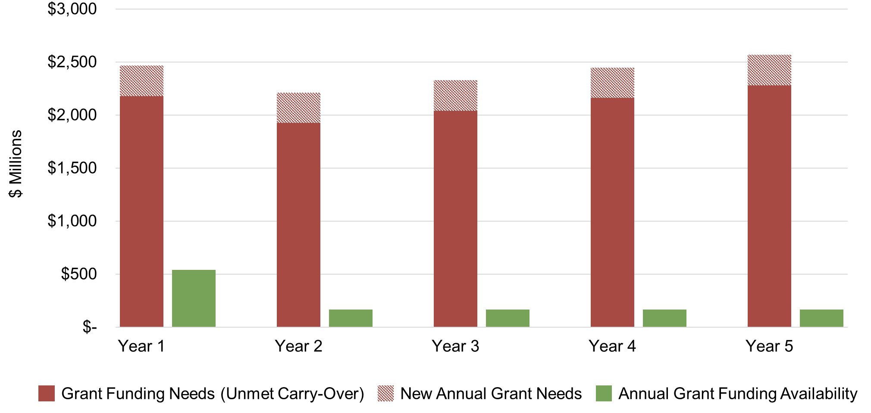
5-Year Cumulative Grant Funding Needs & Funding Availability
CALIFORNIA WATER BOARDS SAFER PROGRAM

Slide 86
Funding and Financing Gap Analysis Results Summary
When compared to the 5-year State Water Board grant and loan funds availability ($2.7 billion), there is a:
  Grant funding gap of $2.05 billion; and
  Financing (loan) gap of $2.55 billion.
$2.95 billion is not eligible for State Water Board loan or grant.
However; it is important to highlight that some of these needs may be met by other State and Federal funding programs. These programs have their own eligibility requirements and are outside the control of the State Water Board.
CALIFORNIA WATER BOARDS SAFER PROGRAM

Slide 87
Discussion Topic: Cost Assessment & Gap Analysis
Do you have any questions or comments about the Cost Assessment & Gap Analysis Methodology and/or Results?

Slide 88
Affordability Assessment Results
Kristyn Abhold
Needs Analysis Unit, SAFER Section
Division of Drinking Water
State Water Resources Control Board
CALIFORNIA WATER BOARDS SAFER PROGRAM

Slide 89

Affordability Assessment Purpose
Identify disadvantaged community water systems, that have instituted customer charges that exceed the “Affordability Threshold” established by the State Water Board in order to provide drinking water that meets State and Federal standards.
Legislation does not define what the Affordability Threshold should be. Nor is there specific guidance on the perspective in which the State Water Board should be assessing the Affordability Threshold.
CALIFORNIA WATER BOARDS SAFER PROGRAM

Slide 90
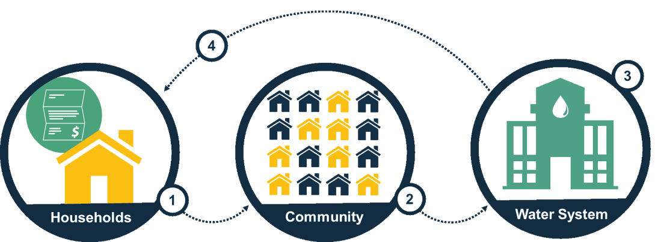
Nexus of Affordability Definitions
Household Affordability: The ability of individual households to pay for an adequate supply of water.
Community Affordability: The ability of households within a community to pay for water services to financially support a resilient water system.
& (4) Water System Financial Capacity: The ability of the water system to financially meet current and future operations and infrastructure needs to deliver safe drinking water. The financial capacity of water systems affects future rate impacts on households.
CALIFORNIA WATER BOARDS SAFER PROGRAM

Slide 91
Affordability Indicators and Thresholds
% Median Household Income: average residential customer charges for 6 hundred cubic feet per month meet or exceed 1.5% (min. thresholds) or 2.5% (max. threshold) of the annual Median Household Income within a water system’s service area.
Extreme Water Bill: customer charges that meet or exceed 150% (min. threshold) or 200% (max. threshold) of statewide average drinking water customer charges at the 6 hundred cubic feet level.
% Shut-Offs: 10% or more of a water system’s residential customer base experienced service shut-offs due to non-payment in 2019.
CALIFORNIA WATER BOARDS SAFER PROGRAM

Slide 92
Water Systems Assessed: Community Water Systems
SAFER Program Status | Risk Assessment | Affordability Assessment
HR2W List System | 326 | 276
At-Risk Public Water System | 617 | 467
Not HR2W or At-Risk System | 1,836 | 2,134
TOTAL: | 2,779 | 2,877
State Small Water Systems and Domestic Wells were NOT included in the Affordability Assessment.
CALIFORNIA WATER BOARDS SAFER PROGRAM

Slide 93
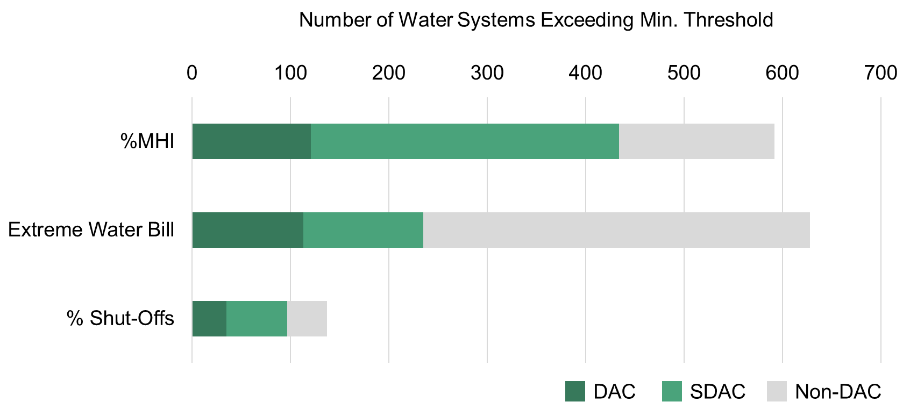
Results per Affordability Indicator, Exceeding Min. Affordability Threshold
121
313
113
122
35
62
CALIFORNIA WATER BOARDS SAFER PROGRAM

Slide 94
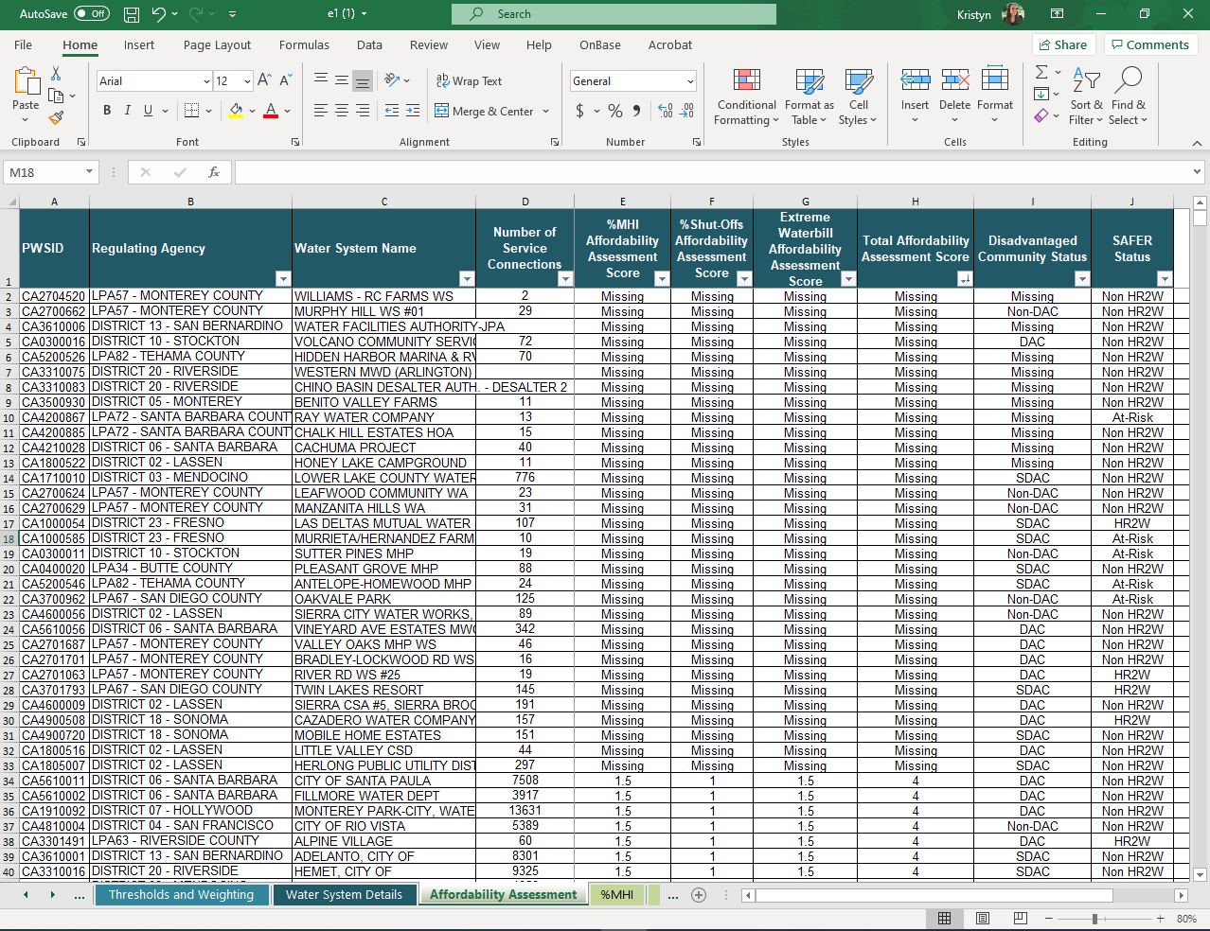
Access the Affordability Assessment Results and Raw Data
Download the Affordability Assessment Results Spreadsheet:
https://bit.ly/3d3jmkC
This spreadsheet will be updated periodically with data refreshes.
CALIFORNIA WATER BOARDS SAFER PROGRAM

Slide 95
Water System Data Change Request
See something that isn’t right? Water systems can submit a data change request here:
https://bit.ly/3t9XgTg
Requests will be reviewed by State Water Board staff.
CALIFORNIA WATER BOARDS SAFER PROGRAM

Slide 96
Conclusions
CALIFORNIA WATER BOARDS SAFER PROGRAM
Notes:
Kristyn reintroduces Itze

Slide 97
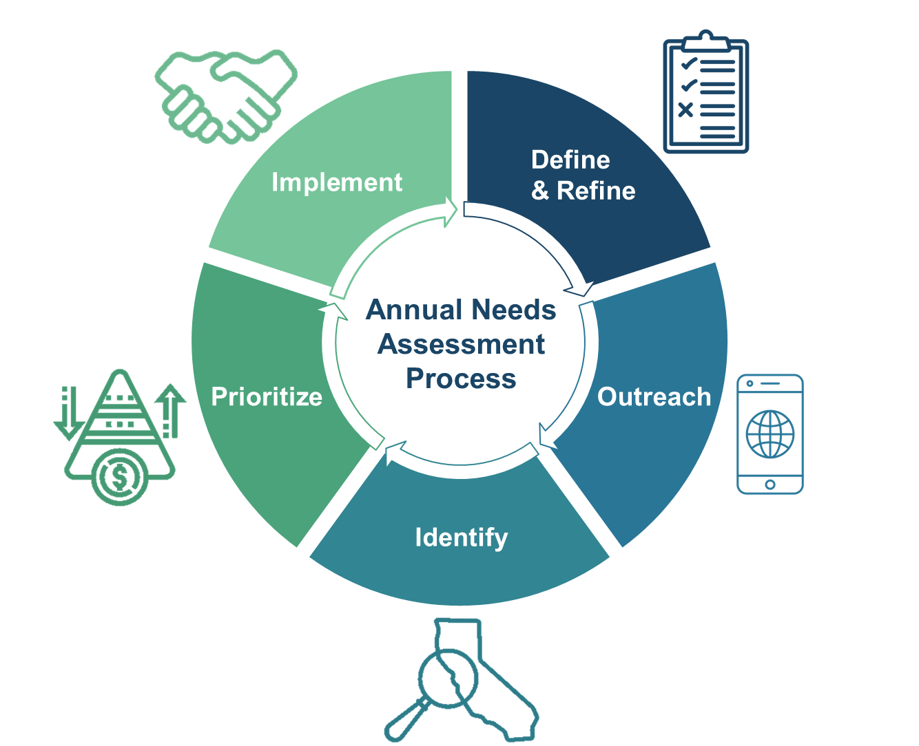
Future Iterations of the Needs Assessment
The Needs Assessment is designed to be conducted annually. The methodologies will be further refined as the SAFER Program develops and additional data becomes available.
CALIFORNIA WATER BOARDS SAFER PROGRAM

Slide 98
Needs Assessment Refinement Opportunities
Improved data
Better alignment across Needs Assessment components
Focused scope
Expanded outreach to Tribal water systems
Alignment with other State efforts
Refinement of Affordability Assessment
Learning by doing and continued public engagement
CALIFORNIA WATER BOARDS SAFER PROGRAM

Slide 99
Next Steps and Announcements
CALIFORNIA WATER BOARDS SAFER PROGRAM
Notes:
Kristyn reintroduces Itze

Slide 100
  SAFER Timeline*
April - June
July - September
October - December
4/20 Board Update: Needs Assessment
4/22 Advisory Group Mtg.
5/27 SAFER Summer Series Kick-Off
6/TBD Draft FEP Released
6/8 Tribal Workshop: Central CA
6/10 Advisory Group Mtg.
6/17 Tribal Workshop: North. CA
6/17 Community Workshop
6/22 Tribal Workshop: South. CA
7/TBD FEP Finalized
7/6 Advisory Group Application Window Opens
8/4 Advisory Group Application Workshop
8/17 Board Considers Adoption of FEP
9/16 Advisory Group Mtg.
9/30 Advisory Group Application Window Closes
10/TBD Stakeholder Affordability Discussions
11/18 Advisory Group Mtg.
12/TBD Advisory Group Members Selected
* Timeline does not include future Needs Assessment refinement workshops. Scheduling coming soon.
CALIFORNIA WATER BOARDS SAFER PROGRAM
Notes:
Immediate Next Steps
Incorporate public feedback to refine List of Potential Risk Indicators and Evaluation Tool
Submit feedback to: SAFER@waterboards.ca.gov
Email Title: Public Water System Risk Assessment
Use Tool to evaluate risk indicators
Share results with the public - September/October webinar workshop
Determine final list of indicators for Risk Assessment 2.0 and begin exploring thresholds, weighting, and scoring approaches

Slide 101
  Immediate Next Steps
Water system data change requests:
  https://bit.ly/3t9XgTg
General feedback on the Needs Assessment results and methodologies:
  2021 Drinking Water Needs Assessment: https://bit.ly/3mAz2yK
  Submit feedback to: SAFER@waterboards.ca.gov
  Please submit feedback on the report by 07.01.2021
  Respond to survey questions here: https://bit.ly/2OH58wm
CALIFORNIA WATER BOARDS SAFER PROGRAM
Notes:
Immediate Next Steps
Incorporate public feedback to refine List of Potential Risk Indicators and Evaluation Tool
Submit feedback to: SAFER@waterboards.ca.gov
Email Title: Public Water System Risk Assessment
Use Tool to evaluate risk indicators
Share results with the public - September/October webinar workshop
Determine final list of indicators for Risk Assessment 2.0 and begin exploring thresholds, weighting, and scoring approaches

Slide 102
  Audience Poll Question 3
Would you be interested in training sessions on how to navigate the Risk Assessment and Affordability Assessment spreadsheets?
  Yes
  No
  Maybe, I haven’t looked at them yet
  Risk Assessment Results Spreadsheet: https://bit.ly/3d0XxSF
  Affordability Assessment Results Spreadsheet: https://bit.ly/3d3jmkC
CALIFORNIA WATER BOARDS SAFER PROGRAM

Slide 103
Discussion Topic: Open Q&A
Do you have any questions or comments about the Needs Assessment?

Slide 104
THANK YOU
CALIFORNIA WATER BOARDS SAFER PROGRAM
Notes:
Itze & Emily

