Slide 1
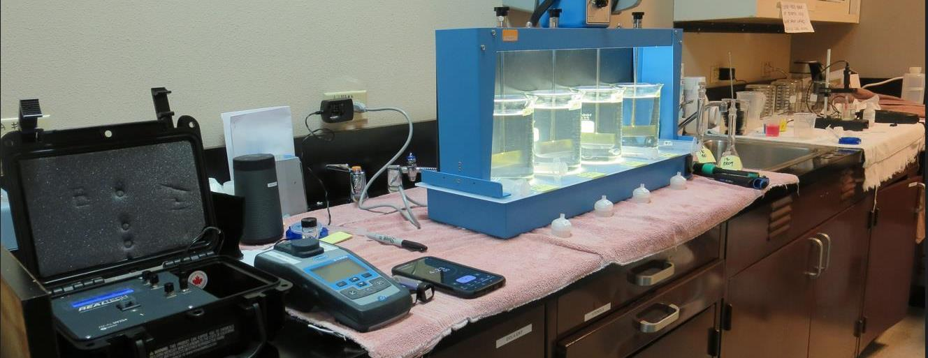
Ione Amador Water Agency CA0310002, Amador County, Jar Test
by Guy Schott, P.E. April 10, 2023

Slide 2
Ryan adding coag.

Slide 3
Ione AWA Source & Treated Water Characteristics, April 10, 2023
Source – Ione Reservoir
pH: 7.35 – 7.49
Alkalinity: 20 mg/L as CaCO₃
Turbidity: 1.89 NTU
UVT: 86.0%,
UVA: 0.065/cm
0.4 um Filtered
Turbidity: 0.40 NTU
UVT: 86.9%,
UVA: 0.060/cm
Plant Filtrate Water
0.05 NTU
UVT: 95.5%,
UVA: 0.019/cm
Plant Filtrate Post Chlorine Water
0.08 NTU
UVT: 96.5%,
UVA: 0.015/cm

Slide 4
Applied Coagulants for Jar Testing (1)
SWT 8809 (Sterling Water Technologies)
25% Aluminum Chlorohydrate
25% pDADMAC
50% Water
11.81% Al₂O₃
6.25% Al
83% Basicity
SG = 1.19-1.33
NSF limit: 20 mg/L as Product
Product dose 6.5 mg/L = 1.62 mg/L pDADMAC
961 (NTU Technologies)
32% Polyaluminum Hydroxychlorosulfate
2% pDADMAC (blend?)
66% Water
SG = 1.2-1.24
NSF limit: 255 mg/L as Product

Slide 5
Applied Coagulants for Jar Testing (2)
NTU Technologies
Pro Pac 9810
45-50% Aluminum Chlorohydrate
45-50% Water
~22.4% Al₂O₃
~11.9% Al
83% Basicity
5% polyamine (50% water, 50% active polyamines)
SG = 1.25-1.34
NSF limit: 200 mg/L as Product;
Product dose 20 mg/L = 0.5 mg/L polyamines active
905 (NTU Technologies)
45-55% Aluminum Chlorohydrate (~49%)
2% pDADMAC (blend?)
45-55% Water
SG = 1.2 – 1.34
NSF limit: 255 mg/L as Product
960 (NTU Technologies)
33% Polyaluminum Hydroxychlorosulfate
67% Water
SG = 1.2 – 1.3
NSF limit: 250 mg/L as Product

Slide 6
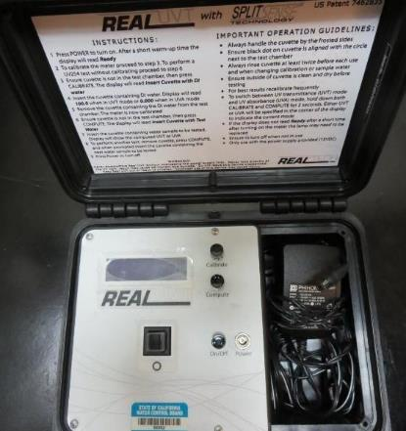
UVT/UVA, pathlength 10 mm
UV transmittance (UVT) is a measurement of the amount of ultraviolet light (254 nm) that passes through a water sample compared to the amount of light that passes through a pure water sample. The measurement is expressed as % UVT.
%UVT = 10^{(-UVA)} x 100%
UV absorbance (UVA) is calculated as a relative measure of the amount of light absorbed by a water sample compared with the amount of light absorbed by a pure water sample.
UVA = -log(%UVT/100)

Slide 7
Cl2 Decay Rate

Slide 8
UVA Reduction

Slide 9
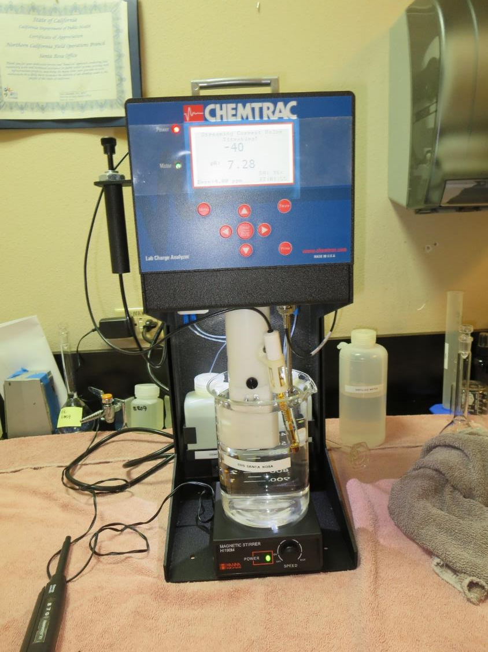
Laboratory Charge Analyzer
LCA: Used to determine coagulant demand of a source water entering the treatment plant.
Source pH: 7.35-7.49
LCA #1: 8809 [Al][PY]
~4.2 mg/L as product

Slide 10
Coagulant Information
Unless stated otherwise, all coagulant doses are reported as Product (100% strength).
Aluminum Sulfate doses are reported as hydrated Al₂(SO₄)₃*14.3H₂0.
Preparation of coagulant stock solutions are generally 1.0 and/or 0.1 percent strength using 100 and/or 200 mL volumetric flasks.
Finnpipette F2 variable volume pipette, capacity 100-1000 micro liters is used for stock solution preparation and coagulant aid jar test dosing.
Finnpipette F2 variable volume pipette, capacity 0.5-5 mL is used for primary coagulant jar test dosing.

Slide 11
Ione AWA: TTHMs Laboratory Results NaOCl dose after filtration: 2 mg/L (Hold Time 2 days)
Jar # | Pre-NaOCl mg/L | 961 mg/L | SWT 8809 mg/L | Filtrate NTU | Filtrate %UVT | Filtrate UVA/cm | %UVA Reduction | TTHM ug/L | Cl2 Residual mg/L
1 | 1.5 | - | 6.5 | 0.05 | 94.3 | 0.025 | 58.3 | 69 | 0.07
2 | 0 | 29 | - | 0.04 | 96.1 | 0.016 | 73.3 | 43 | 0.31

Slide 12
Jar Test – Filtrate Water Spiked with 2 mg/L NaOCl Plant Coagulant Dose vs. Optimum Dose and Coagulant
TTHM: 43 ug/L,
TTHM: 69 ug/L,

Slide 13
Ione AWA; Source: Ione Reservoir Summary of Optimum Dose/Coagulants for Tested Products
Coag Product | NaOCl mg/L | Coag Dose mg/L | Filtrate NTU | Filtrate %UVT | Filtrate UVA/cm | %UVA Reduction | Settle NTU 25 min | pH | Coagulant Max Use, mg/L
8809 | 1.5 | 6.5 | 0.06 | 94.5 | 0.024 | 60.0 | 1.82 | 7.24 | 20
8809 | 1.5 | 6.5 | 0.05 | 94.3 | 0.025 | 58.3 | 3.28 | - | 20
905 | 1.5 | 12 | 0.04 | 95.5 | 0.019 | 68.3 | 2.07 | 7.17 | 255
905 | 1.5 | 15 | 0.03 | 96.1 | 0.017 | 71.7 | 1.42 | 7.16 | 255
9810 | 1.5 | 12 | 0.04 | 95.6 | 0.019 | 68.3 | 1.81 | 7.17 | 200
9810 | 1.5 | 12 | 0.03 | 95.8 | 0.018 | 70.0 | 1.72 | - | 200
961 | 1.5 | 29 | 0.04 | 95.6 | 0.019 | 68.3 | 0.95 | 6.94 | 255
961 | 1.5 | 29 | 0.03 | 95.7 | 0.018 | 70.0 | 0.87 | 6.89 | 255
961 | 0 | 29 | 0.04 | 96.1 | 0.016 | 73.3 | 1.76 | - | 255

Slide 14
Ione AWA; Jar Test 1 - 8 Results Flash Mix 200 RPM (20 sec); Floc Mix 30 RPM (5 min)
Jar# | NaOCl mg/L | 8809 mg/L | Filtrate NTU | Filtrate %UVT | Filtrate UVA/cm | %UVA Reduction | Settle NTU 25 min
J1 | 0 | 3.5 | 0.15 | 92.7 | 0.032 | 46.7 | 2.54
J2 | 0 | 4.0 | 0.08 | 93.5 | 0.028 | 53.3 | 2.44
J3 | 0 | 4.5 | 0.16 | 93.2 | 0.030 | 50.0 | 2.47
J4 | 0 | 5.0 | 0.08 | 94.0 | 0.026 | 56.7 | 2.41
J5 | 1.5 | 3.5 | 0.07 | 93.7 | 0.028 | 53.3 | 2.28
J6 | 1.5 | 4.0 | 0.12 | 93.7 | 0.027 | 55.0 | 2.47
J7 | 1.5 | 4.5 | 0.06 | 94.0 | 0.026 | 56.7 | -
J8 | 1.5 | 5.0 | 0.10 | 94.1 | 0.026 | 56.7 | -

Slide 15
Ione AWA; Jar Test 9 - 16 Results Flash Mix 200 RPM (20 sec); Floc Mix 30 RPM (5 min)
Jar# | 960 mg/L | 961 mg/L | Filtrate NTU | Filtrate %UVT | Filtrate UVA/cm | %UVA Reduction | Settle NTU 25 min
J9 | 5 | - | 0.43 | 87.8 | 0.056 | 6.7 | 1.72
J10 | 10 | - | 0.47 | 88.9 | 0.050 | 16.7 | 1.92
J11 | 15 | - | 0.06 | 93.4 | 0.029 | 51.7 | 1.92
J12 | 20 | - | 0.06 | 93.7 | 0.028 | 53.3 | 1.82
J13 | - | 14 | 0.09 | 93.4 | 0.029 | 51.7 | 1.96
J14 | - | 19 | 0.05 | 94.0 | 0.026 | 56.7 | 1.34
J15 | - | 24 | 0.05 | 94.3 | 0.025 | 58.3 | 1.21
J16 | - | 29 | 0.04 | 94.4 | 0.024 | 60.0 | 0.93

Slide 16
Ione AWA; Jar Test 17 - 24 Results Flash Mix 200 RPM (20 sec); Floc Mix 30 RPM (5 min)
Jar# | NaOCl mg/L | 8809 mg/L | Filtrate NTU | Filtrate %UVT | Filtrate UVA/cm | %UVA Reduction | Settle NTU 25 min
J17 | 1.5 | 5.0 | 0.11 | 93.9 | 0.026 | 56.7 | 3.48
J18 | 1.5 | 5.5 | 0.14 | 94.0 | 0.026 | 56.7 | 3.45
J19 | 1.5 | 6.0 | 0.18 | 93.8 | 0.027 | 55.0 | 3.36
J20 | 1.5 | 6.5 | 0.07 | 94.5 | 0.024 | 60.0 | 3.39
J21 | 0 | 6.5 | 0.21 | 93.0 | 0.031 | 48.3 | 2.8
J22 | 1.5 | 6.5 | 0.06 | 94.1 | 0.026 | 56.7 | 3.1
J23 | 1.5 | 7.0 | 0.21 | 93.4 | 0.029 | 51.7 | 3.1
J24 | 1.5 | 7.5 | 0.09 | 94.1 | 0.026 | 56.7 | 2.6

Slide 17
Ione AWA; Jar Test 25 - 28 Results Flash Mix 200 RPM (20 sec); Floc Mix 30 RPM (5 min)
Jar# | NaOCl mg/L | 8809 mg/L | 961 mg/L | Filtrate NTU | Filtrate %UVT | Filtrate UVA/cm | %UVA Reduction | Settle NTU 25 min
J25 | 1.5 | 6.5 | - | 0.22 | 94.0 | 0.026 | 56.7 | 3.37
J26 | 1.5 | 6.5 | - | 0.05 | 94.3 | 0.025 | 58.3 | 3.28
J27 | 0 | - | 29 | 0.04 | 96.1 | 0.016 | 73.3 | 1.76
J28 | 0 | - | 29 | 0.06 | 95.9 | 0.018 | 70.0 | 1.52

Slide 18
Ione AWA; Jar Test 29 - 36 Results Flash Mix 200 RPM (20 sec); Floc Mix 30 RPM (5 min)
Jar# | NaOCl mg/L | 8809 mg/L | 961 mg/L | Filtrate NTU | Filtrate %UVT | Filtrate UVA/cm | %UVA Reduction | Settle NTU 25 min | pH | Alk mg/L CaCO₃
J29 | 0 | 6.5 | - | 0.16 | 93.2 | 0.030 | 50.0 | 2.28 | 7.33 | 18
J30 | 1.5 | 6.5 | - | 0.06 | 94.3 | 0.025 | 58.3 | 2.42 | 7.30 | 19
J31 | 0 | - | 29 | 0.04 | 95.8 | 0.018 | 70.0 | 1.38 | 6.86 | 16
J32 | 1.5 | - | 29 | 0.04 | 95.7 | 0.018 | 70.0 | 0.95 | 6.87 | 17
J33 | 0 | - | 29 | 0.03 | 94.8 | 0.023 | 61.7 | 0.91 | 6.89 | -
J34 | 1.5 | - | 29 | 0.03 | 95.7 | 0.018 | 70.0 | 0.87 | 6.89 | -
J35 | 0 | - | 34 | 0.03 | 95.8 | 0.018 | 70.0 | 1.08 | 6.81 | -
J36 | 1.5 | - | 34 | 0.03 | 96.0 | 0.017 | 71.7 | 0.95 | 6.86 | -

Slide 19
Ione AWA; Jar Test 37 - 44 Results Flash Mix 200 RPM (20 sec); Floc Mix 30 RPM (5 min)
Jar# | NaOCl mg/L | 905 mg/L | Filtrate NTU | Filtrate %UVT | Filtrate UVA/cm | %UVA Reduction | Settle NTU 25 min | pH | Alk mg/L CaCO₃
J37 | 1.5 | 5 | 0.06 | 93.8 | 0.027 | 55.0 | 1.09 | 7.35 | 19.5
J38 | 1.5 | 10 | 0.03 | 95.6 | 0.019 | 68.3 | 1.32 | 7.23 | 18.5
J39 | 1.5 | 15 | 0.03 | 96.1 | 0.017 | 71.7 | 1.42 | 7.16 | 18.3
J40 | 1.5 | 20 | 0.03 | 96.4 | 0.015 | 75.0 | 1.19 | 7.15 | 19
J41 | 0 | 12 | 0.03 | 95.6 | 0.019 | 68.3 | 1.54 | - | -
J42 | 1.5 | 12 | 0.03 | 95.7 | 0.018 | 70.0 | 1.80 | - | -
J43 | 0 | 15 | 0.08 | 95.4 | 0.020 | 66.7 | 1.66 | - | -
J44 | 1.5 | 15 | 0.04 | 95.9 | 0.017 | 71.7 | 1.48 | - | -

Slide 20
Ione AWA; Jar Test 45 - 48 Results Flash Mix 200 RPM (20 sec); Floc Mix 30 RPM (5 min)
Jar# | NaOCl mg/L | 9810 mg/L | Filtrate NTU | Filtrate %UVT | Filtrate UVA/cm | %UVA Reduction | Settle NTU 25 min
J45 | 1.5 | 6 | 0.04 | 94.5 | 0.024 | 60.0 | 1.43
J46 | 1.5 | 9 | 0.05 | 95.2 | 0.021 | 65.0 | 1.98
J47 | 1.5 | 12 | 0.03 | 95.8 | 0.018 | 70.0 | 1.72
J48 | 1.5 | 15 | 0.03 | 96.0 | 0.017 | 71.7 | 1.84

Slide 21
Ione AWA; Jar Test 49 - 52 Results Flash Mix 200 RPM (20 sec); Floc Mix 30 RPM (5 min)
Jar# | NaOCl mg/L | 8809 mg/L | 905 mg/L | 9810 mg/L | 961 mg/L | Filtrate NTU | Filtrate %UVT | Filtrate UVA/cm | %UVA Reduction | Settle NTU 25 min | pH
J49 | 1.5 | 6.5 | - | - | - | 0.06 | 94.5 | 0.024 |  | 1.82 | 7.24
J50 | 1.5 | - | 12 | - | - | 0.04 | 95.5 | 0.019 |  | 2.07 | 7.17
J51 | 1.5 | - | - | 12 | - | 0.04 | 95.6 | 0.019 |  | 1.81 | 7.17
J52 | 1.5 | - | - | - | 29 | 0.04 | 95.6 | 0.019 |  | 0.95 | 6.94

Slide 22
Jars 1-4 Test Flash Mix 20 Sec (200 RPM) Floc Mix 5 min (30 RPM) Applied Coagulant 8809

Slide 23
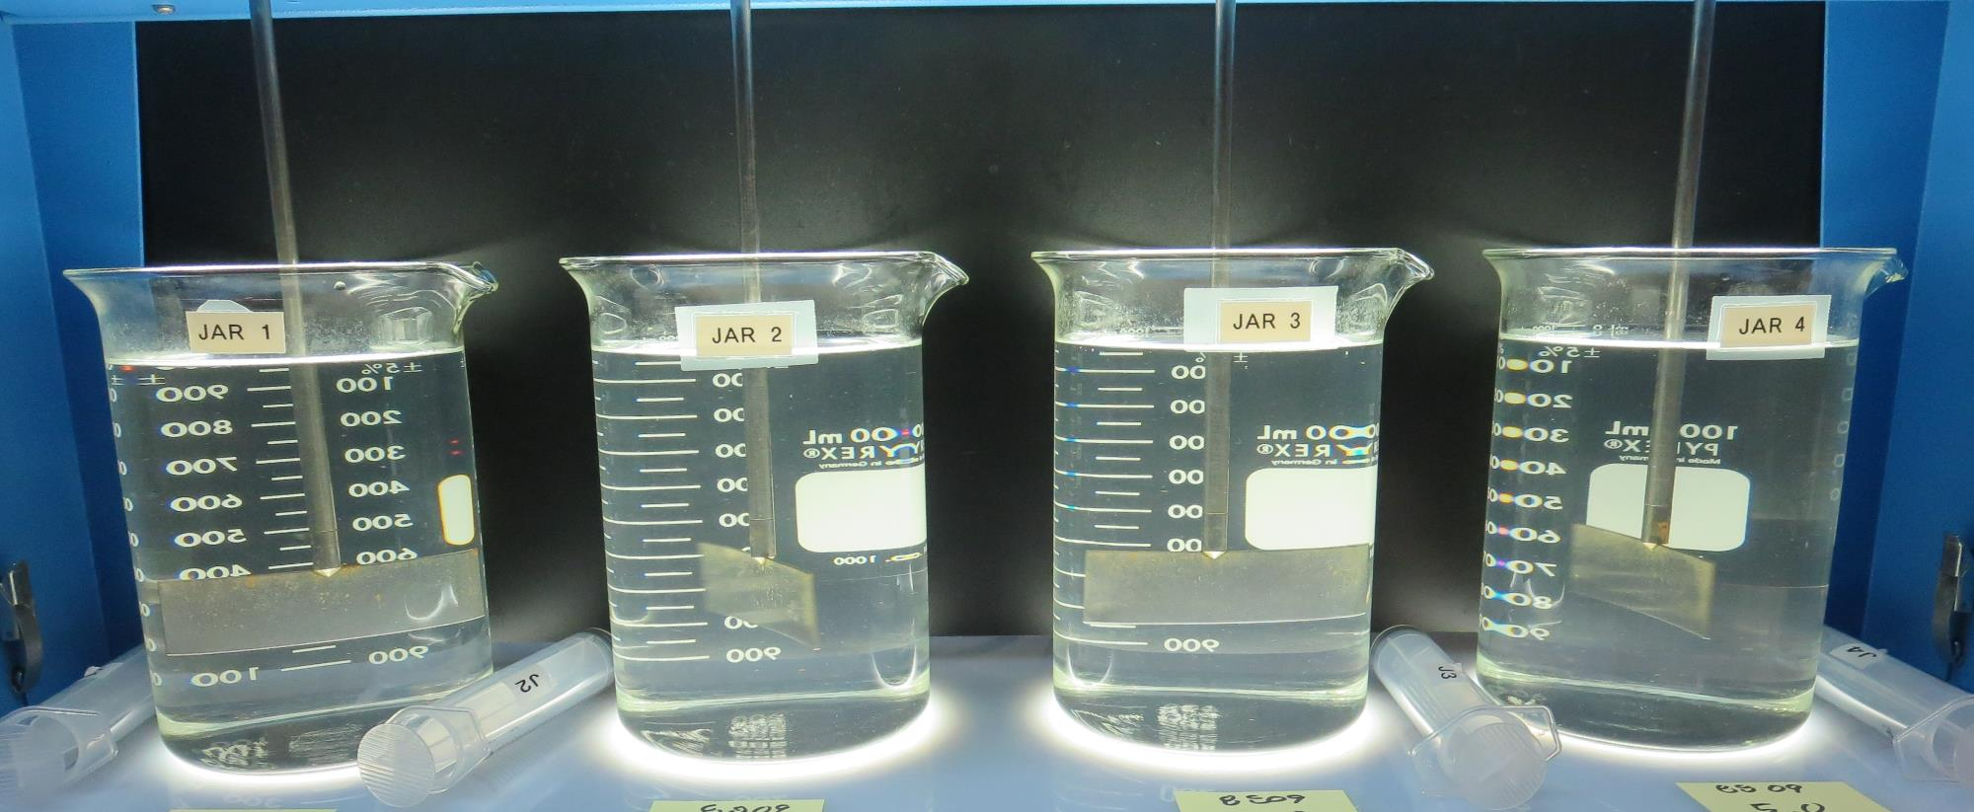
Jars 1-4: End of Floc Duration, 25 mL is syringed for filterability and %UVT/UVA.
0 mg/L NaOCl
3.5 mg/L 8809
Filtrate: 0.15 NTU
UVT: 92.7%
UVA: 0.032/cm
UVA Reduction: 46.7%
Settled: 2.54 NTU
0 mg/L NaOCl
4.0 mg/L 8809
Filtrate: 0.08 NTU
UVT: 93.5%
UVA: 0.028/cm
UVA Reduction: 53.3%
Settled: 2.44 NTU
0 mg/L NaOCl
4.5 mg/L 8809
Filtrate: 0.16 NTU
UVT: 93.2%
UVA: 0.030/cm
UVA Reduction: 50.0%
Settled: 2.47 NTU
0 mg/L NaOCl
5.0 mg/L 961
Filtrate: 0.08 NTU
UVT: 94.0%
UVA: 0.026/cm
UVA Reduction: 56.7%
Settled: 2.41 NTU

Slide 24
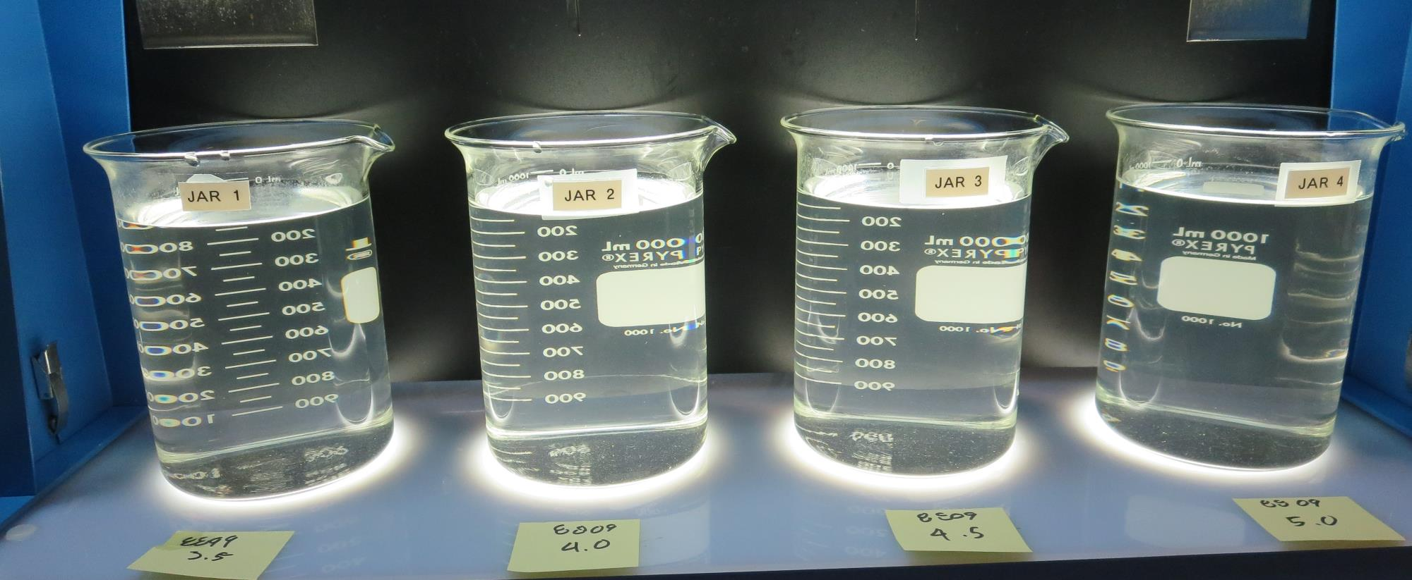
Jars 1-4: After 25-minutes of settling, settled water turbidity is taken.
0 mg/L NaOCl
3.5 mg/L 8809
Filtrate: 0.15 NTU
UVT: 92.7%
UVA: 0.032/cm
UVA Reduction: 46.7%
Settled: 2.54 NTU
0 mg/L NaOCl
4.0 mg/L 8809
Filtrate: 0.08 NTU
UVT: 93.5%
UVA: 0.028/cm
UVA Reduction: 53.3%
Settled: 2.44 NTU
0 mg/L NaOCl
4.5 mg/L 8809
Filtrate: 0.16 NTU
UVT: 93.2%
UVA: 0.030/cm
UVA Reduction: 50.0%
Settled: 2.47 NTU
0 mg/L NaOCl
5.0 mg/L 961
Filtrate: 0.08 NTU
UVT: 94.0%
UVA: 0.026/cm
UVA Reduction: 56.7%
Settled: 2.41 NTU

Slide 25
Jars 5-8 Test Flash Mix 20 Sec (200 RPM) Floc Mix 5 min (30 RPM) Applied Coagulant 8809

Slide 26
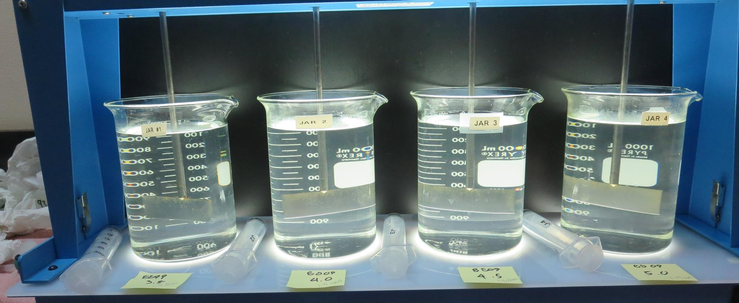
Jars 5-8: End of Floc Duration, 25 mL is syringed for filterability and %UVT/UVA.
1.5 mg/L NaOCl
3.5 mg/L 8809
Filtrate: 0.07 NTU
UVT: 93.7%
UVA: 0.028/cm
UVA Reduction: 53.3%
Settled: 2.28 NTU
1.5 mg/L NaOCl
4.0 mg/L 8809
Filtrate: 0.12 NTU
UVT: 93.7%
UVA: 0.027/cm
UVA Reduction: 55.0%
Settled: 2.47 NTU
1.5 mg/L NaOCl
4.5 mg/L 8809
Filtrate: 0.06 NTU
UVT: 94.0%
UVA: 0.026/cm
UVA Reduction: 56.7%
Settled: - NTU
1.5 mg/L NaOCl
5.0 mg/L 8809
Filtrate: 0.10 NTU
UVT: 94.1%
UVA: 0.026/cm
UVA Reduction: 56.7%
Settled: - NTU

Slide 27
Jars 9-12 Test Flash Mix 20 Sec (200 RPM) Floc Mix 5 min (30 RPM) Applied Coagulant 960

Slide 28
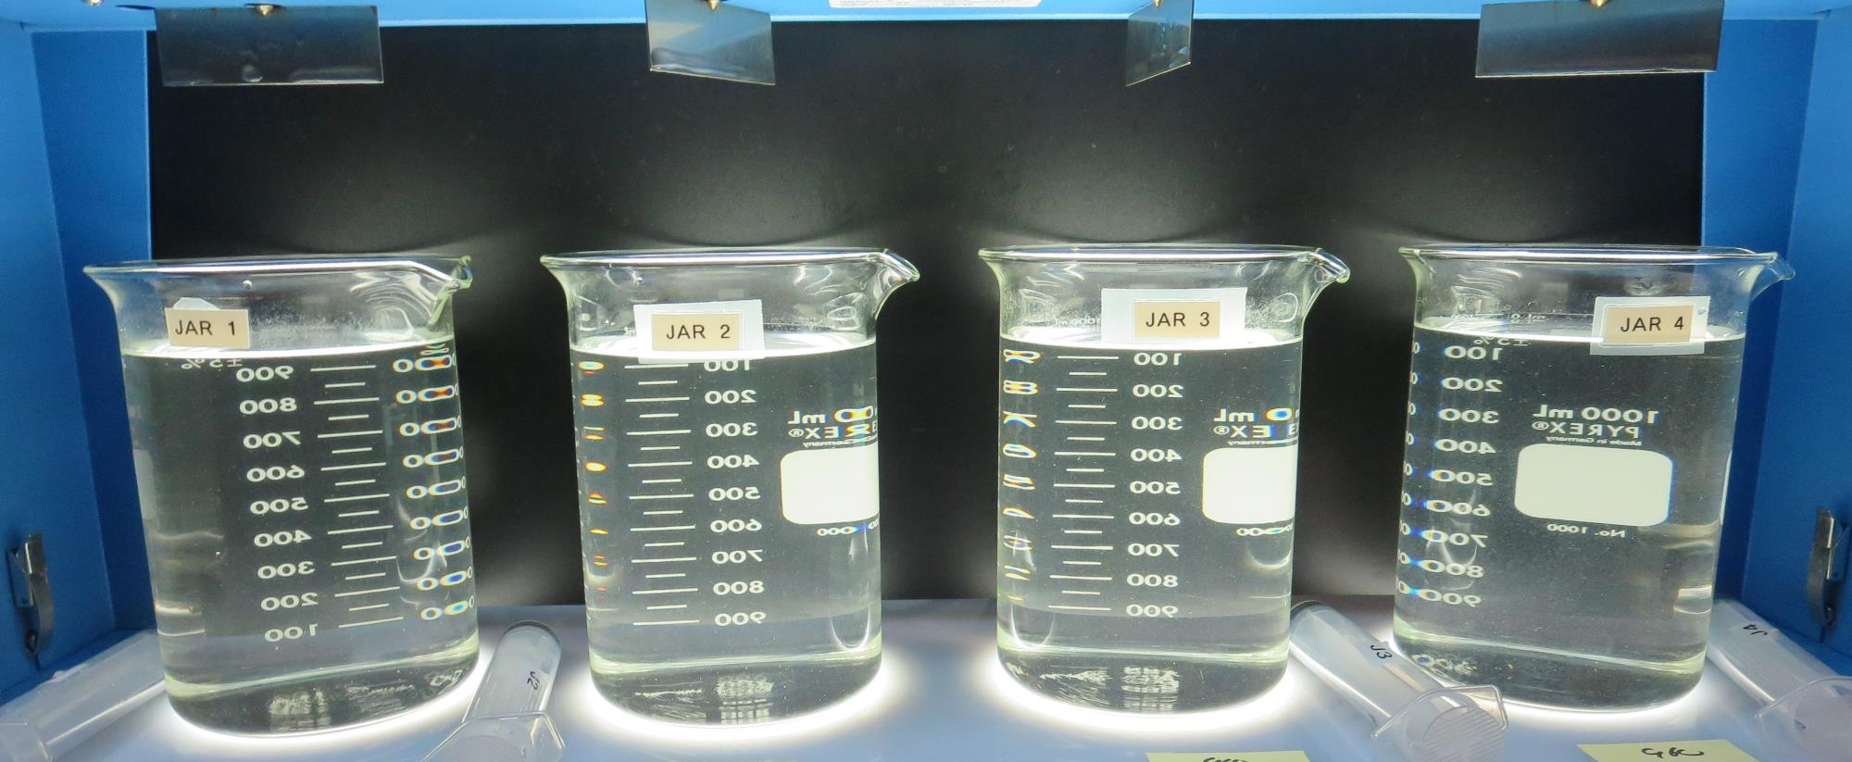
Jars 9-12: End of Floc Duration, 25 mL is syringed for filterability and %UVT/UVA.
0 mg/L NaOCl
5 mg/L 960
Filtrate: 0.43 NTU
UVT: 93.7%
UVA: 0.056/cm
UVA Reduction: 6.7%
Settled: 1.72 NTU
0 mg/L NaOCl
10 mg/L 960
Filtrate: 0.47 NTU
UVT: 88.9%
UVA: 0.050/cm
UVA Reduction: 16.7%
Settled: 1.92 NTU
0 mg/L NaOCl
15 mg/L 960
Filtrate: 0.06 NTU
UVT: 93.4%
UVA: 0.029/cm
UVA Reduction: 51.7%
Settled: 1.92 NTU
0 mg/L NaOCl
20 mg/L 960
Filtrate: 0.06 NTU
UVT: 93.7%
UVA: 0.028/cm
UVA Reduction: 53.3%
Settled: 1.82 NTU

Slide 29
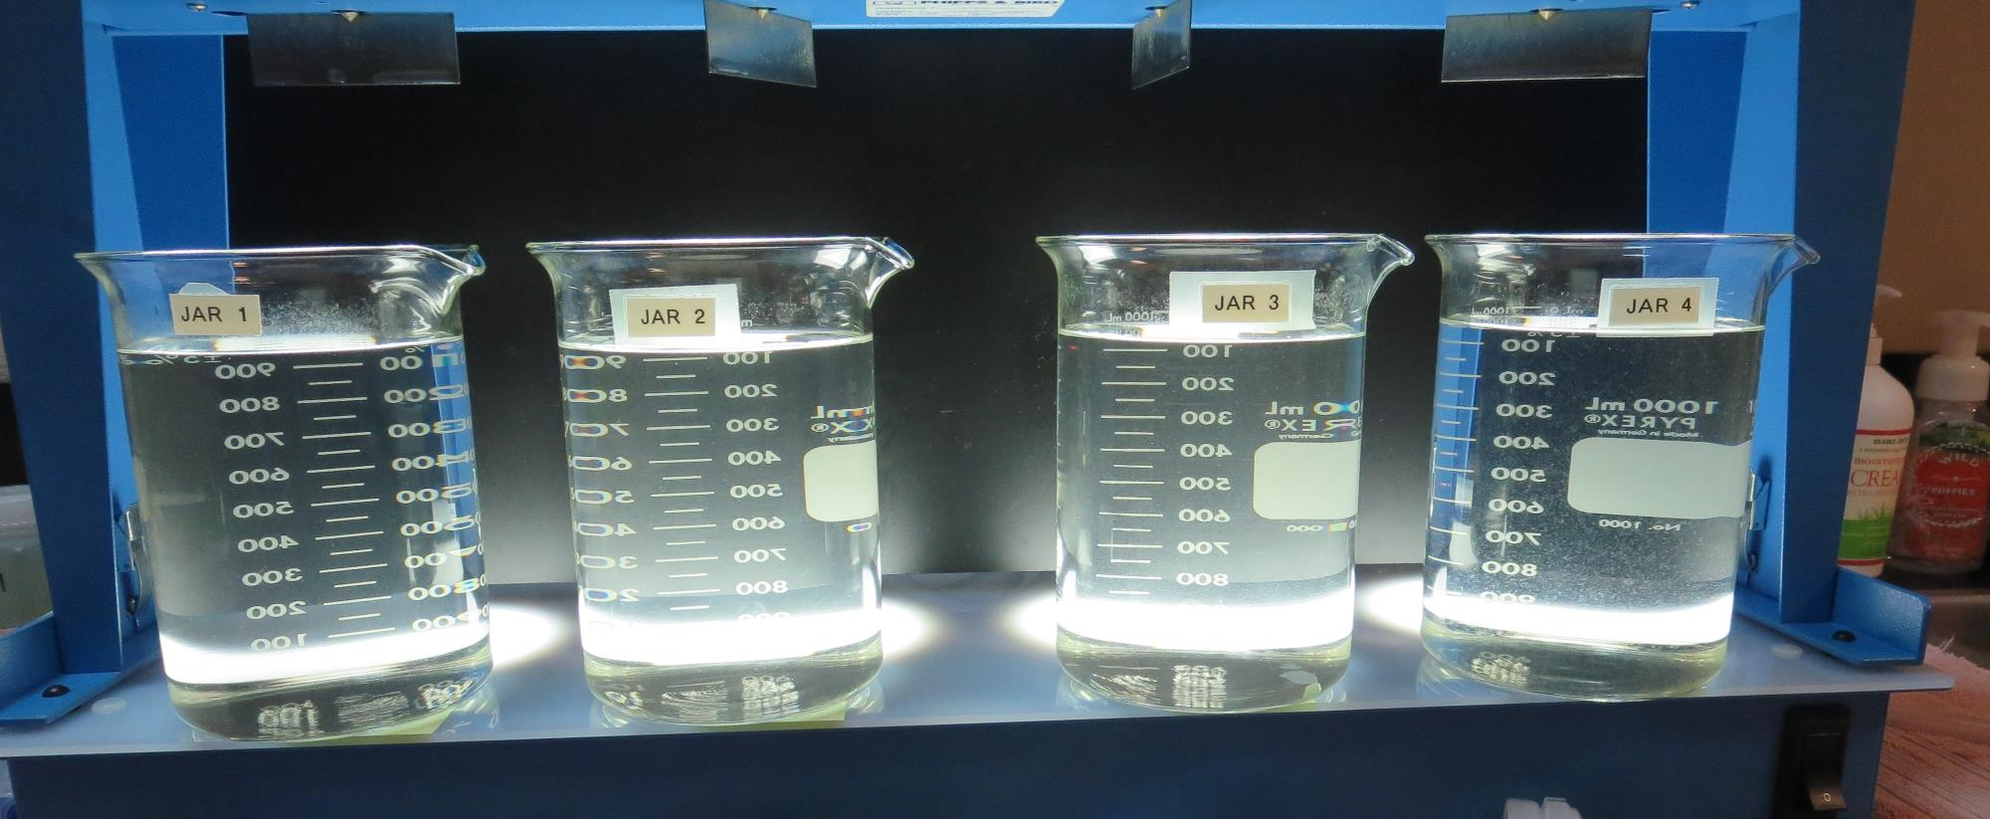
Jars 9-12: After 25-minutes of settling, settled water turbidity is taken.
0 mg/L NaOCl
5 mg/L 960
Filtrate: 0.43 NTU
UVT: 93.7%
UVA: 0.056/cm
UVA Reduction: 6.7%
Settled: 1.72 NTU
0 mg/L NaOCl
10 mg/L 960
Filtrate: 0.47 NTU
UVT: 88.9%
UVA: 0.050/cm
UVA Reduction: 16.7%
Settled: 1.92 NTU
0 mg/L NaOCl
15 mg/L 960
Filtrate: 0.06 NTU
UVT: 93.4%
UVA: 0.029/cm
UVA Reduction: 51.7%
Settled: 1.92 NTU
0 mg/L NaOCl
20 mg/L 960
Filtrate: 0.06 NTU
UVT: 93.7%
UVA: 0.028/cm
UVA Reduction: 53.3%
Settled: 1.82 NTU

Slide 30
Jars 13-16 Test Flash Mix 20 Sec (200 RPM) Floc Mix 5 min (30 RPM) Applied Coagulant 961

Slide 31
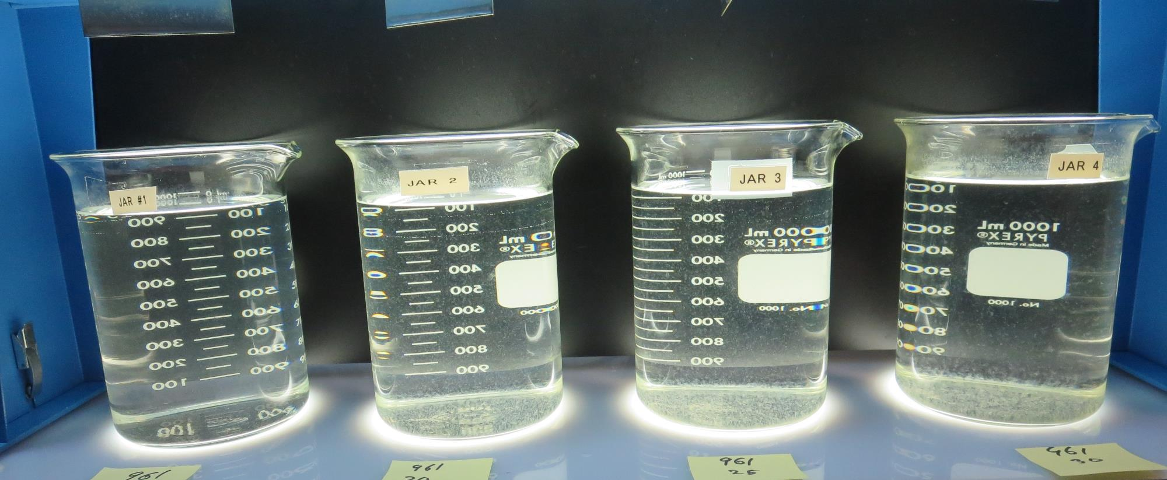
Jars 13-16: After 25-minutes of settling, settled water turbidity is taken.
0 mg/L NaOCl
15 mg/L 961
Filtrate: 0.09 NTU
UVT: 93.4%
UVA: 0.029/cm
UVA Reduction: 51.7%
Settled: 1.96 NTU
0 mg/L NaOCl
20 mg/L 961
Filtrate: 0.05 NTU
UVT: 94.0%
UVA: 0.026/cm
UVA Reduction: 56.7%
Settled: 1.34 NTU
0 mg/L NaOCl
25 mg/L 961
Filtrate: 0.05 NTU
UVT: 94.3%
UVA: 0.025/cm
UVA Reduction: 58.3%
Settled: 1.21 NTU
0 mg/L NaOCl
30 mg/L 961
Filtrate: 0.04 NTU
UVT: 94.4%
UVA: 0.024/cm
UVA Reduction: 60.0%
Settled: 0.93 NTU

Slide 32
Jars 17-20 Test Flash Mix 20 Sec (200 RPM) Floc Mix 5 min (30 RPM) Applied Coagulant 8809

Slide 33
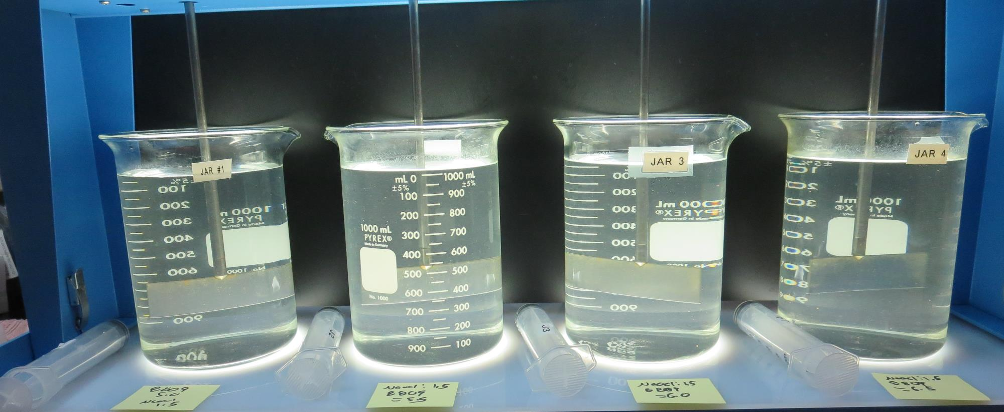
Jars 17-20: End of Floc Duration, 25 mL is syringed for filterability and %UVT/UVA.
1.5 mg/L NaOCl
5.0 mg/L 8809
Filtrate: 0.11 NTU
UVT: 93.9%
UVA: 0.026/cm
UVA Reduction: 56.7%
Settled: 3.48 NTU
1.5 mg/L NaOCl
5.5 mg/L 8809
Filtrate: 0.14 NTU
UVT: 94.0%
UVA: 0.026/cm
UVA Reduction: 56.7%
Settled: 3.45 NTU
1.5 mg/L NaOCl
6.0 mg/L 8809
Filtrate: 0.18 NTU
UVT: 93.8%
UVA: 0.027/cm
UVA Reduction: 55.0%
Settled: 3.36 NTU
1.5 mg/L NaOCl
6.5 mg/L 8809
Filtrate: 0.07 NTU
UVT: 94.5%
UVA: 0.024/cm
UVA Reduction: 60.0%
Settled: 3.39 NTU

Slide 34
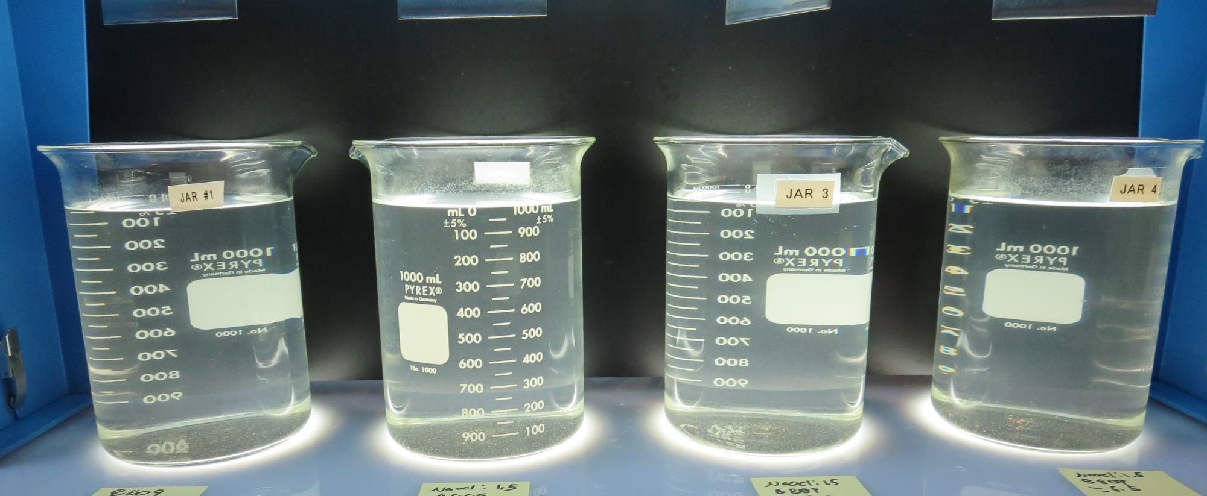
Jars 17-20: After 25-minutes of settling, settled water turbidity is taken.
1.5 mg/L NaOCl
5.0 mg/L 8809
Filtrate: 0.11 NTU
UVT: 93.9%
UVA: 0.026/cm
UVA Reduction: 56.7%
Settled: 3.48 NTU
1.5 mg/L NaOCl
5.5 mg/L 8809
Filtrate: 0.14 NTU
UVT: 94.0%
UVA: 0.026/cm
UVA Reduction: 56.7%
Settled: 3.45 NTU
1.5 mg/L NaOCl
6.0 mg/L 8809
Filtrate: 0.18 NTU
UVT: 93.8%
UVA: 0.027/cm
UVA Reduction: 55.0%
Settled: 3.36 NTU
1.5 mg/L NaOCl
6.5 mg/L 8809
Filtrate: 0.07 NTU
UVT: 94.5%
UVA: 0.024/cm
UVA Reduction: 60.0%
Settled: 3.39 NTU

Slide 35
Jars 21-24 Test Flash Mix 20 Sec (200 RPM) Floc Mix 5 min (30 RPM) Applied Coagulant 8809

Slide 36
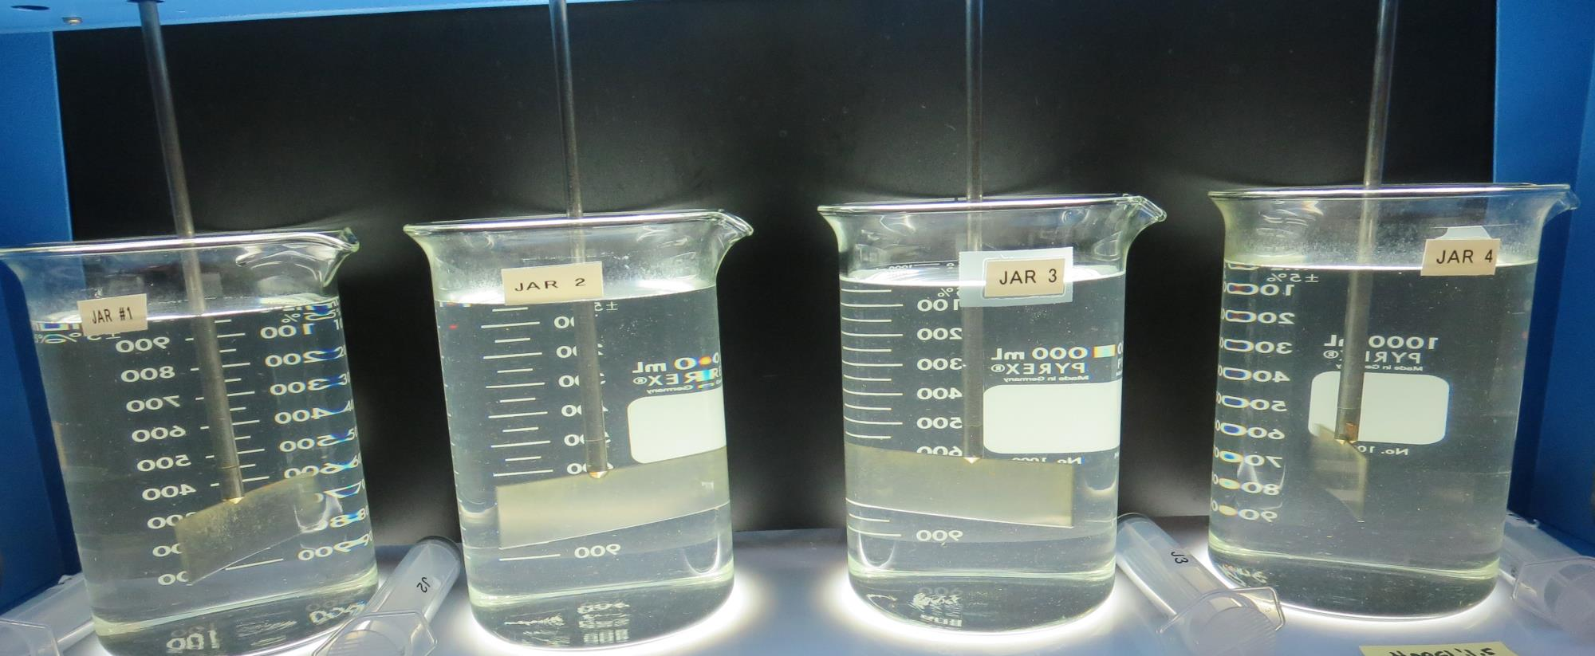
Jars 21-24: End of Floc Duration, 25 mL is syringed for filterability and %UVT/UVA.
0 mg/L NaOCl
6.5 mg/L 8809
Filtrate: 0.21 NTU
UVT: 93.0%
UVA: 0.031/cm
UVA Reduction: 48.3%
Settled: 2.8 NTU
1.5 mg/L NaOCl
6.5 mg/L 8809
Filtrate: 0.06 NTU
UVT: 94.1%
UVA: 0.026/cm
UVA Reduction: 56.7%
Settled: 3.1 NTU
1.5 mg/L NaOCl
7.0 mg/L 8809
Filtrate: 0.21 NTU
UVT: 93.4%
UVA: 0.029/cm
UVA Reduction: 51.7%
Settled: 3.1 NTU
1.5 mg/L NaOCl
7.5 mg/L 8809
Filtrate: 0.09 NTU
UVT: 94.1%
UVA: 0.026/cm
UVA Reduction: 56.7%
Settled: 2.6 NTU

Slide 37
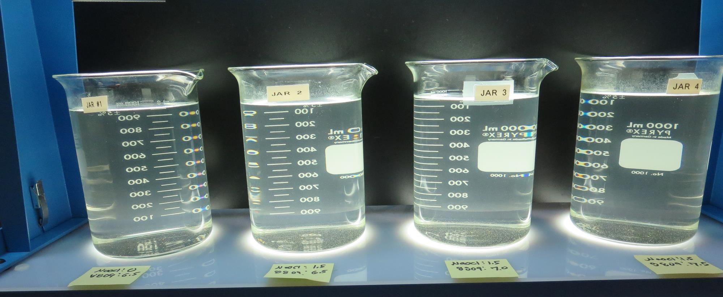
Jars 21-24: After 25-minutes of settling, settled water turbidity is taken.
0 mg/L NaOCl
6.5 mg/L 8809
Filtrate: 0.21 NTU
UVT: 93.0%
UVA: 0.031/cm
UVA Reduction: 48.3%
Settled: 2.8 NTU
1.5 mg/L NaOCl
6.5 mg/L 8809
Filtrate: 0.06 NTU
UVT: 94.1%
UVA: 0.026/cm
UVA Reduction: 56.7%
Settled: 3.1 NTU
1.5 mg/L NaOCl
7.0 mg/L 8809
Filtrate: 0.21 NTU
UVT: 93.4%
UVA: 0.029/cm
UVA Reduction: 51.7%
Settled: 3.1 NTU
1.5 mg/L NaOCl
7.5 mg/L 8809
Filtrate: 0.09 NTU
UVT: 94.1%
UVA: 0.026/cm
UVA Reduction: 56.7%
Settled: 2.6 NTU

Slide 38
Jars 25-28 Test Flash Mix 20 Sec (200 RPM) Floc Mix 5 min (30 RPM) Applied Coagulants 8809 & 961

Slide 39
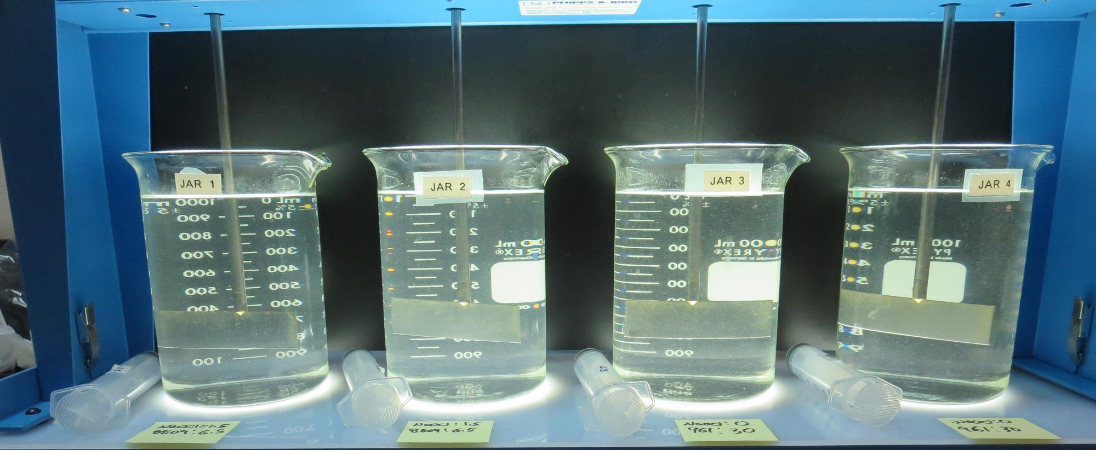
Jars 25-28: End of Floc Duration, 25 mL is syringed for filterability and %UVT/UVA.
1.5 mg/L NaOCl
6.5 mg/L 8809
Filtrate: 0.22 NTU
UVT: 94.0%
UVA: 0.026/cm
UVA Reduction: 56.7%
Settled: 3.37 NTU
1.5 mg/L NaOCl
6.5 mg/L 8809
Filtrate: 0.05 NTU
UVT: 94.3%
UVA: 0.025/cm
UVA Reduction: 58.3%
Settled: 3.28 NTU
0 mg/L NaOCl
30 mg/L 961
Filtrate: 0.04 NTU
UVT: 96.1%
UVA: 0.016/cm
UVA Reduction: 73.3%
Settled: 1.76 NTU
0 mg/L NaOCl
30 mg/L 961
Filtrate: 0.06 NTU
UVT: 95.9%
UVA: 0.018/cm
UVA Reduction: 70.0%
Settled: 1.52 NTU

Slide 40
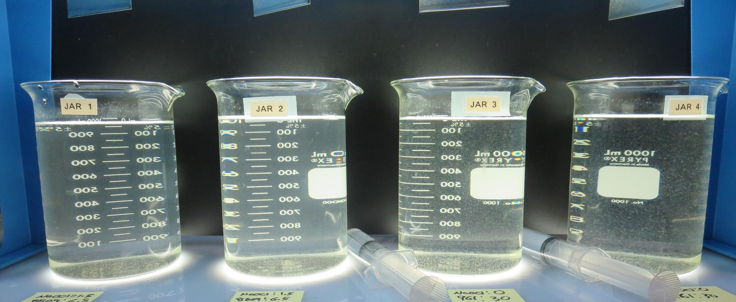
Jars 25-28: After 25-minutes of settling, settled water turbidity is taken.
1.5 mg/L NaOCl
6.5 mg/L 8809
Filtrate: 0.22 NTU
UVT: 94.0%
UVA: 0.026/cm
UVA Reduction: 56.7%
Settled: 3.37 NTU
1.5 mg/L NaOCl
6.5 mg/L 8809
Filtrate: 0.05 NTU
UVT: 94.3%
UVA: 0.025/cm
UVA Reduction: 58.3%
Settled: 3.28 NTU
0 mg/L NaOCl
30 mg/L 961
Filtrate: 0.04 NTU
UVT: 96.1%
UVA: 0.016/cm
UVA Reduction: 73.3%
Settled: 1.76 NTU
0 mg/L NaOCl
30 mg/L 961
Filtrate: 0.06 NTU
UVT: 95.9%
UVA: 0.018/cm
UVA Reduction: 70.0%
Settled: 1.52 NTU

Slide 41
Jars 29-32 Test Flash Mix 20 Sec (200 RPM) Floc Mix 5 min (30 RPM) Applied Coagulants 8809 & 961

Slide 42
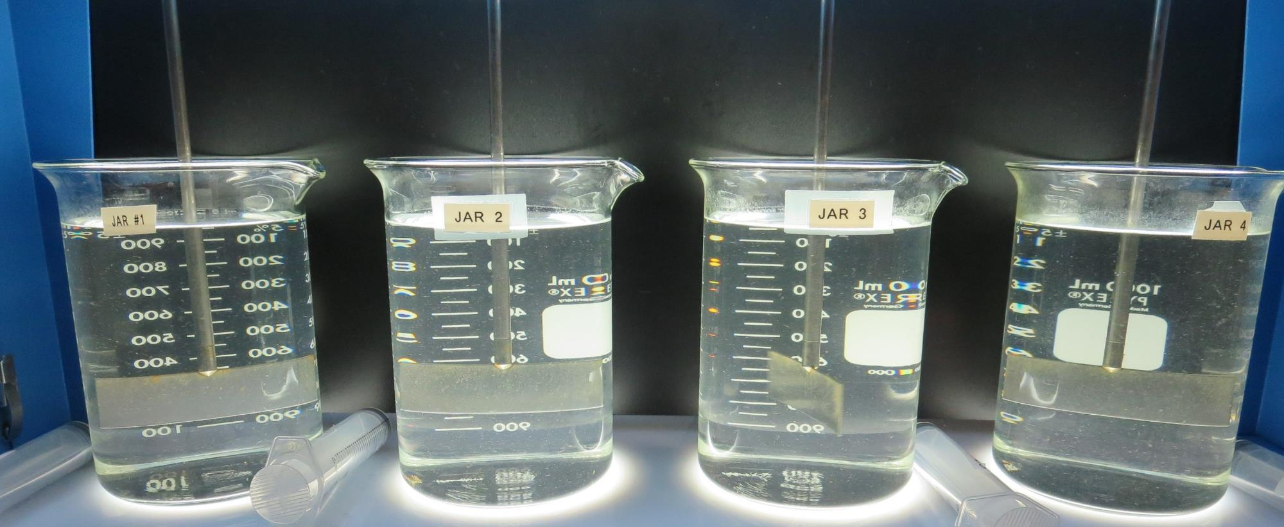
Jars 29-32: End of Floc Duration, 25 mL is syringed for filterability and %UVT/UVA.
0 mg/L NaOCl
6.5 mg/L 8809
Filtrate: 0.16 NTU
UVT: 93.2%
UVA: 0.030/cm
UVA Reduction: 50.0%
Settled: 2.28 NTU
1.5 mg/L NaOCl
6.5 mg/L 8809
Filtrate: 0.06 NTU
UVT: 94.3%
UVA: 0.025/cm
UVA Reduction: 58.3%
Settled: 2.42 NTU
0 mg/L NaOCl
29 mg/L 961
Filtrate: 0.04 NTU
UVT: 95.8%
UVA: 0.018/cm
UVA Reduction: 70.0%
Settled: 1.38 NTU
1.5 mg/L NaOCl
29 mg/L 961
Filtrate: 0.04 NTU
UVT: 95.7%
UVA: 0.018/cm
UVA Reduction: 70.0%
Settled: 0.95 NTU

Slide 43
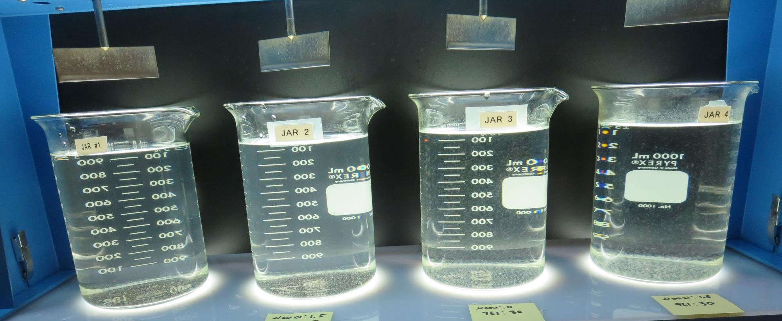
Jars 29-32: After 25-minutes of settling, settled water turbidity is taken.
0 mg/L NaOCl
6.5 mg/L 8809
Filtrate: 0.16 NTU
UVT: 93.2%
UVA: 0.030/cm
UVA Reduction: 50.0%
Settled: 2.28 NTU
1.5 mg/L NaOCl
6.5 mg/L 8809
Filtrate: 0.06 NTU
UVT: 94.3%
UVA: 0.025/cm
UVA Reduction: 58.3%
Settled: 2.42 NTU
0 mg/L NaOCl
29 mg/L 961
Filtrate: 0.04 NTU
UVT: 95.8%
UVA: 0.018/cm
UVA Reduction: 70.0%
Settled: 1.38 NTU
1.5 mg/L NaOCl
29 mg/L 961
Filtrate: 0.04 NTU
UVT: 95.7%
UVA: 0.018/cm
UVA Reduction: 70.0%
Settled: 0.95 NTU

Slide 44
Jars 33-36 Test Flash Mix 20 Sec (200 RPM) Floc Mix 5 min (30 RPM) Applied Coagulant 961

Slide 45
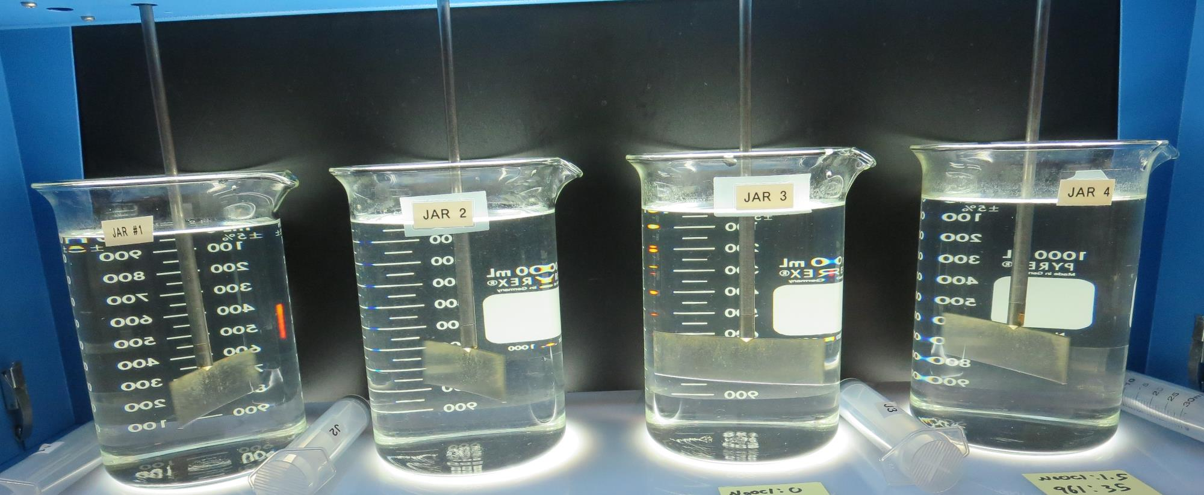
Jars 33-36: End of Floc Duration, 25 mL is syringed for filterability and %UVT/UVA.
0 mg/L NaOCl
29 mg/L 961
Filtrate: 0.03 NTU
UVT: 94.8%
UVA: 0.023/cm
UVA Reduction: 61.7%
Settled: 0.91 NTU
1.5 mg/L NaOCl
29 mg/L 961
Filtrate: 0.03 NTU
UVT: 95.7%
UVA: 0.018/cm
UVA Reduction: 70.0%
Settled: 0.87 NTU
0 mg/L NaOCl
34 mg/L 961
Filtrate: 0.03 NTU
UVT: 95.8%
UVA: 0.018/cm
UVA Reduction: 70.0%
Settled: 1.08 NTU
1.5 mg/L NaOCl
34 mg/L 961
Filtrate: 0.03 NTU
UVT: 96.0%
UVA: 0.017/cm
UVA Reduction: 71.7%
Settled: 0.95 NTU

Slide 46
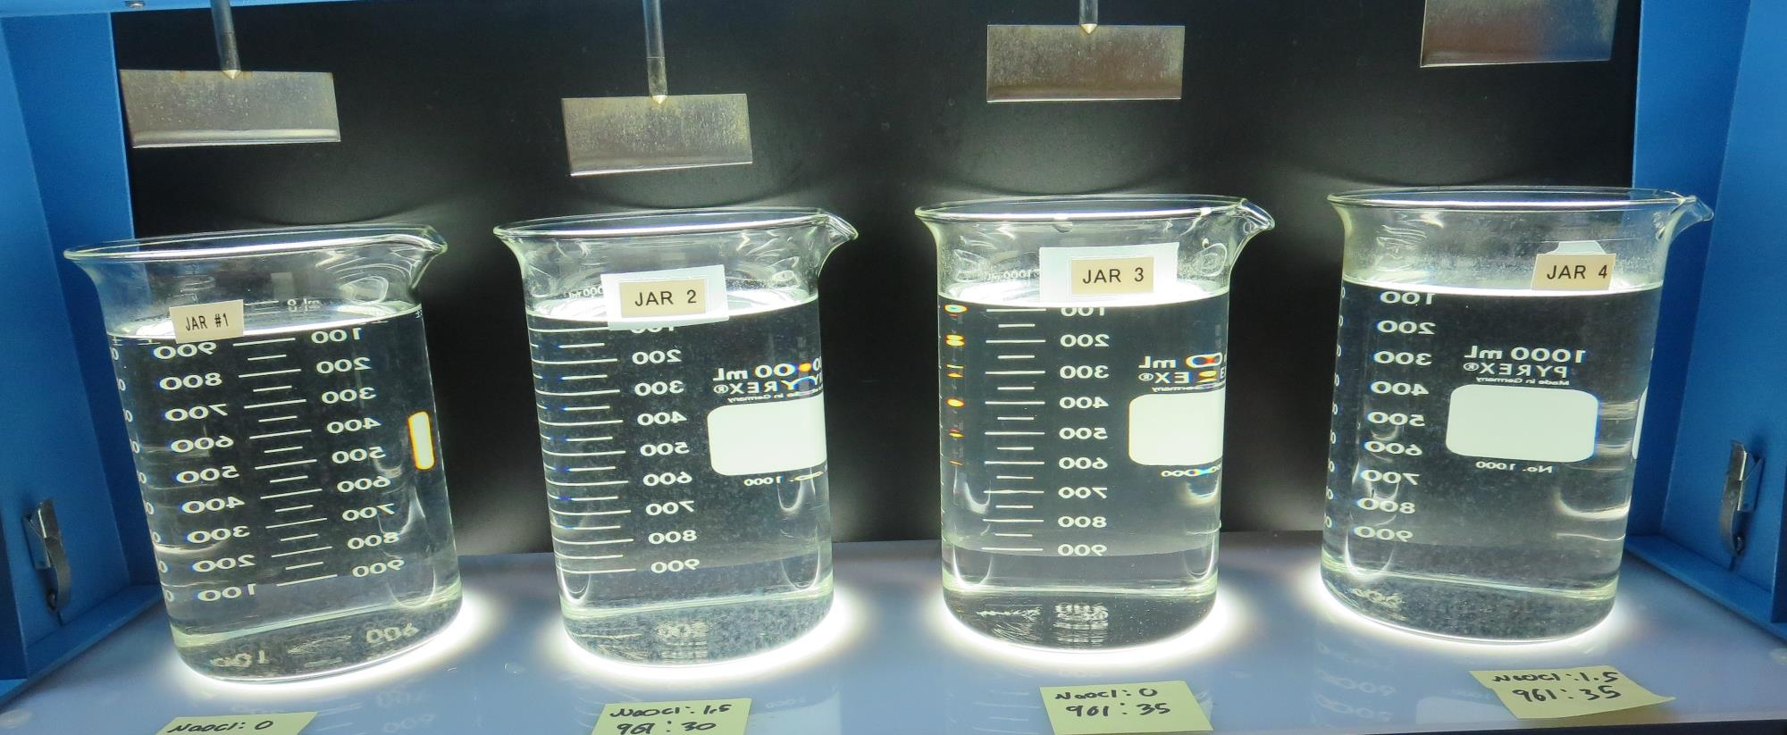
Jars 33-36: After 25-minutes of settling, settled water turbidity is taken.
0 mg/L NaOCl
29 mg/L 961
Filtrate: 0.03 NTU
UVT: 94.8%
UVA: 0.023/cm
UVA Reduction: 61.7%
Settled: 0.91 NTU
1.5 mg/L NaOCl
29 mg/L 961
Filtrate: 0.03 NTU
UVT: 95.7%
UVA: 0.018/cm
UVA Reduction: 70.0%
Settled: 0.87 NTU
0 mg/L NaOCl
34 mg/L 961
Filtrate: 0.03 NTU
UVT: 95.8%
UVA: 0.018/cm
UVA Reduction: 70.0%
Settled: 1.08 NTU
1.5 mg/L NaOCl
34 mg/L 961
Filtrate: 0.03 NTU
UVT: 96.0%
UVA: 0.017/cm
UVA Reduction: 71.7%
Settled: 0.95 NTU

Slide 47
Jars 37-40 Test Flash Mix 20 Sec (200 RPM) Floc Mix 5 min (30 RPM) Applied Coagulant 905

Slide 48
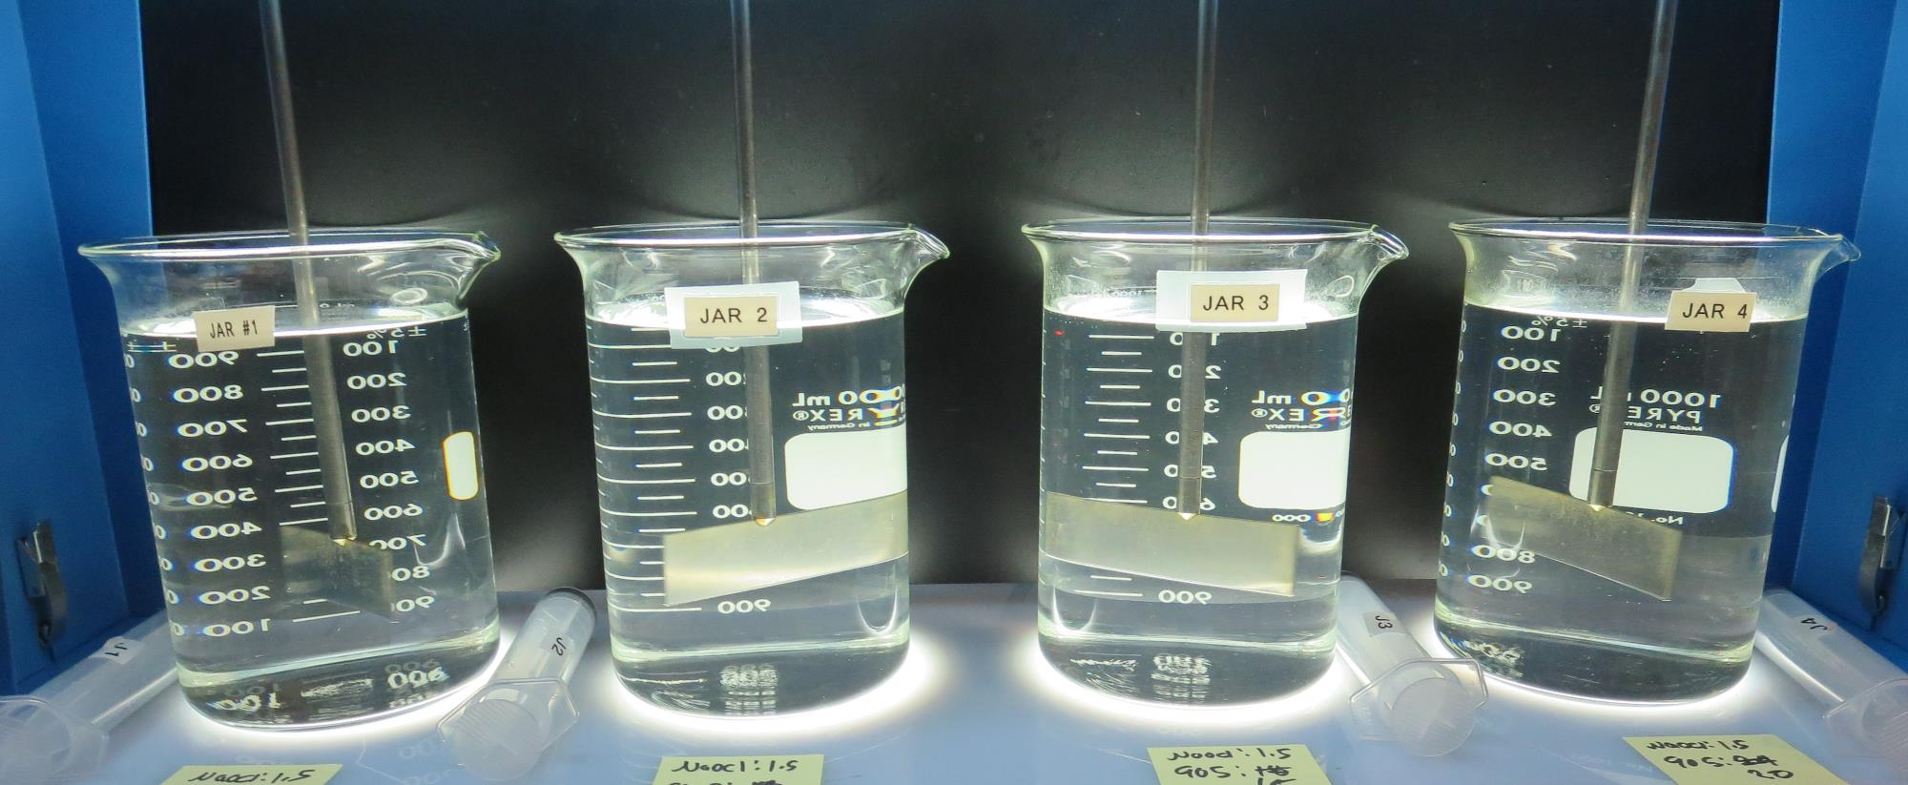
Jars 37-40: End of Floc Duration, 25 mL is syringed for filterability and %UVT/UVA.
1.5 mg/L NaOCl
5 mg/L 905
Filtrate: 0.06 NTU
UVT: 93.8%
UVA: 0.027/cm
UVA Reduction: 55.0%
Settled: 1.09 NTU
1.5 mg/L NaOCl
10 mg/L 905
Filtrate: 0.03 NTU
UVT: 95.6%
UVA: 0.019/cm
UVA Reduction: 68.3%
Settled: 1.32 NTU
1.5 mg/L NaOCl
15 mg/L 905
Filtrate: 0.03 NTU
UVT: 96.1%
UVA: 0.017/cm
UVA Reduction: 71.7%
Settled: 1.42 NTU
1.5 mg/L NaOCl
20 mg/L 905
Filtrate: 0.03 NTU
UVT: 96.4%
UVA: 0.015/cm
UVA Reduction: 75.0%
Settled: 1.19 NTU

Slide 49
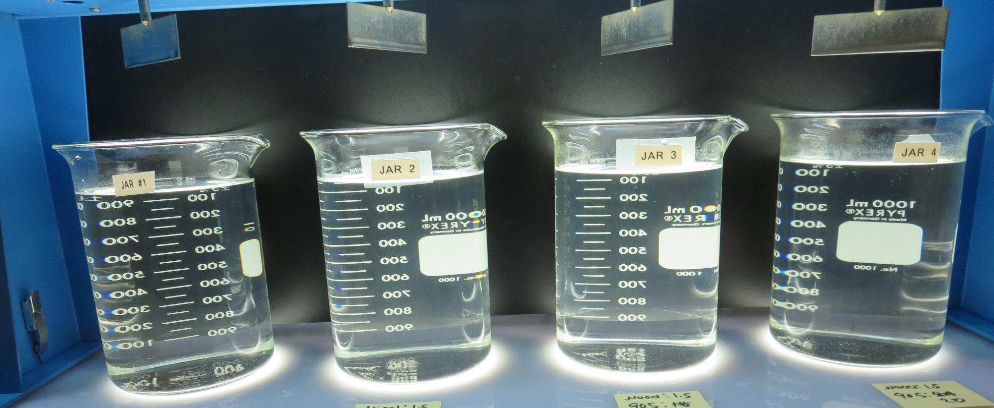
Jars 37-40: After 25-minutes of settling, settled water turbidity is taken.
1.5 mg/L NaOCl
5 mg/L 905
Filtrate: 0.06 NTU
UVT: 93.8%
UVA: 0.027/cm
UVA Reduction: 55.0%
Settled: 1.09 NTU
1.5 mg/L NaOCl
10 mg/L 905
Filtrate: 0.03 NTU
UVT: 95.6%
UVA: 0.019/cm
UVA Reduction: 68.3%
Settled: 1.32 NTU
1.5 mg/L NaOCl
15 mg/L 905
Filtrate: 0.03 NTU
UVT: 96.1%
UVA: 0.017/cm
UVA Reduction: 71.7%
Settled: 1.42 NTU
1.5 mg/L NaOCl
20 mg/L 905
Filtrate: 0.03 NTU
UVT: 96.4%
UVA: 0.015/cm
UVA Reduction: 75.0%
Settled: 1.19 NTU

Slide 50
Jars 41-44 Test Flash Mix 20 Sec (200 RPM) Floc Mix 5 min (30 RPM) Applied Coagulant 905

Slide 51
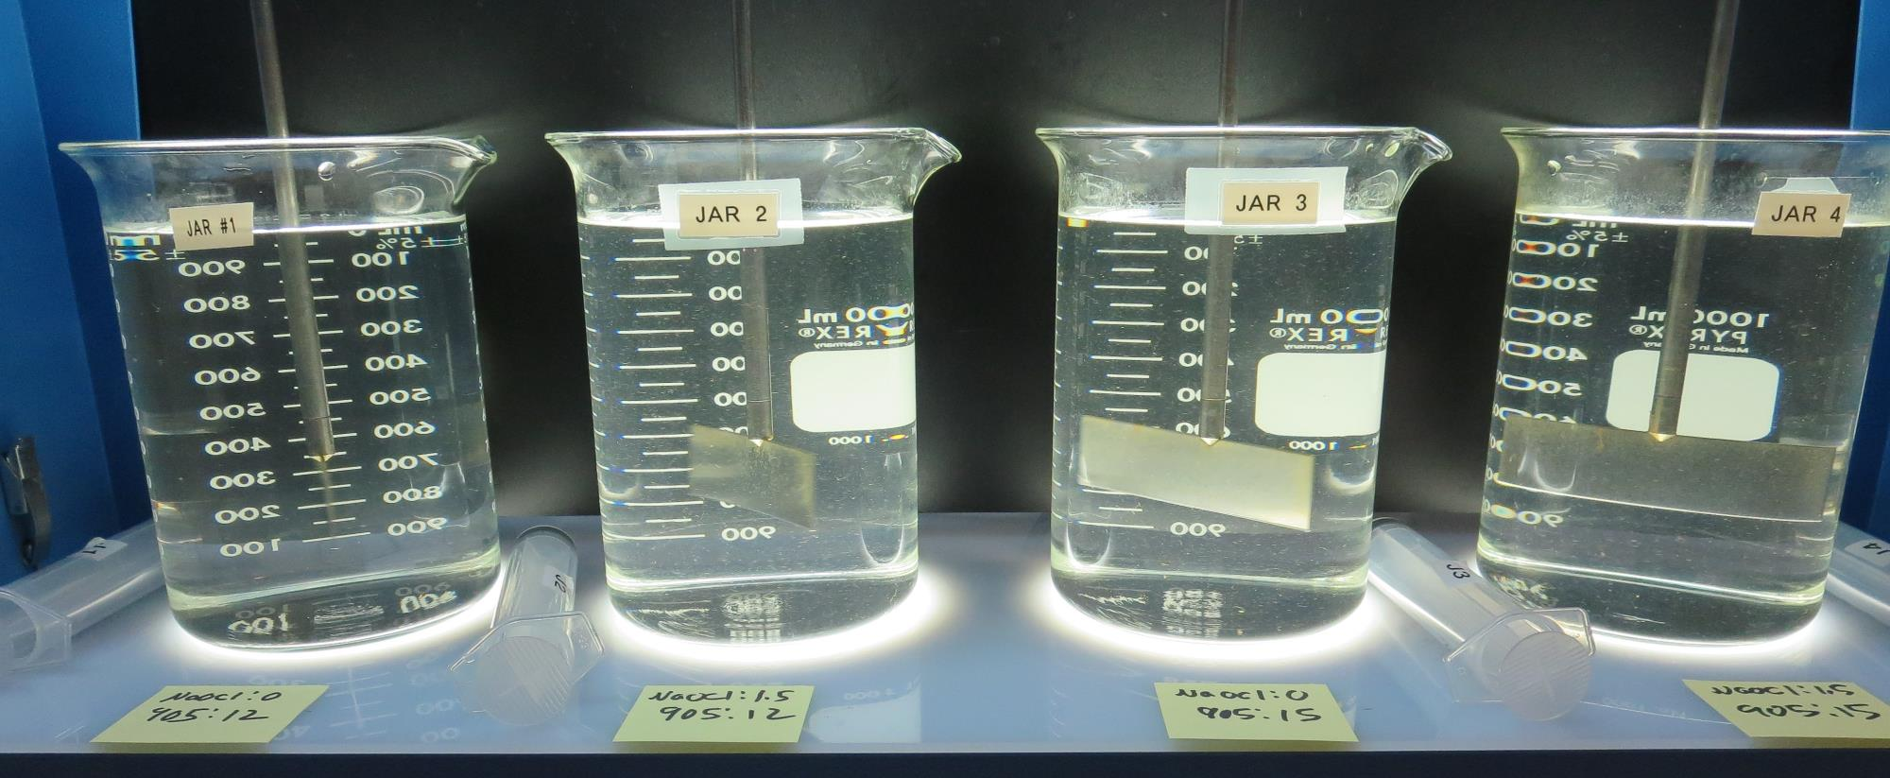
Jars 41-44: End of Floc Duration, 25 mL is syringed for filterability and %UVT/UVA.
0 mg/L NaOCl
12 mg/L 905
Filtrate: 0.03 NTU
UVT: 95.6%
UVA: 0.019/cm
UVA Reduction: 68.3%
Settled: 1.54 NTU
1.5 mg/L NaOCl
12 mg/L 905
Filtrate: 0.03 NTU
UVT: 95.7%
UVA: 0.018/cm
UVA Reduction: 70.0%
Settled: 1.80 NTU
0 mg/L NaOCl
15 mg/L 905
Filtrate: 0.08 NTU
UVT: 95.4%
UVA: 0.020/cm
UVA Reduction: 66.7%
Settled: 1.66 NTU
1.5 mg/L NaOCl
15 mg/L 905
Filtrate: 0.04 NTU
UVT: 95.7%
UVA: 0.017/cm
UVA Reduction: 71.7%
Settled: 1.48 NTU

Slide 52
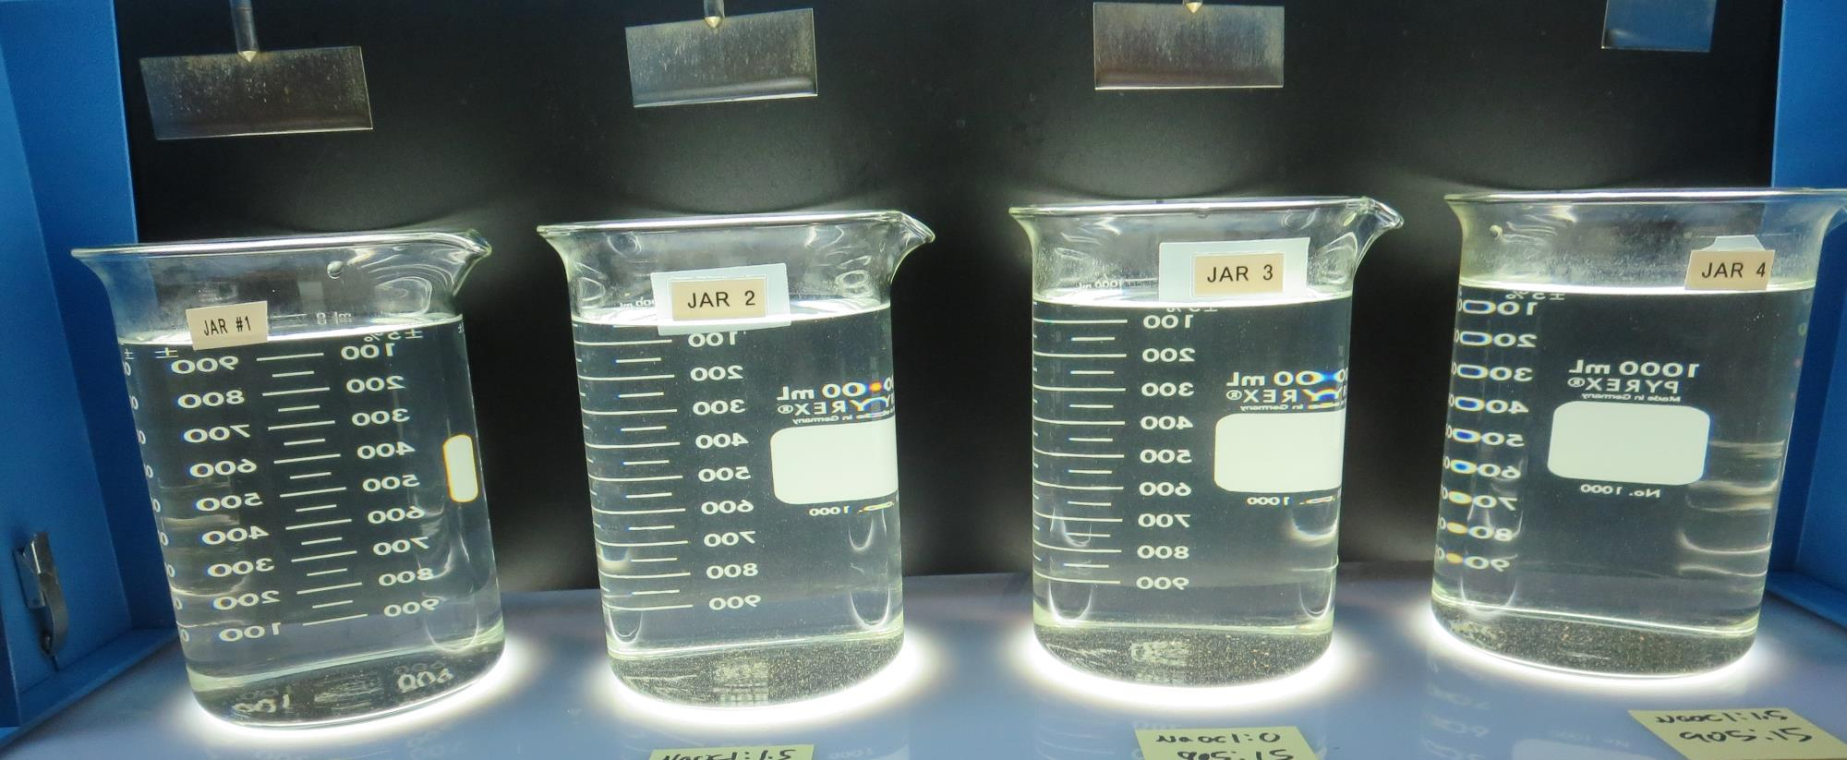
Jars 41-44: After 25-minutes of settling, settled water turbidity is taken.
0 mg/L NaOCl
12 mg/L 905
Filtrate: 0.03 NTU
UVT: 95.6%
UVA: 0.019/cm
UVA Reduction: 68.3%
Settled: 1.54 NTU
1.5 mg/L NaOCl
12 mg/L 905
Filtrate: 0.03 NTU
UVT: 95.7%
UVA: 0.018/cm
UVA Reduction: 70.0%
Settled: 1.80 NTU
0 mg/L NaOCl
15 mg/L 905
Filtrate: 0.08 NTU
UVT: 95.4%
UVA: 0.020/cm
UVA Reduction: 66.7%
Settled: 1.66 NTU
1.5 mg/L NaOCl
15 mg/L 905
Filtrate: 0.04 NTU
UVT: 95.7%
UVA: 0.017/cm
UVA Reduction: 71.7%
Settled: 1.48 NTU

Slide 53
Jars 45-48 Test Flash Mix 20 Sec (200 RPM) Floc Mix 5 min (30 RPM) Applied Coagulant 9810

Slide 54
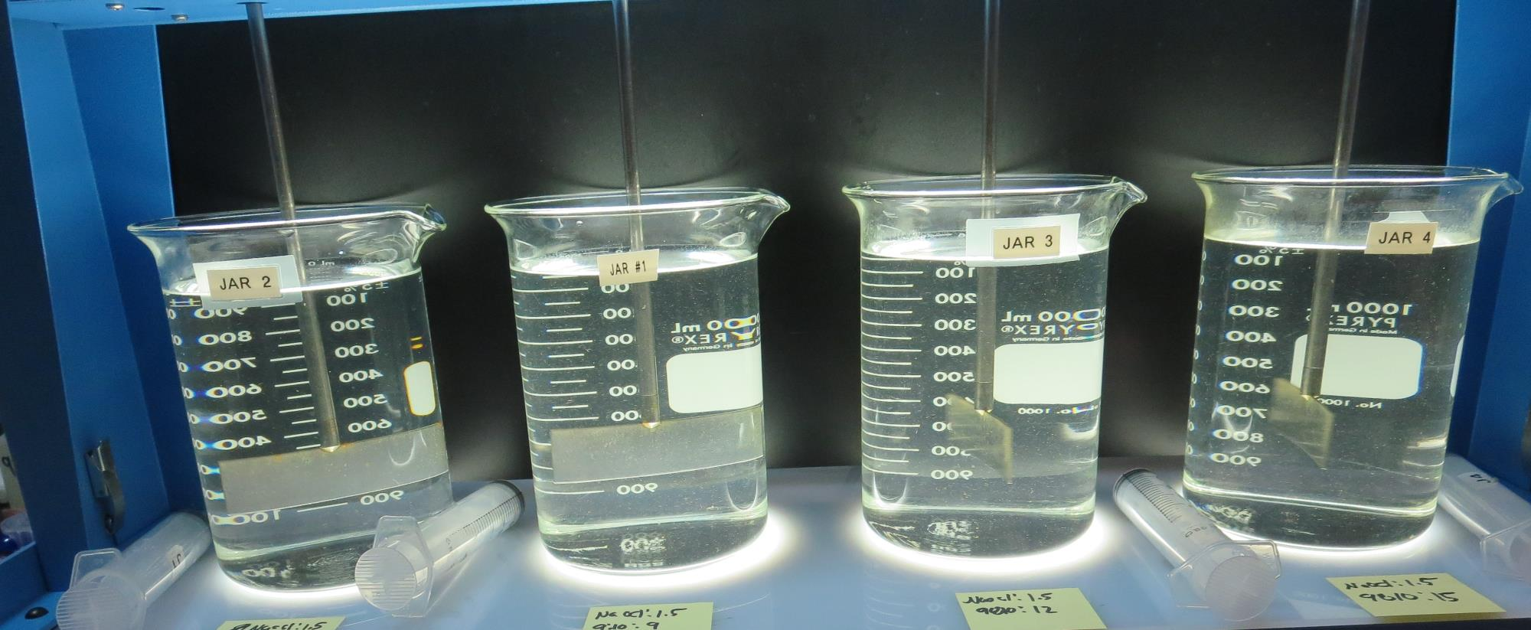
Jars 45-48: End of Floc Duration, 25 mL is syringed for filterability and %UVT/UVA.
1.5 mg/L NaOCl
6 mg/L 9810
Filtrate: 0.04 NTU
UVT: 94.5%
UVA: 0.024/cm
UVA Reduction: 60.0%
Settled: 1.43 NTU
1.5 mg/L NaOCl
9 mg/L 9810
Filtrate: 0.05 NTU
UVT: 95.2%
UVA: 0.021/cm
UVA Reduction: 65.0%
Settled: 1.98 NTU
1.5 mg/L NaOCl
12 mg/L 9810
Filtrate: 0.03 NTU
UVT: 95.8%
UVA: 0.018/cm
UVA Reduction: 70.0%
Settled: 1.72 NTU
1.5 mg/L NaOCl
15 mg/L 9810
Filtrate: 0.03 NTU
UVT: 96.0%
UVA: 0.017/cm
UVA Reduction: 71.7%
Settled: 1.84 NTU

Slide 55
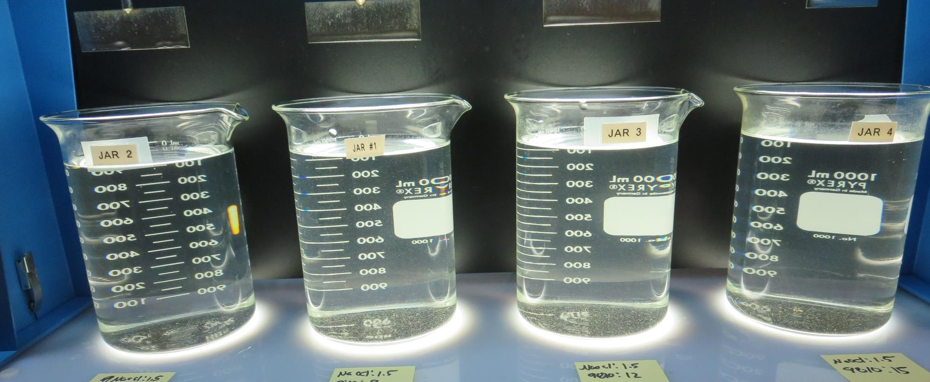
Jars 45-48: After 25-minutes of settling, settled water turbidity is taken.
1.5 mg/L NaOCl
6 mg/L 9810
Filtrate: 0.04 NTU
UVT: 94.5%
UVA: 0.024/cm
UVA Reduction: 60.0%
Settled: 1.43 NTU
1.5 mg/L NaOCl
9 mg/L 9810
Filtrate: 0.05 NTU
UVT: 95.2%
UVA: 0.021/cm
UVA Reduction: 65.0%
Settled: 1.98 NTU
1.5 mg/L NaOCl
12 mg/L 9810
Filtrate: 0.03 NTU
UVT: 95.8%
UVA: 0.018/cm
UVA Reduction: 70.0%
Settled: 1.72 NTU
1.5 mg/L NaOCl
15 mg/L 9810
Filtrate: 0.03 NTU
UVT: 96.0%
UVA: 0.017/cm
UVA Reduction: 71.7%
Settled: 1.84 NTU

Slide 56
Jars 49-52 Test Flash Mix 20 Sec (200 RPM) Floc Mix 5 min (30 RPM) Applied Coagulants 8809, 905, 9810, 961

Slide 57
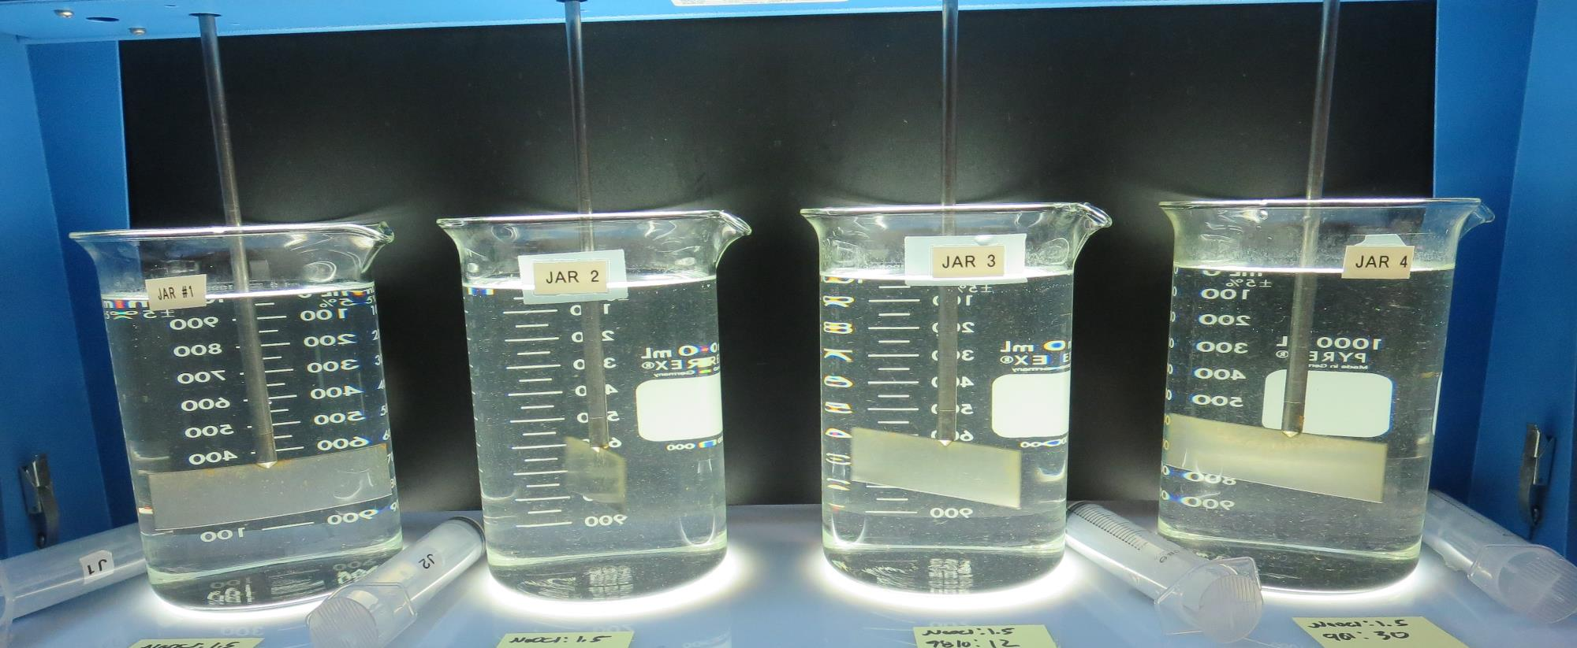
Jars 49-52: End of Floc Duration, 25 mL is syringed for filterability and %UVT/UVA.
1.5 mg/L NaOCl
6.5 mg/L 8809
Filtrate: 0.06 NTU
UVT: 94.5%
UVA: 0.024/cm
UVA Reduction: 60.0%
Settled: 1.82 NTU
1.5 mg/L NaOCl
12 mg/L 905
Filtrate: 0.04 NTU
UVT: 95.5%
UVA: 0.019/cm
UVA Reduction: 68.3%
Settled: 2.07 NTU
1.5 mg/L NaOCl
12 mg/L 9810
Filtrate: 0.04 NTU
UVT: 95.6%
UVA: 0.019/cm
UVA Reduction: 68.3%
Settled: 1.81 NTU
1.5 mg/L NaOCl
29 mg/L 9810
Filtrate: 0.04 NTU
UVT: 95.6%
UVA: 0.019/cm
UVA Reduction: 68.3%
Settled: 0.95 NTU

Slide 58
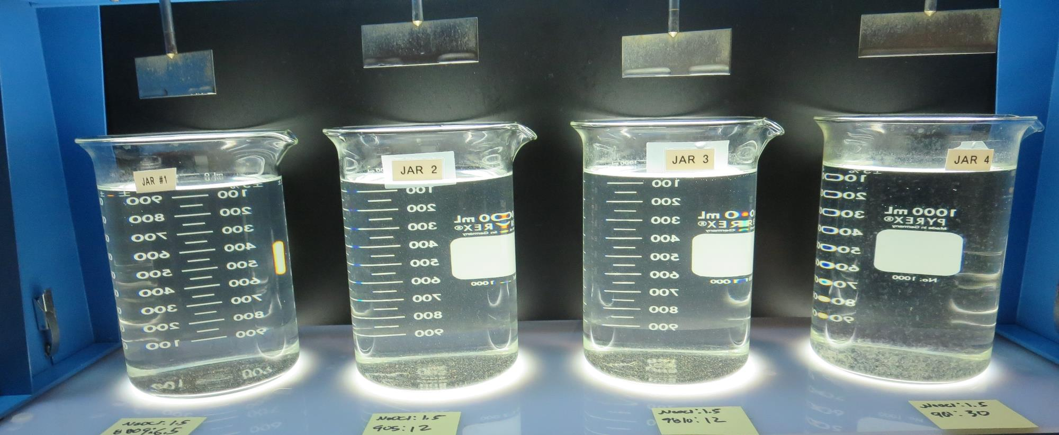
Jars 49-52: After 25-minutes of settling, settled water turbidity is taken.
1.5 mg/L NaOCl
6.5 mg/L 8809
Filtrate: 0.06 NTU
UVT: 94.5%
UVA: 0.024/cm
UVA Reduction: 60.0%
Settled: 1.82 NTU
1.5 mg/L NaOCl
12 mg/L 905
Filtrate: 0.04 NTU
UVT: 95.5%
UVA: 0.019/cm
UVA Reduction: 68.3%
Settled: 2.07 NTU
1.5 mg/L NaOCl
12 mg/L 9810
Filtrate: 0.04 NTU
UVT: 95.6%
UVA: 0.019/cm
UVA Reduction: 68.3%
Settled: 1.81 NTU
1.5 mg/L NaOCl
29 mg/L 9810
Filtrate: 0.04 NTU
UVT: 95.6%
UVA: 0.019/cm
UVA Reduction: 68.3%
Settled: 0.95 NTU

Slide 59
Jar Testing for 1-Liter Jars: Procedures for Most Treatment Plants
Fill jars with source water prior to coagulant injection and set paddle speed at 30 rpm
Add chemicals (i.e., NaOCl, primary coagulant, coagulant aid) to each jar
Flash mix for 15-30 seconds (200 rpm)
Slow mix for 5 minutes (20-30 rpm)
Settled for 5 minutes. Syringe 25 mL from each jar taken 1-inch below surface (25 mL/12 sec rate)
Filtered through 1.2 um isopore membrane into cuvette drip rate, 15 mL/(50-90 sec)
Measure filtrate turbidity, chlorine residual and %UVT/UVA
Measure settled water turbidity after 25 minutes of total setting
Record all data

Slide 60
Jar Test Filterability Test Equipment
Turbidity Instrument
Syringe w/Luer-Lock Tip, 30 cc
(part#: 2225800, by Hach)
Swinnex Filter Holder, 25 mm (part#: SX0002500)
Isopore Membrane Filter, 1.2 um absolute
pore size,
Φ= 25 mm , thickness: 24 um,
hydrophilic polycarbonate membrane
(part #: RTTP02500)
Go to Sigma-Aldrich for laboratory supplies http://www.sigmaaldrich.com/united-states.html

Slide 61
Isopore Membrane Information
Categories | Information
trade name | Isopore
filter color | White
chemistry | Polycarbonate (PC)
water flow rate | Avg. 175 mL/min x cm² (typical results @ 10 psi)
media | Isopore®
wettability | Hydrophilic
porosity | 14.7%
pore size | 1.2 µm
bubble point at 23 °C | 1.0 bar, air with water
thickness | 24 µm
filter diameter (ø) | 25 mm
material size | polycarbonate, Hydrophilic, 1.2 µm, 25 mm, white, plain, 100

Slide 62
Isopore Membrane Background Information
The Isopore membrane is a polycarbonate, track-etched screen filter recommended for all analyses in which the sample is viewed on the surface of the membrane. The Isopore membrane is composed of polycarbonate film, which has a smooth, glass-like surface for clearer sample observation. The unique manufacturing process of the membrane ensures a precise pore diameter and a consistent pore size for accurate separation of samples by size. Matched-weight filters are not usually required because of low, constant tar and ash weights. Features & Benefits: Membrane structure retains particles on the surface, simplifying counting and analysis

Slide 63
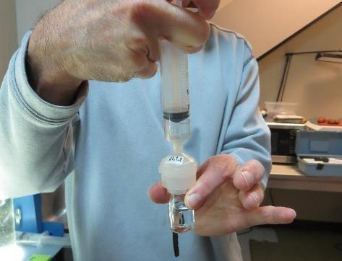
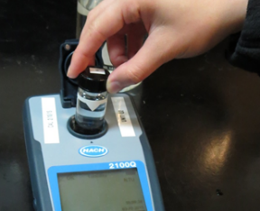
Jar Test - Filterability Test
Syringe ~ 25 mL from jar (after 5-minutes of settling)
Filter-to-waste 3-5 mL
Filter directly into clean cuvette
Measure turbidity
Note: Take several readings before recording final NTU results. Micro bubbles can adhere to glass causing false NTU readings. To remove bubbles, tilt cuvette up to 90 degrees.

Slide 64
Contact
Guy Schott, P.E.
State Water Resources Control Board
Division of Drinking Water
Santa Rosa, CA
Go to Stock Solution/Dose calculations/Jar Test Results for tools to download
www.waterboards.ca.gov/drinking_water/programs/districts/mendocino_district.html
Jar Testing Done Right training video: https://www.youtube.com/watch?v=aGByyxhelkI
Email: Guy Schott - Guy.Schott@waterboards.ca.gov
Office Number: 707-576-2732

