Slide 1
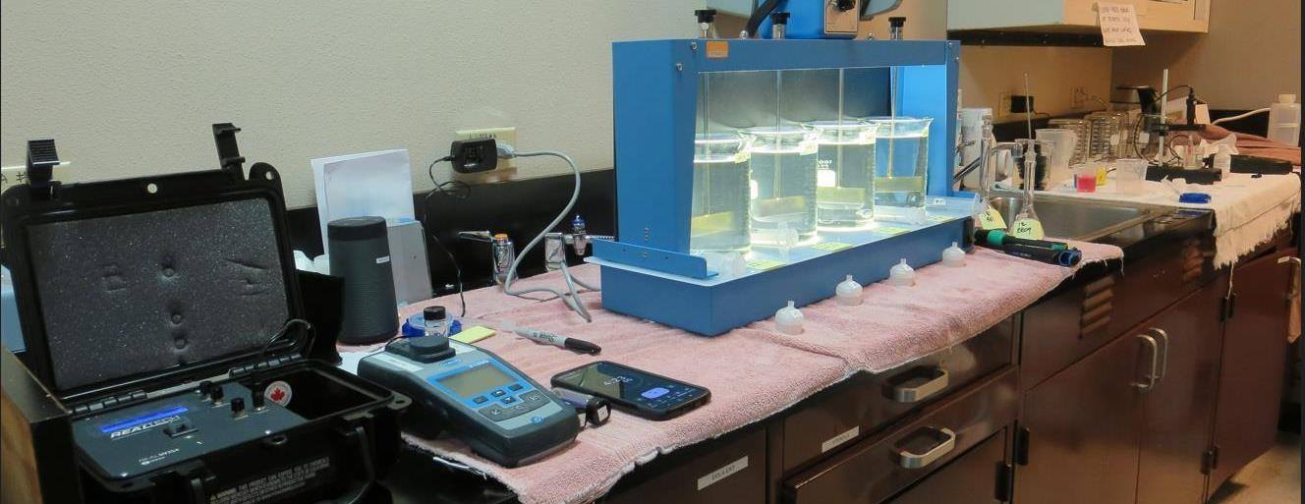
Tanner Amador Water Agency CA0310003, Amador County, Jar Test
by Guy Schott, P.E. April 10, 2023

Slide 2
Tanner AWA Source & Treated Water Characteristics, April 10, 2023
Source – Tanner Reservoir
pH: 7.28
Alkalinity: 14 mg/L as CaCO₃
Turbidity: 0.92 NTU
UVT: 88.0%,
UVA: 0.055/cm
0.4 um Filtered
Turbidity: 0.46 NTU
UVT: 88.0%,
UVA: 0.055/cm
Plant Filtrate Water
0.05 NTU
UVT: 95.9%,
UVA: 0.018/cm
Plant Filtrate Post Chlorine Water
0.11 NTU
UVT: 96.5%,
UVA: 0.015/cm

Slide 3
Applied Coagulants for Jar Testing (1)
SWT 9311 (Sterling Water Technologies)
20-30% Aluminum Chlorohydrate
10-20% pDADMAC (20%)
50-70% Water
SG = 1.15-1.29
NSF limit: 50 mg/L as Product
Product dose 3.5 mg/L = 0.7 mg/L pDADMAC
SWT 2000 (Sterling Water Technologies)
50% Aluminum Chlorohydrate
50% Water
23.62% Al₂O₃
12.5% Al
83% Basicity
SG = 1.25-1.34
NSF limit: 250 mg/L as Product

Slide 4
Applied Coagulants for Jar Testing (2)
961 (NTU Technologies)
32% Polyaluminum Hydroxychlorosulfate
2% pDADMAC (blend?)
66% Water
SG = 1.2-1.24
NSF limit: 255 mg/L as Product
Product dose 10 mg/L = 0.1-0.2 mg/L pDADMAC

Slide 5
Applied Coagulants for Jar Testing (3)
NTU Technologies
Pro Pac 9810
45-50% Aluminum Chlorohydrate
45-50% Water
~22.4% Al₂O₃
~11.9% Al
83% Basicity
5% polyamine (50% water, 50% active polyamines)
SG = 1.25-1.34
NSF limit: 200 mg/L as Product;
Product dose 10 mg/L = 0.25 mg/L polyamines active
905 (NTU Technologies)
45-55% Aluminum Chlorohydrate (~49%)
2% pDADMAC (blend?)
45-55% Water
SG = 1.2 – 1.34
NSF limit: 255 mg/L as Product
Product dose 10 mg/L = 0.1-0.2 mg/L pDADMAC

Slide 6
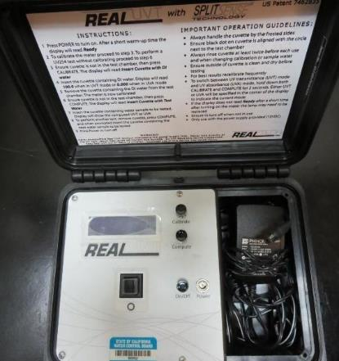
UVT/UVA, pathlength 10 mm
UV transmittance (UVT) is a measurement of the amount of ultraviolet light (254 nm) that passes through a water sample compared to the amount of light that passes through a pure water sample. The measurement is expressed as % UVT.
%UVT = 10^{(-UVA)} x 100%
UV absorbance (UVA) is calculated as a relative measure of the amount of light absorbed by a water sample compared with the amount of light absorbed by a pure water sample.
UVA = -log(%UVT/100)

Slide 7
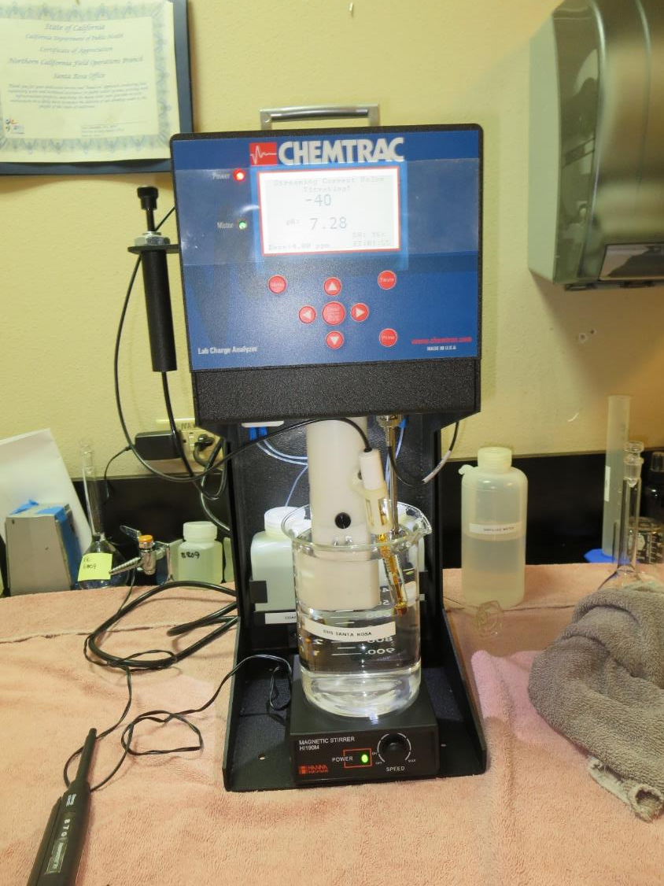
Laboratory Charge Analyzer
LCA: Used to determine coagulant demand of a source water entering the treatment plant.
Source pH: 7.28
LCA #1: SWT-9311 [Al][pDADMAC]
4.0 mg/L as product

Slide 8
Coagulant Information
Unless stated otherwise, all coagulant doses are reported as Product (100% strength).
Aluminum Sulfate doses are reported as hydrated Al₂(SO₄)₃*14.3H₂0.
Preparation of coagulant stock solutions are generally 1.0 and/or 0.1 percent strength using 100 and/or 200 mL volumetric flasks.
Finnpipette F2 variable volume pipette, capacity 100-1000 micro liters is used for stock solution preparation and coagulant aid jar test dosing.
Finnpipette F2 variable volume pipette, capacity 0.5-5 mL is used for primary coagulant jar test dosing.

Slide 9
Tanner AWA; Source: Tanner Reservoir Summary of Optimum Dose/Coagulants for Tested Products
Coag Product | NaOCl mg/L | Coag Dose mg/L | Filtrate NTU | Filtrate %UVT | Filtrate UVA/cm | %UVA Reduction | pH | Coagulant Max Use, mg/L
SWT-9311 | 1.5 | 3.5 | 0.03 | 94.7 | 0.023 | 58.2 | - | 50
SWT-9311 | 1.5 | 3.5 | 0.07 | 94.4 | 0.024 | 56.4 | 7.41 | 50
905 | 0 | 9 | 0.03 | 96.2 | 0.016 | 70.9 | - | 255
905 | 0 | 9 | 0.03 | 96.3 | 0.016 | 70.9 | 7.18 | 255
9810 | 0 | 9 | 0.04 | 96.3 | 0.016 | 70.9 | - | 200
9810 | 0 | 9 | 0.03 | 96.4 | 0.015 | 72.7 | 7.18 | 200
SWT-2000 | 0 | 9 | 0.04 | 96.5 | 0.015 | 72.7 | - | 250
SWT-2000 | 0 | 9 | 0.04 | 96.2 | 0.016 | 70.9 | 7.18 | 250
961 | 0 | 24 | 0.05 | 96.1 | 0.017 | 69.1 | - | 255

Slide 10
Tanner AWA; Jar Test 1 - 8 Results Flash Mix 200 RPM (20 sec); Floc Mix 30 RPM (5 min)
Jar# | NaOCl mg/L | SWT-9311 mg/L | 961 mg/L | Filtrate NTU | Filtrate %UVT | Filtrate UVA/cm | %UVA Reduction
J1 | 1.5 | 3.0 | - | 0.28 | 94.2 | 0.025 | 54.5
J2 | 1.5 | 3.5 | - | 0.08 | 94.5 | 0.024 | 56.4
J3 | 1.5 | 4.0 | - | 0.10 | 95.0 | 0.022 | 60.0
J4 | 1.5 | 4.5 | - | 0.04 | 94.8 | 0.023 | 58.2
J5 | 0 | - | 9 | 0.30 | 90.8 | 0.041 | 25.5
J6 | 0 | - | 14 | 0.05 | 95.0 | 0.022 | 60.0
J7 | 0 | - | 19 | 0.06 | 95.5 | 0.020 | 63.6
J8 | 0 | - | 24 | 0.05 | 96.1 | 0.017 | 69.1

Slide 11
Tanner AWA; Jar Test 9 - 16 Results Flash Mix 200 RPM (20 sec); Floc Mix 30 RPM (5 min)
Jar# | NaOCl mg/L | 905 mg/L | Filtrate NTU | Filtrate %UVT | Filtrate UVA/cm | %UVA Reduction
J9 | 0 | 5 | 0.35 | 90.5 | 0.043 | 21.8
J10 | 0 | 7 | 0.11 | 94.6 | 0.023 | 58.2
J11 | 0 | 9 | 0.03 | 96.2 | 0.016 | 70.9
J12 | 0 | 11 | 0.03 | 96.2 | 0.016 | 70.9
J13 | 0 | 7 | 0.06 | 95.2 | 0.021 | 61.8
J14 | 1.5 | 7 | 0.09 | 95.1 | 0.021 | 61.8
J15 | 0 | 9 | 0.06 | 96.3 | 0.016 | 70.9
J16 | 1.5 | 9 | 0.03 | 96.2 | 0.015 | 70.9

Slide 12
Tanner AWA; Jar Test 17 - 24 Results Flash Mix 200 RPM (20 sec); Floc Mix 30 RPM (5 min)
Jar# | 9810 mg/L | SWT-2000 mg/L | Filtrate NTU | Filtrate %UVT | Filtrate UVA/cm | %UVA Reduction
J17 | 5 | - | 0.13 | 93.5 | 0.029 | 47.3
J18 | 7 | - | 0.05 | 95.5 | 0.019 | 65.5
J19 | 9 | - | 0.04 | 96.3 | 0.016 | 70.9
J20 | 11 | - | 0.04 | 96.4 | 0.015 | 72.7
J21 | - | 6 | 0.16 | 93.9 | 0.027 | 50.9
J22 | - | 7 | 0.04 | 95.9 | 0.017 | 69.1
J23 | - | 8 | 0.04 | 96.3 | 0.016 | 70.9
J24 | - | 9 | 0.04 | 96.5 | 0.015 | 72.7

Slide 13
Tanner AWA; Jar Test 25 - 32 Results Flash Mix 200 RPM (20 sec); Floc Mix 30 RPM (5 min)
Jar# | NaOCl mg/L | SWT-9311 mg/L | Filtrate NTU | Filtrate %UVT | Filtrate UVA/cm | %UVA Reduction
J25 | 1.5 | 3.5 | 0.04 | 94.6 | 0.023 | 58.2
J26 | 1.5 | 4.0 | 0.08 | 94.7 | 0.023 | 58.2
J27 | 1.5 | 4.5 | 0.07 | 94.9 | 0.022 | 60.0
J28 | 1.5 | 5.0 | 0.09 | 95.0 | 0.021 | 61.8
J29 | 0 | 3.5 | 0.04 | 94.1 | 0.026 | 52.7
J30 | 0 | 3.5 | 0.04 | 94.1 | 0.026 | 52.7
J31 | 1.5 | 3.5 | 0.03 | 94.7 | 0.023 | 58.2
J32 | 1.5 | 3.5 | 0.08 | 94.5 | 0.024 | 56.4

Slide 14
Tanner AWA; Jar Test 33 - 36 Results Flash Mix 200 RPM (20 sec); Floc Mix 30 RPM (5 min)
Jar# | NaOCl mg/L | SWT 9311 mg/L | 905 mg/L | 9810 mg/L | SWT 2000 mg/L | Filtrate NTU | Filtrate %UVT | Filtrate UVA/cm | %UVA Reduction | pH | Alk mg/L CaCO₃
J33 | 1.5 | 3.5 | - | - | - | 0.07 | 94.5 | 0.024 | 56.4 | 7.41 | 16
J34 | 0 | - | 9 | - | - | 0.03 | 95.5 | 0.016 | 70.9 | 7.20 | 15.5
J35 | 0 | - | - | 9 | - | 0.03 | 95.6 | 0.015 | 72.7 | 7.20 | 15.5
J36 | 0 | - | - | - | 9 | 0.04 | 95.6 | 0.016 | 70.9 | 7.20 | 15.5

Slide 15
Tanner AWA; Jar Test 37 - 44 Results Flash Mix 200 RPM (20 sec); Floc Mix 30 RPM (5 min)
Jar# | NaOCl mg/L | SWT-9311 mg/L | SWT-2000 mg/L | Filtrate NTU | Filtrate %UVT | Filtrate UVA/cm | %UVA Reduction
J37 | 1.5 | 3.0 | - | 0.05 | 93.8 | 0.027 | 50.9
J38 | 1.5 | 3.5 | - | 0.05 | 93.8 | 0.027 | 50.9
J39 | 1.5 | 3.0 | - | 0.10 | 93.5 | 0.029 | 47.3
J40 | 1.5 | 3.5 | - | 0.05 | 93.6 | 0.028 | 49.1
J41 | 0 | - | 5.0 | 0.12 | 92.7 | 0.032 | 41.8
J42 | 0 | - | 5.0 | 0.21 | 91.7 | 0.037 | 32.7
J43 | 0 | - | 9.0 | 0.03 | 96.1 | 0.016 | 70.9
J44 | 0 | - | 9.0 | 0.04 | 96.1 | 0.017 | 69.1

Slide 16
Tanner AWA; Jar Test 45 - 52 Results Flash Mix 200 RPM (20 sec); Floc Mix 30 RPM (5 min)
Jar# | NaOCl mg/L | 905 mg/L | SWT-2000 mg/L | Filtrate NTU | Filtrate %UVT | Filtrate UVA/cm | %UVA Reduction
J45 | 0 | 4.0 | - | 0.27 | 90.0 | 0.045 | 18.2
J46 | 0 | 5.0 | - | 0.14 | 92.8 | 0.032 | 41.8
J47 | 0 | 7.0 | - | 0.10 | 95.1 | 0.021 | 61.8
J48 | 0 | 9.0 | - | 0.04 | 96.2 | 0.016 | 70.9
J49 | 0 | - | 4.0 | 0.23 | 91.7 | 0.037 | 32.7
J50 | 0 | - | 5.0 | 0.05 | 94.2 | 0.025 | 54.5
J51 | 0 | - | 7.0 | 0.04 | 95.4 | 0.020 | 63.6
J52 | 0 | - | 9.0 | 0.06 | 95.8 | 0.018 | 67.3

Slide 17
Jars 1-4 Test Flash Mix 20 Sec (200 RPM) Floc Mix 5 min (30 RPM) No Photos Applied Coagulant 9311

Slide 18
Jars 5-8 Test Flash Mix 20 Sec (200 RPM) Floc Mix 5 min (30 RPM) No Photos Applied Coagulant 961

Slide 19
Jars 9-12 Test Flash Mix 20 Sec (200 RPM) Floc Mix 5 min (30 RPM) Applied Coagulant 905

Slide 20
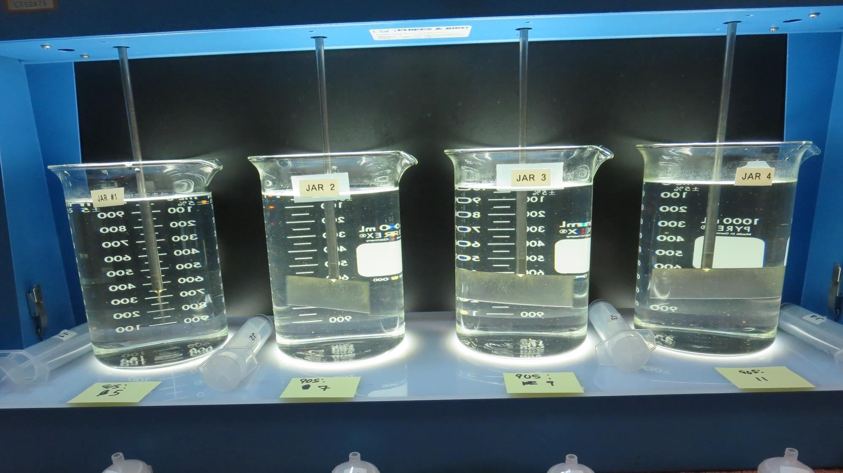
Jars 9-12: End of Floc Duration, 25 mL is syringed for filterability and %UVT/UVA.
5 mg/L 905
Filtrate: 0.35 NTU
UVT: 90.5%
UVA: 0.043/cm
UVA Reduction: 21.8%
7 mg/L 905
Filtrate: 0.11 NTU
UVT: 94.6%
UVA: 0.023/cm
UVA Reduction: 58.2%
9 mg/L 905
Filtrate: 0.03 NTU
UVT: 96.2%
UVA: 0.016/cm
UVA Reduction: 70.9%
11 mg/L 905
Filtrate: 0.03 NTU
UVT: 96.2%
UVA: 0.016/cm
UVA Reduction: 70.9%

Slide 21
Jars 13-16 Test Flash Mix 20 Sec (200 RPM) Floc Mix 5 min (30 RPM) No Photos Applied Coagulant 905

Slide 22
Jars 17-20 Test Flash Mix 20 Sec (200 RPM) Floc Mix 5 min (30 RPM) Applied Coagulant 9810

Slide 23
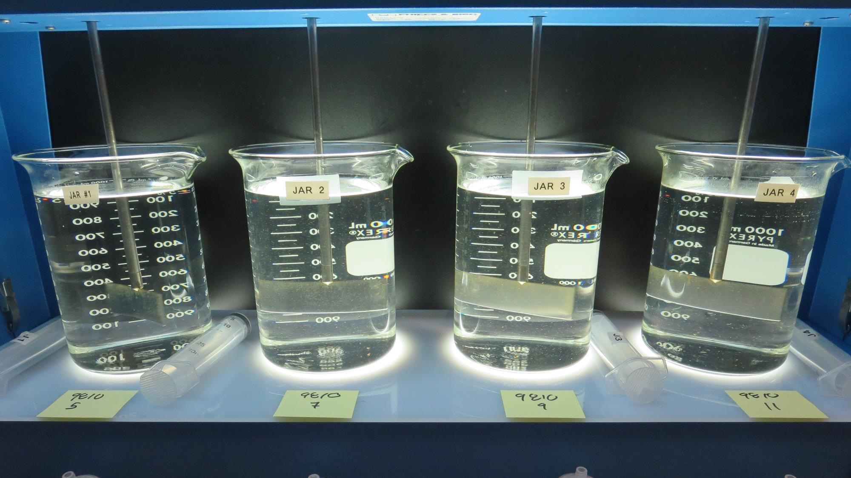
Jars 17-20: End of Floc Duration, 25 mL is syringed for filterability and %UVT/UVA.
5 mg/L 9810
Filtrate: 0.13 NTU
UVT: 93.5%
UVA: 0.029/cm
UVA Reduction: 47.3%
7 mg/L 9810
Filtrate: 0.05 NTU
UVT: 95.5%
UVA: 0.019/cm
UVA Reduction: 65.5%
9 mg/L 9810
Filtrate: 0.04 NTU
UVT: 96.3%
UVA: 0.016/cm
UVA Reduction: 70.9%
11 mg/L 9810
Filtrate: 0.04 NTU
UVT: 96.4%
UVA: 0.015/cm
UVA Reduction: 72.7%

Slide 24
Jars 21-24 Test Flash Mix 20 Sec (200 RPM) Floc Mix 5 min (30 RPM) No Photos Applied Coagulant SWT-2000

Slide 25
Jars 25-28 Test Flash Mix 20 Sec (200 RPM) Floc Mix 5 min (30 RPM) Applied Coagulant 9311

Slide 26
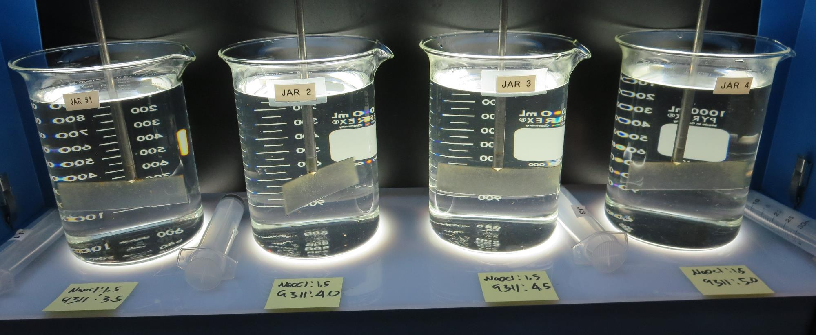
Jars 25-28: End of Floc Duration, 25 mL is syringed for filterability and %UVT/UVA.
1.5 mg/L NaOCl
3.5 mg/L SWT-9311
Filtrate: 0.04 NTU
UVT: 94.6%
UVA: 0.023/cm
UVA Reduction: 58.2%
1.5 mg/L NaOCl
4.0 mg/L SWT-9311
Filtrate: 0.08 NTU
UVT: 94.7%
UVA: 0.023/cm
UVA Reduction: 58.2%
1.5 mg/L NaOCl
4.5 mg/L SWT-9311
Filtrate: 0.07 NTU
UVT: 94.9%
UVA: 0.022/cm
UVA Reduction: 60.0%
1.5 mg/L NaOCl
5.0 mg/L SWT-9311
Filtrate: 0.09 NTU
UVT: 95.0%
UVA: 0.021/cm
UVA Reduction: 61.8%

Slide 27
Jars 29-32 Test Flash Mix 20 Sec (200 RPM) Floc Mix 5 min (30 RPM) Applied Coagulant 9311

Slide 28
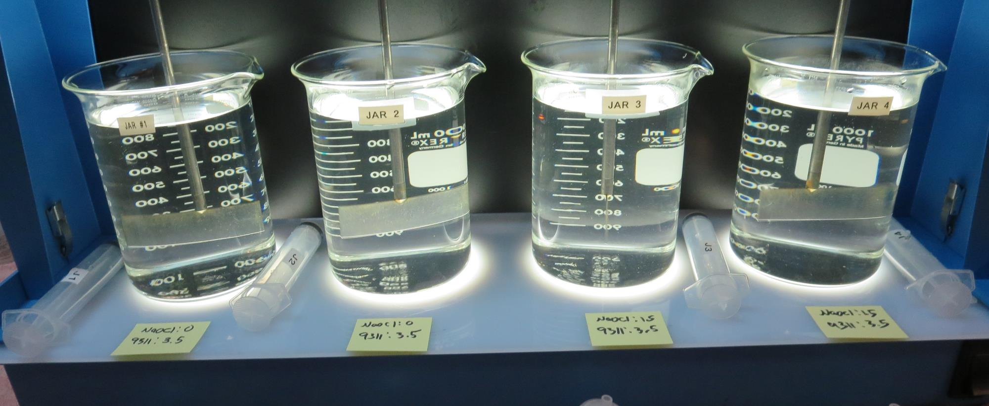
Jars 29-32: End of Floc Duration, 25 mL is syringed for filterability and %UVT/UVA.
0 mg/L NaOCl
3.5 mg/L SWT-9311
Filtrate: 0.04 NTU
UVT: 94.1%
UVA: 0.026/cm
UVA Reduction: 52.7%
0 mg/L NaOCl
3.5 mg/L SWT-9311
Filtrate: 0.04 NTU
UVT: 94.1%
UVA: 0.026/cm
UVA Reduction: 52.7%
1.5 mg/L NaOCl
3.5 mg/L SWT-9311
Filtrate: 0.03 NTU
UVT: 94.7%
UVA: 0.023/cm
UVA Reduction: 58.2%
1.5 mg/L NaOCl
3.5 mg/L SWT-9311
Filtrate: 0.08 NTU
UVT: 94.5%
UVA: 0.024/cm
UVA Reduction: 56.4%

Slide 29
Jars 33-36 Test Flash Mix 20 Sec (200 RPM) Floc Mix 5 min (30 RPM) Applied Coagulants 9311, 905, 9810 & SWT-2000

Slide 30
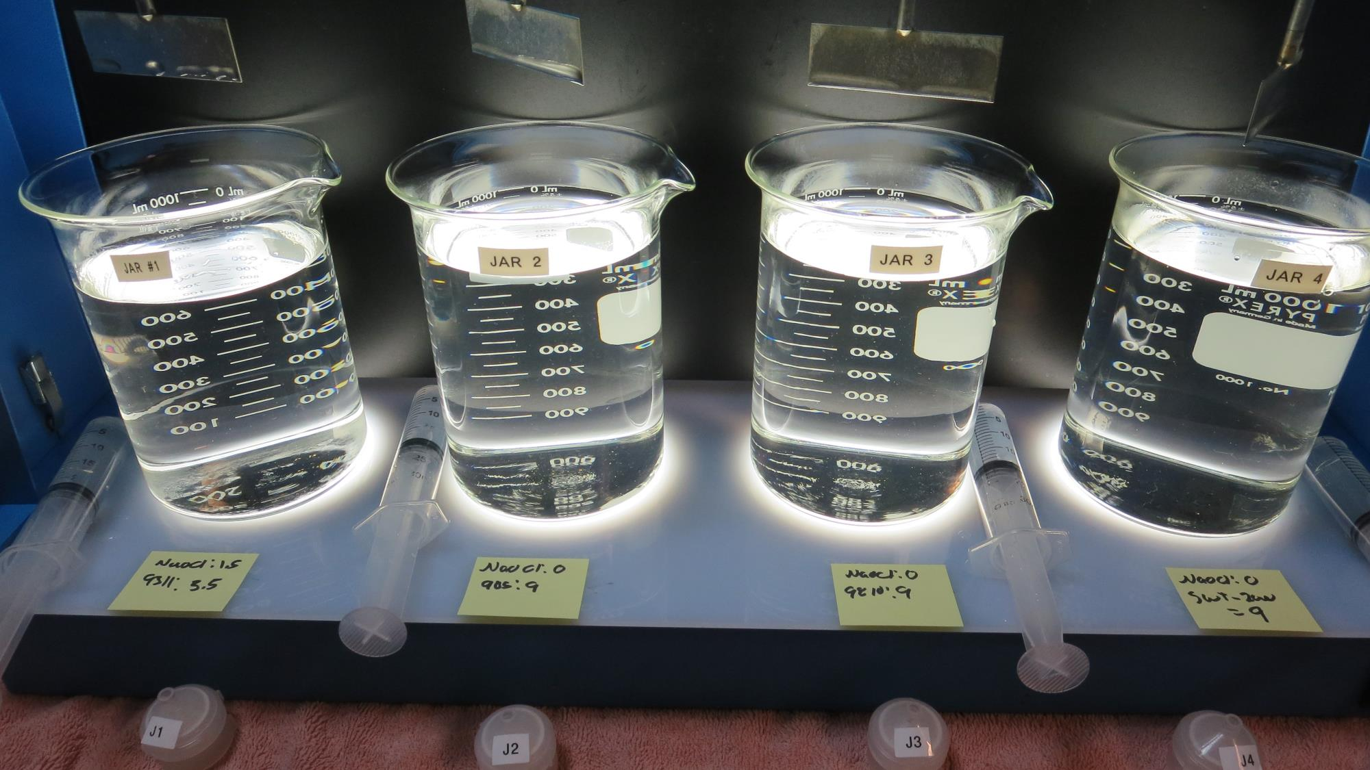
Jars 33-36: End of Floc Duration, 25 mL is syringed for filterability and %UVT/UVA.
1.5 mg/L NaOCl
3.5 mg/L 9311
Filtrate: 0.07 NTU
UVT: 94.4%
UVA: 0.024/cm
UVA Reduction: 56.4%
0 mg/L NaOCl
9 mg/L 905
Filtrate: 0.03 NTU
UVT: 96.3%
UVA: 0.016/cm
UVA Reduction: 70.9%
0 mg/L NaOCl
9 mg/L 9810
Filtrate: 0.03 NTU
UVT: 96.4%
UVA: 0.015/cm
UVA Reduction: 72.7%
0 mg/L NaOCl
9 mg/L SWT-2000
Filtrate: 0.04 NTU
UVT: 96.2%
UVA: 0.016/cm
UVA Reduction: 70.9%

Slide 31
Jars 33-36 Test Flash Mix 20 Sec (200 RPM) Floc Mix 5 min (30 RPM) No Photos Applied Coagulant SWT-9311

Slide 32
Jars 41-44 Test Flash Mix 20 Sec (200 RPM) Floc Mix 5 min (30 RPM) Applied Coagulant SWT-2000

Slide 33
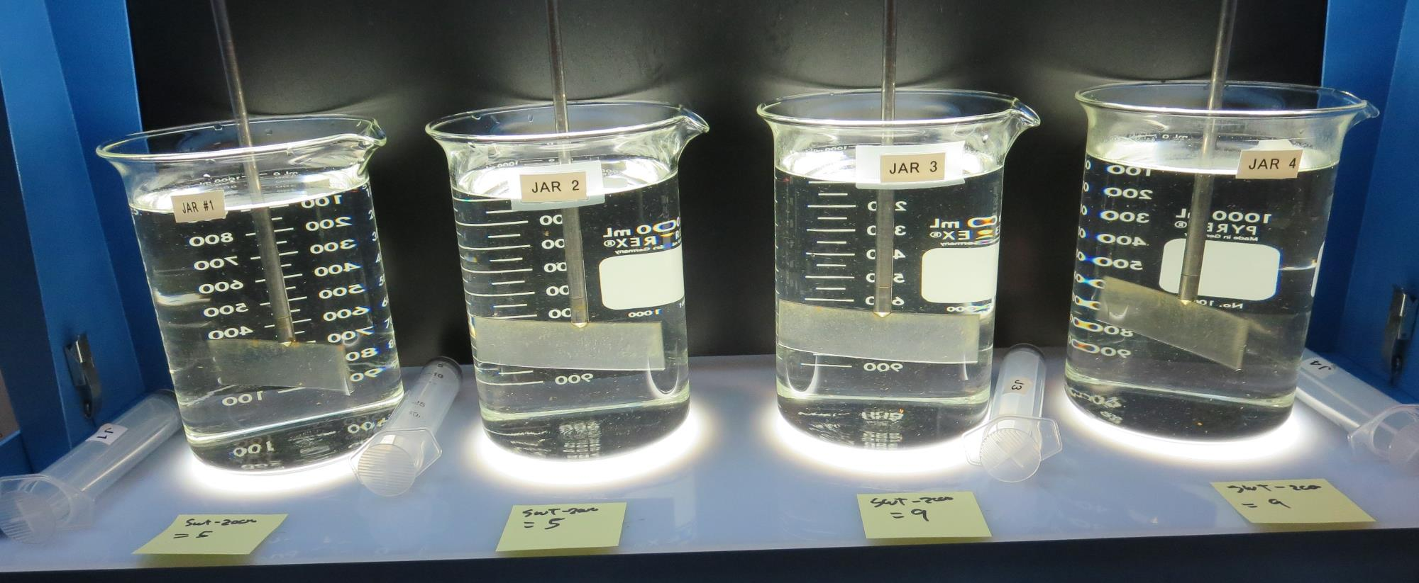
Jars 41-44: End of Floc Duration, 25 mL is syringed for filterability and %UVT/UVA.
0 mg/L NaOCl
5.0 mg/L SWT-2000
Filtrate: 0.12 NTU
UVT: 92.7%
UVA: 0.032/cm
UVA Reduction: 41.8%
0 mg/L NaOCl
5.0 mg/L SWT-2000
Filtrate: 0.21 NTU
UVT: 91.7%
UVA: 0.037/cm
UVA Reduction: 32.7%
0 mg/L NaOCl
9.0 mg/L SWT-2000
Filtrate: 0.03 NTU
UVT: 96.1%
UVA: 0.016/cm
UVA Reduction: 70.9%
0 mg/L NaOCl
9.0 mg/L SWT-2000
Filtrate: 0.04 NTU
UVT: 96.1%
UVA: 0.017/cm
UVA Reduction: 69.1%

Slide 34
Jars 45-48 Test Flash Mix 20 Sec (200 RPM) Floc Mix 5 min (30 RPM) Applied Coagulant 905

Slide 35
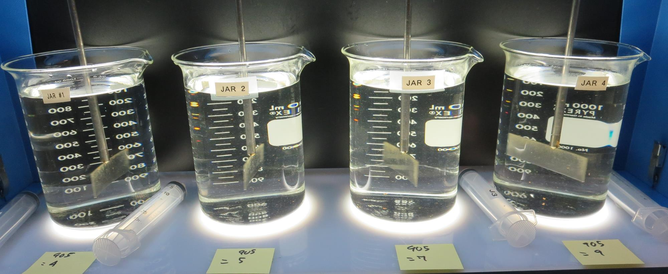
Jars 45-48: End of Floc Duration, 25 mL is syringed for filterability and %UVT/UVA.
0 mg/L NaOCl
4.0 mg/L 905
Filtrate: 0.27 NTU
UVT: 90.0%
UVA: 0.045/cm
UVA Reduction: 18.2%
0 mg/L NaOCl
5.0 mg/L 905
Filtrate: 0.14 NTU
UVT: 92.8%
UVA: 0.032/cm
UVA Reduction: 41.8%
0 mg/L NaOCl
7.0 mg/L 905
Filtrate: 0.10 NTU
UVT: 95.1%
UVA: 0.021/cm
UVA Reduction: 61.8%
0 mg/L NaOCl
9.0 mg/L 905
Filtrate: 0.04 NTU
UVT: 96.2%
UVA: 0.016/cm
UVA Reduction: 70.9%

Slide 36
Jars 49-52 Test Flash Mix 20 Sec (200 RPM) Floc Mix 5 min (30 RPM) Applied Coagulant SWT-2000

Slide 37
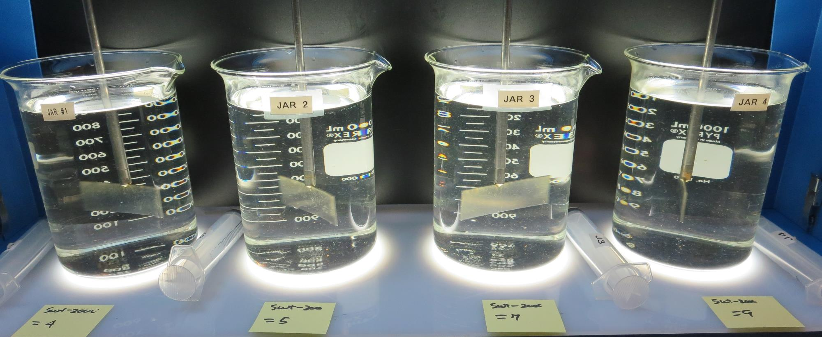
Jars 49-52: End of Floc Duration, 25 mL is syringed for filterability and %UVT/UVA.
0 mg/L NaOCl
4.0 mg/L SWT-2000
Filtrate: 0.23 NTU
UVT: 91.7%
UVA: 0.037/cm
UVA Reduction: 32.7%
0 mg/L NaOCl
5.0 mg/L SWT-2000
Filtrate: 0.05 NTU
UVT: 94.2%
UVA: 0.025/cm
UVA Reduction: 54.5%
0 mg/L NaOCl
7.0 mg/L SWT-2000
Filtrate: 0.04 NTU
UVT: 95.4%
UVA: 0.020/cm
UVA Reduction: 63.6%
0 mg/L NaOCl
9.0 mg/L SWT-2000
Filtrate: 0.06 NTU
UVT: 95.8%
UVA: 0.018/cm
UVA Reduction: 67.3%

Slide 38
Jar Testing for 1-Liter Jars: Procedures for Most Treatment Plants
Fill jars with source water prior to coagulant injection and set paddle speed at 30 rpm
Add chemicals (i.e., NaOCl, primary coagulant, coagulant aid) to each jar
Flash mix for 15-30 seconds (200 rpm)
Slow mix for 5 minutes (20-30 rpm)
Settled for 5 minutes. Syringe 25 mL from each jar taken 1-inch below surface (25 mL/12 sec rate)
Filtered through 1.2 um isopore membrane into cuvette drip rate, 15 mL/(50-90 sec)
Measure filtrate turbidity, chlorine residual and %UVT/UVA
Measure settled water turbidity after 25 minutes of total setting
Record all data

Slide 39
Jar Test Filterability Test Equipment
Turbidity Instrument
Syringe w/Luer-Lock Tip, 30 cc
(part#: 2225800, by Hach)
Swinnex Filter Holder, 25 mm (part#: SX0002500)
Isopore Membrane Filter, 1.2 um absolute
pore size,
Φ= 25 mm , thickness: 24 um,
hydrophilic polycarbonate membrane
(part #: RTTP02500)
Go to Sigma-Aldrich for laboratory supplies http://www.sigmaaldrich.com/united-states.html

Slide 40
Isopore Membrane Information
Categories | Information
trade name | Isopore
filter color | White
chemistry | Polycarbonate (PC)
water flow rate | Avg. 175 mL/min x cm² (typical results @ 10 psi)
media | Isopore®
wettability | Hydrophilic
porosity | 14.7%
pore size | 1.2 µm
bubble point at 23 °C | 1.0 bar, air with water
thickness | 24 µm
filter diameter (ø) | 25 mm
material size | polycarbonate, Hydrophilic, 1.2 µm, 25 mm, white, plain, 100

Slide 41
Isopore Membrane Background Information
The Isopore membrane is a polycarbonate, track-etched screen filter recommended for all analyses in which the sample is viewed on the surface of the membrane. The Isopore membrane is composed of polycarbonate film, which has a smooth, glass-like surface for clearer sample observation. The unique manufacturing process of the membrane ensures a precise pore diameter and a consistent pore size for accurate separation of samples by size. Matched-weight filters are not usually required because of low, constant tar and ash weights. Features & Benefits: Membrane structure retains particles on the surface, simplifying counting and analysis

Slide 42
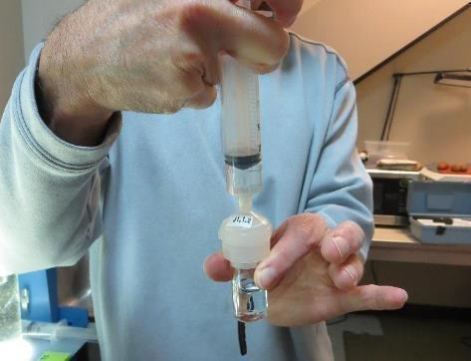
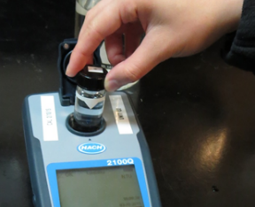
Jar Test - Filterability Test
Syringe ~ 25 mL from jar (after 5-minutes of settling)
Filter-to-waste 3-5 mL
Filter directly into clean cuvette
Measure turbidity
Note: Take several readings before recording final NTU results. Micro bubbles can adhere to glass causing false NTU readings. To remove bubbles, tilt cuvette up to 90 degrees.

Slide 43
Contact
Guy Schott, P.E.
State Water Resources Control Board
Division of Drinking Water
Santa Rosa, CA
Go to Stock Solution/Dose calculations/Jar Test Results for tools to download
www.waterboards.ca.gov/drinking_water/programs/districts/mendocino_district.html
Jar Testing Done Right training video: https://www.youtube.com/watch?v=aGByyxhelkI
Email: Guy Schott - Guy.Schott@waterboards.ca.gov
Office Number: 707-576-2732

