Slide 1
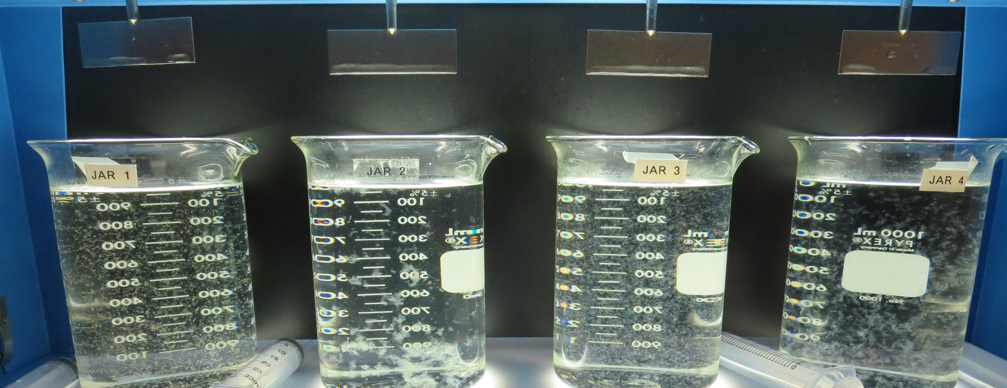
City of Huron CA1010044 Fresno County Jar Test
by Guy Schott, P.E.
July 6, 2021

Slide 2
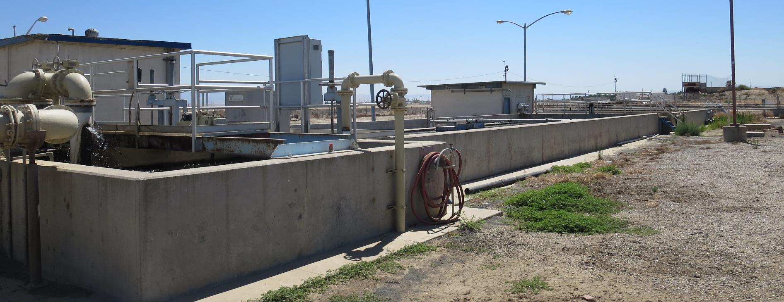
City of Huron, Conventional Treatment Source: CA Aqueduct

Slide 3
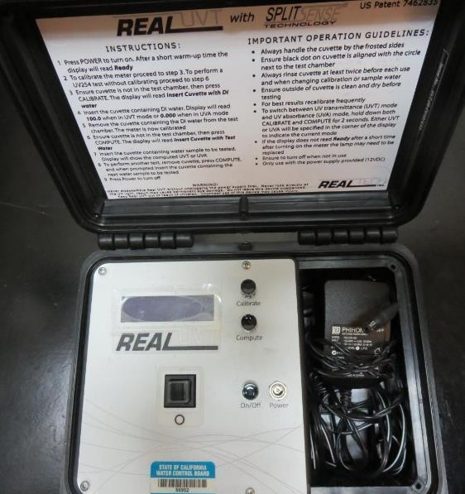
UVT/UVA, pathlength 10 mm
UV transmittance (UVT) is a measurement of the amount of ultraviolet light (254 nm) that passes through a water sample compared to the amount of light that passes through a pure water sample. The measurement is expressed as % UVT.
%UVT = 10^{(-UVA)} x 100%
UV absorbance (UVA) is calculated as a relative measure of the amount of light absorbed by a water sample compared with the amount of light absorbed by a pure water sample.
UVA = -log(%UVT/100)

Slide 4
City of Huron Source Water Characteristics, July 6, 2021
Source
pH: 8.77
Alkalinity: 89-94 mg/L as CaCO₃ (May/June 2021)
Turbidity: 2.4 NTU
UVT: 83.5%,
UVA: 0.078/cm
0.4 um Filtered
Turbidity: 0.25 NTU
UVT: 84.7%,
UVA: 0.071/cm

Slide 5
City of Huron WTP Water Characteristics, July 6, 2021 Treatment Plant Type: Conventional Filtration
Plant Coagulant Dose:
Alum(dry): 20 mg/L
Settled Water: 2.5 NTU
Plant Filtrate Water (pre-chlorination)
Turbidity: 0.23 NTU
UVT: 87.5%,
UVA: 0.057/cm
%UVA Reduction: 19.7%

Slide 6
Applied Coagulants for Jar Testing (1)
Aluminum Sulfate (Product)
Al₂(SO₄)₃*14.3H₂0 (Liquid)
48% Aluminum Sulfate
52% Water
8.2% Al₂O₃
4.3% Al
0% Basicity
SG = 1.32
NSF limit: 400 mg/L (product)
As hydrated Al₂(SO₄)₃*14.3H₂0
17% Al₂O₃
917 (NTU Technologies)
40-50% Aluminum Chlorohydrate
40-50% Water
~21.25% Al₂O₃
~11.25% Al
83% Basicity
10% polyamine (50% water, 50% active polyamines)
SG = 1.25-1.34
NSF limit: 100 mg/L as Product;
Product dose 20 mg/L = 1 mg/L polyamines active

Slide 7
Applied Coagulants for Jar Testing (2)
Pro Pac 9810 (NTU Technologies)
45-50% Aluminum Chlorohydrate
45-50% Water
~22.4% Al₂O₃
~11.9% Al
83% Basicity
5% polyamine (50% water, 50% active polyamines)
SG = 1.25-1.34
NSF limit: 200 mg/L as Product;
Product dose 40 mg/L = 1 mg/L polyamines active
AdvFloc-CTC-00011
Polyaluminum Hydroxy Chlorosulfate
12.55% Al₂O₃
6.64% Al
64.9% Basicity
SG = 1.299
NSF limit: 250 mg/L as Product
BWS, Inc.
Greg Nieckarz, Ph.D.
Greg.niekarz@bws.works
541-953-5112

Slide 8
Applied Coagulants for Jar Testing (3)
917 (NTU Technologies)
40-50% Aluminum Chlorohydrate
40-50% Water
~21.25% Al₂O₃
~11.25% Al
83% Basicity
10% polyamine (50% water, 50% active polyamines)
SG = 1.25-1.34
NSF limit: 100 mg/L as Product;
Product dose 20 mg/L = 1 mg/L polyamines active

Slide 9
Applied Coagulants for Jar Testing (4)
Praestol 186K
Brenntag (559-485-4150)
Solenis
SG = 1.0 – 1.2
Viscosity: 60-180 centipoise
MW: 150,00 g/moles
pDADMAC (20% active, 80% H₂O)
NSF limit: 50 mg/L (product)
Product dose 5 mg/L = 1 mg/L pDADMAC active
Clarifloc C-378
Polydyne Incorporated
SG = 1.0 – 1.2
pDADMAC (20% active, 80% H₂O)
NSF limit: 50 mg/L (product)
Product dose 5 mg/L = 1 mg/L pDADMAC active

Slide 10
Coagulants
Coagulant | Chemical Dose, mg/L | Alkalinity Consumed mg/L as CaCO₃
Alum (dry) | 10 | 5.0
CTC-00011 | 10 | 1.3
9810 | 10 | 1.13
917 | 10 | 1.06

Slide 11
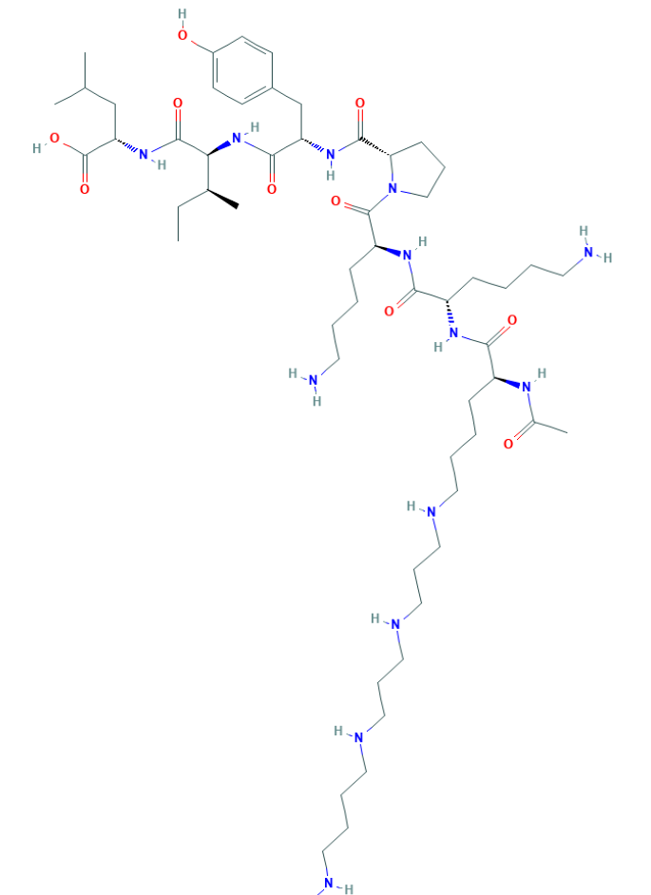
Polyamine C₅₉H₁₀₈N₁₄O₁₀ MW: 1,173.6 g/mol

Slide 12
Diallyldimethylammonium chloride or N-allyl-N,N-dimethylprop-2-en-1-aminium chloride pDADMAC C₈H₁₆ClN MW: 161.67 g/mol
CH₃
CH₂
CH₂
CH
N
+
CH
CH₂
CH₂
CH₃
Cl⁻

Slide 13
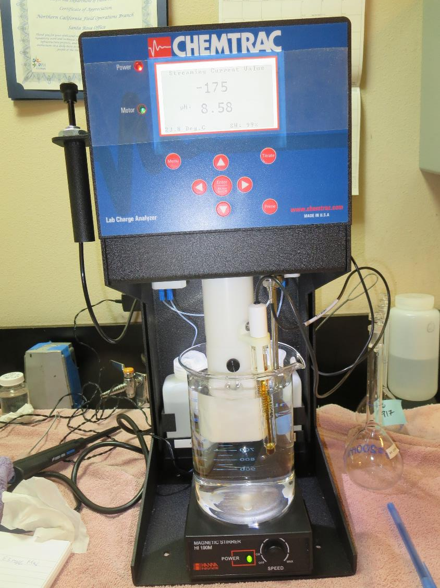
Laboratory Charge Analyzer
LCA: Used to determine coagulant demand of a source water entering the treatment plant.
Source pH: 8.77
LCA #1: Alum: 41.5 mg/L as hydrated
pH adjusted to 6.6 with acetic acid
LCA #2: 917: 15 mg/L
pH adjusted to 7.7 with acetic acid
LCA #3: AdvFloc CTC-00011: 80 mg/L
pH adjusted to 7.7 with acetic acid

Slide 14
Coagulant Information
Unless stated otherwise, all coagulant doses are reported as Product (100% strength).
Aluminum Sulfate doses are reported as hydrated Al₂(SO₄)₃*14.3H₂0.
Preparation of coagulant stock solutions are generally 1.0 and/or 0.1 percent strength using 100 and/or 200 mL volumetric flasks.
Finnpipette F2 variable volume pipette, capacity 100-1000 micro liters is used for stock solution preparation and coagulant aid jar test dosing.
Finnpipette F2 variable volume pipette, capacity 0.5-5 mL is used for primary coagulant jar test dosing.

Slide 15
City of Huron; Source CA Aqueduct; Jar Test 1 - 8 Results Flash Mix 200 RPM (20 sec); Floc Mix 25 RPM (5 min)
Jar# | Alum mg/L | 186K mg/L | Filtrate NTU | Filtrate %UVT | Filtrate UVA/cm | %UVA Reduction | Settle NTU 25 min
J1 | 22 | 0 | 0.17 | 86.7 | 0.061 | 14.1 | 1.38
J2 | 35 | 0 | 0.13 | 89.3 | 0.049 | 31.0 | 0.87
J3 | 40 | 0 | 0.15 | 90.0 | 0.045 | 36.6 | 0.80
J4 | 45 | 0 | 0.07 | 91.2 | 0.040 | 43.7 | 0.46
J5 | 40 | 0 | 0.16 | 90.2 | 0.044 | 38.0 | 0.77
J6 | 40 | 2.0 | 0.08 | 91.1 | 0.040 | 43.7 | 0.37
J7 | 40 | 4.0 | 0.06 | 91.6 | 0.037 | 47.9 | 0.42
J8 | 40 | 6.0 | 0.07 | 91.4 | 0.039 | 45.1 | 0.45

Slide 16
City of Huron; Source CA Aqueduct; Jar Test 9 - 16 Results Flash Mix 200 RPM (20 sec); Floc Mix 25 RPM (5 min)
Jar# | Alum mg/L | 186K mg/L | C-378 mg/L | Filtrate NTU | Filtrate %UVT | Filtrate UVA/cm | %UVA Reduction | Settle NTU 25 min
J9 | 47 | 0.0 | 0.0 | 0.13 | 91.1 | 0.040 | 43.7 | 0.68
J10 | 47 | 2.0 | 0.0 | 0.05 | 91.8 | 0.037 | 47.9 | 0.48
J11 | 47 | 4.0 | 0.0 | 0.06 | 92.2 | 0.035 | 50.7 | 0.44
J12 | 47 | 6.0 | 0.0 | 0.07 | 92.3 | 0.034 | 52.1 | 0.33
J13 | 47 | 0.0 | 0.0 | 0.13 | 91.5 | 0.038 | 46.5 | 0.65
J14 | 47 | 0.0 | 2.0 | 0.07 | 91.7 | 0.037 | 47.9 | 0.39
J15 | 47 | 0.0 | 3.0 | 0.05 | 91.8 | 0.036 | 49.3 | 0.41
J16 | 47 | 0.0 | 4.0 | 0.05 | 92.0 | 0.035 | 50.7 | 0.35

Slide 17
City of Huron; Source CA Aqueduct; Jar Test 17 - 24 Results Flash Mix 200 RPM (20 sec); Floc Mix 25 RPM (5 min)
Jar# | 917 mg/L | AdvFloc CTC-0011 mg/L | Filtrate NTU | Filtrate %UVT | Filtrate UVA/cm | %UVA Reduction | Settle NTU 25 min
J17 | 12 | 0 | 0.08 | 89.7 | 0.047 | 33.8 | 0.59
J18 | 15 | 0 | 0.09 | 89.7 | 0.046 | 35.2 | 0.54
J19 | 18 | 0 | 0.07 | 90.5 | 0.043 | 39.4 | 0.33
J20 | 21 | 0 | 0.07 | 90.9 | 0.041 | 42.3 | 0.26
J21 | 0 | 70 | 0.10 | 91.5 | 0.038 | 46.5 | 0.31
J22 | 0 | 80 | 0.07 | 91.5 | 0.038 | 46.5 | 0.29
J23 | 0 | 90 | 0.09 | 91.9 | 0.036 | 49.3 | 0.28
J24 | 0 | 100 | 0.06 | 92.4 | 0.034 | 52.1 | 0.18

Slide 18
City of Huron; Source CA Aqueduct; Jar Test 25 – 28 Results Flash Mix 200 RPM (20 sec); Floc Mix 25 RPM (5 min)
Jar# | 9810 mg/L | Filtrate NTU | Filtrate %UVT | Filtrate UVA/cm | %UVA Reduction | Settle NTU 25 min
J25 | 21 | 0.09 | 91.2 | 0.040 | 43.7 | 0.43
J26 | 24 | 0.07 | 91.2 | 0.040 | 43.7 | 0.41
J27 | 27 | 0.09 | 91.6 | 0.037 | 47.9 | 0.40
J28 | 30 | 0.08 | 91.5 | 0.038 | 46.5 | 0.26

Slide 19
City of Huron; Source CA Aqueduct; Jar Test 29 - 32 Results Flash Mix 200 RPM (20 sec); Floc Mix 25 RPM (5 min)
Jar# | Alum mg/L | C-378 mg/L | 9810 mg/L | AdvFloc CTC-0011 mg/L | Filtrate NTU | Filtrate %UVT | Filtrate UVA/cm | %UVA Reducton | Settle NTU 25 min
J29 | 20 | 0.0 | 0 | 0 | 0.12 | 88.7 | 0.051 | 28.2 | 0.62
J30 | 48 | 4.0 | 0 | 0 | 0.05 | 93.0 | 0.031 | 56.3 | 0.39
J31 | 0 | 0.0 | 30 | 0 | 0.08 | 91.8 | 0.037 | 47.9 | 0.28
J32 | 0 | 0.0 | 0 | 100 | 0.08 | 92.4 | 0.034 | 52.1 | 0.22

Slide 20
Jars 1-4 Test Flash Mix 20 Sec (200 RPM) Floc Mix 5 min (25 RPM) Applied Coagulant Alum

Slide 21
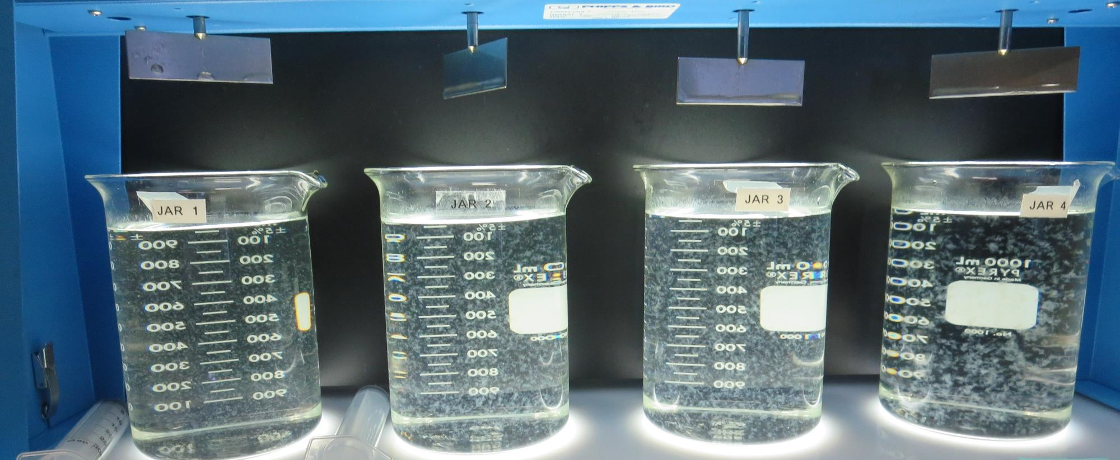
Jars 1-4: End of 5-minute flocculation (25 RPM) duration.
22 mg/L Alum
Filtrate: 0.17 NTU
UVT: 86.7%
UVA: 0.061/cm
UVA Reduction 14.1%
Settled: 1.38 NTU
35 mg/L Alum
Filtrate: 0.13 NTU
UVT: 89.3%
UVA: 0.049/cm
UVA Reduction 31.0%
Settled: 0.87 NTU
40 mg/L Alum
Filtrate: 0.15 NTU
UVT: 90.0%
UVA: 0.045/cm
UVA Reduction 36.6%
Settled: 0.80 NTU
45 mg/L Alum
Filtrate: 0.07 NTU
UVT: 91.2%
UVA: 0.040/cm
UVA Reduction 43.7%
Settled: 0.46 NTU

Slide 22
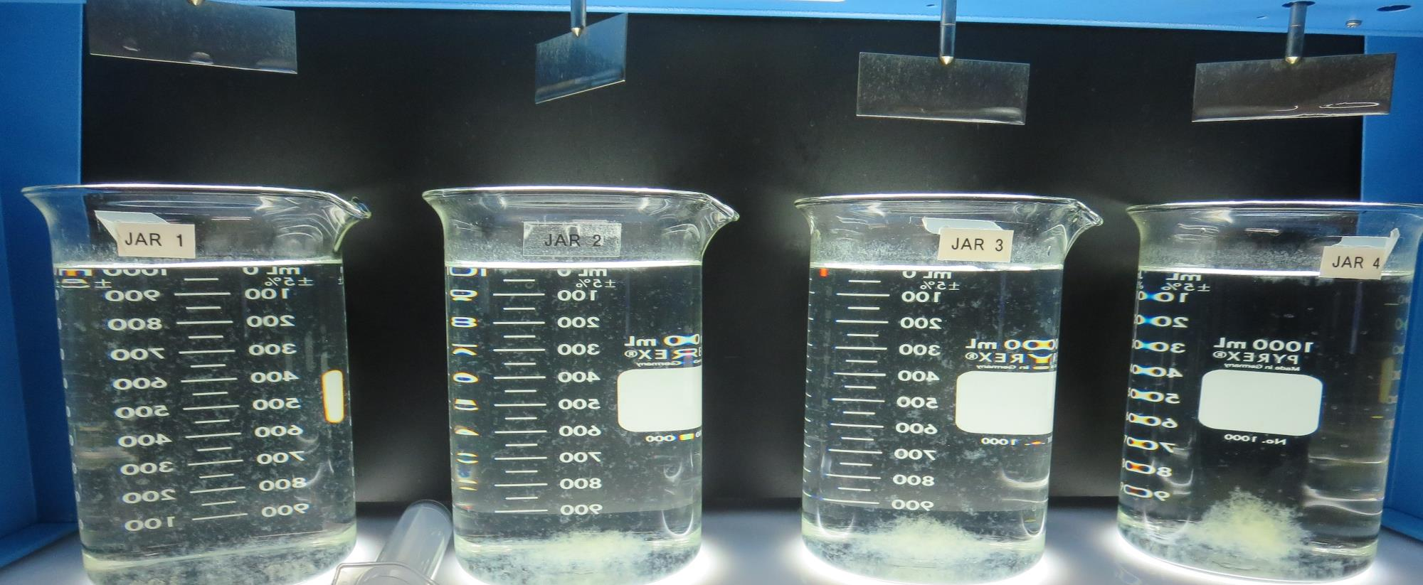
Jars 1-4: After 5 min of settling, 25 mL is syringed for filterability and %UVT/UVA.

Slide 23
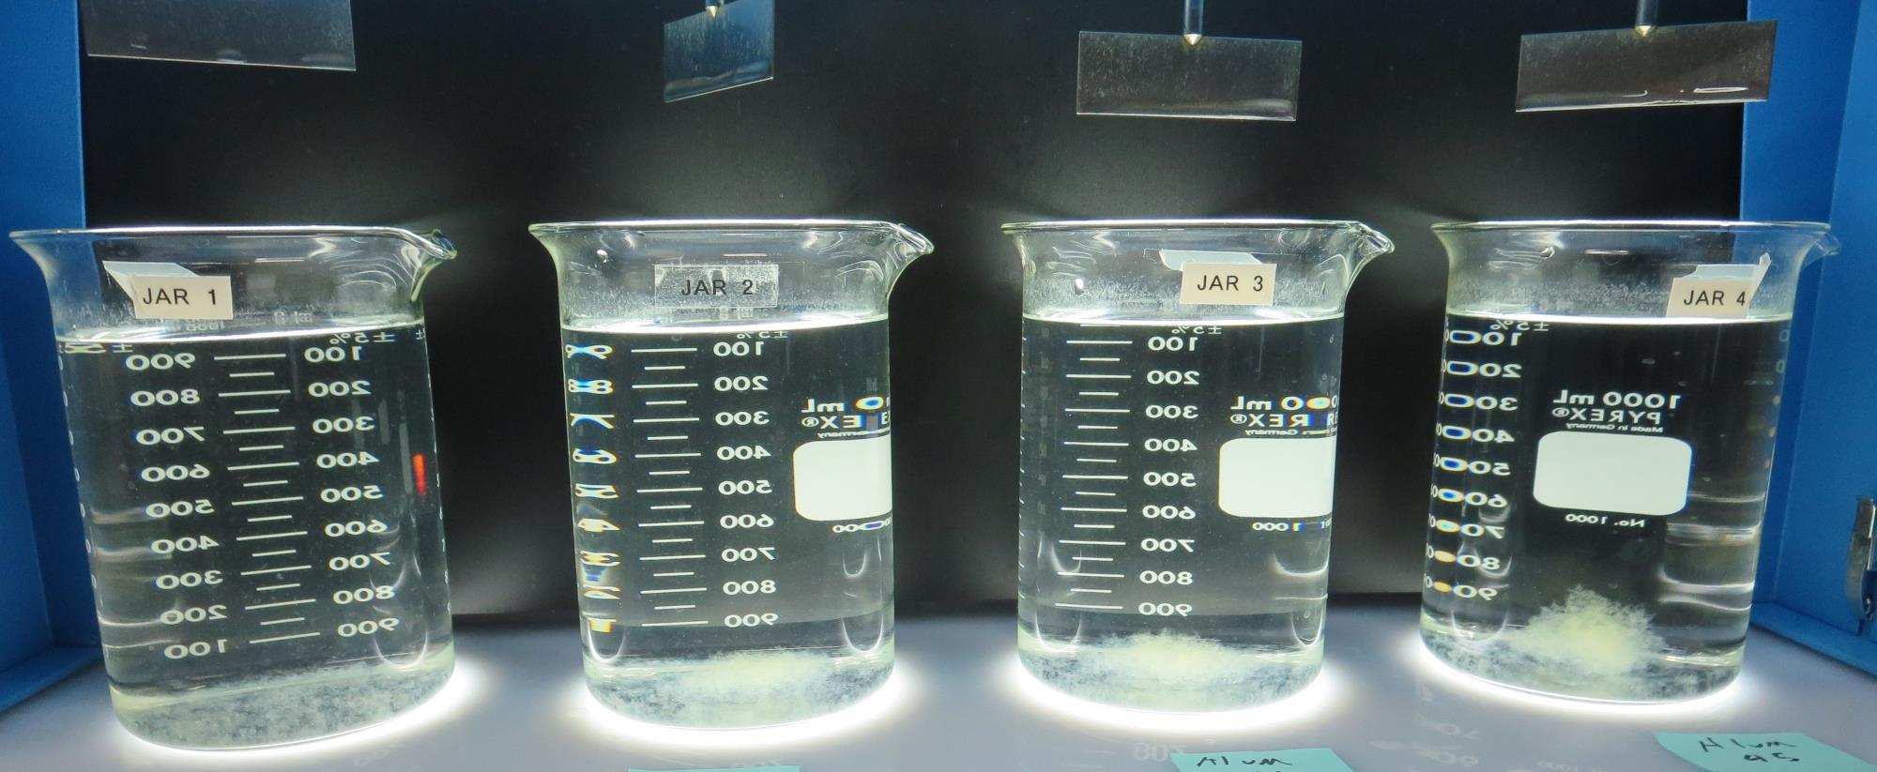
Jars 1-4: After 25-minutes of settling, settled water turbidity is taken.
22 mg/L Alum
Filtrate: 0.17 NTU
UVT: 86.7%
UVA: 0.061/cm
UVA Reduction 14.1%
Settled: 1.38 NTU
35 mg/L Alum
Filtrate: 0.13 NTU
UVT: 89.3%
UVA: 0.049/cm
UVA Reduction 31.0%
Settled: 0.87 NTU
40 mg/L Alum
Filtrate: 0.15 NTU
UVT: 90.0%
UVA: 0.045/cm
UVA Reduction 36.6%
Settled: 0.80 NTU
45 mg/L Alum
Filtrate: 0.07 NTU
UVT: 91.2%
UVA: 0.040/cm
UVA Reduction 43.7%
Settled: 0.46 NTU

Slide 24
Jars 5-8 Test Flash Mix 20 Sec (200 RPM) Floc Mix 5 min (25 RPM) Applied Coagulants Alum 186KH (pDADMAC)

Slide 25
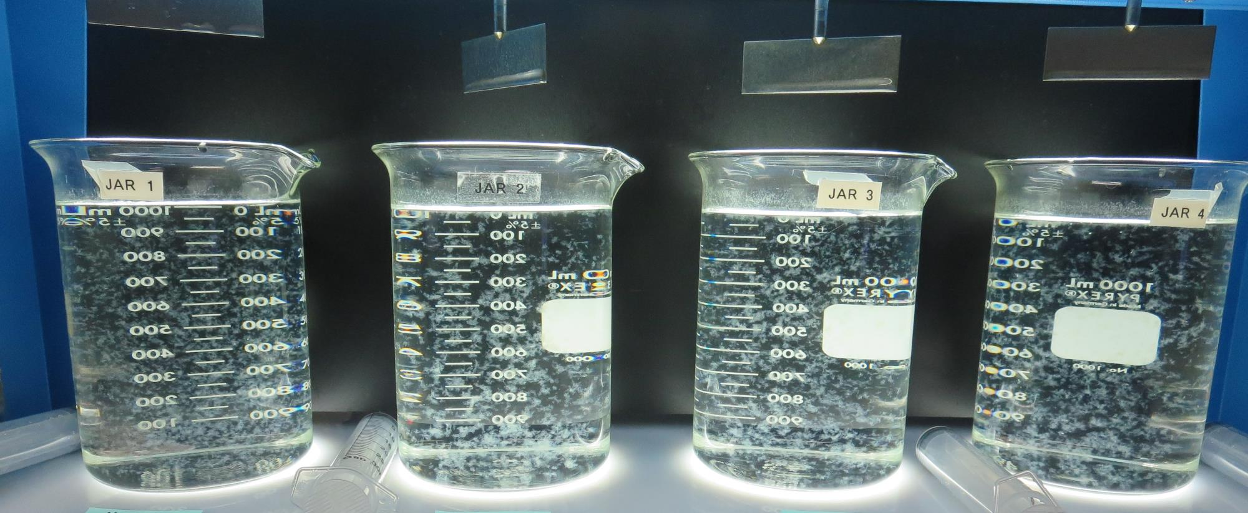
Jars 5-8: End of 5-minute flocculation (25 RPM) duration.
40 mg/L Alum
0.0 mg/L 186K
Filtrate: 0.16 NTU
UVT: 90.2%
UVA: 0.044/cm
UVA Reduction 38.0%
Settled: 0.77 NTU
40 mg/L Alum
2.0 mg/L 186K
Filtrate: 0.08 NTU
UVT: 91.1%
UVA: 0.040/cm
UVA Reduction 43.7%
Settled: 0.37 NTU
40 mg/L Alum
4.0 mg/L 186K
Filtrate: 0.06 NTU
UVT: 91.6%
UVA: 0.037/cm
UVA Reduction 47.9%
Settled: 0.42 NTU
40 mg/L Alum
6.0 mg/L 186K
Filtrate: 0.07 NTU
UVT: 91.4%
UVA: 0.039/cm
UVA Reduction 45.1%
Settled: 0.45 NTU

Slide 26
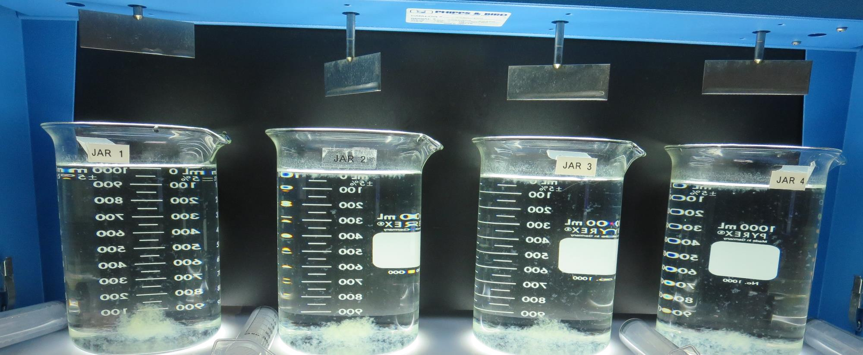
Jars 5-8: After 5 min of settling, 25 mL is syringed for filterability and %UVT/UVA.

Slide 27
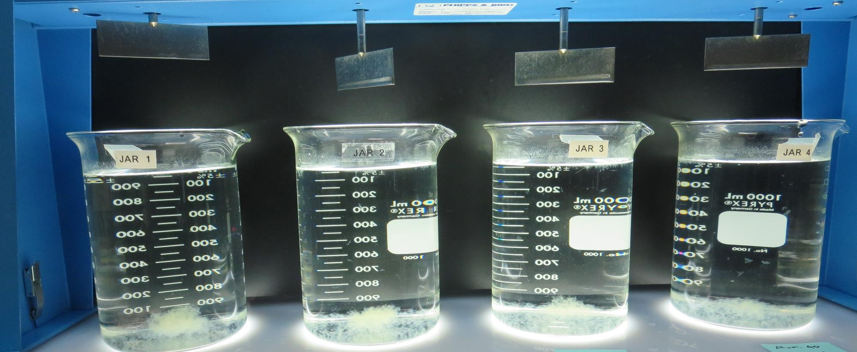
Jars 5-8: After 25-minutes of settling, settled water turbidity is taken.
40 mg/L Alum
0.0 mg/L 186K
Filtrate: 0.16 NTU
UVT: 90.2%
UVA: 0.044/cm
UVA Reduction 38.0%
Settled: 0.77 NTU
40 mg/L Alum
2.0 mg/L 186K
Filtrate: 0.08 NTU
UVT: 91.1%
UVA: 0.040/cm
UVA Reduction 43.7%
Settled: 0.37 NTU
40 mg/L Alum
4.0 mg/L 186K
Filtrate: 0.06 NTU
UVT: 91.6%
UVA: 0.037/cm
UVA Reduction 47.9%
Settled: 0.42 NTU
40 mg/L Alum
6.0 mg/L 186K
Filtrate: 0.07 NTU
UVT: 91.4%
UVA: 0.039/cm
UVA Reduction 45.1%
Settled: 0.45 NTU

Slide 28
Jars 9-12 Test Flash Mix 20 Sec (200 RPM) Floc Mix 5 min (25 RPM) Applied Coagulants Alum 186K (pDADMAC)

Slide 29
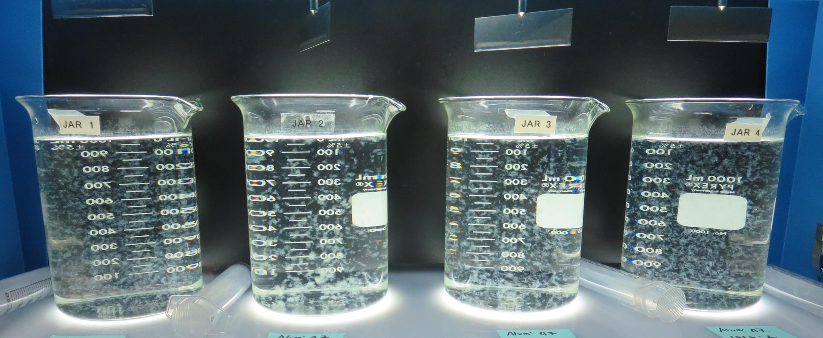
Jars 9-12: End of 5-minute flocculation (25 RPM) duration.
47 mg/L Alum
0.0 mg/L 186K
Filtrate: 0.13 NTU
UVT: 91.1%
UVA: 0.040/cm
UVA Reduction 43.7%
Settled: 0.68 NTU
47 mg/L Alum
2.0 mg/L 186K
Filtrate: 0.05 NTU
UVT: 91.8%
UVA: 0.037/cm
UVA Reduction 47.9%
Settled: 0.48 NTU
47 mg/L Alum
4.0 mg/L 186K
Filtrate: 0.06 NTU
UVT: 92.2%
UVA: 0.035/cm
UVA Reduction 50.7%
Settled: 0.44 NTU
47 mg/L Alum
6.0 mg/L 186K
Filtrate: 0.07 NTU
UVT: 92.3%
UVA: 0.034/cm
UVA Reduction 52.1%
Settled: 0.33 NTU

Slide 30
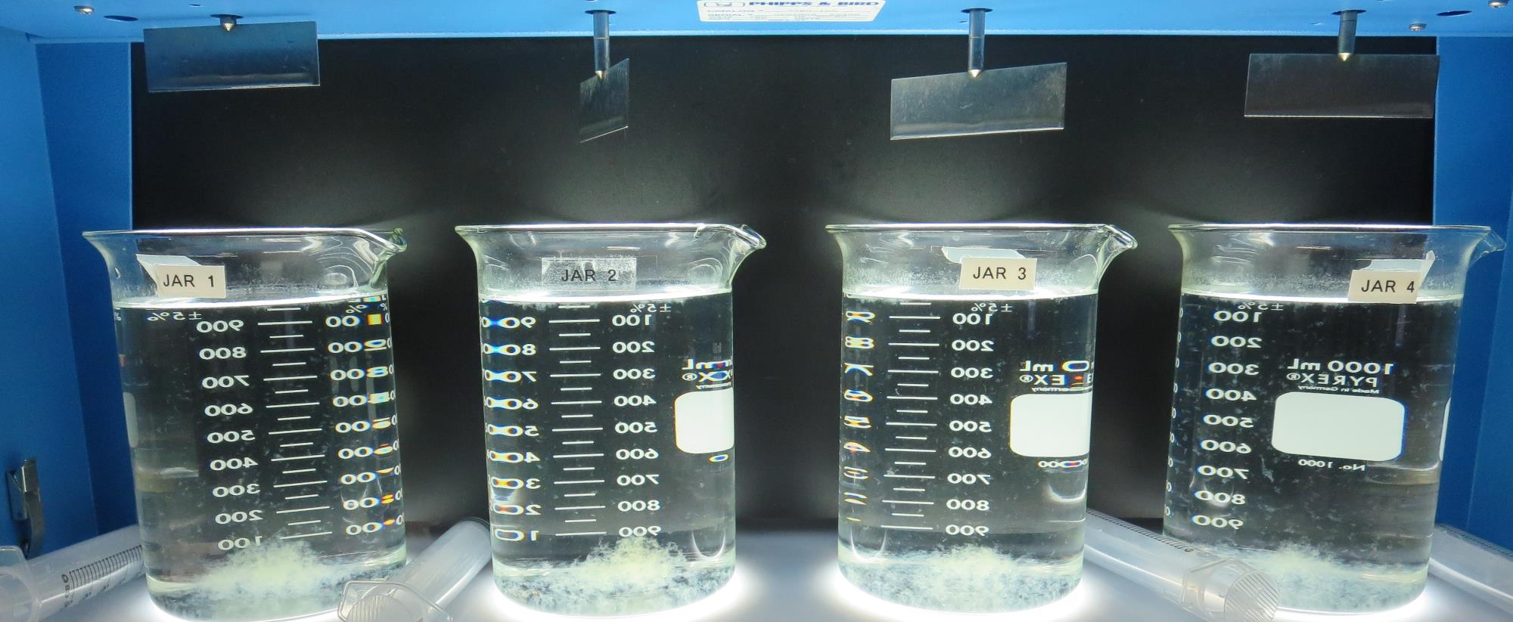
Jars 9-12: After 5 min of settling, 25 mL is syringed for filterability and %UVT/UVA.

Slide 31
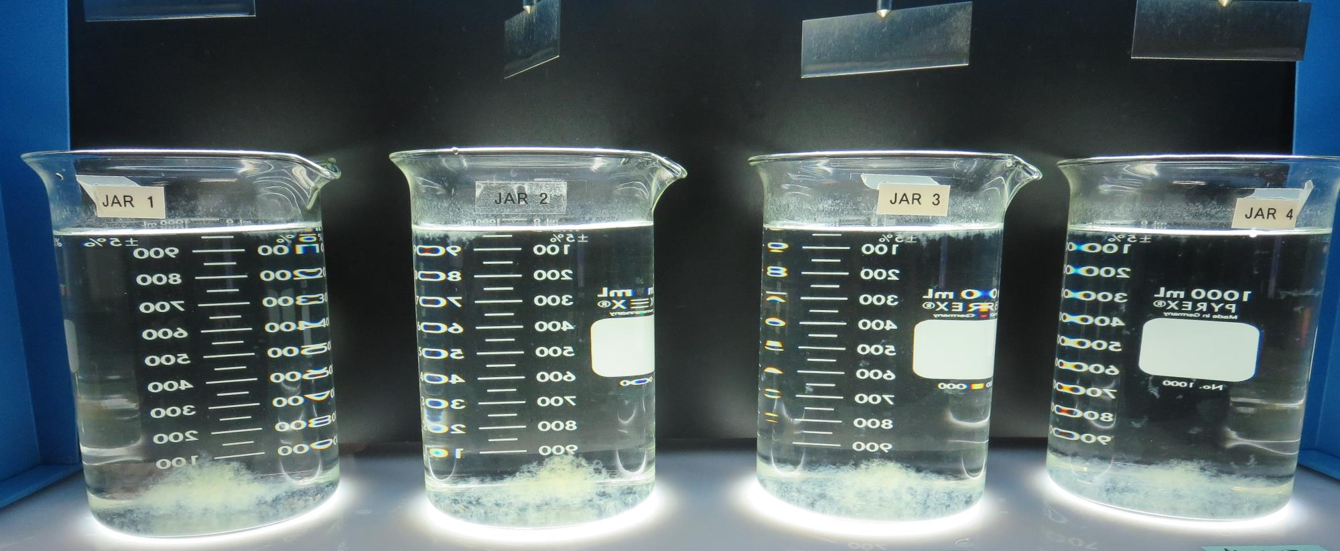
Jars 9-12: After 25-minutes of settling, settled water turbidity is taken.
47 mg/L Alum
0.0 mg/L 186K
Filtrate: 0.13 NTU
UVT: 91.1%
UVA: 0.040/cm
UVA Reduction 43.7%
Settled: 0.68 NTU
47 mg/L Alum
2.0 mg/L 186K
Filtrate: 0.05 NTU
UVT: 91.8%
UVA: 0.037/cm
UVA Reduction 47.9%
Settled: 0.48 NTU
47 mg/L Alum
4.0 mg/L 186K
Filtrate: 0.06 NTU
UVT: 92.2%
UVA: 0.035/cm
UVA Reduction 50.7%
Settled: 0.44 NTU
47 mg/L Alum
6.0 mg/L 186K
Filtrate: 0.07 NTU
UVT: 92.3%
UVA: 0.034/cm
UVA Reduction 52.1%
Settled: 0.33 NTU

Slide 32
Jars 13-16 Test Flash Mix 20 Sec (200 RPM) Floc Mix 5 min (25 RPM) Applied Coagulants Alum C-378 (pDADMAC)

Slide 33
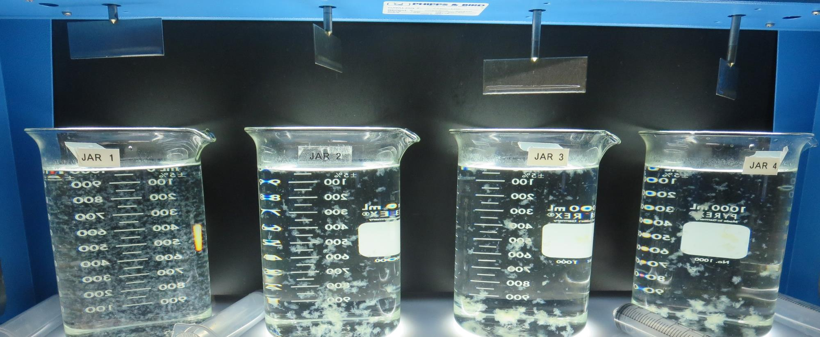
Jars 13-16: End of 5-minute flocculation (25 RPM) duration.
47 mg/L Alum
0.0 mg/L C-378
Filtrate: 0.13 NTU
UVT: 91.5%
UVA: 0.038/cm
UVA Reduction 46.5%
Settled: 0.65 NTU
47 mg/L Alum
2.0 mg/L C-378
Filtrate: 0.07 NTU
UVT: 91.7%
UVA: 0.037/cm
UVA Reduction 47.9%
Settled: 0.39 NTU
47 mg/L Alum
3.0 mg/L C-378
Filtrate: 0.05 NTU
UVT: 91.8%
UVA: 0.036/cm
UVA Reduction 49.3%
Settled: 0.41 NTU
47 mg/L Alum
4.0 mg/L C-378
Filtrate: 0.05 NTU
UVT: 92.0%
UVA: 0.035/cm
UVA Reduction 50.7%
Settled: 0.35 NTU

Slide 34
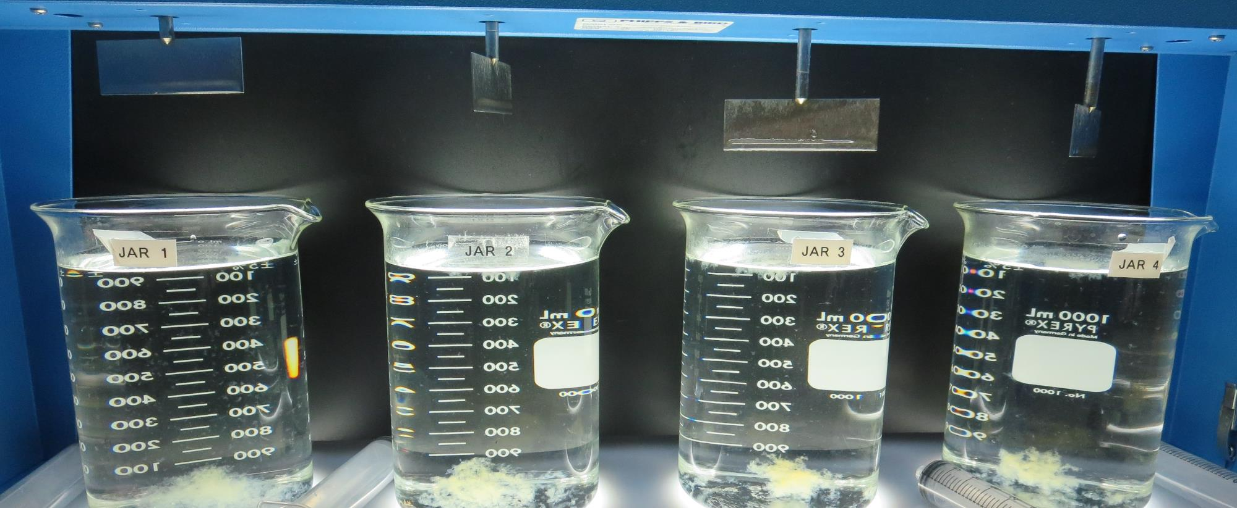
Jars 13-16: After 5 min of settling, 25 mL is syringed for filterability and %UVT/UVA.

Slide 35
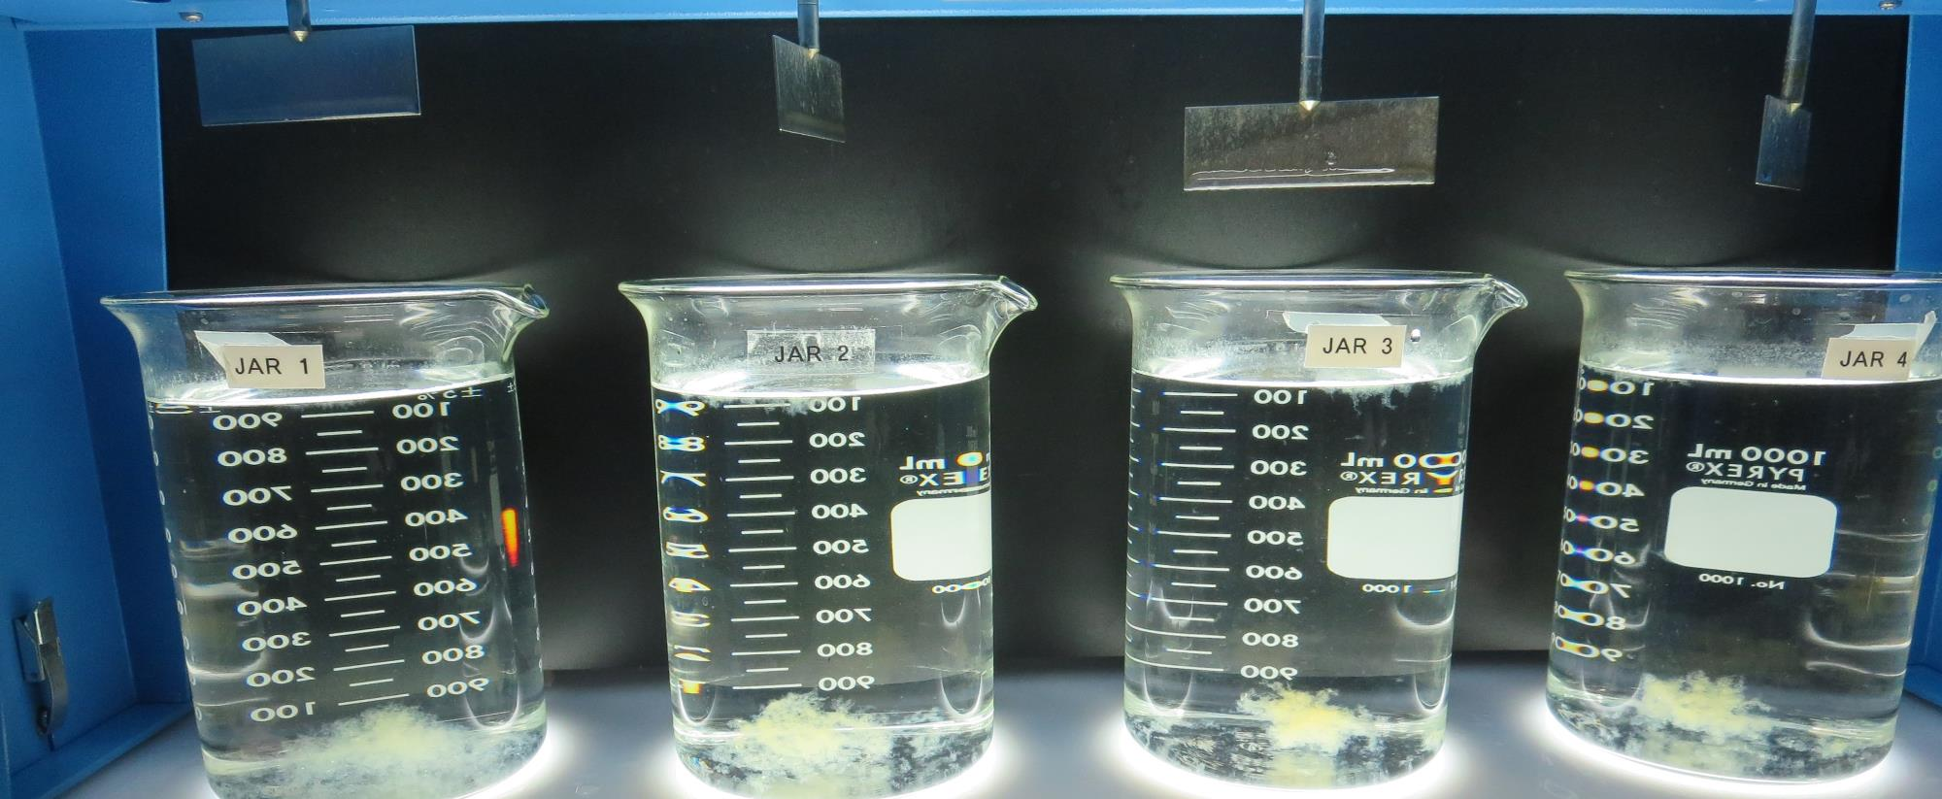
Jars 13-16: After 25-minutes of settling, settled water turbidity is taken.
47 mg/L Alum
0.0 mg/L C-378
Filtrate: 0.13 NTU
UVT: 91.5%
UVA: 0.038/cm
UVA Reduction 46.5%
Settled: 0.65 NTU
47 mg/L Alum
2.0 mg/L C-378
Filtrate: 0.07 NTU
UVT: 91.7%
UVA: 0.037/cm
UVA Reduction 47.9%
Settled: 0.39 NTU
47 mg/L Alum
3.0 mg/L C-378
Filtrate: 0.05 NTU
UVT: 91.8%
UVA: 0.036/cm
UVA Reduction 49.3%
Settled: 0.41 NTU
47 mg/L Alum
4.0 mg/L C-378
Filtrate: 0.05 NTU
UVT: 92.0%
UVA: 0.035/cm
UVA Reduction 50.7%
Settled: 0.35 NTU

Slide 36
Jars 17-20 Test Flash Mix 20 Sec (200 RPM) Floc Mix 5 min (25 RPM) Applied Coagulant 917 (ACH/polyamine)

Slide 37
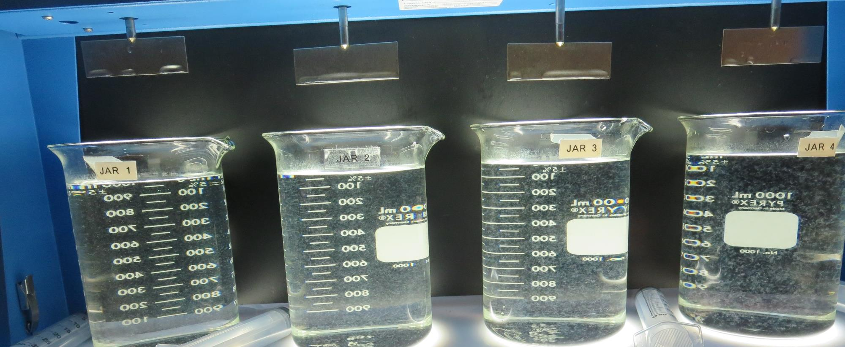
Jars 17-20: End of 5-minute flocculation (25 RPM) duration.
12 mg/L 917
Filtrate: 0.08 NTU
UVT: 89.7%
UVA: 0.047/cm
UVA Reduction 33.8%
Settled: 0.59 NTU
15 mg/L 917
Filtrate: 0.09 NTU
UVT: 89.7%
UVA: 0.046/cm
UVA Reduction 35.2%
Settled: 0.54 NTU
18 mg/L 917
Filtrate: 0.07 NTU
UVT: 90.5%
UVA: 0.043/cm
UVA Reduction 39.4%
Settled: 0.33 NTU
21 mg/L 917
Filtrate: 0.07 NTU
UVT: 90.9%
UVA: 0.041/cm
UVA Reduction 42.3%
Settled: 0.26 NTU

Slide 38
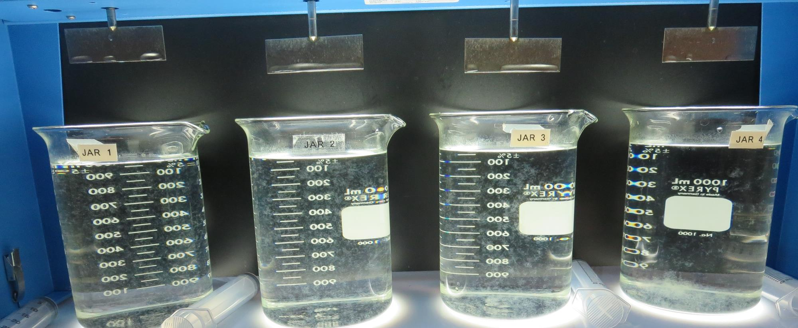
Jars 17-20: After 5 min of settling, 25 mL is syringed for filterability and %UVT/UVA.

Slide 39
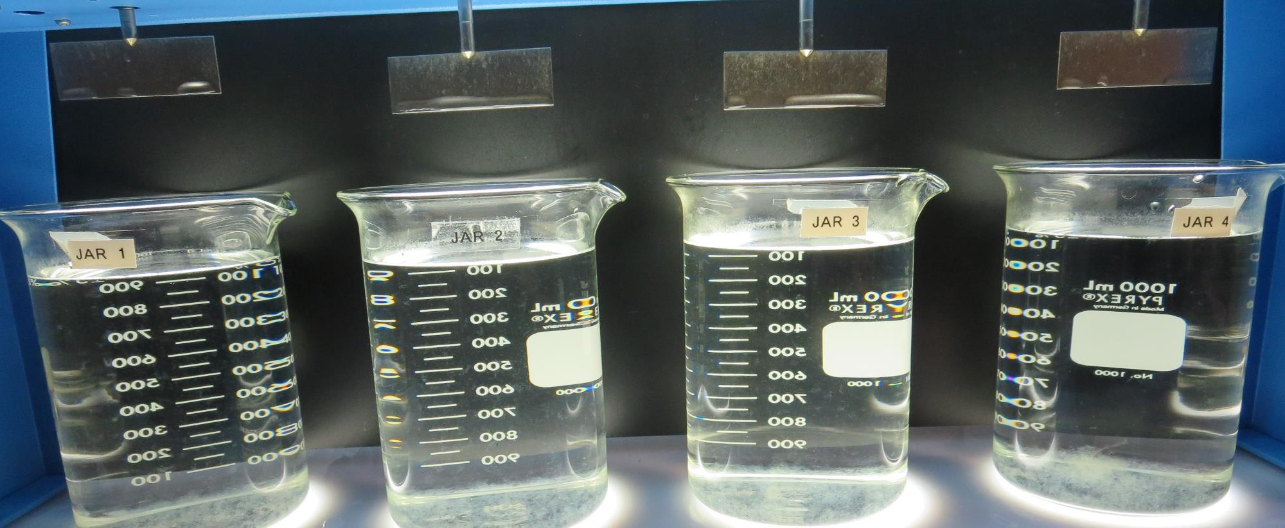
Jars 17-20: After 25-minutes of settling, settled water turbidity is taken.
12 mg/L 917
Filtrate: 0.08 NTU
UVT: 89.7%
UVA: 0.047/cm
UVA Reduction 33.8%
Settled: 0.59 NTU
15 mg/L 917
Filtrate: 0.09 NTU
UVT: 89.7%
UVA: 0.046/cm
UVA Reduction 35.2%
Settled: 0.54 NTU
18 mg/L 917
Filtrate: 0.07 NTU
UVT: 90.5%
UVA: 0.043/cm
UVA Reduction 39.4%
Settled: 0.33 NTU
21 mg/L 917
Filtrate: 0.07 NTU
UVT: 90.9%
UVA: 0.041/cm
UVA Reduction 42.3%
Settled: 0.26 NTU

Slide 40
Jars 21-24 Test Flash Mix 20 Sec (200 RPM) Floc Mix 5 min (25 RPM) Applied Coagulant AdvFloc CTC-00011

Slide 41
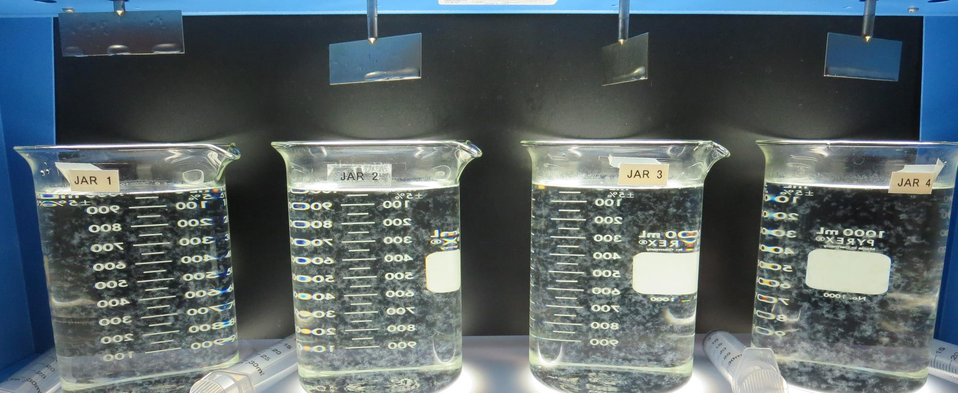
Jars 21-24: End of 5-minute flocculation (25 RPM) duration.
70 mg/L CTC-00011
Filtrate: 0.10 NTU
UVT: 91.5%
UVA: 0.038/cm
UVA Reduction 46.5%
Settled: 0.31 NTU
80 mg/L CTC-00011
Filtrate: 0.07 NTU
UVT: 91.5%
UVA: 0.038/cm
UVA Reduction 46.5%
Settled: 0.29 NTU
90 mg/L CTC-00011
Filtrate: 0.09 NTU
UVT: 91.9%
UVA: 0.036/cm
UVA Reduction 49.3%
Settled: 0.28 NTU
100 mg/L CTC-00011
Filtrate: 0.06 NTU
UVT: 92.4%
UVA: 0.034/cm
UVA Reduction 52.1%
Settled: 0.18 NTU

Slide 42
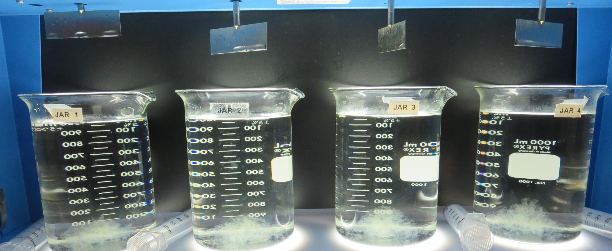
Jars 21-24: After 5 min of settling, 25 mL is syringed for filterability and %UVT/UVA.

Slide 43
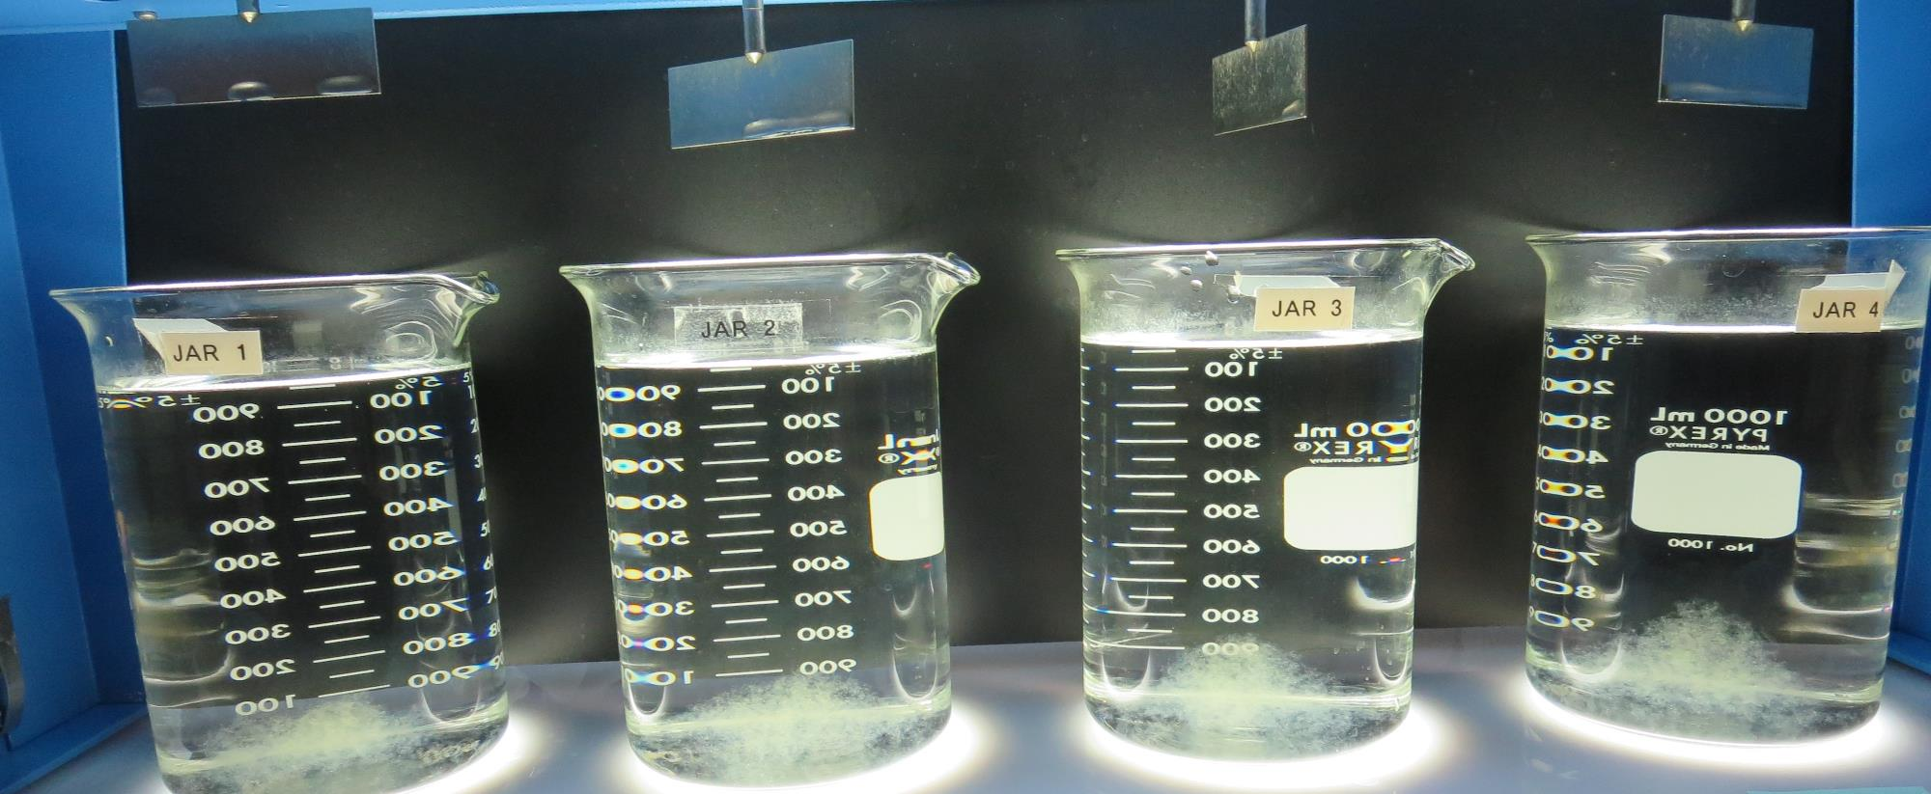
Jars 21-24: After 25-minutes of settling, settled water turbidity is taken.
70 mg/L CTC-00011
Filtrate: 0.10 NTU
UVT: 91.5%
UVA: 0.038/cm
UVA Reduction 46.5%
Settled: 0.31 NTU
80 mg/L CTC-00011
Filtrate: 0.07 NTU
UVT: 91.5%
UVA: 0.038/cm
UVA Reduction 46.5%
Settled: 0.29 NTU
90 mg/L CTC-00011
Filtrate: 0.09 NTU
UVT: 91.9%
UVA: 0.036/cm
UVA Reduction 49.3%
Settled: 0.28 NTU
100 mg/L CTC-00011
Filtrate: 0.06 NTU
UVT: 92.4%
UVA: 0.034/cm
UVA Reduction 52.1%
Settled: 0.18 NTU

Slide 44
Jars 25-28 Test Flash Mix 20 Sec (200 RPM) Floc Mix 5 min (25 RPM) Applied Coagulant 9810 (ACH/polyamine)

Slide 45
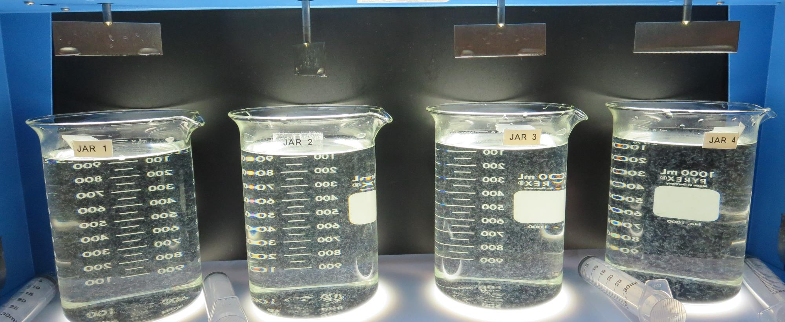
Jars 25-28: End of 5-minute flocculation (25 RPM) duration.
21 mg/L 9810
Filtrate: 0.09 NTU
UVT: 91.2%
UVA: 0.040/cm
UVA Reduction 43.7%
Settled: 0.43 NTU
24 mg/L 9810
Filtrate: 0.07 NTU
UVT: 91.2%
UVA: 0.040/cm
UVA Reduction 43.7%
Settled: 0.41 NTU
27 mg/L 9810
Filtrate: 0.09 NTU
UVT: 91.6%
UVA: 0.037/cm
UVA Reduction 47.9%
Settled: 0.40 NTU
30 mg/L 9810
Filtrate: 0.08 NTU
UVT: 91.5%
UVA: 0.038/cm
UVA Reduction 46.5%
Settled: 0.26 NTU

Slide 46
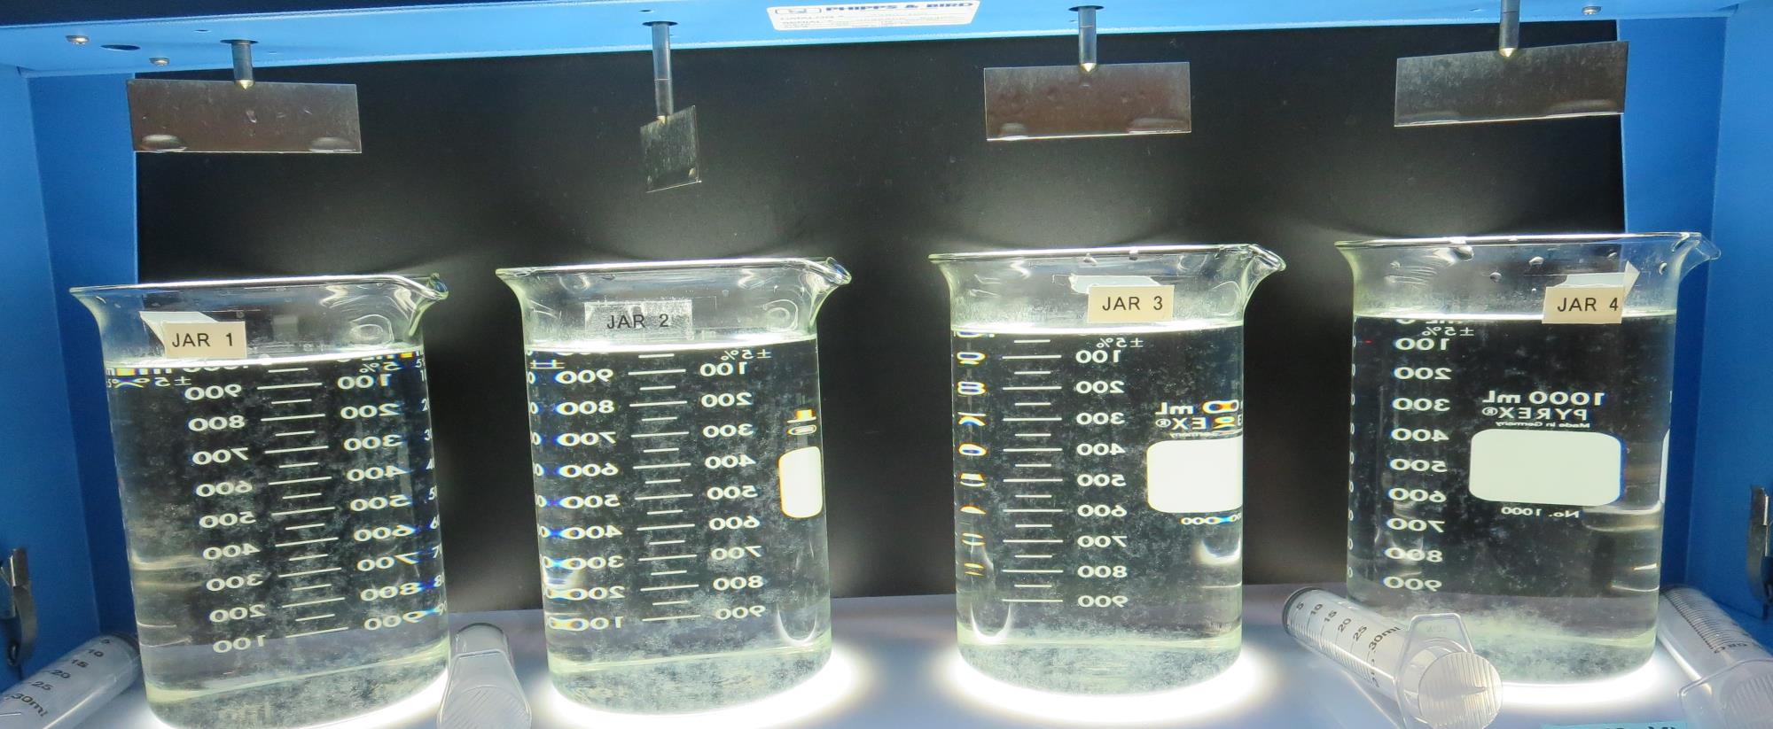
Jars 25-28: After 5 min of settling, 25 mL is syringed for filterability and %UVT/UVA.

Slide 47
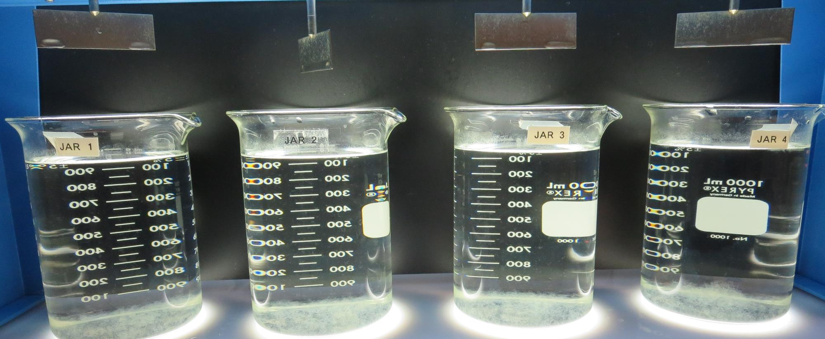
Jars 25-28: After 25-minutes of settling, settled water turbidity is taken.
21 mg/L 9810
Filtrate: 0.09 NTU
UVT: 91.2%
UVA: 0.040/cm
UVA Reduction 43.7%
Settled: 0.43 NTU
24 mg/L 9810
Filtrate: 0.07 NTU
UVT: 91.2%
UVA: 0.040/cm
UVA Reduction 43.7%
Settled: 0.41 NTU
27 mg/L 9810
Filtrate: 0.09 NTU
UVT: 91.6%
UVA: 0.037/cm
UVA Reduction 47.9%
Settled: 0.40 NTU
30 mg/L 9810
Filtrate: 0.08 NTU
UVT: 91.5%
UVA: 0.038/cm
UVA Reduction 46.5%
Settled: 0.26 NTU

Slide 48
Jars 29-32 Test Flash Mix 20 Sec (200 RPM) Floc Mix 5 min (25RPM) Applied Coagulants Alum/C-378 9810/Adv Floc CTC-00011

Slide 49
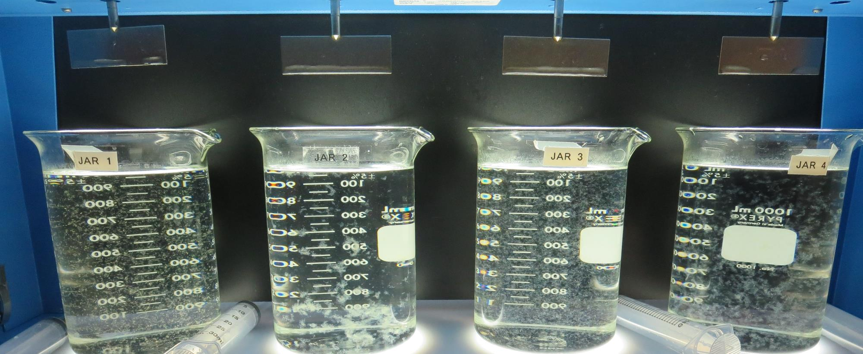
Jars 29-32: End of 5-minute flocculation (25 RPM) duration.
20 mg/L Alum
Filtrate: 0.12 NTU
UVT: 88.7%
UVA: 0.051/cm
UVA Reduction 28.2%
Settled: 0.62 NTU
48 mg/L Alum
4.0 mg/L C-378
Filtrate: 0.05 NTU
UVT: 93.0%
UVA: 0.031/cm
UVA Reduction 56.3%
Settled: 0.39 NTU
30 mg/L 9810
Filtrate: 0.08 NTU
UVT: 91.8%
UVA: 0.037/cm
UVA Reduction 47.9%
Settled: 0.28 NTU
100 mg/L CTC-00011
Filtrate: 0.08 NTU
UVT: 92.4%
UVA: 0.034/cm
UVA Reduction 52.1%
Settled: 0.22 NTU

Slide 50
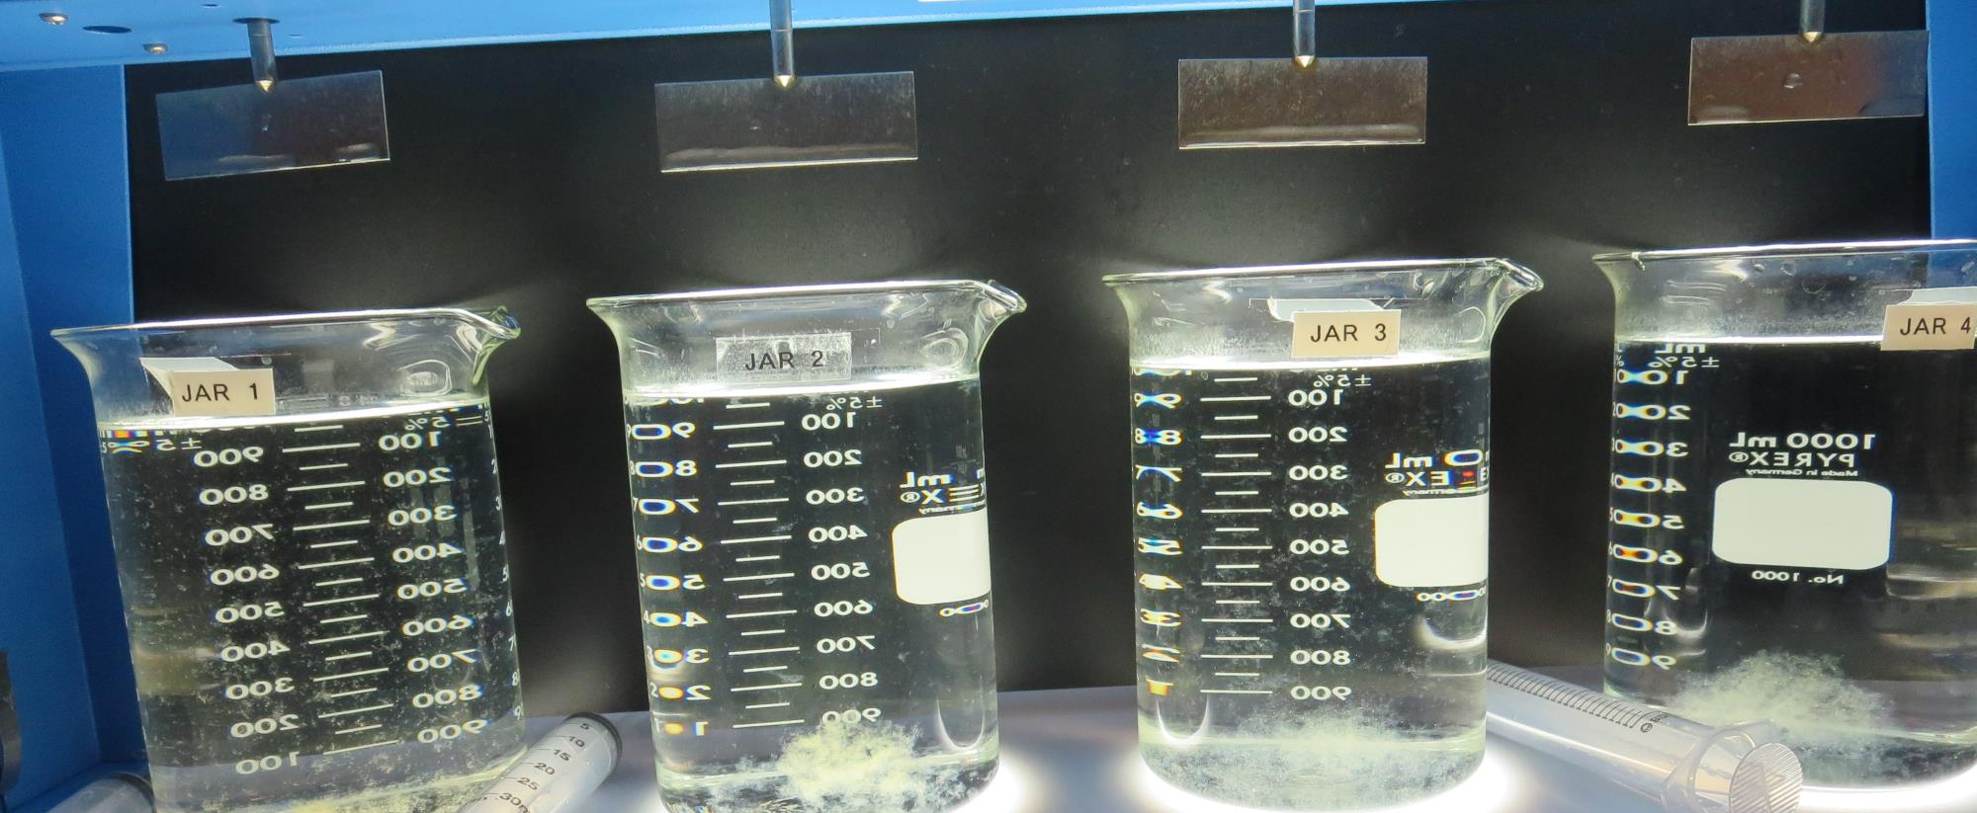
Jars 29-32: After 5 min of settling, 25 mL is syringed for filterability and %UVT/UVA.

Slide 51
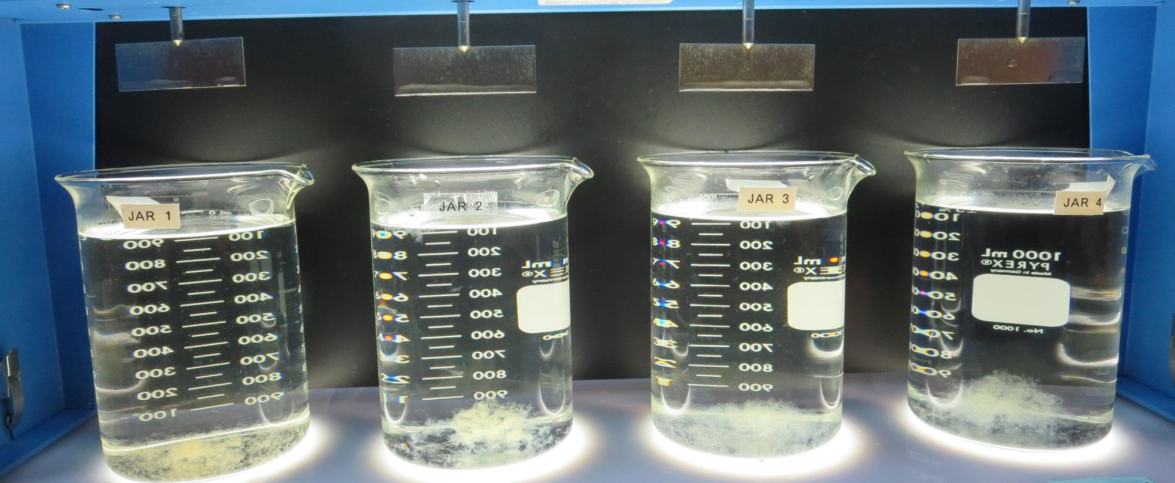
Jars 29-32: After 25-minutes of settling, settled water turbidity is taken.
20 mg/L Alum
Filtrate: 0.12 NTU
UVT: 88.7%
UVA: 0.051/cm
UVA Reduction 28.2%
Settled: 0.62 NTU
48 mg/L Alum
4.0 mg/L C-378
Filtrate: 0.05 NTU
UVT: 93.0%
UVA: 0.031/cm
UVA Reduction 56.3%
Settled: 0.39 NTU
30 mg/L 9810
Filtrate: 0.08 NTU
UVT: 91.8%
UVA: 0.037/cm
UVA Reduction 47.9%
Settled: 0.28 NTU
100 mg/L CTC-00011
Filtrate: 0.08 NTU
UVT: 92.4%
UVA: 0.034/cm
UVA Reduction 52.1%
Settled: 0.22 NTU

Slide 52
Jar Testing for 1-Liter Jars: Procedures for Most Treatment Plants
Fill jars with source water prior to coagulant injection and set paddle speed at 30 rpm
Add chemicals (i.e., NaOCl, primary coagulant, coagulant aid) to each jar
Flash mix for 15-30 seconds (200 rpm)
Slow mix for 5 minutes (20-30 rpm)
Settled for 5 minutes. Syringe 25 mL from each jar taken 1-inch below surface (25 mL/12 sec rate)
Filtered through 1.2 um isopore membrane into cuvette drip rate, 15 mL/(50-90 sec)
Measure filtrate turbidity, chlorine residual and %UVT/UVA
Measure settled water turbidity after 25 minutes of total setting
Record all data

Slide 53
Jar Test Filterability Test Equipment
Turbidity Instrument
Syringe w/Luer-Lock Tip, 30 cc
(part#: 2225800, by Hach)
Swinnex Filter Holder, 25 mm (part#: SX0002500)
Isopore Membrane Filter, 1.2 um absolute
pore size,
Φ= 25 mm , thickness: 24 um,
hydrophilic polycarbonate membrane
(part #: RTTP02500)
Go to Sigma-Aldrich for laboratory supplies http://www.sigmaaldrich.com/united-states.html

Slide 54
Isopore Membrane Information
Categories | Information
trade name | Isopore
filter color | White
chemistry | Polycarbonate (PC)
water flow rate | Avg. 175 mL/min x cm² (typical results @ 10 psi)
media | Isopore®
wettability | Hydrophilic
porosity | 14.7%
pore size | 1.2 µm
bubble point at 23 °C | 1.0 bar, air with water
thickness | 24 µm
filter diameter (ø) | 25 mm
material size | polycarbonate, Hydrophilic, 1.2 µm, 25 mm, white, plain, 100

Slide 55
Isopore Membrane Background Information
The Isopore membrane is a polycarbonate, track-etched screen filter recommended for all analyses in which the sample is viewed on the surface of the membrane. The Isopore membrane is composed of polycarbonate film, which has a smooth, glass-like surface for clearer sample observation. The unique manufacturing process of the membrane ensures a precise pore diameter and a consistent pore size for accurate separation of samples by size. Matched-weight filters are not usually required because of low, constant tar and ash weights. Features & Benefits: Membrane structure retains particles on the surface, simplifying counting and analysis

Slide 56
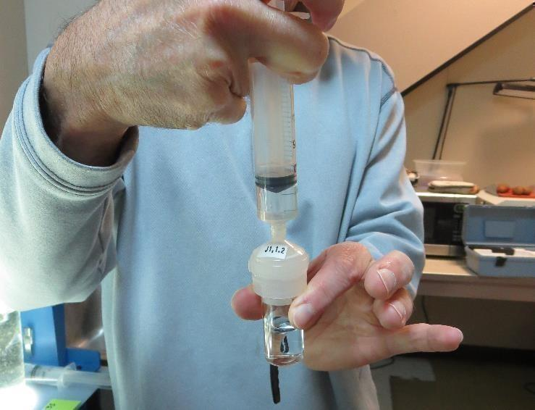
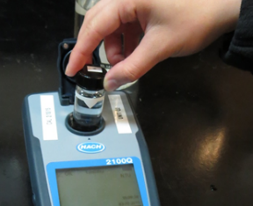
Jar Test - Filterability Test
Syringe ~ 25 mL from jar (after 5-minutes of settling)
Filter-to-waste 3-5 mL
Filter directly into clean cuvette
Measure turbidity
Note: Take several readings before recording final NTU results. Micro bubbles can adhere to glass causing false NTU readings. To remove bubbles, tilt cuvette up to 90 degrees.

Slide 57
Contact
Guy Schott, P.E.
State Water Resources Control Board
Division of Drinking Water
Santa Rosa, CA
Go to Stock Solution/Dose calculations/Jar Test Results for tools to download
www.waterboards.ca.gov/drinking_water/programs/districts/mendocino_district.html
Email: Guy Schott - Guy.Schott@waterboards.ca.gov
Office Number: 707-576-2732

