Slide 1
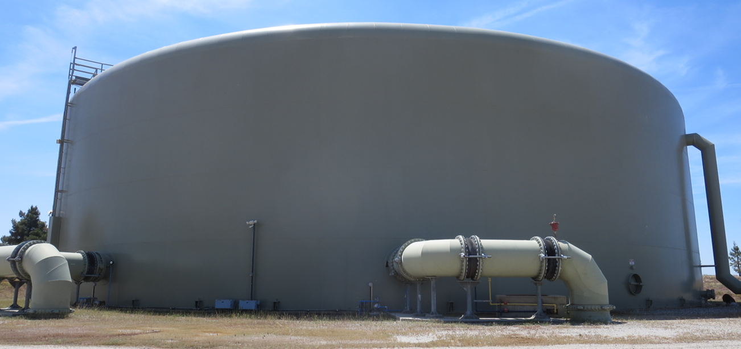
CA1510003
CWS Bakersfield Water Company Tracer Study
Transmission Line + 3 MG Clearwell, June 12, 2025
Performed/Assisted by:
Guy Schott, P.E.
CWS Bakersfield Operators and
Tehachapi & Yosemite District Staff

Slide 2
CWS - Bakersfield Clearwell Tracer Study

Slide 3
CWS – Bakersfield Clearwell Tracer Study

Slide 4
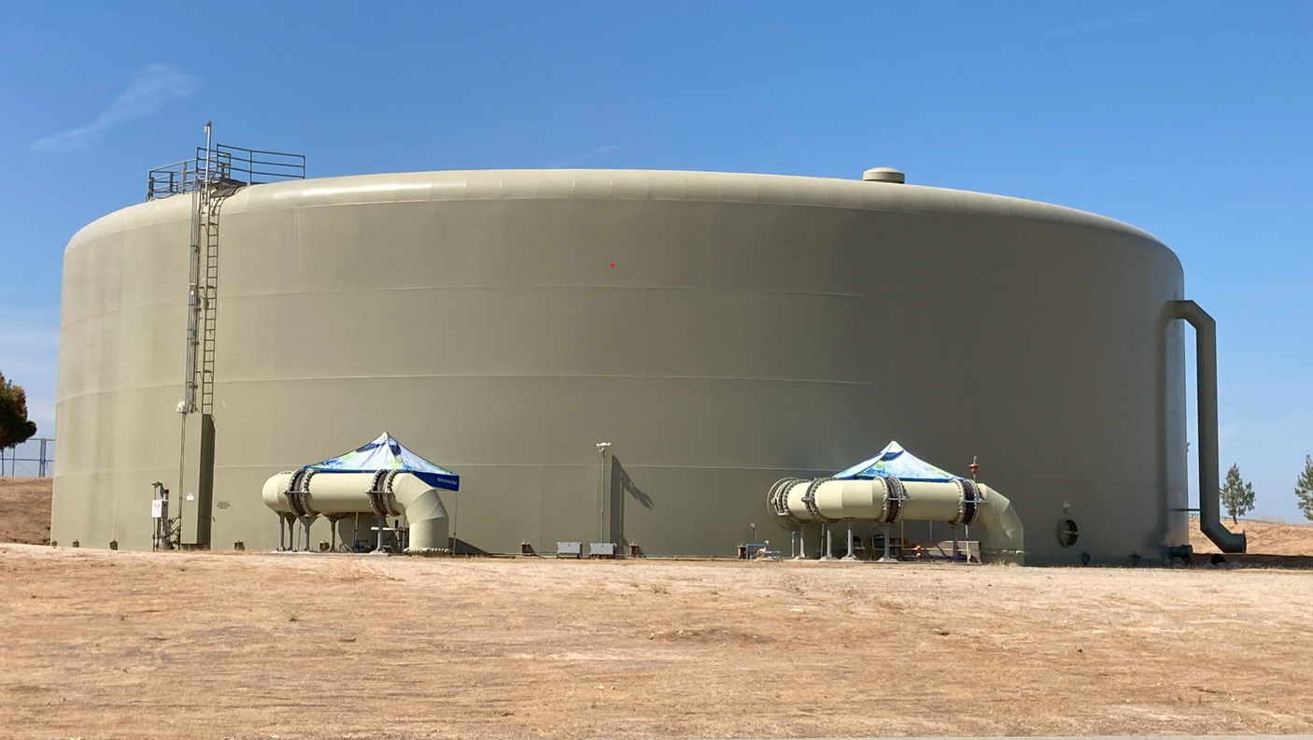
CWS – Bakersfield, 3 MG Clearwell
Inlet
Outlet

Slide 5
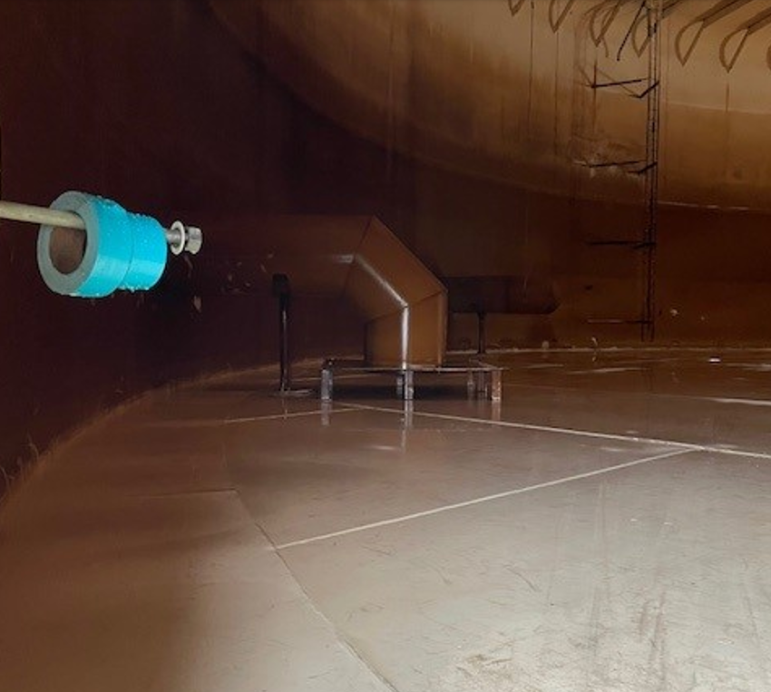
Inlet
36-in
Outlet
36-in

Slide 6
Summary of Tracer Procedures
A single tracer study was conducted on a combined transmission line and 3,000,000-gallon welded steel tank (clearwell).
Hydrofluosilicic Acid (H₂SiF₆) was used as the tracer that was injected at the chlorine injection point upstream of the clearwell into the 320-ft, 42-in diameter transmission line (23,030 gal).
Sampling were conducted at two stations
Station 1: Inlet to clearwell to confirm fluoride dose (mg/L)
Station 2: Exit line of clearwell

Slide 7
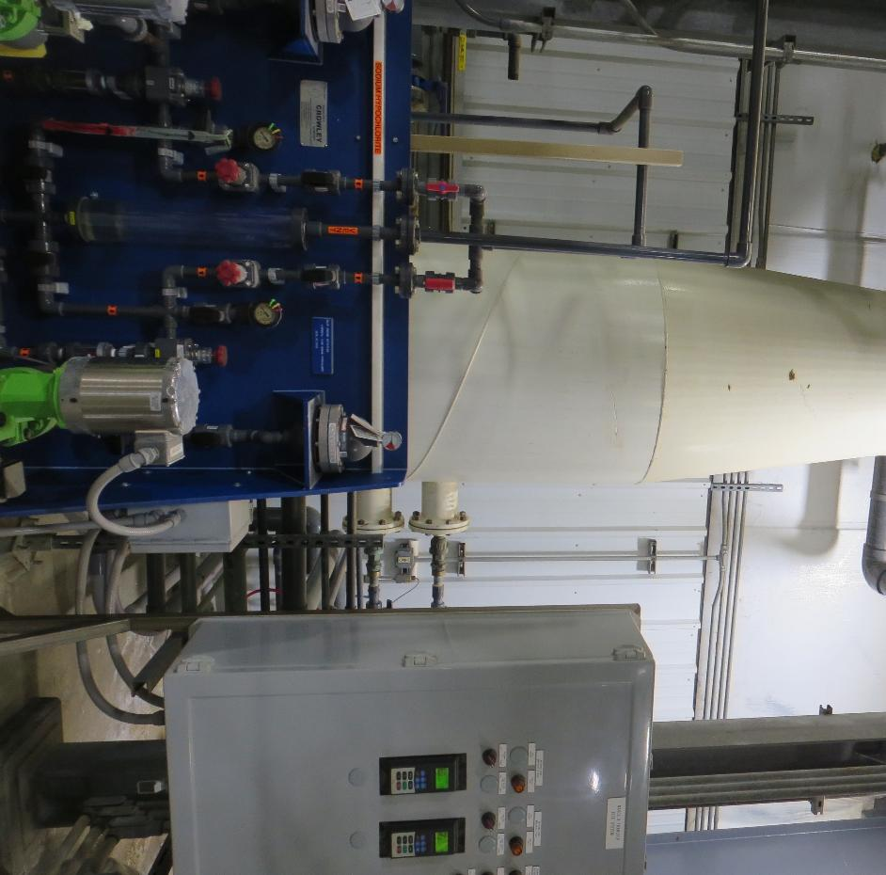
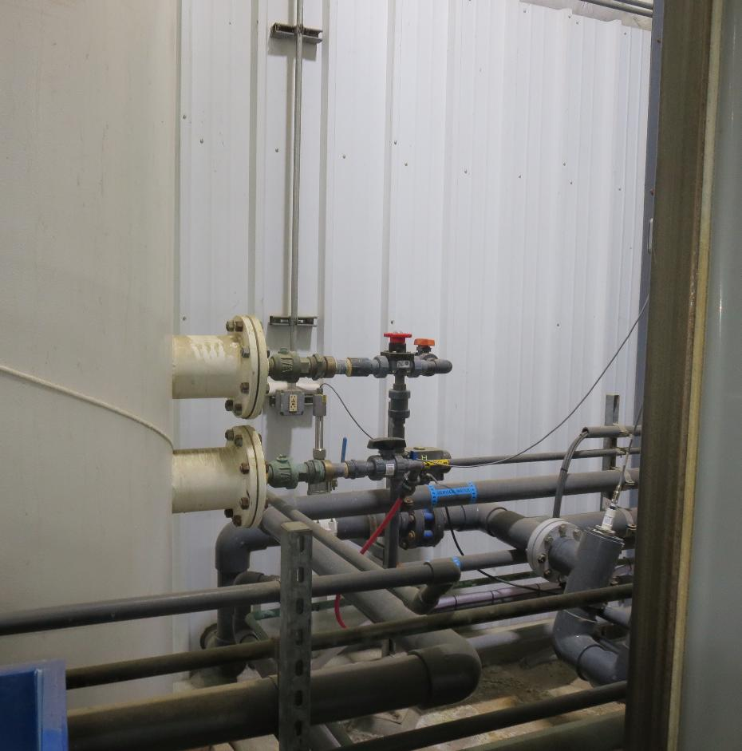
Fluoride and Chlorine Injection Points (post Membranes)

Slide 8
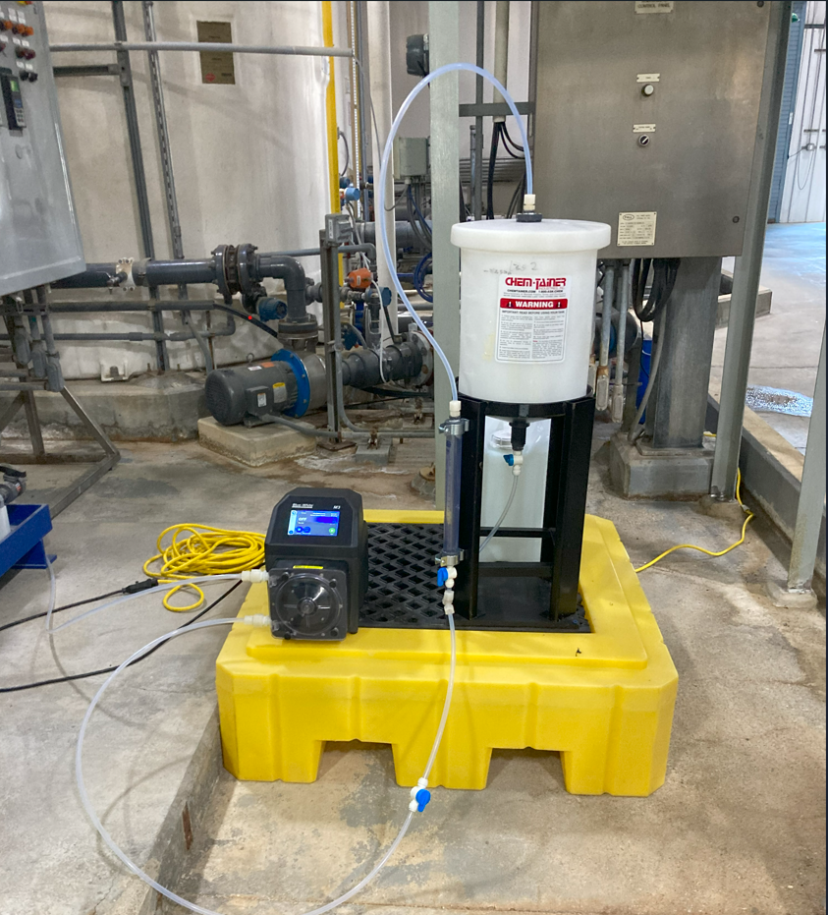
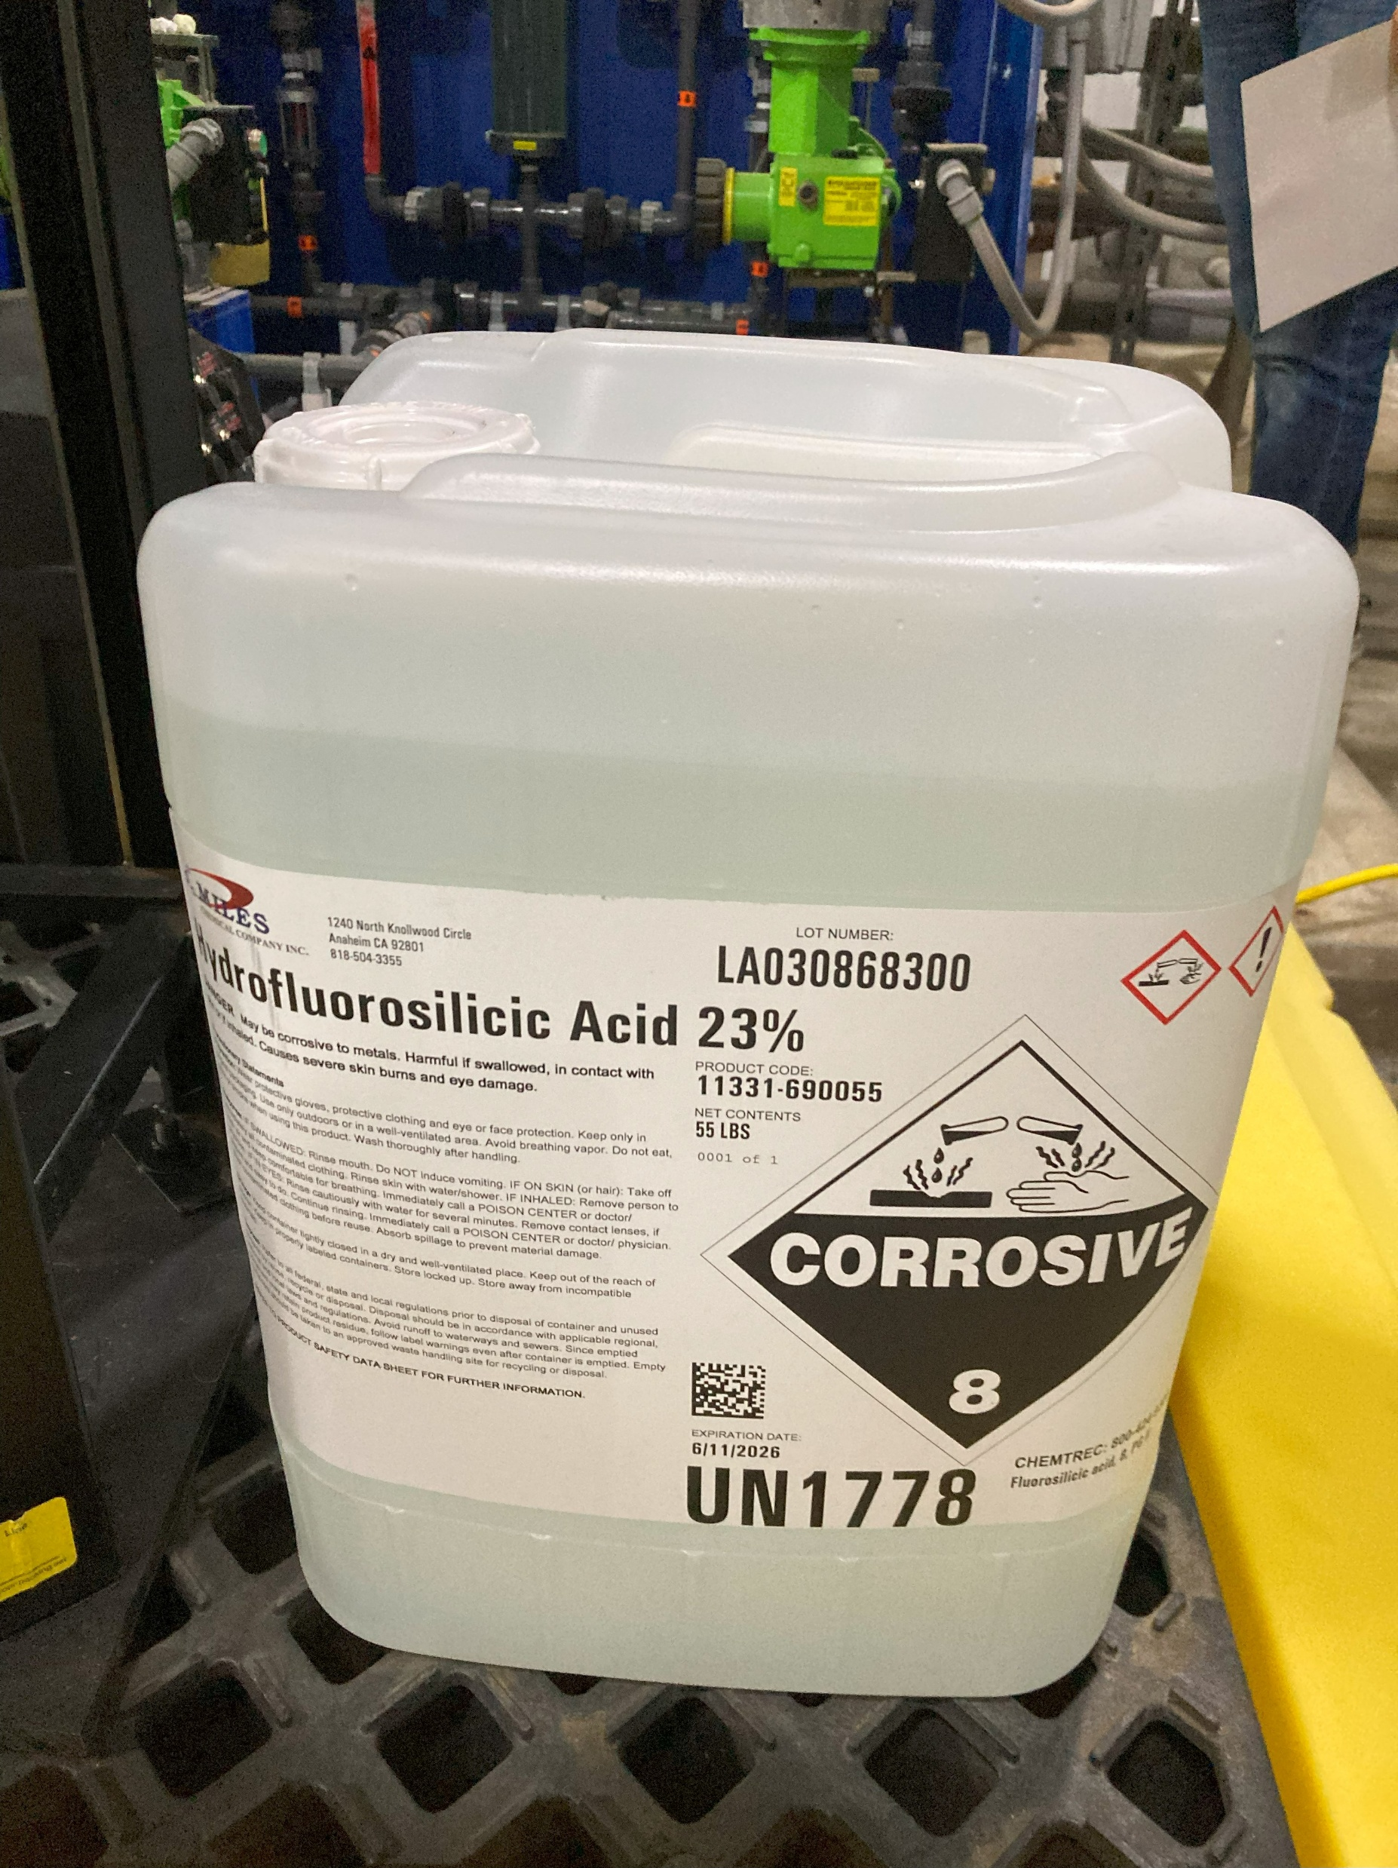
Fluoride
Injection
System

Slide 9
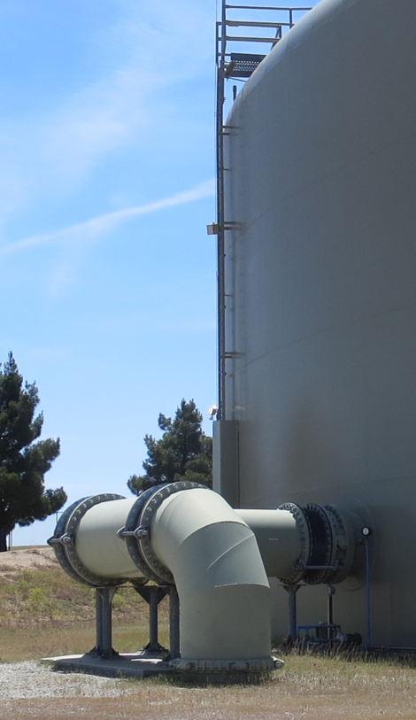
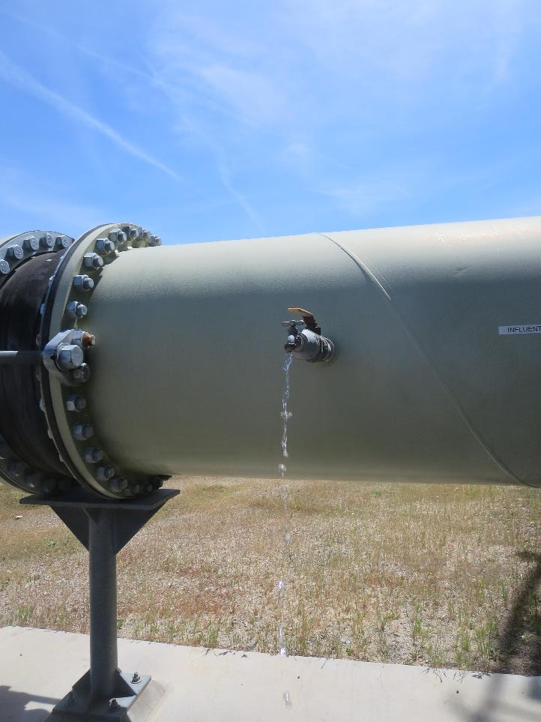
Clearwell – Inlet Sampling

Slide 10
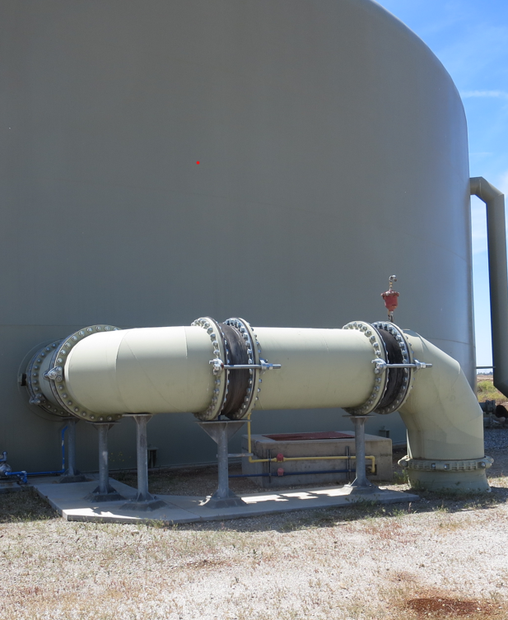
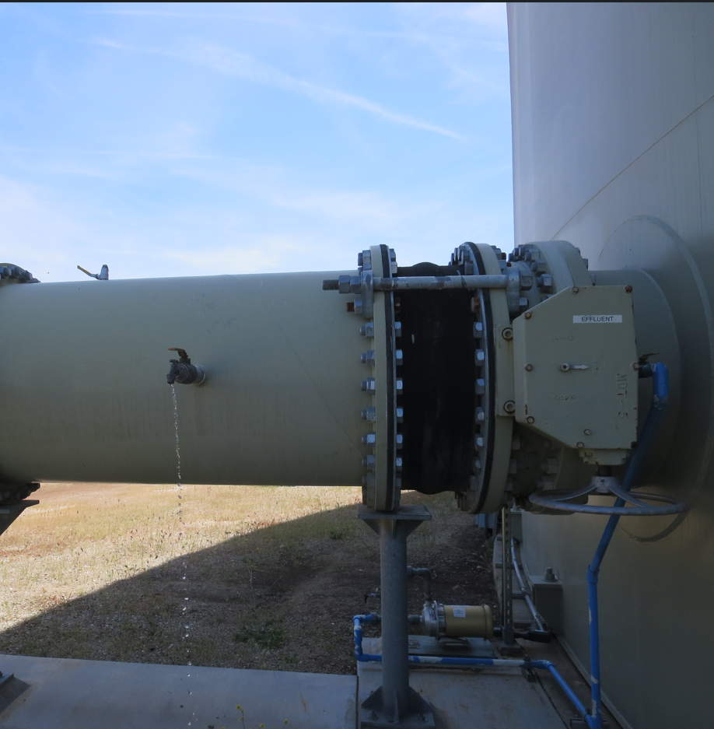
Clearwell – Outlet Sampling

Slide 11
Tracer Test Result Summary – Transmission Line + 3 Million-Gallon Clearwell
Modified Step-Dose
Test Date: 6/12/25
Transmission volume: 23,030 gallons (to Clearwell)
Clearwell avg operating volume: 2,480,613 gallons (25.975 level)
Entry avg flow: 5,075 gpm (7.308 MGD)
Exit avg flow: 5,393 gpm (7.766 MGD)
HRT: 465 minutes (includes pipeline volume of 23,030 gal)
t₁₀: 23.14 minutes
Baffling Factor (t₁₀/HRT): 0.05
Note: The above values are based on the operating range from time 0 to t₁₀ minutes; baffling factor is based on exit flow

Slide 12
t₁₀

Slide 13
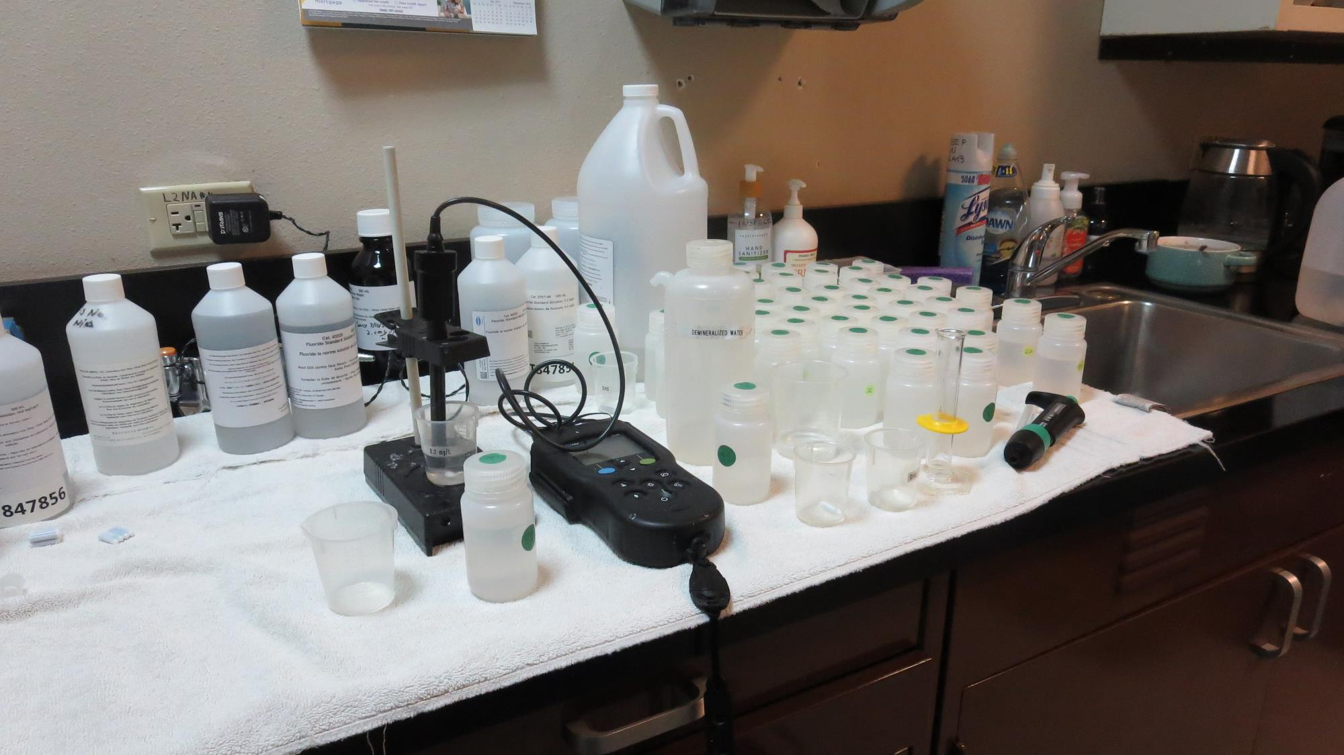
Fluoride Analysis
IntelliCAL Fluoride ISE Probe
Standards: 0.2 & 2.0 mg/L
Ionic Strength Adjustor (ISA)

Slide 14
Test 1: Tracer Fluoride Dose, Inlet to Clearwell
Elapsed Time minutes | *Tracer Fluoride Dose mg/L
12 | 1.34
18 | 1.44
24 | 1.43
30 | 1.40
36 | 1.44
*Excludes background fluoride of 0.143 mg/L

Slide 15
Tracer Test Tabulated Results

Slide 16
Dose: 1.40 mg/L (inlet monitoring)
0.140 mg/L at t₁₀ (outlet monitoring)
T₁₀: 23.14 min
HRT: 465 min
BF: 0.05 (T₁₀/HRT)

Slide 17
BF: 0.05

Slide 18
2004 – Tracer Results
Flow: 21 MGD
Tank Level: 26.5
BF: 0.09

Slide 19
Purpose of a Tracer Study
To determine the hydraulic efficiency or disinfectant exposure time of water through one or more reactors.
The addition of known quantities of a nonreactive chemical (tracer) is added in the form of a pulse (slug) or step-dose input.
The time of travel or disinfectant exposure time through the reactor is impacted by:
Flow rate
Water Depth
Volume
Configuration
Hydraulic mixing
Temperature

Slide 20
Disinfection Exposure Time of Fluid in Vessel for Determining Ct₁₀
C” - disinfectant residual (mg/L) at the point of inactivation compliance.
Disinfection exposure time of water used for Ct₁₀ calculation is the time (t₁₀) it takes for the first 10 percent of the water entering the reactor to exit the reactor.
To determine this, a nonreactive tracer is introduced into the water and is monitored leaving the reactor.
Example: 1.5 mg/L of tracer is continuously dose during testing; t₁₀ is that time when 0.15 mg/L of tracer concentration (10% of dose) has exited the reactor.

Slide 21
Ct₁₀ Value
Log inactivation is based on the Delivered Dose, “Ct₁₀”
“C” is the disinfectant residual (mg/L)
“t₁₀” is the exposure or contact time (minutes)
Multiply them:
C • t₁₀ = mg/L • min (delivered dose to pathogens)
The calculated Ct₁₀ value is looked up in EPA Ct tables to determine the log inactivation based on specific monitoring parameters (pH, disinfectant residual and temperature).

Slide 22
Baffling Factor (BF)
Baffling factor or short-circuiting factor:
Determined from tracer study or estimated
BF = t₁₀/ HRT from tracer study
HRT (hydraulic residence time) = operating volume divided by reactor flow
BF is determined and applied to daily operations of the reactor for determining the disinfectant exposure time.
Example:
Total pipeline + Clearwell operating volume: 2,500,000 gallons
Exit flow: 5,400 gpm (7.776 MGD)
BF: 0.05, from tracer study (combined pipeline and Clearwell)
Calculated contact or disinfection exposure time:
2,500,000 gal ÷ 5,400 gpm × 0.05 = 23.1 minutes = t₁₀

Slide 23
Test Method
Modified Step-Dose Method
It is a continue feed of tracer injected before the reactor at constant rate with plant flow. The “Step-Dose” test has a duration of 3-4 HRT to achieve reactor outlet steady-state tracer concentration. The time “t₁₀” is determined when 10% of the tracer dose concentration has exist the reactor. The “Modified Step-Dose” test allows the test to be completed in less than 1 HRT by physical measurements of the tracer to the inlet of the reactor.

Slide 24
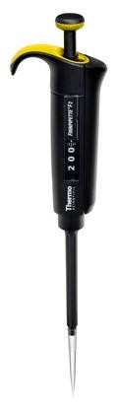
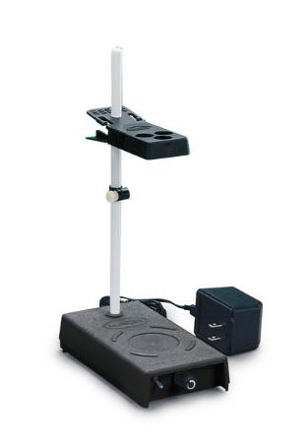
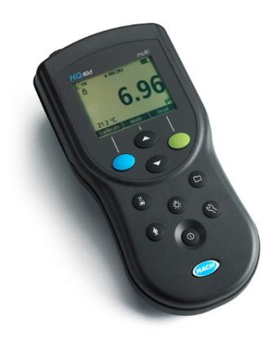
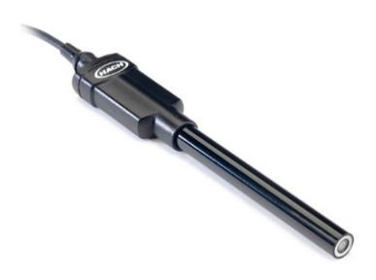
Method of Analysis and Equipment
Intellical™ ISEF121 Fluoride (F⁻) Ion Selective Electrode (ISE)
HQ40d Portable ISE Multi-Parameter Meter
Fluoride Ionic Strength Adjustor (ISA)
Fluoride Standards (0.2 & 2.0 mg/L)
25 mL graduated cylinder
Finnpipette F2 variable volume pipette, capacity 0.5 - 5 mL
Electrode stirrer stand
50 mL beakers
Stir Bar, Magnetic, Polygon

Slide 25

Contact
Guy Schott, P.E.
State Water Resources Control Board
Division of Drinking Water
Santa Rosa, CA
Go to Tracer Test Results for review
www.waterboards.ca.gov/drinking_water/programs/districts/mendocino_district.html
Email: Guy Schott - Guy.Schott@waterboards.ca.gov
Office Number: 707-576-2732

