Slide 1
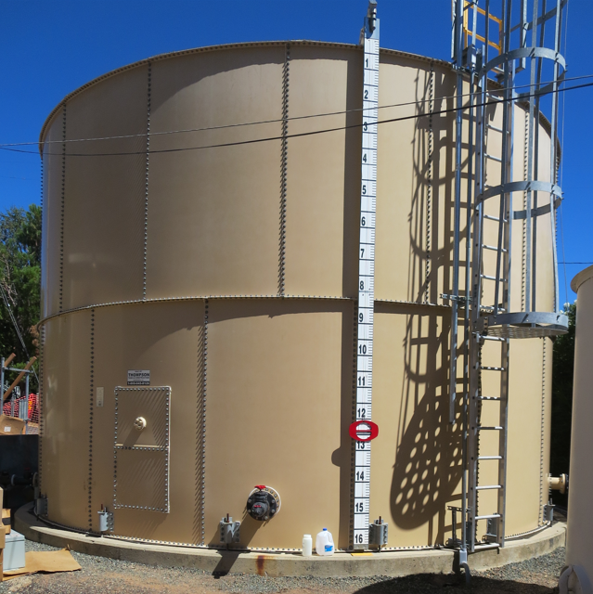
Clearwell
Clear Water MWC CA1700546 Tracer Studies Clearwell August 6, 2025
Performed by:
Guy Schott, P.E
Federico Pacheco Oreamuno

Slide 2
Clear Water Mutual Water Company Clearwell Tracer Study Operations

Slide 3
Summary of Tracer Procedures
The inlet to the 57,000-gallon bolted steel tank (Clearwell) was extended from the bottom to top of tank (14.5-ft off bottom) with a 3-inch Tee. The previous baffling factor was 0.038 when inlet/outlets were bottom-to-bottom. Extending the inlet towards the top of tank increased the baffling factor to 0.25. Liquid fluoride was used as the tracer that was injected near the chlorine injection point upstream of the clearwell. Modified Step-Dose test was used.
Sampling were conducted at two stations
Station 1: Inlet to clearwell to determine fluoride dose (mg/L)
Station 2: Downstream of clearwell and flow meter near high lift pumps
Clearwell entry flow was 44 gpm for both tests
Clearwell exit flow average at 69.5 gpm

Slide 4
Tracer Test Result Summary – 57,000-Gallon Clearwell
Modified Step-Dose
Test Date: 8/11/25
Clearwell avg operating volume: 49,130 gallons
Entry flow: 44 gpm
Exit flow: 68.5 gpm
HRT: 703 minutes
t₁₀: 156 + minutes
Baffling Factor (t₁₀/HRT): 0.25
Notes:
The test ran for 156 minutes. Only 7% of the inlet tracer was observed at the end of test that had a baffling factor of 0.22. Given this, the test was not run long enough to observed 10% of tracer mass existing the clearwell. Based on this information, a conservative 0.25 baffling was assigned.

Slide 5
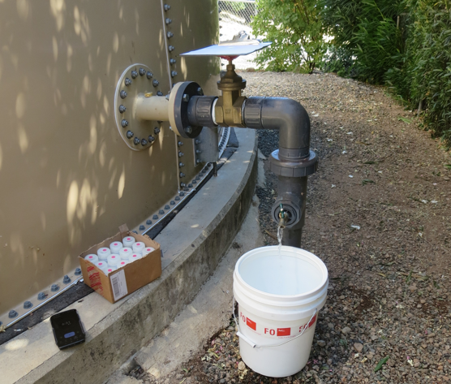
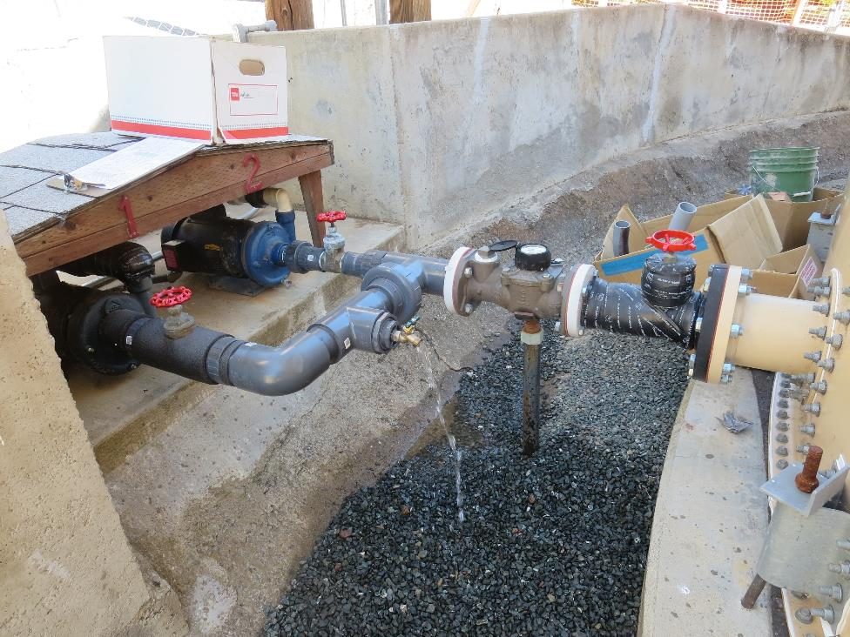
1
Inlet Sample Tap
Outlet Sample Tap

Slide 6
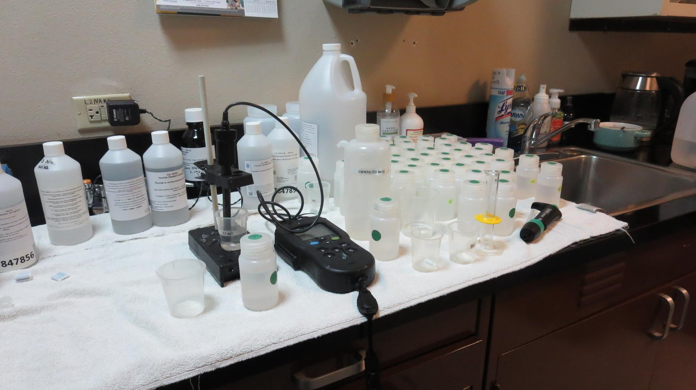
Laboratory
Fluoride Analysis

Slide 7
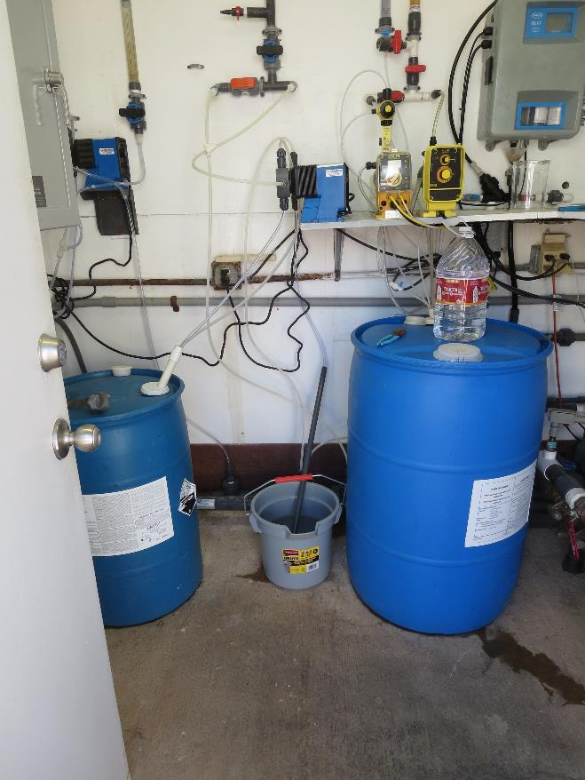
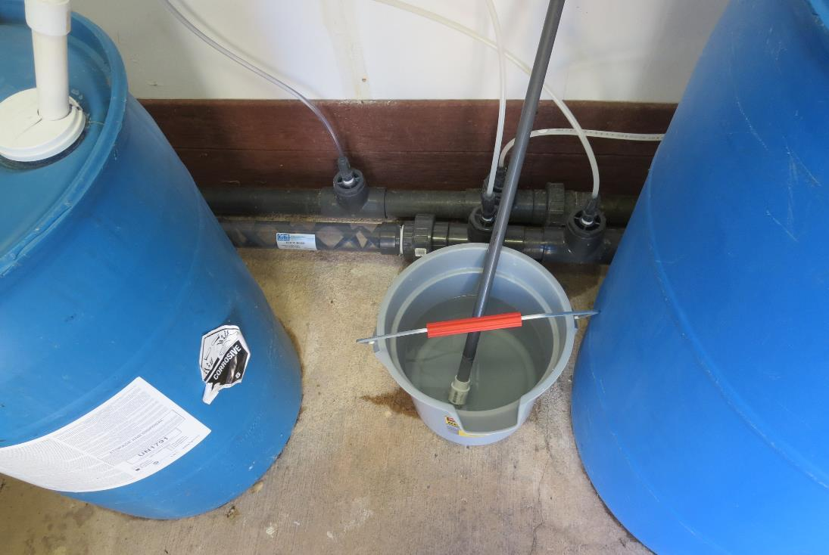
Tracer: H₂SiF₆, Fluoride (F) Injection
Static
Mixer
Solution
of Fluoride
Solution
of Fluoride

Slide 8
Test: Tracer Fluoride Dose, Inlet to Clearwell
Elapsed Time minutes | *Tracer Fluoride Dose mg/L
11 | 2.72
17 | 2.75
23 | 2.75
29 | 2.72
35 | 2.71
41 | 2.66
47 | 2.67
53 | 2.67
59 | 2.65
65 | 2.68
71 | 2.65
77 | 2.66
83 | 2.65
89 | 2.68

Slide 9
Tracer Test Tabulated Results

Slide 10
2

Slide 11
3
BF: 0.22 (T₁₀/HRT), rounded up to 0.25 given tracer test was not run long enough to observe 10% of tracer mass exit

Slide 12
Purpose of a Tracer Study
To determine the hydraulic efficiency or disinfectant exposure time of water through one or more reactors.
The addition of known quantities of a nonreactive chemical (tracer) is added in the form of a pulse (slug) or step-input.
The time of travel or disinfectant exposure time through the reactor is related to:
Flow rate
Reactor water volume
Water Depth
Reactor configuration
Hydraulic mixing

Slide 13
Disinfection Exposure Time of Fluid in Vessel for Determining Ct₁₀
C” is the disinfectant residual (mg/L) at the point of inactivation compliance.
The disinfection exposure time of water used for Ct₁₀ calculation is the time (t₁₀) it takes for the first 10 percent of the water entering the reactor to exit the reactor.
To determine this, a marker (nonreactive tracer) is introduced into the water and is monitored leaving the reactor.
Example: 1.9 mg/L of tracer is continuously dose during testing; t₁₀ is that time when 0.19 mg/L of tracer concentration (10% of dose) has exited the reactor.

Slide 14
Ct₁₀ Value
Log inactivation is based on the Delivered Dose, “Ct₁₀”
“C” is the disinfectant residual (mg/L)
“t₁₀” is the exposure or contact time (minutes)
Multiply them:
C • t₁₀ = mg/L • min (delivered dose to pathogens)
The calculated Ct₁₀ value is looked up in EPA Ct tables to determine the log inactivation based on specific monitoring parameters (pH, disinfectant residual and temperature).

Slide 15
Baffling Factor (BF)
Baffling factor or short-circuiting factor:
Determined from tracer study or estimated
BF = t₁₀/ HRT from tracer study
HRT (hydraulic residence time) = reactor volume divided by reactor flow
Once the BF is determined, then it is applied to the operations of the reactor for determining the disinfectant exposure time.
Example:
Total Clearwell operating volume: 48,000 gallons
Exit flow: 70 gpm (0. 1008 MGD)
BF: 0.25, from tracer study
Calculated contact or disinfection exposure time:
48,000 gal ÷ 70 gpm × 0.25 = 171 minutes = t₁₀

Slide 16
Test Method
Modified Step-Dose Method
It is a continue feed of tracer at constant rate and inlet plant flow throughout the duration of the test. The “Step-Dose” test has a duration of 3-4 HRT to achieve reactor outlet steady-state tracer concentration. The time “t₁₀” is determined when 10% of the tracer dose concentration has exist the reactor. The “Modified Step-Dose” test allows the test to be completed in less than 1 HRT by physical measurements of the tracer inlet flow and/or channel basin concentration.

Slide 17
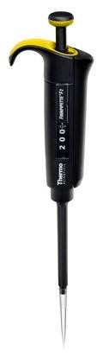
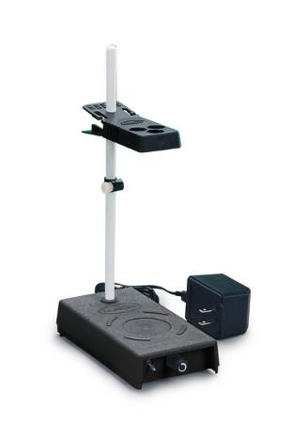
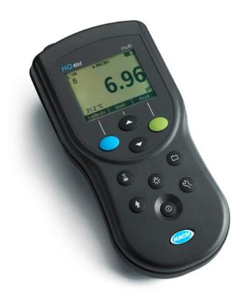
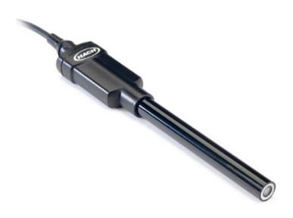
Method of Analysis and Equipment
Intellical™ ISEF121 Fluoride (F⁻) Ion Selective Electrode (ISE)
HQ40d Portable ISE Multi-Parameter Meter
Fluoride Ionic Strength Adjustor (ISA)
Fluoride Standards (0.2 & 2.0 mg/L)
25 mL graduated cylinder
Finnpipette F2 variable volume pipette, capacity 0.5 - 5 mL
Electrode stirrer stand
50 mL beakers
Stir Bar, Magnetic, Polygon

Slide 18

Contact
Guy Schott, P.E.
State Water Resources Control Board
Division of Drinking Water
Santa Rosa, CA
Go to Tracer Test Results for review
www.waterboards.ca.gov/drinking_water/programs/districts/mendocino_district.html
Email: Guy Schott - Guy.Schott@waterboards.ca.gov
Office Number: 707-576-2732

