Slide 1
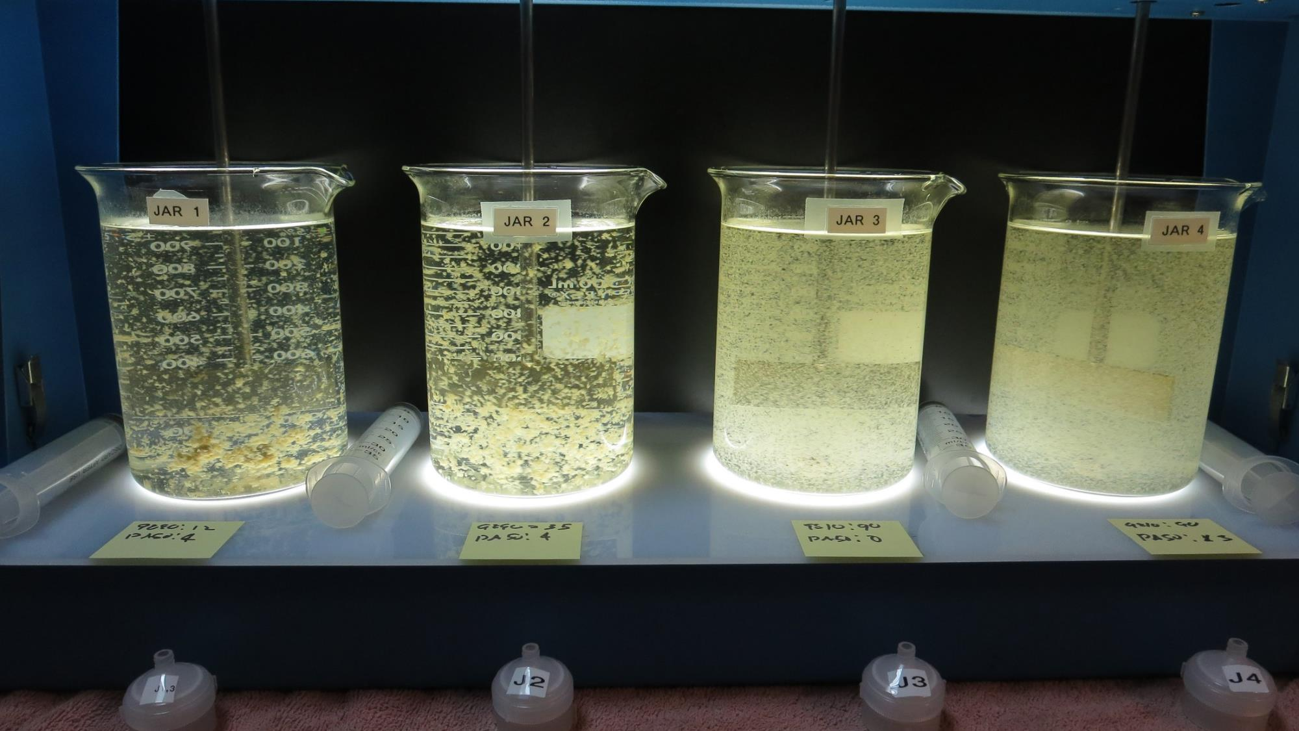
Lake County CSA 21, North Lakeport CA1710021, Lake County Jar Test
by Guy Schott, P.E.
November 10, 2022

Slide 2
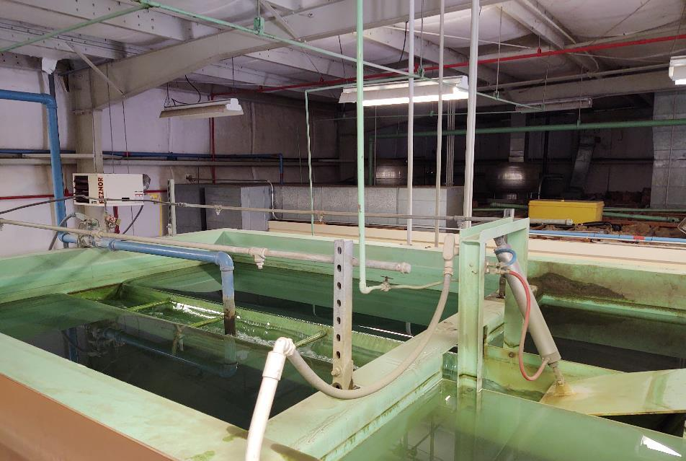
Lake County CSA 21, North Lakeport Trident Surface Water Facility
Clearwell
Pre-Ozone
Tower

Slide 3
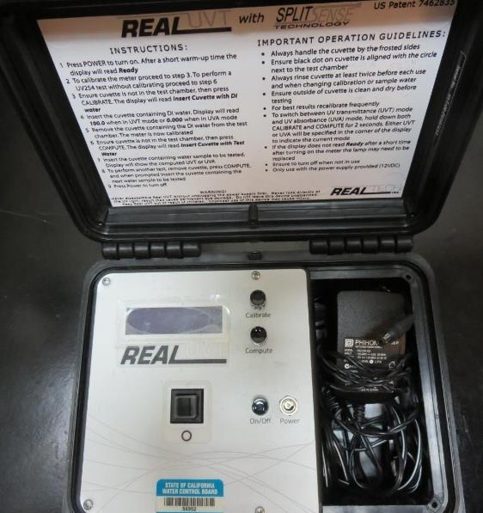
UVT/UVA, pathlength 10 mm
UV transmittance (UVT) is a measurement of the amount of ultraviolet light (254 nm) that passes through a water sample compared to the amount of light that passes through a pure water sample. The measurement is expressed as % UVT.
%UVT = 10^{(-UVA)} x 100%
UV absorbance (UVA) is calculated as a relative measure of the amount of light absorbed by a water sample compared with the amount of light absorbed by a pure water sample.
UVA = -log(%UVT/100)

Slide 4
North Lakeport Source Water Characteristics, November 10, 2022
Plant Coagulant Dose:
Pro Pac 9890: 11.8 mg/L
Zeta Floc PA 50: 3.8 mg/L (polyamine solution)
Source – Before Ozone Injection
pH: 8.46
Alkalinity: 202 mg/L as CaCO₃
Turbidity: 61 NTU
UVT: 59.3%,
UVA: 0.226/cm
0.4 um Filtered
Turbidity: 0.42 NTU
UVT: 81.4%,
UVA: 0.089/cm
Plant Filtrate Water
pH: 8.50
Alkalinity: 197 mg/L as CaCO₃
Turbidity: 0.12 NTU
UVT: 88.7%,
UVA: 0.051/cm
Plant Filtrate GAC Water
pH: 8.63
Alkalinity: 199 mg/L as CaCO₃
Turbidity: 0.07 NTU
UVT: 91.7%,
UVA: 0.039/cm
Note: Jar testing results are based on source water characteristic,
without applied ozone.

Slide 5
Applied Coagulants for Jar Testing (1)
Pro Pac 9890, NTU Technologies
35-45% Aluminum Chlorohydrate
20% polyamine solution (50% water, 50% active polyamine)
35-45% Water
~18.9% Al₂O₃
~10.5% Al
83% Basicity
SG = 1.25-1.34
NSF Max Use: 50 mg/L as Product;
Product dose 50 mg/L = 5 mg/L polyamine active
Zeta Floc PA 50, NTU Technologies
Polyamine (PY)
NSF Max Use: 10 mg/L as Product
(50% water, 50% active polyamine)
Product dose 10 mg/L = 5 mg/L polyamine active

Slide 6
Applied Coagulants for Jar Testing (2)
Pro Pac 9810, NTU Technologies
45-50% Aluminum Chlorohydrate
45-50% Water
~22.4% Al₂O₃
~11.9% Al
83% Basicity
5% polyamine solution (50% water, 50% active polyamine)
SG = 1.25-1.34
NSF limit: 200 mg/L as Product;
Product dose 200 mg/L = 5 mg/L active polyamine

Slide 7
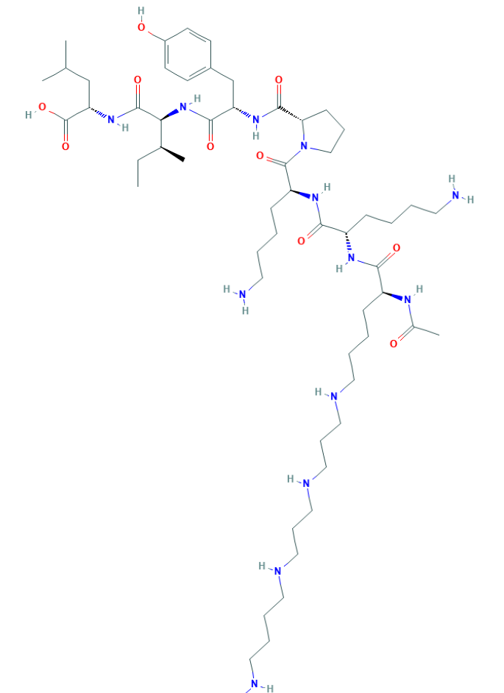
Polyamine C₅₉H₁₀₈N₁₄O₁₀ MW: 1,173.6 g/mol

Slide 8
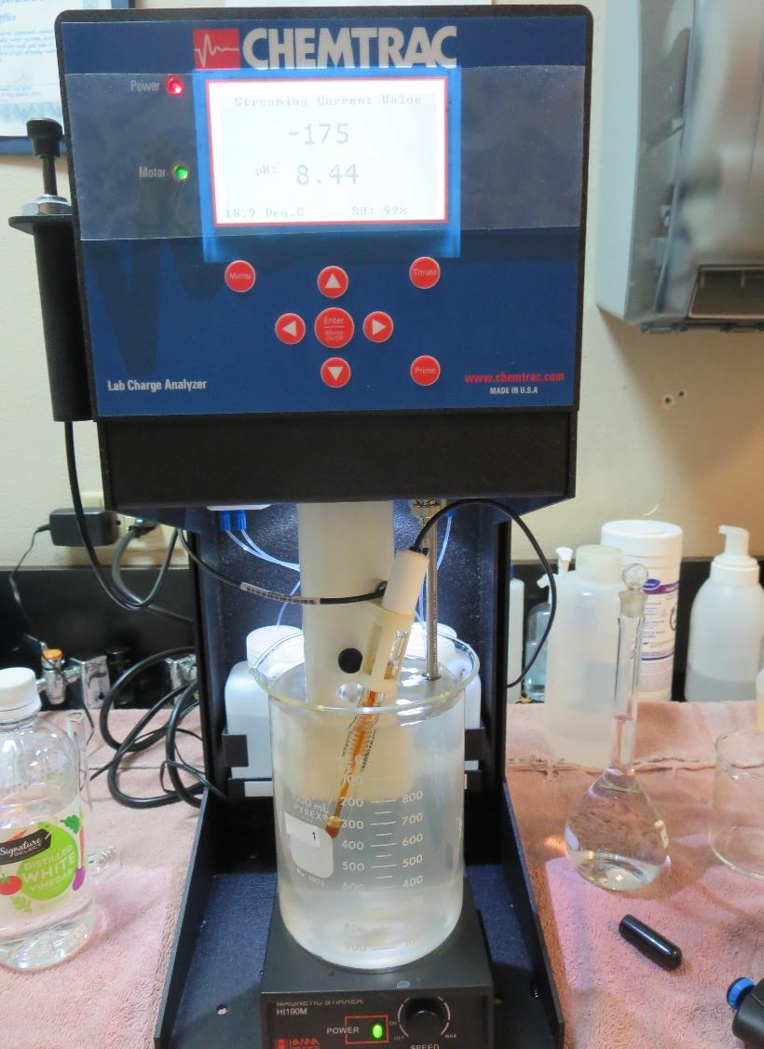
Laboratory Charge Analyzer
LCA: Used to determine coagulant demand of a source water entering the treatment plant.
Source pH: 8.46 (post Ozone)
LCA #1: Manually add Zeta Floc PA 50, 4 mg/L
Pro Pac 9890: 8.6 mg/L
pH adjusted to 7.8 with acetic acid
LCA #2: 9810: Pro Pac 9890: 35.6 mg/L
pH adjusted to 7.8 with acetic acid
LCA #3: 9810: 60.5 mg/L
pH adjusted to 7.8 with acetic acid

Slide 9
Coagulant Information
Unless stated otherwise, all coagulant doses are reported as Product (100% strength).
Aluminum Sulfate doses are reported as hydrated Al₂(SO₄)₃*14.3H₂0.
Preparation of coagulant stock solutions are generally 1.0 and/or 0.1 percent strength using 100 and/or 200 mL volumetric flasks.
Finnpipette F2 variable volume pipette, capacity 100-1000 micro liters is used for stock solution preparation and coagulant aid jar test dosing.
Finnpipette F2 variable volume pipette, capacity 0.5-5 mL is used for primary coagulant jar test dosing.

Slide 10
CSA 21 North Lakeport; Clear Lake; Jar Test 1 - 8 Results Flash Mix 200 RPM (20 sec); Floc Mix 30 RPM (5 min)
Jar# | Pro Pac 9890 mg/L | Zeta Floc PA 50 Polyamine | Filtrate NTU | Filtrate %UVT | Filtrate UVA/cm | %UVA Reduction
J1 | 16 | 0 | 0.30 | 84.5 | 0.073 | 18.0
J2 | 35 | 0 | 0.13 | 85.6 | 0.067 | 24.7
J3 | 40 | 0 | 0.09 | 86.9 | 0.060 | 32.6
J4 | 45 | 0 | 0.09 | 86.4 | 0.063 | 29.2
J5 | 16 | 1 | 0.17 | 84.7 | 0.072 | 19.1
J6 | 16 | 2 | 0.14 | 85.1 | 0.069 | 22.5
J7 | 16 | 3 | 0.10 | 85.8 | 0.066 | 25.8
J8 | 16 | 4 | 0.11 | 85.6 | 0.067 | 24.7

Slide 11
CSA 21 North Lakeport; Clear Lake; Jar Test 9 - 16 Results Flash Mix 200 RPM (20 sec); Floc Mix 30 RPM (5 min)
Jar# | Pro Pac 9810 mg/L | Zeta Floc PA 50 Polyamine | Filtrate NTU | Filtrate %UVT | Filtrate UVA/cm | %UVA Reduction
J9 | 55 | 0 | 0.07 | 86.4 | 0.063 | 29.2
J10 | 60 | 0 | 0.08 | 86.6 | 0.062 | 30.3
J11 | 65 | 0 | 0.08 | 86.8 | 0.061 | 31.5
J12 | 70 | 0 | 0.10 | 86.9 | 0.060 | 32.6
J13 | 55 | 3 | 0.06 | 87.3 | 0.059 | 33.7
J14 | 60 | 3 | 0.08 | 87.3 | 0.058 | 34.8
J15 | 65 | 3 | 0.06 | 87.7 | 0.057 | 36.0
J16 | 70 | 3 | 0.06 | 87.8 | 0.056 | 37.1

Slide 12
CSA 21 North Lakeport; Clear Lake; Jar Test 17 - 24 Results Flash Mix 200 RPM (20 sec); Floc Mix 30 RPM (5 min)
Jar# | Pro Pac 9890 mg/L | Pro Pac 9810 mg/L | Zeta Floc PA 50 Polyamine | Filtrate NTU | Filtrate %UVT | Filtrate UVA/cm | %UVA Reduction
J17 | 20 | - | 3 | 0.12 | 85.8 | 0.066 | 25.8
J18 | 25 | - | 3 | 0.10 | 86.0 | 0.065 | 27.0
J19 | 30 | - | 3 | 0.08 | 86.1 | 0.064 | 28.1
J20 | 35 | - | 3 | 0.09 | 86.4 | 0.063 | 29.2
J21 | - | 70 | 3 | 0.06 | 88.0 | 0.055 | 38.2
J22 | - | 80 | 3 | 0.05 | 88.2 | 0.054 | 39.3
J23 | - | 90 | 3 | 0.05 | 89.0 | 0.050 | 43.8
J24 | - | 100 | 3 | 0.05 | 88.5 | 0.052 | 41.6

Slide 13
CSA 21 North Lakeport; Clear Lake; Jar Test 25 - 28 Results Flash Mix 200 RPM (20 sec); Floc Mix 30 RPM (5 min)
Jar# | Pro Pac 9890 mg/L | Pro Pac 9810 mg/L | Zeta Floc PA 50 Polyamine | Filtrate NTU | Filtrate %UVT | Filtrate UVA/cm | %UVA Reduction
J25 | 12 | - | 4 | 0.16 | 85.5 | 0.067 | 24.7
J26 | 35 | - | 4 | 0.08 | 86.0 | 0.065 | 27.0
J27 | - | 90 | 0 | 0.08 | 87.1 | 0.059 | 33.7
J28 | - | 90 | 3 | 0.06 | 88.9 | 0.050 | 43.8

Slide 14
Jars 1-4 Test Flash Mix 20 Sec (200 RPM) Floc Mix 5 min (30 RPM) Without-Ozone Applied Coagulant Pro Pac 9890

Slide 15
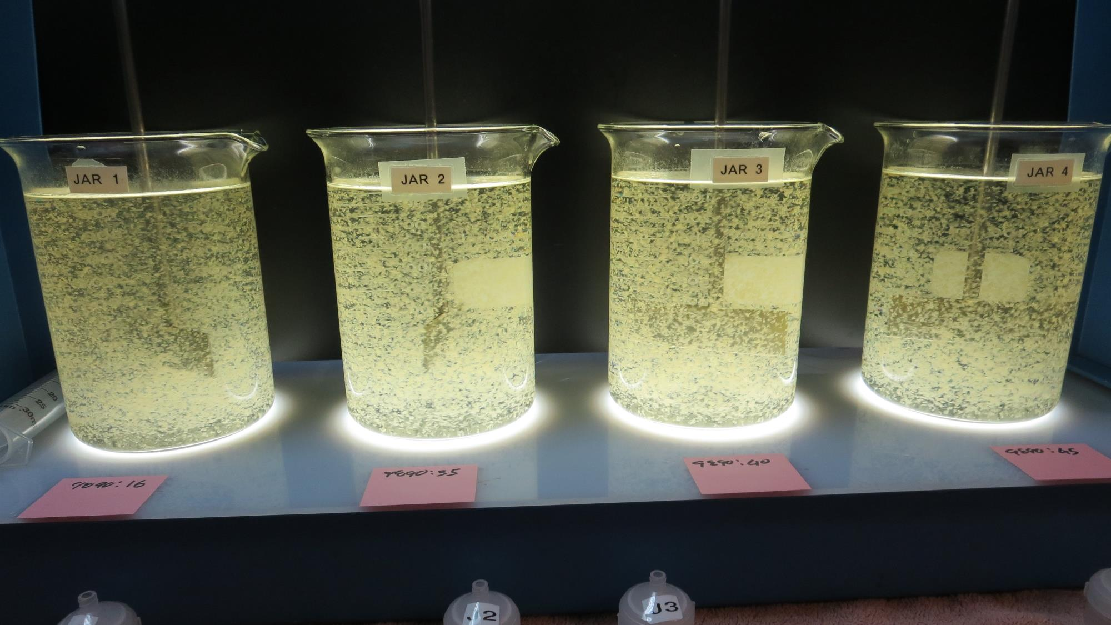
Jars 1-4: During Flocculation

Slide 16
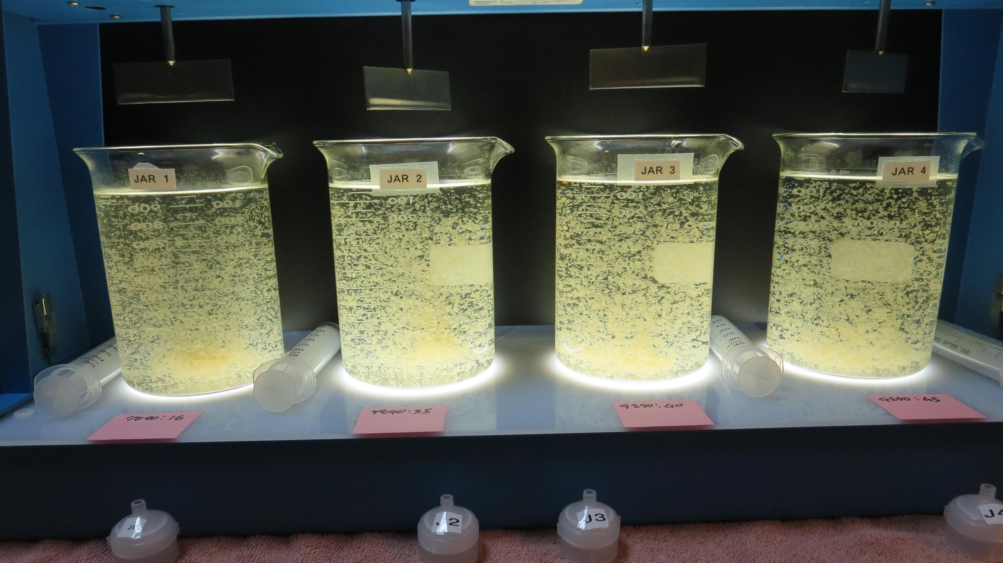
Jars 1-4: End of 5-minute flocculation (30 RPM) duration.
16 mg/L 9890
Filtrate 0.30 NTU
UVT: 84.5%
UVA: 0.073/cm
UVA Reduction: 18.0%
35 mg/L 9890
Filtrate 0.13 NTU
UVT: 85.6%
UVA: 0.067/cm
UVA Reduction: 24.7%
40 mg/L 9890
Filtrate 0.09 NTU
UVT: 86.9%
UVA: 0.060/cm
UVA Reduction: 32.6%
45 mg/L 9890
Filtrate 0.09 NTU
UVT: 86.4%
UVA: 0.063/cm
UVA Reduction: 29.2%

Slide 17
Jars 5-8 Test Flash Mix 20 Sec (200 RPM) Floc Mix 5 min (30 RPM) Without-Ozone Applied Coagulants Pro Pac 9890 Zeta Floc PA 50

Slide 18
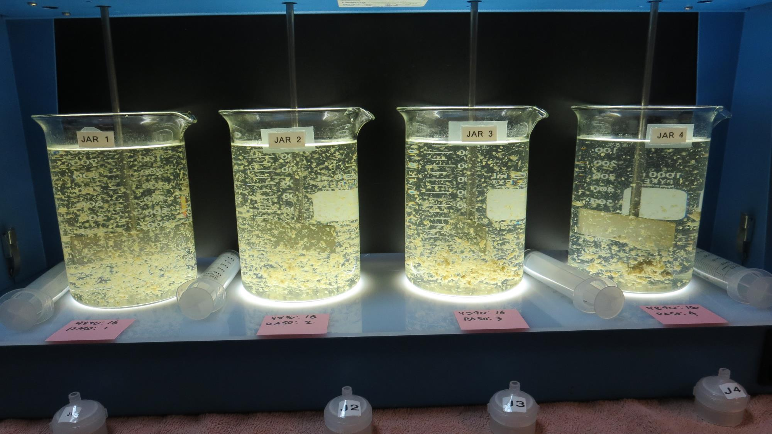
Jars 5-8: During Flocculation

Slide 19
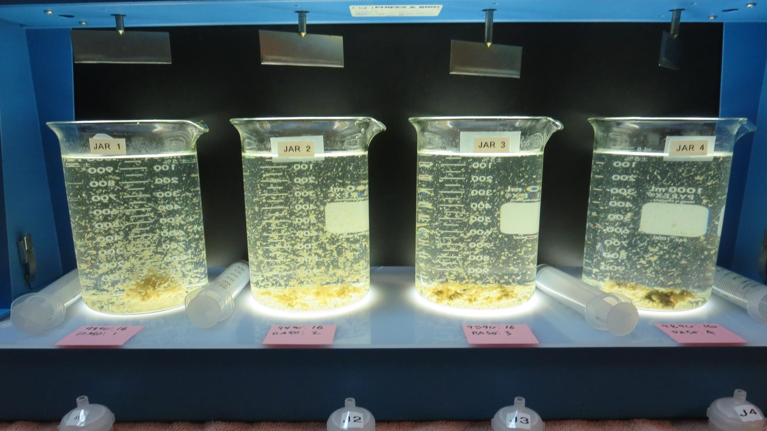
Jars 5-8: End of 5-minute flocculation (30 RPM) duration.
16 mg/L 9890
1 mg/L Zeta Floc PA 50
Filtrate 0.17 NTU
UVT: 84.7%
UVA: 0.072/cm
UVA Reduction: 19.1%
16 mg/L 9890
2 mg/L Zeta Floc PA 50
Filtrate 0.14 NTU
UVT: 85.1%
UVA: 0.069/cm
UVA Reduction: 22.5%
16 mg/L 9890
3 mg/L Zeta Floc PA 50
Filtrate 0.10 NTU
UVT: 85.8%
UVA: 0.066/cm
UVA Reduction: 25.8%
16 mg/L 9890
4 mg/L Zeta Floc PA 50
Filtrate 0.11 NTU
UVT: 85.6%
UVA: 0.067cm
UVA Reduction: 24.7%

Slide 20
Jars 9-12 Test Flash Mix 20 Sec (200 RPM) Floc Mix 5 min (30 RPM) Without-Ozone Applied Coagulant Pro Pac 9810

Slide 21
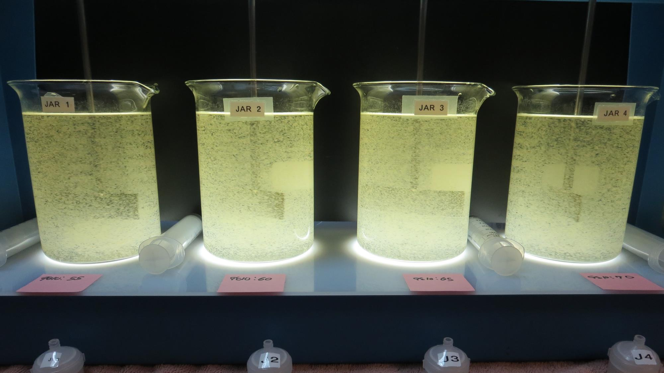
Jars 9-12: During Flocculation

Slide 22
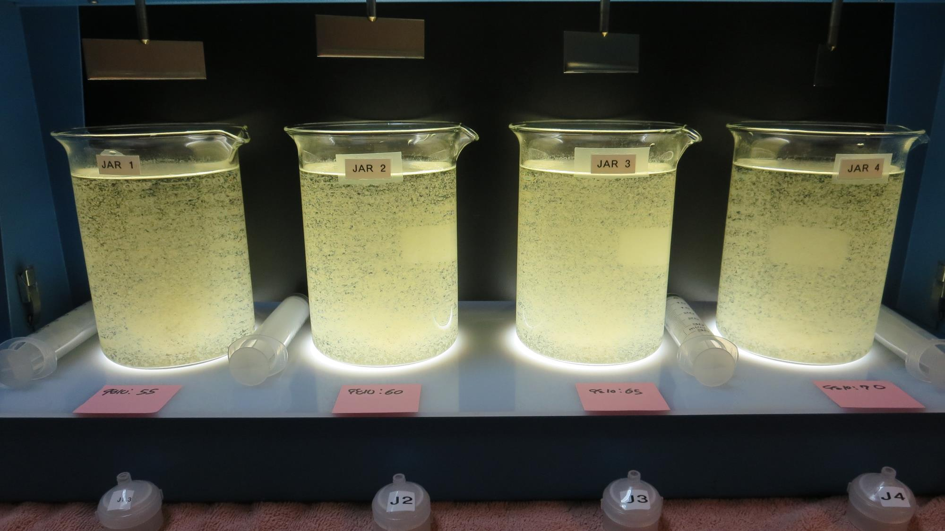
Jars 9-12: End of 5-minute flocculation (30 RPM) duration.
55 mg/L 9810
Filtrate 0.07 NTU
UVT: 86.4%
UVA: 0.073/cm
UVA Reduction: 29.2%
60 mg/L 9810
Filtrate 0.08 NTU
UVT: 86.6%
UVA: 0.067/cm
UVA Reduction: 30.3%
65 mg/L 9810
Filtrate 0.08 NTU
UVT: 86.8%
UVA: 0.060/cm
UVA Reduction: 31.5%
70 mg/L 9810
Filtrate 0.10 NTU
UVT: 86.9%
UVA: 0.063/cm
UVA Reduction: 32.6%

Slide 23
Jars 13-16 Test Flash Mix 20 Sec (200 RPM) Floc Mix 5 min (30 RPM) Without-Ozone Applied Coagulants Pro Pac 9810 Zeta Floc PA 50

Slide 24
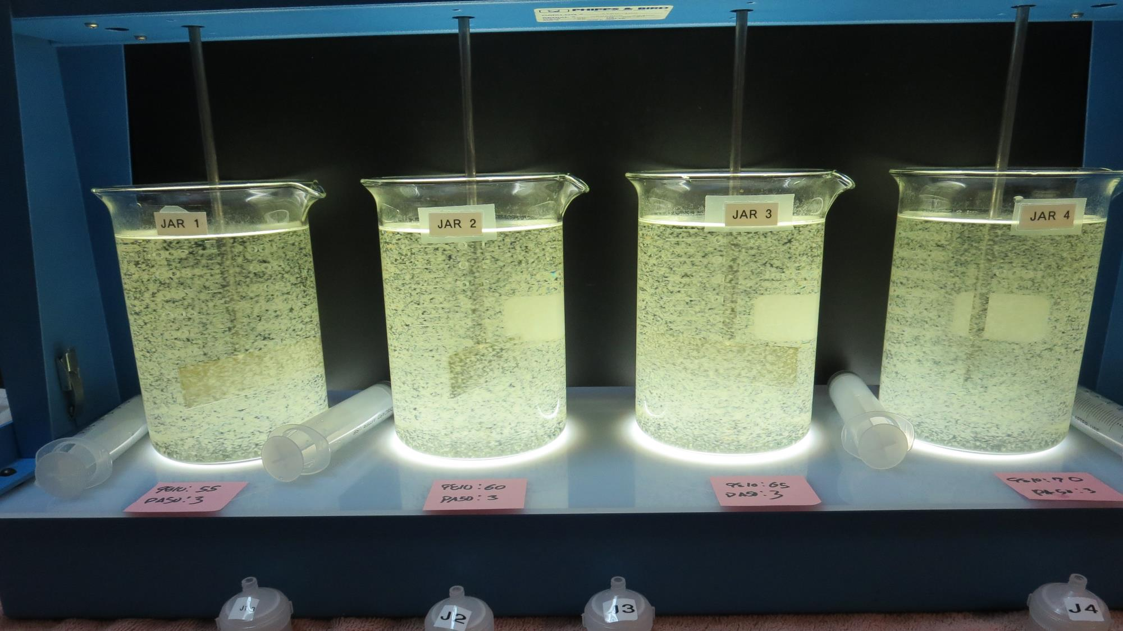
Jars 13-16: During Flocculation

Slide 25
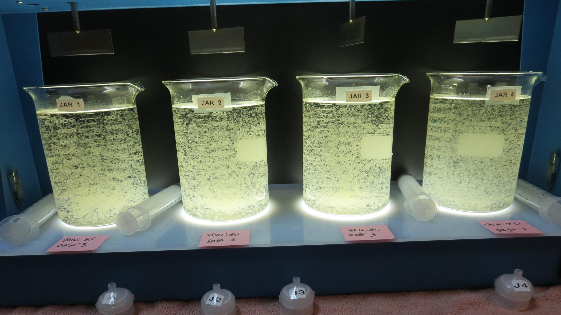
Jars 13-16: End of 5-minute flocculation (30 RPM) duration.
55 mg/L 9810
3 mg/L Zeta Floc PA 50
Filtrate 0.06 NTU
UVT: 87.3%
UVA: 0.059/cm
UVA Reduction: 33.7%
60 mg/L 9810
3 mg/L Zeta Floc PA 50
Filtrate 0.08 NTU
UVT: 87.3%
UVA: 0.058/cm
UVA Reduction: 34.8%
65 mg/L 9810
3 mg/L Zeta Floc PA 50
Filtrate 0.06 NTU
UVT: 87.7%
UVA: 0.057/cm
UVA Reduction: 36.0%
70 mg/L 9810
3 mg/L Zeta Floc PA 50
Filtrate 0.06 NTU
UVT: 87.8%
UVA: 0.057cm
UVA Reduction: 37.1%

Slide 26
Jars 17-20 Test Flash Mix 20 Sec (200 RPM) Floc Mix 5 min (30 RPM) Without-Ozone Applied Coagulants Pro Pac 9890 Zeta Floc PA 50

Slide 27
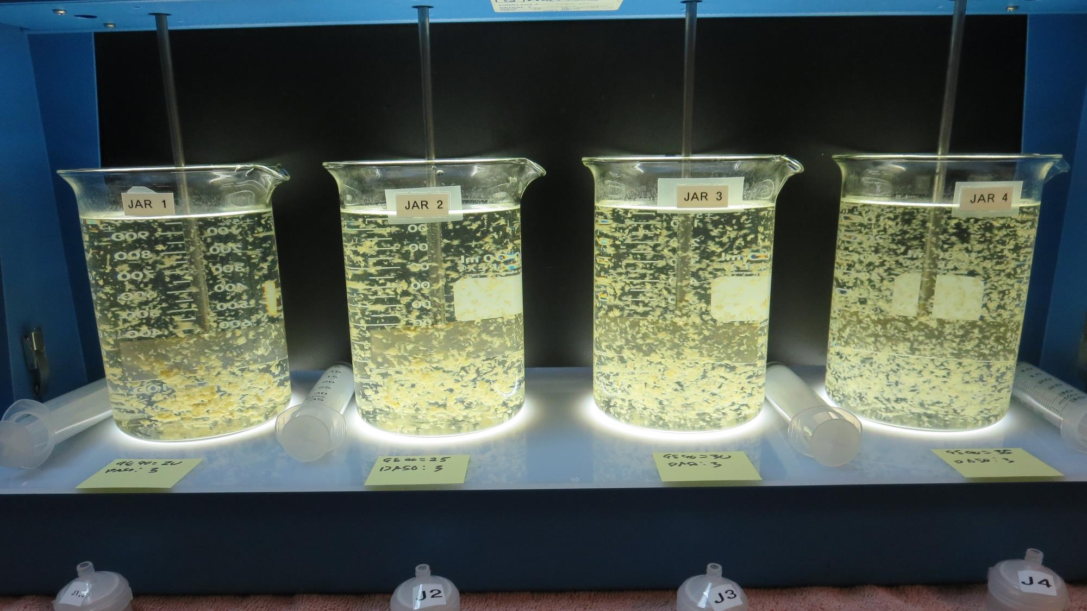
Jars 17-20: During Flocculation

Slide 28
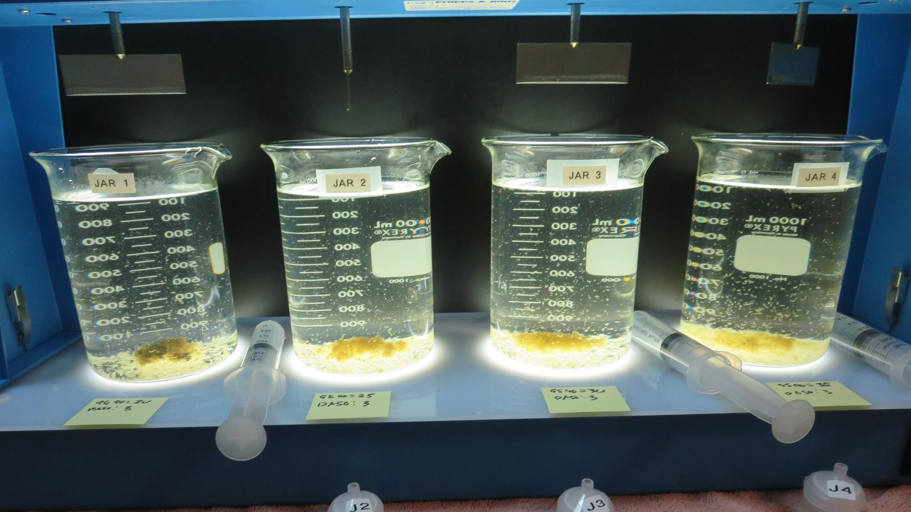
Jars 17-20: End of 5-minute flocculation (30 RPM) duration.
20 mg/L 9890
3 mg/L Zeta Floc PA 50
Filtrate 0.12 NTU
UVT: 85.8%
UVA: 0.066/cm
UVA Reduction: 25.8%
25 mg/L 9890
3 mg/L Zeta Floc PA 50
Filtrate 0.10 NTU
UVT: 86.0%
UVA: 0.065/cm
UVA Reduction: 27.0%
30 mg/L 9890
3 mg/L Zeta Floc PA 50
Filtrate 0.08 NTU
UVT: 86.1%
UVA: 0.064/cm
UVA Reduction: 28.1%
35 mg/L 9890
3 mg/L Zeta Floc PA 50
Filtrate 0.09 NTU
UVT: 86.4%
UVA: 0.063cm
UVA Reduction: 29.2%

Slide 29
Jars 21-24 Test Flash Mix 20 Sec (200 RPM) Floc Mix 5 min (30 RPM) Without-Ozone Applied Coagulant 9810

Slide 30
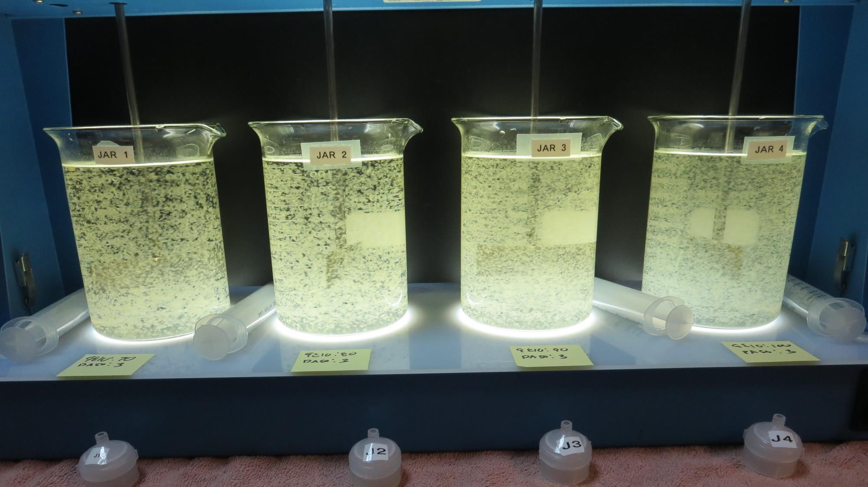
Jars 21-24: During Flocculation

Slide 31
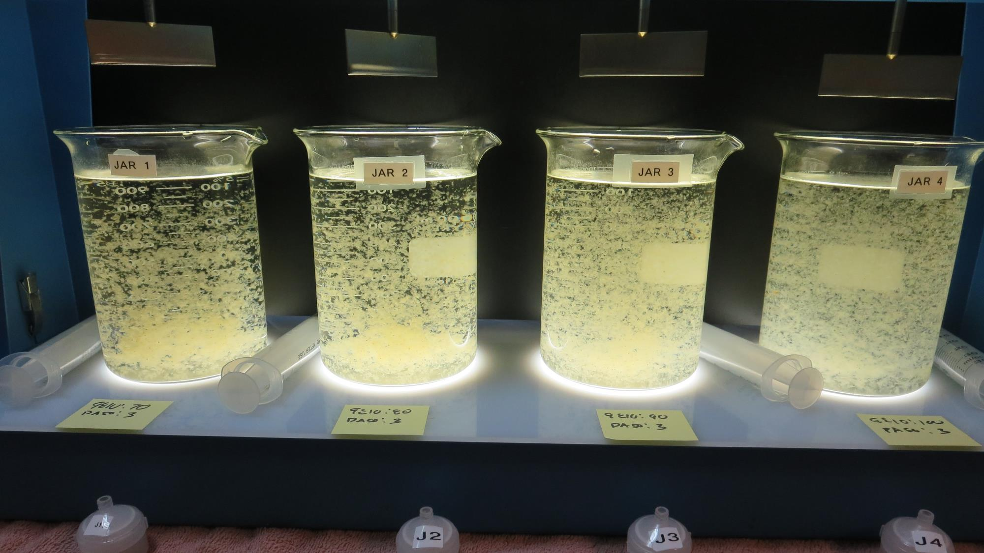
Jars 21-24: End of 5-minute flocculation (30 RPM) duration.
70 mg/L 9810
3 mg/L Zeta Floc PA 50
Filtrate 0.06 NTU
UVT: 88.0%
UVA: 0.055/cm
UVA Reduction: 38.2%
80 mg/L 9810
3 mg/L Zeta Floc PA 50
Filtrate 0.05 NTU
UVT: 88.2%
UVA: 0.054/cm
UVA Reduction: 39.3%
90 mg/L 9810
3 mg/L Zeta Floc PA 50
Filtrate 0.05 NTU
UVT: 89.0%
UVA: 0.050/cm
UVA Reduction: 43.8%
100 mg/L 9810
3 mg/L Zeta Floc PA 50
Filtrate 0.05 NTU
UVT: 88.5%
UVA: 0.052/cm
UVA Reduction: 41.6%

Slide 32
Jars 25-28 Test Flash Mix 20 Sec (200 RPM) Floc Mix 5 min (30 RPM) Without-Ozone Applied Coagulants Pro Pac 9890 Pro Pac 9810 Zeta Floc PA 50

Slide 33
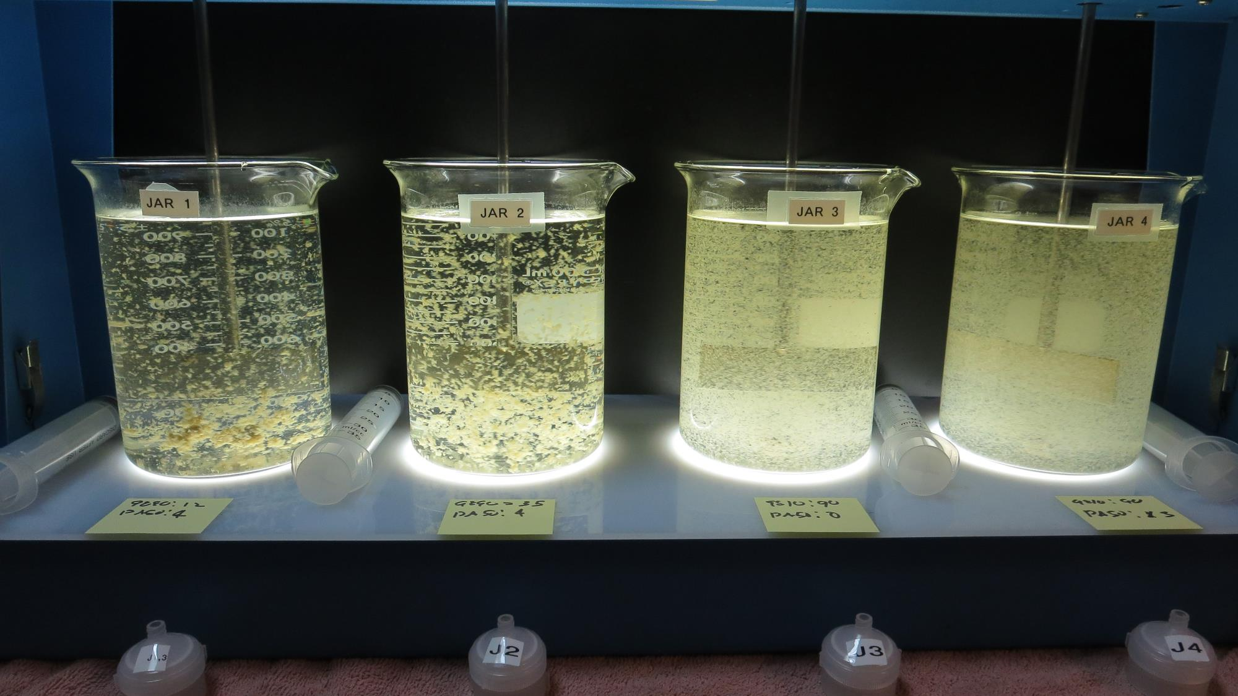
Jars 25-28: During Flocculation

Slide 34
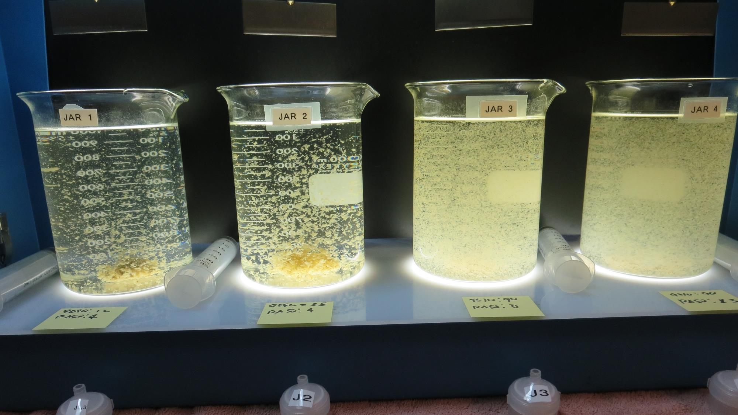
Jars 25-28: End of 5-minute flocculation (30 RPM) duration.
12 mg/L 9890
4 mg/L Zeta Floc PA 50
Filtrate 0.16 NTU
UVT: 85.5%
UVA: 0.067/cm
UVA Reduction: 24.7%
80 mg/L 9890
4 mg/L Zeta Floc PA 50
Filtrate 0.08 NTU
UVT: 86.0%
UVA: 0.065/cm
UVA Reduction: 27.0%
90 mg/L 9810
0 mg/L Zeta Floc PA 50
Filtrate 0.08 NTU
UVT: 87.1%
UVA: 0.059/cm
UVA Reduction: 33.7%
90 mg/L 9810
3 mg/L Zeta Floc PA 50
Filtrate 0.06 NTU
UVT: 88.9%
UVA: 0.050/cm
UVA Reduction: 43.8%

Slide 35
Jar Testing for 1-Liter Jars: Procedures for Most Treatment Plants
Fill jars with source water prior to coagulant injection and set paddle speed at 30 rpm
Add chemicals (i.e., NaOCl, primary coagulant, coagulant aid) to each jar
Flash mix for 15-30 seconds (200 rpm)
Slow mix for 5 minutes (20-30 rpm)
Syringe 25 mL from each jar taken 1-inch below surface (25 mL/12 sec rate)
Filtered through 1.2 um isopore membrane into cuvette drip rate, 15 mL/(50-90 sec)
Measure filtrate turbidity, chlorine residual and %UVT/UVA
Measure settled water turbidity after 25 minutes of total setting
Record all data

Slide 36
Jar Test Filterability Test Equipment
Turbidity Instrument
Syringe w/Luer-Lock Tip, 30 cc
(part#: 2225800, by Hach)
Swinnex Filter Holder, 25 mm (part#: SX0002500)
Isopore Membrane Filter, 1.2 um absolute
pore size,
Φ= 25 mm , thickness: 24 um,
hydrophilic polycarbonate membrane
(part #: RTTP02500)
Go to Sigma-Aldrich for laboratory supplies http://www.sigmaaldrich.com/united-states.html

Slide 37
Isopore Membrane Information
Categories | Information
trade name | Isopore
filter color | White
chemistry | Polycarbonate (PC)
water flow rate | Avg. 175 mL/min x cm² (typical results @ 10 psi)
media | Isopore®
wettability | Hydrophilic
porosity | 14.7%
pore size | 1.2 µm
bubble point at 23 °C | 1.0 bar, air with water
thickness | 24 µm
filter diameter (ø) | 25 mm
material size | polycarbonate, Hydrophilic, 1.2 µm, 25 mm, white, plain, 100

Slide 38
Isopore Membrane Background Information
The Isopore membrane is a polycarbonate, track-etched screen filter recommended for all analyses in which the sample is viewed on the surface of the membrane. The Isopore membrane is composed of polycarbonate film, which has a smooth, glass-like surface for clearer sample observation. The unique manufacturing process of the membrane ensures a precise pore diameter and a consistent pore size for accurate separation of samples by size. Matched-weight filters are not usually required because of low, constant tar and ash weights. Features & Benefits: Membrane structure retains particles on the surface, simplifying counting and analysis

Slide 39
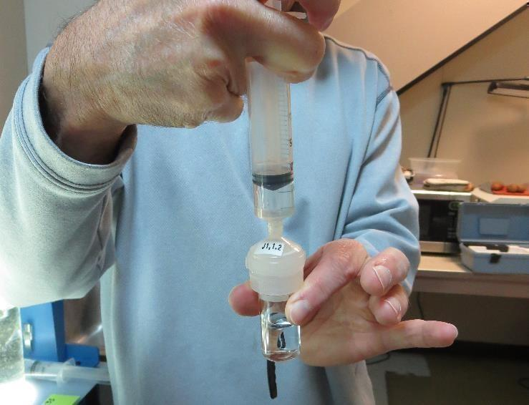
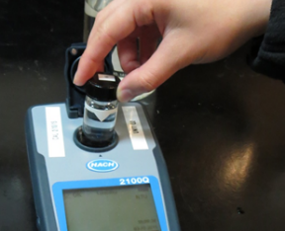
Jar Test - Filterability Test
Syringe ~ 25 mL from jar (after 5-minutes of settling)
Filter-to-waste 3-5 mL
Filter directly into clean cuvette
Measure turbidity
Note: Take several readings before recording final NTU results. Micro bubbles can adhere to glass causing false NTU readings. To remove bubbles, tilt cuvette up to 90 degrees.

Slide 40
Contact
Guy Schott, P.E.
State Water Resources Control Board
Division of Drinking Water
Santa Rosa, CA
Go to Jar Test Results/Procedures for tools to download
www.waterboards.ca.gov/drinking_water/programs/districts/mendocino_district.html
Jar Testing Done Right video training https://youtu.be/aGByyxhelkI
Email: Guy Schott - Guy.Schott@waterboards.ca.gov
Office Number: 707-576-2732

