Slide 1
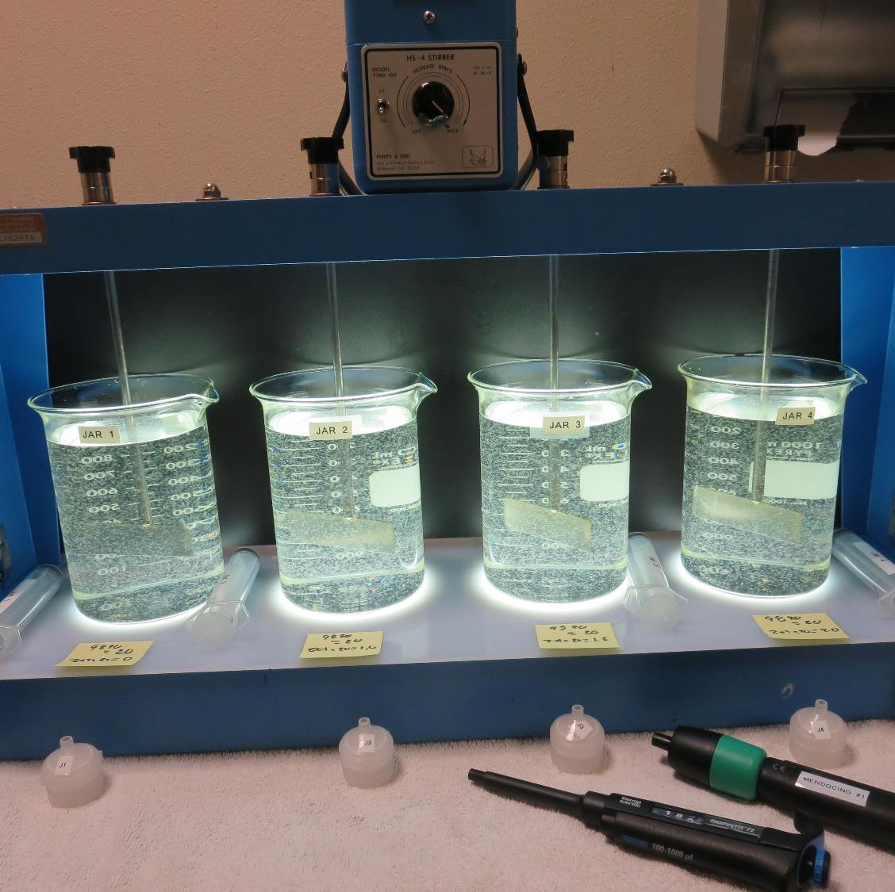
Lake County CSA 21, North Lakeport
CA1710021, Lake County
Jar Test
by Guy Schott, P.E.
November 26, 2024

Slide 2
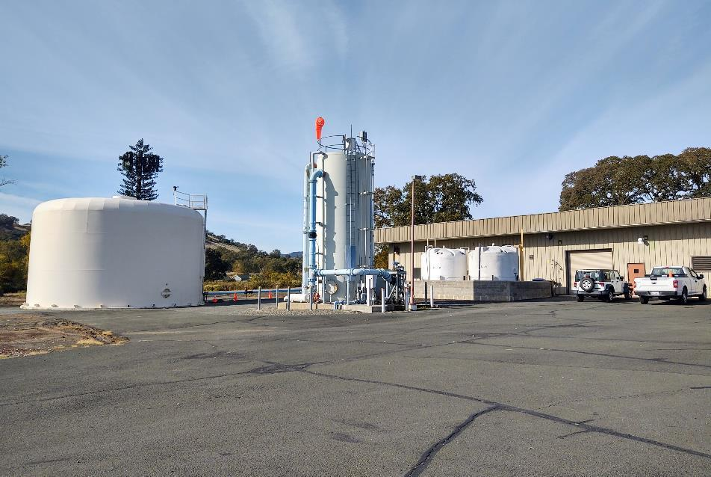
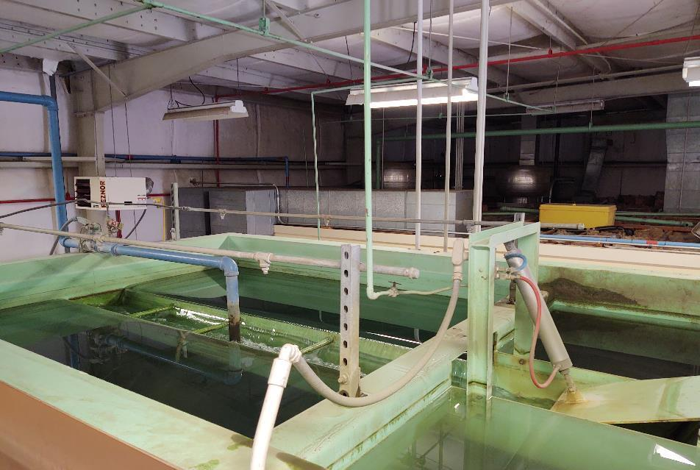
Lake County CSA 21, North Lakeport
Trident Surface Water Facility
Clearwell
Pre-Ozone
Tower

Slide 3
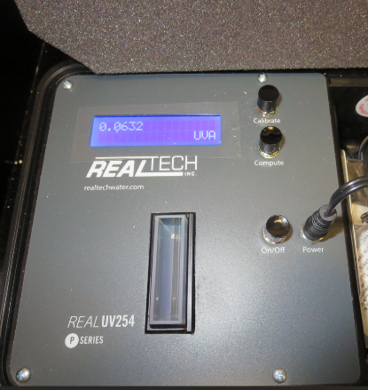
UVT/UVA, pathlength 40 mm
UV transmittance (UVT) is a measurement of the amount of ultraviolet light (254 nm) that passes through a water sample compared to the amount of light that passes through a pure water sample. The measurement is expressed as % UVT.
%UVT = 10^{(-UVA)} x 100%
UV absorbance (UVA) is calculated as a relative measure of the amount of light absorbed by a water sample compared with the amount of light absorbed by a pure water sample.
UVA = -log(%UVT/100)

Slide 4
North Lakeport Source Water
Characteristics, November 26, 2024
Plant Coagulant Dose:
Pro Pac 9890: 22 mg/L
Zeta Floc PA 50: 2 mg/L (polyamine solution)
Source – Before Ozone Injection
pH: 7.87
Alkalinity: 149 mg/L as CaCO₃
Turbidity: 6.16 NTU
UVT: 75.79%,
UVA: 0.1204/cm
0.4 um Filtered
Turbidity: 0.54 NTU
UVT: 78.79%,
UVA: 0.1036/cm
Plant Filtrate Water
Turbidity: 0.18 NTU
UVT: 91.14%,
UVA: 0.0403/cm
Plant Filtrate GAC Water
Turbidity: 0.06 NTU
UVT: 92.84%,
UVA: 0.0323/cm
Note: Jar testing results are based on source water characteristic,
without applied ozone.

Slide 5
Applied Coagulants for Jar Testing (1)
Pro Pac 9890, NTU Technologies
35-45% Aluminum Chlorohydrate
20% polyamine solution (50% water, 50% active polyamine)
35-45% Water
~18.9% Al₂O₃
~10.5% Al
83% Basicity
SG = 1.25-1.34
NSF Max Use: 50 mg/L as Product;
Product dose 50 mg/L = 5 mg/L polyamine active
Zeta Floc PA 50, NTU Technologies
Polyamine (PY)
NSF Max Use: 10 mg/L as Product
(50% water, 50% active polyamine)
Product dose 10 mg/L = 5 mg/L polyamine active
Ferric Sulfate
50% Ferric Sulfate
50% Water
SG = 1.40-1.51
NSF limit: 600 mg/L as Product

Slide 6
Applied Coagulants for Jar Testing (2)
Pro Pac 9810, NTU Technologies
45-50% Aluminum Chlorohydrate
45-50% Water
~22.4% Al₂O₃
~11.9% Al
83% Basicity
5% polyamine solution (50% water, 50% active polyamine)
SG = 1.25-1.34
NSF limit: 200 mg/L as Product;
Product dose 200 mg/L = 5 mg/L active polyamine
NTU Technologies
Zeta Floc 20, Organic Polymer
20% pDADMAC
80% Water
SG = 1.07
NSF limit: 50 mg/L as Product

Slide 7
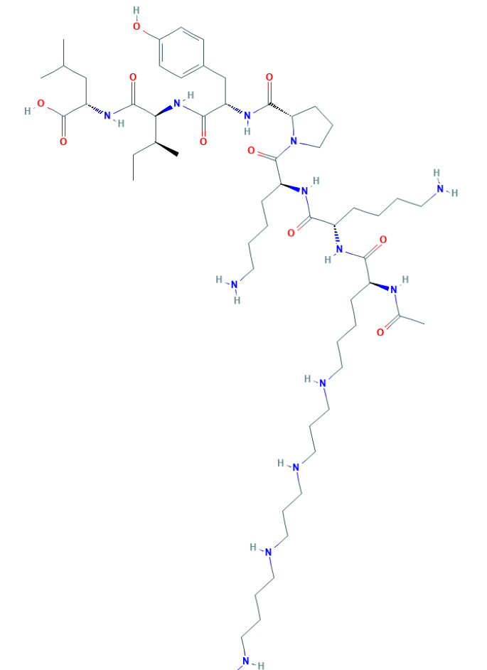
Polyamine
C₅₉H₁₀₈N₁₄O₁₀
MW: 1,173.6 g/mol

Slide 8
Diallyldimethylammonium chloride or
N-allyl-N,N-dimethylprop-2-en-1-aminium chloride pDADMAC
C₈H₁₆ClN
MW: 161.67 g/mol
CH₃
CH₂
CH₂
CH
N
+
CH
CH₂
CH₂
CH₃
Cl⁻

Slide 9
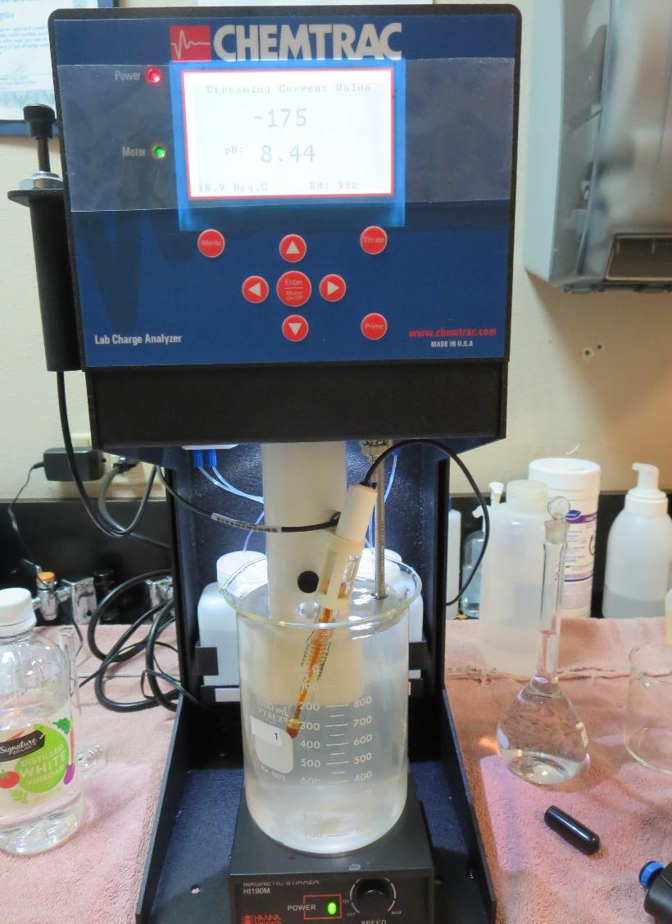
Laboratory Charge Analyzer
LCA: Used to determine coagulant demand of a source water entering the treatment plant.
Source pH: 8.46 (post Ozone)
LCA #1: Pro Pac 9890: 17.4 mg/L
pH adjusted to 7.5 with acetic acid
LCA #2: 9810: 26.4 mg/L
pH adjusted to 7.5 with acetic acid

Slide 10
Coagulant Information
Unless stated otherwise, all coagulant doses are reported as Product (100% strength).
Aluminum Sulfate doses are reported as hydrated Al₂(SO₄)₃*14.3H₂0.
Preparation of coagulant stock solutions are generally 1.0 and/or 0.1 percent strength using 100 and/or 200 mL volumetric flasks.
Finnpipette F2 variable volume pipette, capacity 100-1000 micro liters is used for stock solution preparation and coagulant aid jar test dosing.
Finnpipette F2 variable volume pipette, capacity 0.5-5 mL is used for primary coagulant jar test dosing.

Slide 11
CSA 21 North Lakeport; Clear Lake; Jar Test 1 - 8 Results
Flash Mix 200 RPM (20 sec); Floc Mix 20 RPM (5 min)
Jar# | Pro Pac 9810 mg/L | Pro Pac 9890 mg/L | Filtrate NTU | Filtrate %UVT | Filtrate UVA/cm | %UVA Reduction
J1 | 22 | - | 0.10 | 85.79 | 0.0666 | 35.7
J2 | 24 | - | 0.13 | 86.53 | 0.0628 | 39.4
J3 | 26 | - | 0.09 | 86.92 | 0.0609 | 41.2
J4 | 28 | - | 0.09 | 87.65 | 0.0603 | 41.8
J5 | - | 16 | 0.08 | 87.00 | 0.0567 | 45.3
J6 | - | 18 | 0.06 | 87.31 | 0.0590 | 43.1
J7 | - | 20 | 0.05 | 87.56 | 0.0579 | 44.1
J8 | - | 22 | 0.07 | 86.91 | 0.0609 | 42.7

Slide 12
CSA 21 North Lakeport; Clear Lake; Jar Test 9 - 16 Results
Flash Mix 200 RPM (20 sec); Floc Mix 20 RPM (5 min)
Jar# | Pro Pac 9890 mg/L | Zeta Floc PA 50 Polyamine | Filtrate NTU | Filtrate %UVT | Filtrate UVA/cm | %UVA Reduction
J9 | 16 | 2.0 | 0.09 | 85.94 | 0.0658 | 36.5
J10 | 18 | 2.0 | 0.07 | 86.51 | 0.0629 | 39.3
J11 | 20 | 2.0 | 0.05 | 87.18 | 0.0596 | 42.5
J12 | 22 | 2.0 | 0.05 | 87.60 | 0.0575 | 44.5
J13 | 20 | 0 | 0.05 | 89.86 | 0.0464 | 55.2
J14 | 20 | 1.0 | 0.04 | 87.14 | 0.0598 | 45.0
J15 | 20 | 1.5 | 0.04 | 87.04 | 0.0603 | 41.8
J16 | 20 | 2.0 | 0.05 | 87.09 | 0.0601 | 42.0

Slide 13
CSA 21 North Lakeport; Clear Lake; Jar Test 17 - 24 Results
Flash Mix 200 RPM (20 sec); Floc Mix 20 RPM (5 min)
Jar# | Ferric Sulfate mg/L | Filtrate NTU | Filtrate %UVT | Filtrate UVA/cm | %UVA Reduction
J17 | 10 | 0.09 | 81.53 | 0.0887 | 14.4
J18 | 15 | 0.10 | 81.75 | 0.0876 | 15.4
J19 | 20 | 0.09 | 82.48 | 0.0837 | 19.2
J20 | 25 | 0.08 | 83.21 | 0.0798 | 23.0
J21 | 35 | 0.31 | 82.36 | 0.0843 | 18.6
J22 | 40 | 0.25 | 83.38 | 0.0789 | 23.8
J23 | 45 | 0.38 | - | - | -
J24 | 50 | 0.38 | 85.24 | 0.0694 | 33.0

Slide 14
CSA 21 North Lakeport; Clear Lake; Jar Test 25 – 32 Results
Flash Mix 200 RPM (20 sec); Floc Mix 20 RPM (5 min)
Jar# | Pro Pac 9890 mg/L | Zeta Floc PA 20 pDADMAC | Zeta Floc PA 50 Polyamine | Filtrate NTU | Filtrate %UVT | Filtrate UVA/cm | %UVA Reduction
J25 | 20 | 0 | - | 0.08 | 86.39 | 0.0636 | 38.6
J26 | 20 | 1.0 | - | 0.07 | 86.44 | 0.0633 | 38.9
J27 | 20 | 1.5 | - | 0.07 | 86.65 | 0.0623 | 39.9
J28 | 20 | 2.0 | - | 0.07 | 86.58 | 0.0626 | 39.6
J29 | 20 | - | 0 | 0.08 | 86.57 | 0.0626 | 39.6
J30 | 20 | - | 2.0 | 0.06 | 86.61 | 0.0625 | 39.7
J31 | 22 | - | 0 | 0.06 | 86.68 | 0.0621 | 40.1
J32 | 22 | - | 2.0 | 0.06 | 86.65 | 0.0622 | 40.0

Slide 15
Jar Testing for 1-Liter Jars:
Procedures for Most Treatment Plants
Fill jars with source water prior to coagulant injection and set paddle speed at 30 rpm
Add chemicals (i.e., NaOCl, primary coagulant, coagulant aid) to each jar
Flash mix for 15-30 seconds (200 rpm)
Slow mix for 5 minutes (20-30 rpm)
Syringe 25 mL from each jar taken 1-inch below surface (25 mL/12 sec rate)
Filtered through 1.2 um isopore membrane into cuvette drip rate, 15 mL/(50-90 sec)
Measure filtrate turbidity, chlorine residual and %UVT/UVA
Measure settled water turbidity after 25 minutes of total setting
Record all data

Slide 16

Jar Test
Filterability Test Equipment
Turbidity Instrument
Syringe w/Luer-Lock Tip, 30 cc
(part#: 2225800, by Hach)
Swinnex Filter Holder, 25 mm (part#: SX0002500)
Isopore Membrane Filter, 1.2 um absolute
pore size,
Φ= 25 mm , thickness: 24 um,
hydrophilic polycarbonate membrane
(part #: RTTP02500)
Go to Sigma-Aldrich for laboratory supplies http://www.sigmaaldrich.com/united-states.html

Slide 17
Isopore Membrane Information
Categories | Information
trade name | Isopore
filter color | White
chemistry | Polycarbonate (PC)
water flow rate | Avg. 175 mL/min x cm² (typical results @ 10 psi)
media | Isopore®
wettability | Hydrophilic
porosity | 14.7%
pore size | 1.2 µm
bubble point at 23 °C | 1.0 bar, air with water
thickness | 24 µm
filter diameter (ø) | 25 mm
material size | polycarbonate, Hydrophilic, 1.2 µm, 25 mm, white, plain, 100

Slide 18
Isopore Membrane Background Information
The Isopore membrane is a polycarbonate, track-etched screen filter recommended for all analyses in which the sample is viewed on the surface of the membrane. The Isopore membrane is composed of polycarbonate film, which has a smooth, glass-like surface for clearer sample observation. The unique manufacturing process of the membrane ensures a precise pore diameter and a consistent pore size for accurate separation of samples by size. Matched-weight filters are not usually required because of low, constant tar and ash weights.
Features & Benefits:
Membrane structure retains particles on the surface, simplifying counting and analysis

Slide 19
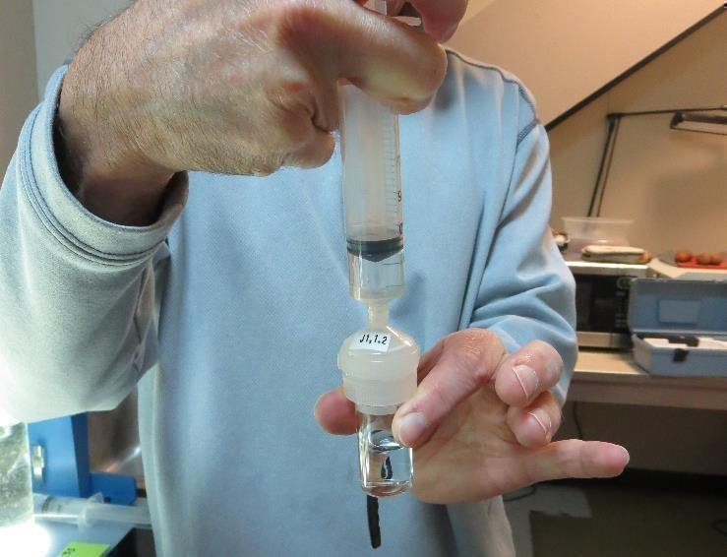

Jar Test - Filterability Test
Syringe ~ 25 mL from jar (after 5-minutes of settling)
Filter-to-waste 3-5 mL
Filter directly into clean cuvette
Measure turbidity
Note: Take several readings before recording final NTU results. Micro bubbles can adhere to glass causing false NTU readings. To remove bubbles, tilt cuvette up to 90 degrees.

Slide 20

Contact
Guy Schott, P.E.
State Water Resources Control Board
Division of Drinking Water
Santa Rosa, CA
Go to Jar Test Results/Procedures for tools to download
www.waterboards.ca.gov/drinking_water/programs/districts/mendocino_district.html
Jar Testing Done Right video training https://youtu.be/aGByyxhelkI
Email: Guy Schott - Guy.Schott@waterboards.ca.gov
Office Number: 707-576-2732

