Slide 1
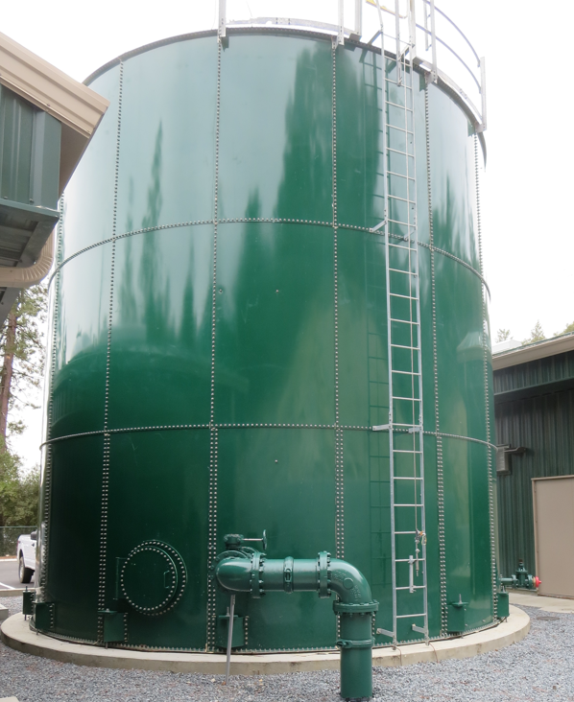
Clearwell
Base Lake Water Company
CA2010003
Tracer Study
Clearwell
April 30, 2025
Performed/Assisted by:
Guy Schott, P.E
Allexis Ortiz-Vasquez
Bass Lake Operators

Slide 2
Bass Lake Water Company
Clearwell Tracer Study Operations

Slide 3
Bass Lake Water Company
Clearwell Tracer Study Operations.

Slide 4
Summary of Tracer Procedures
A single tracer study was conducted on a 67,000-gallon bolted steel tank (clearwell) with three baffles. Liquid fluoride was used as the tracer that was injected at the chlorine injection point upstream of the clearwell.
Sampling were conducted at two stations
  Station 1: Inlet to clearwell to confirm fluoride dose (mg/L)
  Station 2: Exit line of clearwell
Clearwell entry flow was 315 gpm
Clearwell exit flow average 300 gpm

Slide 5
Tracer Test Result Summary –
67,000-Gallon Clearwell
Modified Step-Dose – Test 3
Test Date: 3/12/25
Clearwell avg operating level: 19.08-ft
Clearwell avg operating volume: 63,278 gallons
Three baffled; L:W 15.3
Entry flow: 315 gpm
Exit flow: 300 gpm
HRT: 211 minutes
t₁₀: 40.9 minutes
Baffling Factor (t₁₀/HRT): 0. 19

Slide 6
Tracer Test Result Summary –
67,000-Gallon Clearwell
Note: Test 1 (2/12/25) the baffling factor was 0.21. After Test 1, tank was drained, and photos were sent showing gaps between the tank floor and baffles where the baffles crossed the tank’s studded bolts. These gaps were repaired, and a second tracer test was conducted.
Based on Test 2 (3/21/25) results (BF: 0.20), the repairs to the baffles had no impact on the tank’s hydraulic efficiency. Tank was drained and post test 2 photos were sent, and more gaps were found and along with construction issues. Repairs were made and a third test was conducted.
Test 3 (4/30/25) – 0.19 baffling factor. The tank was again drained and inspected. Based on visual inspection and photos, no gaps were found under the baffles. Based on this information, the poor baffling factors may be the results of thermo-stratification. The tank was filled several days before the test. If incoming water is colder than water in the clearwell, this can cause primary flow along the clearwell bottom with little mixing.

Slide 7
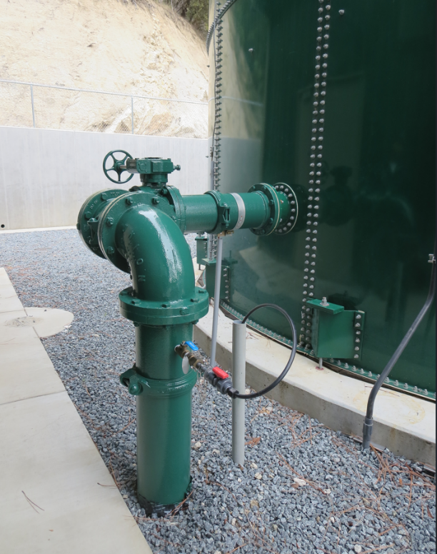
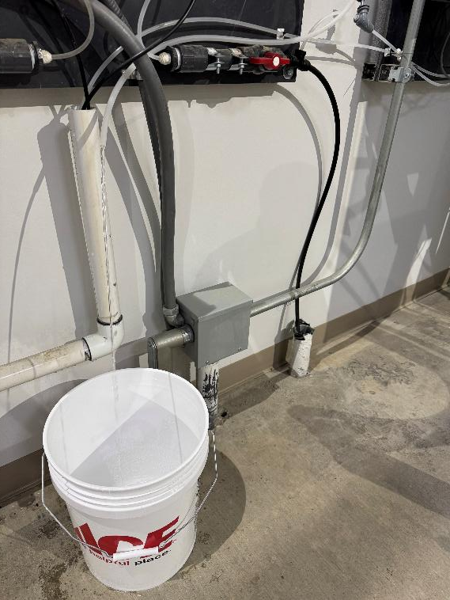
Clearwell Inlet Sampling Tap
Inlet Sampling Location
inside building
Inlet Sampling Line

Slide 8
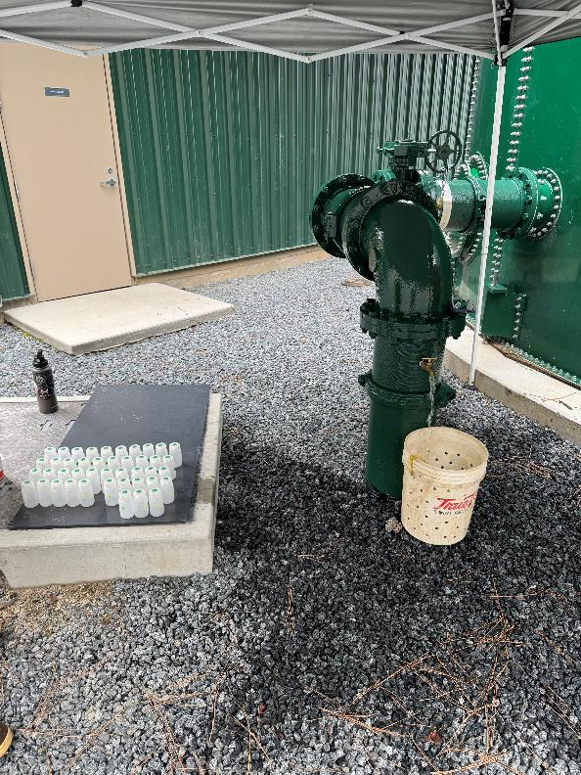
Clearwell Outlet Sampling Tap
Outlet Sampling Tap
Outlet Sampling Tap

Slide 9
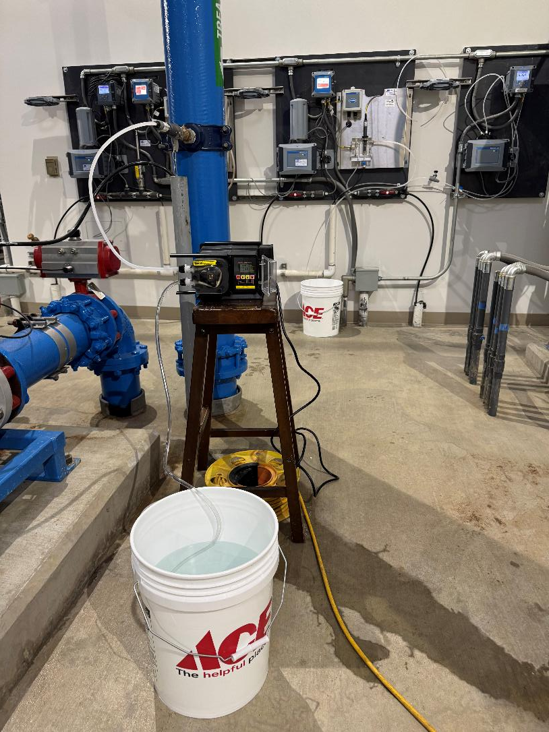
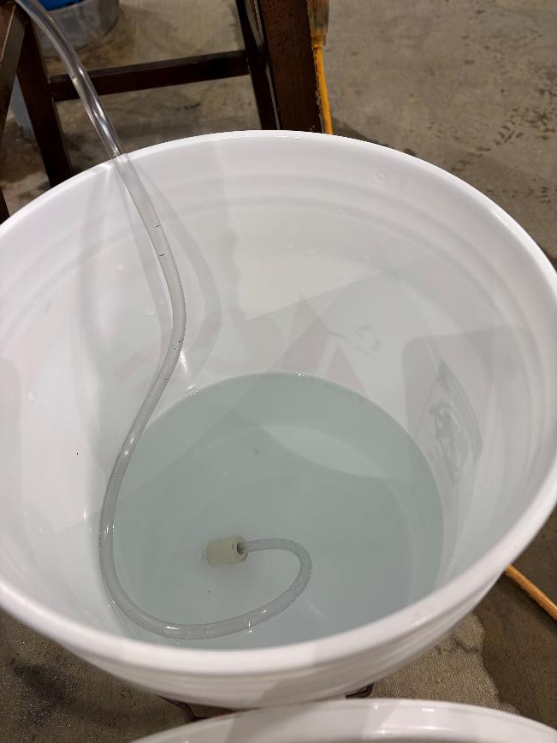
Tracer: H₂SiF₆, Fluoride (F) Injection

Slide 10
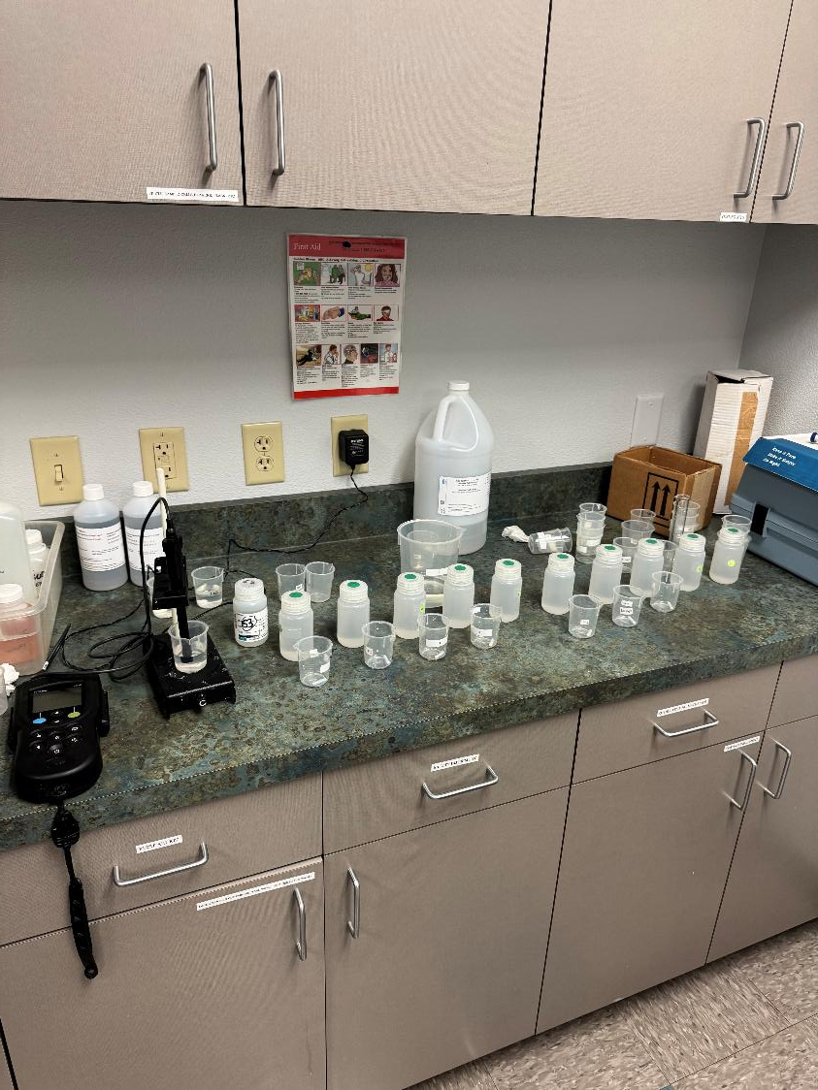
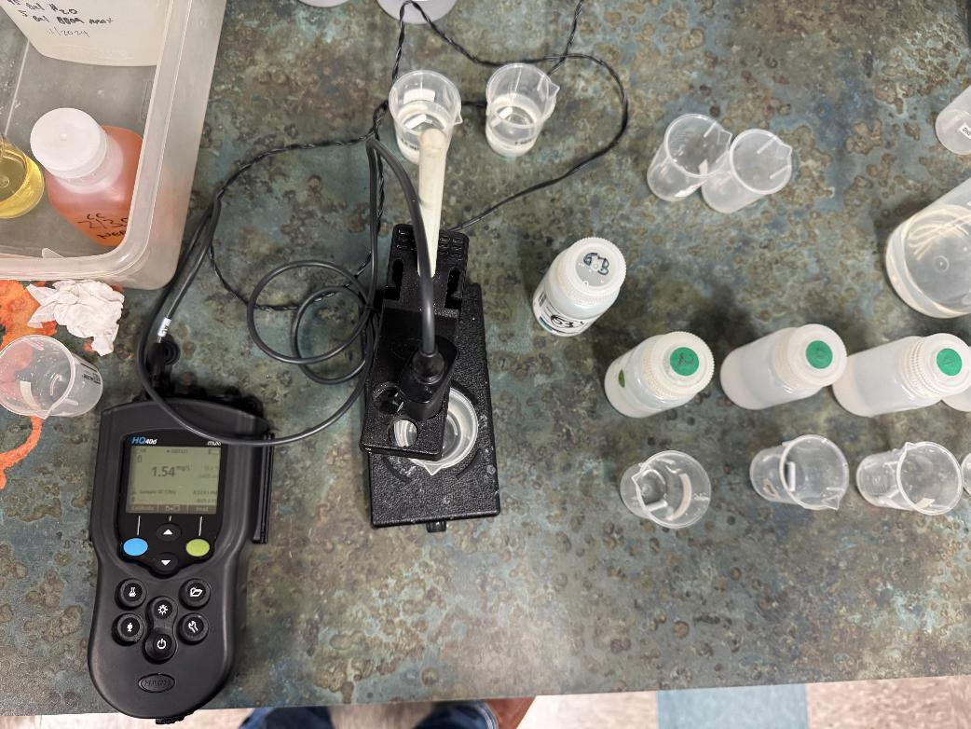
Fluoride Analysis

Slide 11
Test 3: Tracer Fluoride Dose, Inlet to Clearwell
Elapsed Time minutes | *Tracer Fluoride Dose mg/L
15 | 2.07
21 | 2.10
27 | 2.08
33 | 2.09
45 | 2.05
*Excludes background fluoride of 0.051 mg/L

Slide 12
Tracer Test Tabulated Results

Slide 13
Test 3.
Dose: 2.08 mg/L (inlet monitoring)
0.208 mg/L at t₁₀ (outlet monitoring)
T₁₀: 40.9 min
HRT: 211 min
BF: 0.19 (T₁₀/HRT)

Slide 14
Test 3
BF: 0.19

Slide 15
Purpose of a Tracer Study
To determine the hydraulic efficiency or disinfectant exposure time of water through one or more reactors.
The addition of known quantities of a nonreactive chemical (tracer) is added in the form of a pulse (slug) or step-dose input.
The time of travel or disinfectant exposure time through the reactor is impacted by:
  Flow rate
  Water Depth
  Volume
  Configuration
  Hydraulic mixing
  Temperature

Slide 16
Clearwell Photos
Photos inside the Clearwell during and after construction. Thereafter, are photos taken after tank was drained.

Slide 17
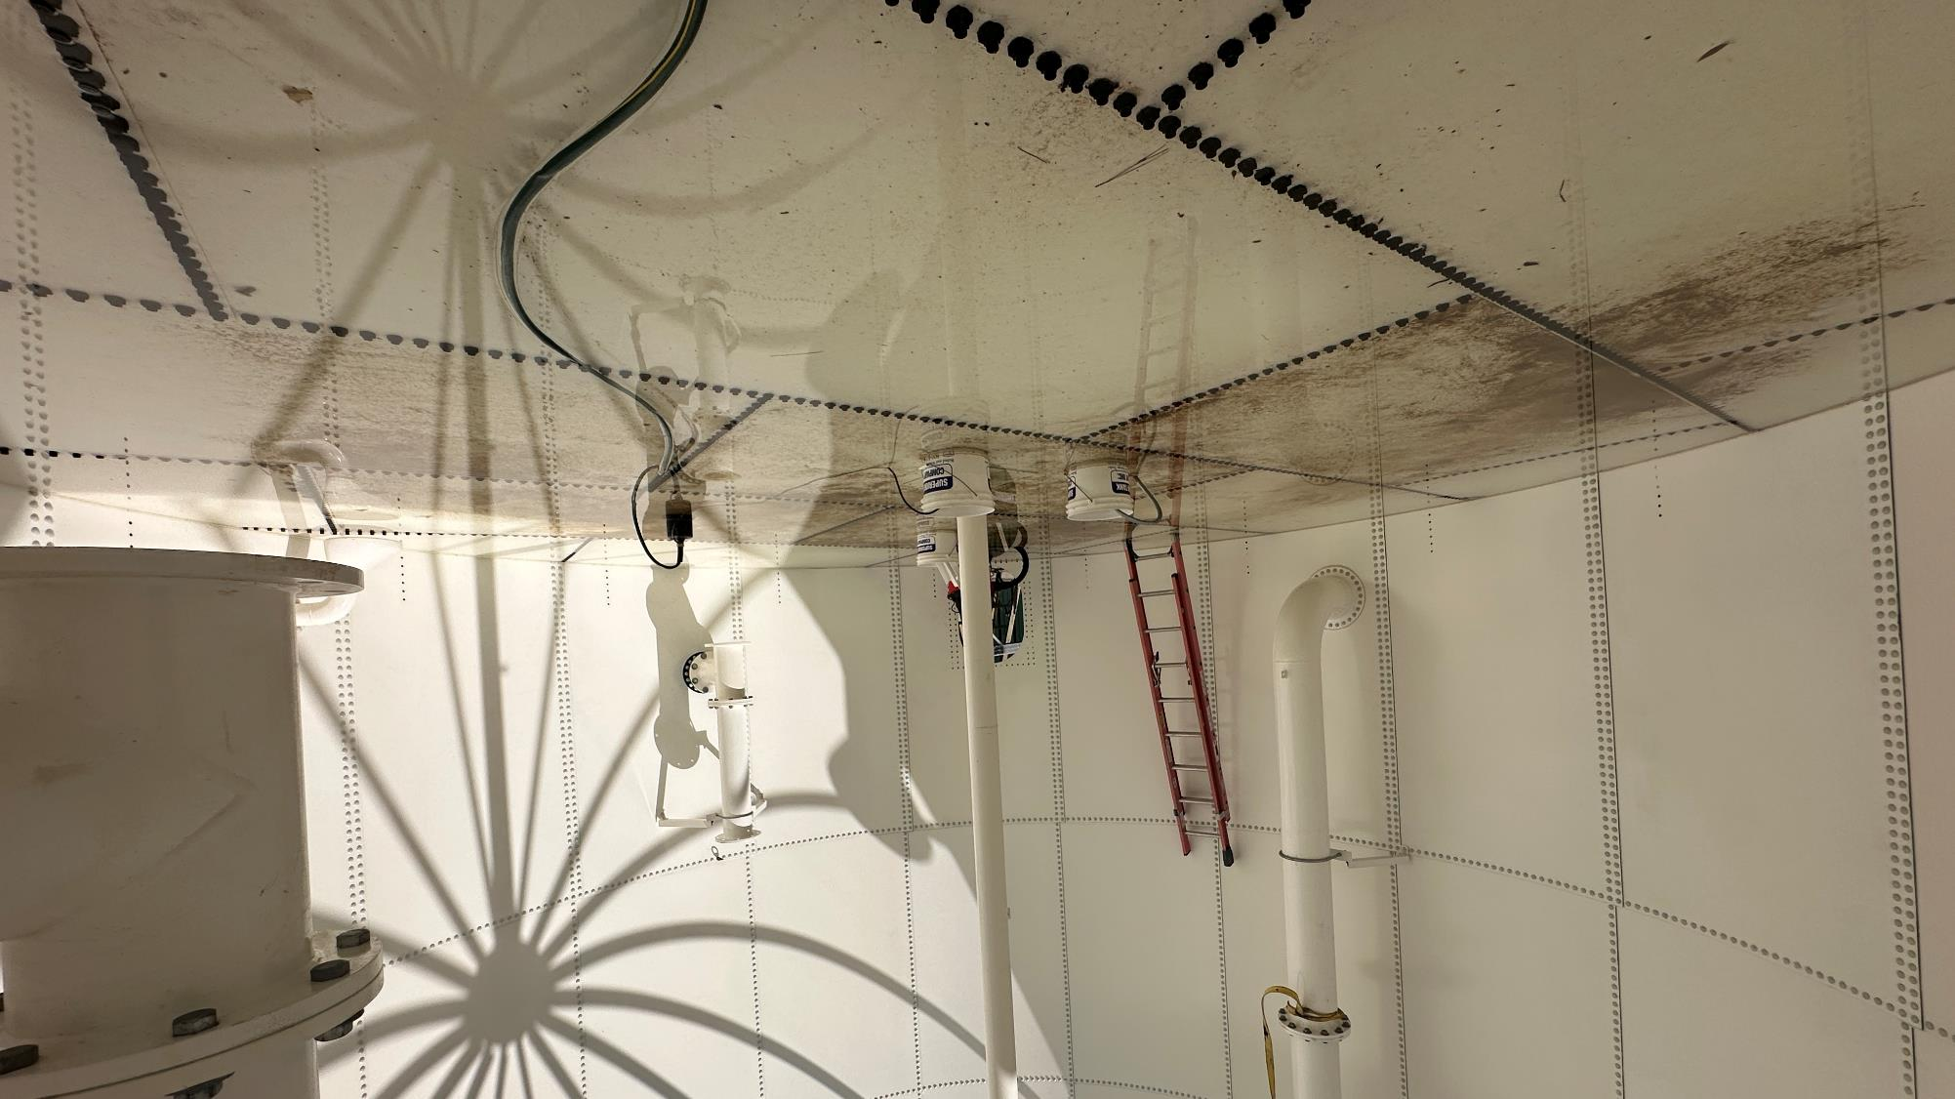
`

Slide 18
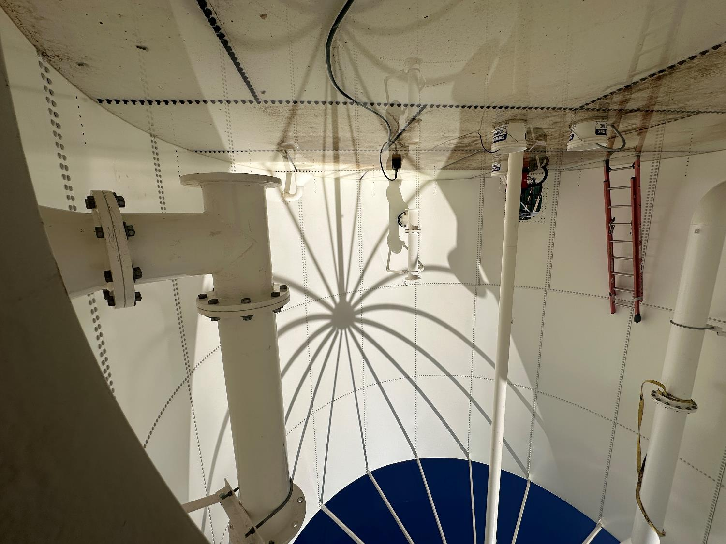
1

Slide 19
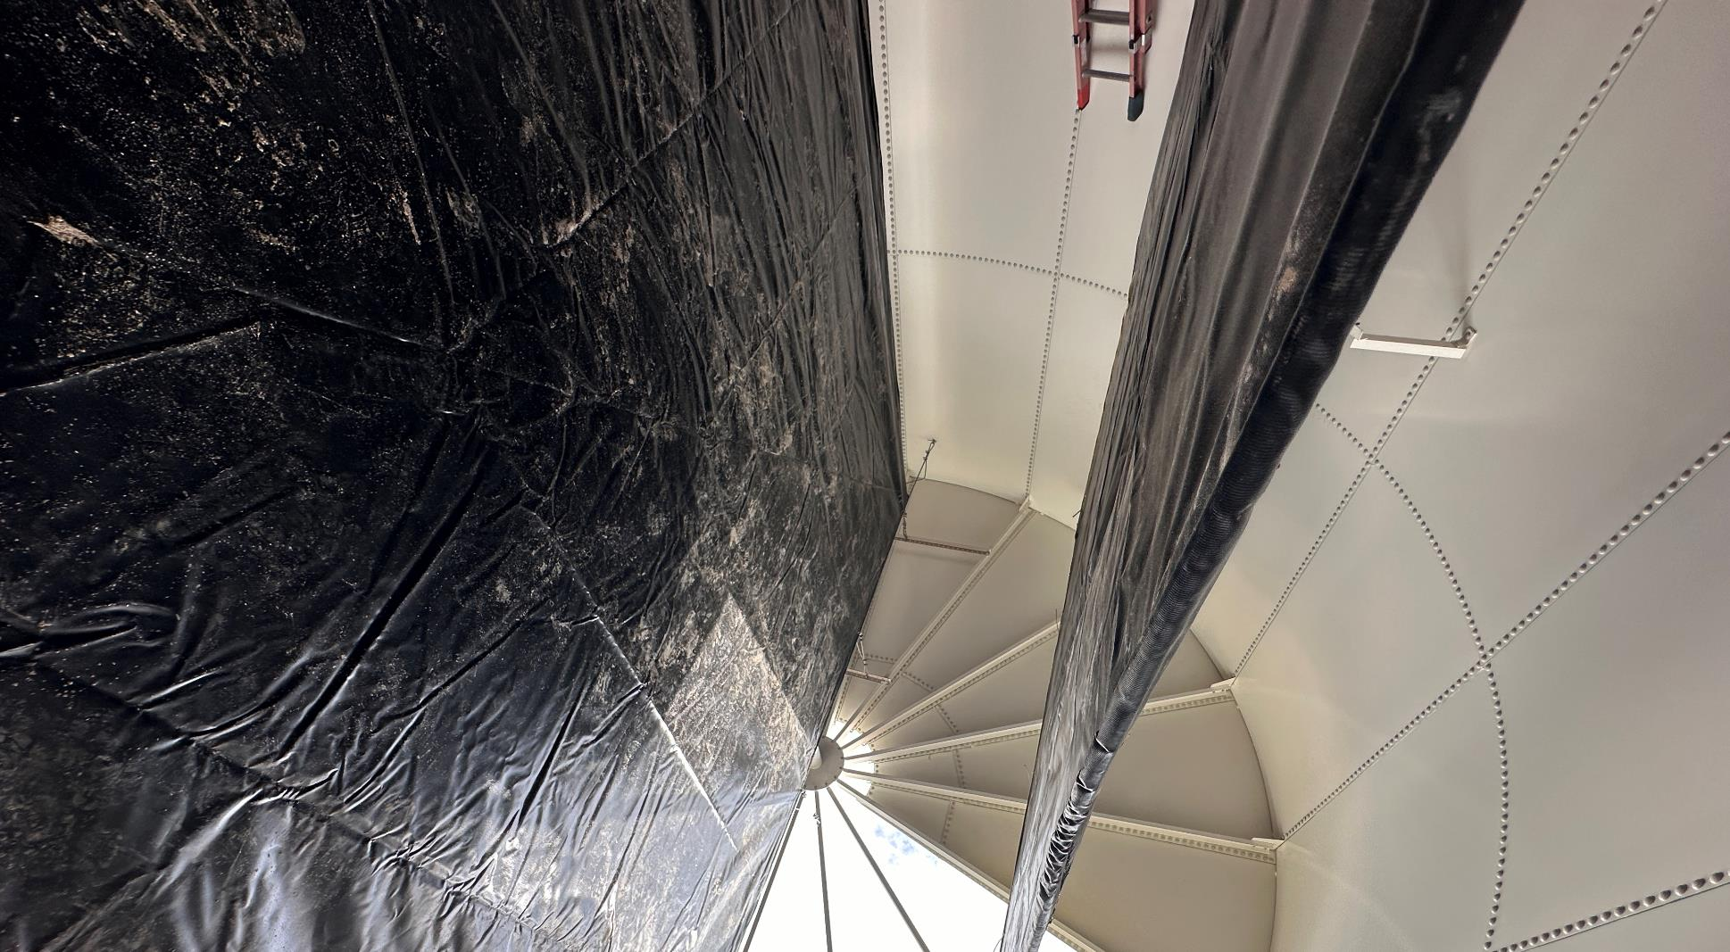
2

Slide 20
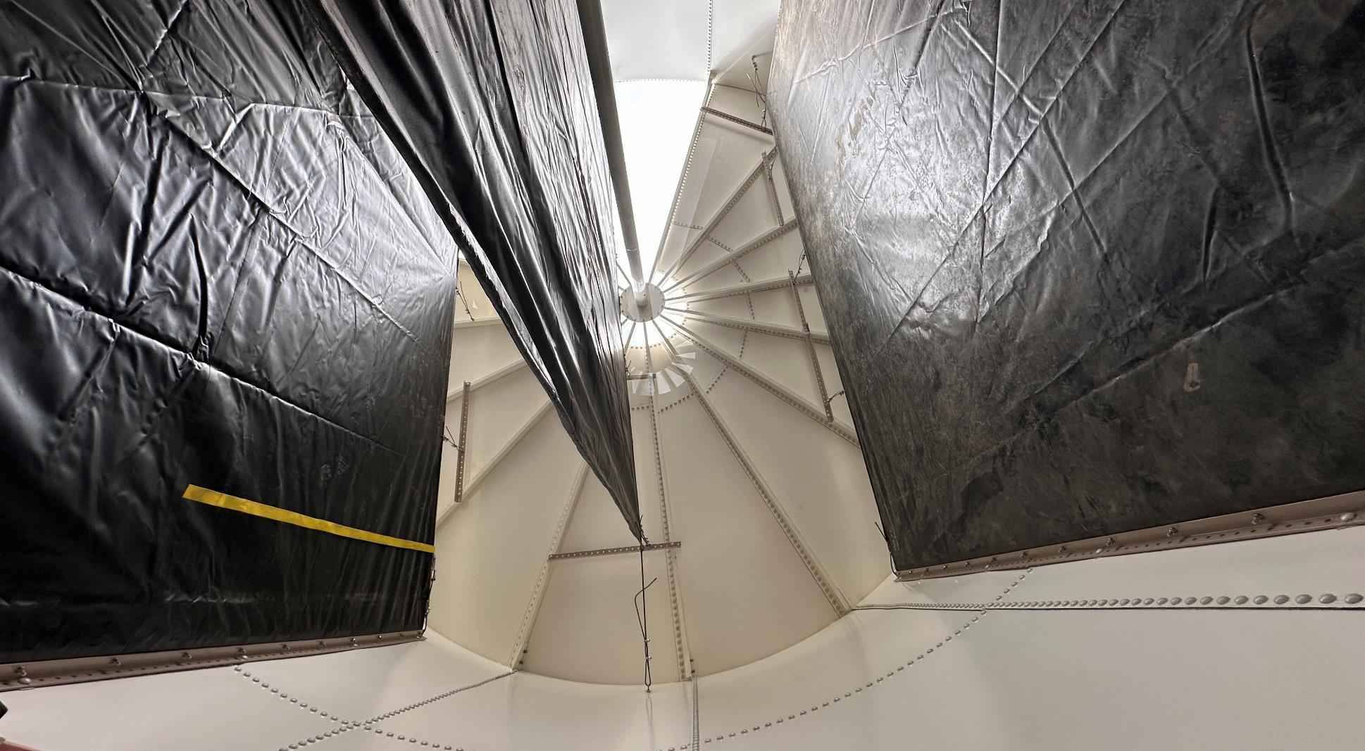
3

Slide 21
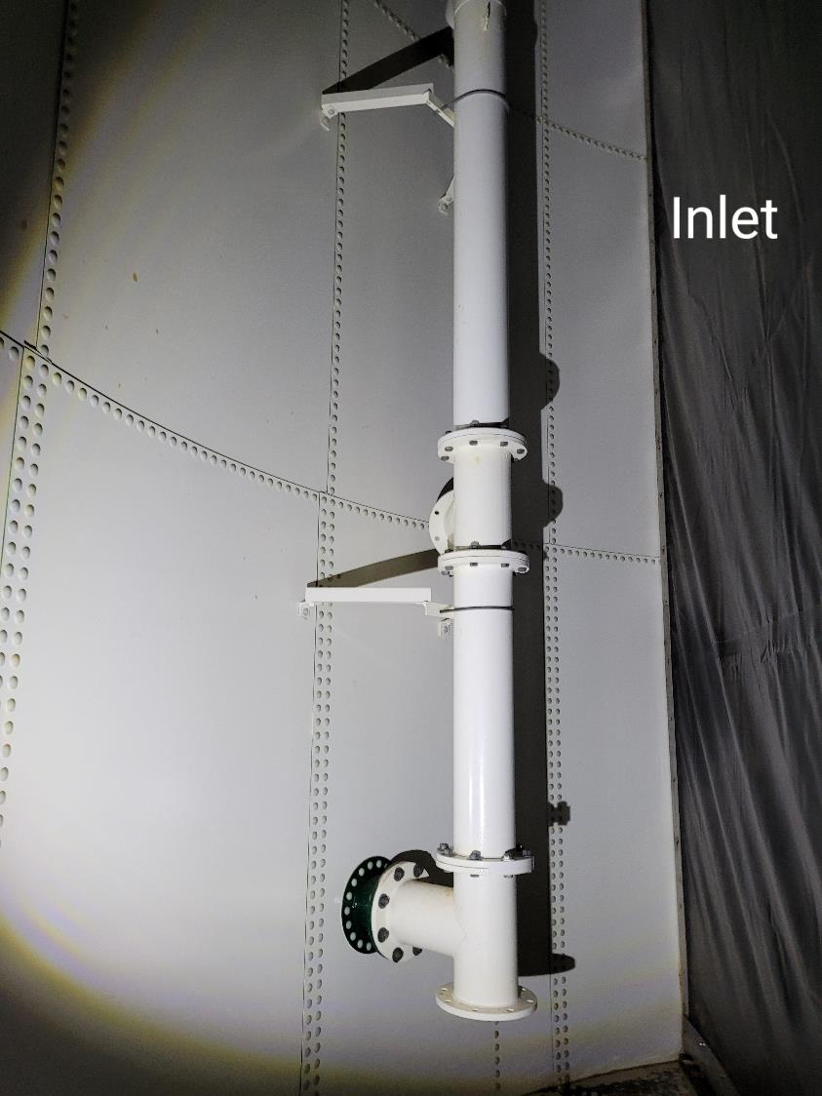
4

Slide 22
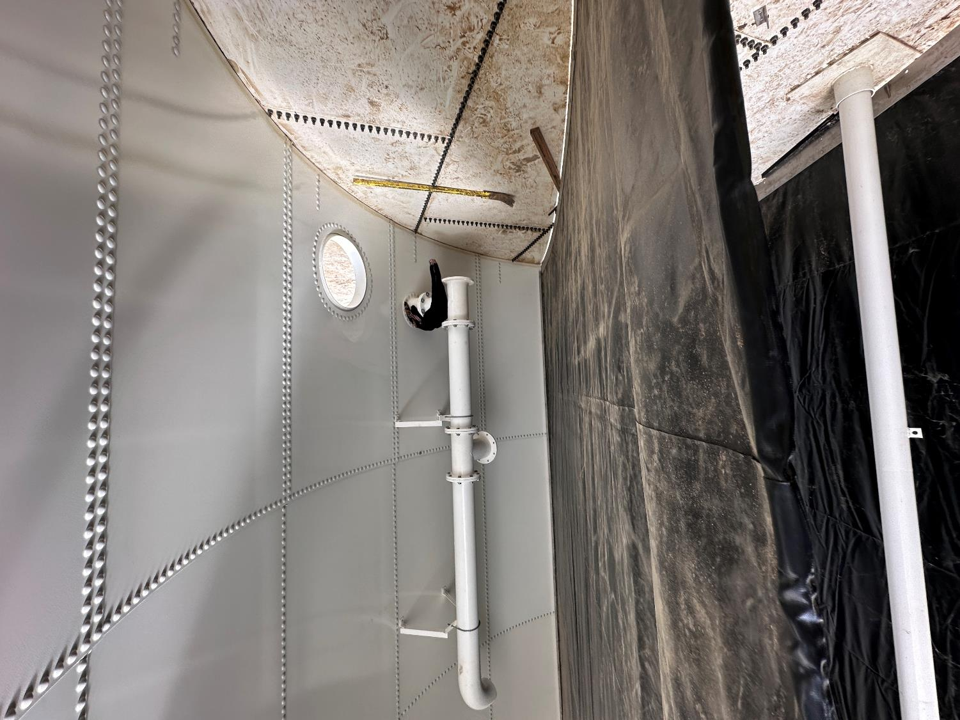
11
Outlet Pipe
Note: Inlet is identical to outlet pipe

Slide 23
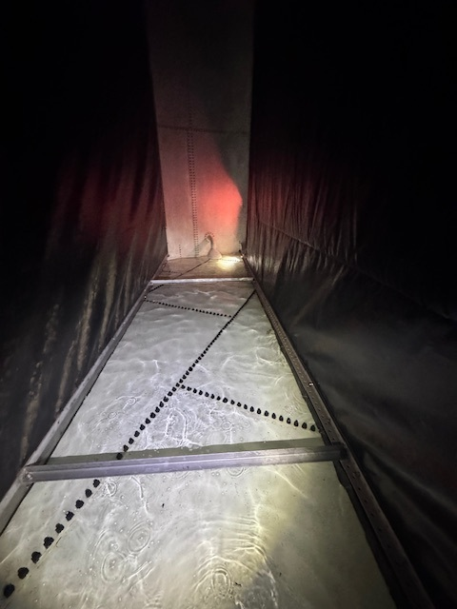
111

Slide 24
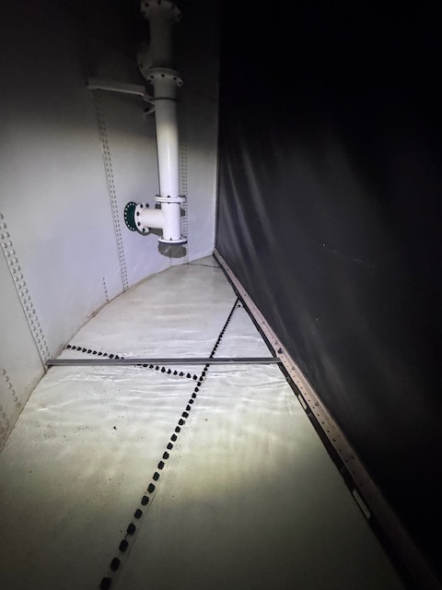
1111

Slide 25
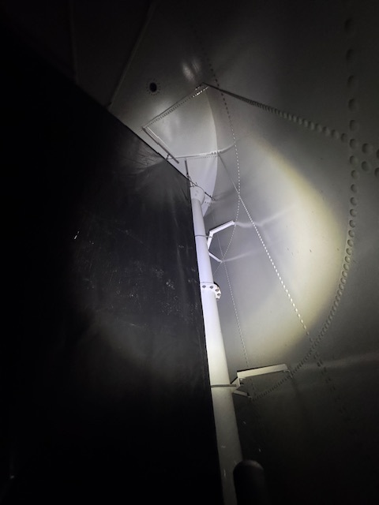
12

Slide 26
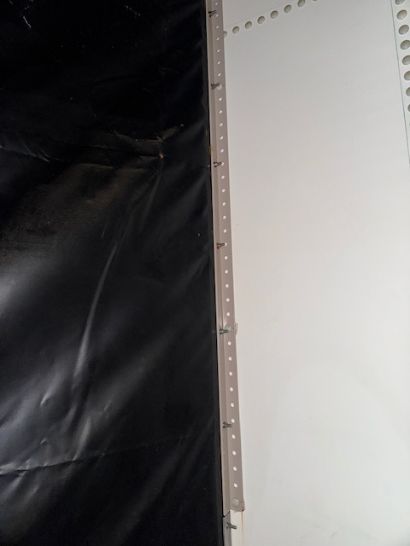
123

Slide 27
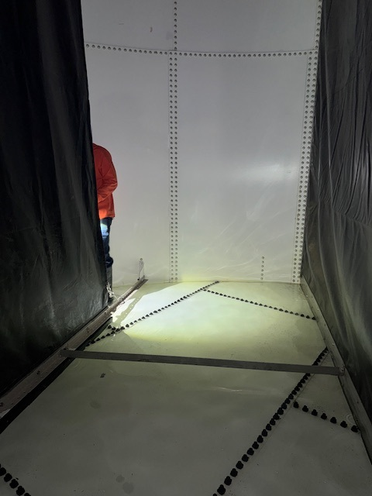
1234

Slide 28
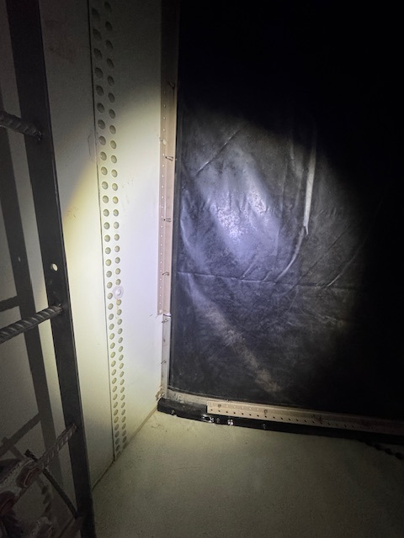
12345

Slide 29
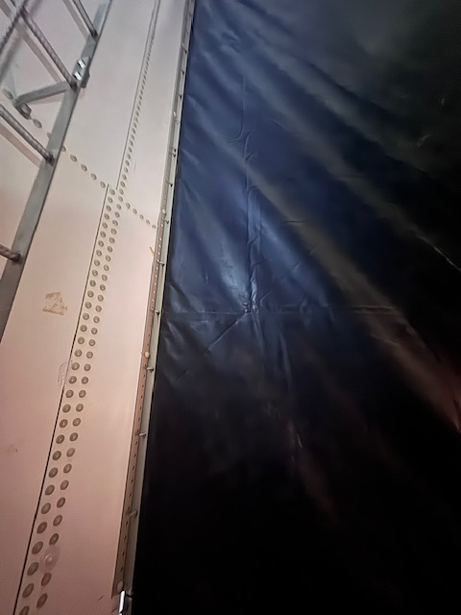
154

Slide 30
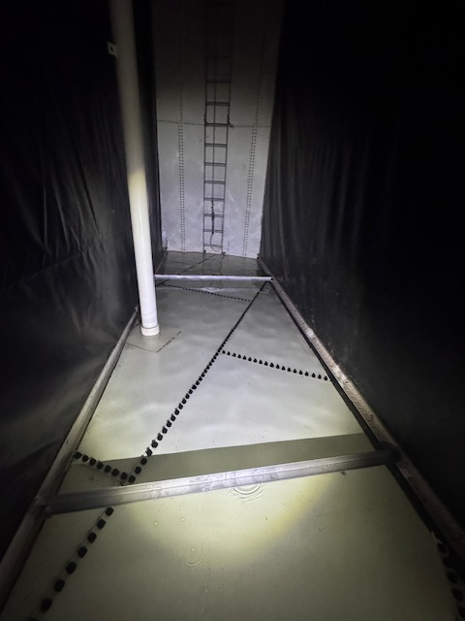
325

Slide 31
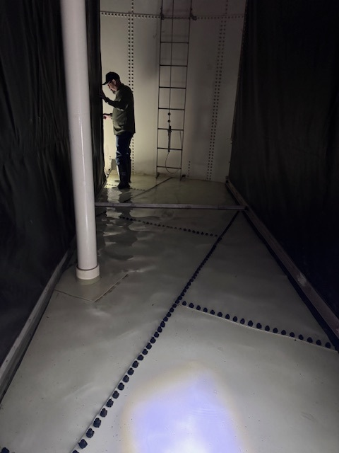
99

Slide 32
Disinfection Exposure Time of Fluid in Vessel for Determining Ct₁₀
C” - disinfectant residual (mg/L) at the point of inactivation compliance.
Disinfection exposure time of water used for Ct₁₀ calculation is the time (t₁₀) it takes for the first 10 percent of the water entering the reactor to exit the reactor.
To determine this, a nonreactive tracer is introduced into the water and is monitored leaving the reactor.
Example: 1.5 mg/L of tracer is continuously dose during testing; t₁₀ is that time when 0.15 mg/L of tracer concentration (10% of dose) has exited the reactor.

Slide 33
Ct₁₀ Value
Log inactivation is based on the Delivered Dose, “Ct₁₀”
  “C” is the disinfectant residual (mg/L)
  “t₁₀” is the exposure or contact time (minutes)
  Multiply them:
C • t₁₀ = mg/L • min (delivered dose to pathogens)
The calculated Ct₁₀ value is looked up in EPA Ct tables to determine the log inactivation based on specific monitoring parameters (pH, disinfectant residual and temperature).

Slide 34
Baffling Factor (BF)
Baffling factor or short-circuiting factor:
  Determined from tracer study or estimated
  BF = t₁₀/ HRT from tracer study
  HRT (hydraulic residence time) = operating volume divided by reactor flow
BF is determined and applied to daily operations of the reactor for determining the disinfectant exposure time.
Example:
  Total Clearwell operating volume: 63,000 gallons
  Exit flow: 400 gpm (0. 576 MGD)
  BF: 0.19, from tracer study
  Calculated contact or disinfection exposure time:
    63,000 gal ÷ 400 gpm × 0.19 = 30 minutes = t₁₀

Slide 35
Test Method
Modified Step-Dose Method
It is a continue feed of tracer injected before the reactor at constant rate with plant flow. The “Step-Dose” test has a duration of 3-4 HRT to achieve reactor outlet steady-state tracer concentration. The time “t₁₀” is determined when 10% of the tracer dose concentration has exist the reactor. The “Modified Step-Dose” test allows the test to be completed in less than 1 HRT by physical measurements of the tracer to the inlet of the reactor.

Slide 36
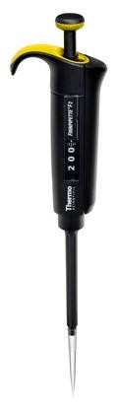
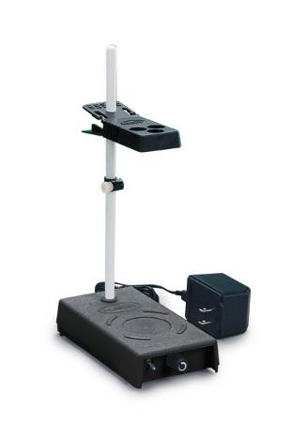
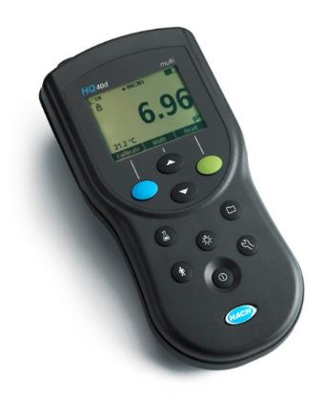
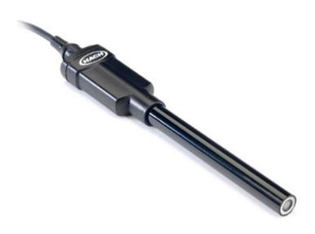
Method of Analysis and Equipment
Intellical™ ISEF121 Fluoride (F⁻) Ion Selective Electrode (ISE)
HQ40d Portable ISE Multi-Parameter Meter
Fluoride Ionic Strength Adjustor (ISA)
Fluoride Standards (0.2 & 2.0 mg/L)
25 mL graduated cylinder
Finnpipette F2 variable volume pipette, capacity 0.5 - 5 mL
Electrode stirrer stand
50 mL beakers
Stir Bar, Magnetic, Polygon

Slide 37

Contact
Guy Schott, P.E.
State Water Resources Control Board
Division of Drinking Water
Santa Rosa, CA
Go to Tracer Test Results for review
www.waterboards.ca.gov/drinking_water/programs/districts/mendocino_district.html
Email: Guy Schott - Guy.Schott@waterboards.ca.gov
Office Number: 707-576-2732

