Slide 1
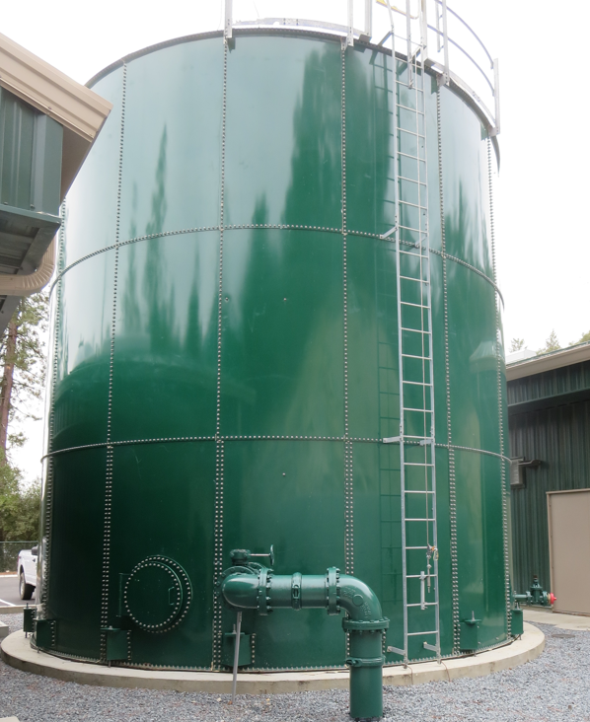
Clearwell
Base Lake Water Company
CA2010003
Tracer Study
Clearwell
February 11, 2025
Performed/Assisted by:
Guy Schott, P.E
Bass Lake Operators
Madera & Yosemite Districts

Slide 2
Bass Lake Water Company
Clearwell Tracer Study Operations

Slide 3
Bass Lake Water Company
Clearwell Tracer Study Operations .

Slide 4
Summary of Tracer Procedures
A single tracer study was conducted on a 67,000-gallon bolted steel tank (clearwell) with three baffles. Liquid fluoride was used as the tracer that was injected at the chlorine injection point upstream of the clearwell.
Sampling were conducted at two stations
  Station 1: Inlet to clearwell to confirm fluoride dose (mg/L)
  Station 2: Exit line of clearwell
Clearwell entry flow was 300 gpm
Clearwell exit flow average 296 gpm

Slide 5
Tracer Test Result Summary –
67,000-Gallon Clearwell
Modified Step-Dose – Test 1
Test Date: 2/11/25
Clearwell avg operating volume: 63,450 gallons
Three baffled; L:W 15.3
Entry flow: 300 gpm
Exit flow: 296 gpm
HRT: 214 minutes
t₁₀: 45.5 minutes
Baffling Factor (t₁₀/HRT): 0.21
Note: Based on the poor baffling factor result, it was suspected there was leakage between the baffles and the tank floor. After the test, post construction photos were sent. The photos revealed gaps between the tank floor and baffles where the baffled crossed the tank’s studded bolts (see photos in slides, 17-22).

Slide 6
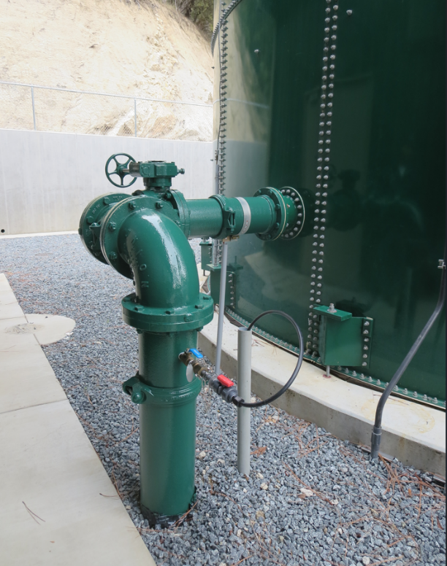
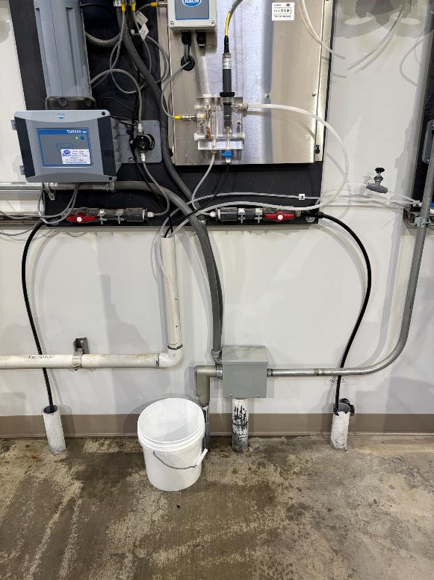
Clearwell Inlet Sampling Tap
Inlet Sampling Location
inside building
Inlet Sampling Line

Slide 7
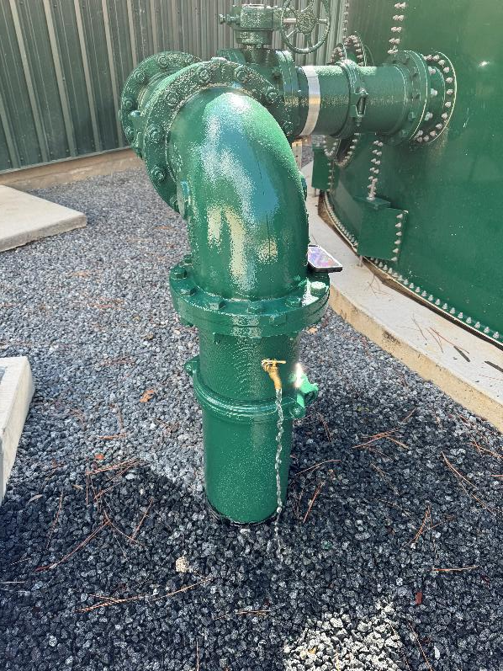
Clearwell Outlet Sampling Tap
Outlet Sampling Tap
Outlet Sampling Tap

Slide 8
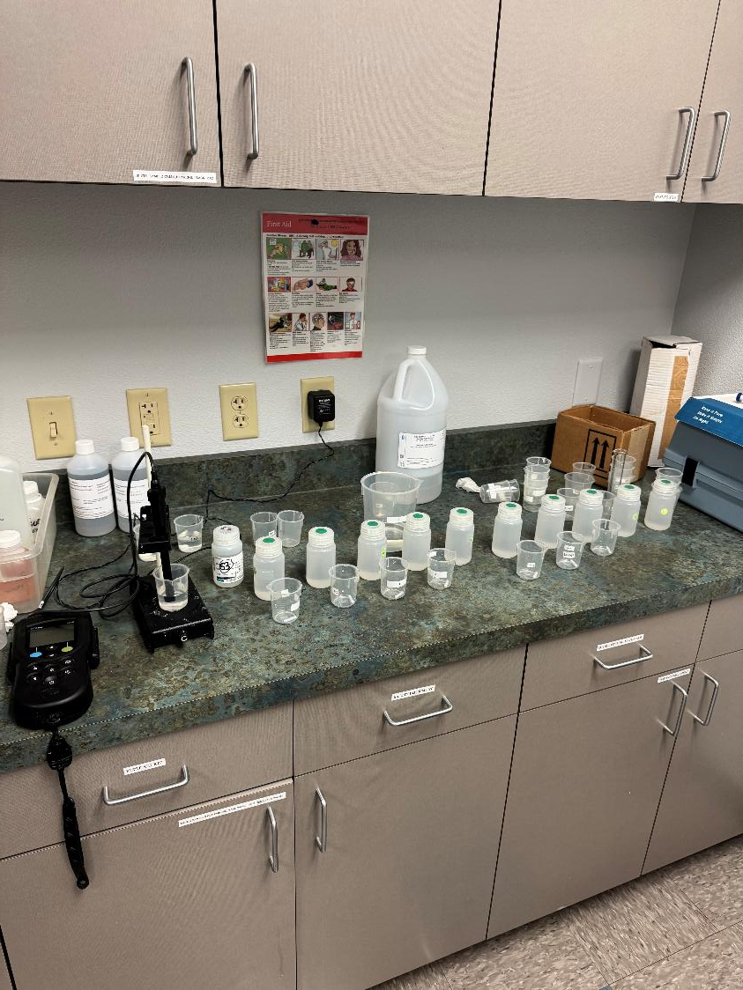
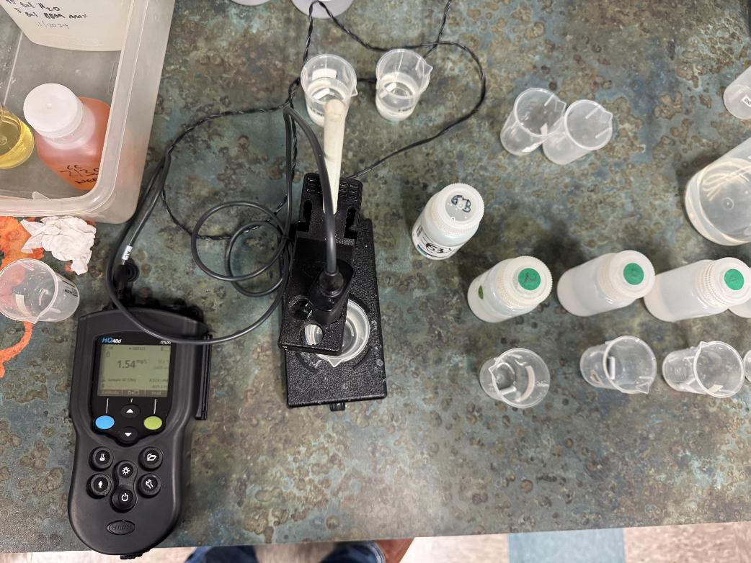
Fluoride Analysis

Slide 9
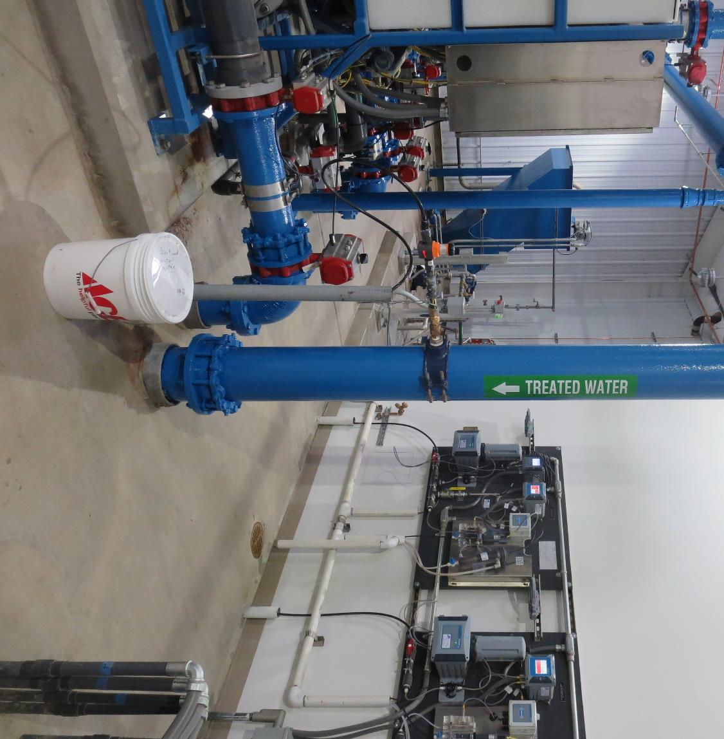
Bass Lake WC– Tracer Injection Point

Slide 10
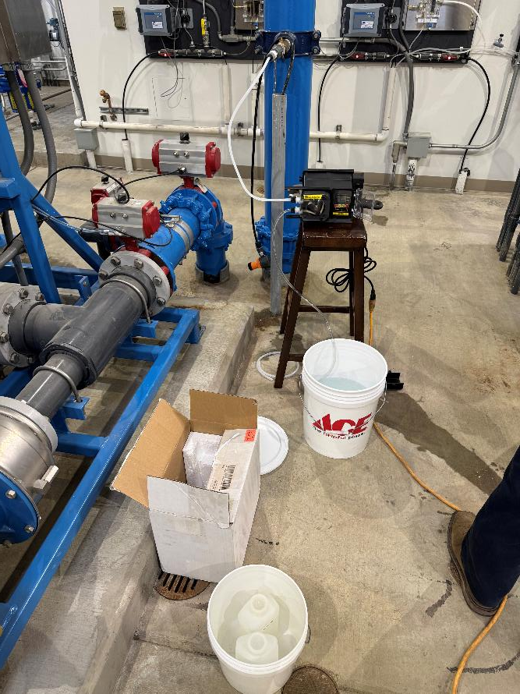
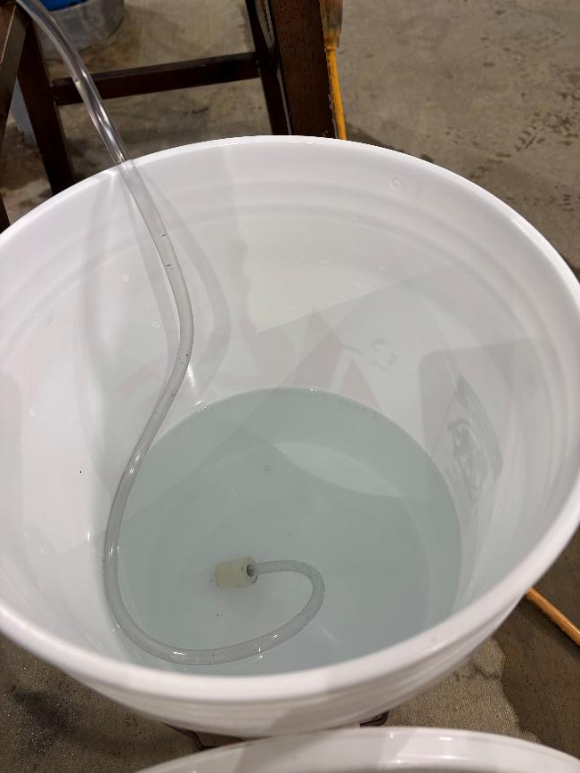
Tracer: H₂SiF₆, Fluoride (F) Injection
Post Membrane
Chlorine Injection Point
where tracer was injected
Solution
of Fluoride

Slide 11
Test 1: Tracer Fluoride Dose, Inlet to Clearwell
Elapsed Time minutes | *Tracer Fluoride Dose mg/L
22.5 | 1.67
30.5 | 1.59
38.5 | 1.61
54.5 | 1.61
62.5 | 1.62
*Excludes background fluoride of 0.0326 mg/L

Slide 12
Tracer Test Tabulated Results

Slide 13
Test 1.
Dose: 1.587 mg/L (inlet monitoring)
0.1587 mg/L at t₁₀ (outlet monitoring)
T₁₀: 45.5 min
HRT: 214 min
BF: 0.212 (T₁₀/HRT)

Slide 14
Test 1
BF: 0.21

Slide 15
Purpose of a Tracer Study
To determine the hydraulic efficiency or disinfectant exposure time of water through one or more reactors.
The addition of known quantities of a nonreactive chemical (tracer) is added in the form of a pulse (slug) or step-dose input.
The time of travel or disinfectant exposure time through the reactor is impacted by:
  Flow rate
  Water Depth
  Volume
  Configuration
  Hydraulic mixing
  Temperature

Slide 16
Clearwell Short-Circuiting Issues
The next 7 slides are photos inside the Clearwell during and after construction.
Issue with short-circuiting is due to design gaps between baffles and tank floor as baffle cross the studded bolts.
Seal between baffle and wall is unknown.

Slide 17
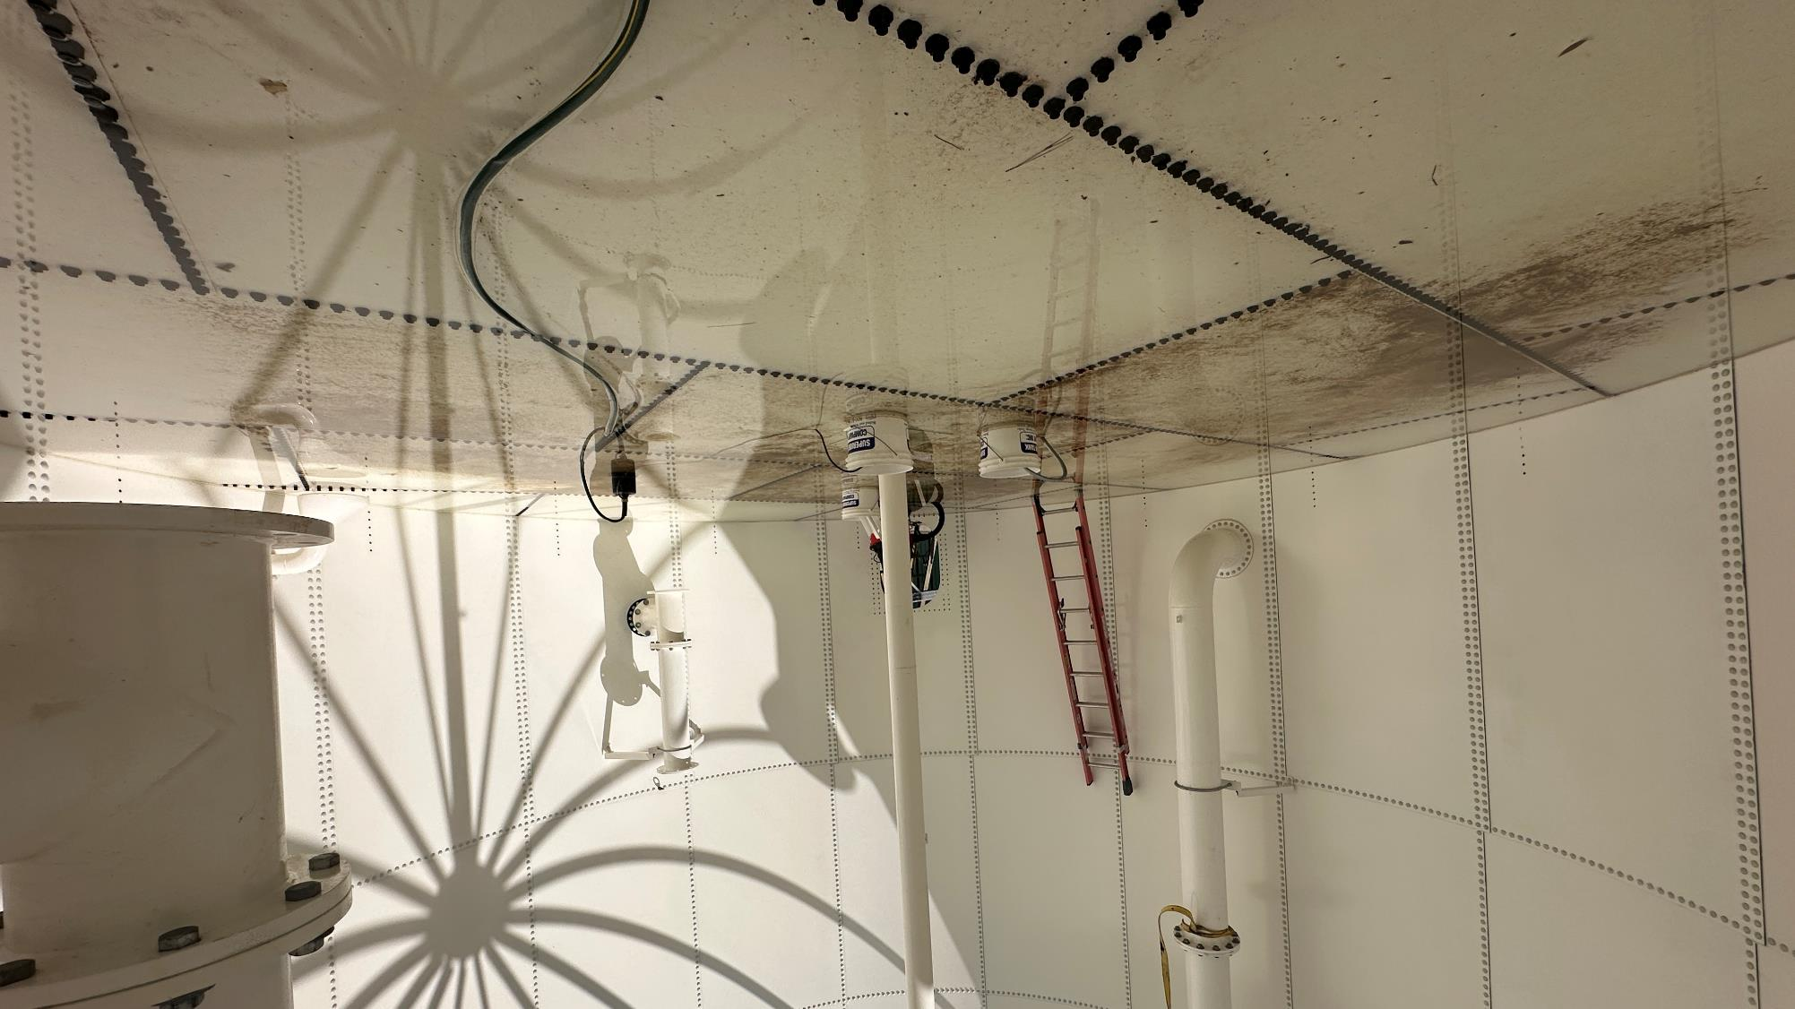
..

Slide 18
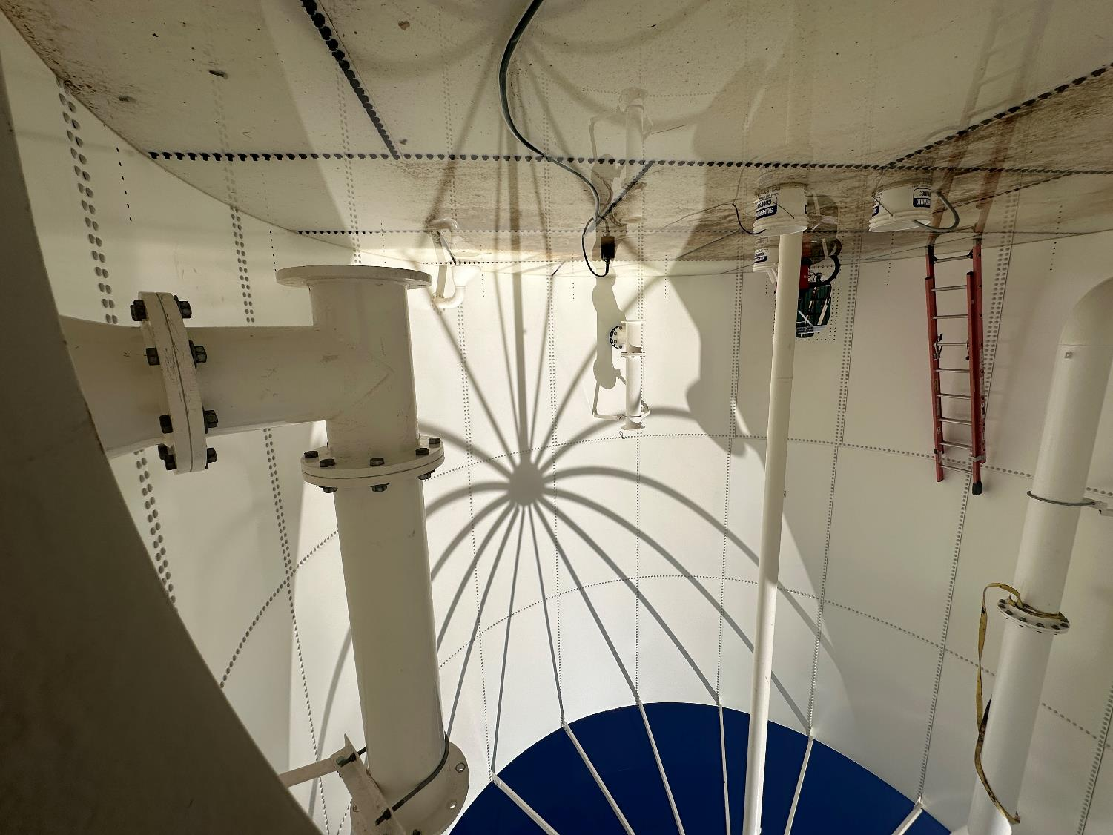
…

Slide 19
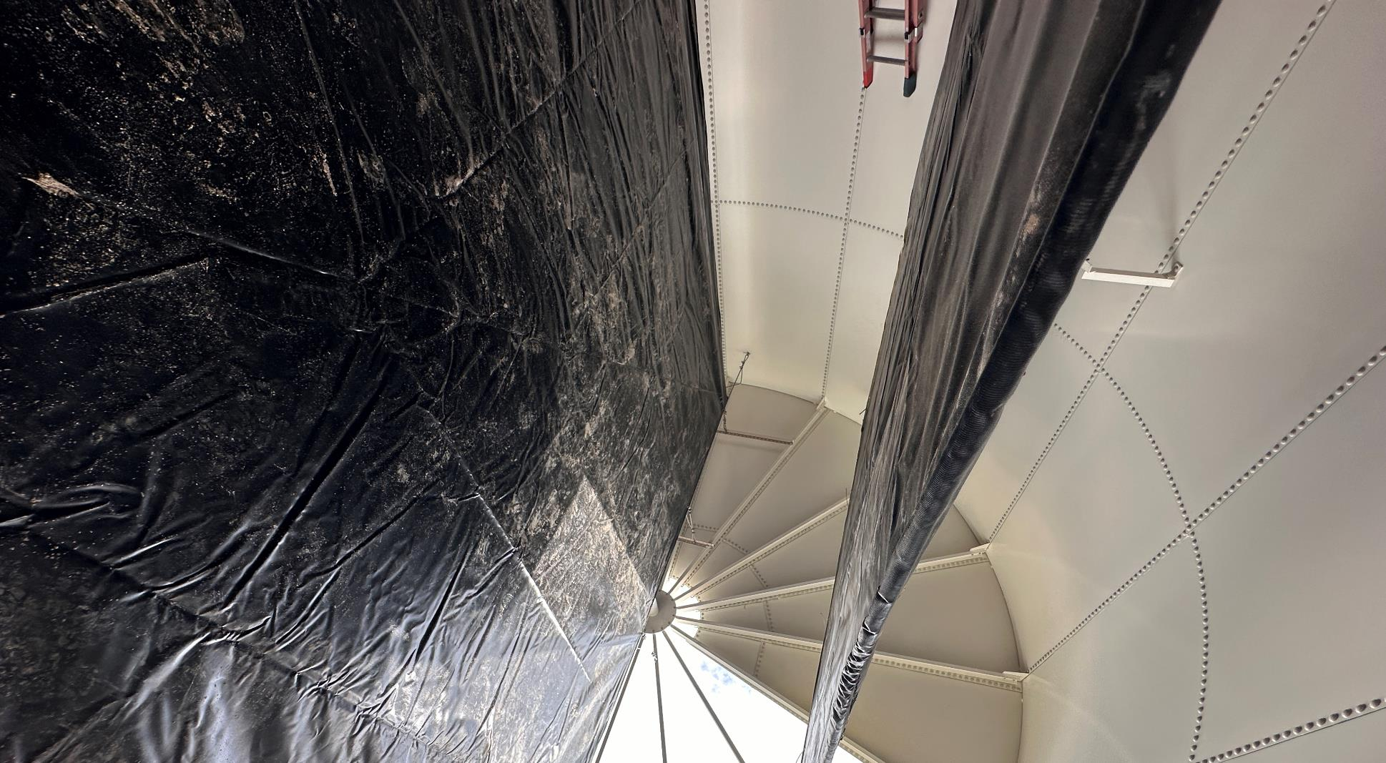
1

Slide 20
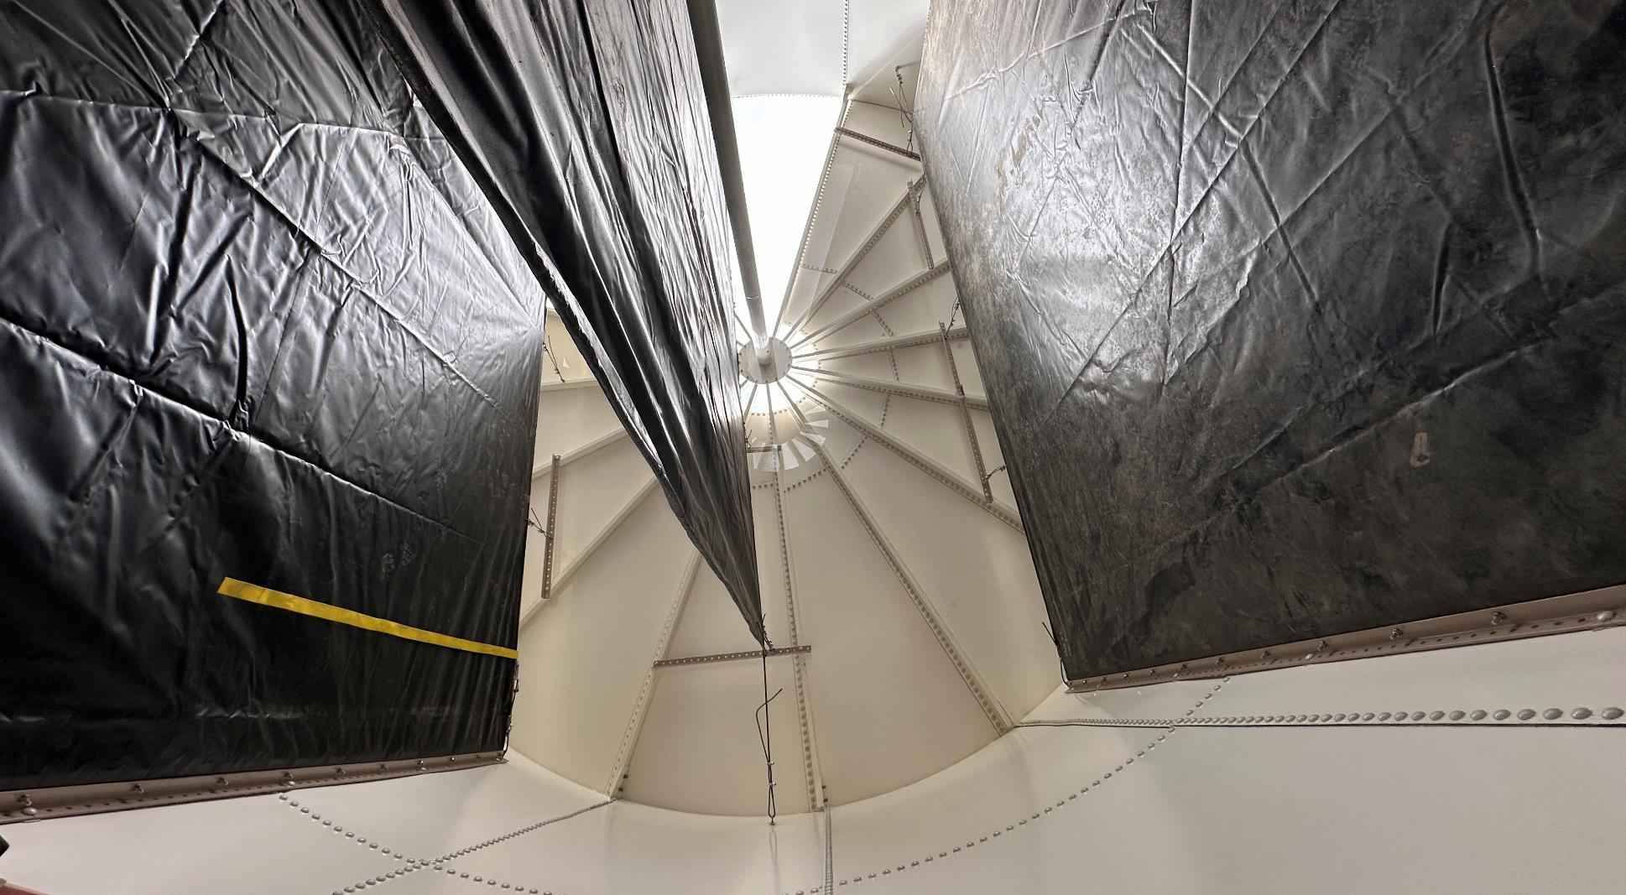
2

Slide 21
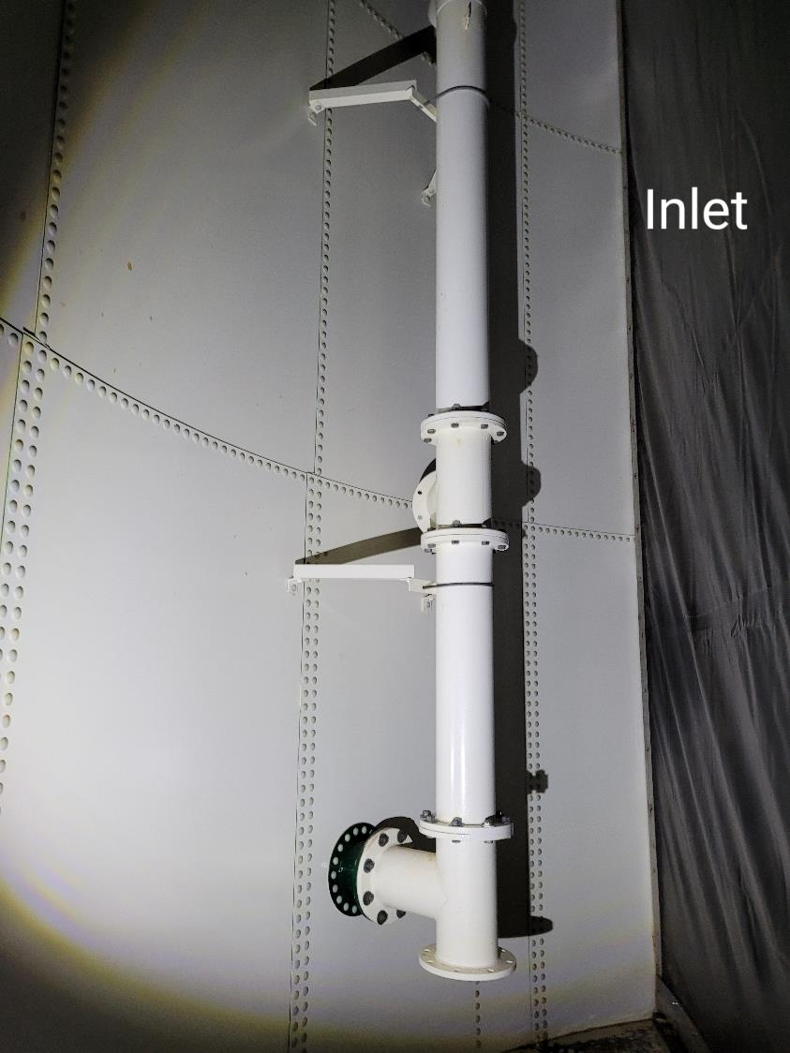
….

Slide 22
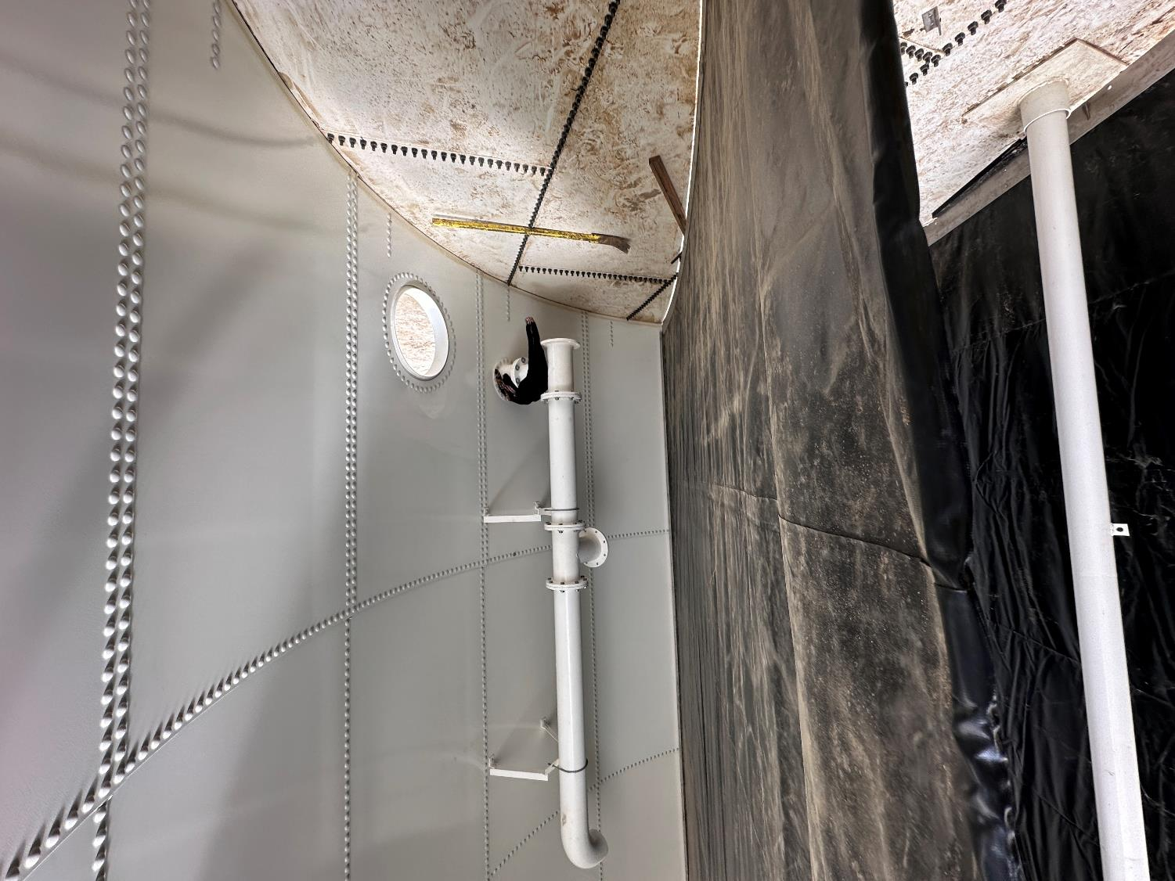
-
Outlet Pipe
Note: Inlet is identical to outlet pipe

Slide 23
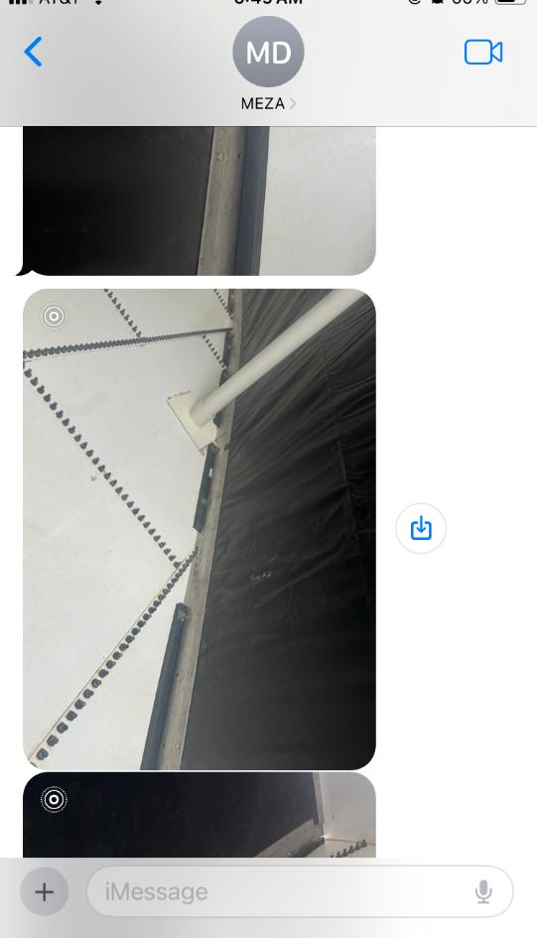
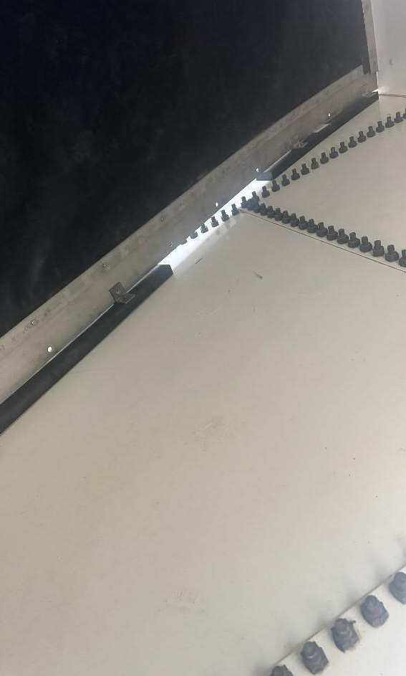
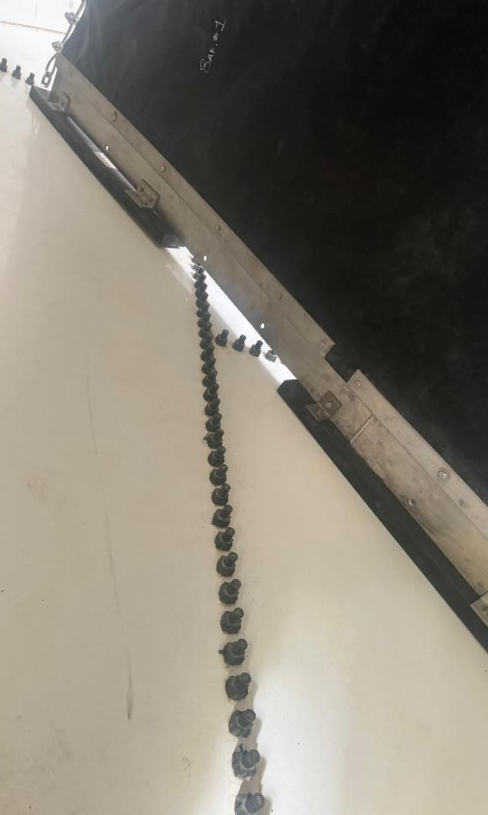
--
Gap
Gap
Gap

Slide 24
Chlorine Decay Rate Study
On 2/11/25, approximately 2 liters of permeate water was collected.
500 mL of this water was transfer to a 1-liter beaker and spiked with approximately 2.1 mg/L of NaOCl
Transfer to a clean plastic 500 mL brown bottle for storage
Daily chlorine residual, %UVT and UVA/cm analysis were conducted for the next 9 days

Slide 25
Definitions
UV transmittance (UVT) is a measurement of the amount of ultraviolet light (254 nm) that passes through a water sample compared to the amount of light that passes through a pure water sample. The measurement is expressed as a percentage, % UVT.
%UVT = 10^{(-UVA)} x 100%
UV absorbance (UVA) is calculated as a relative measure of the amount of light absorbed by a water sample compared with the amount of light absorbed by a pure water sample.
UVA = -log(%UVT/100)

Slide 26
.
Dose: 2.1 mg/L NaOCl

Slide 27
,
89.7% UVT without chlorine

Slide 28
,,
0.0471 UVA/cm without chlorine

Slide 29
,,,
Dose: 2.1 mg/L NaOCl at time zero
(0.0471 – UVA_{t})/(0.0471) * 100%

Slide 30
Disinfection Exposure Time of Fluid in Vessel for Determining Ct₁₀
C” - disinfectant residual (mg/L) at the point of inactivation compliance.
Disinfection exposure time of water used for Ct₁₀ calculation is the time (t₁₀) it takes for the first 10 percent of the water entering the reactor to exit the reactor.
To determine this, a nonreactive tracer is introduced into the water and is monitored leaving the reactor.
Example: 1.5 mg/L of tracer is continuously dose during testing; t₁₀ is that time when 0.15 mg/L of tracer concentration (10% of dose) has exited the reactor.

Slide 31
Ct₁₀ Value
Log inactivation is based on the Delivered Dose, “Ct₁₀”
  “C” is the disinfectant residual (mg/L)
  “t₁₀” is the exposure or contact time (minutes)
  Multiply them:
C • t₁₀ = mg/L • min (delivered dose to pathogens)
The calculated Ct₁₀ value is looked up in EPA Ct tables to determine the log inactivation based on specific monitoring parameters (pH, disinfectant residual and temperature).

Slide 32
Baffling Factor (BF)
Baffling factor or short-circuiting factor:
  Determined from tracer study or estimated
  BF = t₁₀/ HRT from tracer study
  HRT (hydraulic residence time) = operating volume divided by reactor flow
BF is determined and applied to daily operations of the reactor for determining the disinfectant exposure time.
Example:
  Total Clearwell operating volume: 63,000 gallons
  Exit flow: 400 gpm (0. 576 MGD)
  BF: 0.21, from tracer study
  Calculated contact or disinfection exposure time:
    63,000 gal ÷ 400 gpm × 0.21 = 33 minutes = t₁₀

Slide 33
Test Method
Modified Step-Dose Method
It is a continue feed of tracer injected before the reactor at constant rate with plant flow. The “Step-Dose” test has a duration of 3-4 HRT to achieve reactor outlet steady-state tracer concentration. The time “t₁₀” is determined when 10% of the tracer dose concentration has exist the reactor. The “Modified Step-Dose” test allows the test to be completed in less than 1 HRT by physical measurements of the tracer to the inlet of the reactor.

Slide 34
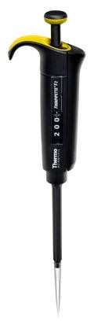
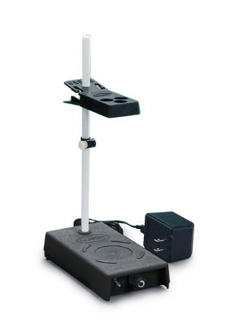
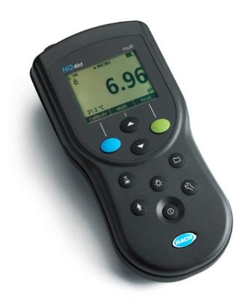
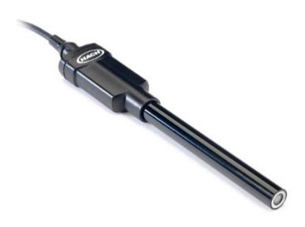
Method of Analysis and Equipment
Intellical™ ISEF121 Fluoride (F⁻) Ion Selective Electrode (ISE)
HQ40d Portable ISE Multi-Parameter Meter
Fluoride Ionic Strength Adjustor (ISA)
Fluoride Standards (0.2 & 2.0 mg/L)
25 mL graduated cylinder
Finnpipette F2 variable volume pipette, capacity 0.5 - 5 mL
Electrode stirrer stand
50 mL beakers
Stir Bar, Magnetic, Polygon

Slide 35

Contact
Guy Schott, P.E.
State Water Resources Control Board
Division of Drinking Water
Santa Rosa, CA
Go to Tracer Test Results for review
www.waterboards.ca.gov/drinking_water/programs/districts/mendocino_district.html
Email: Guy Schott - Guy.Schott@waterboards.ca.gov
Office Number: 707-576-2732

