Slide 1
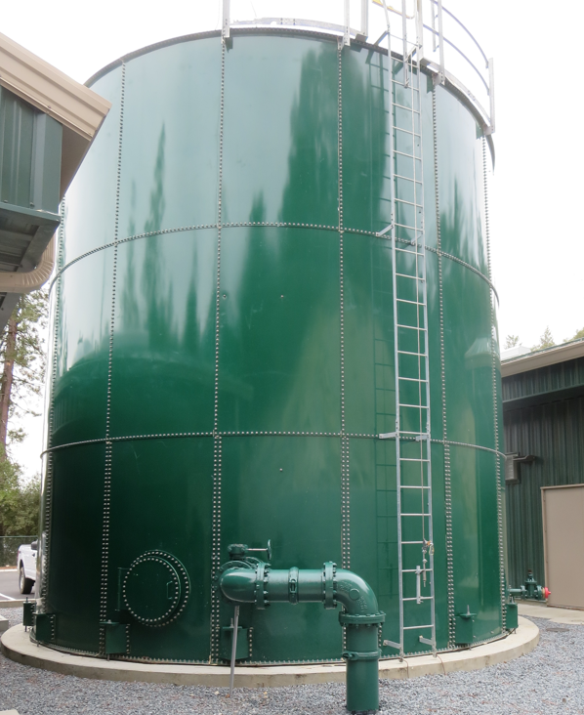
Clearwell
Base Lake Water Company CA2010003 Tracer Study Clearwell March 12, 2025
Performed/Assisted by:
Guy Schott, P.E
Allexis Ortiz-Vasquez
Bass Lake Operators

Slide 2
Bass Lake Water Company Clearwell Tracer Study Operations

Slide 3
Bass Lake Water Company Clearwell Tracer Study Operations.

Slide 4
Summary of Tracer Procedures
A single tracer study was conducted on a 67,000-gallon bolted steel tank (clearwell) with three baffles. Liquid fluoride was used as the tracer that was injected at the chlorine injection point upstream of the clearwell.
Sampling were conducted at two stations
Station 1: Inlet to clearwell to confirm fluoride dose (mg/L)
Station 2: Exit line of clearwell
Clearwell entry flow was 302 gpm
Clearwell exit flow average 287 gpm

Slide 5
Tracer Test Result Summary – 67,000-Gallon Clearwell
Modified Step-Dose – Test 2
Test Date: 3/12/25
Clearwell avg operating volume: 64,090 gallons
Three baffled; L:W 15.3
Entry flow: 302 gpm
Exit flow: 287 gpm
HRT: 223 minutes
t₁₀: 45.8 minutes
Baffling Factor (t₁₀/HRT): 0.20
Note: Test 1 (2/12/25) the baffling factor was 0.21. After Test 1, post construction photos were sent showing gaps between the tank floor and baffles where the baffles crossed the tank’s studded bolts. These gaps were repaired, and a second tracer test was conducted. Based on Test 2 results, the repairs to the baffles had no impact on the tank’s hydraulic efficiency. Post test 2 photos were sent, and more gaps were found and along with construction issues.

Slide 6
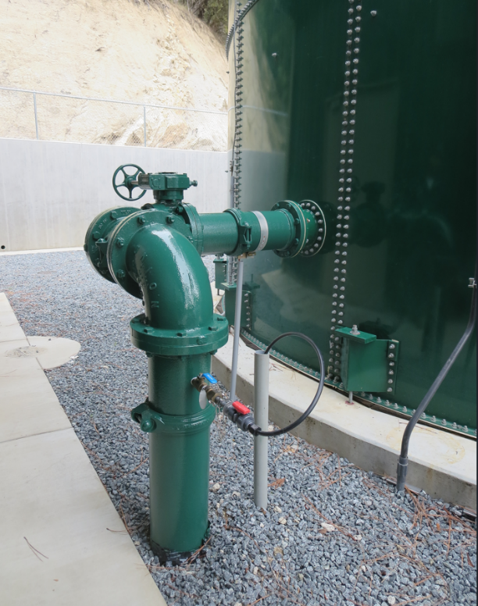
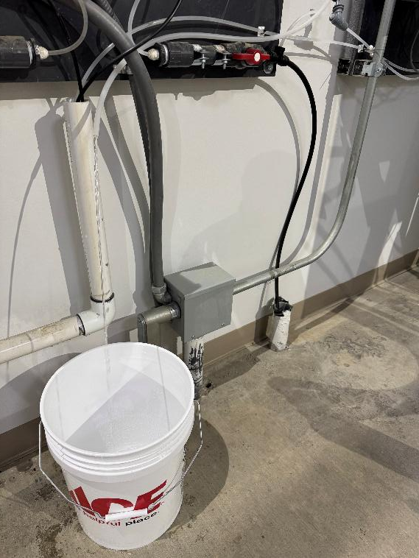
Clearwell Inlet Sampling Tap
Inlet Sampling Location
inside building
Inlet Sampling Line

Slide 7
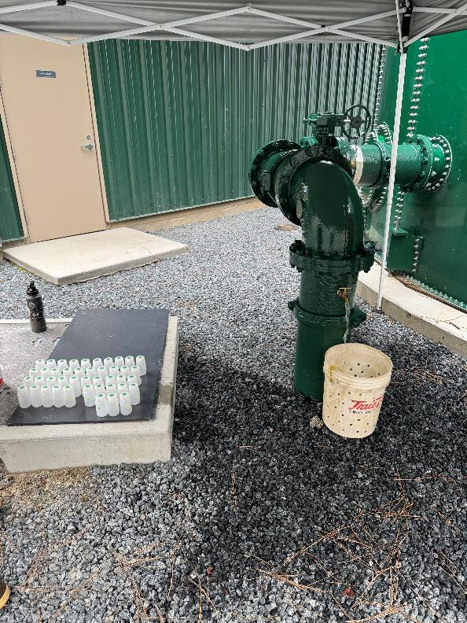
Clearwell Outlet Sampling Tap
Outlet Sampling Tap
Outlet Sampling Tap

Slide 8
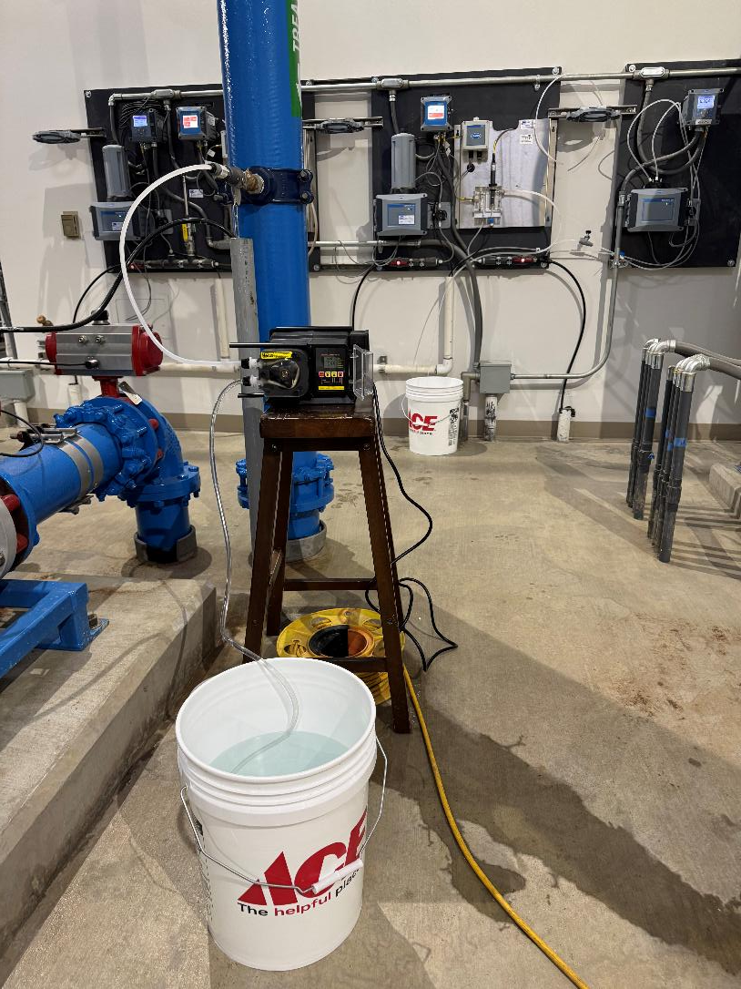
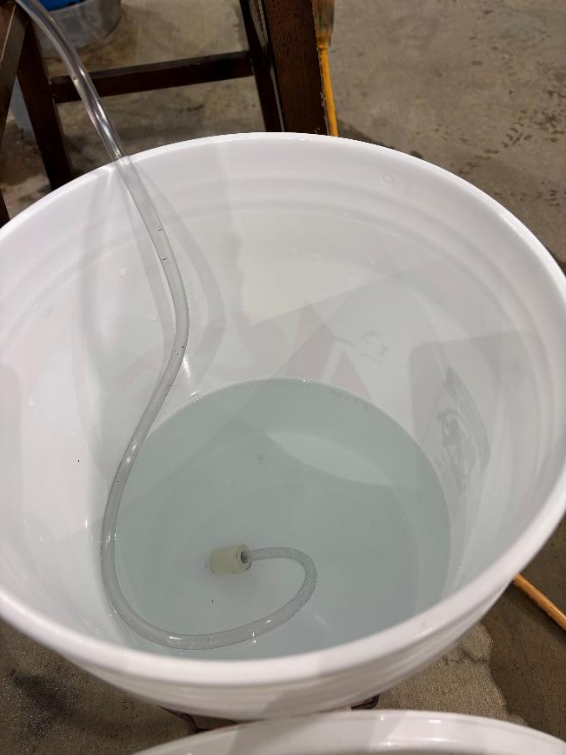
Tracer: H₂SiF₆, Fluoride (F) Injection

Slide 9
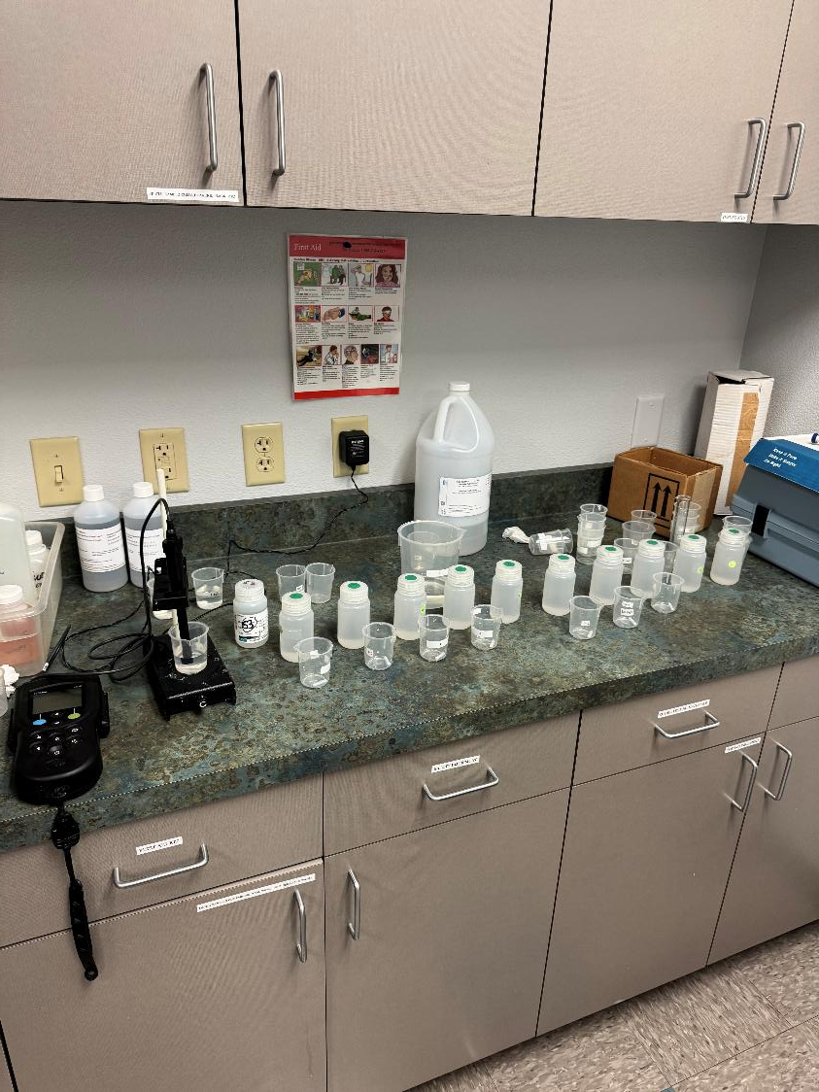
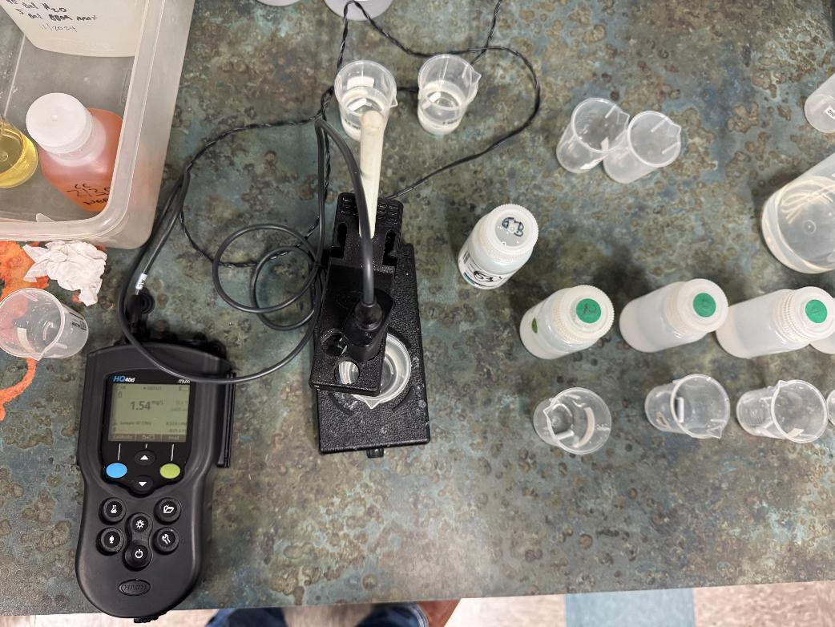
Fluoride Analysis

Slide 10
Test 2: Tracer Fluoride Dose, Inlet to Clearwell
Elapsed Time Minutes | *Tracer Fluoride Dose mg/L
15 | 2.36
22 | 2.42
36 | 2.46
43 | 2.46
50 | 2.48
*Excludes background fluoride of 0.045 mg/L

Slide 11
Tracer Test Tabulated Results

Slide 12
Test 2.
Dose: 2.43 mg/L (inlet monitoring)
0.243 mg/L at t₁₀ (outlet monitoring)
T₁₀: 45.8 min
HRT: 223 min
BF: 0.205 (T₁₀/HRT)

Slide 13
Test 2
BF: 0.20

Slide 14
Purpose of a Tracer Study
To determine the hydraulic efficiency or disinfectant exposure time of water through one or more reactors.
The addition of known quantities of a nonreactive chemical (tracer) is added in the form of a pulse (slug) or step-dose input.
The time of travel or disinfectant exposure time through the reactor is impacted by:
Flow rate
Water Depth
Volume
Configuration
Hydraulic mixing
Temperature

Slide 15
Clearwell Photos
The next 6 slides are photos inside the Clearwell during and after construction. Thereafter, are photos taken after tank was drain that showed gaps under the baffles.

Slide 16
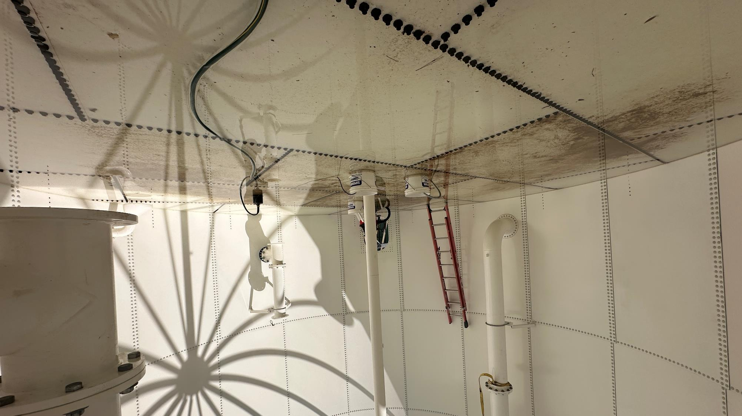
.

Slide 17
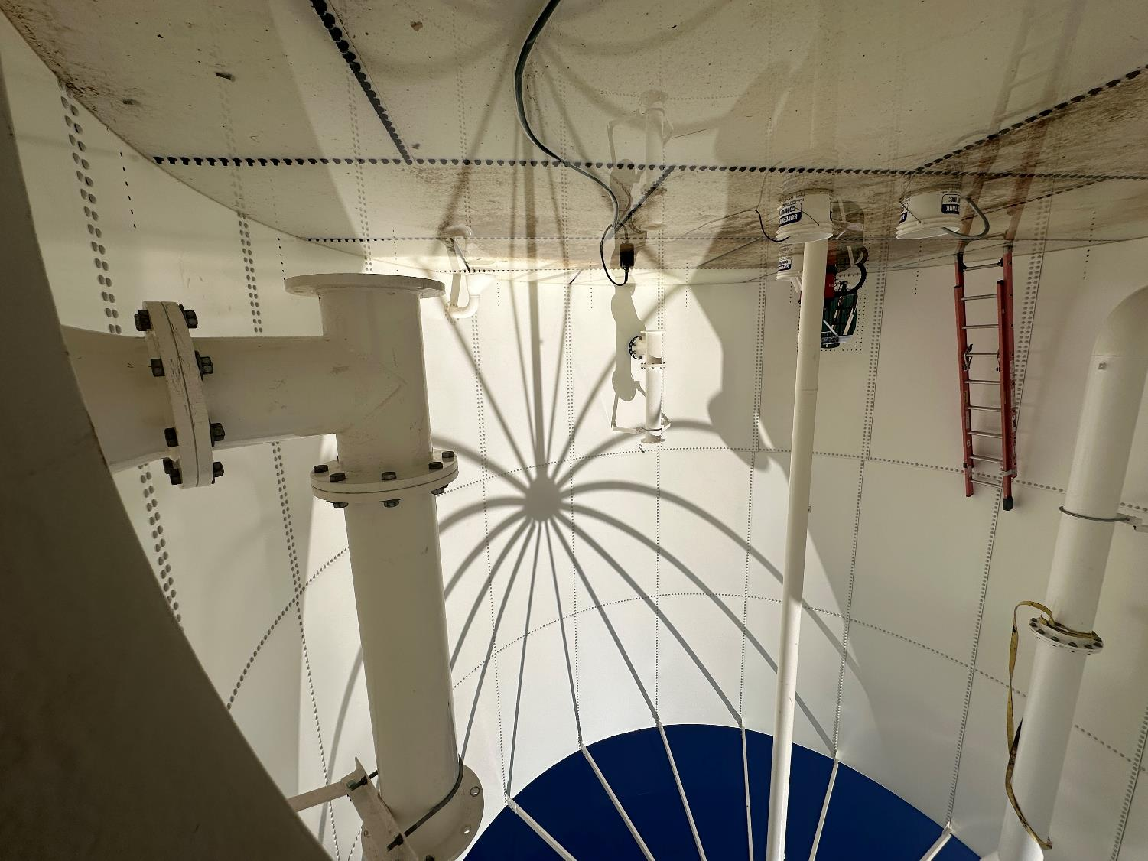
..

Slide 18
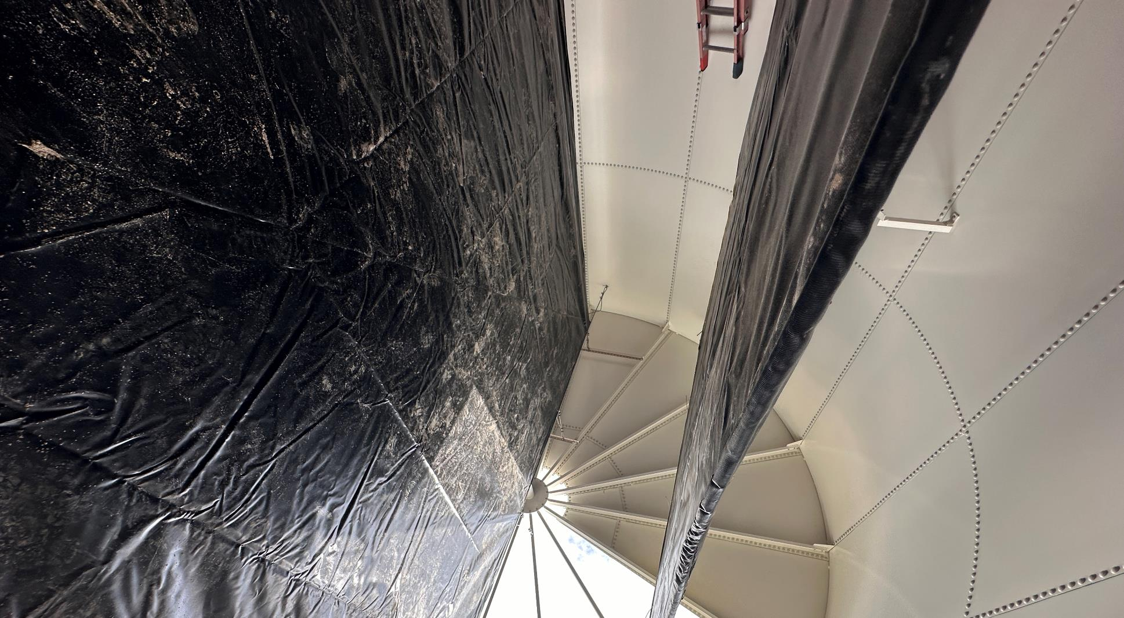
,

Slide 19
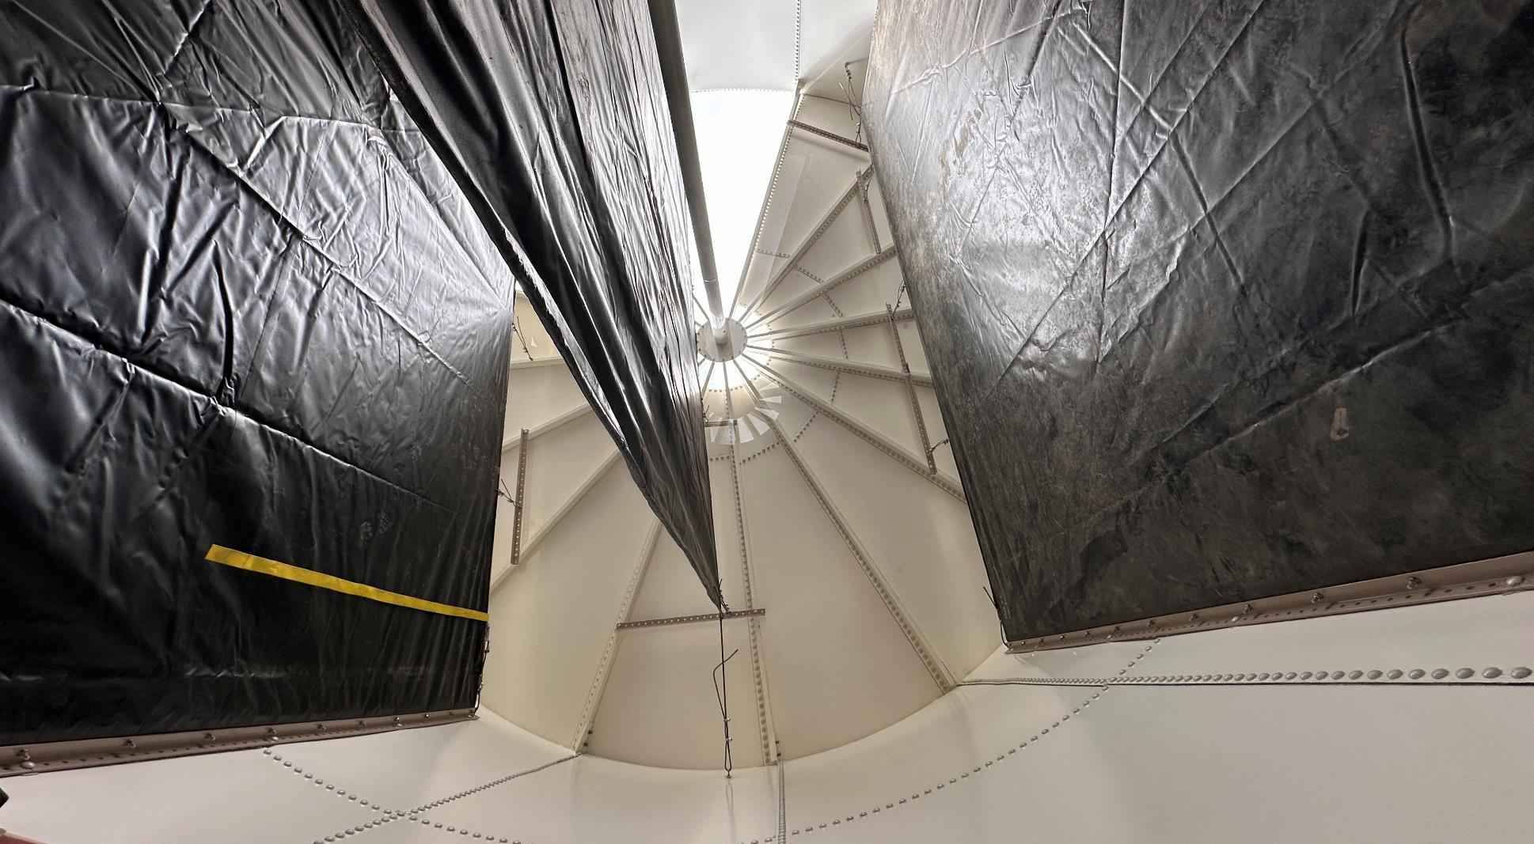
,,

Slide 20
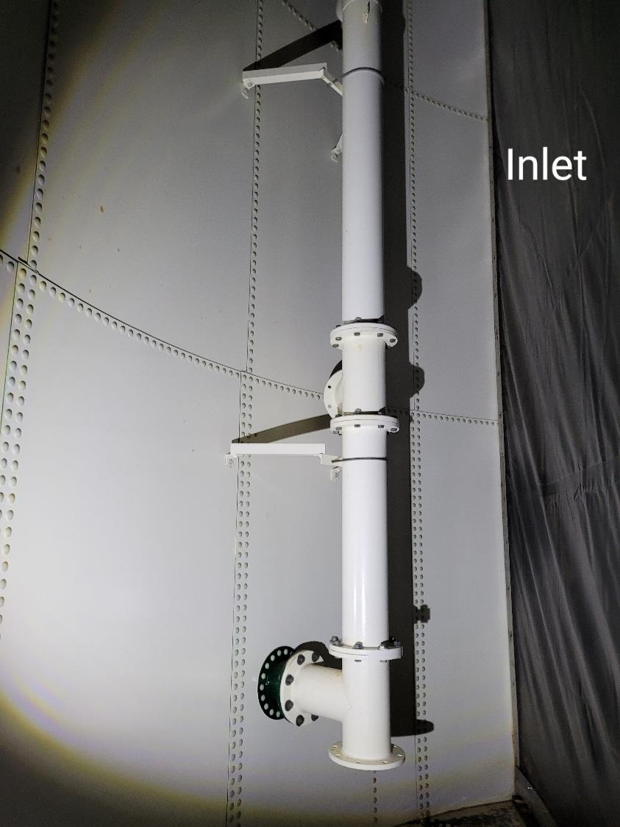
-

Slide 21
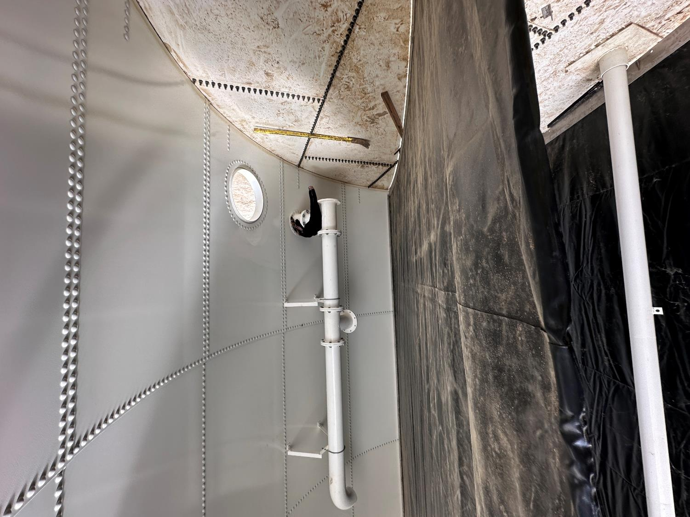
Outlet Pipe
Note: Inlet is identical to outlet pipe

Slide 22
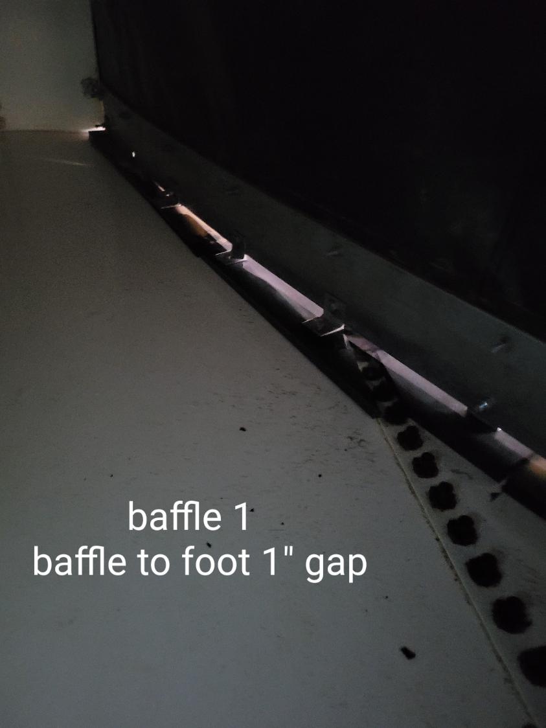
--

Slide 23
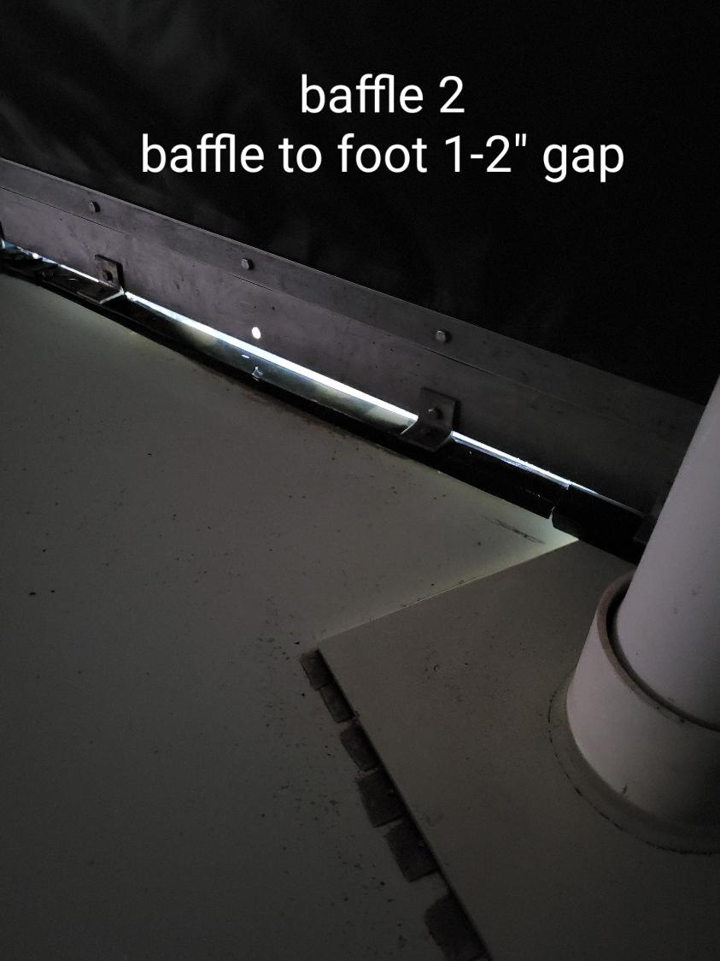
---

Slide 24
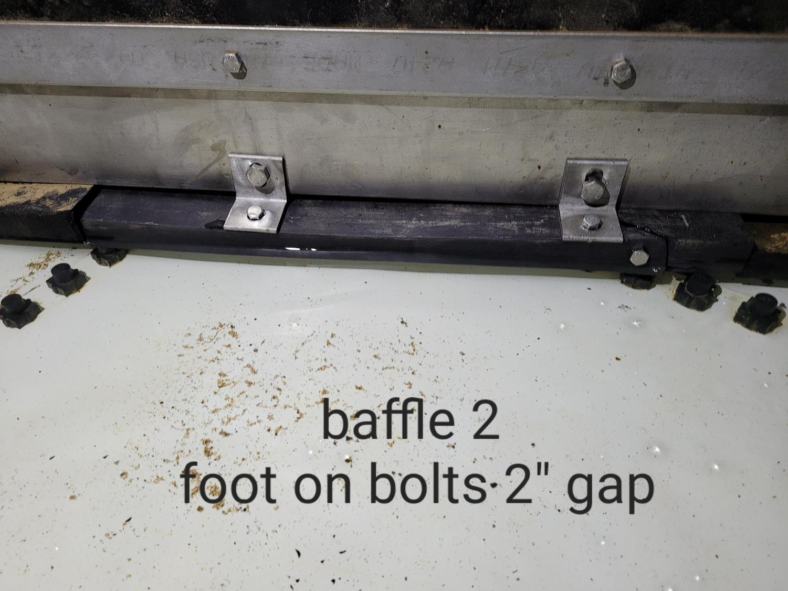
a

Slide 25
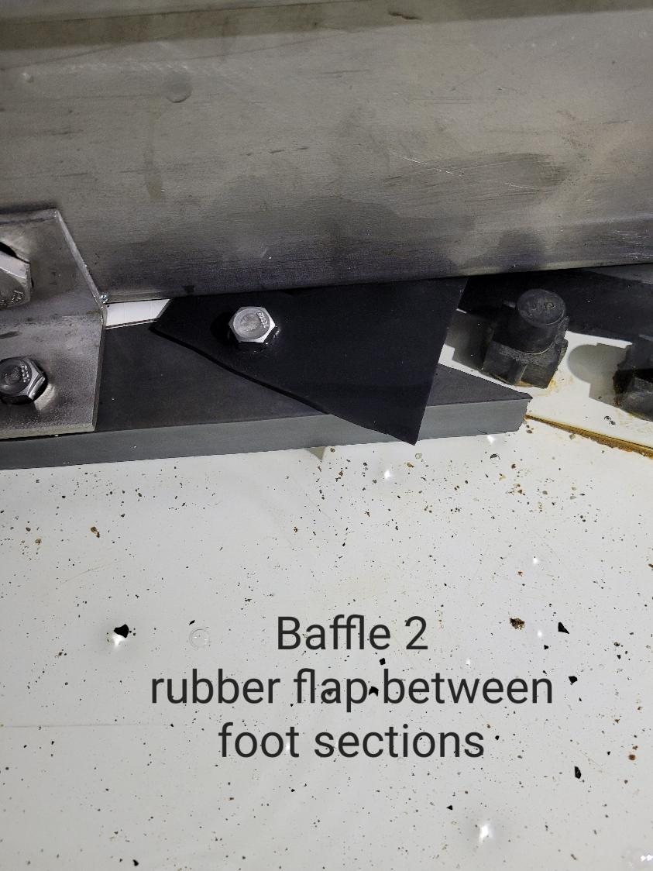
c

Slide 26
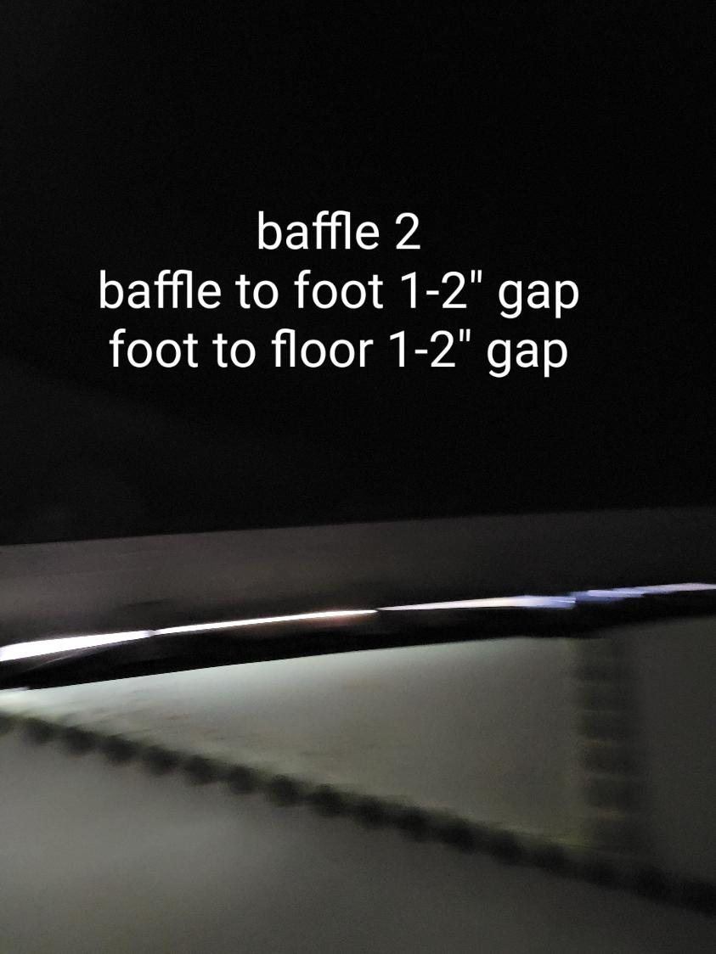
d

Slide 27
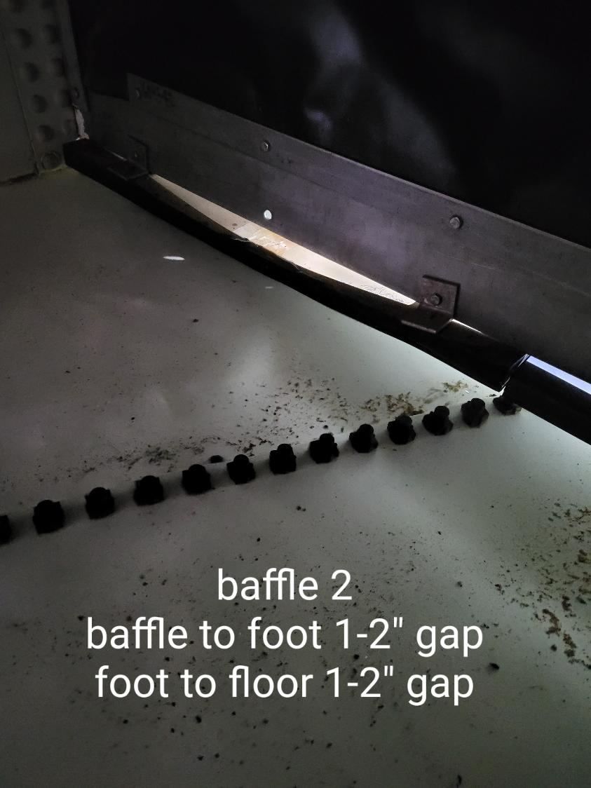
h

Slide 28
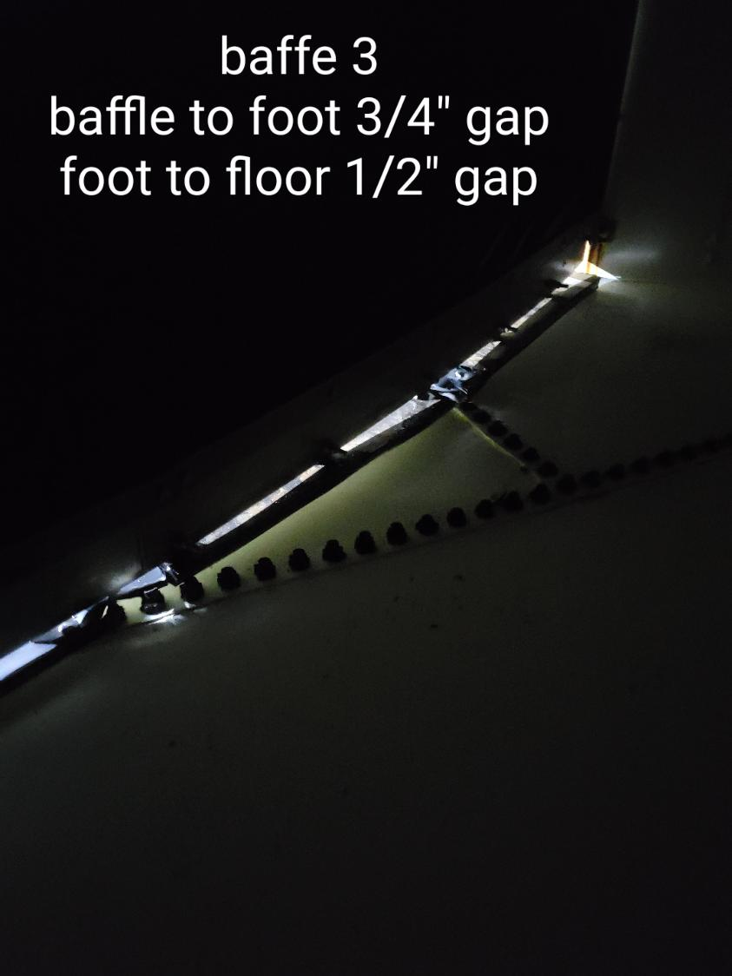
k

Slide 29
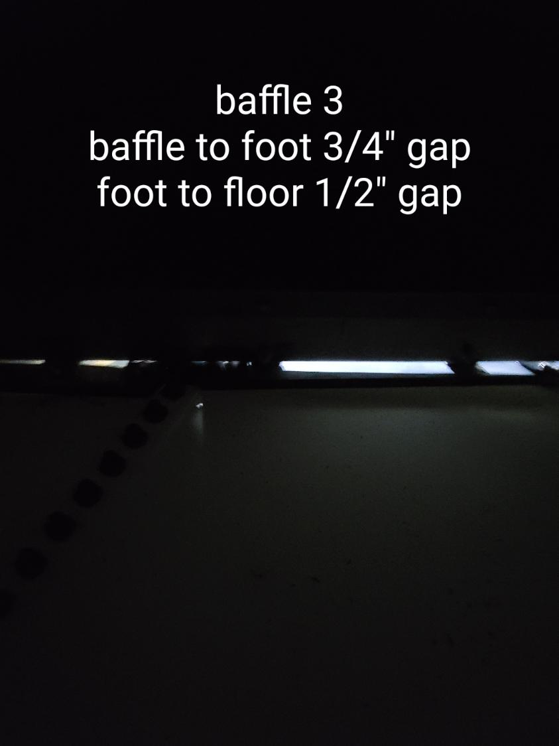
o

Slide 30
Disinfection Exposure Time of Fluid in Vessel for Determining Ct₁₀
C” - disinfectant residual (mg/L) at the point of inactivation compliance.
Disinfection exposure time of water used for Ct₁₀ calculation is the time (t₁₀) it takes for the first 10 percent of the water entering the reactor to exit the reactor.
To determine this, a nonreactive tracer is introduced into the water and is monitored leaving the reactor.
Example: 1.5 mg/L of tracer is continuously dose during testing; t₁₀ is that time when 0.15 mg/L of tracer concentration (10% of dose) has exited the reactor.

Slide 31
Ct₁₀ Value
Log inactivation is based on the Delivered Dose, “Ct₁₀”
“C” is the disinfectant residual (mg/L)
“t₁₀” is the exposure or contact time (minutes)
Multiply them:
C • t₁₀ = mg/L • min (delivered dose to pathogens)
The calculated Ct₁₀ value is looked up in EPA Ct tables to determine the log inactivation based on specific monitoring parameters (pH, disinfectant residual and temperature).

Slide 32
Baffling Factor (BF)
Baffling factor or short-circuiting factor:
Determined from tracer study or estimated
BF = t₁₀/ HRT from tracer study
HRT (hydraulic residence time) = operating volume divided by reactor flow
BF is determined and applied to daily operations of the reactor for determining the disinfectant exposure time.
Example:
Total Clearwell operating volume: 63,000 gallons
Exit flow: 400 gpm (0. 576 MGD)
BF: 0.20, from tracer study
Calculated contact or disinfection exposure time:
63,000 gal ÷ 400 gpm × 0.20 = 31.5 minutes = t₁₀

Slide 33
Test Method
Modified Step-Dose Method
It is a continue feed of tracer injected before the reactor at constant rate with plant flow. The “Step-Dose” test has a duration of 3-4 HRT to achieve reactor outlet steady-state tracer concentration. The time “t₁₀” is determined when 10% of the tracer dose concentration has exist the reactor. The “Modified Step-Dose” test allows the test to be completed in less than 1 HRT by physical measurements of the tracer to the inlet of the reactor.

Slide 34
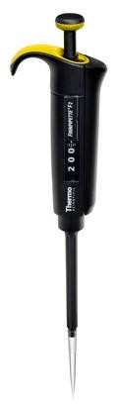
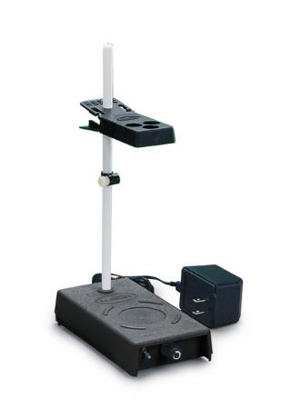
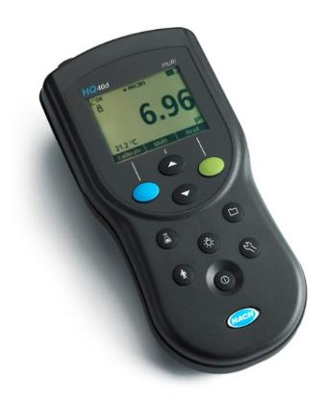
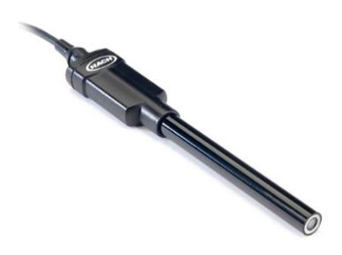
Method of Analysis and Equipment
Intellical™ ISEF121 Fluoride (F⁻) Ion Selective Electrode (ISE)
HQ40d Portable ISE Multi-Parameter Meter
Fluoride Ionic Strength Adjustor (ISA)
Fluoride Standards (0.2 & 2.0 mg/L)
25 mL graduated cylinder
Finnpipette F2 variable volume pipette, capacity 0.5 - 5 mL
Electrode stirrer stand
50 mL beakers
Stir Bar, Magnetic, Polygon

Slide 35

Contact
Guy Schott, P.E.
State Water Resources Control Board
Division of Drinking Water
Santa Rosa, CA
Go to Tracer Test Results for review
www.waterboards.ca.gov/drinking_water/programs/districts/mendocino_district.html
Email: Guy Schott - Guy.Schott@waterboards.ca.gov
Office Number: 707-576-2732

