Slide 1
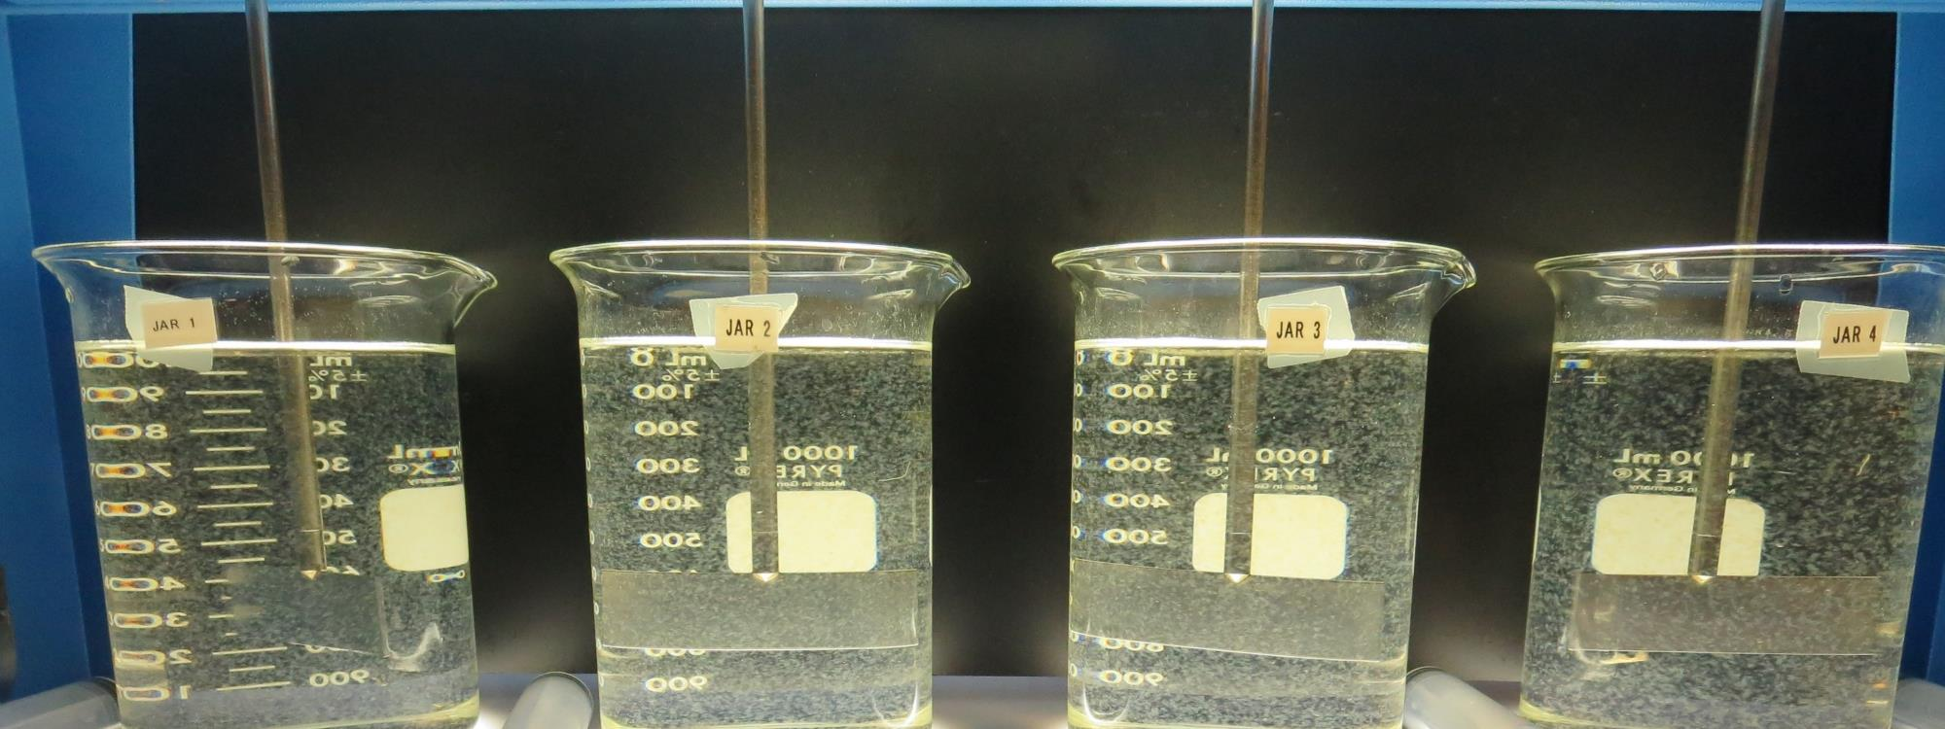
Surfwood Mutual Water Corporation CA2300590 Mendocino County Jar Test
by Guy Schott, P.E.
September 11, 2019

Slide 2
Source Water: Jack Peter’s Creek Roughing Filter followed by Multi-Media Filtration
Source Water Characteristics
Turbidity: 1.95 NTU
pH: 7.30
UVT: 67.8%, UVA: 0.169/cm
0.4 um Filtered
UVT: 68%, UVA: 0.167/cm
Treated Water
Turbidity: 0.09 NTU
UVT: 88.2%, UVA: 0.055/cm

Slide 3
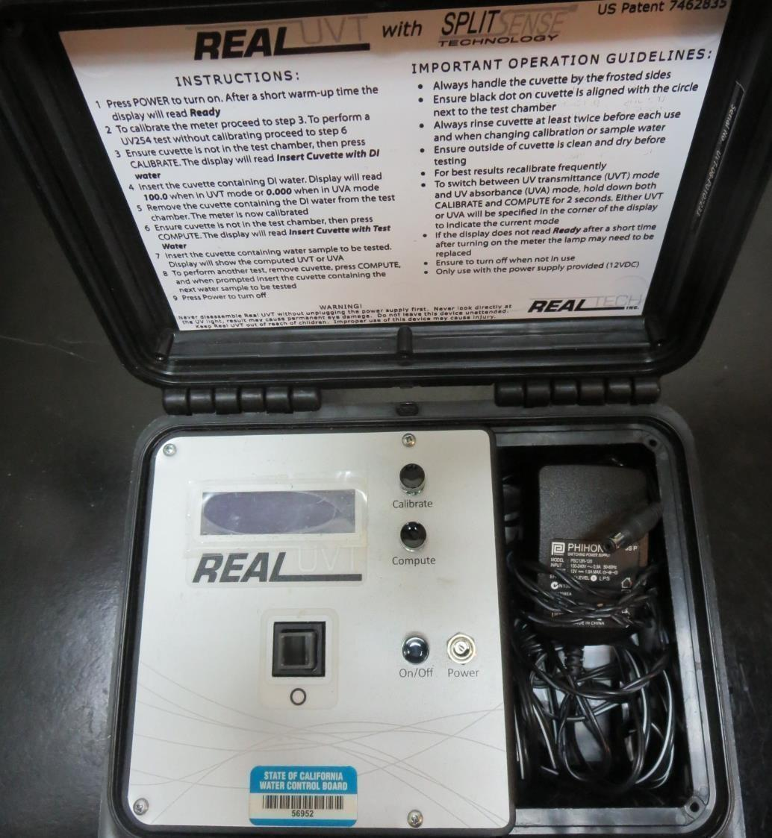
UVT/UVA
UV transmittance (UVT) is a measurement of the amount of ultraviolet light (commonly at 254 nm due to its germicidal effect) that passes through a water sample compared to the amount of light that passes through a pure water sample. The measurement is expressed as a percentage, % UVT.
%UVT = 10^{(-UVA)} x 100%
UV absorbance (UVA) is calculated as a relative measure of the amount of light absorbed by a water sample compared with the amount of light absorbed by a pure water sample.
UVA = -log(%UVT/100)

Slide 4
Coagulant Used for Jar Testing
7016 (Garratt Callahan)
1– 40% Polydimethyldiallylammonium Chloride
SG = 1.28
7036 (Garratt Callahan)
25– 50% Poly Aluminum Hydroxychloride Sulfate
SG = 1.23
7066 (Garratt Callahan)
10 – 30% Poly Aluminum Hydroxychloride Sulfate
SG = 1.2
AH-710 (Garratt Callahan)
1-50% 1,2-Ehaanediammine, polymer w/(chloromethyl) and Methylmethanamine (Epichlorohydrin Dimethylamine Copolymer)
SG = 1.31

Slide 5
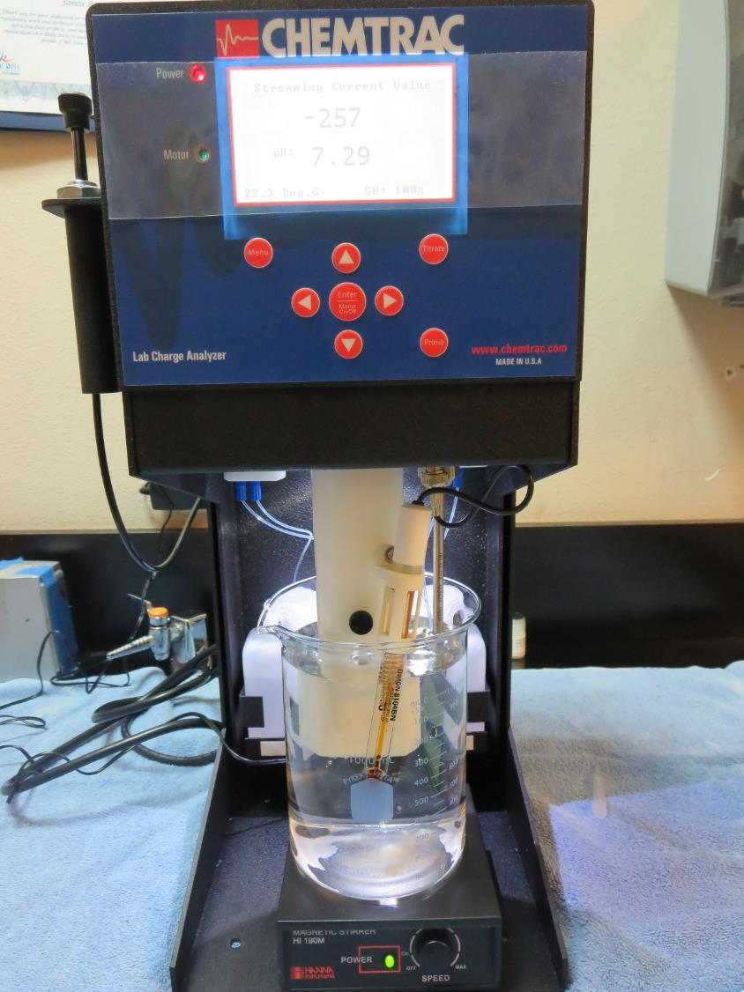
Laboratory Charge Analyzer
LCA: Used to determine coagulant demand of a source water entering the treatment plant.
Source pH: 7.30
LCA#1: 7066: 58.6 mg/L as product (no pH adj)
Final pH: 6.56
LCA #2: 7032: 22 mg/L as product (no pH adj)
Final pH: 7.11
LCA #3:
7016: 24 mg/L as product (no pH adj)
Final pH: 7.17
LCA #4:
AH-710: 20 mg/L as product (no pH adj)
Final pH: 7.21

Slide 6
Coagulant Information
Unless stated otherwise, all coagulant doses are reported as Product (100% strength).
Preparation of coagulant stock solutions are generally 1.0 or 0.1 percent strength using 100 and/or 200 mL volumetric flasks.
Finnpipette F2 variable volume pipette, capacity 100-1000 micro liters is used for stock solution preparation and coagulant aid jar test dosing.
Finnpipette F2 variable volume pipette, capacity 0.5-5 mL is used for primary coagulant jar test dosing.

Slide 7
Surfwood MWC: Jar Test 1-8 Results Filtrate samples taken immediately at end of flocculation period.
Jar | 200 RPM Flash Mix seconds | 30 RPM Floc Duration minutes | 7066 mg/L | Filtrate NTU | Filtrate %UVT | Filtrate UVA/cm | Settle NTU 25 min | Al Added mg/L
J1 | 60 | 5 | 50 | 0.17 | 94.7 | 0.024 | 0.71 | 2.5
J2 | 60 | 5 | 55 | 0.15 | 95.3 | 0.021 | 0.65 | 2.75
J3 | 60 | 5 | 60 | 0.07 | 96.5 | 0.015 | 0.86 | 3.0
J4 | 60 | 5 | 65 | 0.07 | 96.9 | 0.014 | 0.75 | 3.25
J5 | 60 | 5 | 60 | 0.10 | 96.0 | 0.018 | 0.31 | 3.0
J6 | 60 | 5 | 64 | 0.10 | 95.7 | 0.019 | 0.47 | 3.2
J7 | 60 | 5 | 68 | 0.10 | 96.1 | 0.017 | 0.45 | 3.4
J8 | 60 | 5 | 72 | 0.10 | 96.3 | 0.016 | 0.54 | 3.6

Slide 8
Surfwood MWC: Jar Test 9-16 Results Filtrate samples taken immediately at end of flocculation period.
Jar | 200 RPM Flash Mix seconds | 30 RPM Floc Duration minutes | 7016 mg/L | Filtrate NTU | Filtrate %UVT | Filtrate UVA/cm | Settle NTU 25 min | Settle NTU 36 min
J9 | 60 | 5 | 22.5 | 0.09 | 96.2 | 0.017 | n/a | 0.81
J10 | 60 | 5 | 24.0 | 0.13 | 96.1 | 0.017 | n/a | 0.87
J11 | 60 | 5 | 25.5 | 0.23 | 95.4 | 0.020 | n/a | 1.0
J12 | 60 | 5 | 27.0 | 0.06 | 97.1 | 0.013 | n/a | 1.52
J13 | 60 | 5 | 21.0 | 0.23 | 94.4 | 0.025 | 1.54 | n/a
J14 | 60 | 5 | 22.5 | 0.24 | 94.9 | 0.023 | 1.34 | n/a
J15 | 60 | 5 | 27.0 | 0.21 | 95.7 | 0.019 | 2.48 | n/a
J16 | 60 | 5 | 28.5 | 0.23 | 95.7 | 0.019 | 3.0 | n/a

Slide 9
Surfwood MWC: Jar Test 17-24 Results Filtrate samples taken immediately at end of flocculation period.
Jar | 200 RPM Flash Mix seconds | 30 RPM Floc Duration minutes | AH-710 mg/L | Filtrate NTU | Filtrate %UVT | Filtrate UVA/cm | Settle NTU 25 min | Al Added mg/L
J17 | 60 | 5 | 19 | 0.33 | 92.8 | 0.032 | 1.1 | 2.09
J18 | 60 | 5 | 20 | 0.10 | 95.7 | 0.019 | 1.1 | 2.20
J19 | 60 | 5 | 21 | 0.22 | 94.4 | 0.025 | 1.2 | 2.31
J20 | 60 | 5 | 22 | 0.10 | 96.3 | 0.016 | 1.2 | 2.42
J21 | 60 | 5 | 24 | 0.08 | 96.9 | 0.014 | 1.5 | 2.64
J22 | 60 | 5 | 26 | 0.23 | 95.2 | 0.021 | 3.2 | 2.86
J23 | 60 | 5 | 28 | 0.43 | 92.7 | 0.033 | 3.1 | 3.08
J24 | 60 | 5 | 30 | 0.46 | 91.5 | 0.039 | 2.9 | 3.30

Slide 10
Surfwood MWC: Jar Test 25-32 Results Filtrate samples taken immediately at end of flocculation period.
Jar | 200 RPM Flash Mix seconds | 30 RPM Floc Duration minutes | 7035 mg/L | Filtrate NTU | Filtrate %UVT | Filtrate UVA/cm | Settle NTU 25 min | Al Added mg/L
J25 | 60 | 5 | 48 | 0.12 | 95.2 | 0.021 | 0.76 | 2.88
J26 | 60 | 5 | 52 | 0.18 | 94.4 | 0.025 | 0.76 | 3.12
J27 | 60 | 5 | 56 | 0.18 | 94.6 | 0.024 | 0.75 | 3.36
J28 | 60 | 5 | 60 | 0.09 | 96.3 | 0.016 | 0.61 | 3.60
J29 | 60 | 5 | 60 | 0.15 | 95.6 | 0.020 | 0.56 | 3.60
J30 | 60 | 5 | 63 | 0.15 | 95.8 | 0.019 | 0.59 | 3.78
J31 | 60 | 5 | 66 | 0.07 | 97.1 | 0.013 | 0.61 | 3.96
J32 | 60 | 5 | 69 | 0.06 | 97.2 | 0.012 | 0.77 | 4.14

Slide 11
Surfwood MWC: Jar Test 25-32 Results, Flash Mix 200 RPM (60 sec) Filtrate samples taken immediately at end of flocculation period.
Jar | 30 RPM Floc Duration minutes | 7035 mg/L | 7066 mg/L | Filtrate NTU | Filtrate %UVT | Filtrate UVA/cm | Settle NTU 25 min | Al Added mg/L
J33 | 5 | 66 | n/a | 0.10 | 96.7 | 0.015 | 0.51 | 3.96
J34 | 5 | 69 | n/a | 0.07 | 97.1 | 0.013 | 0.59 | 4.14
J35 | 5 | 72 | n/a | 0.10 | 96.7 | 0.015 | 0.96 | 4.32
J36 | 5 | 75 | n/a | 0.07 | 97.1 | 0.013 | 0.93 | 4.50
J37 | 5 | n/a | 60 | 0.10 | 96.3 | 0.016 | 0.43 | 3.00
J38 | 5 | n/a | 65 | 0.10 | 96.2 | 0.017 | 0.46 | 3.25
J39 | 5 | n/a | 70 | 0.10 | 96.7 | 0.015 | 0.48 | 3.50
J40 | 5 | n/a | 75 | 0.08 | 97.0 | 0.013 | 0.61 | 3.75

Slide 12
Jars 1-4 Test Flash Mix 60 Sec (200 RPM) Floc Mix 5 min (30 RPM) Applied Coagulant 7066

Slide 13
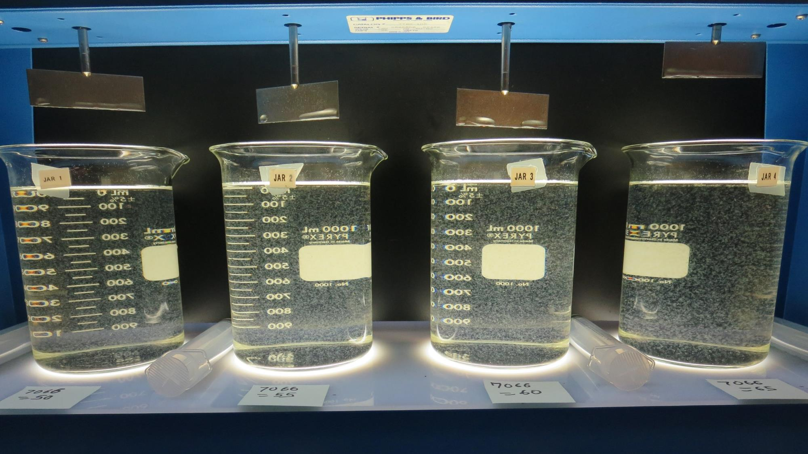
Jars 1-4: End of Floc Duration, 25 mL is syringed for filterability and %UVT/UVA.
50 mg/L 7066
Filtrate 0.17 NTU
UVT: 94.7%
UVA: 0.024/cm
Settled: 0.71 NTU
55 mg/L 7066
Filtrate 0.15 NTU
UVT: 95.3%
UVA: 0.021/cm
Settled: 0.65 NTU
60 mg/L 7066
Filtrate 0.07 NTU
UVT: 96.5%
UVA: 0.015/cm
Settled: 0.96 NTU
65 mg/L 7066
Filtrate 0.07 NTU
UVT: 96.9%
UVA: 0.014/cm
Settled: 0.75 NTU

Slide 14
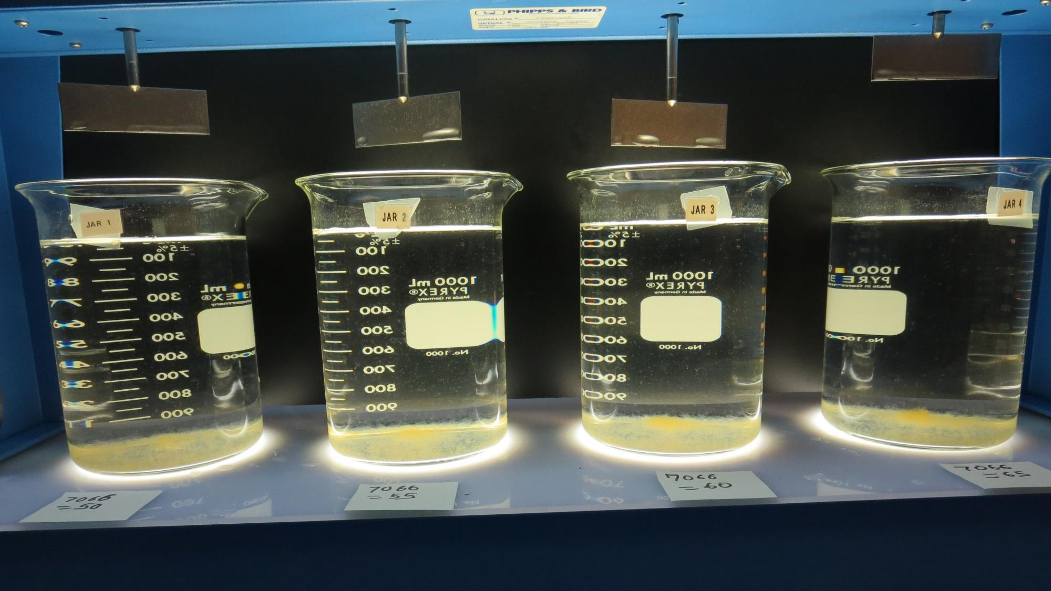
Jars 1-4: After 25-minutes of settling, settled water turbidity is taken.

Slide 15
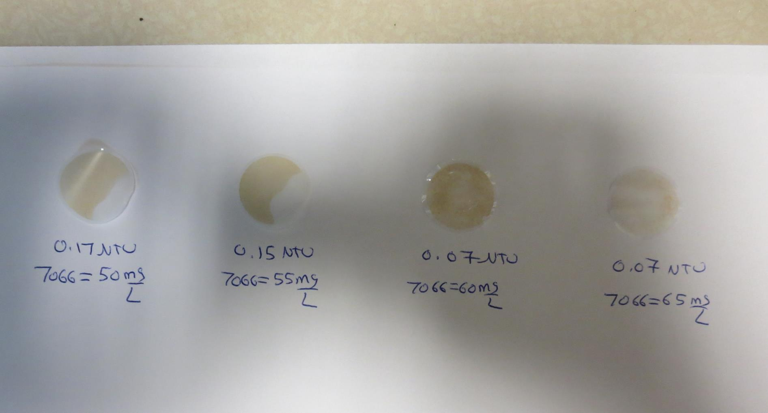
Visual of Filterability of Jars 1-4
50 mg/L 7066
Filtrate 0.17 NTU
UVT: 94.7%
UVA: 0.024/cm
Settled: 0.71 NTU
55 mg/L 7066
Filtrate 0.15 NTU
UVT: 95.3%
UVA: 0.021/cm
Settled: 0.65 NTU
60 mg/L 7066
Filtrate 0.07 NTU
UVT: 96.5%
UVA: 0.015/cm
Settled: 0.96 NTU
65 mg/L 7066
Filtrate 0.07 NTU
UVT: 96.9%
UVA: 0.014/cm
Settled: 0.75 NTU

Slide 16
Jars 5-8 Test Flash Mix 60 Sec (200 RPM) Floc Mix 5 min (30 RPM) Applied Coagulant 7066

Slide 17
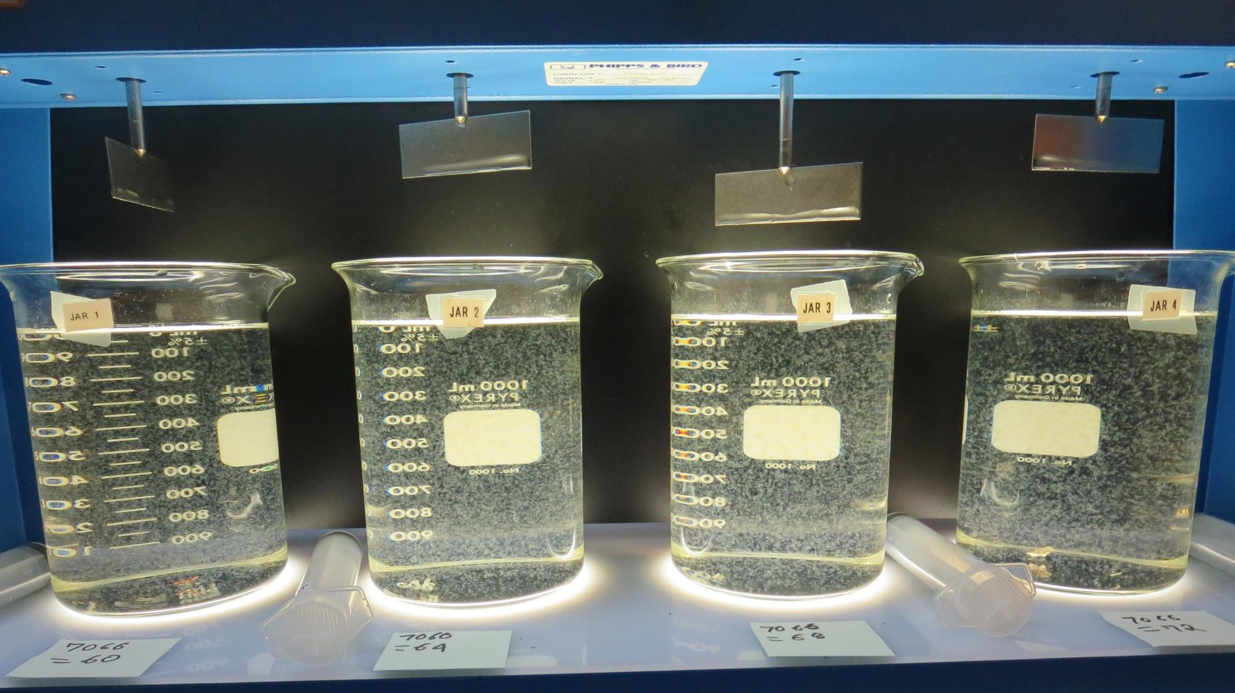
Jars 5-8: End of Floc Duration, 25 mL is syringed for filterability and %UVT/UVA
60 mg/L 7066
Filtrate 0.10 NTU
UVT: 96.0%
UVA: 0.018/cm
Settled: 0.31 NTU
64 mg/L 7066
Filtrate 0.10 NTU
UVT: 95.7%
UVA: 0.019/cm
Settled: 0.47 NTU
68 mg/L 7066
Filtrate 0.10 NTU
UVT: 96.1%
UVA: 0.017/cm
Settled: 0.45 NTU
72 mg/L 7066
Filtrate 0.10 NTU
UVT: 96.3%
UVA: 0.016/cm
Settled: 0.54 NTU

Slide 18
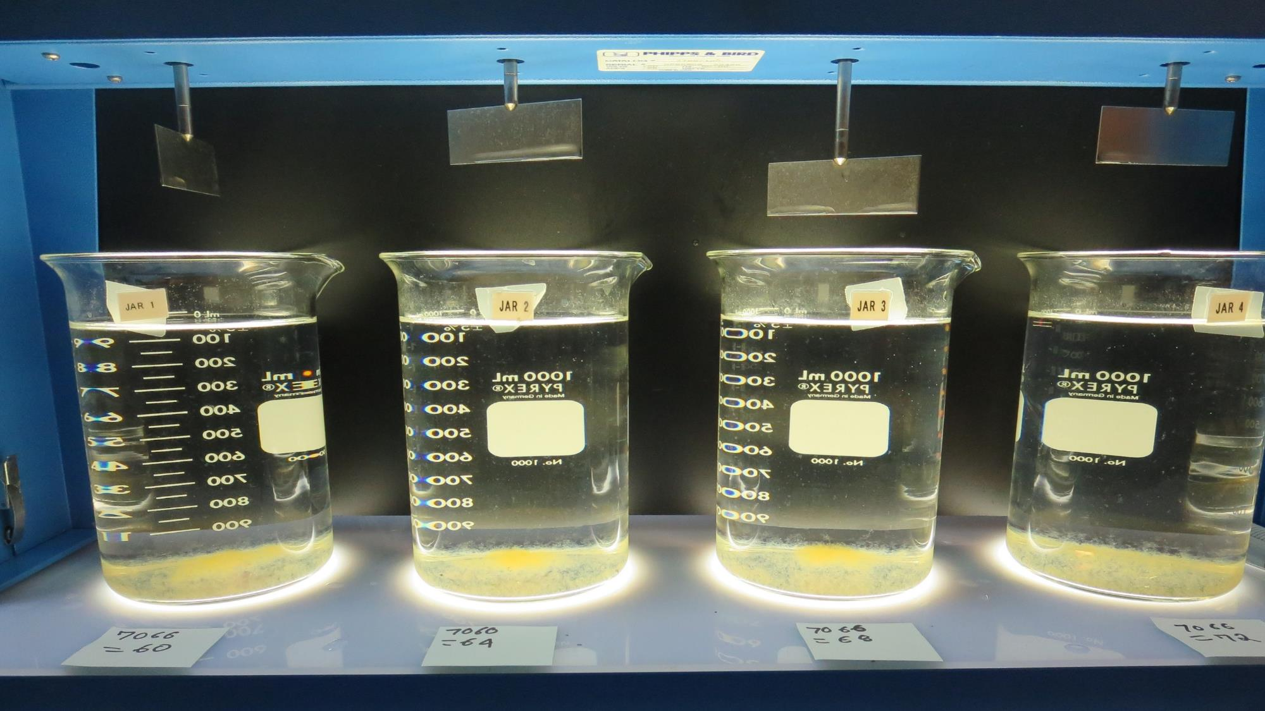
Jars 5-8: After 25-minutes of settling, settled water turbidity is taken.

Slide 19
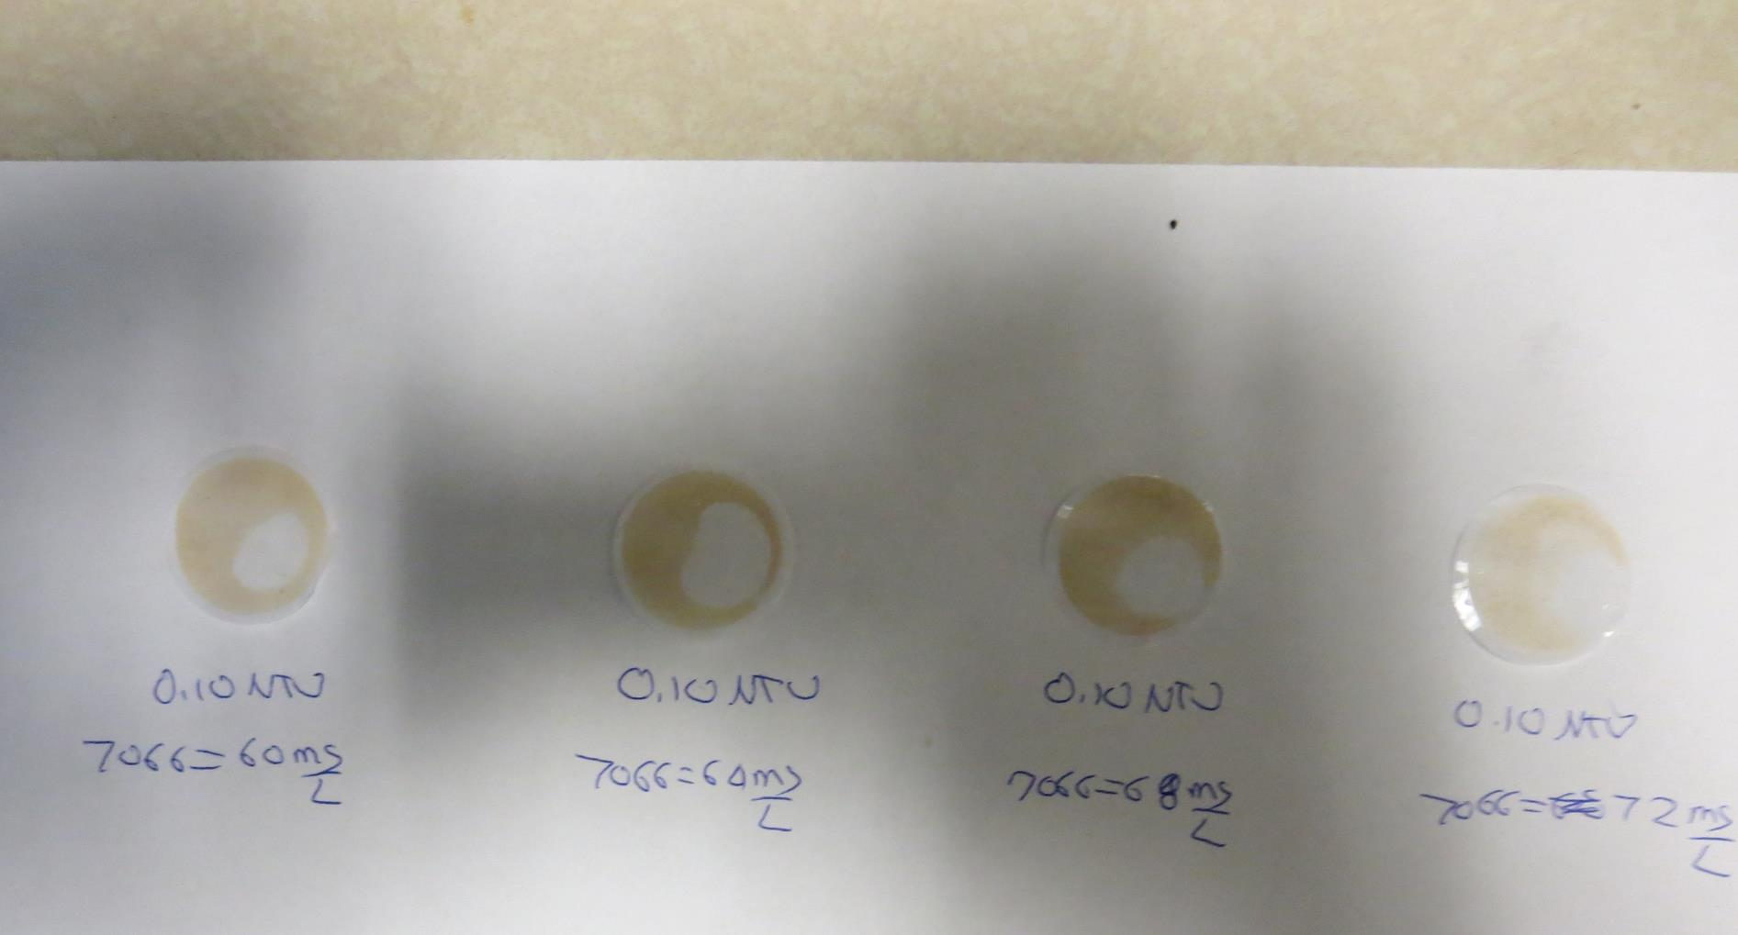
Visual of Filterability of Jars 5-8
60 mg/L 7066
Filtrate 0.10 NTU
UVT: 96.0%
UVA: 0.018/cm
Settled: 0.31 NTU
64 mg/L 7066
Filtrate 0.10 NTU
UVT: 95.7%
UVA: 0.019/cm
Settled: 0.47 NTU
68 mg/L 7066
Filtrate 0.10 NTU
UVT: 96.1%
UVA: 0.017/cm
Settled: 0.45 NTU
72 mg/L 7066
Filtrate 0.10 NTU
UVT: 96.3%
UVA: 0.016/cm
Settled: 0.54 NTU

Slide 20
Jars 9-12 Test Flash Mix 60 Sec (200 RPM) Floc Mix 5 min (30 RPM) Applied Coagulant 7016

Slide 21
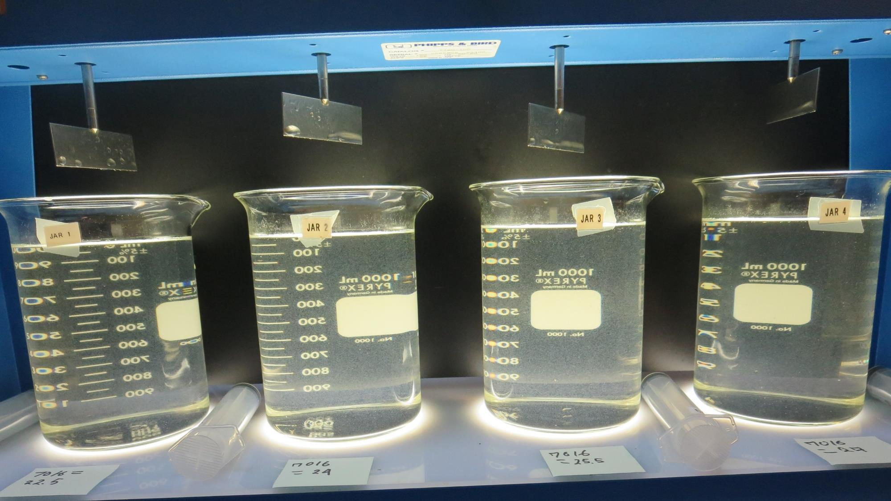
Jars 9-12: End of Floc Duration, 25 mL is syringed for filterability and %UVT/UVA
22.5 mg/L 7016
Filtrate 0.09 NTU
UVT: 96.2%
UVA: 0.017/cm
Settled: 0.81 NTU
24 mg/L 7016
Filtrate 0.13 NTU
UVT: 96.1%
UVA: 0.017/cm
Settled: 0.87 NTU
25.5 mg/L 7016
Filtrate 0.23 NTU
UVT: 95.4%
UVA: 0.020/cm
Settled: 1.0 NTU
27 mg/L 7016
Filtrate 0.06 NTU
UVT: 97.1%
UVA: 0.013/cm
Settled: 1.52 NTU

Slide 22
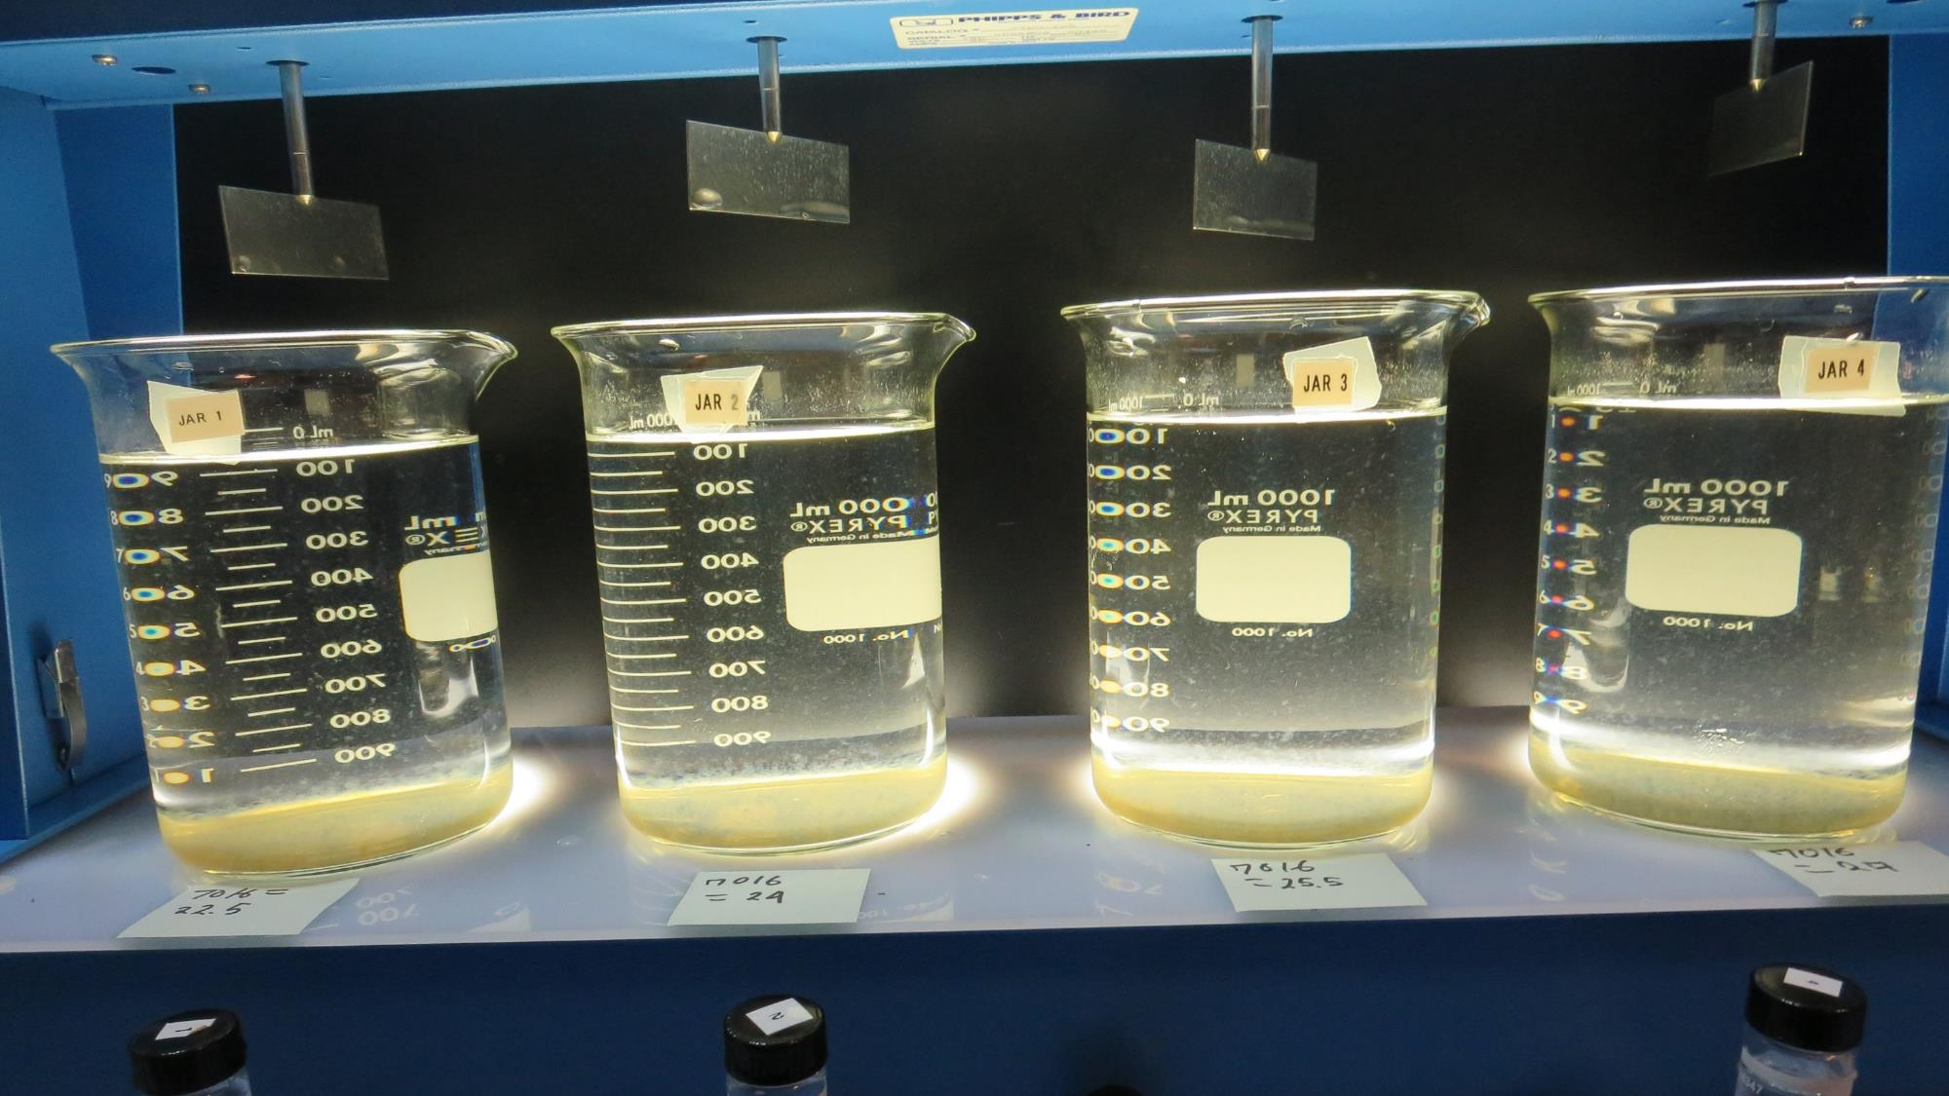
Jars 9-12: After 36-minutes of settling, settled water turbidity is taken.

Slide 23
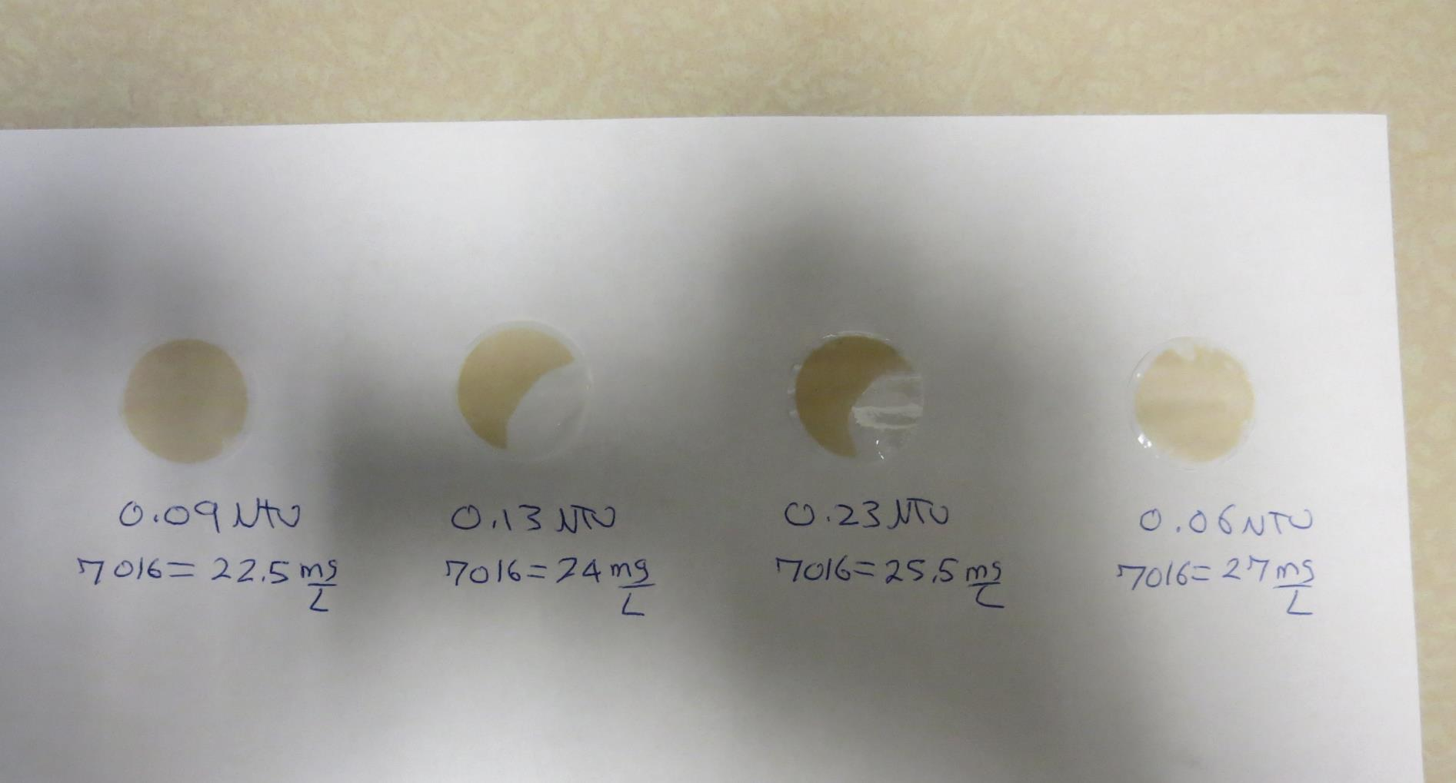
Visual of Filterability of Jars 9-12
22.5 mg/L 7016
Filtrate 0.09 NTU
UVT: 96.2%
UVA: 0.017/cm
Settled: 0.81 NTU
24 mg/L 7016
Filtrate 0.13 NTU
UVT: 96.1%
UVA: 0.017/cm
Settled: 0.87 NTU
25.5 mg/L 7016
Filtrate 0.23 NTU
UVT: 95.4%
UVA: 0.020/cm
Settled: 1.0 NTU
27 mg/L 7016
Filtrate 0.06 NTU
UVT: 97.1%
UVA: 0.013/cm
Settled: 1.52 NTU

Slide 24
Jars 13-16 Test Flash Mix 60 Sec (200 RPM) Floc Mix 5 min (30 RPM) Applied Coagulant 7016

Slide 25
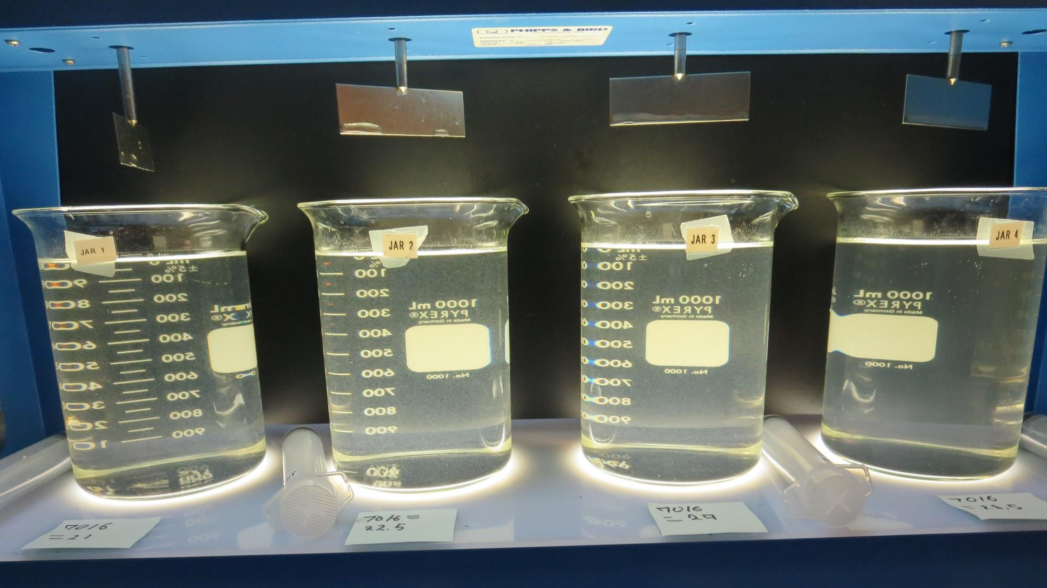
Jars 13-16: End of Floc Duration, 25 mL is syringed for filterability and %UVT/UVA
21 mg/L 7016
Filtrate 0.23 NTU
UVT: 94.4%
UVA: 0.025/cm
Settled: 1.54 NTU
22.5 mg/L 7016
Filtrate 0.24 NTU
UVT: 94.9%
UVA: 0.023/cm
Settled: 1.23 NTU
27 mg/L 7016
Filtrate 0.21 NTU
UVT: 95.7%
UVA: 0.019/cm
Settled: 2.48 NTU
28.5 mg/L 7016
Filtrate 0.23 NTU
UVT: 95.7%
UVA: 0.019/cm
Settled: 3.0 NTU

Slide 26
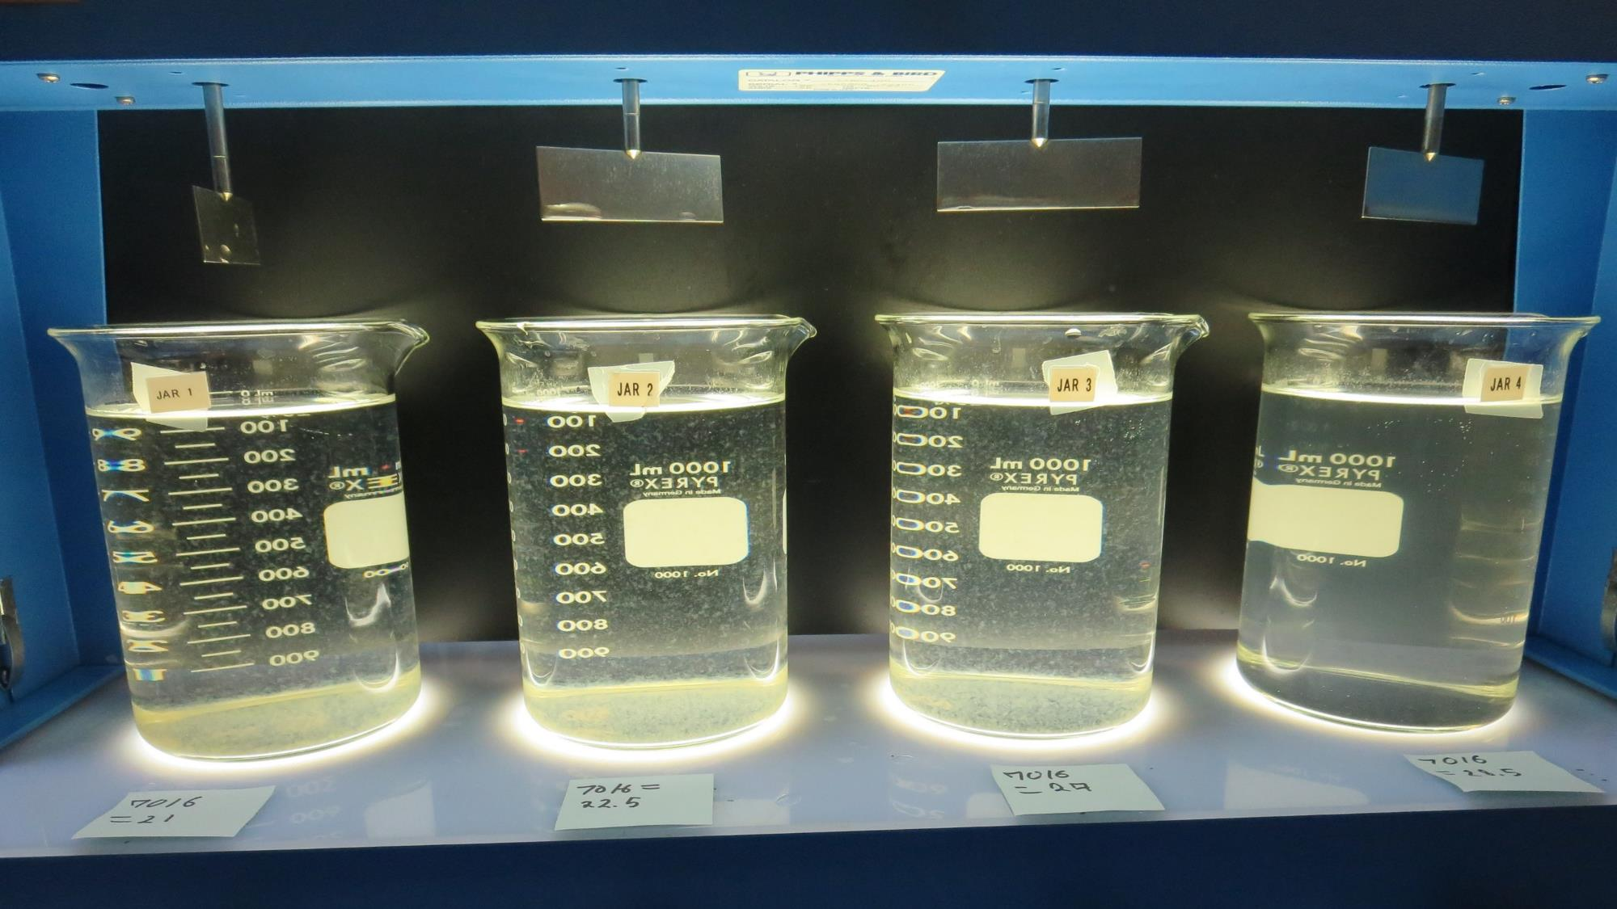
Jars 13-16: After 25-minutes of settling, settled water turbidity is taken.

Slide 27
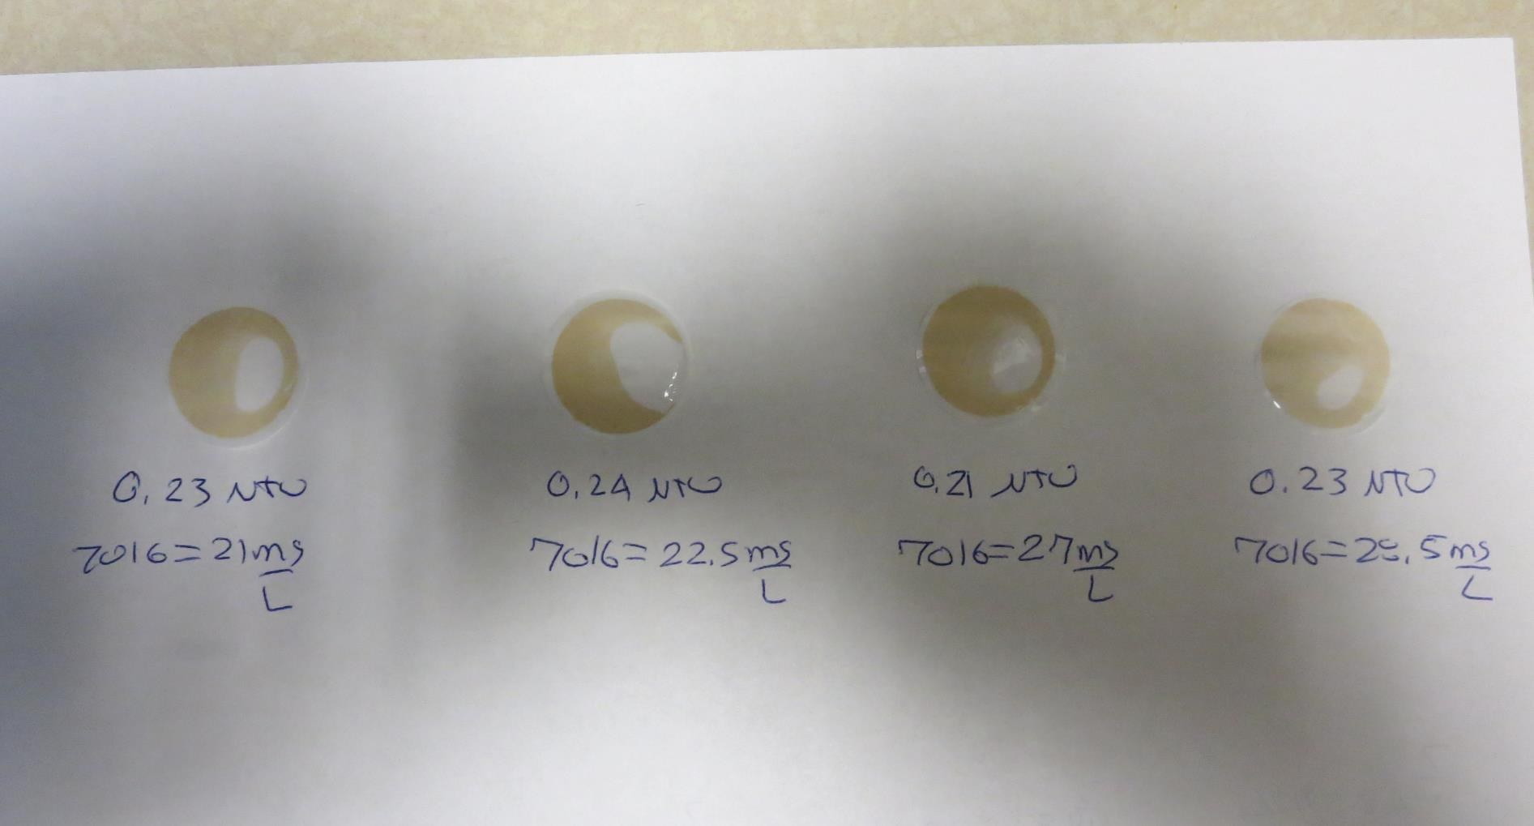
Visual of Filterability of Jars 13-16
21 mg/L 7016
Filtrate 0.23 NTU
UVT: 94.4%
UVA: 0.025/cm
Settled: 1.54 NTU
22.5 mg/L 7016
Filtrate 0.24 NTU
UVT: 94.9%
UVA: 0.023/cm
Settled: 1.23 NTU
27 mg/L 7016
Filtrate 0.21 NTU
UVT: 95.7%
UVA: 0.019/cm
Settled: 2.48 NTU
28.5 mg/L 7016
Filtrate 0.23 NTU
UVT: 95.7%
UVA: 0.019/cm
Settled: 3.0 NTU

Slide 28
Jars 17-20 Test Flash Mix 60 Sec (200 RPM) Floc Mix 5 min (30 RPM) Applied Coagulant AH-710

Slide 29
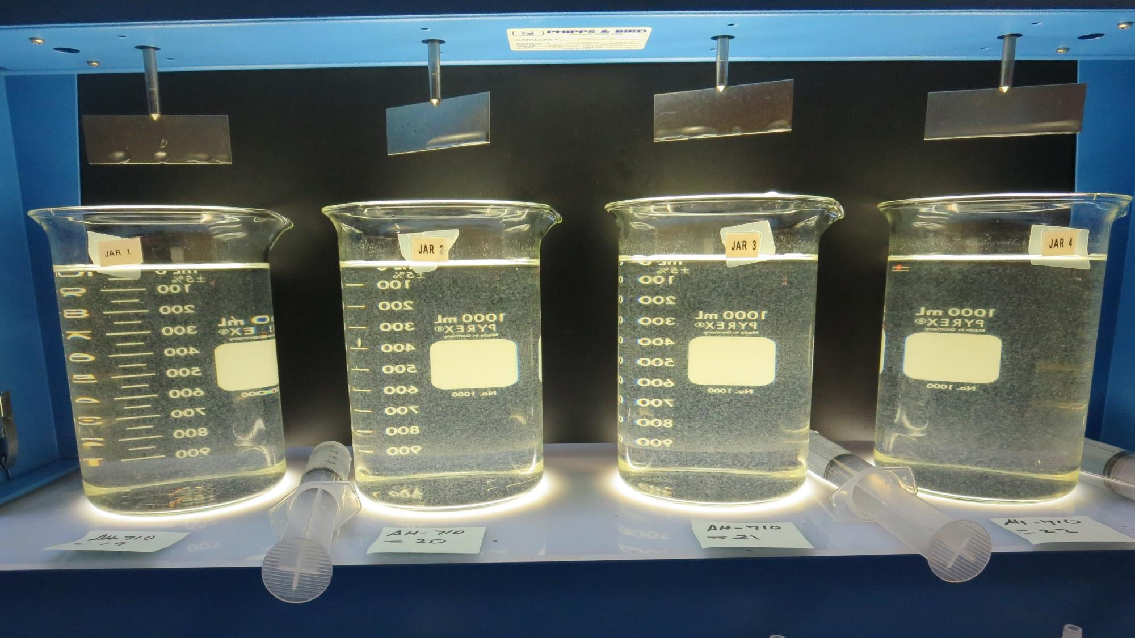
Jars 17-20: End of Floc Duration, 25 mL is syringed for filterability and %UVT/UVA
19 mg/L AH-710
Filtrate 0.33 NTU
UVT: 92.8%
UVA: 0.032/cm
Settled: 1.1 NTU
20 mg/L AH-710
Filtrate 0.10 NTU
UVT: 95.7%
UVA: 0.019/cm
Settled: 1.1 NTU
21 mg/L AH-710
Filtrate 0.22 NTU
UVT: 94.4%
UVA: 0.025/cm
Settled: 1.2 NTU
22 mg/L AH-710
Filtrate 0.10 NTU
UVT: 96.3%
UVA: 0.016/cm
Settled: 1.2 NTU

Slide 30
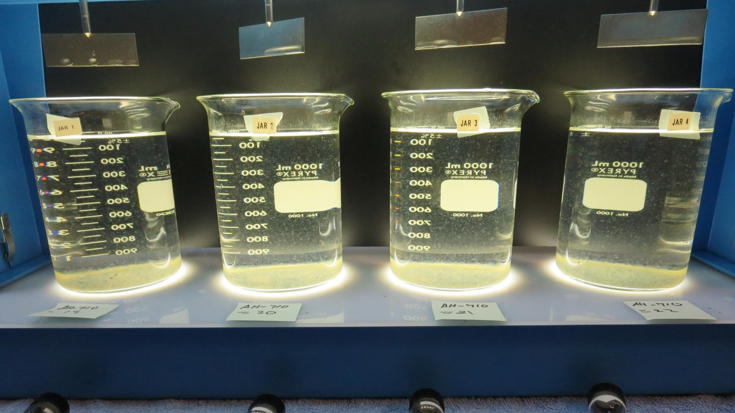
Jars 17-20: After 25-minutes of settling, settled water turbidity is taken.

Slide 31
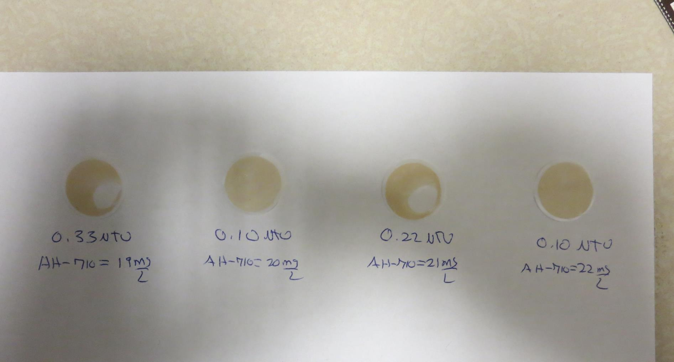
Visual of Filterability of Jars 17-20
19 mg/L AH-710
Filtrate 0.33 NTU
UVT: 92.8%
UVA: 0.032/cm
Settled: 1.1 NTU
22.5 mg/L 7016
Filtrate 0.24 NTU
UVT: 94.9%
UVA: 0.023/cm
Settled: 1.23 NTU
21 mg/L AH-710
Filtrate 0.22 NTU
UVT: 94.4%
UVA: 0.025/cm
Settled: 1.2 NTU
22 mg/L AH-710
Filtrate 0.10 NTU
UVT: 96.3%
UVA: 0.016/cm
Settled: 1.2 NTU

Slide 32
Jars 21-24 Test Flash Mix 60 Sec (200 RPM) Floc Mix 5 min (30 RPM) Applied Coagulant AH-710

Slide 33
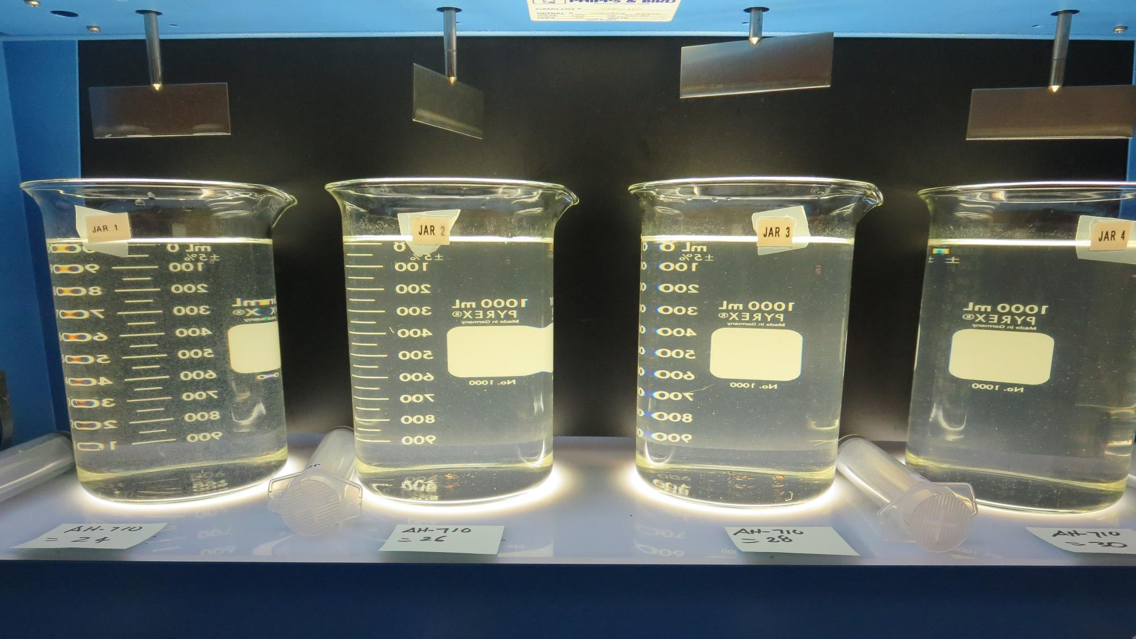
Jars 21-24: End of Floc Duration, 25 mL is syringed for filterability and %UVT/UVA
24 mg/L AH-710
Filtrate 0.08 NTU
UVT: 96.9%
UVA: 0.014/cm
Settled: 1.5 NTU
26 mg/L AH-710
Filtrate 0.23 NTU
UVT: 95.2%
UVA: 0.021/cm
Settled: 3.2 NTU
28 mg/L AH-710
Filtrate 0.43 NTU
UVT: 92.7%
UVA: 0.033/cm
Settled: 3.1 NTU
30 mg/L AH-710
Filtrate 0.46 NTU
UVT: 91.5%
UVA: 0.039/cm
Settled: 2.9 NTU

Slide 34
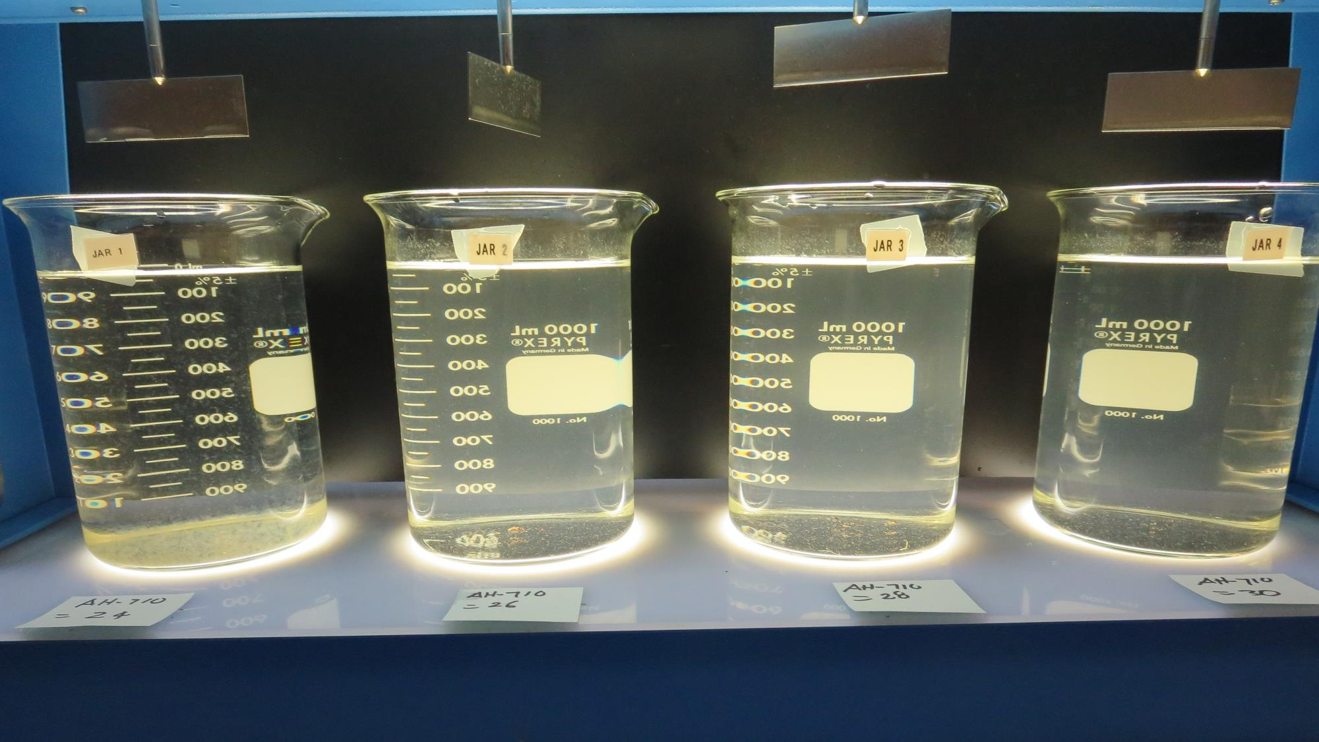
Jars 21-24: After 25-minutes of settling, settled water turbidity is taken.

Slide 35
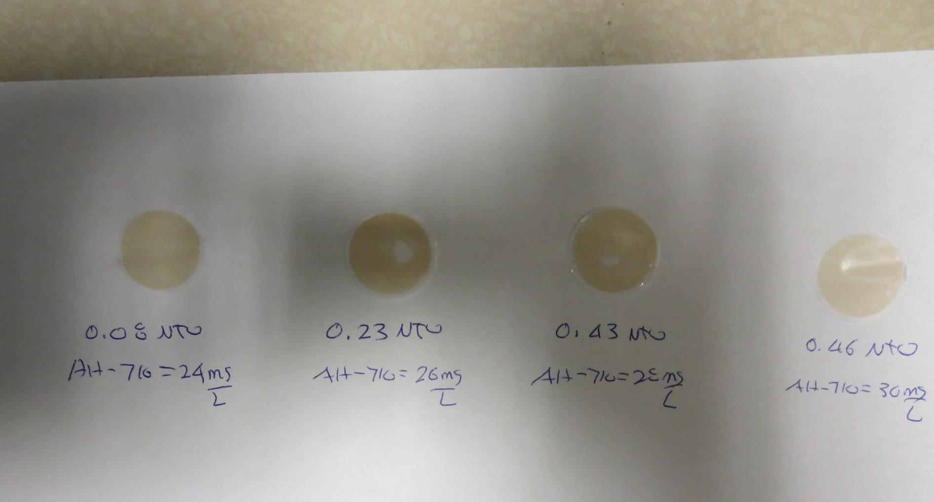
Visual of Filterability of Jars 21-24
24 mg/L AH-710
Filtrate 0.08 NTU
UVT: 96.9%
UVA: 0.014/cm
Settled: 1.5 NTU
26 mg/L AH-710
Filtrate 0.23 NTU
UVT: 95.2%
UVA: 0.021/cm
Settled: 3.2 NTU
28 mg/L AH-710
Filtrate 0.43 NTU
UVT: 92.7%
UVA: 0.033/cm
Settled: 3.1 NTU
30 mg/L AH-710
Filtrate 0.46 NTU
UVT: 91.5%
UVA: 0.039/cm
Settled: 2.9 NTU

Slide 36
Jars 25-28 Test Flash Mix 60 Sec (200 RPM) Floc Mix 5 min (30 RPM) Applied Coagulant 7035

Slide 37
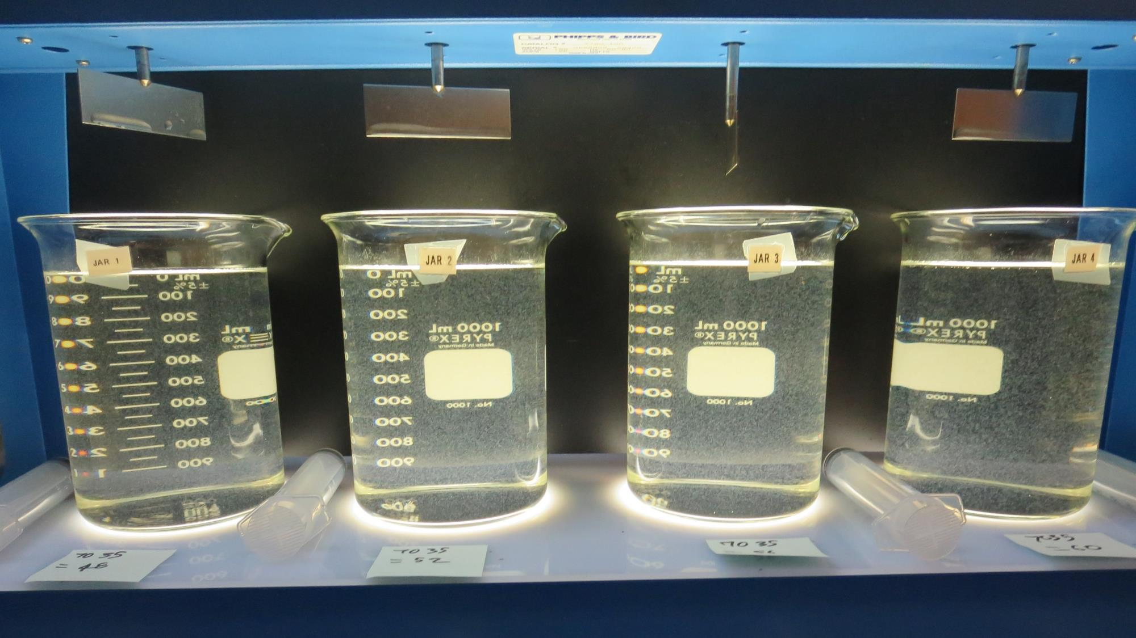
Jars 25-28: End of Floc Duration, 25 mL is syringed for filterability and %UVT/UVA
48 mg/L 7035
Filtrate 0.12 NTU
UVT: 95.2%
UVA: 0.021/cm
Settled: 0.76 NTU
52 mg/L 7035
Filtrate 0.18 NTU
UVT: 94.4%
UVA: 0.025/cm
Settled: 0.76 NTU
56 mg/L 7035
Filtrate 0.18 NTU
UVT: 94.6%
UVA: 0.024/cm
Settled: 0.75 NTU
60 mg/L 7035
Filtrate 0.09 NTU
UVT: 96.3%
UVA: 0.016/cm
Settled: 0.61 NTU

Slide 38
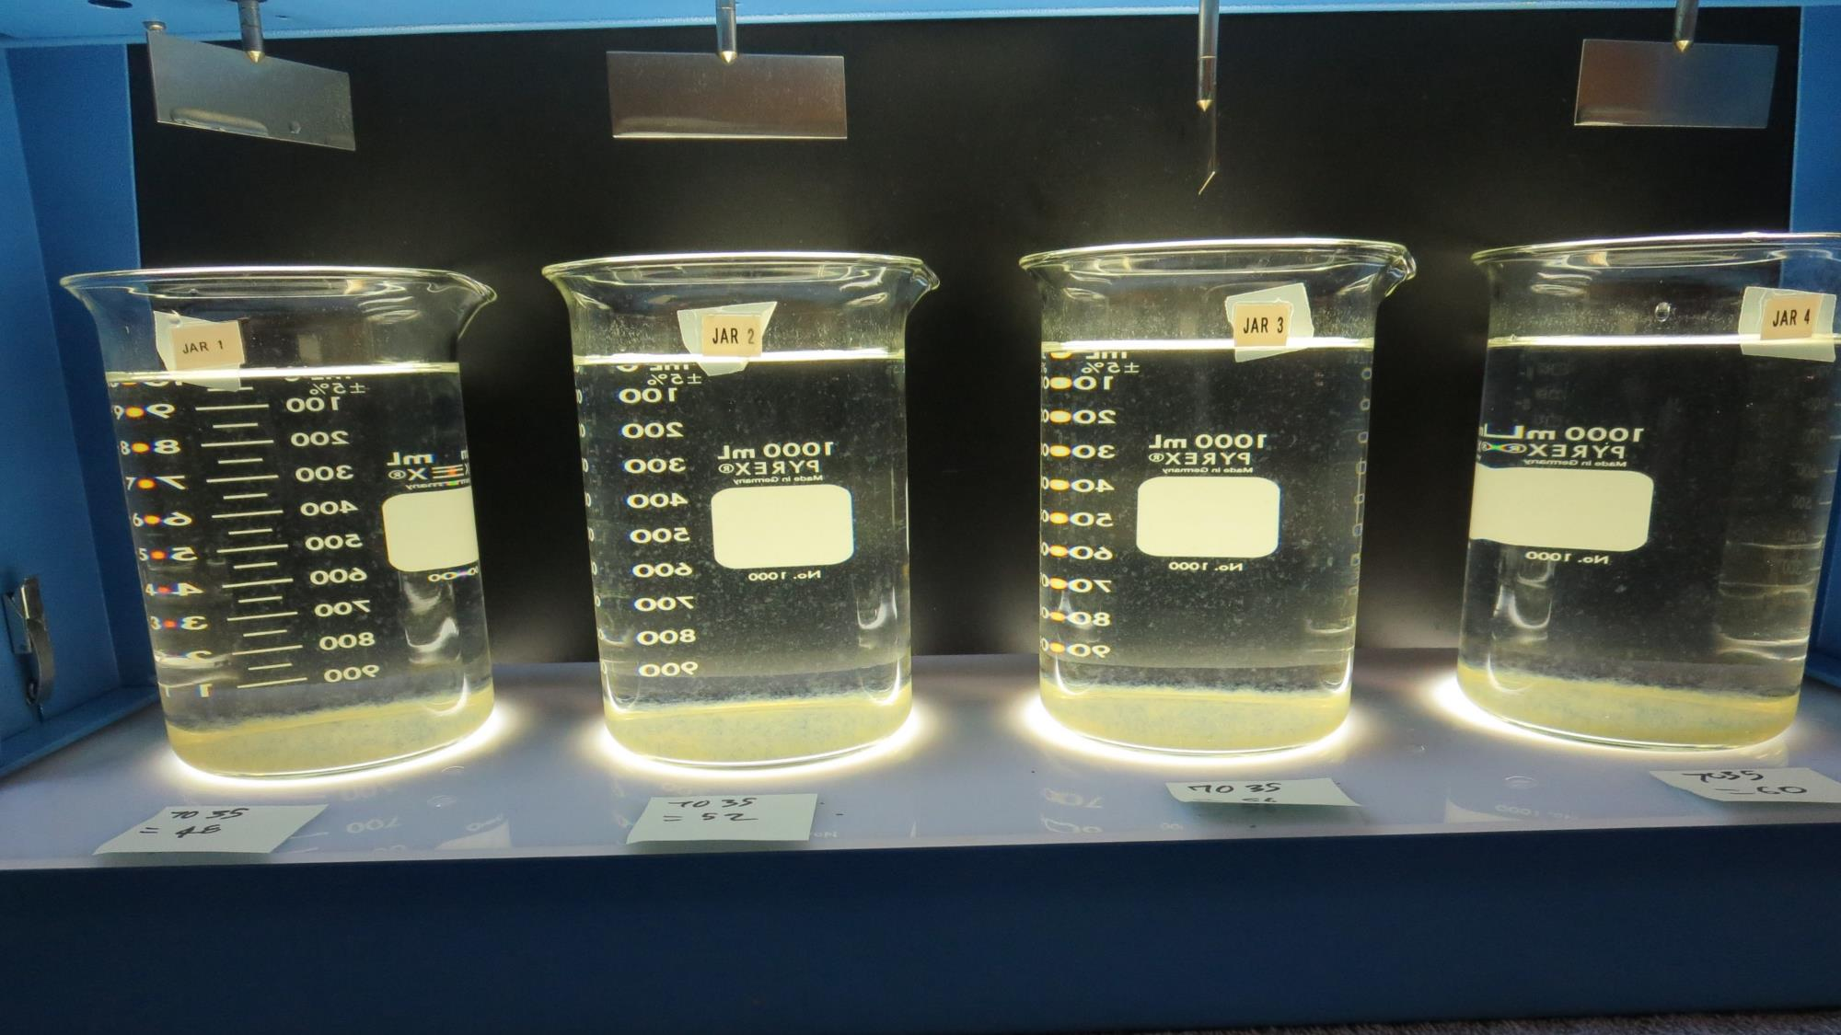
Jars 25-28: After 25-minutes of settling, settled water turbidity is taken.

Slide 39
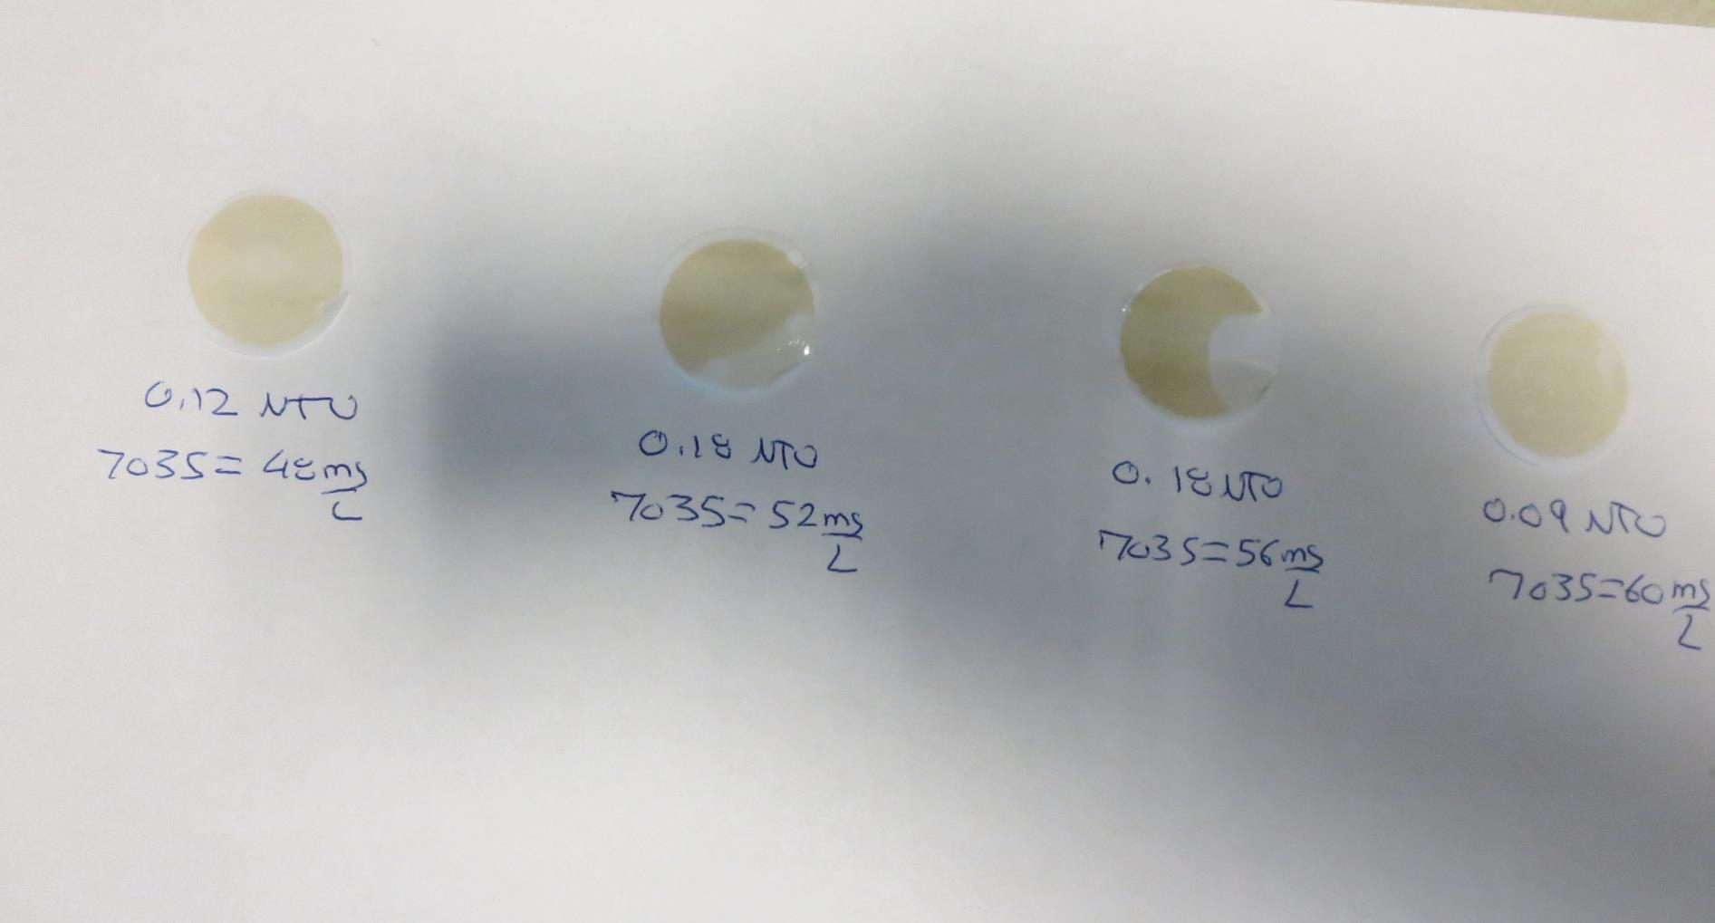
Visual of Filterability of Jars 25-28
48 mg/L 7035
Filtrate 0.12 NTU
UVT: 95.2%
UVA: 0.021/cm
Settled: 0.76 NTU
52 mg/L 7035
Filtrate 0.18 NTU
UVT: 94.4%
UVA: 0.025/cm
Settled: 0.76 NTU
56 mg/L 7035
Filtrate 0.18 NTU
UVT: 94.6%
UVA: 0.024/cm
Settled: 0.75 NTU
60 mg/L 7035
Filtrate 0.09 NTU
UVT: 96.3%
UVA: 0.016/cm
Settled: 0.61 NTU

Slide 40
Jars 29-32 Test Flash Mix 60 Sec (200 RPM) Floc Mix 5 min (30 RPM) Applied Coagulant 7035

Slide 41
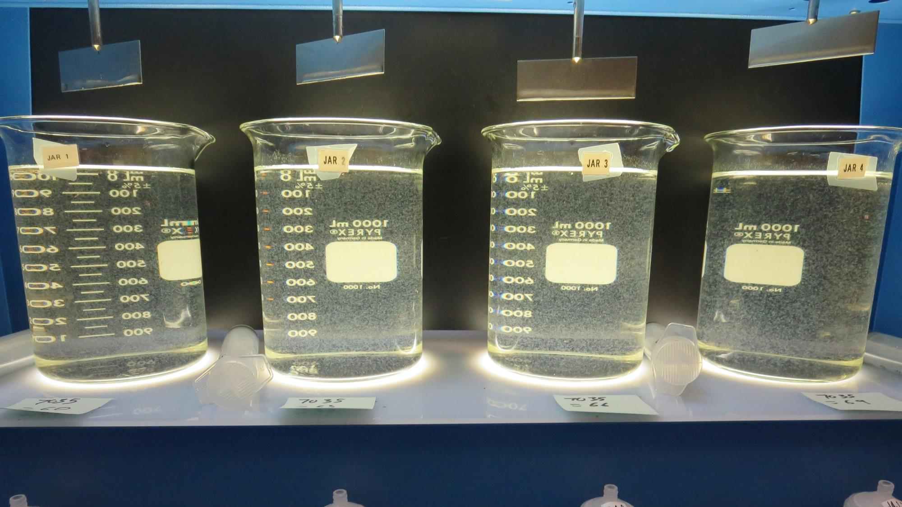
Jars 29-32: End of Floc Duration, 25 mL is syringed for filterability and %UVT/UVA
60 mg/L 7035
Filtrate 0.15 NTU
UVT: 95.6%
UVA: 0.020/cm
Settled: 0.56 NTU
63 mg/L 7035
Filtrate 0.15 NTU
UVT: 95.8%
UVA: 0.019/cm
Settled: 0.59 NTU
66 mg/L 7035
Filtrate 0.07 NTU
UVT: 97.1%
UVA: 0.013/cm
Settled: 0.61 NTU
69 mg/L 7035
Filtrate 0.06 NTU
UVT: 97.2%
UVA: 0.012/cm
Settled: 0.77 NTU

Slide 42
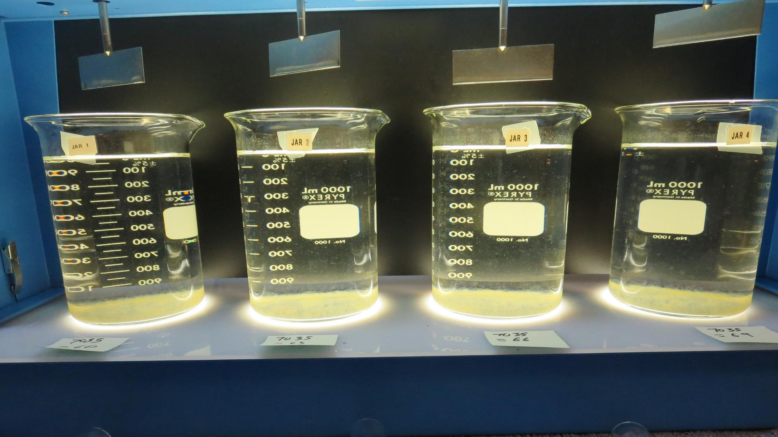
Jars 29-32: After 25-minutes of settling, settled water turbidity is taken.

Slide 43
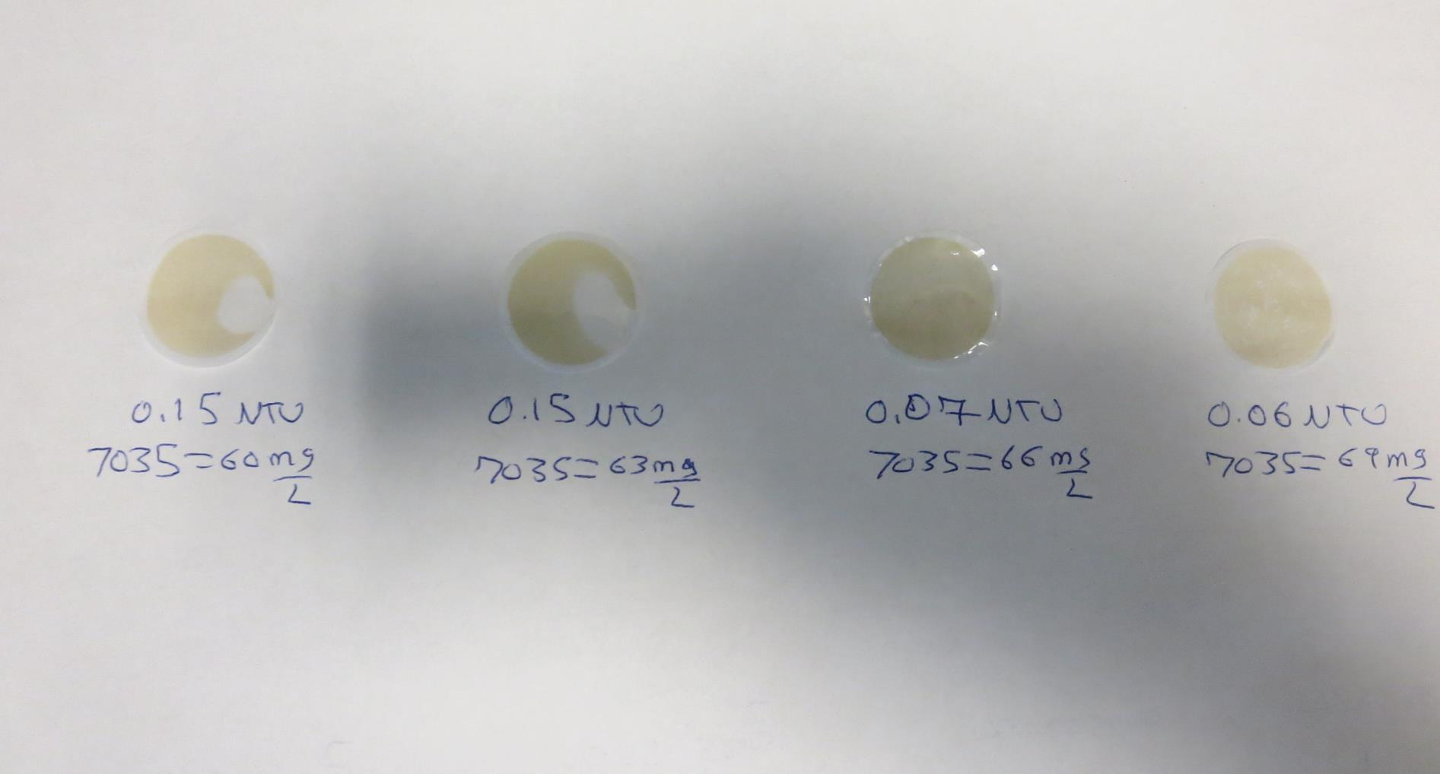
Visual of Filterability of Jars 29-32
60 mg/L 7035
Filtrate 0.15 NTU
UVT: 95.6%
UVA: 0.020/cm
Settled: 0.56 NTU
63 mg/L 7035
Filtrate 0.15 NTU
UVT: 95.8%
UVA: 0.019/cm
Settled: 0.59 NTU
66 mg/L 7035
Filtrate 0.07 NTU
UVT: 97.1%
UVA: 0.013/cm
Settled: 0.61 NTU
69 mg/L 7035
Filtrate 0.06 NTU
UVT: 97.2%
UVA: 0.012/cm
Settled: 0.77 NTU

Slide 44
Jars 33-36 Test Flash Mix 60 Sec (200 RPM) Floc Mix 5 min (30 RPM) Applied Coagulant 7035

Slide 45
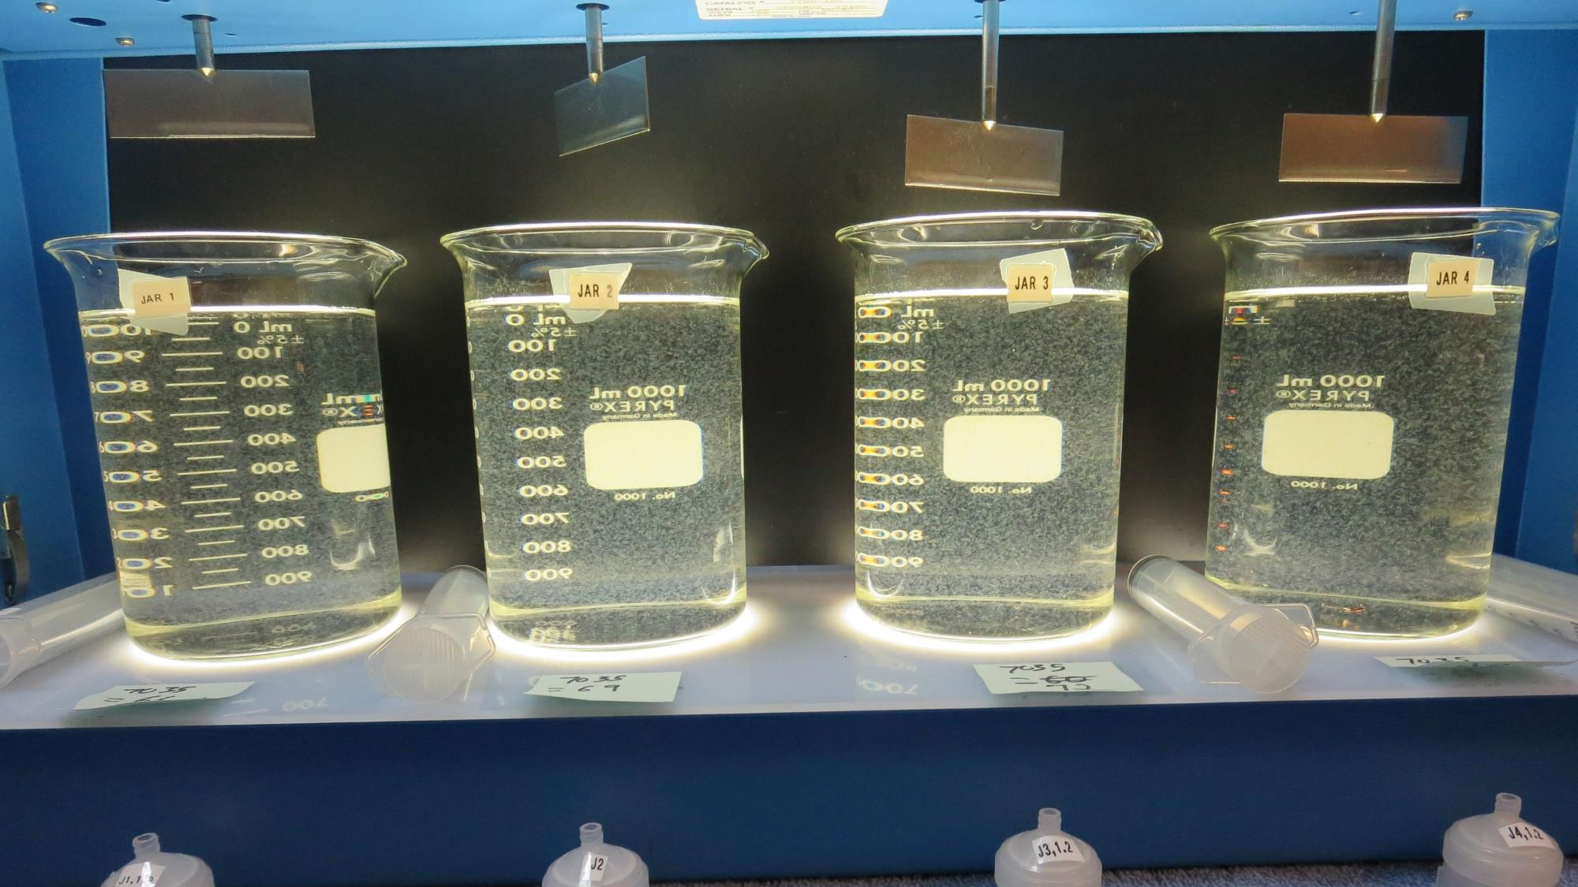
Jars 33-36: End of Floc Duration, 25 mL is syringed for filterability and %UVT/UVA
66 mg/L 7035
Filtrate 0.10 NTU
UVT: 96.7%
UVA: 0.015/cm
Settled: 0.51 NTU
69 mg/L 7035
Filtrate 0.07 NTU
UVT: 97.1%
UVA: 0.013/cm
Settled: 0.59 NTU
72 mg/L 7035
Filtrate 0.10 NTU
UVT: 96.7%
UVA: 0.015/cm
Settled: 0.96 NTU
75 mg/L 7035
Filtrate 0.07 NTU
UVT: 97.1%
UVA: 0.013/cm
Settled: 0.93 NTU

Slide 46
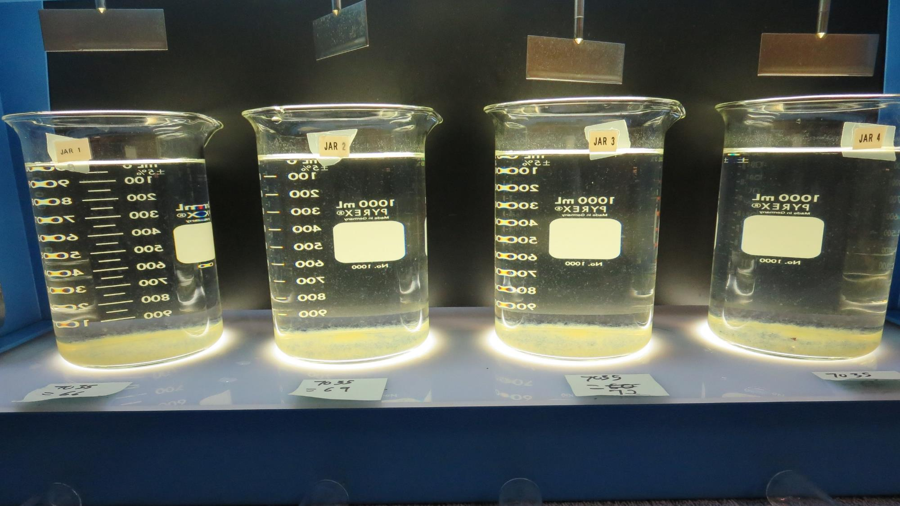
Jars 33-36: After 25-minutes of settling, settled water turbidity is taken.

Slide 47
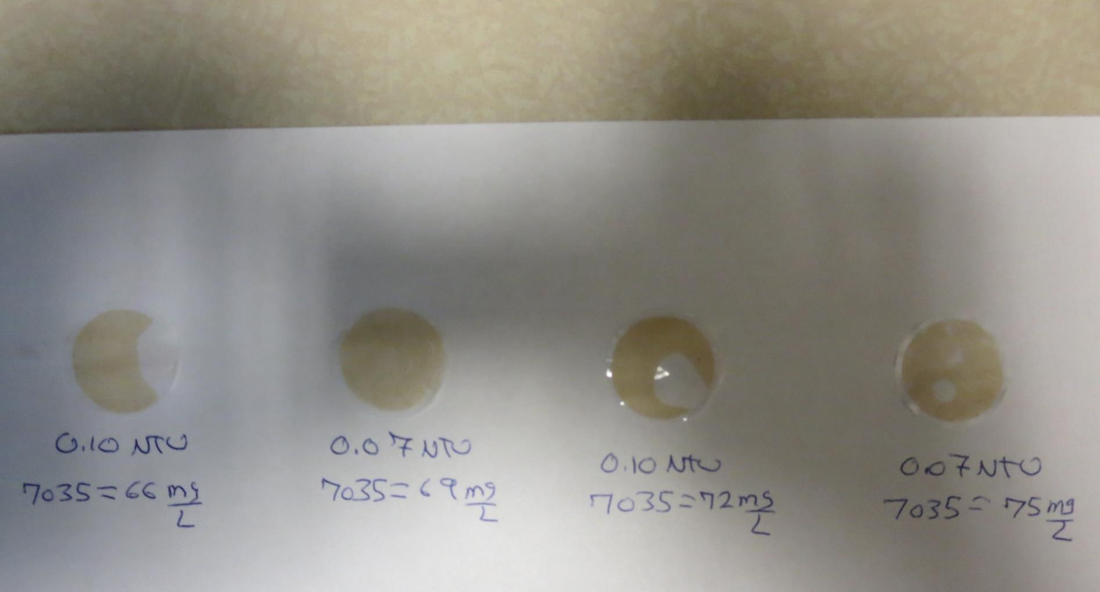
Visual of Filterability of Jars 33-36
66 mg/L 7035
Filtrate 0.10 NTU
UVT: 96.7%
UVA: 0.015/cm
Settled: 0.51 NTU
69 mg/L 7035
Filtrate 0.07 NTU
UVT: 97.1%
UVA: 0.013/cm
Settled: 0.59 NTU
72 mg/L 7035
Filtrate 0.10 NTU
UVT: 96.7%
UVA: 0.015/cm
Settled: 0.96 NTU
75 mg/L 7035
Filtrate 0.07 NTU
UVT: 97.1%
UVA: 0.013/cm
Settled: 0.93 NTU

Slide 48
Jars 37-40 Test Flash Mix 60 Sec (200 RPM) Floc Mix 5 min (30 RPM) Applied Coagulant 7066

Slide 49
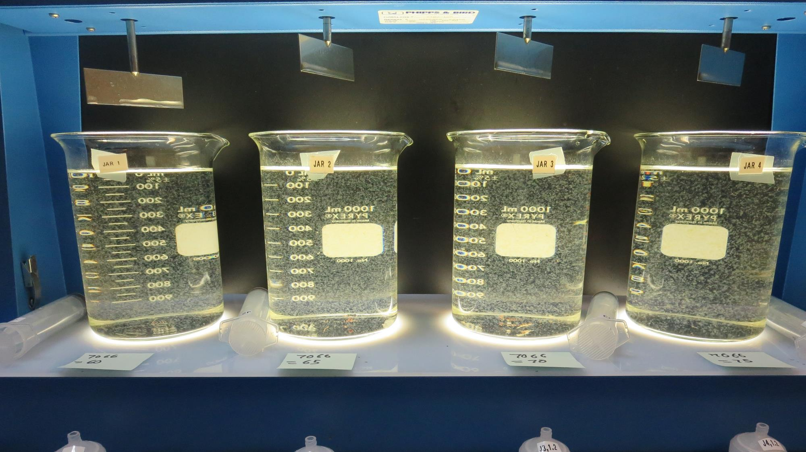
Jars 37-40: End of Floc Duration, 25 mL is syringed for filterability and %UVT/UVA
60 mg/L 7066
Filtrate 0.10 NTU
UVT: 96.3%
UVA: 0.016/cm
Settled: 0.43 NTU
65 mg/L 7066
Filtrate 0.10 NTU
UVT: 96.2%
UVA: 0.017/cm
Settled: 0.46 NTU
70 mg/L 7066
Filtrate 0.10 NTU
UVT: 96.7%
UVA: 0.015/cm
Settled: 0.48 NTU
75 mg/L 7066
Filtrate 0.08 NTU
UVT: 97.0%
UVA: 0.013/cm
Settled: 0.61 NTU

Slide 50
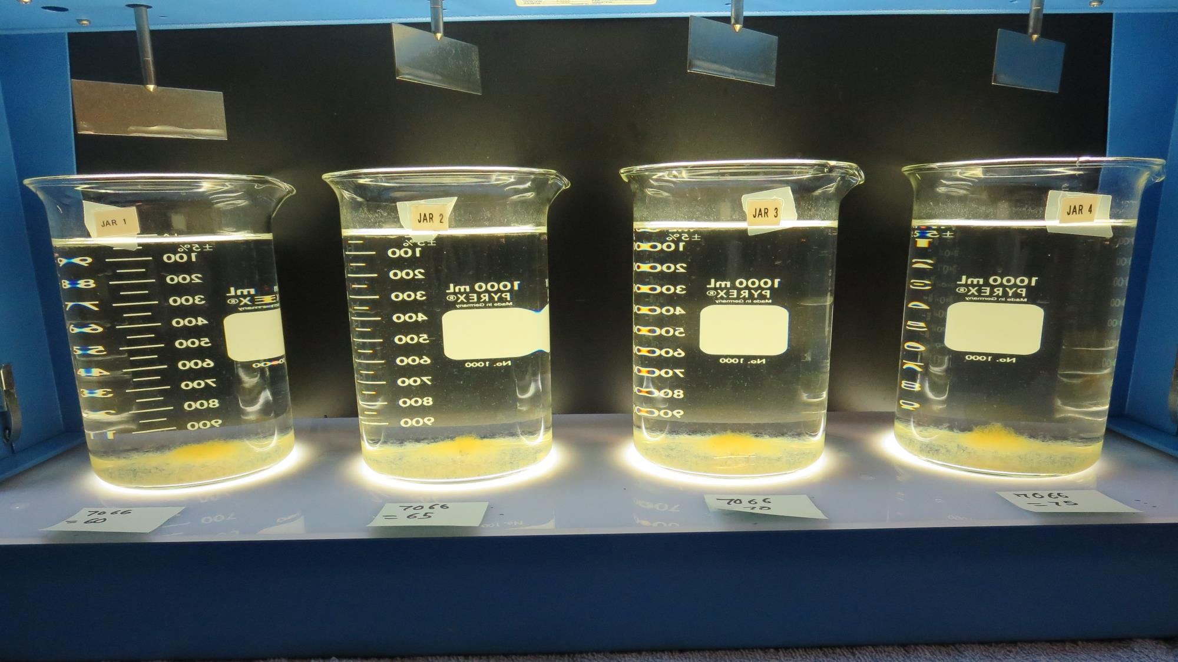
Jars 37-40: After 25-minutes of settling, settled water turbidity is taken.

Slide 51
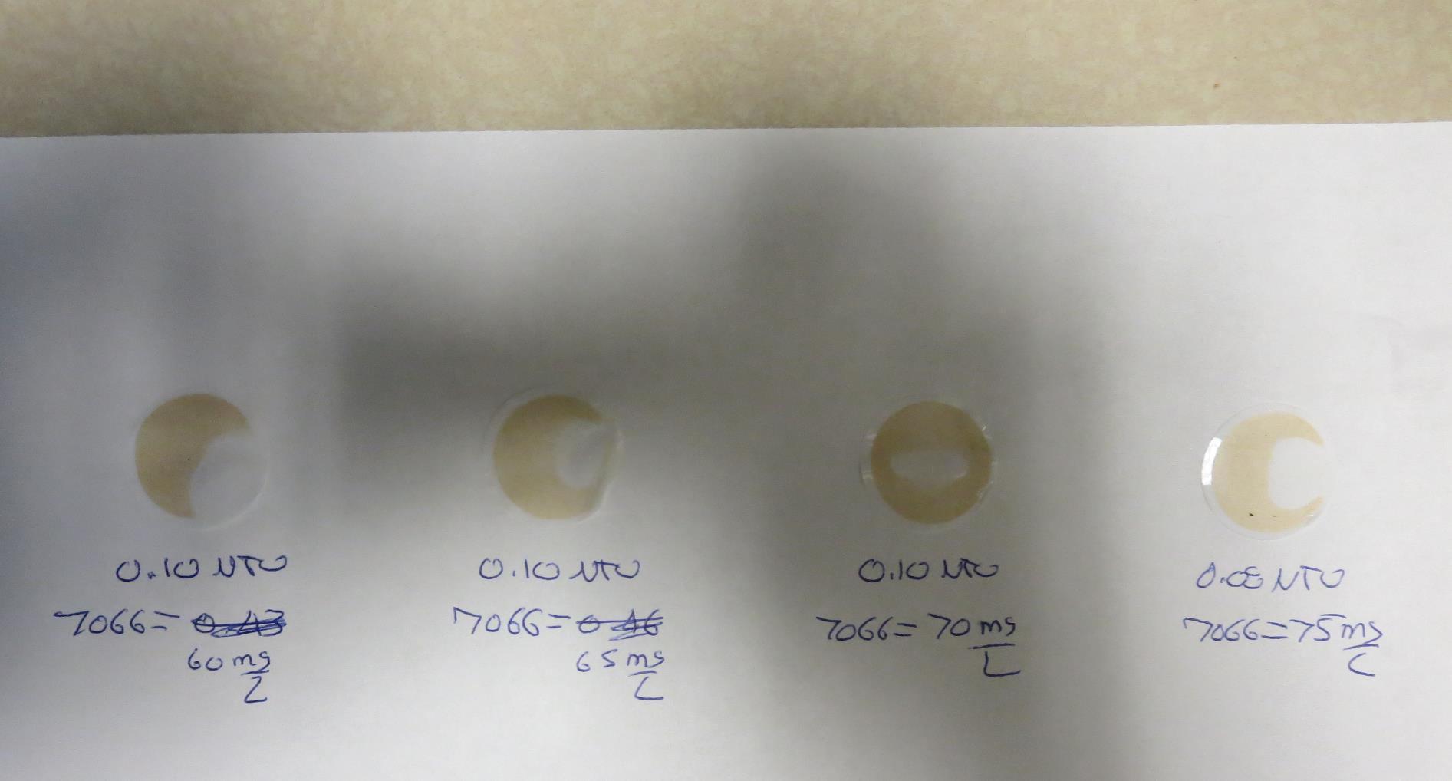
Visual of Filterability of Jars 36-40

Slide 52
Jar Testing for 1-Liter Jars: Procedures for Most Treatment Plants
Fill jars with source water prior to coagulant injection and set paddle speed at 30 rpm
Add chemicals (i.e., NaOCl, primary coagulant, coagulant aid) to each jar
Flash mix for 15-60 seconds (200 rpm)
Slow mix for 5 minutes (20-30 rpm)
Settled for 5 minutes. Syringe 25 mL from each jar taken 1-inch below surface (25 mL/12 sec rate). For this study, 25 mL was syringed at end of floc period.
Filtered through 1.2 um isopore membrane into cuvette drip rate, 15 mL/(50-90 sec)
Measure filtrate turbidity, chlorine residual and %UVT/UVA
Measure settled water turbidity after 25 minutes of total setting
Record all data

Slide 53
Jar Test Filterability Test Equipment
Turbidity Instrument
Syringe w/Luer-Lock Tip, 30 cc
(part#: 2225800, by Hach)
Swinnex Filter Holder, 25 mm (part#: SX0002500)
Isopore Membrane Filter, 1.2 um absolute
pore size,
Φ= 25 mm , thickness: 24 um,
hydrophilic polycarbonate membrane
(part #: RTTP02500)
Go to Sigma-Aldrich for laboratory supplies http://www.sigmaaldrich.com/united-states.html

Slide 54
Isopore Membrane Information
Categories | Information
trade name | Isopore
filter color | White
chemistry | Polycarbonate (PC)
water flow rate | Avg. 175 mL/min x cm² (typical results @ 10 psi)
media | Isopore®
wettability | Hydrophilic
porosity | 14.7%
pore size | 1.2 µm
bubble point at 23 °C | 1.0 bar, air with water
thickness | 24 µm
filter diameter (ø) | 25 mm
material size | polycarbonate, Hydrophilic, 1.2 µm, 25 mm, white, plain, 100

Slide 55
Isopore Membrane Background Information
The Isopore membrane is a polycarbonate, track-etched screen filter recommended for all analyses in which the sample is viewed on the surface of the membrane. The Isopore membrane is composed of polycarbonate film, which has a smooth, glass-like surface for clearer sample observation. The unique manufacturing process of the membrane ensures a precise pore diameter and a consistent pore size for accurate separation of samples by size. Matched-weight filters are not usually required because of low, constant tar and ash weights. Features & Benefits: Membrane structure retains particles on the surface, simplifying counting and analysis

Slide 56
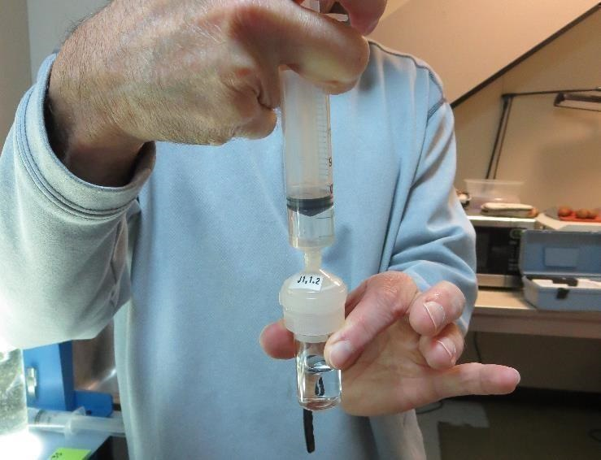
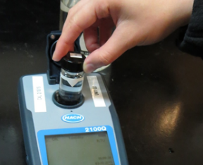
Jar Test - Filterability Test
Syringe ~ 25 mL from jar (after 5-minutes of settling)
Filter-to-waste 3-5 mL
Filter directly into clean cuvette
Measure turbidity
Note: Take several readings before recording final NTU results. Micro bubbles can adhere to glass causing false NTU readings. To remove bubbles, tilt cuvette up to 90 degrees.

Slide 57
Contact
Guy Schott, P.E.
State Water Resources Control Board
Division of Drinking Water
Santa Rosa, CA
Go to Stock Solution/Dose calculations/Jar Test Results for tools to download
www.waterboards.ca.gov/drinking_water/programs/districts/mendocino_district.html
Email: Guy Schott - Guy.Schott@waterboards.ca.gov
Office Number: 707-576-2732

