Slide 1
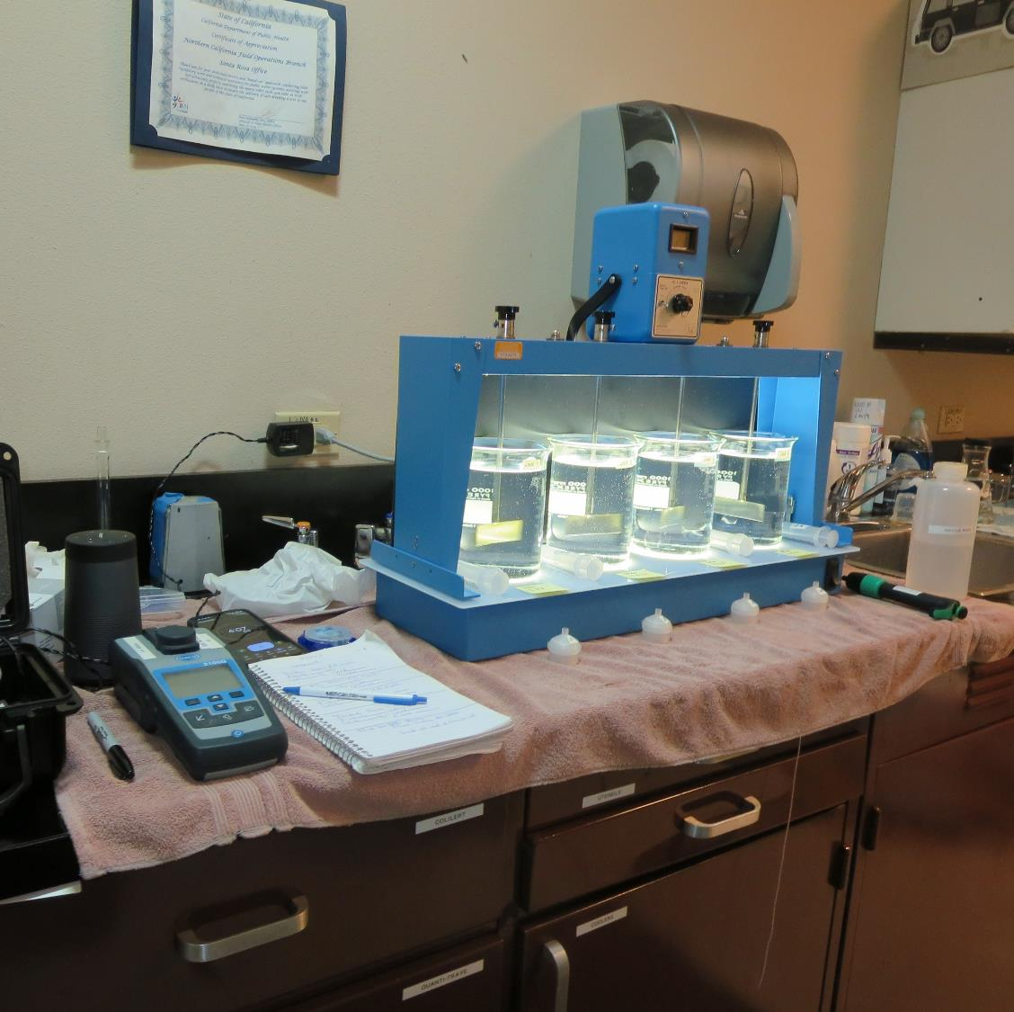
Westport County Water District CA2300730 Mendocino County Jar Test
by Guy Schott, P.E
August 21, 2023

Slide 2
Source Water: Wage Creek - Direct Filtration August 21, 2023
Source – Wage Creek
pH: 7.10
Alkalinity: 77 mg/L as CaCO₃
Turbidity: 1.0 NTU
UVT: 93.0%,
UVA: 0.031/cm
0.4 um Filtered
Turbidity: 0.29 NTU
UVT: 94.6%,
UVA: 0.023/cm

Slide 3
Westport CWS Source Particle Counts August 21, 2023
Particle Size Range (um) | Number of Particles per mL
2-3 | 1,017
3-5 | 580
5-7 | 206
7-10 | 44
10-15 | 13
15-25 | 6
25-50 | 2
>50 | 0
Total: | 1,864

Slide 4
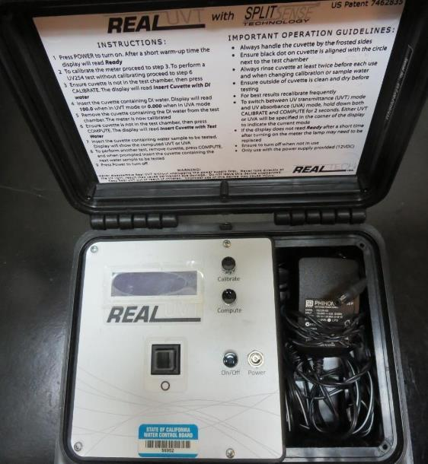
UVT/UVA, pathlength 10 mm
UV transmittance (UVT) is a measurement of the amount of ultraviolet light (commonly at 254 nm due to its germicidal effect) that passes through a water sample compared to the amount of light that passes through a pure water sample. The measurement is expressed as a percentage, % UVT.
%UVT = 10^{(-UVA)} x 100%
UV absorbance (UVA) is calculated as a relative measure of the amount of light absorbed by a water sample compared with the amount of light absorbed by a pure water sample.
UVA = -log(%UVT/100)

Slide 5
Applied Coagulants for Jar Testing (1)
960 (NTU Technologies)
33% Polyaluminum Hydroxychlorosulfate
67% Water
SG = 1.29
NSF limit: 250 mg/L as Product
961 (NTU Technologies)
~32% Polyaluminum Hydroxychlorosulfate
66% Water
2% pDADMAC
Active pDADMAC: 0.02 x 255 = 5.1 mg/L
SG = 1.29
NSF limit: 255 mg/L as Product

Slide 6
Applied Coagulants for Jar Testing (2)
NTU Technologies
Pro Pac 9810
45-50% Aluminum Chlorohydrate
45-50% Water
~22.4% Al₂O₃
~11.9% Al
83% Basicity
5% polyamine (50% water, 50% active polyamines)
Active polyamine: 0.05 x 0.5 x 200 = 5 mg/L
SG = 1.25-1.34
NSF limit: 200 mg/L as Product;
Product dose 20 mg/L = 0.5 mg/L polyamines active
Pro Pac 9800 (NTU Technologies)
50% Aluminum Chlorohydrate
50% Water
23.62% Al₂O₃
12.5% Al
83% Basicity
SG = 1.25-1.34
NSF limit: 250 mg/L as Product
926 (NTU Technologies)
35% Aluminum Chlorohydrate
35% Water
30% pDADMAC (60% H₂O, 40% pDADMAC active)
Active pDADMAC: 0.3 x 0.4 x 83 = 10 mg/L
SG = 1.2 – 1.34
NSF limit: 83 mg/L as Product

Slide 7
Coagulant Information
Unless stated otherwise, all coagulant doses are reported as Product (100% strength).
Preparation of coagulant stock solutions are generally 2.0, 1.0 or 0.1 percent strength using 100 and/or 200 mL volumetric flasks.
Finnpipette F2 variable volume pipette, capacity 100-1000 micro liters is used for stock solution preparation and coagulant aid jar test dosing.
Finnpipette F2 variable volume pipette, capacity 0.5-5 mL is used for primary coagulant jar test dosing.

Slide 8
Filtrate and %UVT/UVA Analysis
For this study, all jars were samples for Filtrate and %UVT/UVA analysis immediately at the end of the flocculation period.

Slide 9
Westport CWS; Jar Test 1 - 8 Results Flash Mix 200 RPM (20 sec); Floc Mix 20 RPM (5 min)
Jar# | 9800 mg/L | Filtrate NTU | Filtrate %UVT | Filtrate UVA/cm | %UVA Reduction
J1 | 2.5 | 0.20 | 97.1 | 0.012 | 47.8
J2 | 3.0 | 0.31 | 96.6 | 0.014 | 39.1
J3 | 3.5 | 0.15 | 97.4 | 0.011 | 52.2
J4 | 4.0 | 0.05 | 98.0 | 0.008 | 65.2
J5 | 4.0 | 0.06 | 98.3 | 0.007 | 69.6
J6 | 4.5 | 0.07 | 98.3 | 0.007 | 69.6
J7 | 5.0 | 0.07 | 98.4 | 0.007 | 69.6
J8 | 5.5 | 0.17 | 98.0 | 0.008 | 65.2

Slide 10
Westport CWS; Jar Test 9 - 16 Results Flash Mix 200 RPM (20 sec); Floc Mix 20 RPM (5 min)
Jar# | NaOCl mg/L | 960 mg/L | Filtrate NTU | Filtrate %UVT | Filtrate UVA/cm | %UVA Reduction | Cl₂ mg/L
J9 | 0 | 12 | 0.04 | 98.1 | 0.008 | 65.2 | -
J10 | 0 | 16 | 0.10 | 98.0 | 0.008 | 65.2 | -
J11 | 0 | 20 | 0.04 | 98.6 | 0.006 | 73.9 | -
J12 | 0 | 24 | 0.03 | 98.6 | 0.006 | 73.9 | -
J13 | 0 | 20 | 0.04 | 98.6 | 0.006 | 73.9 | -
J14 | 3.0 | 20 | 0.12 | 97.7 | 0.010 | 56.5 | 2.12
J15 | 4.0 | 20 | 0.09 | 97.7 | 0.010 | 56.5 | >2.2
J16 | 5.0 | 20 | 0.03 | 97.8 | 0.009 | 60.9 | >2.2

Slide 11
Westport CWS; Jar Test 17 - 24 Results Flash Mix 200 RPM (20 sec); Floc Mix 20 RPM (5 min)
Jar# | NaOCl mg/L | 961 mg/L | 9810 mg/L | Filtrate NTU | Filtrate %UVT | Filtrate UVA/cm | %UVA Reduction | Cl₂ mg/L
J17 | 0 | 16 | - | 0.03 | 98.2 | 0.007 | 69.6 | -
J18 | 2.5 | 16 | - | 0.04 | 97.9 | 0.009 | 60.9 | 1.95
J19 | 0 | 20 | - | 0.05 | 98.1 | 0.008 | 65.2 | -
J20 | 2.5 | 20 | - | 0.06 | 97.6 | 0.010 | 56.5 | 1.73
J21 | 0 | - | 3.6 | 0.21 | 97.3 | 0.011 | 52.2 | -
J22 | 2.5 | - | 3.6 | 0.03 | 98.0 | 0.008 | 65.2 | 1.96
J23 | 0 | - | 4.0 | 0.03 | 98.3 | 0.007 | 69.6 | -
J24 | 2.5 | - | 4.0 | 0.04 | 98.0 | 0.008 | 65.2 | 1.95

Slide 12
Westport CWS; Jar Test 25 - 32 Results Flash Mix 200 RPM (20 sec); Floc Mix 20 RPM (5 min)
Jar# | NaOCl mg/L | 926 mg/L | 9890 mg/L | Filtrate NTU | Filtrate %UVT | Filtrate UVA/cm | %UVA Reduction | Cl₂ mg/L
J25 | - | 3.0 | - | 0.03 | 98.3 | 0.007 | 69.6 | -
J26 | - | 3.6 | - | 0.12 | 97.9 | 0.009 | 60.9 | -
J27 | - | - | 3.0 | 0.13 | 97.5 | 0.010 | 56.5 | -
J28 | - | - | 3.6 | 0.36 | 95.8 | 0.018 | 21.7 | -
J29 | 0 | 2.6 | - | 0.14 | 97.7 | 0.010 | 56.5 | -
J30 | 2.5 | 2.6 | - | 0.09 | 97.5 | 0.010 | 56.5 | 1.99
J31 | 0 | 3.0 | - | 0.05 | 98.3 | 0.007 | 69.6 | -
J32 | 2.5 | 3.0 | - | 0.04 | 98.1 | 0.008 | 65.2 | 1.98

Slide 13
Westport CWS; Jar Test 33 - 35 Results Flash Mix 200 RPM (20 sec); Floc Mix 20 RPM (5 min)
Jar# | NaOCl mg/L | 926 mg/L | 9910 mg/L | 961 mg/L | Filtrate NTU | Filtrate %UVT | Filtrate UVA/cm | %UVA Reduction | Cl₂ mg/L
J33 | 2.5 | 3.0 | - | - | 0.16 | 97.0 | 0.013 | 43.5 | 1.98
J34 | 2.5 | - | 4.0 | - | 0.23 | 96.3 | 0.016 | 30.4 | 1.96
J35 | 2.5 | - | - | 20 | 0.03 | 97.9 | 0.009 | 60.9 | 1.90

Slide 14
Jars 1-4 Test Flash Mix 20 Sec (200 RPM) Floc Mix 5 min (20 RPM) 25 mL sampled end of Floc Applied Coagulant 9800

Slide 15
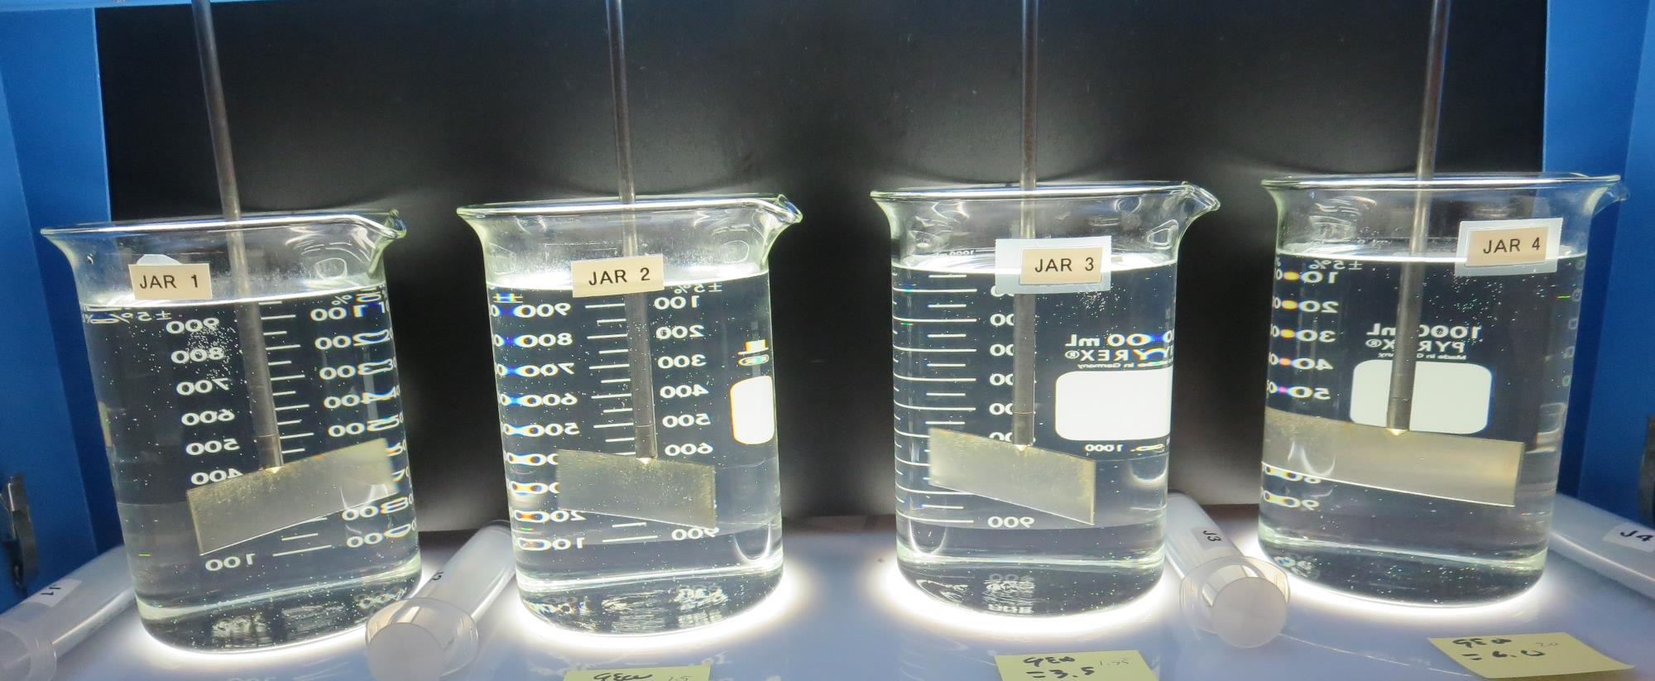
Jars 1-4: End of Floc Duration, 25 mL is syringed for filterability and %UVT/UVA.
2.5 mg/L 9800
Filtrate: 0.20 NTU
UVT: 97.1%
UVA: 0.012/cm
UVA Reduction: 47.8%
3.0 mg/L 9800
Filtrate: 0.31 NTU
UVT: 96.6%
UVA: 0.014/cm
UVA Reduction: 39.1%
3.5 mg/L 9800
Filtrate: 0.15 NTU
UVT: 97.4%
UVA: 0.011/cm
UVA Reduction: 52.2%
4.0 mg/L 9800
Filtrate: 0.05 NTU
UVT: 98.0%
UVA: 0.008/cm
UVA Reduction: 65.2%

Slide 16
Jars 5-8 Test Flash Mix 20 Sec (200 RPM) Floc Mix 5 min (20 RPM) 25 mL sampled end of Floc Applied Coagulant 9800

Slide 17
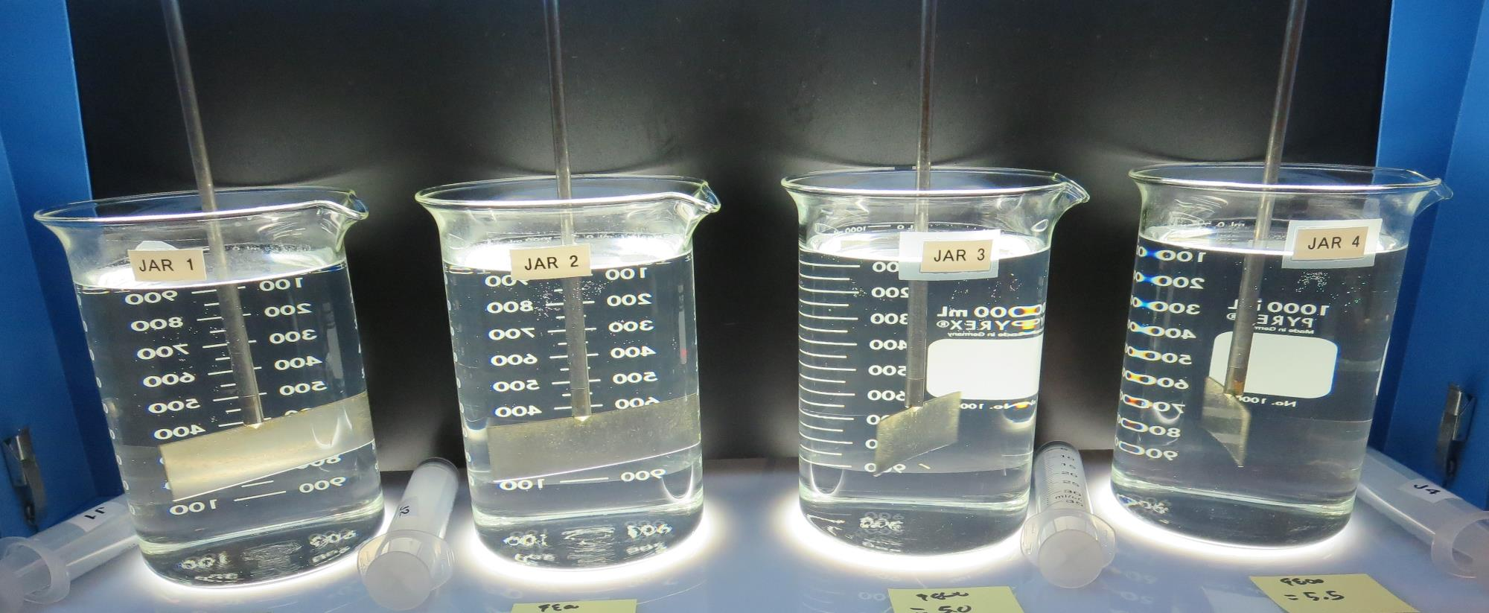
Jars 5-8: End of Floc Duration, 25 mL is syringed for filterability and %UVT/UVA.
4.0 mg/L 9800
Filtrate: 0.06 NTU
UVT: 98.3%
UVA: 0.007/cm
UVA Reduction: 69.6%
4.5 mg/L 9800
Filtrate: 0.07 NTU
UVT: 98.3%
UVA: 0.007/cm
UVA Reduction: 69.6%
5.0 mg/L 9800
Filtrate: 0.07 NTU
UVT: 98.3%
UVA: 0.007/cm
UVA Reduction: 69.6%
5.5 mg/L 9800
Filtrate: 0.17 NTU
UVT: 98.0%
UVA: 0.007/cm
UVA Reduction: 65.2%

Slide 18
Jars 9-12 Test Flash Mix 20 Sec (200 RPM) Floc Mix 5 min (20 RPM) 25 mL sampled end of Floc Applied Coagulant 960

Slide 19
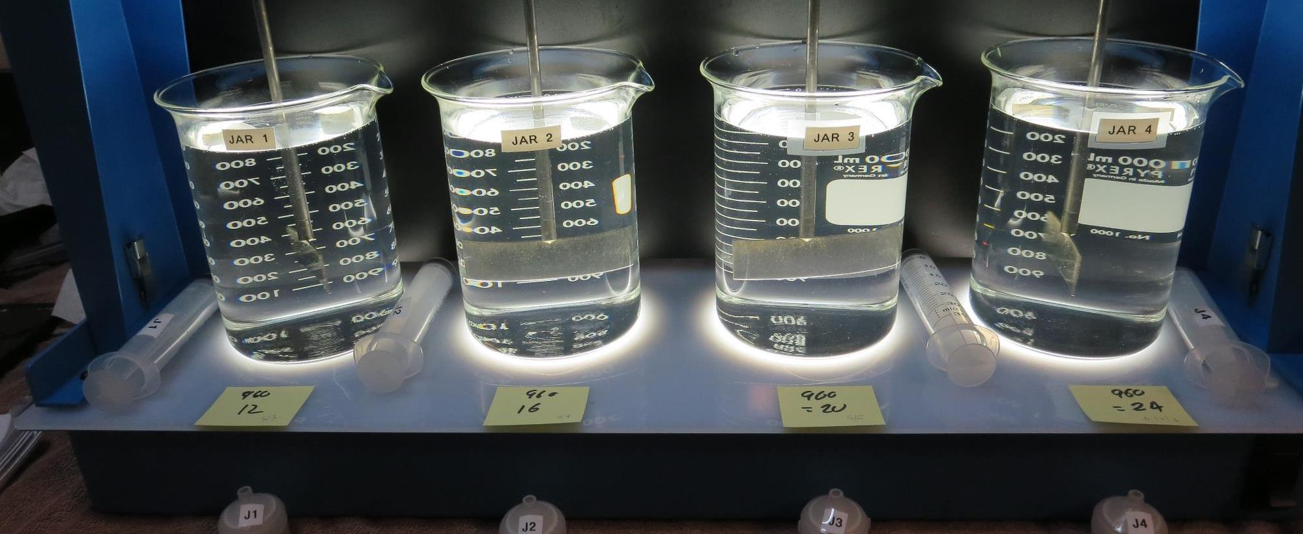
Jars 9-12: End of Floc Duration, 25 mL is syringed for filterability and %UVT/UVA.
12 mg/L 960
Filtrate: 0.04 NTU
UVT: 98.1%
UVA: 0.008/cm
UVA Reduction: 65.2%
16 mg/L 960
Filtrate: 0.10 NTU
UVT: 98.0%
UVA: 0.008/cm
UVA Reduction: 65.2%
20 mg/L 960
Filtrate: 0.04 NTU
UVT: 98.6%
UVA: 0.006/cm
UVA Reduction: 73.9%
24 mg/L 960
Filtrate: 0.03 NTU
UVT: 98.6%
UVA: 0.006/cm
UVA Reduction: 73.9%

Slide 20
Jars 13-16 Test Flash Mix 20 Sec (200 RPM) Floc Mix 5 min (20 RPM) 25 mL sampled end of Floc Applied Coagulant 960

Slide 21
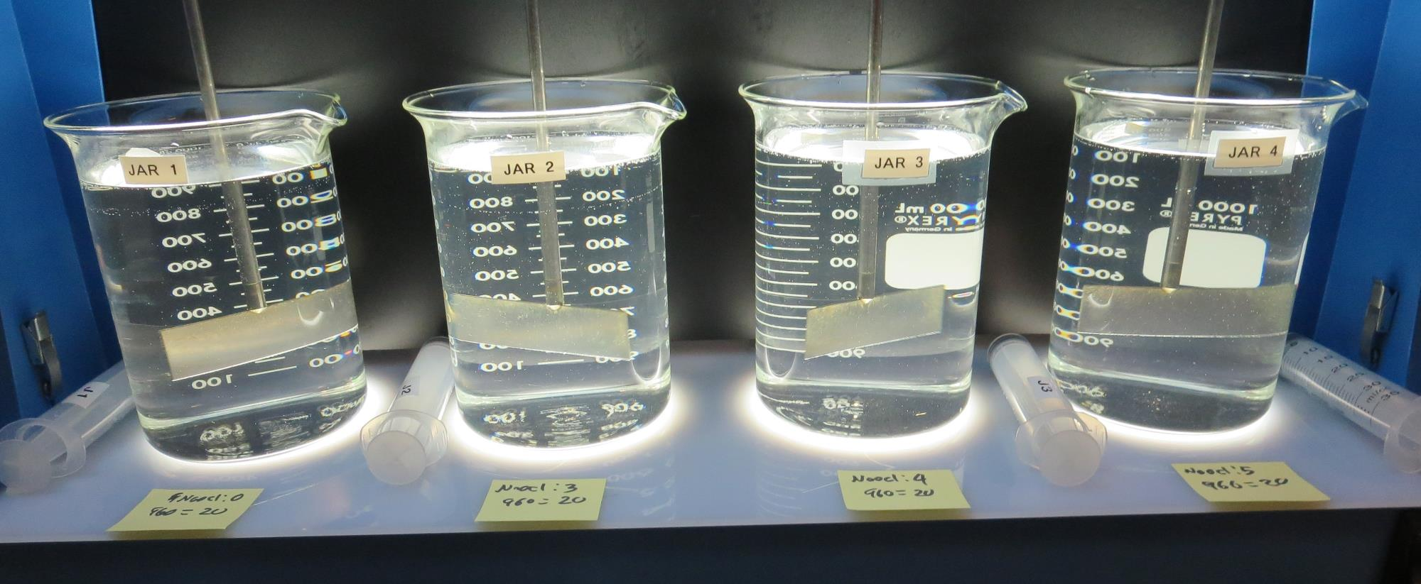
Jars 13-16: End of Floc Duration, 25 mL is syringed for filterability and %UVT/UVA.
NaOCl: 0
20 mg/L 960
Filtrate: 0.04 NTU
UVT: 98.6%
UVA: 0.006/cm
UVA Reduction: 73.9%
NaOCl: 3.0
20 mg/L 960
Filtrate: 0.12 NTU
UVT: 97.7%
UVA: 0.010/cm
UVA Reduction: 56.5%
NaOCl: 4.0
20 mg/L 960
Filtrate: 0.09 NTU
UVT: 97.7%
UVA: 0.010/cm
UVA Reduction: 56.5%
NaOCl: 5.0
20 mg/L 960
Filtrate: 0.03 NTU
UVT: 97.8%
UVA: 0.009/cm
UVA Reduction: 60.9%

Slide 22
Jars 17-20 Test Flash Mix 20 Sec (200 RPM) Floc Mix 5 min (20 RPM) 25 mL sampled end of Floc Applied Coagulant 961

Slide 23
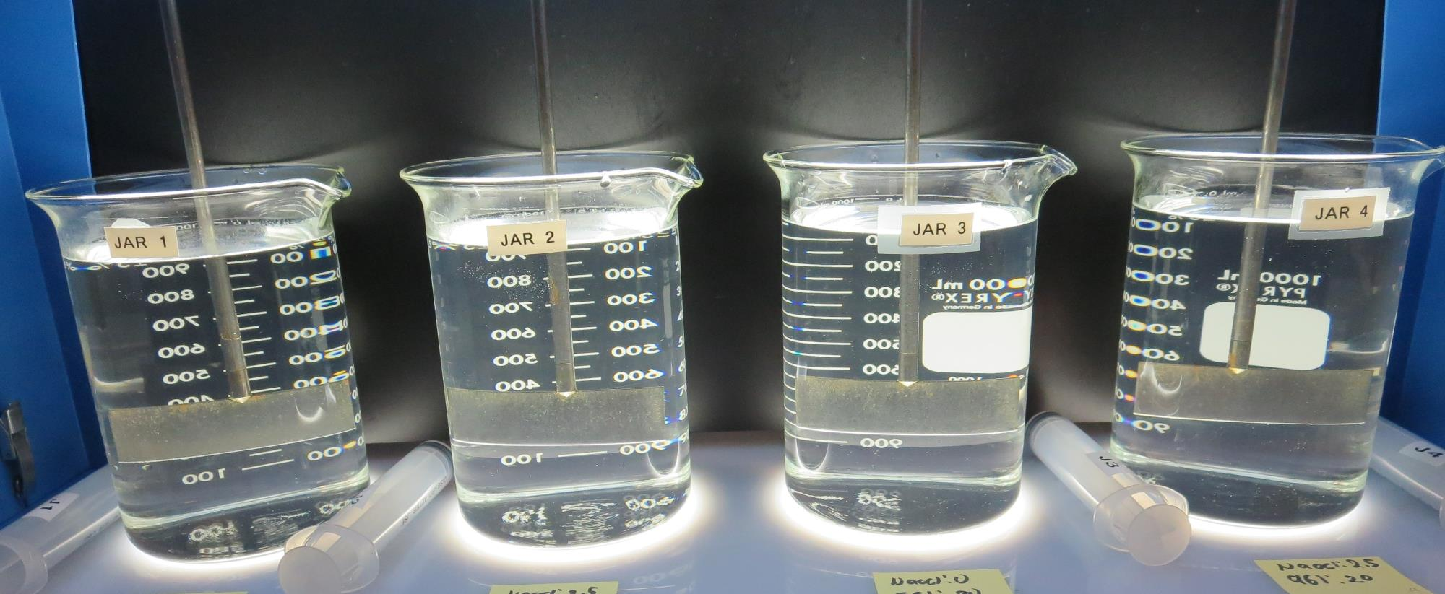
Jars 17-20: End of Floc Duration, 25 mL is syringed for filterability and %UVT/UVA.
NaOCl: 0
16 mg/L 961
Filtrate: 0.03 NTU
UVT: 98.2%
UVA: 0.007/cm
UVA Reduction: 69.6%
NaOCl: 2.5
16 mg/L 961
Filtrate: 0.03 NTU
UVT: 97.9%
UVA: 0.009/cm
UVA Reduction: 60.9%
NaOCl: 0
20 mg/L 961
Filtrate: 0.05 NTU
UVT: 98.1%
UVA: 0.008/cm
UVA Reduction: 65.2%
NaOCl: 2.5
20 mg/L 961
Filtrate: 0.06 NTU
UVT: 97.6%
UVA: 0.010/cm
UVA Reduction: 56.52%

Slide 24
Jars 21-24 Test Flash Mix 20 Sec (200 RPM) Floc Mix 5 min (20 RPM) 25 mL sampled end of Floc Applied Coagulant 9810

Slide 25
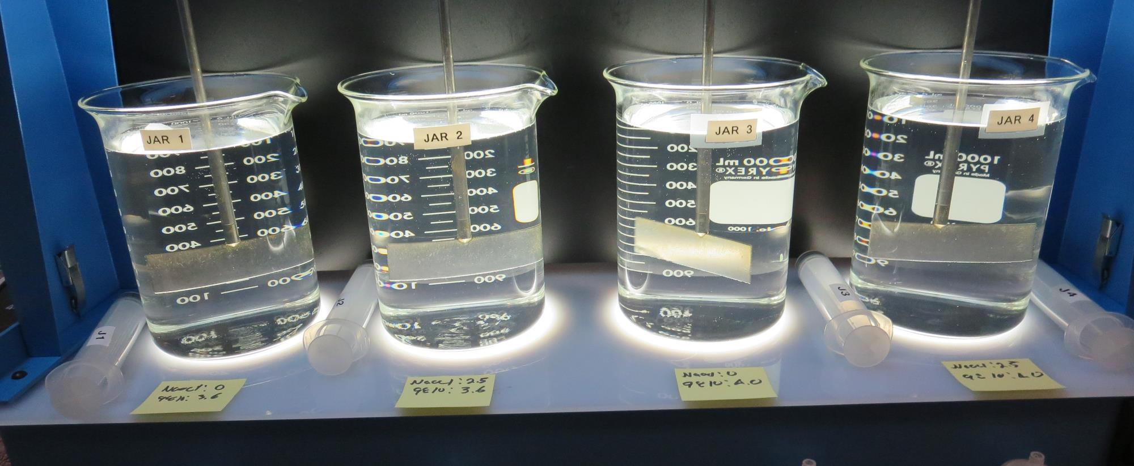
Jars 21-24: End of Floc Duration, 25 mL is syringed for filterability and %UVT/UVA.
NaOCl: 0
3.6 mg/L 9810
Filtrate: 0.21 NTU
UVT: 98.2%
UVA: 0.011/cm
UVA Reduction: 52.2%
NaOCl: 2.5
3.6 mg/L 9810
Filtrate: 0.03 NTU
UVT: 98.0%
UVA: 0.008/cm
UVA Reduction: 65.2%
NaOCl: 0
4.0 mg/L 9810
Filtrate: 0.03 NTU
UVT: 98.3%
UVA: 0.007/cm
UVA Reduction: 69.6%
NaOCl: 2.5
4.0 mg/L 9810
Filtrate: 0.04 NTU
UVT: 98.0%
UVA: 0.008/cm
UVA Reduction: 65.2%

Slide 26
Jars 25-28 Test Flash Mix 20 Sec (200 RPM) Floc Mix 5 min (20 RPM) 25 mL sampled end of Floc Applied Coagulants 926/9890

Slide 27
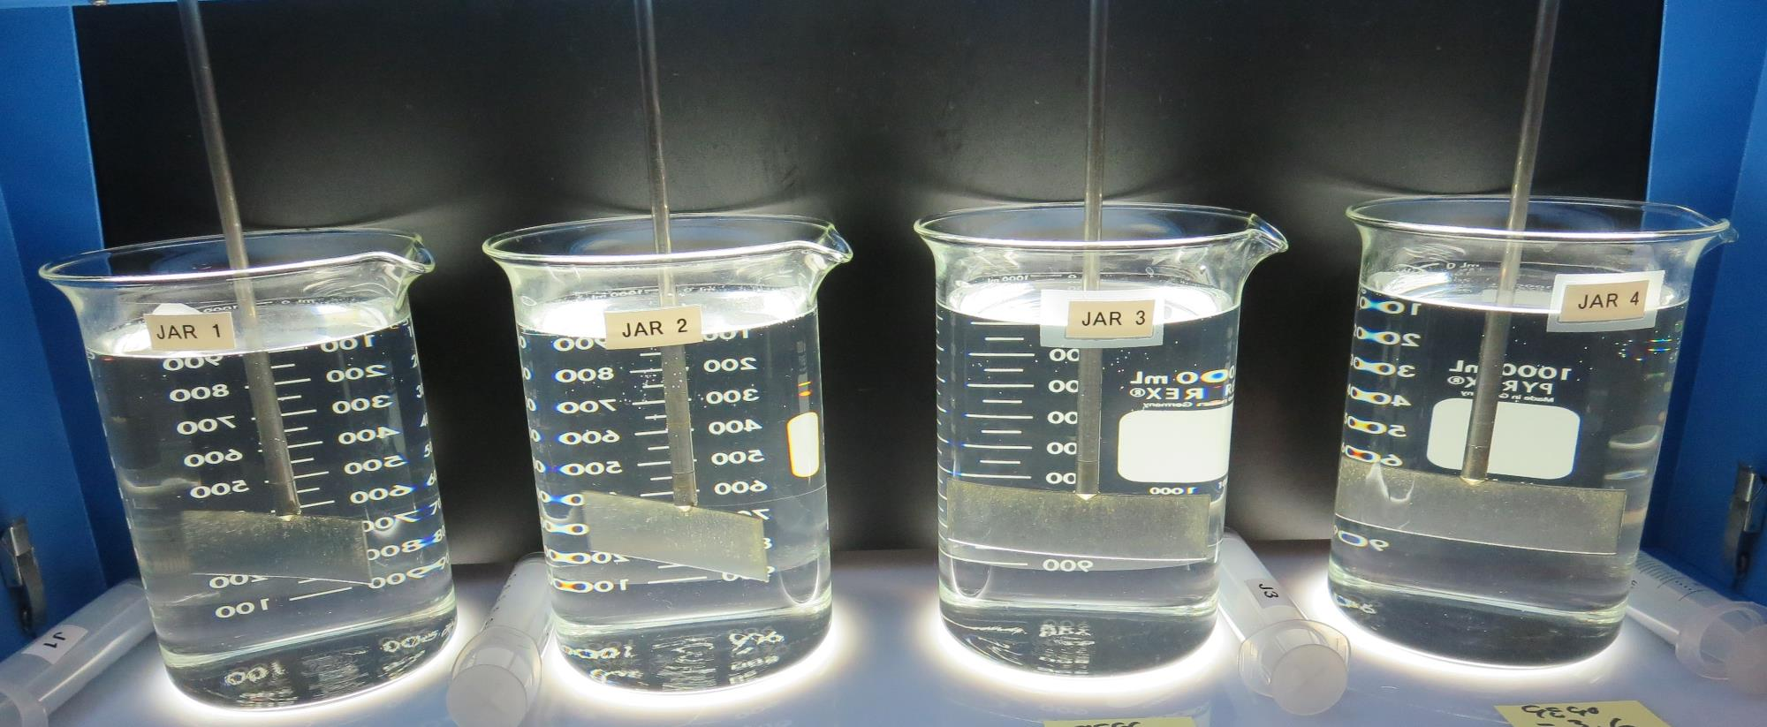
Jars 25-28: End of Floc Duration, 25 mL is syringed for filterability and %UVT/UVA.
3.0 mg/L 926
Filtrate: 0.03 NTU
UVT: 98.3%
UVA: 0.007/cm
UVA Reduction: 69.6%
3.6 mg/L 926
Filtrate: 0.12 NTU
UVT: 97.9%
UVA: 0.009/cm
UVA Reduction: 60.9%
3.0 mg/L 9890
Filtrate: 0.13 NTU
UVT: 97.5%
UVA: 0.010/cm
UVA Reduction: 56.5%
3.6 mg/L 9890
Filtrate: 0.36 NTU
UVT: 95.8%
UVA: 0.018/cm
UVA Reduction: 21.7%

Slide 28
Jars 29-32 Test Flash Mix 20 Sec (200 RPM) Floc Mix 5 min (20 RPM) 25 mL sampled end of Floc Applied Coagulant 926

Slide 29
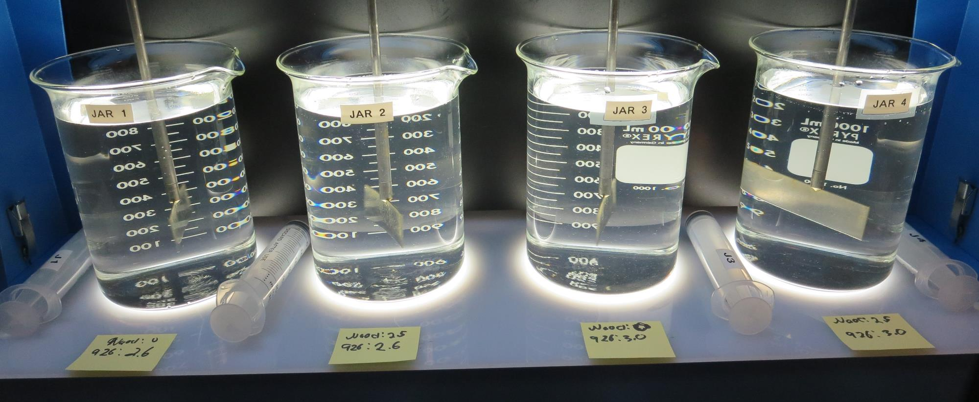
Jars 29-32: End of Floc Duration, 25 mL is syringed for filterability and %UVT/UVA.
NaOCl: 0
2.6 mg/L 926
Filtrate: 0.14 NTU
UVT: 97.7%
UVA: 0.010/cm
UVA Reduction: 56.5%
NaOCl: 2.5
2.6 mg/L 926
Filtrate: 0.09 NTU
UVT: 97.5%
UVA: 0.010/cm
UVA Reduction: 56.5%
NaOCl: 0
3.0 mg/L 926
Filtrate: 0.05 NTU
UVT: 98.3%
UVA: 0.007/cm
UVA Reduction: 69.6%
NaOCl: 2.5
3.0 mg/L 926
Filtrate: 0.04 NTU
UVT: 98.1%
UVA: 0.008/cm
UVA Reduction: 65.2%

Slide 30
Jars 33-35 Test Flash Mix 20 Sec (200 RPM) Floc Mix 5 min (20 RPM) 25 mL sampled end of Floc Applied Coagulants 926/9810/961

Slide 31
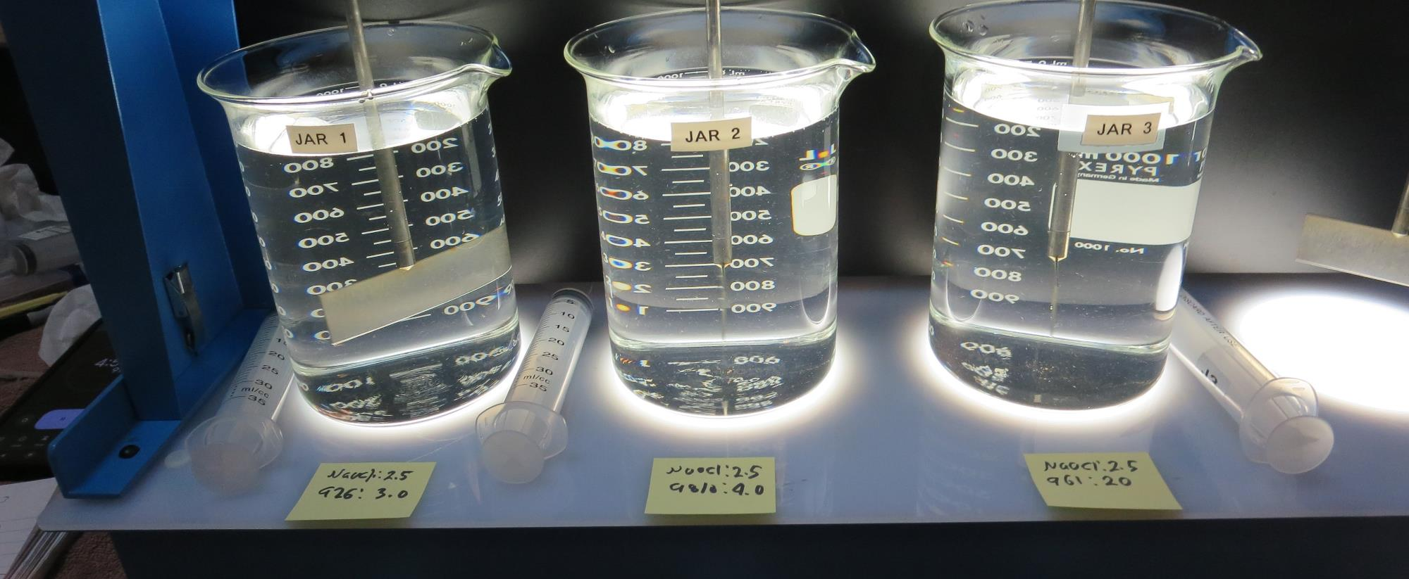
Jars 33-35: End of Floc Duration, 25 mL is syringed for filterability and %UVT/UVA.
NaOCl: 2.5
3.0 mg/L 926
Filtrate: 0.16 NTU
UVT: 97.0%
UVA: 0.013/cm
UVA Reduction: 43.5%
NaOCl: 2.5
4.0 mg/L 9810
Filtrate: 0.23 NTU
UVT: 96.3%
UVA: 0.016/cm
UVA Reduction: 30.4%
NaOCl: 2.5
20 mg/L 961
Filtrate: 0.03 NTU
UVT: 97.9%
UVA: 0.009/cm
UVA Reduction: 60.9%

Slide 32
Jar Testing for 1-Liter Jars: Procedures for Most Treatment Plants
Fill jars with source water prior to coagulant injection and set paddle speed at 20-30 rpm
Add chemicals (i.e., NaOCl, primary coagulant, coagulant aid) to each jar
Flash mix for 15-30 seconds (200 rpm)
Slow mix for 5 minutes (20-30 rpm)
Settled for 5 minutes. Syringe 25 mL from each jar taken 1-inch below surface (25 mL/12 sec rate). For this study, samples were taken immediately at the end of flocculation process.
Filtered through 1.2 um isopore membrane into cuvette drip rate, 15 mL/(50-90 sec)
Measure filtrate turbidity, chlorine residual and %UVT/UVA
Measure settled water turbidity after 25 minutes of total setting
Record all data

Slide 33
Jar Test Filterability Test Equipment
Turbidity Instrument
Syringe w/Luer-Lock Tip, 30 cc
(part#: 2225800, by Hach)
Swinnex Filter Holder, 25 mm (part#: SX0002500)
Isopore Membrane Filter, 1.2 um absolute
pore size,
Φ= 25 mm , thickness: 24 um,
hydrophilic polycarbonate membrane
(part #: RTTP02500)
Go to Sigma-Aldrich for laboratory supplies http://www.sigmaaldrich.com/united-states.html

Slide 34
Isopore Membrane Information
Categories | Information
trade name | Isopore
filter color | White
chemistry | Polycarbonate (PC)
water flow rate | Avg. 175 mL/min x cm² (typical results @ 10 psi)
media | Isopore®
wettability | Hydrophilic
porosity | 14.7%
pore size | 1.2 µm
bubble point at 23 °C | 1.0 bar, air with water
thickness | 24 µm
filter diameter (ø) | 25 mm
material size | polycarbonate, Hydrophilic, 1.2 µm, 25 mm, white, plain, 100

Slide 35
Isopore Membrane Background Information
The Isopore membrane is a polycarbonate, track-etched screen filter recommended for all analyses in which the sample is viewed on the surface of the membrane. The Isopore membrane is composed of polycarbonate film, which has a smooth, glass-like surface for clearer sample observation. The unique manufacturing process of the membrane ensures a precise pore diameter and a consistent pore size for accurate separation of samples by size. Matched-weight filters are not usually required because of low, constant tar and ash weights. Features & Benefits: Membrane structure retains particles on the surface, simplifying counting and analysis

Slide 36
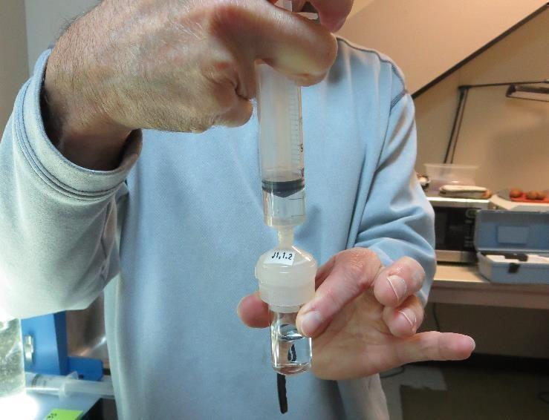
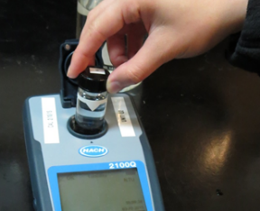
Jar Test - Filterability Test
Syringe ~ 25 mL from jar (after 5-minutes of settling)
Filter-to-waste 3-5 mL
Filter directly into clean cuvette
Measure turbidity
Note: Take several readings before recording final NTU results. Micro bubbles can adhere to glass causing false NTU readings. To remove bubbles, tilt cuvette up to 90 degrees.

Slide 37
Contact
Guy Schott, P.E.
State Water Resources Control Board
Division of Drinking Water
Santa Rosa, CA
Go to Jar Test Results/Procedures for tools to download
www.waterboards.ca.gov/drinking_water/programs/districts/mendocino_district.html
Jar Testing Done Right video training https://youtu.be/aGByyxhelkI
Email: Guy Schott - Guy.Schott@waterboards.ca.gov
Office Number: 707-576-2732

