Slide 1
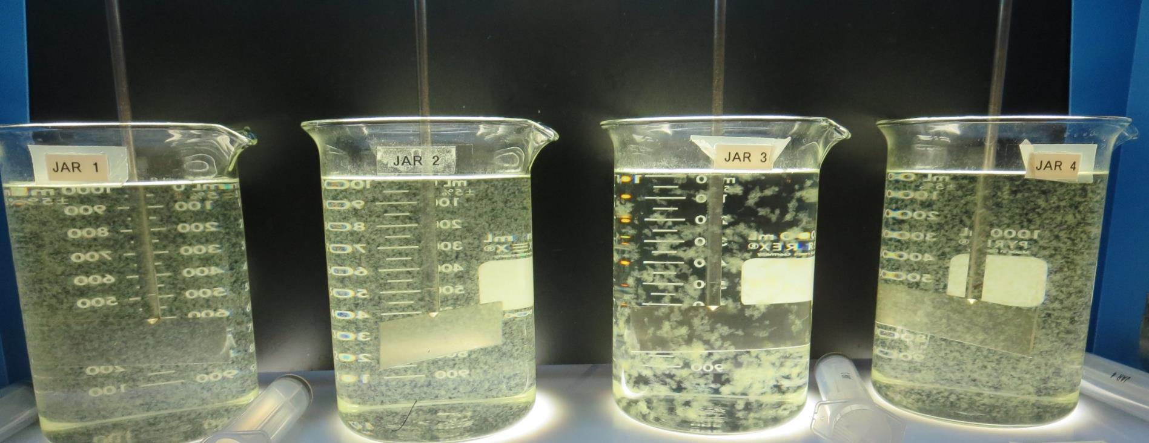
Pope Valley School CA2800840, Napa County, Jar Test
by Guy Schott, P.E. November 4, 2020

Slide 2
Pope Valley School., November 4, 2020 Source Water Characteristics
Source: Burton Creek
pH: 8.07
Turbidity: 6.6 NTU
UVT: 75.0%
UVA: 0.124/cm
0.4 um Filtered
Turbidity: 0.37 NTU
UVT: 78.9%
UVA: 0.102/cm
Using the P200 UVT/UVA analyzer; calibrated with organic free water.
Post Filtration Aluminum
75 mg/L 9800
Turbidity: 0.08 NTU
UVT: 90.1%
UVA: 0.045/cm
Al: 0 mg//L
230 mg/L Adv Coagulant
Turbidity: 0.09 NTU
UVT: 90.3%
UVA: 0.044/cm
Al: 0.065 mg//L
Aluminum Secondary Standard: 0.2 mg/L
Aluminum Primary Standard; 1. mg/L

Slide 3
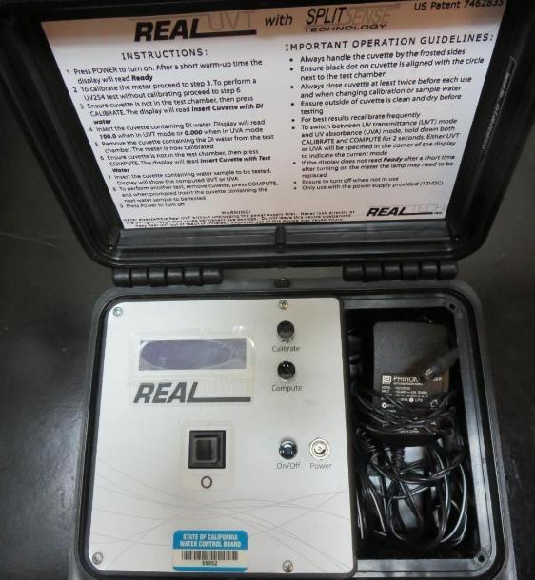
UVT/UVA, pathlength 10 mm
UV transmittance (UVT) is a measurement of the amount of ultraviolet light (commonly at 254 nm due to its germicidal effect) that passes through a water sample compared to the amount of light that passes through a pure water sample. The measurement is expressed as a percentage, % UVT.
%UVT = 10^{(-UVA)} x 100%
UV absorbance (UVA) is calculated as a relative measure of the amount of light absorbed by a water sample compared with the amount of light absorbed by a pure water sample.
UVA = -log(%UVT/100)

Slide 4
Applied Coagulants for Jar Testing
Pro Pac 9800 (NTU Technologies)
50% Aluminum Chlorohydrate
50% Water
SG = 1.25-1.34
Max dose: 250 mg/L as product
Pro Pac 917 (NTU Technologies)
40-50% Aluminum Chlorohydrate
40-50% Water
10% polyamine
SG = 1.25-1.34
Max dose: 100 mg/L as product
BWS, Inc.
Advanced Coagulant
AdvFloc-CTC-00011
Polyaluminum Chloride
12.55% Al₂O₃
64.9% Basicity
SG = 1.299
Max dose: 250 mg/L as product
Gregory F. Nieckarz, Ph.D.
Principal Consultant
SWS Consulting, LLC.
+1.541.953.5112
gregn.swsc@gmail.com

Slide 5
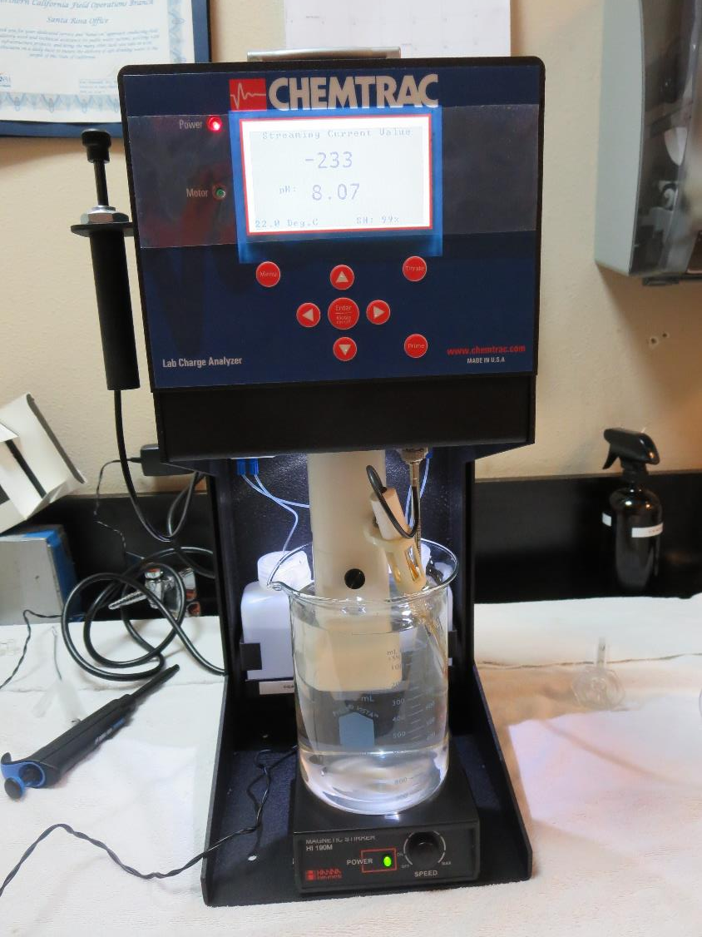
Laboratory Charge Analyzer
LCA: Used to determine coagulant demand of a source water entering the treatment plant.
All pH adjusted to 7.5 w/acetic acid solution
Source pH: 8.07
LCA #1:
9800:
28 mg/L as product
LCA #2:
AdvFloc-CTC-00011:
199 mg/L as product

Slide 6
Coagulant Information
Unless stated otherwise, all coagulant doses are reported as Product (100% strength).
Preparation of coagulant stock solutions are generally 1.0 and/or 0.1 percent strength using 100 and/or 200 mL volumetric flasks.
Finnpipette F2 variable volume pipette, capacity 100-1000 micro liters is used for stock solution preparation and coagulant aid jar test dosing.
Finnpipette F2 variable volume pipette, capacity 0.5-5 mL is used for primary coagulant jar test dosing.

Slide 7
Pope Valley School: TTHMs/HAA5s Lab Samples NaOCl dose after filtration: 3 mg/L; Measurements after 20 minutes (Cl2, %UVT/UVA).
Coagulant (Dose, mg/L) | Filtrate NTU | Filtrate %UVT | Filtrate UVA/cm | Filtrate Cl₂ mg/L | Filtrate %UVT | Filtrate UVA/cm
9800 (70) | 0.09 | 89.8 | 0.046 | 1.1 | 90.9 | 0.041
Adv Coag (200) | 0.09 | 89.7 | 0.046 | 1.19 | 91.2 | 0.039
917 (60) | 0.11 | 89.4 | 0.048 | 0.74 | 91.2 | 0.039

Slide 8
Pope Valley School: TTHMs/HAA5s Lab Samples NaOCl dose after filtration: 3 mg/L; Measurements after 72 hours (Cl₂, %UVT/UVA).
Coagulant (Dose, mg/L) | Filtrate %UVT (before NaOCl addition) | Filtrate UVA/cm (before NaOCl addition) | Filtrate %UVT 72 hrs | Filtrate UVA/cm 72 hrs | Filtrate Cl₂ mg/L 72 hrs
9800 (70) | 89.8 | 0.046 | Not Avail | Not Avail | 0
Adv Coag (200) | 89.7 | 0.046 | 92.4 | 0.033 | 0
917 (60) | 89.4 | 0.048 | 92.0 | 0.035 | 0

Slide 9
Pope Valley School: TTHMs/HAA5s Laboratory Results NaOCl dose after filtration: 3 mg/L; Hold Time: 3 days (72 hrs) before DBPs measurements
Coagulant (Dose, mg/L) | Filtrate %UVT (before NaOCl addition) | Filtrate UVA/cm (before NaOCl addition) | %UVA Reduction (before NaOCl addition) | TTHM ug/L | HAA5 ug/L | Cl₂ mg/L
9800 (70) | 89.8 | 0.046 | 54.9 | 55 | 35 | 0
Adv Coag (200) | 89.7 | 0.046 | 54.9 | 53 | 35 | 0
917 (60) | 89.4 | 0.048 | 52.9 | 65 | 37 | 0

Slide 10
Pope Valley School: Jar Test 1-8 Results Source: Burton Creek
Jar # | 200 RPM Flash Mix Duration seconds | 20 RPM Floc Duration minutes | 9800 mg/L | Filtrate NTU | Filtrate %UVT | Filtrate UVA/cm | %UVA Reduction
J1 | 20 | 5 | 26 | 0.10 | 86.6 | 0.062 | 39.2
J2 | 20 | 5 | 28 | 0.12 | 86.3 | 0.063 | 38.2
J3 | 20 | 5 | 30 | 0.11 | 86.8 | 0.061 | 40.2
J4 | 20 | 5 | 32 | 0.10 | 87.1 | 0.059 | 42.2
J5 | 20 | 5 | 34 | 0.11 | 87.6 | 0.057 | 44.1
J6 | 20 | 5 | 36 | 0.10 | 87.7 | 0.056 | 45.1
J7 | 20 | 5 | 38 | 0.11 | 87.8 | 0.056 | 45.1
J8 | 20 | 5 | 40 | 0.11 | 87.9 | 0.056 | 45.1

Slide 11
Pope Valley School: Jar Test 9-16 Results Source: Burton Creek
Jar # | 200 RPM Flash Mix Duration seconds | 20 RPM Floc Duration minutes | 9800 mg/L | Filtrate NTU | Filtrate %UVT | Filtrate UVA/cm | %UVA Reduction
J9 | 20 | 5 | 45 | 0.12 | 88.7 | 0.051 | 50.0
J10 | 20 | 5 | 50 | 0.11 | 88.8 | 0.051 | 50.0
J11 | 20 | 5 | 55 | 0.09 | 89.2 | 0.049 | 52.0
J12 | 20 | 5 | 60 | 0.09 | 89.3 | 0.049 | 52.0
J13 | 20 | 5 | 70 | 0.10 | 89.9 | 0.046 | 54.9
J14 | 20 | 5 | 75 | 0.08 | 90.1 | 0.045 | 55.9
J15 | 20 | 5 | 80 | 0.10 | 90.1 | 0.045 | 55.9
J26 | 20 | 5 | 85 | 0.09 | 90.0 | 0.045 | 55.9

Slide 12
Pope Valley School: Jar Test 17-24 Results Source: Burton Creek
Jar # | 200 RPM Flash Mix Duration seconds | 20 RPM Floc Duration minutes | Adv Coag. mg/L | Filtrate NTU | Filtrate %UVT | Filtrate UVA/cm | %UVA Reduction
J17 | 20 | 5 | 140 | 0.11 | 88.5 | 0.052 | 49.0
J18 | 20 | 5 | 160 | 0.15 | 89.2 | 0.049 | 52.0
J19 | 20 | 5 | 180 | 0.10 | 89.6 | 0.047 | 53.9
J20 | 20 | 5 | 200 | 0.08 | 89.9 | 0.045 | 55.9
J21 | 20 | 5 | 200 | 0.09 | 89.9 | 0.046 | 54.9
J22 | 20 | 5 | 210 | 0.09 | 89.7 | 0.046 | 54.9
J23 | 20 | 5 | 220 | 0.08 | 90.0 | 0.045 | 55.9
J24 | 20 | 5 | 230 | 0.09 | 90.3 | 0.044 | 56.9

Slide 13
Pope Valley School: Jar Test 25-28 Results Source: Burton Creek
Jar # | 200 RPM Flash Mix Duration seconds | 20 RPM Floc Duration minutes | 917 mg/L | Filtrate NTU | Filtrate %UVT | Filtrate UVA/cm | %UVA Reduction
J25 | 20 | 5 | 40 | 0.09 | 88.8 | 0.051 | 50.0
J26 | 20 | 5 | 50 | 0.08 | 89.3 | 0.048 | 52.9
J27 | 20 | 5 | 60 | 0.08 | 89.7 | 0.046 | 54.9
J28 | 20 | 5 | 70 | 0.10 | 90.1 | 0.045 | 55.9

Slide 14
Pope Valley School: Jar Test 29-35 Results; Source: Burton Creek Flash 200 RPM (20 sec); Floc 20 RPM (5 min)
Jar # | 9800 mg/L | Adv Coag. mg/L | 917 mg/L | Filtrate NTU | Filtrate %UVT | Filtrate UVA/cm | %UVA Reduction
J29 | 75 | 0 | 0 | 0.13 | 89.7 | 0.047 | 53.9
J30 | 0 | 200 | 0 | 0.09 | 89.4 | 0.048 | 52.9
J31 | 0 | 0 | 60 | 0.08 | 89.3 | 0.049 | 52.0
J32 | 70 | 0 | 0 | 0.09 | 89.8 | 0.046 | 54.9
J33 | 75 | 0 | 0 | 0.09 | 89.7 | 0.046 | 54.9
J34 | 0 | 200 | 0 | 0.09 | 89.7 | 0.046 | 54.9
J35 | 0 | 0 | 60 | 0.11 | 89.4 | 0.048 | 52.9

Slide 15
Jars 1-4 Test Flash Mix 20 Sec (200 RPM) Floc Mix 5 min (20 RPM) Applied Coagulant 9800

Slide 16
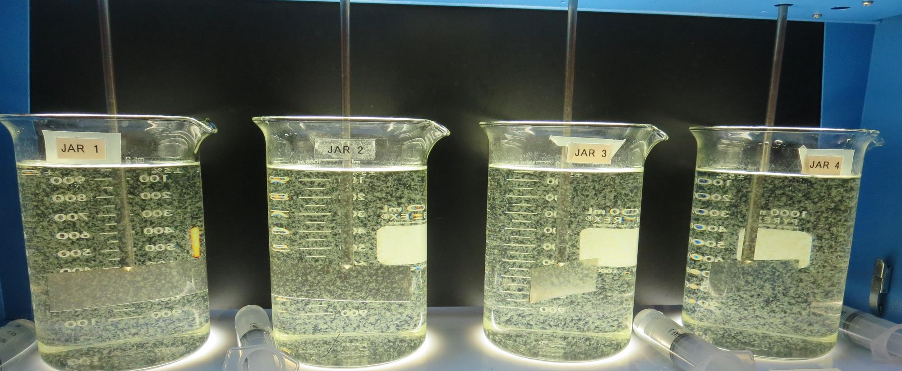
Jars 1-4: End of 5-minute flocculation (20 RPM) duration. 25 mL is syringed for filterability and %UVT/UVA.
26 mg/L 9800
Filtrate 0.10 NTU
UVT: 86.6%
UVA: 0.062/cm
UVA Reduction: 39.2%
28 mg/L 9800
Filtrate 0.12 NTU
UVT: 86.6%
UVA: 0.063/cm
UVA Reduction: 38.2%
30 mg/L 9800
Filtrate 0.11 NTU
UVT: 86.8%
UVA: 0.061/cm
UVA Reduction: 40.2%
32 mg/L 9800
Filtrate 0.10 NTU
UVT: 87.1%
UVA: 0.059/cm
UVA Reduction: 42.2%

Slide 17
Jars 5-8 Test Flash Mix 20 Sec (200 RPM) Floc Mix 5 min (20 RPM) Applied Coagulant 9800

Slide 18
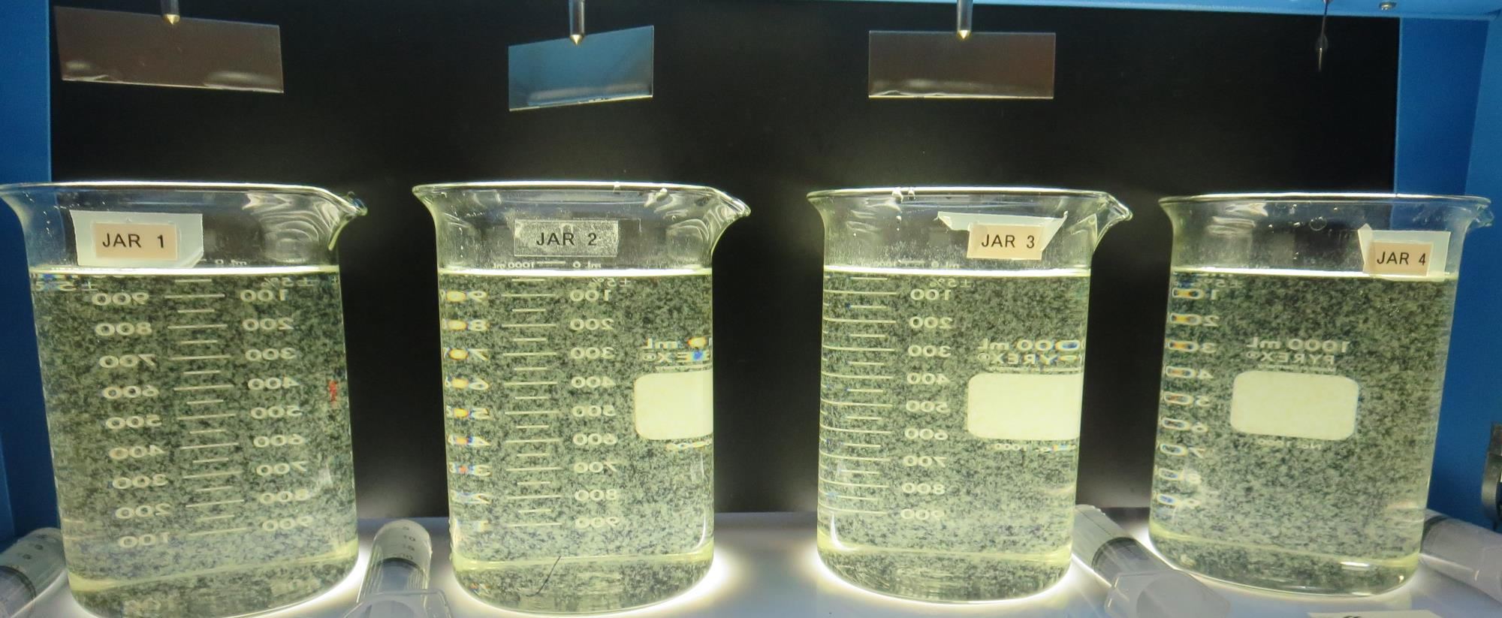
Jars 5-8: End of 5-minute flocculation (20 RPM) duration. 25 mL is syringed for filterability and %UVT/UVA.
34 mg/L 9800
Filtrate 0.11 NTU
UVT: 87.6%
UVA: 0.057/cm
UVA Reduction: 44.1%
36 mg/L 9800
Filtrate 0.10 NTU
UVT: 87.7%
UVA: 0.056/cm
UVA Reduction: 45.1%
38 mg/L 9800
Filtrate 0.11 NTU
UVT: 87.8%
UVA: 0.056/cm
UVA Reduction: 45.1%
40 mg/L 9800
Filtrate 0.11 NTU
UVT: 87.9%
UVA: 0.056/cm
UVA Reduction: 45.1%

Slide 19
Jars 9-12 Test Flash Mix 20 Sec (200 RPM) Floc Mix 5 min (20 RPM) Applied Coagulant 9800

Slide 20
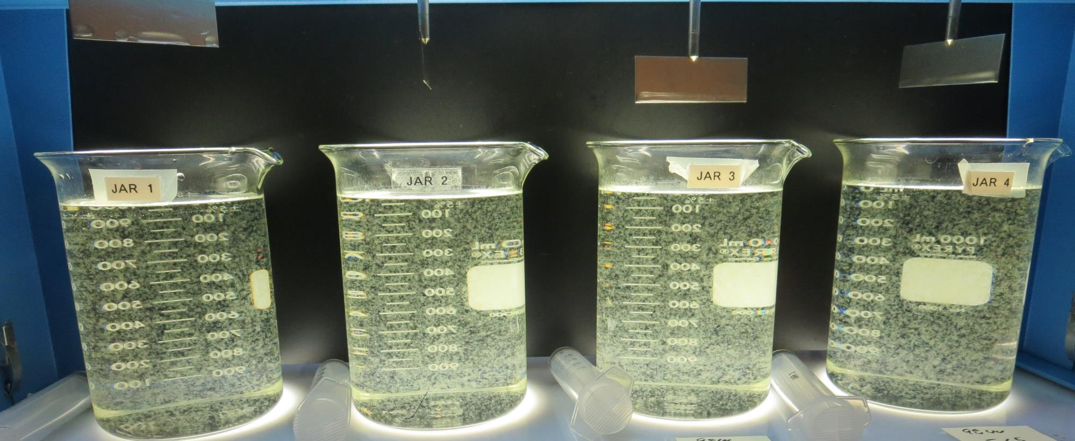
Jars 9-12: End of 5-minute flocculation (20 RPM) duration. 25 mL is syringed for filterability and %UVT/UVA.
45 mg/L 9800
Filtrate 0.12 NTU
UVT: 88.7%
UVA: 0.051/cm
UVA Reduction: 50.0%
50 mg/L 9800
Filtrate 0.11 NTU
UVT: 88.8%
UVA: 0.051/cm
UVA Reduction: 50.0%
55 mg/L 9800
Filtrate 0.09 NTU
UVT: 89.2%
UVA: 0.049/cm
UVA Reduction: 52.0%
60 mg/L 9800
Filtrate 0.09 NTU
UVT: 89.3%
UVA: 0.049/cm
UVA Reduction: 52.0%

Slide 21
Jars 13-16 Test Flash Mix 20 Sec (200 RPM) Floc Mix 5 min (20 RPM) Applied Coagulant 9800

Slide 22
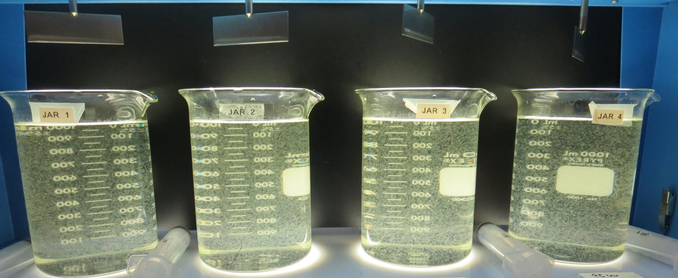
Jars 13-16: End of 5-minute flocculation (20 RPM) duration. 25 mL is syringed for filterability and %UVT/UVA.
70 mg/L 9800
Filtrate 0.10 NTU
UVT: 88.9%
UVA: 0.046/cm
UVA Reduction: 54.9%
75 mg/L 9800
Filtrate 0.08 NTU
UVT: 90.1%
UVA: 0.045/cm
UVA Reduction: 55.9%
80 mg/L 9800
Filtrate 0.10 NTU
UVT: 90.1%
UVA: 0.045/cm
UVA Reduction: 55.9%
85 mg/L 9800
Filtrate 0.09 NTU
UVT: 90.0%
UVA: 0.045/cm
UVA Reduction: 55.9%

Slide 23
Jars 17-20 Test Flash Mix 20 Sec (200 RPM) Floc Mix 5 min (20 RPM) Applied Coagulant Advanced Coagulant

Slide 24
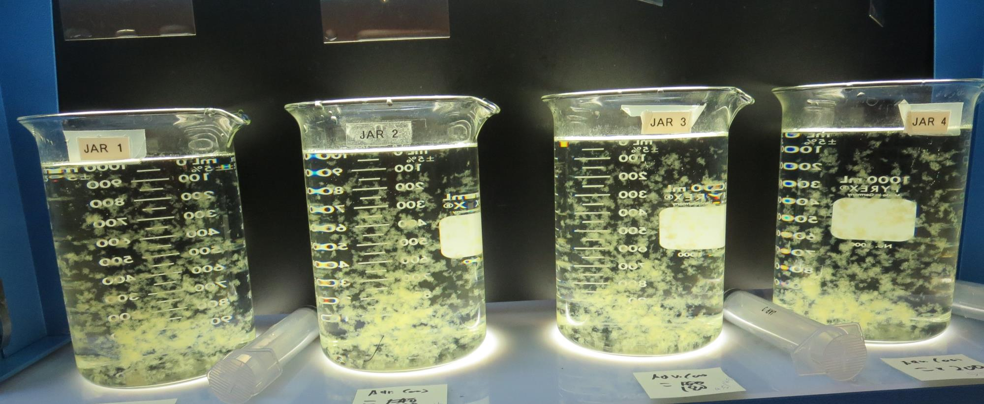
Jars 17-20: End of 5-minute flocculation (20 RPM) duration. 25 mL is syringed for filterability and %UVT/UVA.
140 mg/L Adv Coag.
Filtrate 0.11 NTU
UVT: 88.5%
UVA: 0.052/cm
UVA Reduction: 49.0%
160 mg/L Adv Coag.
Filtrate 0.15 NTU
UVT: 89.2%
UVA: 0.049/cm
UVA Reduction: 52.0%
180 mg/L Adv Coag.
Filtrate 0.10 NTU
UVT: 89.6%
UVA: 0.047/cm
UVA Reduction: 53.9%
200 mg/L Adv Coag.
Filtrate 0.08 NTU
UVT: 89.9%
UVA: 0.045/cm
UVA Reduction: 55.9%

Slide 25
Jars 21-24 Test Flash Mix 20 Sec (200 RPM) Floc Mix 5 min (20 RPM) Applied Coagulant Advanced Coagulant

Slide 26
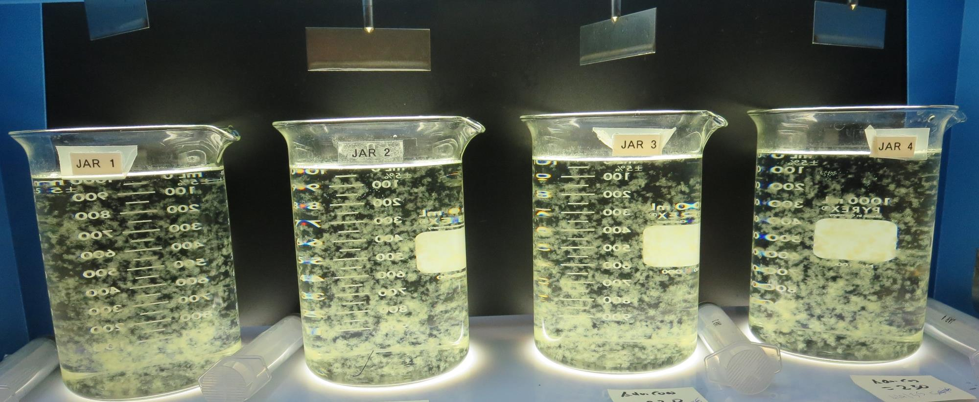
Jars 21-24: End of 5-minute flocculation (20 RPM) duration. 25 mL is syringed for filterability and %UVT/UVA.
200 mg/L Adv Coag.
Filtrate 0.09 NTU
UVT: 89.9%
UVA: 0.046/cm
UVA Reduction: 54.9%
210 mg/L Adv Coag.
Filtrate 0.09 NTU
UVT: 89.7%
UVA: 0.046/cm
UVA Reduction: 54.9%
220 mg/L Adv Coag.
Filtrate 0.08 NTU
UVT: 90.0%
UVA: 0.045/cm
UVA Reduction: 55.9%
230 mg/L Adv Coag.
Filtrate 0.09 NTU
UVT: 90.3%
UVA: 0.044/cm
UVA Reduction: 56.9%

Slide 27
Jars 25-28 Test Flash Mix 20 Sec (200 RPM) Floc Mix 5 min (20 RPM) Applied Coagulant 917

Slide 28
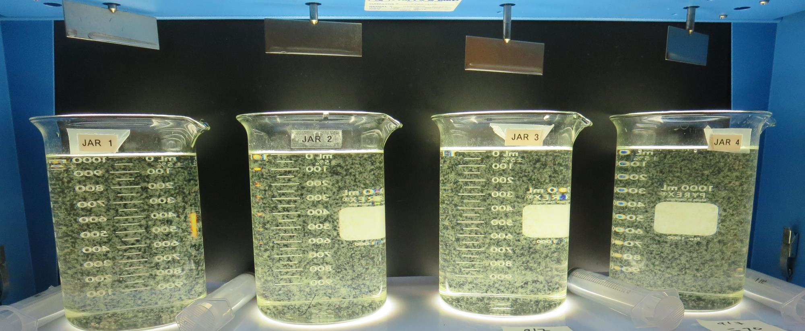
Jars 25-28: End of 5-minute flocculation (20 RPM) duration. 25 mL is syringed for filterability and %UVT/UVA.
40 mg/L 917
Filtrate 0.09 NTU
UVT: 88.8%
UVA: 0.051/cm
UVA Reduction: 50.0%
50 mg/L 917
Filtrate 0.08 NTU
UVT: 89.3%
UVA: 0.048/cm
UVA Reduction: 52.9%
60 mg/L 917
Filtrate 0.08 NTU
UVT: 89.7%
UVA: 0.046/cm
UVA Reduction: 54.9%
70 mg/L 917
Filtrate 0.08 NTU
UVT: 89.7%
UVA: 0.046/cm
UVA Reduction: 54.9%

Slide 29
Jars 29-31 Test Flash Mix 20 Sec (200 RPM) Floc Mix 5 min (20 RPM) Applied Coagulants 9800/Adv Coag/917

Slide 30
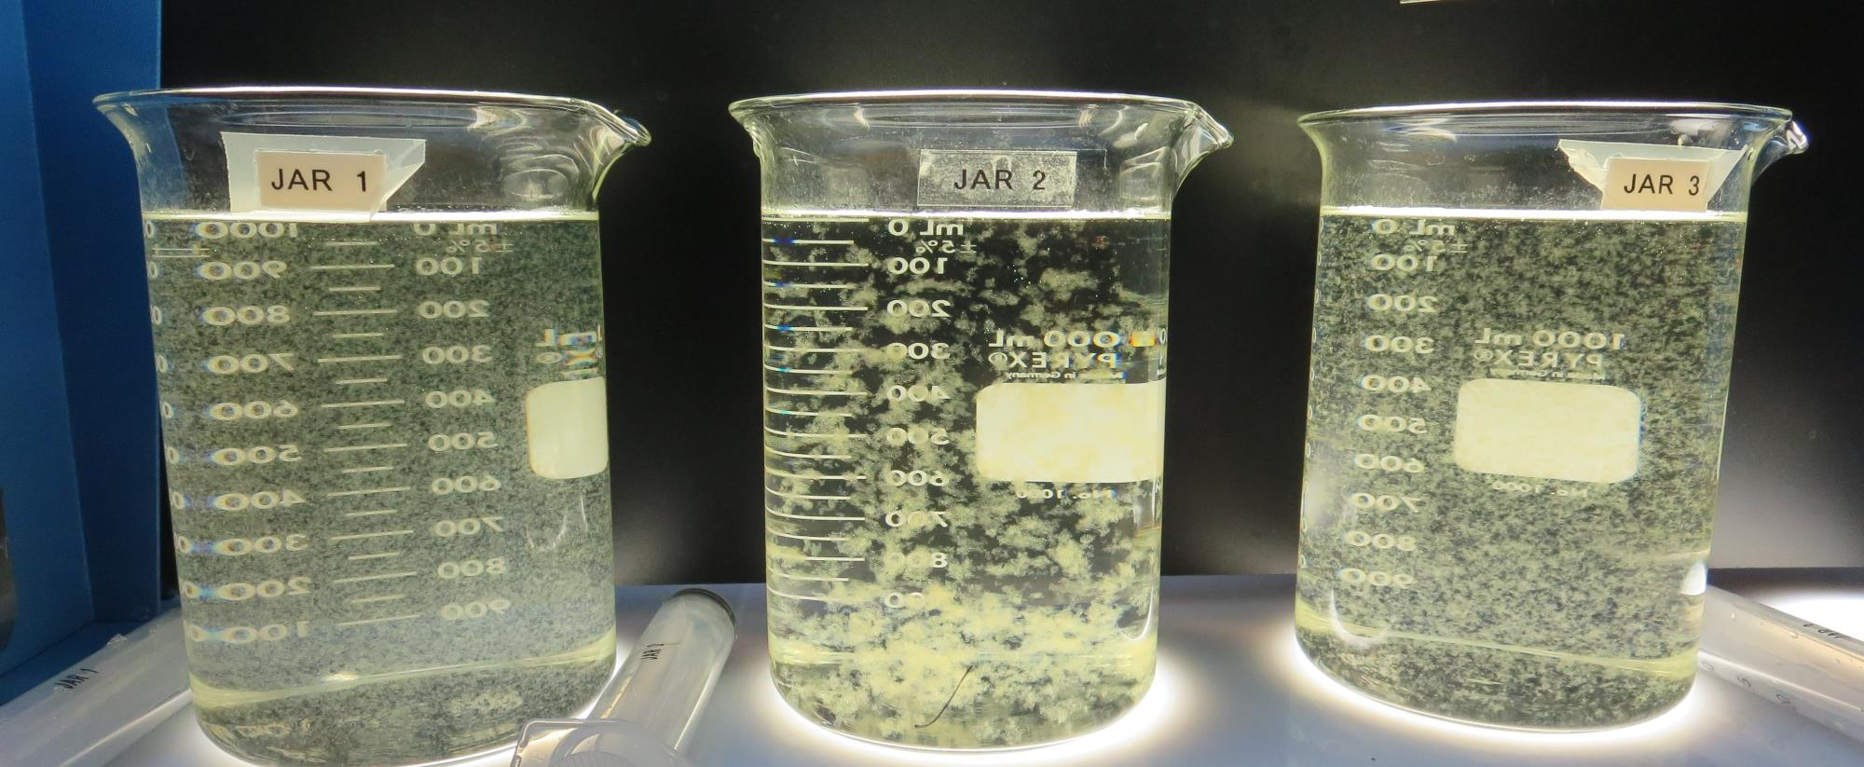
Jars 29-31: End of 5-minute flocculation (20 RPM) duration. 25 mL is syringed for filterability and %UVT/UVA.
75 mg/L 9800
Filtrate 0.3 NTU
UVT: 89.7%
UVA: 0.047/cm
UVA Reduction: 53.9%
200 mg/L Adv Coag.
Filtrate 0.09 NTU
UVT: 89.4%
UVA: 0.048/cm
UVA Reduction: 52.9%
60 mg/L 917
Filtrate 0.08 NTU
UVT: 89.3%
UVA: 0.049/cm
UVA Reduction: 52.0%

Slide 31
Jars 32-35 Test Flash Mix 20 Sec (200 RPM) Floc Mix 5 min (20 RPM) Applied Coagulants 9800/Adv Coag/917

Slide 32
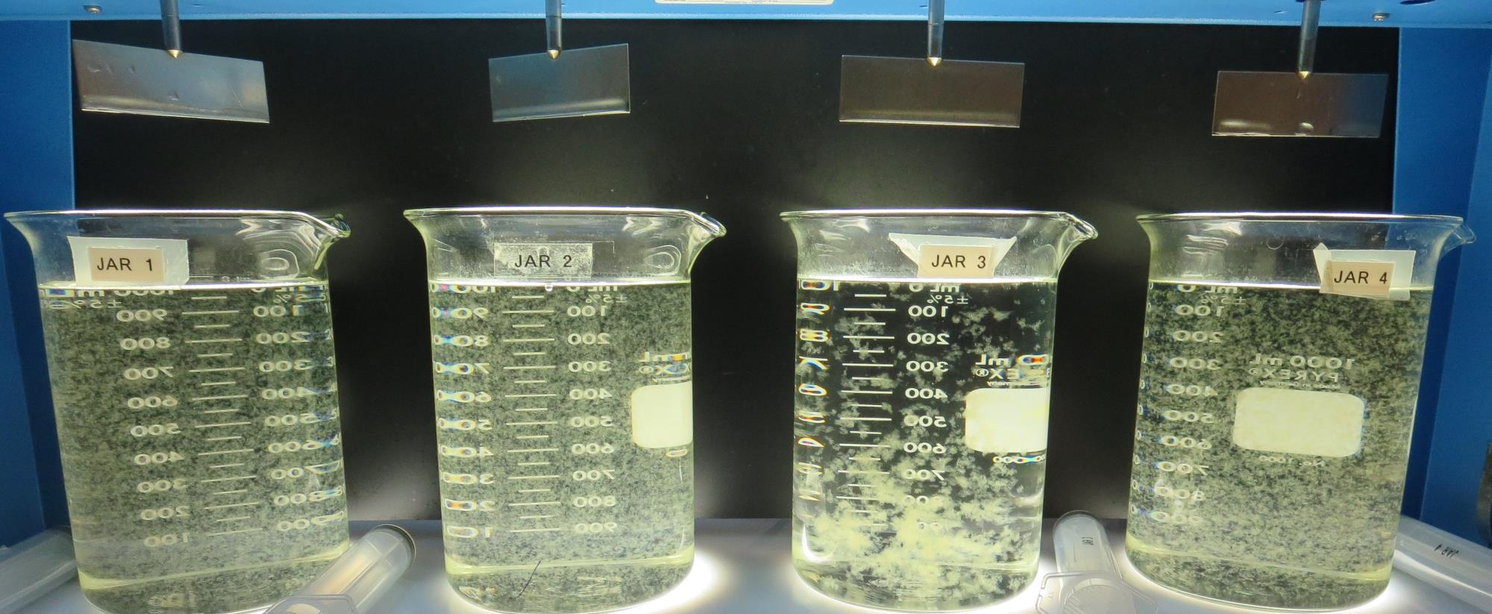
Jars 32-35: End of 5-minute flocculation (20 RPM) duration. 25 mL is syringed for filterability and %UVT/UVA.
70 mg/L 9800
Filtrate 0.09 NTU
UVT: 89.8%
UVA: 0.046/cm
UVA Reduction: 54.9%
75 mg/L 9800
Filtrate 0.09 NTU
UVT: 89.7%
UVA: 0.046/cm
UVA Reduction: 54.9%
200 mg/L Adv Coag.
Filtrate 0.09 NTU
UVT: 89.7%
UVA: 0.046/cm
UVA Reduction: 54.9%
60 mg/L 917
Filtrate 0.11 NTU
UVT: 89.4%
UVA: 0.048/cm
UVA Reduction: 52.9%

Slide 33
Jar Testing for 1-Liter Jars: Procedures for Most Treatment Plants
Fill jars with source water prior to coagulant injection and set paddle speed at 30 rpm
Add chemicals (i.e., NaOCl, primary coagulant, coagulant aid) to each jar
Flash mix for 15-30 seconds (200 rpm)
Slow mix for 5 minutes (20-30 rpm)
Settled for 5 minutes. Syringe 25 mL from each jar taken 1-inch below surface (25 mL/12 sec rate). For this study, 25 mL was taken at end of floc period.
Filtered through 1.2 um isopore membrane into cuvette drip rate, 15 mL/(50-90 sec)
Measure filtrate turbidity, chlorine residual and %UVT/UVA
Measure settled water turbidity after 25 minutes of total setting
Record all data

Slide 34
Jar Test Filterability Test Equipment
Turbidity Instrument
Syringe w/Luer-Lock Tip, 30 cc
(part#: 2225800, by Hach)
Swinnex Filter Holder, 25 mm (part#: SX0002500)
Isopore Membrane Filter, 1.2 um absolute
pore size,
Φ= 25 mm , thickness: 24 um,
hydrophilic polycarbonate membrane
(part #: RTTP02500)
Go to Sigma-Aldrich for laboratory supplies http://www.sigmaaldrich.com/united-states.html

Slide 35
Isopore Membrane Information
Categories | Information
trade name | Isopore
filter color | White
chemistry | Polycarbonate (PC)
water flow rate | Avg. 175 mL/min x cm² (typical results @ 10 psi)
media | Isopore®
wettability | Hydrophilic
porosity | 14.7%
pore size | 1.2 µm
bubble point at 23 °C | 1.0 bar, air with water
thickness | 24 µm
filter diameter (ø) | 25 mm
material size | polycarbonate, Hydrophilic, 1.2 µm, 25 mm, white, plain, 100

Slide 36
Isopore Membrane Background Information
The Isopore membrane is a polycarbonate, track-etched screen filter recommended for all analyses in which the sample is viewed on the surface of the membrane. The Isopore membrane is composed of polycarbonate film, which has a smooth, glass-like surface for clearer sample observation. The unique manufacturing process of the membrane ensures a precise pore diameter and a consistent pore size for accurate separation of samples by size. Matched-weight filters are not usually required because of low, constant tar and ash weights. Features & Benefits: Membrane structure retains particles on the surface, simplifying counting and analysis

Slide 37
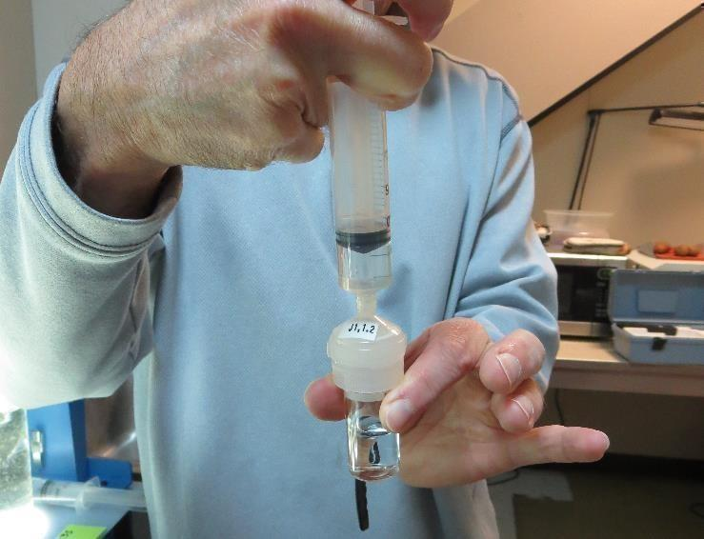
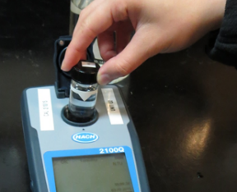
Jar Test - Filterability Test
Syringe ~ 25 mL from jar (after 5-minutes of settling)
Filter-to-waste 3-5 mL
Filter directly into clean cuvette
Measure turbidity
Note: Take several readings before recording final NTU results. Micro bubbles can adhere to glass causing false NTU readings. To remove bubbles, tilt cuvette up to 90 degrees.

Slide 38
Contact
Guy Schott, P.E.
State Water Resources Control Board
Division of Drinking Water
Santa Rosa, CA
Go to Stock Solution/Dose calculations/Jar Test Results for tools to download
www.waterboards.ca.gov/drinking_water/programs/districts/mendocino_district.html
Email: Guy Schott - Guy.Schott@waterboards.ca.gov
Office Number: 707-576-2732

