Slide 1
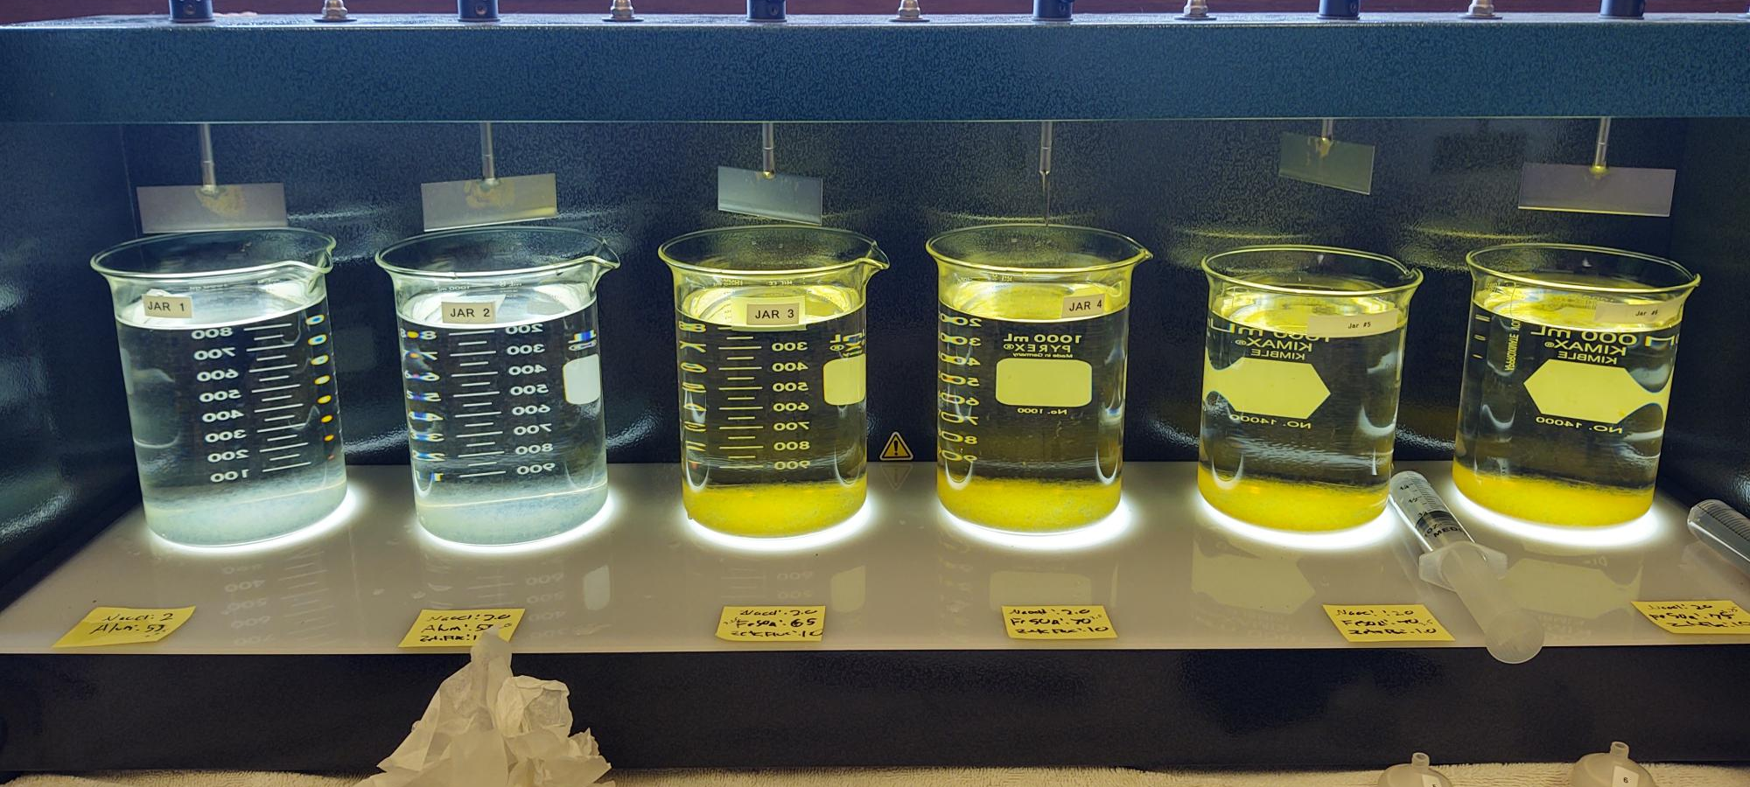
City of St. Helena, CA2810004
Napa County
Jar Test
by Guy Schott, P.E.
October 23, 2024

Slide 2
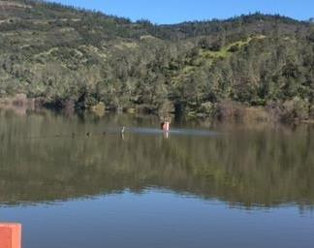
Source Water:
Bell Canyon Reservoir

Slide 3
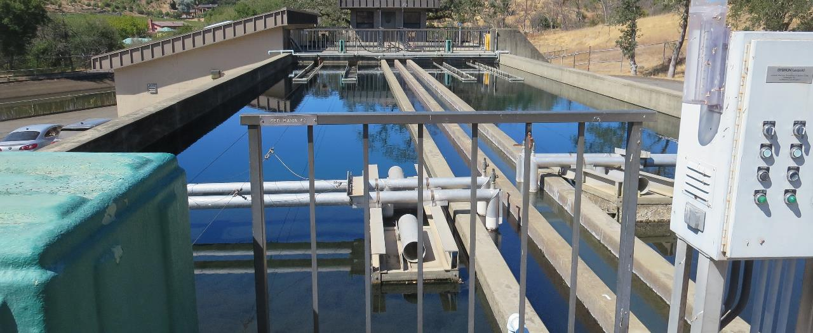
Flocculation/Sedimentation Basins

Slide 4
Bell Canyon Reservoir Source & Treated Water Characteristics, September 5, 2024
Source – Bell Canyon Reservoir
pH: 7.30
Alkalinity: 33 mg/L as CaCO₃
Turbidity: x NTU
UVT: x%,
UVA: x/cm
0.4 um Filtered
Turbidity: x NTU
UVT: x%,
UVA: x/cm
Plant Filtrate Water
0.06 NTU
UVT: 91.16%,
UVA: 0.0402/cm
Plant Filtrate Water
pH: 7.13
Alkalinity: 25 mg/L as CaCO₃
0.09 NTU
UVT: 91.53%,
UVA: 0.0385/cm

Slide 5
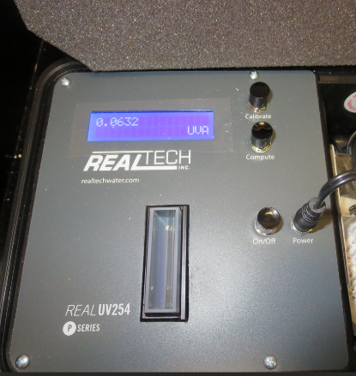
UVT/UVA, pathlength 40 mm
UV transmittance (UVT) is a measurement of the amount of ultraviolet light (commonly at 254 nm due to its germicidal effect) that passes through a water sample compared to the amount of light that passes through a pure water sample. The measurement is expressed as a percentage, % UVT.
%UVT = 10^{(-UVA)} x 100%
UV absorbance (UVA) is calculated as a relative measure of the amount of light absorbed by a water sample compared with the amount of light absorbed by a pure water sample.
UVA = -log(%UVT/100)

Slide 6
Applied Coagulants for Jar Testing (1)
Aluminum Sulfate (Product)
Al₂(SO₄)₃*14.3H₂0 (Liquid)
47.47% Aluminum Sulfate
52% Water
8.08% Al₂O₃
0% Basicity
SG = 1.325
NSF max use: 400 mg/L (product)
As hydrated Al₂(SO₄)₃*14.3H₂0
17% Al₂O₃
Ferric Sulfate
50% Ferric Sulfate
50% Water
SG = 1.40-1.51
NSF limit: 600 mg/L as Product
NTU Technologies
Zeta Floc 20, Organic Polymer
20% pDADMAC
80% Water
SG = 1.07
NSF limit: 50 mg/L as Product

Slide 7
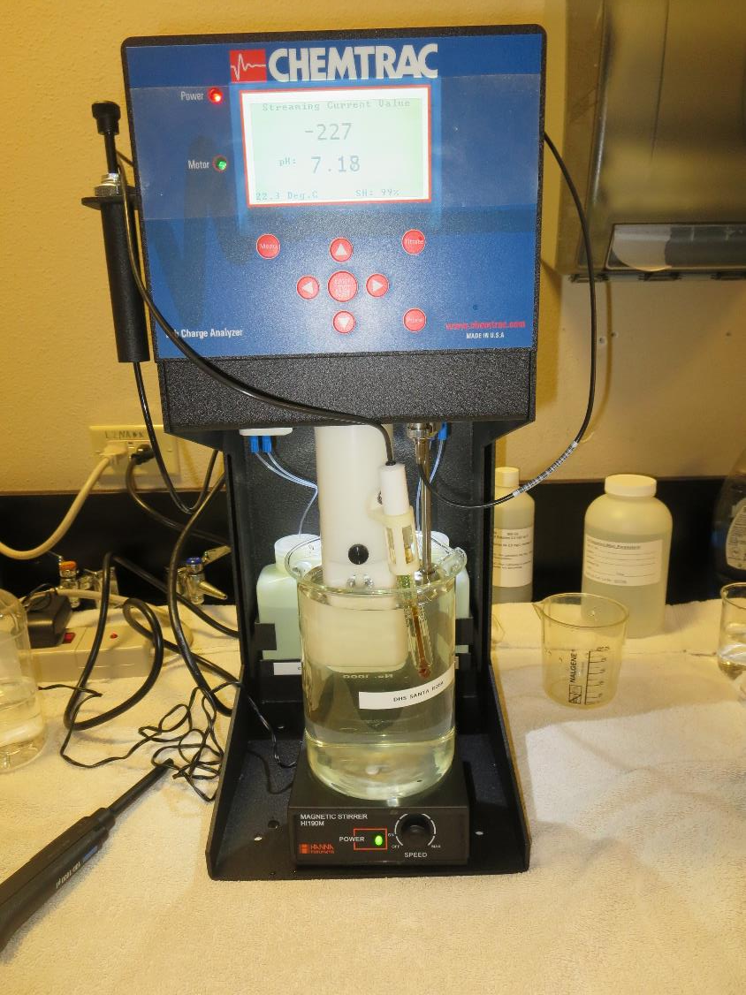
Laboratory Charge Analyzer
LCA: Used to determine coagulant demand of a source water entering the treatment plant.
Source pH: 7.30
LCA #1
FeSO₄: 68 mg/L
End pH: 5.55
No pH adjustment.

Slide 8
Coagulant Information
Unless stated otherwise, all coagulant doses are reported as Product (100% strength). Aluminum sulfate is reported as Alum.
Preparation of coagulant stock solutions are generally 1.0 and/or 0.1 percent strength using 100 and/or 200 mL volumetric flasks.
Finnpipette F2 variable volume pipette, capacity 100-1000 micro liters is used for stock solution preparation and coagulant aid jar test dosing.
Finnpipette F2 variable volume pipette, capacity 0.5-5 mL is used for primary coagulant jar test dosing.

Slide 9
City of St. Helena : Jar Test 1-6 Results
Flash Mix 200 RPM (30 sec); Floc Mix 30 RPM (9 min)
Jar # | NaOCl mg/L | Alum mg/L | Ferric Sulfate mg/L | Zeta Floc20 mg/L | Filtrate NTU | Filtrate %UVT | Filtrate UVA/cm | %UVA Improved Reduction* | Settle NTU 25 min | pH | Alk mg/L
J1 | 2.0 | 53 | - | 0 | 0.06 | 89.26 | 0.0494 | -1.2 | 0.38 | - | -
J2 | 2.0 | 53 | - | 1.0 | 0.04 | 89.65 | 0.0475 | 0 | 0.63 | 6.10 | 6.5
J3 | 2.0 | - | 65 | 1.0 | 0.04 | 92.21 | 0.0352 | 25.9 | 0.42 | 5.63 | 5.0
J4 | 2.0 | - | 70 | 1.0 | 0.04 | 92.24 | 0.0347 | 26.9 | 0.46 | 5.40 | -
J5 | 2.0 | - | 70 | 1.0 | 0.04 | 91.65 | 0.0379 | 20.2 | 1.23 | - | -
J6 | 2.0 | - | 75 | 1.0 | 0.06 | - | - | - | 0.53 | 5.03 | -
*The %UVA is the relative improvement from the filtrate UVA/cm for the Alum dose of 53 mg/L and Zeta Floc20 of 1.0 mg/L.
Jars 2 and 3 were filtered (1.2 um Isopore membrane, 200 mL) and dose with NaOCl at 4.0 mg/L,
held for 5 days and tested for TTHM/HAA5.
Source water jar testing was taken after Post NaMnO₄

Slide 10
City of St. Helena
Jar Test and TTHMs/HAA5s Laboratory Results
NaOCl dose after filtration: 4.0 mg/L (Hold Time 5 days)
Jar # | Alum mg/L | Ferric Sulfate mg/L | Zeta Floc20 mg/L | Filtrate NTU | Filtrate %UVT | Filtrate UVA/cm | *TTHM ug/L | HAA5 ug/L
A: Alum | 53 | - | 1.0 | 0.04 | 89.65 | 0.0475 | - | 80
B: Ferric Sulfate | - | 65 | 1.0 | 0.04 | 92.21 | 0.0352 | - | 66
Note: TTHMs were conducted (68 ug/L for Ferric Sulfate and 65 ug/L for Alum jars). Based on UVA, chlorine decay and HAA5 results, we have concluded the TTHM results to be invalid. It is expected the TTHM results came from the same set of bottles for one of the jars.

Slide 11
%UVA Reduction Improvement from
Alum to Ferric Sulfate: 25.9%
Filtrate jar tested water; Dose NaOCl: 4.0 mg/L
HAA5s taken after a 5 day hold time.
Alum jar: HAA5 = 80 ug/L
Ferric Sulfate ja r: HAA5 = 66 ug/L

Slide 12
Jar Testing for 1-Liter Jars:
Procedures for Most Treatment Plants
Fill jars with source water prior to coagulant injection and set paddle speed at 30 rpm
Add chemicals (i.e., NaOCl, primary coagulant, coagulant aid) to each jar
Flash mix for 15-60 seconds (200 rpm)
Slow mix for 5 minutes (20-30 rpm)
Settled for 5 minutes. Syringe 25 mL from each jar taken 1-inch below surface (25 mL/12 sec rate)
Filtered through 1.2 um isopore membrane into cuvette drip rate, 15 mL/(50-90 sec)
Measure filtrate turbidity, chlorine residual and %UVT/UVA
Measure settled water turbidity after 25 minutes of total setting
Record all data

Slide 13

Jar Test
Filterability Test Equipment
Turbidity Instrument
Syringe w/Luer-Lock Tip, 30 cc
(part#: 2225800, by Hach)
Swinnex Filter Holder, 25 mm (part#: SX0002500)
Isopore Membrane Filter, 1.2 um absolute
pore size,
Φ= 25 mm , thickness: 24 um,
hydrophilic polycarbonate membrane
(part #: RTTP02500)
Go to Sigma-Aldrich for laboratory supplies http://www.sigmaaldrich.com/united-states.html

Slide 14
Isopore Membrane Information
Categories | Information
trade name | Isopore
filter color | White
chemistry | Polycarbonate (PC)
water flow rate | Avg. 175 mL/min x cm² (typical results @ 10 psi)
media | Isopore®
wettability | Hydrophilic
porosity | 14.7%
pore size | 1.2 µm
bubble point at 23 °C | 1.0 bar, air with water
thickness | 24 µm
filter diameter (ø) | 25 mm
material size | polycarbonate, Hydrophilic, 1.2 µm, 25 mm, white, plain, 100

Slide 15
Isopore Membrane Background Information
The Isopore membrane is a polycarbonate, track-etched screen filter recommended for all analyses in which the sample is viewed on the surface of the membrane. The Isopore membrane is composed of polycarbonate film, which has a smooth, glass-like surface for clearer sample observation. The unique manufacturing process of the membrane ensures a precise pore diameter and a consistent pore size for accurate separation of samples by size. Matched-weight filters are not usually required because of low, constant tar and ash weights.
Features & Benefits:
Membrane structure retains particles on the surface, simplifying counting and analysis

Slide 16
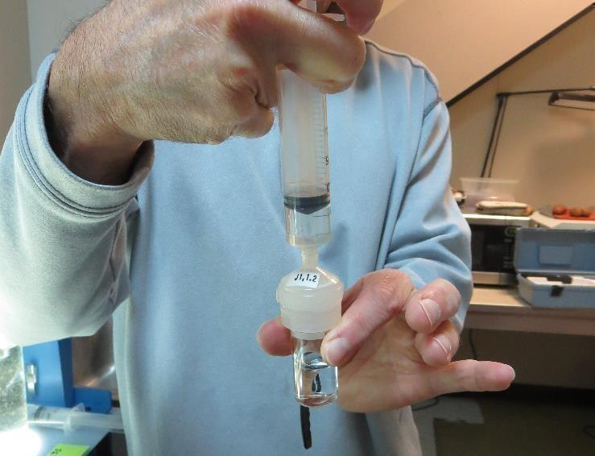

Jar Test - Filterability Test
Syringe ~ 25 mL from jar (after 5-minutes of settling)
Filter-to-waste 3-5 mL
Filter directly into clean cuvette
Measure turbidity
Note: Take several readings before recording final NTU results. Micro bubbles can adhere to glass causing false NTU readings. To remove bubbles, tilt cuvette up to 90 degrees.

Slide 17

Contact
Guy Schott, P.E.
State Water Resources Control Board
Division of Drinking Water
Santa Rosa, CA
Go to Stock Solution/Dose calculations/Jar Test Results for tools to download
www.waterboards.ca.gov/drinking_water/programs/districts/mendocino_district.html
Jar Testing Done Right training video: https://www.youtube.com/watch?v=aGByyxhelkI
Email: Guy Schott - Guy.Schott@waterboards.ca.gov
Office Number: 707-576-2732

