Slide 1
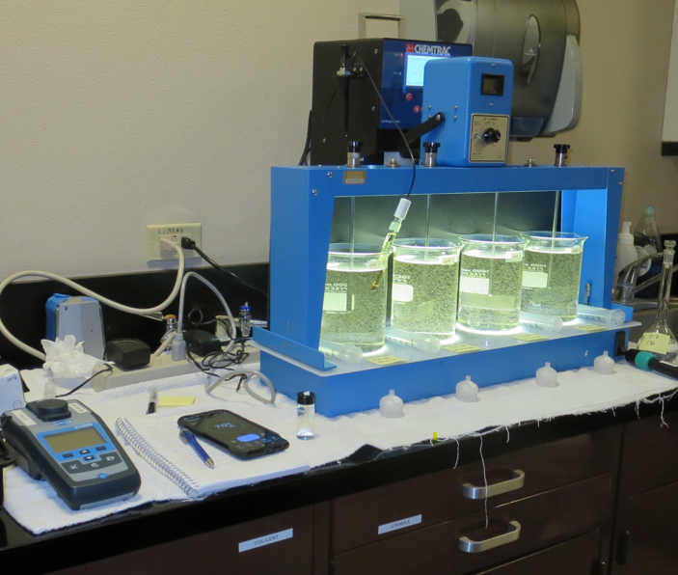
City of St. Helena CA2810004 Napa County Jar Test
by Guy Schott, P.E.
September 5, 2024

Slide 2
Source Water: Bell Canyon Reservoir
Source Water Characteristics
Turbidity: 8.94 NTU
pH: 7.21
UVT: 69.21%
UVA: 0.1599
0.4 um Filtered
UVT: 73.46%
UVA: 0.1340

Slide 3
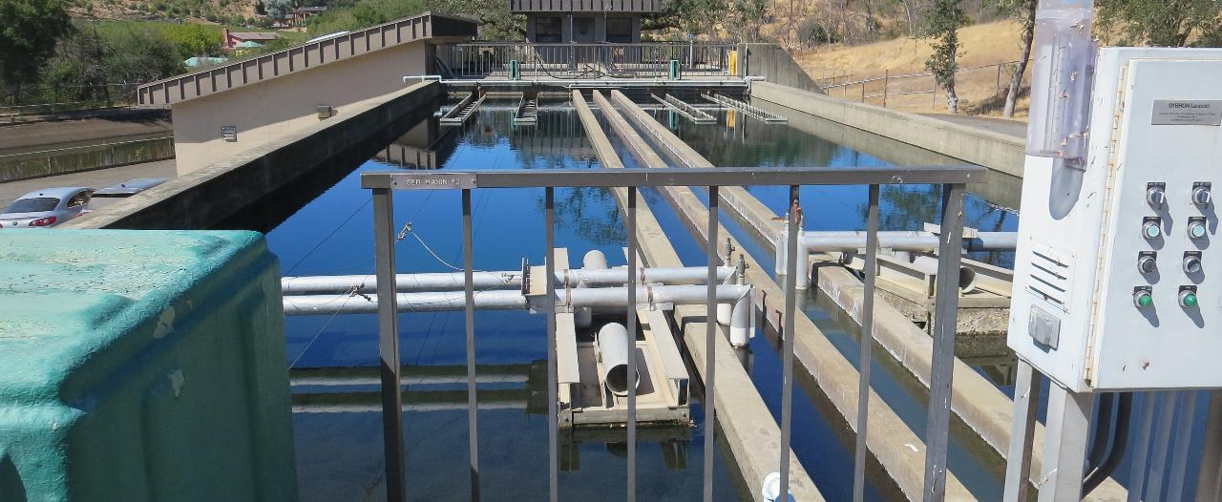
Flocculation/Sedimentation Basins

Slide 4
Bell Canyon Reservoir Source & Treated Water Characteristics, September 5, 2024
Source – Bell Canyon Reservoir
pH: 7.21
Alkalinity: 32 mg/L as CaCO₃
Turbidity: 8.94 NTU
UVT: 69.21%,
UVA: 0.1599/cm
0.4 um Filtered
Turbidity: 0.74 NTU
UVT: 73.46%,
UVA: 0.1340/cm
Plant Filtrate Water
pH: 6.31
Alkalinity: 11.7 mg/L as CaCO₃
0.08 NTU
UVT: 90.37%,
UVA: 0.0440/cm

Slide 5
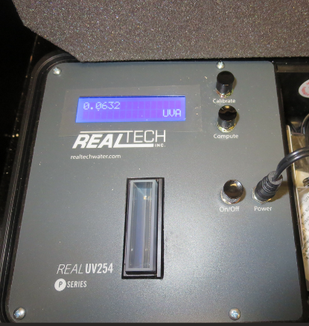
UVT/UVA, pathlength 40 mm
UV transmittance (UVT) is a measurement of the amount of ultraviolet light (commonly at 254 nm due to its germicidal effect) that passes through a water sample compared to the amount of light that passes through a pure water sample. The measurement is expressed as a percentage, % UVT.
%UVT = 10^{(-UVA)} x 100%
UV absorbance (UVA) is calculated as a relative measure of the amount of light absorbed by a water sample compared with the amount of light absorbed by a pure water sample.
UVA = -log(%UVT/100)

Slide 6
Applied Coagulants for Jar Testing (1)
Aluminum Sulfate (Product)
Al₂(SO₄)₃*14.3H₂0 (Liquid)
47.47% Aluminum Sulfate
52% Water
8.08% Al₂O₃
0% Basicity
SG = 1.325
NSF max use: 400 mg/L (product)
As hydrated Al₂(SO₄)₃*14.3H₂0
17% Al₂O₃
Ferric Chloride
42.4% Ferric Chloride
47.6% Water
SG = 1.44
NSF limit: 250 mg/L as Product

Slide 7
Applied Coagulants for Jar Testing (2)
Pro Pac 917 (NTU Technologies, Inc.)
10% polyamine (50% water, 50% active polyamines)
45% Aluminum Chlorohydrate (ACH)
~21.3% Al₂O₃
~11.3% Al
45% Water
83% Basicity
SG = 1.25-1.34
NSF limit: 100 mg/L as Product
NTU Technologies
Pro Pac 9810
45-50% Aluminum Chlorohydrate
45-50% Water
~22.4% Al₂O₃
~11.9% Al
83% Basicity
5% polyamine (50% water, 50% active polyamines)
SG = 1.25-1.34
NSF Max Use: 200 mg/L as Product;

Slide 8
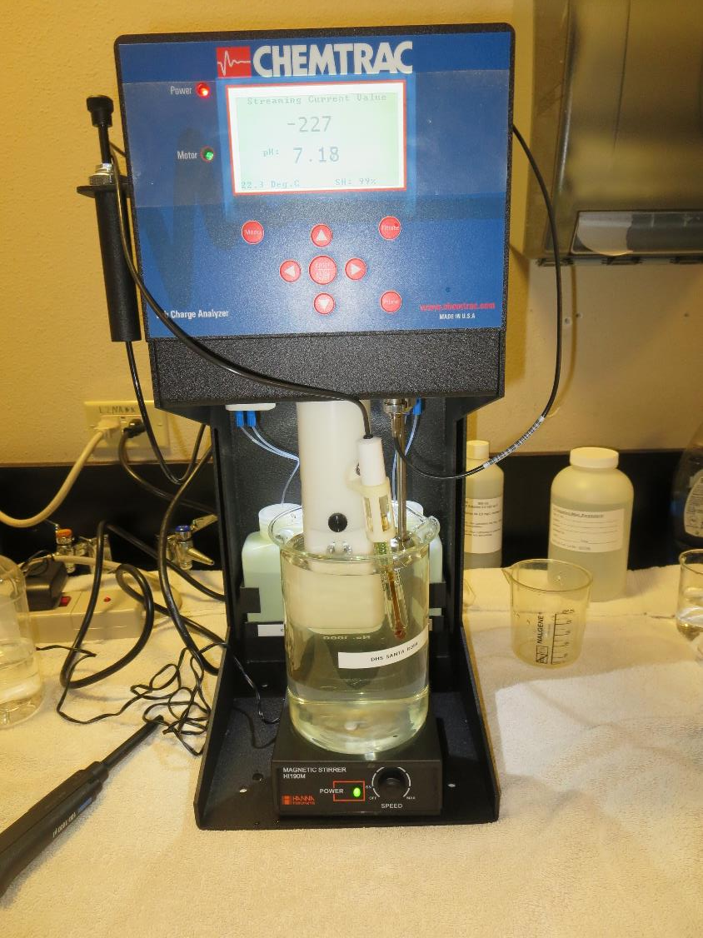
Laboratory Charge Analyzer
LCA: Used to determine coagulant demand of a source water entering the treatment plant.
Source pH: 7.21
LCA #1
917: 18.7 mg/L as product
No pH adjustment.
LCA #2:
Aluminum Sulfate: 49.9 mg/L as Alum
pH adjusted to 6.6
Aluminum Sulfate: 67.6 mg/L as Alum
No pH adjustment

Slide 9
Coagulant Information
Unless stated otherwise, all coagulant doses are reported as Product (100% strength). Aluminum sulfate is reported as Alum.
Preparation of coagulant stock solutions are generally 1.0 and/or 0.1 percent strength using 100 and/or 200 mL volumetric flasks.
Finnpipette F2 variable volume pipette, capacity 100-1000 micro liters is used for stock solution preparation and coagulant aid jar test dosing.
Finnpipette F2 variable volume pipette, capacity 0.5-5 mL is used for primary coagulant jar test dosing.

Slide 10
City of St. Helena : Jar Test 1-4 Results Flash Mix 200 RPM (20 sec); Floc Mix 30 RPM (7 min)
Jar # | Alum mg/L | Filtrate NTU | Filtrate %UVT | Filtrate UVA/cm | %UVA Reduction | Settle NTU 25 min | pH | Alk mg/L CaCO3
J1 | 45 | 0.06 | 88.35 | 0.0538 | 59.8 | 0.26 | 6.15 | 13.5
J2 | 50 | 0.05 | 89.41 | 0.0487 | 63.7 | 0.33 | 6.06 | 11.5
J3 | 55 | 0.05 | 89.63 | 0.0476 | 64.5 | 0.25 | 5.93 | 10.4
J4 | 60 | 0.07 | 89.82 | 0.0467 | 65.2 | 0.28 | 5.83 | 8.3
Source water jar testing was taken after Post NaMnO₄

Slide 11
City of St. Helena : Jar Test 5-8 Results Flash Mix 200 RPM (20 sec); Floc Mix 30 RPM (9 min)
Jar # | 917 mg/L | Filtrate NTU | Filtrate %UVT | Filtrate UVA/cm | %UVA Reduction | Settle NTU 25 min | pH | Alk mg/L CaCO3
J5 | 18 | 0.06 | 86.33 | 0.0639 | 52.3 | 0.47 | 7.16 | 32.2
J6 | 22 | 0.05 | 87.38 | 0.0586 | 56.3 | 0.25 | 7.13 | 30.8
J7 | 26 | 0.05 | 88.11 | 0.0586 | 58.3 | 0.22 | 7.12 | 31.0
J8 | 30 | 0.06 | 88.66 | 0.0523 | 61.0 | 0.44 | 7.10 | 30.9
Source water jar testing was taken after Post NaMnO₄

Slide 12
City of St. Helena : Jar Test 9-12 Results Flash Mix 200 RPM (20 sec); Floc Mix 30 RPM (9 min)
Jar # | 917 mg/L | Alum mg/L | Filtrate NTU | Filtrate %UVT | Filtrate UVA/cm | %UVA Reduction | Settle NTU 25 min | pH | Alk mg/L CaCO3
J9 | 20 | 0 | 0.06 | 55.4 | 0.0597 | 55.4 | 0.25 | 7.15 | 31.3
J10 | 20 | 10 | 0.06 | 56.5 | 0.0583 | 56.5 | 0.24 | 6.86 | 26.8
J11 | 20 | 20 | 0.05 | 59.3 | 0.0546 | 59.3 | 0.25 | 6.63 | 22.2
J12 | 20 | 30 | 0.06 | 61.4 | 0.0517 | 61.4 | 0.40 | 6.42 | 18.3
Source water jar testing was taken after Post NaMnO₄

Slide 13
City of St. Helena : Jar Test 13-16 Results Flash Mix 200 RPM (20 sec); Floc Mix 30 RPM (9 min)
Jar # | 917 mg/L | Alum mg/L | Filtrate NTU | Filtrate %UVT | Filtrate UVA/cm | %UVA Reduction | Settle NTU 25 min | pH | Alk mg/L CaCO3
J13 | 20 | 35 | 0.05 | 89.90 | 0.0463 | 65.4 | 0.30 | 6.31 | 16.5
J14 | 20 | 40 | 0.05 | 90.01 | 0.0457 | 65.9 | 0.46 | 6.20 | 14.0
J15 | 20 | 45 | 0.05 | 90.39 | 0.0439 | 67.2 | 0.49 | 6.11 | 13.0
J16 | 20 | 50 | 0.05 | 92.00 | 0.0448 | 66.6 | 0.46 | 6.00 | 10.5
Source water jar testing was taken after Post NaMnO₄

Slide 14
City of St. Helena : Jar Test 17-20 Results Flash Mix 200 RPM (20 sec); Floc Mix 30 RPM (9 min)
Jar # | 9810 mg/L | Alum mg/L | Filtrate NTU | Filtrate %UVT | Filtrate UVA/cm | %UVA Reduction | Settle NTU 25 min | pH | Alk mg/L CaCO3
J17 | 24 | 0 | 0.05 | 88.04 | 0.0554 | 58.7 | 0.20 | 7.20 | 30.7
J18 | 24 | 20 | 0.05 | 88.83 | 0.0513 | 61.7 | 0.17 | 6.63 | 22.0
J19 | 24 | 25 | 0.05 | 89.01 | 0.0506 | 62.2 | 0.20 | 6.54 | 19.9
J20 | 24 | 30 | 0.05 | 89.22 | 0.0496 | 63.0 | 0.24 | 6.42 | 18.0
Source water jar testing was taken after Post NaMnO₄

Slide 15
City of St. Helena : Jar Test 21-24 Results Flash Mix 200 RPM (20 sec); Floc Mix 30 RPM (9 min)
Jar # | 9810 mg/L | Alum mg/L | Filtrate NTU | Filtrate %UVT | Filtrate UVA/cm | %UVA Reduction | Settle NTU 25 min | pH | Alk mg/L CaCO3
J21 | 0 | 50 | 0.05 | 89.77 | 0.0469 | 65.0 | 0.26 | 6.05 | 11.9
J22 | 28 | 25 | 0.06 | 89.57 | 0.0478 | 64.3 | 0.34 | 6.48 | 20.0
J23 | 32 | 25 | 0.08 | 89.74 | 0.0470 | 64.9 | 0.45 | 6.45 | 19.8
J24 | 36 | 25 | 0.08 | 89.83 | 0.0466 | 65.2 | 0.47 | 6.44 | 20.5
Source water jar testing was taken after Post NaMnO₄

Slide 16
City of St. Helena : Jar Test 25-28 Results Flash Mix 200 RPM (20 sec); Floc Mix 30 RPM (7 min)
Jar # | 9810 mg/L | FeCl₃ mg/L | Filtrate NTU | Filtrate %UVT | Filtrate UVA/cm | %UVA Reduction | Settle NTU 25 min | pH | Alk mg/L CaCO3
J25 | 0 | 27 | 0.08 | 88.92 | 0.0510 | 61.9 | 0.50 | 6.19 | 13.2
J26 | 24 | 10 | 0.05 | 89.48 | 0.0473 | 64.7 | 0.42 | 6.74 | 23.4
J27 | 24 | 15 | 0.05 | 90.46 | 0.0430 | 67.9 | 0.42 | 6.53 | 19.9
J28 | 24 | 20 | 0.05 | 91.30 | 0.0395 | 70.5 | 0.66 | 6.35 | 16.7
J29 | 0 | 35 | 0.05 | 92.63 | 0.0333 | 75.1 | 0.35 | 5.79 | 7.4
J30 | 24 | 25 | 0.05 | 91.76 | 0.0374 | 72.1 | 1.79 | 6.14 | -
Source water jar testing was taken after Post NaMnO₄

Slide 17
Jars 1-4 Test Flash Mix 20 Sec (200 RPM) Floc Mix 7 min (30 RPM) Post NaMnO₄ Applied Coagulant Alum

Slide 18
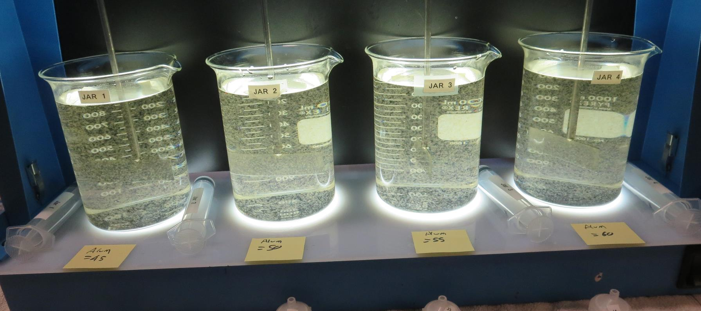
Jars 1-4: End of 7-minute flocculation (30 RPM) duration.
45 mg/L Alum
Filtrate: 0.06 NTU
UVT: 88.35%
UVA: 0.0538/cm
UVA Reduction: 59.9%
Settled: 0.26 NTU
pH: 6.15, Alk: 13.5 mg/L
50 mg/L Alum
Filtrate: 0.05 NTU
UVT: 89.41%
UVA: 0.0487/cm
UVA Reduction: 63.7%
Settled: 0.33 NTU
pH: 6.06, Alk: 11.5 mg/L
55 mg/L Alum
Filtrate: 0.05 NTU
UVT: 89. 63%
UVA: 0.0476/cm
UVA Reduction: 64.5%
Settled: 0.25 NTU
pH: 5.93, Alk: 10.4 mg/L
60 mg/L Alum
Filtrate: 0.07 NTU
UVT: 89. 82%
UVA: 0.0467/cm
UVA Reduction: 65.2%
Settled: 0.28 NTU
pH: 5.83, Alk: 8.3 mg/L

Slide 19
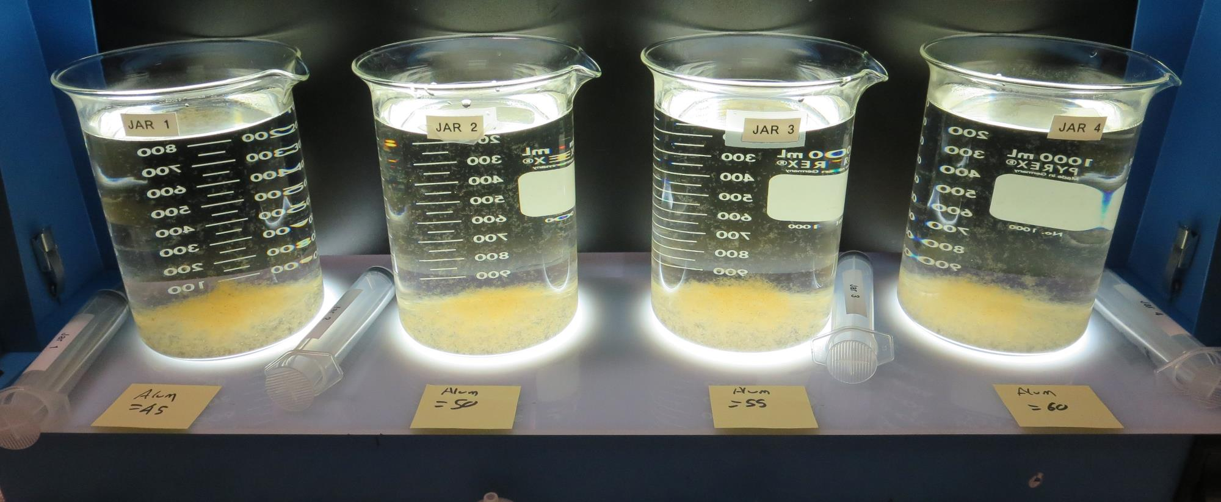
Jars 1-4: After 5 min of settling, 25 mL is syringed for filterability and %UVT/UVA

Slide 20
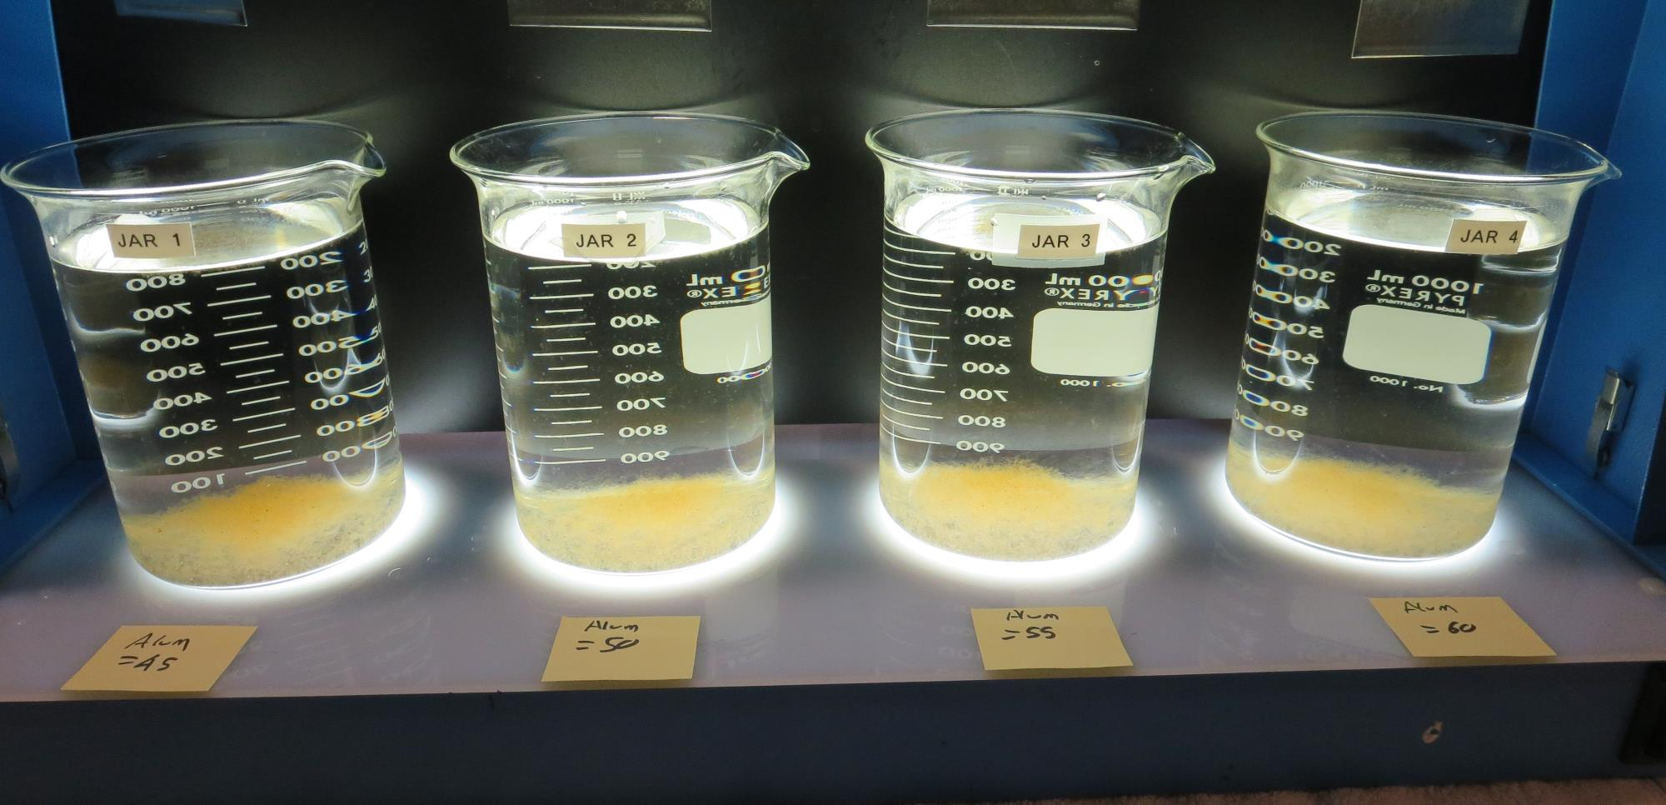
Jars 1-4: After 25-minutes of settling, settled water turbidity is taken.
45 mg/L Alum
Filtrate: 0.06 NTU
UVT: 88.35%
UVA: 0.0538/cm
UVA Reduction: 59.9%
Settled: 0.26 NTU
pH: 6.15, Alk: 13.5 mg/L
50 mg/L Alum
Filtrate: 0.05 NTU
UVT: 89.41%
UVA: 0.0487/cm
UVA Reduction: 63.7%
Settled: 0.33 NTU
pH: 6.06, Alk: 11.5 mg/L
55 mg/L Alum
Filtrate: 0.05 NTU
UVT: 89. 63%
UVA: 0.0476/cm
UVA Reduction: 64.5%
Settled: 0.25 NTU
pH: 5.93, Alk: 10.4 mg/L
60 mg/L Alum
Filtrate: 0.07 NTU
UVT: 89. 82%
UVA: 0.0467/cm
UVA Reduction: 65.2%
Settled: 0.28 NTU
pH: 5.83, Alk: 8.3 mg/L

Slide 21
Jars 5-8 Test Flash Mix 20 Sec (200 RPM) Floc Mix 9 min (30 RPM) Post NaMnO₄ Applied Coagulant 917

Slide 22
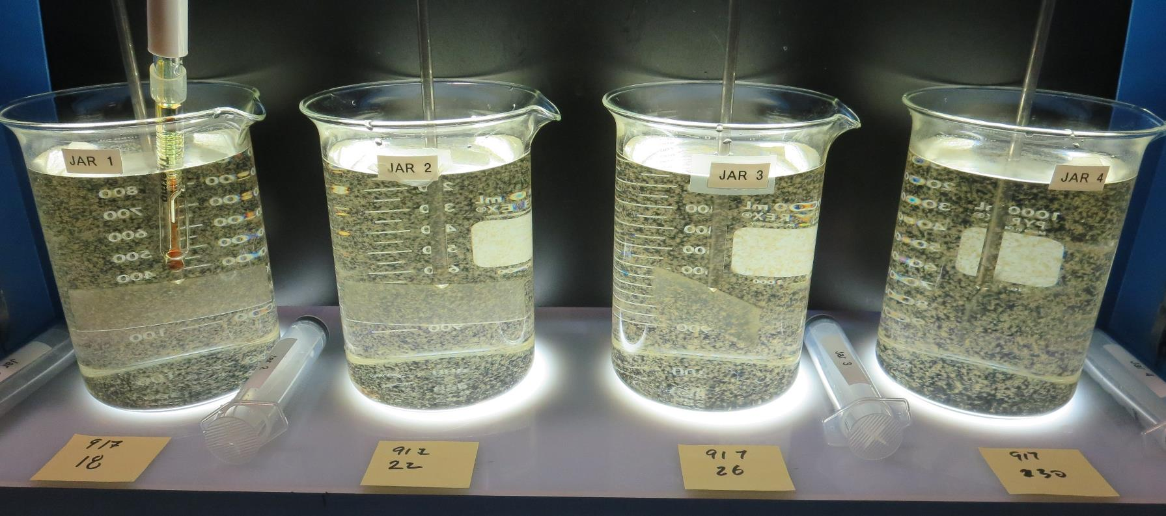
Jars 5-8: End of 9-minute flocculation (30 RPM) duration.
18 mg/L 917
Filtrate: 0.06 NTU
UVT: 86.4%
UVA: 0.0639/cm
UVA Reduction: 52.3%
Settled: 0.47 NTU
pH: 7.16, Alk: 32.2 mg/L
22 mg/L 917
Filtrate: 0.05 NTU
UVT: 87.4%
UVA: 0.0586/cm
UVA Reduction: 56.3%
Settled: 0.25 NTU
pH: 7.13, Alk: 30.8 mg/L
26 mg/L 917
Filtrate: 0.05 NTU
UVT: 88.1%
UVA: 0.0550/cm
UVA Reduction: 59.0%
Settled: 0.22 NTU
pH: 7.12, Alk: 31.0 mg/L
30 mg/L 917
Filtrate: 0.05 NTU
UVT: 88.7%
UVA: 0.0523/cm
UVA Reduction: 61.0%
Settled: 0.44 NTU
pH: 7.10, Alk: 30.9 mg/L

Slide 23
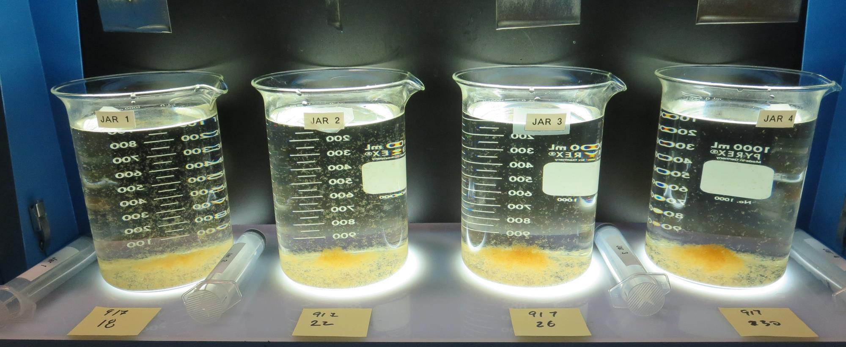
Jars 5-8: After 5 min of settling, 25 mL is syringed for filterability and %UVT/UVA

Slide 24
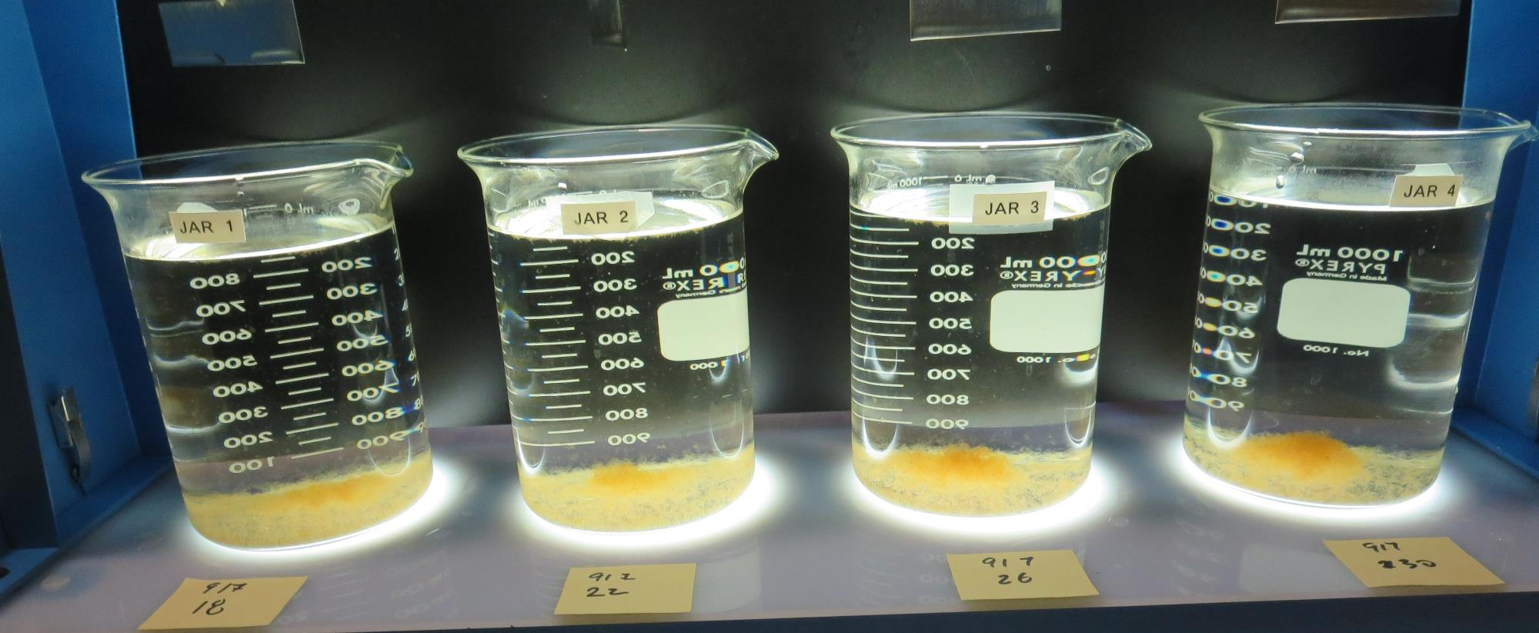
Jars 5-8: After 25-minutes of settling, settled water turbidity is taken.
18 mg/L 917
Filtrate: 0.06 NTU
UVT: 86.4%
UVA: 0.0639/cm
UVA Reduction: 52.3%
Settled: 0.47 NTU
pH: 7.16, Alk: 32.2 mg/L
22 mg/L 917
Filtrate: 0.05 NTU
UVT: 87.4%
UVA: 0.0586/cm
UVA Reduction: 56.3%
Settled: 0.25 NTU
pH: 7.13, Alk: 30.8 mg/L
26 mg/L 917
Filtrate: 0.05 NTU
UVT: 88.1%
UVA: 0.0550/cm
UVA Reduction: 59.0%
Settled: 0.22 NTU
pH: 7.12, Alk: 31.0 mg/L
30 mg/L 917
Filtrate: 0.05 NTU
UVT: 88.7%
UVA: 0.0523/cm
UVA Reduction: 61.0%
Settled: 0.44 NTU
pH: 7.10, Alk: 30.9 mg/L

Slide 25
Jars 9-12 Test Flash Mix 20 Sec (200 RPM) Floc Mix 8 min (30 RPM) Post NaMnO₄ Applied Coagulant 917 Alum

Slide 26
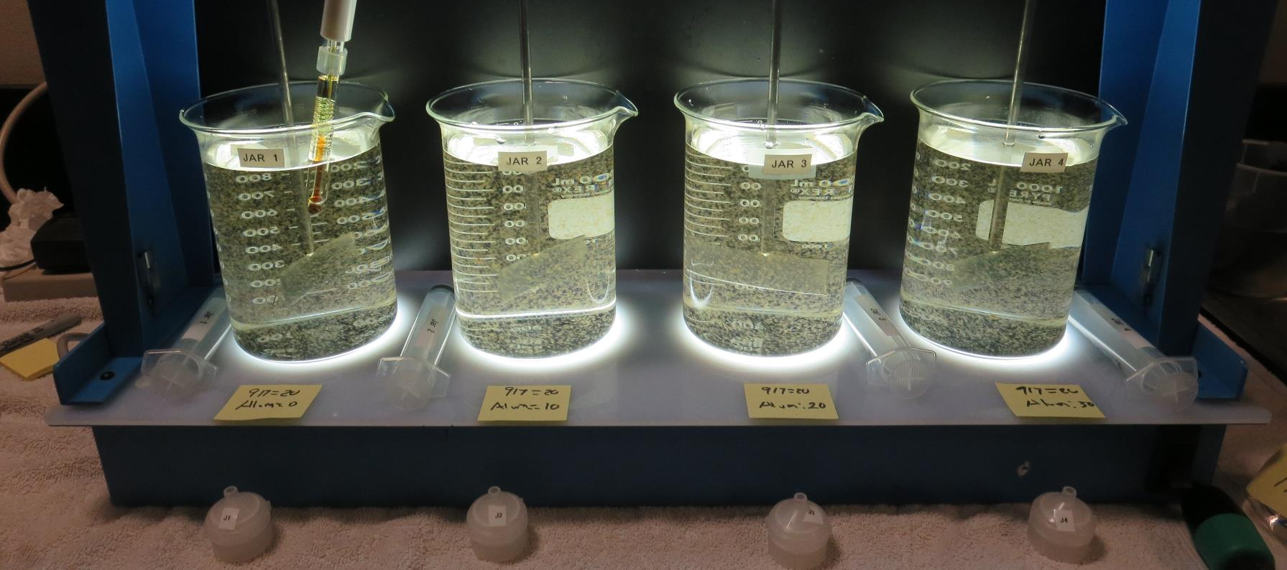
Jars 9-12: End of 8-minute flocculation (30 RPM) duration.
20 mg/L 917
0 mg/L Alum
Filtrate: 0.06 NTU
UVT: 87.2%
UVA: 0.0597/cm
UVA Reduction: 55.4%
Settled: 0.25 NTU
pH: 7.15, Alk: 31.3 mg/L
20 mg/L 917
10 mg/L Alum
Filtrate: 0.06 NTU
UVT: 87.4%
UVA: 0.0583/cm
UVA Reduction: 56.5%
Settled: 0.23 NTU
pH: 6.86, Alk: 23.8 mg/L
20 mg/L 917
20 mg/L Alum
Filtrate: 0.05 NTU
UVT: 88.2%
UVA: 0.0546/cm
UVA Reduction: 59.3%
Settled: 0.25 NTU
pH: 6.63, Alk: 22.2 mg/L
20 mg/L 917
30 mg/L Alum
Filtrate: 0.06 NTU
UVT: 88.8%
UVA: 0.0517/cm
UVA Reduction: 61.4%
Settled: 0.40 NTU
pH: 6.42, Alk: 18.3 mg/L

Slide 27
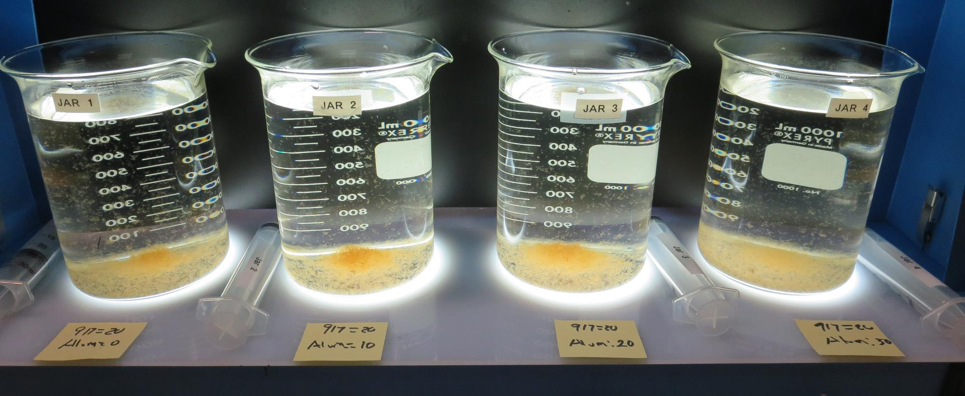
Jars 9-12: After 5 min of settling, 25 mL is syringed for filterability and %UVT/UVA

Slide 28
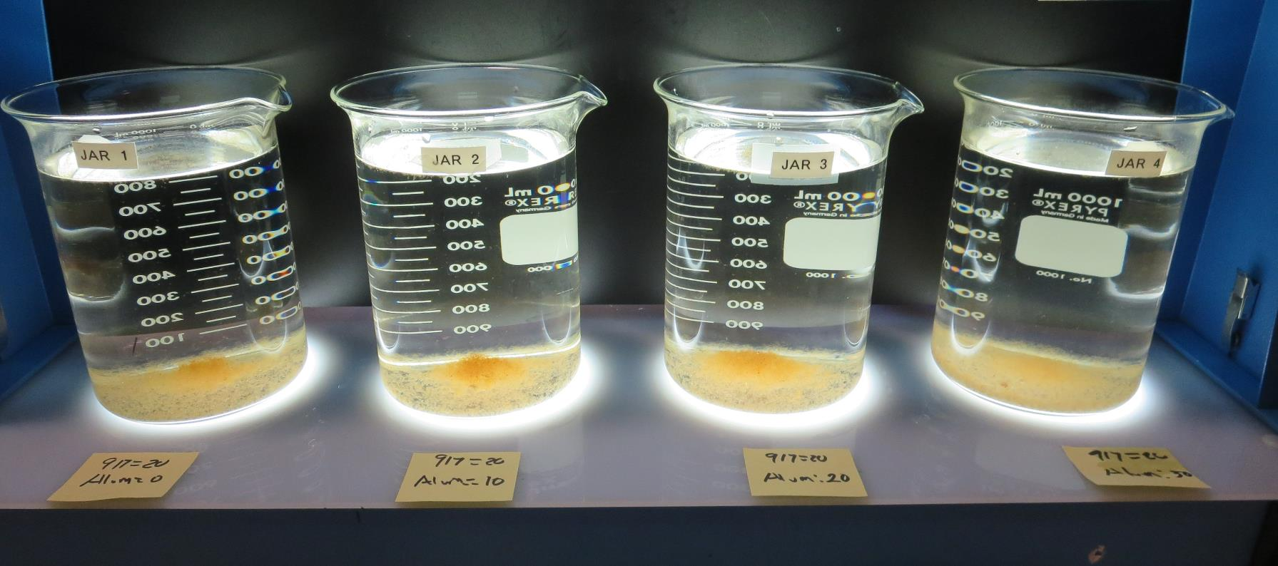
Jars 9-12: After 25-minutes of settling, settled water turbidity is taken.
20 mg/L 917
0 mg/L Alum
Filtrate: 0.06 NTU
UVT: 87.2%
UVA: 0.0597/cm
UVA Reduction: 55.4%
Settled: 0.25 NTU
pH: 7.15, Alk: 31.3 mg/L
20 mg/L 917
10 mg/L Alum
Filtrate: 0.06 NTU
UVT: 87.4%
UVA: 0.0583/cm
UVA Reduction: 56.5%
Settled: 0.23 NTU
pH: 6.86, Alk: 23.8 mg/L
20 mg/L 917
20 mg/L Alum
Filtrate: 0.05 NTU
UVT: 88.2%
UVA: 0.0546/cm
UVA Reduction: 59.3%
Settled: 0.25 NTU
pH: 6.63, Alk: 22.2 mg/L
20 mg/L 917
30 mg/L Alum
Filtrate: 0.06 NTU
UVT: 88.8%
UVA: 0.0517/cm
UVA Reduction: 61.4%
Settled: 0.40 NTU
pH: 6.42, Alk: 18.3 mg/L

Slide 29
Jars 13-16 Test Flash Mix 30 Sec (200 RPM) Floc Mix 9 min (30 RPM) Post NaMnO₄ Applied Coagulants 917 Alum

Slide 30
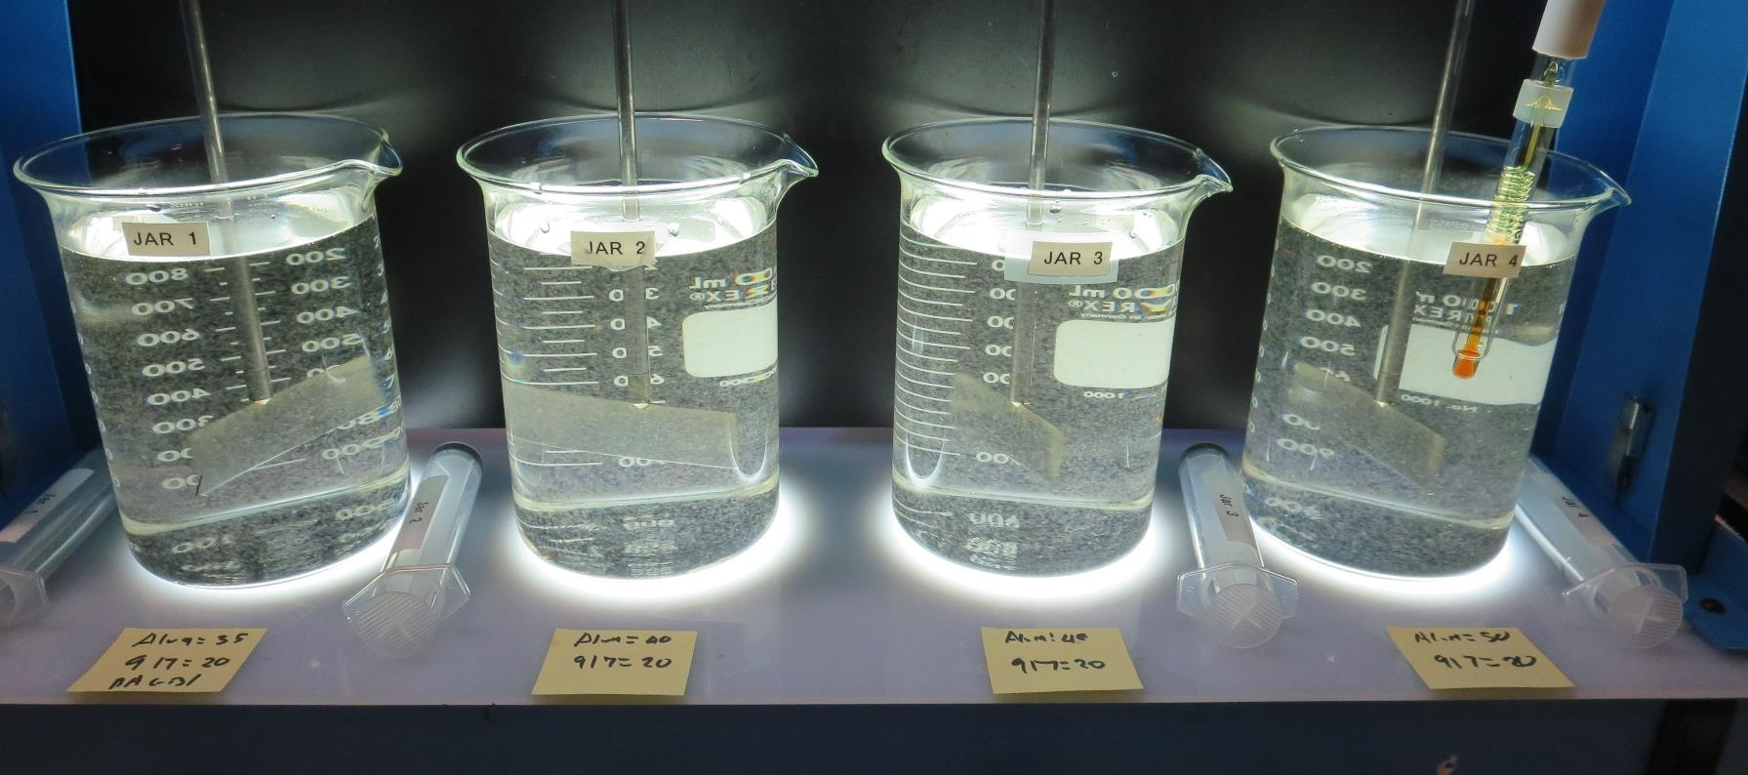
Jars 13-16: End of 9-minute flocculation (30 RPM) duration.
20 mg/L 917
35 mg/L Alum
Filtrate: 0.05 NTU
UVT: 89.90%
UVA: 0.0463/cm
UVA Reduction: 65.4%
Settled: 0.30 NTU
pH: 6.31, Alk: 16.5 mg/L
20 mg/L 917
40 mg/L Alum
Filtrate: 0.05 NTU
UVT: 90.01%
UVA: 0.0457/cm
UVA Reduction: 65.9%
Settled: 0.46 NTU
pH: 6.20, Alk: 14.0 mg/L
20 mg/L 917
45 mg/L Alum
Filtrate: 0.05 NTU
UVT: 90.39%
UVA: 0.0439/cm
UVA Reduction: 67.2%
Settled: 0.49 NTU
pH: 6.11, Alk: 13.0 mg/L
20 mg/L 917
50 mg/L Alum
Filtrate: 0.05 NTU
UVT: 90.20%
UVA: 0.0448/cm
UVA Reduction: 66.6%
Settled: 0.46 NTU
pH: 6.00, Alk: 10.5 mg/L

Slide 31
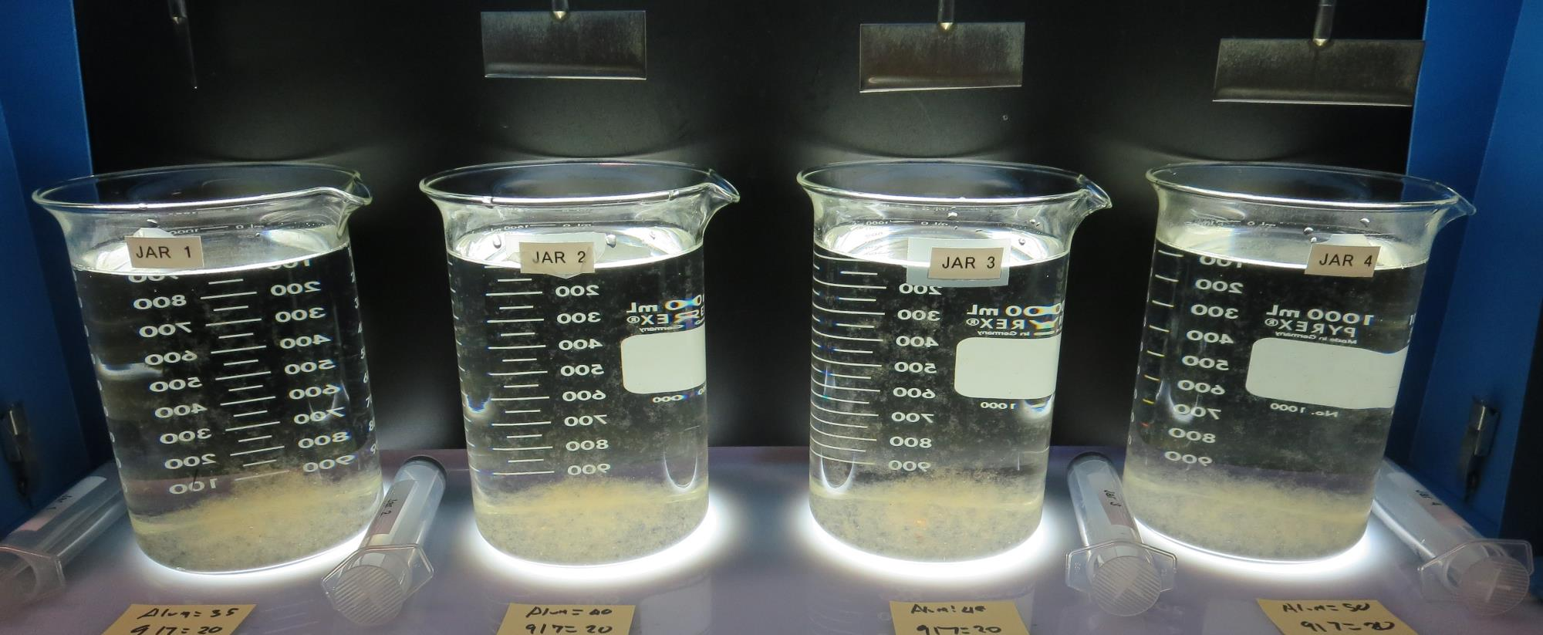
Jars 13-16: After 5 min of settling, 25 mL is syringed for filterability and %UVT/UVA

Slide 32
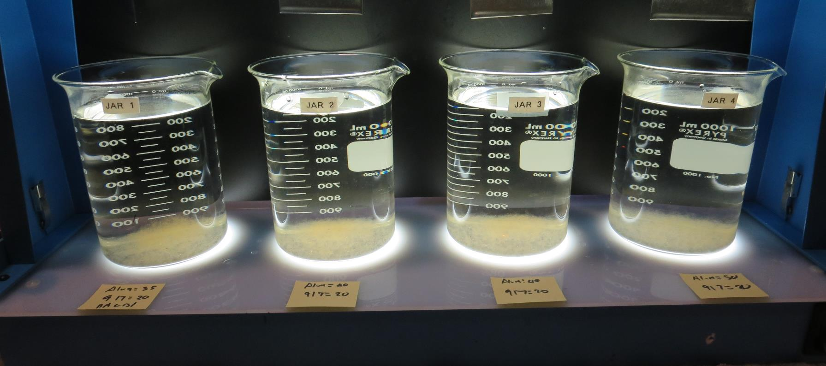
Jars 13-16: After 25-minutes of settling, settled water turbidity is taken.
20 mg/L 917
35 mg/L Alum
Filtrate: 0.05 NTU
UVT: 89.90%
UVA: 0.0463/cm
UVA Reduction: 65.4%
Settled: 0.30 NTU
pH: 6.31, Alk: 16.5 mg/L
20 mg/L 917
40 mg/L Alum
Filtrate: 0.05 NTU
UVT: 90.01%
UVA: 0.0457/cm
UVA Reduction: 65.9%
Settled: 0.46 NTU
pH: 6.20, Alk: 14.0 mg/L
20 mg/L 917
45 mg/L Alum
Filtrate: 0.05 NTU
UVT: 90.39%
UVA: 0.0439/cm
UVA Reduction: 67.2%
Settled: 0.49 NTU
pH: 6.11, Alk: 13.0 mg/L
20 mg/L 917
50 mg/L Alum
Filtrate: 0.05 NTU
UVT: 90.20%
UVA: 0.0448/cm
UVA Reduction: 66.6%
Settled: 0.46 NTU
pH: 6.00, Alk: 10.5 mg/L

Slide 33
Jars 17-20 Test Flash Mix 30 Sec (200 RPM) Floc Mix 8 min (30 RPM) Post NaMnO₄ Applied Coagulants 9810 Alum

Slide 34
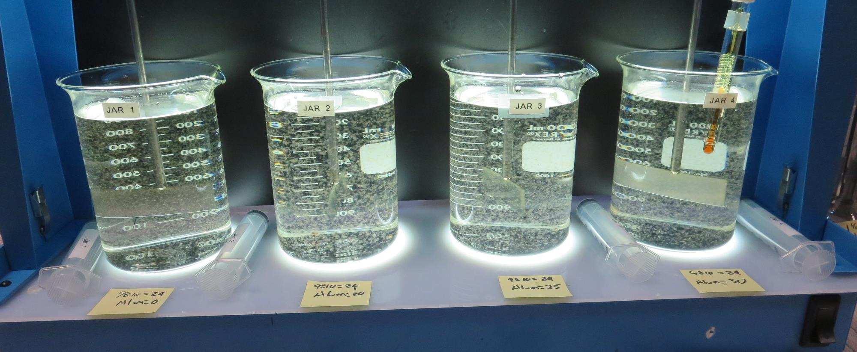
Jars 17-20: End of 8-minute flocculation (30 RPM) duration.
24 mg/L 9810
0 mg/L Alum
Filtrate: 0.05 NTU
UVT: 89.04%
UVA: 0.0554/cm
UVA Reduction: 58.7%
Settled: 0.20 NTU
pH: 7.20, Alk: 30.7 mg/L
24 mg/L 9810
20 mg/L Alum
Filtrate: 0.05 NTU
UVT: 89.83%
UVA: 0.0513/cm
UVA Reduction: 61.7%
Settled: 0.17 NTU
pH: 6.63, Alk: 22 mg/L
24 mg/L 9810
25 mg/L Alum
Filtrate: 0.05 NTU
UVT: 89.01%
UVA: 0.0506/cm
UVA Reduction: 62.2%
Settled: 0.20 NTU
pH: 6.54, Alk: 19.9 mg/L
24 mg/L 9810
30 mg/L Alum
Filtrate: 0.05 NTU
UVT: 89.22%
UVA: 0.0496/cm
UVA Reduction: 63.0%
Settled: 0.24 NTU
pH: 6.42, Alk: 18.0 mg/L

Slide 35
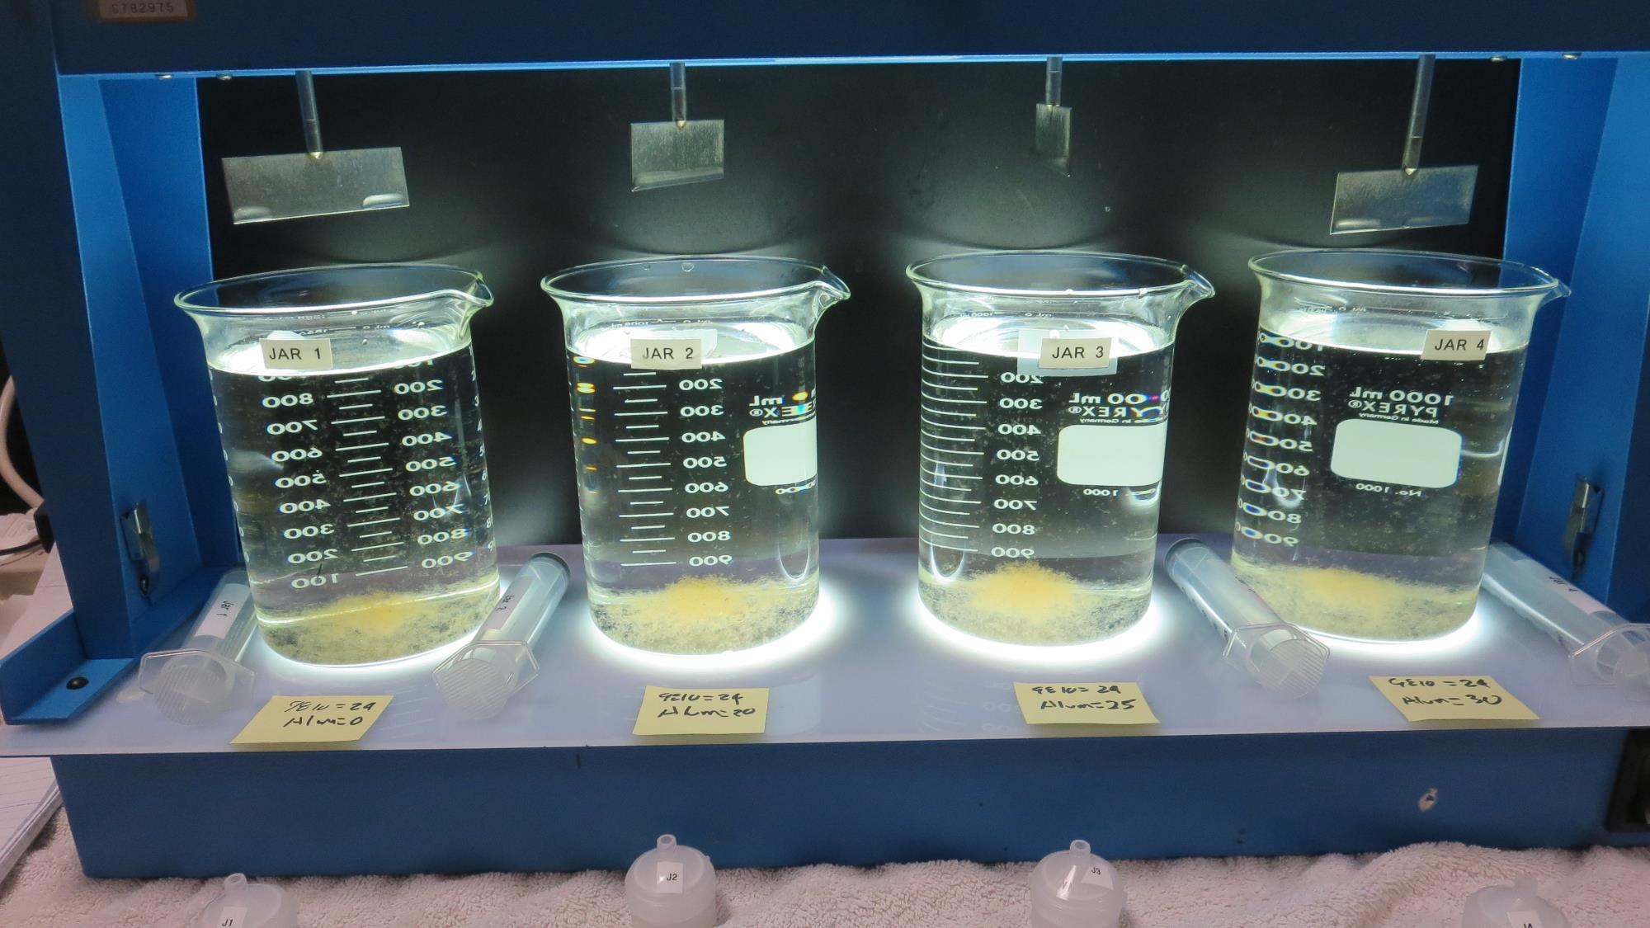
Jars 17-20: After 5 min of settling, 25 mL is syringed for filterability and %UVT/UVA

Slide 36
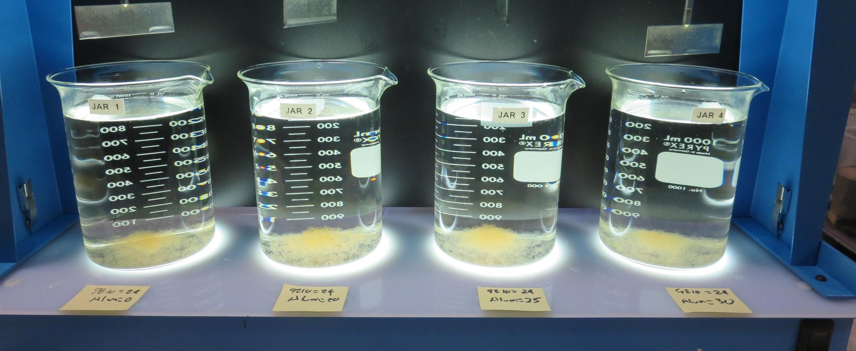
Jars 17-20: After 25-minutes of settling, settled water turbidity is taken.
24 mg/L 9810
0 mg/L Alum
Filtrate: 0.05 NTU
UVT: 89.04%
UVA: 0.0554/cm
UVA Reduction: 58.7%
Settled: 0.20 NTU
pH: 7.20, Alk: 30.7 mg/L
24 mg/L 9810
20 mg/L Alum
Filtrate: 0.05 NTU
UVT: 89.83%
UVA: 0.0513/cm
UVA Reduction: 61.7%
Settled: 0.17 NTU
pH: 6.63, Alk: 22 mg/L
24 mg/L 9810
25 mg/L Alum
Filtrate: 0.05 NTU
UVT: 89.01%
UVA: 0.0506/cm
UVA Reduction: 62.2%
Settled: 0.20 NTU
pH: 6.54, Alk: 19.9 mg/L
24 mg/L 9810
30 mg/L Alum
Filtrate: 0.05 NTU
UVT: 89.22%
UVA: 0.0496/cm
UVA Reduction: 63.0%
Settled: 0.24 NTU
pH: 6.42, Alk: 18.0 mg/L

Slide 37
Jars 21-24 Test Flash Mix 20 Sec (200 RPM) Floc Mix 9 min (30 RPM) Post NaMnO₄ Applied Coagulants Alum/9810

Slide 38
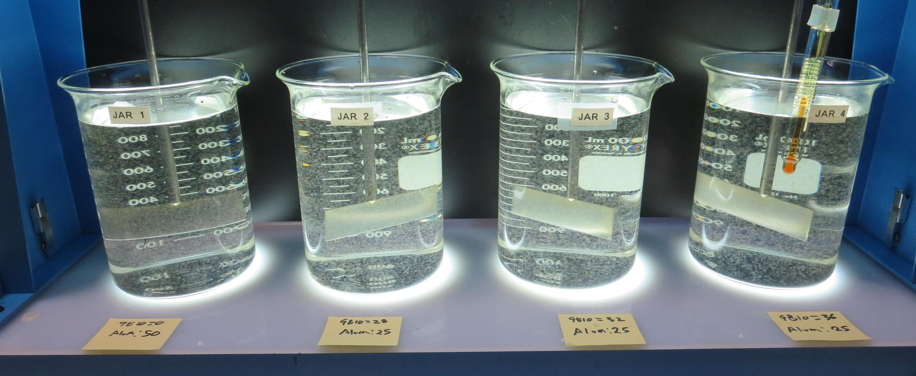
Jars 21-24: End of 9-minute flocculation (30 RPM) duration.
0mg/L 9810
50 mg/L Alum
Filtrate: 0.05 NTU
UVT: 89.8%
UVA: 0.0469/cm
UVA Reduction: 65.0%
Settled: 0.26 NTU
pH: 6.05, Alk: 11.9 mg/L
28 mg/L 9810
25 mg/L Alum
Filtrate: 0.06 NTU
UVT: 89.6%
UVA: 0.0478/cm
UVA Reduction: 64.3%
Settled: 0.34 NTU
pH: 6.48, Alk: 20.0 mg/L
32 mg/L 9810
25 mg/L Alum
Filtrate: 0.08 NTU
UVT: 89.7%
UVA: 0.0470/cm
UVA Reduction: 64.9%
Settled: 0.45 NTU
pH: 6.45, Alk: 19.8 mg/L
36 mg/L 9810
25 mg/L Alum
Filtrate: 0.08 NTU
UVT: 89.8%
UVA: 0.0466/cm
UVA Reduction: 89.8%
Settled: 0.47 NTU
pH: 6.44, Alk: 20.5 mg/L

Slide 39
Jars 21-24: After 5 min of settling, 25 mL is syringed for filterability and %UVT/UVA

Slide 40
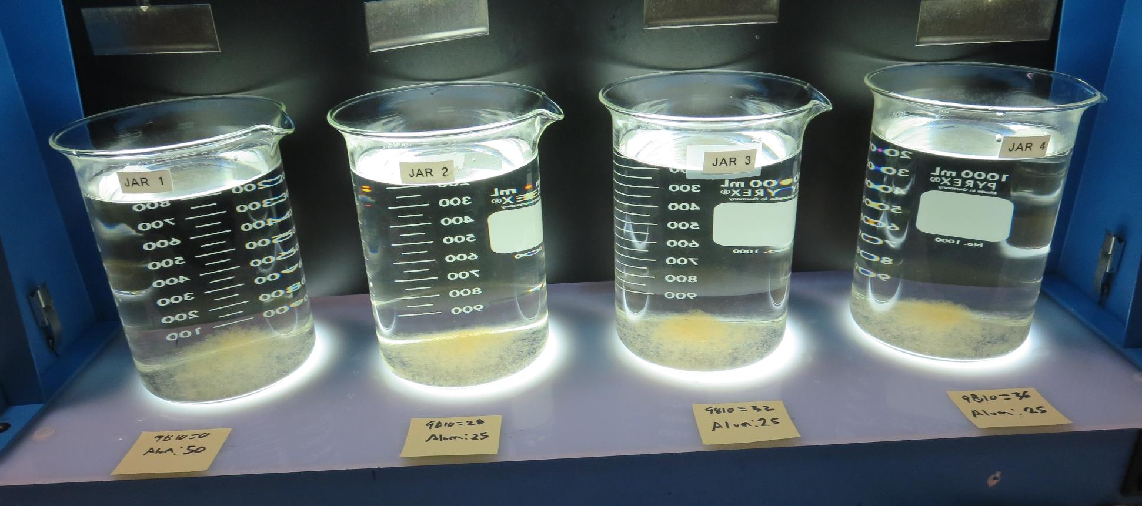
Jars 21-24: After 25-minutes of settling, settled water turbidity is taken.
0mg/L 9810
50 mg/L Alum
Filtrate: 0.05 NTU
UVT: 89.8%
UVA: 0.0469/cm
UVA Reduction: 65.0%
Settled: 0.26 NTU
pH: 6.05, Alk: 11.9 mg/L
28 mg/L 9810
25 mg/L Alum
Filtrate: 0.06 NTU
UVT: 89.6%
UVA: 0.0478/cm
UVA Reduction: 64.3%
Settled: 0.34 NTU
pH: 6.48, Alk: 20.0 mg/L
32 mg/L 9810
25 mg/L Alum
Filtrate: 0.08 NTU
UVT: 89.7%
UVA: 0.0470/cm
UVA Reduction: 64.9%
Settled: 0.45 NTU
pH: 6.45, Alk: 19.8 mg/L
36 mg/L 9810
25 mg/L Alum
Filtrate: 0.08 NTU
UVT: 89.8%
UVA: 0.0466/cm
UVA Reduction: 89.8%
Settled: 0.47 NTU
pH: 6.44, Alk: 20.5 mg/L

Slide 41
Jars 25-28 Test Flash Mix 20 Sec (200 RPM) Floc Mix 7 min (30 RPM) Pre-NaMnO₄ Applied Coagulants FeCl₃/9810

Slide 42
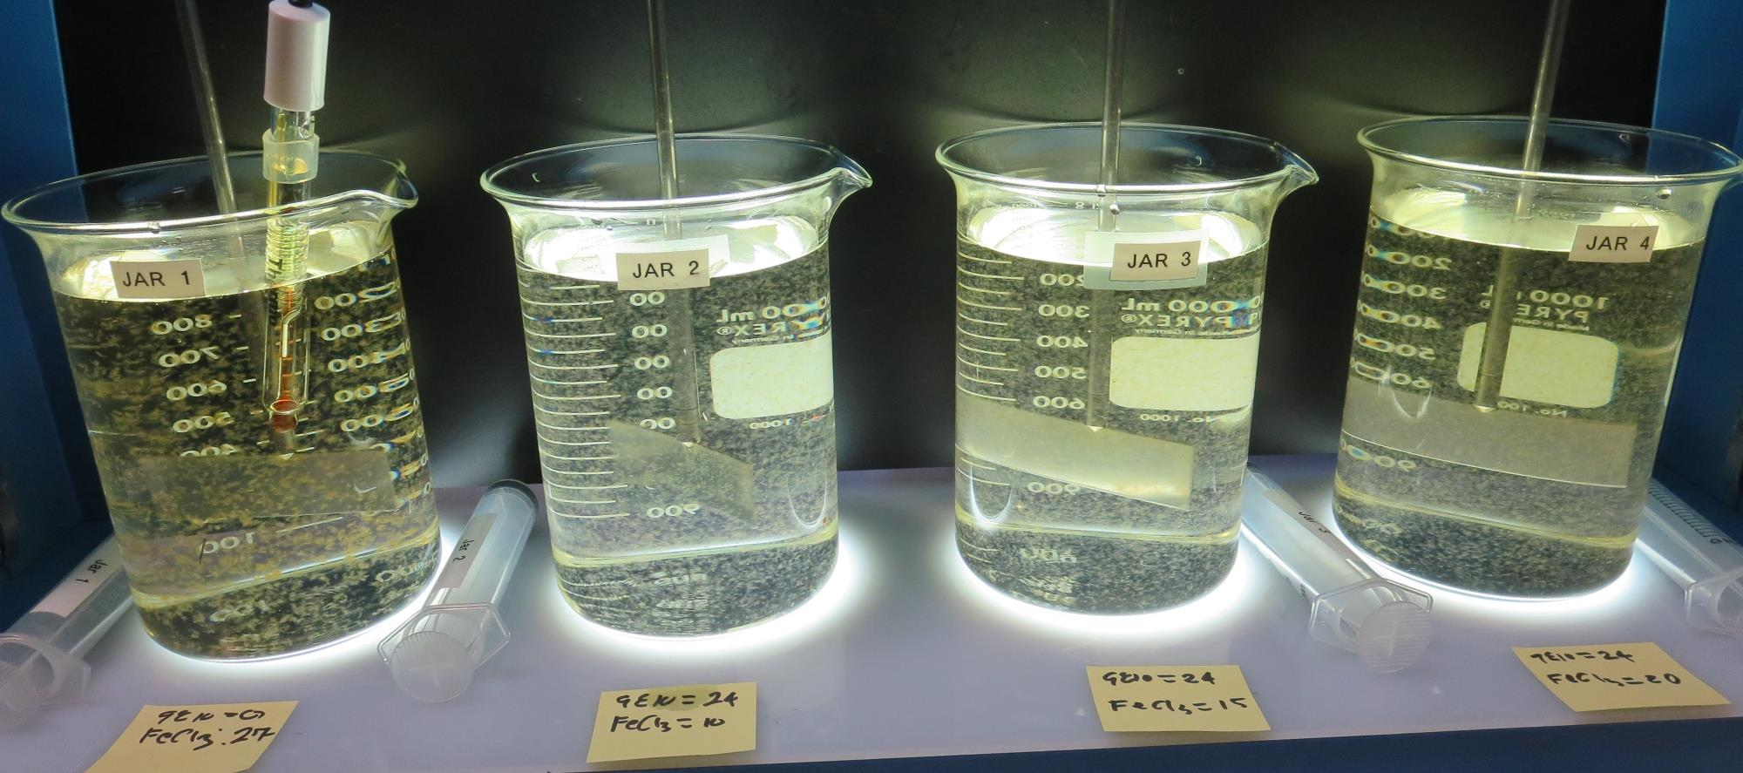
Jars 25-28: End of 10-minute flocculation (30 RPM) duration.
0 mg/L 9810
27 mg/L FeCl₃
Filtrate: 0.08 NTU
UVT: 88.92%
UVA: 0.0510/cm
UVA Reduction: 61.9%
Settled: 0.50 NTU
pH: 6.19, Alk: 13.2 mg/L
24 mg/L 9810
10 mg/L FeCl₃
Filtrate: 0.05 NTU
UVT: 89.5%
UVA: 0.0473/cm
UVA Reduction: 64.7%
Settled: 0.50 NTU
pH: 6.74, Alk: 23.4 mg/L
24 mg/L 9810
15 mg/L FeCl₃
Filtrate: 0.05 NTU
UVT: 90.5%
UVA: 0.0436/cm
UVA Reduction: 67.9%
Settled: 0.42 NTU
pH: 6.53, Alk: 19.9 mg/L
24 mg/L 9810
20 mg/L FeCl₃
Filtrate: 0.05 NTU
UVT: 91.3%
UVA: 0.0395/cm
UVA Reduction: 70.5%
Settled: 0.66 NTU
pH: 6.35, Alk: 16.7 mg/L

Slide 43
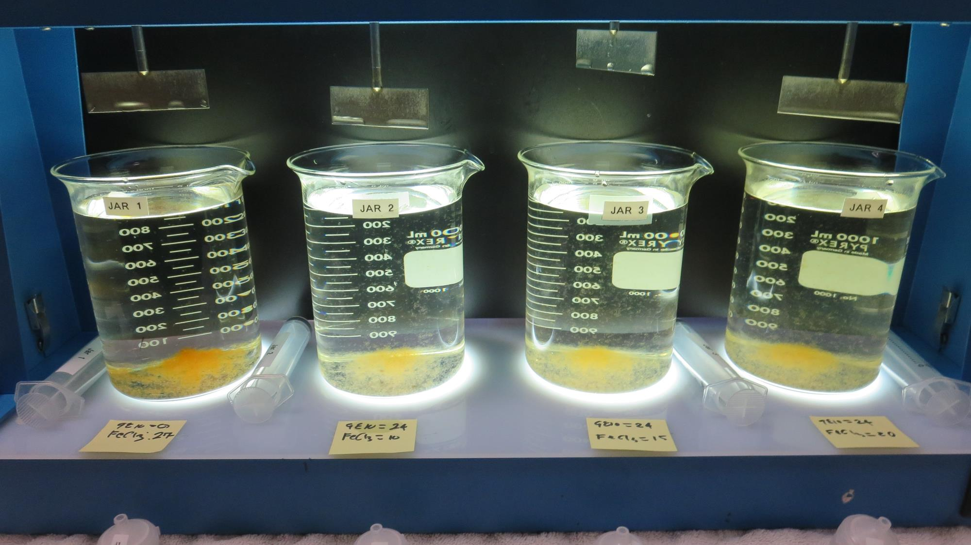
Jars 25-28: After 5 min of settling, 25 mL is syringed for filterability and %UVT/UVA

Slide 44
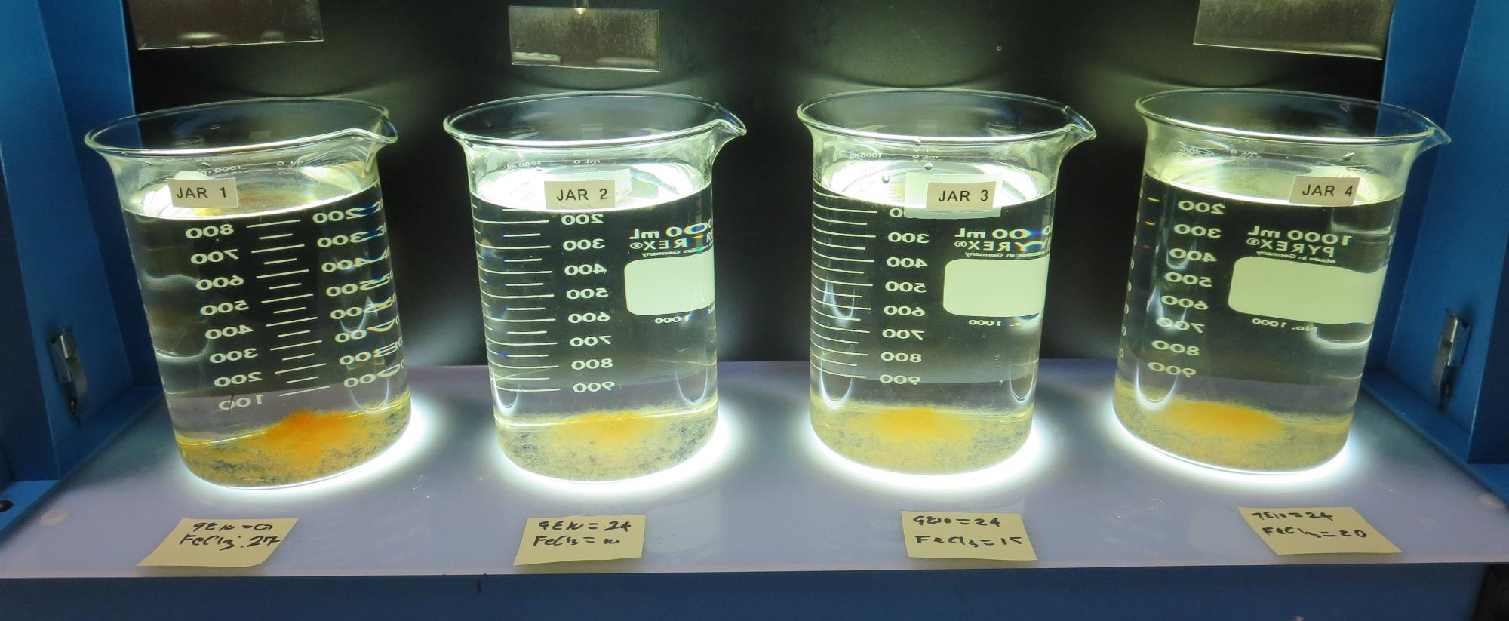
Jars 25-28: After 25-minutes of settling, settled water turbidity is taken.
0 mg/L 9810
27 mg/L FeCl₃
Filtrate: 0.08 NTU
UVT: 88.92%
UVA: 0.0510/cm
UVA Reduction: 61.9%
Settled: 0.50 NTU
pH: 6.19, Alk: 13.2 mg/L
24 mg/L 9810
10 mg/L FeCl₃
Filtrate: 0.05 NTU
UVT: 89.5%
UVA: 0.0473/cm
UVA Reduction: 64.7%
Settled: 0.50 NTU
pH: 6.74, Alk: 23.4 mg/L
24 mg/L 9810
15 mg/L FeCl₃
Filtrate: 0.05 NTU
UVT: 90.5%
UVA: 0.0436/cm
UVA Reduction: 67.9%
Settled: 0.42 NTU
pH: 6.53, Alk: 19.9 mg/L
24 mg/L 9810
20 mg/L FeCl₃
Filtrate: 0.05 NTU
UVT: 91.3%
UVA: 0.0395/cm
UVA Reduction: 70.5%
Settled: 0.66 NTU
pH: 6.35, Alk: 16.7 mg/L

Slide 45
Jars 29-31 Test Flash Mix 60 Sec (200 RPM) Floc Mix 10 min (30 RPM) Pre-NaMnO₄ Applied Coagulant 926

Slide 46
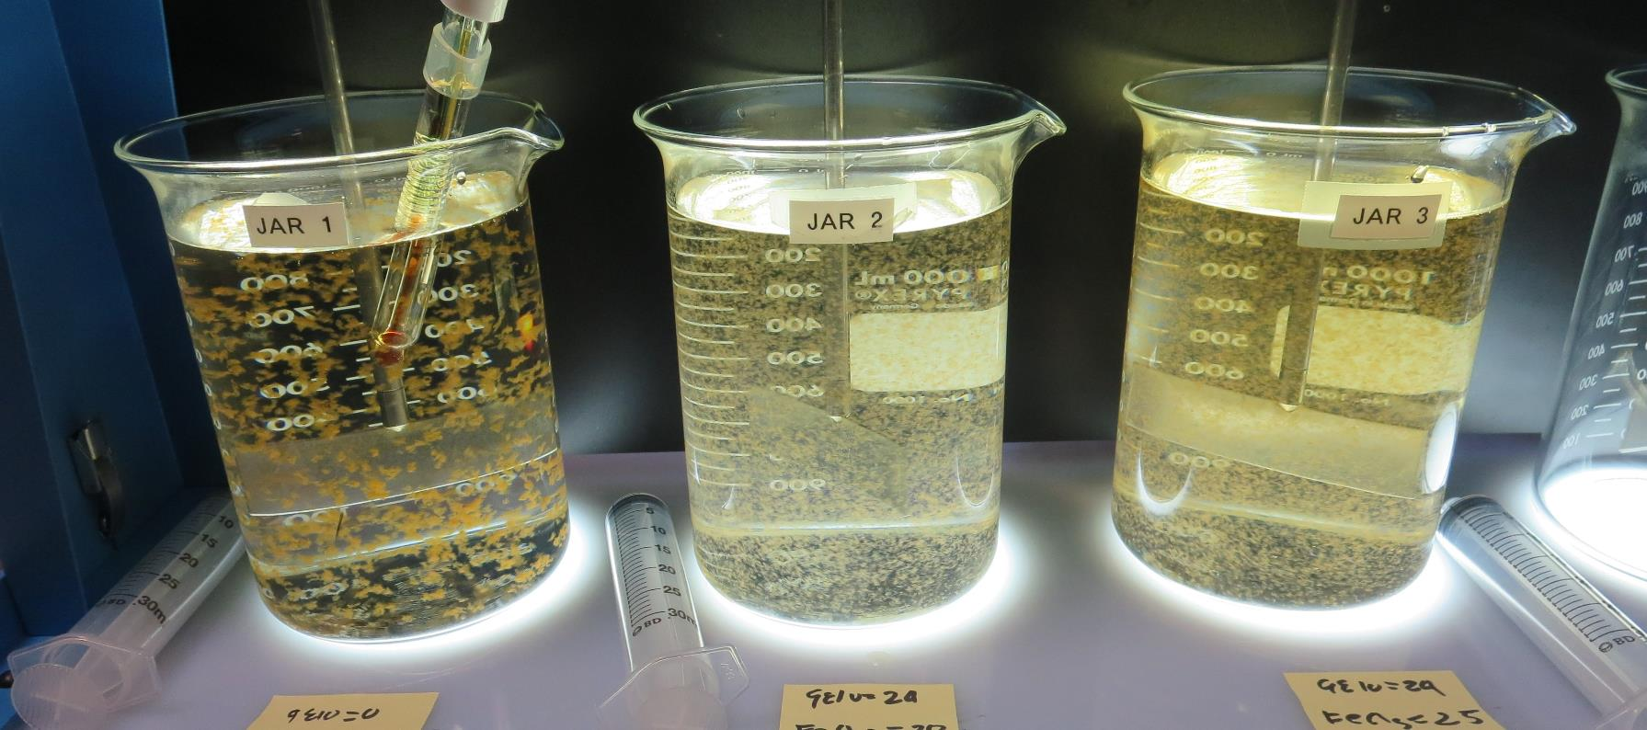
Jars 29-31: End of 10-minute flocculation (30 RPM) duration.
35 mg/L FeCl₃
Filtrate: 0.05 NTU
UVT: 92.5%
UVA: 0.0333/cm
UVA Reduction: 75.1%
Settled: 0.35 NTU
pH: 5.79, Alk: 7.4 mg/L
24 mg/L 9810
25 mg/L FeCl₃
Filtrate: 0.05 NTU
UVT: 91.6%
UVA: 0.0374/cm
UVA Reduction: 72.1%
Settled: 1.79 NTU
pH: 6.14, Alk: x mg/L
Invalidate

Slide 47
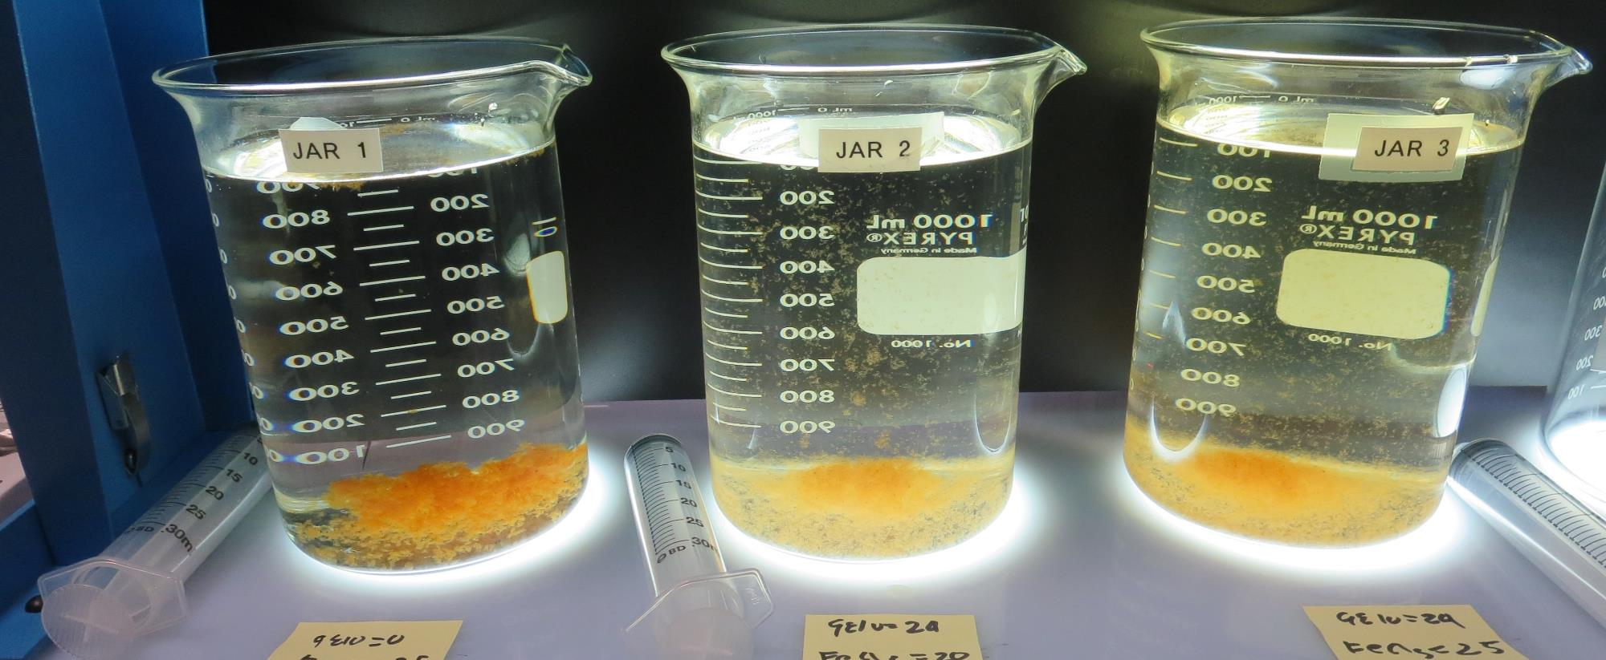
Jars 29-31: After 5 min of settling, 25 mL is syringed for filterability and %UVT/UVA

Slide 48
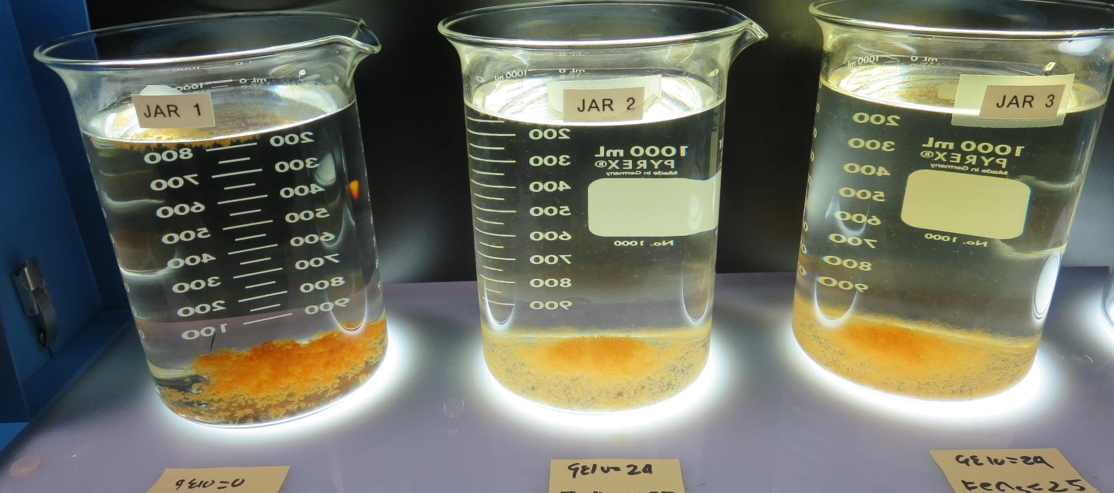
Jars 29-31: After 25-minutes of settling, settled water turbidity is taken.
35 mg/L FeCl₃
Filtrate: 0.05 NTU
UVT: 92.5%
UVA: 0.0333/cm
UVA Reduction: 75.1%
Settled: 0.35 NTU
pH: 5.79, Alk: 7.4 mg/L
24 mg/L 9810
25 mg/L FeCl₃
Filtrate: 0.05 NTU
UVT: 91.6%
UVA: 0.0374/cm
UVA Reduction: 72.1%
Settled: 1.79 NTU
pH: 6.14, Alk: x mg/L
Invalidate

Slide 49
Jar Testing for 1-Liter Jars: Procedures for Most Treatment Plants
Fill jars with source water prior to coagulant injection and set paddle speed at 30 rpm
Add chemicals (i.e., NaOCl, primary coagulant, coagulant aid) to each jar
Flash mix for 15-60 seconds (200 rpm)
Slow mix for 5 minutes (20-30 rpm)
Settled for 5 minutes. Syringe 25 mL from each jar taken 1-inch below surface (25 mL/12 sec rate)
Filtered through 1.2 um isopore membrane into cuvette drip rate, 15 mL/(50-90 sec)
Measure filtrate turbidity, chlorine residual and %UVT/UVA
Measure settled water turbidity after 25 minutes of total setting
Record all data

Slide 50
Jar Test Filterability Test Equipment
Turbidity Instrument
Syringe w/Luer-Lock Tip, 30 cc
(part#: 2225800, by Hach)
Swinnex Filter Holder, 25 mm (part#: SX0002500)
Isopore Membrane Filter, 1.2 um absolute
pore size,
Φ= 25 mm , thickness: 24 um,
hydrophilic polycarbonate membrane
(part #: RTTP02500)
Go to Sigma-Aldrich for laboratory supplies http://www.sigmaaldrich.com/united-states.html

Slide 51
Isopore Membrane Information
Categories | Information
trade name | Isopore
filter color | White
chemistry | Polycarbonate (PC)
water flow rate | Avg. 175 mL/min x cm² (typical results @ 10 psi)
media | Isopore®
wettability | Hydrophilic
porosity | 14.7%
pore size | 1.2 µm
bubble point at 23 °C | 1.0 bar, air with water
thickness | 24 µm
filter diameter (ø) | 25 mm
material size | polycarbonate, Hydrophilic, 1.2 µm, 25 mm, white, plain, 100

Slide 52
Isopore Membrane Background Information
The Isopore membrane is a polycarbonate, track-etched screen filter recommended for all analyses in which the sample is viewed on the surface of the membrane. The Isopore membrane is composed of polycarbonate film, which has a smooth, glass-like surface for clearer sample observation. The unique manufacturing process of the membrane ensures a precise pore diameter and a consistent pore size for accurate separation of samples by size. Matched-weight filters are not usually required because of low, constant tar and ash weights. Features & Benefits: Membrane structure retains particles on the surface, simplifying counting and analysis

Slide 53
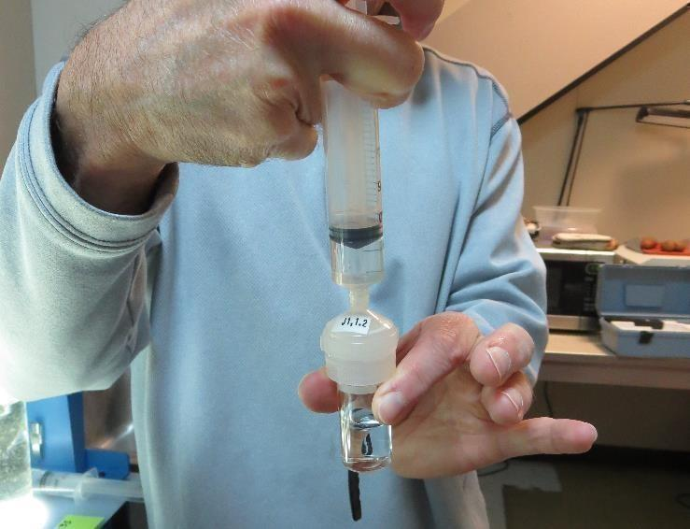
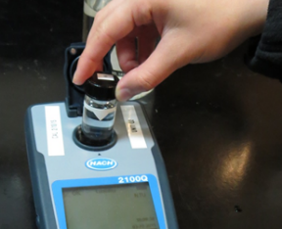
Jar Test - Filterability Test
Syringe ~ 25 mL from jar (after 5-minutes of settling)
Filter-to-waste 3-5 mL
Filter directly into clean cuvette
Measure turbidity
Note: Take several readings before recording final NTU results. Micro bubbles can adhere to glass causing false NTU readings. To remove bubbles, tilt cuvette up to 90 degrees.

Slide 54
Contact
Guy Schott, P.E.
State Water Resources Control Board
Division of Drinking Water
Santa Rosa, CA
Go to Stock Solution/Dose calculations/Jar Test Results for tools to download
www.waterboards.ca.gov/drinking_water/programs/districts/mendocino_district.html
Jar Testing Done Right training video: https://www.youtube.com/watch?v=aGByyxhelkI
Email: Guy Schott - Guy.Schott@waterboards.ca.gov
Office Number: 707-576-2732

