Slide 1
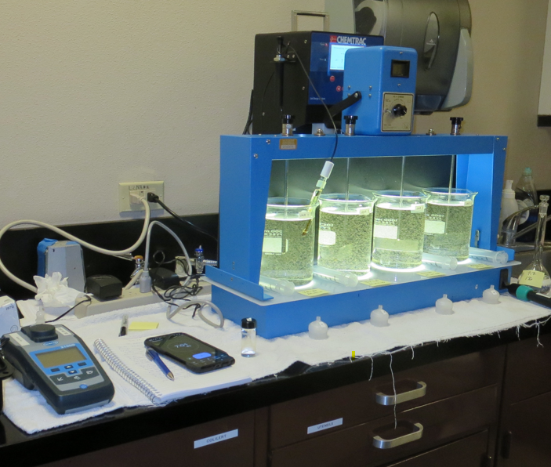
City of
American Canyon
CA2810005
Napa County
Jar Test
by Guy Schott, P.E.
October 11, 2024

Slide 2
North Bay Aqueduct Source & Treated Water Characteristics, October 11, 2024
Source – North Bay Aqueduct
pH: 7.66
Alkalinity: 93 mg/L as CaCO₃
Turbidity: 5.0 NTU
UVT: 72.54%,
UVA: 0.1395/cm
0.4 um Filtered
Turbidity: 0.45 NTU
UVT: 75.95%,
UVA: 0.1195/cm
East Filter Water
pH: 6.98
Alkalinity: 63 mg/L as CaCO₃
0. 07 NTU
UVT: 92.30%,
UVA: 0.0348/cm
Pre-Clearwell Water
pH: 8.50
Alkalinity: 99 mg/L as CaCO₃
0.07 NTU
UVT: 93.49%,
UVA: 0.0292/cm

Slide 3
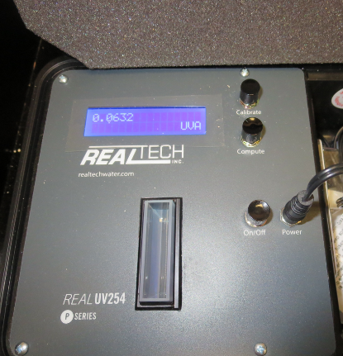
UVT/UVA, pathlength 40 mm
UV transmittance (UVT) is a measurement of the amount of ultraviolet light (commonly at 254 nm due to its germicidal effect) that passes through a water sample compared to the amount of light that passes through a pure water sample. The measurement is expressed as a percentage, % UVT.
%UVT = 10^{(-UVA)} x 100%
UV absorbance (UVA) is calculated as a relative measure of the amount of light absorbed by a water sample compared with the amount of light absorbed by a pure water sample.
UVA = -log(%UVT/100)

Slide 4
Applied Coagulants for Jar Testing (1)
Chemtrade
Clar+Ion A7,
7% Acid Aluminum Sulfate
Al₂(SO₄)₃*14.3H₂0 (Liquid)
36.48% Aluminum Sulfate
6.2% Al₂O₃
7% H₂SO₄
0% Basicity
SG = 1.3
NSF max use: 400 mg/L (product)
As hydrated Al₂(SO₄)₃*14.3H₂0
17% Al₂O₃
Ferric Sulfate
50% Ferric Sulfate
50% Water
SG = 1.40-1.51
NSF limit: 600 mg/L as Product
NTU Technologies
Zeta Floc 20, Organic Polymer
20% pDADMAC
80% Water
SG = 1.07
NSF limit: 50 mg/L as Product

Slide 5
Applied Coagulant for Jar Testing (2)
Ferric Chloride
42.4% Ferric Chloride
47.6% Water
SG = 1.44
NSF limit: 250 mg/L as Product

Slide 6
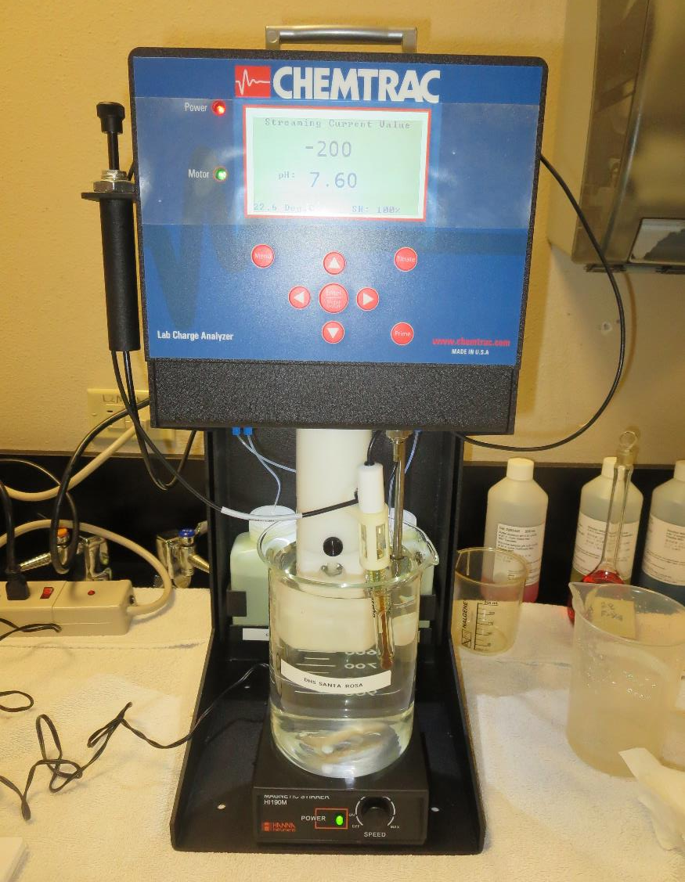
Laboratory Charge Analyzer
LCA: Used to determine coagulant demand of a source water entering the treatment plant.
Source pH: 7.66
LCA #1
FeSO₄: 113 mg/L
pH adjusted to 6.7
LCA #2:
Alum: 40 mg/L
pH adjusted to 6.7

Slide 7
Coagulant Information
Unless stated otherwise, all coagulant doses are reported as Product (100% strength). Aluminum sulfate is reported as Alum.
Preparation of coagulant stock solutions are generally 1.0 and/or 0.1 percent strength using 100 and/or 200 mL volumetric flasks.
Finnpipette F2 variable volume pipette, capacity 100-1000 micro liters is used for stock solution preparation and coagulant aid jar test dosing.
Finnpipette F2 variable volume pipette, capacity 0.5-5 mL is used for primary coagulant jar test dosing.

Slide 8
City of American Canyon : Jar Test Summary - Results
Jar # | Alum mg/L | H₂SO₄ mg/L | FeSO₄ mg/L | Zeta Floc 20 mg/L | Filtrate NTU | Filtrate %UVT | Filtrate UVA/cm | Settle NTU 25 min | %UVA Improved Reduction* | pH
JA | 44 | 8.5 | - | 1.0 | 0.04 | 91.06 | 0.0407 | 1.14 | 0 | 6.67
JB | 48 | 9.2 | - | 1.0 | 0.04 | 91.57 | 0.0383 | 0.98 | 5.9 | 6.60
JC | - | - | 96 | 1.0 | 0.04 | 93.79 | 0.0279 | 3.69 | 31.4 | 6.37
JD | - | - | 96 | 1.0 | 0.04 | 93.77 | 0.0280 | 3.36 | 31.2 | 6.38
*The %UVA is the relative improvement from the UVA/cm for the Alum dose of 44 mg/L.

Slide 9
City of American Canyon : Jar Test 1-8 Results
Flash Mix 200 RPM (20 sec); Floc Mix 30 RPM (5 min)
Jar # | Alum mg/L | H₂SO₄ mg/L | FeSO₄ mg/L | Filtrate NTU | Filtrate %UVT | Filtrate UVA/cm | %UVA Reduction | Settle NTU 25 min | pH | Alk mg/L
J1 | 44 | 8.5 | - | 0.05 | 90.43 | 0.0437 | 63.4 | 1.10 | 6.68 | 63
J2 | 54 | 10.4 | - | 0.07 | 91.18 | 0.0401 | 66.4 | 1.12 | 6.54 | 57
J3 | - | - | 90 | 0.05 | 92.76 | 0.0323 | 73.0 | 2.21 | 6.43 | 47
J4 | - | - | 110 | 0.08 | 93.44 | 0.0295 | 75.3 | 6.25 | 6.25 | 42
J5 | 44 | 8.5 | - | 0.07 | 90.60 | 0.0429 | 64.1 | 0.95 | 6.65 | 63
J6 | 48 | 9.2 | - | 0.06 | 91.00 | 0.0406 | 66.0 | 1.06 | 6.60 | 60
J7 | - |  | 80 | 0.08 | 91.76 | 0.0374 | 68.7 | 5.02 | 6.51 | 51
J8 | - |  | 90 | 0.11 | 92.01 | 0.0362 | 69.7 | 2.56 | 6.43 | 50

Slide 10
City of American Canyon : Jar Test 9-16 Results
Flash Mix 200 RPM (20 sec); Floc Mix 30 RPM (5 min)
Jar # | NaOCl mg/L | Alum mg/L | H₂SO₄ mg/L | FeSO₄ mg/L | Zeta Floc 20 mg/L | Filtrate NTU | Filtrate %UVT | Filtrate UVA/cm | %UVA Reduction | Settle NTU 25 min | pH
J9 | - | 44 | 8.5 | - | 1.0 | 0.04 | 91.06 | 0.0407 | 65.9 | 1.14 | 6.67
J10 | - | 48 | 9.2 | - | 1.0 | 0.04 | 91.57 | 0.0383 | 67.9 | 0.98 | 6.60
J11 | - | - | - | 90 | 1.0 | 0.06 | 93.22 | 0.0305 | 74.5 | 3.21 | 6.43
J12 | - | - | - | 96 | 1.0 | 0.04 | 93.79 | 0.0279 | 76.7 | 3.69 | 6.37
J13 | - | 48 | 9.2 | - | 1.0 | 0.04 | 91.48 | 0.0387 | 67.6 | 0.95 | 6.60
J14 | 2.0 | 48 | 9.2 | - | 1.0 | 0.04 | 91.86 | 0.0369 | 69.1 | 0.95 | 6.61
J15 | - | - | - | 96 | 1.0 | 0.04 | 93.77 | 0.0280 | 76.6 | 3.36 | 6.38
J16 | 2.0 | - | - | 96 | 1.0 | 0.03 | 93.75 | 0.0280 | 76.6 | 2.91 | 6.38

Slide 11
City of American Canyon : Jar Test 17-20 Results
Flash Mix 200 RPM (20 sec); Floc Mix 30 RPM (5 min)
Jar # | FeCl₃ mg/L | Zeta Floc 20 mg/L | Filtrate NTU | Filtrate %UVT | Filtrate UVA/cm | %UVA Reduction | Settle NTU 25 min | pH | Alk mg/L
J17 | 30 | 1.0 | 0.15 | 87.69 | 0.0571 | 52.2 | 0.93 | 6.88 | -
J18 | 35 | 1.0 | 0.08 | 89.86 | 0.0464 | 61.2 | 1.35 | 6.80 | -
J19 | 40 | 1.0 | 0.09 | 89.95 | 0.0460 | 61.5 | 0.78 | 6.72 | -
J20 | 45 | 1.0 | 0.04 | 90.75 | 0.0423 | 64.6 | 0.95 | 6.66 | 58

Slide 12
Jars 1-4 Test
Flash Mix 20 Sec (200 RPM)
Floc Mix 5 min (30 RPM)
Applied Coagulants
Alum/FeSO₄

Slide 13
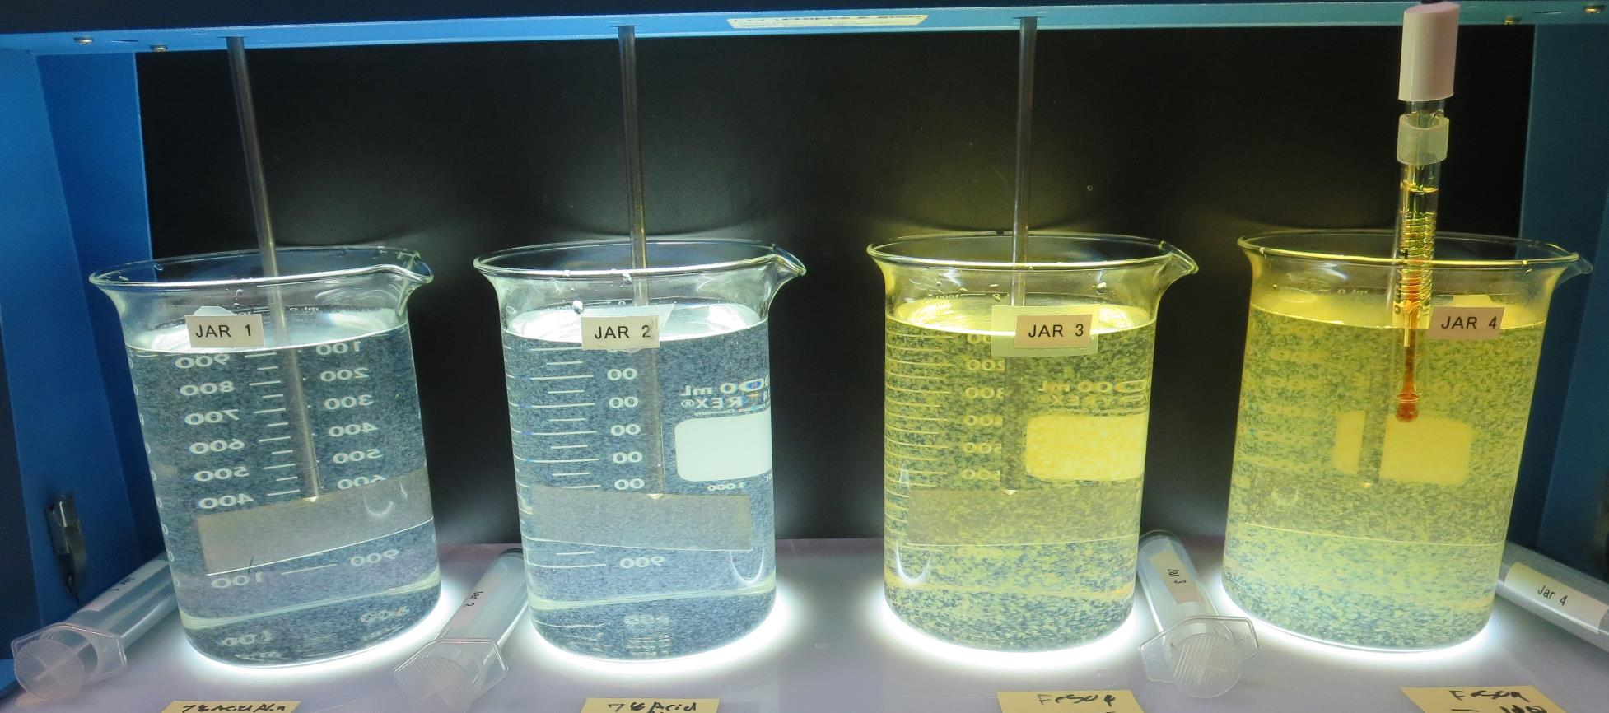
Jars 1-4: End of 5-minute flocculation (30 RPM) duration.
44 mg/L Alum
8.5 mg/L H₂SO₄
Filtrate: 0.05 NTU
UVT: 90.43%
UVA: 0.0437/cm
UVA Reduction: 63.4%
Settled: 1.10 NTU
pH: 6.68, Alk: 63 mg/L
54 mg/L Alum
10.4 mg/L H₂SO₄
Filtrate: 0.07 NTU
UVT: 91.18%
UVA: 0.0401/cm
UVA Reduction: 66.4%
Settled: 1.12 NTU
pH: 6.54, Alk: 57 mg/L
90 mg/L FeSO₄
Filtrate: 0.05 NTU
UVT: 92.76%
UVA: 0.0323/cm
UVA Reduction: 73.0%
Settled: 2.21 NTU
pH: 6.43, Alk: 47 mg/L
110 mg/L FeSO₄
Filtrate: 0.05 NTU
UVT: 93.44%
UVA: 0.0295/cm
UVA Reduction: 75.3%
Settled: 6.65 NTU
pH: 6.25, Alk: 42 mg/L

Slide 14
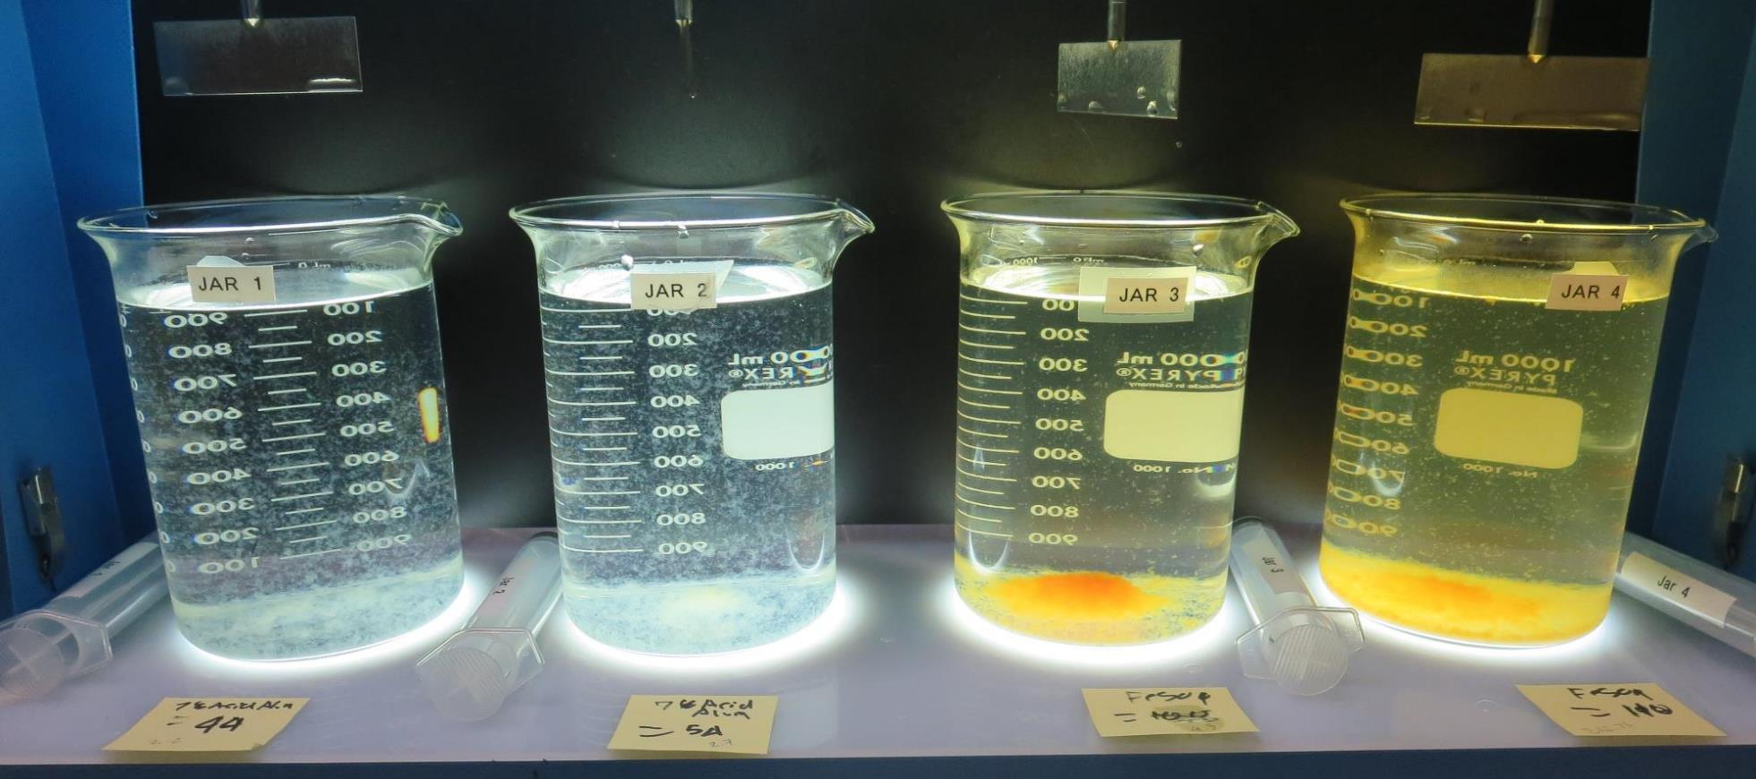
Jars 1-4: After 5 min of settling, 25 mL is syringed for filterability and %UVT/UVA

Slide 15
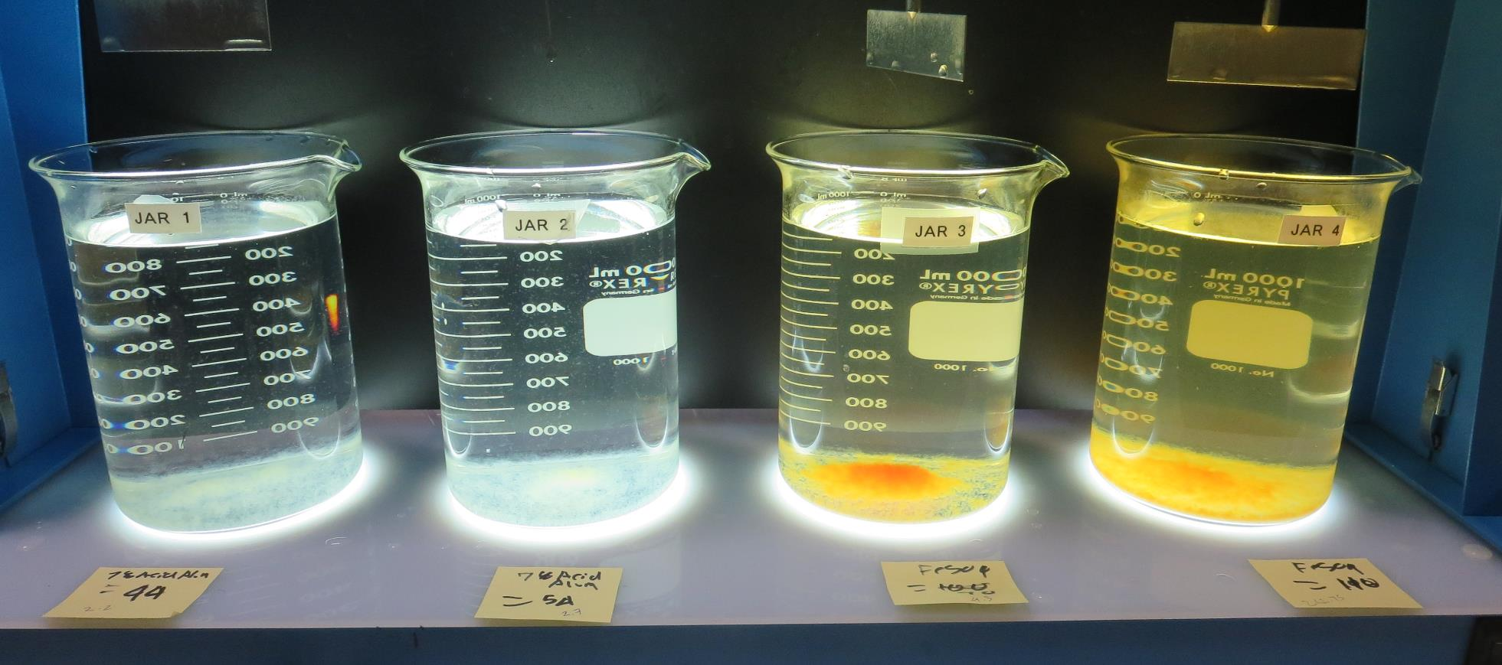
Jars 1-4: After 25-minutes of settling, settled water turbidity is taken.
44 mg/L Alum
8.5 mg/L H₂SO₄
Filtrate: 0.05 NTU
UVT: 90.43%
UVA: 0.0437/cm
UVA Reduction: 63.4%
Settled: 1.10 NTU
pH: 6.68, Alk: 63 mg/L
54 mg/L Alum
10.4 mg/L H₂SO₄
Filtrate: 0.07 NTU
UVT: 91.18%
UVA: 0.0401/cm
UVA Reduction: 66.4%
Settled: 1.12 NTU
pH: 6.54, Alk: 57 mg/L
90 mg/L FeSO₄
Filtrate: 0.05 NTU
UVT: 92.76%
UVA: 0.0323/cm
UVA Reduction: 73.0%
Settled: 2.21 NTU
pH: 6.43, Alk: 47 mg/L
110 mg/L FeSO₄
Filtrate: 0.05 NTU
UVT: 93.44%
UVA: 0.0295/cm
UVA Reduction: 75.3%
Settled: 6.65 NTU
pH: 6.25, Alk: 42 mg/L

Slide 16
Jars 5-8 Test
Flash Mix 20 Sec (200 RPM)
Floc Mix 5 min (30 RPM)
Applied Coagulants
Alum/FeSO₄

Slide 17
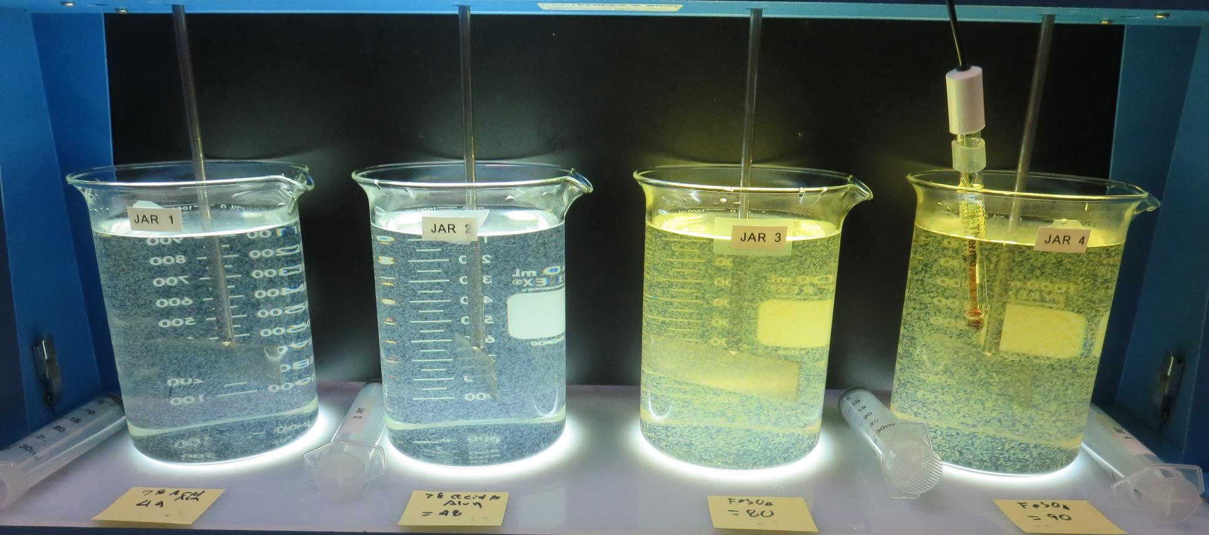
Jars 5-8: End of 5-minute flocculation (30 RPM) duration.
44 mg/L Alum
8.5 mg/L H₂SO₄
Filtrate: 0.07 NTU
UVT: 90.60%
UVA: 0.0429/cm
UVA Reduction: 64.1%
Settled: 0.95 NTU
pH: 6.65, Alk: 63 mg/L
48 mg/L Alum
9.2 mg/L H₂SO₄
Filtrate: 0.06 NTU
UVT: 91. 08%
UVA: 0.0406/cm
UVA Reduction: 66.0%
Settled: 1.06 NTU
pH: 6.60, Alk: 60 mg/L
80 mg/L FeSO₄
Filtrate: 0.08 NTU
UVT: 91.76%
UVA: 0.0374/cm
UVA Reduction: 68.7%
Settled: 5.02 NTU
pH: 6.51, Alk: 51 mg/L
90 mg/L FeSO₄
Filtrate: 0.11 NTU
UVT: 92.0%
UVA: 0.0362/cm
UVA Reduction: 69.7%
Settled: 2.56 NTU
pH: 6.43, Alk: 50 mg/L

Slide 18
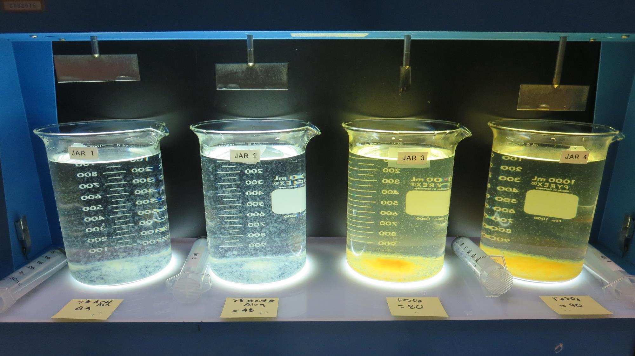
Jars 5-8: After 5 min of settling, 25 mL is syringed for filterability and %UVT/UVA

Slide 19
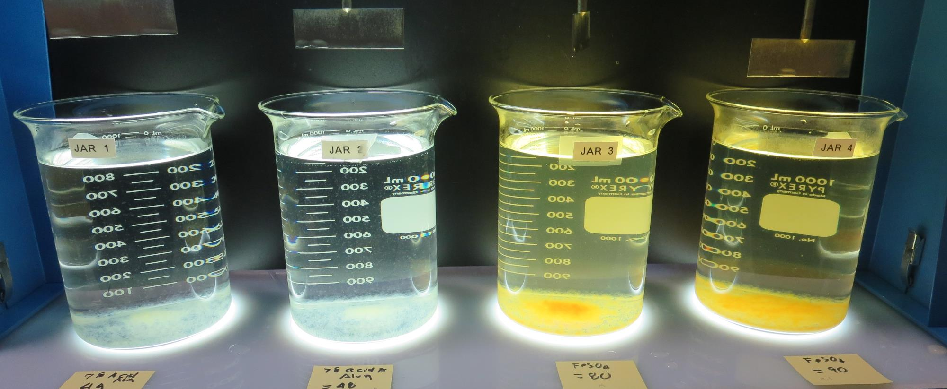
Jars 5-8: After 25-minutes of settling, settled water turbidity is taken.
44 mg/L Alum
8.5 mg/L H₂SO₄
Filtrate: 0.07 NTU
UVT: 90.60%
UVA: 0.0429/cm
UVA Reduction: 64.1%
Settled: 0.95 NTU
pH: 6.65, Alk: 63 mg/L
48 mg/L Alum
9.2 mg/L H₂SO₄
Filtrate: 0.06 NTU
UVT: 91. 08%
UVA: 0.0406/cm
UVA Reduction: 66.0%
Settled: 1.06 NTU
pH: 6.60, Alk: 60 mg/L
80 mg/L FeSO₄
Filtrate: 0.08 NTU
UVT: 91.76%
UVA: 0.0374/cm
UVA Reduction: 68.7%
Settled: 5.02 NTU
pH: 6.51, Alk: 51 mg/L
90 mg/L FeSO₄
Filtrate: 0.11 NTU
UVT: 92.0%
UVA: 0.0362/cm
UVA Reduction: 69.7%
Settled: 2.56 NTU
pH: 6.43, Alk: 50 mg/L

Slide 20
Jars 9-12 Test
Flash Mix 20 Sec (200 RPM)
Floc Mix 5 min (30 RPM)
Applied Coagulants
Alum/FeSO₄
_{pDADMAC Filter Aid}

Slide 21
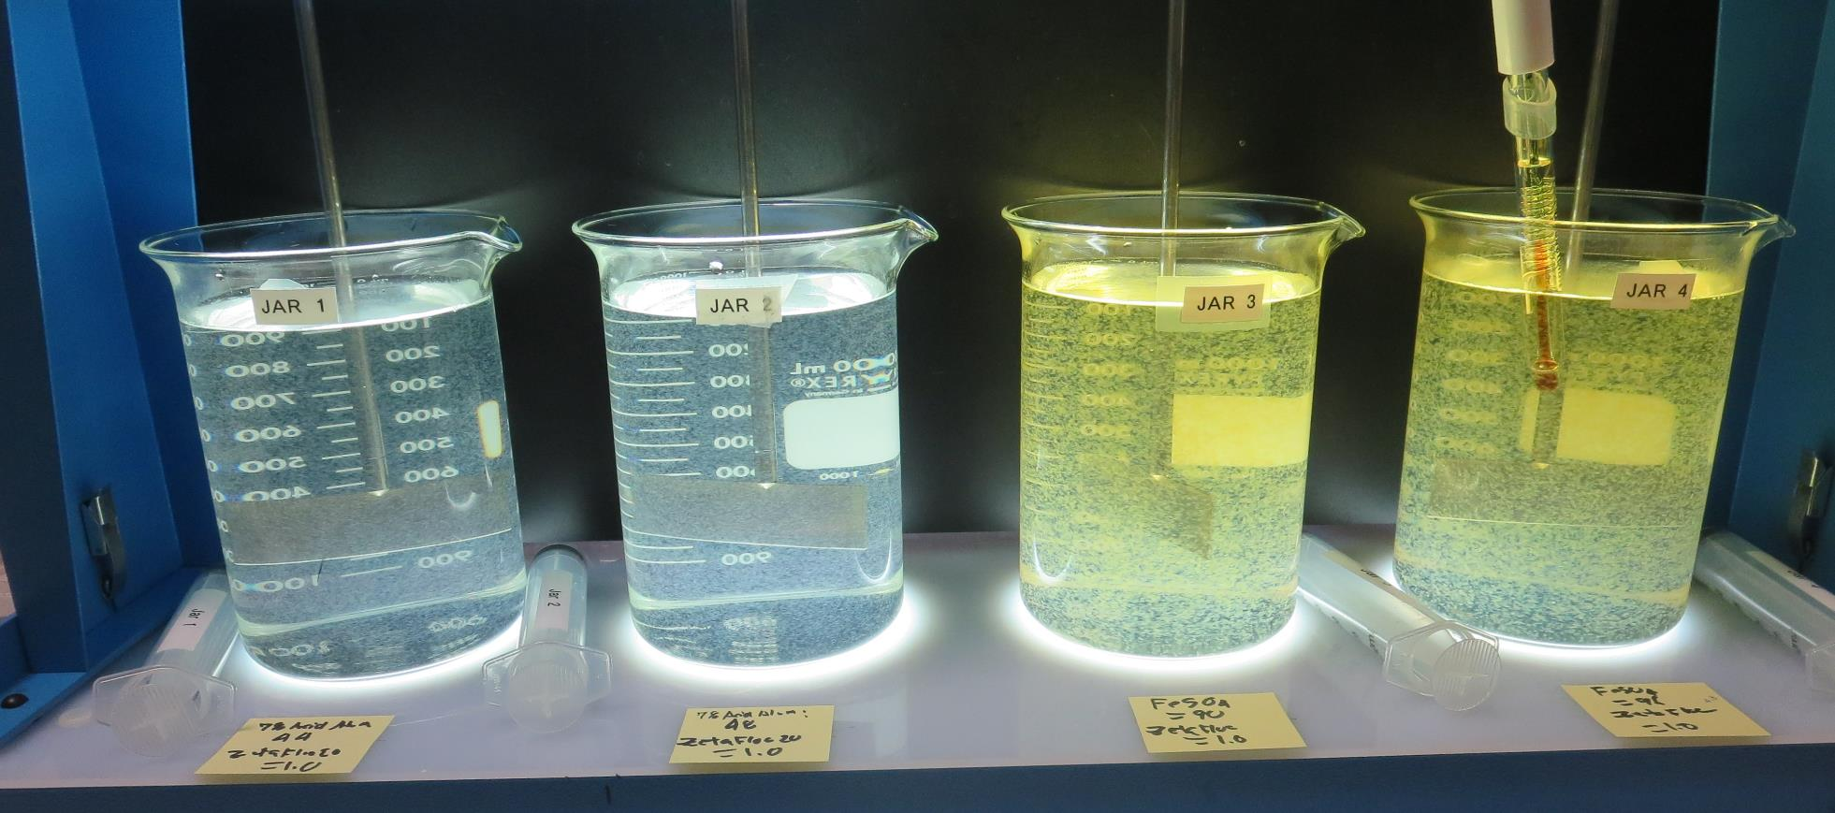
Jars 9-12: End of 5-minute flocculation (30 RPM) duration.
44 mg/L Alum
8.5 mg/L H₂SO₄
1.0 mg/L ZetaFloc20
Filtrate: 0.04 NTU
UVT: 91.06%
UVA: 0.0407/cm
UVA Reduction: 65.9%
Settled: 1.14 NTU
pH: 6.67
48 mg/L Alum
9.2 mg/L H₂SO₄
1.0 mg/L ZetaFloc20
Filtrate: 0.04 NTU
UVT: 91. 57%
UVA: 0.0383/cm
UVA Reduction: 67.9%
Settled: 0.98 NTU
pH: 6.60
90 mg/L FeSO₄
1.0 mg/L ZetaFloc20
Filtrate: 0.06 NTU
UVT: 93.22%
UVA: 0.0305/cm
UVA Reduction: 74.5%
Settled: 3.21 NTU
pH: 6.43
96 mg/L FeSO₄
1.0 mg/L ZetaFloc20
Filtrate: 0.04 NTU
UVT: 93.79%
UVA: 0.0279/cm
UVA Reduction: 76.7%
Settled: 3.69 NTU
pH: 6.37

Slide 22
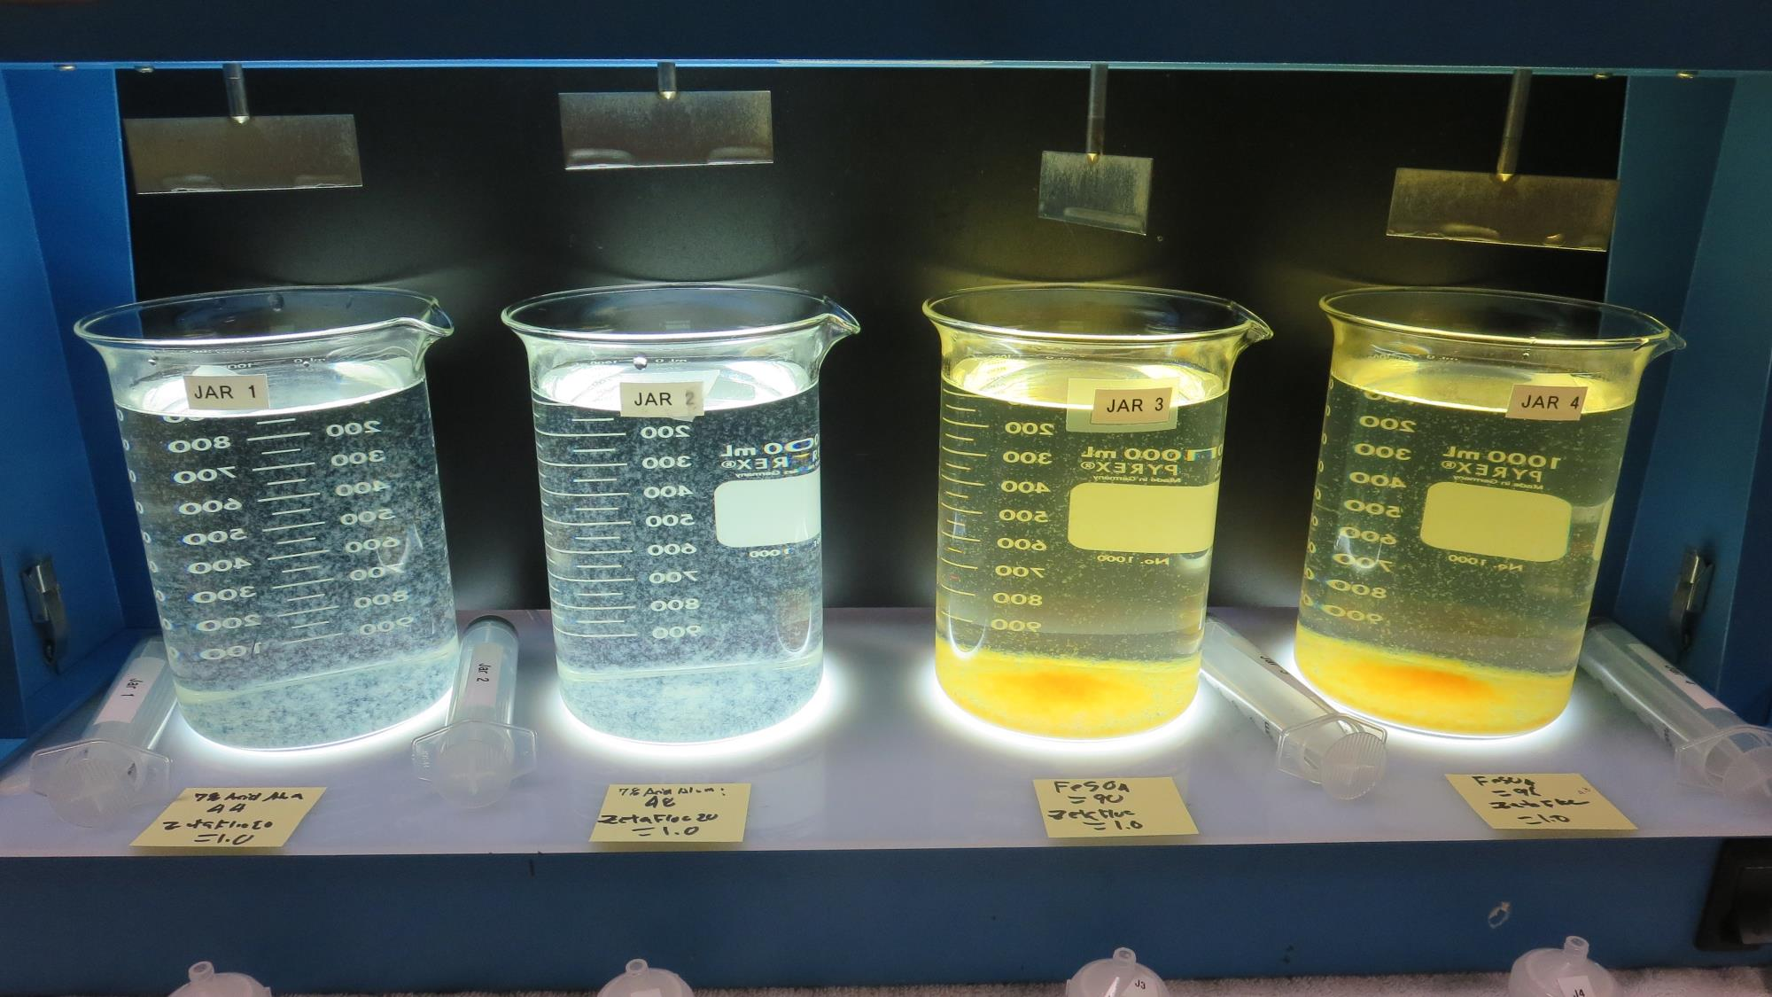
Jars 9-12: After 5 min of settling, 25 mL is syringed for filterability and %UVT/UVA

Slide 23
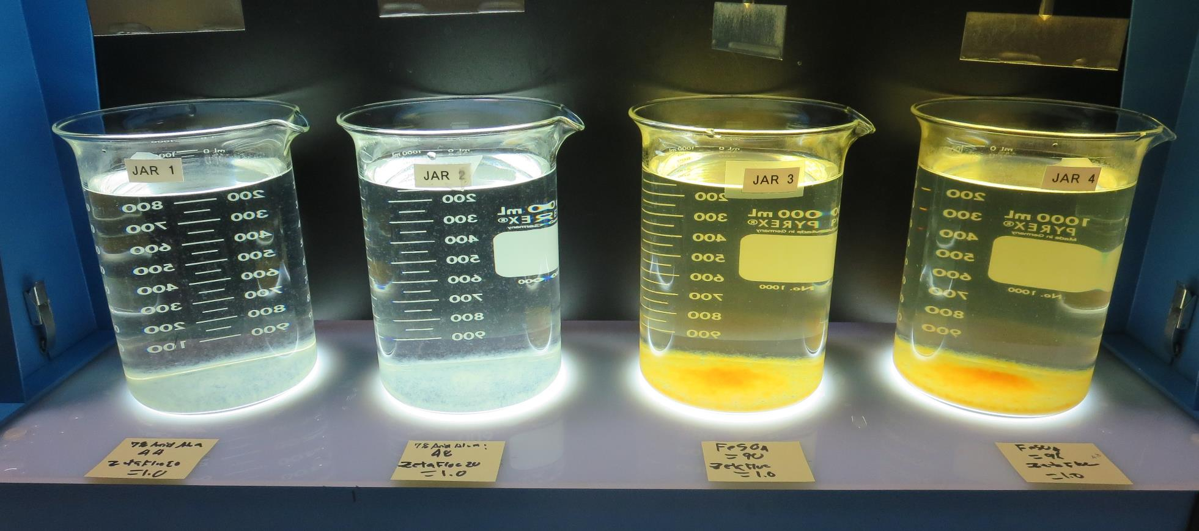
Jars 9-12: After 25-minutes of settling, settled water turbidity is taken.
44 mg/L Alum
8.5 mg/L H₂SO₄
1.0 mg/L ZetaFloc20
Filtrate: 0.04 NTU
UVT: 91.06%
UVA: 0.0407/cm
UVA Reduction: 65.9%
Settled: 1.14 NTU
pH: 6.67
48 mg/L Alum
9.2 mg/L H₂SO₄
1.0 mg/L ZetaFloc20
Filtrate: 0.04 NTU
UVT: 91. 57%
UVA: 0.0383/cm
UVA Reduction: 67.9%
Settled: 0.98 NTU
pH: 6.60
90 mg/L FeSO₄
1.0 mg/L ZetaFloc20
Filtrate: 0.06 NTU
UVT: 93.22%
UVA: 0.0305/cm
UVA Reduction: 74.5%
Settled: 3.21 NTU
pH: 6.43
96 mg/L FeSO₄
1.0 mg/L ZetaFloc20
Filtrate: 0.04 NTU
UVT: 93.79%
UVA: 0.0279/cm
UVA Reduction: 76.7%
Settled: 3.69 NTU
pH: 6.37

Slide 24
Jars 13-16 Test
Flash Mix 20 Sec (200 RPM)
Floc Mix 5 min (30 RPM)
Applied Coagulants
Alum/FeSO₄
_{pDADMAC Filter Aid}

Slide 25
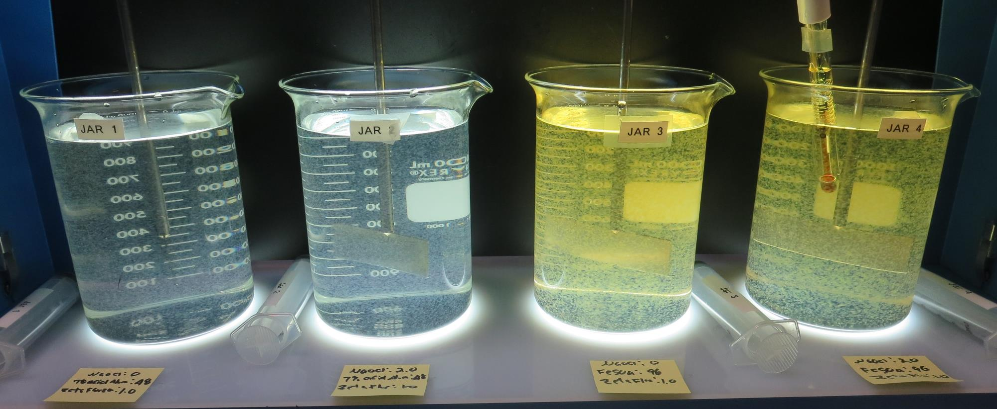
Jars 13-16: End of 5-minute flocculation (30 RPM) duration.
0 mg/L NaOCl
48 mg/L Alum
9.2 mg/L H₂SO₄
1.0 mg/L ZetaFloc20
Filtrate: 0.04 NTU
UVT: 91.48%
UVA: 0.0387/cm
UVA Reduction: 67.6%
Settled: 0.95 NTU
pH: 6.60
2.0 mg/L NaOCl
48 mg/L Alum
9.2 mg/L H₂SO₄
1.0 mg/L ZetaFloc20
Filtrate: 0.04 NTU
UVT: 91. 86%
UVA: 0.0369/cm
UVA Reduction: 69.1%
Settled: 0.95 NTU
pH: 6.61
0 mg/L NaOCl
96 mg/L FeSO₄
1.0 mg/L ZetaFloc20
Filtrate: 0.04 NTU
UVT: 93.77%
UVA: 0.0280/cm
UVA Reduction: 76.6%
Settled: 3.36 NTU
pH: 6.38
2.0 mg/L NaOCl
96 mg/L FeSO₄
1.0 mg/L ZetaFloc20
Filtrate: 0.04 NTU
UVT: 93.75%
UVA: 0.0280/cm
UVA Reduction: 76.6%
Settled: 2.91 NTU
pH: 6.38

Slide 26
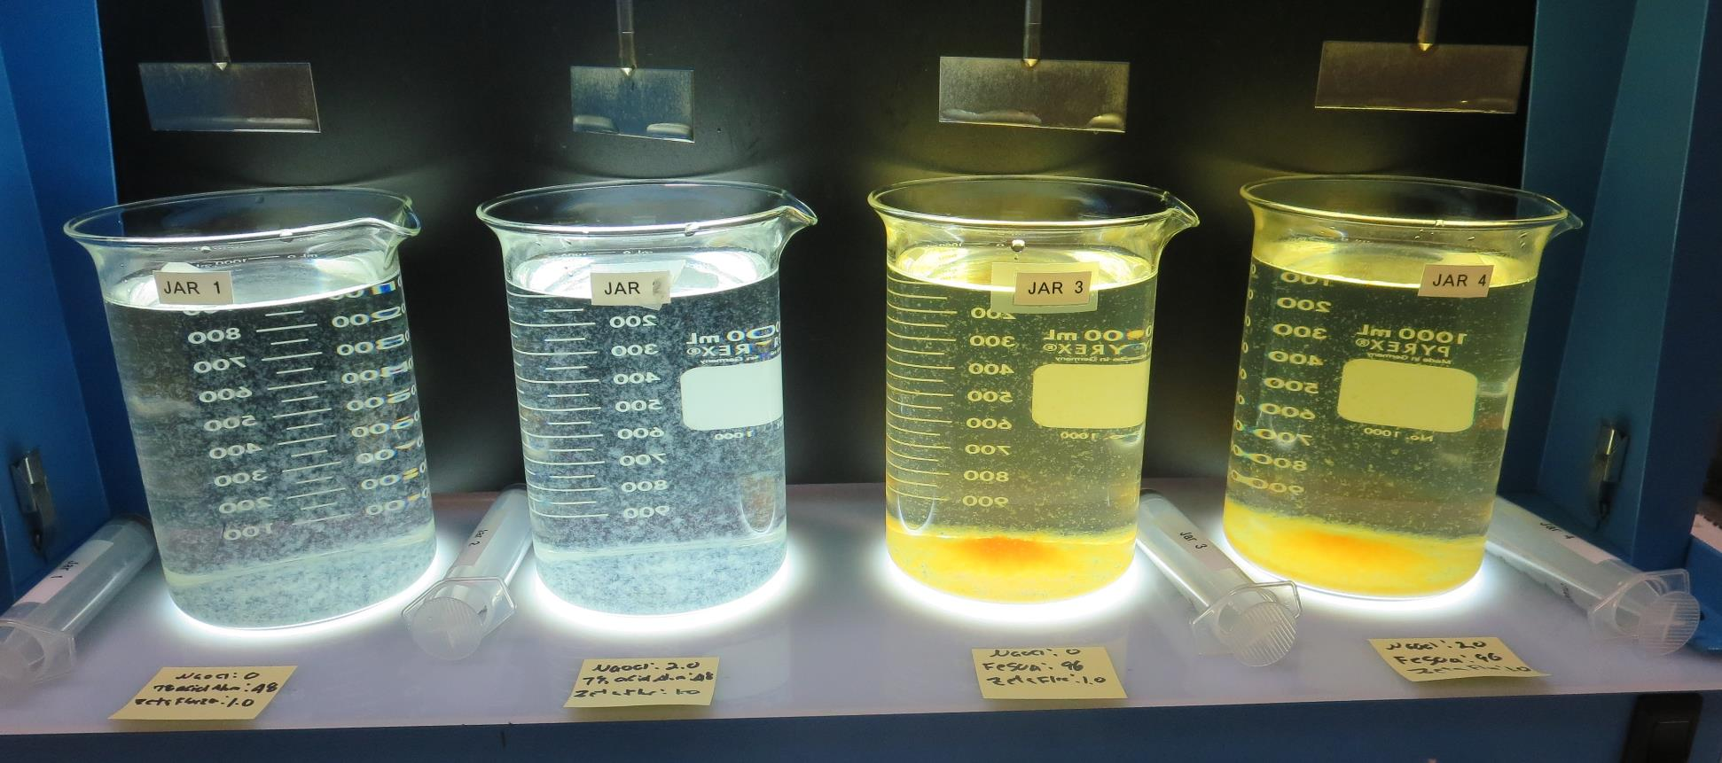
Jars 13-16: After 5 min of settling, 25 mL is syringed for filterability and %UVT/UVA

Slide 27
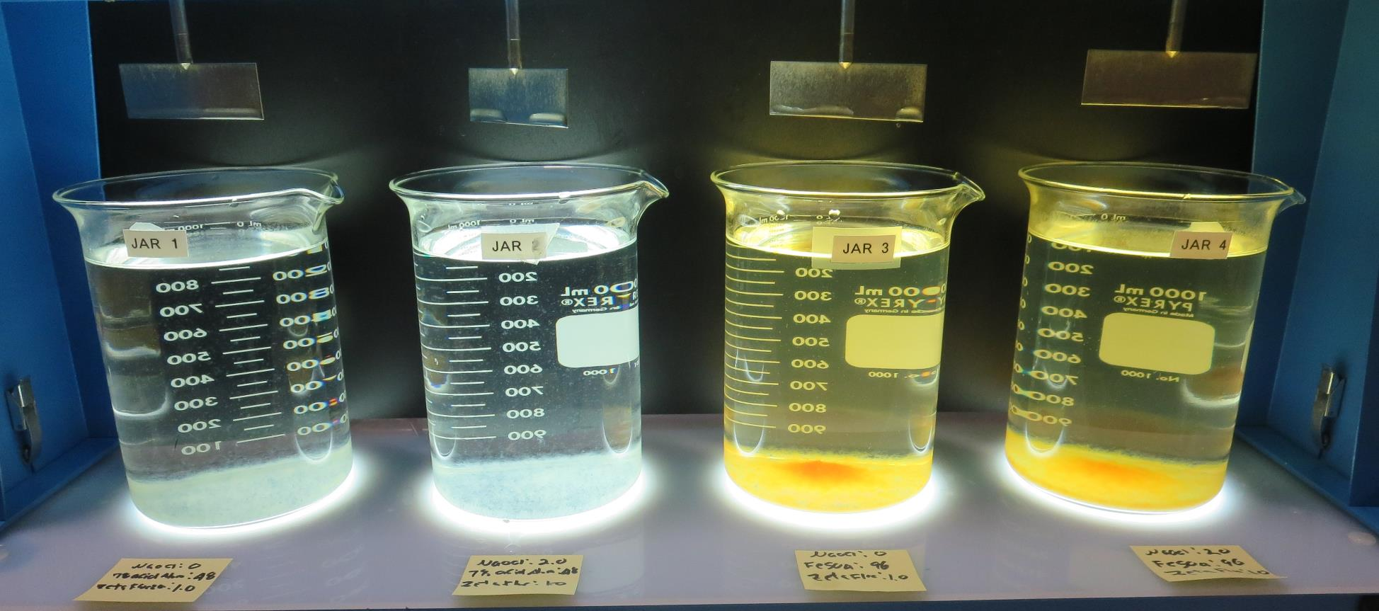
Jars 13-16: After 25-minutes of settling, settled water turbidity is taken.
0 mg/L NaOCl
48 mg/L Alum
9.2 mg/L H₂SO₄
1.0 mg/L ZetaFloc20
Filtrate: 0.04 NTU
UVT: 91.48%
UVA: 0.0387/cm
UVA Reduction: 67.6%
Settled: 0.95 NTU
pH: 6.60
2.0 mg/L NaOCl
48 mg/L Alum
9.2 mg/L H₂SO₄
1.0 mg/L ZetaFloc20
Filtrate: 0.04 NTU
UVT: 91. 86%
UVA: 0.0369/cm
UVA Reduction: 69.1%
Settled: 0.95 NTU
pH: 6.61
0 mg/L NaOCl
96 mg/L FeSO₄
1.0 mg/L ZetaFloc20
Filtrate: 0.04 NTU
UVT: 93.77%
UVA: 0.0280/cm
UVA Reduction: 76.6%
Settled: 3.36 NTU
pH: 6.38
2.0 mg/L NaOCl
96 mg/L FeSO₄
1.0 mg/L ZetaFloc20
Filtrate: 0.04 NTU
UVT: 93.75%
UVA: 0.0280/cm
UVA Reduction: 76.6%
Settled: 2.91 NTU
pH: 6.38

Slide 28
Jars 17-20 Test
Flash Mix 20 Sec (200 RPM)
Floc Mix 5 min (30 RPM)
Applied Coagulants
FeCl₃
_{pDADMAC Filter Aid}

Slide 29
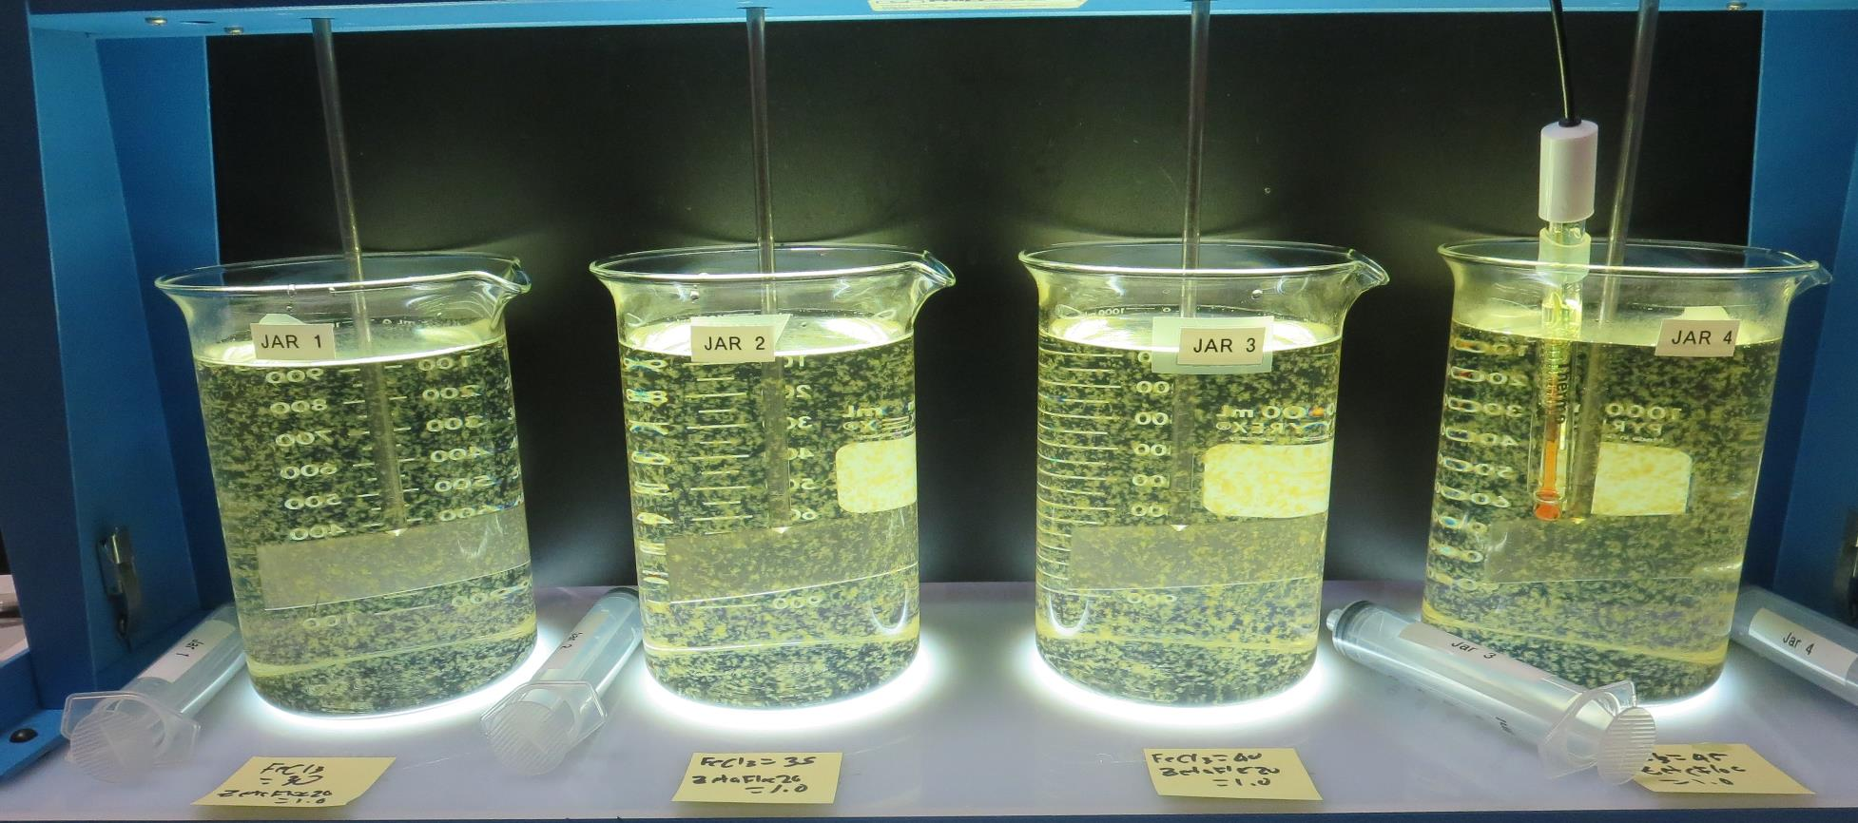
Jars 17-20: End of 5-minute flocculation (30 RPM) duration.
30 mg/L FeCl₃
1.0 mg/L ZetaFloc20
Filtrate: 0.15 NTU
UVT: 87.69%
UVA: 0.0571/cm
UVA Reduction: 52.2%
Settled: 0.93 NTU
pH: 6.88
35 mg/L FeCl₃
1.0 mg/L ZetaFloc20
Filtrate: 0.08 NTU
UVT: 89.86%
UVA: 0.0464/cm
UVA Reduction: 61.2%
Settled: 1.35 NTU
pH: 6.80
40 mg/L FeCl₃
1.0 mg/L ZetaFloc20
Filtrate: 0.09 NTU
UVT: 89.95%
UVA: 0.0460/cm
UVA Reduction: 61.5%
Settled: 0.78 NTU
pH: 6.72
45 mg/L FeCl₃
1.0 mg/L ZetaFloc20
Filtrate: 0.04 NTU
UVT: 90.72%
UVA: 0.0423/cm
UVA Reduction: 64.6%
Settled: 0.95 NTU
pH: 6.66

Slide 30
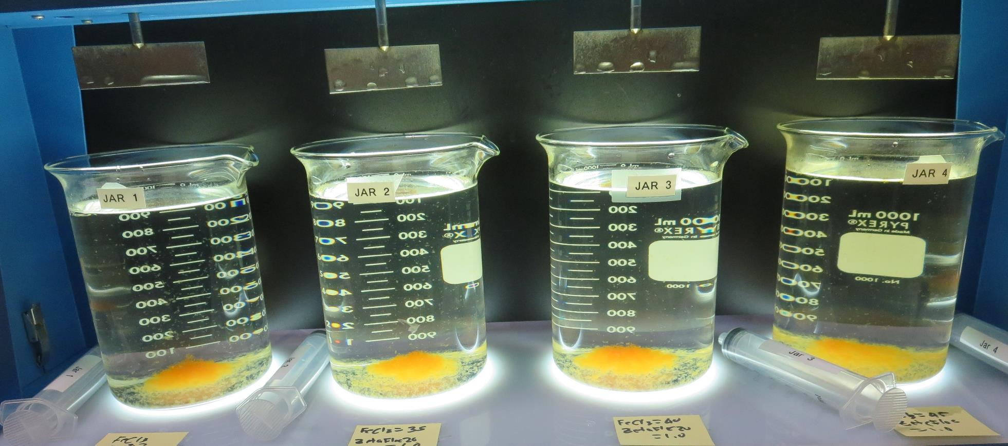
Jars 17-20: After 5 min of settling, 25 mL is syringed for filterability and %UVT/UVA

Slide 31
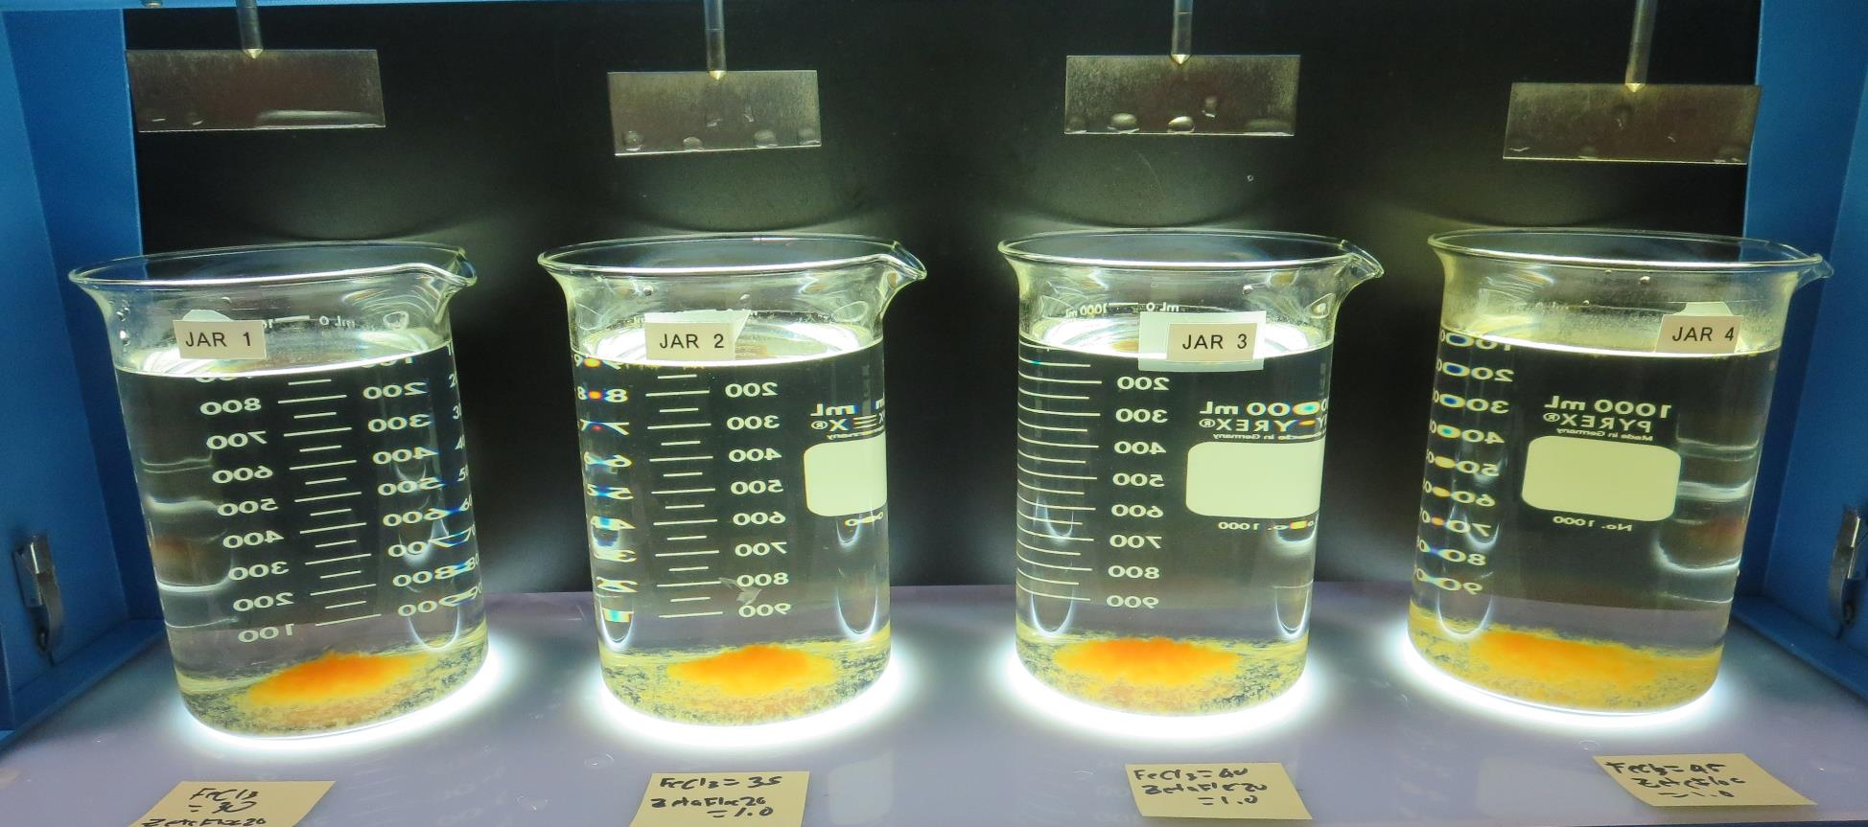
Jars 17-20: After 25-minutes of settling, settled water turbidity is taken.
30 mg/L FeCl₃
1.0 mg/L ZetaFloc20
Filtrate: 0.15 NTU
UVT: 87.69%
UVA: 0.0571/cm
UVA Reduction: 52.2%
Settled: 0.93 NTU
pH: 6.88
35 mg/L FeCl₃
1.0 mg/L ZetaFloc20
Filtrate: 0.08 NTU
UVT: 89.86%
UVA: 0.0464/cm
UVA Reduction: 61.2%
Settled: 1.35 NTU
pH: 6.80
40 mg/L FeCl₃
1.0 mg/L ZetaFloc20
Filtrate: 0.09 NTU
UVT: 89.95%
UVA: 0.0460/cm
UVA Reduction: 61.5%
Settled: 0.78 NTU
pH: 6.72
45 mg/L FeCl₃
1.0 mg/L ZetaFloc20
Filtrate: 0.04 NTU
UVT: 90.72%
UVA: 0.0423/cm
UVA Reduction: 64.6%
Settled: 0.95 NTU
pH: 6.66, Alk: 58 mg/L

Slide 32
Jar Testing for 1-Liter Jars:
Procedures for Most Treatment Plants
Fill jars with source water prior to coagulant injection and set paddle speed at 30 rpm
Add chemicals (i.e., NaOCl, primary coagulant, coagulant aid) to each jar
Flash mix for 15-60 seconds (200 rpm)
Slow mix for 5 minutes (20-30 rpm)
Settled for 5 minutes. Syringe 25 mL from each jar taken 1-inch below surface (25 mL/12 sec rate)
Filtered through 1.2 um isopore membrane into cuvette drip rate, 15 mL/(50-90 sec)
Measure filtrate turbidity, chlorine residual and %UVT/UVA
Measure settled water turbidity after 25 minutes of total setting
Record all data

Slide 33

Jar Test
Filterability Test Equipment
Turbidity Instrument
Syringe w/Luer-Lock Tip, 30 cc
(part#: 2225800, by Hach)
Swinnex Filter Holder, 25 mm (part#: SX0002500)
Isopore Membrane Filter, 1.2 um absolute
pore size,
Φ= 25 mm , thickness: 24 um,
hydrophilic polycarbonate membrane
(part #: RTTP02500)
Go to Sigma-Aldrich for laboratory supplies http://www.sigmaaldrich.com/united-states.html

Slide 34
Isopore Membrane Information
Categories | Information
trade name | Isopore
filter color | White
chemistry | Polycarbonate (PC)
water flow rate | Avg. 175 mL/min x cm² (typical results @ 10 psi)
media | Isopore®
wettability | Hydrophilic
porosity | 14.7%
pore size | 1.2 µm
bubble point at 23 °C | 1.0 bar, air with water
thickness | 24 µm
filter diameter (ø) | 25 mm
material size | polycarbonate, Hydrophilic, 1.2 µm, 25 mm, white, plain, 100

Slide 35
Isopore Membrane Background Information
The Isopore membrane is a polycarbonate, track-etched screen filter recommended for all analyses in which the sample is viewed on the surface of the membrane. The Isopore membrane is composed of polycarbonate film, which has a smooth, glass-like surface for clearer sample observation. The unique manufacturing process of the membrane ensures a precise pore diameter and a consistent pore size for accurate separation of samples by size. Matched-weight filters are not usually required because of low, constant tar and ash weights.
Features & Benefits:
Membrane structure retains particles on the surface, simplifying counting and analysis

Slide 36
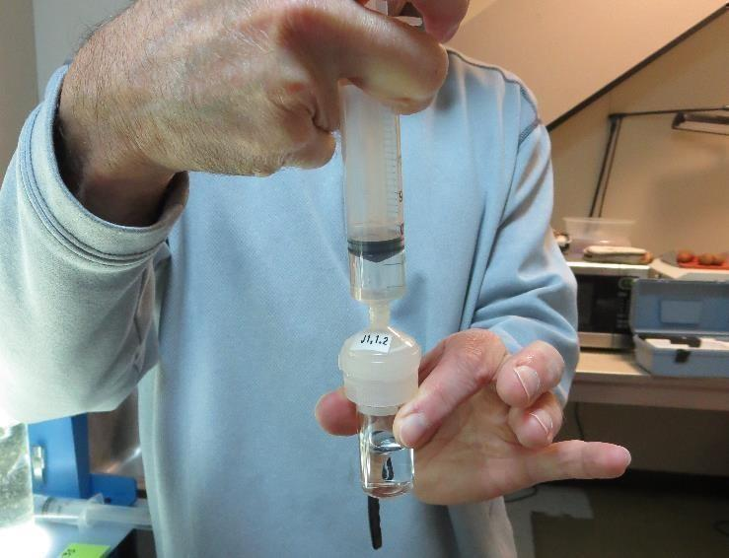

Jar Test - Filterability Test
Syringe ~ 25 mL from jar (after 5-minutes of settling)
Filter-to-waste 3-5 mL
Filter directly into clean cuvette
Measure turbidity
Note: Take several readings before recording final NTU results. Micro bubbles can adhere to glass causing false NTU readings. To remove bubbles, tilt cuvette up to 90 degrees.

Slide 37

Contact
Guy Schott, P.E.
State Water Resources Control Board
Division of Drinking Water
Santa Rosa, CA
Go to Stock Solution/Dose calculations/Jar Test Results for tools to download
www.waterboards.ca.gov/drinking_water/programs/districts/mendocino_district.html
Jar Testing Done Right training video: https://www.youtube.com/watch?v=aGByyxhelkI
Email: Guy Schott - Guy.Schott@waterboards.ca.gov
Office Number: 707-576-2732

