Slide 1
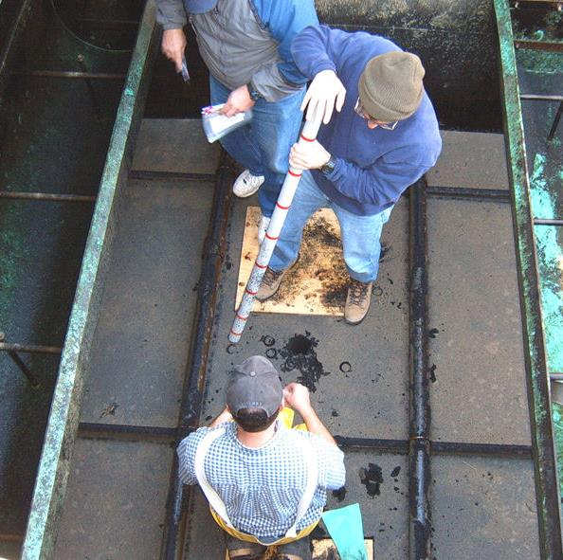
Filter Surveillance Training
by Guy Schott, P.E.
March 2, 2022

Slide 2
What is a Filter Surveillance
Filter Surveillance– is a series of tests designed to gather information about the filter vessel, condition of filter media, filter backwash process and performance.
Gathered information is used to document and take corrective actions in maintaining a viable and properly performing filter(s).
Section 64660. Operating Criteria (b) (8) Pressure filters shall be physically inspected and evaluated annually for such factors as media condition, mudball formation, and short circuiting.

Slide 3
Outline – Filter Surveillance
Filter media characteristics
Underdrains
Filter Surveillance: 9 Steps for assessment
Pictures

Slide 4
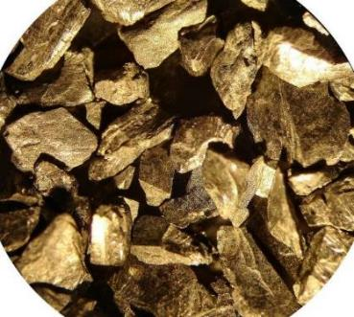
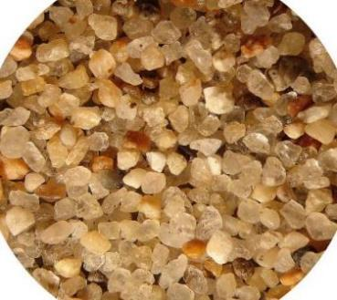
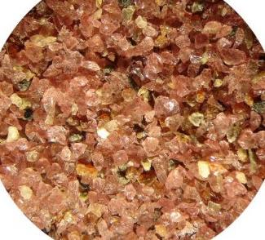
Filter Media – Common Types
Anthracite Coal
Silica Sand
Garnet Sand

Slide 5
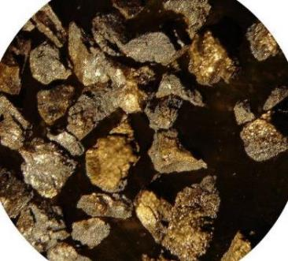
Filter Media -
Bituminous Coal (GAC) or Coconut Shell

Slide 6
Filter Media - Typical
Anthracite/Sand
Anthracite/Sand/Garnet
Surface Washers
0
30 Inches
0
30 Inches
Anthracite
18”
Anthracite
18”
9”
Silica Sand
12”
Silica Sand
3”
Garnet Sand

Slide 7
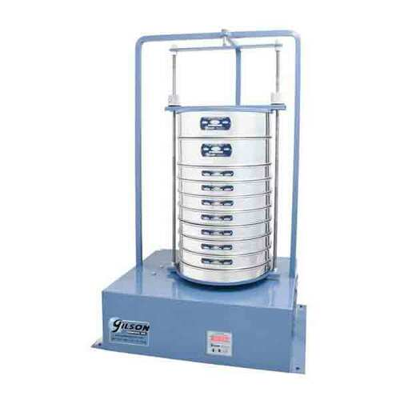
Media Characteristics
Effective size (d₁₀): The size opening that will just pass 10 percent (by dry weight) of a representative sample of the filter material.
Uniformity coefficient (UC, d₆₀/d₁₀): A ratio calculated as the size opening that will just pass 60 percent (by dry weight) of a representative sample of the filter material divided by the size opening that will just pass 10 percent (by dry weight) of the same sample.

Slide 8
Media/Gravel – Example Design
(underdrain orifice size, 6.35 mm (0.25 in))
Typical:
18”
Anthracite
d10 = 0.9 - 1 mm, UC < 1.4
12”
Silica Sand
d10 = 0.45 – 0.55 mm, UC < 1.4
3”
Graded Gravel
3.35 mm – 1.70 mm (No.6 – No. 12)
3”
6.3 mm – 3.35 mm (¼”– No. 6)
3”
12.5 mm – 6.3 mm (1/2”– ¼”)
3-4”
25 mm – 12.5 mm (1” – 1/2”)

Slide 9
Media/Gravel – Example Design
(wedge wire underdrain)
Typical:
Anthracite
d10 = 0.9 - 1 mm, UC < 1.4
or larger
24”
15”
Silica Sand
d10 = 0.45 – 0.55 mm, UC < 1.4 or larger
Wedge wire underdrain
3-4” Pea gravel

Slide 10
Media/Gravel – Water System Design
System X:
30”
Anthracite
d10 = 1.0 - 1.25 mm; UC < 1.5
9”
Silica Sand
d10 =0.53 – 0.60 mm; UC<1.5
3”
Graded Gravel
4.75 mm – 2.0 mm (No.4 – No. 10)
3”
9.5 mm – 4.75 mm (3/8”– 3/16”)
3”
19 mm – 16 mm (3/4”– 5/8”)
3”
25.0 mm – 19 mm (1” – 5/8”)

Slide 11
Deep Bed– GAC Example Design
Typical:
GAC
d10 = 1.5 – 1.6 mm
6-ft
2-ft
Silica Sand
d10 = 0.5 – 0.55 mm
Air-Scouring System

Slide 12
Support Gravel
Support gravel is required if openings in underdrain system are larger than filter media.
Gravel layers – help prevent filter media from entering and blocking underdrain system and to help distribute backwash water evenly.
Should have 4 to 5 gravel layers. Exception are systems with wedge wire underdrains and/or flat bottom slits.
Reference: American Water Works Association, ANSI/AWWA B100-01, Granular Filter Material

Slide 13
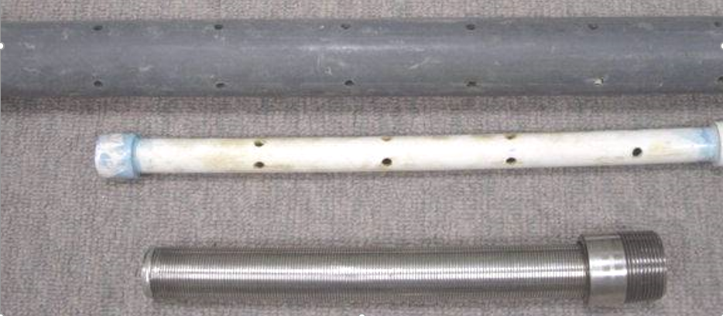
PVC and Wedge Wire Underdrain Piping
0.25” orifice openings
0.01” slot openings

Slide 14
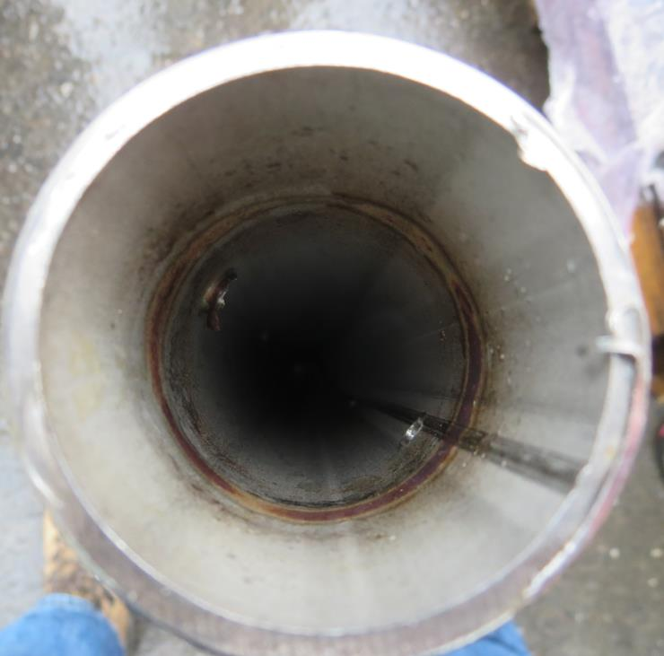
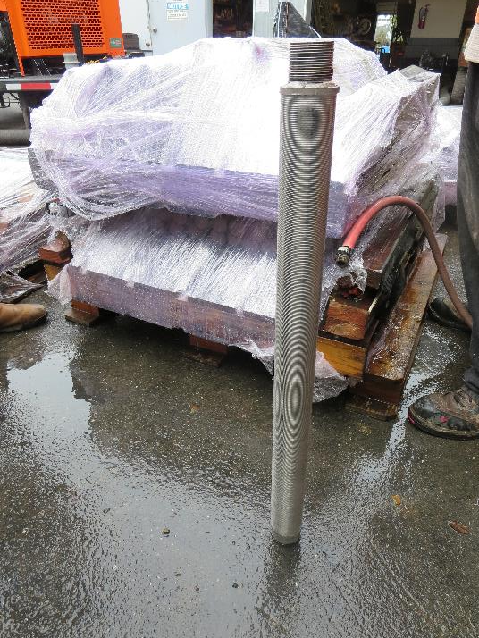
Wedge Wire Lateral
Inner pipe orifice holes

Slide 15
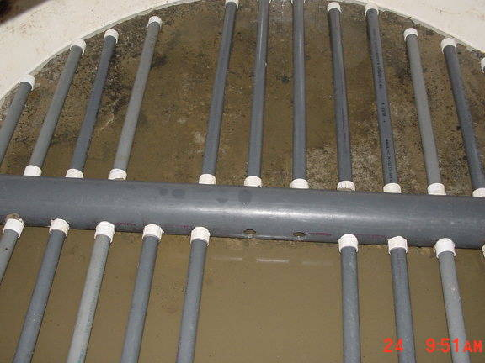
PVC Underdrain Laterals

Slide 16
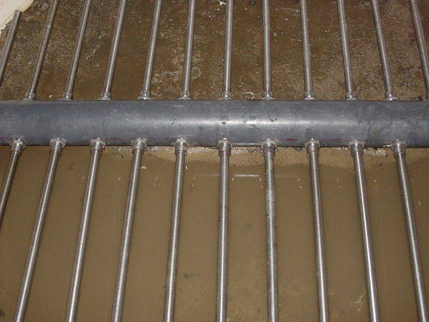
Wedge Wire Underdrain

Slide 17
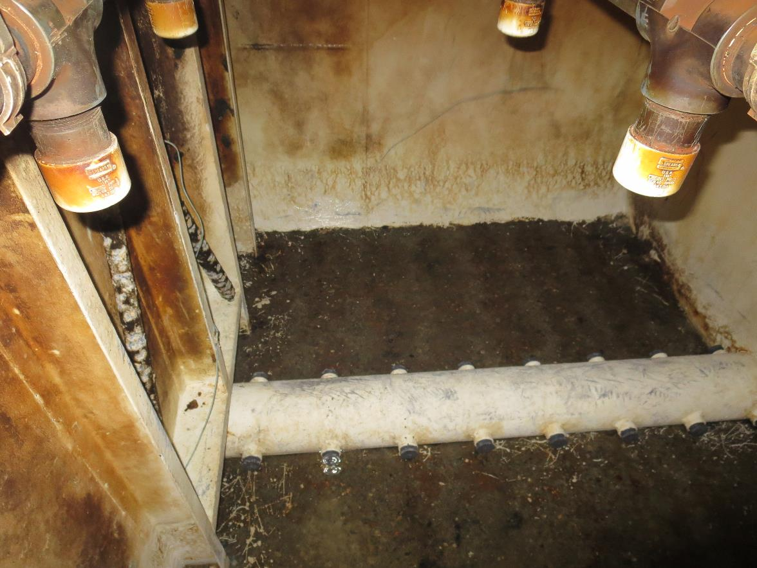
Inside Horizontal Pressure Vessel Cell

Slide 18
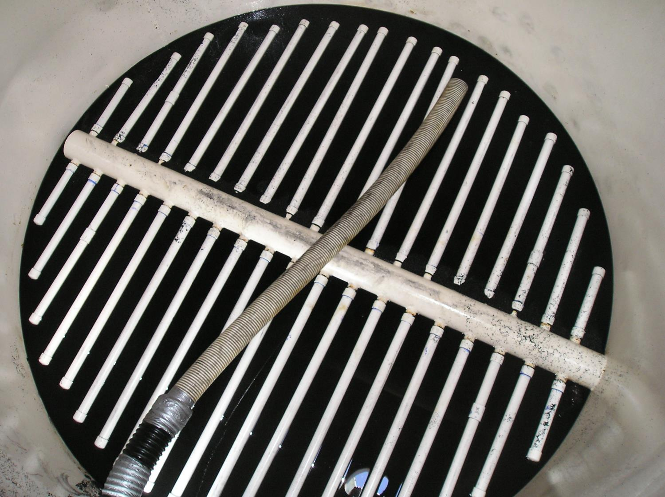
Wedge Wire underdrain41

Slide 19
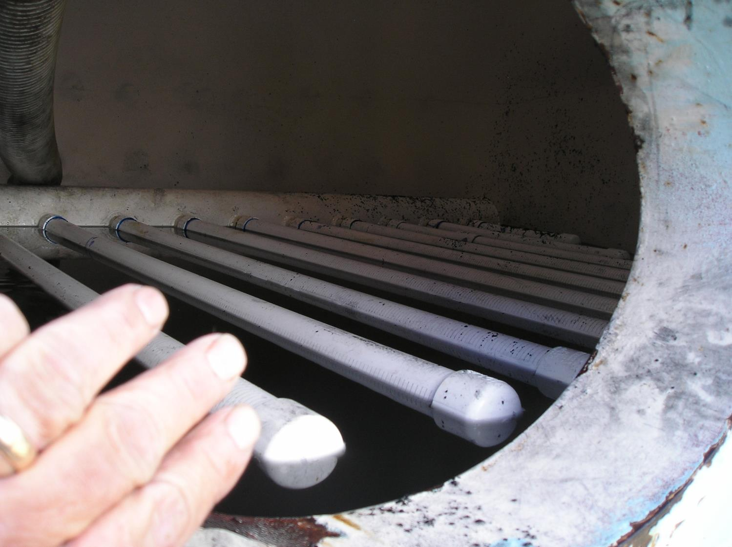
Underdrain wedge wire

Slide 20
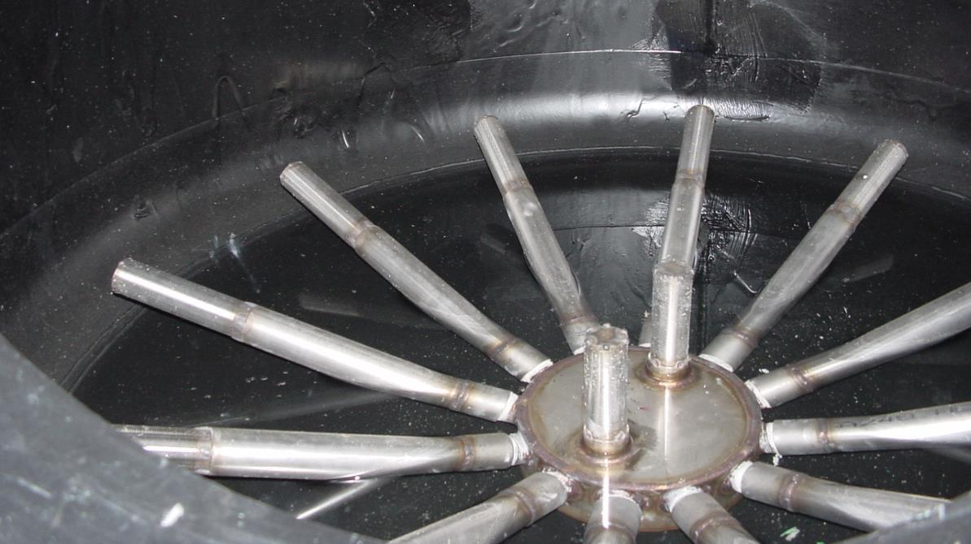
Slide23

Slide 21
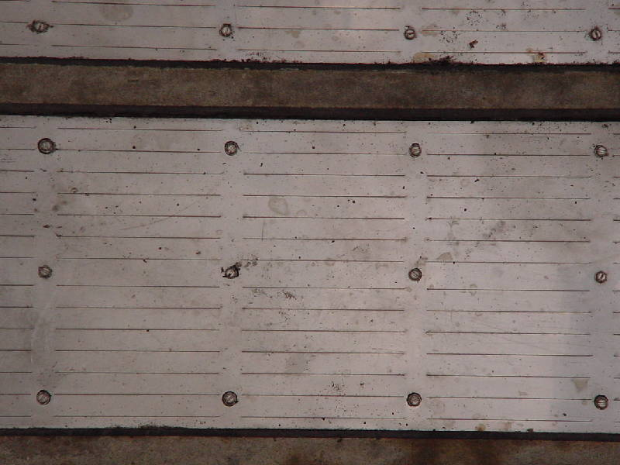
Porous Plate Underdrain

Slide 22
Type of Filter Vessels
Pressure Filters
  Horizontal
  Vertical
  Loading rates 1 – 3 gpm/ft²
Gravity Filters
  Loading rates 3 – 6 gpm/ft²

Slide 23
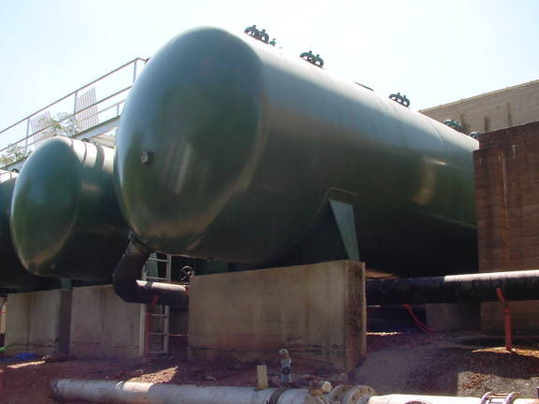
Horizontal Pressure Vessels (10-ft Dia)

Slide 24
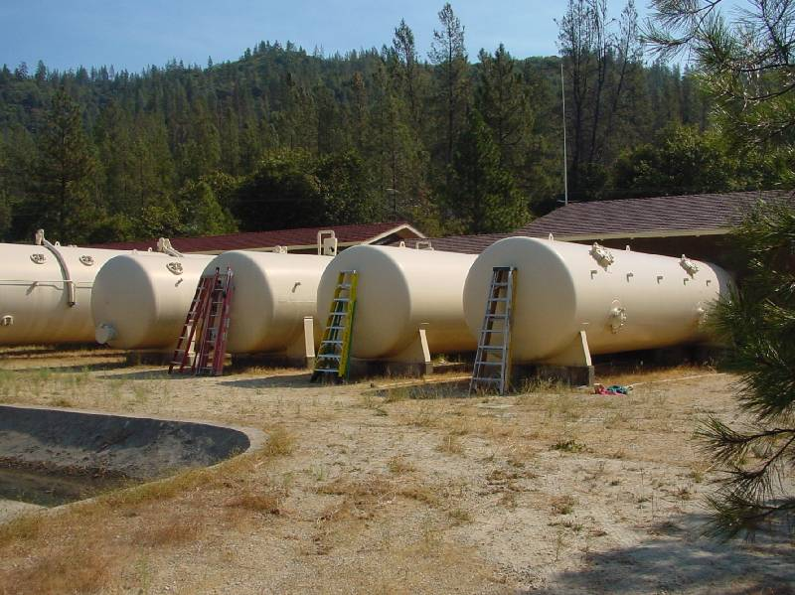
Horizontal Pressure Filters (8-ft Diam.)

Slide 25
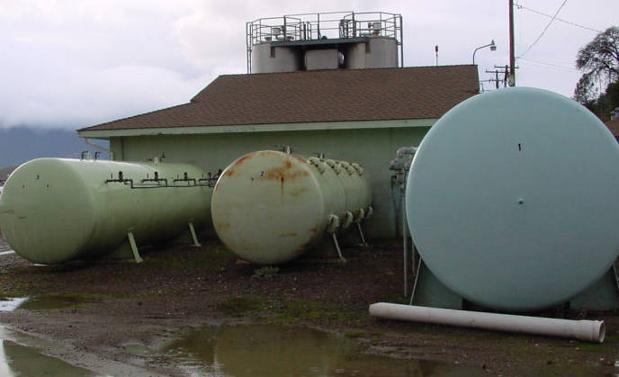
Horizontal Pressure Filters (6 & 8-ft Diam.)

Slide 26
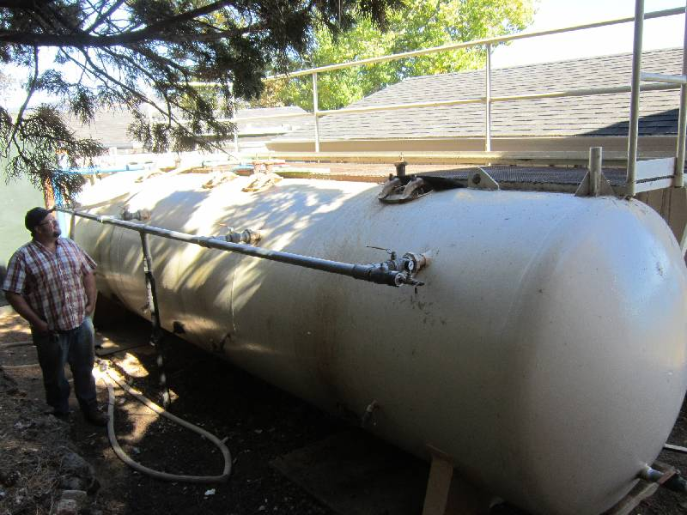
Horizontal Pressure Filter (6-ft Diam.)

Slide 27
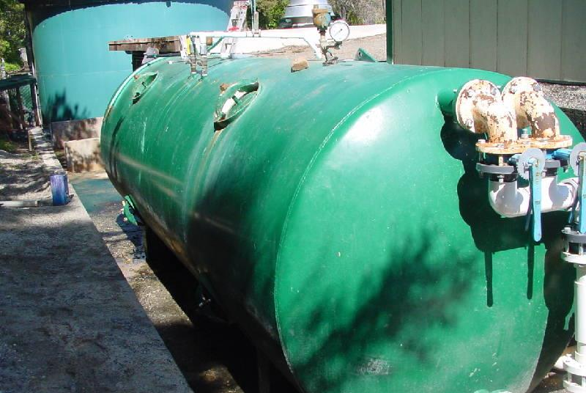
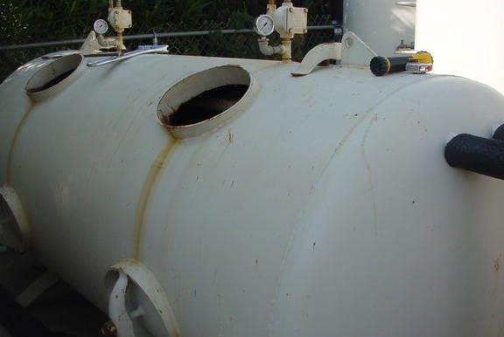
Horizontal Pressure Filters (5 & 4-ft Diam.)

Slide 28
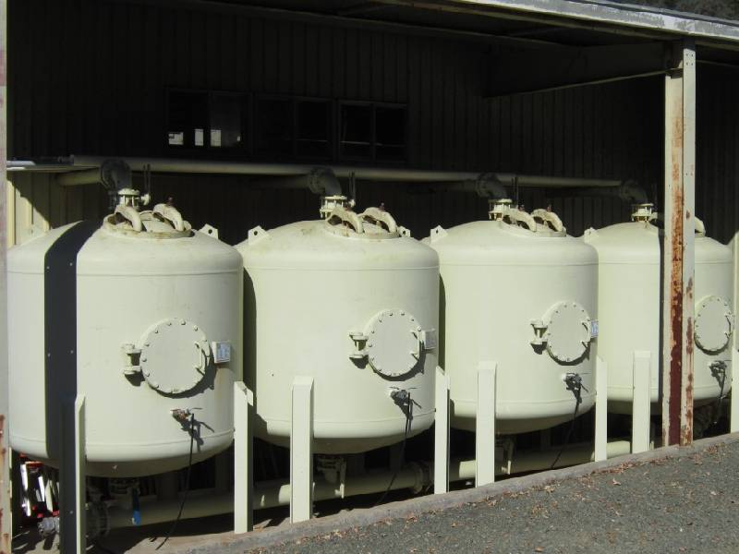
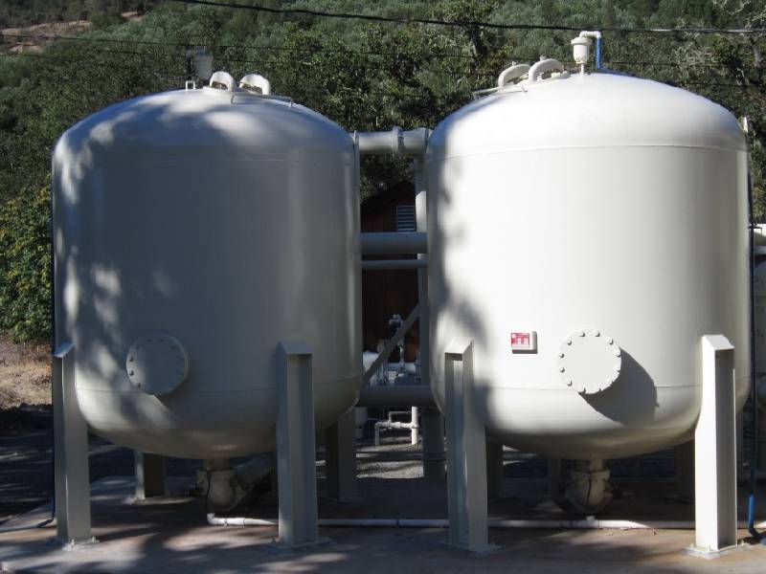
Vertical Pressure Filters

Slide 29
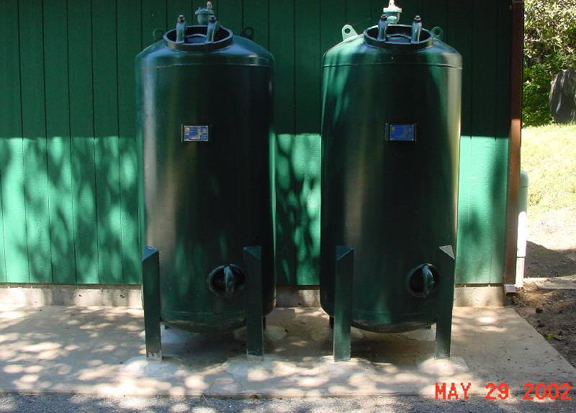
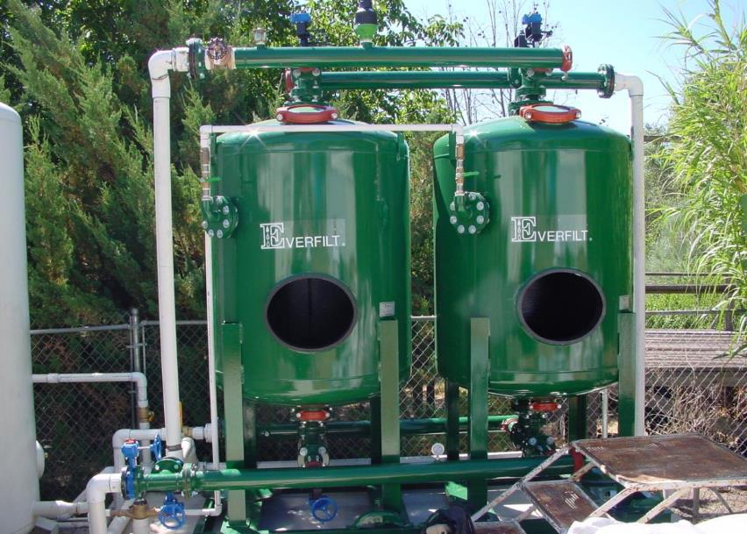
Vertical Small Pressure Filters

Slide 30
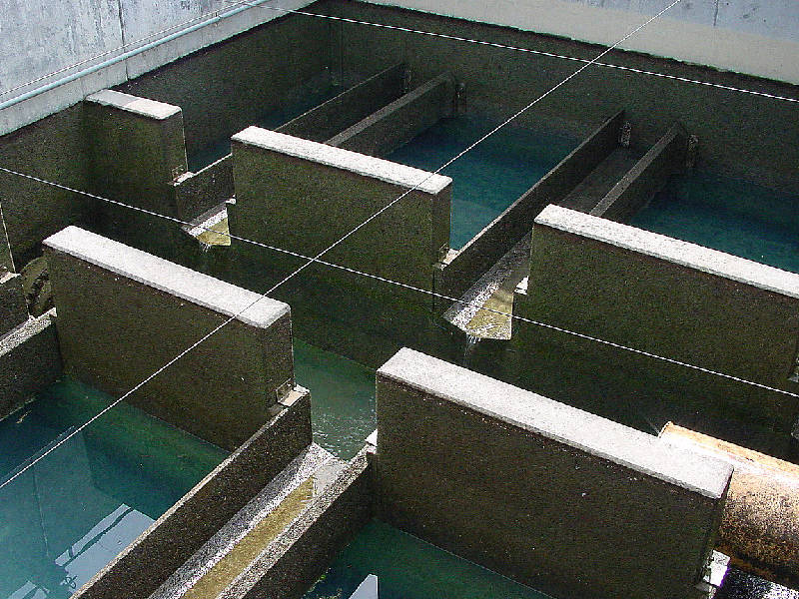
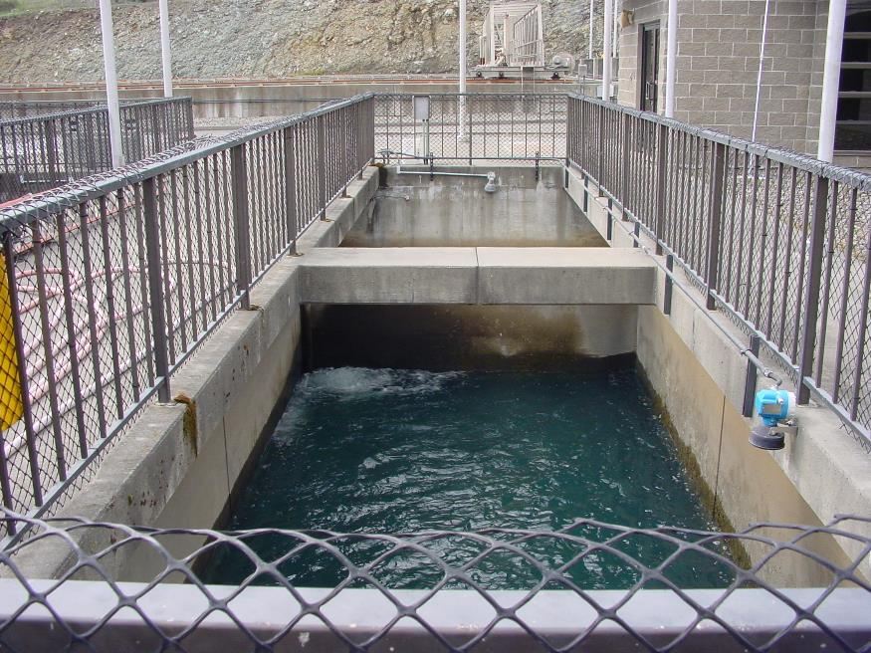
Inground Large Gravity Filters

Slide 31
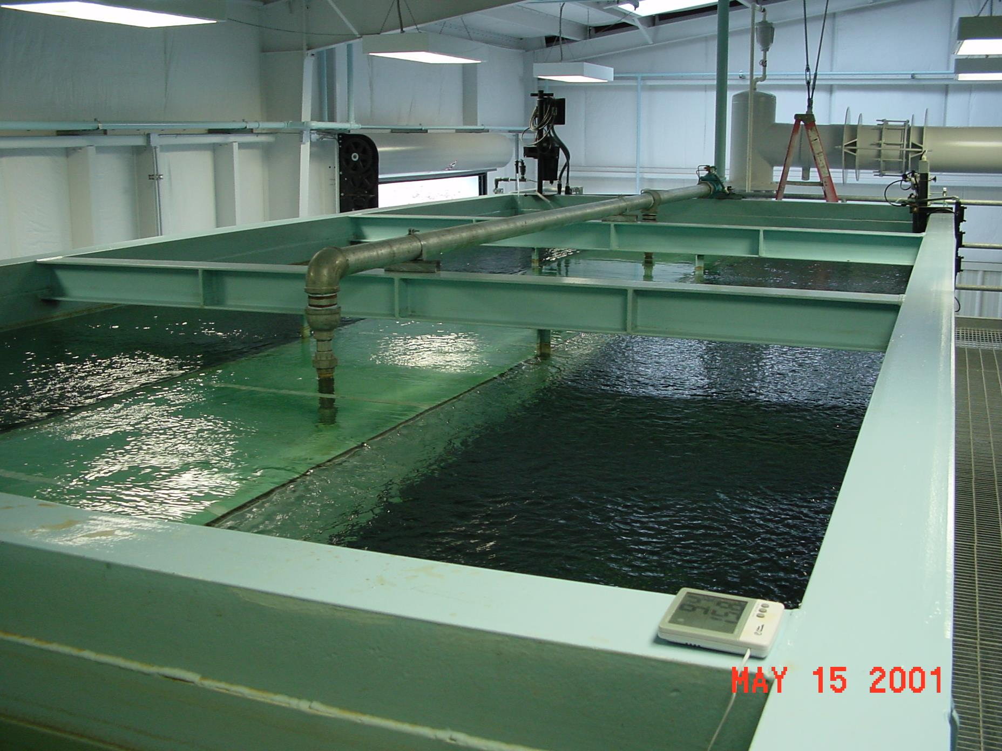
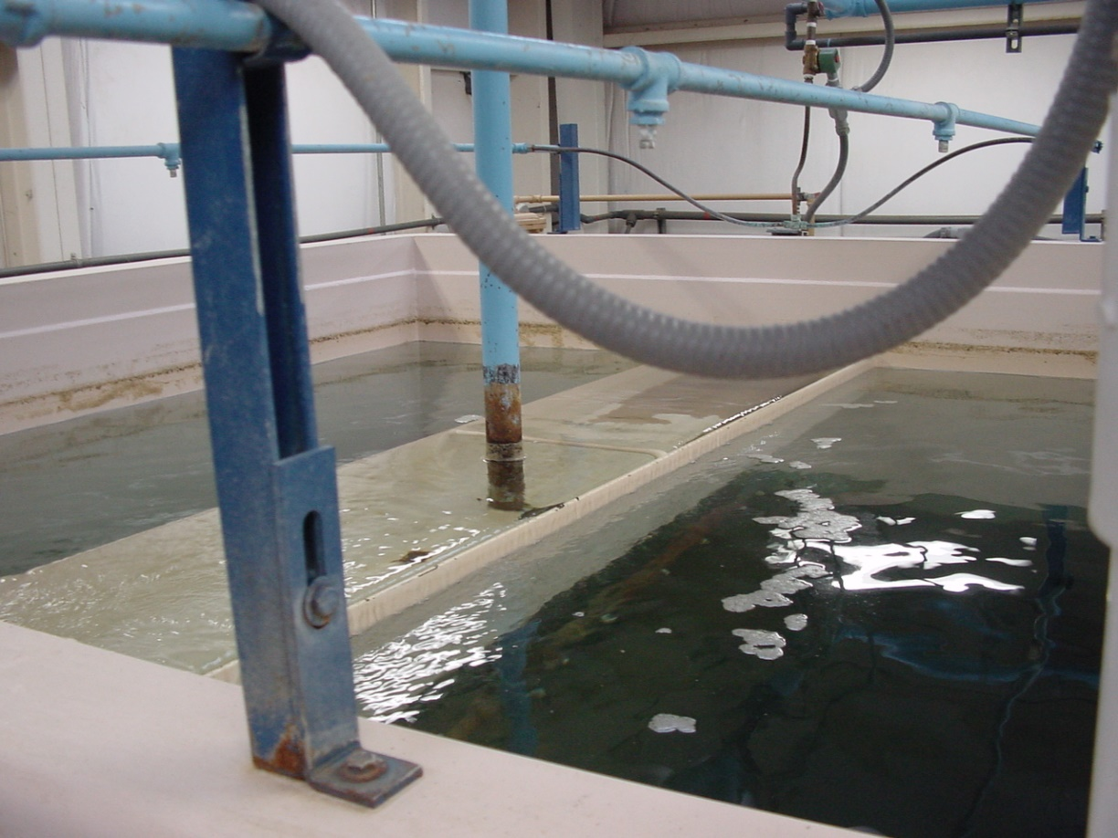
Small Gravity Filters (package plants)

Slide 32
9 Steps – Filter Surveillance
Visual inspection of filter media
Free board measurements
Media probing
Coring (mud profile and media depths)
Mud ball check (visual/digging)
Inspection of surface washers (plugging, missing, working)
Filter media expansion (pan pipe or secie disc)
Backwash loading rate/turbidity profile
Floc retention analysis (mud profile from cored samples)

Slide 33
Level of Filter Evaluation
Depends on:
Experience, Needs, and Motivation
Size and number of Filters & Type (Pressure vs. Gravity).
Season & Available Personnel
Available tools
Observation during examinations

Slide 34
1. Visual Inspection of Filter Media
  After filter is drained, visually note any abnormalities of the media.
  Document by taking pictures and/or videos.
  Note to team partner of what is observed
  Note: Draining a dirty filter will take longer than a filter that was just backwashed. Investigate beforehand the best way to drain filter in the most efficient way.

Slide 35
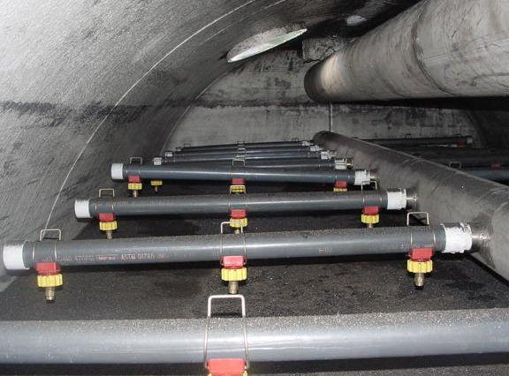
Slide24

Slide 36
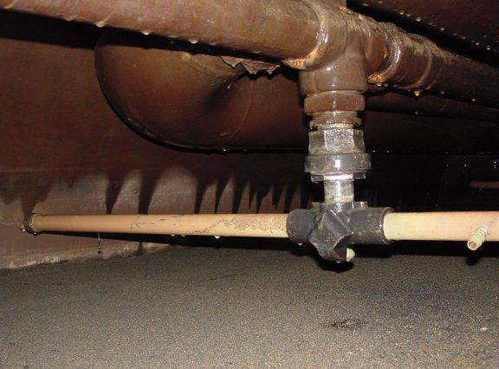
Slide25

Slide 37
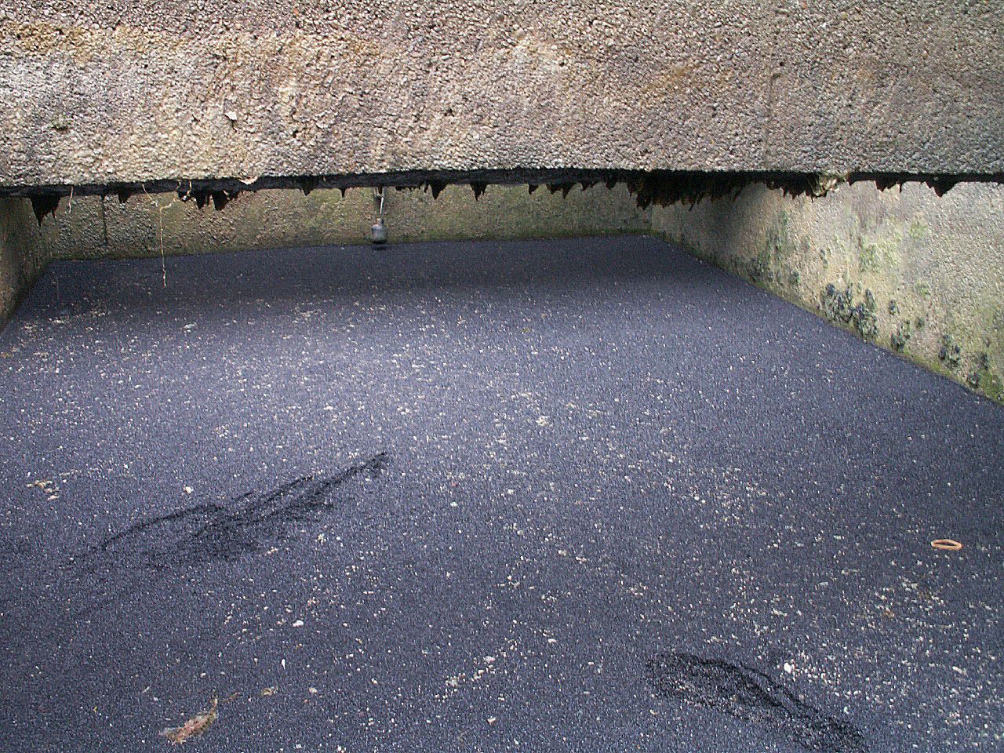
Slide26

Slide 38
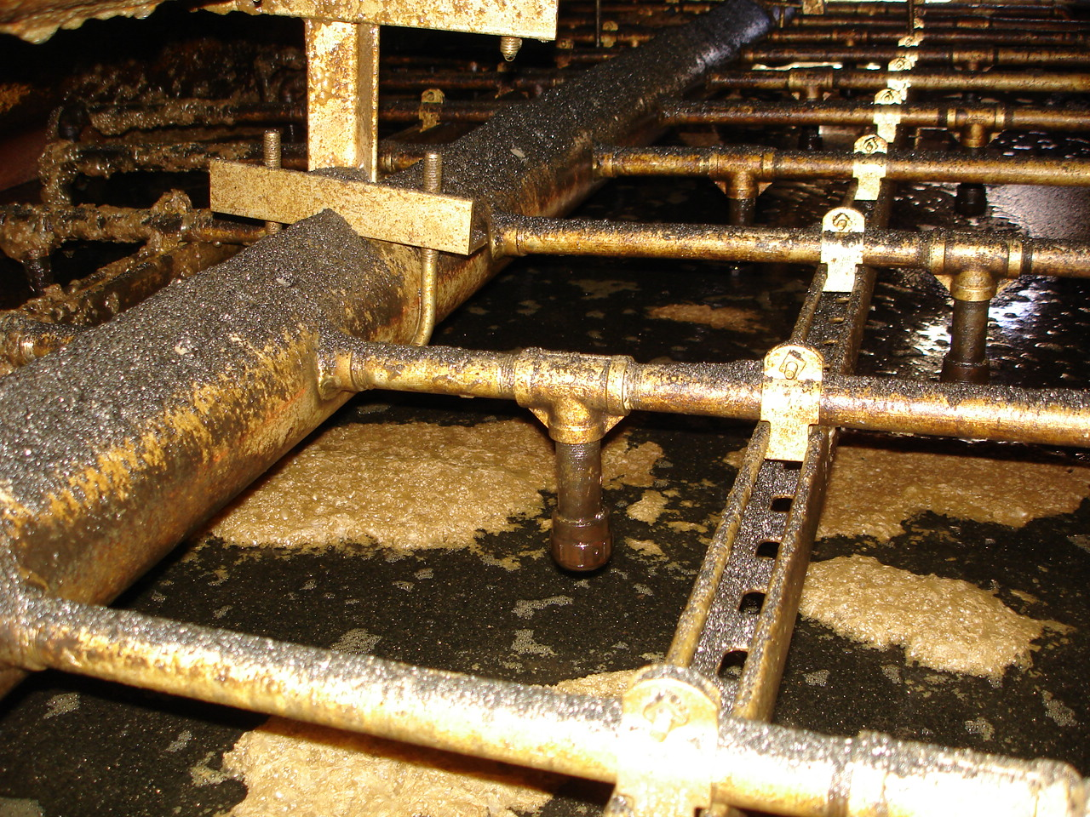
Slide1

Slide 39
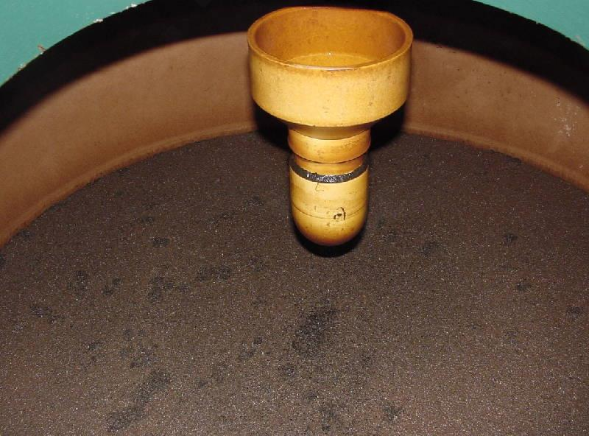
Slide28

Slide 40
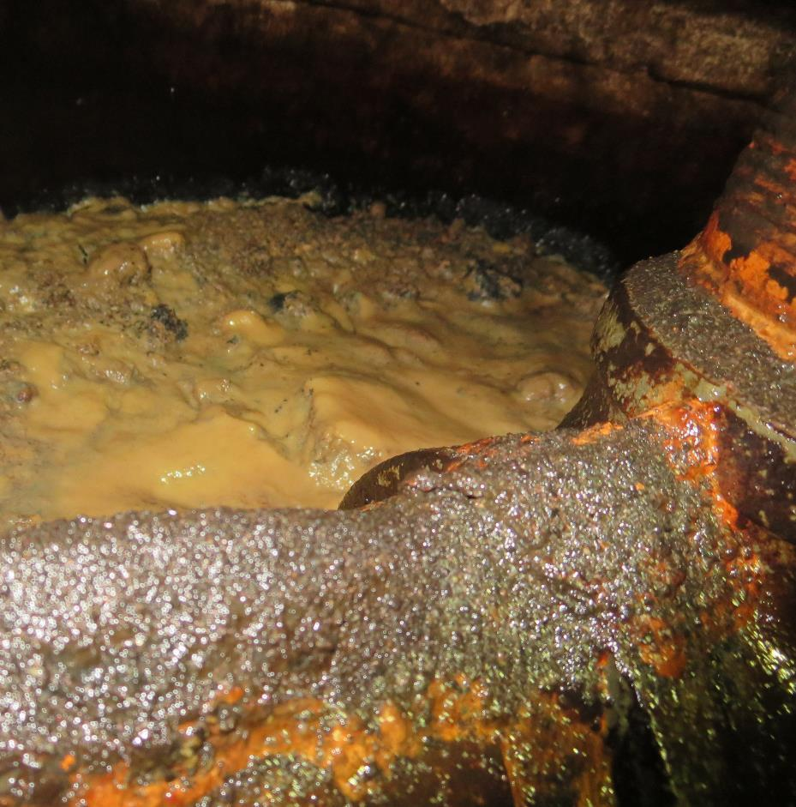
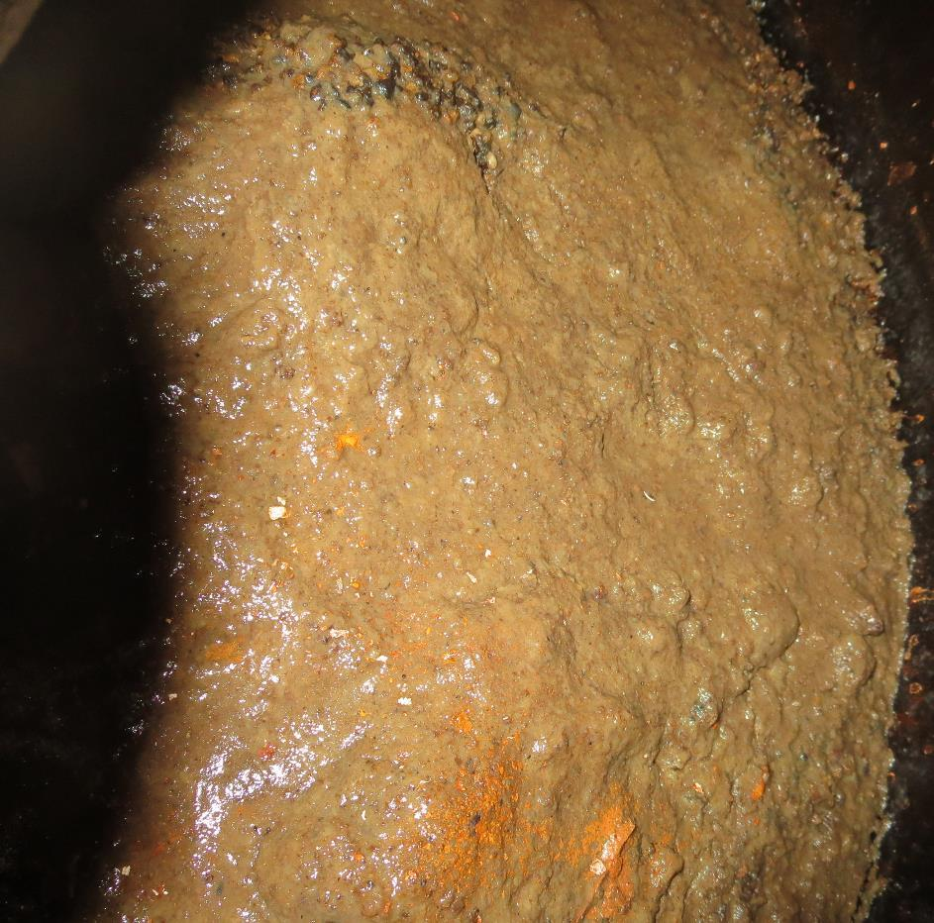
Slide29

Slide 41
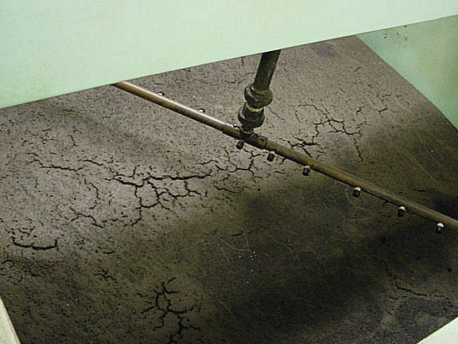
Slide30

Slide 42
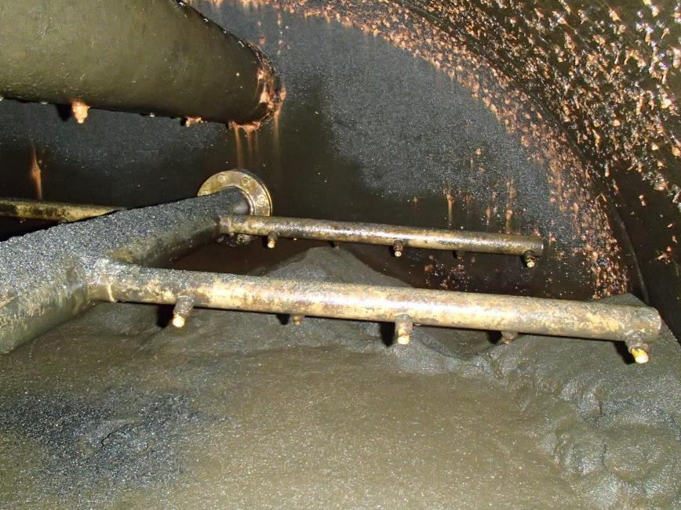
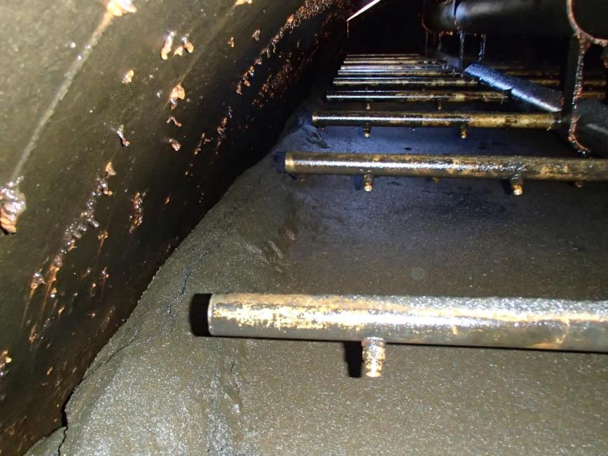
Slide31

Slide 43
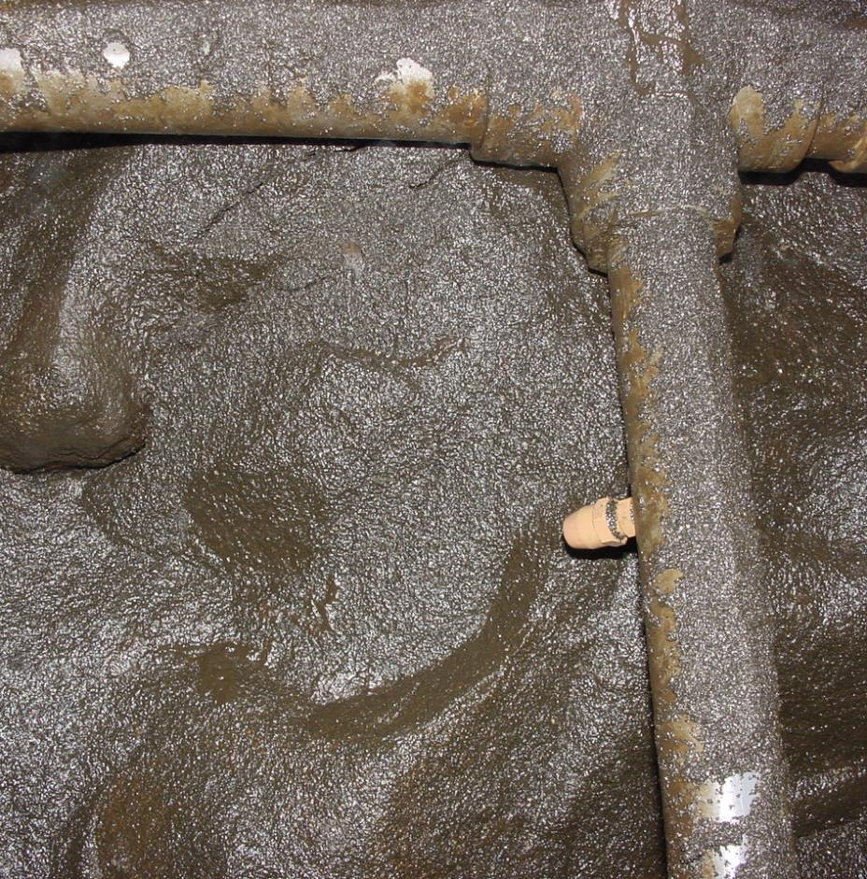
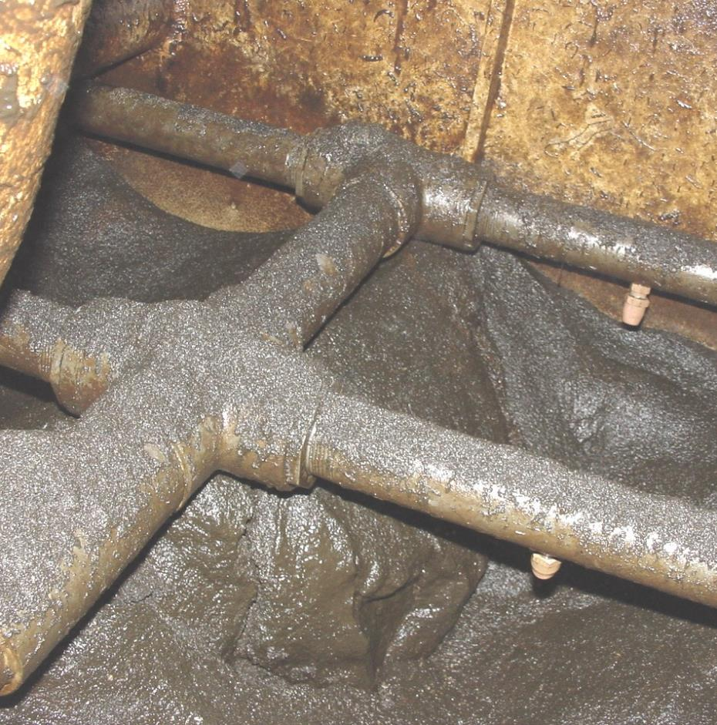
Slide2

Slide 44
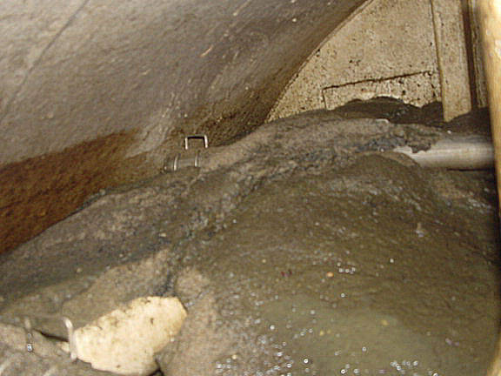
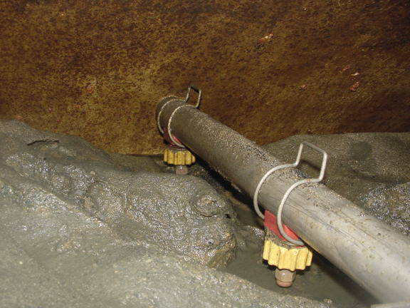
Slide32

Slide 45
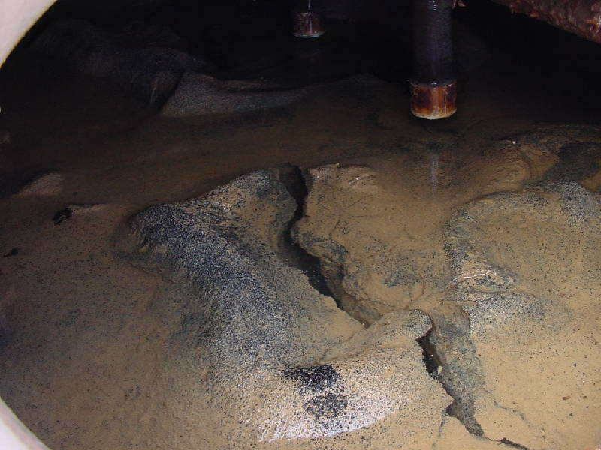
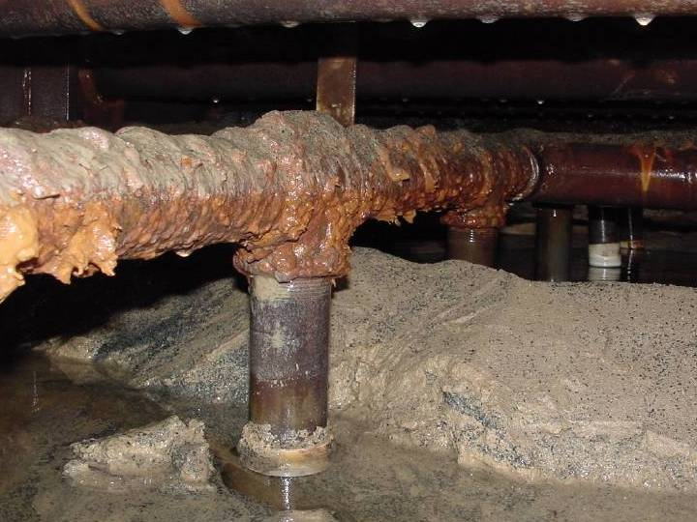
Slide3

Slide 46
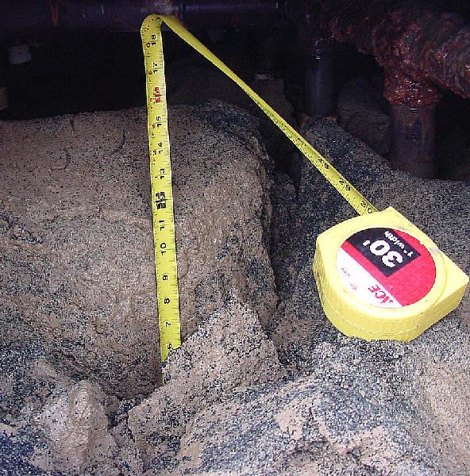
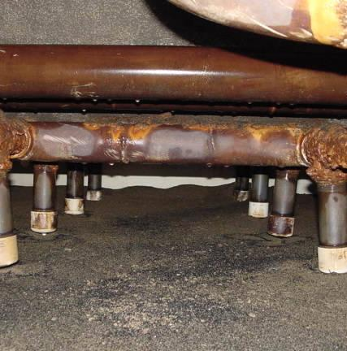
Slide4

Slide 47
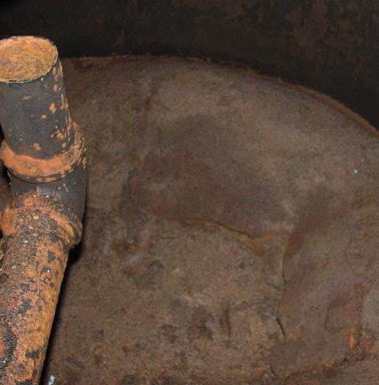
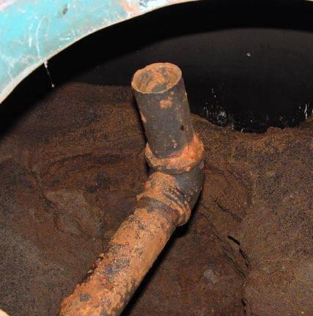
Slide5
Media harder over
Short-Circuiting

Slide 48


Slide6
Lawn Sprinklers

Slide 49

2. Measurements
Take freeboard measurements
  Surface nozzle to top of media
  Header or trough to top of media

Slide 50

Slide7

Slide 51

Slide8

Slide 52

3. Media Depth Probing
Probe media for depth
  Pressure filter – conducted at hatch area
  Gravity filter – grid area probing
  Use ½-inch steel rod from 4 – 10 feet

Slide 53


Slide9

Slide 54
Media Depth – Gravity Filters
Trough
Probing points

Slide 55

4. Core Media (mud profile and filter depth)
Core before and after backwash
  Requires two people
  Coring samples
    0 – 2 inches
    2 – 6 inches
    6 – 12 inches
    12 – 18 inches …………etc.
  Use golf tube or electrical conduit
  (PVC piping is not suitable)
  Place samples in labeled zip-lock bags

Slide 56

Slide10

Slide 57

Slide11

Slide 58


Slide13

Slide 59


Slide12

Slide 60


Slide14

Slide 61

Depth of Media Layers
  Estimate media layer
  depth from core samples
  Anthracite
  Interface (anthracite/sand)
  Silica Sand
  Garnet sand

Slide 62

5. Check for Mud Balls
Dig into filter media with hands
  Feel for mud balls – clump of media/coagulant stuck together.
  Document sizes

Slide 63
6. Test Surface Washers
Turn on Surface Washers (min throttled)
  Missing nozzles
  Plugged nozzles
  Broken pipes
  Pressure filters w/multi cells
    Is surface washer on cell that is being backwashed
  Recommend to back filled with water just above media before testing surface washers. This will minimize flying media.

Slide 64


Slide15

Slide 65


7. Filter Media Expansion Test
Measure filter media expansion during backwash cycle.
  Pan Pipe tool
  Place pan pipe on top of media and clamp
  Pan Pipe material
    ¾-in PVC and Duct Tap
    Each pipe 1 inch longer
    Bed expansion (15 – 35%)
    Secchi disc for gravity filters

Slide 66


Slide16

Slide 67

Slide17

Slide 68


Slide18

Slide 69
8. Filter Backwash
Backwash Filter – Turbidity Profile
  Note and record backwash rate (gpm/ft²)
  Note surface wash rate and duration
  Sample discharge of filter backwash once every 30 to 60 second and record turbidity.
  Typical Backwash Rates:
    Pressure Filters (10 – 15 gpm/ft²)
    Gravity Filters (12 – 18 gpm/ft²)
  Loading Rate: Backwash flow (gpm) divided by filter area (ft²)

Slide 70

Slide19

Slide 71


Slide20

Slide 72


Slide21

Slide 73
Turbidity Backwash Profile

Slide 74

9. Floc Retention Analysis
  Materials Needed
  Turbidity Meter
  Two 500 mL Erlenmeyer
  Wide mouth flask
  Rubber stopper (size 10)
  500 mL beaker
  100 mL graduated cylinder
  50 mL media sampler
  Plastic spoon

Slide 75


Slide22

Slide 76
9. Floc Retention Analysis – cont1.
  Procedures:
  Pour media sample into 500 mL beaker and mix with spoon.
  Transfer 50-mL of sample to the 500-mL flask.
  Add 100 mL of tap water into the 500-mL flask, stopper and shake vigorously for 30 sec.
  Decant turbid water into the 500-mL second 500-mL flask
  Using the same media, repeat cleaning procedure four more time until there is a total of 500 mL of turbid water in the beaker.
  Invert 500-mL sample of turbid water in flask to re-suspend solids before performing the turbidity analysis.

Slide 77
9. Floc Retention Analysis – cont2.
  Procedures – cont.:
  Multiply the turbidity value by 2 so that final tabulations is based 100 mL of sample.
  Repeat previous steps for remaining core samples.
  Graph the turbidity (x-axis) versus media depth (y-axis) for both the before and after backwash samples.
  From results, determine weighted average turbidity per 100 mL of entire core samples for both the before and after backwash samples.
  Compare results and determine percent reduction of floc before and after backwash.

Slide 78
Floc Retention Analysis
Core Samples | NTU (50 mL sample) | NTU x 2 Based on (100 mL sample | Weighted Factor | Weighted Avg.
0 – 2” | 351 | 702 | 2/30 | 47
2 – 6” | 140 | 280 | 4/30 | 37
6 – 12” | 90 | 180 | 6/30 | 36
12 – 18” | 70 | 140 | 6/30 | 28
18 – 24” | 50 | 100 | 6/30 | 20
24 – 30” | 45 | 90 | 6/30 | 18
 |  | Sum: | 30 | 186

Slide 79
Filter Bed Cleanliness Evaluation
NTU/100 mL per Sample | Actions to Take (after filter backwash)
60 – 120 NTU | Clean bed (normal)/partially ripened – no action required
120 – 300 NTU | Slight dirty bed – ensure retention analysis is done within one year
300 – 600 NTU | Dirty bed/well ripened – evaluate filter wash system and procedures.
600 – 1,000 NTU | Dirty bed/well ripened/possible mud balls – evaluate filter wash system and procedures; may need to replace filter media.
1,000 – 5,000 NTU | Extremely dirty bed/possible mud balls and sludge buildup – Replace media and evaluate filter wash system and procedures.

Slide 80
9 Steps – Filter Surveillance -
Visual inspection of filter media (document w/pictures)
Free board measurements
Media probing
Coring (for floc retention analysis and media depths)
Mud ball check (visual/digging)
Inspection of surface washers (plugging, missing, working)
Filter media expansion (pan pipe or secie disc)
Backwash loading rate/turbidity profile
Floc retention analysis (mud profile from cored samples)

Slide 81
Documentation – Suggestions
Lots of pictures inserted into PowerPoint:
  In toolbar: Insert/Photo Alum/New Photo Alum/File Disk
Tables of results
  Measurements (Cell 1, Cell 2, …..)
    Media depth (total)
    Media layer depths (anthracite, sand, garnet)
    Distance from media to surface wash nozzle
  Backwash results (loading rate, NTU profile)
  Floc retention analysis

Slide 82

Contact
Guy Schott, P.E.
State Water Resources Control Board
Division of Drinking Water
Santa Rosa, CA
Go to Filter Surveillance for presentation
www.waterboards.ca.gov/drinking_water/programs/districts/mendocino_district.html
Email: Guy Schott - Guy.Schott@waterboards.ca.gov
Office Number: 707-576-2732

