Slide 1
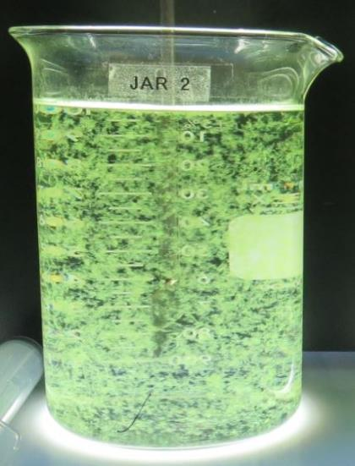
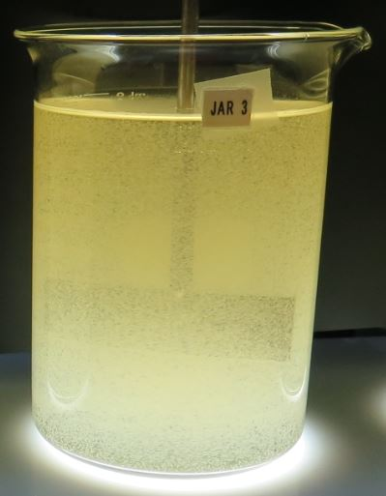
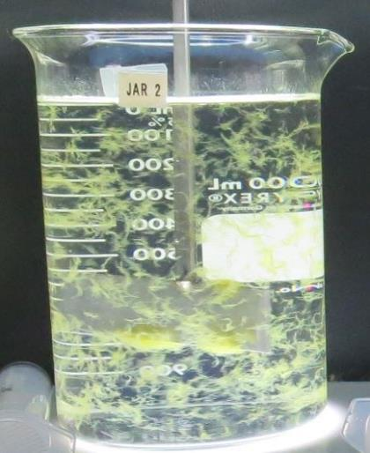
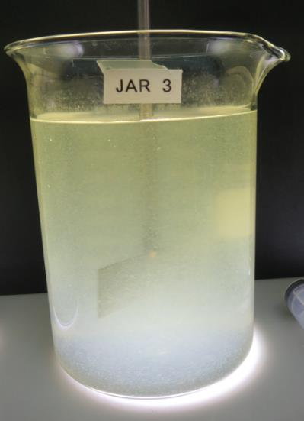
Jar Testing
Confidence in Results for Plant Application
CA-NV AWWA Water Conference of the West, San Diego, CA
by Guy Schott, P.E. April 7, 2026
Algal Bloom (Microcystin)
Rain Event
Algal Bloom (Lyngbya)
Drought

Slide 2
Presentation Overview
The importance of jar testing and outcomes
Lab Equipment/Materials
Analysis (Filterability, UVT/UVA & Settleability)
Procedures
Case/Application Study
Training Video – Jar Testing Done Right

Slide 3
Why Jar Test?
When there is a change in source water quality that can impact
  Filtration process
  Disinfection by-product formations
Evaluate
  pre-oxidants (chlorine, KMnO₄, ozone)
  pH adjustment
  powder activated carbon
  other coagulants and organic polymers
To practice

Slide 4
Jar Testing & Analysis –
What’s Important
The chemistry that results in the best
Filterability (floc strength, turbidity, and head loss)
Dissolved organic carbon reduction (UVA surrogate)
Settleability (turbidity)
Confidence in your jar testing results
Fast, simple, and effective

Slide 5
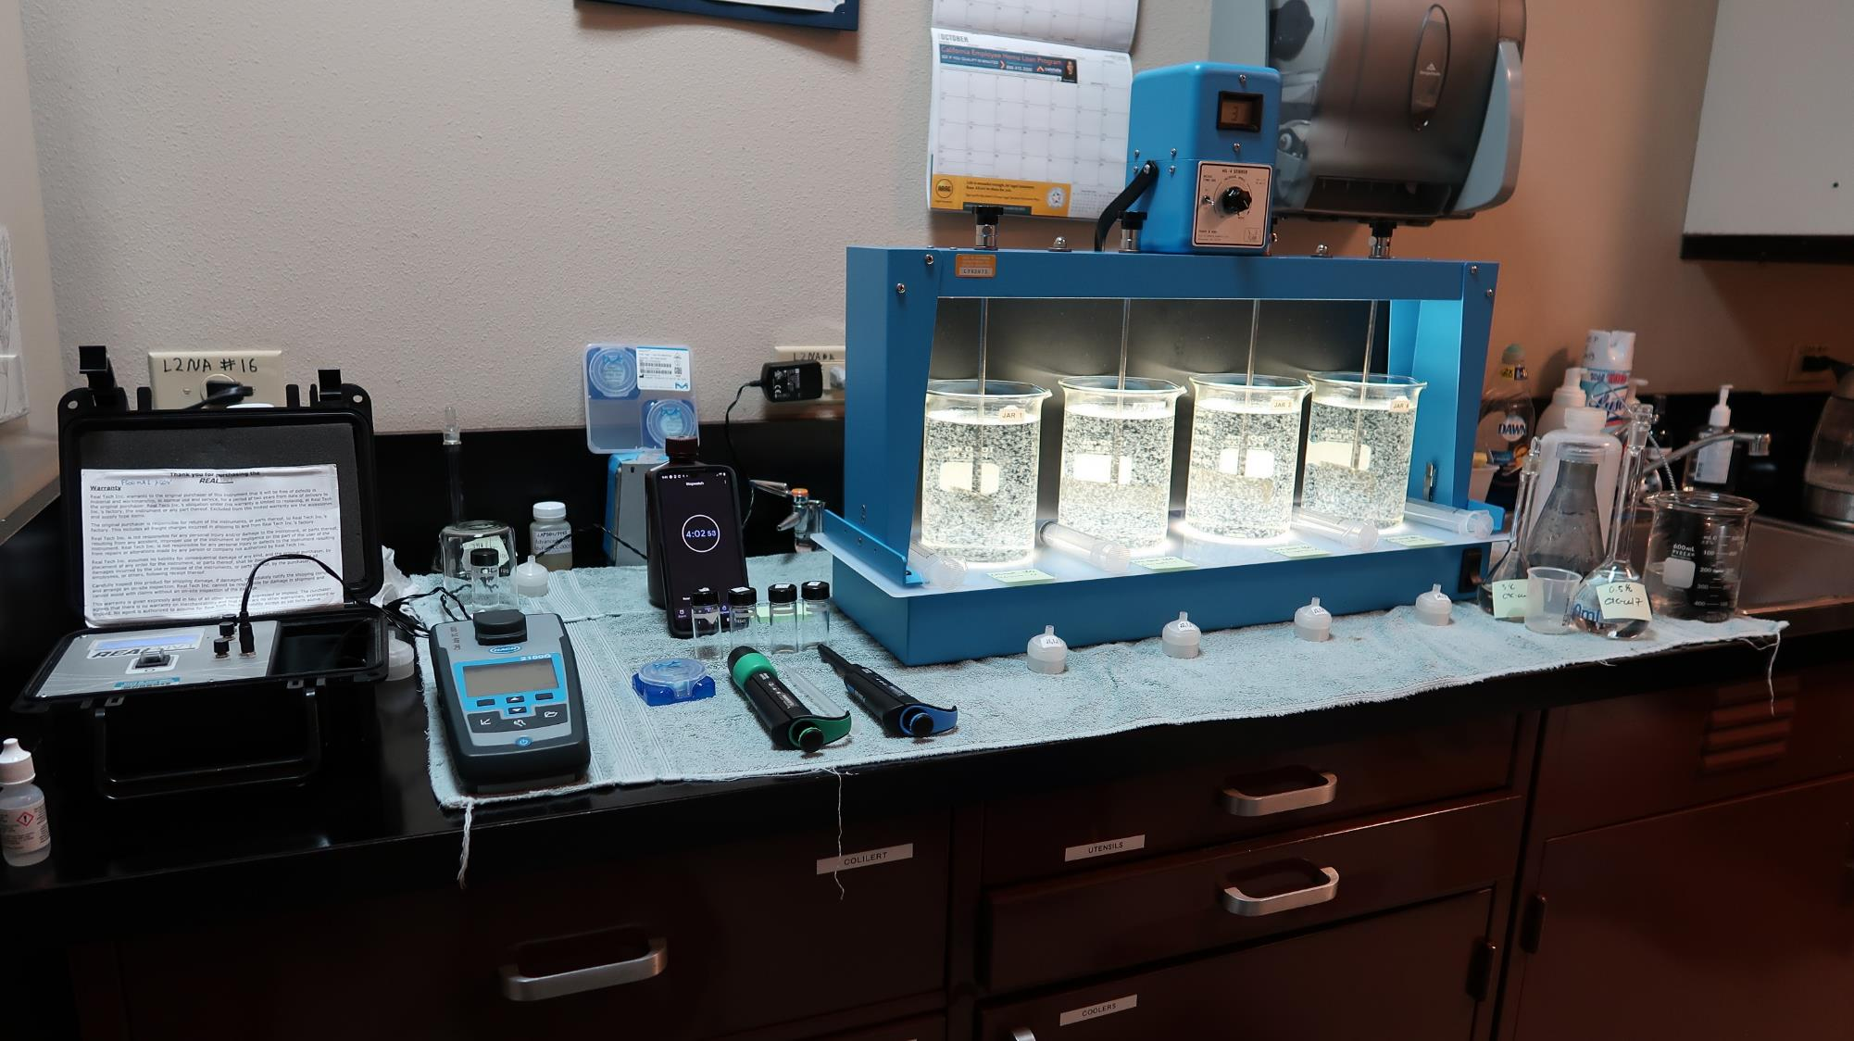
Lab
4-Jar Tester
Cuvettes
UVA/%UVT
Luer-Lock Syringes (30 cc)
Stock
Solutions
Filters
(1.2 um absolute
Isopore polycarbonate
membrane)
Pipettes
100-1000 uL
0.5-5 mL
Turbidity

Slide 6
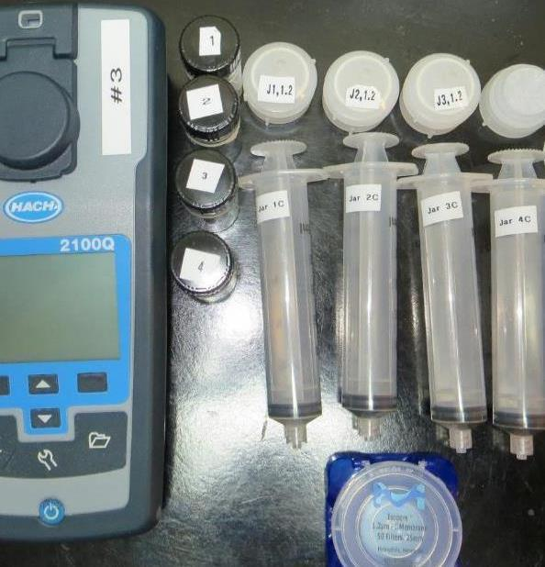
1. Filterability Analysis
Evaluate which chemicals and dose provide the best filtrate NTU (<0.1 NTU)
1.2 um absolute Isopore polycarbonate membrane
Weak floc - increase filtrate turbidity
Strong floc - decrease in filtrate turbidity
Samples are collected at end of flocculation period (0-5 minutes)
Notes:
Discuss if your difference pore size

Slide 7
Filterability Sensitivity Performance Analysis –
Plant dose (Alum: 35 mg/L, pDADMAC: 6.0 mg/L product)
Jar#
Alum
pDADMAC
Filtrate
Floc
(dry)
Solution
NTU
Strength
mg/L
mg/L
J1
35
0
1.06
Very Weak
J2
45
0
0.66
Very Weak
J3
55
0
0.27
Weak
J4
65
0
0.26
Weak
J5
35
6.0
0.10
Good
J6
45
6.0
0.05
Strong
J7
55
6.0
0.04
Strong
J8
65
6.0
0.05
Strong

Slide 8
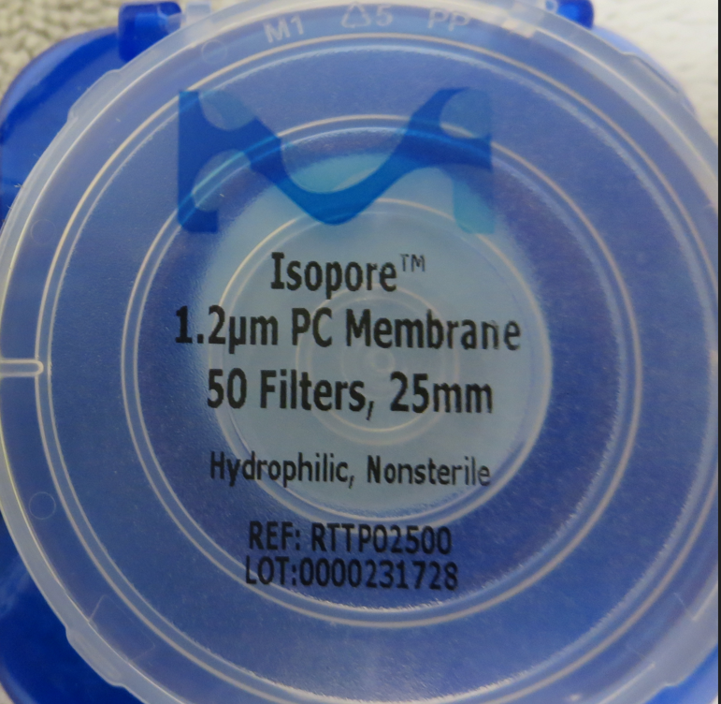
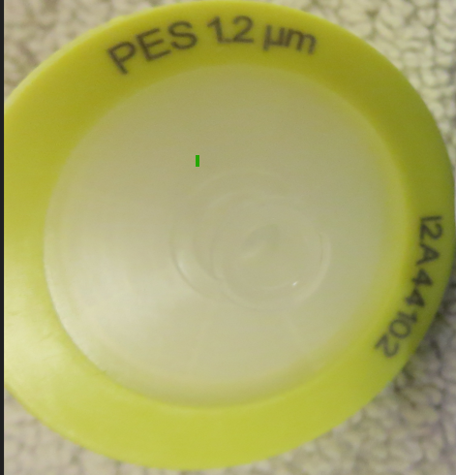
Use the Correct Specified Filter
1.2 um Polycarbonate Filter
Correct filter for Jar Testing
1.2 um Polyethersulfone Filter
Incorrect filter for Jar Testing

Slide 9
Specified Filter Material/Size must be used.
*Note: Laboratory Charged Analyzer (LCA) results: 3.9 mg/L as coagulant product
Jar #
Blend of
Filtrate NTU
Filtrate NTU
*ACH/pDADMAC
(Polyethersulfone)
(Polycarbonate)
mg/L
1.2 um Membrane
1.2 um Membrane
Incorrect Filter
Specified Filter
J1
3.0
0.04
0.13
J2
3.5
0.04
0.06
J3
4.0
0.04
0.04
J4
5.5
0.04
0.05
J5
6.0
0.04
0.08
J6
6.5
0.05
0.23
For filterability analysis, use Isopore Membrane Filter, 1.2 um absolute pore size, Φ= 25 mm , thickness: 24 um, hydrophilic polycarbonate membrane (part #: RTTP02500, Sigma-Aldrich)

Slide 10
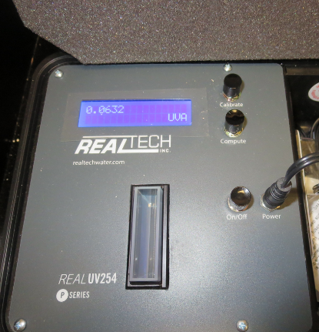
2. Filtrate UV-Absorption (UVA) Analysis
Surrogate for dissolved organic carbon (DOC)
Compare %UVA reduction between jars
% UVA Reduction = (Source UVA – Filtrate UVA)/(Source UVA)*100%
Systems with DPB issues, UVA measurements are critical for determining optimum coagulant and dose
Notes:
Discuss if your difference pore size

Slide 11
2. Filtrate UV-Absorption (UVA) Analysis –Ex
Jar
Filtrate
Filtrate
Filtrate
%UVA
Settled
TTHM
HAA5
NTU
%UVT
UVA/cm
Reduction
NTU
ug/L
ug/L
Plant
0.04
89.9
0.046
65.9
2.0
90
63
Dose
Optimum
0.04
93.2
0.030
77.8
2.0
59
40
Dose
Note: There is an additional 35% reduction in UVA from Jar 1 to 2.
Notes:
Discuss if your difference pore size

Slide 12
3. Settleability Analysis
Relative performance measurement between jars based on coagulant type, dose and flocculation duration
Samples are collected 25 minutes from the end of the flocculation period for a 4-jar tester
Note: Settleability has no supporting data on filterability and UVA reduction

Slide 13
Jar Testing Procedures and Analysis
35 minutes or less complete 4-jar testing and analysis
Jar Testing 5.5 minutes
1. Flash Mix 200 RPM (20-30 sec) | 2. Flocculation 20-30 RPM (5 min)
Analysis 20 - 25 minutes
3. Filterability & Filtrate %UVT/UVA (5 min/jar = 20 min) | 4. Settleability (5 min)
*Note: Floc duration longer than 5 minutes has no significant impact on filterability and filtrate UVA results.

Slide 14
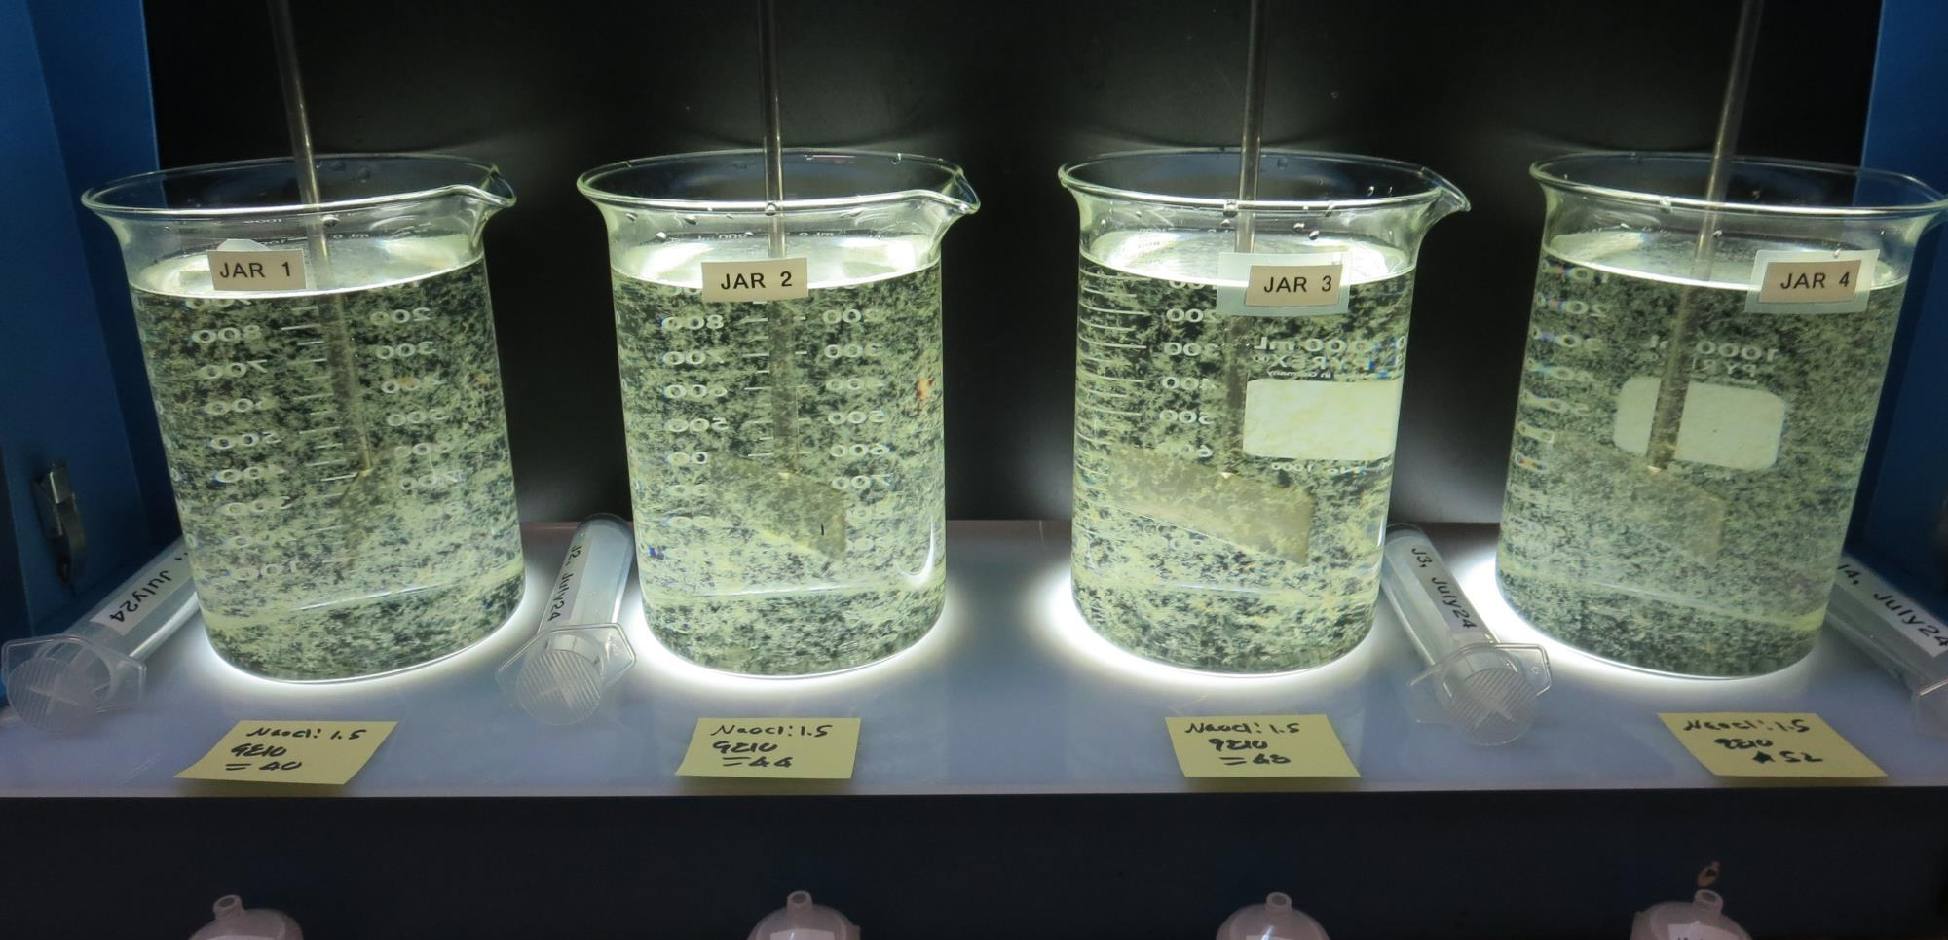
End of 5-minute flocculation (30 RPM) duration.

Slide 15
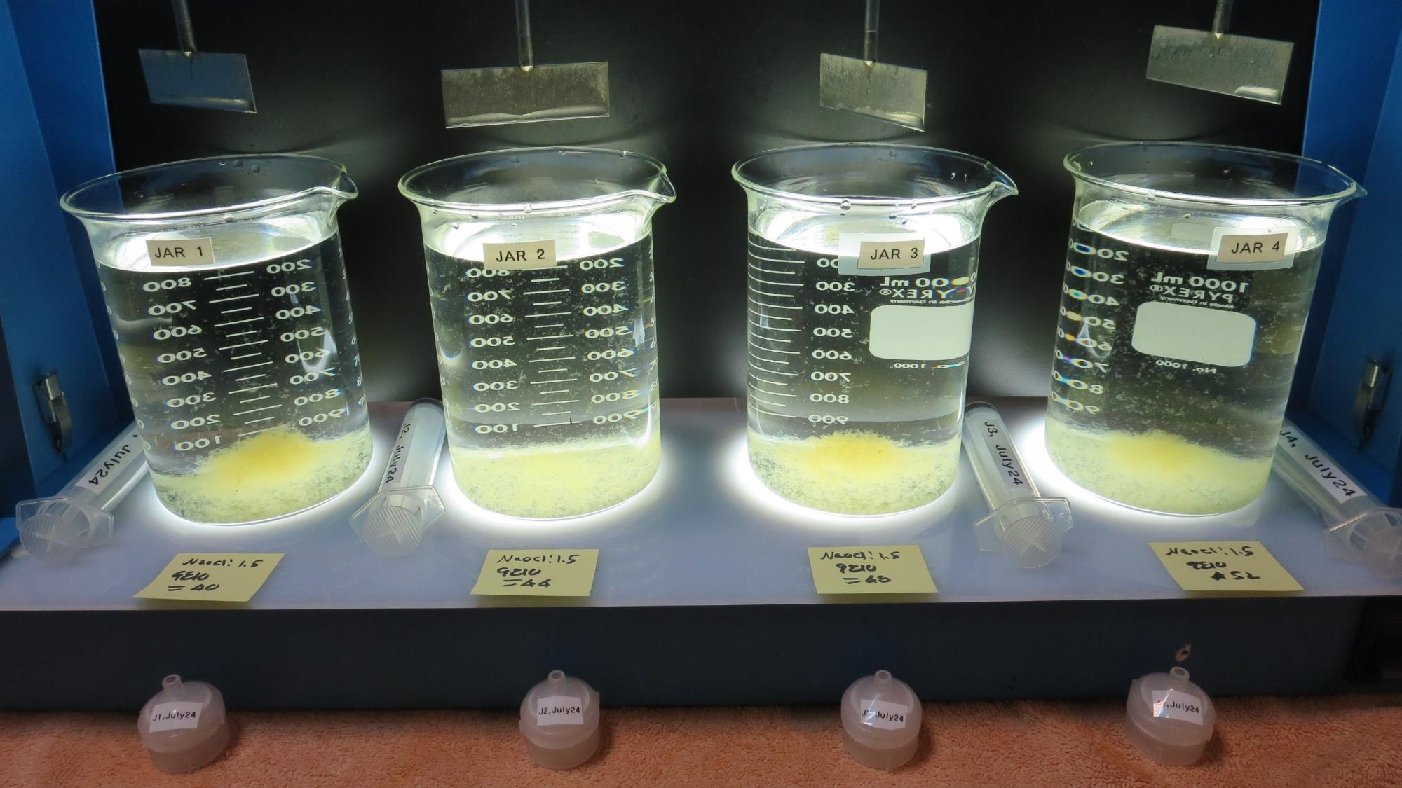
After 5 min of settling, 25 mL is syringed for filterability and %UVT/UVA.

Slide 16
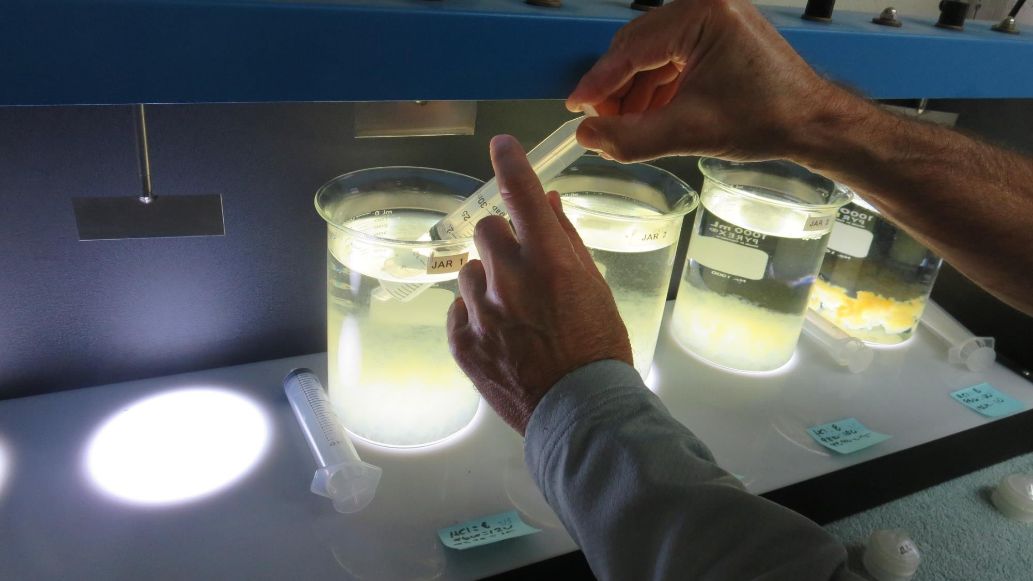
Syringing
Filterability (20-25 mL syringed)

Slide 17
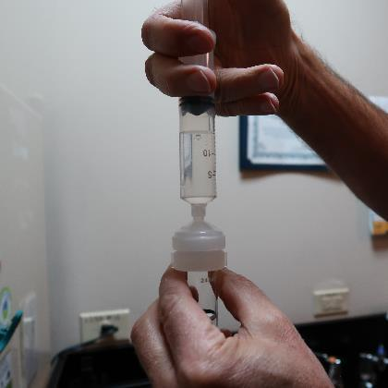
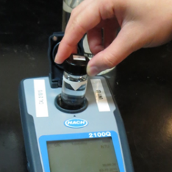
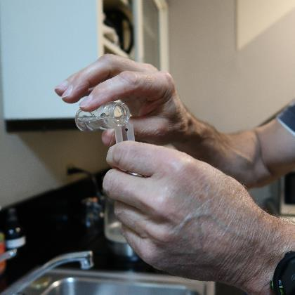
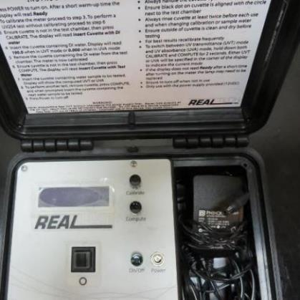
Filterability and UVT/UVA Analysis (5 min/Jar)
1.
2.
3.
4.
Flocculated water is pushed through a 1.2 um absolute polycarbonate membrane (drip-rate) into cuvette
Measured filtrate turbidity (several readings until stable) and record
Transfer water from cuvette to UVT/UVA cuvette
Measure UVT/UVA and record

Slide 18
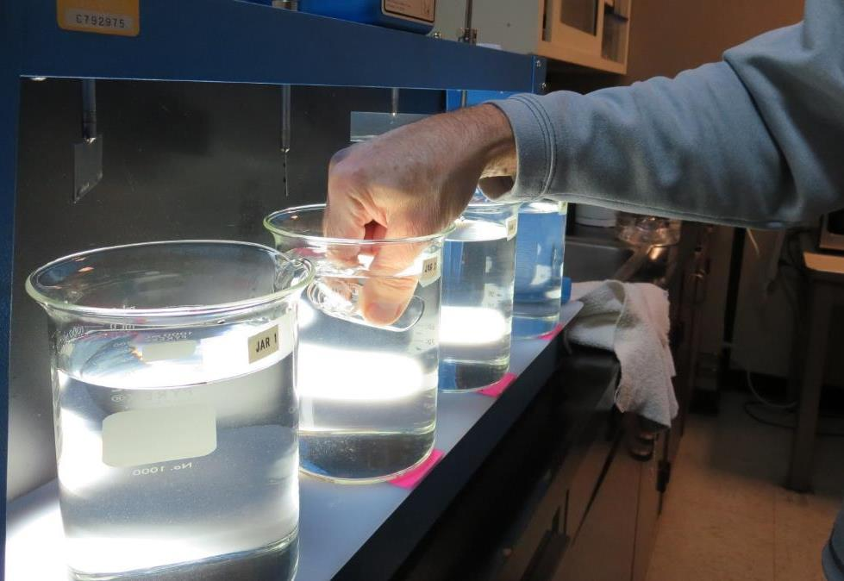
Settleability Sampling

Slide 19
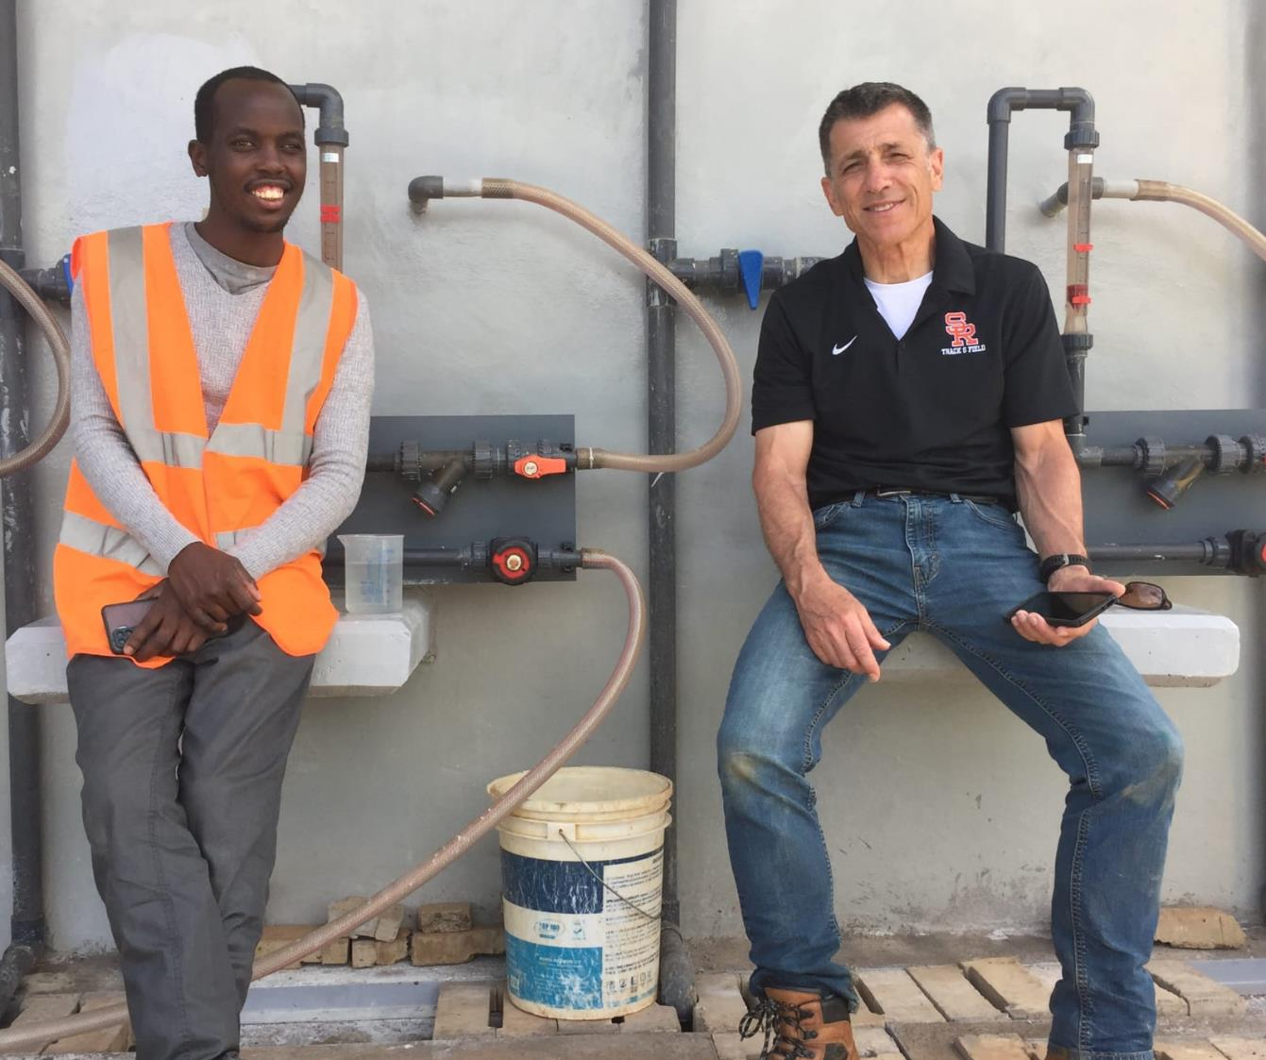
Kenya
Tenwek Hospital
Surface Water Treatment Plant
Case Study:
Mission:
Plant Optimization & Operator Training
Onsite: April/May 2022

Slide 20
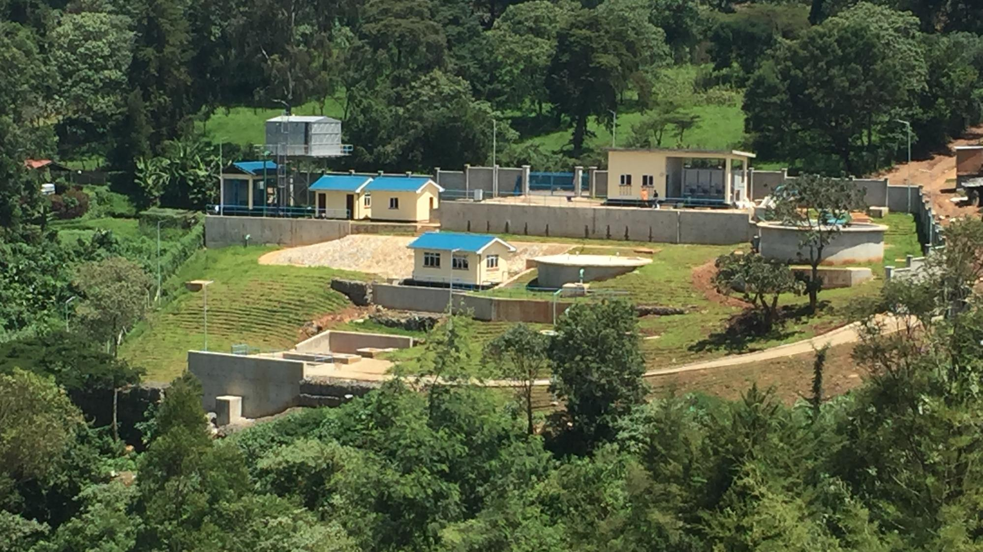
Case 1: Kenya -Tenwek Hospital Surface Water Treatment Plant
Booster
Pump
Bld
Clearwell
Gravity
Chemical
Feeders
Clarifier
& Filter
Surface Water Treatment Plant
(29.17 m³/hr., 128 gpm, 700 m³/day, 184,940 gal/day)

Slide 21
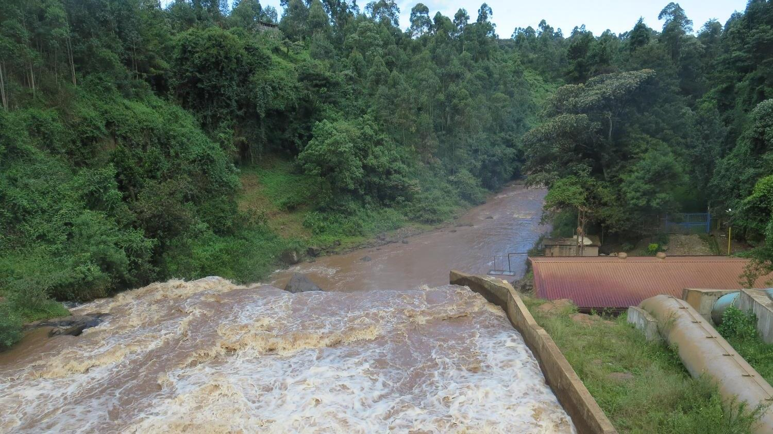
River Mara
Source Water
  River Mara
  Alkalinity: 12 mg/L CaCO₃
  pH: 6s
  Turbidity: 300 – 800 NTU
  Rain every afternoon

Slide 22
Case 1. Upon arrival (April 2022) at Tenwek Hospital – New Surface Water Treatment Plant
  Source Alkalinity: 12 mg/L CaCO₃
  Chemical added at source: Alum/Soda Ash
  Clearwell: Calcium Hypochlorite
  Plant operating filtrate turbidity: >1 - 5 NTUs
  Filter backwash frequency: once every 8 hours
  Kenya’s turbidity performance standard: <=5 NTUs

Slide 23
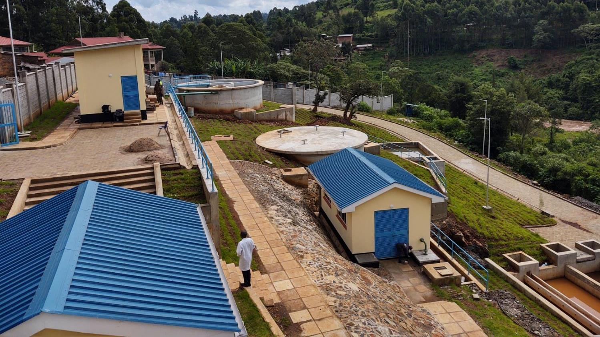
Kenya - Tenwek
Chemical Storage/
Gravity feeders
CFI (composite filtration unit)
100 m³ Clearwell
Treated/Backwash
Pump Building
Sludge Drying
Beds

Slide 24
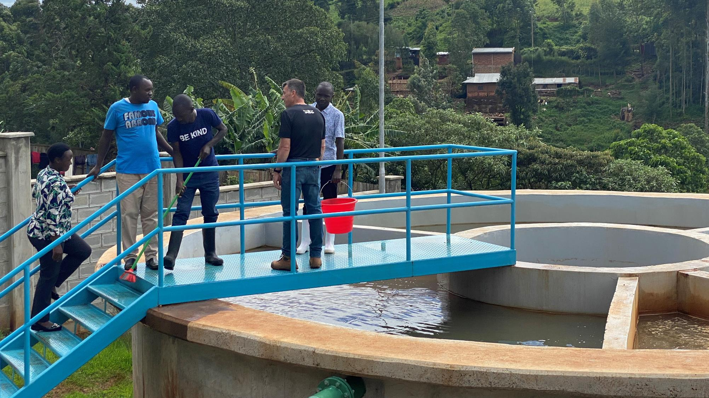
Clarifier/Filter
Sand
Filter

Slide 25
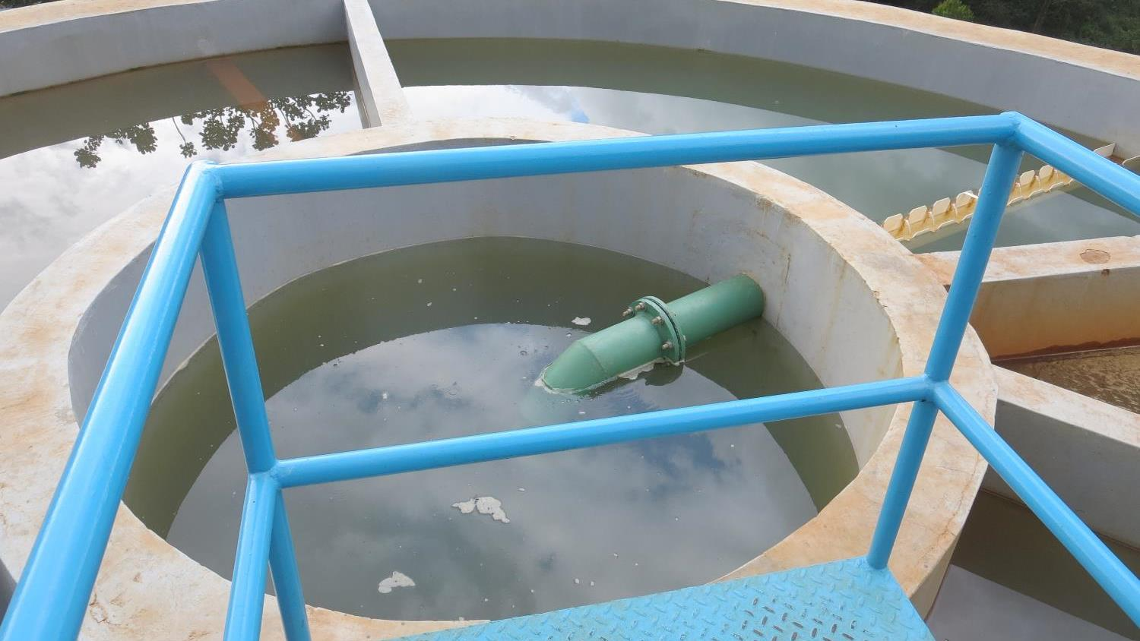
Sand Filter
Dia.: 8.86-ft
Area: 78.47 ft²

Slide 26
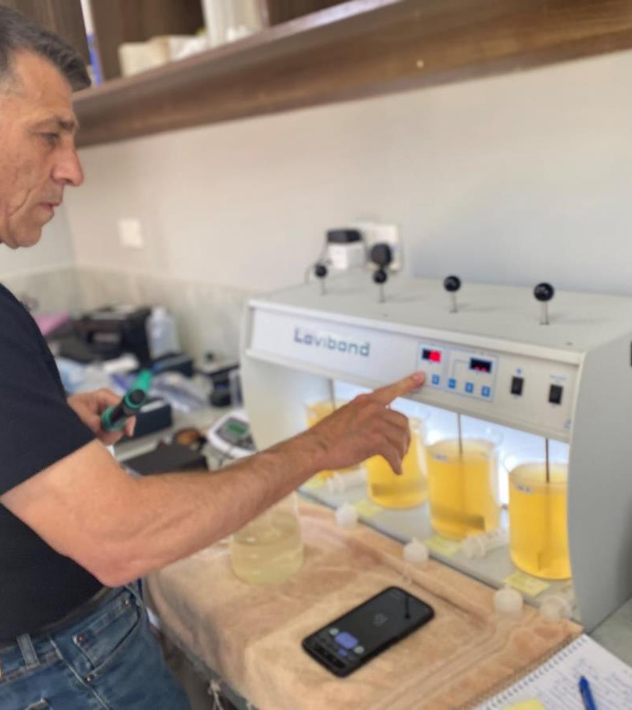
Jar Testing - Results
Soda Ash (Na₂CO₃) had negative impact on filterability
  Moved Na₂CO₃ to post filtration
  Optimized Alum dose via jar testing
  Results:
    Filtrate turbidity <0.1 NTU
    Filtrate UVA: 0.008/cm
    Filtrate UVT: 98%
    Filter backwash every 24 hours

Slide 27
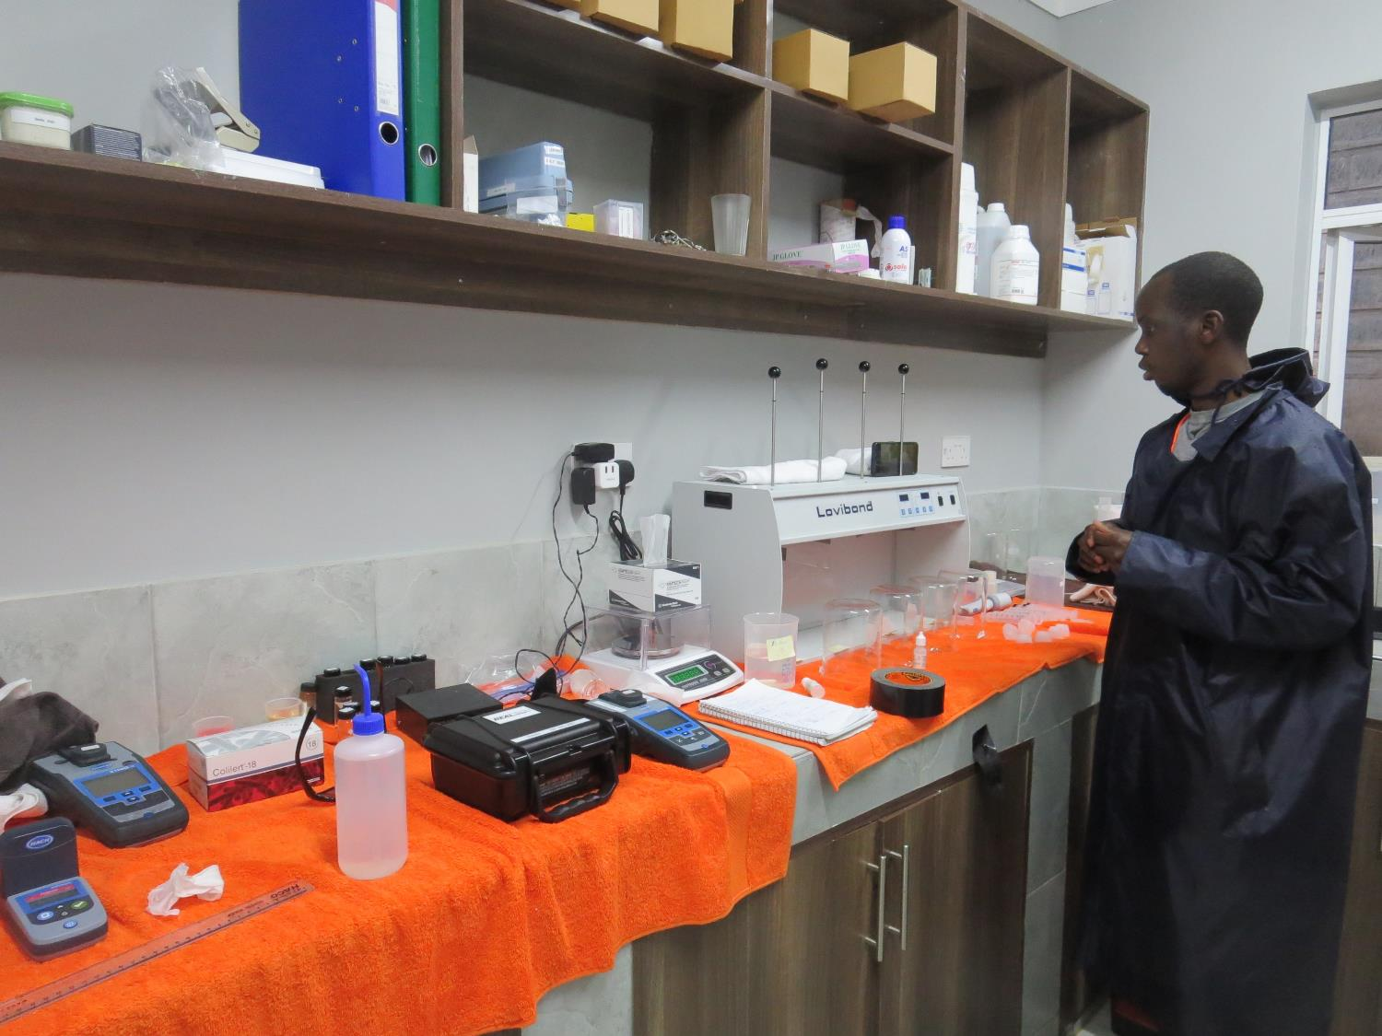
Laboratory
https://kewi.go.ke/
Victor Siele (operator)

Slide 28
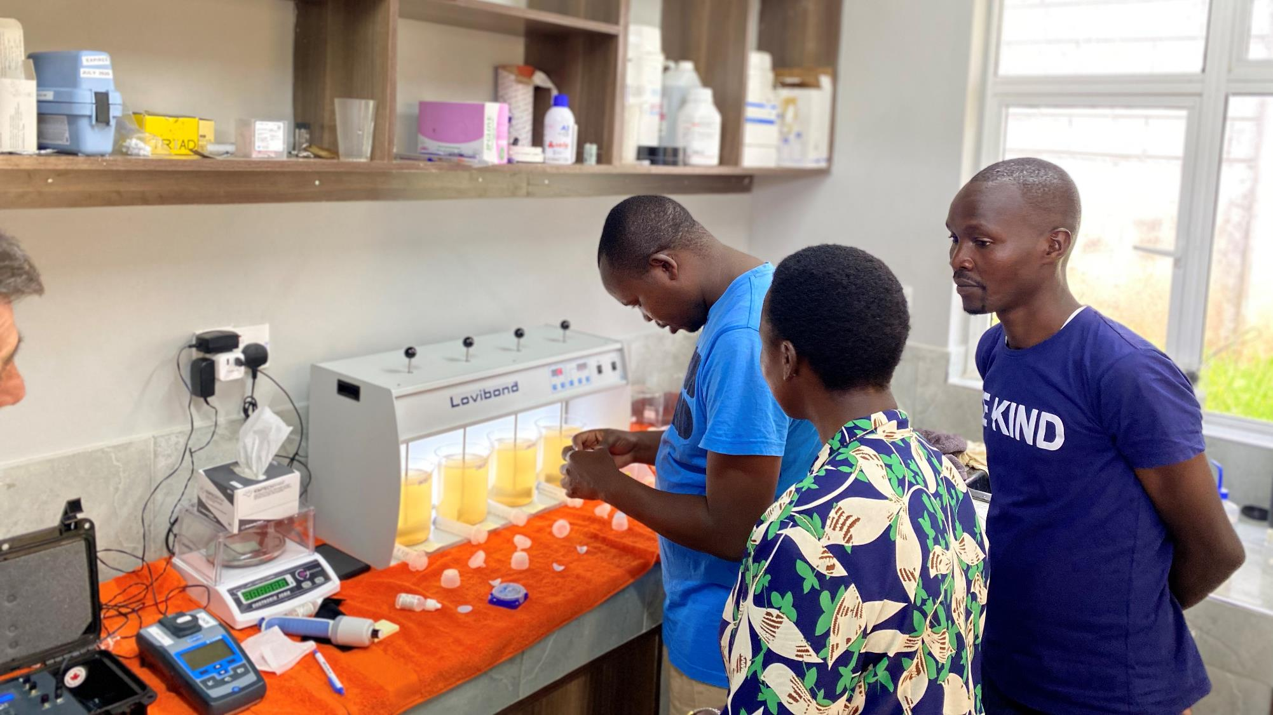
Operators learning
jar testing

Slide 29
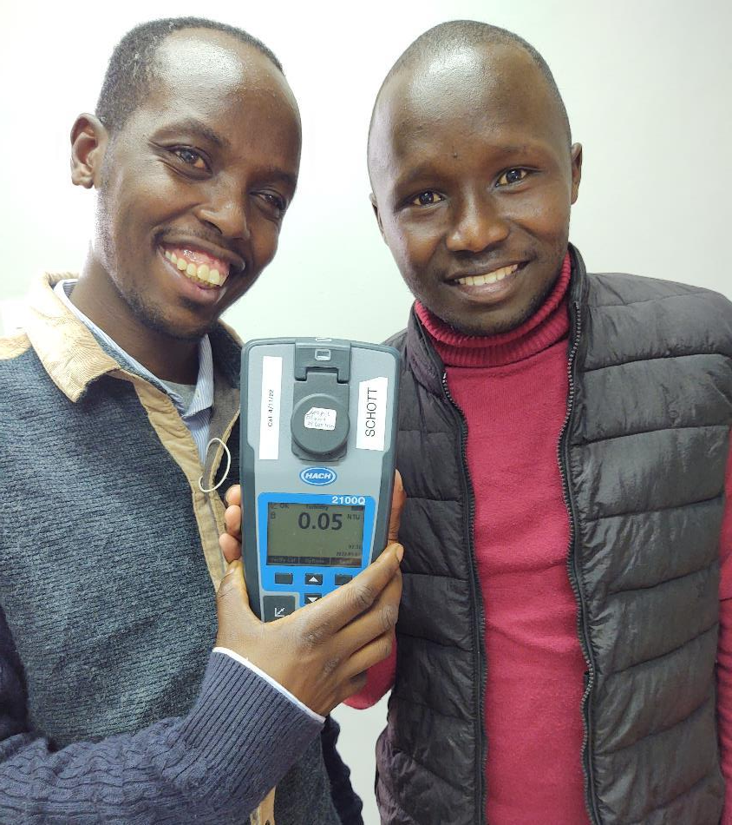
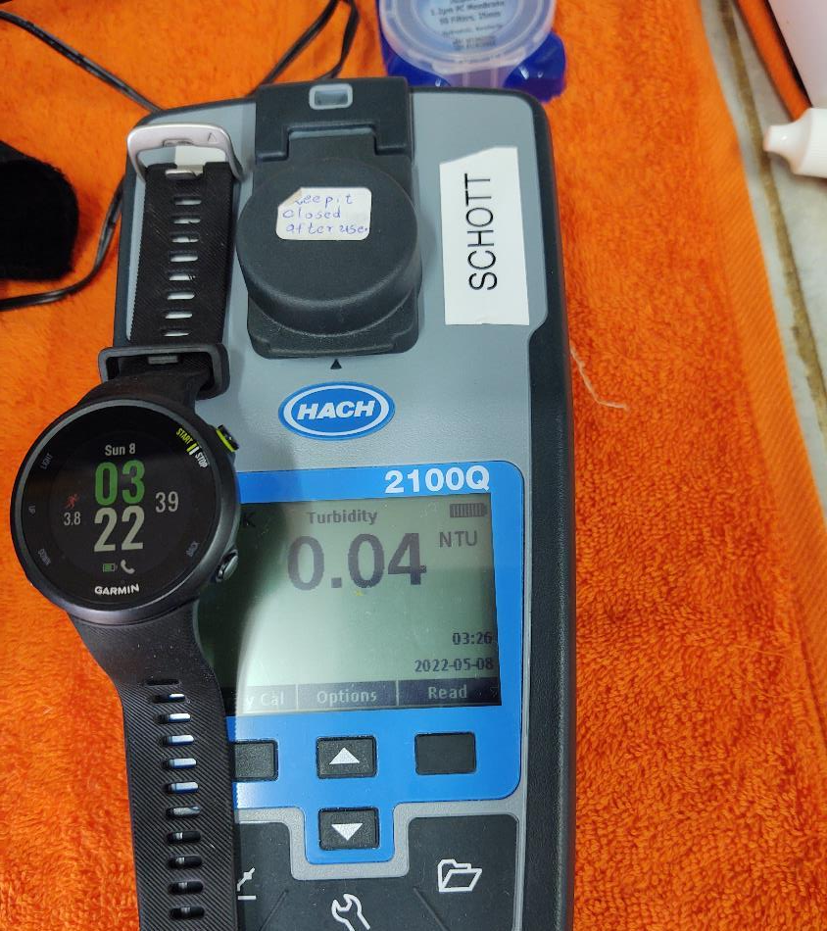
Victor with NTU

Slide 30
Thank you for attending!
Contact and Links
Guy Schott, P.E.
State Water Resources Control Board
Division of Drinking Water
Santa Rosa, CA
Go to Jar Test Results/Procedures for tools to download
www.waterboards.ca.gov/drinking_water/programs/districts/mendocino_district.html
Jar Testing Done Right video training https://youtu.be/aGByyxhelkI
Email: Guy Schott - Guy.Schott@waterboards.ca.gov
Office Number: 707-576-2732

