Slide 1
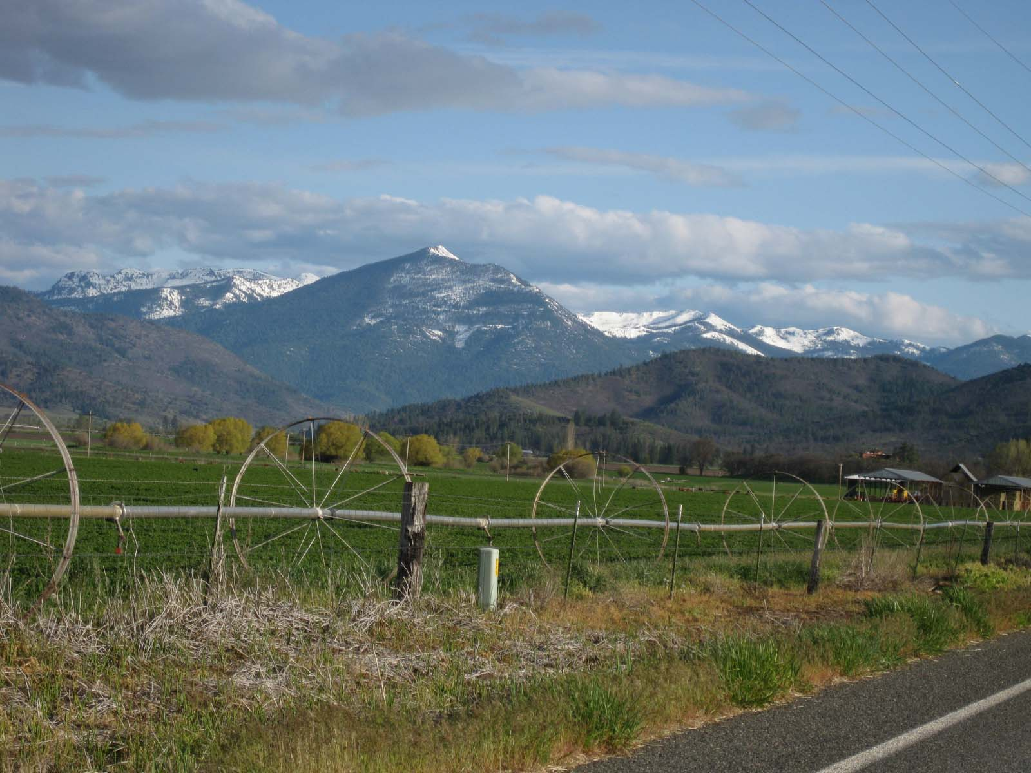
Conjunctive Water Management and Potential for Streamflow Increase in the Scott River Watershed
North Coast Regional Water Quality Control Board Meeting
Thomas Harter, Gus Tolley, Laura Foglia, Steve Orloff, Helen Dahlke
University of California Davis & UC Ag & Natural Resources
June 29th , 2017
Photo: Liz Bowen

Slide 6
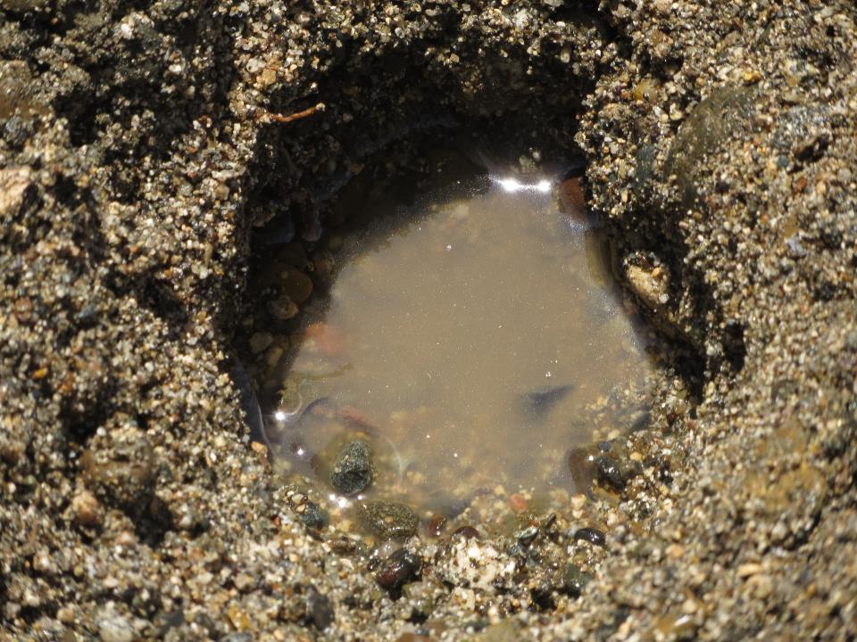

Slide 10
gaining stream

Slide 11
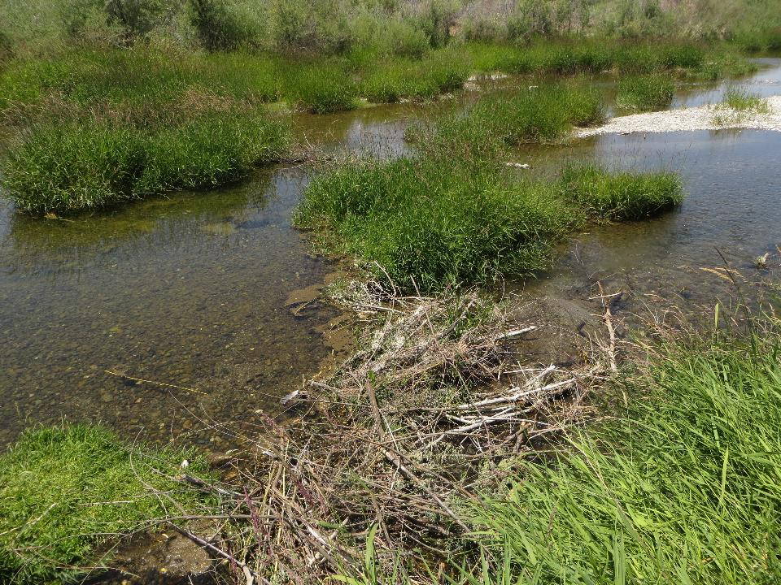

Slide 12
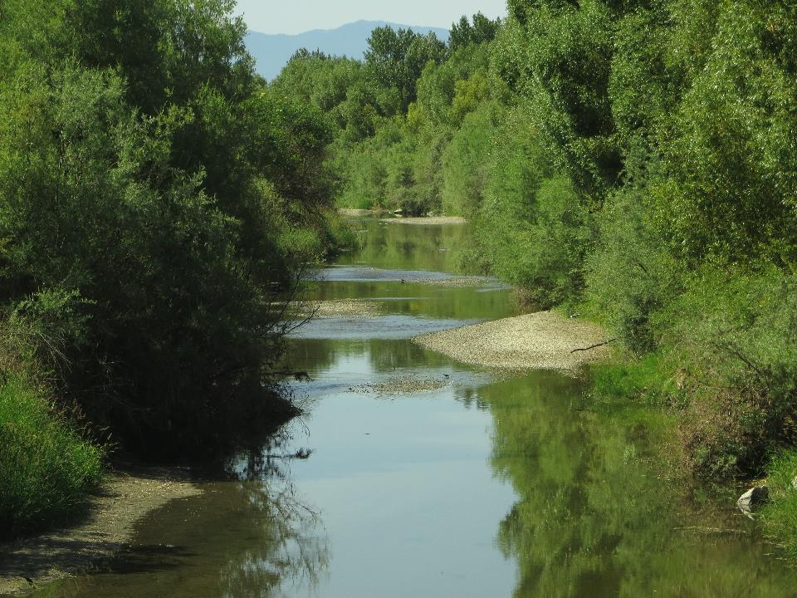

Slide 13
gaining stream

Slide 14
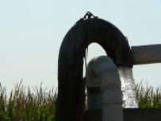
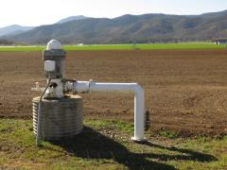

Slide 15
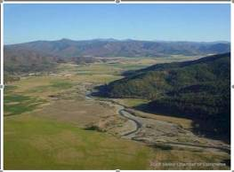
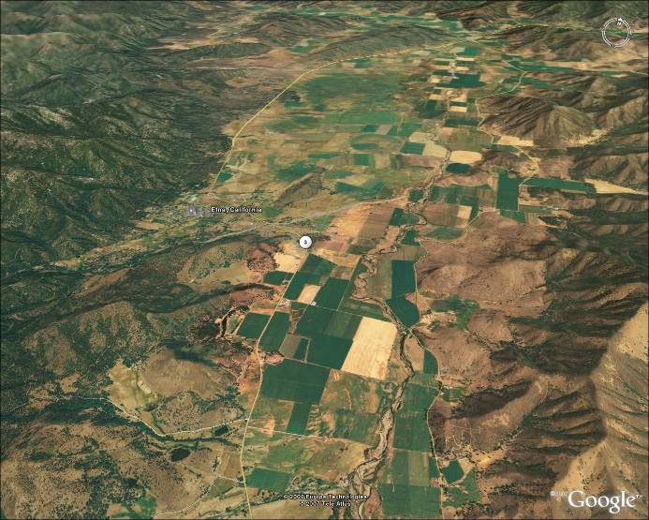
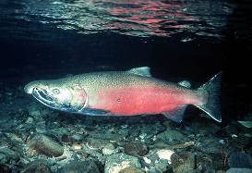
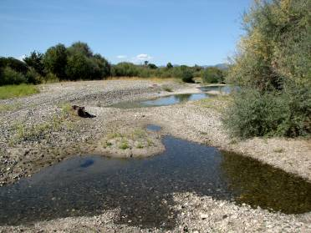
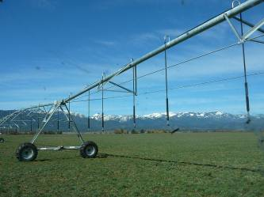
Impact from Groundwater Pumping

Slide 16
losing stream

Slide 17
losing stream

Slide 19
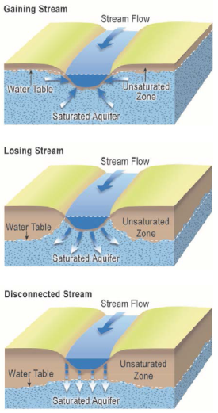
California DWR, 2017

Slide 20
Private Monitoring Network: Seasonal Hydrographs

Slide 21
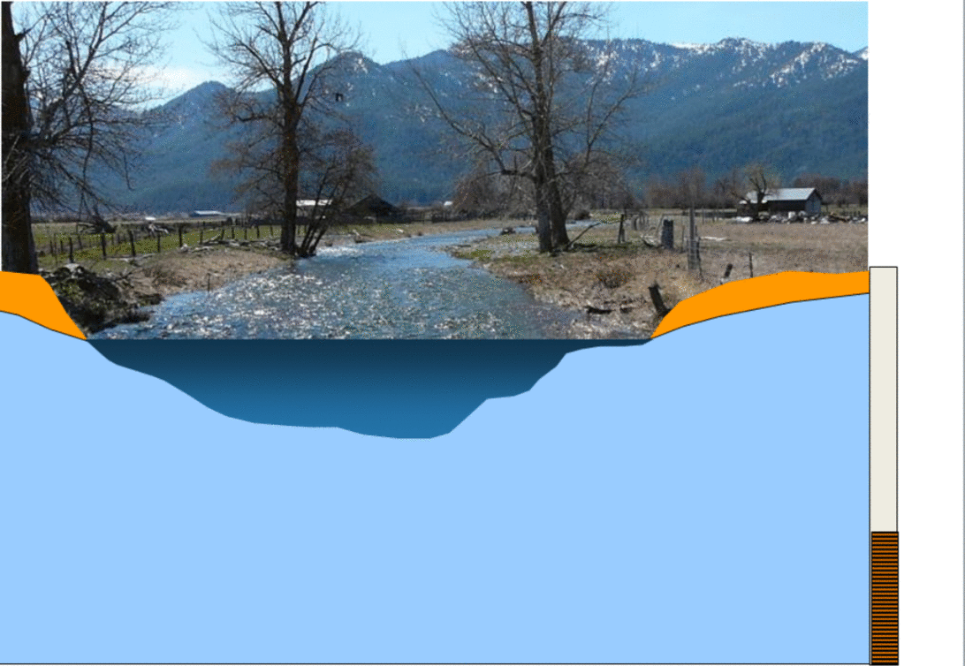
Delayed Impact of Pumping on Stream Depletion

Slide 22
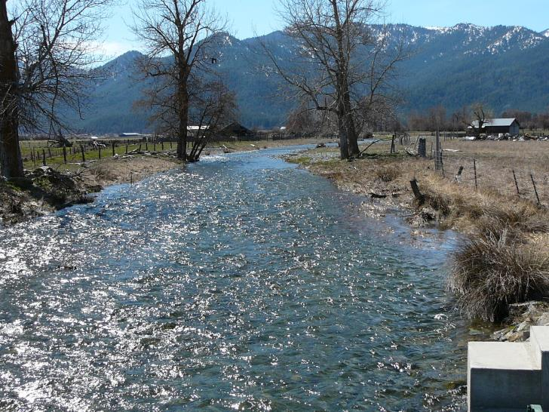
Managed Aquifer Recharge Near a Stream

Slide 23
Managed Aquifer Recharge Near a Stream

Slide 24
Managed Aquifer Recharge Near a Stream

Slide 25
Managed Aquifer Recharge Near a Stream

Slide 26
Managed Aquifer Recharge Near a Stream

Slide 27
Managed Aquifer Recharge Near a Stream

Slide 28
Managed Aquifer Recharge Near a Stream

Slide 29
Managed Aquifer Recharge Near a Stream

Slide 30
Managed Aquifer Recharge Near a Stream

Slide 31
Managed Aquifer Recharge Near a Stream

Slide 32
Managed Aquifer Recharge Near a Stream

Slide 33
Managed Aquifer Recharge Near a Stream

Slide 34
Managed Aquifer Recharge Near a Stream

Slide 35
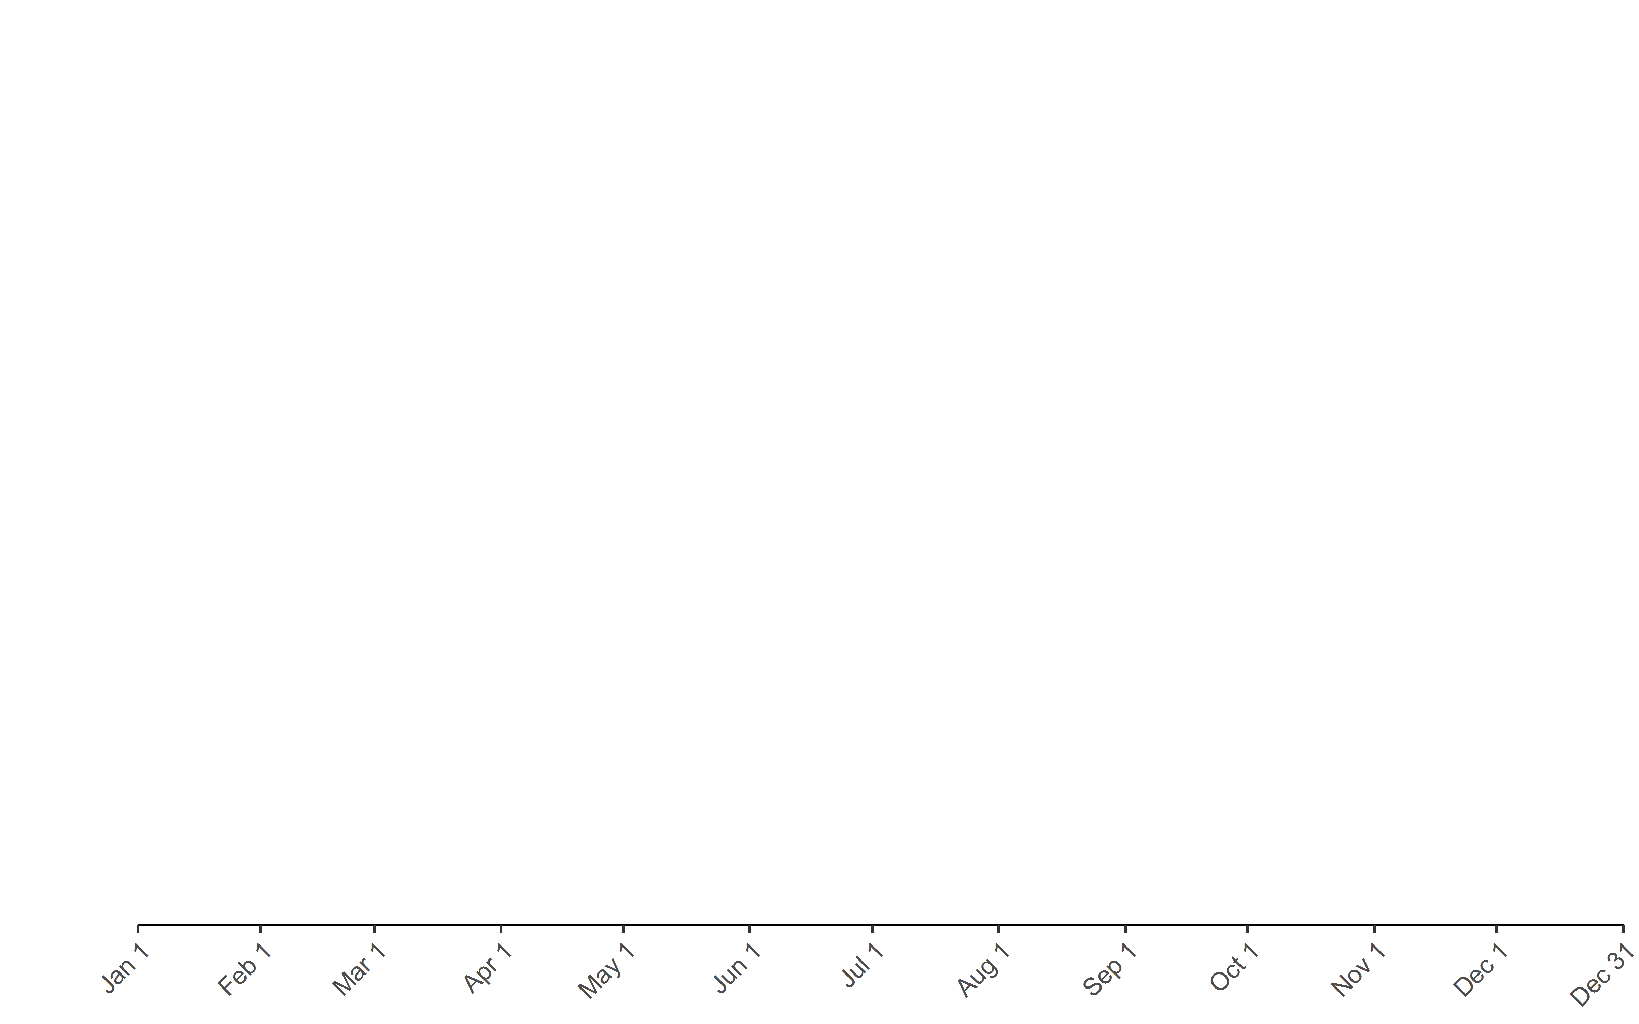
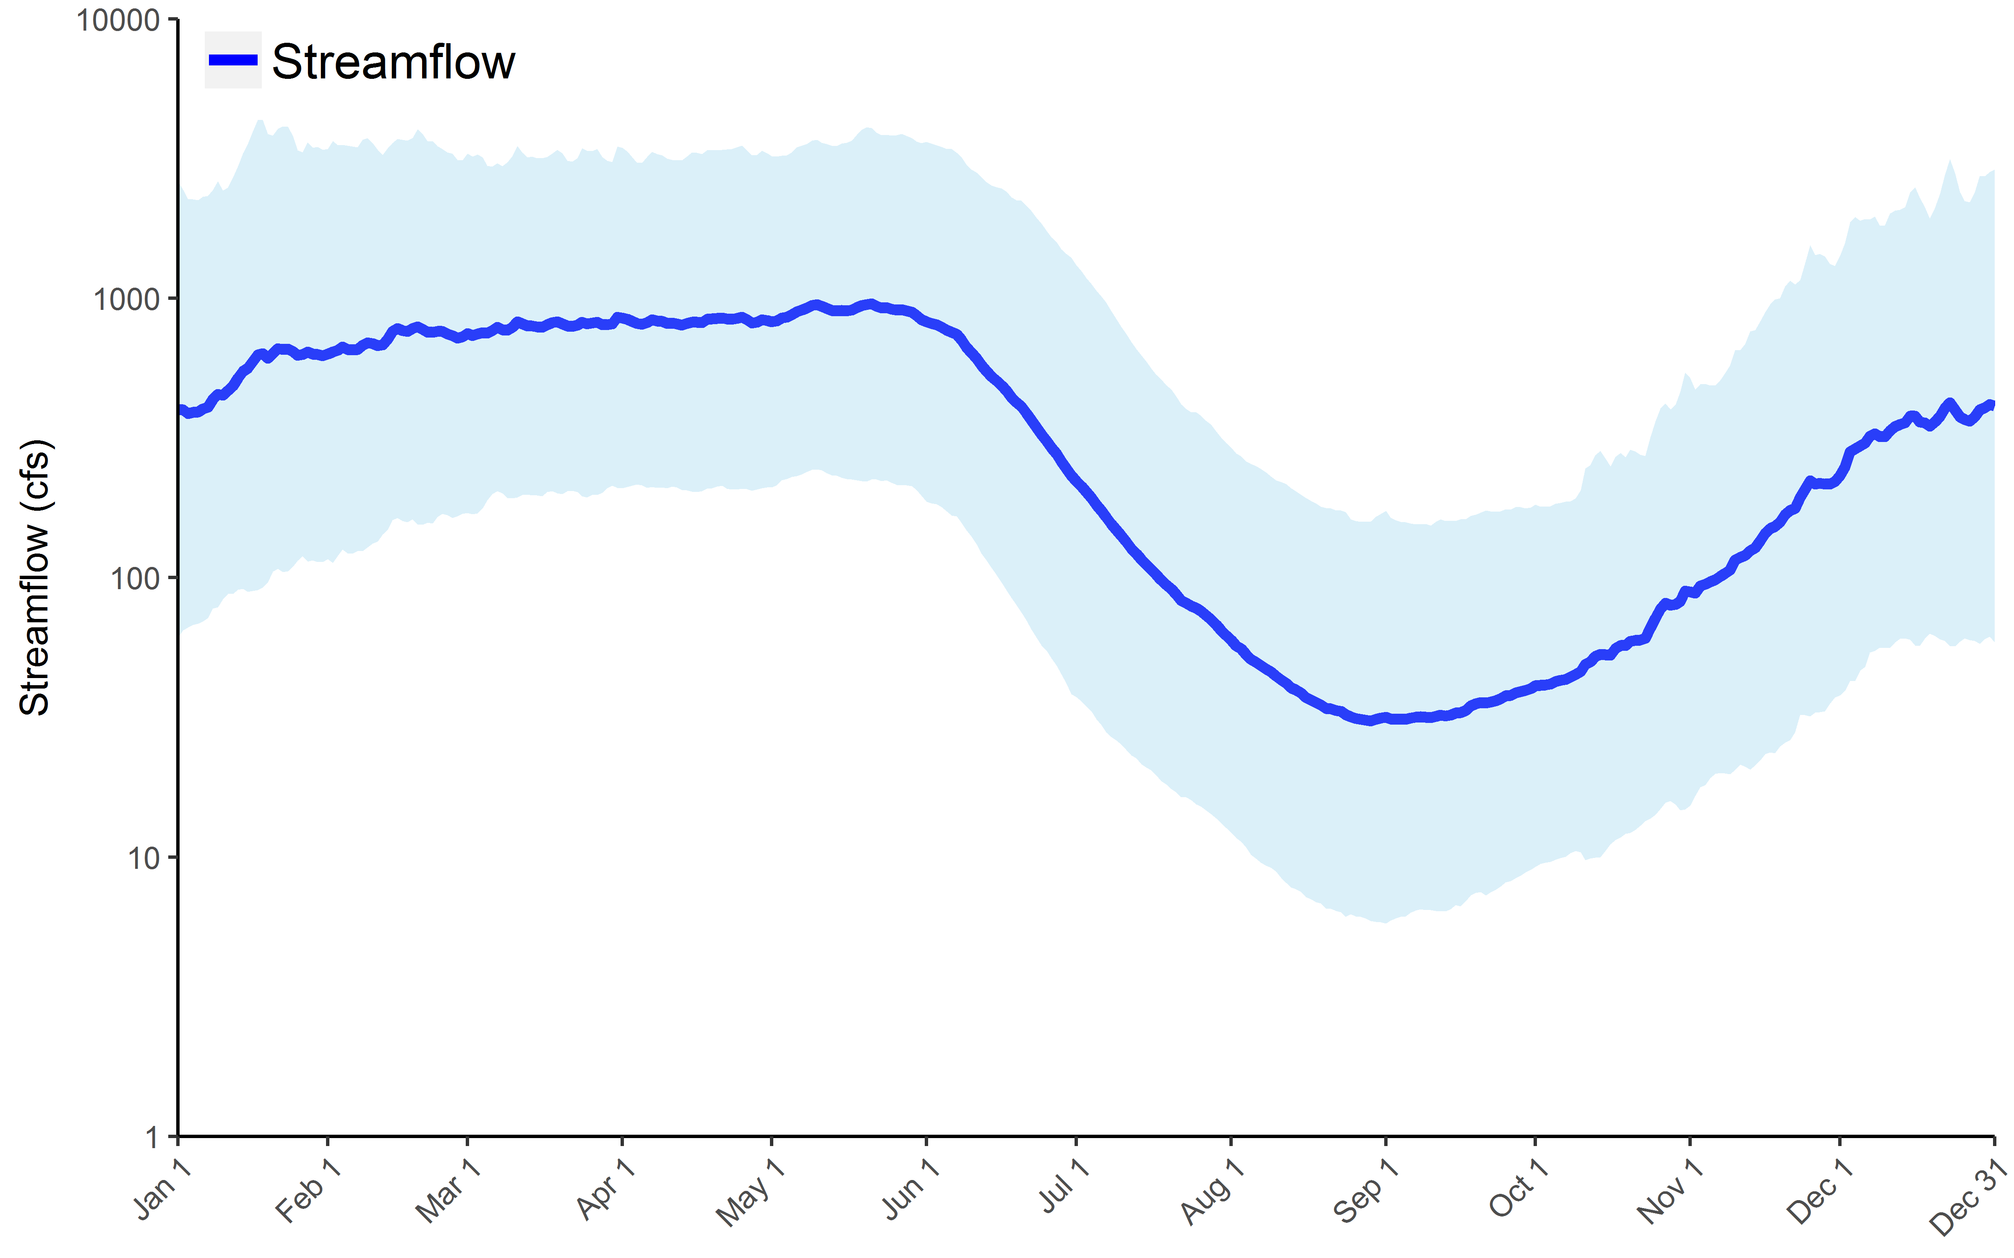
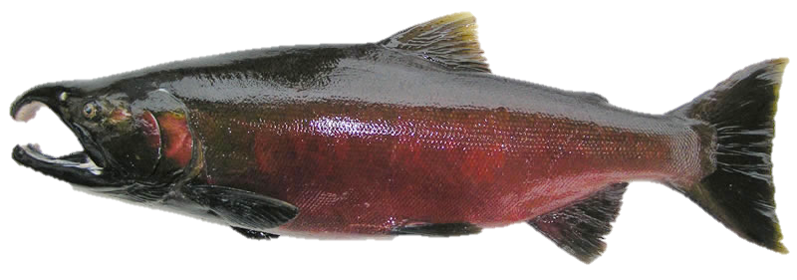
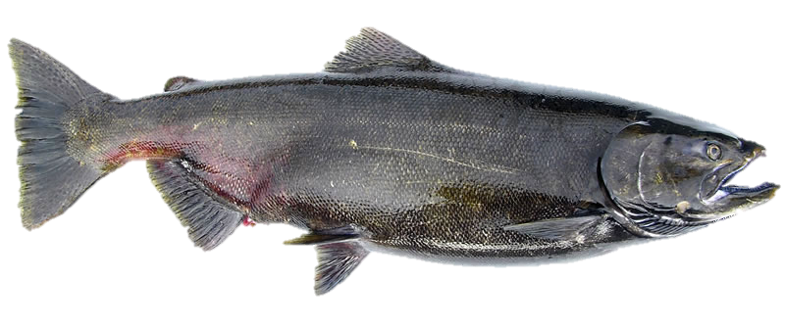
Scott River Ecohydrology
Ag Growing Season
Critical
Low Flow
Period
Stream Disconnections
Increased Water Temperatures
coho
Juvenile coho in main stem(?)
Chinook

Slide 36
Conceptual Outline of SVIHM
Streamflow entering Scott Valley
(Regression model)
Upper Watershed Model
Recharge and pumping within the valley
(Tipping bucket model)
Soil-Water Budget
Model
Detailed groundwater levels and streamflow within the valley
(MODFLOW model)
Groundwater-Surface-Water Model

Slide 37
Soil-Water Budget Model Calibration
Measured ET and Applied Water on 3 Scott Valley Alfalfa Fields, in/yr (2012-3013)
Simulated ET and Applied Water from Soil-Water Budget Model, in/yr (1990-2011)
Initial
Irrigation Rates Overestimated
2012 | Fawaz | Menne | Morris
ETa | 30.8 | 28.9 | 28.7
Rain + Irrig. | 18.9 | 21.7 | 22.3
2013 | Fawaz | Menne | Finley
ETa | 32.8 | 30.4 | 35.4
Rain + Irrig. | 32.3 | 27.0 | 28.5
2014 | Fawaz | Menne | Finley
ETa | 32.9 | 28.0 | 29.1
Rain + Irrig. | 29.5 | 26.1 | 22.5
Foglia et al. (2013a)
Updated
Irrigation Rates Agree with Measured Values
Average Rain + Irrig. = 25.4
Orloff et al. (in prep)
Average Rain ~5-6 in

Slide 38
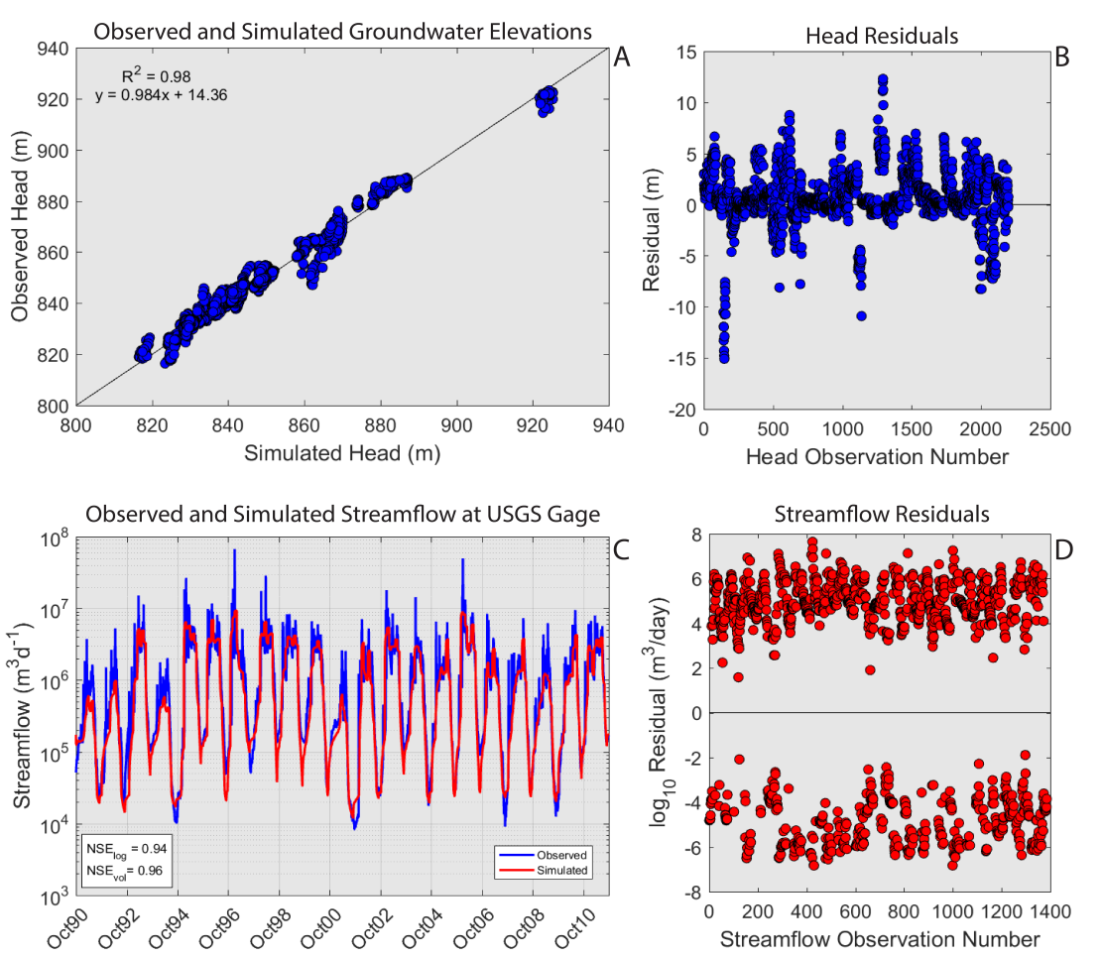
MODFLOW Model Calibration

Slide 39
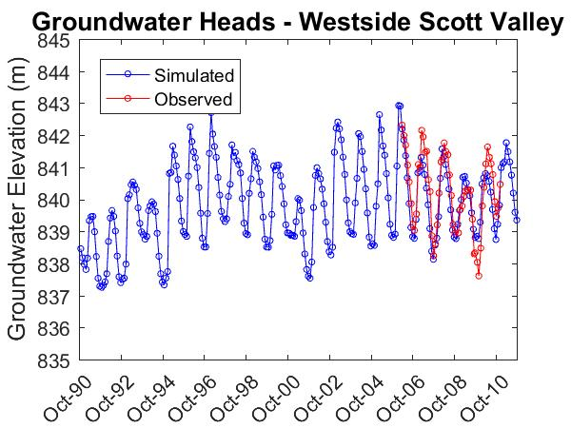
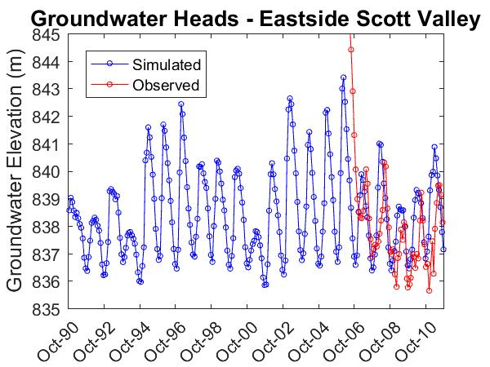
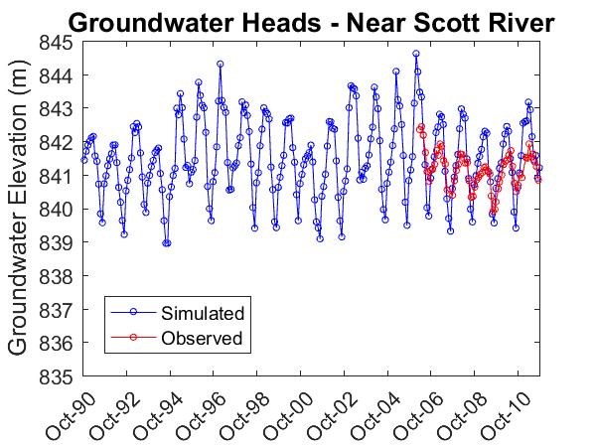
MODFLOW Model Calibration
Model results match observed head and streamflow very well

Slide 40
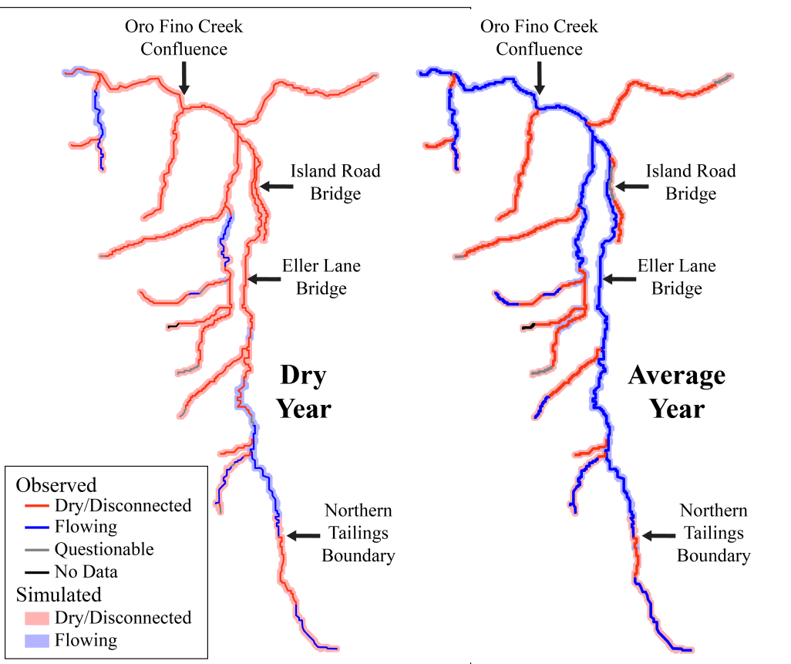
MODFLOW Model Validation
Very good agreement between observed dry sections and simulated dry sections for different water year types

Slide 41
SVIHM Applications
Learning tool
  Basin water budget
  Hydrologic flow paths and residence times
  Identify data gaps
Management tool
  Estimate current hydrologic conditions
  Predict hydrologic conditions given future climate predictions (forecasting)
Scenario testing
  “What if…”
  Not limited by legal, physical, or financial constraints (except for computational costs)
  Can provide guidance for which scenarios may be the most promising to pursue relative to each other

Slide 42
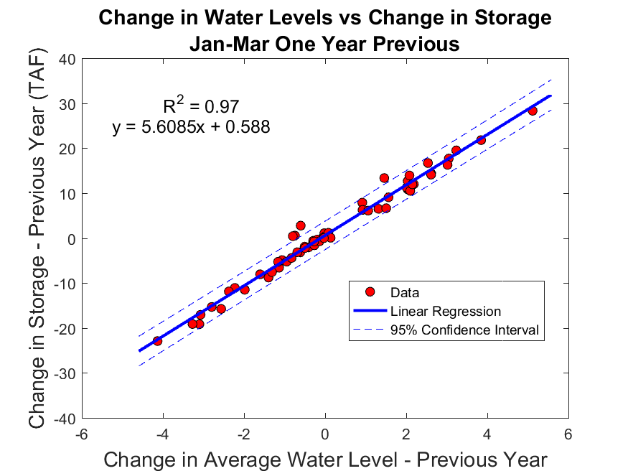
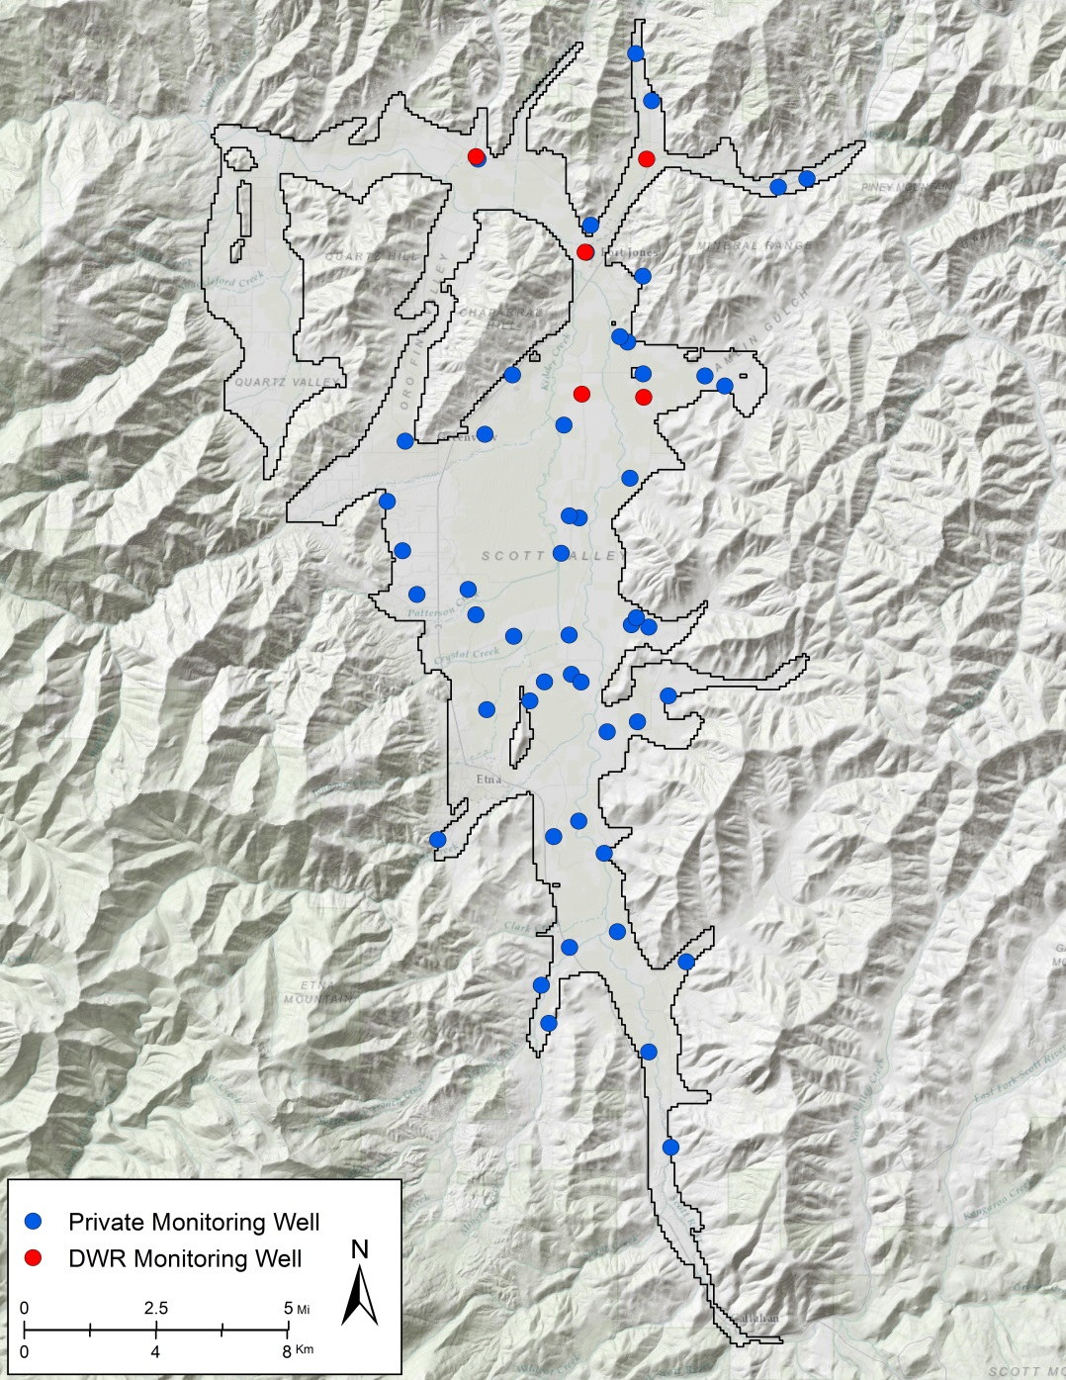
SVIHM Applications
Learning tool
  Basin water budget
  Hydrologic flow paths and residence times
  Identify data gaps
Management tool
  Estimate current hydrologic conditions
  Predict hydrologic conditions given future climate predictions (forecasting)
Scenario testing
  “What if…”
  Not limited by legal, physical, or financial constraints (except for computational costs)
  Can provide guidance for which scenarios may be the most promising to pursue relative to each other

Slide 43
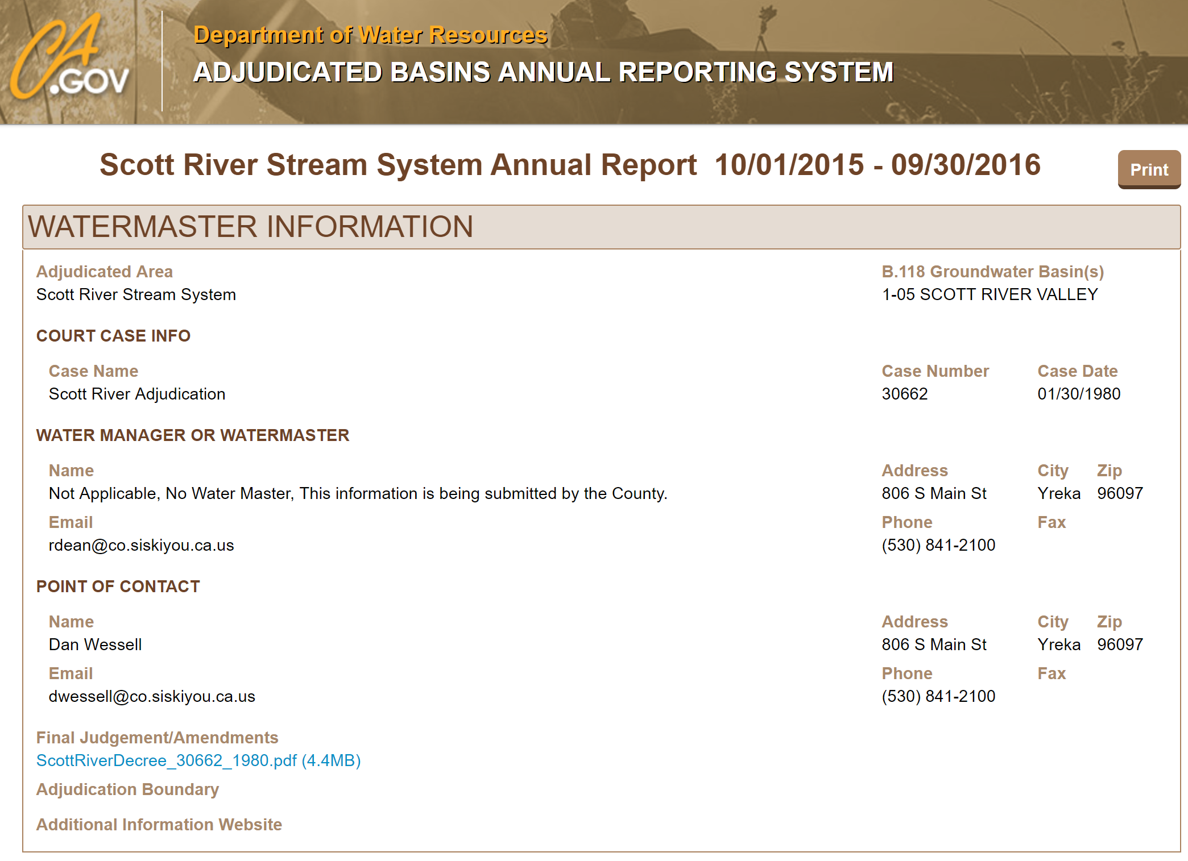
Estimated Groundwater Storage Change

Slide 44
SVIHM Applications
Learning tool
  Basin water budget
  Hydrologic flow paths and residence times
  Identify data gaps
Management tool
  Estimate current hydrologic conditions
  Predict hydrologic conditions given future climate predictions (forecasting)
Scenario testing
  “What if…”
  Not limited by legal, physical, or financial constraints (except for computational costs)
  Can provide guidance for which scenarios may be the most promising to pursue relative to each other

Slide 45
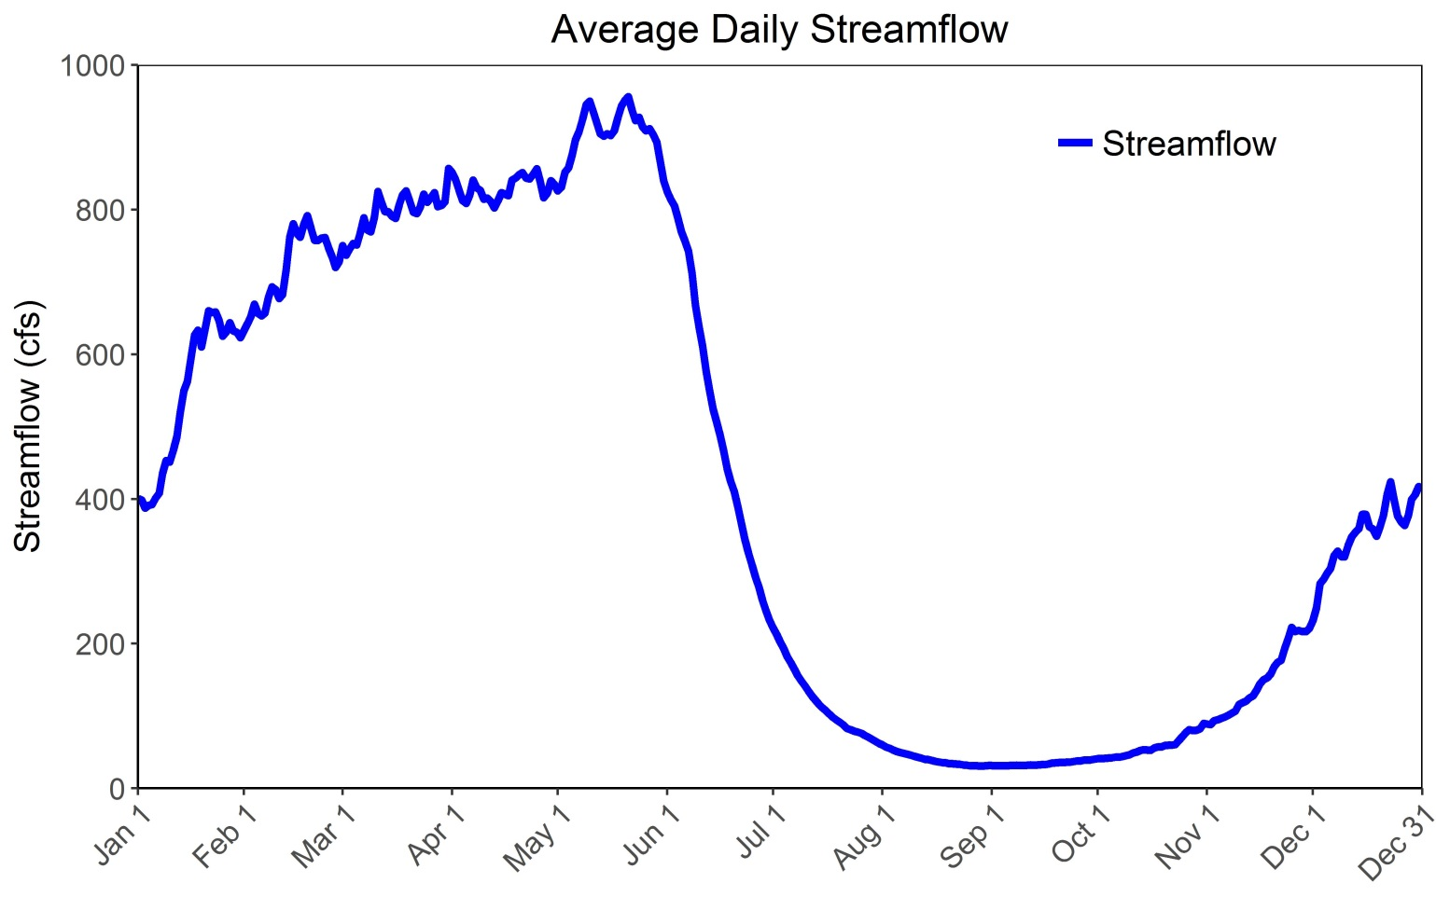
Conjunctive Water Use
Scott Valley is a storage-limited system
  Average annual discharge is 5x average ET demand
  Plenty of water, just not at the right time
Increase residence time of water in the valley
  Surface water: hours to days
  Groundwater: days to months (years?)
Ag
Growing Season

Slide 46
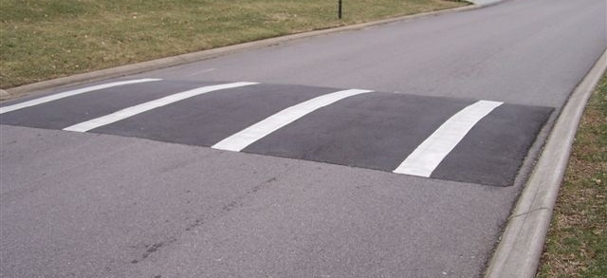
Conjunctive Water Use
Scott Valley is a storage-limited system
  Average annual discharge is 5x average ET demand
  Plenty of water, just not at the right time
Increase residence time of water in the valley
  Surface water: hours to days
  Groundwater: days to months (years?)
Add a hydrologic “speed bump”

Slide 47
Conjunctive Use Scenarios
4 conjunctive use scenarios identified:
1) Managed Aquifer Recharge (MAR)
2) In Lieu Recharge (ILR)
3) Combination of MAR and ILR
4) Beaver Dams

Slide 48
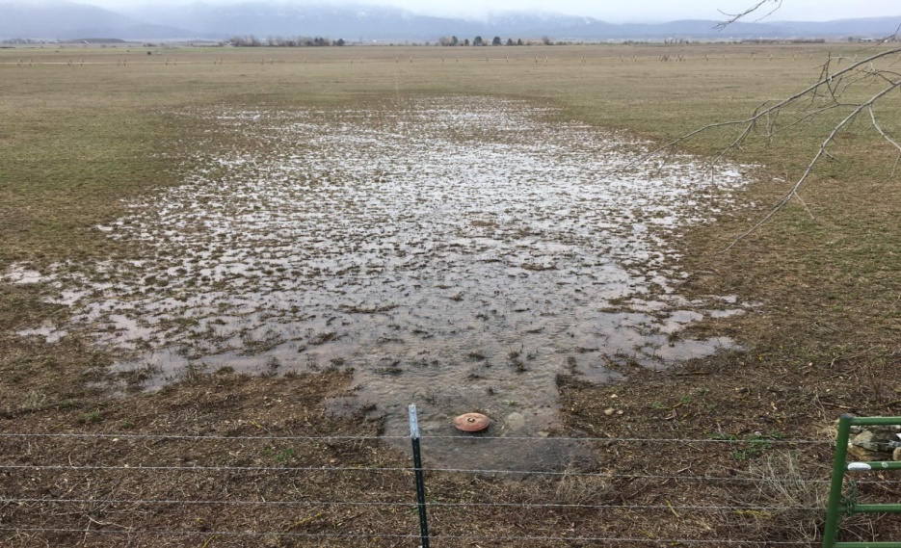
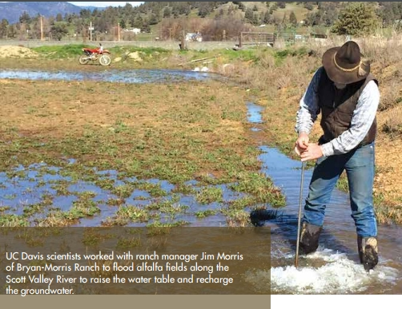
Managed Aquifer Recharge
Use agricultural fields as temporary spreading basins during winter months
  Flood fields during crop dormancy
  Flows are high and demand is low
Increase residence time of water in the valley
  Surface water: hours to days
  Groundwater: days to months
CA&ES Outlook F2015

Slide 49
Managed Aquifer Recharge – Potential Concerns
Does this cause additional consumptive water use?
  MAR timing is during crop dormancy
  Growers are already irrigating as much as they want/can
    No agricultural expansion expected
  Additional recharge will be partitioned to:
    Increased streamflow (vast majority of MAR water)
    Increased ET from native riparian vegetation

Slide 50
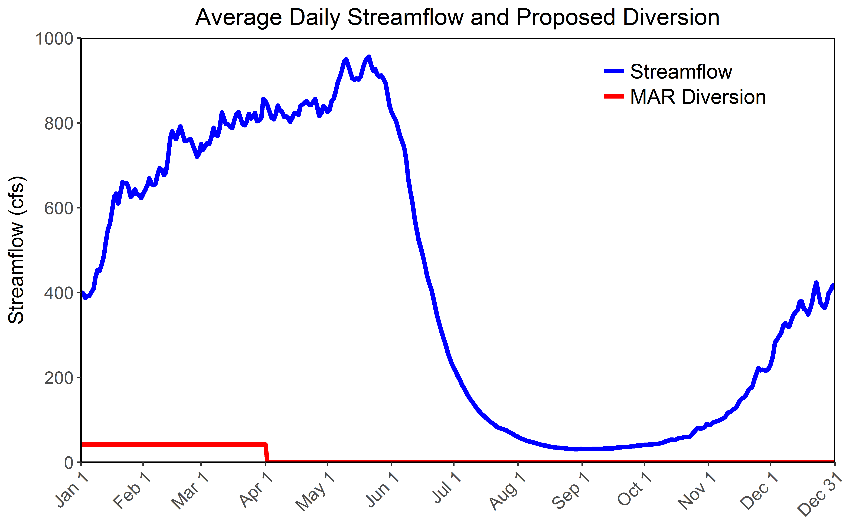
Managed Aquifer Recharge – Potential Concerns
Will this negatively affect fish habitat during the winter months?
  Winter diversion is less than 5% of average flow at that time
  Potential for habitat benefit in the summer far exceeds potential harm during the winter

Slide 51
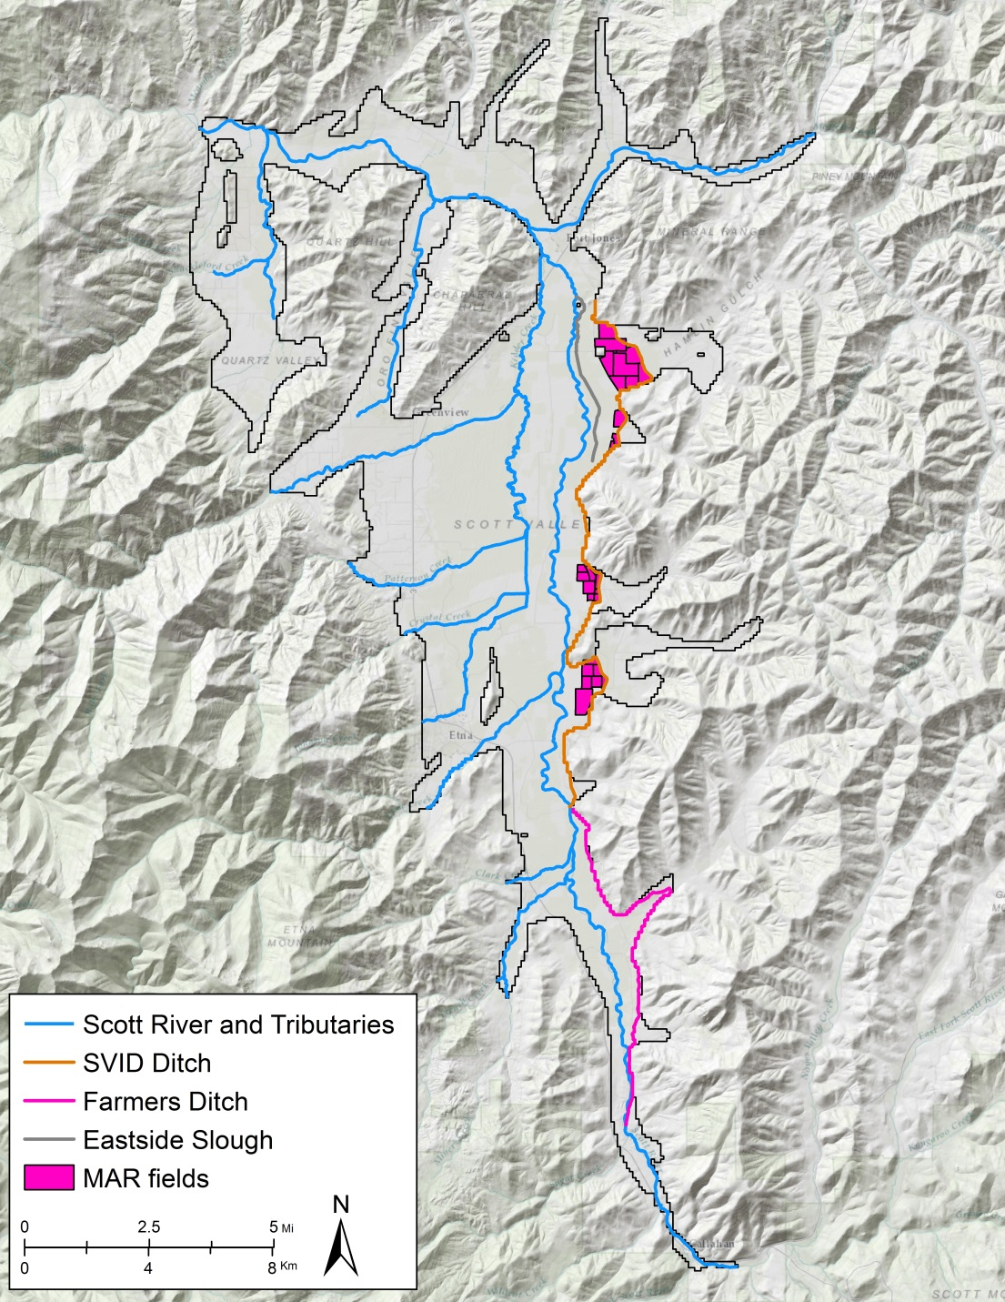
Managed Aquifer Recharge
Use selected fields as temporary spreading basins
  ~1,400 acres
Divert water January through March at SVID Ditch and apply to fields
  ~7,500 acre-ft
Leverages current infrastructure with lowest investment cost
  Easiest scenario to implement

Slide 52
Managed Aquifer Recharge
Use selected fields as temporary spreading basins
  ~1,400 acres
Divert water January through March at SVID Ditch and apply to fields
  ~7,500 acre-ft total
Leverages current infrastructure with lowest investment cost
  Easiest scenario to implement

Slide 53
Managed Aquifer Recharge
Use selected fields as temporary spreading basins
  ~1,400 acres
Divert water January through March at SVID Ditch and apply to fields
  ~7,500 acre-ft total
Leverages current infrastructure for lowest investment cost
  Easiest scenario to implement

Slide 54
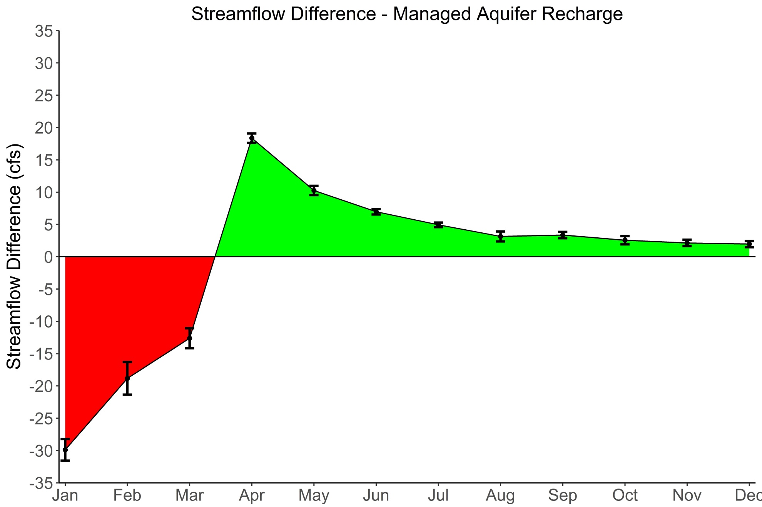
Managed Aquifer Recharge – Preliminary Results
Increased flow due to groundwater discharge to Scott River
Decreased flow due to diversion for recharge

Slide 55
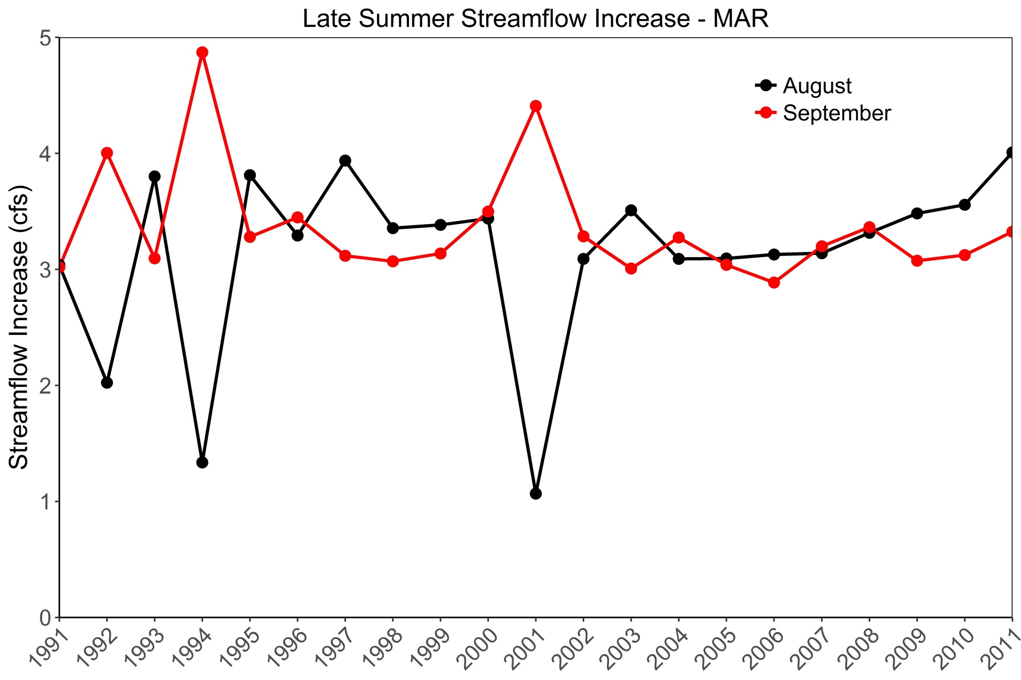
Managed Aquifer Recharge – Preliminary Results

Slide 56
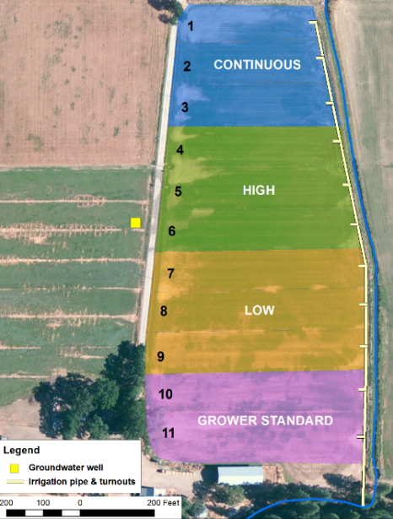
Managed Aquifer Recharge – Pilot Project
Stoner gravelly sandy loam
Three winter water application rates:
  Continuous – every day
  High – 3-5 water applications per week
  Low – 1-3 water applications per week
  Standard - no winter water application
15 acre 9-yr old alfalfa stand

Slide 57
Managed Aquifer Recharge – Pilot Project
 | Precipitation | Applied winter water | Total annual deep percolationª | Deep percolation from winter water application | Deep percolation as percent of applied water | Contribution to soil storage ^{b}
 | in | in | In | in | % | in | %
SCOTT VALLEY - 2015
Standard | 19.6 | 0.0 | 7.8 | - | - | - | -
Low | 19.6 | 47.2 | 51.8 | 44.0 | 93% | 3.2 | 6.8%
High | 19.6 | 87.0 | 91.4 | 83.6 | 96% | 3.4 | 3.9%
Continuous | 19.6 | 310.6 | 314.5 | 306.8 | 99% | 3.7 | 1.2%
SCOTT VALLEY - 2016
Standard | 23.7 | 0.0 | 11.2 | - | - | - | -
Low | 23.7 | 19.8 | 30.9 | 19.7 | 99% | 0.2 | 0.8%
High | 23.7 | 48.5 | 59.6 | 48.7 | 100% | 0.2 | 0.3%
Continuous | 23.7 | 130.6 | 141.7 | 130.5 | 100% | 0.1 | 0.1%
Check 7 | 23.7 | 155.6 | 163.8 | 152.6 | 98% | 3.0 | 1.9%
3.6 ft
7. 0 ft
25.6 ft
ª includes deep percolation from precipitation
^{b} amount of applied winter water used to bring soil water content to field capacity
1 inch = 2.54 cm
Dahlke et al. (in prep)
Up to 25.6 ft/acre recharged with >90% reaching groundwater table
No discernable effect on crop yield (needs further investigation)

Slide 58
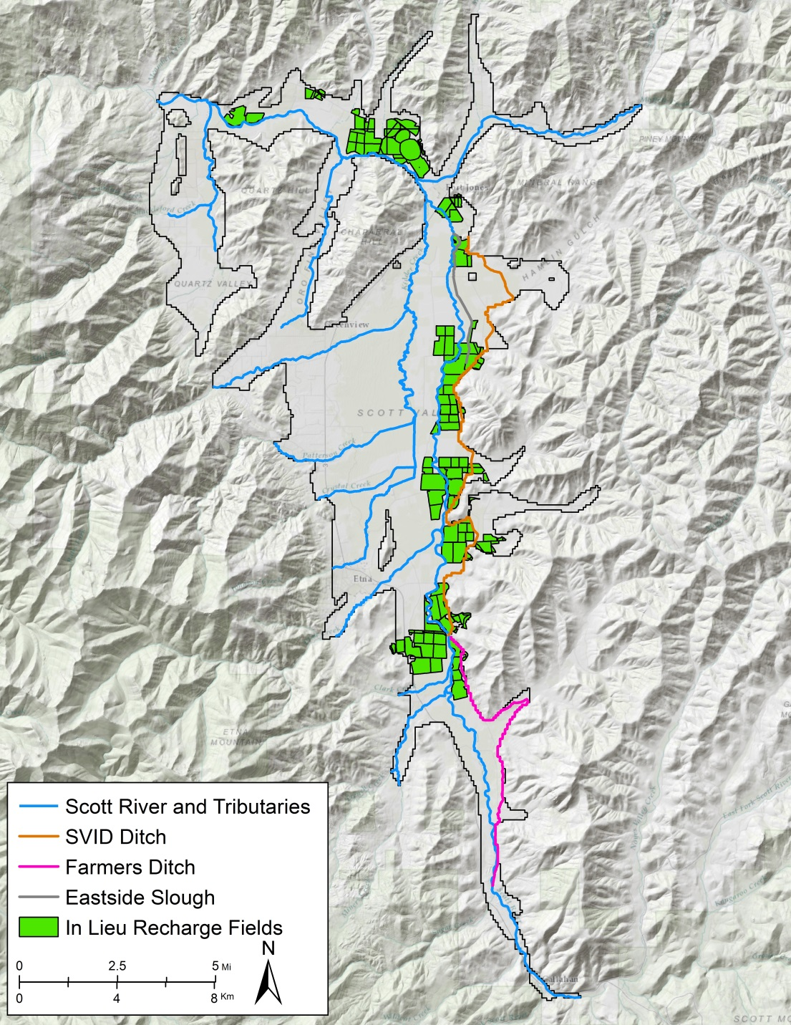
In Lieu Recharge
Use surface water instead of groundwater when available on selected fields
  ~5,900 acres
Delays portion of groundwater pumping until later in the summer
  Important streamflow depletion effects

Slide 59
In Lieu Recharge
Use surface water instead of groundwater when available on selected fields
  ~5,900 acres
Delays portion of groundwater pumping until later in the summer
  Important streamflow depletion effects

Slide 60
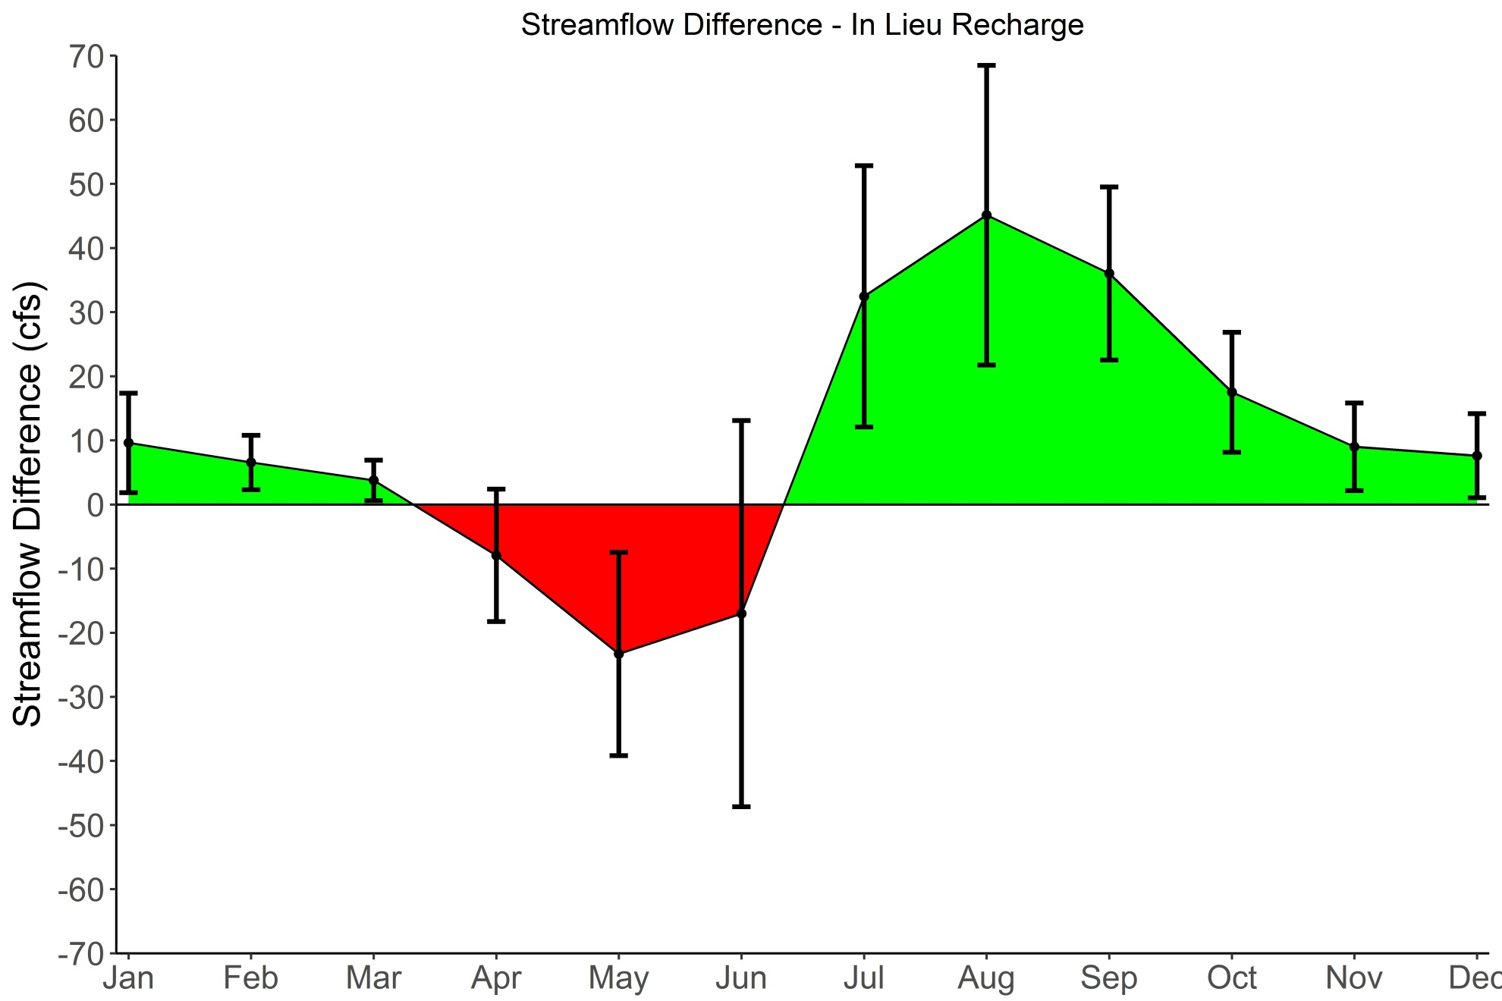
In Lieu Recharge – Preliminary Results
Increased flow due to groundwater discharge to Scott River
Decreased flow due to diversion for recharge

Slide 61
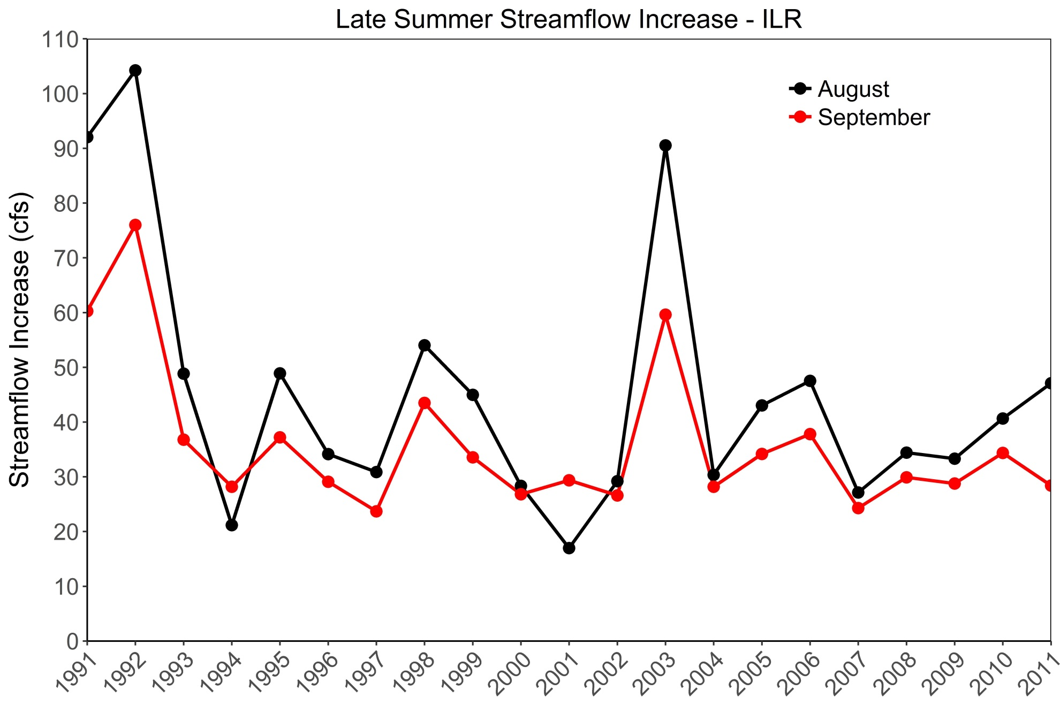
In Lieu Recharge – Preliminary Results

Slide 62
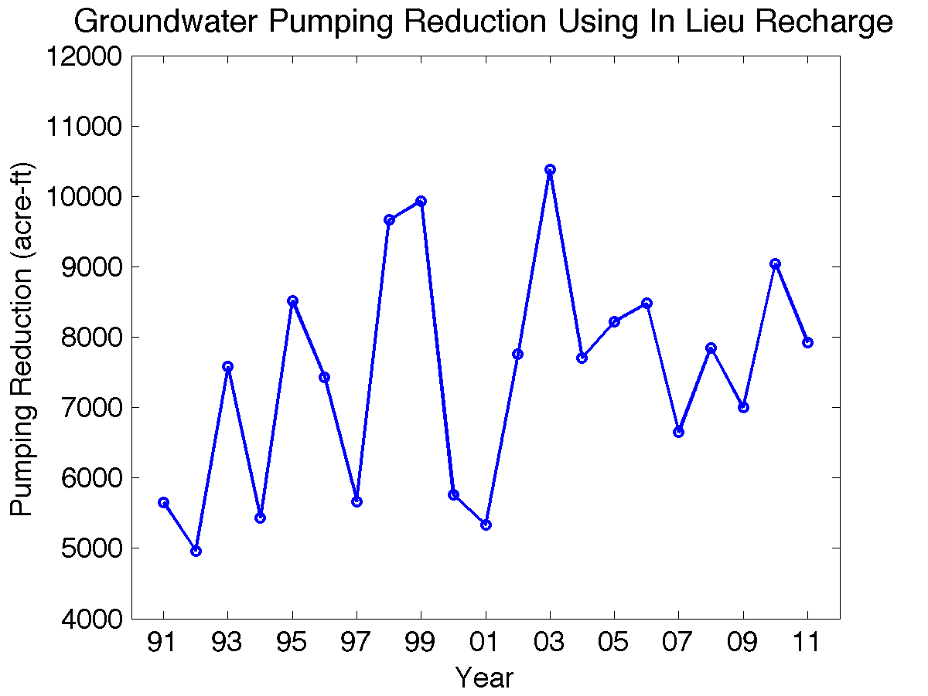
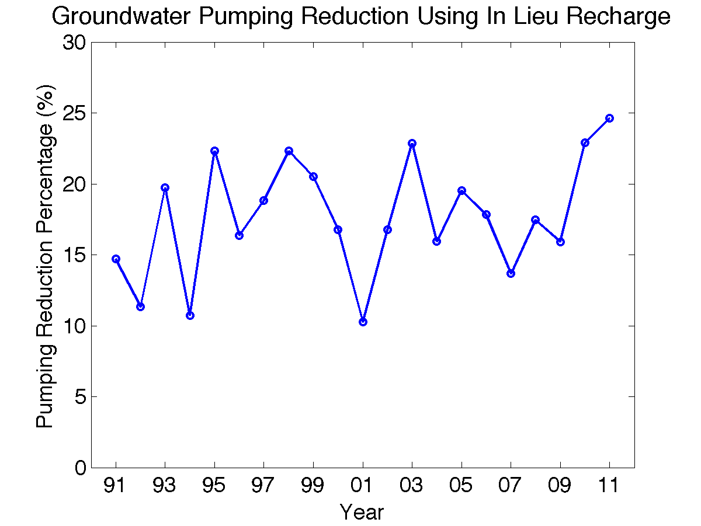
In Lieu Recharge – Preliminary Results

Slide 63
In Lieu Recharge– Potential Concerns
Reduction of spring and summer flows due to increased diversions
Are the negative impacts in the spring and early-summer outweighed by the late-summer benefits?
  SVIHM suggests they are
  Likely need more complex 2D surface-water modeling (velocity and depth) for more detailed quantitative assessment

Slide 64
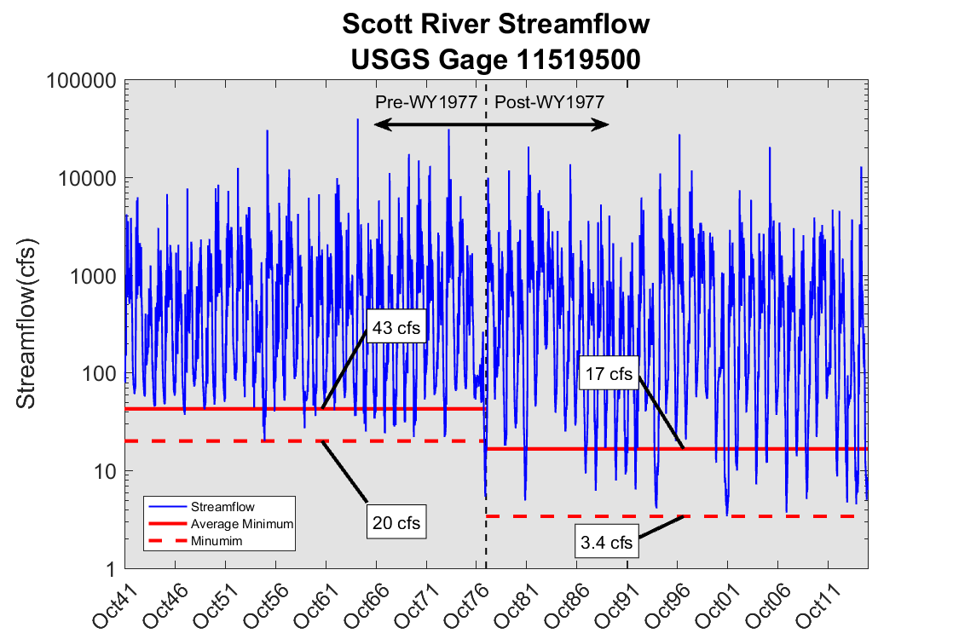
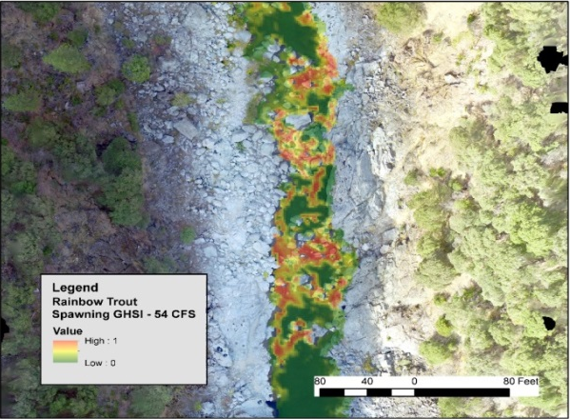
In Lieu Recharge– Concerns
Reduction of spring and summer flows due to increased diversions
Are the negative impacts in the spring and early-summer outweighed by the late-summer benefits?
  SVIHM suggests they are
  Likely need more complex 2D surface-water modeling (velocity and depth) for more detailed quantitative assessment
Predominantly
Flood Irrigation
With SW
Sprinkler & Flood Irrigation, GW & SW
GHSI – Fish Habitat Index
Weiner, in prep

Slide 65
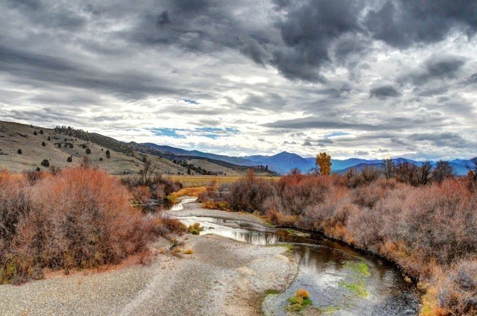
Conclusions
Conjunctive use management represents a potential win-win scenario for farmers and fish
  Streamflow increases during critically dry period (summer/fall)
  Decreased groundwater pumping while applying same amount of water to agricultural fields
Potential for synergistic benefits implementing the two scenarios simultaneously
Sari Sommarstrom

Slide 66


Conclusions
Conjunctive use management represents a potential win-win scenario for farmers and fish
  Streamflow increases during critically dry period
  Decreased groundwater pumping while applying same amount of water to agricultural fields
Potential for synergistic benefits implementing the two scenarios simultaneously

Slide 67
Future Work
  Incorporate model parameter uncertainty into scenario analysis
Add feedback from MODFLOW model to soil-water budget model (nearly complete)
  Currently uni-directional coupling between the two
  Add capability to model effects of beaver dams or beaver dam analogs (BDAs)
Create “pre-development” version of SVIHM
  Model natural, “unimpaired” flows in the valley
Create more sophisticated upper-watershed model
  Climate change applications
  Explore effects of forest management scenarios on valley water supplies
http://www.blendspace.com
Scott River Watershed Council
Scott River Watershed Council

Slide 68
Future Work
  Incorporate model parameter uncertainty into scenario analysis
Add feedback from MODFLOW model to soil-water budget model
  Currently uni-directional coupling between the two
  Add capability to model effects of beaver dams or beaver dam analogs (BDAs)
Create “pre-development” version of SVIHM
  Model natural, “unimpaired” flows in the valley
Create more sophisticated upper-watershed model
  Climate change applications
  Explore effects of forest management scenarios on valley water supplies
Soil-Water Budget
Model
Groundwater-Surface-Water Model
http://www.blendspace.com
Scott River Watershed Council
Scott River Watershed Council

Slide 69
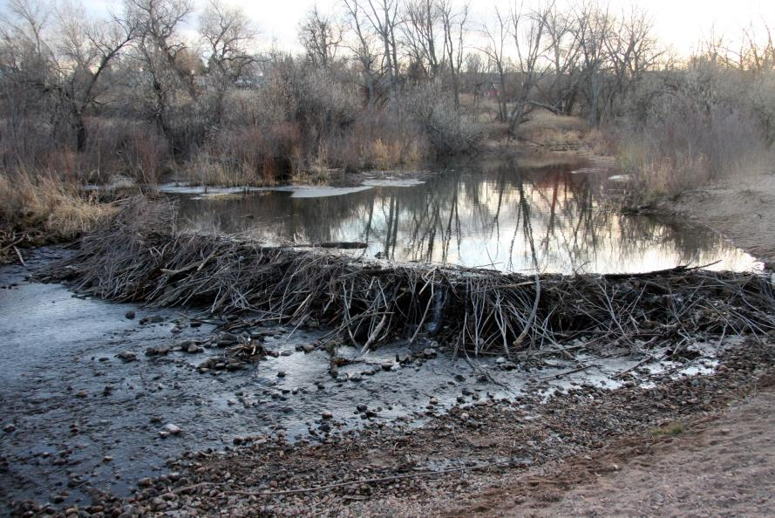
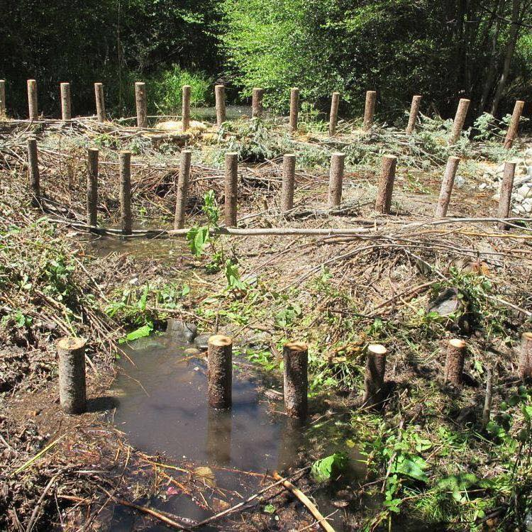
Future Work
  Incorporate model parameter uncertainty into scenario analysis
Add feedback from MODFLOW model to soil-water budget model
  Currently uni-directional coupling between the two
  Add capability to model effects of beaver dams or beaver dam analogs (BDAs)
Create “pre-development” version of SVIHM
  Model natural, “unimpaired” flows in the valley
Create more sophisticated upper-watershed model
  Climate change applications
  Explore effects of forest management scenarios on valley water supplies
http://www.blendspace.com
Scott River Watershed Council
http://www.blendspace.com
Scott River Watershed Council
Scott River Watershed Council

Slide 70
Future Work
  Incorporate model parameter uncertainty into scenario analysis
Add feedback from MODFLOW model to soil-water budget model
  Currently uni-directional coupling between the two
  Add capability to model effects of beaver dams or beaver dam analogs (BDAs)
Create “pre-development” version of SVIHM
  Model natural, “unimpaired” flows in the valley
Create more sophisticated upper-watershed model
  Climate change applications
  Explore effects of forest management scenarios on valley water supplies
http://www.blendspace.com
Scott River Watershed Council
Scott River Watershed Council

Slide 71
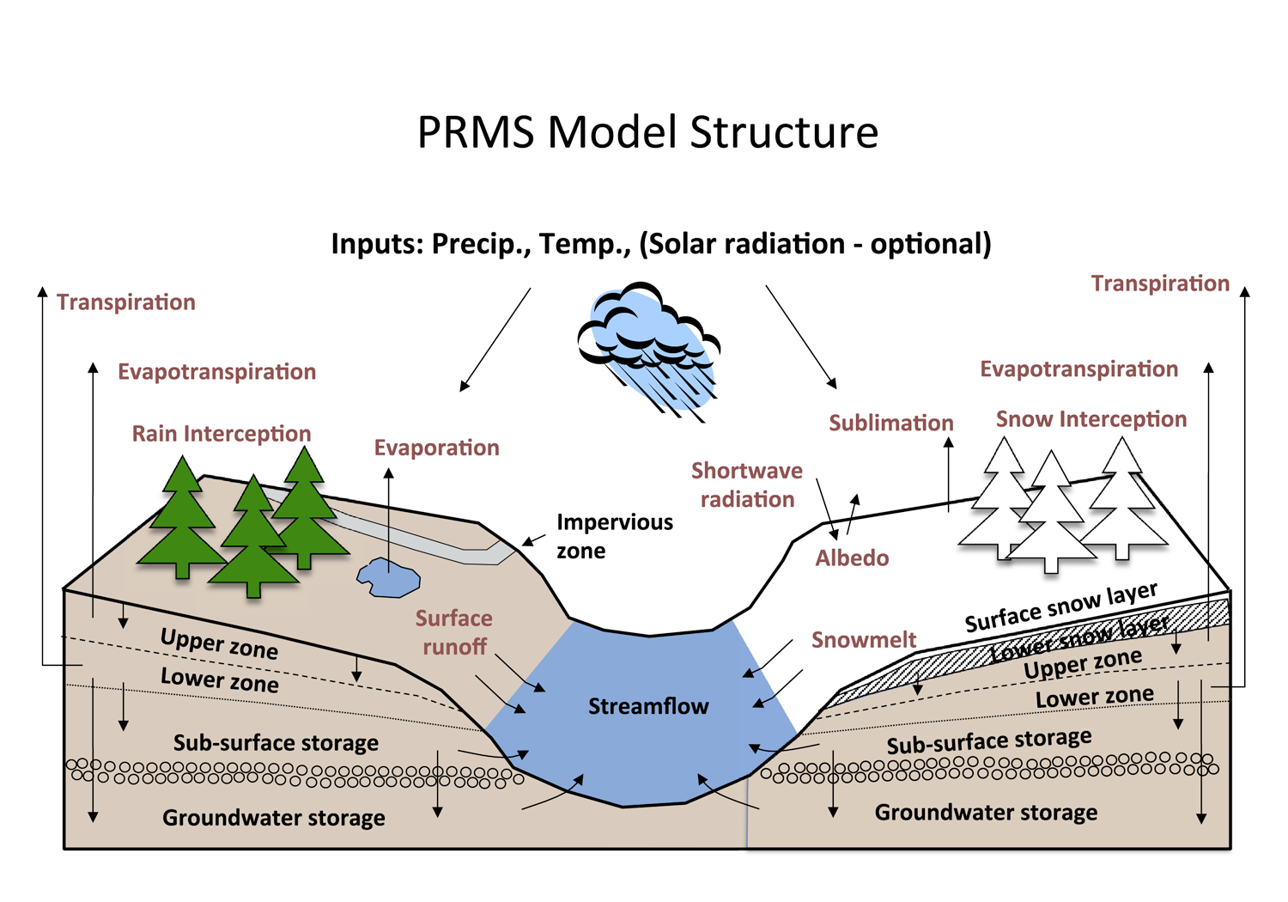
Future Work
  Incorporate model parameter uncertainty into scenario analysis
Add feedback from MODFLOW model to soil-water budget model
  Currently uni-directional coupling between the two
  Add capability to model effects of beaver dams or beaver dam analogs (BDAs)
Create “pre-development” version of SVIHM
  Model natural, “unimpaired” flows in the valley
Create more sophisticated upper-watershed model
  Climate change applications
  Explore effects of forest management scenarios on valley water supplies
http://www.blendspace.com
Scott River Watershed Council

Slide 72
References
Coe, J. J. (1990). Conjunctive use-advantages, constraints, and examples. Journal of irrigation and drainage engineering, 116(3), 427-443.
Foglia, L., Mcnally, A., Hall, C., Ledesma, L., Hines, R., & Harter, T. (2013). Scott Valley Integrated Hydrologic Model : Data Collection, Analysis, and Water Budget, 101 p.
Niswonger, R. G., Panday, S., & Ibaraki, M. (2011). MODFLOW-NWT, a Newton formulation for MODFLOW-2005. US Geological Survey Techniques and Methods, 6, A37
Niswonger, R. G., & Prudic, D. E. (2005). Documentation of the Streamflow-Routing (SFR2) Package to Include Unsaturated Flow Beneath Streams—A Modification to SFR1: U.S. Geological Survey Techniques and Methods 6-A13. U.S. Geological Survey, (April 2010), 59 p.
Mack, S. (1958). Geology and ground-water features of Scott Valley, Siskiyou County, California. USGS Water-supply paper 1462, 110 p.

Slide 73
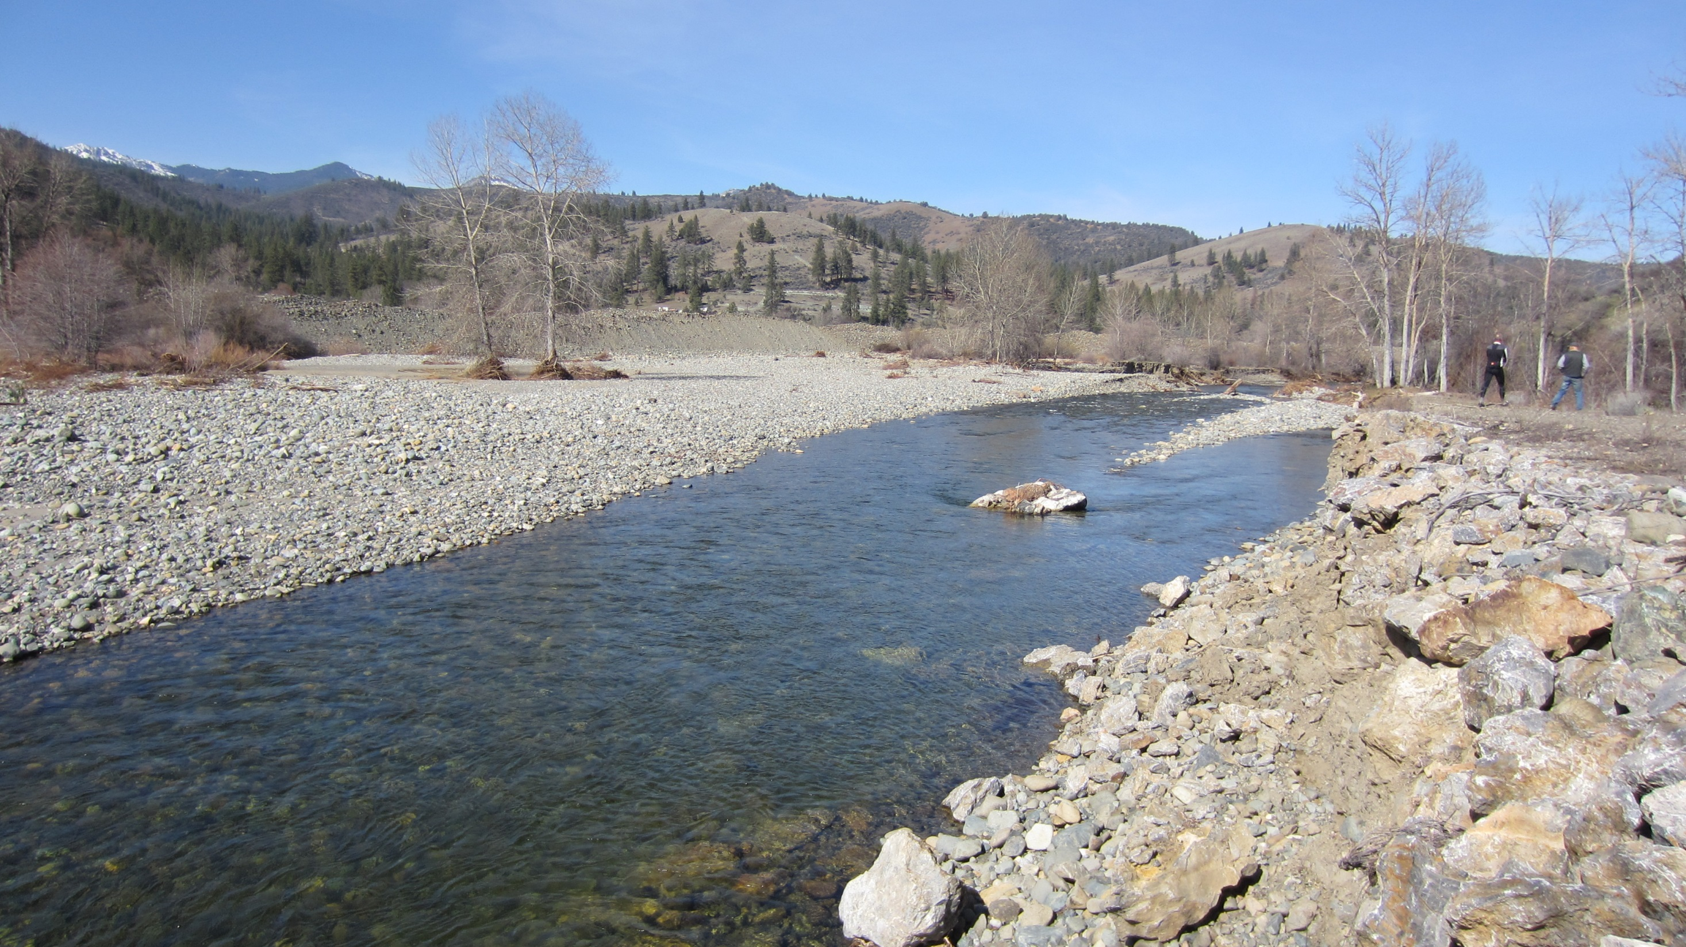
Questions?

Slide 74
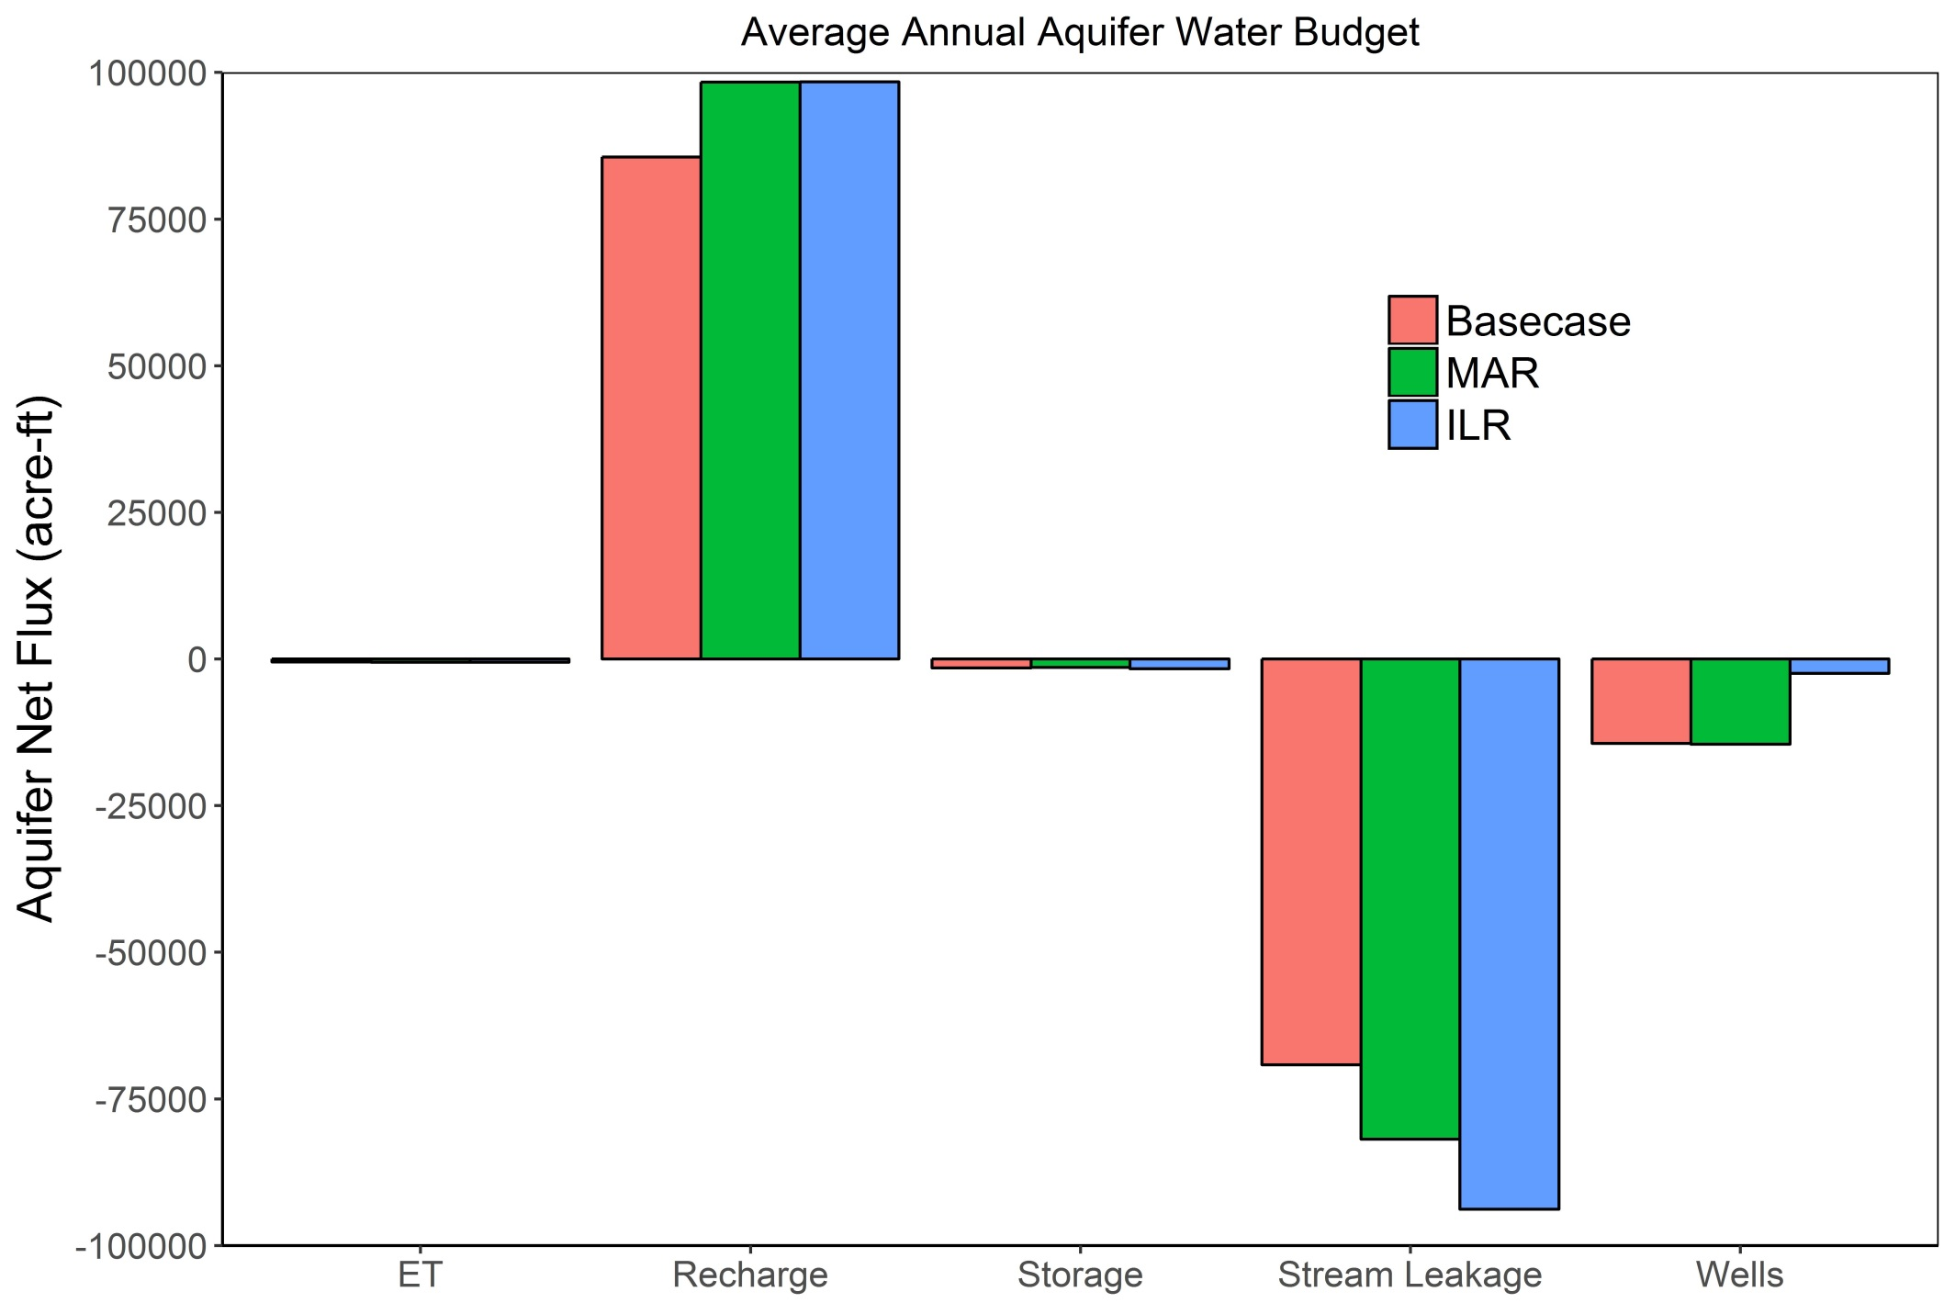
SVIHM – Average Annual Aquifer Budgets

Slide 75
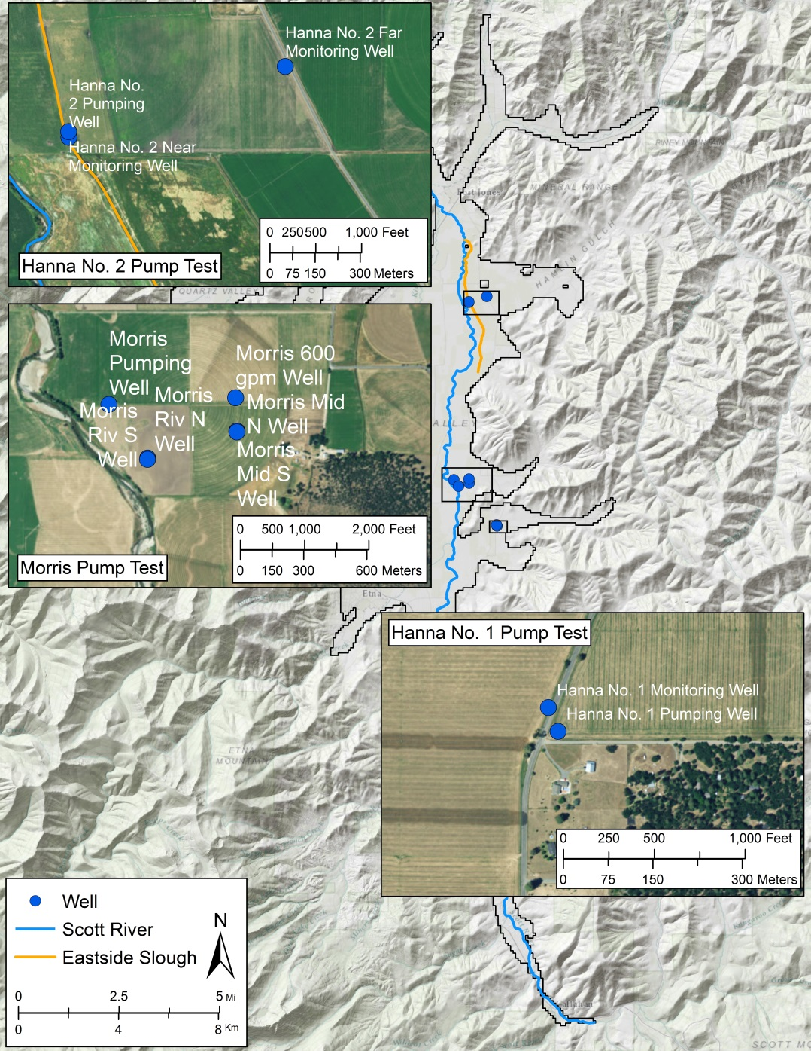
UCD and Affiliated Data Collection and Analysis
Pumping test analysis
  Physical hydraulic properties of aquifer
Evapotranspiration
  Estimated
  Surface renewal
  New CIMIS station (225)
Soil moisture and texture sampling
Applied irrigation rates
Well log digitization
Voluntary groundwater monitoring program
SAGBI

Slide 76
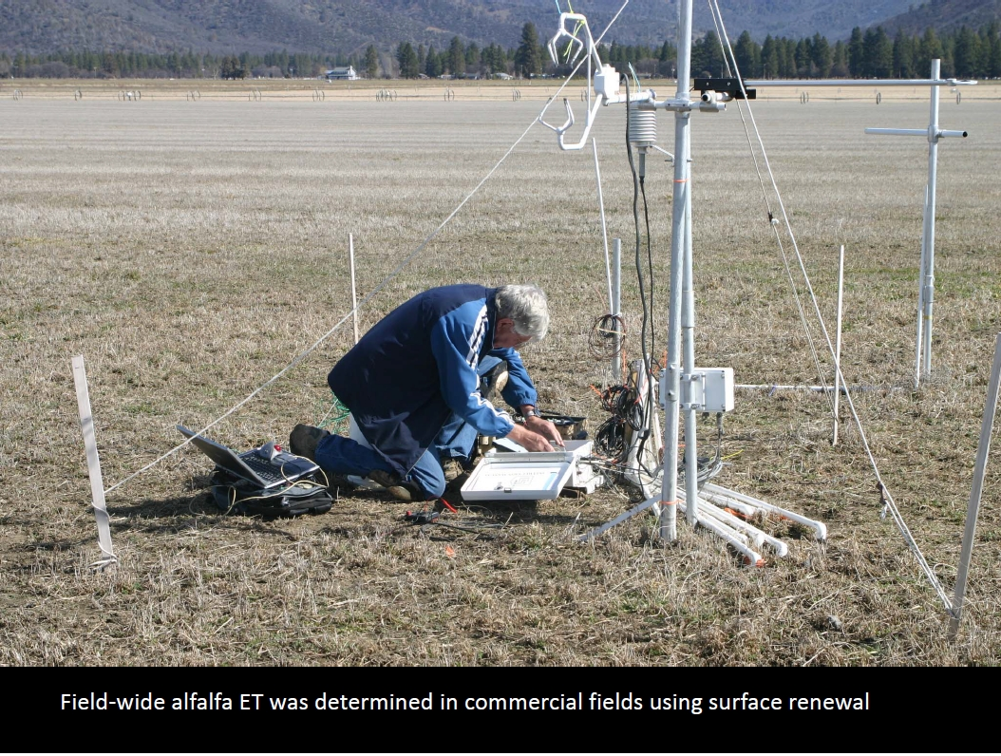


UCD and Affiliated Data Collection and Analysis
Pumping test analysis
  Physical hydraulic properties of aquifer
Evapotranspiration
  Estimated
  Surface renewal
  New CIMIS station (225)
Soil moisture and texture sampling
Applied irrigation rates
Well log digitization
Voluntary groundwater monitoring program
SAGBI
Orloff, Snyder, and Harter, in preparation

Slide 77



UCD and Affiliated Data Collection and Analysis
Pumping test analysis
  Physical hydraulic properties of aquifer
Evapotranspiration
  Estimated
  Surface renewal
  New CIMIS station (225)
Soil moisture and texture sampling
Applied irrigation rates
Well log digitization
Voluntary groundwater monitoring program
SAGBI
Orloff, Snyder, and Harter, in preparation

Slide 78


UCD and Affiliated Data Collection and Analysis
Pumping test analysis
  Physical hydraulic properties of aquifer
Evapotranspiration
  Estimated
  Surface renewal
  New CIMIS station (225)
Soil moisture and texture sampling
Applied irrigation rates
Well log digitization
Voluntary groundwater monitoring program
SAGBI
Orloff, Snyder, and Harter, in preparation

Slide 79



Stakeholder Involvement
UCD Team Meetings with
  Siskiyou County
  Scott Valley Groundwater Advisory Committee
  Cooperative Extension
  Community Meetings
  Resources Conservation District
  Scott River Watershed Council
  USDA Natural Resources Conservation Service
  Quartz Valley Tribe
  Karuk Tribe
  Department of Water Resources
  Department of Fish and Wildlife
  SWRCB
Field work coordinated with
  RCD
  Local landowners
  Scott Valley GWAC

Slide 80

Managed Aquifer Recharge - Results
total simulated streamflow recovery after 13 years: > 99.5%

Slide 81

Conjunctive Use
Conjunctive water use
  Coordinated management of surface-water and groundwater supplies to improve water availability and reliability
  Treat surface-water and groundwater as a single resource, instead of two separate resources as is commonly done
Goals
  Maintain current agricultural production in the valley
  Increase groundwater discharge to Scott River during the late-summer

Slide 82
Conjunctive Use Methodology
Growing Season
Critical Streamflow Period
Critical Streamflow Period = Baseflow Dominant

Slide 83

Conjunctive Use Methodology
Aquifer Water Budget
$$Recharge+SW Flux in −SW Flux Out −ET −Pumping= ∆S$$

Slide 84

Conjunctive Use Methodology
Aquifer Water Budget
$$Recharge+SW Flux in −SW Flux Out −ET −Pumping= ∆S$$
$$SW Flux Out =Recharge+SW Flux in −ET −Pumping −∆S$$

Slide 85
Conjunctive Use
Conjunctive water use
  Coordinated management of surface-water and groundwater supplies to improve water availability and reliability
  Treat surface-water and groundwater as a single resource, instead of two separate resources as is commonly done
Goals
  Maintain current agricultural production in the valley
  Increase groundwater discharge to Scott River during the late-summer

Slide 86

Available Data
Climate station data
  Precipitation
  Temperature
  Humidity
  Wind speed
  Cloud Cover
Streamflow data
  USGS Fort Jones Gauge
  RCD Gauges
Land use data
  CADWR land use survey
Groundwater levels
  DWR
Soil Data

Slide 87

Available Data
Climate station data
  Precipitation
  Temperature
  Humidity
  Wind speed
  Cloud Cover
Streamflow data
  USGS Fort Jones Gauge
  RCD Gauges
Land use data
  CADWR land use survey
Groundwater levels
  DWR
Soil Data
Notes:
Climate and streamflow analysis by Courtney Hall, in the UC Davis 2013 report on SVIHM and in the WRR article in 2013

Slide 88

Available Data
Climate station data
  Precipitation
  Temperature
  Humidity
  Wind speed
  Cloud Cover
Streamflow data
  USGS Fort Jones Gauge
  RCD Gauges
Land use data
  CADWR land use survey
Groundwater levels
  DWR
Soil Data

Slide 89

Available Data
Climate station data
  Precipitation
  Temperature
  Humidity
  Wind speed
  Cloud Cover
Streamflow data
  USGS Fort Jones Gauge
  RCD Gauges
Land use data
  CADWR land use survey
Groundwater levels
  DWR
Soil Data

Slide 90

Available Data
Climate station data
  Precipitation
  Temperature
  Humidity
  Wind speed
  Cloud Cover
Streamflow data
  USGS Fort Jones Gauge
  RCD Gauges
Land use data
  CADWR land use survey
Groundwater levels
  DWR
Soil Data

Slide 91



Study Area
Scott Valley
  Watershed: 2,100 km² (800 mi²)
    Valley: 200 km² (77 mi² = 50k ac)
  Mediterranean Climate
    Wet winters and dry summers
  “Bathtub” style sedimentary basin
    Up to 76 m (250 ft) thick aquifer
  Scott River flows from south to north
    12 major tributary streams
    2 major diversion ditches

Slide 92

Climate
Scott Valley
  Watershed: 2,100 km² (800 mi²)
    Valley: 200 km² (77 mi² = 50k ac)
  Mediterranean Climate
    Wet winters and dry summers
  “Bathtub” style sedimentary basin
    Up to 76 m (250 ft) thick aquifer
  Scott River flows from south to north
    12 major tributary streams
    2 major diversion ditches
PRISM (2013)

Slide 93


Geology
Scott Valley
  Watershed: 2,100 km² (800 mi²)
    Valley: 200 km² (77 mi² = 50k ac)
  Mediterranean Climate
    Wet winters and dry summers
  “Bathtub” style sedimentary basin
    Up to 76 m (250 ft) thick aquifer
  Scott River flows from south to north
    12 major tributary streams
    2 major diversion ditches
D
D’
D
Mack (1958)
D’

Slide 94

Hydrology
Scott Valley
  Watershed: 2,100 km² (800 mi²)
    Valley: 200 km² (77 mi² = 50k ac)
  Mediterranean Climate
    Wet winters and dry summers
  “Bathtub” style sedimentary basin
    Up to 76 m (250 ft) thick aquifer
  Scott River flows from south to north
    12 major tributary streams
    2 major diversion ditches

Slide 95


UCD and Affiliated Data Collection and Analysis
Climate Data Analysis
  Build 1944 – 2011 time series
  Spatial trends within Scott Valley
  Water year type analysis
Evapotranspiration
  Estimated
  Surface renewal
  New CIMIS station (225)
Soil moisture and texture sampling
Applied irrigation rates
Well log digitization
Voluntary groundwater monitoring program
SAGBI
Foglia et al., 2013a: http://groundwater.ucdavis.edu/files/165395.pdf

Slide 96


UCD and Affiliated Data Collection and Analysis (cont.)
Pumping test analysis
  Physical hydraulic properties of aquifer
Evapotranspiration
  Estimated
  Surface renewal
  New CIMIS station (225)
Soil moisture and texture sampling
Applied irrigation rates
Well log digitization
Voluntary groundwater monitoring program
SAGBI

Slide 97
UCD and Affiliated Data Collection and Analysis (cont.)
Pumping test analysis
  Physical hydraulic properties of aquifer
Evapotranspiration
  Estimated
  Surface renewal
  New CIMIS station (225)
Soil moisture and texture sampling
Applied irrigation rates
Well log digitization
Voluntary groundwater monitoring program
SAGBI
UC Davis, 2016: Voluntary Private Water Level Monitoring Program 2006-2016, http://groundwater.ucdavis.edu/files/153816.pdf

Slide 98


UCD and Affiliated Data Collection and Analysis (cont.)
Pumping test analysis
  Physical hydraulic properties of aquifer
Evapotranspiration
  Estimated
  Surface renewal
  New CIMIS station (225)
Soil moisture and texture sampling
Applied irrigation rates
Well log digitization
Voluntary groundwater monitoring program
SAGBI
https://casoilresource.lawr.ucdavis.edu/sagbi/

Slide 99
UCD and Affiliated Data Collection and Analysis (cont.)
Stream temperature observations (DTS)
3.2 ft deep stratified pool
Hines & Harter, UC Davis, draft manuscript

Slide 100
UCD and Affiliated Data Collection and Analysis (cont.)
Stream temperature observations (DTS)
Agricultural practices survey
  Landuse and irrigation type map updates
Foglia et al., 2013a: http://groundwater.ucdavis.edu/files/165395.pdf

Slide 101

UCD and Affiliated Data Collection and Analysis (cont.)
Stream temperature observations (DTS)
Agricultural practices survey
  Landuse and irrigation type map updates
Validation of DWR’s Irrigation Demand Calculator (IDC)
http://baydeltaoffice.water.ca.gov/modeling/hydrology/IDC/index_IDC.cfm

Slide 102



Upper Watershed Model
Regression model
Foglia et al. (2013)

Slide 103


MODFLOW Model Sensitivity Analysis
Assume simple “black box” model with only 3 parameters
P1
P2
P3
+
+
=

Slide 104

MODFLOW Model Sensitivity Analysis
P1
P2
P3
+
+
=
=
+
+
Not Sensitive
=
+
+
Sensitive
=
+
+
Not Sensitive

Slide 105

MODFLOW Model Sensitivity Analysis
Find model parameters that have greatest influence on model results
35 model parameters identified
  Hydraulic conductivity
  Aquifer storage
  Streambed characteristics
  Mountain front recharge
  Ditch seepage
  Recharge scaling factors
Performed 5 different sensitivity analyses
  Different starting values
  Account for model non-linearity
Aquifer Property Zones

Slide 106
MODFLOW Model Sensitivity Analysis
Find model parameters that have greatest influence on model results
35 model parameters identified
  Hydraulic conductivity
  Aquifer storage
  Streambed characteristics
  Mountain front recharge
  Ditch seepage
  Recharge scaling factors
Performed 5 different sensitivity analyses
  Different starting values
  Account for model non-linearity
Aquifer Property Zones

Slide 107
MODFLOW Model Sensitivity Analysis
Find model parameters that have greatest influence on model results
35 model parameters identified
  Hydraulic conductivity
  Aquifer storage
  Streambed characteristics
  Mountain front recharge
  Ditch seepage
  Recharge scaling factors
Performed 5 different sensitivity analyses
  Different starting values
  Account for model non-linearity
Aquifer Property Zones

Slide 108

MODFLOW Model Sensitivity Analysis
6 parameters consistently most sensitive

Slide 109


MODFLOW Model Calibration
Adjust 6 parameters to minimize difference between observed and simulated values
  Streamflow (at USGS gauge) – 1385 observations
  Groundwater elevations – 2197 observations

Slide 110

MODFLOW Model Calibration
Despite large number of observations of different types, there is still a problem of non-uniqueness during calibration

Slide 111

Soil-Water Budget Model
Calculates daily water fluxes at field-scale
Input data (text files)
  Landuse
  Soil properties
  Irrigation type
  Water source
  Potential ET
  Crop Coefficient (Kc)
  Rooting depth
  Precipitation
  Streamflow
Windows executable (.exe)

Slide 112




Soil-Water Budget Model
Calculates daily water fluxes at field-scale
Input data (text files)
  Landuse
  Soil properties
  Irrigation type
  Water source
  Potential ET
  Crop Coefficient (Kc)
  Rooting depth
  Precipitation
  Streamflow
Windows executable (.exe)

Slide 113
Soil-Water Budget Model
Calculates daily water fluxes at field-scale
Input data (text files)
  Landuse
  Soil properties
  Irrigation type
  Water source
  Potential ET
  Crop Coefficient (Kc)
  Rooting depth
  Precipitation
  Streamflow
Windows executable (.exe)

Slide 114
Soil-Water Budget Model Timing
Kc
Crop Coefficient
Alfalfa Irrigation
(March 25 – August 31)
Evapotranspiration
Potential ET * Crop Coefficient
Alfalfa ET (Constant Kc)
(March 1 – Nov 15)
Grain Irrigation
(March 15 – July 18)
Grain ET (Variable Kc)
(March 15 – July 18)
Pasture Irrigation
(April 15 – October 15)
Pasture ET (Constant Kc)
(April 15 – October 15)

Slide 115
Soil-Water Budget Model - Example
Precipitation
Field Capacity
Soil Water Content
Maximum Allowable Depletion (0.55*FC)
Groundwater Recharge

Slide 116

Soil-Water Budget Model - Example
Irrigation = ET_{c} / Irrigation Efficiency
Evapotranspiration = Potential ET * Crop Coefficient
ET_{c} = ET_{pot}*Kc
Field Capacity
Maximum Allowable Depletion (0.55*FC)
Calculated each day for each individual field

Slide 117

Soil-Water Budget Model Output
Daily outputs for each field
  Potential ET
  Actual ET (water limited)
  Total irrigation
  Applied surface-water
  Applied groundwater
  Groundwater recharge
  Soil water content
Groundwater recharge and pumping are averaged to monthly values for MODFLOW model

Slide 118
Soil-Water Budget Model Output
Daily outputs for each field
  Potential ET
  Actual ET (water limited)
  Total irrigation
  Applied surface-water
  Applied groundwater
  Groundwater recharge
  Soil water content
Groundwater recharge and pumping are averaged to monthly values for MODFLOW model

Slide 119
Landscape Water Budget

Slide 120
Landscape Water Budget

Slide 121

Soil Water Budget Model: Sensitivity Analysis

Slide 122
Landscape Water Budget

Slide 123

MODFLOW Model
Model Domain
Elevation
  LIDAR (~cm)
  DEM (10 m)
  Averaged to 100 x 100 m
Streambed Elevations
  Scott River thalweg from LIDAR
Pink + Yellow = Layer 1
Yellow = Layer 2

Slide 124


MODFLOW Model
Model Domain
Elevation
  LIDAR (~cm)
  DEM (10 m)
  Averaged to 100 x 100 m
Streambed Elevations
  Scott River thalweg from LIDAR

Slide 125

MODFLOW Model
Model Domain
Elevation
  LIDAR (~cm)
  DEM (10 m)
  Averaged to 100 x 100 m
Streambed Elevations
  Thalweg from LIDAR (where available)
Vertical Exaggeration = 300x

Slide 126


MODFLOW Model
Daily time steps with monthly stress periods
  Boundary conditions vary month to month, but not daily; at land parcel scale (fields, canals, streams)
100m lateral discretizatin (relatively high resolution)
Streamflow routing package (SFR) used to simulate Scott River and tributaries
  More sophisticated representation of GW-SW interactions
Oct 1, 1990 – Sep 30, 2011 simulation period

Slide 127



MODFLOW Model
Daily time steps with monthly stress periods
  Boundary conditions vary month to month, but not daily; at land parcel scale (fields, canals, streams)
100m lateral discretization (relatively high resolution)
Streamflow routing package (SFR) used to simulate Scott River and tributaries
  More sophisticated representation of GW-SW interactions
Oct 1, 1990 – Sep 30, 2011 simulation period

Slide 128

MODFLOW Model
Daily time steps with monthly stress periods
  Boundary conditions vary month to month, but not daily; at land parcel scale (fields, canals, streams)
100m lateral discretizatin (relatively high resolution)
Streamflow routing package (SFR) used to simulate Scott River and tributaries
  More sophisticated representation of GW-SW interactions
Oct 1, 1990 – Sep 30, 2011 simulation period

Slide 129
MODFLOW Model
Daily time steps with monthly stress periods
  Boundary conditions don’t vary within a month (but specific for each field, tributary, canal, etc.)
100m lateral discretization (relatively high resolution)
Streamflow routing package (SFR) used to simulate Scott River and tributaries
  More sophisticated representation of GW-SW interactions
Oct 1, 1990 – Sep 30, 2011 simulation period
Specify for each node
  Elevation
  Reach length
  Reach width
  Bed hydraulic conductivity
  Bed thickness
  Bed slope

Slide 130

MODFLOW Model
Daily time steps with monthly stress periods
  Boundary conditions vary month to month, but not daily; at land parcel scale (fields, canals, streams)
100m lateral discretizatin (relatively high resolution)
Streamflow routing package (SFR) used to simulate Scott River and tributaries
  More sophisticated representation of GW-SW interactions
Oct 1, 1990 – Sep 30, 2011 simulation period
Ditches and Mountain Front Recharge

Slide 131

MODFLOW Model
Daily time steps with monthly stress periods
  Boundary conditions vary month to month, but not daily; at land parcel scale (fields, canals, streams)
100m lateral discretizatin (relatively high resolution)
Streamflow routing package (SFR) used to simulate Scott River and tributaries
  More sophisticated representation of GW-SW interactions
Oct 1, 1990 – Sep 30, 2011 simulation period

Slide 132
MODFLOW Model
Windows executable (.exe) with text file inputs
  MODFLOW OWHM using Newton (NWT) Solver
    Allows for rewetting of cells that go dry along basin margin
  Specify name (.nam) file that calls the following input files:
  ~45 to 60 min runtime
  Binary and text output files
    Binary files need to be translated before they can be used

Slide 133
MODFLOW Model
Windows executable (.exe) with text file inputs
  MODFLOW OWHM using Newton (NWT) Solver
    Allows for rewetting of cells that go dry along basin margin
  Specify name (.nam) file that calls the following input files:
  ~45 to 60 min runtime
  Binary and text output files
    Binary files need to be translated before they can be used
.bas | .dis | .upw | .zone
.hob | .pvl | .sfr | .gag
.wel | .ets | .rch | .oc
 | .mult | .nwt

Slide 134
MODFLOW Model
Windows executable (.exe) with text file inputs
  MODFLOW OWHM using Newton (NWT) Solver
    Allows for rewetting of cells that go dry along basin margin
  Specify name (.nam) file that calls the following input files:
  ~45 to 60 min runtime
  Binary and text output files
    Binary files need to be translated before they can be used
.bas | .dis | .upw | .zone
.hob | .pvl | .sfr | .gag
.wel | .ets | .rch | .oc
 | .mult | .nwt

Slide 135
MODFLOW Model
Windows executable (.exe) with text file inputs
  MODFLOW OWHM using Newton (NWT) Solver
    Allows for rewetting of cells that go dry along basin margin
  Specify name (.nam) file that calls the following input files:
  ~45 to 60 min runtime
  Binary and text output files
    Binary files need to be translated before they can be used
.bas | .dis | .upw | .zone
.hob | .pvl | .sfr | .gag
.wel | .ets | .rch | .oc
 | .mult | .nwt

Slide 136

Relative Stream Depletion from Well Pumping
(or: Relative Stream Repletion from Intentional Recharge)
Infinite, confined, uniform aquifer, fully penetrated by the stream.
$$\frac{q}{Q}=erfc⁡\left(\sqrt{\frac{SDF}{4t}}\right)$$
Q
distance, a
thickness, b
q
K, S
Bredehoeft, 2010

Slide 137



Soil water balance and saturated/unsaturated flow model
Thornthwaite-Mather model (root zone, 0-2ft)
Soil water balance
$R_{t}=I_{t}+P_{t}−ET_{t}−∆S_{t}−Q_{t}$
R = Deep percolation (in)
I = applied winter water (in) at time t,
P = precipitation (in),
ET = evapotranspiration (in),
ΔS = change in soil storage (in) (dependent on AWC)
Q = surface runoff (in).
1D saturated/unsaturated flow model (transmission zone, 2-5ft)
$$θ_{t}=θ_{d}−\frac{θ_{s}−θ_{d}}{κ}ln\left[\frac{\left.κK_{sat}Δt\text{exp}(−κ\right)}{L\left(θ_{s}−θ_{d}\right)}+\text{exp}\left(−κ\frac{θ_{t−Δt}−θ_{d}}{θ_{s}−θ_{d}}\right)\right]$$
θ_{t} = volumetric water content (volume fraction) at time t,
θ_{s} = volumetric water content at field capacity
θ_{d} = volumetric water content at the wilting point (volume fraction),
κ is a constant (positive),
K_{sat} is the saturated hydraulic conductivity, and $Δt$ is the time step.
AWC = available water content
Dahlke et al. 2017, submitted
Notes:
Use Thornthwaite-Mather soil water balance model to estimate deep percolation and losses to evapotranspiration and soil storage
Use 1D van Genuchten-Mualem model to estimate recharge into deeper soil

Slide 138
Deep percolation estimates – Scott Valley
Water table rose up to 6 ft in response to winter recharge
AWC (SSURGO) = 4.9”
AWC (1D model) = 15–18.5”
θ_{s} = 0.57, θ_{d} = 0.1
θ_{s} = 0.46, θ_{d} = 0.08

Slide 139
Travel time of water to groundwater table

Slide 140

Crop yield – both sites
Scott Valley
Application of up to 26 ft of water caused no discernible difference in alfalfa yield
Crop response in Davis was impacted by gopher damage
Davis, CA

Slide 141

Crop Water Use
ET_{c} = K_{c} x ET_{o}
Crop Evapotranspiration (ET_{c}) is calculated by multiplying the reference crop evapotranspiration, ET_{o}, by a crop coefficient, K_{c}:

Slide 142
Region | Site | Year | Age Of alfalfa | Seasonal ET (inches) | Reference ET (inches)
Imperial Valley | LM1 LM2 LM2 GR EL WA | 2007 2008 2009 2010 2010 2010 | 3 2 3 2 2 2 | 55.8 66.0 55.6 63.5 59.8 65.8 | 73.2 73.3 67.9 73.2 70.0 70.0
San Joaquin Valley | KC KC | 2007 2008 | 2 3 | 56.6 59.4 | 57.0 59.3
Sacramento Valley | CH1 CH2 CH2 CH2 EE EW | 2005 2006 2007 2008 2010 2010 | 3 2 3 4 3 4 | 49.4 54.8 55.0 50.4 46.3 42.5 | 63.6 55.9 58.0 59.4 48.8 48.8
Scott Valley/Shasta Valley | EN EN EN FI SH AP FI FA | 2007 2008 2009 2009 2009 2010 2010 2010 | 2 3 4 5 4 5 2 6 | 39.6 32.8 33.8 36.1 38.8 37.3 34.7 38.8 | 44.0 42.6 40.4 37.4 40.4 37.4 37.4 41.1
Tulelake | TU TU | 2007 2008 | 4 5 | 39.0 34.3 | 40.5 36.5
Ave. 37 in.

Slide 143

So…How is Applied Water Calculated?
And, how much water should growers apply to alfalfa (and what to assume in model)
Item | Explanation | Amount
Alfalfa ET | (March 15 – October 1) | 40 in.
Soil moisture contribution | 4 ft. rooting depth x 2 in. avail/ft. | 8 in.

Slide 144

So…How is Applied Water Calculated?
And, how much water should growers apply to alfalfa (and what to assume in model)
Item | Explanation | Amount
Alfalfa ET | (March 15 – October 1) | 40 in.
Soil moisture contribution | 4 ft. rooting depth x 2 in. avail/ft. | 8 in.
In-season rainfall | 6 in. (effective rainfall?) | 6 in.

Slide 145
So…How is Applied Water Calculated?
And, how much water should growers apply to alfalfa (and what to assume in model)
Item | Explanation | Amount
Alfalfa ET | (March 15 – October 1) | 40 in.
Soil moisture contribution | 4 ft. rooting depth x 2 in. avail/ft. | 8 in.
In-season rainfall | 6 in. (effective rainfall?) | 6 in.
Net irrigation | Amount needed to satisfy ET | 26 in.

Slide 146
Application Efficiencies for Different Irrigation Systems (Canessa et al. 2011)
Irrigation System | Application Low | Efficiencies Mean | (%) High
Surface Irrigation
Wild Flood | 50 | 68 | 86
Border | 62 | 73 | 83
Basin | 72 | 83 | 93
Furrow | 60 | 73 | 85
Sprinkler
Permanent | 70 | 78 | 85
Hand-Move | 60 | 70 | 80
Linear-Move | 73 | 82 | 90
Side-Roll | 60 | 70 | 80
Hose-Pull | 70 | 73 | 75
Center-Pivot | 70 | 80 | 90
Drip
Above ground | 77 | 86 | 95
Buried drip | 77 | 86 | 95
Flood Irrigation 70%; Wheel-line 75%; Center Pivot 90%;

Slide 147
So…How is Applied Water Calculated?
And, how much water should growers apply to alfalfa (and what to assume in model)
Item | Explanation | Amount
Alfalfa ET | (March 15 – October 1) | 40 in.
Soil moisture contribution | 4 ft. rooting depth x 2 in. avail/ft. | 8 in.
In-season rainfall | 6 in. (effective rainfall?) | 6 in.
Net irrigation | Amount needed to satisfy ET | 26 in.
Gross irrigation | 26 in. ÷ 0.78 (applic. effic.) | 33.3 in

Slide 148
Eight commercial alfalfa fields
(4 center pivot & 4 wheel-line)
  Surface renewal instruments in 3 of the 8 fields
  Temporary CIMIS station in an irrigated pasture
  Gravimetric soil moisture content determined April-March and early October down to 8 feet
  Watermark sensors at 1-foot increments down to 8 feet (2 locations per field)
  Permanently installed flow meters some systems
  Nozzle output on wheel-line sprinklers
  Tipping rain gauge at each site
  Yield measurements at each cutting
ET
Soil
Irrig.

Slide 149


Slide 150

Irrigation Interval Around Cuttings Wheel-Line Fields
2012 & 2013
 | Irrigation Interval Before – After 1st Cut (days) | Irrigation Interval Before – After 2nd Cut (days)
Grower 1 | 30 | 24
Grower 2 | 52 | 29
Grower 3 | 25 | 22
Grower 4 | 41 | 19
Grower 1 | 38 | 30
Grower 2 | 48 | 41
Grower 3 | 42 | 24
Grower 4 | 34 | 33
Mean | 39 | 28

Slide 151

Irrigation Interval Around Cuttings Center Pivot Fields
2012 & 2013
 | Irrigation Interval Before – After 1st Cut (days) | Irrigation Interval Before – After 2nd Cut (days) | Irrigation Interval Before – After 3rd Cut (days)
Grower 1 | -- | 25 | --
Grower 2 | 29 | 20 | --
Grower 3 | 29 | 29 | --
Grower 1 | 35 | 14 | 18
Grower 2 | 24 | 18 | 16
Grower 3 | 26 | 17 | --
Grower 4 | 42 | 17 | --
Mean | 31 | 19 | 17

Slide 152
Seasonal Soil Moisture Levels
Scott Valley, 2012 (Grower A)

Slide 153
Seasonal Soil Moisture Levels
Scott Valley, 2012 (Grower G)

Slide 154
Application Efficiency
How well an irrigation system performs to get water to plant roots
Portion of the total water volume delivered to the field that is stored in the root zone that is available to meet crop evapotranspiration (ET)
Losses: deep percolation and runoff
So if under-irrigating…

Slide 155
Conclusions
Grower application rates approximately 1/3 less than assumed values
Seasonal Kc 0.92 rather than 0.95 – 0.99 (0.90 likely representation of Valley overall)
Many growers under irrigating so not refilling profile and little to no in-season deep percolation
Long intervals between irrigations around cuttings
When under-irrigating application efficiency approaches 100%
Therefore, when estimating water application rates, cannot use ET value and divide by assumed application efficiency for given irrigation system

