Slide 1
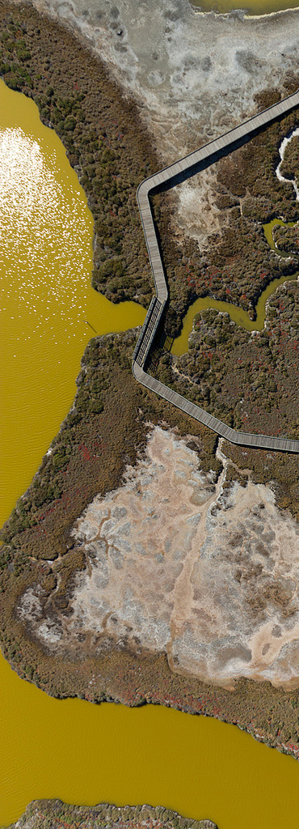

Work Products Update
  Conceptual Model Report
  Suisun Synthesis I
  Loading Study
Science Plan
David Senn and Emily Novick
davids@sfei.org
Image: C. Benton

Slide 2
Work Products
 | Draft | Final
NNE Literature Review | Spring 2011 | Sep 2011
Nutrient Strategy | Mar 2012 | Nov 2012
Conceptual Model | Apr 2013 | Dec 2013
Suisun Synthesis I | Nov 2012 | Dec 2013
Loading Study | Apr 2013 | Dec 2013
Yr.1 Effluent Characterization | Oct 2013 | Oct 2013
GG exchange conceptual model | Nov 2013 | Dec 2013
Lower South Bay Synthesis | Jan 2014 | Mar 2014
Suisun Synthesis II | Jul 2014 | Sep 2014
Science Plan – v.1, v.2 | May 2014 | Q1 2014
Modeling Program Development Plan | Aug 2013 | Dec 2013
Modeling Workplan | Jan 2014 | Feb 2014
DO in South Bay and LSB margins | Oct 2013
Assessment Framework report #1 | May 2013
Assessment Framework report #2 | Q2/Q3 2014
Monitoring Program Development Plan | Mar 2013
*
*
*

Slide 3
Nutrient Conceptual Model
Comments received:
  RMP Technical Review Committee (Tom Hall, EOA)
  SacRegional CSD
  State and Federal Contractors Water Agency (SFCWA)
  City of Sunnyvale

Slide 4
Comments Subset: Conceptual Model
The report focuses too much on the classic eutrophication concept, not on the impacts of elevated NH4 of altered N:P ratios
  Insufficient treatment of relevant literature (ammonium inhibition of nitrate uptake by phytoplankton and the potential role of nutrient stoichiometry in shaping community composition)
Need to clarify when issues being discussed apply to SFB as a whole, or to certain subembayments
Light-limitation paradigm based on modeled not measured data
No discussion of how much nutrient concentrations need to reduce to be nutrient limiting

Slide 5
Comments Subset: Conceptual Model
Shouldn’t suggest that SFB is not currently impaired by nutrients, or has been resistant in previous decades – “…has been experiencing more subtle, though perhaps no less serious, symptoms of over-enrichment for decades. “
Incorporate flushing/residence time into discussions of phytoplankton biomass, particularly when comparing to other estuaries
The report should discuss the challenges in trying to predict the course of eutrophication, and recovery, with examples of how other estuaries have responded to decreased N loads
The report should lay out a 10-yr plan with phased objectives and checkpoints and clearly-defined goal.
Too many “very high” priority study areas

Slide 6
Suisun Synthesis I
Comments received:
San Jose Wastewater Treatment Plant / BACWA (Jim Ervin)
Central Valley Regional Water Quality Control board (Chris Foe)
SFCWA
SacRegional CSD
CCCSD

Slide 7
Suisun Synthesis I
Does not adequately describe the role of advection of high-chl water from elsewhere on the standing stock of biomass in Suisun Bay
Insufficient treatment of other nutrient issues, such as N:P, high nutrients, and elevated ammonium on phytoplankton community composition
Should give a more balanced view of Teh copepod study. Both criticisms and defenses that are not cited
Zooplankton section is copepod-centric (include mysids, etc.)

Slide 8
External Nutrient Loads Report
Comments received:
Central Valley Water Board (Chris Foe)
SFCWA
SFPUC

Slide 9
External Nutrient Loads Report
Delta loads methods
  Stations used in calculating Delta loads are too far upstream from Suisun Bay (10-30km) – what transformations could occur in this time?
  Are we adequately capturing flood event loads if monitoring rarely occurs during these times?
Report should have more balanced language regarding potential impacts of nutrients on phytoplankton community composition
Report does not include all potential sources/sinks and does not assess their potential magnitude
Specific comments related to load calculations from individual POTWs

